Slide 1
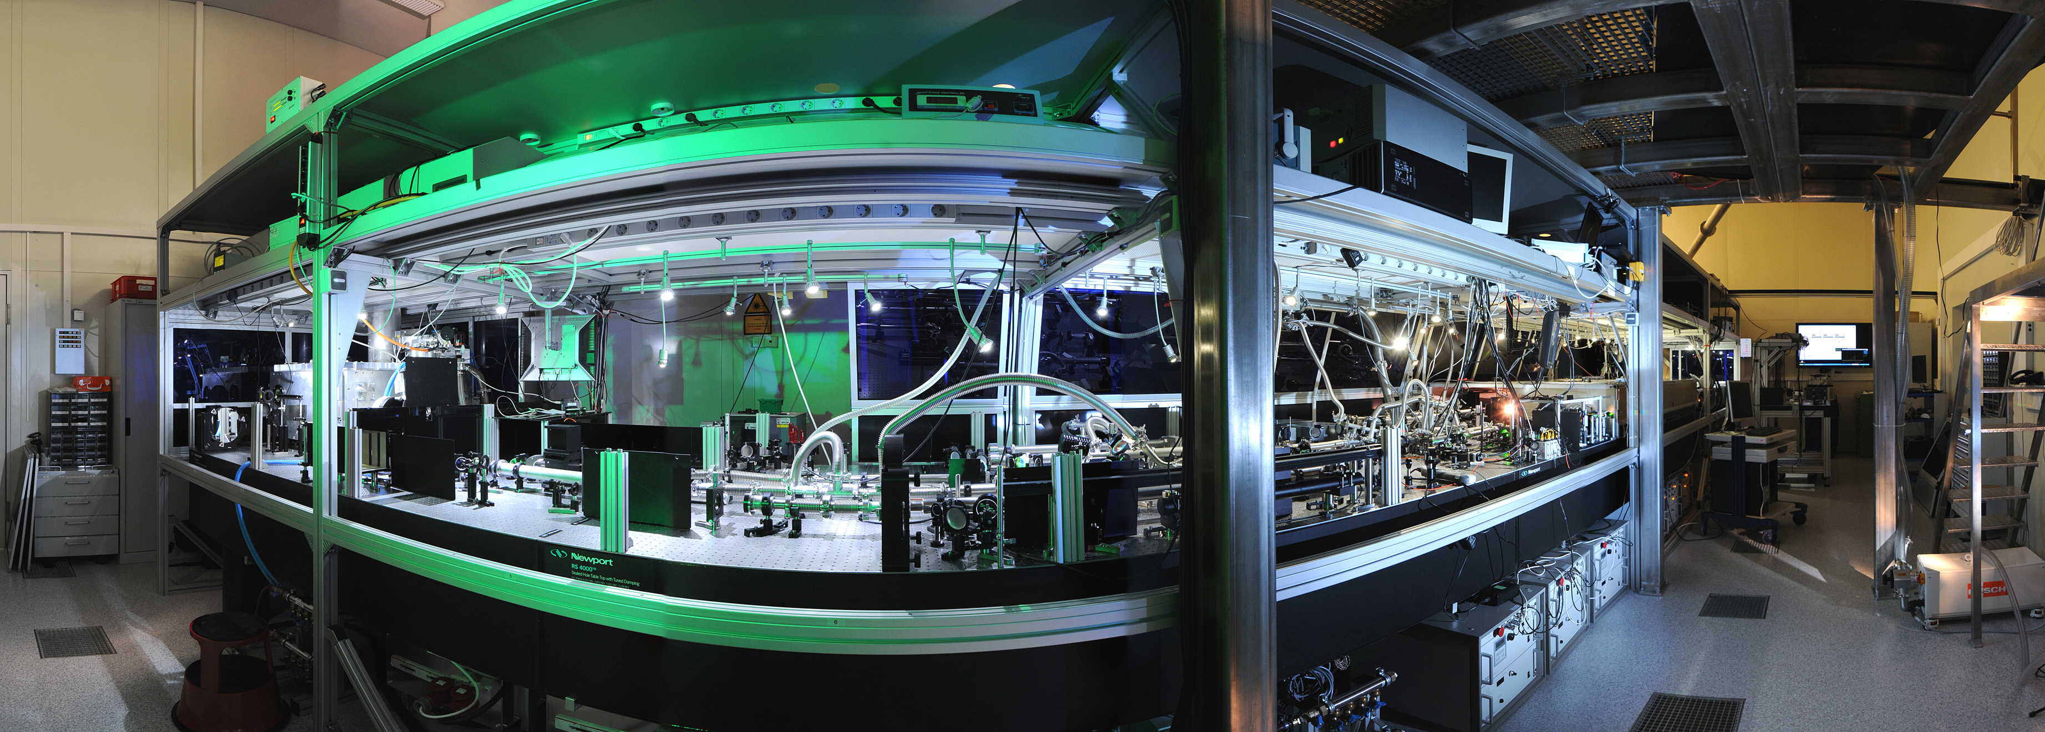

Generation and applications of relativisitic quasi-single-cycle laser pulses
Laszlo Veisz¹, Daniel Rivas¹, Gilad Marcus¹, Xun Gu¹, Daniel Cardenas¹, Julia Mikhailova¹, Alexander Buck^{1,2}, Tibor Wittmann¹, Christopher M. S. Sears¹, Shao-wei Chou¹, Jiancai Xu¹, Guangjin Ma¹, Daniel Herrmann³, Olga Razskazovskaya², Vladimir Pervak², George Tsakiris¹, Ferenc Krausz^{1,2}
¹ Max-Planck-Institut für Quantenoptik, Hans-Kopfermann-Strasse 1, 85748 Garching, Germany
² Ludwig-Maximilians-Universität München, Am Coulombwall 1, 85748 Garching, Germany
³ Lehrstuhl für BioMolekulare Optik, Department für Physik, Ludwig-Maximilians-Universität,Oettingenstrasse 67, 80538 München, Germany
Notes:
1

Slide 2
Outline
Motivation and state of the art
Optical parametric synthesizer principle
Setup of Light Wave Synthesizer 20 (LWS-20)
Applications
Summary

Slide 3
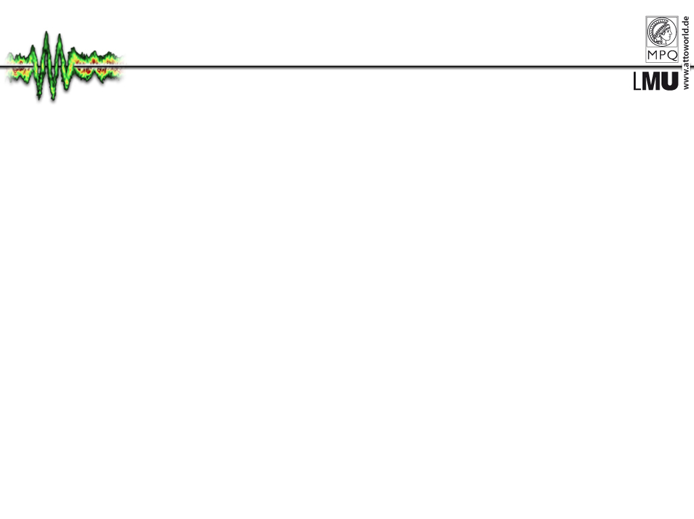
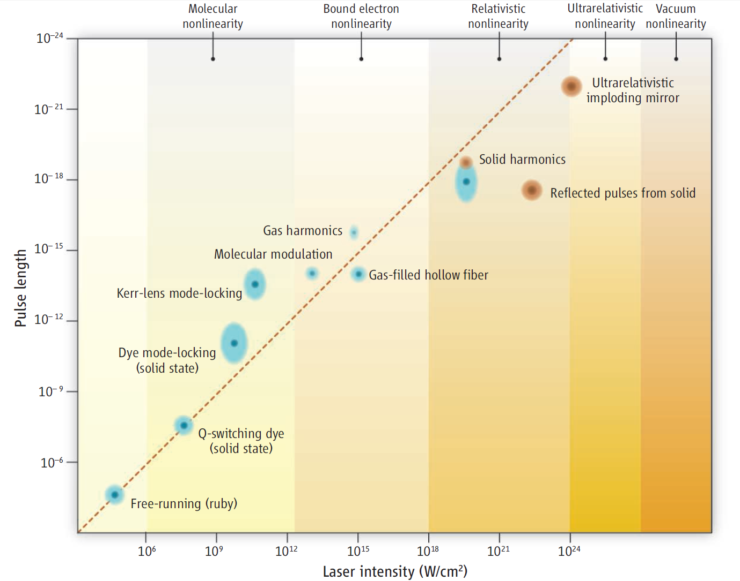
Shorter and shorter pulses – Why?
Better and better time resolution (see later applications)
The pulse intensity − duration conjecture
Shorter = more intense
G. Mourou and T. Tajima Science 331, 41 (2011)

Slide 4
Shorter pulses with low energy
10ps
Nd:glass
Nd:YAG
Nd:YLF
Dye
S-P Dye
Diode
nJ-scale energy
1ps
CW Dye
The shortest pulses
are shorter than the
supported
gain bandwidth of
a given medium!!!
(Due to self-phase
modulation)
Color
SHORTEST PULSE DURATION
Center
100fs
Cr:LiS(C)AF
CP
M
Dye
Er:fiber
Nd:fiber
Cr:YAG
10fs
Cr:forsterite
w/Compression
Ti:sapphire
One optical cycle
1965
1970 1975
1980 1985
1990 1995
2000
2005
YEAR

Slide 5
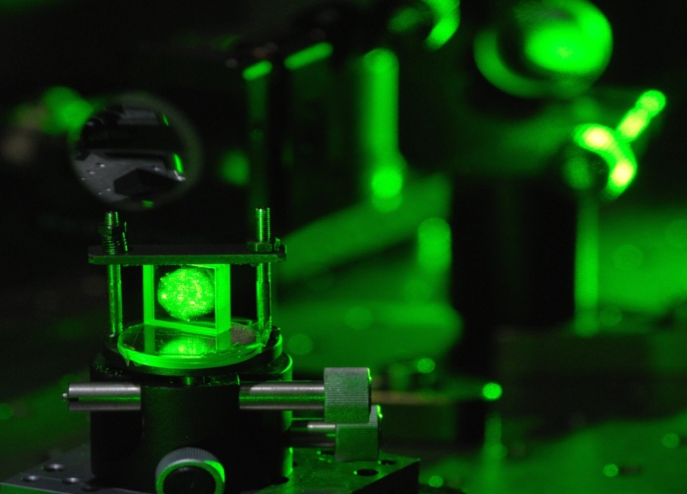
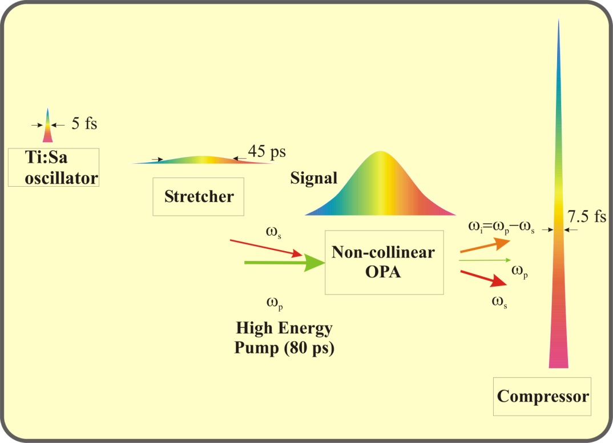
Noncollinear optical parametric chirped
pulse amplification (NOPCPA)
Idler
Pump
Seed
BBO
crystal
Advantages
Broad gain bandwidth,
supporting few-cycle pulses
Huge single pass gain (~10⁶)
No thermal load in the
amplifier crystals
Good contrast achievable
Challenges
Stretching and compression of
huge spectral bandwidth
Pump laser
Synchronization of pump and seed
Amplification of the optical parametric
fluorescence (superfluorescence)
Carrier envelope phase stabilization
mJ-scale OPCPA systems: D. Herrmann et al. Opt. Lett., 34, 2459 (2009);
F. Tavella et al. Opt. Lett. 32,2227 (2007); S. Adachi et al. Opt. Express 16,14341 (2008); S. Witte et al. Opt. Express 14,8168 (2006)

Slide 6
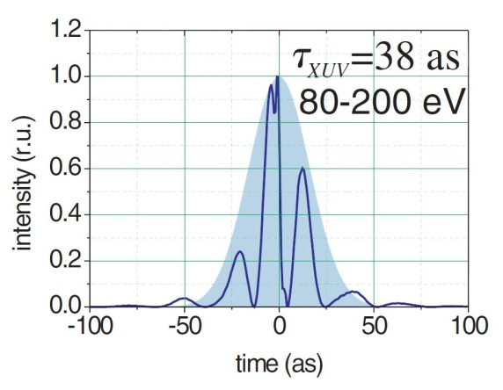
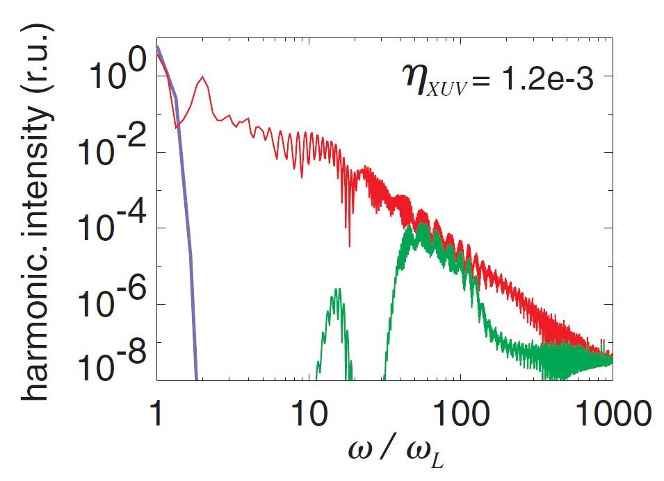
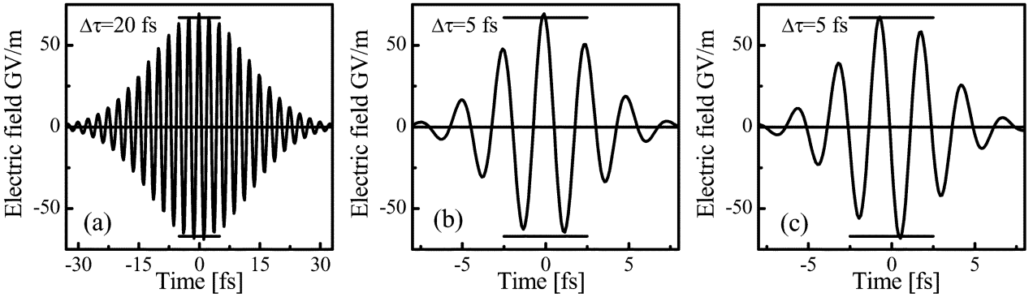
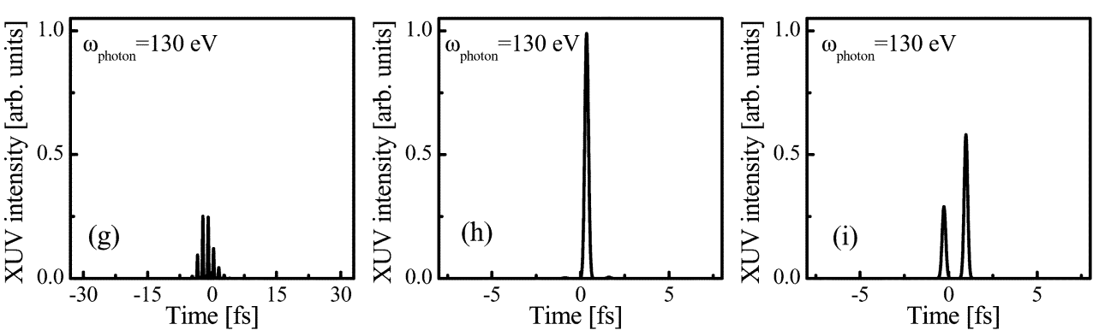
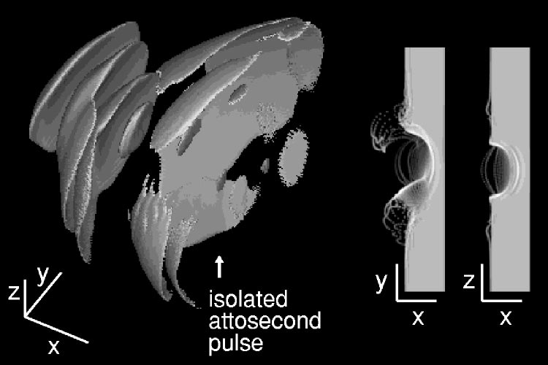
Why to go to 5 fs ?
Relativistic HHG
Generation of single attosecond light and
electron pulses in gas and plasma medium
5 fs cos
Gas harmonics
20 fs
5 fs cos
5 fs sin
λ³ regime
G. D. Tsakiris et al., New J. Phys. 8, 19 (2006)
N. M.Naumova et al., Phys. Plas. 12, 056707 (2005)
A. Baltuska et al., IEEE J. of Sel. Top. in Quantum Electronics 9, 972 (2003)

Slide 7
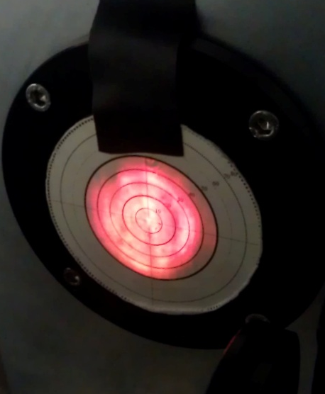
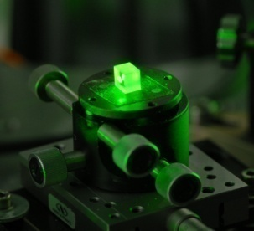
Principle of optical parametric synthesizer
1.8 µJ
Seed
1,3 mJ
1,5 mJ
67 mJ
101 mJ
532 nm
19 mJ
355 nm
19 mJ
532 nm
400 mJ
355 nm
300 mJ

Slide 8
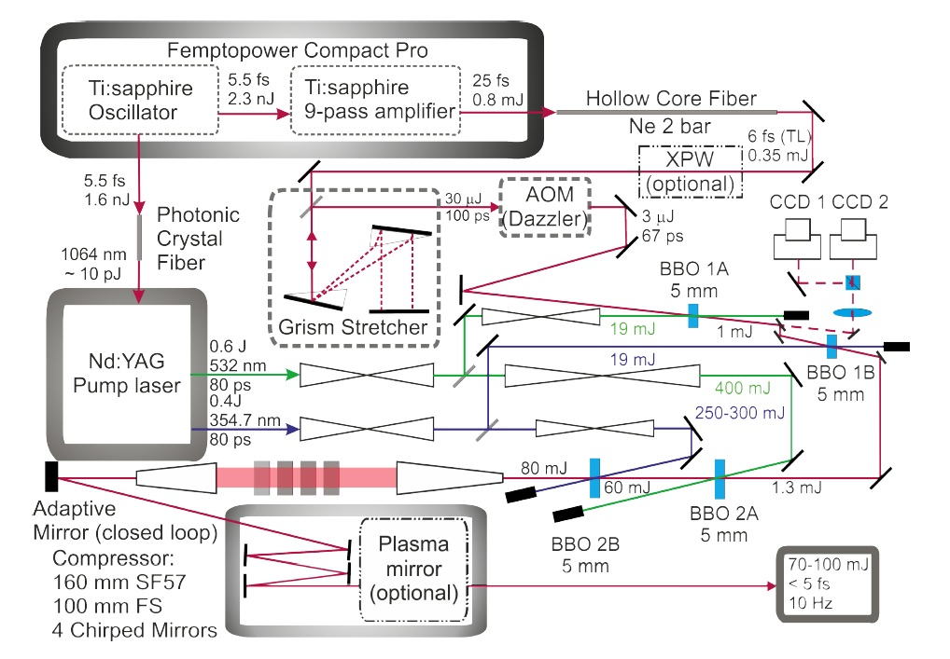
Setup for the 5 fs LWS-20
Femtopower Compact Pro
1064 nm
10 nJ
Fiber amplifier
0.5 J
532 nm
80 ps
0.35 J
355 nm
80 ps
85-130 mJ
60-80 mJ
Phase
meter

Slide 9
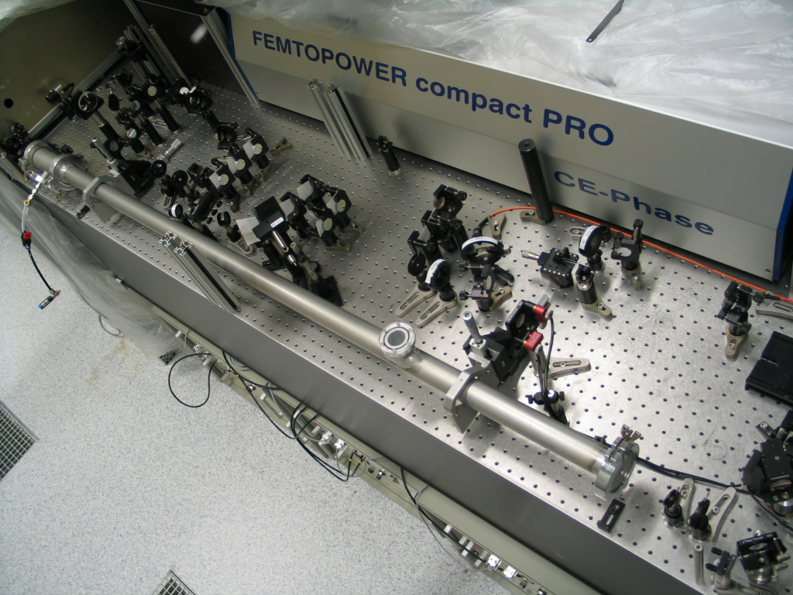
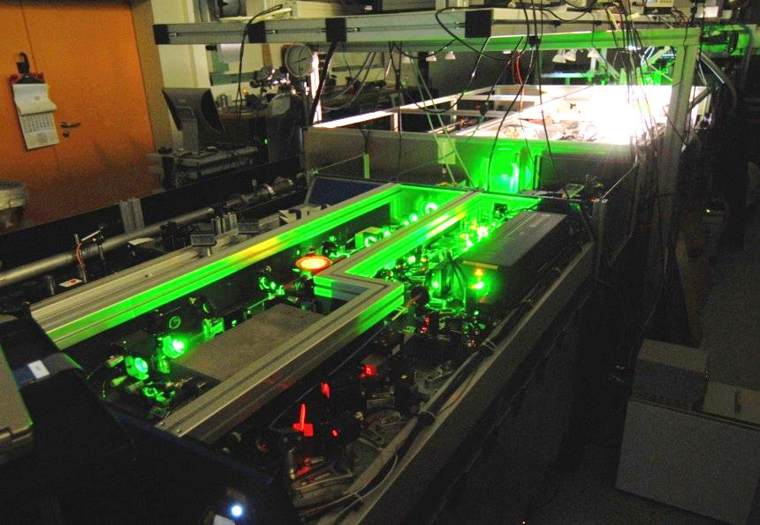
Front end & hollow core fiber
Femtopower Compact Pro
Hollow Core Fibre
& XPW setup
1kHz Ti:Sa Front End
1064 nm
10 nJ
Fiber amplifier
0.5 J
532 nm
80 ps
0.35 J
355 nm
80 ps
85-130 mJ
60-80 mJ
Phase
meter

Slide 10
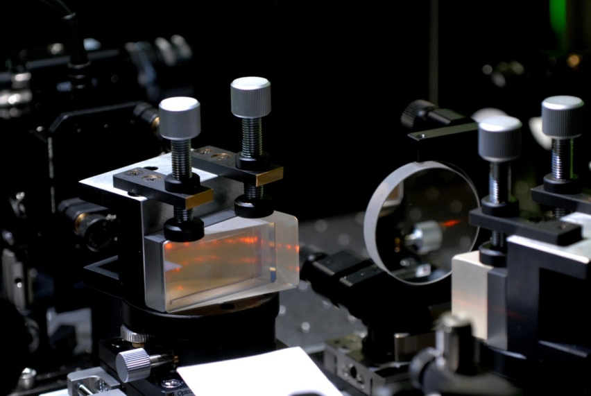
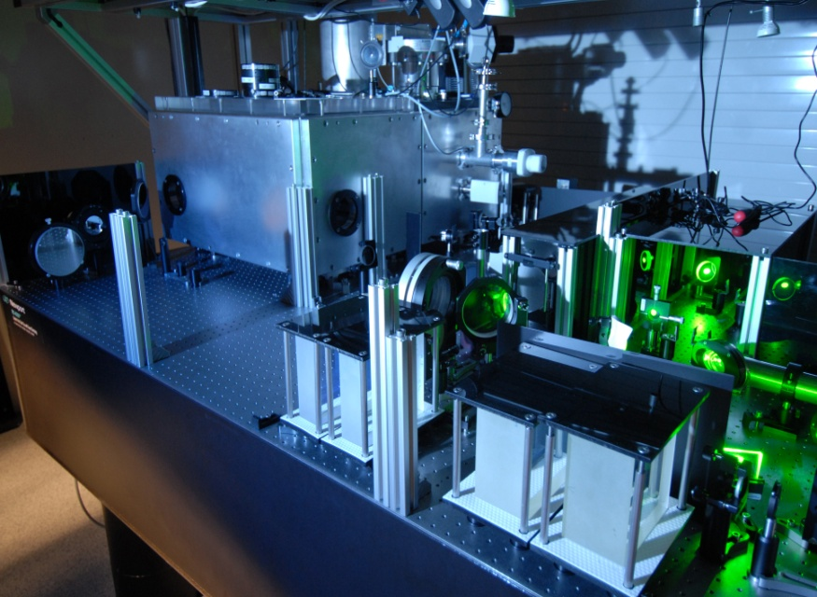
Dispersion management
Conventional grating compressor
with LWS-20 bandwidth has T=50% !!!
Grism stetcher
High transmission compressor bulk glass & chirped mirror compressor T=80%
Special design results in stretching with 100 ps group delay between 580-1020 nm
1064 nm
10 nJ
Fiber amplifier
0.5 J
532 nm
80 ps
0.35 J
355 nm
80 ps
4 chirped
mirrors
85-130 mJ
2x80 mm
SF57
60-80 mJ
100 mm
SQ1
Bulk compressor
Phase
meter
T. H. Dou et al., Opt. Exp. 18, p. 27900 (2010)

Slide 11

Four NOPCPA stages
2A BBO NOPA stage
2B BBO NOPA stage
1A stage
1B stage
532 nm
19 mJ
580-1020 nm
Seed
355 nm
19 mJ
532 nm
400 mJ
355 nm
250 mJ
1064 nm
10 nJ
Fiber amplifier
0.5 J
532 nm
80 ps
0.35 J
355 nm
80 ps
85-130 mJ
60-80 mJ
Phase
meter

Slide 12
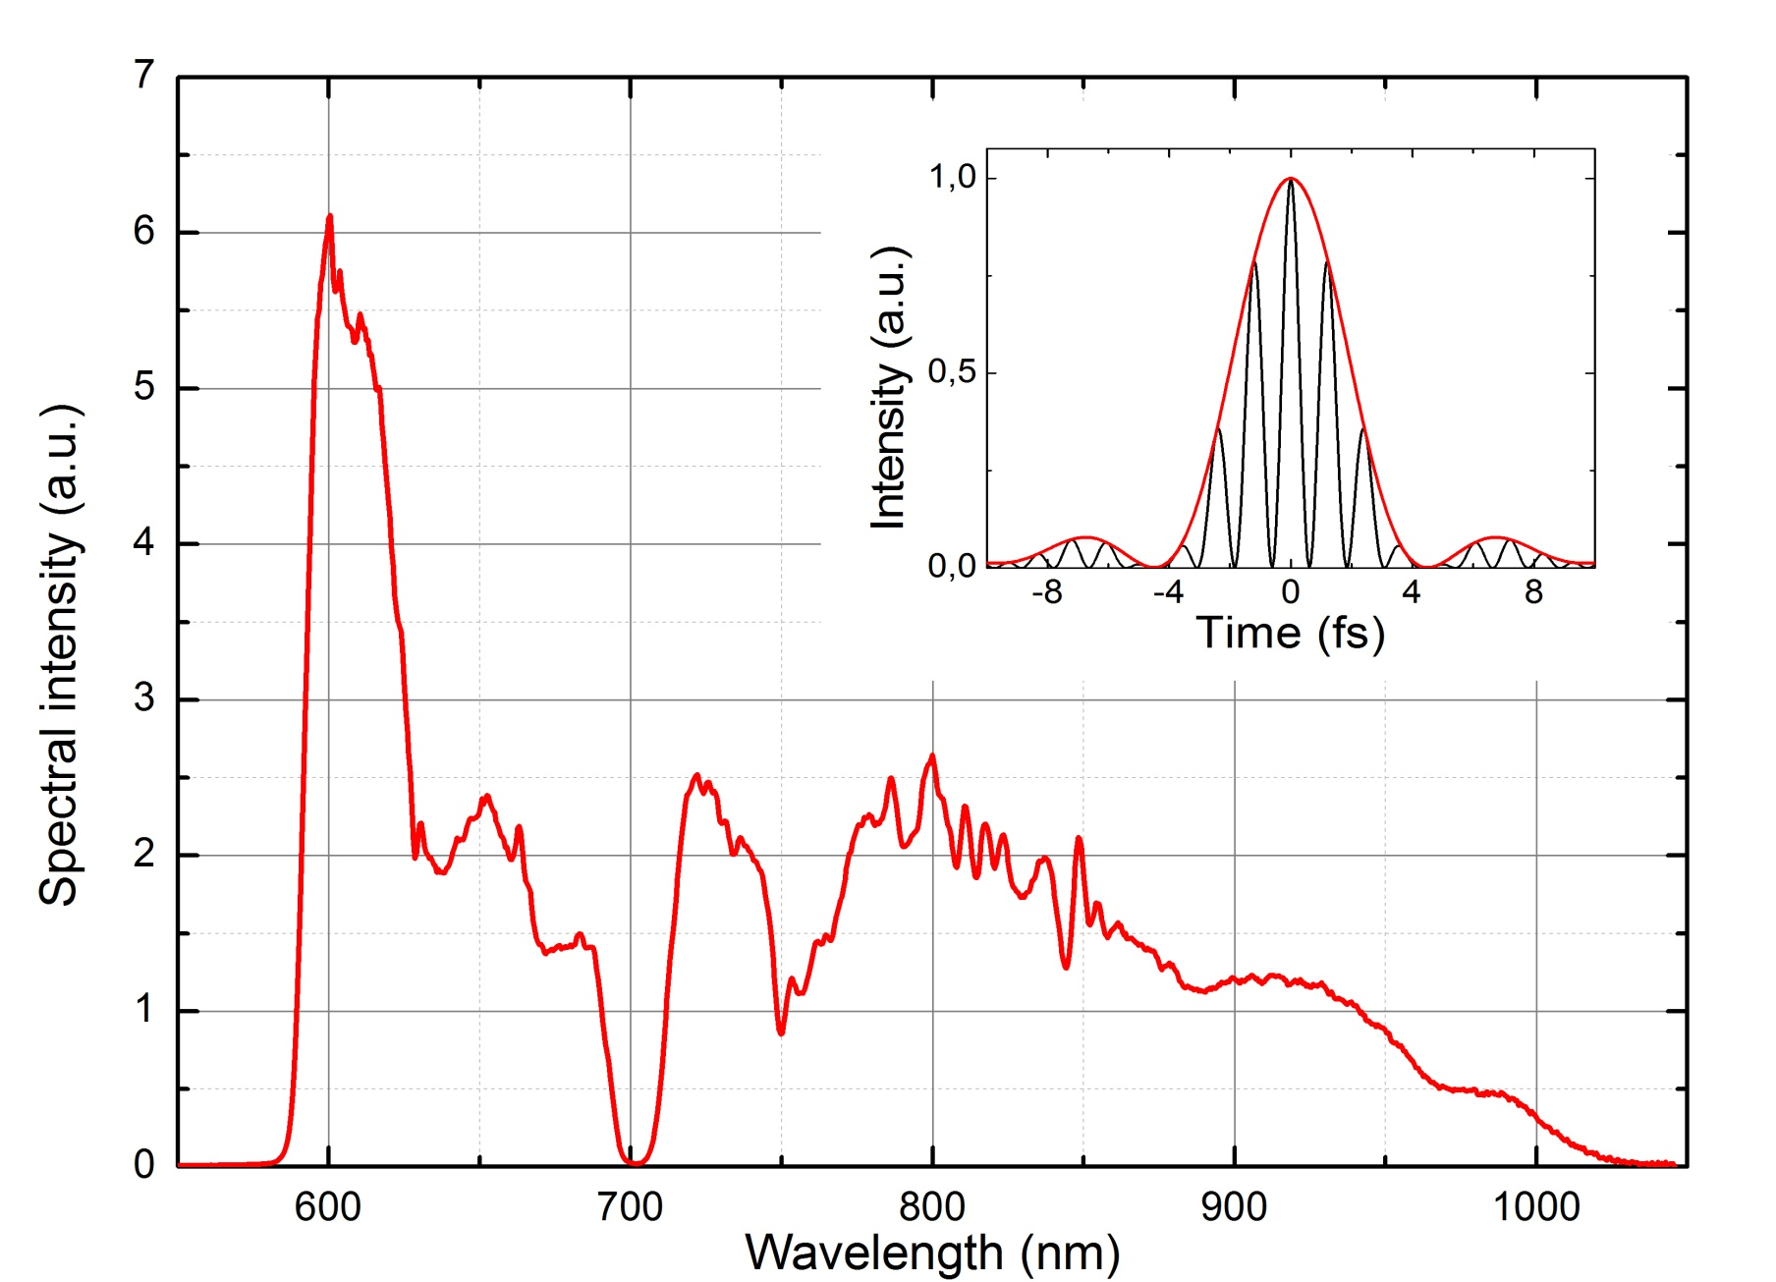
Broad spectrum of 5 fs LWS-20
Fourier limit:
1.63 periods
4.0 fs
Energy: 100 mJ before compression, possible improvement towards 140 mJ
~80 mJ after compression

Slide 13
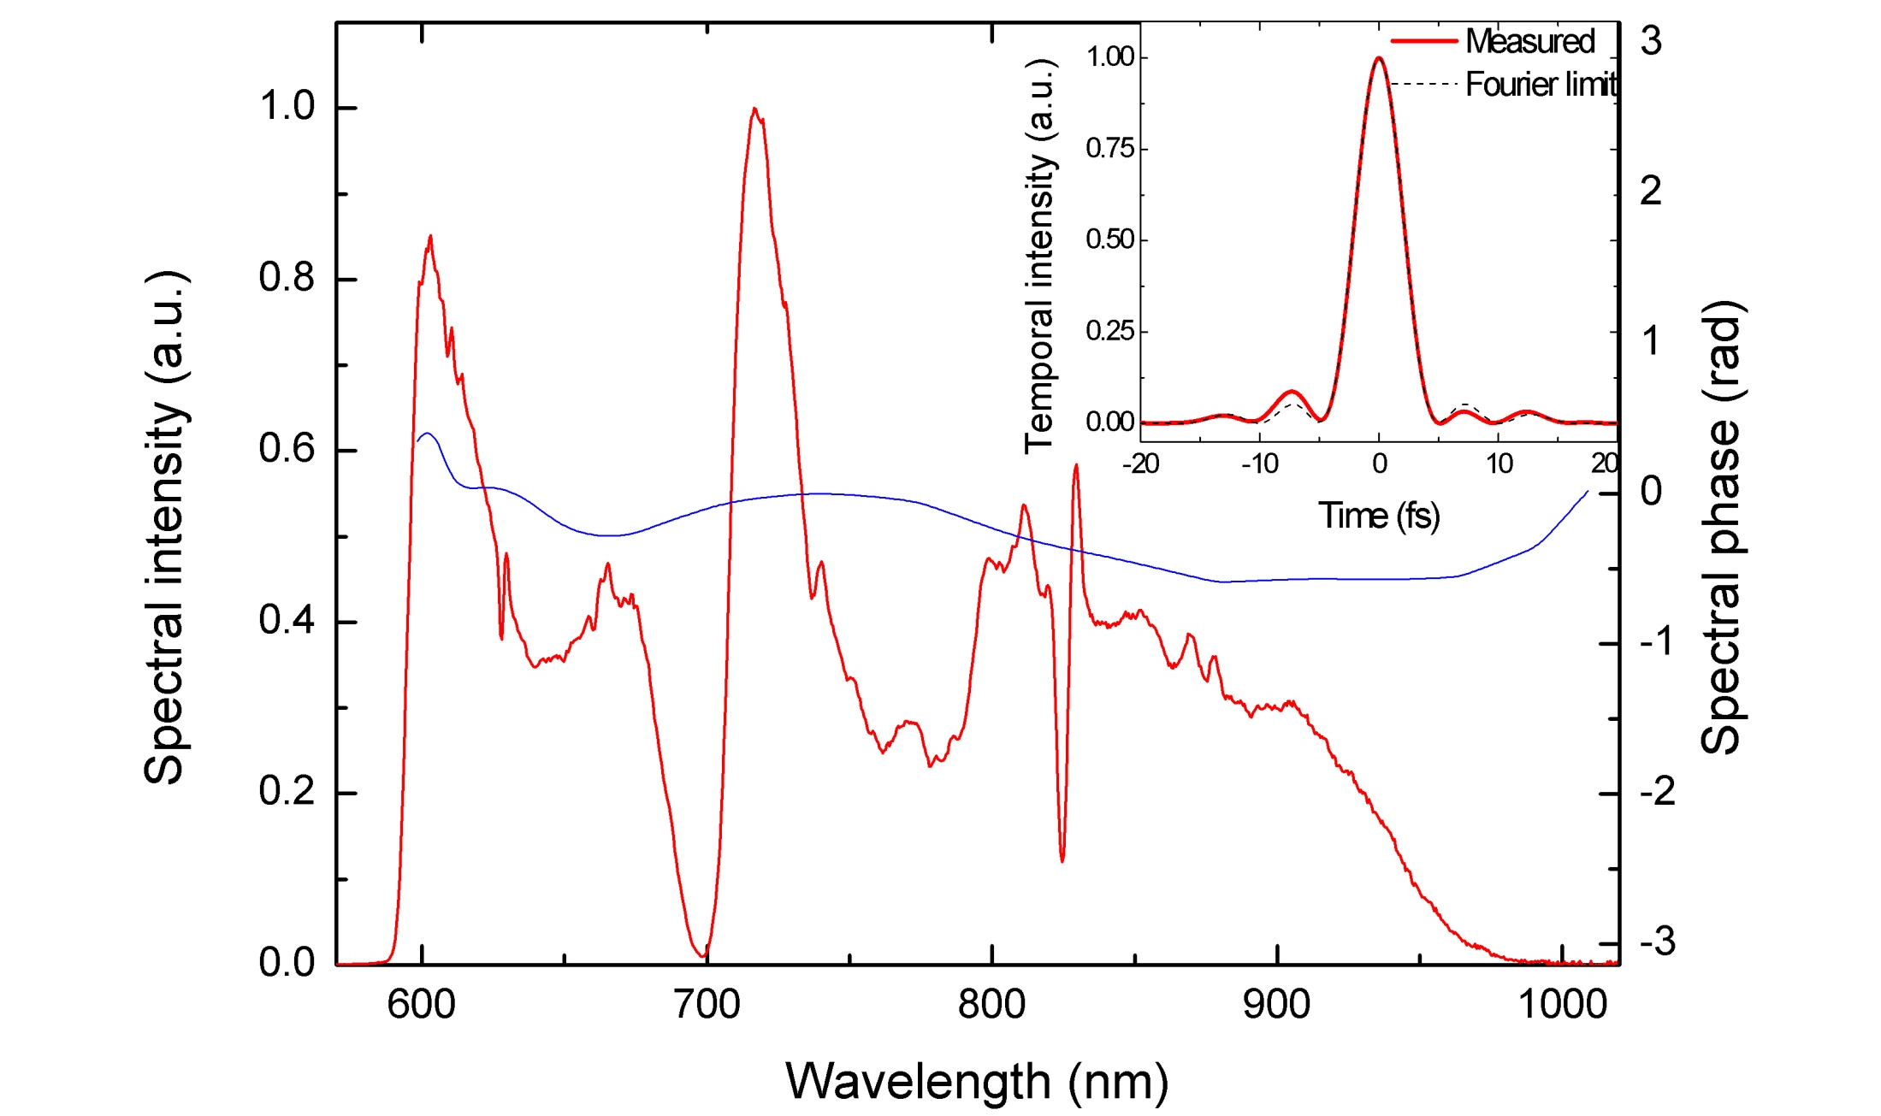
Compression
FWHM:
4.5 fs
Dazscope evaluation
FWHM Fourier limit: 4.5 fs
FWHM pulse duration: 4.5 fs
SHG AC indicates also this duration!

Slide 14
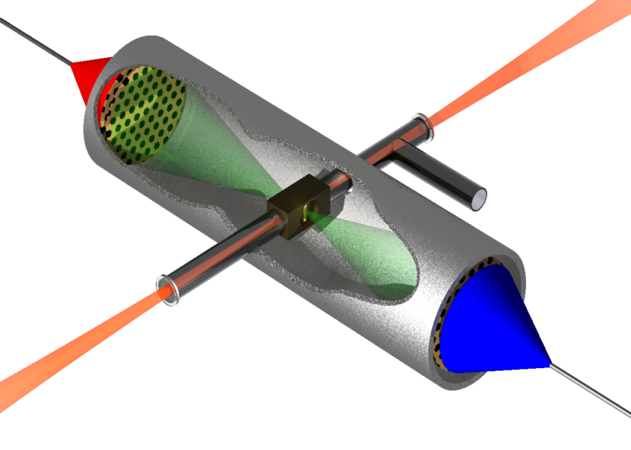
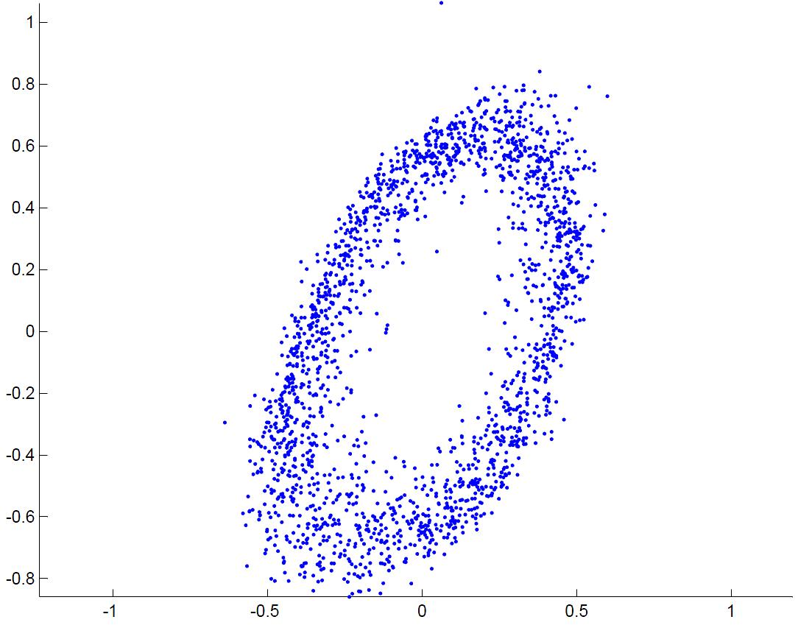
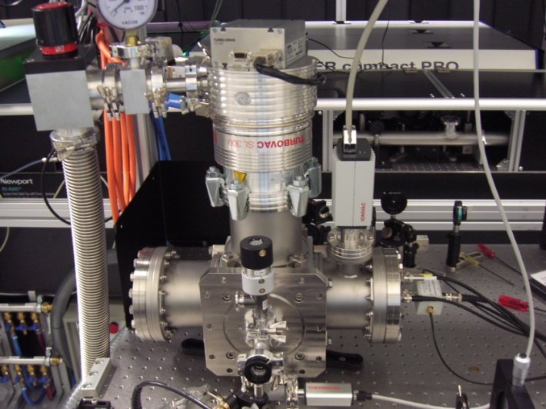
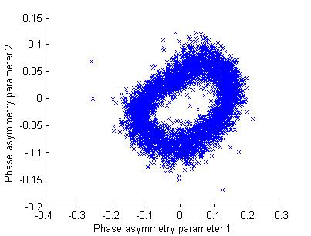
First single shot CEP results
Single shot CEP tagging is crucial!
Raw single shot CEP
meter spectra using LWS-20:
Large amplitude asymmetry
needs ~4.5 fs pulse duration
Shot 1
A new phase
meter is
working.
Shot 2
T. Wittmann et al., Nature Phys. 5, 357 (2009)

Slide 15

Further goals
Upgrade step I:
Bandwidth increase to reach
~5 fs pulse duration
Single shot CEP-measurement
Upgrade step II:
Pump laser energy upgrade
4 x more energy with 80 ps,
10 Hz is delivered
CEP-stabilization of the OPCPA system
LWS-20
80 mJ, sub-5 fs, 16-18 TW
CEP tagged OPCPA system
Future upgrade goal: LWS-100
300-500 mJ, 5 fs, 60-100 TW

Slide 16
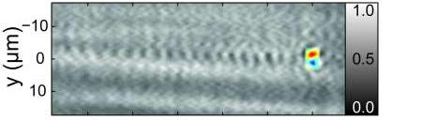
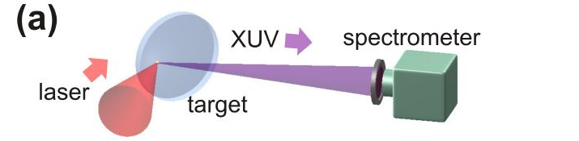
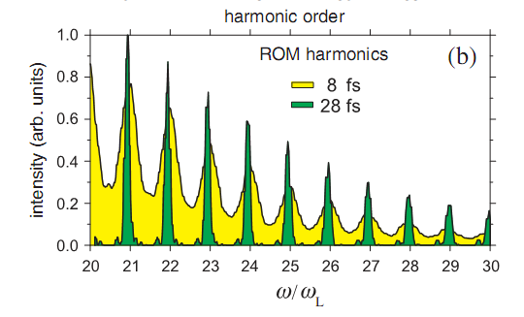
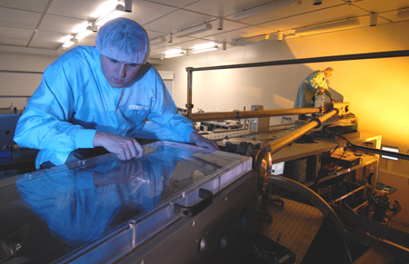
Applications
Femto-attosecond electron beams
Intense isolated attosecond XUV pulses from relativistic plasmas
Intense isolated attosecond XUV pulses from gas medium

Slide 17
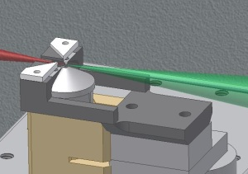
Applications: Laser-driven electron
acceleration with sub-5-fs pulses
Results using shock-front injection
Tritium reference
Peak Energy (MeV) | 7.12 ± 0.56
Energy spread FWHM (MeV) | 3.36 ± 0.38
Charge (pC) | 4.78 ± 1.05
Divergence FWHM (mrad) | 36.5 ± 2.29
Pointing fluctuation (mrad) Electron density (cm⁻³) | 8.17 7 · 10¹⁹
< 5 fs
≈ 30 mJ on target
  opens up a new era of
  few-femtosecond
  electron diffraction!
Notes:
Focus optimization
Phase file?

Slide 18
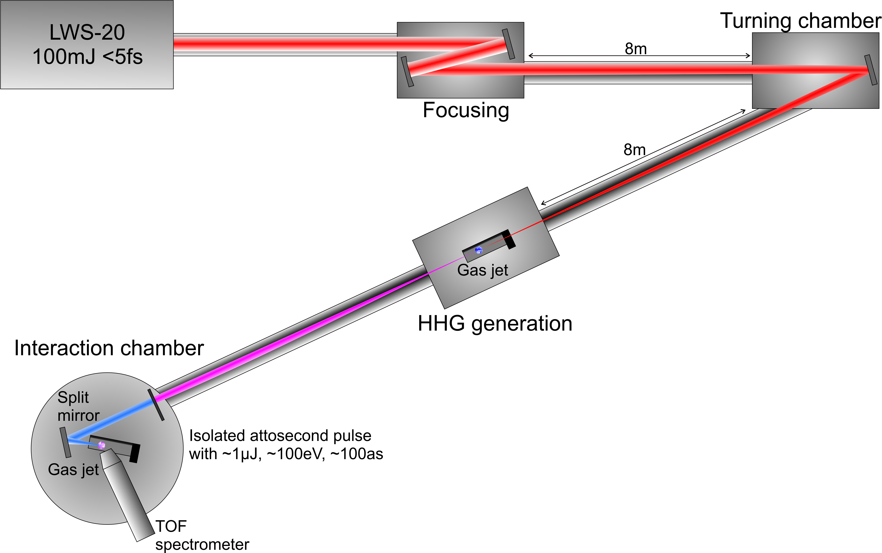
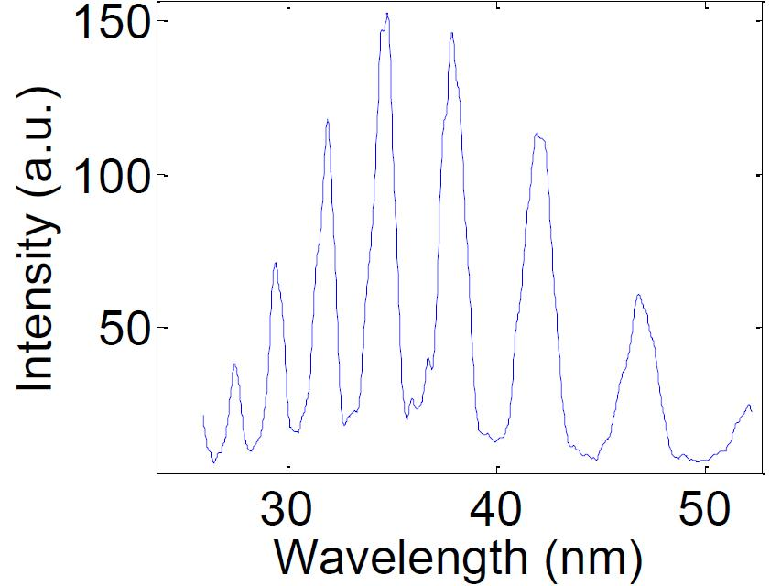
Applications: gas HHG
High harmonic generation from gas targets
  Single (few-)100-attosecond pulse generation
  up to 1 µJ around 100 eV in Neon in an isolated attosecond pulse
19
Ar spectrum
GDD = -70 fs²
23
15
27
  opens up a new era of nonlinear attosecond
  XUV physics!

Slide 19
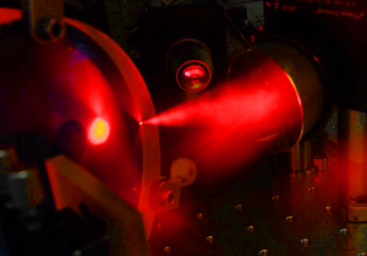
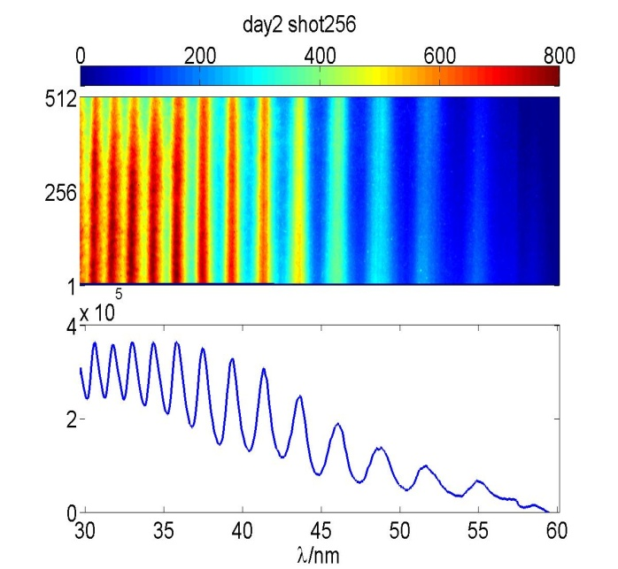
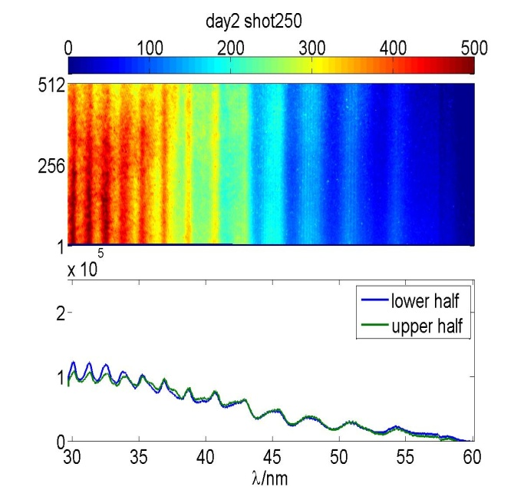
Applications: relativistic HHG
Relativistic high harmonic generation in plasmas
  Shorter attosecond pulses, higher photon energy
  100 µJ – 1 mJ energy in isolated attosecond pulse
F# 1.5 ~ 1.5 µm FWHM focal spot
I ~ 10²⁰ W/cm²
Glass target 4.5 hours @ 10Hz
  opens up a new era of nonlinear attosecond XUV physics!

Slide 20

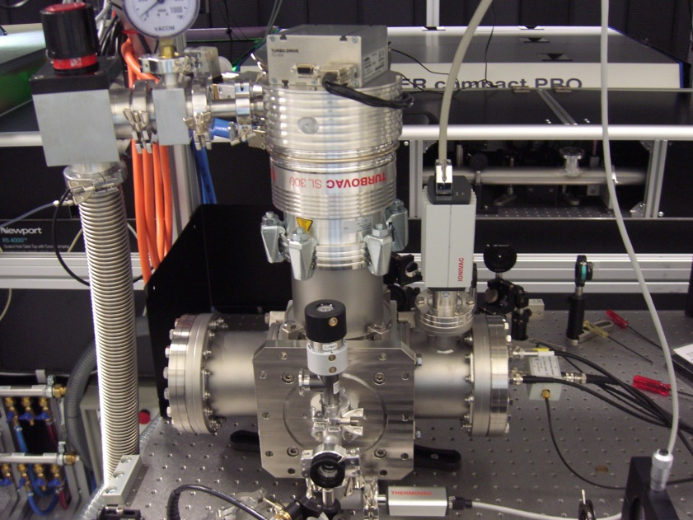
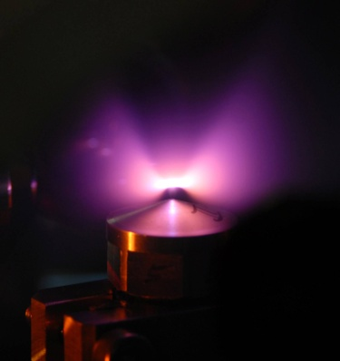
Summary
LWS-20 upgrade, an optical parametric synthesizer, with 80 mJ, sub-5 fs, CEP tagging is ready
Experiments towards generation of intense isolated attosecond pulses in gas as well as in plasma medium and femto-attosecond electron beams are running
Upgrade to ~100 TW is planned

Slide 21
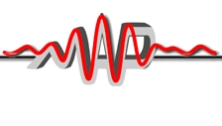


Thank you for your attention !
Acknowledgements:
Munich Center for
Advanced Photonics
Laserlab Europe II
Sonderforschungsbereich Transregio 18
Deutsche Forschungsgemeinschaft

Slide 22
    Thank you for your attention !
    Acknowledgements
    MPQ¹ / LMU²
    Laszlo Veisz¹
    Daniel Rivas¹
    Alexander Buck^{1,2}
    Karl Schmid¹
    Jiancai Xu¹
    Julia Mikhailova¹
    Tai Dou¹
    Chris Sears¹
    Benedikt Mayer¹
    Raphael Tautz¹
    Daniel Herrmann¹
    Xun Gu¹
    Gilad Marcus¹
    Tibor Wittmann¹
    Johannes Wenz²
    Matthias Heigoldt²
    Konstantin Khrennikov²
    Stefan Karsch^{1,2}
    Ferenc Krausz^{1,2}
IOQ Jena³ / HI Jena⁴
Maria Nicolai³
Alexander Sävert³
Malte C. Kaluza^{3,4}
Jana Bierbach³
Christian Rödel^{3,4}
Gerhard Paulus^{3,4}
Wigner Inst. Budapest, Hungary
Angéla Barna
István Földes
FORTH Heraklion, Greece:
Paris Tzallas
Dimitris Charalambidis
Munich Center for
Advanced Photonics
Laserlab Europe II
Sonderforschungsbereich Transregio 18
Deutsche Forschungsgemeinschaft
Notes:
22

Slide 23
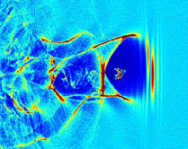
Outlook
100 TW upgrade of LWS-20, 400-500 mJ & sub-5-fs
CEP dependent collective effects in electron acceleration
Attosecond electron pulses for electron diffraction
Intense isolated attosecond XUV / x-ray pulses for nonlinear
attosecond physics
Electron bunch
Gas Jet

Slide 24

Light Wave Synthesizer-20 (LWS-20) <5 fs
Properties :
Most intense few-cycle laser system in the world!
100 mJ / pulse before compression (80 mJ after)
4.4-4.9 fs FWHM pulse duration
16-18 TW power
10 Hz repetition rate
1.5 µm/ 4 µm FWHM focus diameter (F#1.5 / F#4 optics)
>10²⁰ W/cm² / 4 x 10¹⁸ W/cm² peak intensity
>10¹⁰ contrast in +-40ps time window

Slide 25
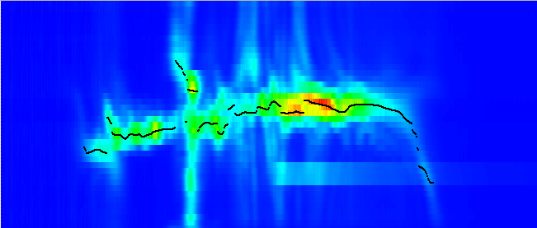
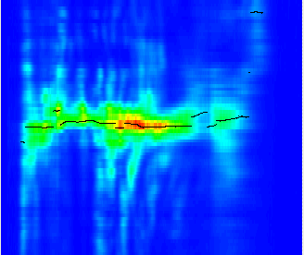
Compression 1
Dazzler
GDD (fs²)
SHG spectrum as a function of GDD (Dazscope principle)
1500
625
GDD scan using Dazzler.
-250
Highest intensity at λ corresponds to total GDD(λ) = 0
-1125
-2000
λ (nm)
300
350
400
450
500
Dazzler
GDD (fs²)
GDD(λ)
Phase(λ)
800
Integrating
400
After phase compensation
with Dazzler:
0
-400
-800
λ (nm)
300
350
400
450
500

Slide 26
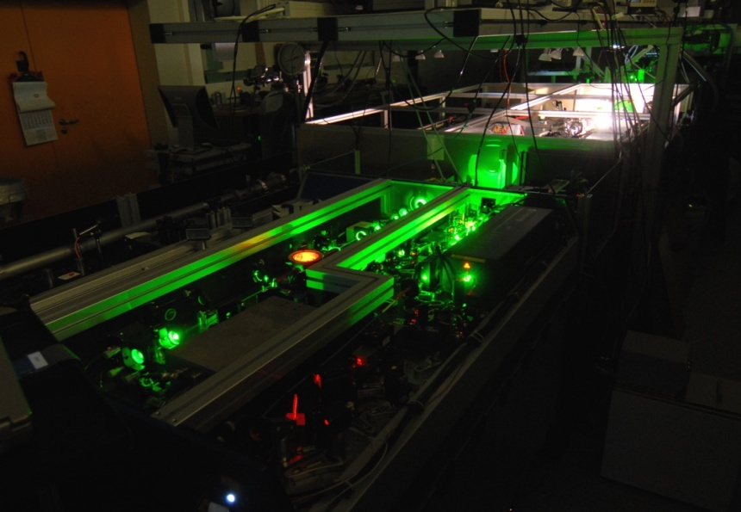
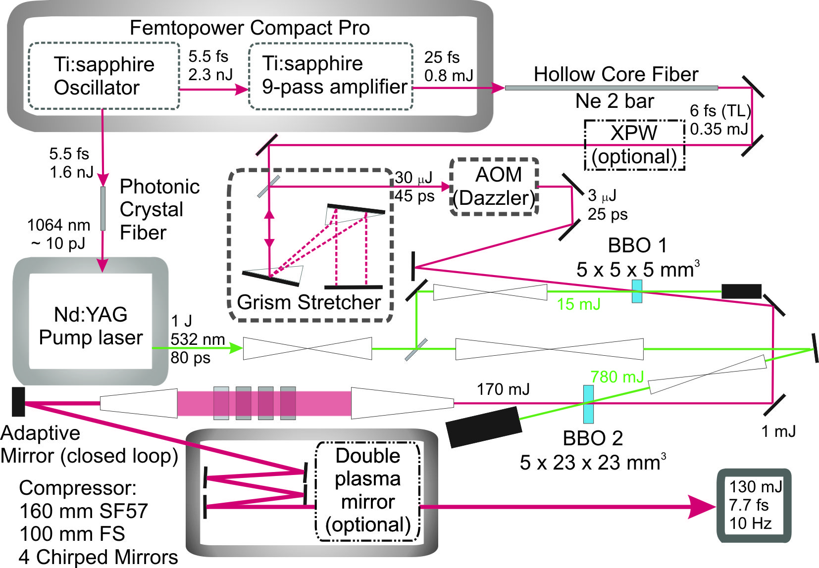
LWS-20 OPCPA Setup
Hollow Core Fibre
& XPW setup
1kHz Ti:Sa Front End
XPW:
25 % eff with
5.5 fs pulses
5.5 fs
250 µJ
Grism stetcher
1st stage
532 nm
Pump
700-1020 nm
Seed
2nd BBO based OPA stage
Plasma mirror
(optional)
Bulk compressor
LWS-20: D. Herrmann et al. Opt. Lett. 34, p. 2459 (2009)

Slide 27
First spectrum of 5 fs LWS-20
Generation of even shorter than 5 fs / 2 cycle pulses is feasible!

Slide 28
Spectral tuning in LWS-20

Slide 29
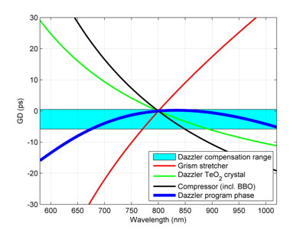

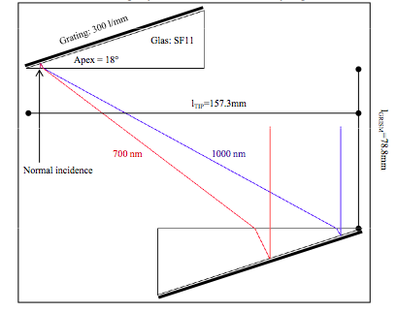
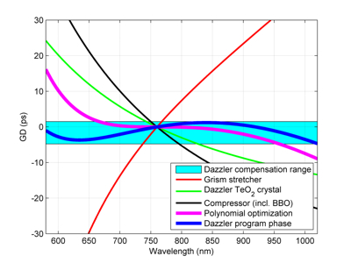
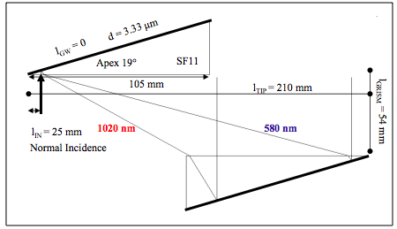
Designing a New Grism Stretcher
Old
out of range
New
fully in range
T. H. Dou et al., Opt. Exp. 18, p. 27900 (2010)

Slide 30
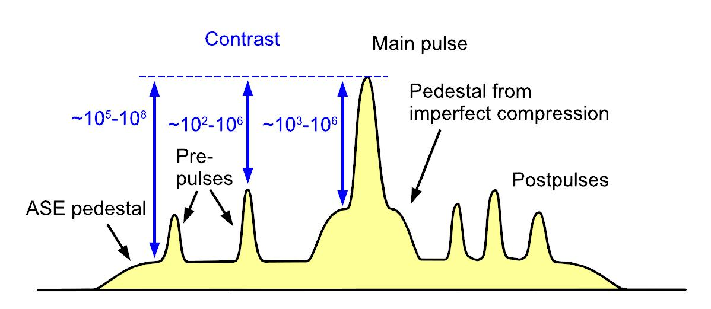
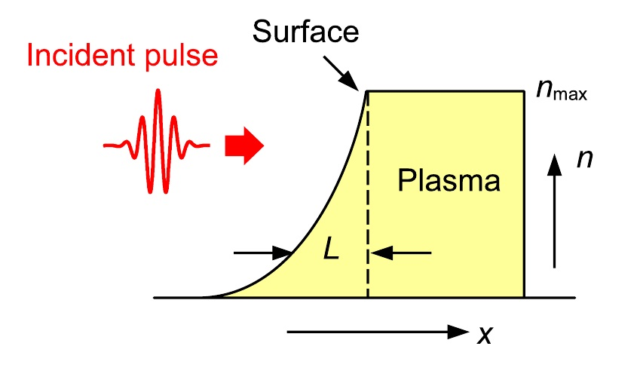
Role of contrast
I(t)
t
Features
ns-, ps-pedestal (ASE, OPF)
Pre- and postpulses (double
internal reflection from optics +
nonlin. prepulse gen., birefringence)
Foot of the pulse (spectral clipping,
imperfect compression, pump noise
transfer)
preplasma generation at 10¹⁰-10¹² W/cm²
no laser interaction with overdense plasmas

Slide 31
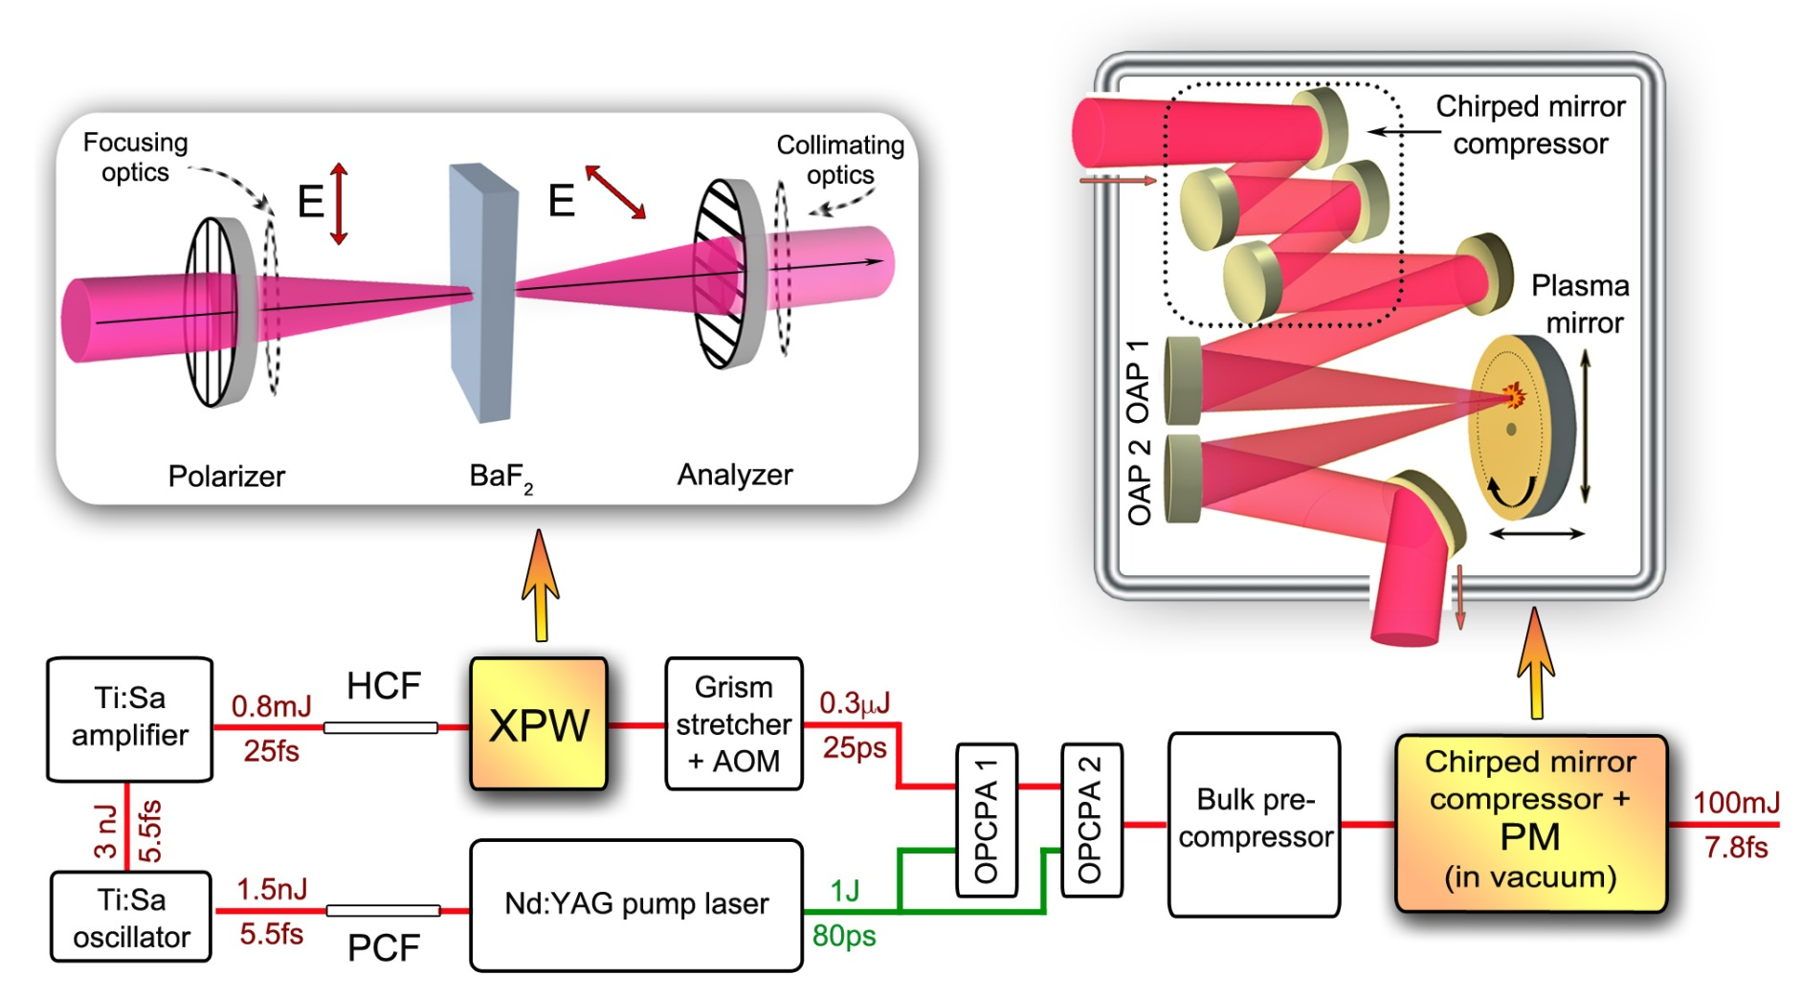
LWS-20 contrast
PM: Plasma mirror
XPW: Cross-polarized wave generation unit
Contrast of LWS-20:
10⁸ from front end
+ 10⁴ XPW
+ 10⁵ OPCPA
+10^{2.5} PM
→ 10¹⁹
HCF: hollow core fiber
PCF: photonic crystal fiber for optical synchronization of the pump and seed in OPCPA
AOM: acousto-optical modulator
J. M. Mikhailova et al., Opt. Lett. 36, 3145 (2011)

Slide 32
  Contrast improvement by short pump OPCPA
Finite pump pulse duration → finite temporal gain window
Expected improvement @ 40-50 ps before pulse peak:
1 µJ → 100 mJ ~10⁵
Measured improvement
with misaligned front end
@ 40-50 ps before
pulse peak:
10⁵
Pump laser envelope
Detection limit
Free contrast review: Coherence and Ultrashort Pulse Laser Emission, ISBN 978-953-307-242-5, ed. F. J. Duarte (2011); Online: http://www.intechopen.com/articles/show/title/contrast-improvement-of-relativistic-few-cycle-light-pulses

Slide 33
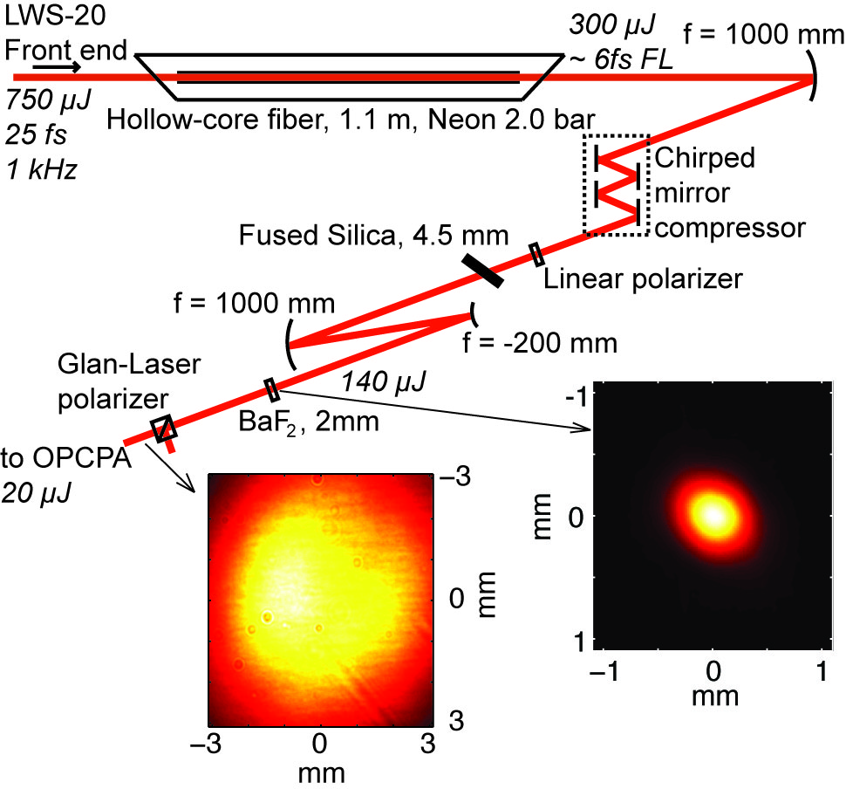
Contrast improvement by XPW
LWS-20
Front end:
Ti:Sa oscillator
Ti:Sa 9 pass
amplifier
compressor
Profile after analyzer
Energy: 20 µJ
~ 15 % conversion
~ 8 % throughput
Profile at crystal
E = 140 µJ, t ~ 6 fs, I ~ 7·10¹² W/cm²
Free contrast review: Coherence and Ultrashort Pulse Laser Emission, ISBN 978-953-307-242-5, ed. F. J. Duarte (2011); Online: http://www.intechopen.com/articles/show/title/contrast-improvement-of-relativistic-few-cycle-light-pulses

Slide 34
Contrast improvement by XPW
Expected improvement with R=2x10⁴ polarizer: 10⁴
before main pulse
after main pulse
misaligned LWS-20 contrast :
5x10⁻⁶ @ 10ps
5x10⁻⁷ @ 20ps
contrast of LWS-20 + XPW:
5x10⁻¹⁰ @ 10ps
< 10⁻¹⁰ @ 20ps
Measured improvement:
4 orders of magnitude improvement
10⁴
Detection limit

Slide 35

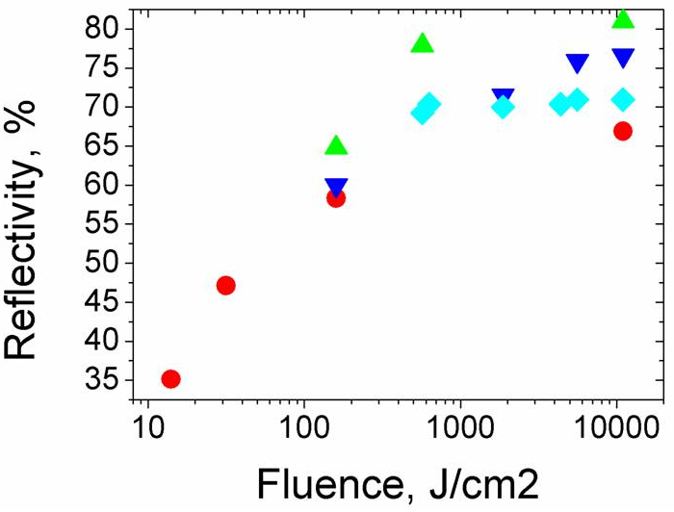
            Plasma mirror reflectivity
Conclusions:
Reflectivity 70-80%
Reflectivity doesn’t decrease with fluence → very good input contrast!

Slide 36
            Contrast improvement by plasma mirror
4.3 hours of
continuous
operation
time at 10 Hz !
Expected
Improvement with
AR targets and the
measured 80 % refl.:
3x10² - 10³
Measured contrast improvement:
2.5 orders of magnitude
In cooperation with A. Borot

Slide 37

LWS-20 contrast with cross-polarized wave generation (XPW) + Plasma mirror (PM)
before main pulse
after main pulse
Combining the enhancement factors and overestimating the optical parametric fluorescence (10^{10.5}).
contrast of LWS-20 + XPW + plasma mirror:
10^{-10.5} @ 2ps
10⁻¹³ @ 20ps
<10⁻¹⁹ @ >45ps
with 8 fs duration !!!
Detection
threshold
Measured trace
Combined results
J. M. Mikhailova et al., Opt. Lett. 36, 3145 (2011)

Slide 38
Applications
1.) Few-cycle Laser-Driven Electron Acceleration
  Laser-wakefield acceleration to sub-10-MeV
  Femtosec to attosec electron bunch duration
2.) High harmonic generation from gas targets
  Single (few-)100-attosecond pulse generation
  up to 1 µJ around 100 eV in an attosecond pulse
3.) Relativistic high harmonic generation in plasmas
  Shorter attosecond pulses, higher photon energy
  100 µJ – 1 mJ energy in isolated attosecond pulse
  1: opens up a new era of attosecond electron diffraction
  2 & 3: open up a new era of XUV pump – XUV probe
  experiments with single attosecond pulses!
Electrons: A. Buck et al. Nature Phys., 7, 543 (2011); K. Schmid et al. PRL 102, 124801 (2009)
Plasma HHG: Y. Nomura et al. Nature Phys. 5, 124 (2009); P. Heissler et al. PRL 108, 235003 (2012)

