Slide 1



Soft X-Ray Lasers for FAIR
B. Ecker, D. Hochhaus, B. Zielbauer, V. Bagnoud, P. Neumayer, T. Kuehl, GSI (Germany)
E. Oliva, T. T. T. Le, Ph. Zeitoun, L. Lu, ENSTA (France)
K. Cassou, S. Daboussi, O. A. Guilbaud, S. Kazamias, D. Ros, U. Paris-Sud (France)
B. Landgraf, J. Seres, Ch. Spielmann Jena (Germany)
D. Ursescu INFN Bucharest (Romania)
B. Aurand, Lund Univ. (Sweden)
H.Y. Zhao, Q. Jin, Institute of Modern Physics (China)
S. Namba, Hiroshima University (Japan)

Slide 2
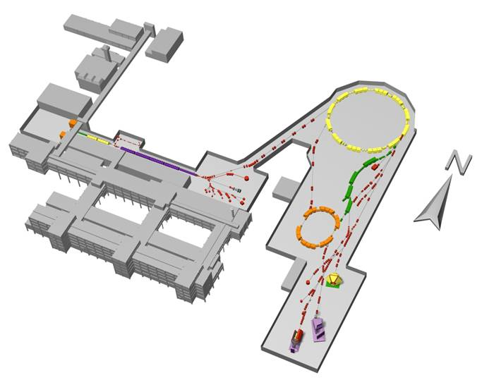
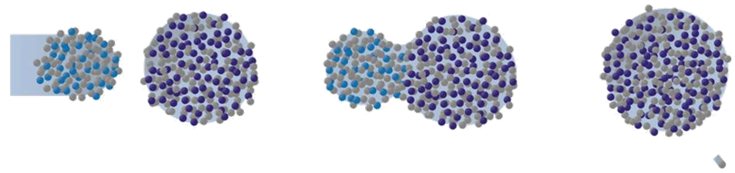
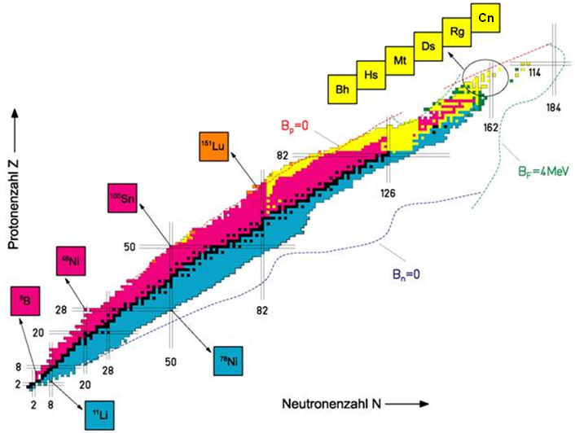
GSI – today
The chart of nuclei
Ds
„Darmstadtium“
62
28
Ni
+
208
82
Pb
269
110
Ds
+
n

Slide 3
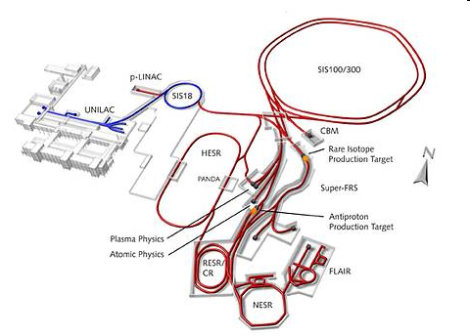
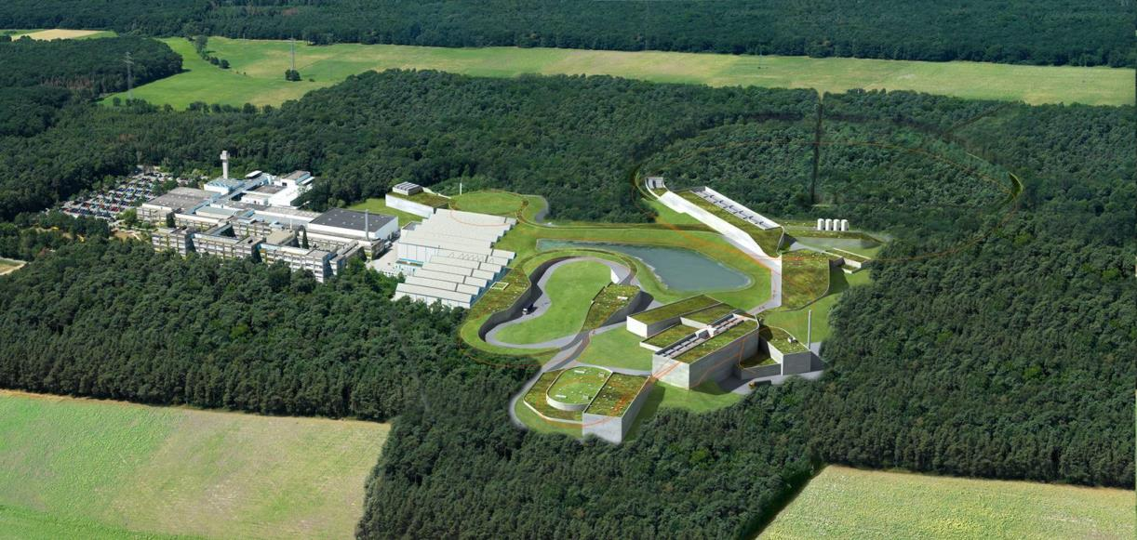














GSI‘s future: Facility for Antiproton and Ion Research
Ions and Antiprotons
100x increased primary intensities (10¹¹ ions/s)
energies from rest up to 35 GeV/u
antiprotons
CN DE ES FI FR GB GR IN IT PL RO RU SE

Slide 4
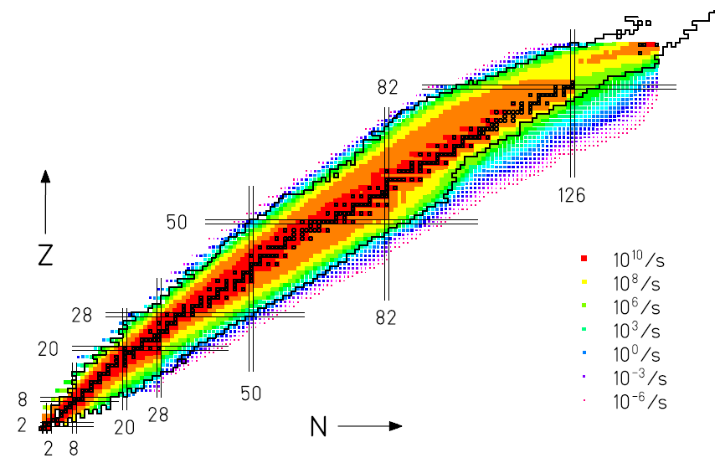
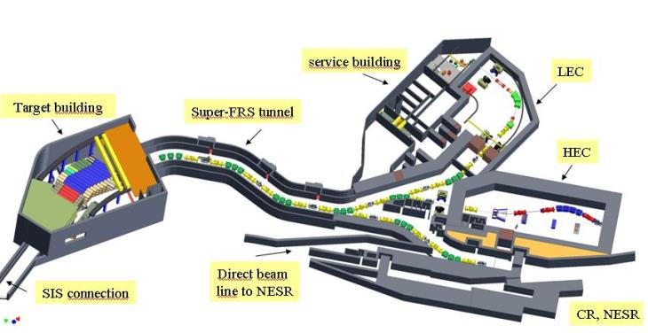
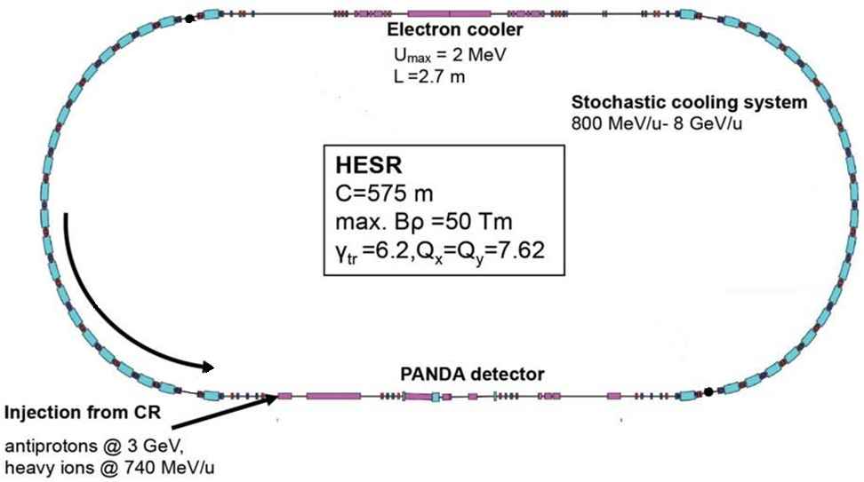
FAIR tools to study rare isotopes
Superconducting Fragment Separator:
next-generation rare-isotope beam facility
Fragmentation and in-flight separation
10.000x increased intensity for rare isotopes
HESR: High-Energy Storage Ring
storage of ions for hours/days
single-ion up to 10¹⁰
Electron + stochastic cooling
→ v/v~10^{-4...-5}
Masses, lifetimes
Also: Laser spectroscopy

Slide 5
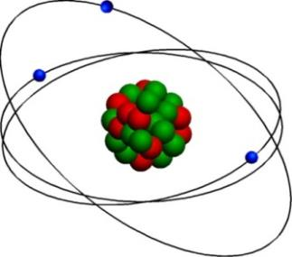
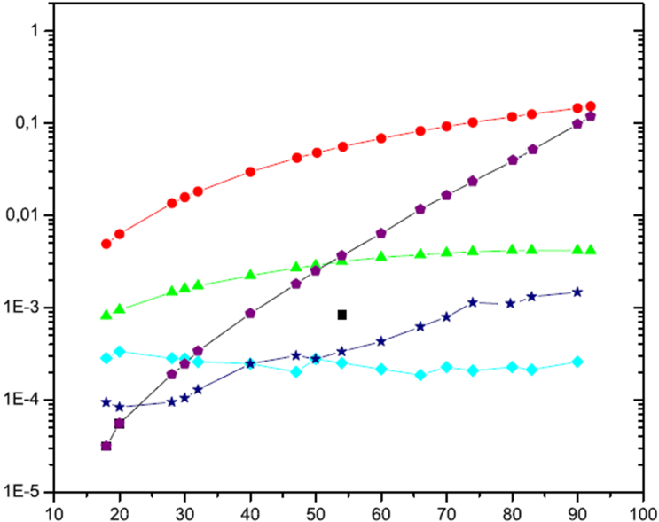
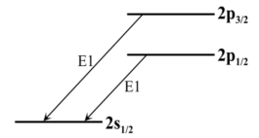
Precision spectroscopy on few-electron heavy ions
Accurate knowledge of electronic factor necessary!
Fewer electrons → simpler!
Li-like ion
1e⁻-QED
<ρ >
2e⁻-QED
rel. contribution (2p_{1/2}-2s_{1/2})
theory
2p_{3/2}→2s_{1/2}
nuclear charge
Nuclear charge radii, isotope/isotone shift, ..
Spin, magnetic moments
Test QED in high fields
2p_{1/2}→2s_{1/2}

Slide 6
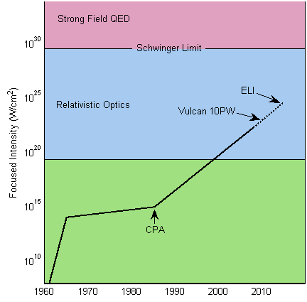
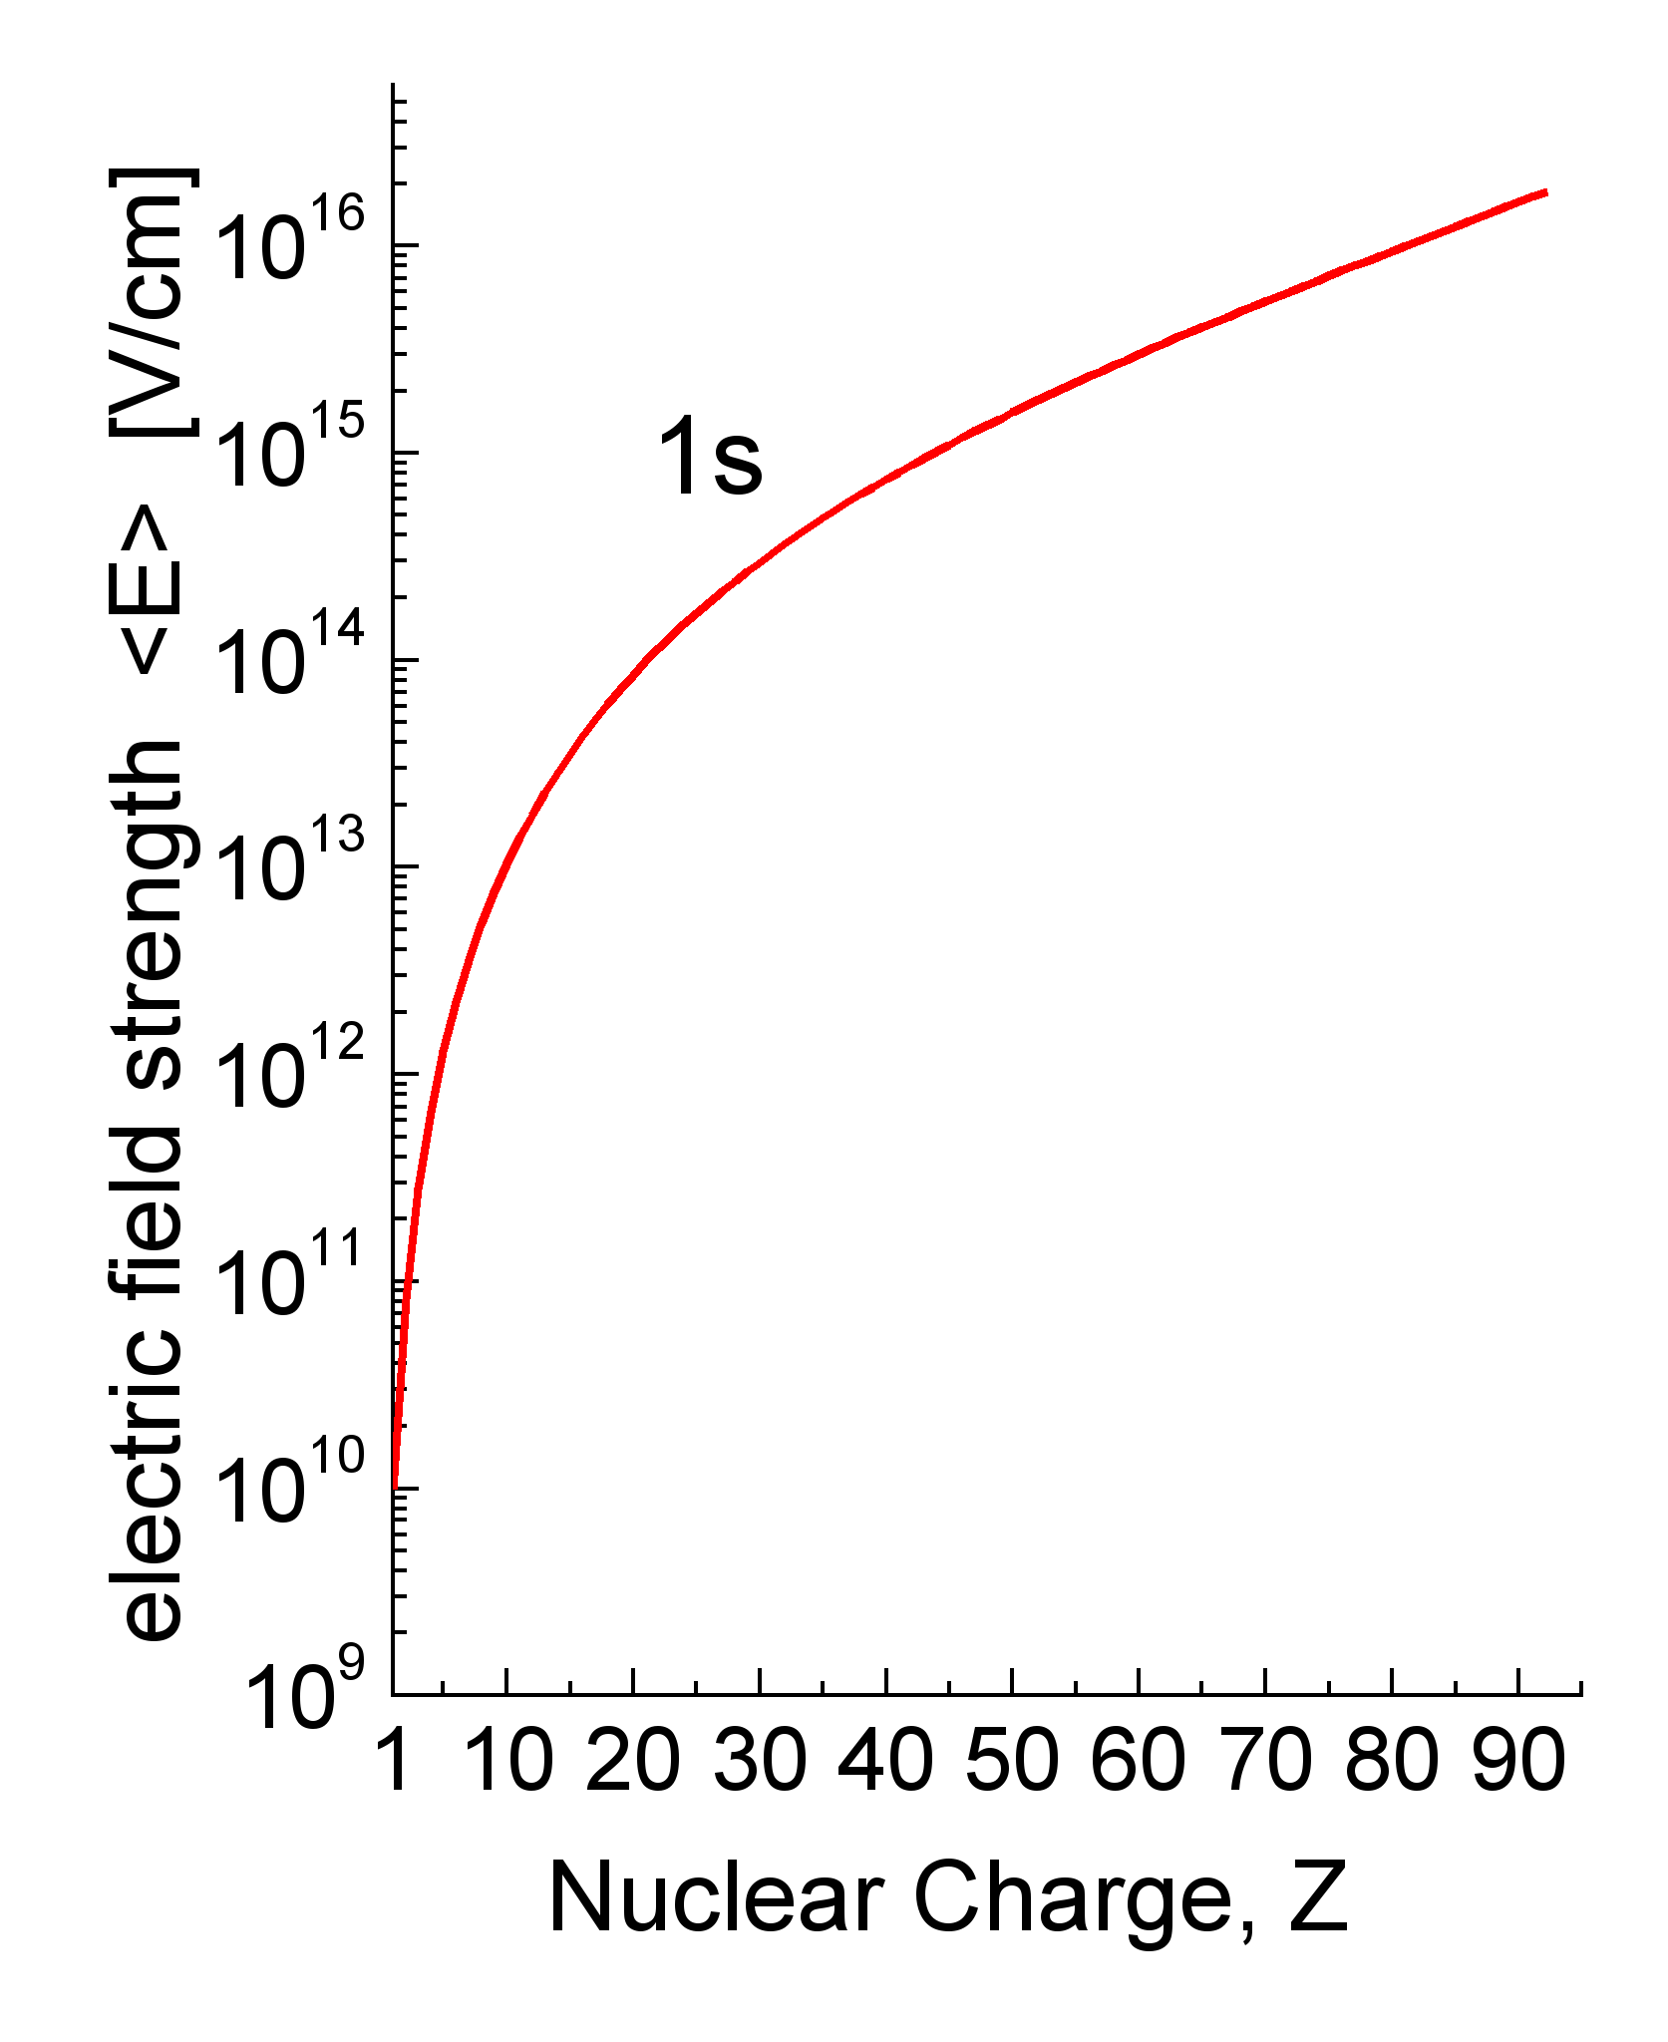
Extreme fields: lasers and heavy ions
Lasers
Heavy ions
Equivalent to I ≥ 10²⁸ W/cm²
(adapted from Mourou, Tajima, Bulanov, RMP 78, 2006)
Sub-femtosecond pulses
Huge fields of microscopic dimension are present in heavy ions!
Notes:
6

Slide 7
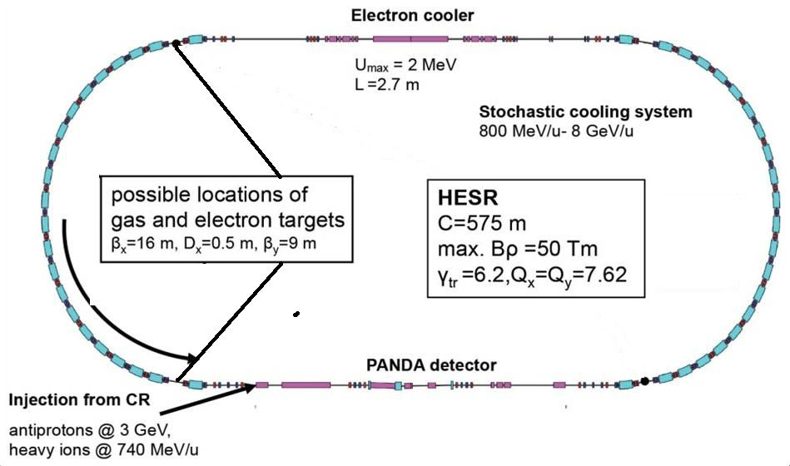

XRL spectroscopy at the HESR – possible scenario
Collinear spectroscopy, counter-propagating beams:
→ Doppler effect!
XRL
v
$$E_{rest}=E_{lab}\sqrt{{\left(1−β\right)}/{\left(1+β\right)}}$$
tune to scan energy range
boost energy in rest frame
HESR: β > 0.98 (γ > 6)
Ag (13.9nm)
Mo (18.9nm)
energy [eV]
2p_{3/2}→2s_{1/2}
2p_{1/2}→2s_{1/2}

Slide 8
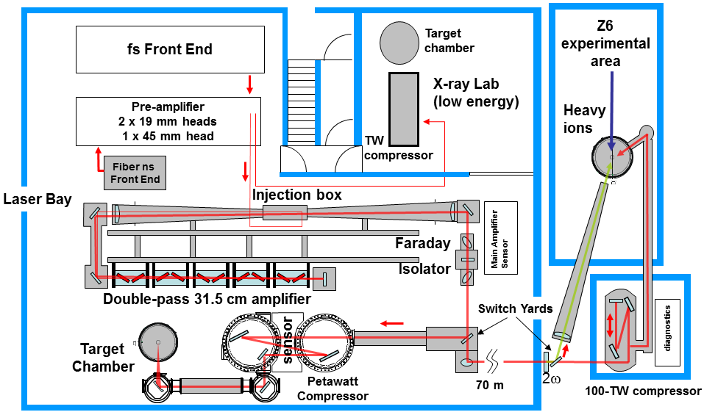
PHELIX laser architecture

Slide 9
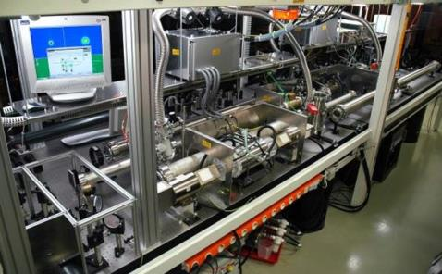
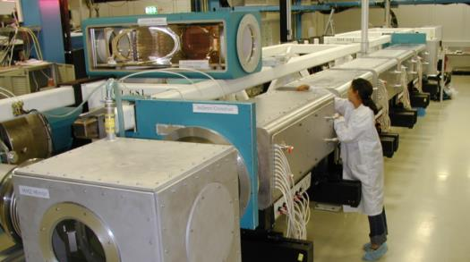
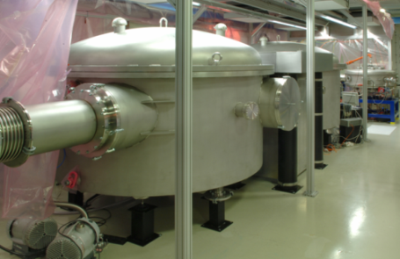
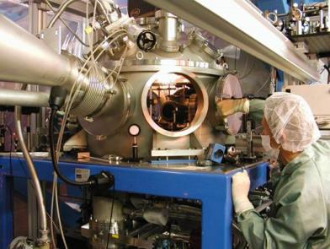
PHELIX – Petawatt High Energy Laser for heavy Ion eXperiments
Short pulse front-end
Main amplifier chain
High-energy pulse compressor
Mode | Long pulse (1w) | Long pulse (2w) | Short pulse
Pulse duration | 0.7...20 ns | 0.7...10 ns | 0.4...20 ps
Energy on target | 0.3...1 kJ | 200 J | 200 J
Max. intensity | 10¹⁶ W/cm² |  | 10²¹ W/cm²
Contrast | 50 dB |  | 10¹⁰
Rep. rate (max energy) | 1 shot / hour
Rep rate (Joule level) | 1 shot / 2 min.
Several target areas

Slide 10
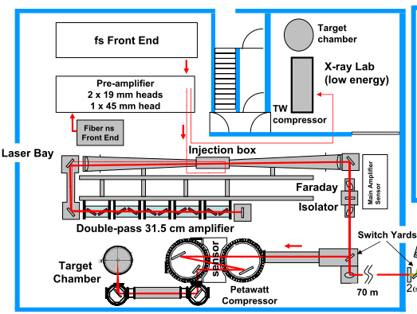
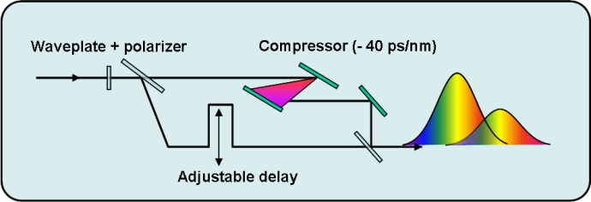
Generation of double-pulses
Mach-Zehnder Interferometer
Collinear double-pulse
→ one beamline
Adjustable energy ratio
Adjustable delay (0 – 2 ns)
Different pulse durations

Slide 11
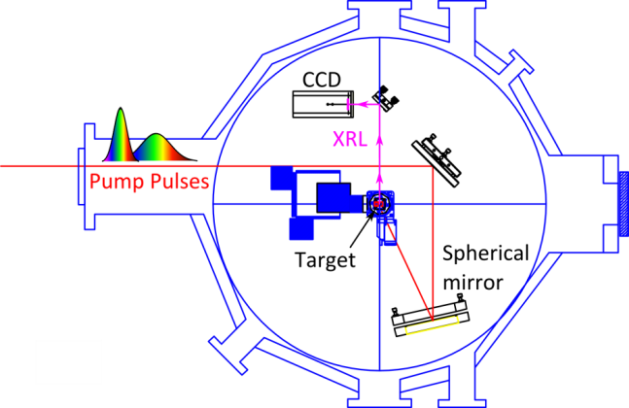
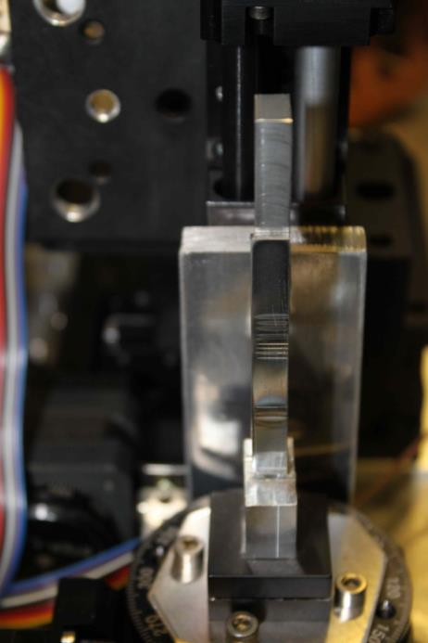
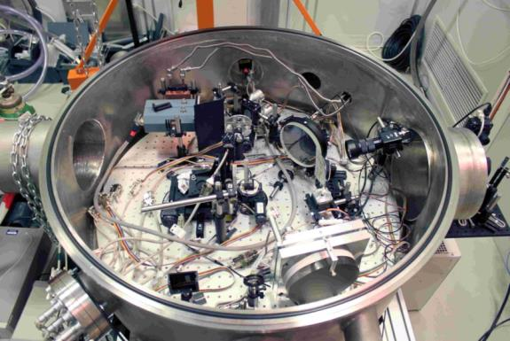
Grazing incident pumping („GRIP“)
Grazing angle: 25°
➔ TWE ~ 1.1 c

Slide 12
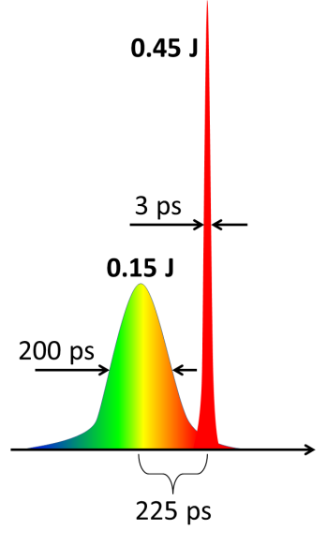
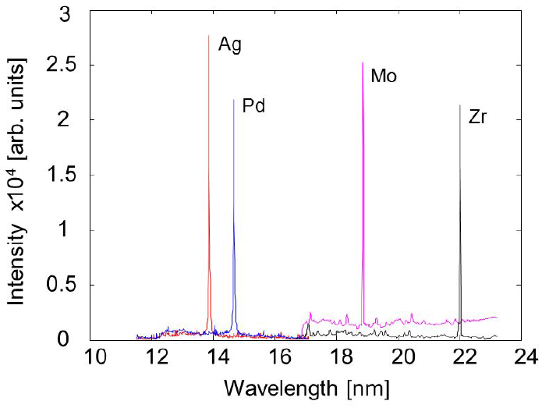
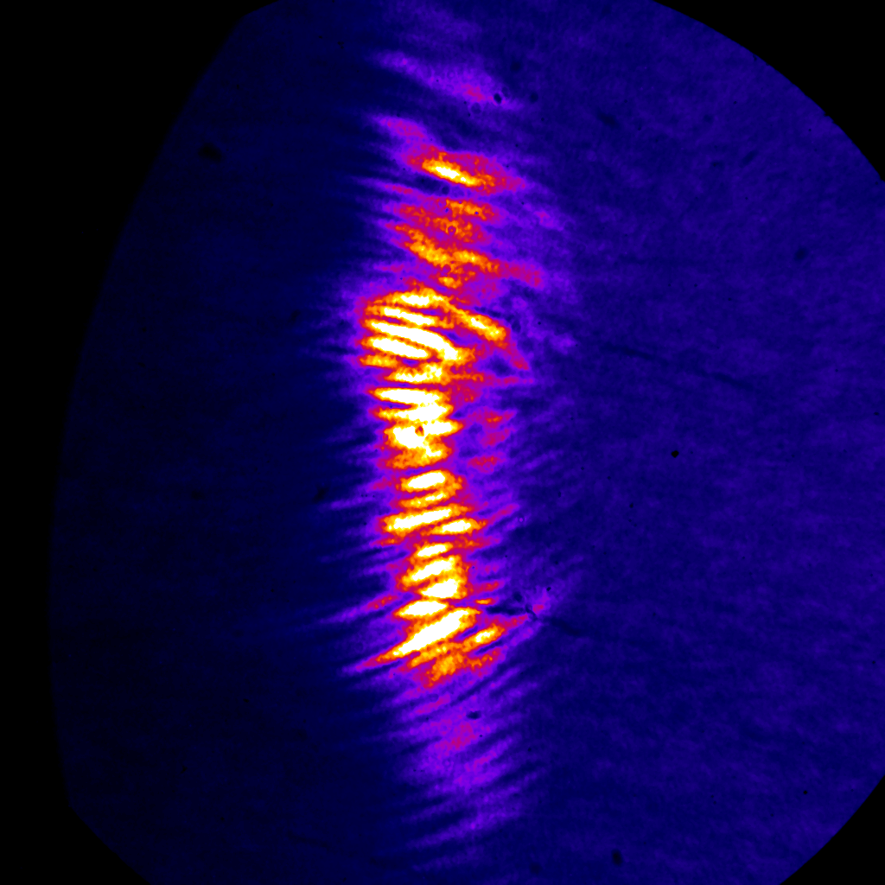
Optimization of Ni-like XRL in double-pulse pumping
Parameter optimization
Delay → 225 ps
Ratio → 25/75
(pre-/main-pulse)
Main pulse
duration → 3 ps
Far-field beam profile
Total pump energy: ~ 600 mJ
output XRL energy: typ. 100 nJ
Line focus: 70 µm x 6 mm
→ Divergence ~ 30 x 8 mrad

Slide 13

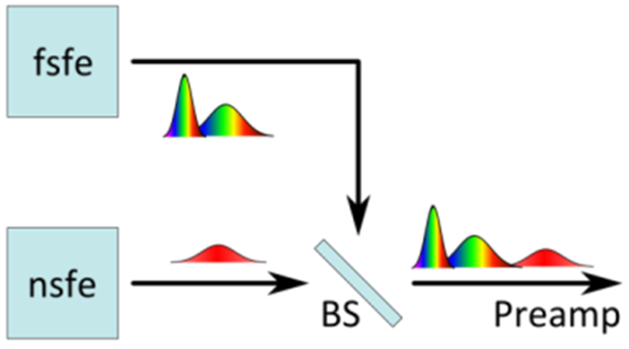
Adding nanosecond pre-pulse
One beam splitter before
the preamplifier section
Duration: 1.5 ns – 20 ns
Energy:
1% - 25% of the main pulse
Delay:
Via delay generator

Slide 14
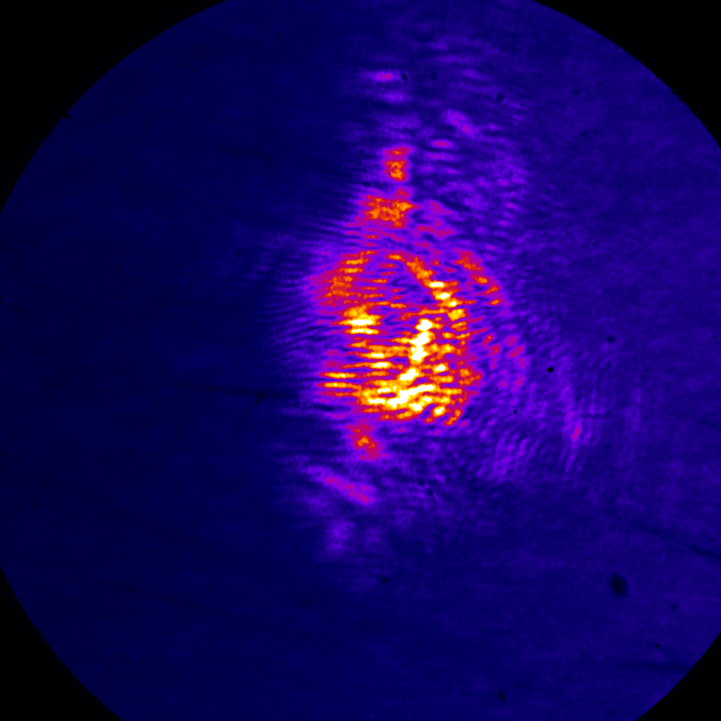
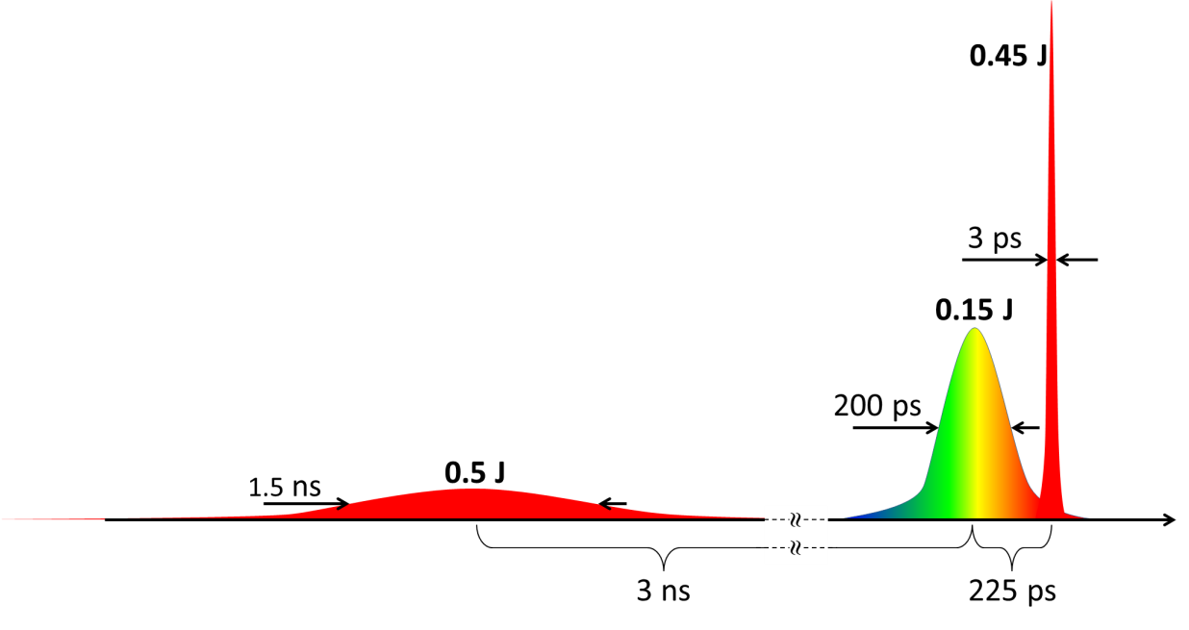
Results with triple-pulse pumping
Total pump energy:
~ 600 mJ (CPA) + 500 mJ (ns-pulse)
Far-field beam profile
optimum delay
ns-pulse – CPA-pulses: 3 ns
→ Divergence ~ 15 x 15 mrad
Experiments at Bucharest show decrease of pumping threshold

Slide 15
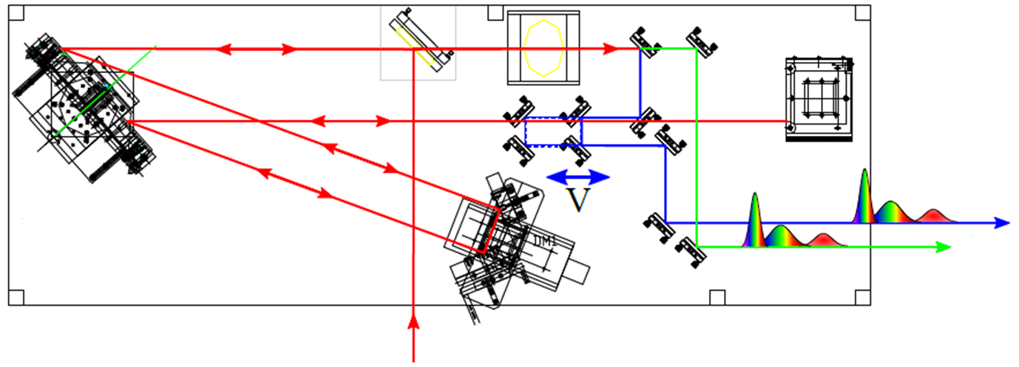
Pulse compression and splitting
vert. fold
mirror
delay
line
to seed XRL
gold
grating
hor. fold
mirror
to amplifier

Slide 16
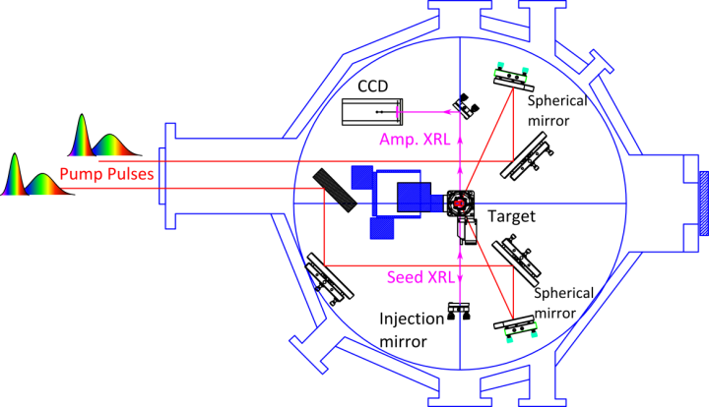
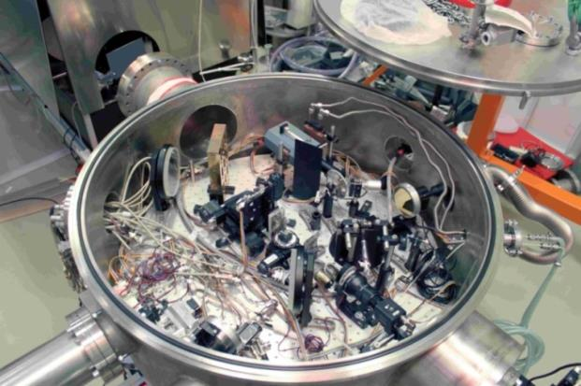
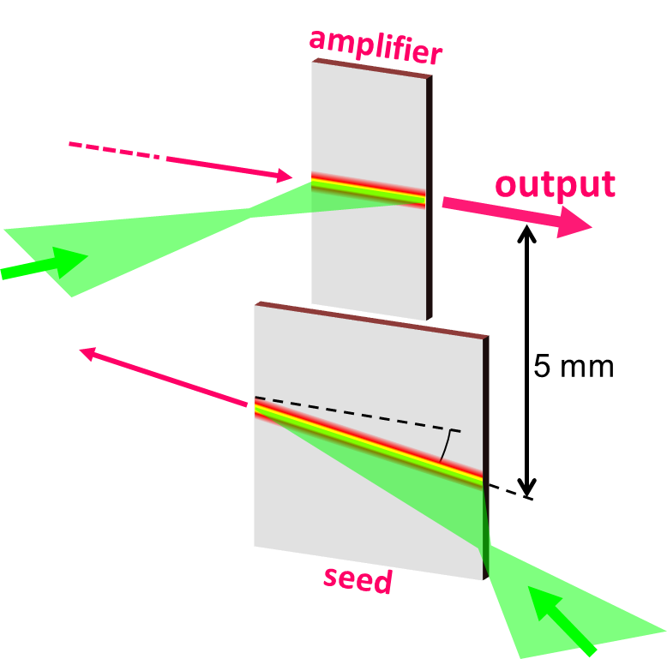
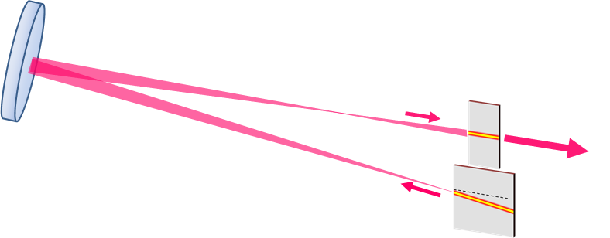
X-Ray Sources: Plasma XRL
Ampl. line focus:
220 µm x 2.5 mm
Seed-injection using spherical VUV-mirror
Seed line-focus:
90 µm x 5.0 mm
B.Ecker et al. Optics Express 2013 submitted

Slide 17
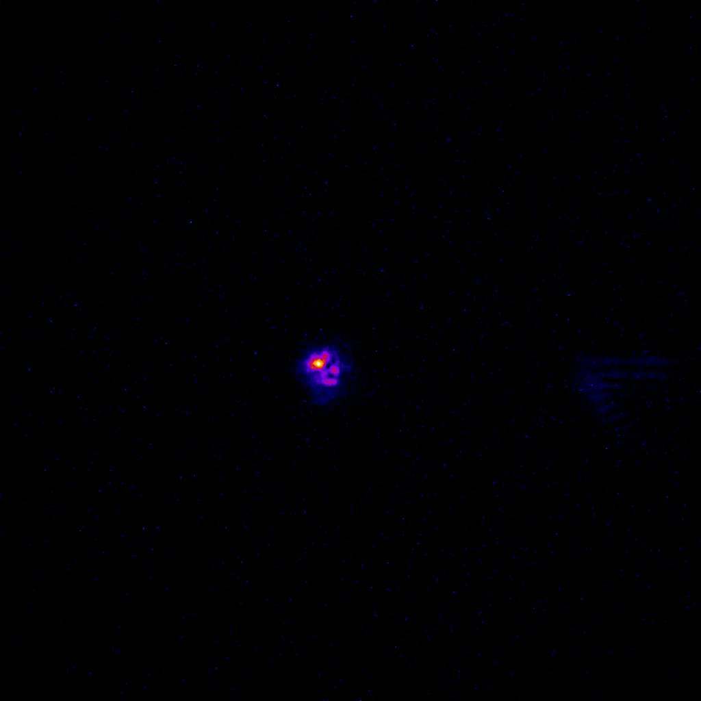
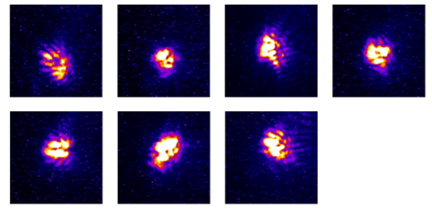
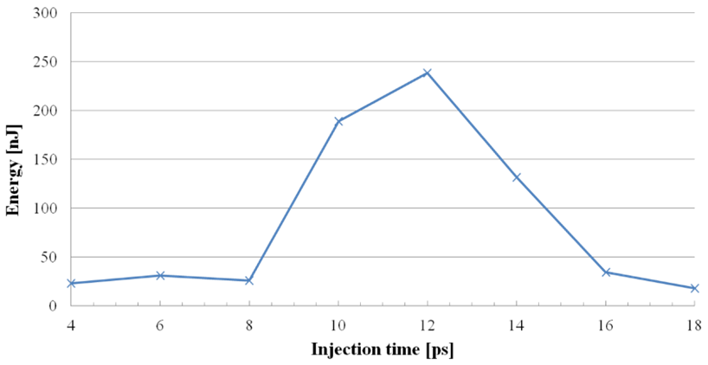
Generates Microjoule at 100 eV
Seed XRL: 130 nJ, 15 mrad x 15 mrad
Spatial coupling 6%
Amplified Seed XRL: 240 nJ
  2 mrad x 2 mrad
→ 2 orders of magnitude in brilliance !!
Seed
Amplified
Decent repeatability...
Gain lifetime measurement
...
~5ps

Slide 18
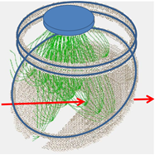
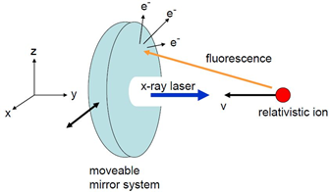
Future directions
Higher rep. rates → 1/10s
Larger volume of amplifier
Development of highy efficient fluorescence detection system
Fluorescence photons again Doppler-shifted → keV energies
Relativistic velocity → emission in forward cone
Particle simulation of secondary-electron collection

Slide 19
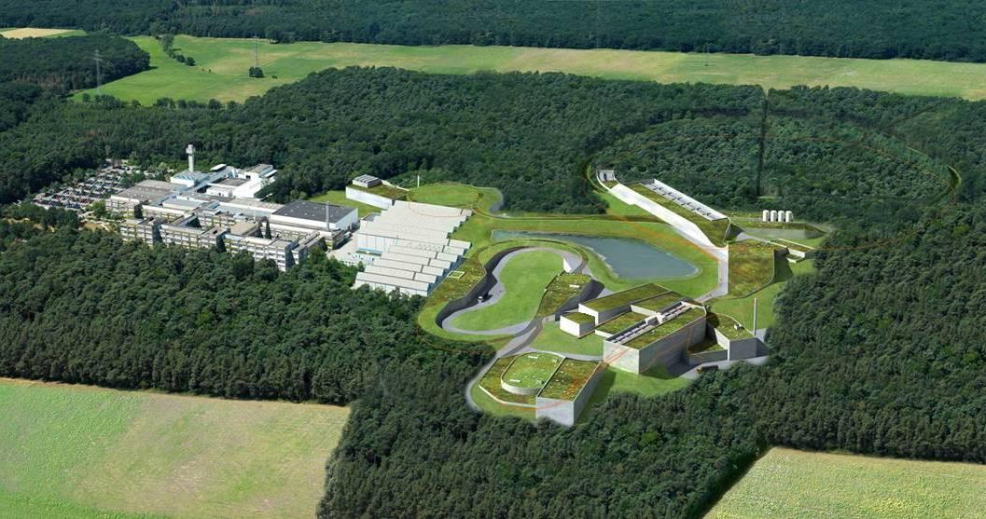
FAIR
The use of novel laser sources at the HESR storage ring will allow to address new and exciting physics
Seeded X-ray lasers combine high brilliance and narrow bandwidth
Highly-charged ion represent an attractive test ground for high field physics in bound states and allow also to study the effect of the external field exerted in collisions with photons and atoms
The large Doppler boost dramatically extends the range of photon energy and pulse power of present and evolving laser sources
The single-particle detection capability enables experiments even at small cross-sections
C

