Slide 1

Laser driven shock waves and equation of state of matter
I.V.Lomonosov
IPCP RAS, Chernogolovka, Moscow reg., RUSSIAловка
EOS definition, examples
Motivation
Extreme states: experiment & theory
Importance of laser-driven shock waves
Shock-wave methods and EOS
Conclusions

Slide 2
EOS definition, examples
EOS - fundamental property of matter, defining its thermodynamic, mechanic,… as functional form f(x,y,z)=0 (V,T,P,…) or tables or graphs.
Shock - wave data compendium: Copper, Cu
R= 8.930 g/cc
2 L. V. Al'tshuler, K. K. Krupnikov, M. I. Brazhnik,
Dynamical compressibility of metals under pressure from 400000 to
4 million atmospheres,
Zh. Eksp. Teor. Fiz. 34, 886-893 (1958) [in Russian]
(Sov. Phys. - JETP 7, 614-618 (1958)).
m U D P V0/V R
1.000 0.940 5.360 44.993 1.213 10.8291
2.290 7.130 145.806 1.473 13.1551
4.190 10.160 380.154 1.702 15.1975
3 L. V. Al'tshuler, S. B. Kormer, A. A. Bakanova, R. F. Trunin,
Equations of state for aluminum, copper and lead in the high
pressure region,
Zh. Eksp. Teor. Fiz. 38, 790-798 (1960) [in Russian]
(Sov. Phys. - JETP 11, 573-579 (1960)).
m U D P V0/V R
1.000 1.820 6.640 107.917 1.378 12.3019
2.710 8.060 195.055 1.507 13.4534
4.430 10.580 418.544 1.720 15.3625
4.140 10.120 374.139 1.692 15.1123
T=const, Birch
«soft» spheres
Mie-Grueneisen

Slide 3
Motivation
Fundamental science
Phenomena at extreme conditions – pulsed, high-energy-density processes
3D, big gradients, sophisticated flow
Numerical modeling is required to treat fulfilled experiments & prognostic goals
EOS governs system of gas dynamic equations and
defines reliability & accuracy of modeling results

Slide 4
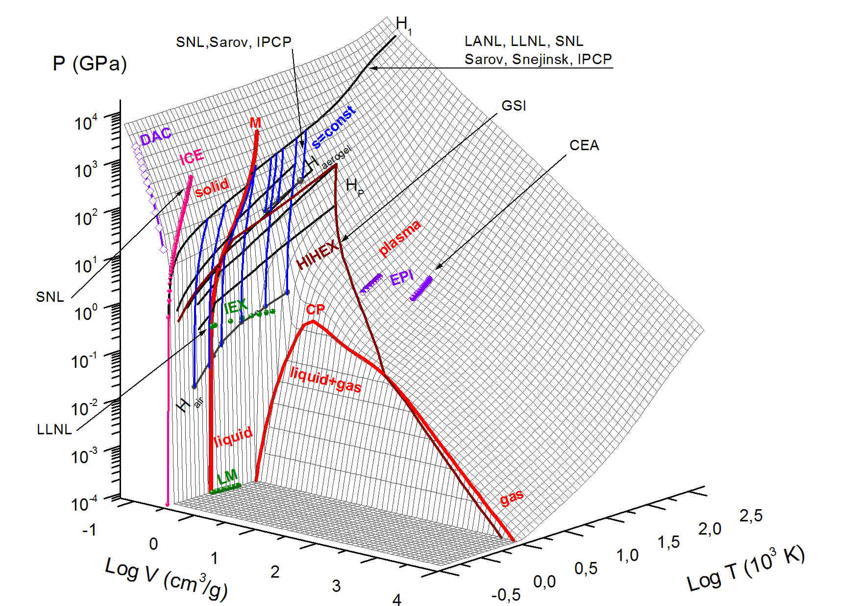
EOS data: Al
S=const: P - U_{P} (P_{S},V_{S},E_{S})
Hugoniots H₁, H_{p}: U_{s}-U_{p} (P,V,E)
DAC:
P(V,T=const)
EPI: P, E (V=const)
HIHEX: P, E, T (t)
SIS18 & SYS100
ICE: P(V,S=const)
IEX: E,V,T,H,
Cs (P=const)

Slide 5
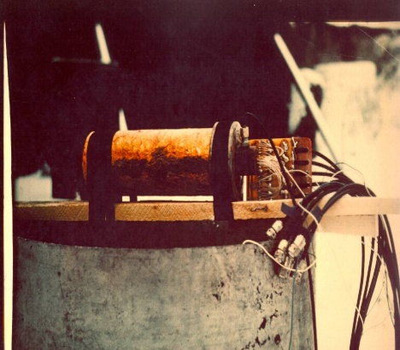
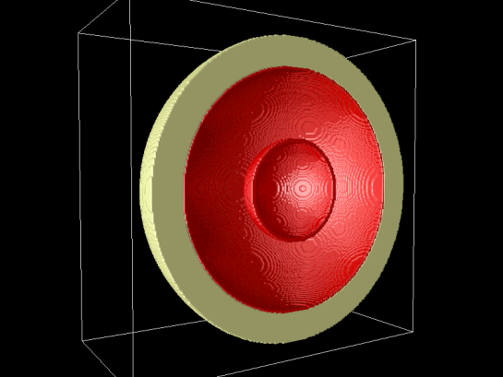
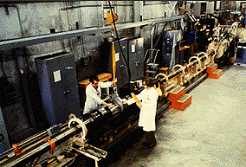
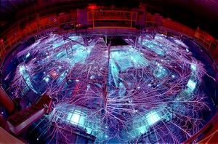
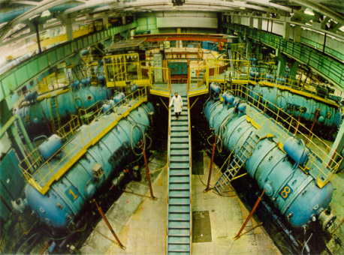
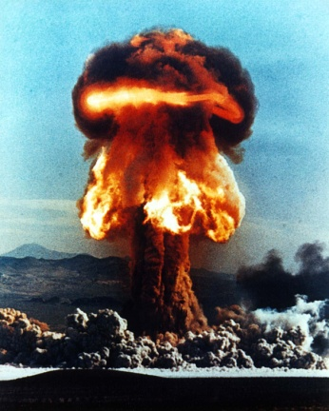
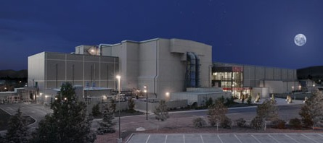
Shock-Wave Generators
High explosives
& guns
plain gun, 8 km/s
sphere, 14 km/s (Fe)
light gas gun, 8 km/s
Z, Sandia
Angara-5
Pulsed power
railgun, 10 km/s
20 МА, 40 km/s (Al),
300 TW x-ray
6 МА, 12 km/s, 5 TW
Nuclear
4 Gbar
1000 km/s
NIF, Livermore
21 kJ (10 кJ@350 nm)х192 lasers = 4 MJ (500 TW)

Slide 6

Shock & release waves
Hugoniot relations:
Riemann invariants:
shock compression
shock compression
adiabatic expansion
U, P, E, V
D
U, P_{H}, E_{H}, V_{H}
U_{S}, P_{S}, E_{S}, V_{S}
P₀, E₀, V₀
t ~ 10⁻⁶
- 10⁻⁹ s

Slide 7
Laser driven shock-wave data
,
Laser | Reference
ASHURA (KrF, 249 nm, 30 ns, 0.66 kJ) acceleration of Al foil to 15 km/s, Al-Al impact pressure to 0.3 TPa | T. Kadonoa et al J. App. Phys., 88(5), 2943-2947 (2000)
ASTERIX (I, 440 nm, FWHM 450 ps, 250 J) pressures of 2-10 TPa in Au | D. Batani et al Phys. Rev. B., 61(14), 9287-9284 (2000)
CAT (Nd:YAG, 1060 nm, FWHM 200 ps, 2 J) pressure of 1.4 TPa in Au | H. C. Pant et al. J. Phys.: Condens. Matter, 14, 10787–10791 (2002)
PHEBUS (Nd, 526 nm, rectangular, 4 ns, 0.6-2.5 kJ) pressures of 1-4.5 TPa in Fe | D. Batani et al. Equation of State Data for Iron at Pressures beyond 10 Mbar. Phys. Rev. Lett., 88(23), 235502 (2002)
Shenguang-II (Nd, 525 nm, trapeze, 1 ns, 350 J) pressure of 2.2 TPa in Cu | Sizu Fu, et al. J. Appl. Phys., 101, 043517 (2007)
.
PHELIX: up to 5 TPa shock pressure in Cu, Fe

Slide 8
Extreme states: PHELIX
Table refers to shock pressures, corresponding to evaporation in the release isentrope at 1 bar (P₁), passing of the release isentrope through the critical point (P₂) and complete evaporation in the release isentrope at 1 bar (P₃).
Metal | P₁, GPa | P₂, GPa | P₃, GPa | Metal | P₁, GPa | P₂, GPa | P₃, GPa
Lithium Berillium Sodium Magnesium Aluminum Potassium Vanadium Chromium Iron Cobalt Nickel Copper Zinc Zirconium | 36.9 374 17.3 67.9 211 8.9 322 347 354 486 489 317 111 188 | 125 1720 57.2 205 546 28.9 1072 1140 1500 2115 1884 966 397 744 | 808 9260 413 964 2363 86.9 4270 5576 5548 7140 5880 3232 1847 1804 | Niobium Molybdenum Silver Cadmium Tin Hafnium Tantalum Tungsten Rhenium Iridium Platinum Gold Lead Bismuth | 408 476 246 76 138 255 452 627 658 597 546 316 87.3 47.7 | 2136 1512 902 329 512 990 1688 2147 2030 1948 1680 815 262 189 | 4000 5252 2748 1278 1280 2112 3784 10280 4680 4444 4242 2516 569 610
Shock melting and evaporating are accessible for all elements with PHELIX

Slide 9
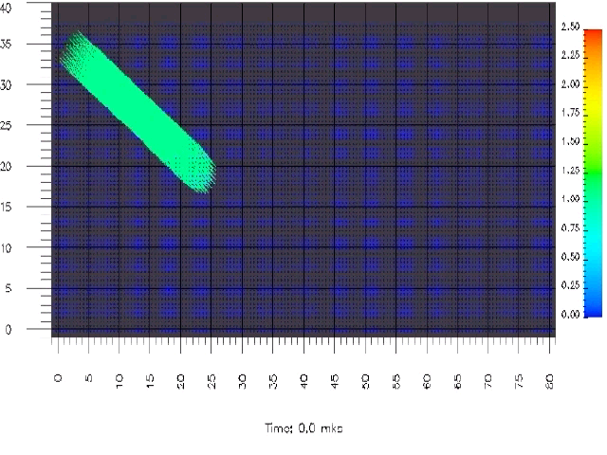
Importance of high-pressure melting: rod impact
hydrodynamic approach with elastic-plastic

Slide 10
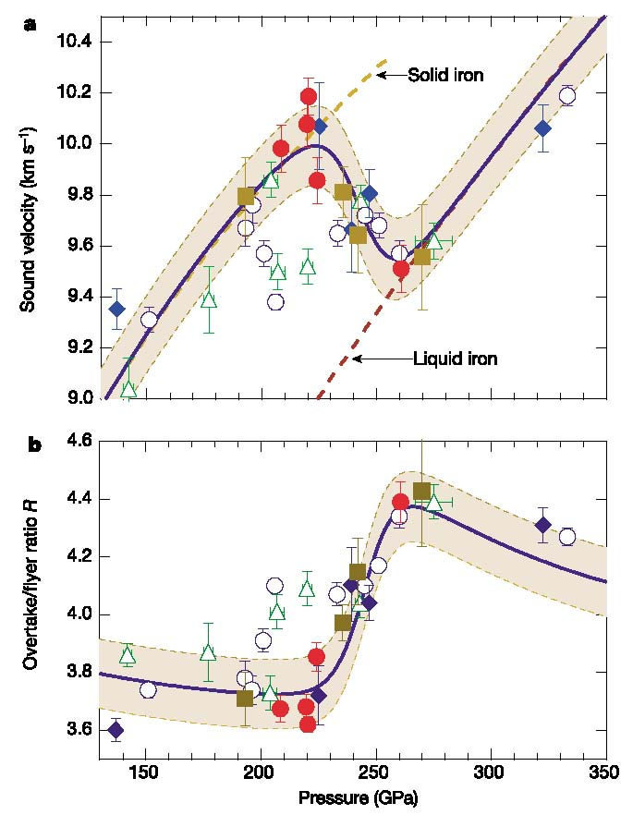
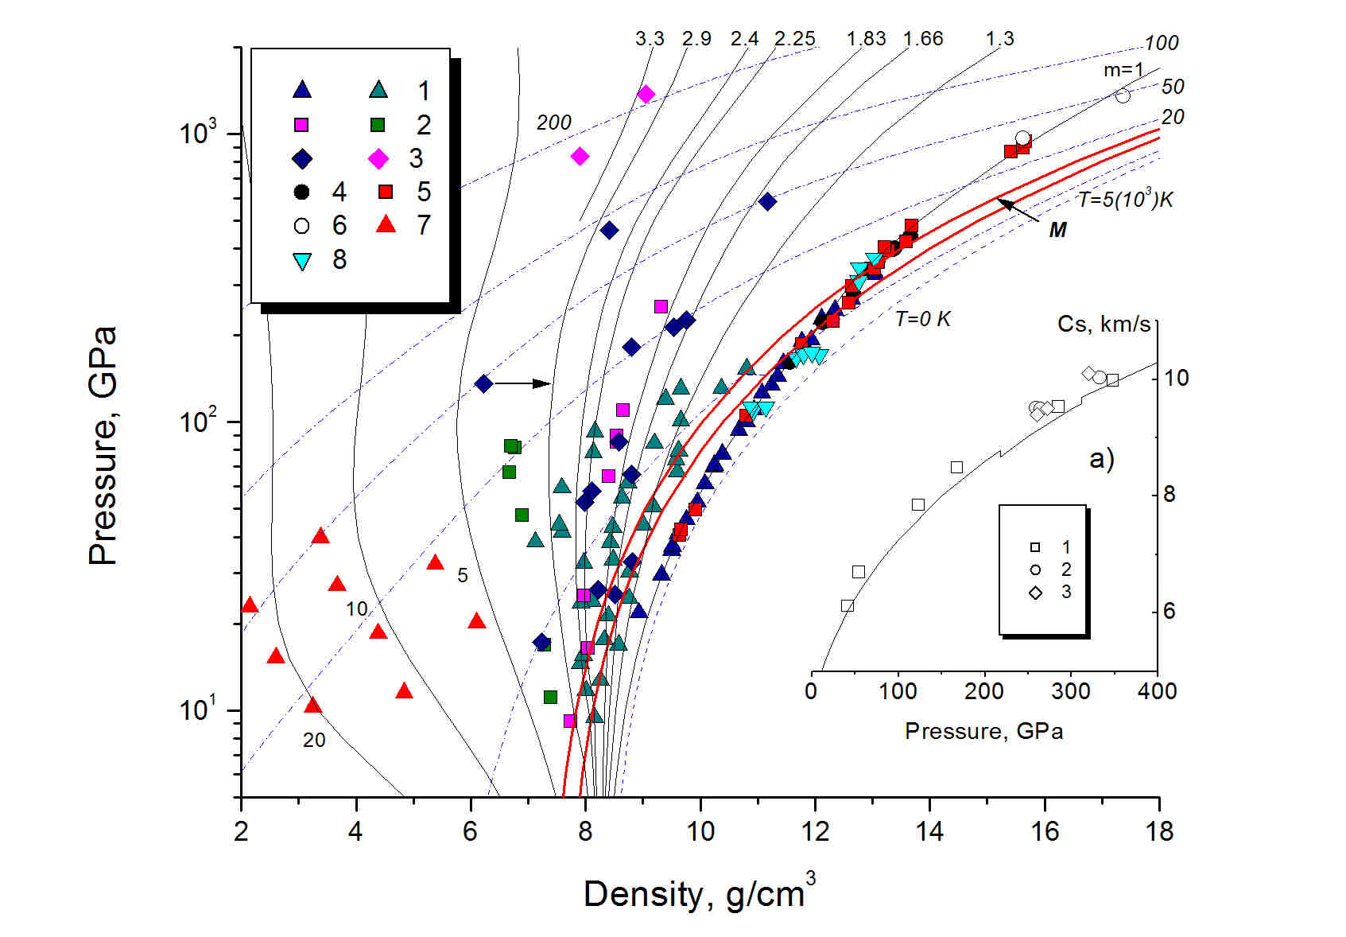
High-pressure melting: indirect method
Cs=Cs(P) by release overtaken technique – indication of phase transitions
Aluminum high-pressure diagram by
I.V.Lomonosov, LPB, 25, 567-584 (2007)
Diagnostic tools: x(t), P(t) (sapphire?)
Melting of iron according to
J. H. Nguen and N.C. Holmes, Nature, 427, 339-342 (2004)

Slide 11
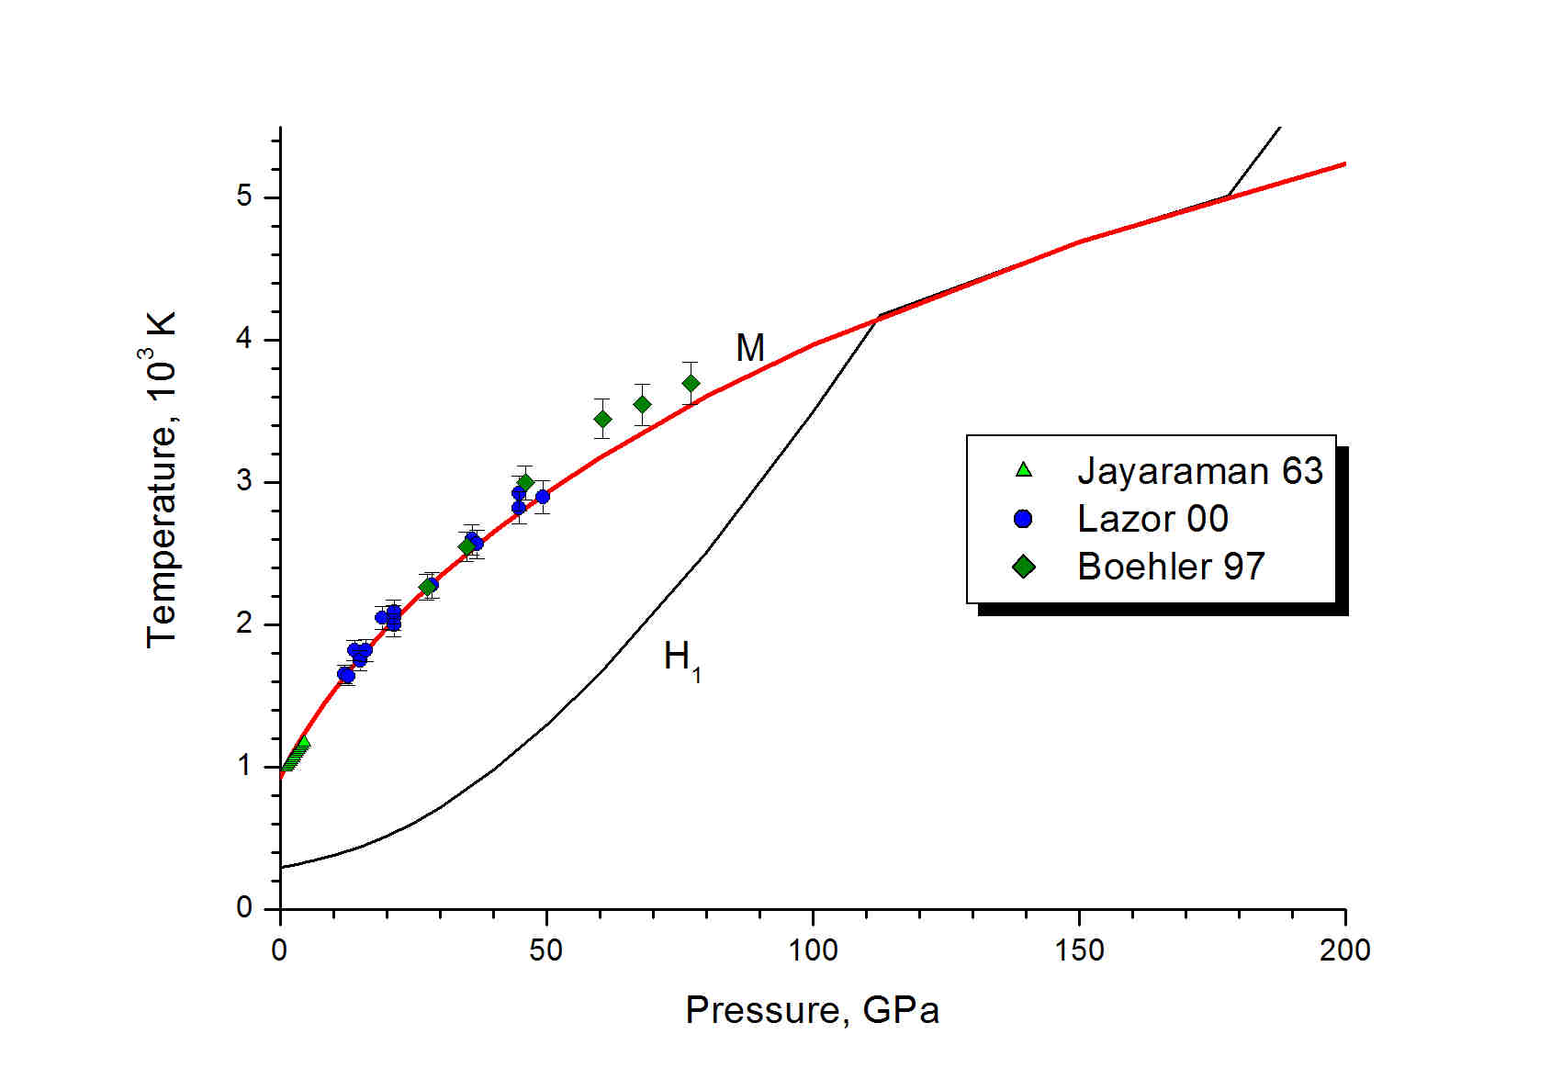
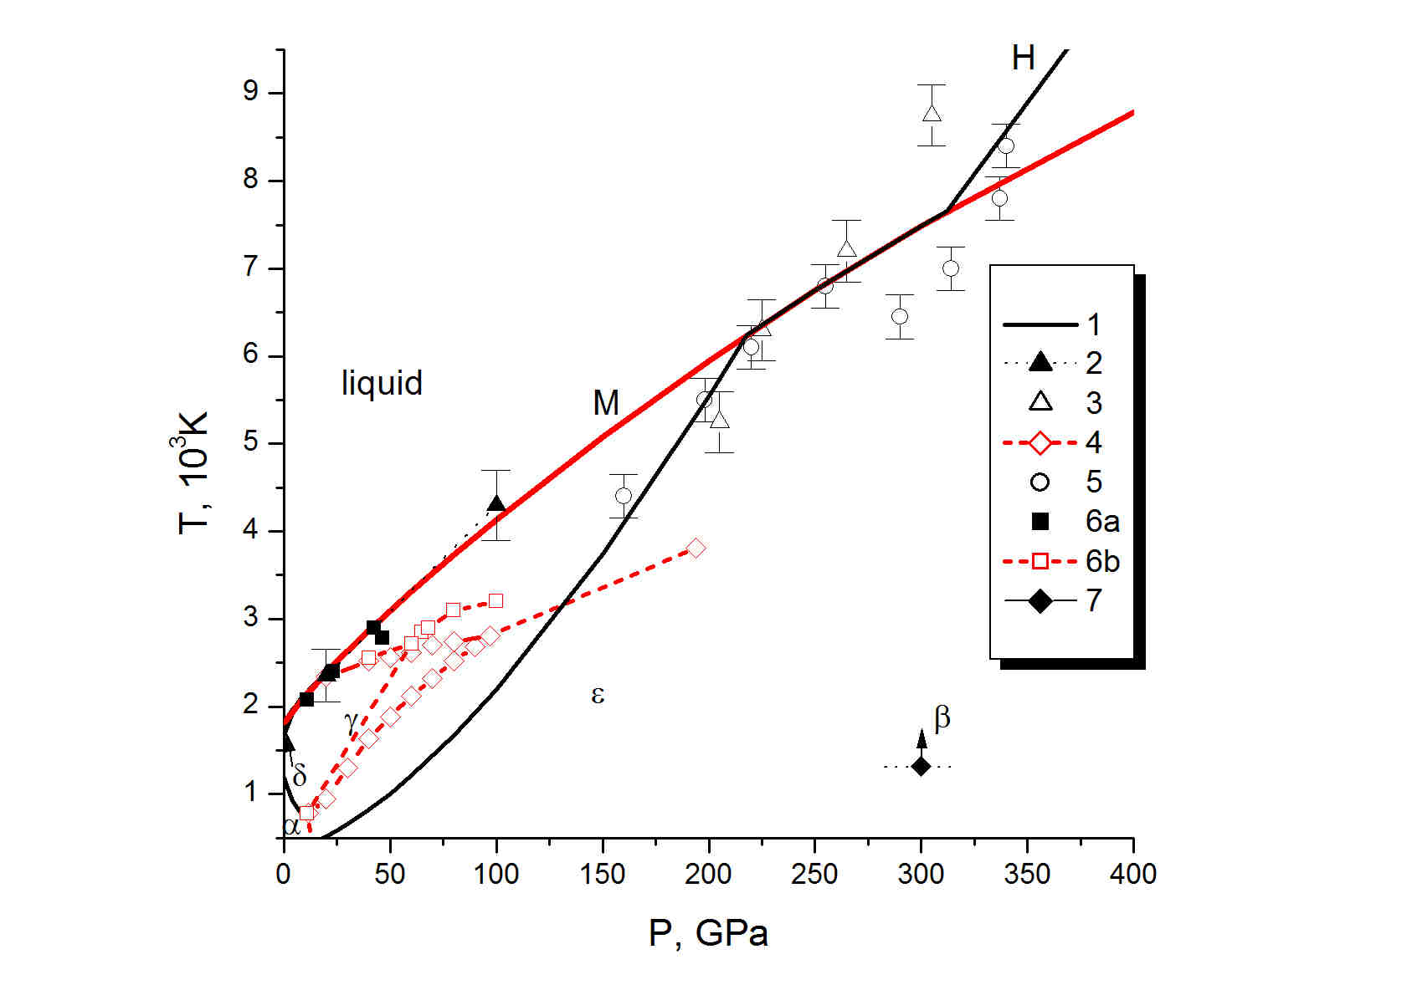
High-pressure melting: direct method and problems
~ 1800 K discreapancy
Melting of Al: I.V.Lomonosov, LPB, 25, 567-584 (2007)
Melting of Fe: Fortov VE and Lomonosov IV. TOPPJ 3, 122-130 (2010)

Slide 12
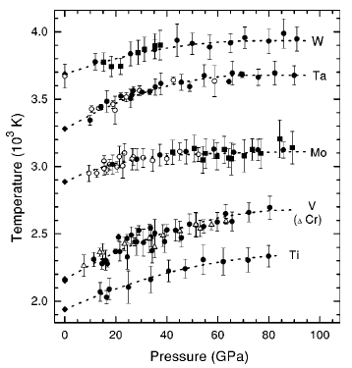
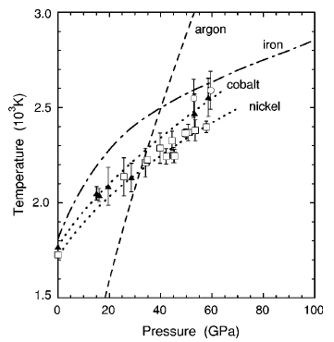
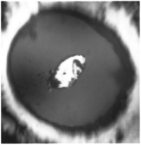
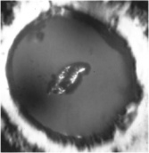
Melting in LDAC
~ order of magnitude dicreapancy
Co&Ni
Lindemann criterion
Arbitrary spectrum
Errandonea et al., PRB, 63, 132104 (2001)

Slide 13
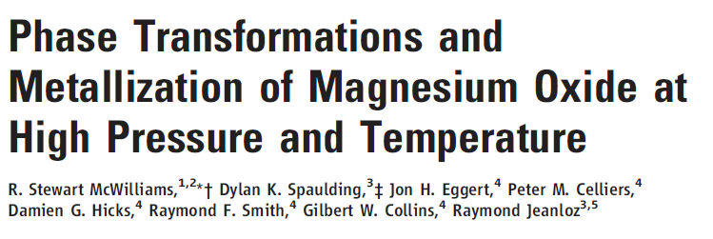

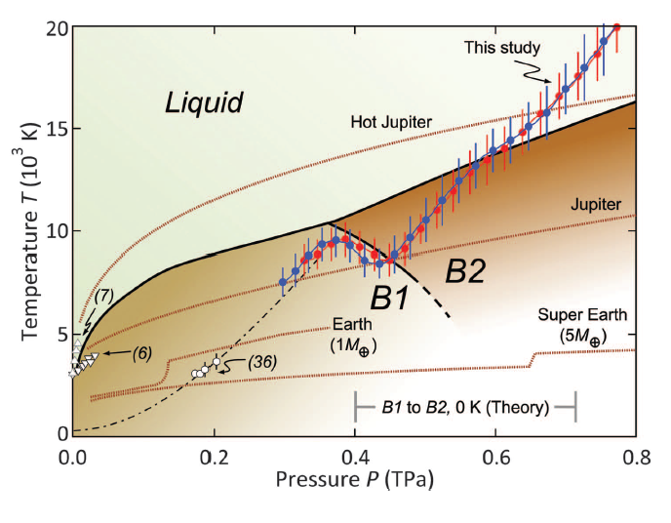
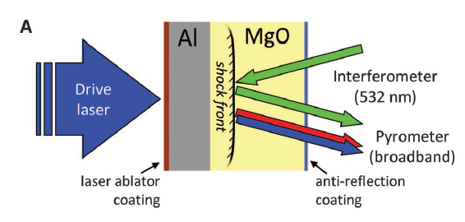
Laser-driven structural phase transitions
Required diagnostic tools:
VISAR & pyrometer
Laser-driven shock melting: no chemical reactions

Slide 14
Importance of evaporating: Pb ball on plate impact
debris cloud
Pb impactor, 1.5 cm
mass 20 g
W=6.6 km/s
Pb plate, 0.63 cm
Liquornik, D.J. (1986), Results by G.W.Pomykal. Digitized data for Delco test 4007, lead-on-lead. Lawrence Livermore Laboratory Report DDV-86-0010

Slide 15
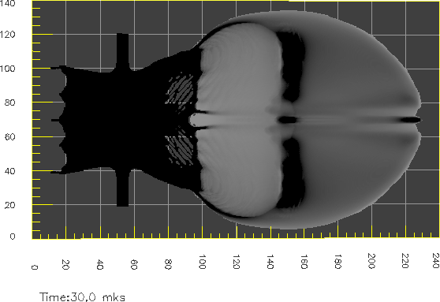
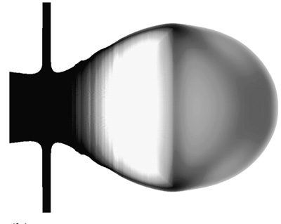
Integrated density
Experimental x-ray diagram
Caloric EOS
Multi-phase EOS
V. E. Fortov, V. V. Kim, I. V. Lomonosov, A. V. Matveichev, A. V. Ostrik. Numerical modeling of hypervelocity impacts, Intern J Impact Engineering, 33, 244-253 (2006)

Slide 16
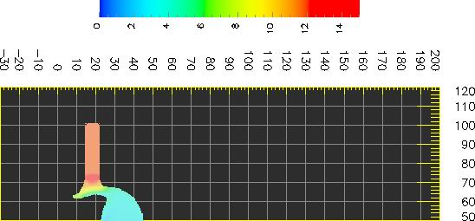
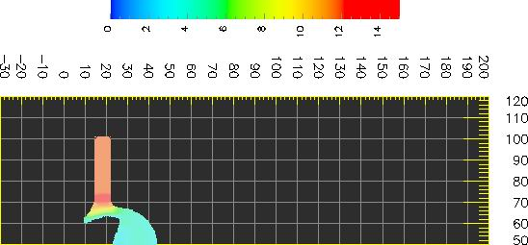
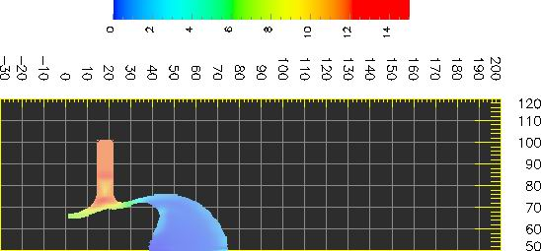
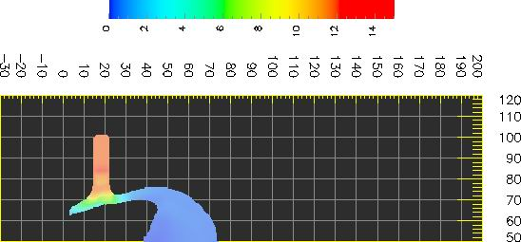
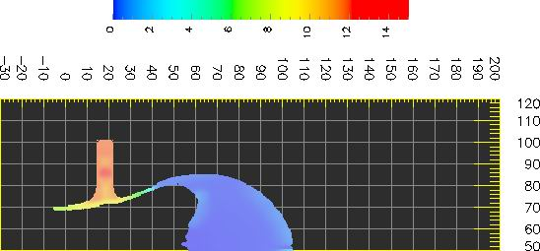
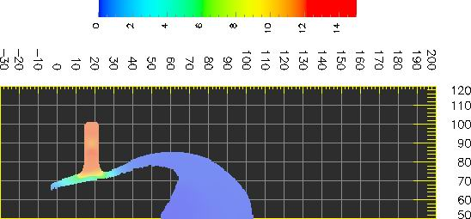
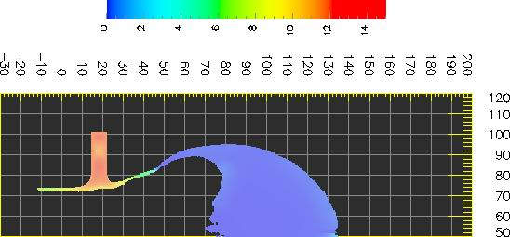
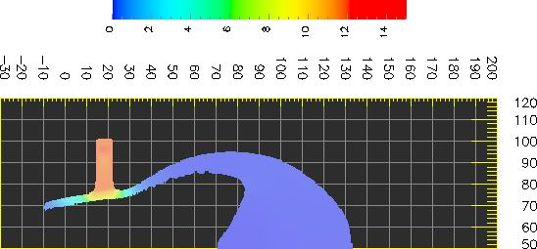
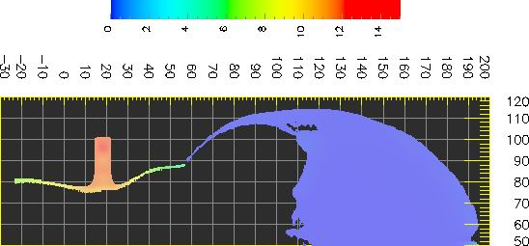
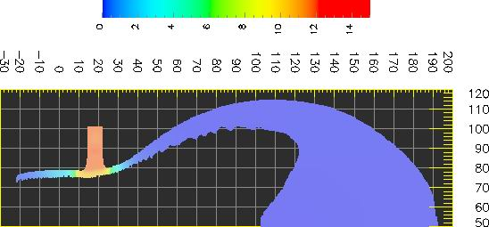
Density distribution
5 mks
5 m
10 mks
Caloric EOS
15 mks
Multi-phase EOS
20 mks
30 mks

Slide 17
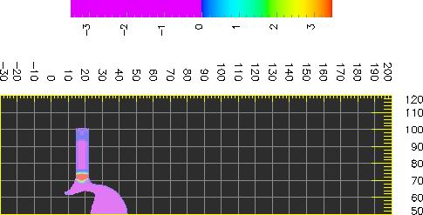
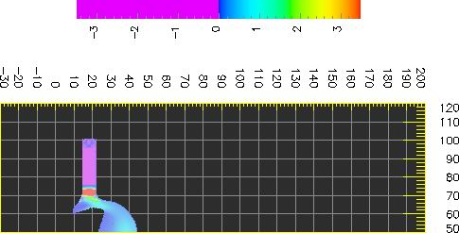
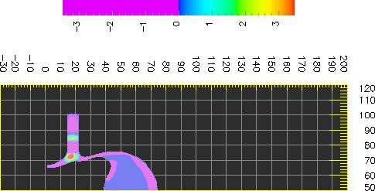

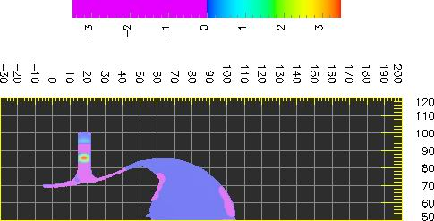
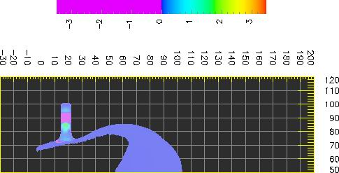
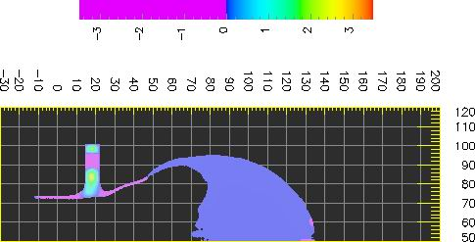
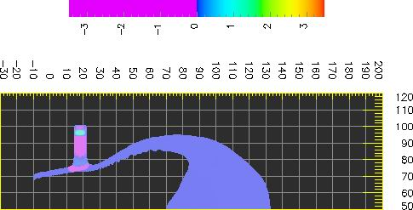
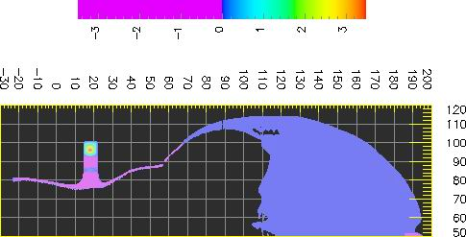
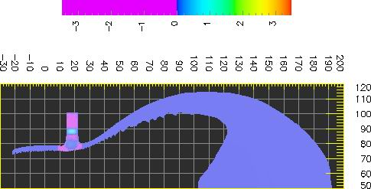
Pressure distribution
5 mks
10 mks
Caloric EOS
15 mks
Multi-phase EOS
20 mks
30 mks

Slide 18
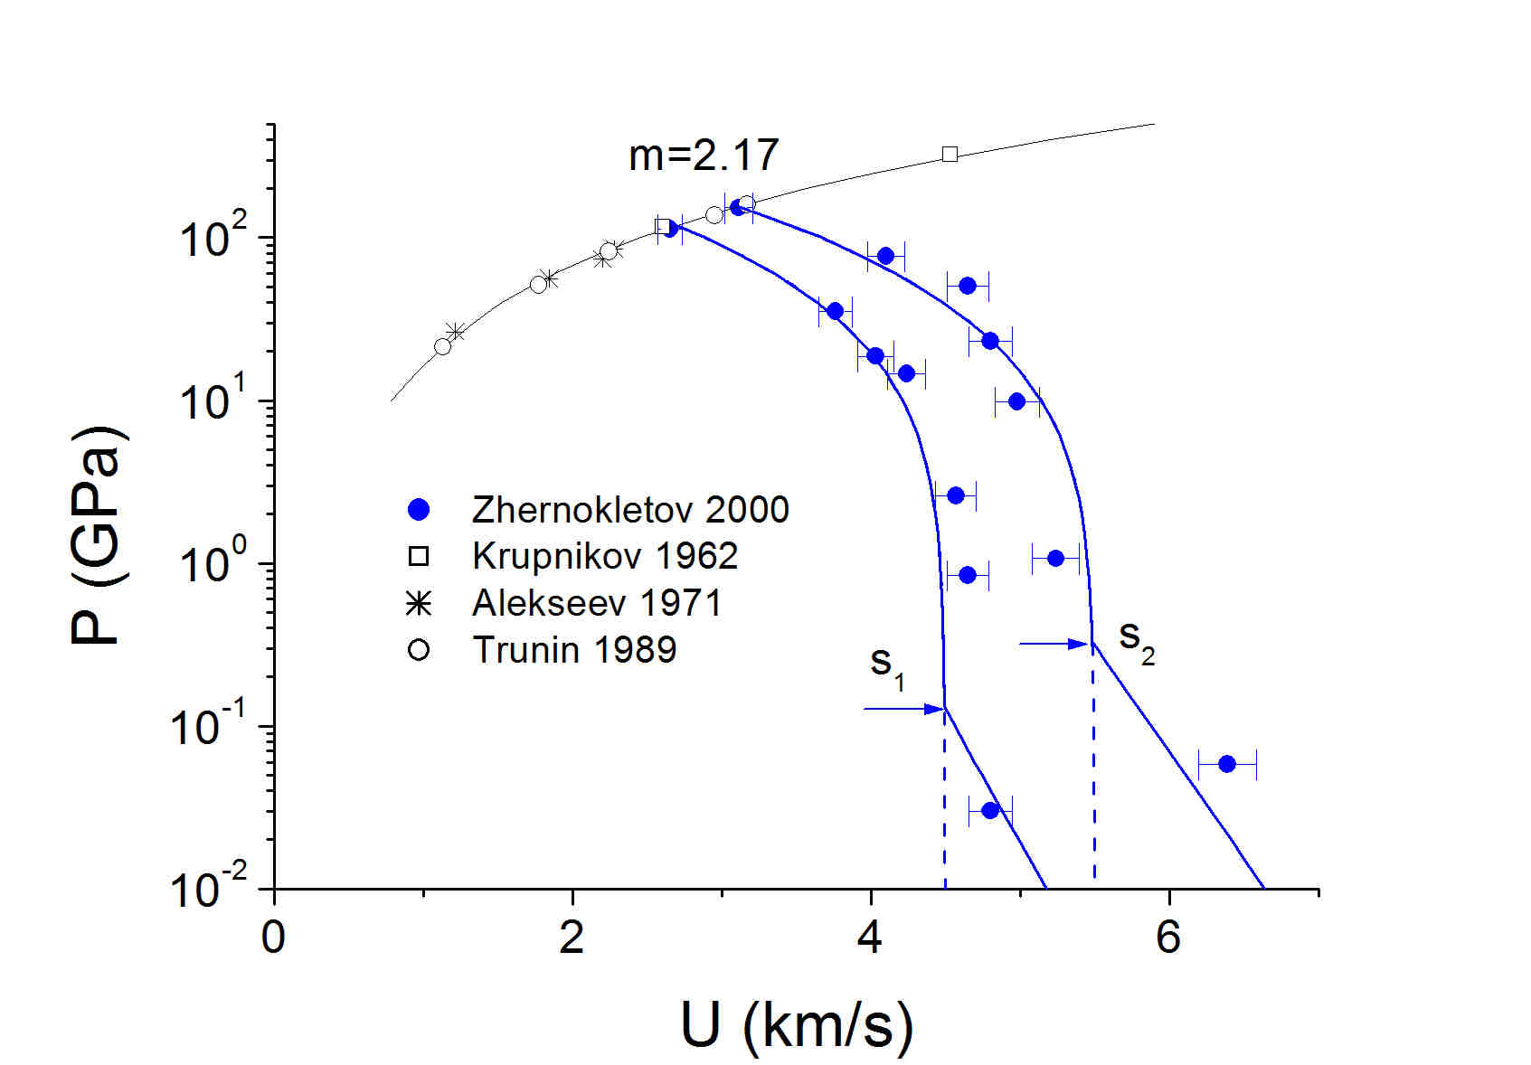
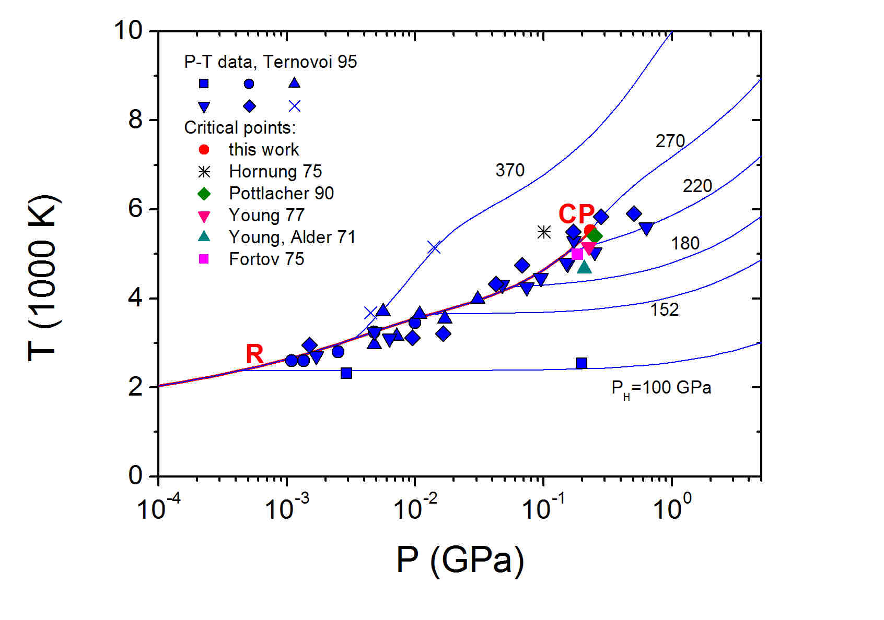
Shock evaporating: direct & indirect methods
Direct P – T data Indirect P=P(U) measurements
Evaporating of Pb: Fortov VE and Lomonosov IV. Pure& Appl. Chem., 69(4), 893-904 (1997)
Evaporating of W: Fortov VE and Lomonosov IV. TOPPJ 3, 122-130 (2010)

Slide 19
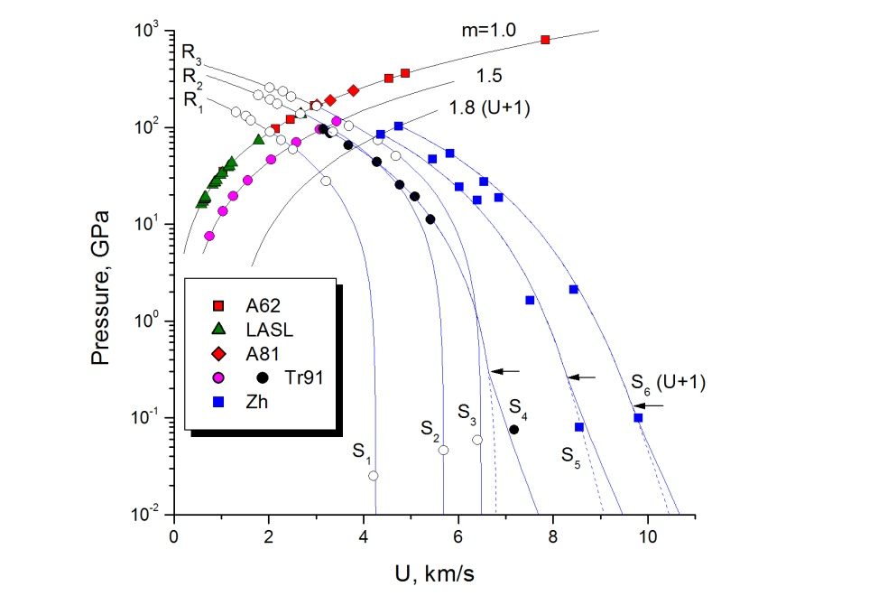
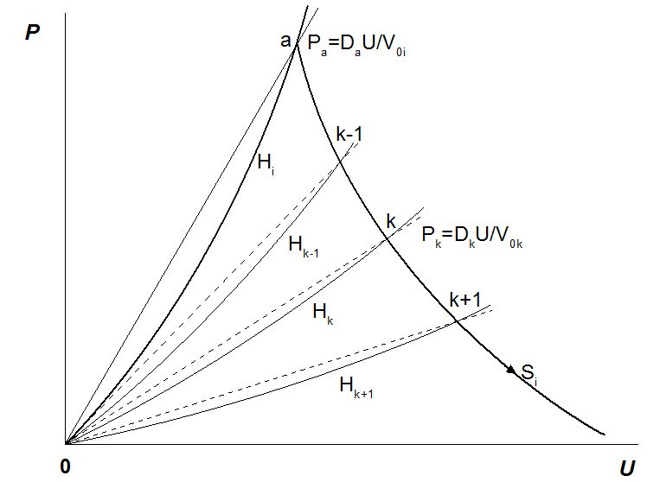
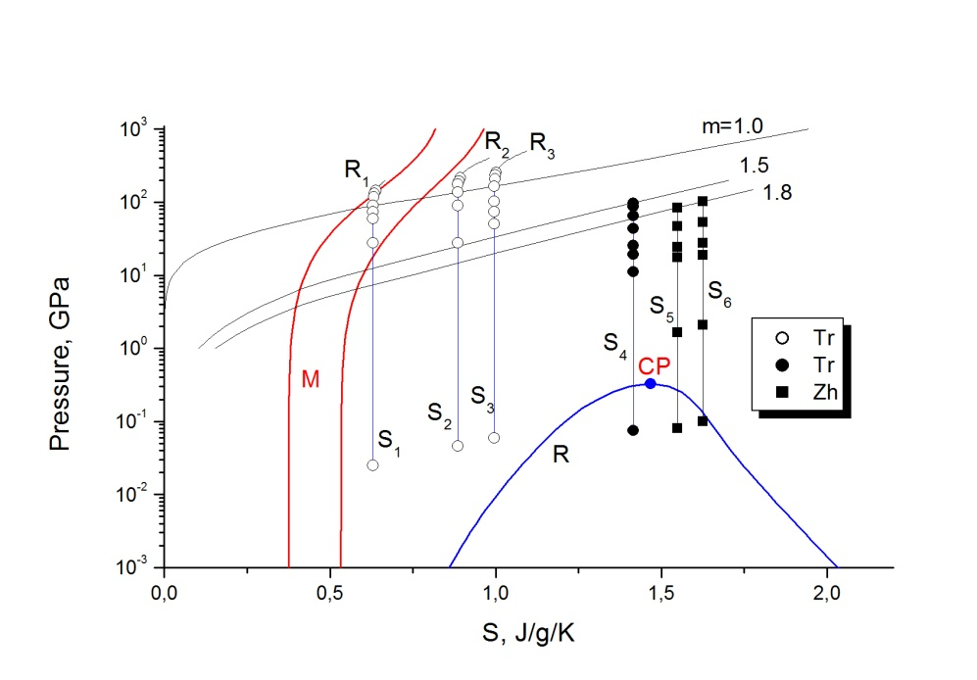
Shock evaporating: indirect method 1
Evaporating of Zn
Typical experiment on determination release isentrope
(fixed shock pressure)
Khishchenko K.V., Zhernokletov M.V., Fortov V.E., Kirshanov S.I., Kovalev A.E., Lomonosov I.V., Mochalov M.F. and Shuikin A.N. Isentropic expansion of shock-compressed zinc at high pressures and temperatures. High Temperatures-High Pressures, 37(4), 291-298 (2008).

Slide 20
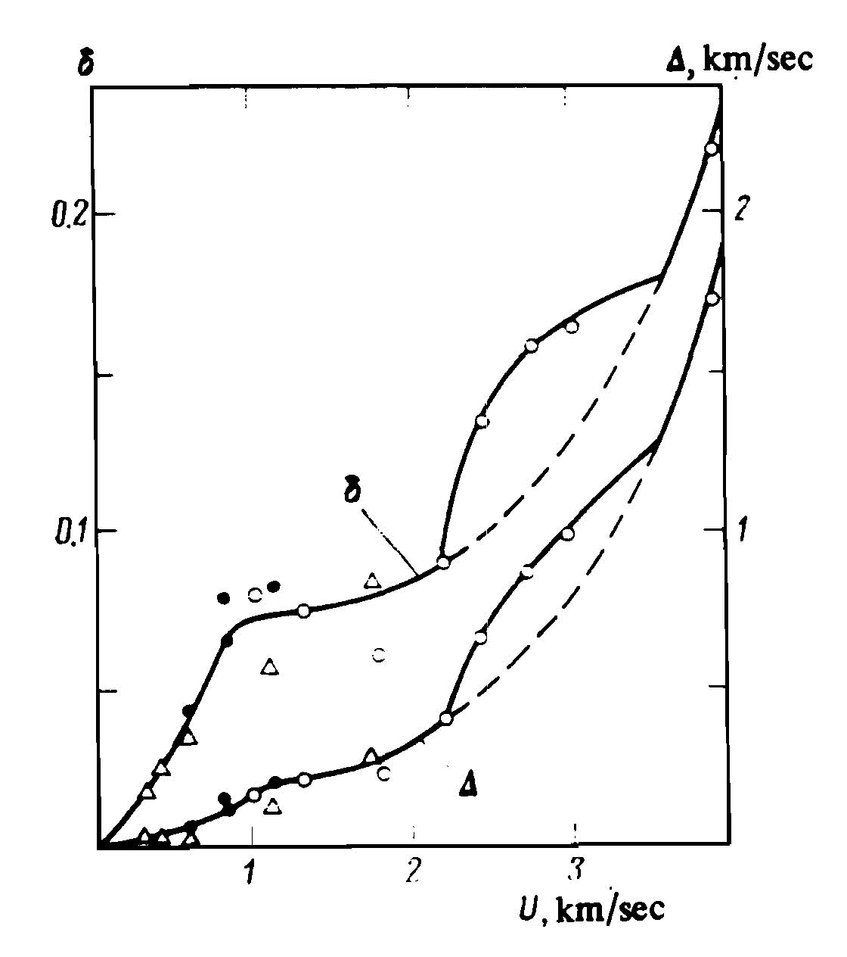
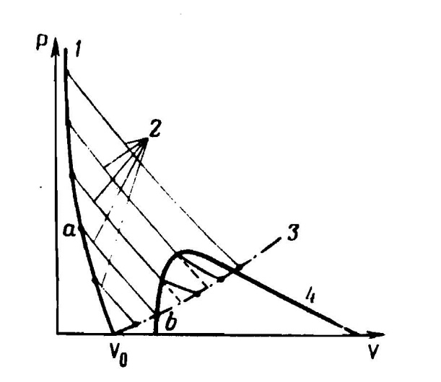
Shock evaporation of Pb according to L.V.Altshuler (Sov. Phys. - JETP 46(5), 980-983 (1977))
Shock evaporating: indirect method 2
Expansion into media (gas) from different
shock pressure
1-shock adiabat, 2-release isentropes (the metastable isentropes are shown dashed), 3-final-state curve in the case of release in air, 4-boundary of liquid-vapor two-phase region
Isentropic expansion of metals into air: no evaporating
Deviation from the doubling law in isentropic expansion of lead in air. Equilibrium and metastable (dashed) expansion at P_{air} = 1 bar (Δ= W - 2U, δ = Δ/2U); points – experimental data
Required tools: P, U, T

Slide 21
Conclusions
new EOS data at extreme conditions are required
FAIR facilities – intense ion and laser beams can access HED states
melting & evaporating are accessible for most elements with use of laser-driven shock waves
PHELIX laser-driven shock waves:
# melting & structural phase transitions
# evaporating
# required diagnostic tools: VISAR, pyrometer (spectrometer)
ion-beams applications: stopping in shocked matter

