Slide 1

Laser generated γ-ray source optimisation for penetrating imaging applications
Lucy Wilson
Central Laser Facility
Rutherford Appleton Laboratories
Didcot, UK
(lucy.wilson@stfc.ac.uk)
EMMI Workshop, GSI Darmstadt, Germany
2/10/2013

Slide 2
Acknowledgements
Data presented is from experiments undertaken in collaboration with Robert Deas and DSTL.
We would also like to thank all those involved with the experiments which also involved groups at Imperial college, Strathclyde and Queens university Belfast.
We acknowledge funding from SFTC Innovations and DSTL

Slide 3
Contents
Introduction to laser produced γ-ray imaging.
  Production mechanisms
Modelling using radiation transport code FLUKA
  Target thickness and material
  Refluxing
  Laser intensity
Overview of experiment on Vulcan
  Gamma ray images
  Gamma ray spectroscopy

Slide 4
Introduction
Laser interactions with gas or solid targets are capable of generating beams of high energy (100’s of MeV ) electrons.
  Acceleration by J X B, Brunel heating, wakefield acceleration etc.
These produce γ-rays via bremsstrahlung as they slow down in a high Z target.
Direction of γ-ray beam depends on acceleration mechanism and therefore scale-length.
  Short scale length towards target normal
  Longer scale length towards laser axis
  Very long scale length varies randomly due to filamentation and instabilities
prepulse
No prepulse
(See: Courtois et al. 2009, Santala 2000)

Slide 5
γ- ray production in a solid target
γ
γ
e⁻
e⁻
e⁻
γ
e⁻
γ
γ
Laser
e⁻
e⁻
γ
γ
γ
Laser interaction with target produces electron beam
Electrons produce Bremsstrahlung γ-rays
Electrons continue to reflux in target

Slide 6
Applications of laser produced γ-ray sources
γ-rays can be used to induce photo-fission, cause (γ,n) reactions and pair production.
  Detection of nuclear material by inducing and detecting photo-fission.
  Source of positrons from pair-production in high Z targets.
  Increase in applications as laser technology such as repetition rates, energies and efficiencies increase.
Penetrative imaging using MeV γ-ray sources…

Slide 7
Laser produced γ-ray Imaging
10s of MeV γ-rays can penetrate high density materials
Highly directional and tuneable.
Ultrashort <2ps timescale pulses gives high temporal resolution – gives an “instantaneous” snapshot.
Small source size (<0.1mm) gives high spatial resolution images.

Slide 8

FLUKA is a MonteCarlo simulation code for calculations of particle transport and interaction with matter.
Developed by INFN, CERN and SLAC
Models electron interaction from 30KeV – 1000s of TeV and Photons from 1KeV to 1000s of TeV.
Can be used to model gamma ray production from an electron with a quasi – refluxing model.
Assumes electron distribution is target independent, and that laser interacts with small region at front surface only.
Fluka simulations courtesy of F. Fiorini.
CLF annual report 2010-2011

Slide 9
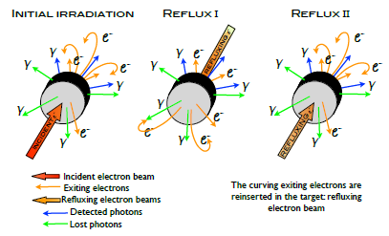
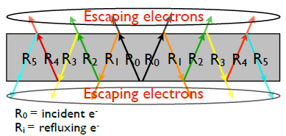
Fluka Simulations
Refluxing: force 90% of electrons leaving target to re-enter target until number of exciting electrons is zero.
Electrons re-enter target at the same point as they escape with their direction inverted.
Spectra from each reflux process is saved and summed at the end.
“Fluka simulations of laser irradiated targets: thickness study for production of X-ray beams” F. Fiorini et al. CLF annual report 2010- 2011

Slide 10
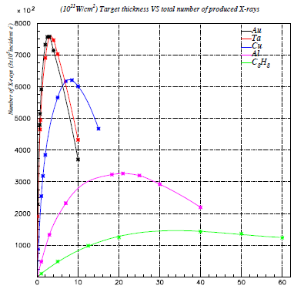
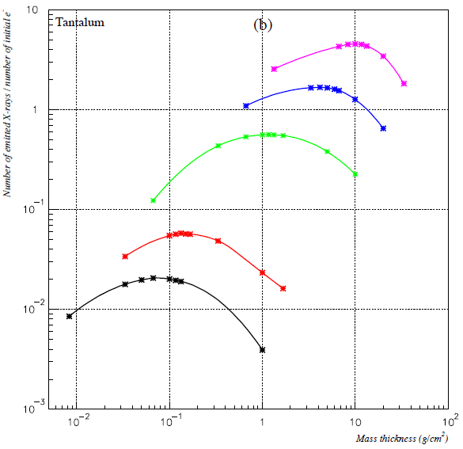
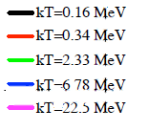
Target thickness and material
Number of X-rays / number of initial electrons
Total number of X-ray photons per 3x10⁵ electrons
Mass Thickness (g/cm²)
Thickness (mm)

Slide 11
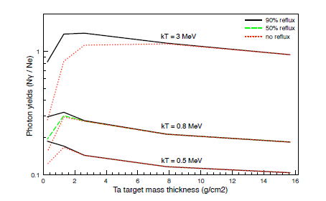
Refluxing
Refluxing increases gamma yield significantly in thinner targets.

Slide 12
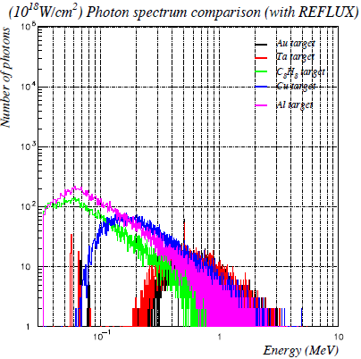
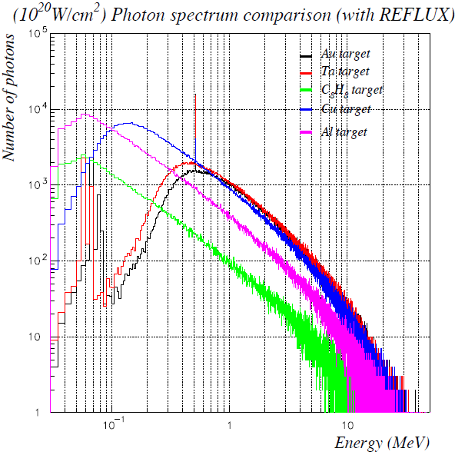
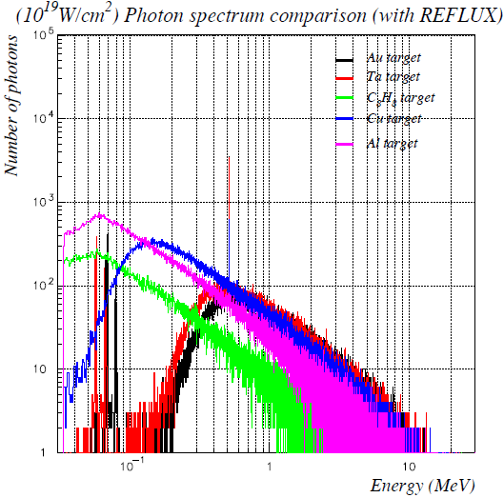
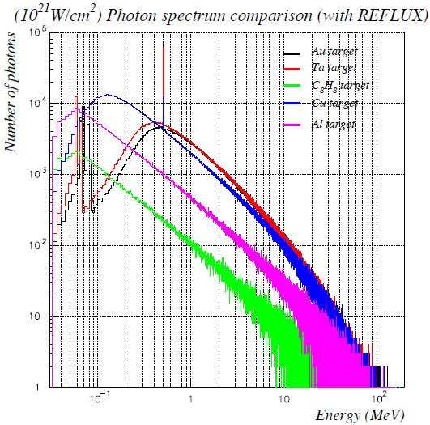
Laser Intensity

Slide 13
Fluka Summary
Higher Z produces greater flux of γ-rays as well as highest energy γ-rays.
Optimum Target thickness varies with energy, thicker targets are required to produce maximum flux with higher energy electrons.
Lower Z materials have thicker optimum targets.
Refluxing increases γ-ray yield in thinner targets.

Slide 14
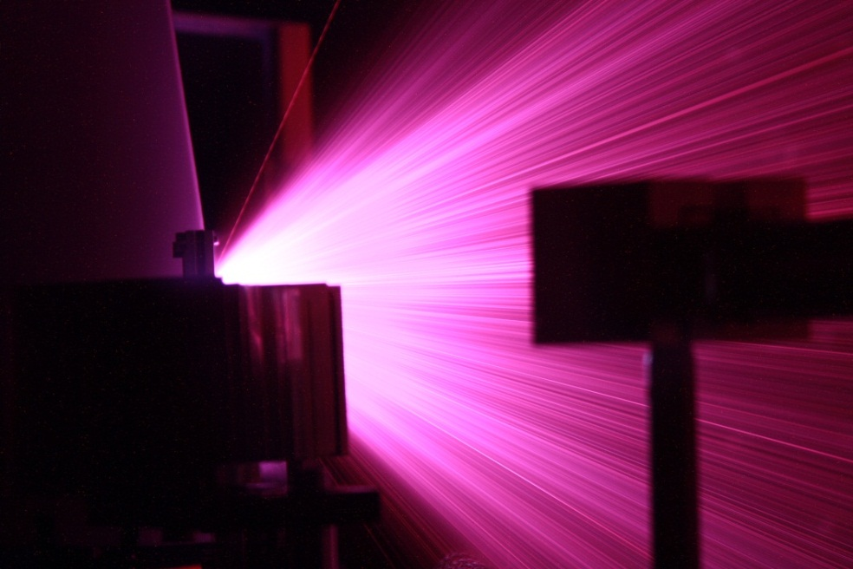
Vulcan Experiment
50J on target
500fs – 1ps pulse length
Intensities varied by defocusing
Targets: Ta, Cu, CH, Al
Thicknesses of target, angle of incidence and prepulse level changed.
Laser
Gamma -rays
Target

Slide 15
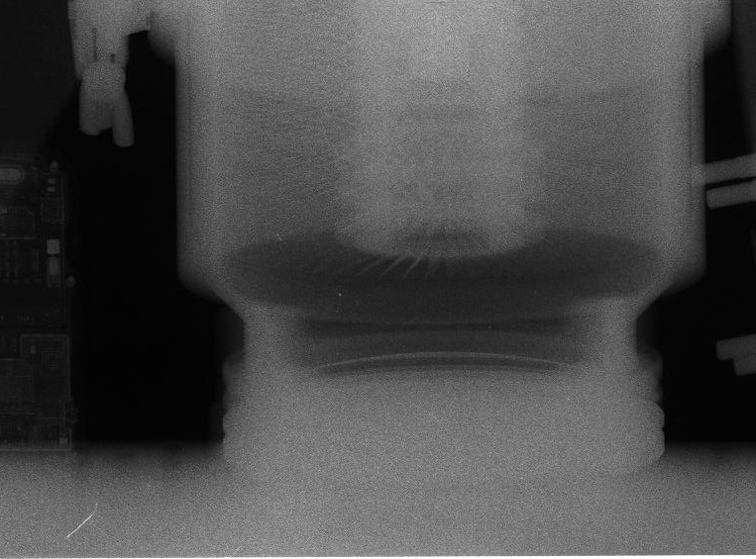
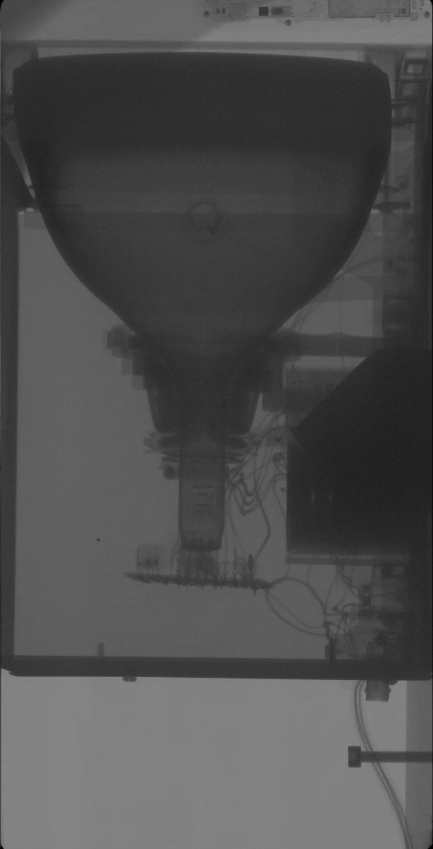

γ-ray Images
Images with defocused laser
Turbo pump in motion
CRT (television)

Slide 16
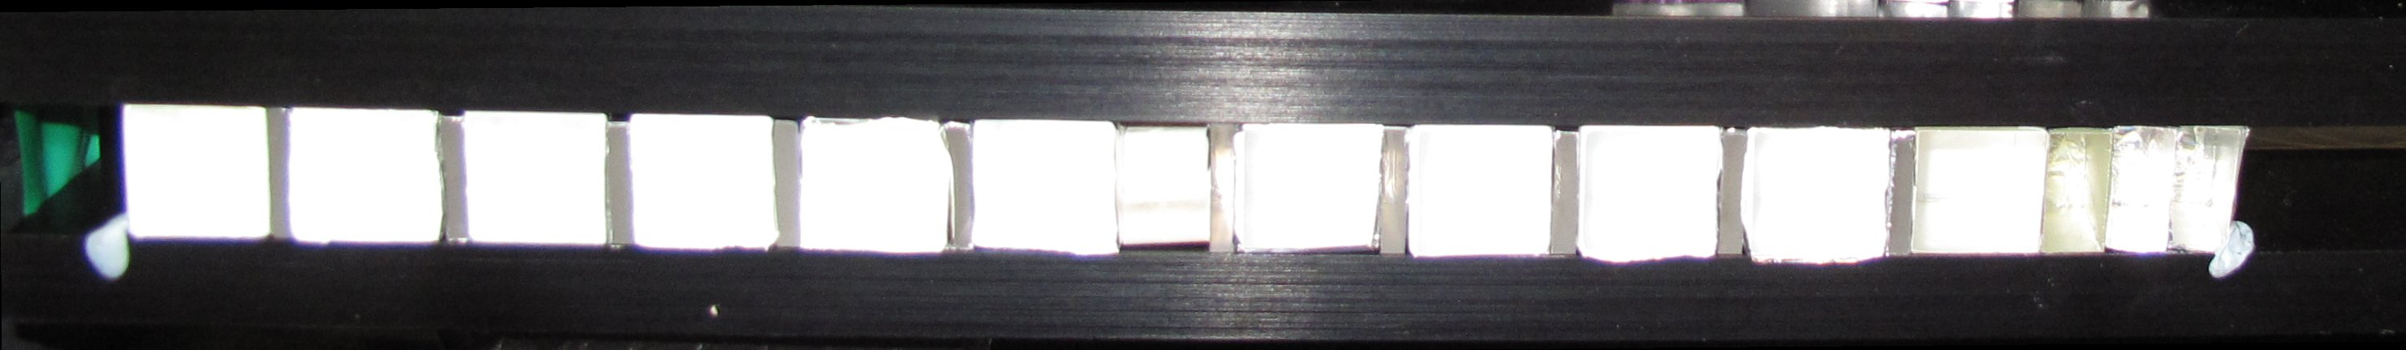
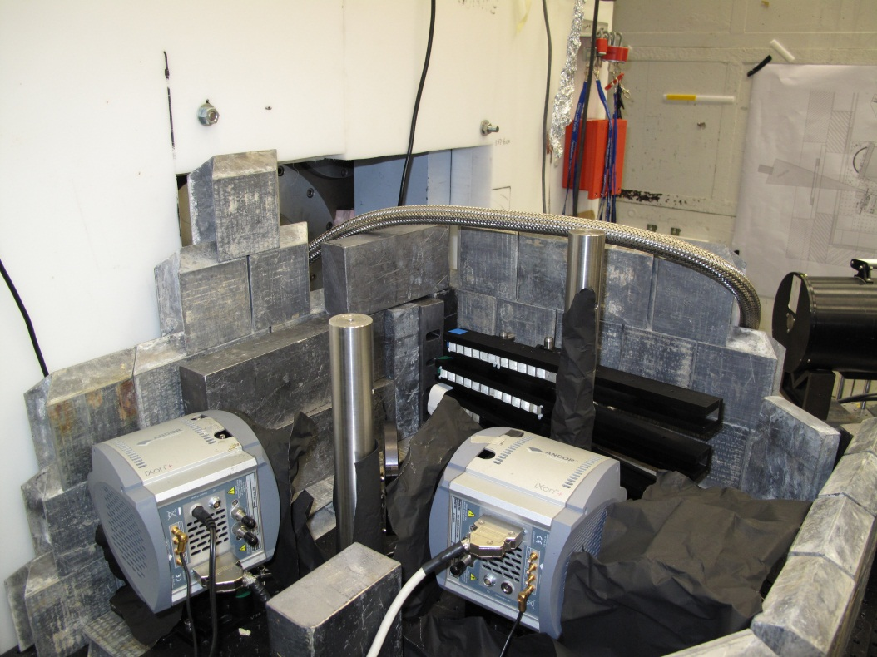
Gamma Ray spectroscopy
Arrangement of scintillator crystals in rail
Set up of the rails and cameras surrounded by lead. Magnets are placed in front to remove electron signal.

Slide 17
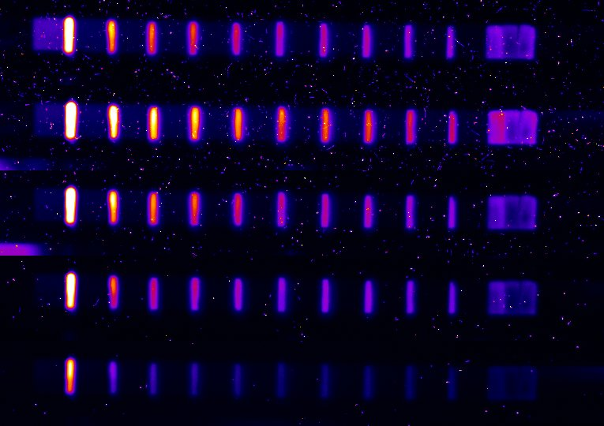
Tantalum (0.1mm) Focus Scan
Target | Defocus (um) | Energy on target (J) | Intensity on Target (W/cm²⁾
Ta | 0 | 48.6 | 1.8E+19
Ta | 100 | 46.5 | 6.8E+17
Ta | 200 | 43.4 | 1.8E+17
Ta | 400 | 47.2 | 4.8E+16
Ta | 600 | 52.5 | 2.4E+16
Grey scale: 396-2313
Data courtesy of Dean Rusby

Slide 18
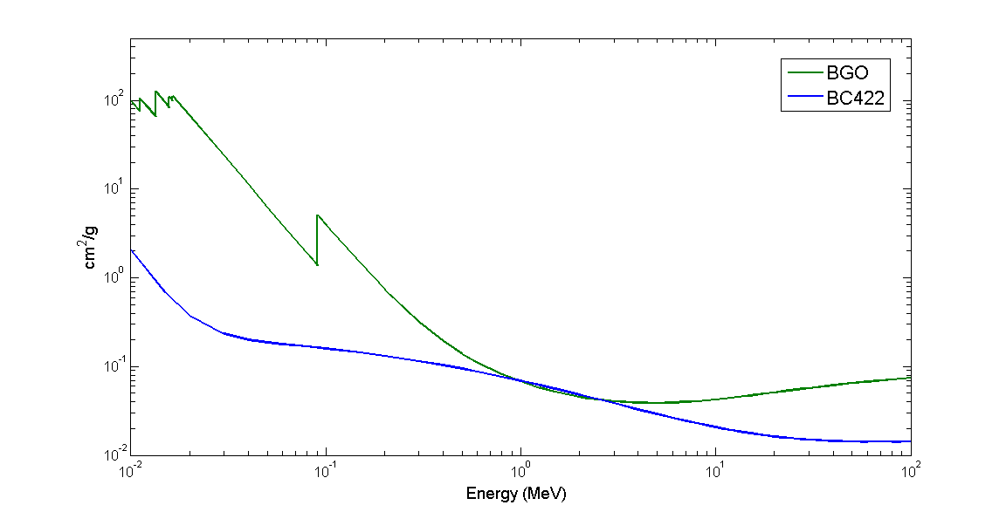
Gamma Ray spectroscopy

Slide 19
Summary
Laser interactions with solid targets are capable of producing beams of short pulse highly penetrating γ-rays.
Refluxing in thin targets is significant. Target thickness, Z and laser intensity are also important.
Defocused laser appears to give best image resolution
Gamma ray spectrometer used – analysis and deconvolution of data is in progress.
Analysis and modelling is on going.

