Slide 1
Longitudinal and Transverse Focusing of
Heavy Ion Beams at GSI/FAIR
Peter Spiller
High Energy Density Physics Workshop
2026

Slide 2
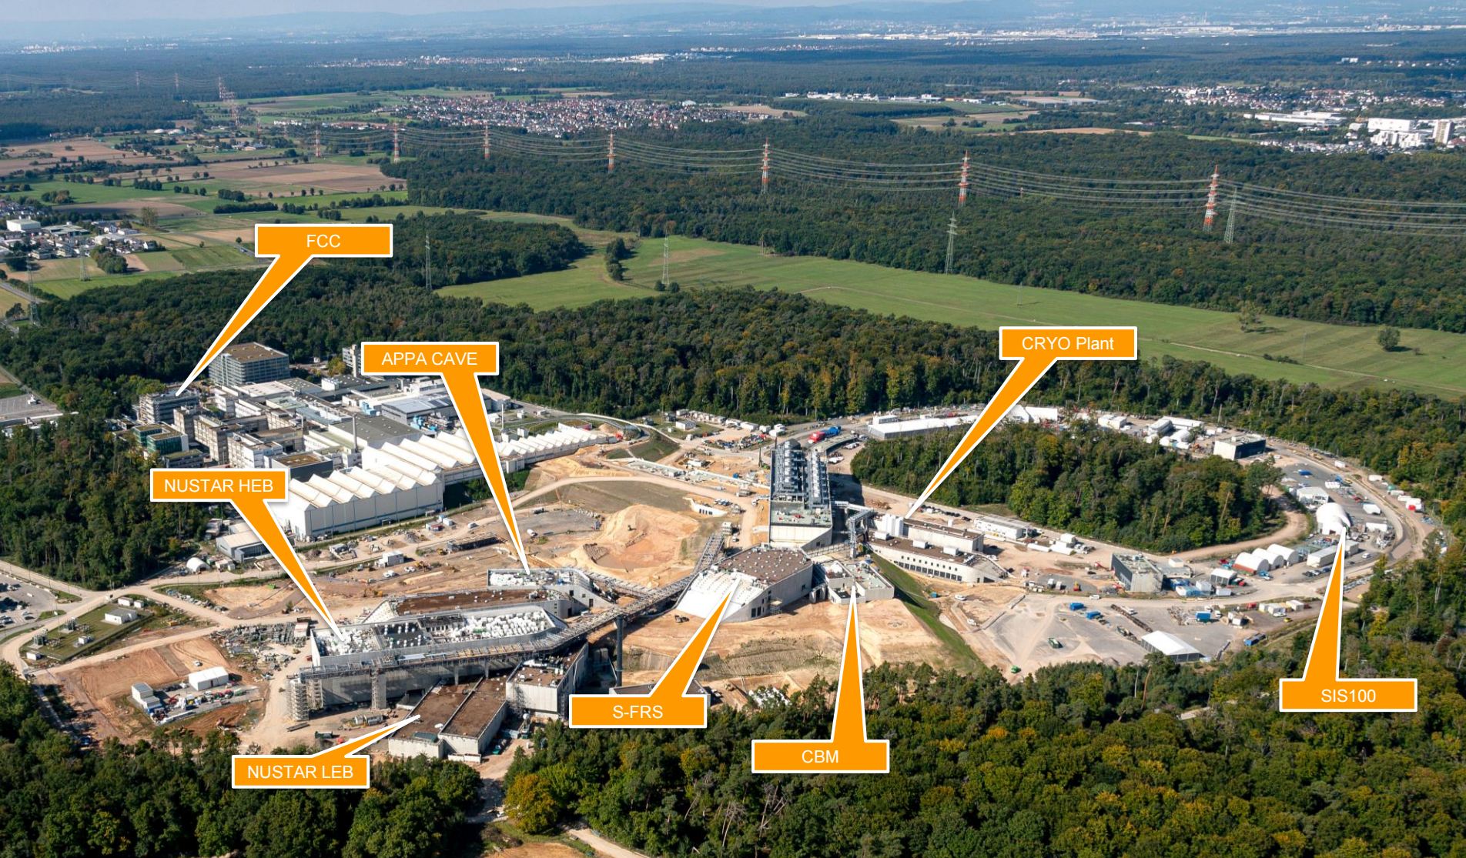
FAIR @ GSI

Slide 3
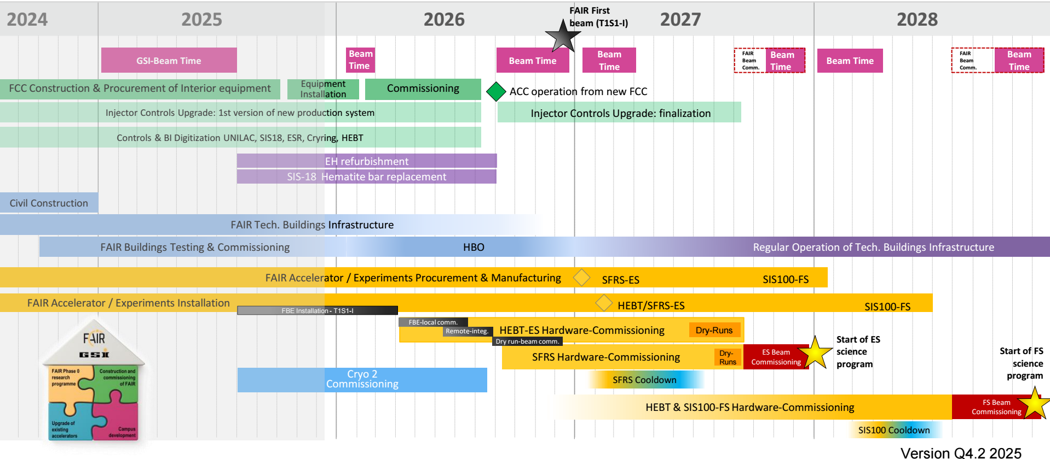
FAIR/GSI Major Milestones

Slide 4
SIS18 U²⁸⁺ Intensity Records
Highest number of heavy ions are provided by SIS18 for U²⁸⁺ @200 MeV/u.
Approximated intensity for SIS100:
4x10¹⁰ x 4 = 1.6x10¹¹
U²⁸⁺ ions/cycle
after SIS100 commissioning.
In routine operation, Uranium beams with charge state 73+ are used at an intensity of 4x10⁹ ions /cycle.
Reaching >10¹¹ Uranium ions in SIS100 will be easier than reaching 10¹⁰ U⁷³⁺-ions in SIS18.

Slide 5
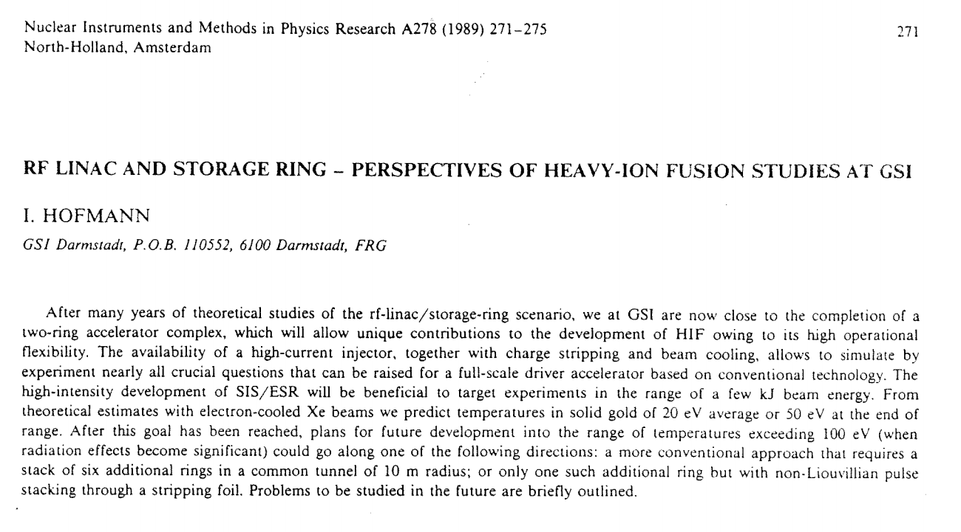
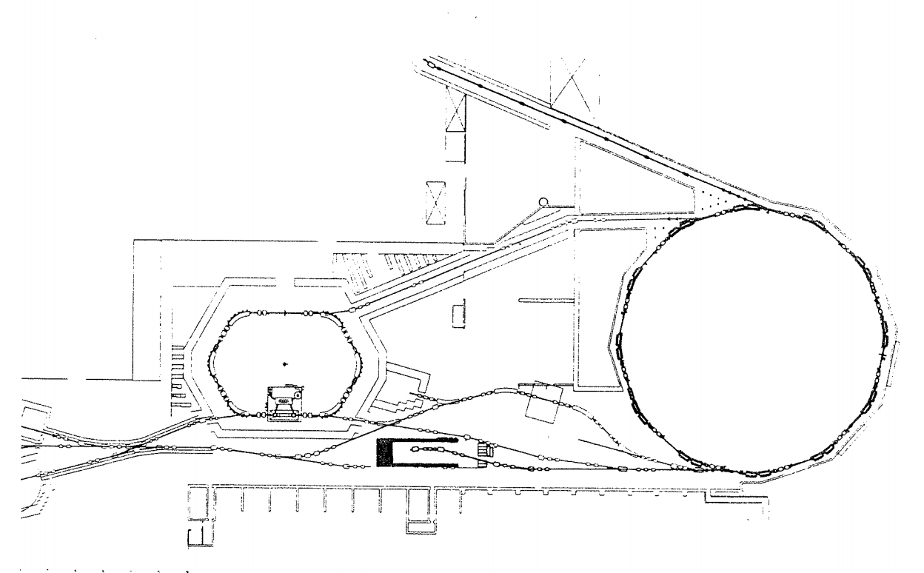
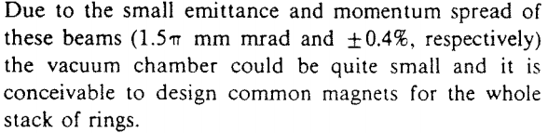
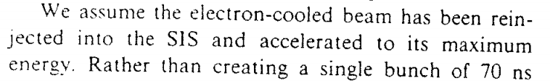
HHT Final Focusing System

Slide 6
HHT Final Focusing System
The existing HHT final focusing system is designed for a magnetic rigidity of 6 Tm and a beam emittance of 1.5 x 1.5 mmm mrad supposed to be generate by reinjection of a beam from ESR into SIS18. These parameters can only be achieved in the relevant energy range by charge stripping and electron cooling.
However, a beam directly extracted from SIS18 has an emittance of about 40 x 10 mm mrad (without cooling). Thus, at focusing of such a beam in the HHT final focusing system to small spot sizes, significant beam loss in the last two magnetes accures.
Electron cooling after/during injection in SIS18 improves the transverse beam quality but, a) limits the maximum intensity and b) can not be applied at low charge state heavy ions, e.g. U²⁸⁺ (having the highest intensities).

Slide 7
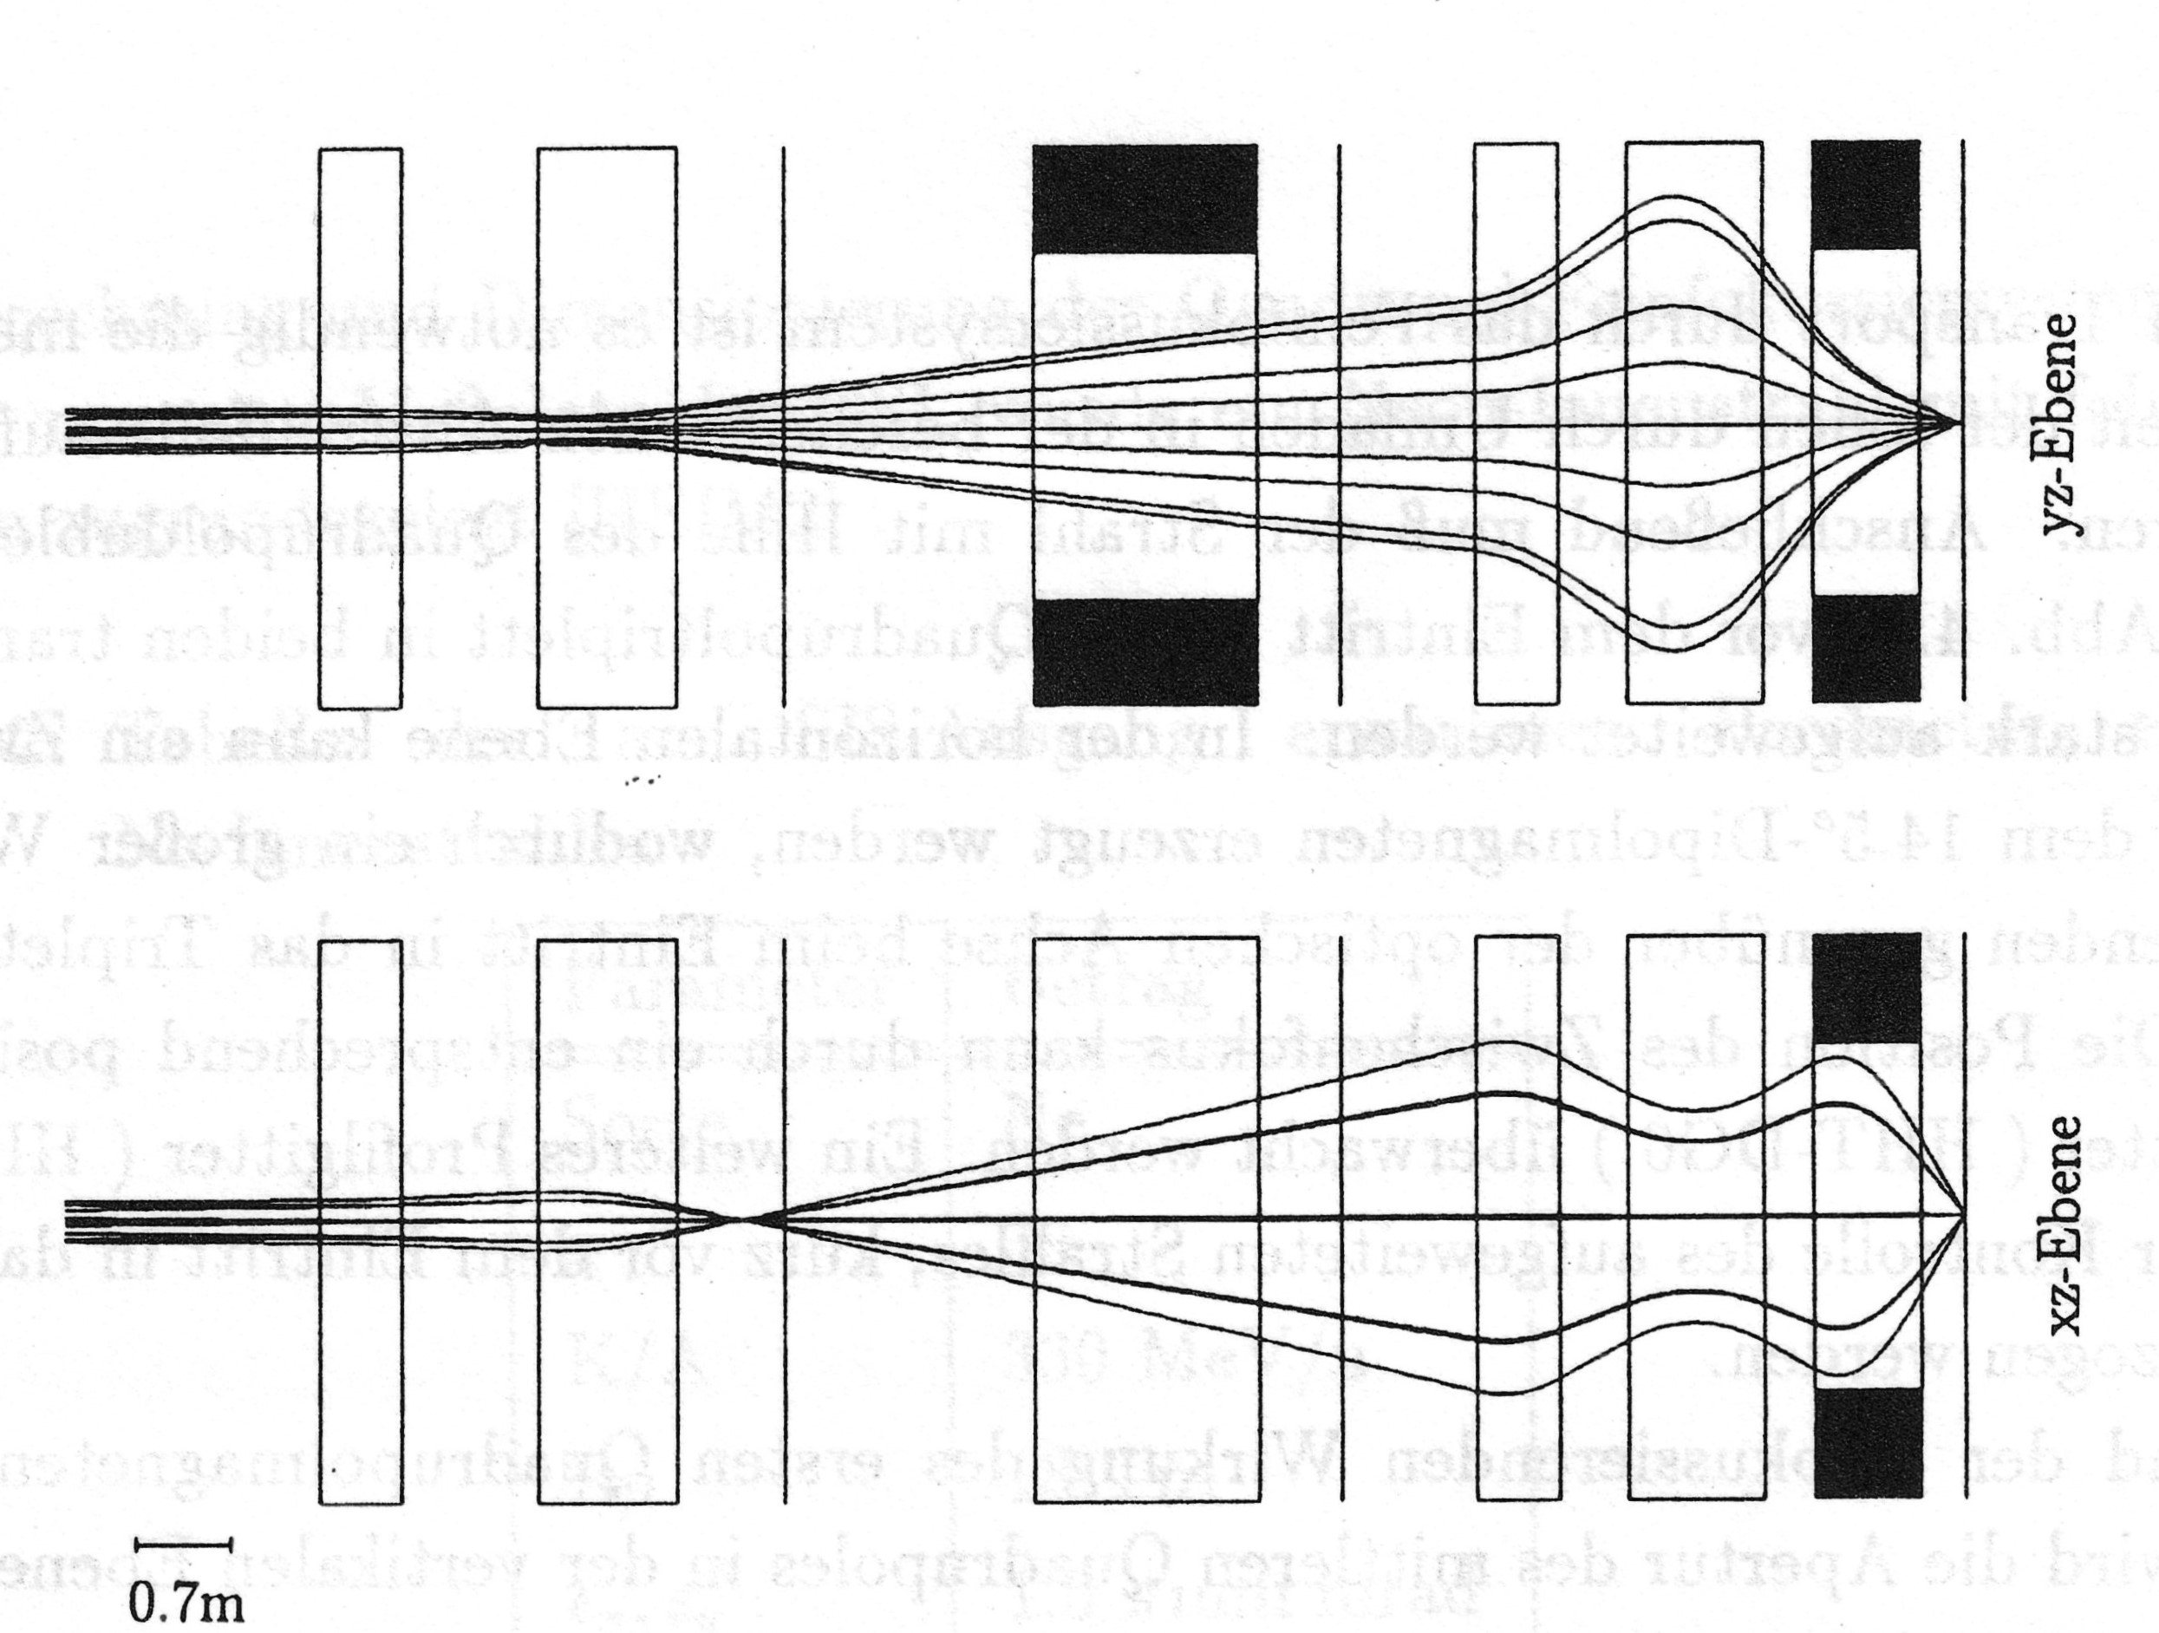
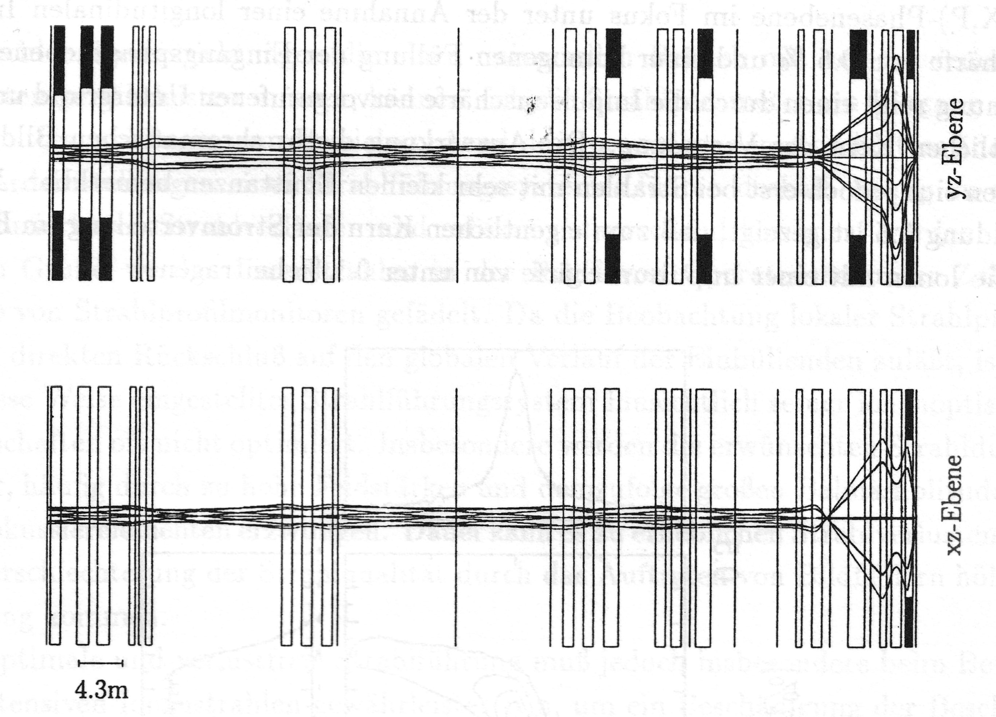
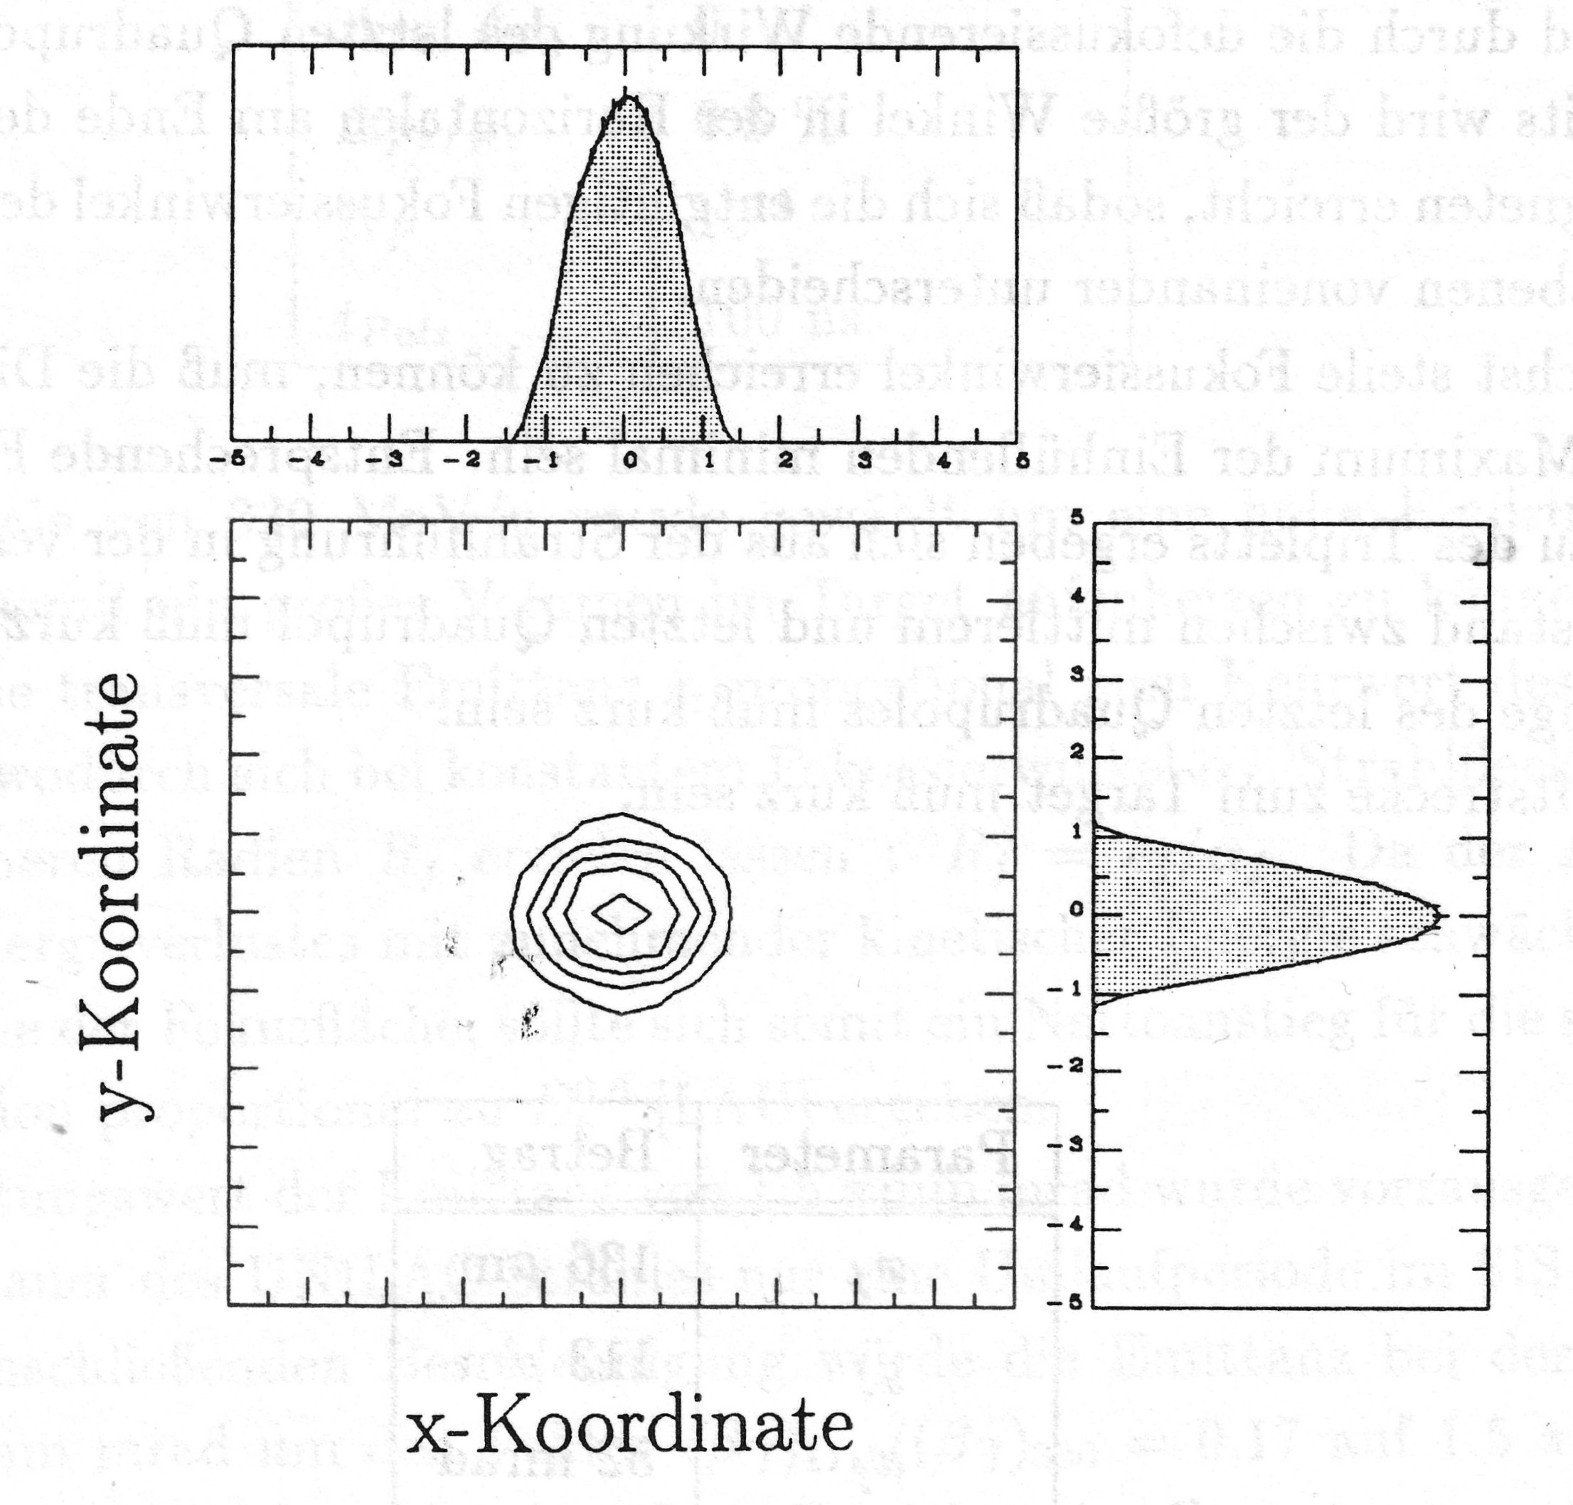
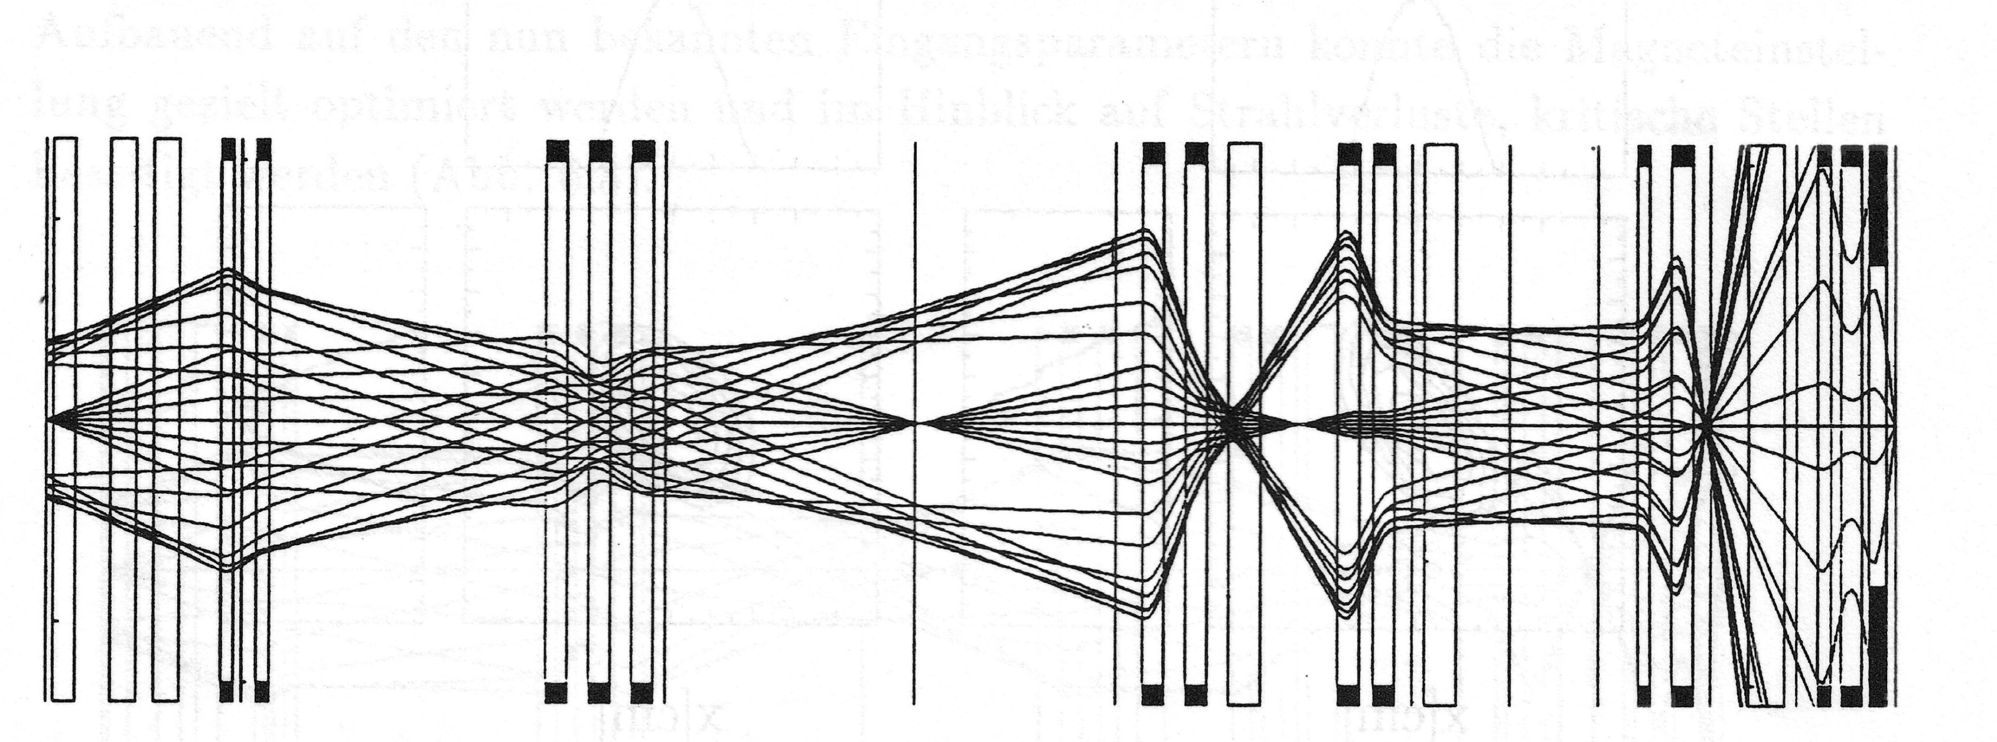
HHT Final Focusing System
Design spot radius 0.15 mm
Envelopes for the design emittance of 1.5 mm mrad
Envelopes for the design emittance (top) and real emittance from SIS18 (bottom)
Consequences:
The spot radius is larger (about 0.45 mm at target distance 0.3 m).
Beam loss in the order of 50 % is generated in the last two quadrupoles.
The Uranium beam with highest intensity (U²⁸⁺ - 18 Tm) can not be focused at all.

Slide 8
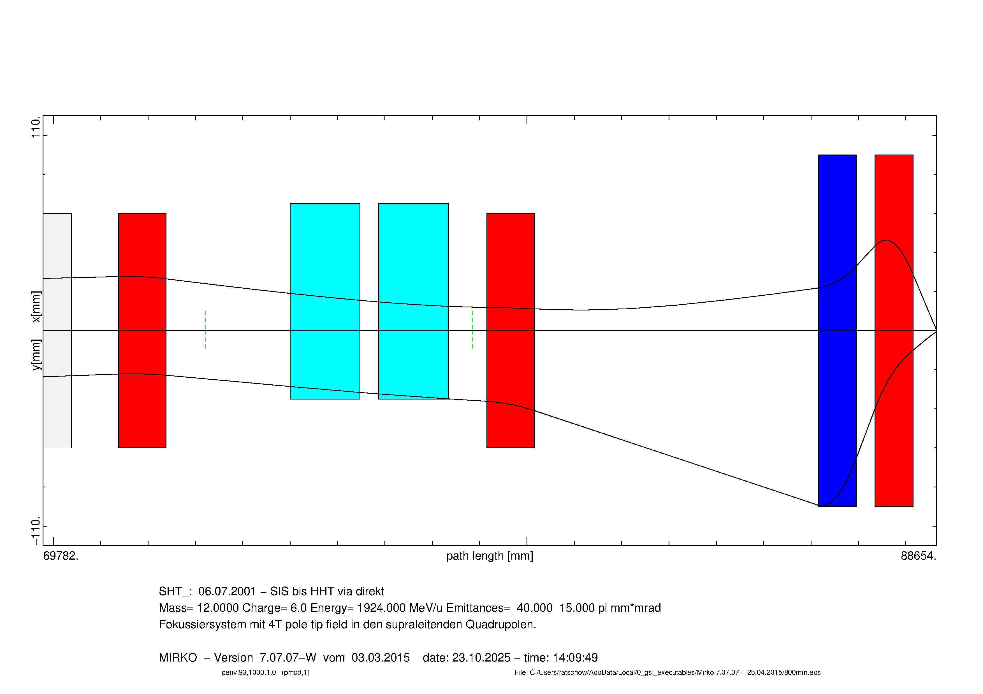
HTS s.c. Final Focusing System
Replacing the last three magnets by two s.c. large aperture quadrupole magnets
Pole tip field equivalent: 4 T
Pole aperture: 0.09 m
Technical simplification by two equal apertures
Conduction cooled by means of local cold head and compressor station (no LHe, no cryoplant and distribution system)
No dynamic loss – no fast ramping required.
RT beam pipe – no CWT (short distance to target > small spot).
Target distance: 1 m
Spot radius: 1 mm

Slide 9
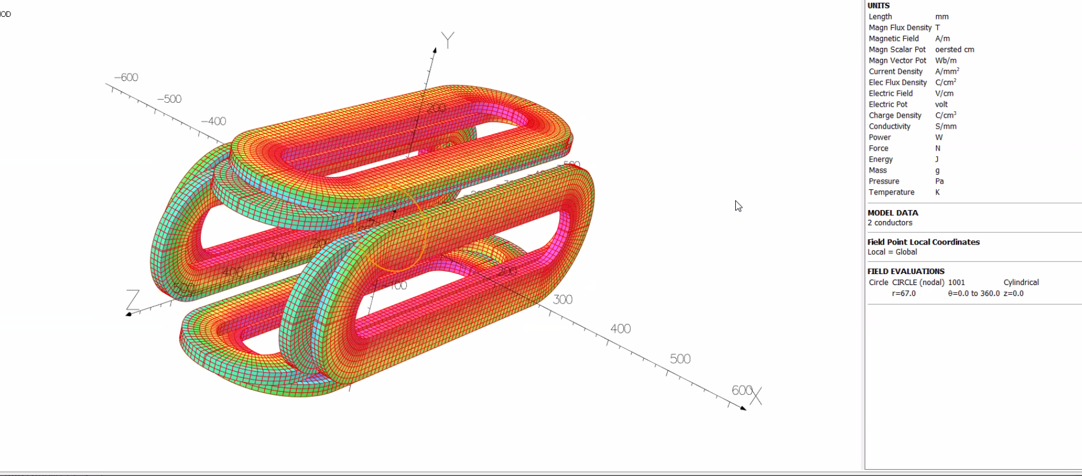
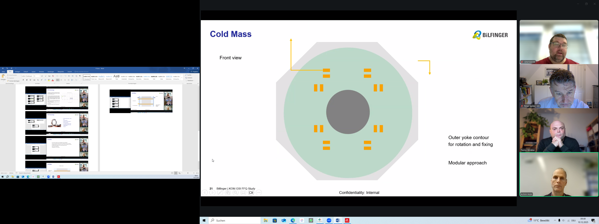
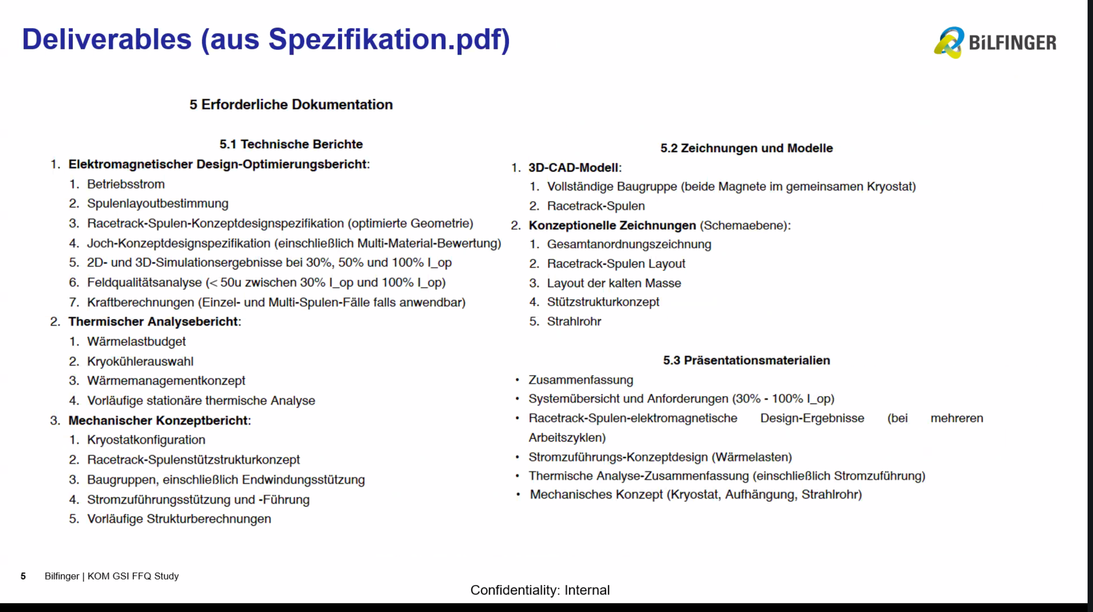
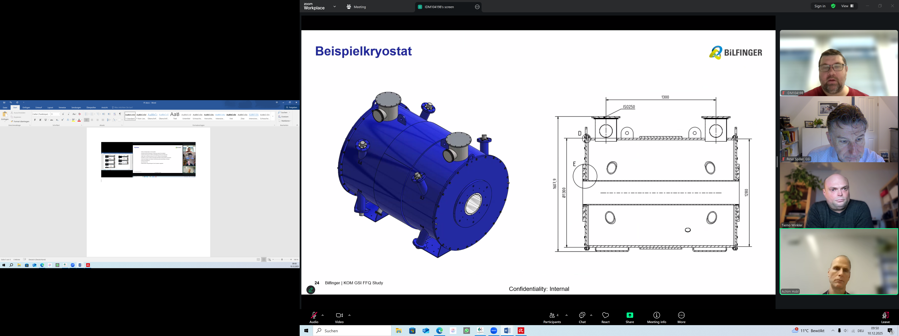
HTS s.c. Final Focusing System
First indications for realistic peak field at conductor

Slide 10
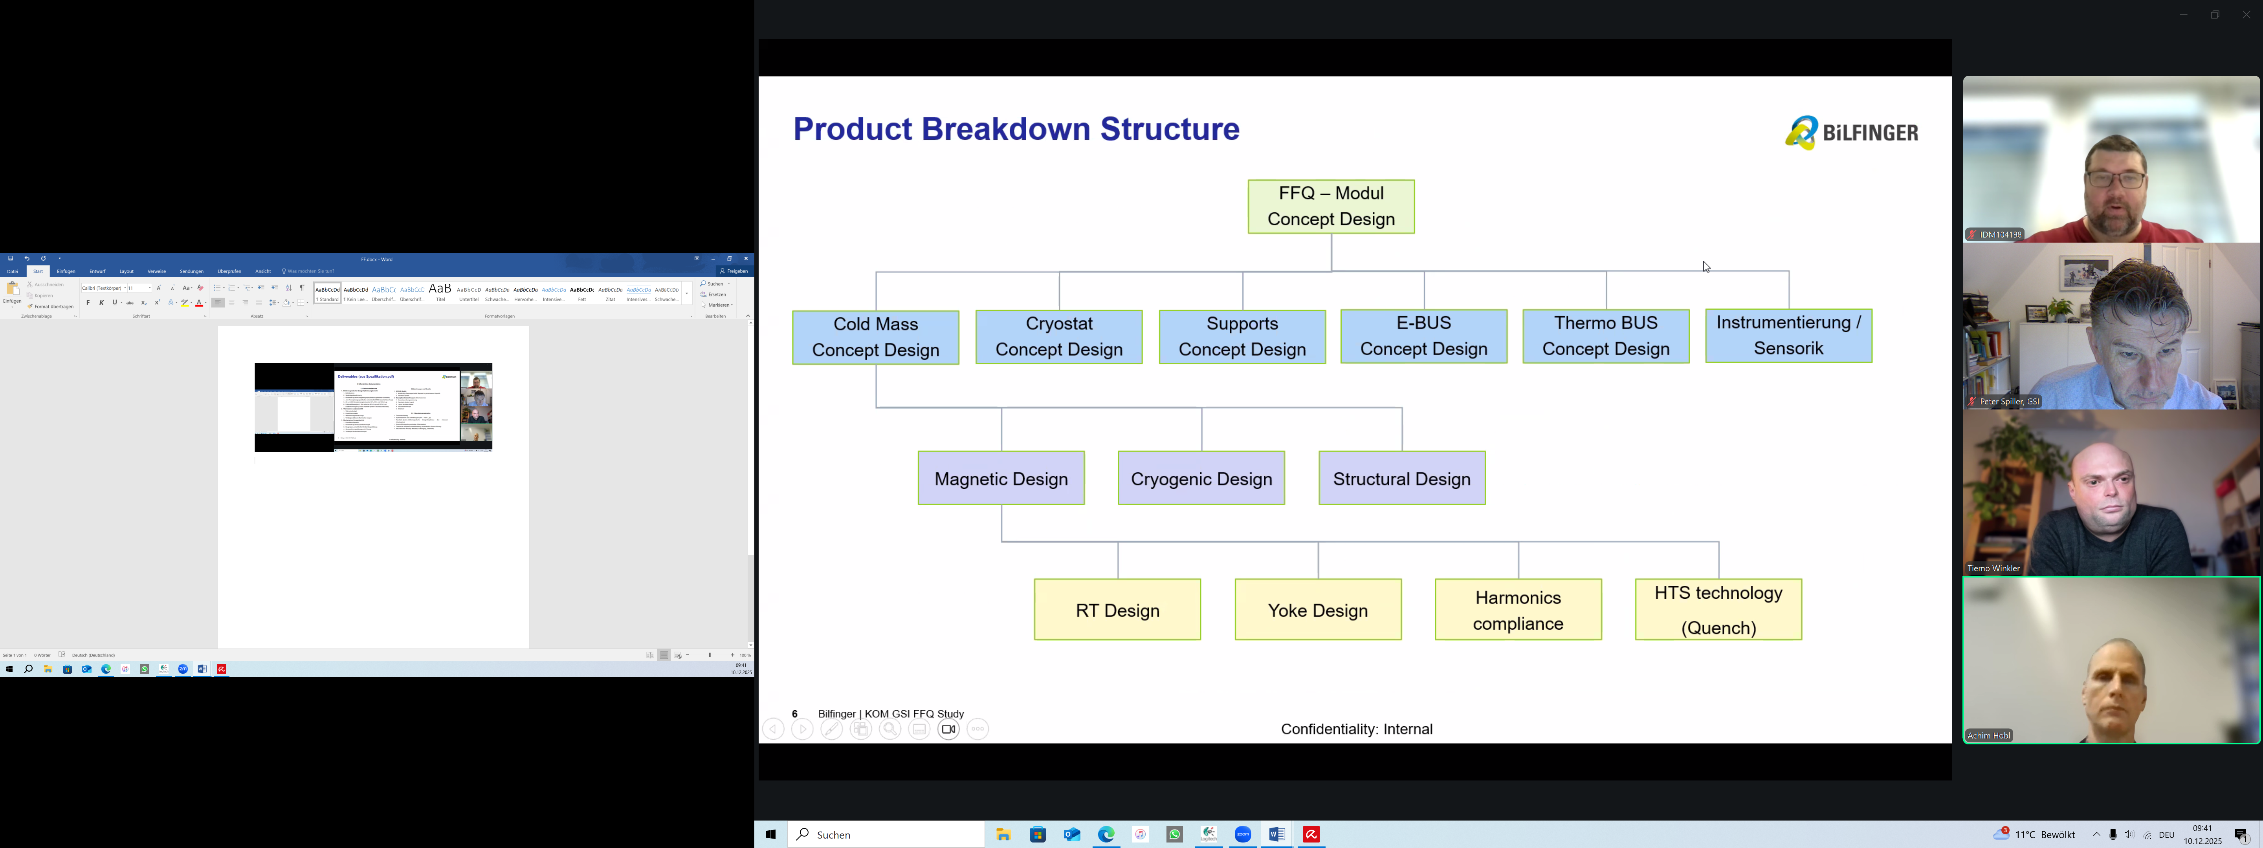
HTS s.c. Final Focusing System
Quench detection and protection system for HTS superconductor
Potentially new (cheap) power converter.
Possible Milestones:
2025/2026: Feasibility study (running)
2026/2027: Engineering design
2027: Project organisation and manufacturing contract (if funding available)
2029: Replacement/installation of HHT quadrupoles
In case of feasibility is demonstrated, application of the design for the APPA final focusing system may be possible.

Slide 11
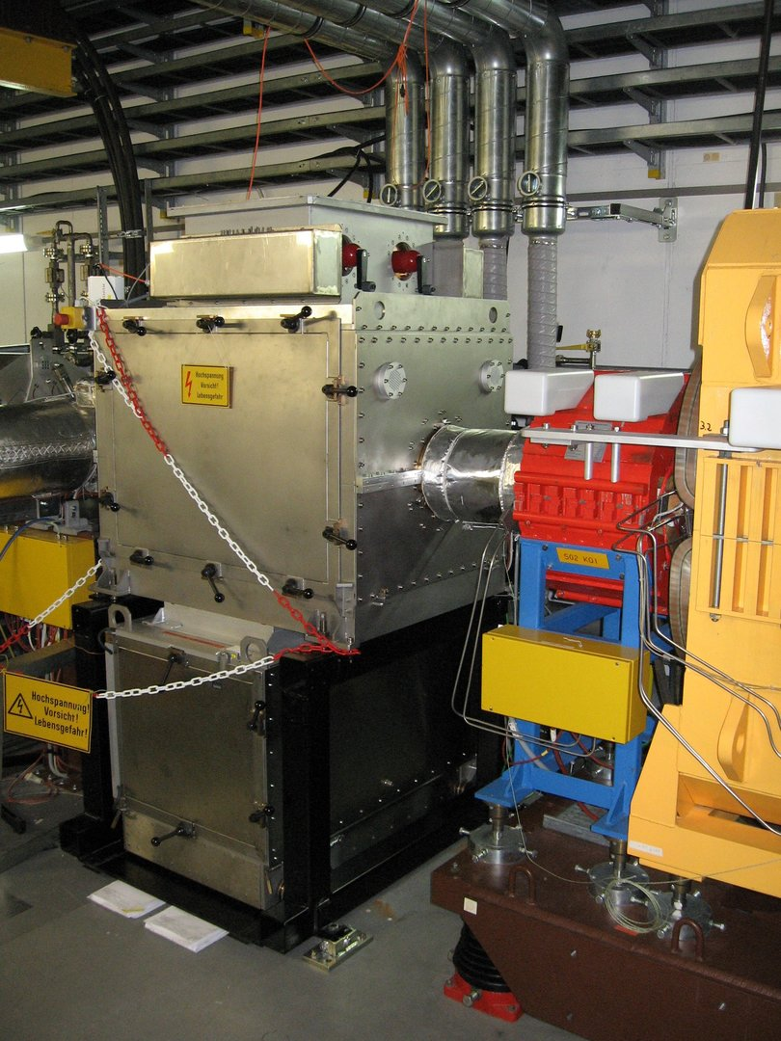
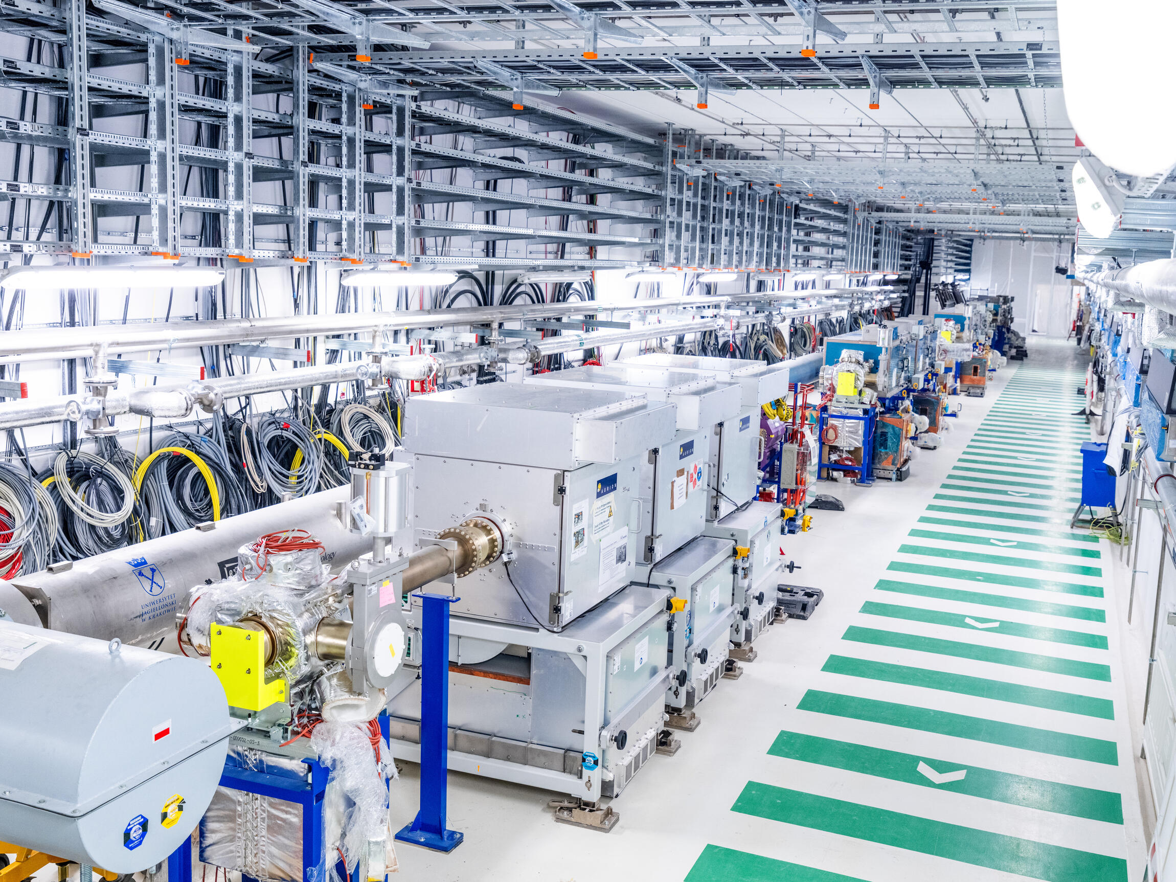
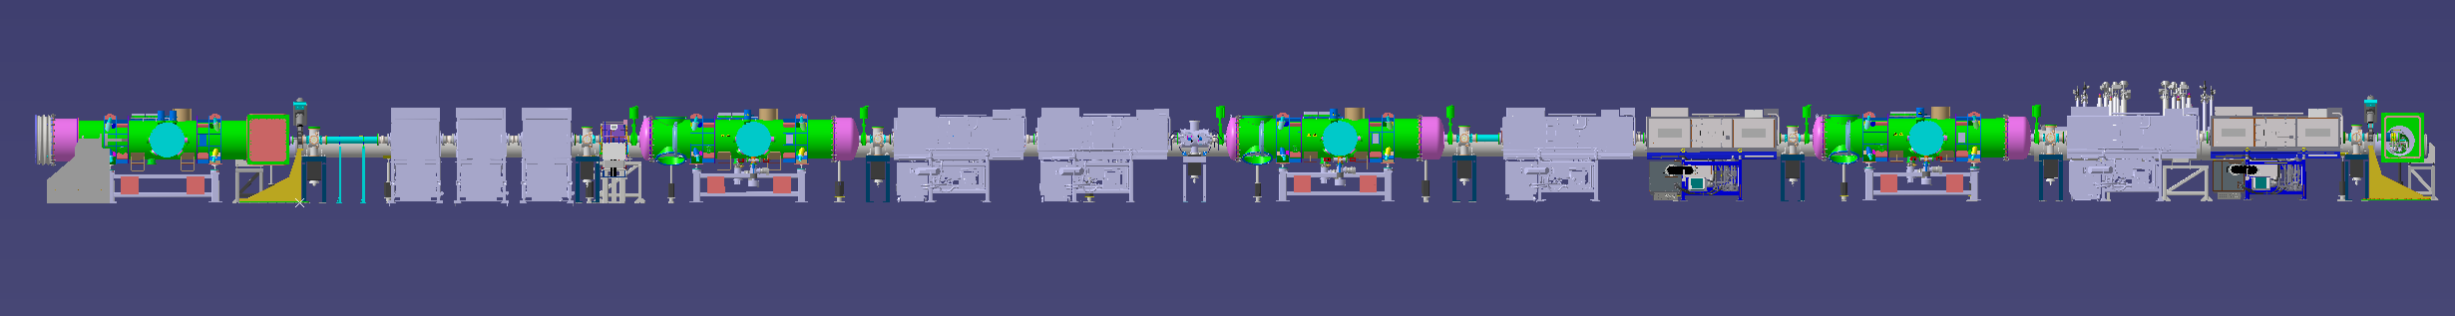
Rf Bunch Compression
SIS18: One BC RF cavity 40 kV
SIS100: Nine BC Rf cavities 360 kV

Slide 12
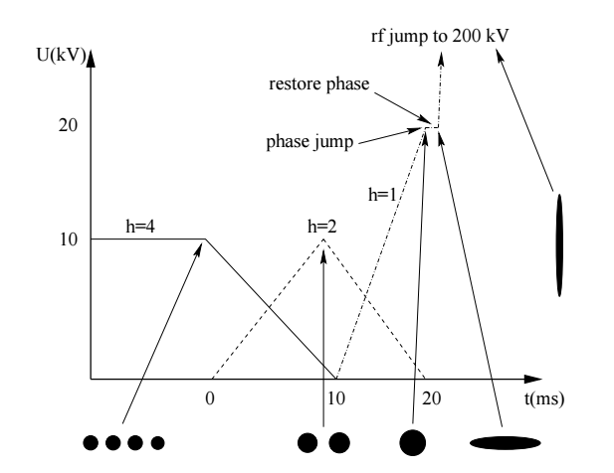
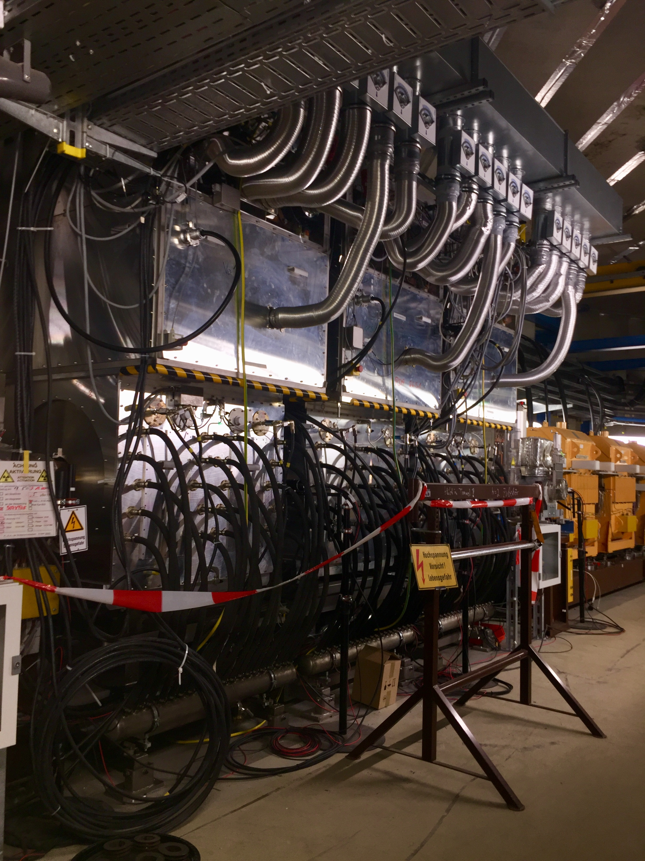
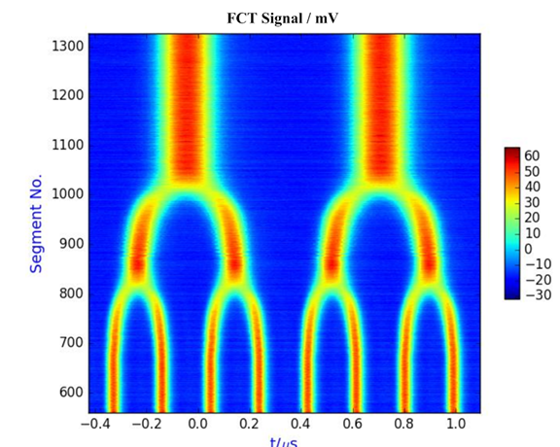
Rf Bunch Compression
Single bunch generation
MA acceleration cavities in SIS18
(3x 13 kV)
Example: Bunch merging h=8 > h=2

Slide 13
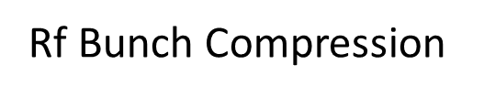
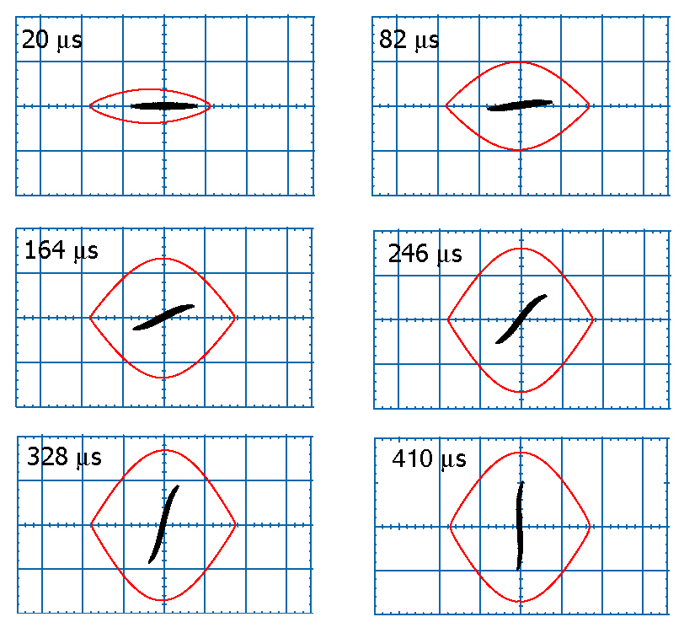
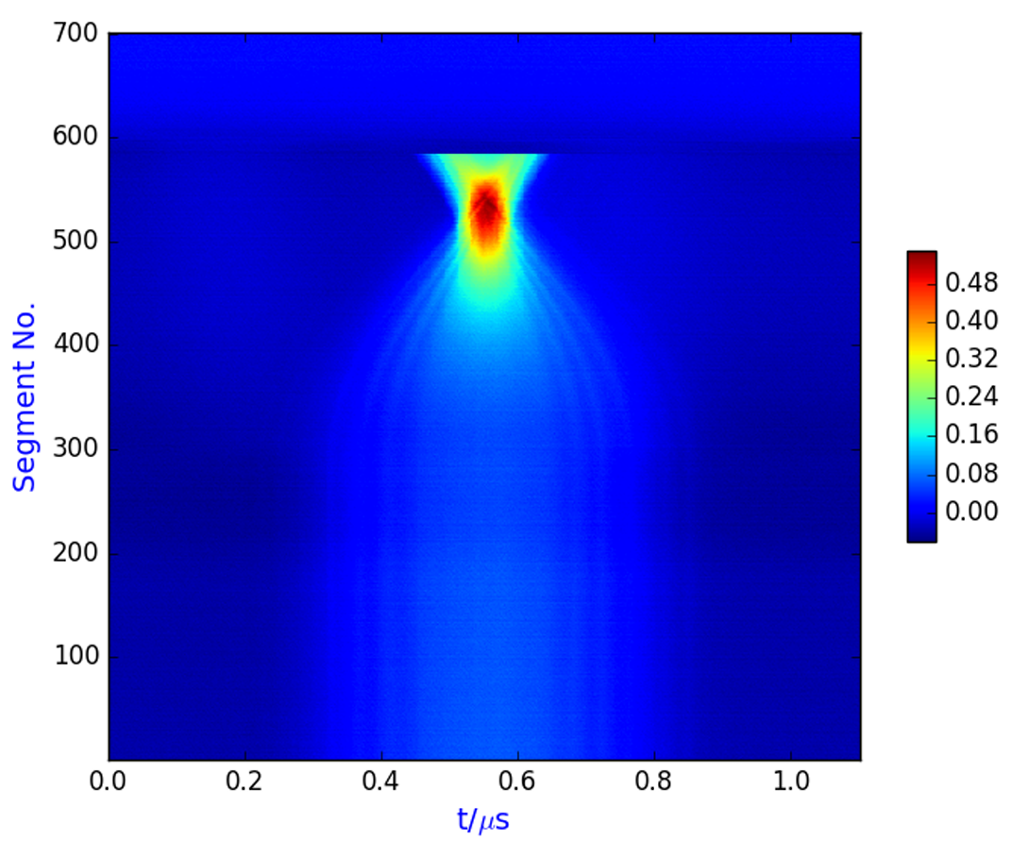
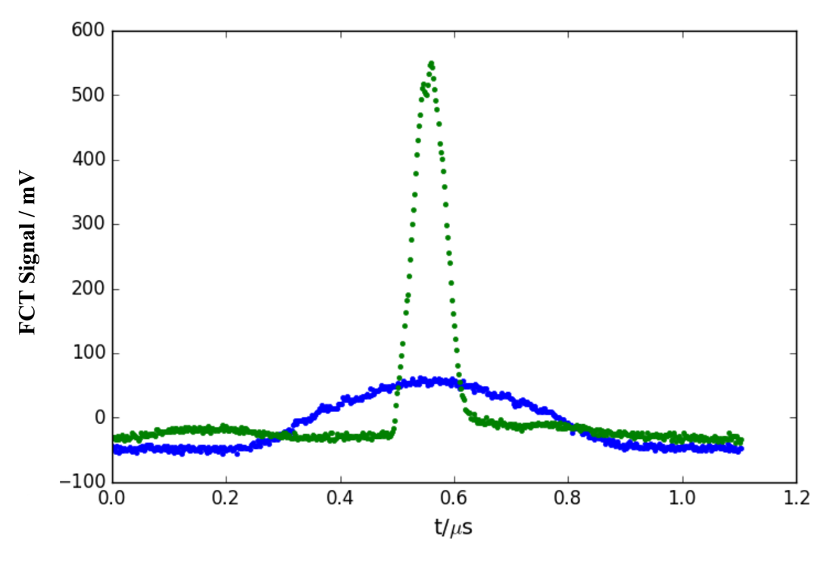
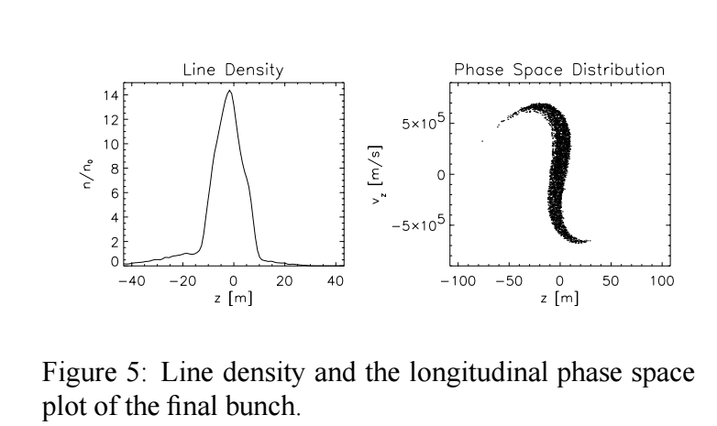


Long. Phase Space
during Compression
VBC,max = 40 kV
Typical compression factor: 3-6

Slide 14
Estimated Target Parameters
 | SIS18
Ion | U28+
E /MeV/u | 200
Number of particles | 5x10¹⁰
Range / mm | 0.8
Spot radius | 1 mm
Bunch length /ns | 200
Es /kJ/g | 5 (on surface)
Ps /GW/g | 25
T/eV | 1
M /mg | 50

Slide 15
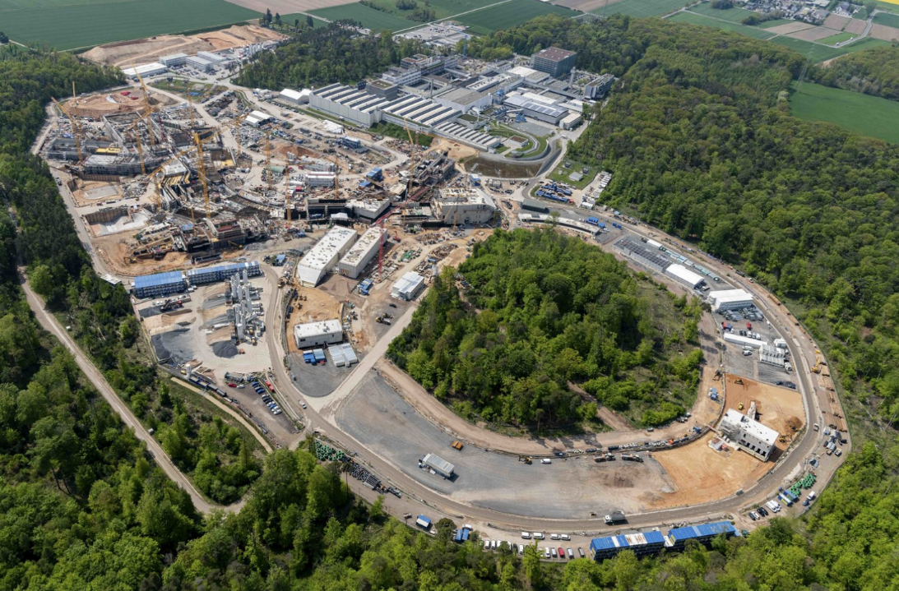
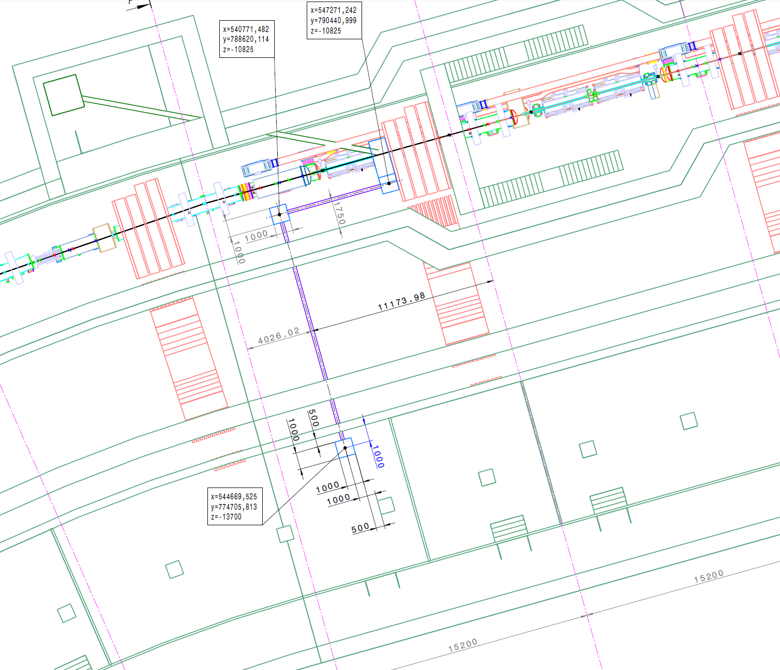
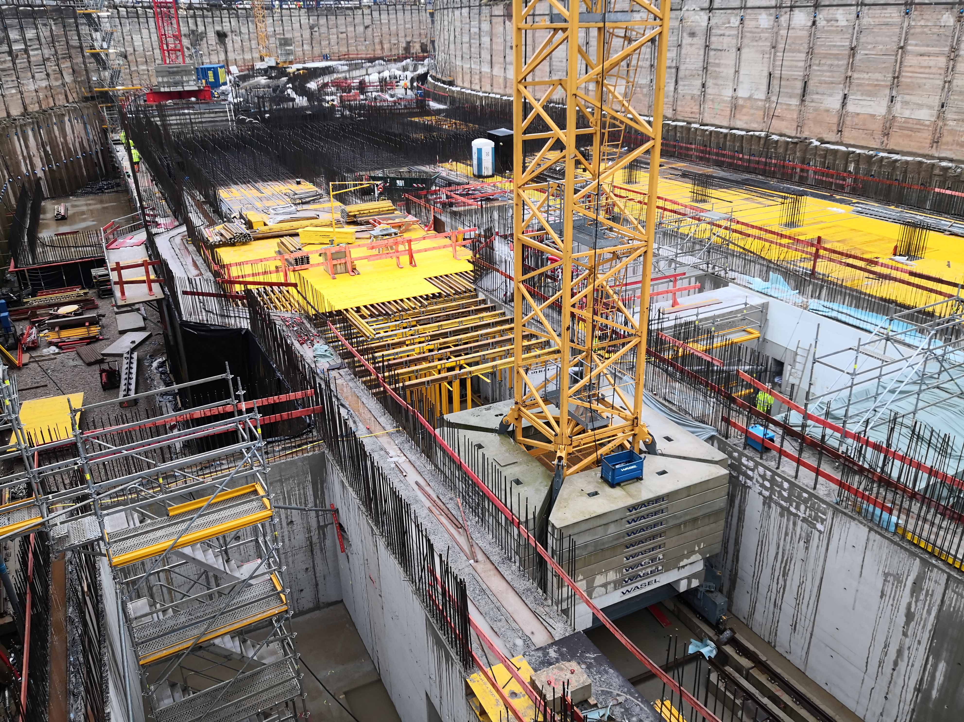
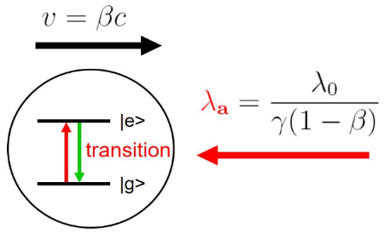
SIS100 Laser Cooler
Beam Quality and Bunching by means of Lasers
SIS100 will be the first user synchrotron equiped with a „laser cooler“ world wide.
Laser-cooled relativistic heavy-ion beams (γ up to 13 for Z = 10 - 60)
Only cooling method at relativistic energies (Δp/p<10⁻⁷)
Extraction of very cold and very short ultra-relativistic ion bunches
SIS100
detector
cave
ions
fluorescence
accelerator
tunnel
beamline
laser
laser
maintenance
tunnel
ions
laser
lab
fluorescence

Slide 16
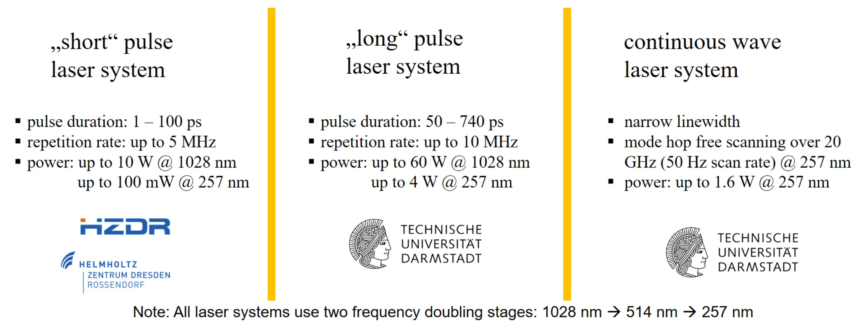


SIS100 Laser Cooler
Beam Quality and Bunching by means of Lasers
Using three laser systems at the SIS100
simultaneously combines the advantages of:
covering a large ion velocity range
suppressing heating effects like IBS
fast cooling (order of seconds)
lowest possible longitudinal ion momentum spread ∆𝑝/𝑝 ~10⁻⁷
But … requires overlap of ion and laser beams
in space, time & energy !
Bucket acceptance
N, I
initial / final
ion velocity
distribution
cw laser (TU Da)
long pulse laser (TU Da)
short pulse laser (HZDR)
v, λ

Slide 17
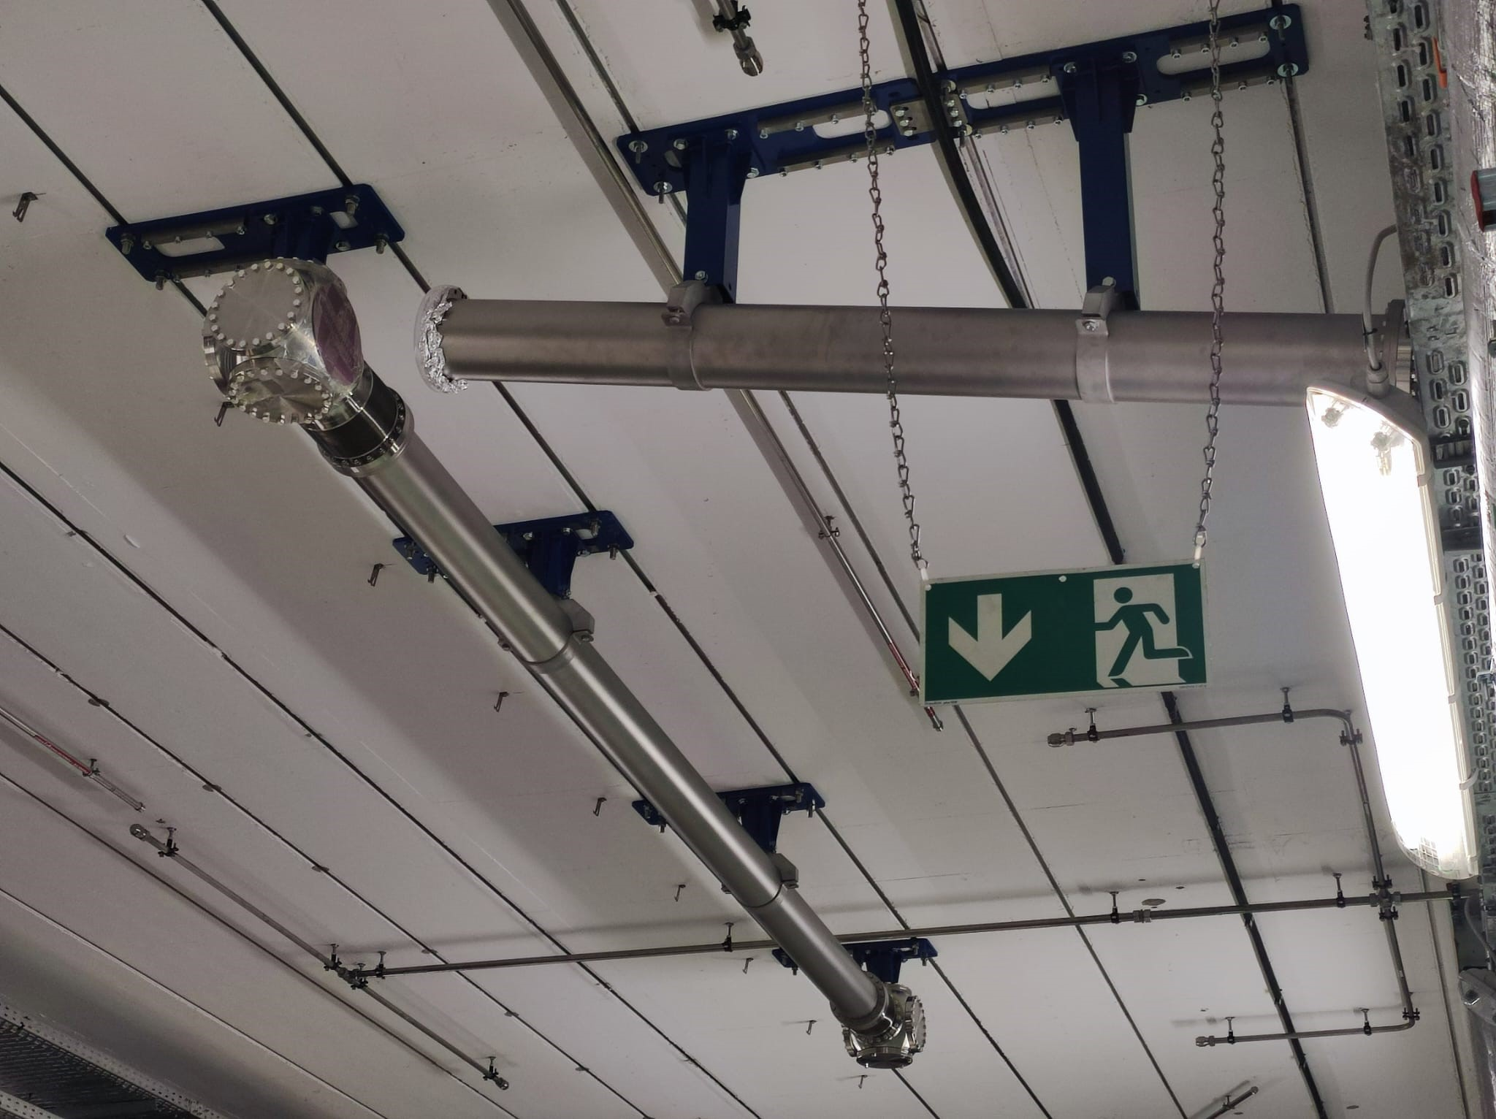
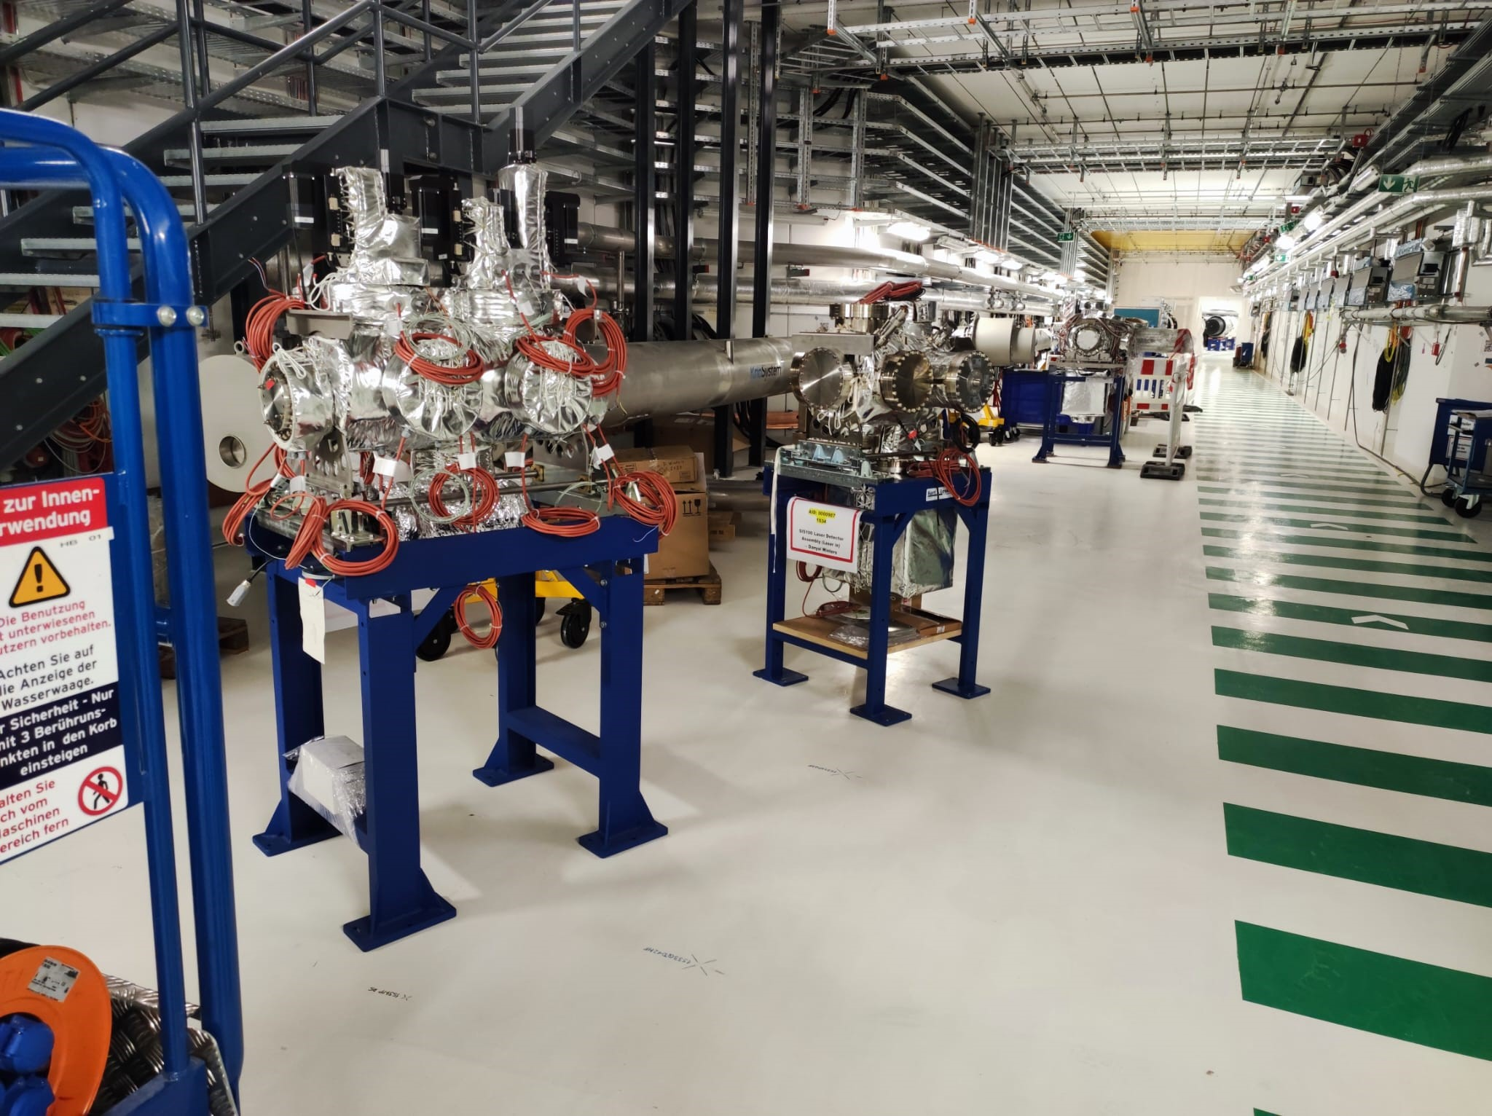
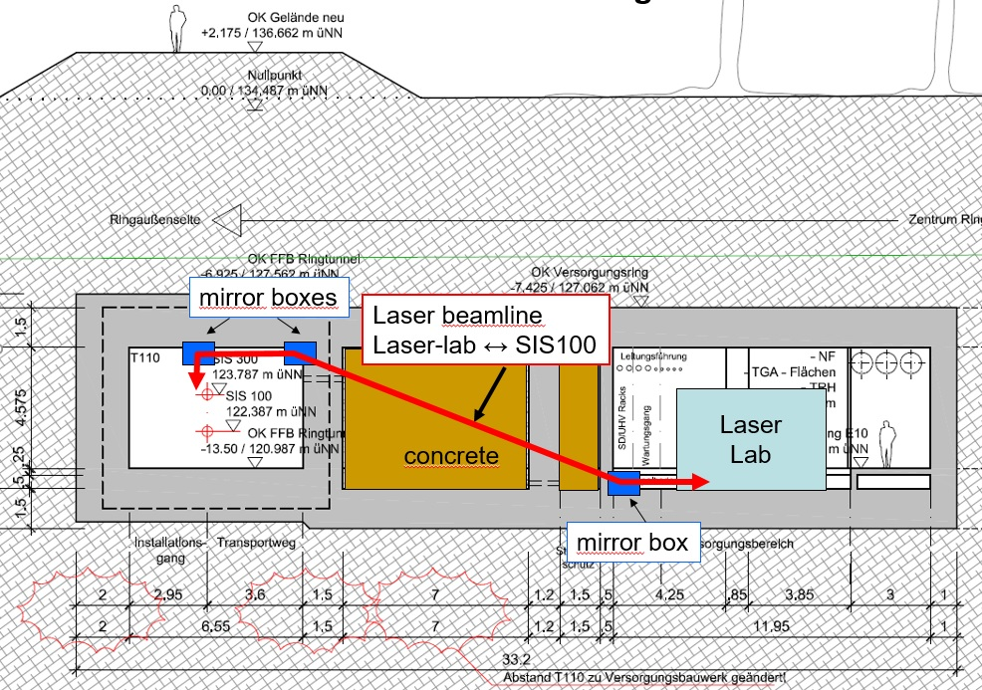
SIS100 Laser Cooler

Slide 18
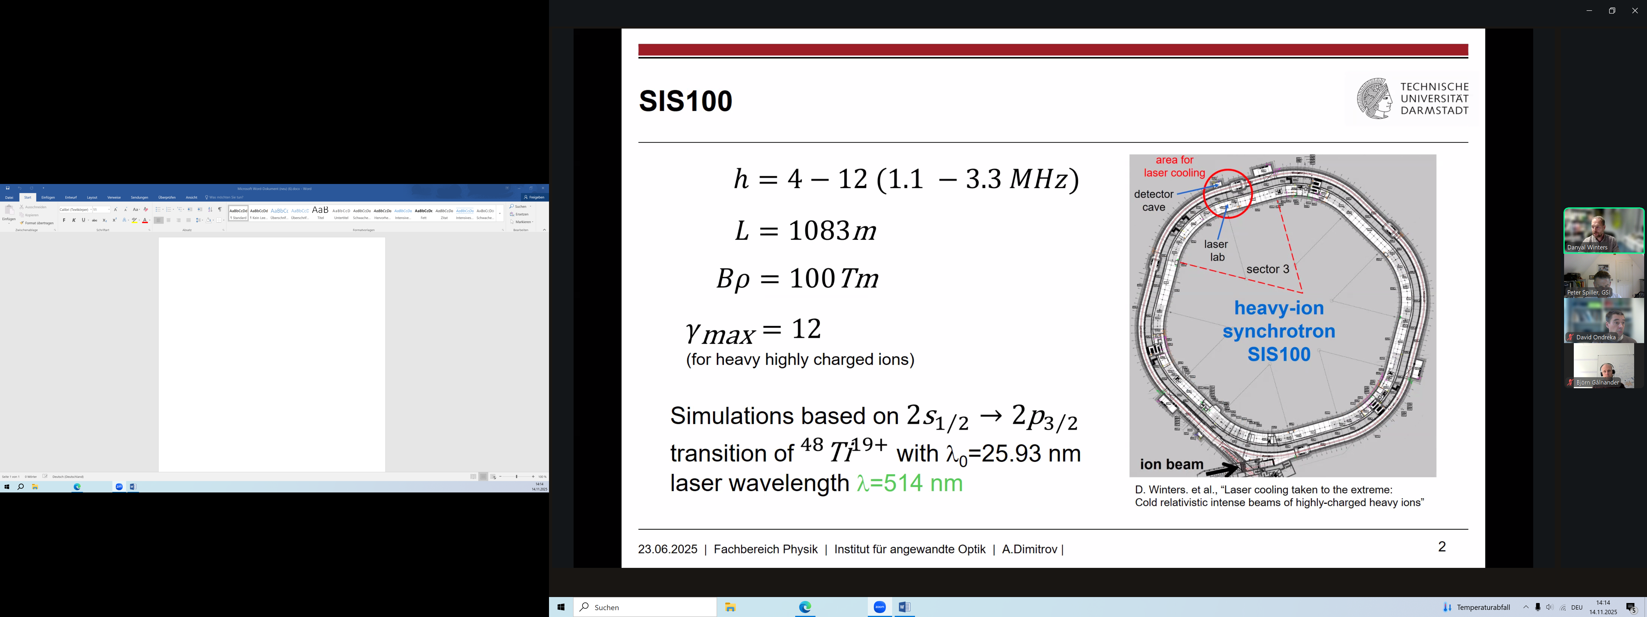
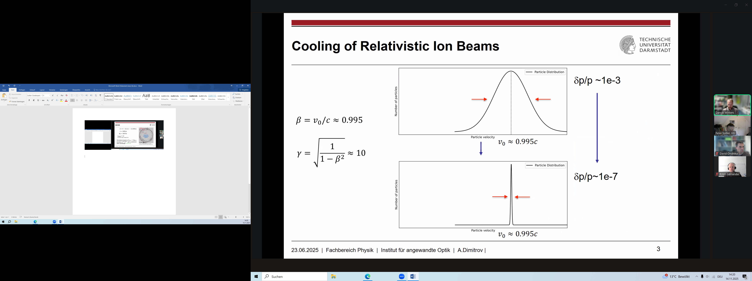
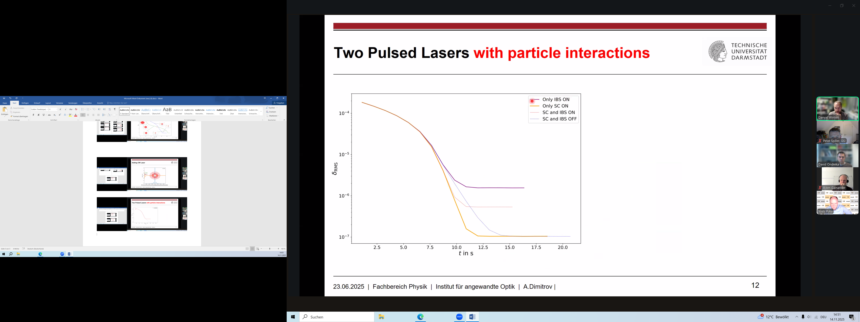
Bunch Compression with Laser Cooler
WP leader SIS100 laser cooling: D. Winters
The extremly low momtum spread expected after laser cooling enables the generation of very short heavy ion bunches.
Subsequent bunch compression (phase space rotation) provides ultra short heavy ion bunches and high target power.

Slide 19
Bunching of Laser Cooled Beam
Ti 19+
N = 1E8
Brho = 78.05 Tm
E/u = 8.4 GeV/u
Hbunch= 8, Hrf = 10
Icoast = 0.09 mA
dp/p coast = 4.5E-7
dp/p bunch = 1E-6
------------------------------
Adiabatic compresion
Hbunch = 1, Hrf = 10
Urf= 280 kV
Tbunch = 1-2 ns

Slide 20
Summary
A new HTS s.c. final focusing system is being studied for the HHT- and potentially APPA cave.
A temperature of 1 eV may be achieved after proper focusing of Uranium beams from SIS18.
The start intensitiy of Uranium beams in SIS100 will be >10¹¹ ions/cycle.
The higher beam energy from SIS100 (range) enables heating of a large macroscopic amount of matter.
Laser cooling in SIS100 serves the generation of extremly short ion bunches in the order of 1-2 ns. Detailed simulations with optimal use of the RF acceleration and Rf bunch compression systems wil be performed.

