Slide 1
Status of the PANDA Magnet Yoke
Presented by E. Koshurnikov
GSI , June 26, 2013

Slide 2
Overview of the magnet yoke design
Status of Interface coordination
Mechanical analysis
What should be done before announce the tender for the yoke?

Slide 3
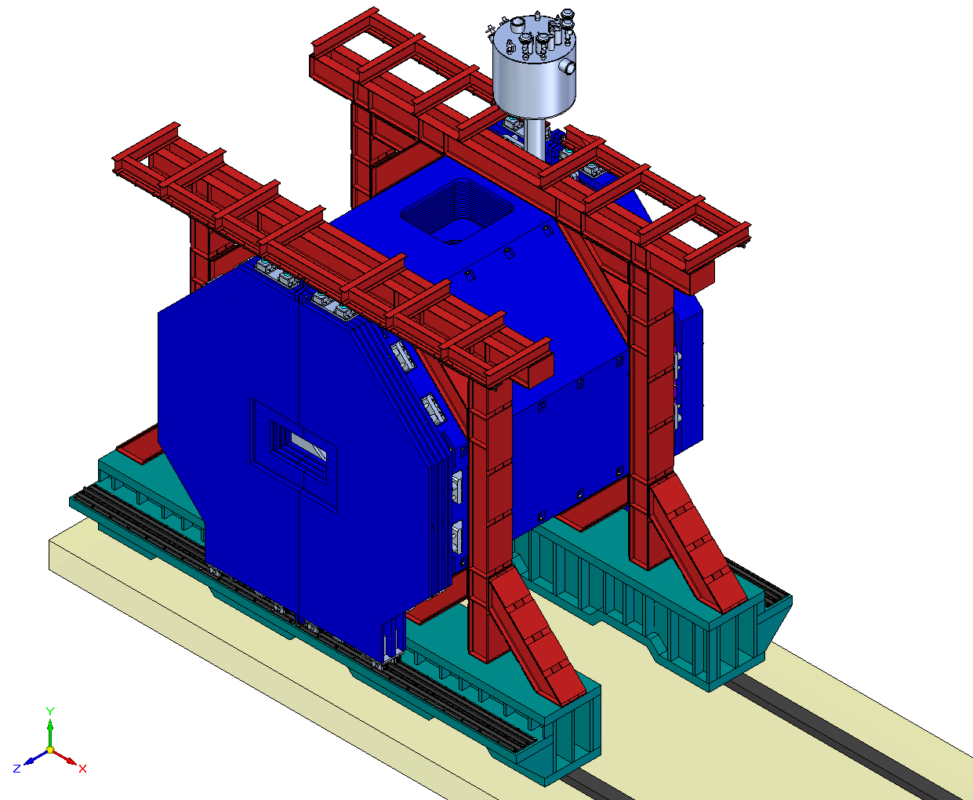
Magnet of the Target Spectrometer

Slide 4
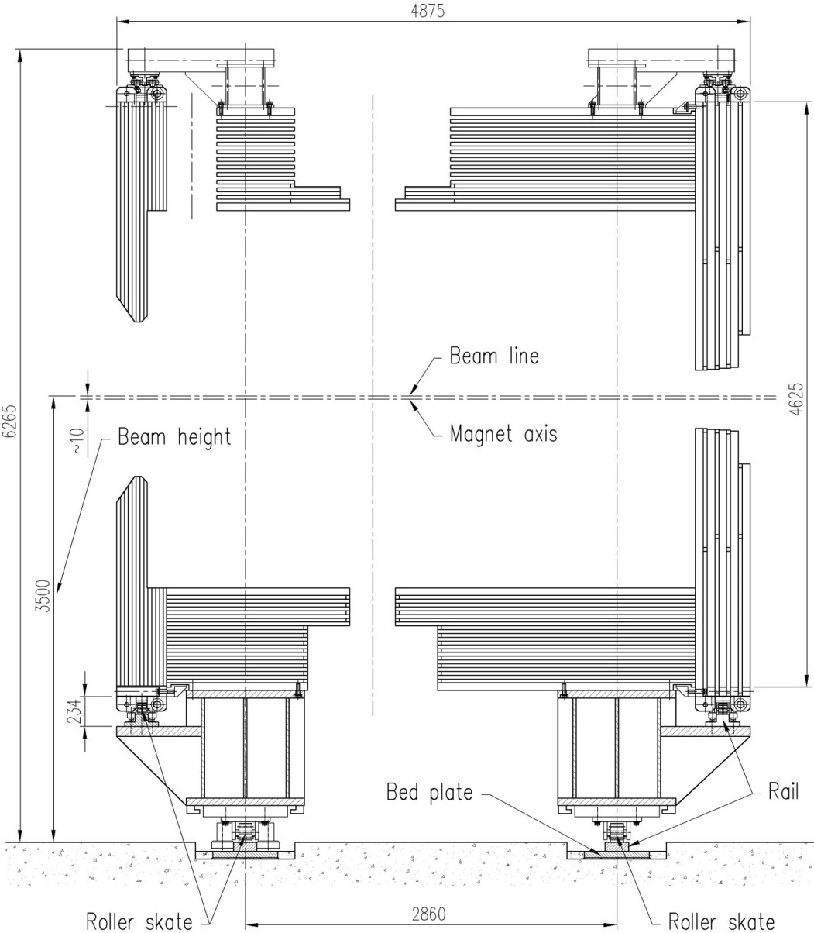
Roller skates for moving of the magnet and for opening doors
The PANDA magnet will be transported into the beam position after completion of the assembly on four track-guided roller skates. Typically once a year, a return move into the parking position for detector repair/upgrade should be foreseen.
The magnet is on the roller skates

Slide 5
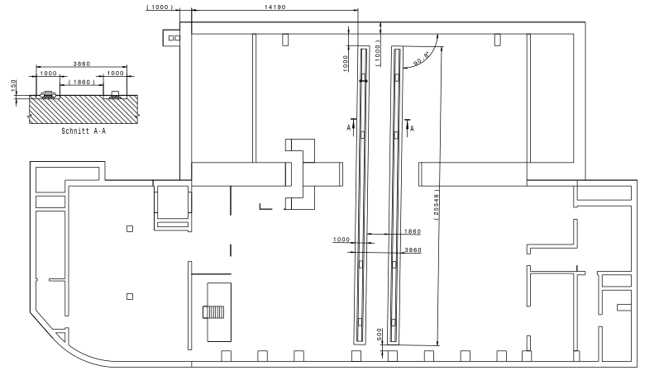
Experimental Hall Floor Plan with TS-Rail track
Deformations and stresses in the magnet and detector components during the movement should be minimized. It will be provided by keeping the magnet rails parallel

Slide 6
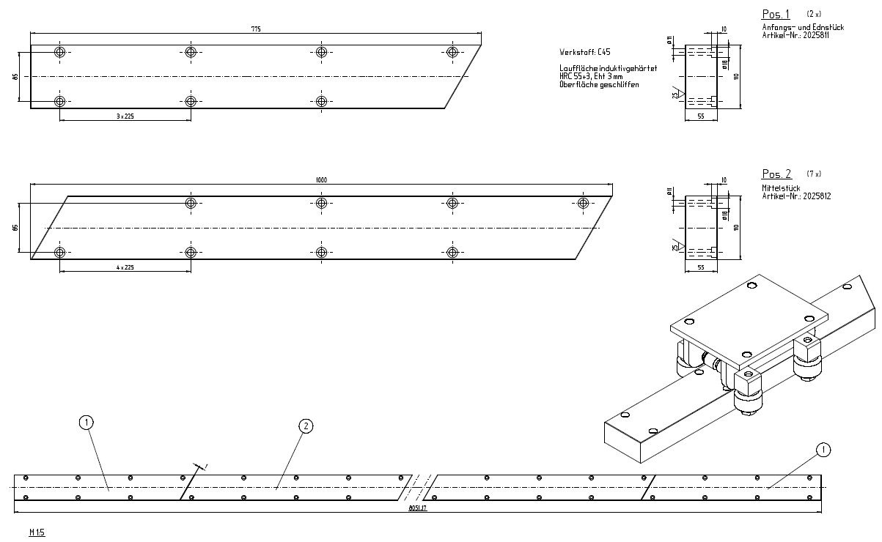
Rails for the door and for the magnet

Slide 7
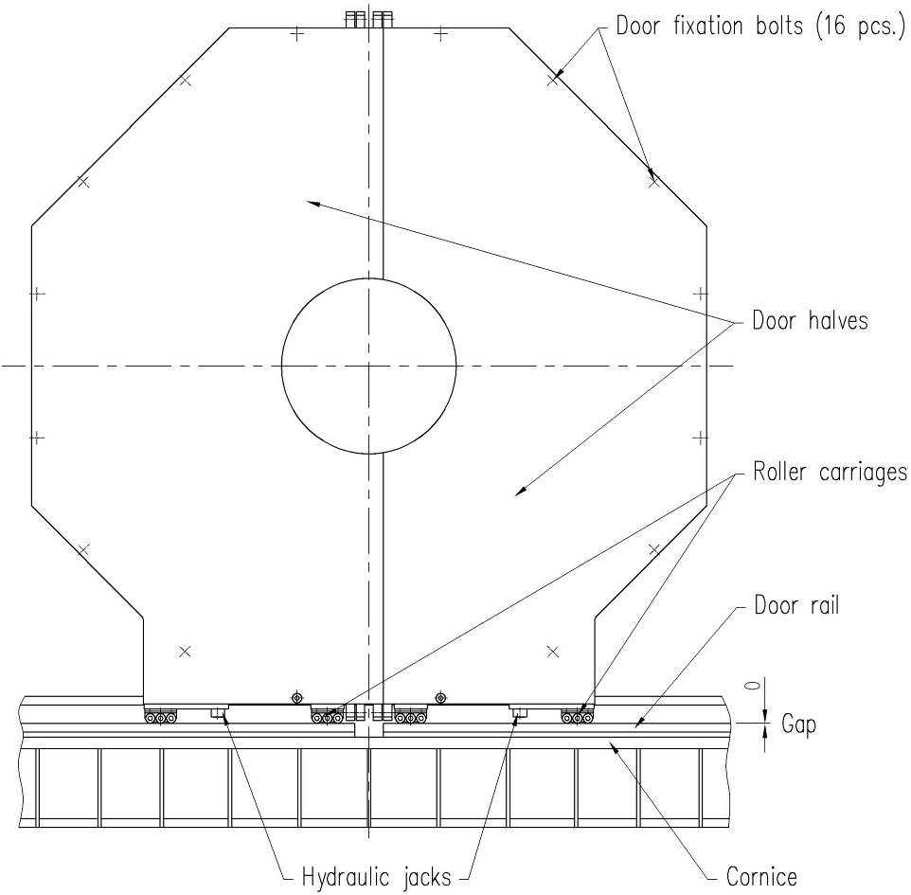
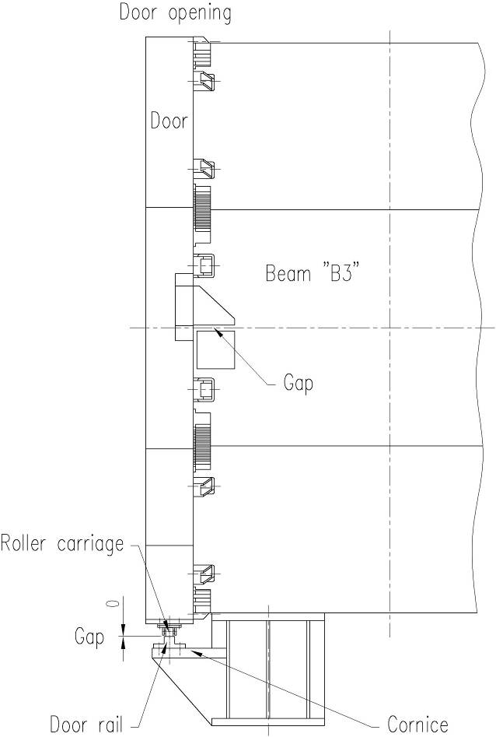
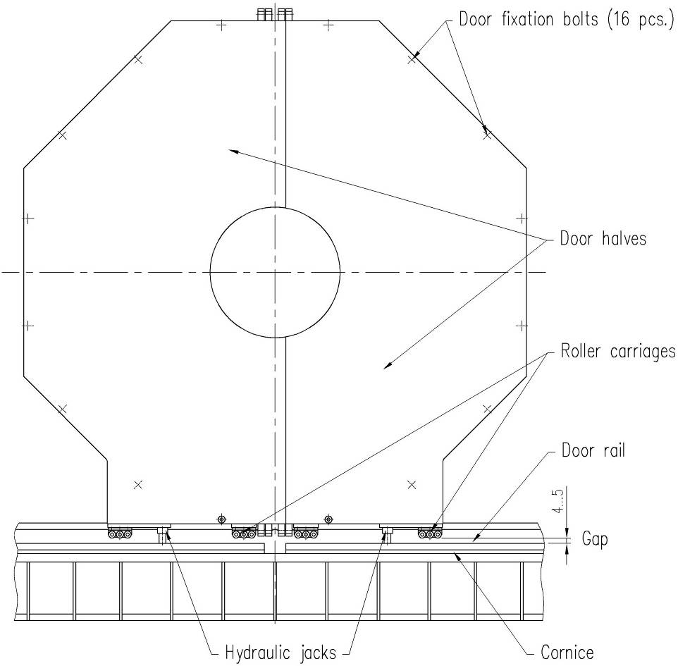
Door Opening System Arrangement
Ball bearing guidance is used to prevent tearing
of the door and but ends of the barrel

Slide 8
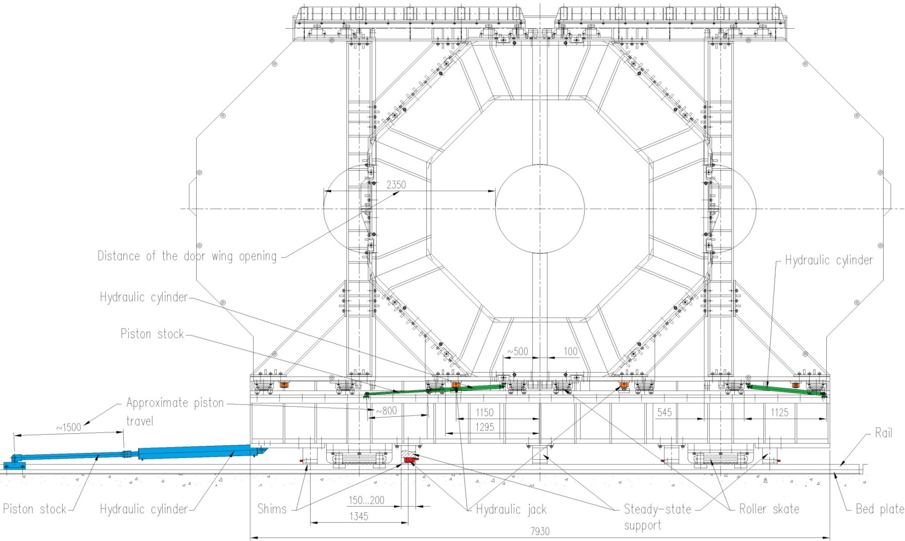
Hydraulic equipment of the magnet
The detector movement will be provided by two hydraulic actuators by means of displaceable fixation units. One step of movement will be 1.5 m at maximum. The total distance between parking and beam positions is ~12 m.

Slide 9
Status of Interface coordination

Slide 10
List of interface problems to be finalized
Solenoid coil tolerances v.r.t. the yoke
Attachment of the cryostat to the yoke:
  positions (coordinates) of the support points
  engineering design of the attachment units (part of the unit connected to the yoke)
  estimates of maximal loads (components of force and momentum) acting on the attachment units
Engineering design of the attachment units, loads on them (components of force and momentum) and their geometrical characteristics for fixation to the yoke:
  target production system
  target dump (also shape and dimensions of the recess for it in the lower barrel beam)
  forward EMC and disc DIRC (information taken from presentation by H.Löhner, 2009)
  backward EMC (possible interference with the door and its rails)
  cryogenic system on top of the magnet (chimney, bucket)
Additional equipment attached to the magnet from outside (fixation points, masses, possible loads and acceptable deformations):
  on the upper barrel beam (pumps, …?)
  on the lower barrel beam (optical system for the target dump control, …?)
  at the magnet side, on the platform (boxes with electronics, …?) – possible interference with the support frame that includes outer inclined beams
  muon filter – distance to the upstream magnet end cap, possibility of door opening: access to the units of the door halves fixation to each other is necessary
Final positions, shape and dimensions of recesses in the yoke for the cable passages
Limitations for the yoke parts displacements???

Slide 11
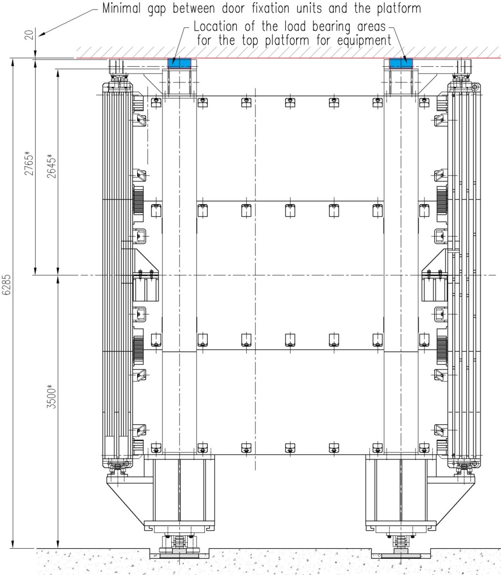
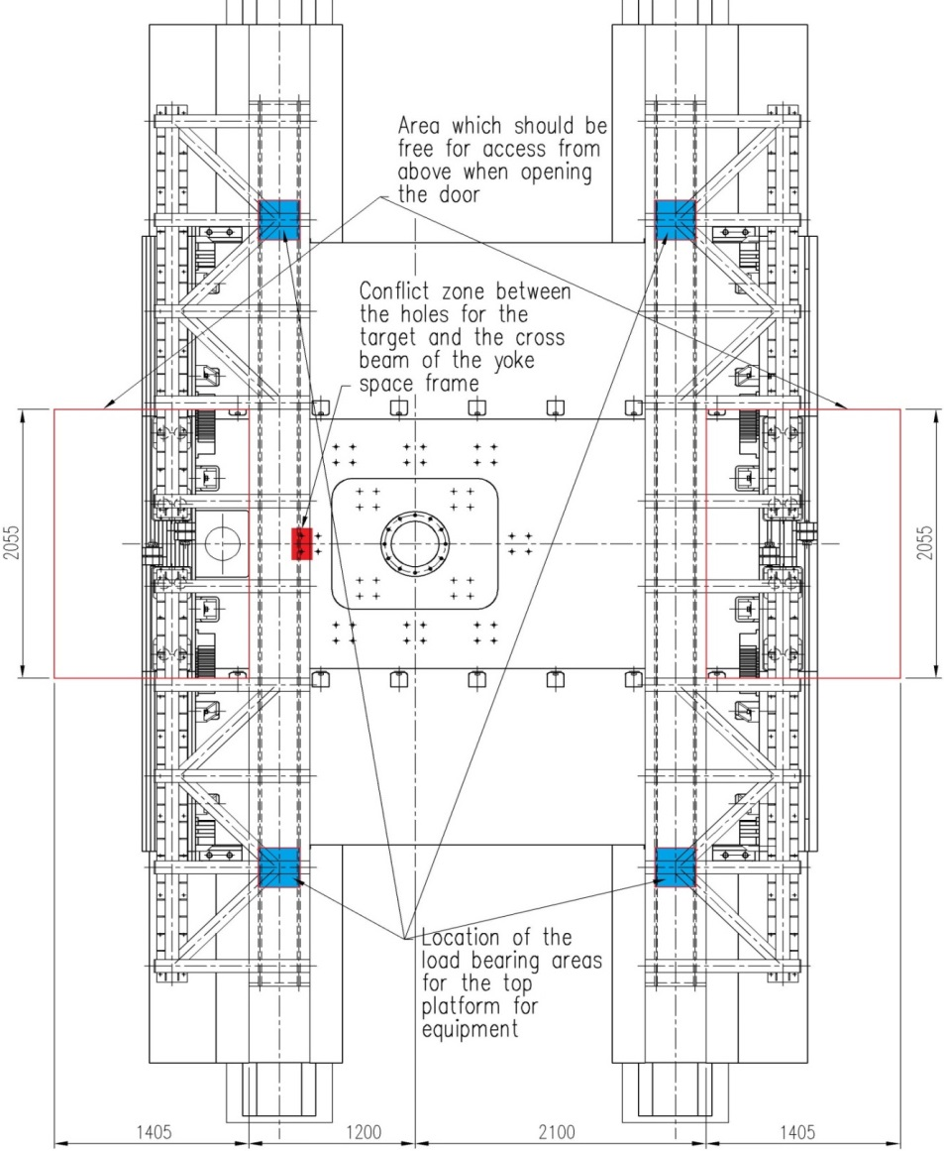
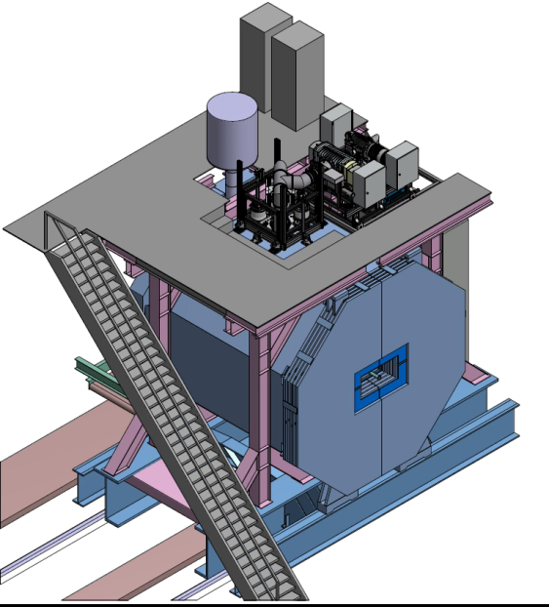
Yoke/Top platform Interface suggestion (25.02.2013)

Slide 12
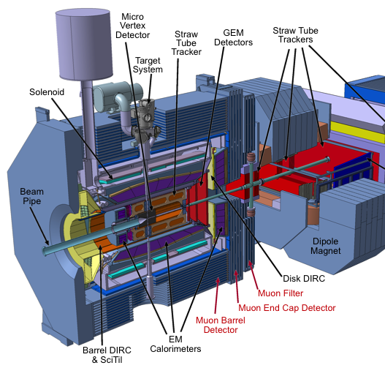
Interfaces that have not formalized jet
  Backward EMC
  Boxes with electronics on the platform sides
  Muon filter
  Top platform

Slide 13
Yoke Strength Analysis

Slide 14
Extensive computations were undertaken to validate the yoke design and its ability to withstand all loads in the process of yoke assembly, movement and operation.
It was considered about thirty load cases of the yoke for different design models:
yoke with/wo doors;
four or ten magnet supports;
different rigidity of the door fixation to the butt end of the yoke;
different options of the cryostat fixation to the yoke,
and in different regimes
  assembly on steady state supports;
  magnet movement on roller skates;
  run into on-path irregularity in the process of movement;
  divergence of moving directions of roller skates;
  operative mode of the magnet with maximal decentering magnetic forces;
  seismic accident (the magnet is in operative regime).

Slide 15
Initial Data
All main dimensions of the yoke FE model are in accordance with CAD model https://edms.cern.ch FAIR Project, PANDA, Magnets, Solenoid yoke ID = 1064509
Cryostat dimensions, loads and points of their application are in accordance :
  http://panda-wiki.gsi.de/pub/Magnet/Internal/keep_away_25_02_2011.zip
  http://panda-wiki.gsi.de/pub/Magnet/Internal/pandaTS_spectrometer_25_02_2011.zip
  http://panda-wiki.gsi.de/pub/Magnet/Internal/panda_coil_25_02_2011.zip,
  (Letter from R.Parodi of 30.11.11)
Material properties of the cryostat shells are from presentation «Panda TS Aluminium Cryostat» (letter from R.Parodi of 12.05.12).
Magnetic and seismic forces are in accordance with “New load table” of R. Parodi and H. Orth, May 8, 2012

Slide 16
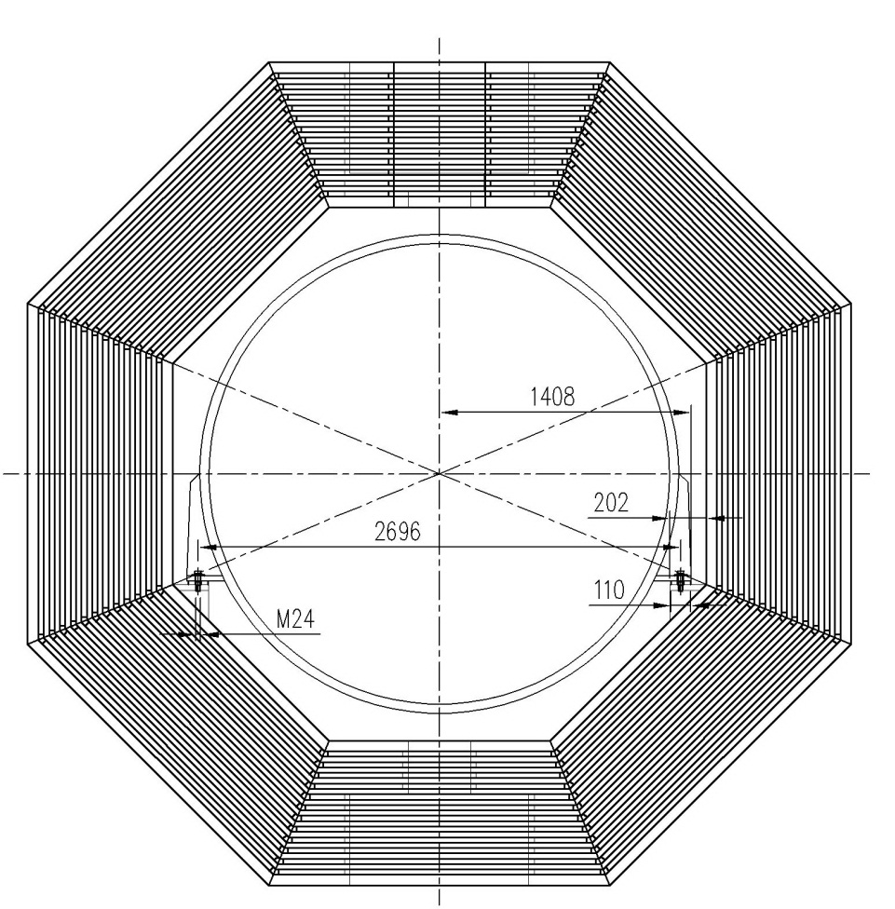
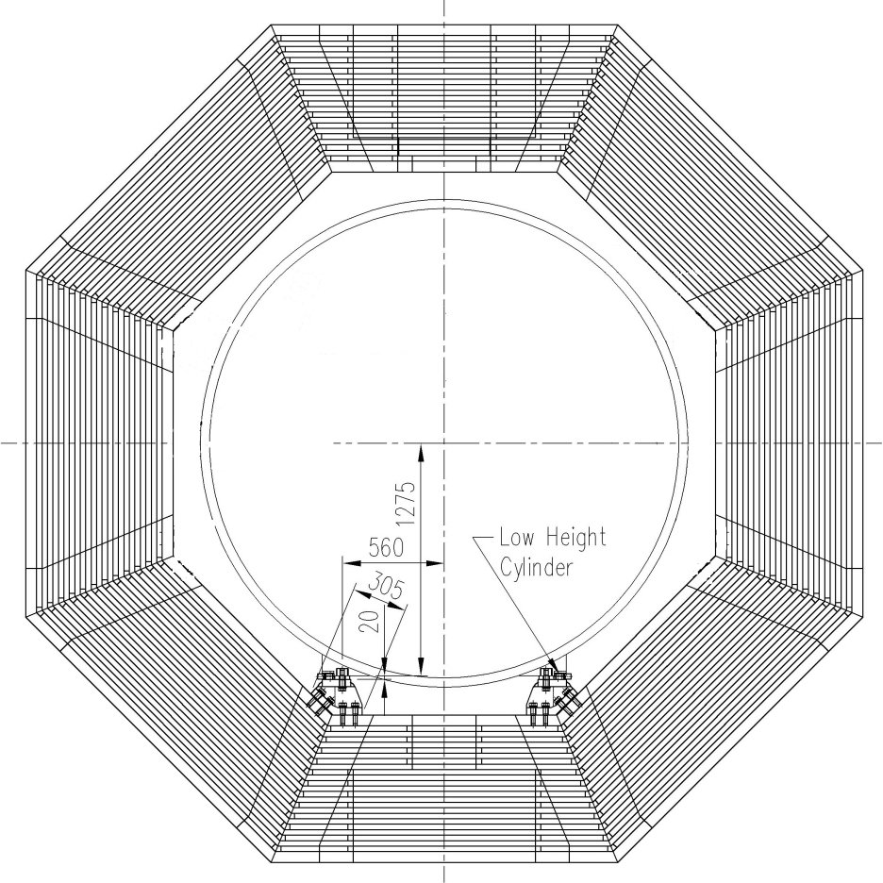
Cryostat fixation units
Option 1. Bottom beam fixation
Option 2. Tilted beam fixation

Slide 17
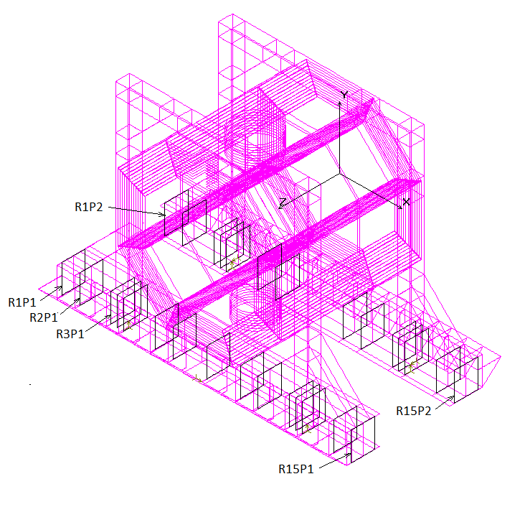
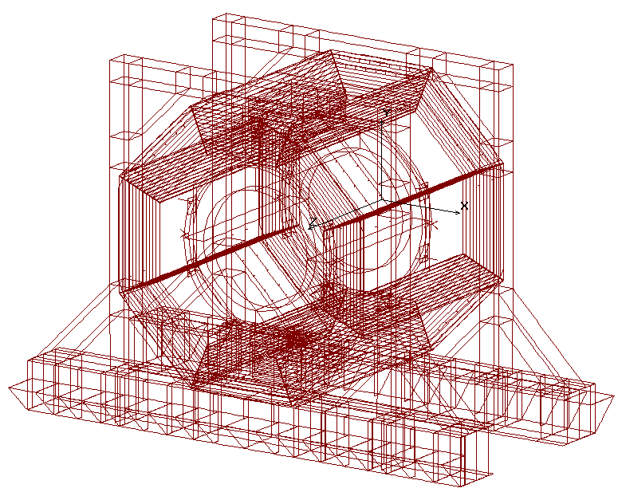
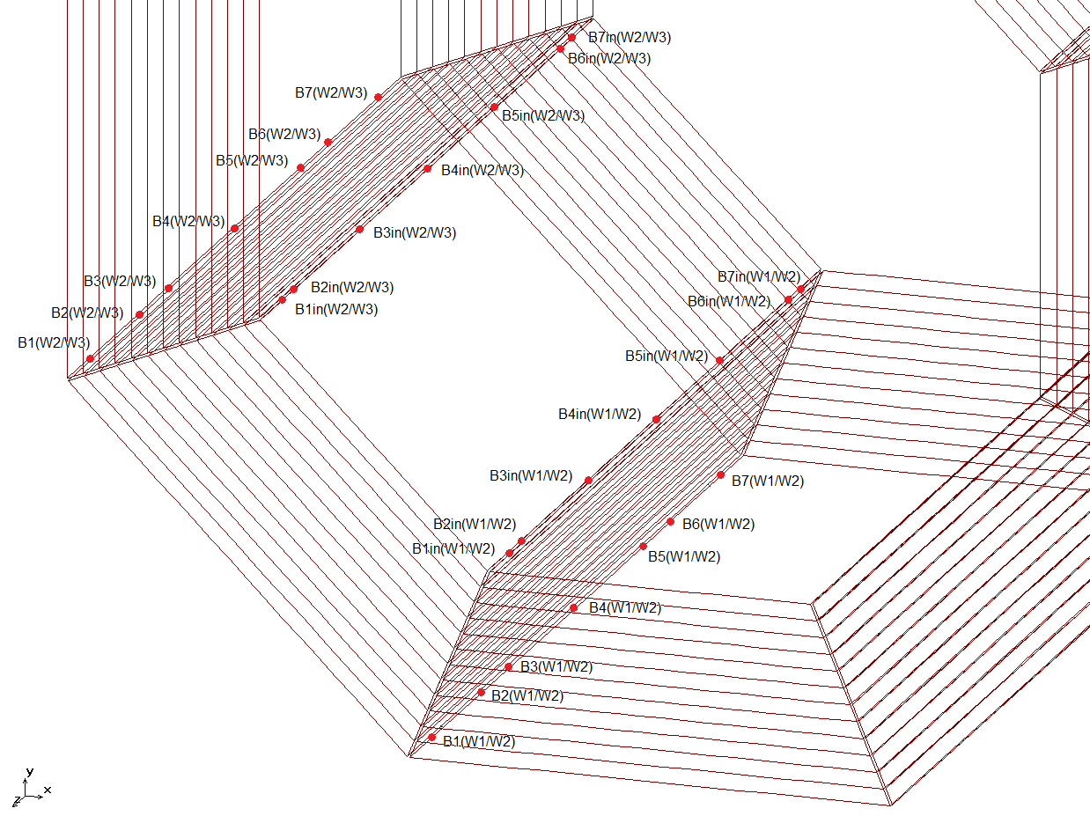
Magnet FE model

Slide 18
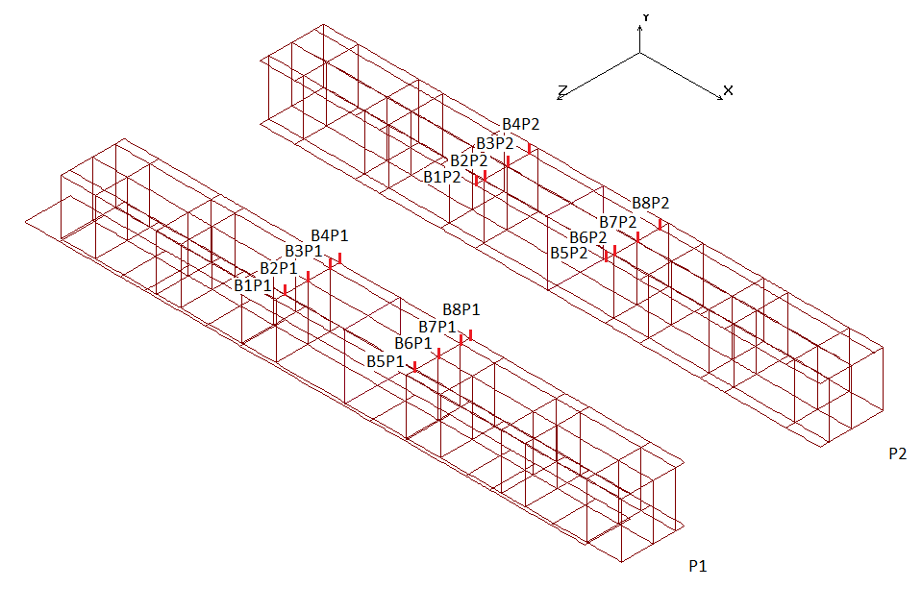
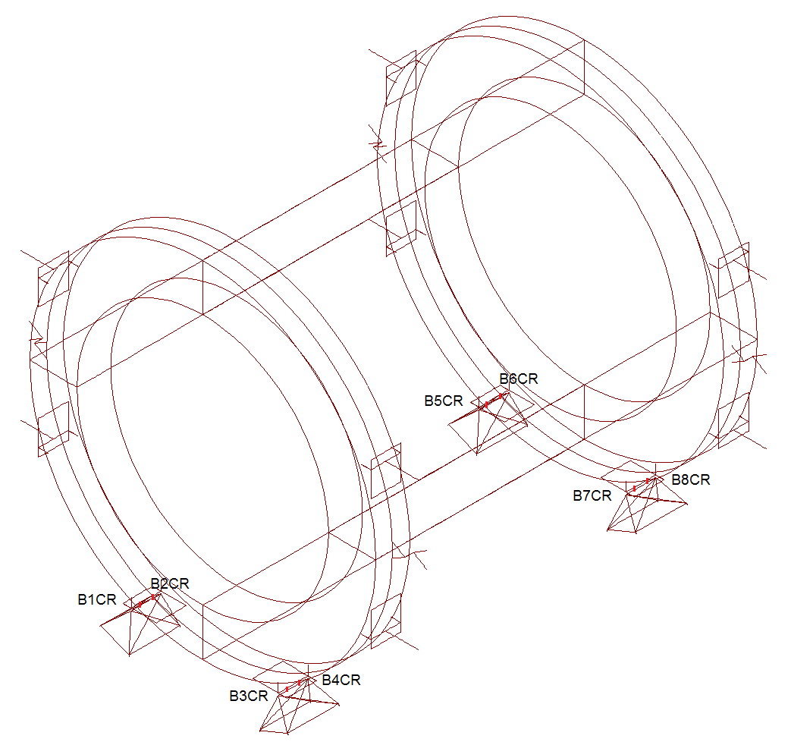
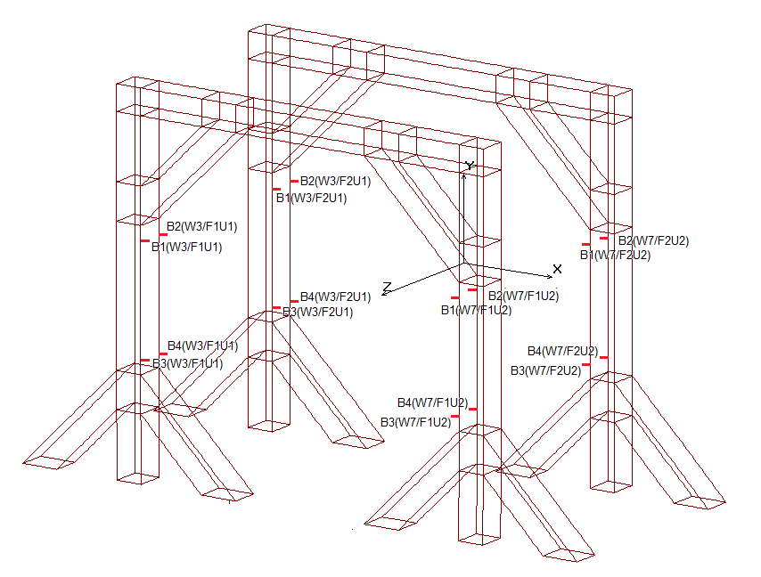
Details of the FE design model

Slide 19
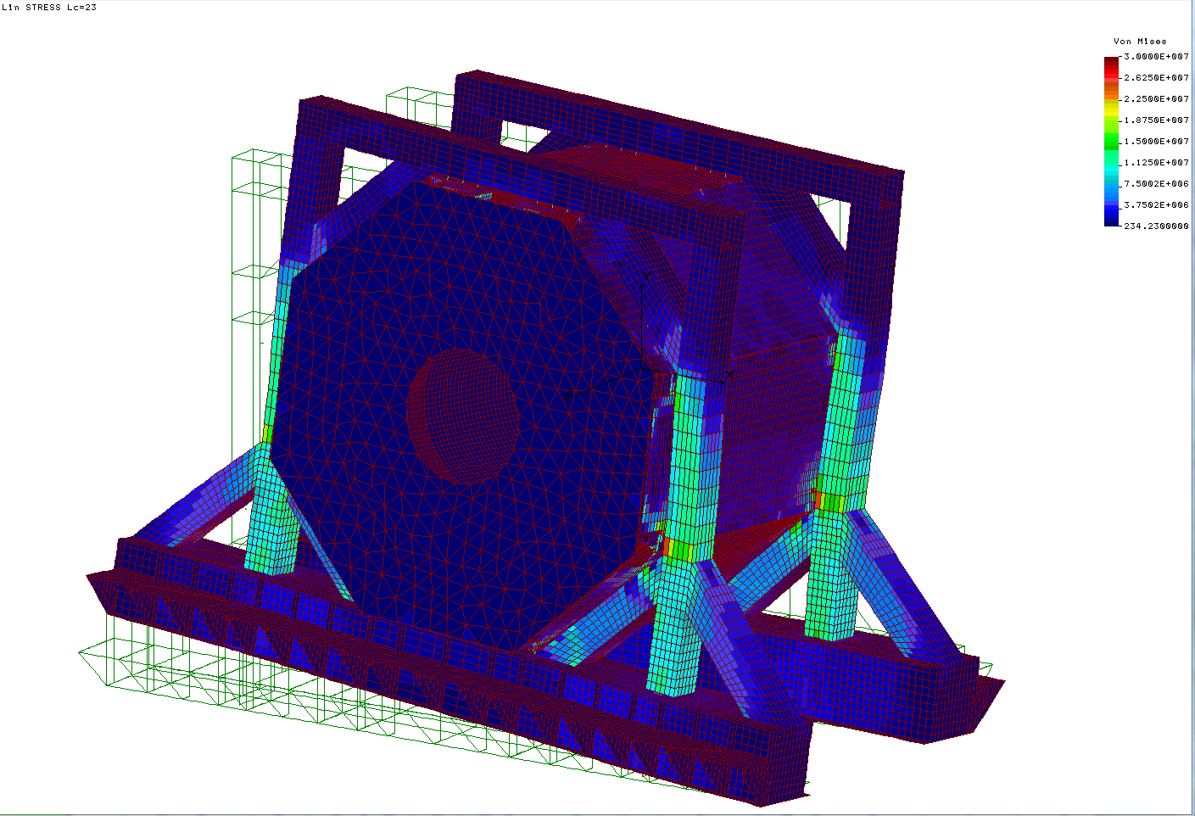
Deviations of Vertical Reactions in the Magnet Supports
Smooth way | Run into an elevation +1mm
R_{s11}=834 kN; R_{s12}=834 kN; R_{s21}=822 kN R_{s22}=822 kN | R_{s11}=1221 kN; R_{s12}=447 kN; R_{s21}=435 kN R_{s22}=1209 kN
Run into on-path unevenness of 1 mm in high
The deviations of vertical load on roller skates from average depends on the rail track quality. The vertical reaction can change within 225 ÷ 387 kN per 1 mm of the irregularity high. The spread is defined by uncertainty of the contact properties of the yoke barrel/doors fixation. An irregularity of about 1.9 mm in high could lead to doubling of initial load of two diagonal supports and rail contact loss in two other supports. The maximal acceptable rail nonparallelism of the rails projections on a plane YX has to be limited by 0.2 mrad on the length of the magnet road or by vertical deflection 1 mm/5m in any position on the rails surface.

Slide 20
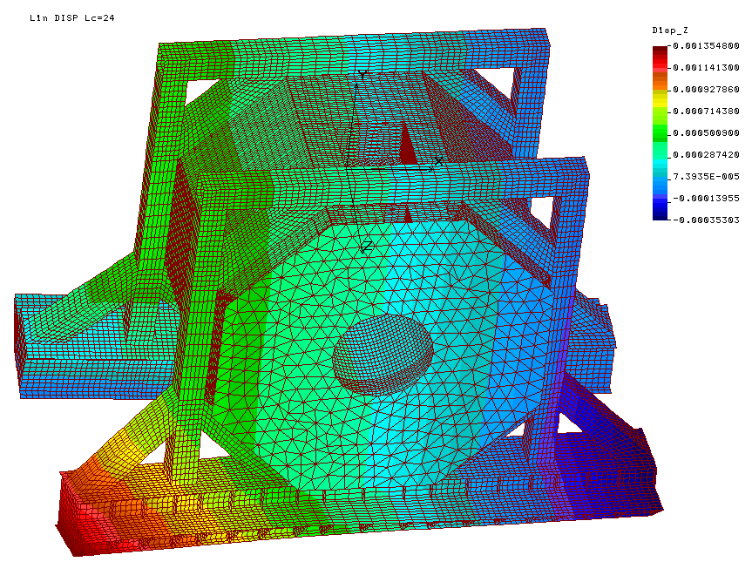
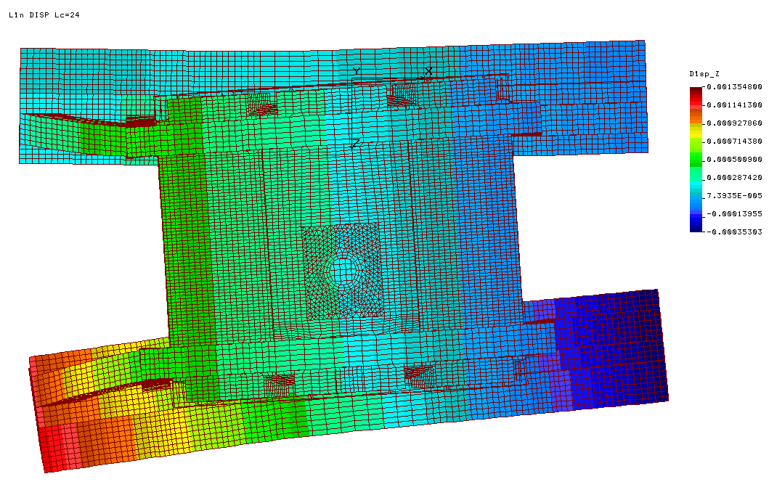
Divergence of moving directions of roller skates as an origin of lateral load applied to the platform beams
Top view
Fz
Axial stiffness of the platform arrangement 152 kN/mm
Maximal possible separation of the platform beams before roller carriage starts slipping is 0.8 mm (friction factor is 0.1).
1 mm separation is acceptable for yoke strength.
Lateral force applied to the platform beams

Slide 21
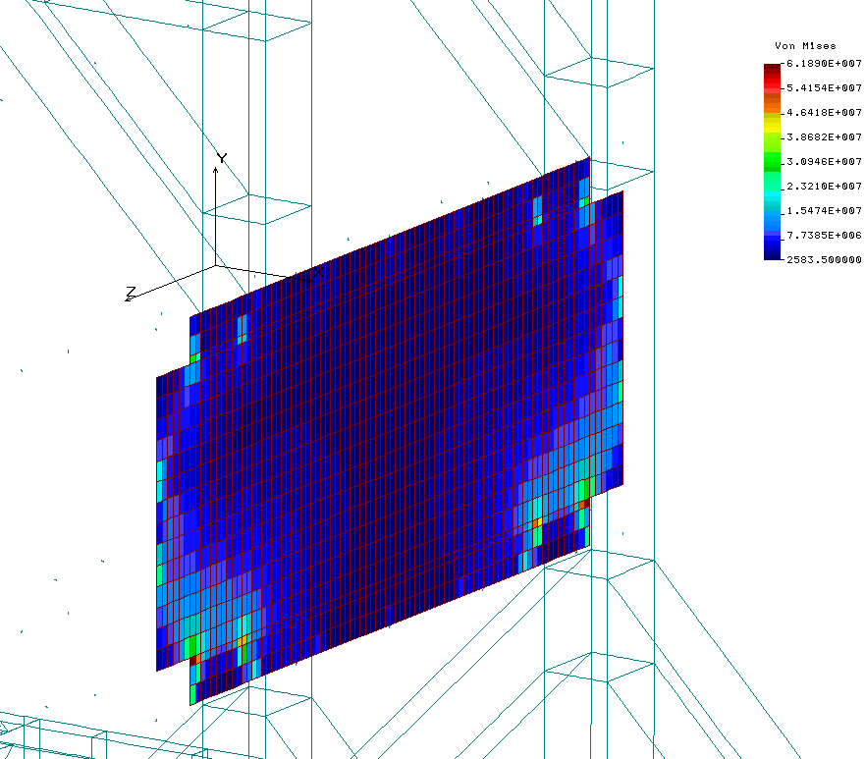
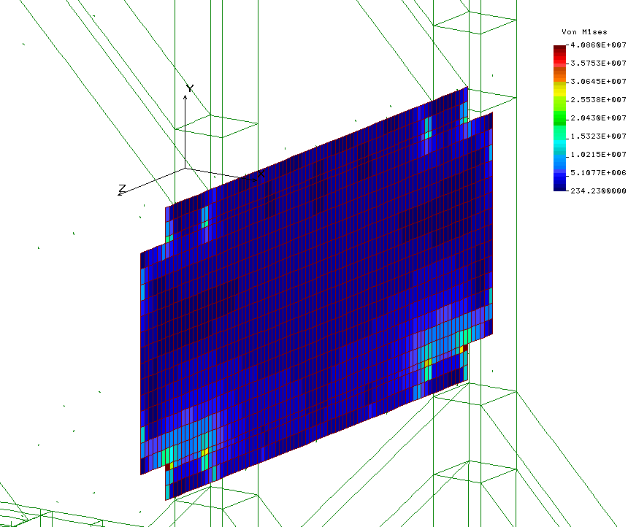
Equivalent stress (Von Mises) in the outer plate of the vertical beam
62+40=102MPa
η = [140]/102 ≈1.4
Magnet on four roller skates.
Run into on-path irregularity 1 mm in high

Slide 22
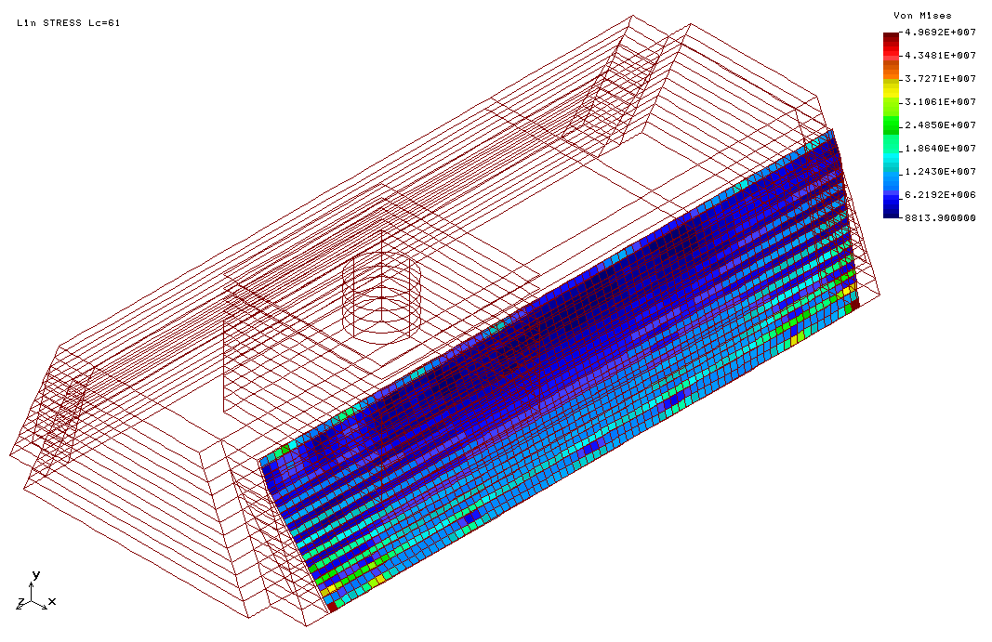
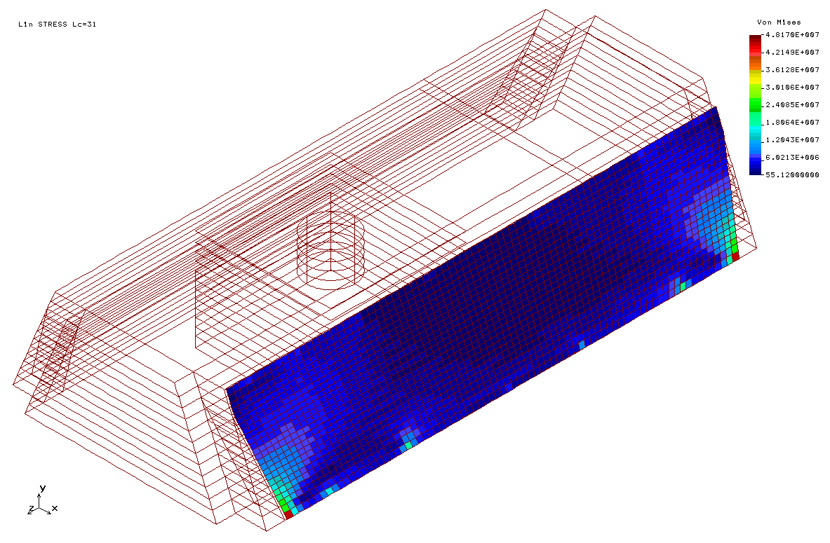
Equivalent stress (Von Mises) in the side plate of the beam W8 (junction W8/W1)
Magnet on four roller skates
Widening of the roller track up to +1mm
50+45 = 94 Mpa
η = 140/94 ≈1.5

Slide 23
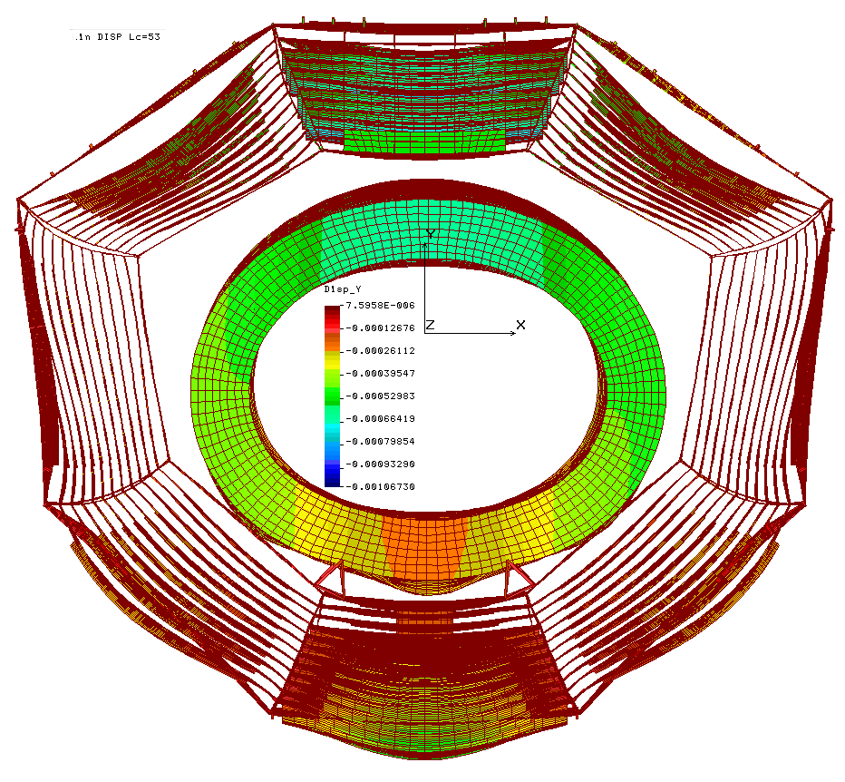
Vertical deformity of the yoke barrel beams
Maximal decreasing of gaps ~-0.7mm (Δ12W8)

Slide 24
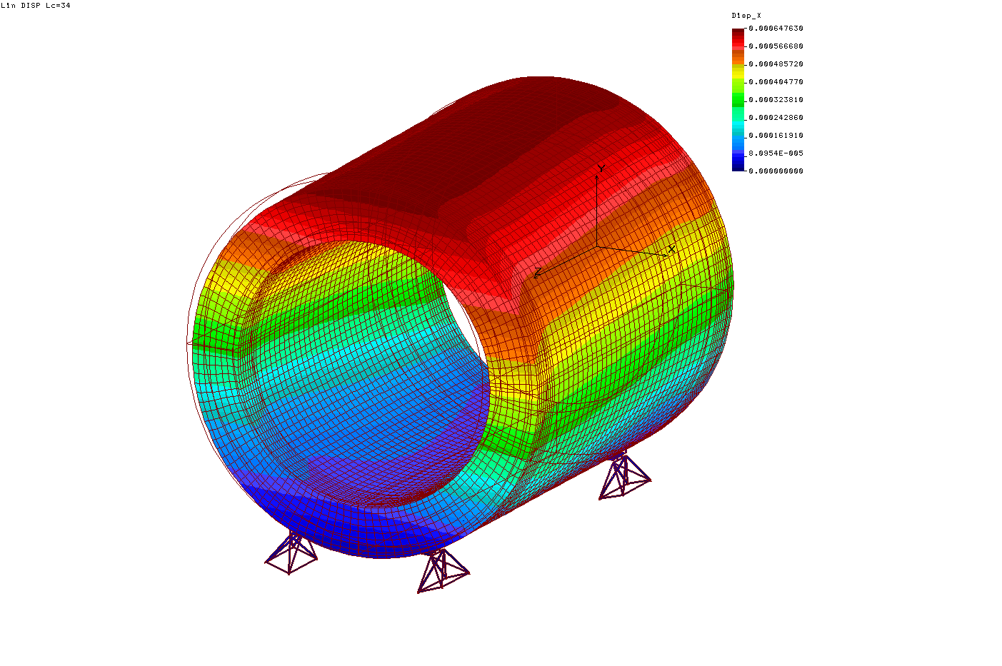
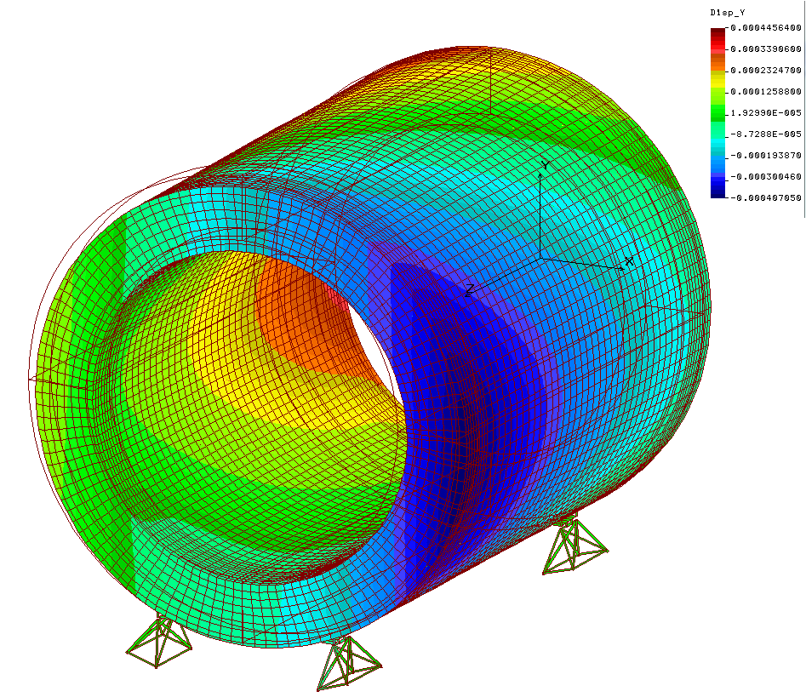
Cryostat deformity under action of magnetic forces Fx=45kN + Fz=140kN
Cryostat Support Option 1
Deformity in Y direction
Deformity in X direction
ΔXmax≈0.65mm
ΔYmax≈0.45mm
αmax = 0.137 mrad < [0.3 ] mrad

Slide 25
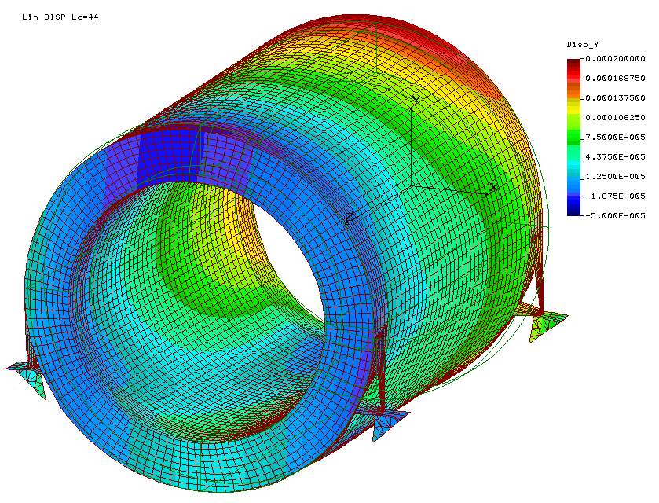
Cryostat deformity under action of magnetic forces Fx=45kN + Fz=140kN
Deformity in Y direction
Cryostat Support Option 2
αmax = 0.07 mrad < [0.3 ] mrad
ΔYmax≈0.2mm

Slide 26
Margin of safety for fixation units
 |  | η_{tension} | η_{shear} | Position | Load case
1. | Barrel bolts M24x2 | 1.7 |  | B5(W8/W1) | LC67
2. | Platform bolts M24x2 | 1.4 |  | B8P2 | LC63
3. | Cryostat support boltsM24x2 | 2.1 |  | B6CR | LC75
4. | Space frame bolts M24x2 |  | 1.9 | B7(W2/F2PL2) | LC85
5. | Door/barrel bolts M36x3 |  | 4 | B1(D1/W3) | LC64
6. | Door wings bolts M36x3 |  | 9 | B1(D11/D12) | LC83
 | η_{min=} | 1.4 |  | B8P2 | LC63

Slide 27
Main results of computations
The strength of the main components and fixation units of the iron yoke is on a sufficient level. The yoke is able to bear loads in all assembly, transportation and operative regimes with minimal safety margin 1.4.
The request of muon group for increased passages for cabling has been met.
The both cryostat support design options meet the demand of the GSI/INFN colleagues. From yoke strength point of view they are virtually identical.
Main characteristics of the yoke supports are prepared for Technical Specification of the rail track in GSI.

Slide 28
What design modifications should be made on the basis of mechanical computations?
The GSI chosen cryostat support option has to be designed.
The fixation units of the barrel beams to the space frame has to be redesigned (to remove some excessive bolts and to replace the bolts which are not tensioned by rests) .
Barrel connection bolts are loaded by essential shear forces. It takes to have some dowel pins to relieve the shear loads of bolts in radial and axial directions.
8 bolts in the barrel-platform interface bear tension&compression loads. The other 12 bolts are always compressed. All bolts are loaded by large shear forces. Bolt connections without tensile loads have to be replaced by rests which takes shear forces.
The deflection of the bottom barrel beam plate under weight of the forward electromagnetic calorimeter has to be compensated by a steel pad rigidly fixated to the barrel plate.
Door opener system and the rests for the maim actuator cylinders have to be designed.

Slide 29
What should be done before announce the tender for the yoke?
It takes
to coordinate and approve all interfaces;
to make final design modifications based on the results of mechanical computations and interface coordination (to make the final release of the drawings);
to prepare technical description and technical specification for the yoke

Slide 30
THANK YOU
FOR YOUR ATTENTION!

Slide 31


Magnet design process
Before 2007: preliminary studies and elaboration of the conceptual design
  April 2007, GSI: Review meeting, recommendations by international experts (A.Dael, D.Tommasini, A.Yamamoto), choice of the general concept
  July 2007, Dubna: XXI PANDA Collaboration Meeting, decision on the further magnet design strategy
March 2008, GSI: agreement on the Work Packages and Responsibilities for the TS magnet parts among 4 groups from Germany, Italy, Russia, Poland. Dubna group responsibility: Flux Return Yoke. By the end of 2008 the technical design of the solenoid was prepared by groups for the reviewing process and adopted by the PANDA Collaboration
2010-2011: coordination of the technical details with the detector groups.
2012 – acceptance of the JINR yoke support concept and mechanical analysis of the yoke design

Slide 32
What should be estimated for the rail track
Bearing strength of concrete floor for steady state support
Bearing strength of concrete floor below a roller skate
Bearing strength of concrete floor below a hydraulic jack
Temperature deformation of the support plate
Strength of welding connections of the support plate
Buckling resistance of the support plate in compression
Strength of fasteners of the replaceable rest for hydraulic actuators

