Slide 1

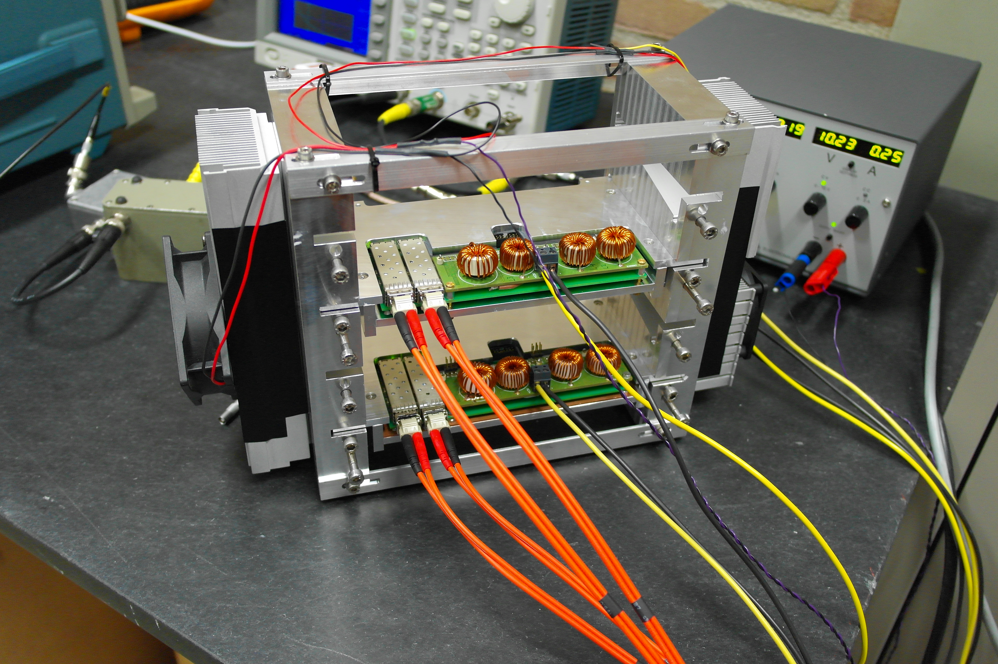



EMC Front-End Electronics
for the Preassembly
M. Tiemens, M. Kavatsyuk
KVI, University of Groningen

Slide 2
Readout for Electromagnetic Calorimeter
EMC Volume
SADC clock sync. signals
slow control
Data Concentrator
Calibration
Merge data from 2 photo-sensors
SODANET
-25 °C
Digitizer
Preamplifier
SADC
FPGA
Online pulse-data processing;
Feature Extraction
Optical Link
Compute Node
LAAPD’s
Hit data
Feature Extraction: (developed at KVI)
Stage I:
Base-line follower
Pulse detection
Pile-up detection (output waveforms)
Time-stamp at maximum
Stage II:
Precise time
Precise energy
Data Concentration:
(developed at KVI)
Time ordering data from all inputs
Pile-up recovery (to be implemented)

Slide 3
SODANET Topology
slow
control
SODANET
source
FEE
DC
HUB
slow
control
FEE
DC
HUB
slow
control
FEE
HUB
DC
slow
control
FEE
HUB
DC
slow
control
Burst building network (BBN)

Slide 4
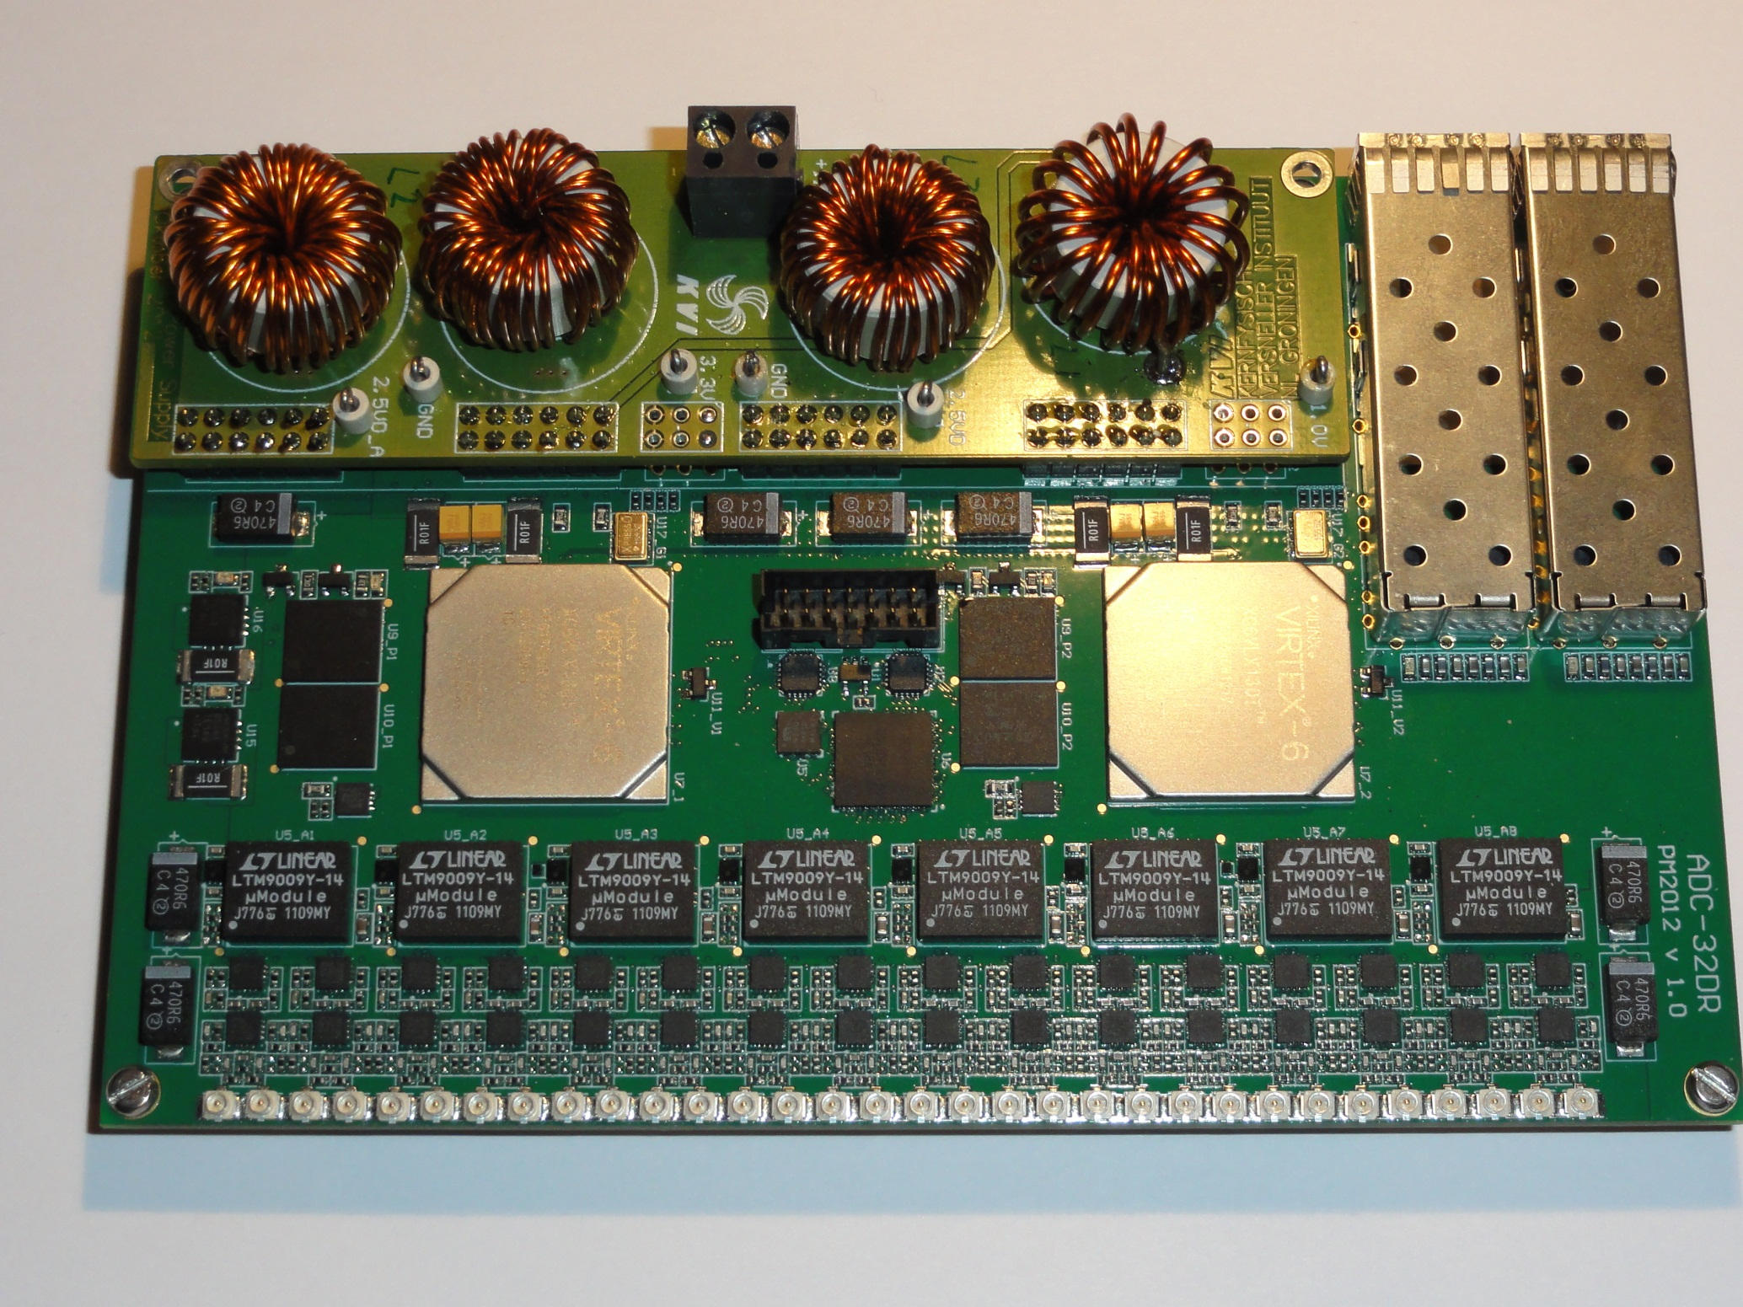
EMC Digitizer
- Data rates
EMC Volume
Digitizer prototype v2
Digitizer
SADC
FPGA
Online pulse-data processing;
Feature Extraction
(developed by P. Marciniewski)
Forward End Cap:
Average hit rate of 350 kHz -> ~ 2.2 Gbps
Required channel density reached
Radiation hardness is being studied

Slide 5
EMC Digitizer
- Data rates
EMC Volume
Digitizer prototype v2
Digitizer
SADC
FPGA
Online pulse-data processing;
Feature Extraction
TOO EXPENSIVE
(developed by P. Marciniewski)
Redesign required:
Replace Virtex 6 with Kintex 7 FPGA
New board expected ready next year

Slide 6
EMC Digitizer
- Passive cooling & readout
Ready to use & fully functional with existing test readout (EMC only, no external triggers)
Tests with PROTO192 on-going
Development of SODA source, time-distribution network (SODANET) and new data concentrator is on-going
Once done, hopefully end of summer
Common tests with other subsystems
Online event building
Possibility of external triggering

Slide 7
Data Concentrator
- Functionality
Required functionality (EMC):
Time-distribution functionality
Separation of the hit-data and slow-control streams
Combine information from two photo-sensors, reading out same crystal
Identification and correction of a nuclear counter effect
Energy calibration
Time-ordering of the data
Pile-up recovery

Slide 8
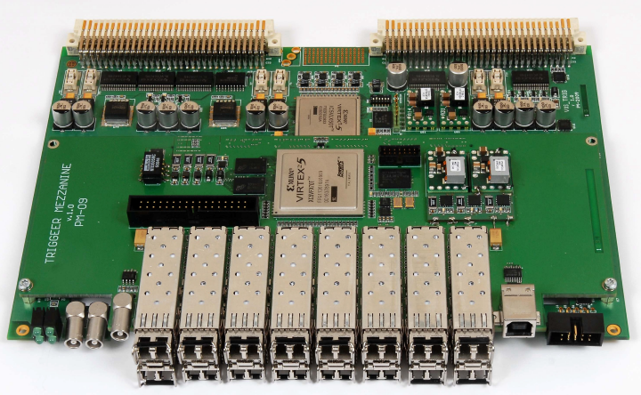
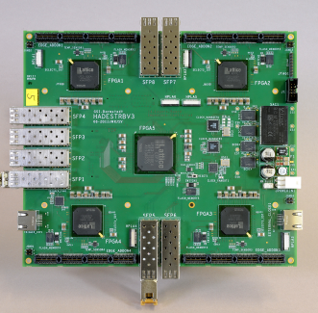
Data Concentrator
- Implementation
Current implementation:
Hardware: WASA data concentrator
Functional
EMC only
Desired implementation:
Hardware: TRBv3 Board
Combined readout for: EMC, STT, MVD, DIRC
Ready by end of summer

Slide 9
TRB as a Data Concentrator
Advantages:
Different configurations of readout system possible
Disadvantages:
Low optical fibre speed (max 3 Gbps)
Possible TRB configurations for the End Cap:
Low speed/EMC hit-rate
(<60 kHz/crystal):
1 SODANET IO (TRB main board)
1 link to CN (TRB main board)
24 links to digitizers (piggyback boards)
High speed (expected at normal operation at HESR):
1 SODANET IO (TRB main board)
6 links to CN (piggyback boards)
18 links to digitizers
(piggyback boards)

Slide 10
Interface to DAQ
- Low rate
Preamps
# Input channels: 6941×2
# Digitizers: 217
# TRB boards: 9
# Fibres to CN: 9
Digitizers
DC
TRB Boards
To time-ordering network/ Compute Nodes

Slide 11
Interface to DAQ
- High rate
Preamps
# Input channels: 6941×2
# Digitizers: 217
# TRB boards: 12
# Fibres to CN: 72
Digitizers
DC
TRB Boards
To time-ordering network/ Compute Nodes

Slide 12
Summary
Digitizers:
Board which fulfils EMC requirements is functional (can be ordered for interested parties)
First prototype of passive-cooling crate is functional: optimization is on-going
Redesign is required to reduce costs
Data concentrator:
Existing version (based on WASA hardware) is functional; works for EMC only
TRB board is under development
Allows to combine data of different subsystems
Flexible configuration for readout of the EMC forward end cap with few Compute Nodes:
Complete end cap readout at low rates (<60 kHz/crystal)
Partial end cap readout at high rates

