Slide 1

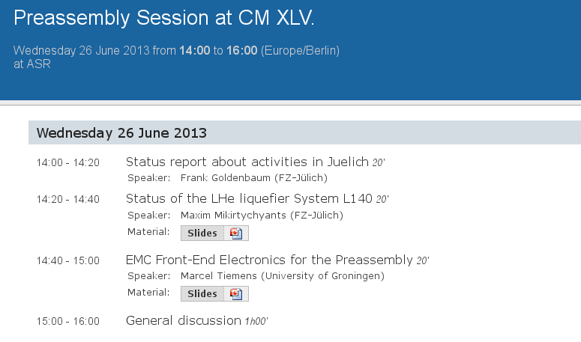

Slide 2
Preassembly Funding Request… (FZJ Investitionsfonds)
Email → PANDA-TB@gsi.de (Fri, 3 May 2013): Dear colleague, …In a recent discussion, our division head, Sebastian Schmidt (member of the board of directors), requested that the Jülich contribution is put in context with the total cost for the preassembly. The goal is that we make a presentable package turning the preassembly into a proper and visible project. Thus, we need to list the external contributions during the preassembly phase. We would appreciate if you could tell us about the money that you will have to invest in the preassembly. The list can include manpower…
Many thanks for your valueable input !!!
→ only integral number of money contributions, manpower, hardware, traveling money, list of components communicated
→ wait for decision on next board-of-directors meeting

Slide 3
Preassembly Funding Request…
NRW-FAIR revival: letter of Sebastian Schmidt to Rectors of the NRW-Universities (Bochum, Bonn, Iserlohn, Münster) in order to contact Svenja Schulze (NRW minister for Innovation, Science & Research)
potential contribution via FAIR GmbH ?
integration in COSTBOOK ?
(pre-assembly common fund ? )

Slide 4
Beam Time in 2013/14

Slide 5
Beam Time in 2013/14
PAC

Slide 7
System and sub-system managers
Systems and sub-systems | Name
Magnets | Lars Schmitt (prov.)
Solenoid coil & cryostat Pellet Target | Renzo Parodi
Solenoid return yoke | Alexander Vodopianov
Dipole | Lars Schmitt (prov.)
Support & positioning | Edward Lisowski
Targets | Alfons Khoukaz
Pellet Target | Markus Büscher
Cluster Target | Alfons Khoukaz
Beamline and interaction region | Dieter Prasuhn
Silicon detectors | Kai T. Brinkmann
Pixels | Daniela Calvo
Strips | Tobias Stockmanns
Luminosity Monitor | Miriam Fritsch
Trackers | Paola Gianotti
STT | Peter Wintz
Endcap GEM | Bernd Voss
Forward trackers | Jerzy Smyrski
Systems and sub-systems | Name
EMC | Rainer Novotny
Barrel | Andrea Wilms
FW-Endcap BW-Endcap | Fritz-Herbert Heinsius David Rodriguez
Forward Shashlyk | Pavel Semenov
Charged Particle ID | Carsten Schwarz
Barrel DIRC | Jochen Schwiening
Endcap Cherenkov | Klaus Föhl, Björn Seitz
Forward RICH | Ralf Kaiser
TOF | Carsten Schwarz
Muon system | Genadi Alexeev, Maria Pia Bussa (deputy)
Hypernuclei equipment | Josef Pochodzalla
Electronics | Piotr Salabura
Frontend Electronics | Angelo Rivetti, Myroslav Kavatsyuk (deputy)
DAQ/Trigger | Wolfgang Kühn
Control systems | Lars Schmitt (prov.)

Slide 8
readiness for pre-assembly (slide of dec 2012)
Number of issues to be addressed
space requirements
staging (e.g. availability of other detector components)
which detector will come when?
Status and time planning of mechanical construction;
Status and major results of prototype performance evaluations;
Status and time planning of engineering drawings;
Availability of crucial detector components;
Status and time planning of the readout system;
Specific goals of the pre-assembly:
which systems integrated subsystems have to function together;
which results are expected from the pre-assembly or system tests.
Sourcing human, financial and material resources need input asap

