Slide 1
CST Studio @ GSI

Slide 2
Licenses

Slide 3
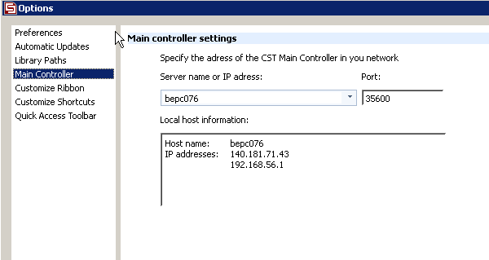
Solver Server
You can send Jobs with high memory or CPU requirements to a solver server in order to keep your desktop computer fast
In configuration, add bepc076 as Main Controller

Slide 4
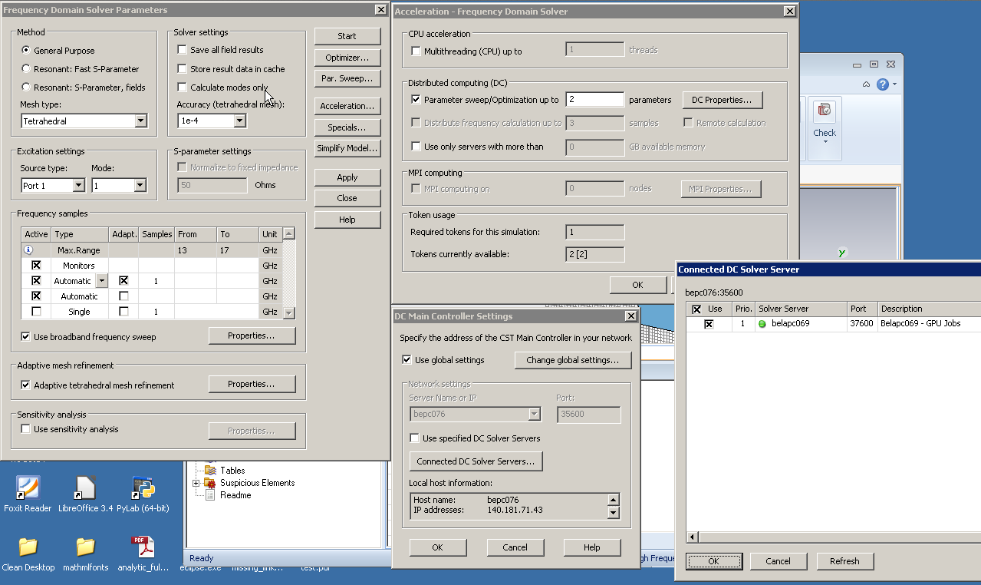
2
1
4. Select server with
high memory
3

Slide 5
CST-USERs mailinglist
There is a mailinglist cst-users on the GSI listserv
We will use it to announce new versions, changes in License or Solver Server and to communicate outages (for example the license server has to be upgraded in the near future)
Please ask colleagues using CST to subscribe to cst-users at http://www-listserv.gsi.de/

