Slide 1
Project Interfaces Machine Installation
SIS100 Klausur 22.-24.09.2025
Janet Schmidt

Slide 2
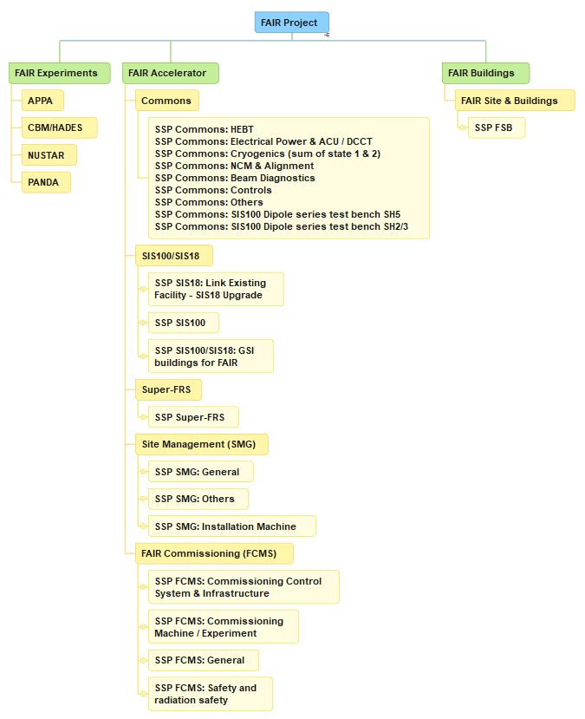
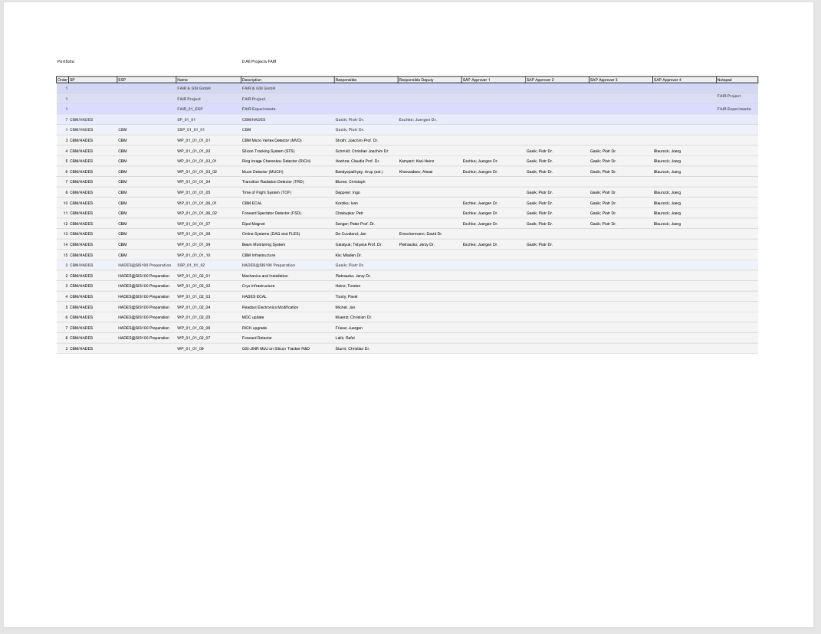
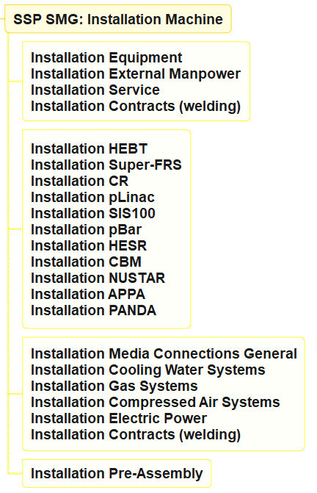
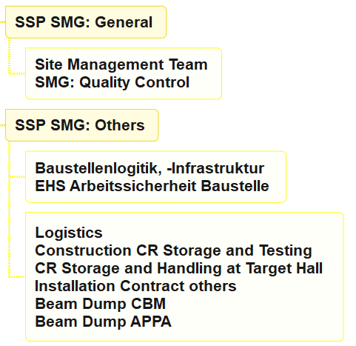
FAIR Project
EDMS:1762113

Slide 3
Machine Installation – Project Milestones
Order |  | Name | Description
0 | 1 | M10 | SAT A accepted / component ready for installation or pre-assembly
0 | 2 | M10-1 | 1st component ready for installation or pre-assembly
0 | 3 | M92 | End of Shipment
9 | 4 | S06P | Pre-assembly and testing of components / modules
1 | 5 | A10-P | Pre-assembly and testing of components / modules
2 | 6 | M10-P | Pre-assembly and testing of components / modules is finished
13 | 7 | MB10 | Building ready for installation
14 | 8 | ACC10 | timeframe for machine installation
15 | 9 | MCC150-MB10-LV | Building ready for installation + Low Voltage distribution boards active
13 | 10 | SCC4 | Building commissioning / Inbetriebnahme Gebäude (Anteil Lp 8)
1 | 11 | MCC160-S | start with testing and commissioning Building
2 | 12 | ACC160 | testing and commissioning
3 | 13 | MCC160-MB11 | completion of testing and commissioning Building
7 | 14 | S007 | Installation in tunnel / cave
0 | 15 | ABL1 | Blue lining
1 | 16 | MBLF1 | Blue Line Finished
2 | 17 | A110 | Transport into tunnel / to experimental site
3 | 18 | M102-S | Start of ACC/EXP components installation
4 | 19 | A112 | Assembly of ACC/EXP components
5 | 20 | M102-1 | 1st ACC/EXP component assembly and alignment finished
6 | 21 | M102 | End of ACC/EXP components installation
7 | 22 | AAL1 | Alignment of ACC/EXP components
8 | 23 | MALF1 | Alignment of ACC/EXP components is finished
9 | 24 | MR103-S | Start of ACC local commissining (Phase 1.0) - Gate Review

Slide 4
Machine Installation – Project Milestones
Order |  | Name | Description
0 | 1 | M10 | SAT A accepted / component ready for installation or pre-assembly
0 | 2 | M10-1 | 1st component ready for installation or pre-assembly
0 | 3 | M92 | End of Shipment
9 | 4 | S06P | Pre-assembly and testing of components / modules
1 | 5 | A10-P | Pre-assembly and testing of components / modules
2 | 6 | M10-P | Pre-assembly and testing of components / modules is finished
13 | 7 | MB10 | Building ready for installation
14 | 8 | ACC10 | timeframe for machine installation
15 | 9 | MCC150-MB10-LV | Building ready for installation + Low Voltage distribution boards active
13 | 10 | SCC4 | Building commissioning / Inbetriebnahme Gebäude (Anteil Lp 8)
1 | 11 | MCC160-S | start with testing and commissioning Building
2 | 12 | ACC160 | testing and commissioning
3 | 13 | MCC160-MB11 | completion of testing and commissioning Building
7 | 14 | S007 | Installation in tunnel / cave
0 | 15 | ABL1 | Blue lining
1 | 16 | MBLF1 | Blue Line Finished
2 | 17 | A110 | Transport into tunnel / to experimental site
3 | 18 | M102-S | Start of ACC/EXP components installation
4 | 19 | A112 | Assembly of ACC/EXP components
5 | 20 | M102-1 | 1st ACC/EXP component assembly and alignment finished
6 | 21 | M102 | End of ACC/EXP components installation
7 | 22 | AAL1 | Alignment of ACC/EXP components
8 | 23 | MALF1 | Alignment of ACC/EXP components is finished
9 | 24 | MR103-S | Start of ACC local commissining (Phase 1.0) - Gate Review

Slide 5
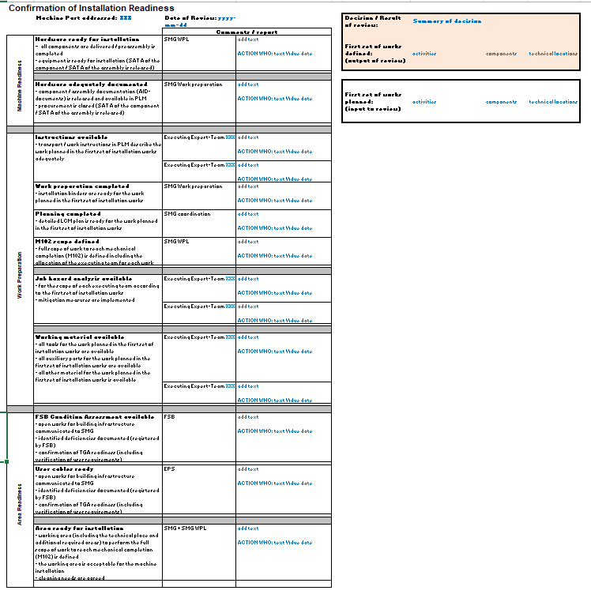
M102-S Gate Review „Installation Readiness“
Input:
Readiness of the machine components (M10 / M10-P)
hardware and documentation
Readiness of the work preparation
instructions, work binders, planning, scope, material, safety
Readiness of the installation area
FSB open tasks
cabling status
overall area condition
Output:
Discission to start machine installation in a new area
EDMS: 3327242

Slide 6
M102-S Gate Review „Installation Readiness“
Input:
Readiness of the machine components (M10 / M10-P)
hardware and documentation
Readiness of the work preparation
instructions, work binders, planning, scope, material, safety
Readiness of the installation area
FSB open tasks
cabling status
overall area condition
Output:
Discission to start machine installation in a new area
SMG-APLs machine, assembly responsibles
SMG work preparation, excecuting teams
FSB (U. Munsberg, J. Uhrich), electrical installation team
SMG SSPL machine installation and SMG-APLs machine
(based on input from the review team)

Slide 7
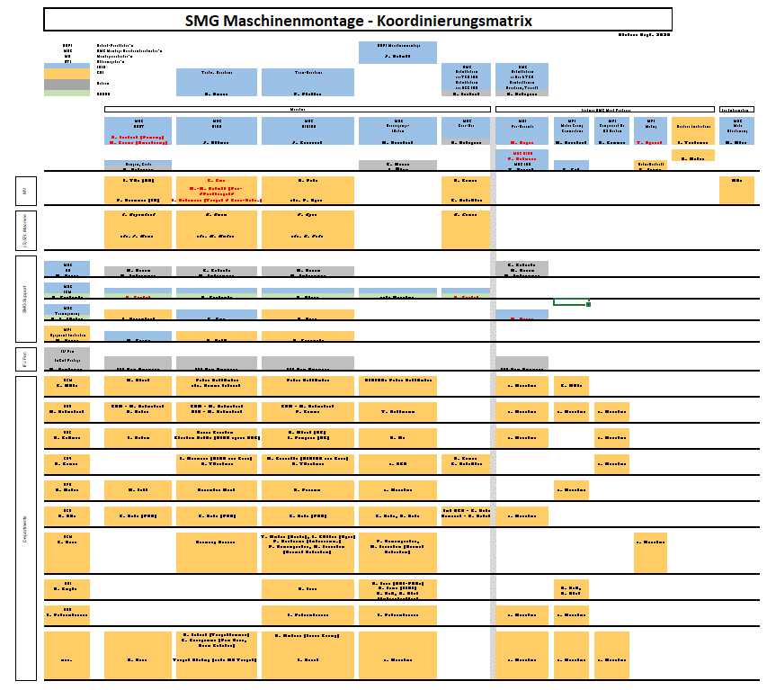
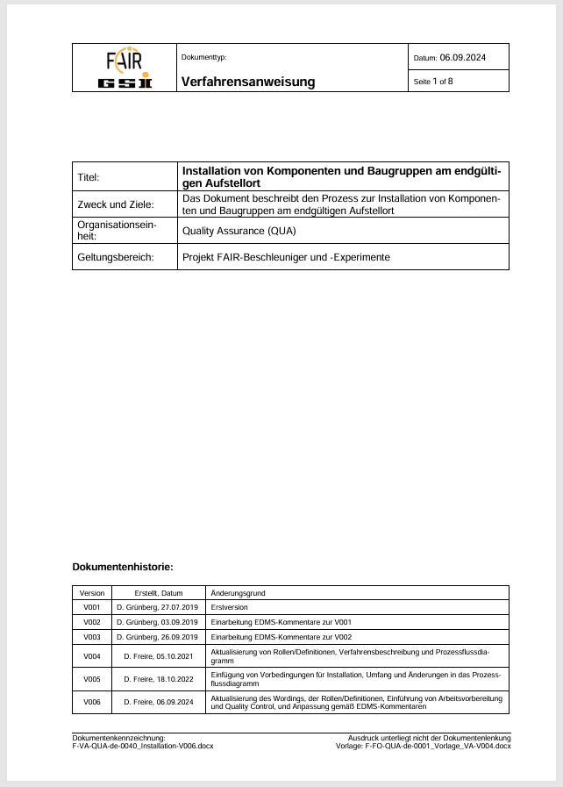
Machine Installation
People
Process
GSI - Maschinenmontage
EDMS:2401271,
2381180 and 3313828
EDMS:2206040,
2217753 and more

Slide 8
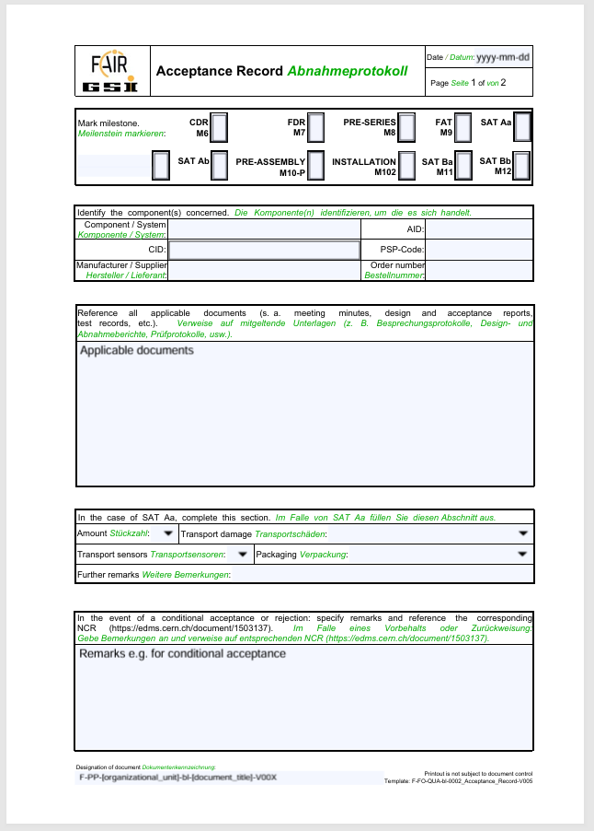
Machine Installation Compleation
M102 acceptance protocol
template from QUA (EDMS: 1458121)
based on technical locations
M102 status:
all components positioned
vacuum closed and tested
media connected
cooling water
cooling air
cabling
pressured air, N2, experimental gases
cryo
all connections tested
no electrical power and no cryo distribution during installation
beamline aligned
handover to commissioning

Slide 9
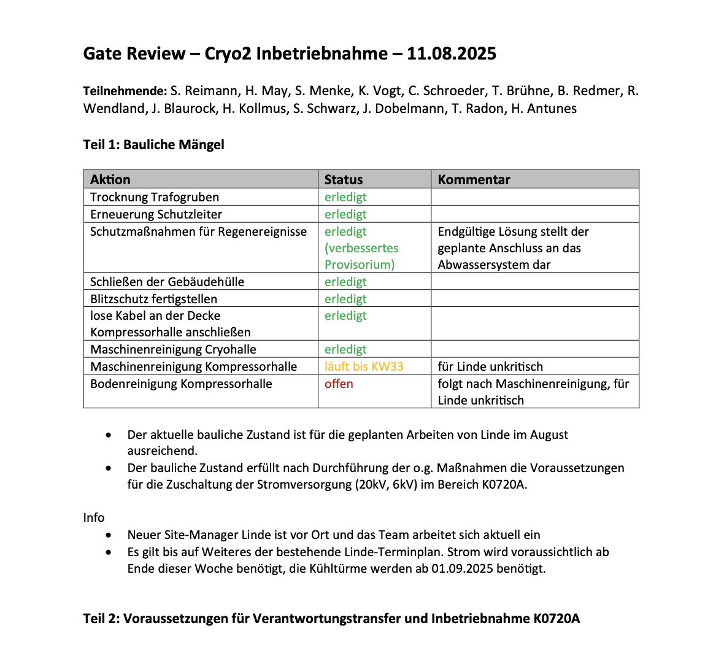
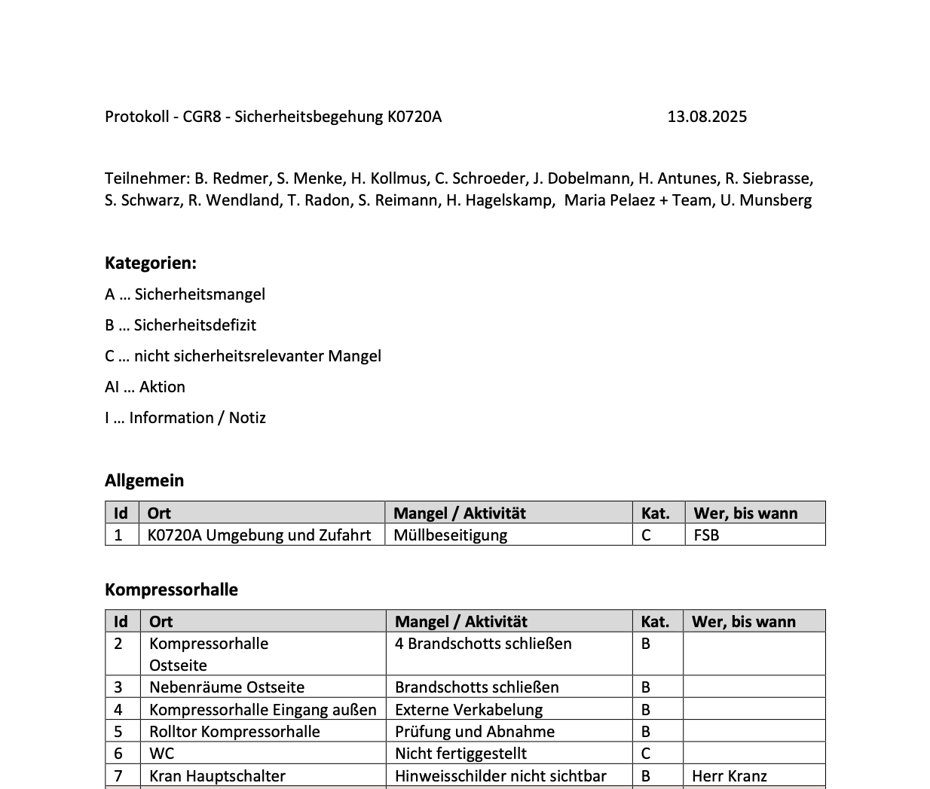
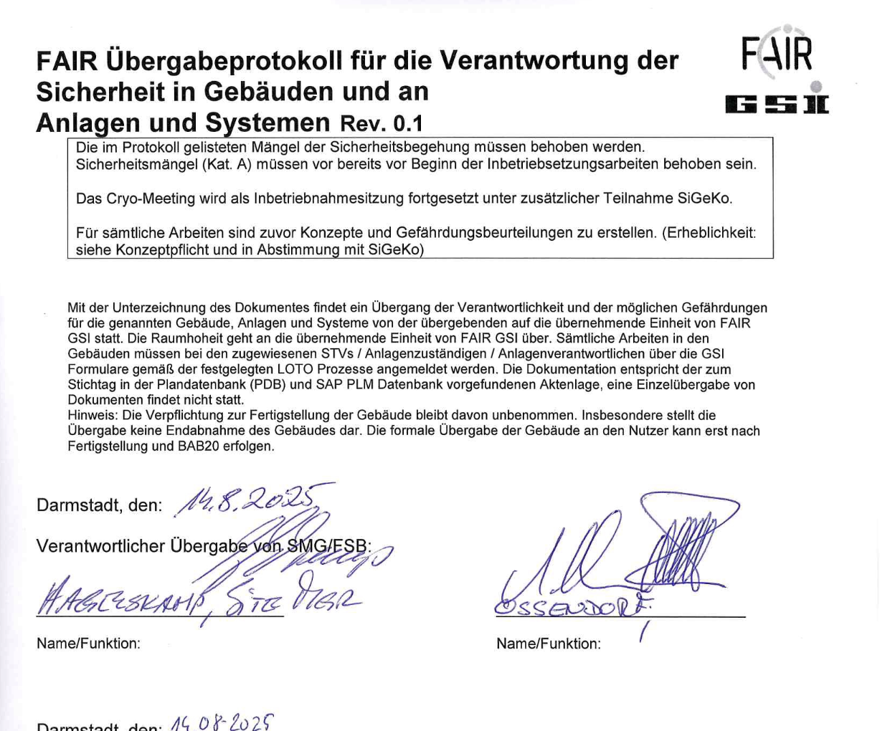
Transition from Installation to Commissioning
slide by S. Reimann!
Gate Review - review of readiness for commissioning – document status (incl. M102 acceptance protocol), organisation, role designation status
On Site Safety inspection and preparation of a remaining issues list
Handover of safety responsibility from SMG to FCM&GAT upon signature
Enforcement of access rules for commissioning phase, Key handover
Commissioning safety organization (SiFas, STVs, AZs) becomes effective

