Slide 1
Lessons learned from practical and daily installation process
4th SIS100 Workshop Procurement and Installation
Jan Kollarczyk, for Machine Installation Team
24.09.2025

Slide 2
Basic Points
Process of installation at FAIR [12 min]
On-site Machine Installation
Interaction with works on Technical Building Equipment (TBE)
Lean Construction Managent (LCM) for SIS100
Work registration, preparation and documentation
Discussion [3 min]

Slide 3
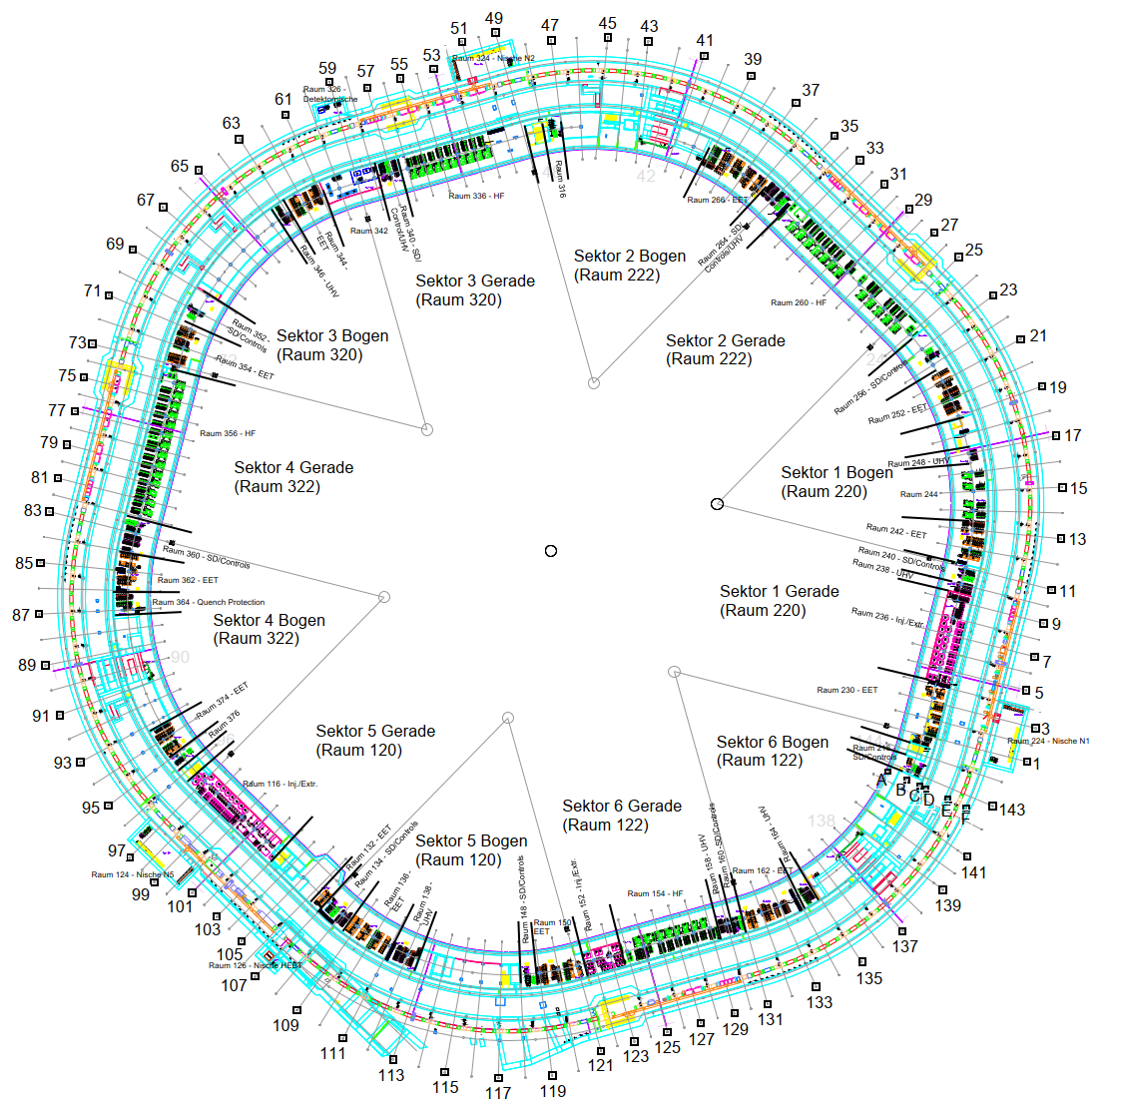
On-site Machine Installation
1) TRI
2) TRI, VAC
1) MEW
2) MEW, IFJ
1) ELC, FSB
2) SCM, MEW
1) ELC
2) ELC, FSB
1) -
2) ELC, RRF
1) MEW
2) IFJ
Status of
Works in Machine Tunnel
1) ongoing
2) soon within next 8 weeks
1) TRI
2) ELC, FSB
1) -
2) -
1) ELC
2) FSB
1) -
2) IFJ, TRI, SCM
1) ELC
2) FSB
1) -
2) -

Slide 4
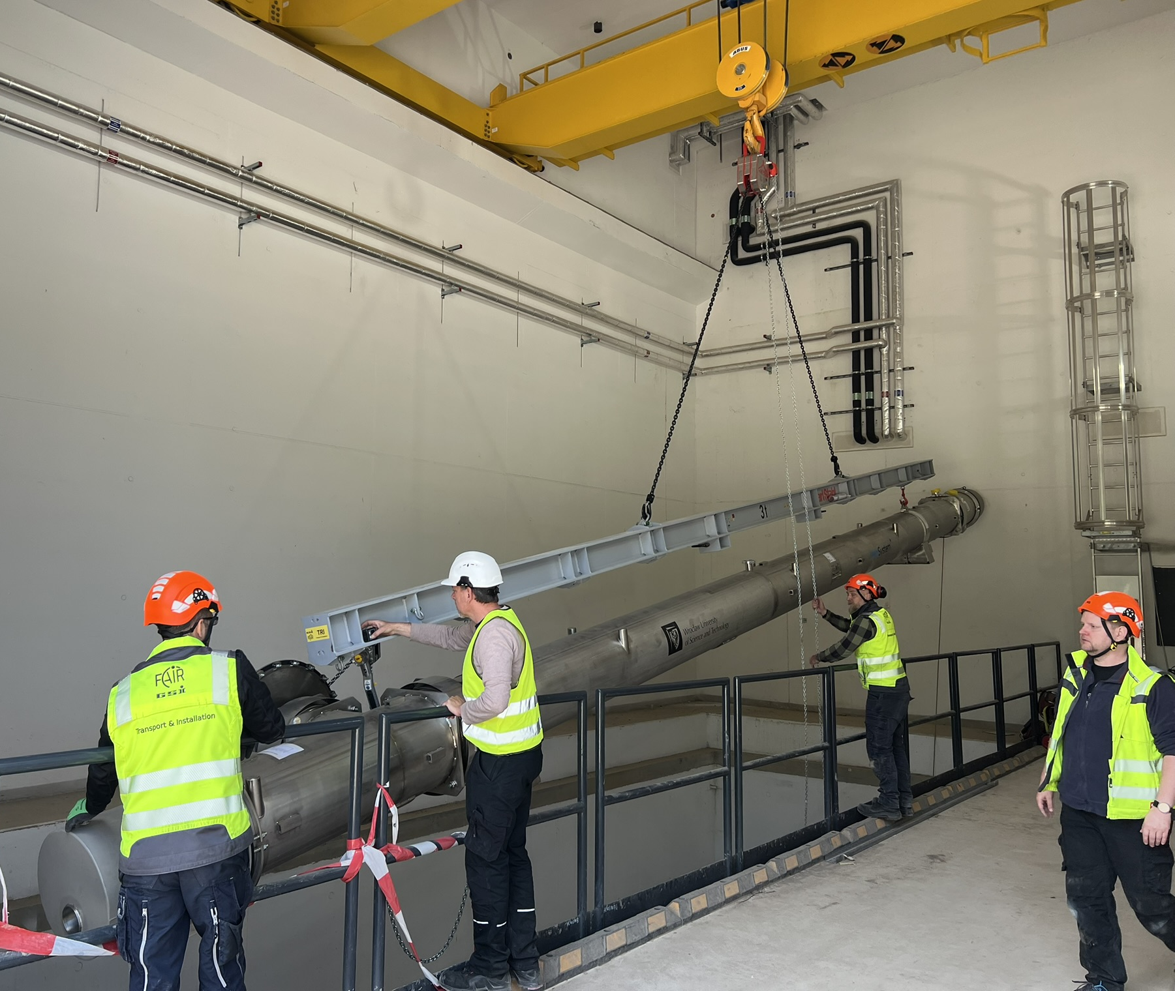
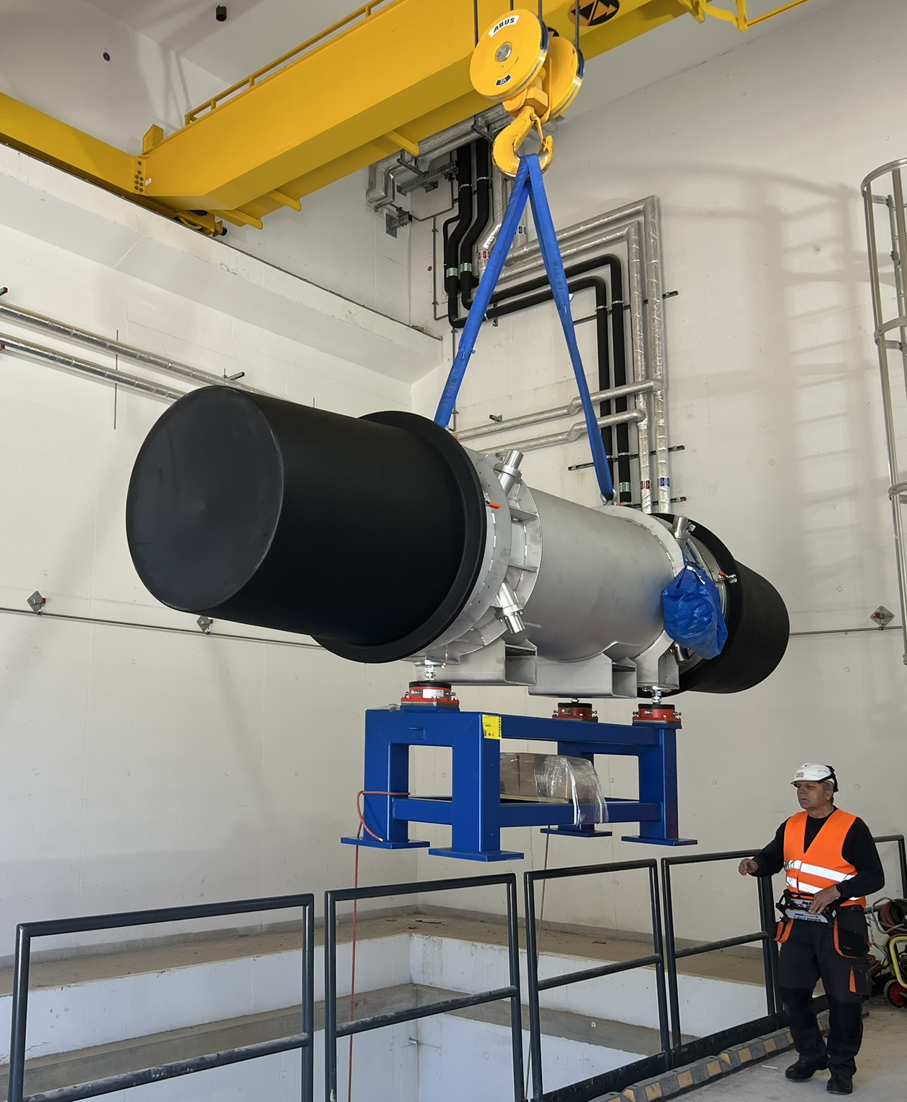
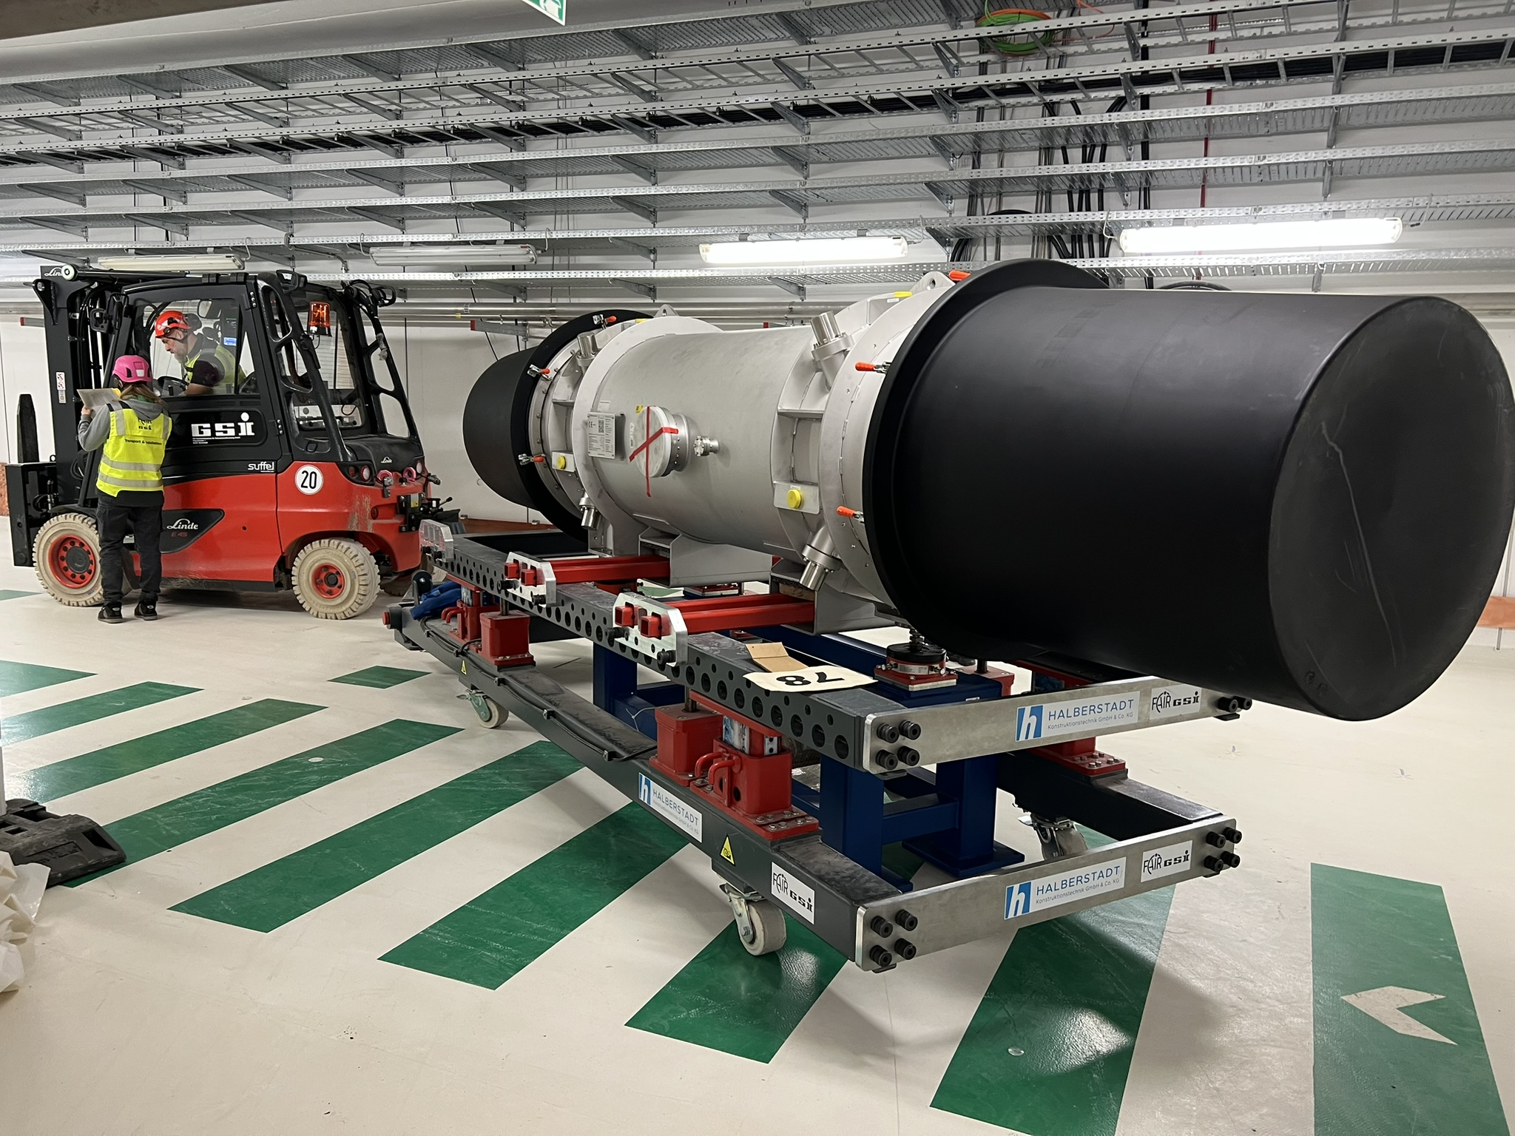
On-site Machine Installation
TRI
Backbone team of machine installation
Machine transport and positioning
Preparation for other work packages
Changing conditions and capacities
LCM plan adjusted for 1 team
Later

Slide 5
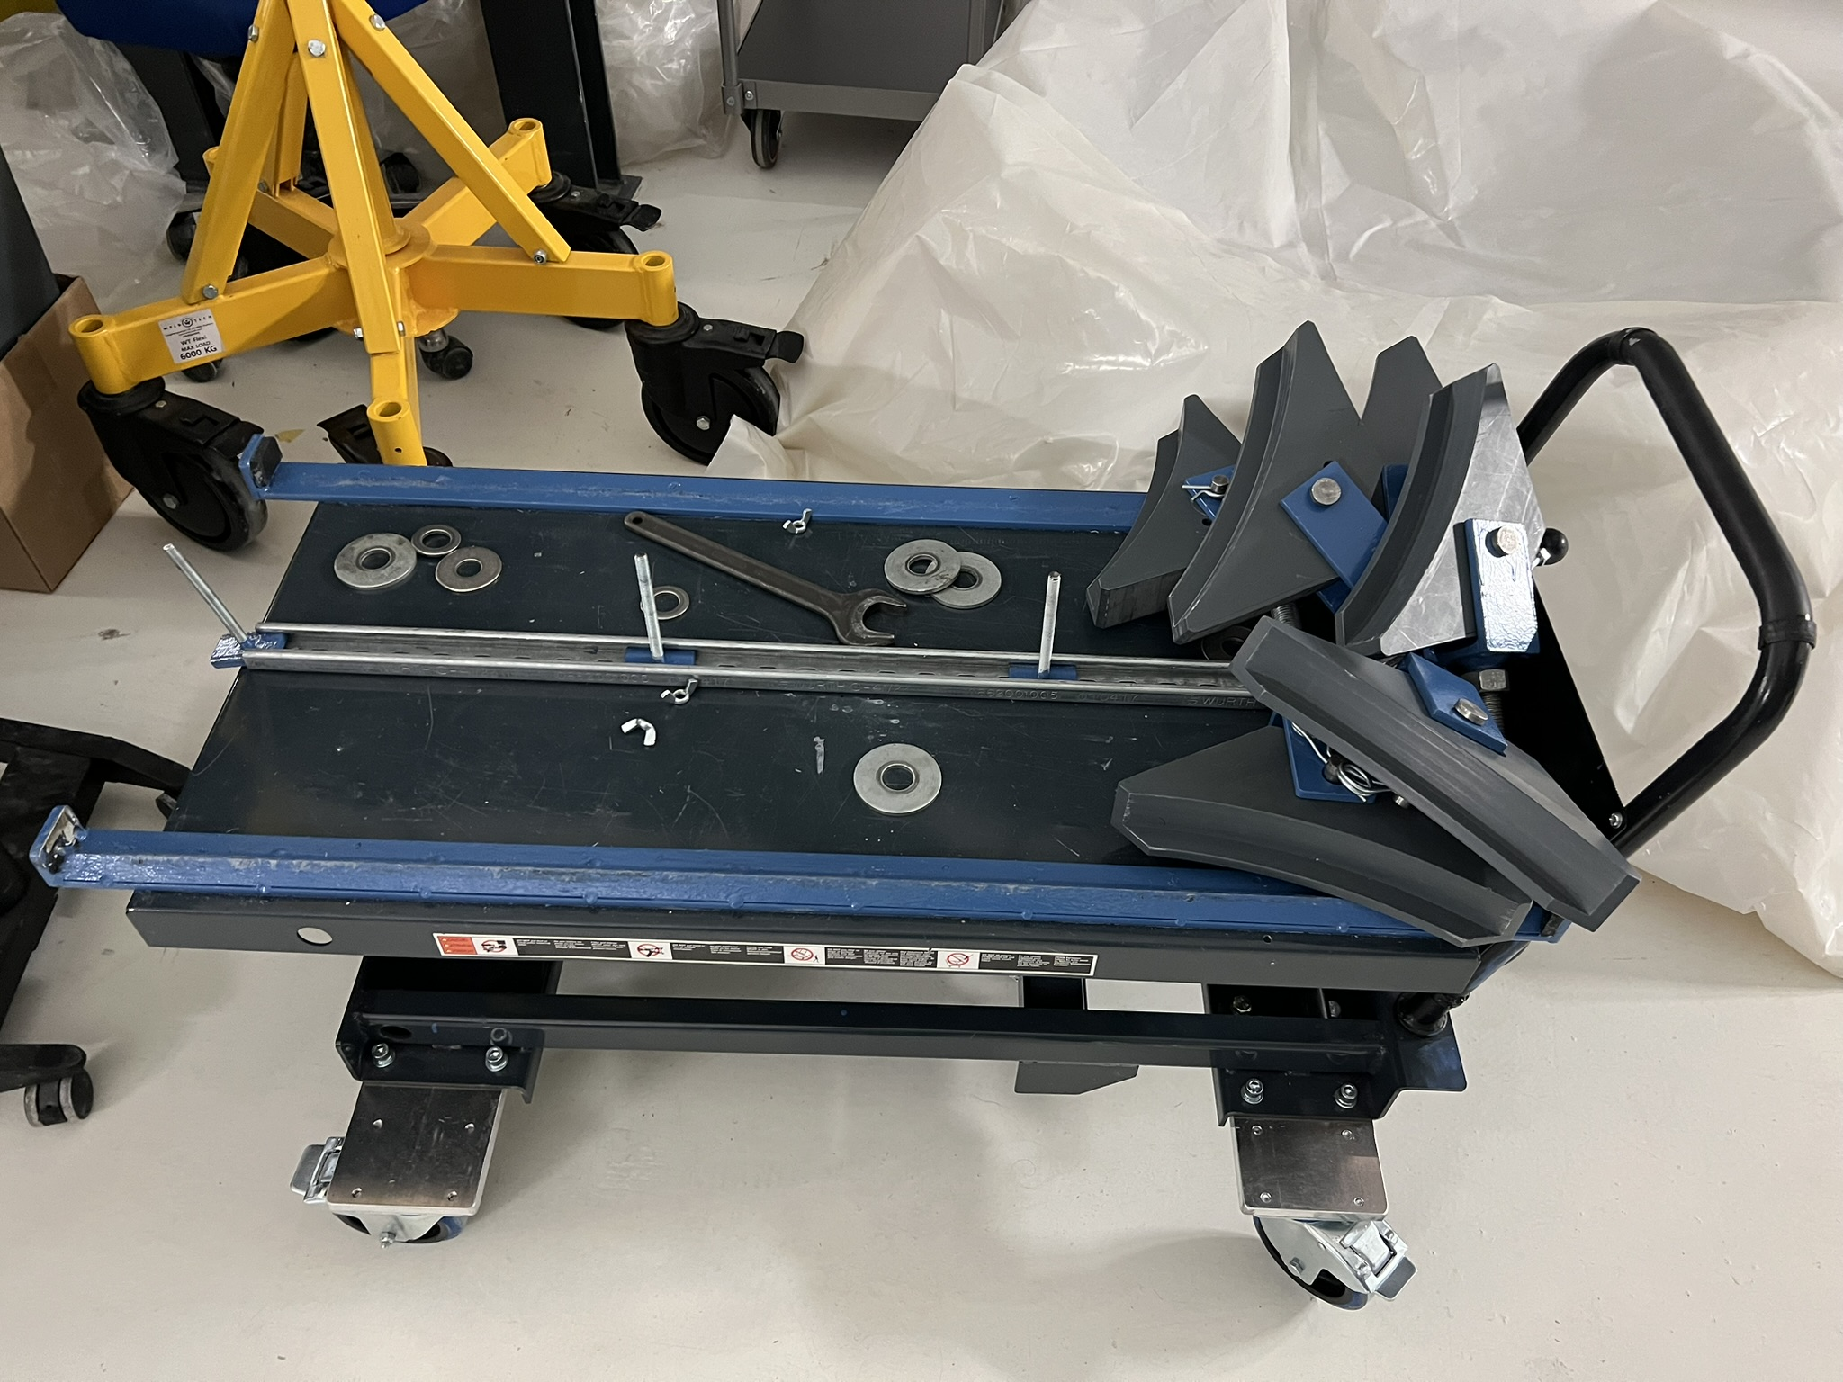
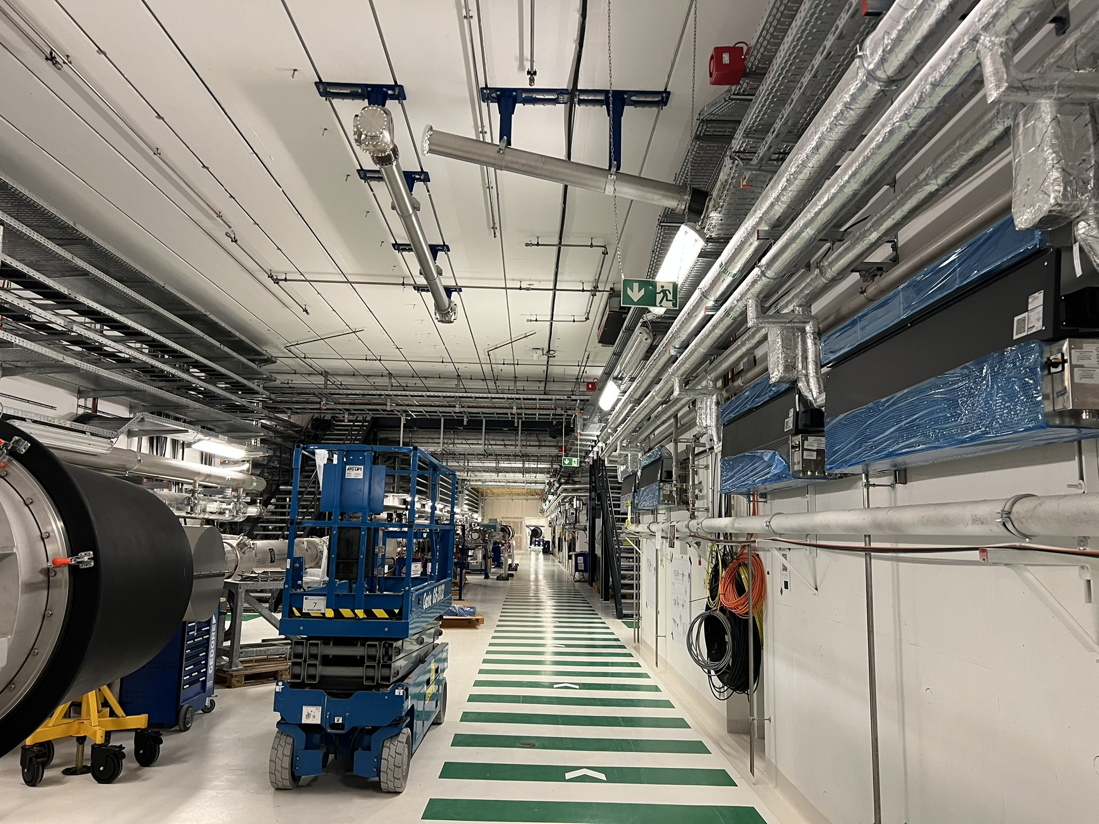
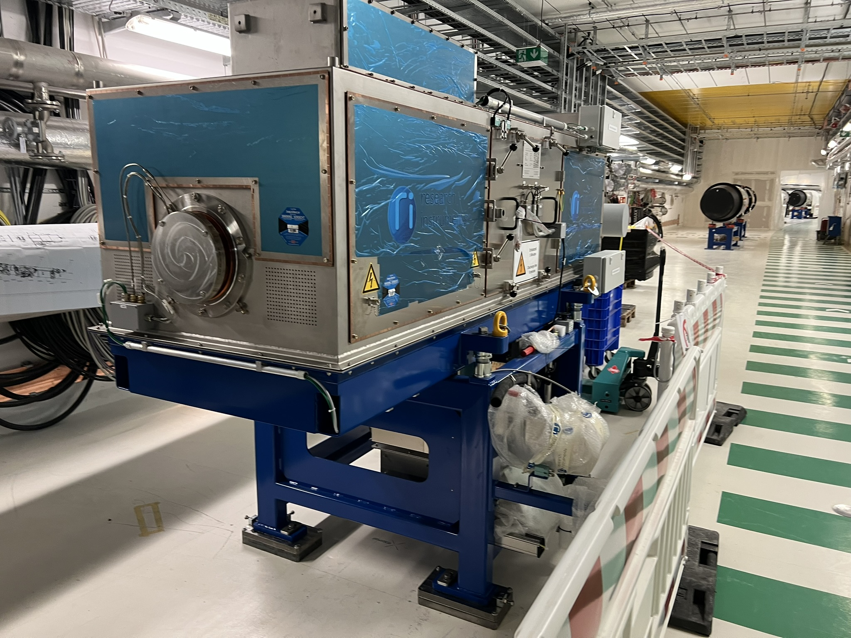
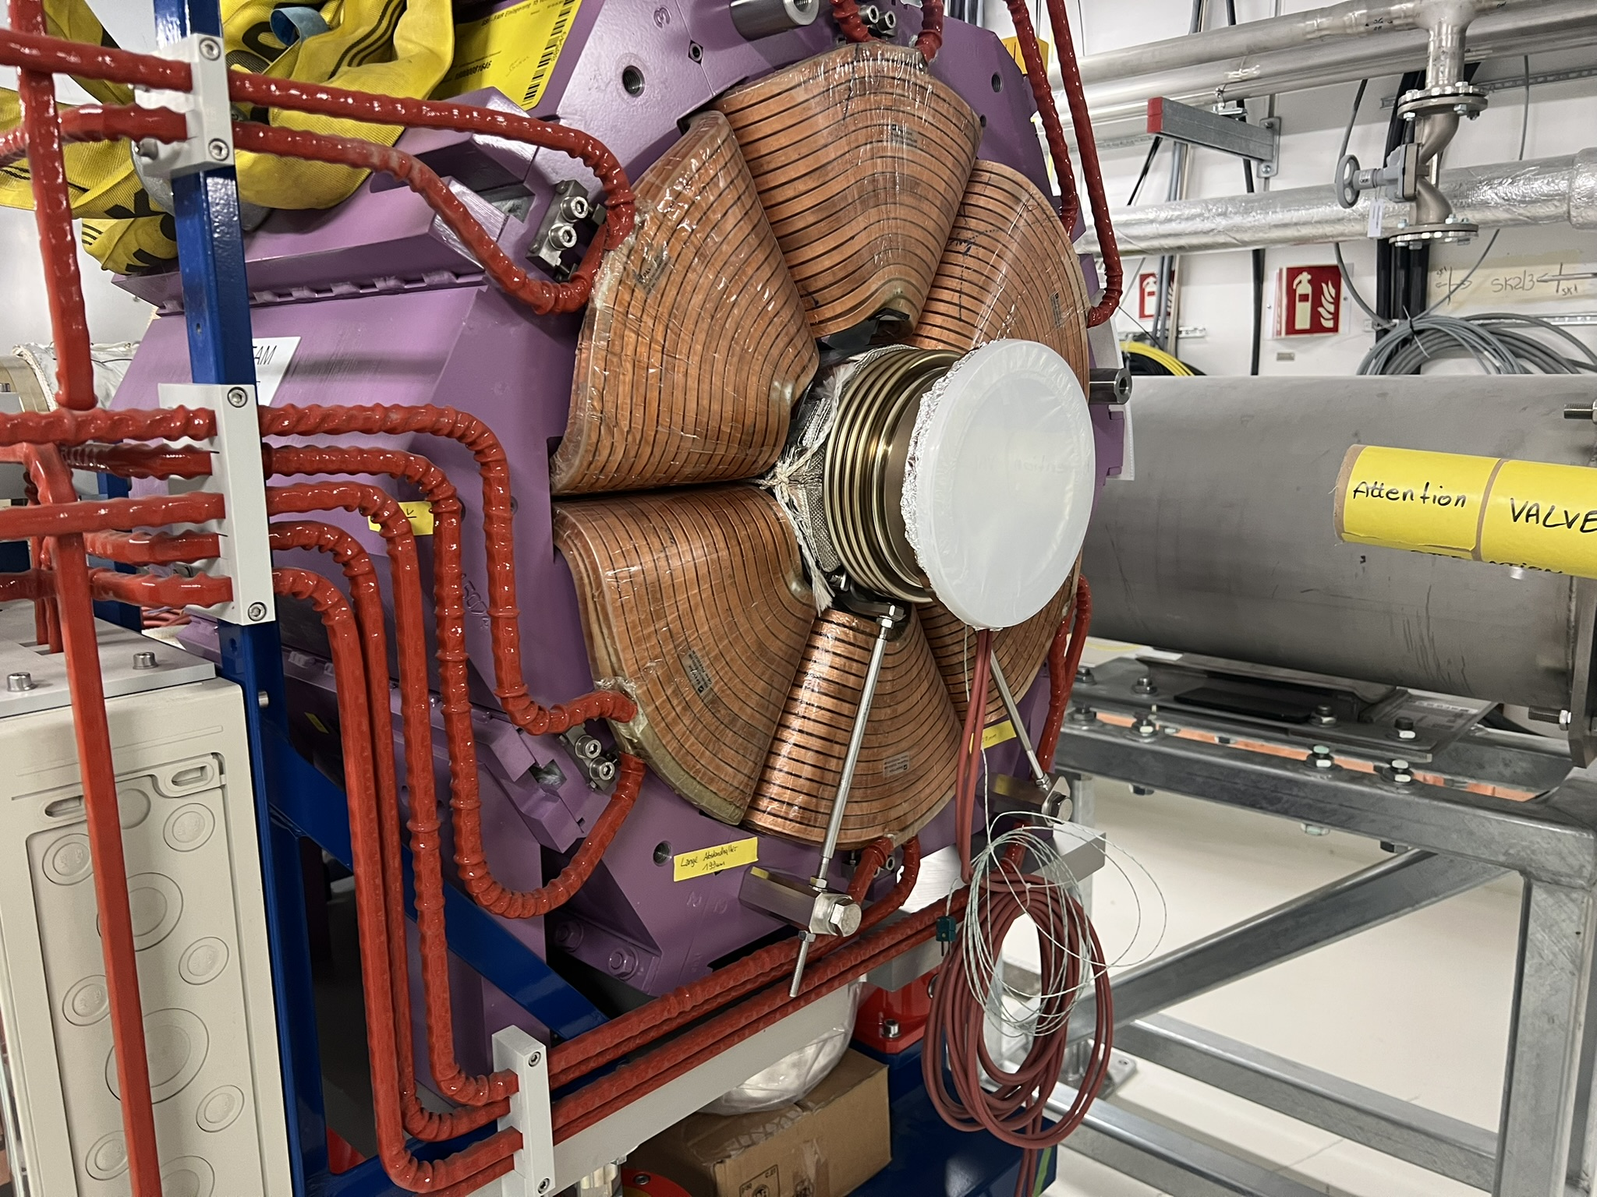
On-site Machine Installation
TRI
examples of issues during assembly
Deliveries of material for assembly
Resonance Sextupole Assembly
Laser cooling beamline on the ceiling
Missing tool for bellow interconnections
Later

Slide 6
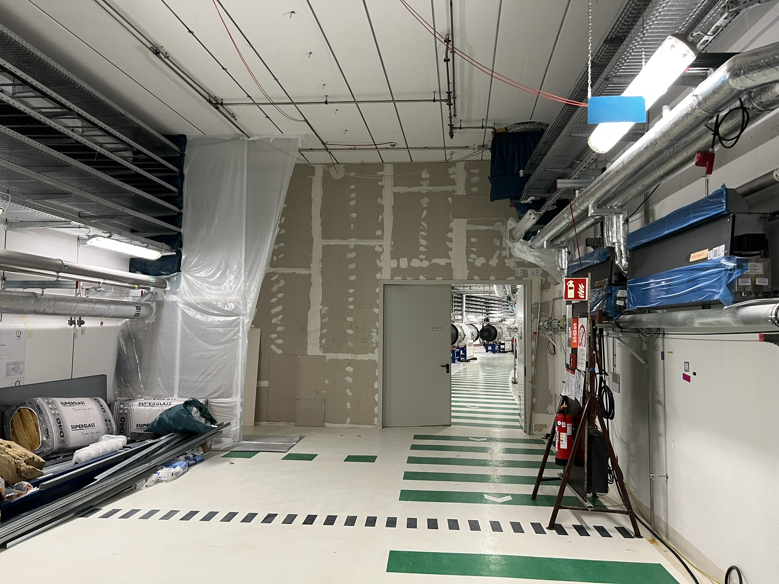
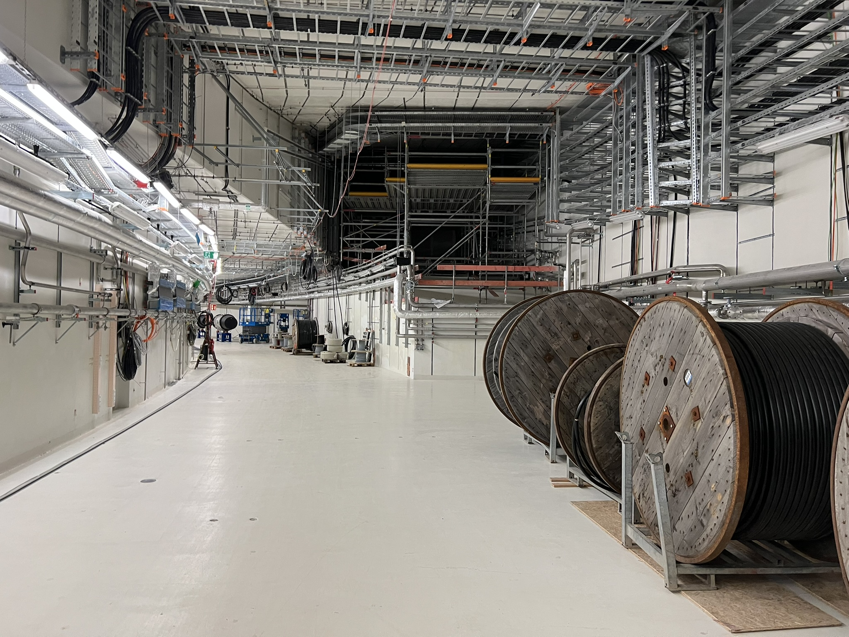
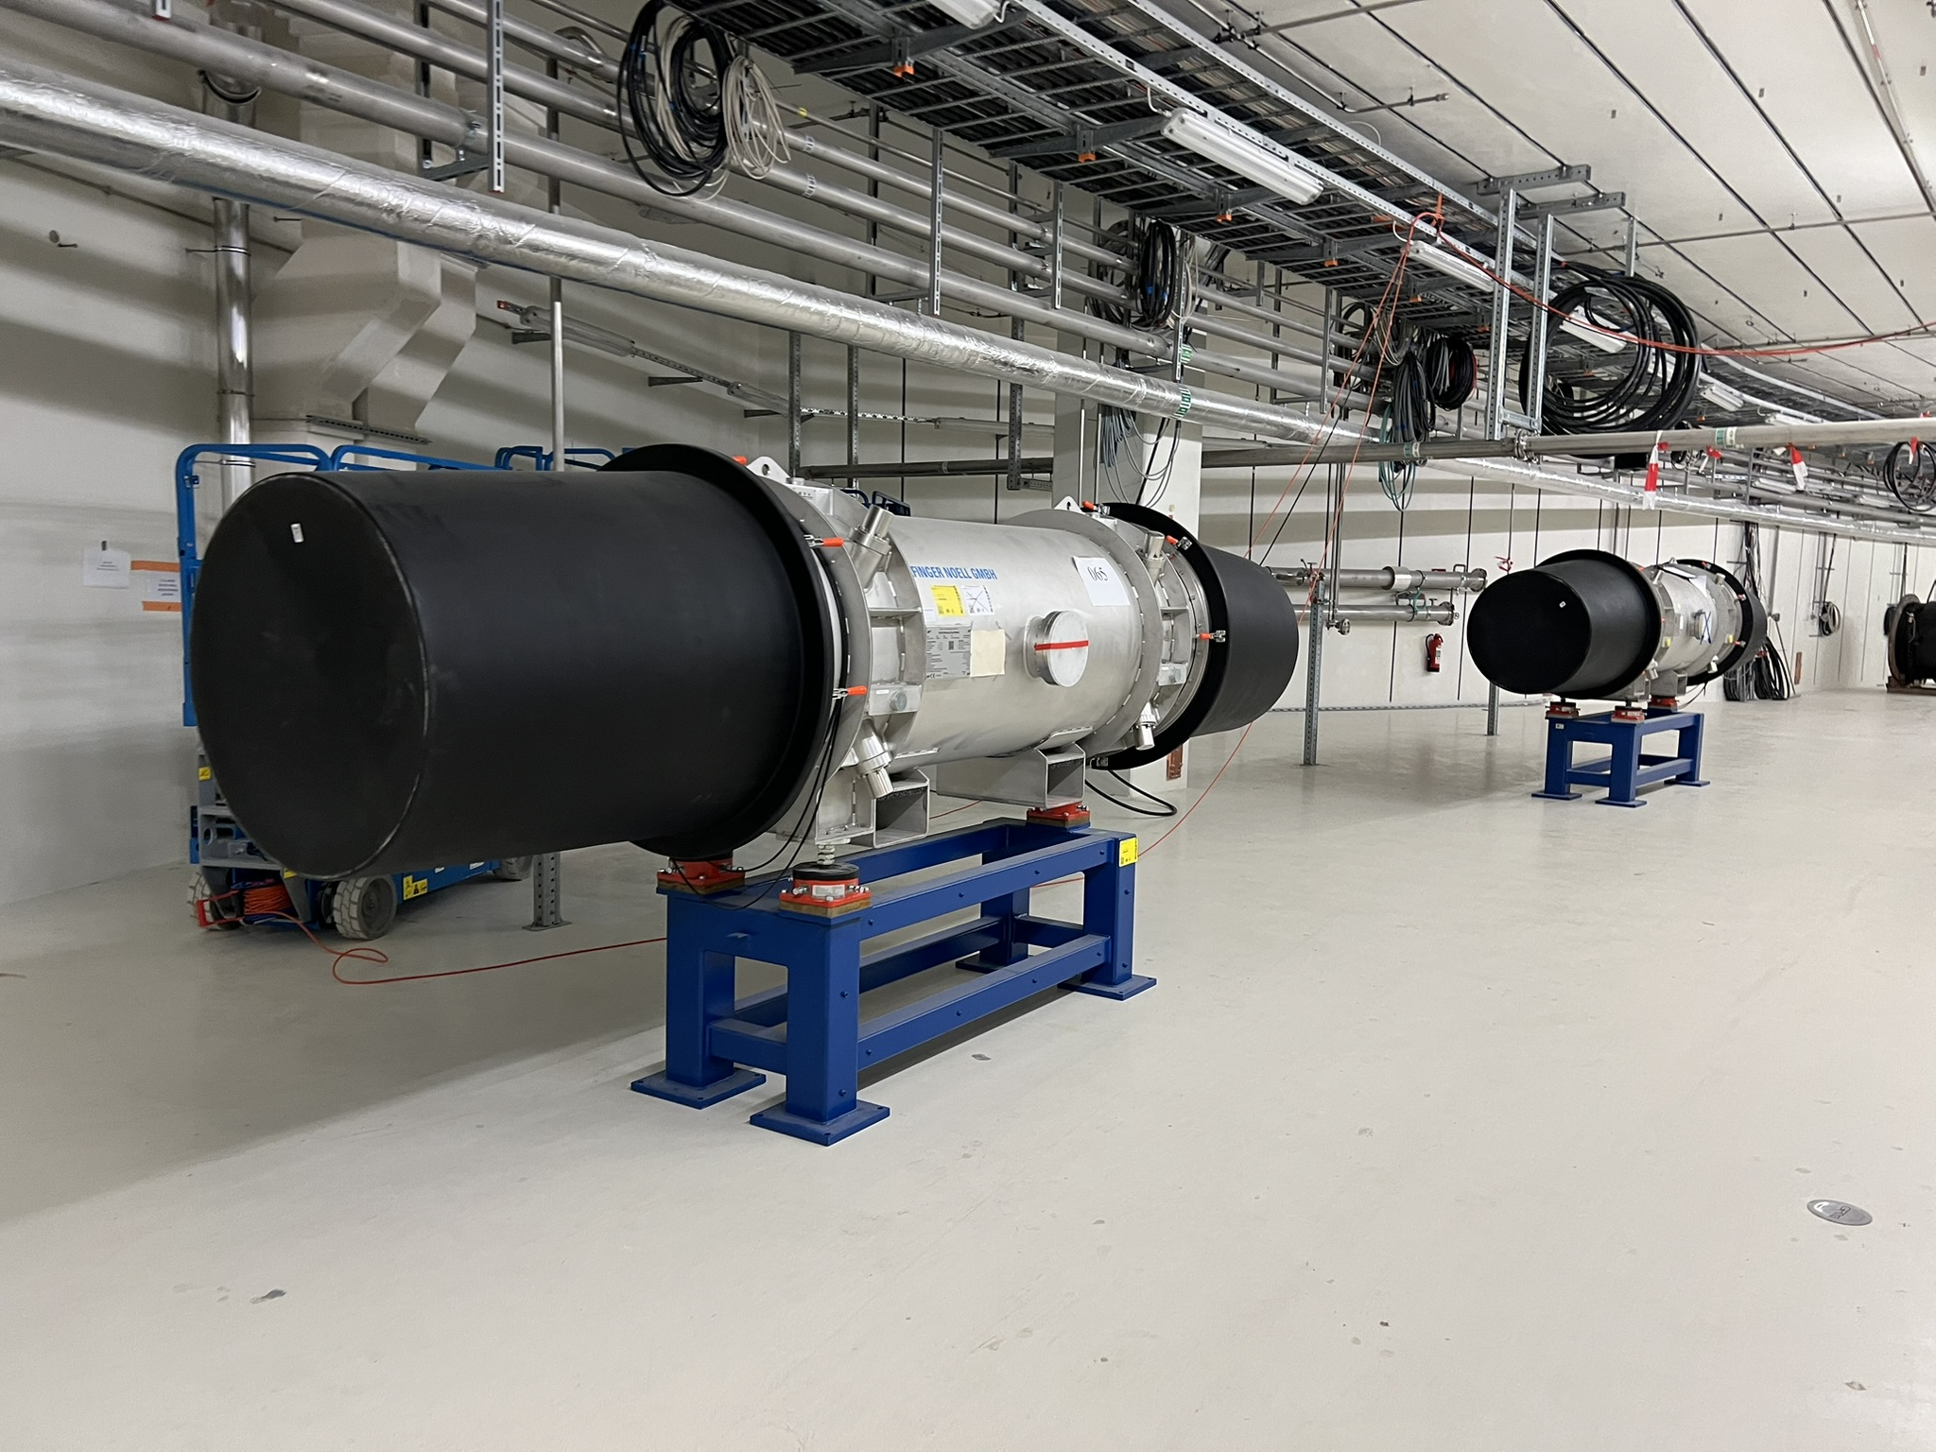
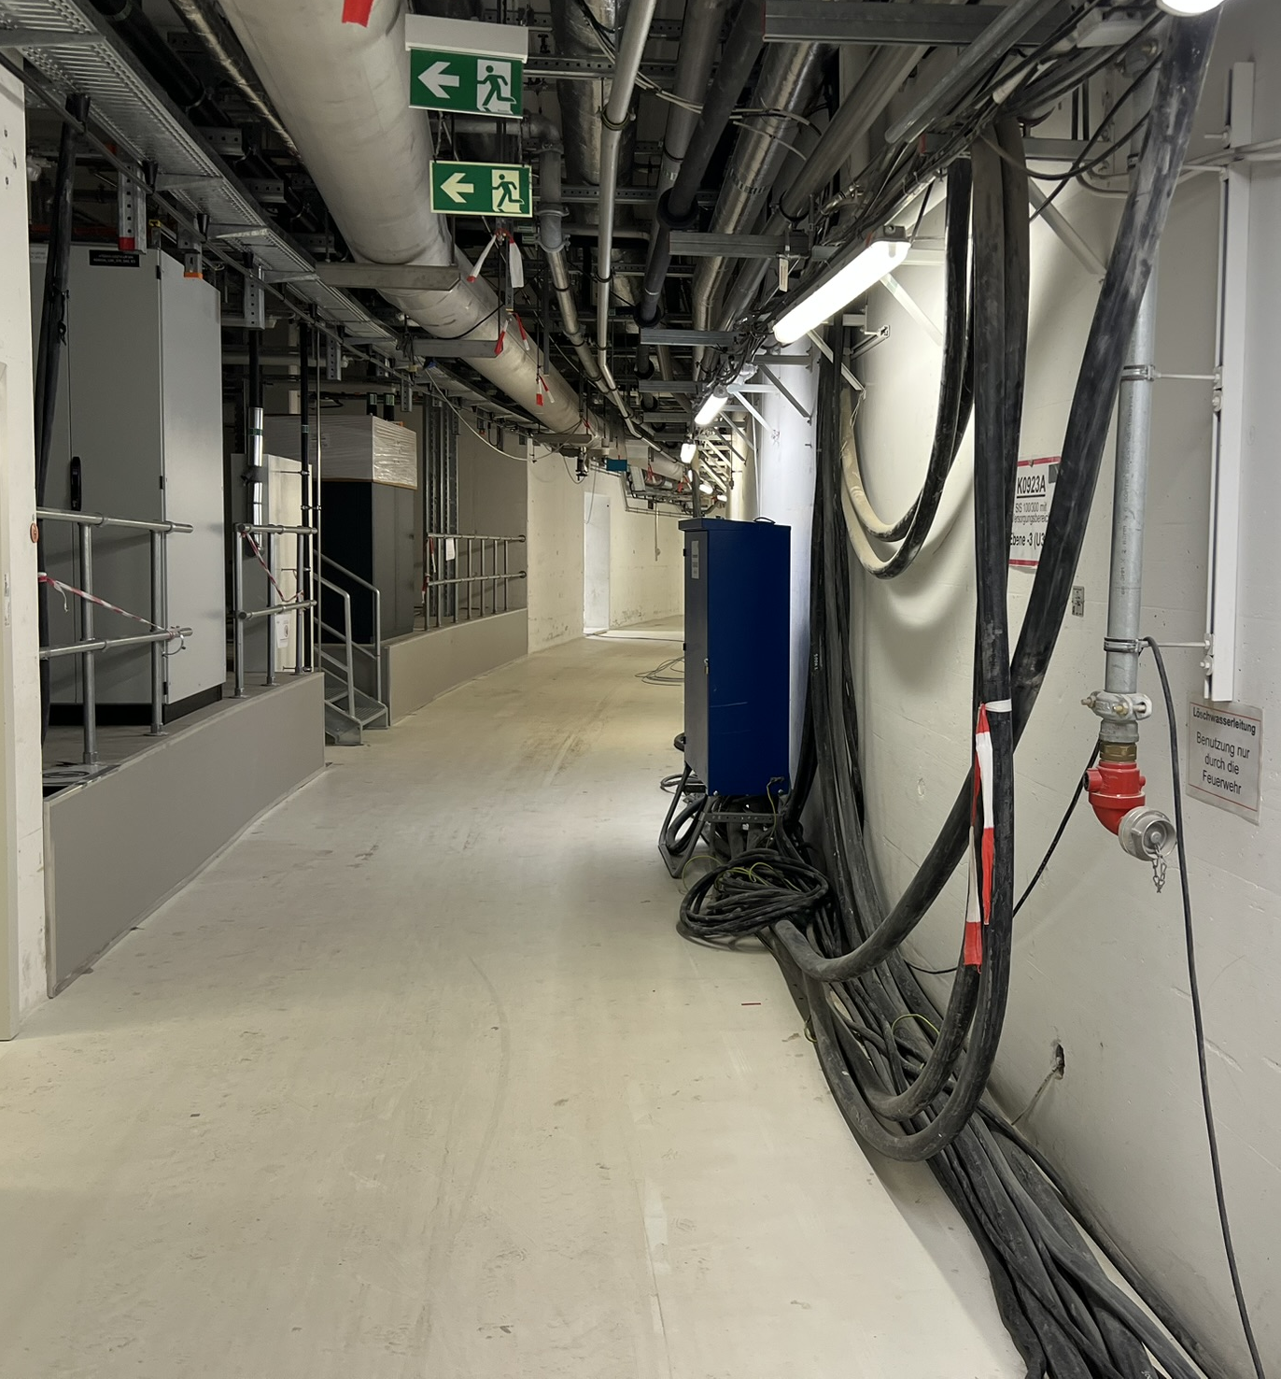
On-site Machine Installation
TRI
Transport issues
Space in Machine & Supply tunnel
Magnet Modules under fire protection walls
Later

Slide 7
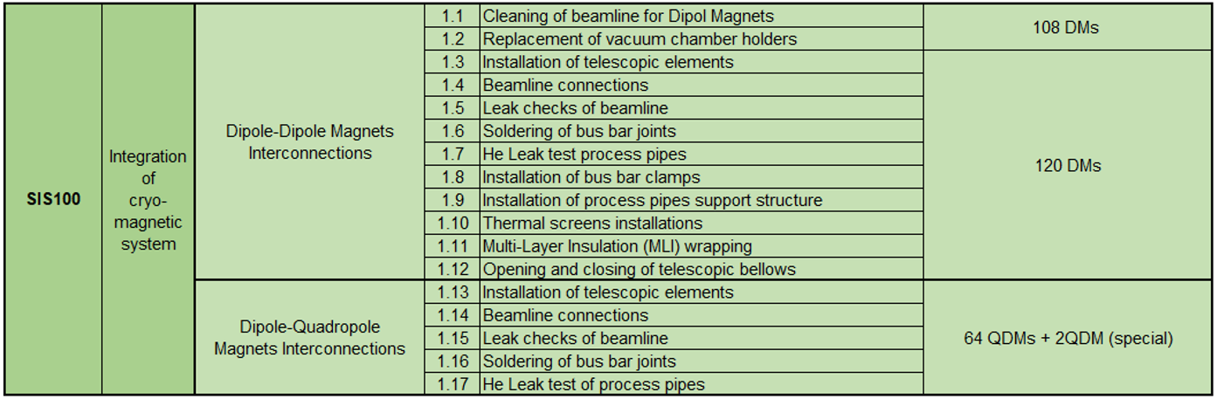
On-site Machine Installation
Later
IFJ PAN
Welcome back
Scope of works defined
Restart in October 2025

Slide 8
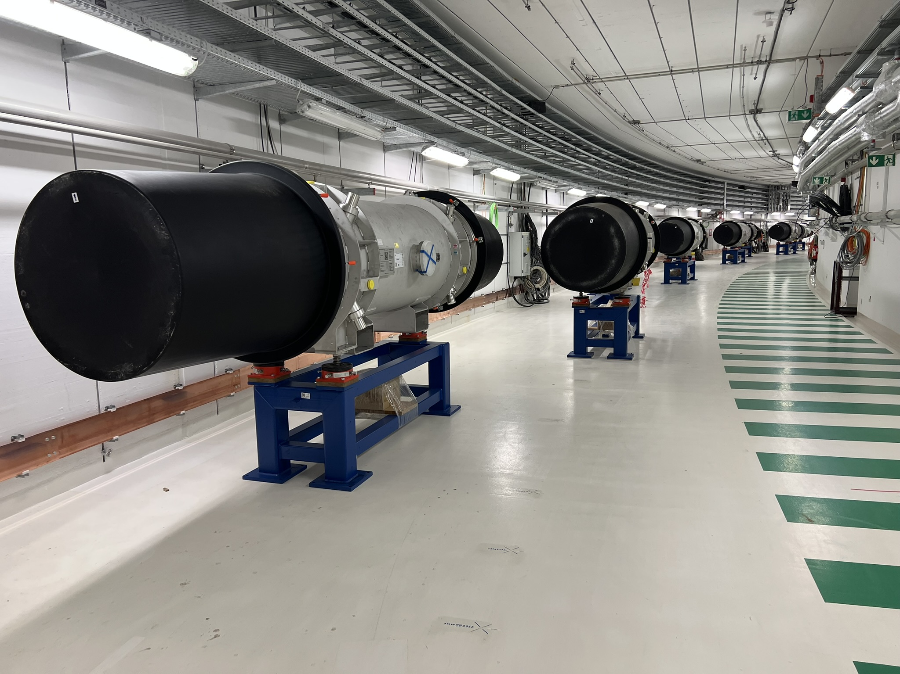
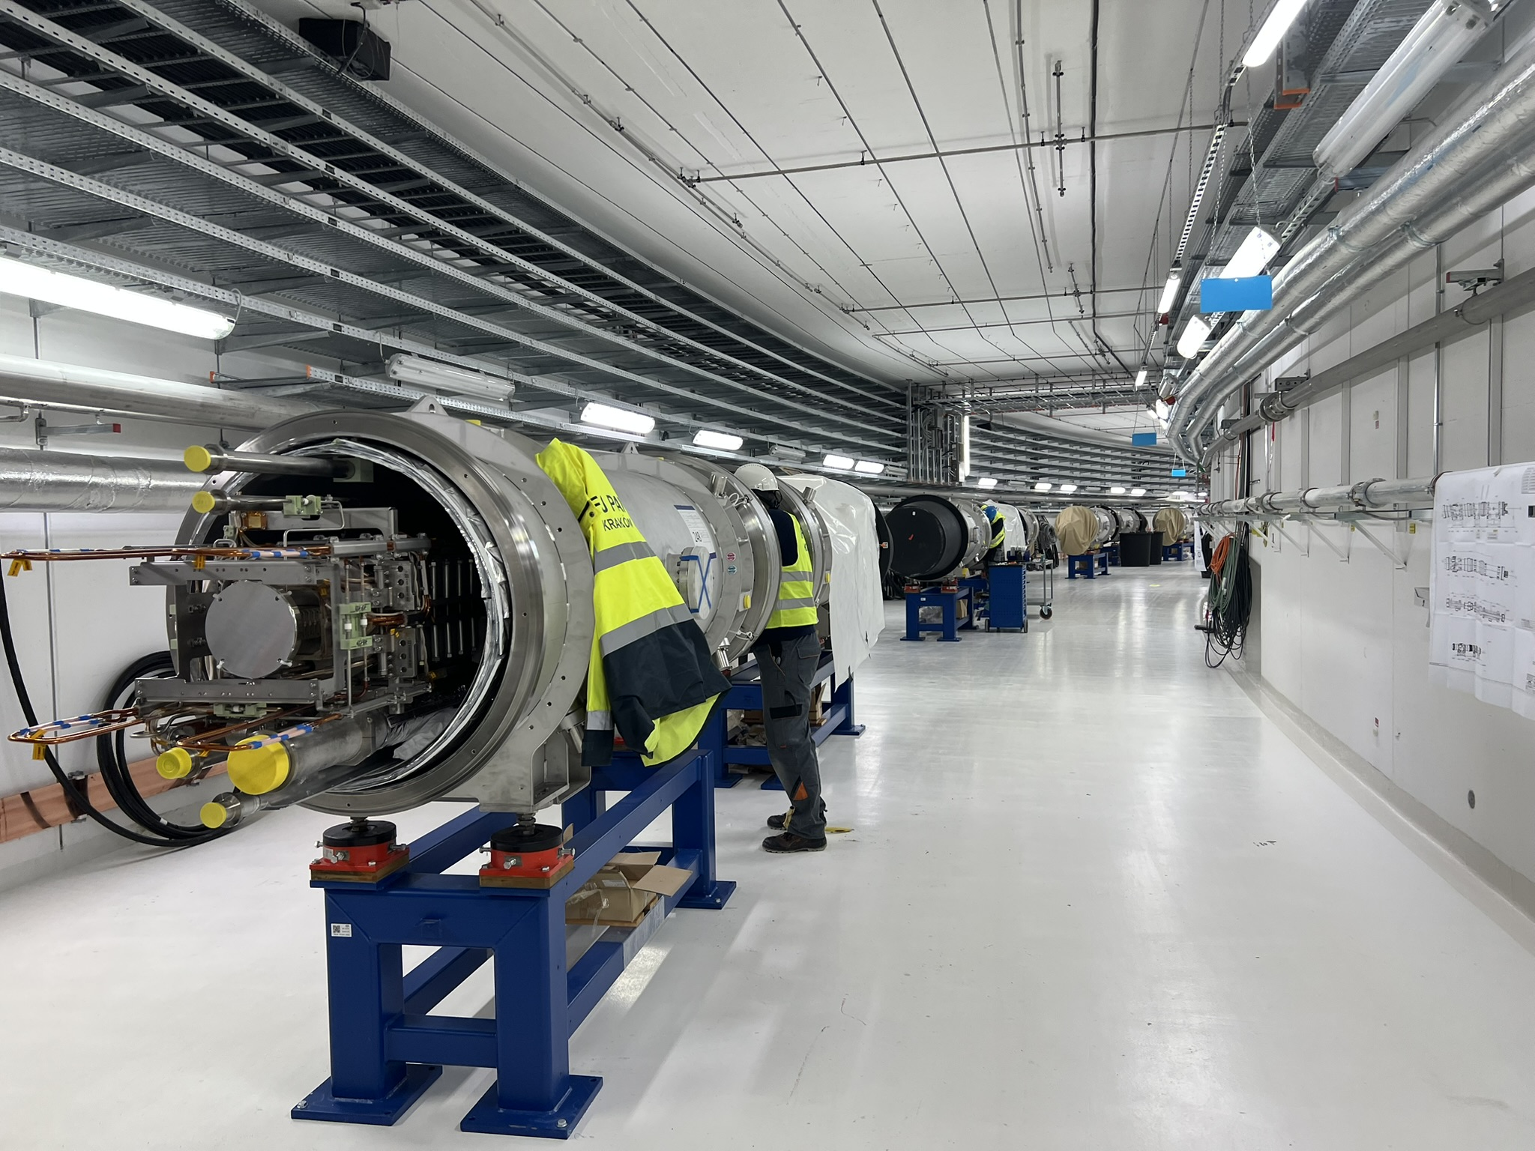
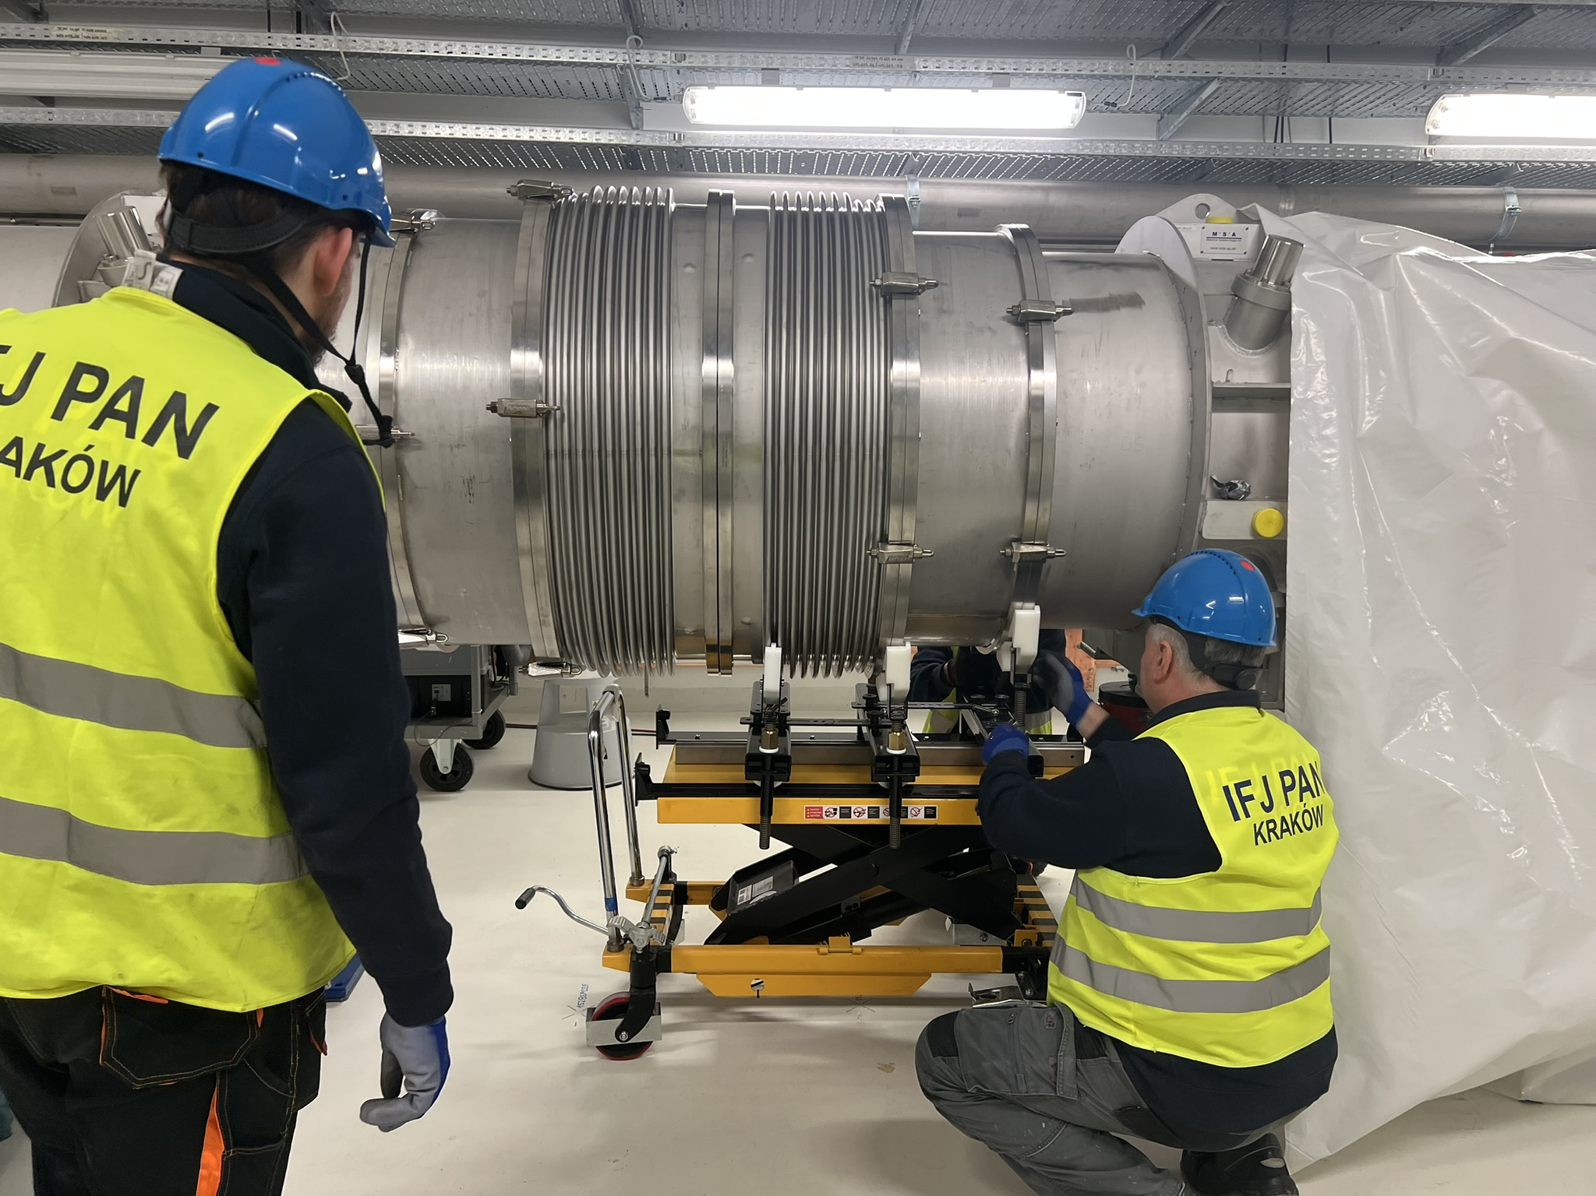
On-site Machine Installation
Later
IFJ PAN
Coming activities:
String test
Dipole-Dipole Magnet Interconnections, arc 6
Leak test of process pipes, arc 1
input from VAC: work instructions

Slide 9
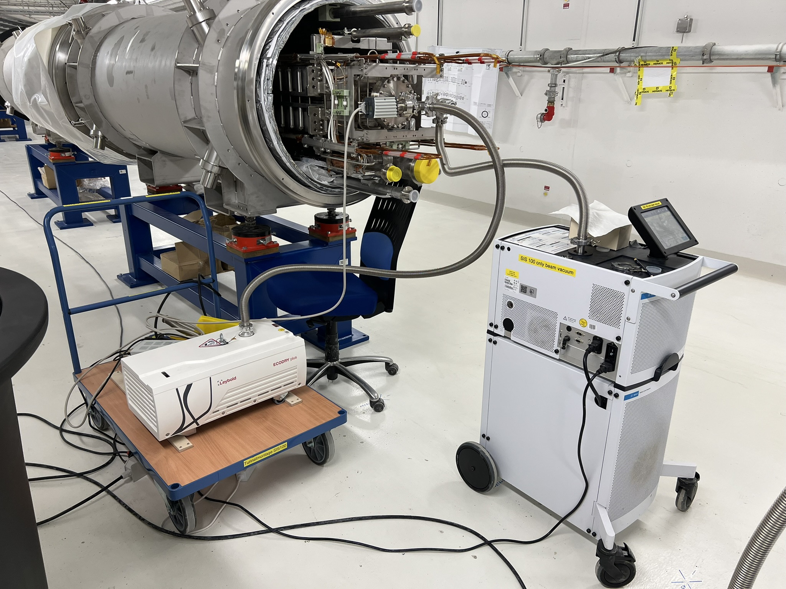
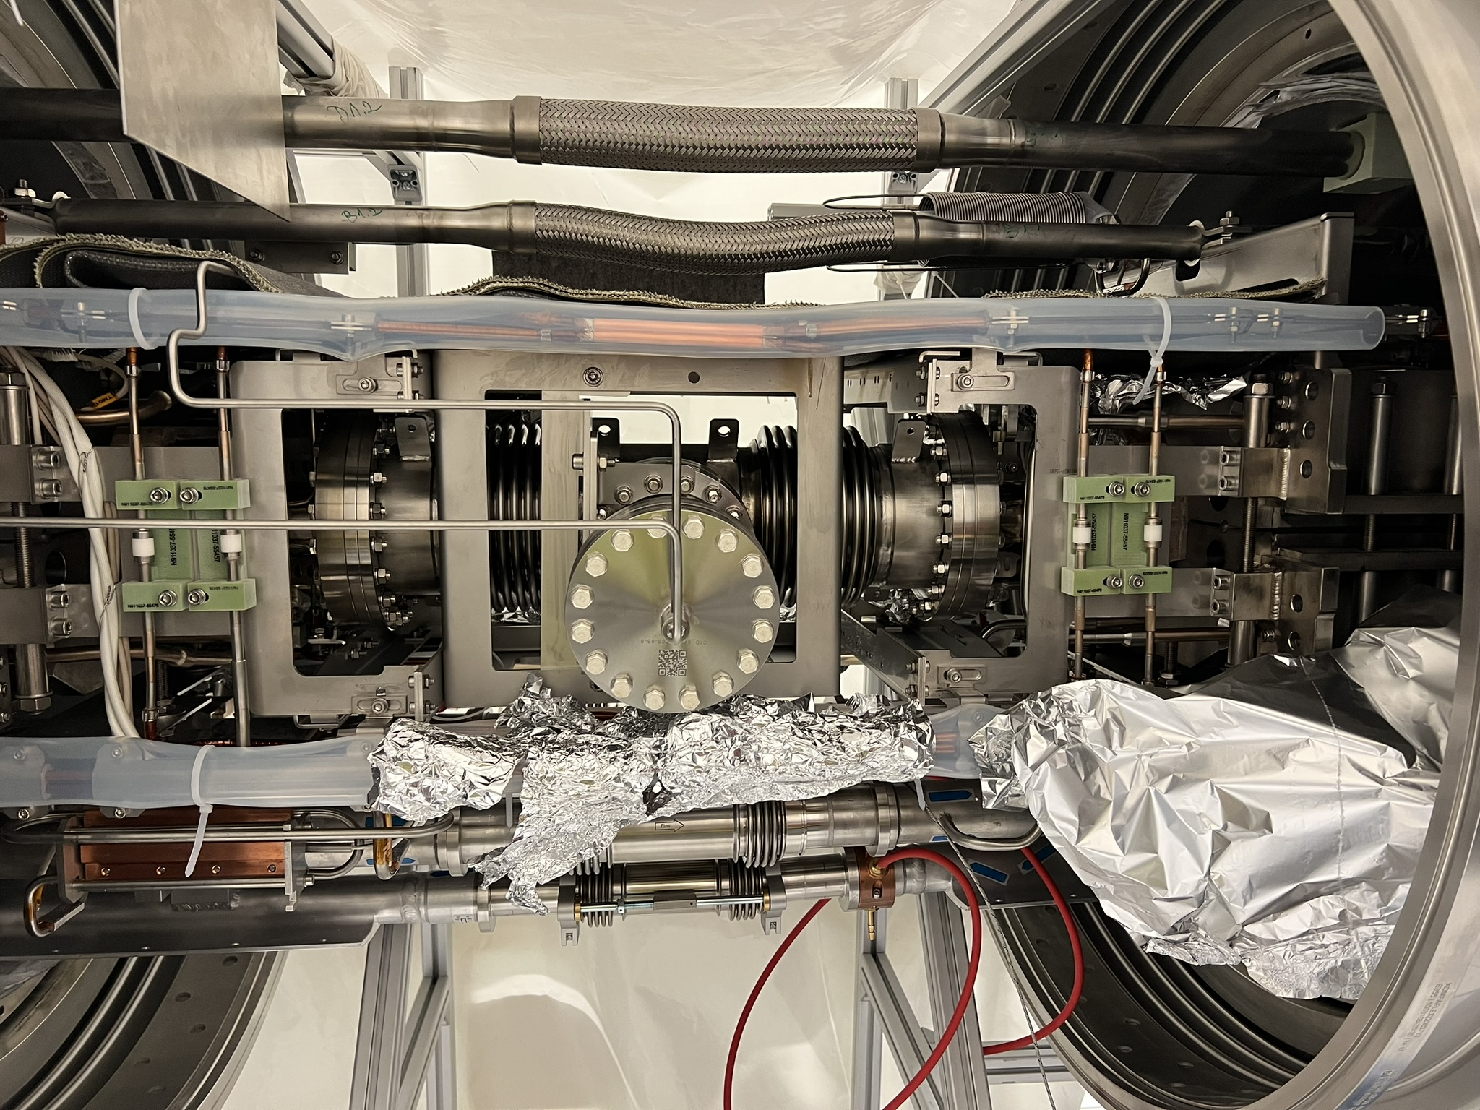
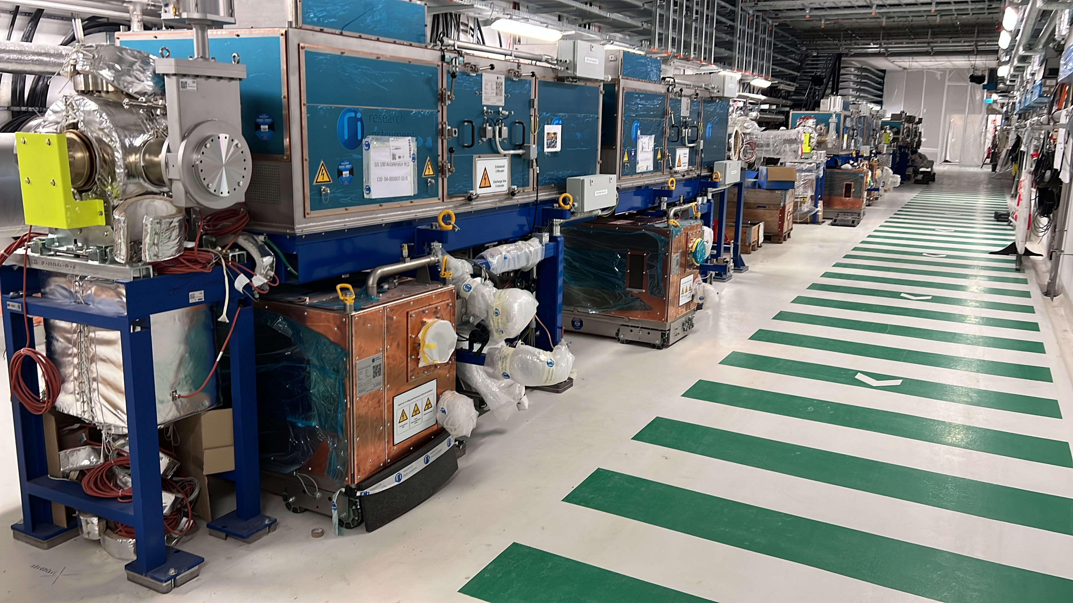
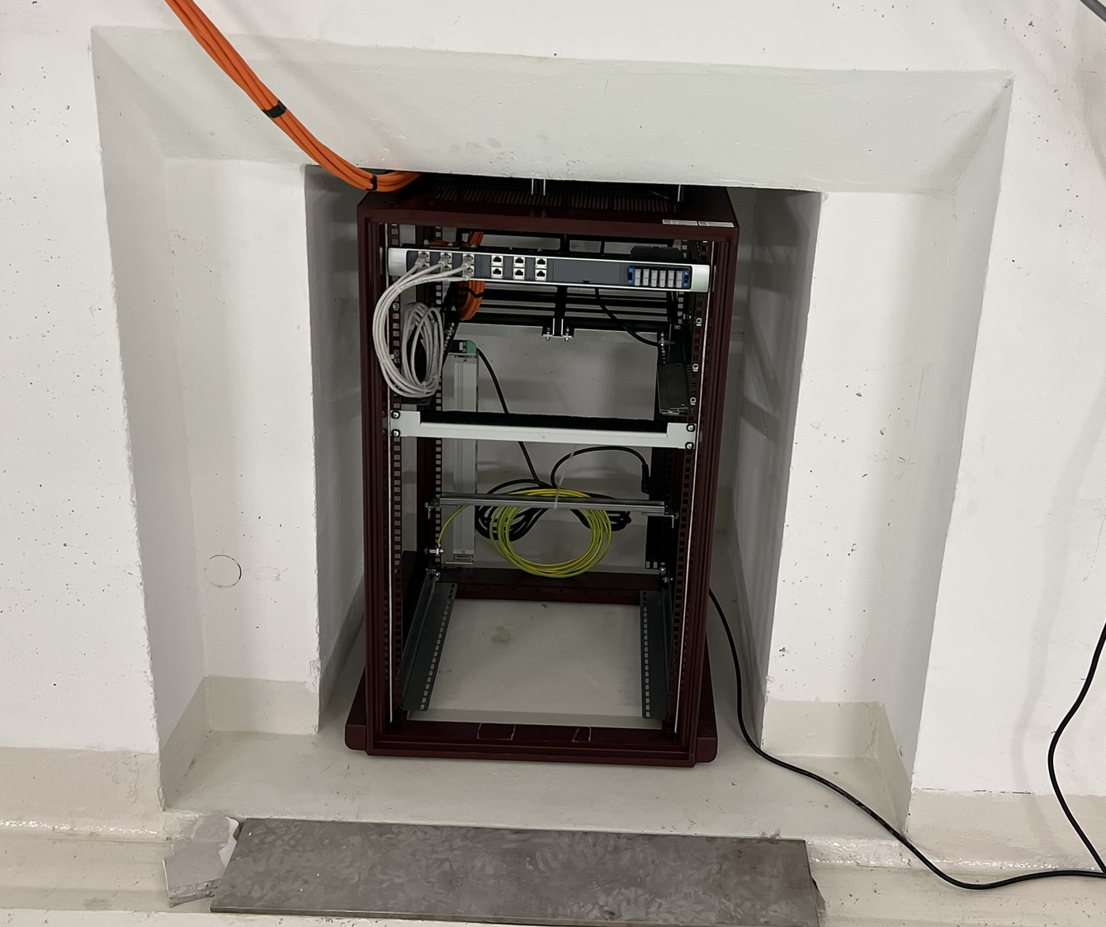
On-site Machine Installation
VAC – vacuum acceptance tests, straigt 3
MEW – welding of interconnections, arc 2
SCM – electrical tests, arc 6
RRF – RF cavities, sector 4
BEA – racks in niches
NCM – Survey and Alignment
EPS – power systems planning

Slide 10
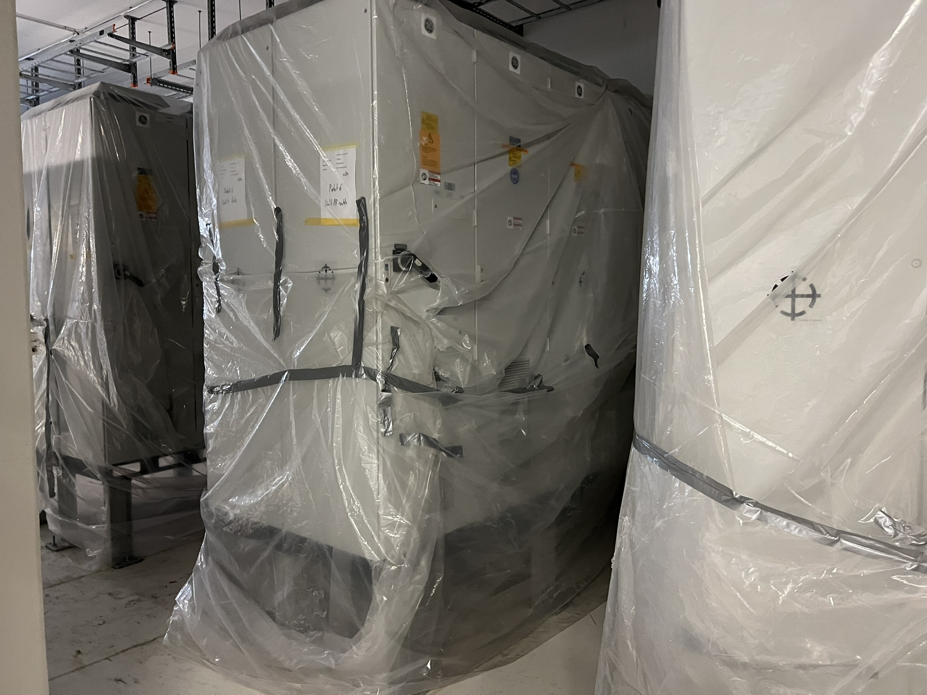
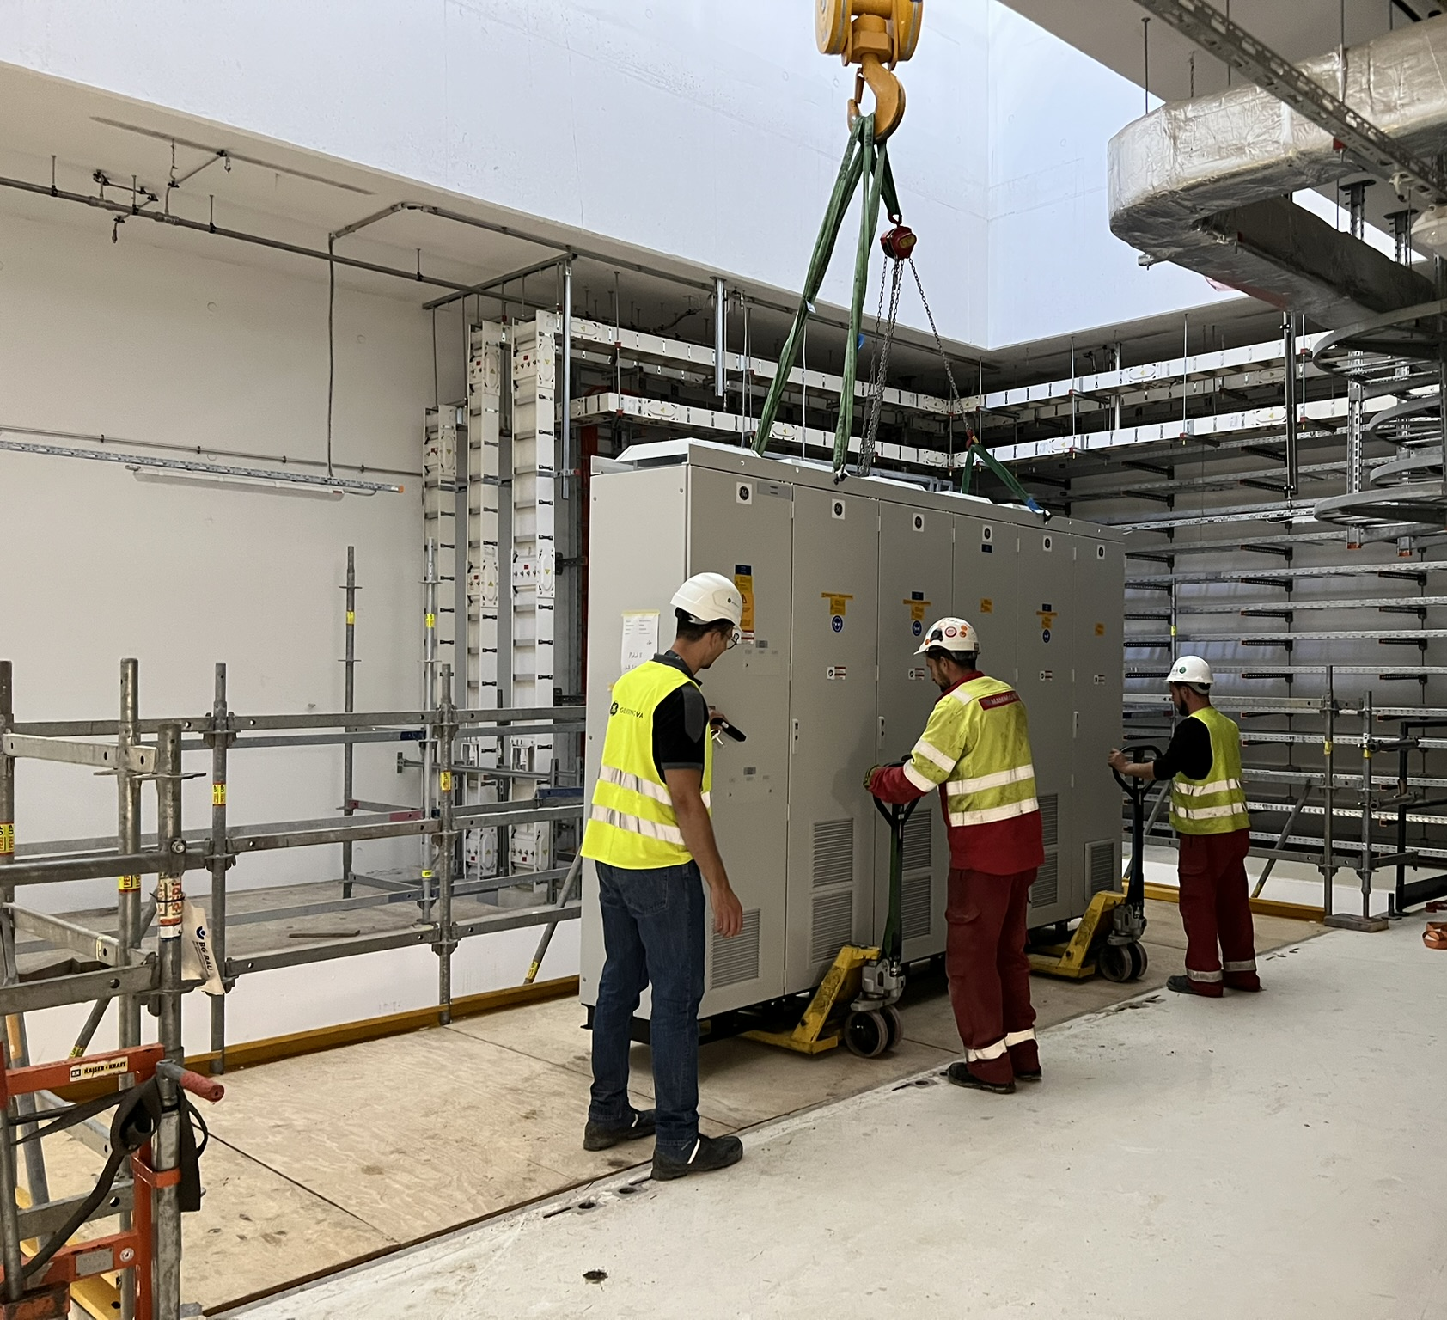
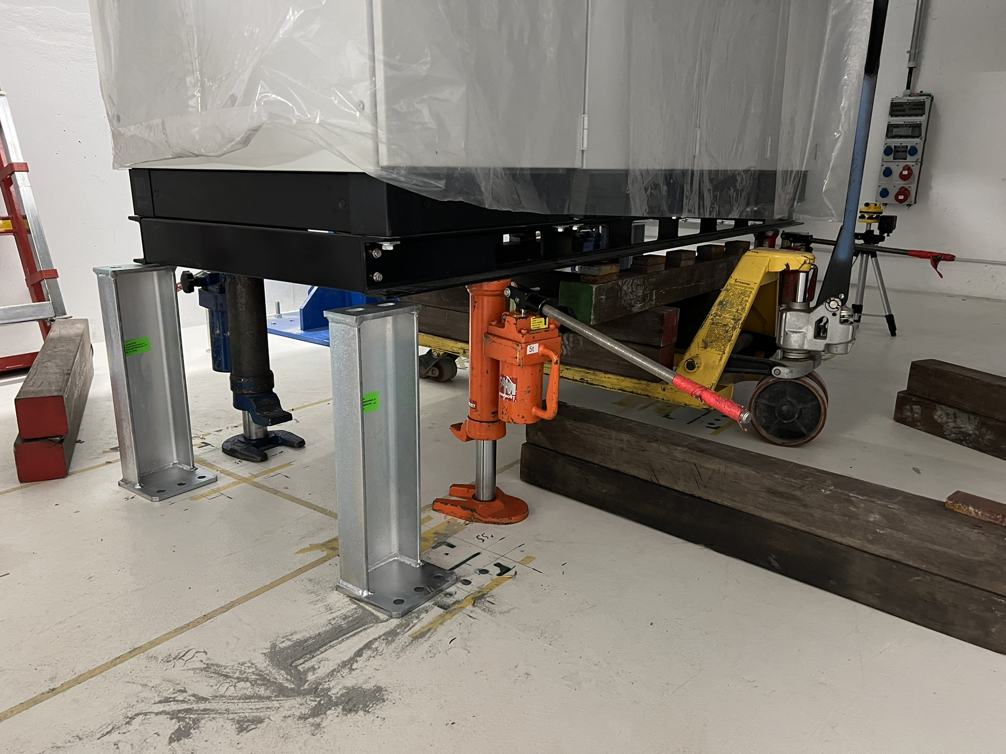
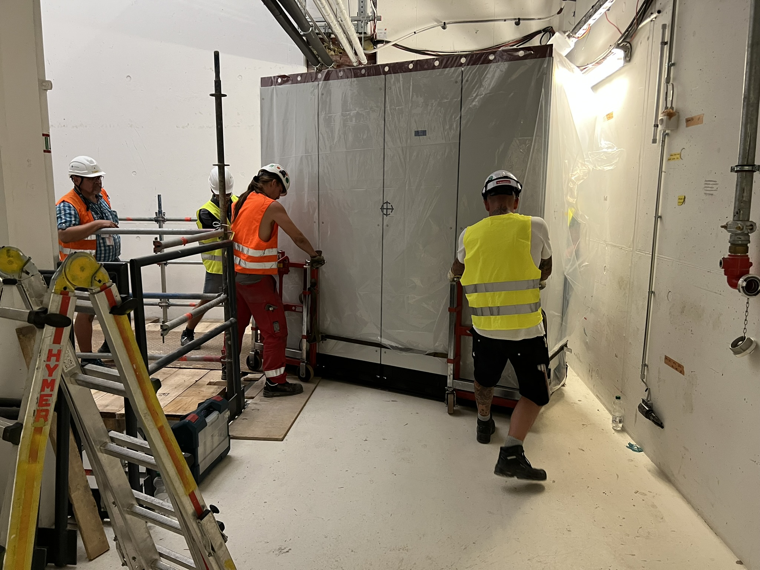
On-site Machine Installation
Dealing with contractors of GSI
Registration at FAIR
List of necessary documents
Installation concepts
Time schedules
GE Vernova
Installation of SIS100 Power Converters

Slide 11
Interaction with TBE works
Basic features:
Work registration
safety measures and work coordination considerations
Regular communication
Reflection in LCM plan for Machine installation
FSB
List of rest works for the whole building K0923A
List for single areas not existing
LCM FAIR: TBE activities

Slide 12
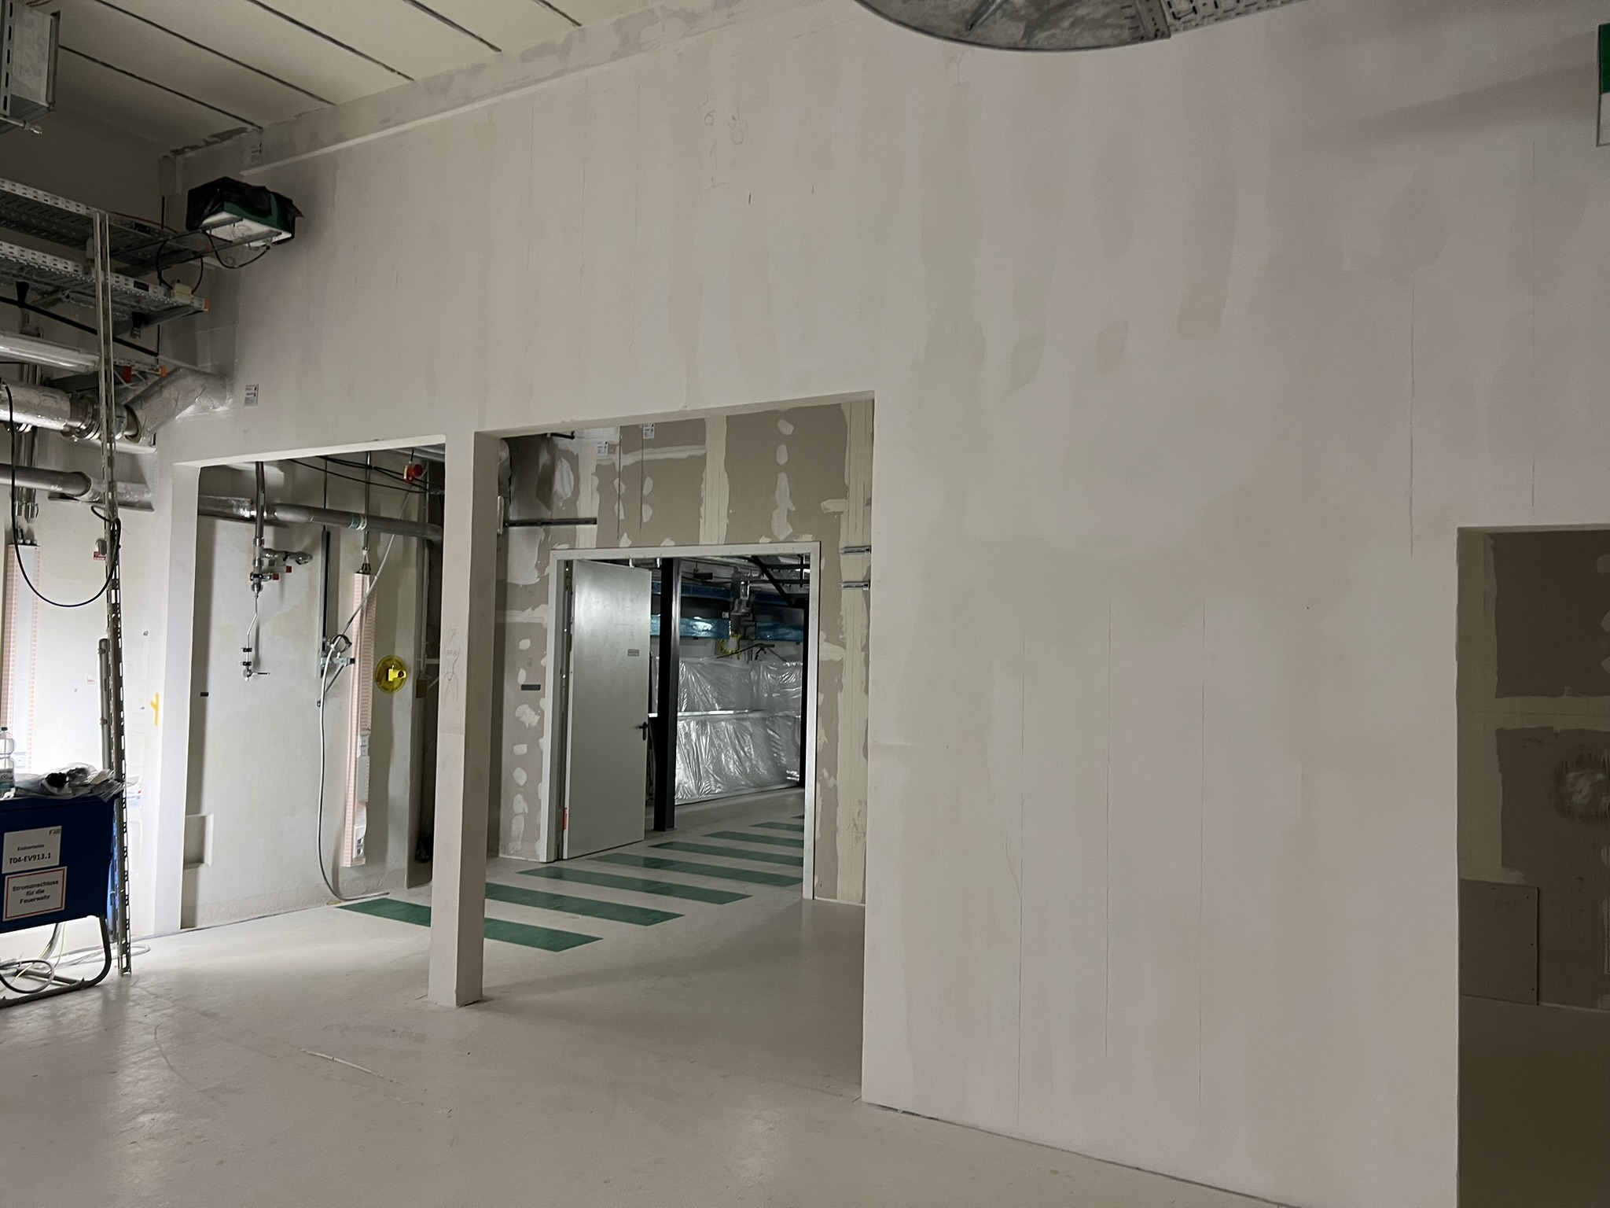
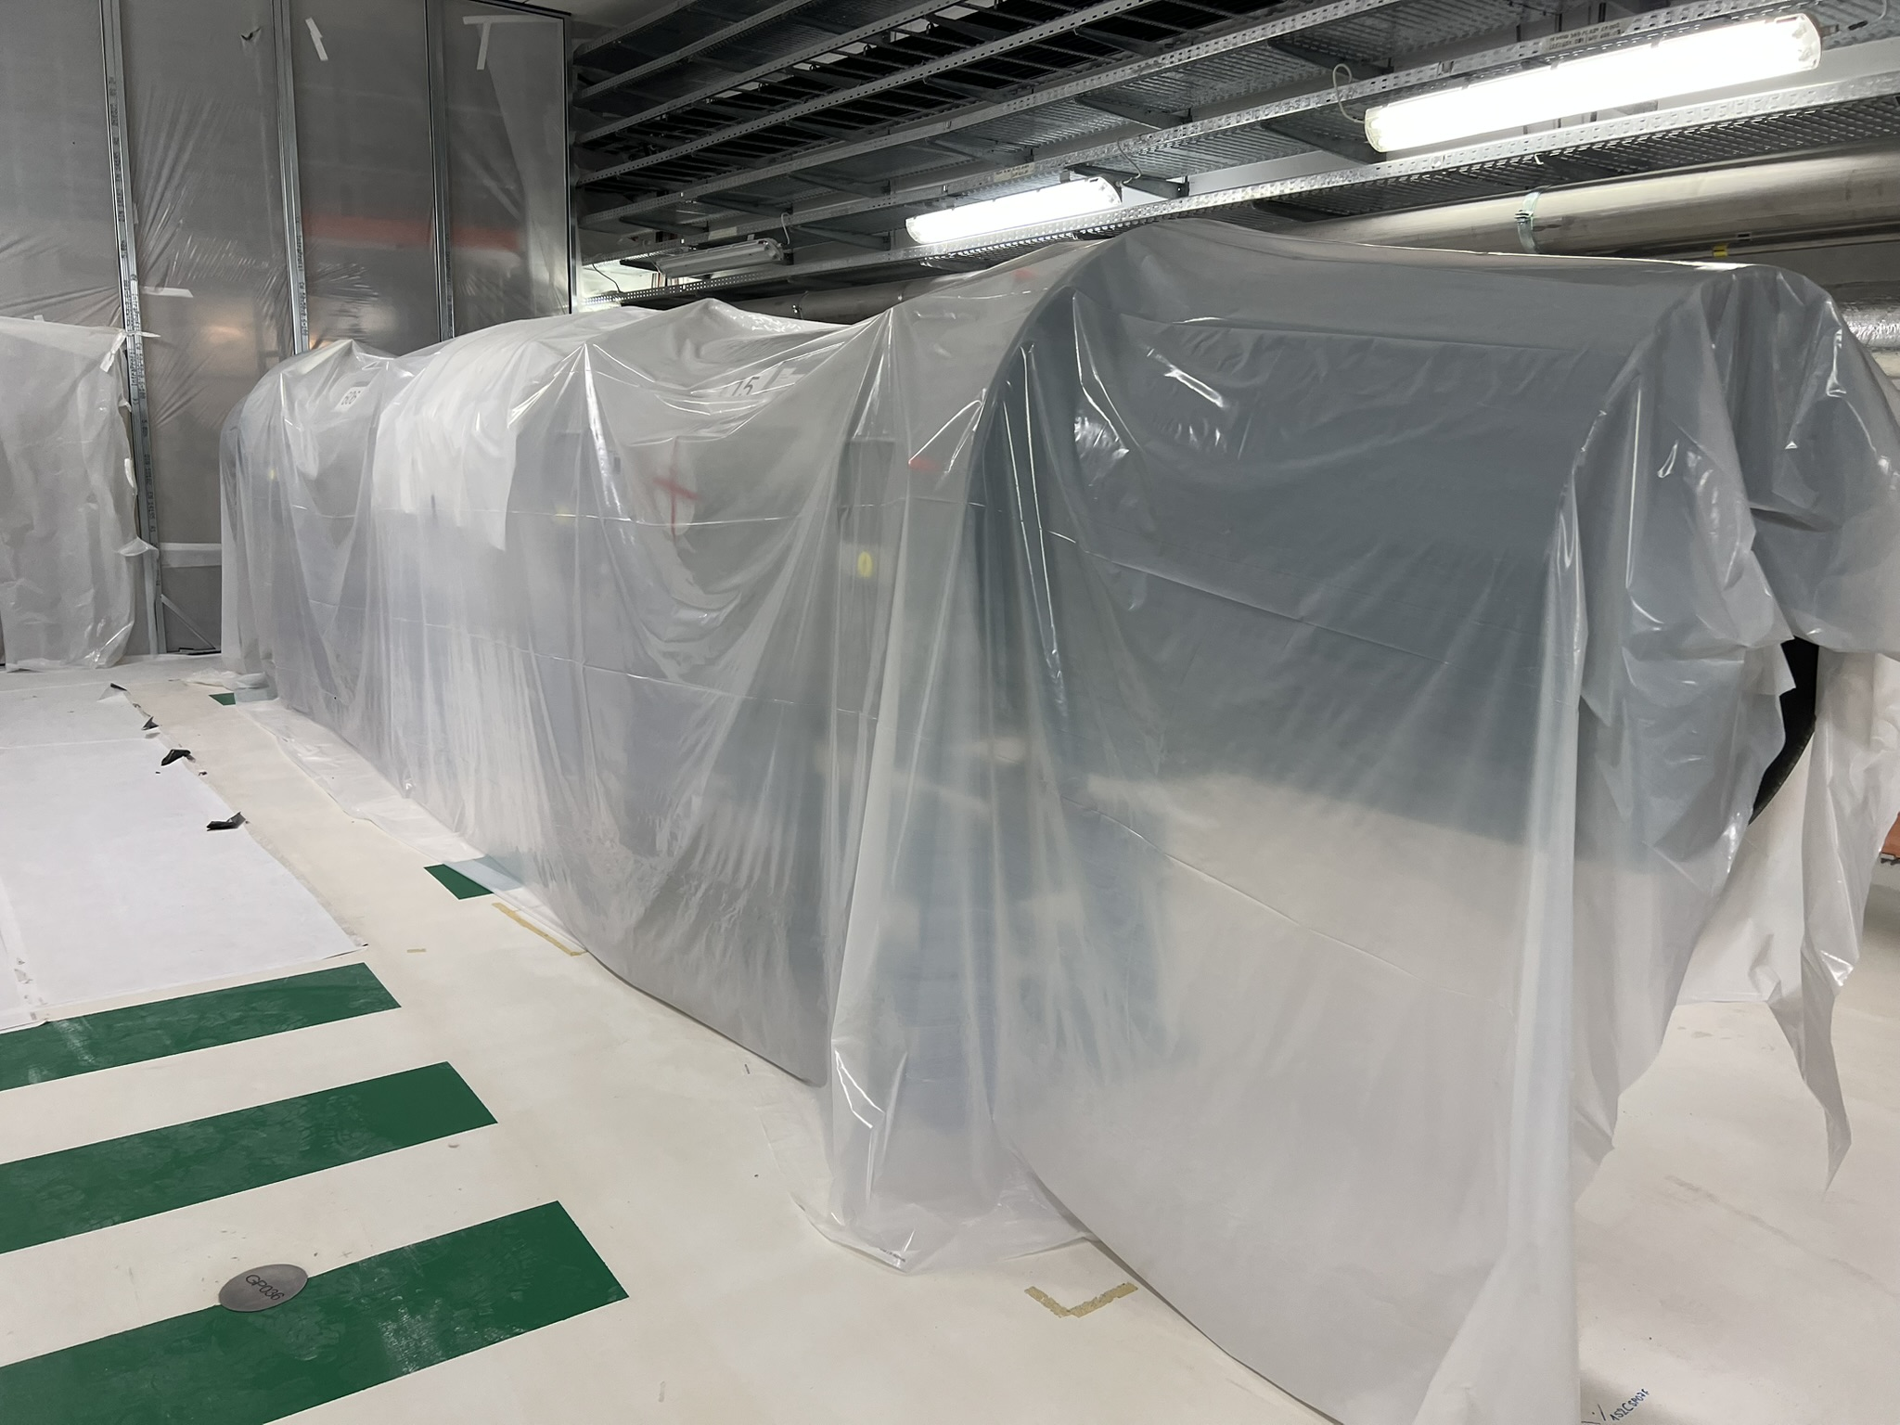
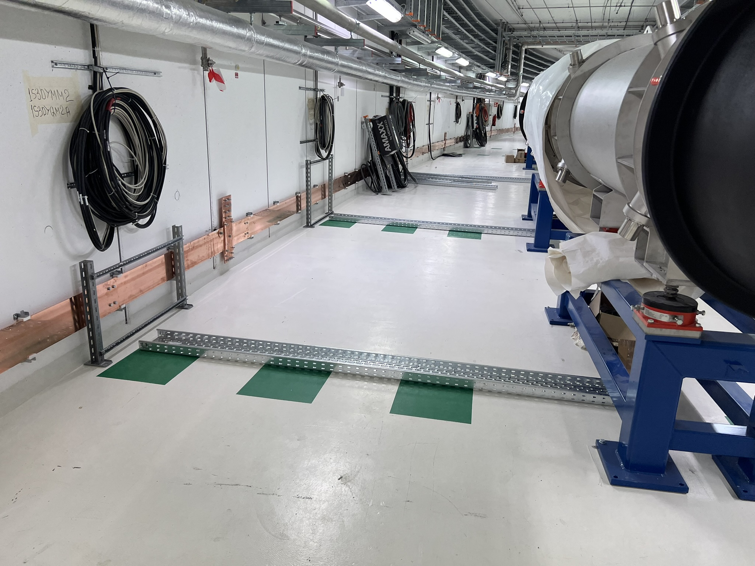
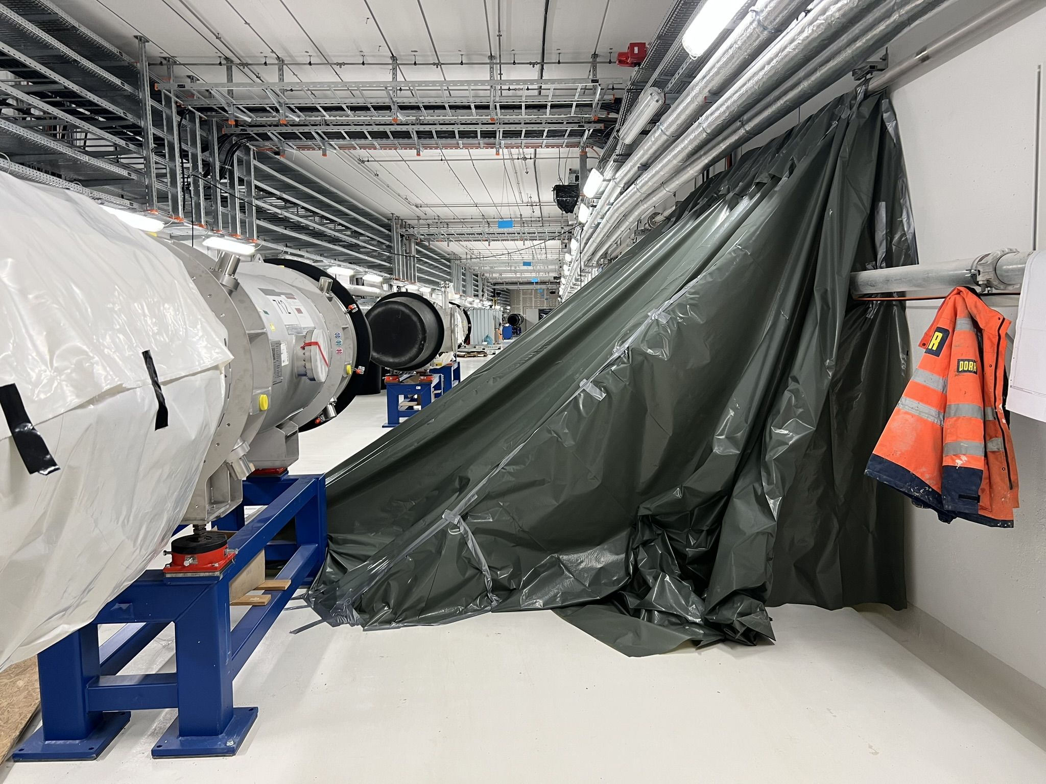
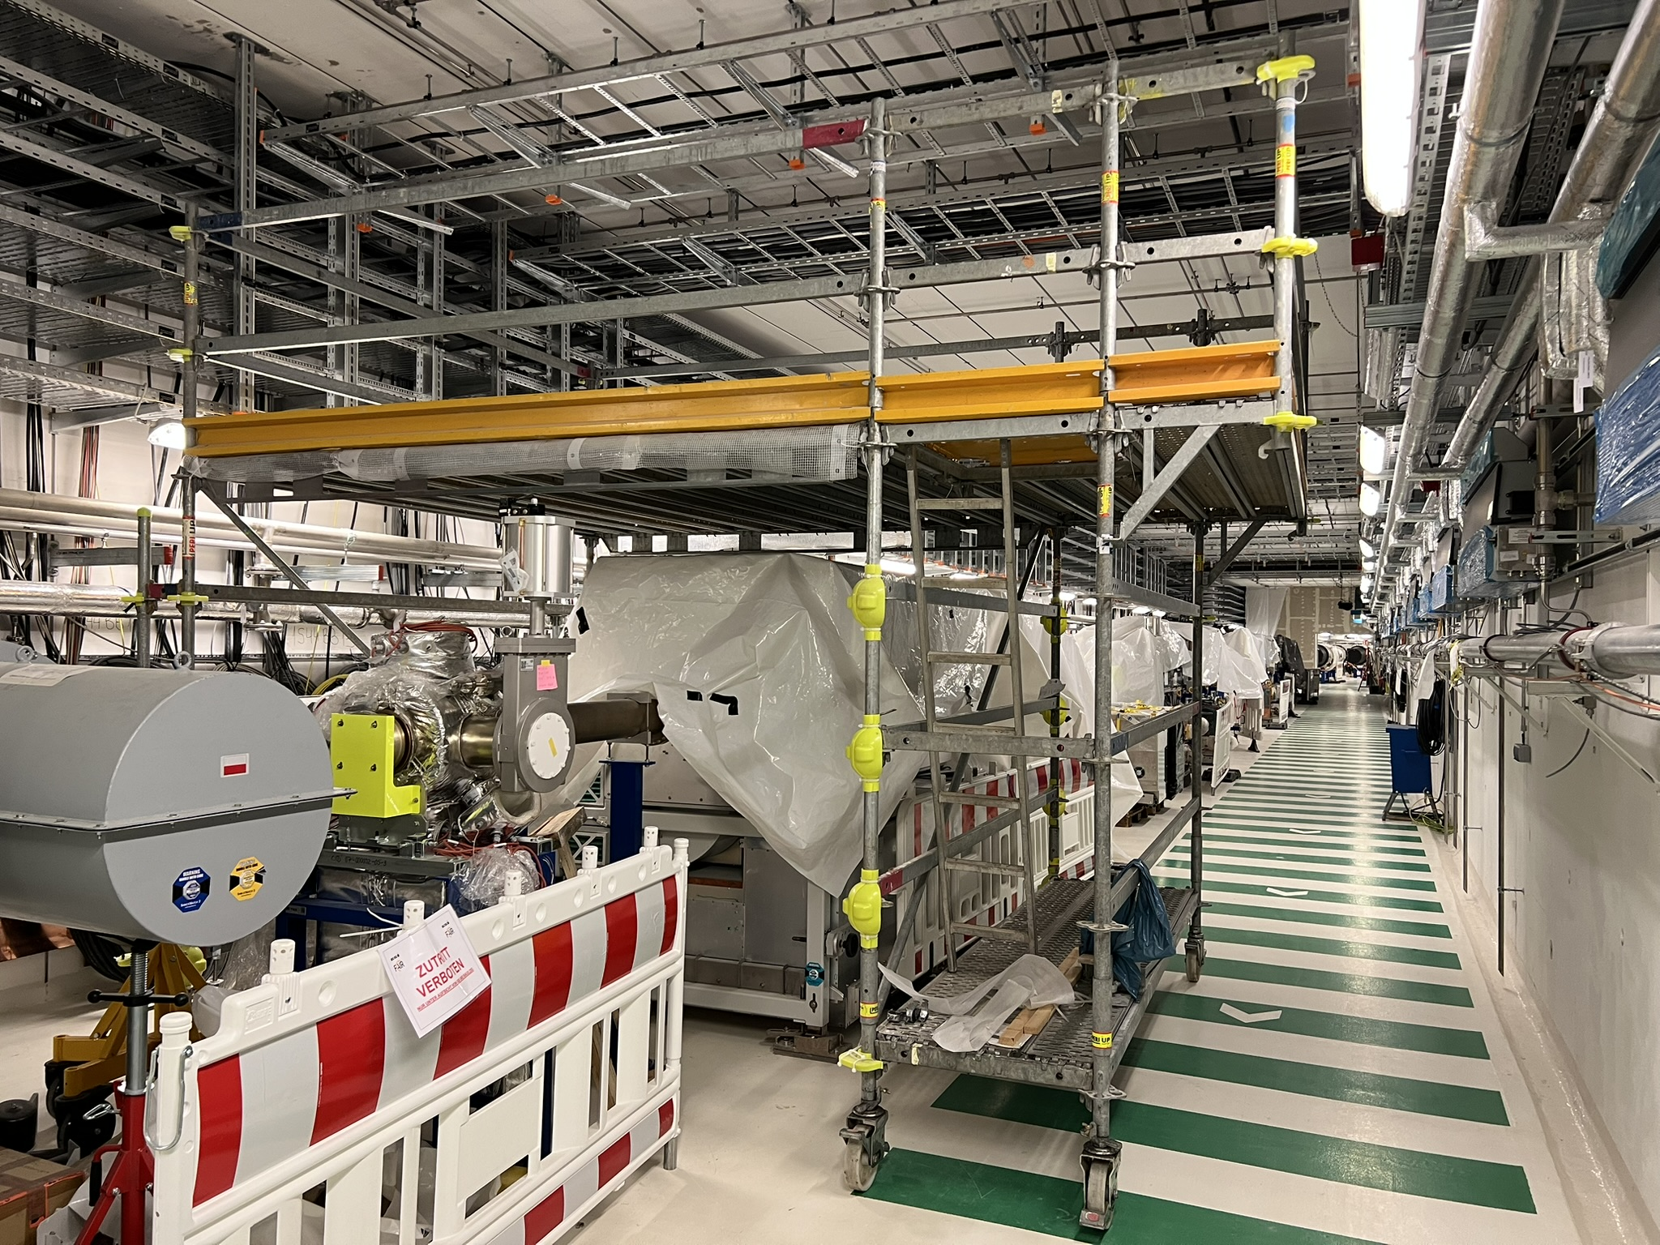
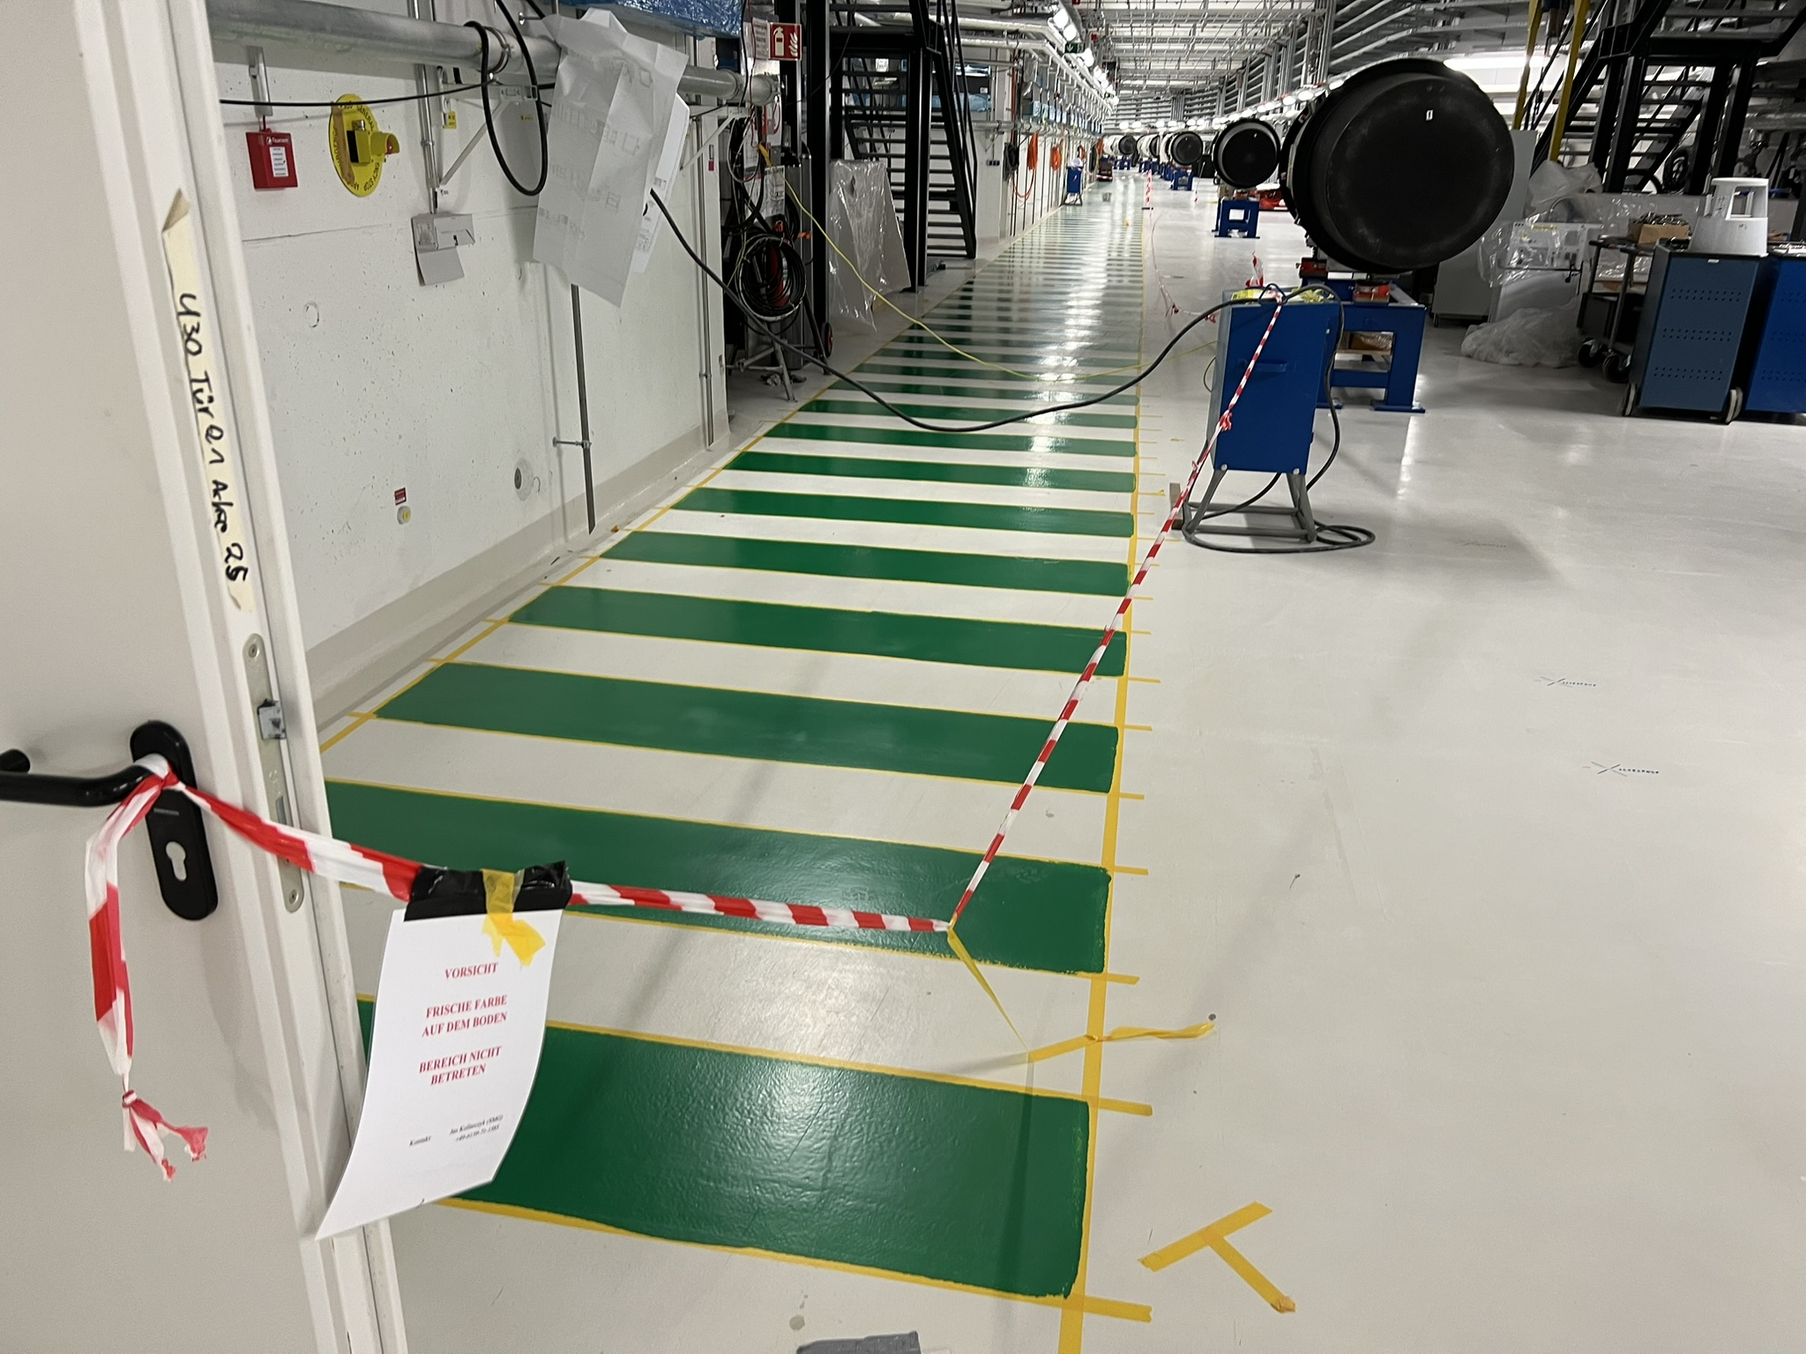
Interaction with TBE works
Example of TBE Works:
Dismantling of temporary pipeline with fire-fighting medium
Grouting of water entry points (Leakage on ceiling)
Cable trays to the machines on the floor
Fireproof insulation of cable pipelines
Masonry works and door in arc 5
Room temperature sensors
Paintwork on the floor
Fire protection walls
Cable installations

Slide 13
LCM for SIS100
Machine installation & TBE works comprised
Planing on daily level
Every activity captured in LCM plan
Coordination with all current installation participants
Coordinated parallel works possible and necessary
Team capacity considerations
Prioritising, Flexibility

Slide 14
Work registration, preparation and documentation
Installation Readinness
Work Registration at SMG
DGUV sheet:
according to German Social Accident Insurance
occupational health and safety
installation management
on-site supervision
work coordination authority
Work & Test instructions, Work Binders
EDMS Structure
Following Quality Control Plan during instalaltion

Slide 15
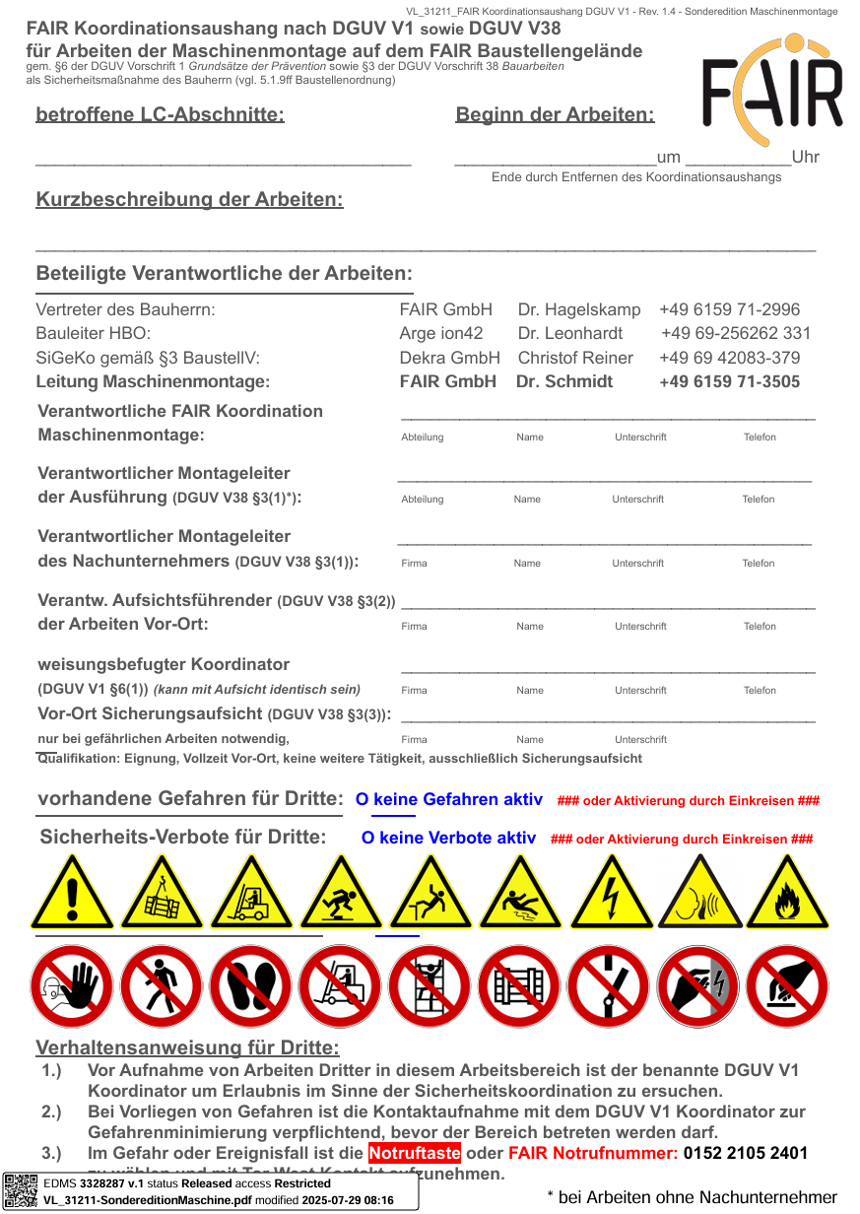
Work registration, preparation and documentation
Installation Readinness
Work Registration at SMG
DGUV sheet:
according to German Social Accident Insurance
occupational health and safety
installation management
on-site supervision
work coordination authority
Work & Test instructions, Work Binders
EDMS Structure
Following Quality Control Plan during instalaltion

Slide 16
Conclusion
Following installation towards Mechanical Completion
Transformation of installation strategy into serial assembly
Keeping harmony between Machine installation & TBE
Centralised coordination of Machine installation
Communication of each intention on first place
Ideas for improvements welcome
Reflection of weak points

Slide 17
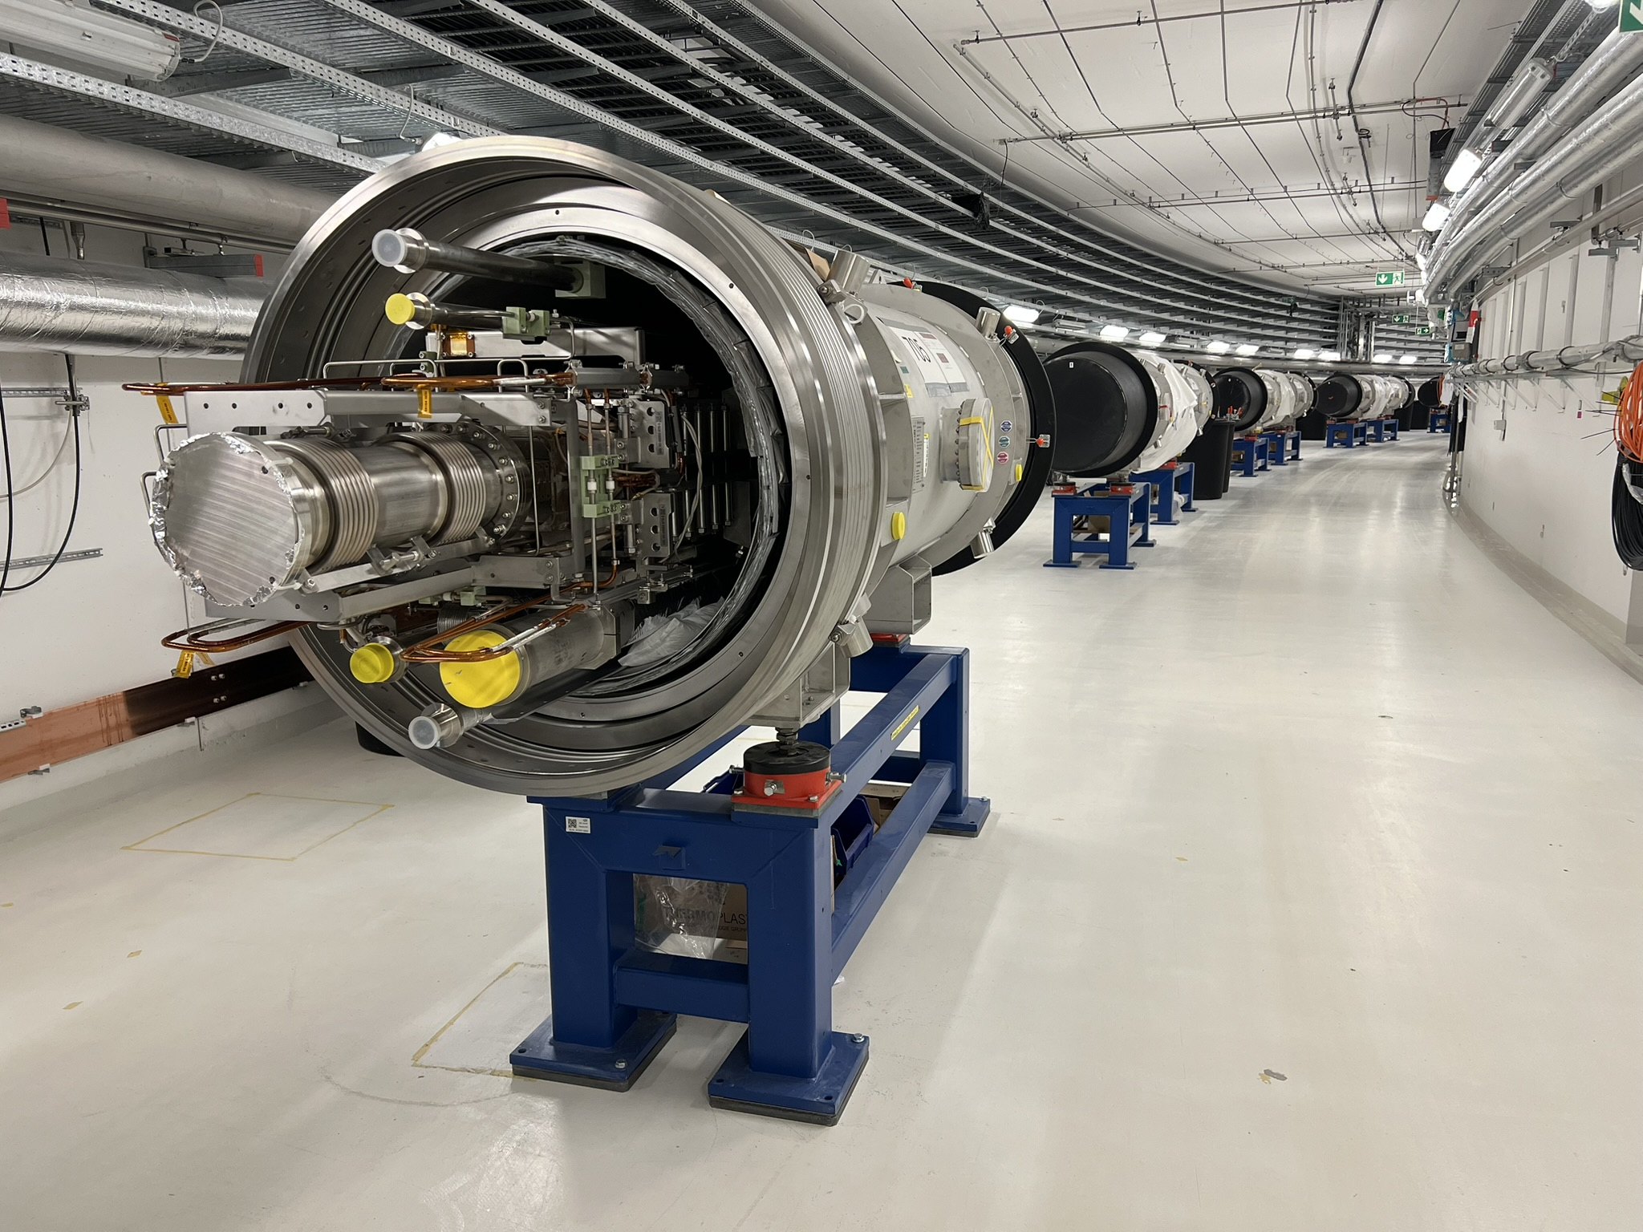
Discussion
Thank you for your attention

