Slide 1
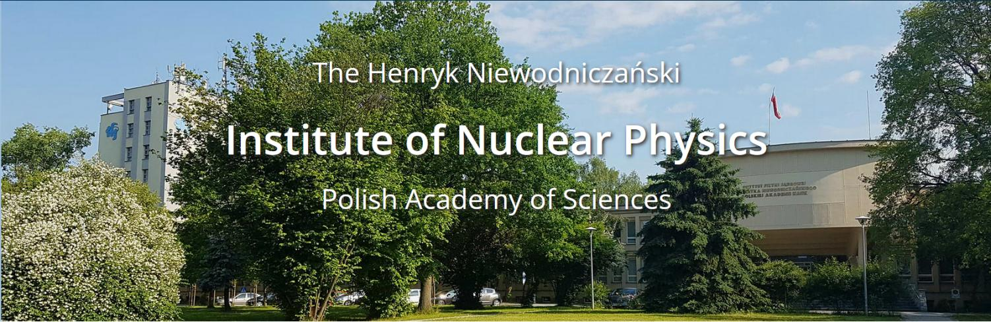
DIVISION OF SCIENTIFIC EQUIPMENT AND INFRASTRUCTURE CONSTRUCTION
(DAI)
IFJ PAN Contribution to Module Integration
Jacek Świerblewski, Michał Sienkiewicz
22-24 September 2025, Kloster Eberbach

Slide 2
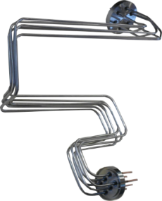
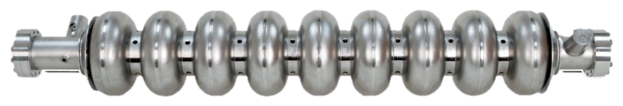
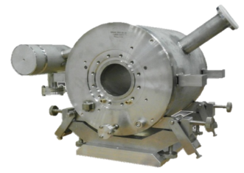
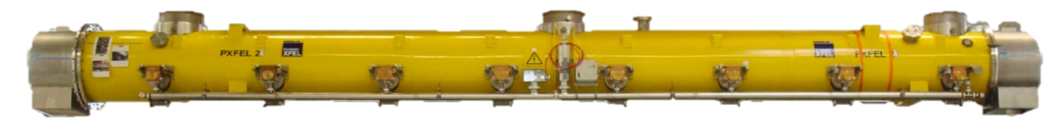
Acceptance tests of superconducting components of the XFEL accelerator
IFJ PAN in-kind contribution to the XFEL 2010 – 2016
103 x
Current Lead
840 x
Cold magnet
Cavity
103 x
Cryomodule
22-24 September 2025, Kloster Eberbach

Slide 3
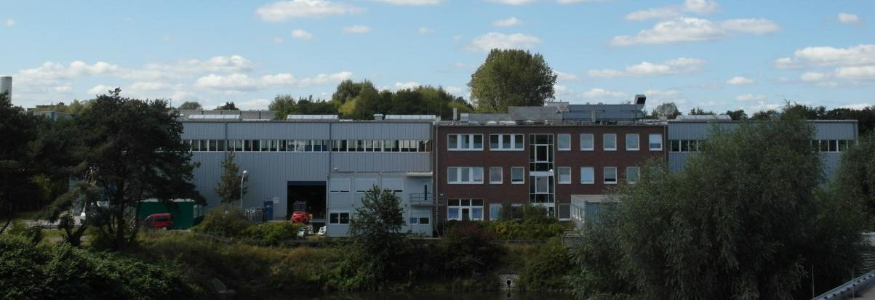
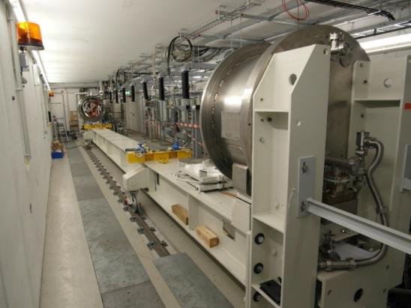
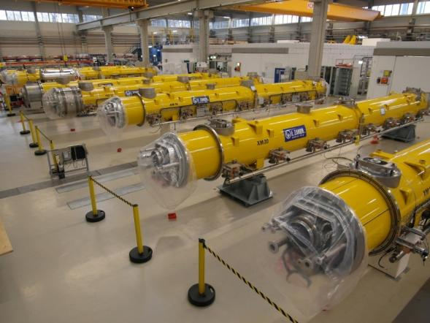
Location: DESY campus at Hamburg
IFJ PAN Team met the logistic challenge in facility operating (equipped with) :
Two cryostats
Preparation area for cavities (6 Inserts)
Three test stands for cryomodules
Preparation areas for cryomodules(3x special support for survey check + additional 5 place for further incoming check.
Limited Storage areas for cavities and cryomodules
2 cryo operation(2 slots) available at the same time
22-24 September 2025, Kloster Eberbach

Slide 4
Number of FTEs over 6 years ~160
Number of people involved ~80 (~40 engineers)
In total were performed:
1214 tests for 813 series cavities performed
108 tests performed of 101 series cold magnets and current leads
107 tests for 100 series cryomodules
22-24 September 2025, Kloster Eberbach

Slide 5
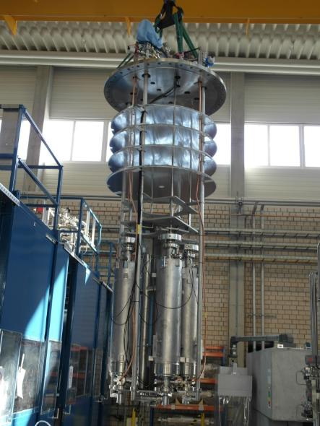
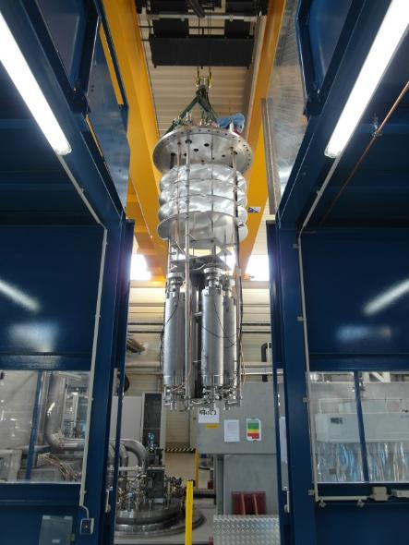
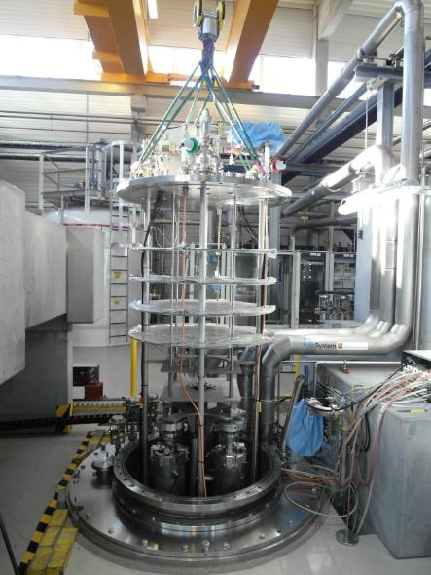
Transport of the Insert to the cryostat + vacuum connection
22-24 September 2025, Kloster Eberbach

Slide 6
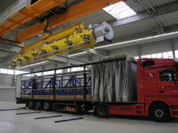
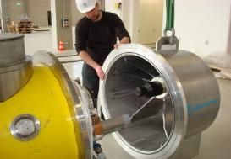
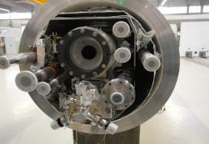
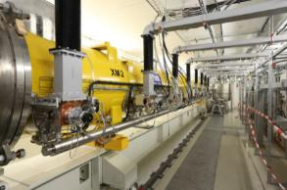
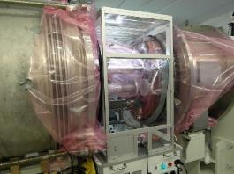
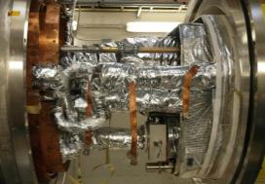
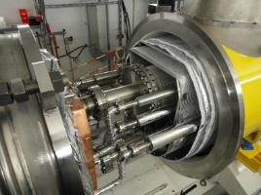

Preparation and assembling of the cryomodule - Main tasks:
Unload the cryomodule from the truck
Incoming checks
Load the cryomodule to the movable support
Assembling Cryomodule at the test stand
Connecting Cryomodule beam line to the test stand under
clean room conditions
Leak check of beam line interconnections and mass spectroscopy of the beam line
Connecting of the waveguides
Connecting of all electrical cables
Connect of all cryomodule process pipes to the test stands
Leak check of cryomodule vessel (ISO-VAC)
Leak check of cryomodule cryogenic lines
Assembly and isolating thermal shields
Pumping down of isolation vacuum
22-24 September 2025, Kloster Eberbach

Slide 7
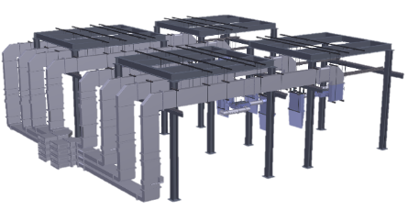
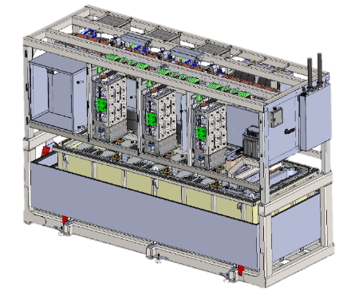
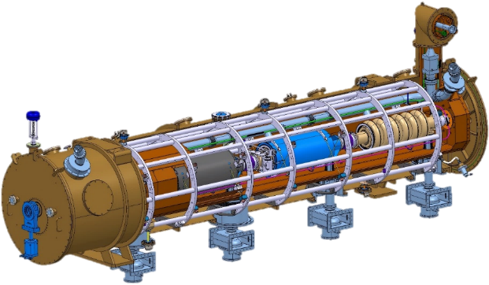
IFJ PAN IK contribution to ESS
RF Installation
Stub installation
LLRF installation
LPS installation
Distribution system installation
High Power Amplifier installation
PC Installation
Klystrons Modulators for RFQ and DTL
Klystron Modulators for Medium / High Beta
Magnet Power Converters
~116 FTE over 5 Years
Cryomodule test
Preparation and performing tests for 30 Cryomodule
22-24 September 2025, Kloster Eberbach

Slide 8

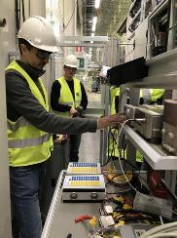
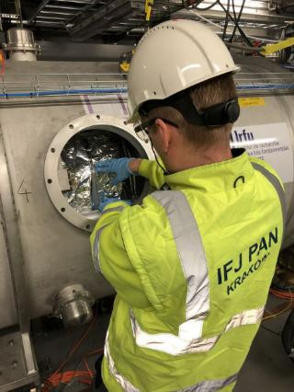
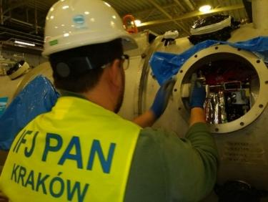
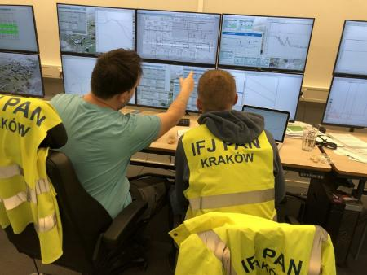
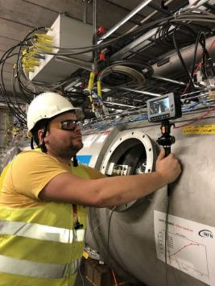
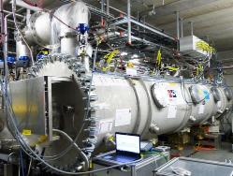
Cryomodule test at TS2
Reception of cryomodules
Incoming Inspections
Removing of cavity fixation system
Preparing of the CM to survey check
Connection of the beam vacuum pump station
Actuator installation and test of the gate valve
Making of all interconnections
  Waveguides
  Cryogenic lines
  Cooling water pipes
  Instrumentation
  Compressed air
  Cables
Connection of the insulation vacuum pump station
Leak check of insulation vacuum
Leak check of cryogenic circuits
Mounting of door knobs (support for ESS)
…
22-24 September 2025, Kloster Eberbach

Slide 9
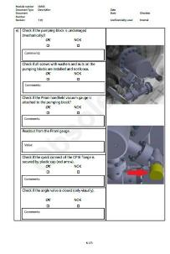
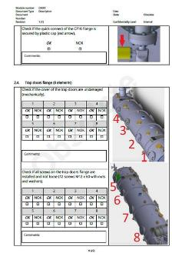
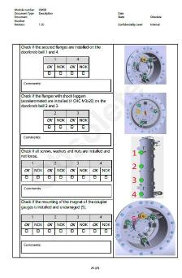
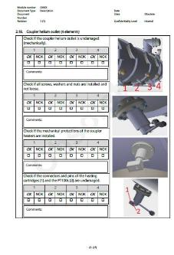
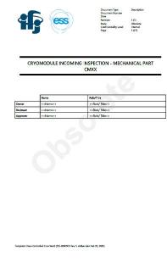
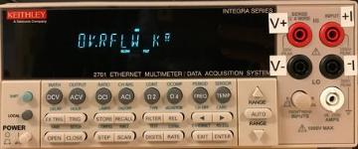
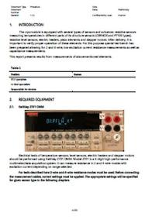
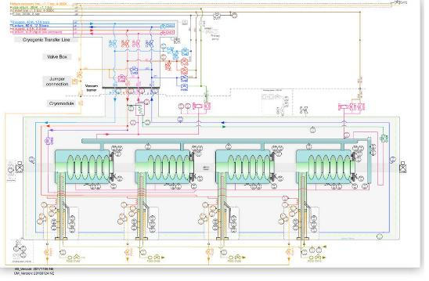
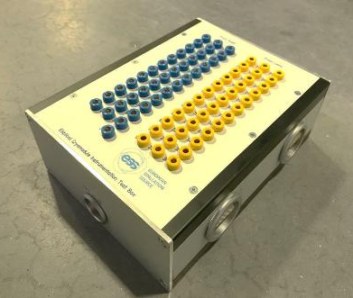
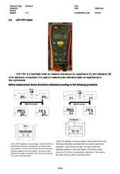
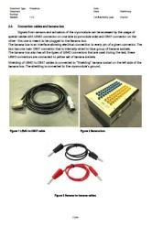
Activities example
Mechanical inspection
The main vacuum tests in TS2
Electrical checks
22-24 September 2025, Kloster Eberbach

Slide 10
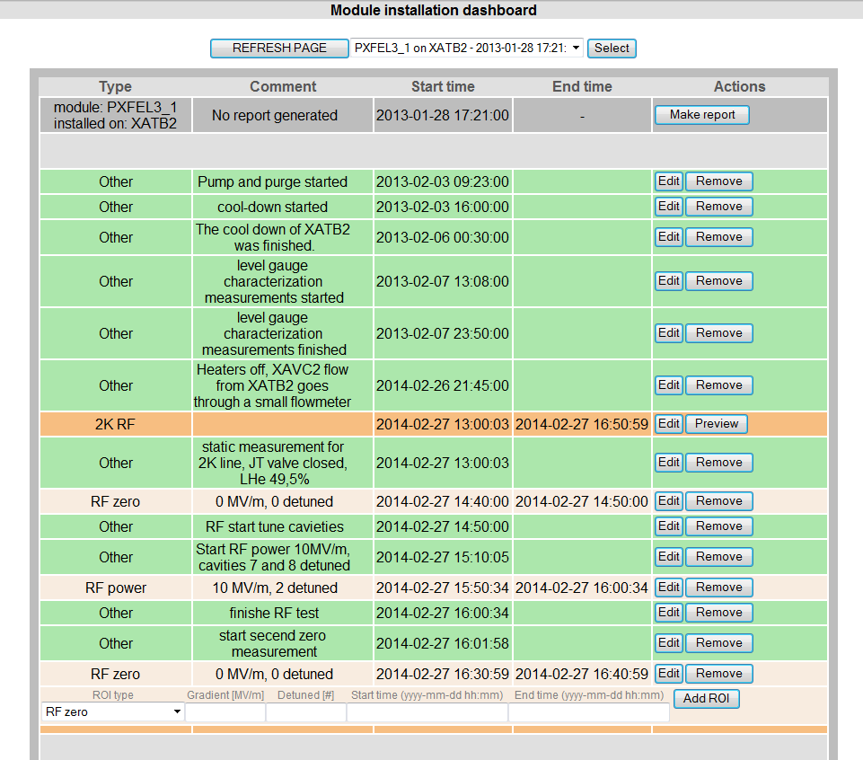
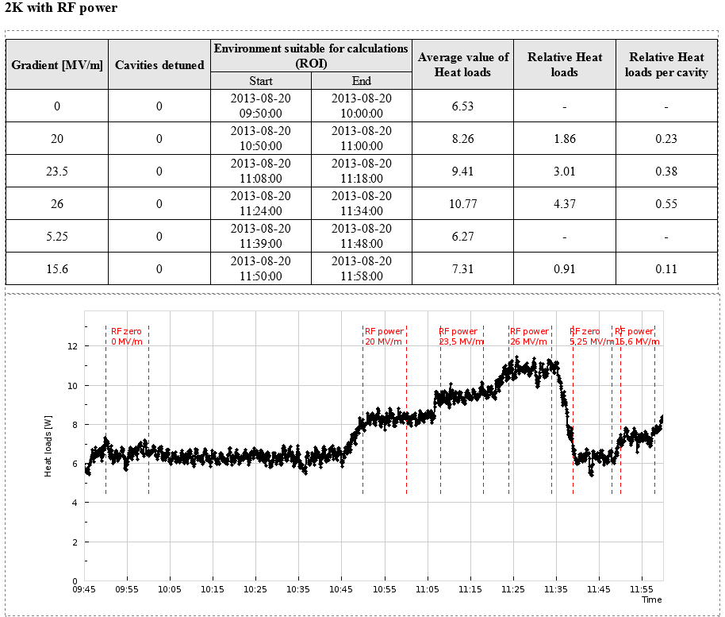
Heat loads Measurements - Cryo Report Generator
Heat load is calculated for each cryo circuit (2K, 4.5K, 40K)
Calculation is performed by the EIPCS control system on specially prepared channels using HEPAK library
Data is stored in the archives
Final result is retrieved as a mean value from stable test period
22-24 September 2025, Kloster Eberbach

Slide 11

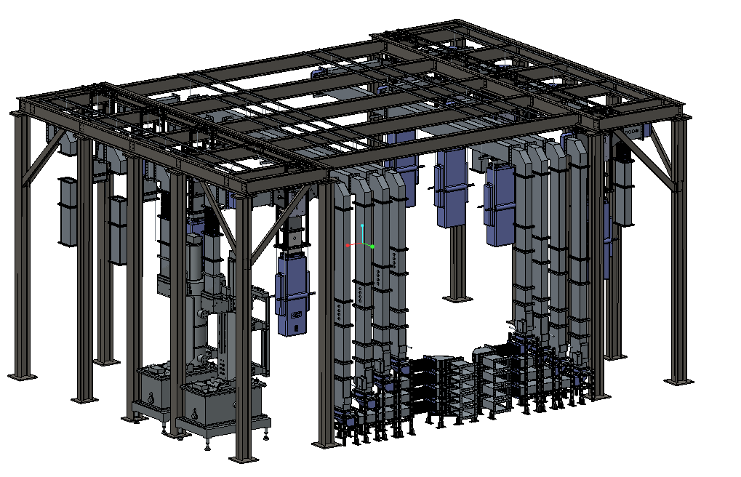
RF systems installations.
Supporting structure with some elements for “beta RF cell”
Hangers
Circulators
Loads
Waveguides
Supporting structure
22-24 September 2025, Kloster Eberbach

Slide 12
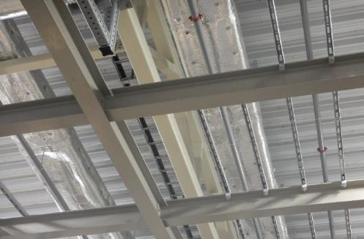
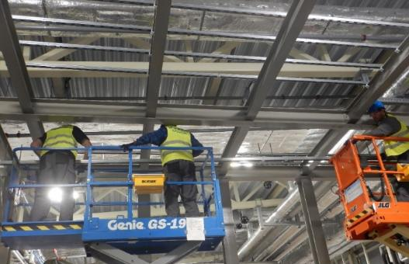
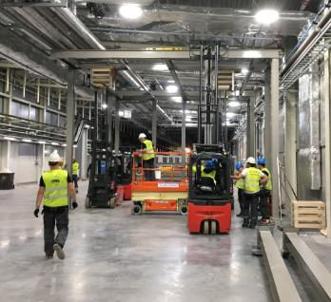
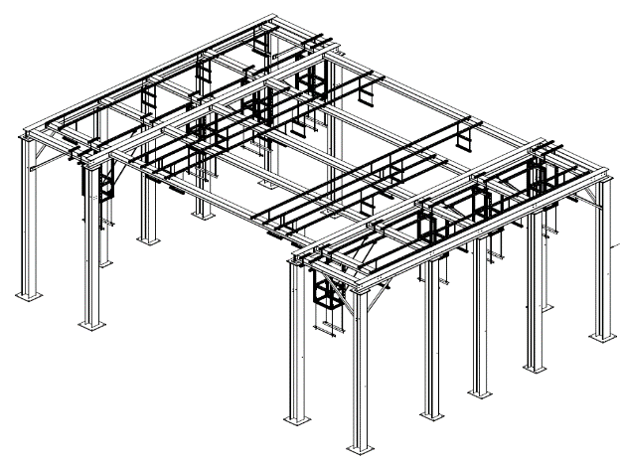
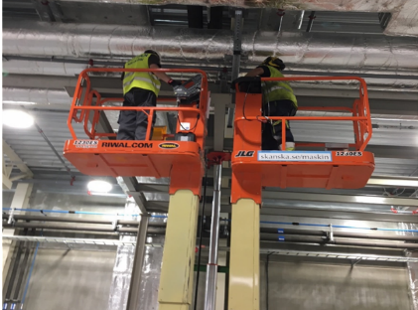
Installation of the support structure
17 supporting structures have been mounted
Support Structure
22-24 September 2025, Kloster Eberbach

Slide 13
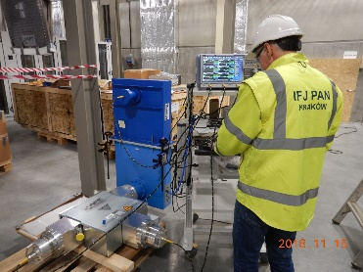
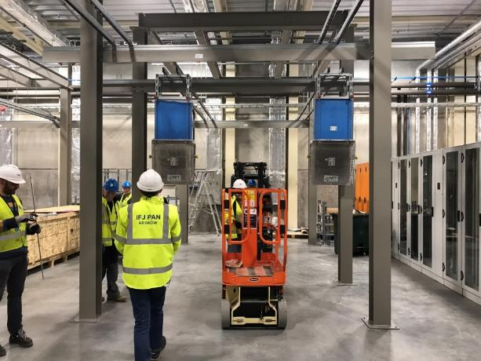
352 MHz Loads have been tested and installed
27 loads (352 MHz) have been tested and hanged
82 loads (704 MHz) received and tested with VNA
26 circulators (352 MHz) have been tested with VNA and installed
22-24 September 2025, Kloster Eberbach

Slide 14
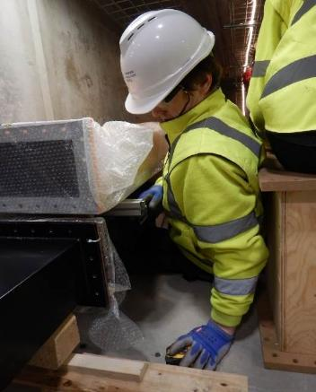
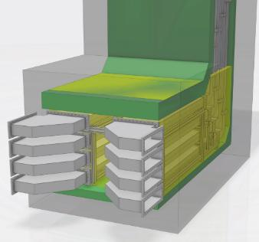


Initial works in stubs:
tests with wooden mockup
All waveguides have been installed
22-24 September 2025, Kloster Eberbach

Slide 15




Data management - systems
quality control
problem analysis
automatic report generation (in development)
electronic logbook
Data Base – Cavity status at AMTF
Screen at hall
Data Base – cryomodule tasks XFEL
Cryomodule tasks ESS
22-24 September 2025, Kloster Eberbach

Slide 16
Collaboration between IFJ PAN and GSI/FAIR
Accelerator Co-operation Agreement between IFJ PAN and GSI -> April 2022
Extension of collaboration -> October 2023 (IFJ PAN, GSI and FAIR)
22-24 September 2025, Kloster Eberbach

Slide 17





String Test
IFJ PAN team together with SCM colleagues assembled all the String Test components and prepared them for the first cooling.
Methods for performing individual tasks were developed, verified, and optimized.
Procedures/Work instructions have been developed and now they are basis for the ongoing work in the tunnel.
Faults and errors were identified and corrected before starting the work in the tunnel.
IFJ PAN team also assisted in the activities between the first and second cold runs.
22-24 September 2025, Kloster Eberbach

Slide 18








SIS 100 - Tunnel installations
April 2024 – February 2025
Cleaning of beamline and replacement of vacuum chamber holders
Installation of telescopic elements and closing of the interconnection
Beamline connection and leak check
Soldering of bus bar joints
22-24 September 2025, Kloster Eberbach

Slide 19
Status of work completed by IFJ PAN Team during the first phase of SIS100 tunnel installation. (DP-DP interconnection)
Collaboration agreement IFJ PAN – GSI/FAIR
 |  | Sector 1 | Sector 2 | Sector 3 | Sector 4 | Sector 5 | Sector 6
1.1 | Cleaning of beamline | 95% ¹ | 95% ¹ | 100% | 0% | 0% | 0%
1.2 | Replacement of vacuum chamber holders | 95% ¹ | 95% ¹ | 100% | 0% | 0% | 0%
1.3 | Installation of telescopic elements | 90% ^{1,2} | 90% ^{1,2} | 90% ^{1,2} | 0% | 0% | 0%
1.4 | Beamline connections | 90% ¹ | 90% ¹ | 90% ¹ | 0% | 0% | 0%
1.5 | Leak check of beamline | 50% ^{1,4} | 90% ¹ | 90% ¹ | 0% | 0% | 0%
1.6 | Soldering of bus bar joints | 70% ^{1,4} | 90% ¹ | 90% ¹ | 0% | 0% | 0%
1.7 | He Leak test of process pipes | 0% | 0% | 0% | 0% | 0% | 0%
1.8 | Installation of bus bar clamps | 0% | 0% | 0% | 0% | 0% | 0%
1.9 | Installation of process pipes support structure | 0% | 0% | 0% | 0% | 0% | 0%
1.10 | Thermal screens installations | 0% | 0% | 0% | 0% | 0% | 0%
1.11 | Multi-Layer Insulation (MLI) wrapping | 0% | 0% | 0% | 0% | 0% | 0%
1.12 | Opening and closing of telescopic bellows | 0% | 90% ^{1,3} | 90% ^{1,3} | 0% | 0% | 0%
¹ It was not possible to place the magnets in their final position before the fire protection wall was completed.
² Installed only on the connection side between the DP-DP magnets to avoid potential damage at QDM-DP side during the long wait for the remaining QDM magnets
³ Temporarily closed due to waiting for process pipe welding
⁴ Work was suspended due to the installation team's departure
22-24 September 2025, Kloster Eberbach

Slide 20



Pre-assembly of sextupoles
IFJ PAN team was involved in integration of vacuum chambers and installation of strain relief system on resonance sextupoles
22-24 September 2025, Kloster Eberbach

Slide 21



SIS 18 shutdown – IFJ PAN Team support
examples of the activities -> replace IGP and TSP pumps during last SIS18 shutdown
22-24 September 2025, Kloster Eberbach

Slide 22

In-kind agreement
FAIR – JU– IFJ PAN
X.2025 - XII.2028+
It has been signed in summer time 2025
22-24 September 2025, Kloster Eberbach

Slide 23

SIS 100 – Scope of work
22-24 September 2025, Kloster Eberbach

Slide 24

Scope of work – other sub-projects
22-24 September 2025, Kloster Eberbach

Slide 25

Strong pillars as the basis of the agreement
The principle of bilateral approval of procedures
Code of Conduct
Well defined circulation/flow of information.
22-24 September 2025, Kloster Eberbach

Slide 26
Thank You
22-24 September 2025, Kloster Eberbach

