Slide 1
Status IND control systems
4th SIS100 Workshop

Slide 2
Status IND control systems
Status control systems for SIS100
  PAS (Personel Access System)
  INSULATION VACUUM
  BEAMLINE VACUUM
  BAKEOUT
  CRYO
Notes:
I want to give you a brief overview about the status of the control systems related to the SIS100.
Contrary to the anouncement I will not only talk about Cryo Control.

Slide 3
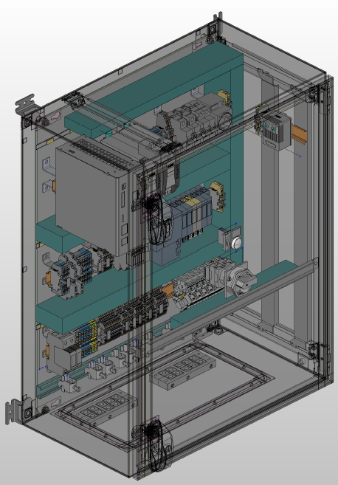
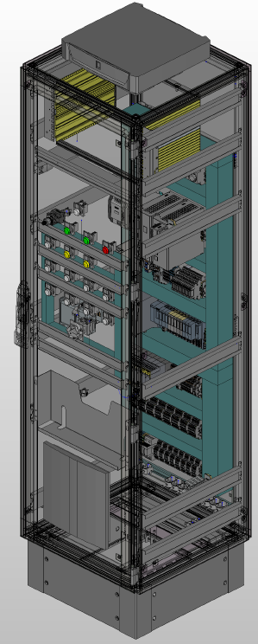
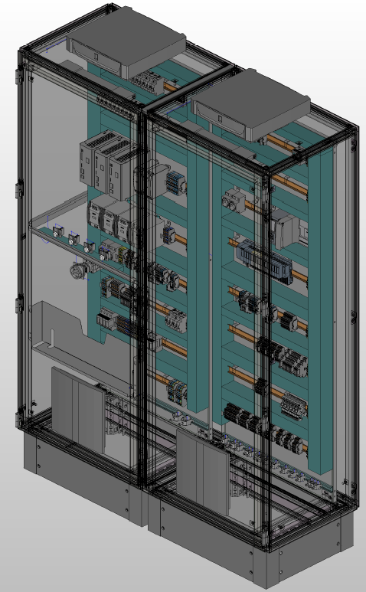
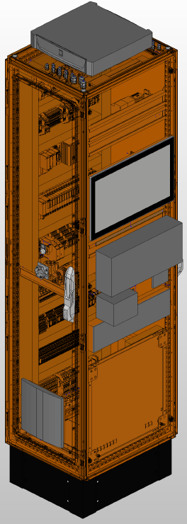
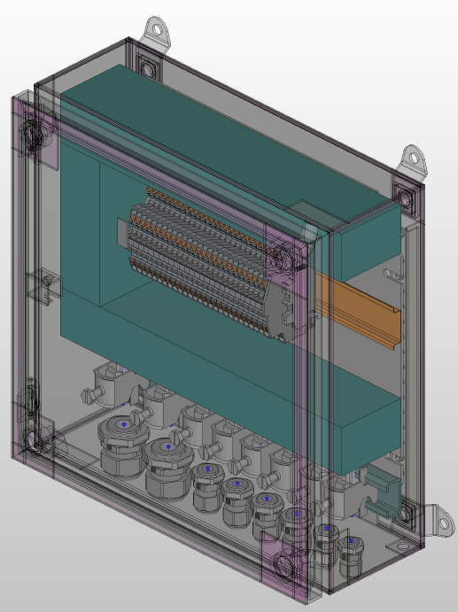
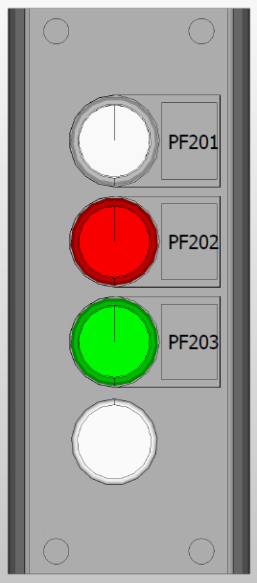
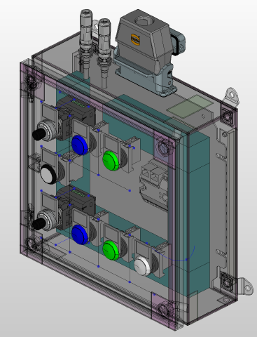
Status IND control system
- PAS
Status
  Cabinet status: FoS for all cabinet types was successfully tested, cabinets released for production, FAT ongoing, delivery Q4 2025
  (21 Cabinets / 12 terminal boxes / 31 operator panels)
  PLC software status: In progress / already advanced
  HMI software status: In progress
6x
12x
29x
2x
3x
6x
6x
Notes:
FOS cabinets were successfully tested for all different types of cabinets.
As you can see here, we have a lot of different cabinet types.
All cabinets will be delivered by the end of the year 2025.
Detailed lists of cabinets not only for the PAS are included to the presentation for those who are interested.

Slide 4
Status IND control system preparations - PAS
Overview 1/3
cabinets are in production and delivery is expected in 2025
Equipment | Material | Bezeichnung technisches Objekt | Arbeitspaket | PSP Element | Referenzkennzeichnung | CDB Comp. Name | Bemerkung | Tender req. | Tender status | Status | LT expected | LT PLC comp.
out of: CID:55000010016 - CID:55000010252 | AID:0003277 | PAS main area control cabinet | PAS Control System | 2.14.10.11.1 | '=FP64+UH001 | MB310.NE020.UH020, =FP64+UH001 | finale Zuordnung CID erfolgt beim Aufbau | x | X | In production | Q4/2025 | x
 | AID:0003277 | PAS main area control cabinet | PAS Control System | 2.14.10.11.1 | '=FP65+UH001 | MB310.NE020.UH030, =FP65+UH001
 | AID:0003277 | PAS main area control cabinet | PAS Control System | 2.14.10.11.1 | '=FP66+UH001 | MB310.NE020.UH040, =FP66+UH001
 | AID:0003277 | PAS main area control cabinet | PAS Control System | 2.14.10.11.1 | '=FP60+UH001 | MB310.NE030.UH010, =FP60+UH001
 | AID:0003277 | PAS main area control cabinet | PAS Control System | 2.14.10.11.1 | '=FP61+UH001 | MB310.NE030.UH030, =FP61+UH001
 | AID:0003277 | PAS main area control cabinet | PAS Control System | 2.14.10.11.1 | '=FP62+UH001 | MB310.NE030.UH050, =FP62+UH001
out of CID:55000017848 - CID:55000018081 |  | PAS PAG access gate | PAS Control System | 2.14.10.11.1 | =FP64-FQS01 |  | finale Zuordnung CID erfolgt beim Aufbau |  |  | In production | Q4/2025 | -
 |  | PAS PAG access gate | PAS Control System | 2.14.10.11.1 | =FP65-FQS01
 |  | PAS PAG access gate | PAS Control System | 2.14.10.11.1 | =FP66-FQS01
 |  | PAS PAG access gate | PAS Control System | 2.14.10.11.1 | =FP60-FQS01
 |  | PAS PAG access gate | PAS Control System | 2.14.10.11.1 | =FP61-FQS01
 |  | PAS PAG access gate | PAS Control System | 2.14.10.11.1 | =FP62-FQS01
out of CID:55000010269 - CID:55000010498 | AID:0003278 | PAS BOG control cabinet V1 | PAS Control System | 2.14.10.11.1 | '=FN11+UH101 | MB217.NE130.UH010, =FN11+UH101 | finale Zuordnung CID erfolgt beim Aufbau |  |  | In production | Q4/2025 | x
 | AID:0003278 | PAS BOG control cabinet V1 | PAS Control System | 2.14.10.11.1 | '=FN15+UH101 | MB217.NE130.UH090, =FN15+UH101
 | AID:0003278 | PAS BOG control cabinet V1 | PAS Control System | 2.14.10.11.1 | '=FN51+UH101 | MB310.NE020.UH010, =FN51+UH101
out of CID:55000010511 - CID:55000010757 | AID:0003280 | PAS PAG control cabinet | PAS Control System | 2.14.10.11.1 | '=FP64+UH011 | MB310.NE020.UH060, =FP64+UH011 | finale Zuordnung CID erfolgt beim Aufbau |  |  | In production | Q4/2025 | x
 | AID:0003280 | PAS PAG control cabinet | PAS Control System | 2.14.10.11.1 | '=FP65+UH011 | MB310.NE020.UH070, =FP65+UH011
 | AID:0003280 | PAS PAG control cabinet | PAS Control System | 2.14.10.11.1 | '=FP66+UH011 | MB310.NE020.UH080, =FP66+UH011
 | AID:0003280 | PAS PAG control cabinet | PAS Control System | 2.14.10.11.1 | '=FP60+UH011 | MB310.NE030.UH080, =FP60+UH011
 | AID:0003280 | PAS PAG control cabinet | PAS Control System | 2.14.10.11.1 | '=FP61+UH011 | MB310.NE030.UH090, =FP61+UH011
 | AID:0003280 | PAS PAG control cabinet | PAS Control System | 2.14.10.11.1 | '=FP62+UH011 | MB310.NE030.UH100, =FP62+UH011
out of CID:55000010764 - CID:55000011204 | AID:0003281 | PAS AAD control cabinet V1 | PAS Control System | 2.14.10.11.1 | '=FP60+UH031 | MB310.NE030.UH020, =FP60+UH031 | finale Zuordnung CID erfolgt beim Aufbau |  |  | In production | Q4/2025 | x
 | AID:0003281 | PAS AAD control cabinet V1 | PAS Control System | 2.14.10.11.1 | '=FP61+UH031 | MB310.NE030.UH040, =FP61+UH031
 | AID:0003281 | PAS AAD control cabinet V1 | PAS Control System | 2.14.10.11.1 | '=FP62+UH031 | MB310.NE030.UH070, =FP62+UH031
out of CID:55000013949 - CID:55000014137 | AID:0003113 | PAS SAD control cabinet V2 | PAS Control System | 2.14.10.11.1 | '=FP70+UH051 | MB310.NE020.UH050, =FP70+UH051 | finale Zuordnung CID erfolgt beim Aufbau |  |  | In production | Q4/2025 | x
 | AID:0003113 | PAS SAD control cabinet V2 | PAS Control System | 2.14.10.11.1 | '=FP67+UH051 | MB204.NE020.UH050, =FP67+UH051

Slide 5
Status IND control system preparations - PAS
Overview 2/3
Equipment | Material | Bezeichnung technisches Objekt | Arbeitspaket | PSP Element | Referenzkennzeichnung | CDB Comp. Name | Bemerkung | Tender req. | Tender status | Status | LT expected | LT PLC comp.
out of CID:55000014144 - CID:55000014335 | AID:0003114 | PAS ECD control cabinet V3 | PAS Control System | 2.14.10.11.1 | '=FP62+UH021 | MB310.NE030.UH060, =FP62+UH021 | finale Zuordnung CID erfolgt beim Aufbau | x | x | In production | Q4/2025 | x
out of CID:55000011211 - CID:55000011433 | AID:0003282 | PAS MAD TB V4 | PAS Control System | 2.14.10.11.1 | '=FP60-FQM01+UC01 | BF310.TP001.QQ008, =FP60-FQM01+UC01 | finale Zuordnung CID erfolgt beim Aufbau |  |  | In production | Q4/2025 | x
 | AID:0003282 | PAS MAD TB V4 | PAS Control System | 2.14.10.11.1 | '=FP61-FQM01+UC01 | BF310.TP001.QQ011, =FP61-FQM01+UC01
 | AID:0003282 | PAS MAD TB V4 | PAS Control System | 2.14.10.11.1 | '=FP62-FQM01+UC01 | BF310.TP001.QQ013, =FP62-FQM01+UC01
 | AID:0003282 | PAS MAD TB V4 | PAS Control System | 2.14.10.11.1 | '=FP64-FQM01+UC01 | BF310.TP101.QQ002, =FP64-FQM01+UC01
 | AID:0003282 | PAS MAD TB V4 | PAS Control System | 2.14.10.11.1 | '=FP65-FQM01+UC01 | BF310.TP101.QQ004, =FP65-FQM01+UC01
 | AID:0003282 | PAS MAD TB V4 | PAS Control System | 2.14.10.11.1 | '=FP66-FQM01+UC01 | BF310.TP101.QQ006, =FP66-FQM01+UC01
out of CID:55000011440 - CID:55000011549 | AID:0003283 | PAS ECD TB V3 | PAS Control System | 2.14.10.11.1 | '=FP62-FQT01+UC01 | BF310.TF090.QQ072, =FP62-FQT01+UC01 | finale Zuordnung CID erfolgt beim Aufbau |  |  | In production | Q4/2025 | x
out of CID:55000011556 - CID:55000011754 | AID:0003284 | PAS AAD TB V1 | PAS Control System | 2.14.10.11.1 | '=FP61-FQB01+UC01 | BF310.TP001.QQ009, =FP61-FQB01+UC01 | finale Zuordnung CID erfolgt beim Aufbau |  |  | In production | Q4/2025 | x
 | AID:0003284 | PAS AAD TB V1 | PAS Control System | 2.14.10.11.1 | '=FP62-FQB01+UC01 | BF310.TP001.QQ014, =FP62-FQB01+UC01
 | AID:0003284 | PAS AAD TB V1 | PAS Control System | 2.14.10.11.1 | '=FP60-FQB01+UC01 | BF310.TP001.QQ016, =FP60-FQB01+UC01
out of CID:55000011761 - CID:55000011914 | AID:0003285 | PAS SAD TB V2 | PAS Control System | 2.14.10.11.1 | '=FP67-FQA01+UC01 | BF204.TP101.QQ001, =FP67-FQA01+UC01 | finale Zuordnung CID erfolgt beim Aufbau |  |  | In production | Q4/2025 | x
 | AID:0003285 | PAS SAD TB V2 | PAS Control System | 2.14.10.11.1 | '=FP70-FQA01+UC01 | BF310.TP001.QQ015, =FP70-FQA01+UC01

Slide 6
Status IND control system preparations - PAS
Overview 3/3
Equipment | Material | Bezeichnung technisches Objekt | Subprojekt | Arbeitspaket | Institute | PSP Element | EDMS Container | Referenzkennzeichnung | CDB Comp. Name | Bemerkung | Tender req. | Tender status | Status | LT expected | LT PLC comp.
out of CID:55000011938 - CID:55000012157 | AID:0003287 | PAS MAD OP V4 outside | Commons | PAS Control System | GSI | 2.14.10.11.1 | FAIR- | '=FP60-FQM01+SZ201 |  | finale Zuordnung CID erfolgt beim Aufbau | x | x | In production | Q4/2025 | x
 | AID:0003287 | PAS MAD OP V4 outside | Commons | PAS Control System | GSI | 2.14.10.11.1 | FAIR- | '=FP61-FQM01+SZ201
 | AID:0003287 | PAS MAD OP V4 outside | Commons | PAS Control System | GSI | 2.14.10.11.1 | FAIR- | '=FP62-FQM01+SZ201
 | AID:0003287 | PAS MAD OP V4 outside | Commons | PAS Control System | GSI | 2.14.10.11.1 | FAIR- | '=FP64-FQM01+SZ201
 | AID:0003287 | PAS MAD OP V4 outside | Commons | PAS Control System | GSI | 2.14.10.11.1 | FAIR- | '=FP65-FQM01+SZ201
 | AID:0003287 | PAS MAD OP V4 outside | Commons | PAS Control System | GSI | 2.14.10.11.1 | FAIR- | '=FP66-FQM01+SZ201
out of CID:55000012164 - CID:55000012386 | AID:0003288 | PAS MAD OP V5 MTK outside | Commons | PAS Control System | GSI | 2.14.10.11.1 | FAIR- | '=FP60-FQM01+SZ203 |  | finale Zuordnung CID erfolgt beim Aufbau |  |  | In production | Q4/2025 | x
 | AID:0003288 | PAS MAD OP V5 MTK outside | Commons | PAS Control System | GSI | 2.14.10.11.1 | FAIR- | '=FP61-FQM01+SZ203
 | AID:0003288 | PAS MAD OP V5 MTK outside | Commons | PAS Control System | GSI | 2.14.10.11.1 | FAIR- | '=FP62-FQM01+SZ203
 | AID:0003288 | PAS MAD OP V5 MTK outside | Commons | PAS Control System | GSI | 2.14.10.11.1 | FAIR- | '=FP64-FQM01+SZ203
 | AID:0003288 | PAS MAD OP V5 MTK outside | Commons | PAS Control System | GSI | 2.14.10.11.1 | FAIR- | '=FP65-FQM01+SZ203
 | AID:0003288 | PAS MAD OP V5 MTK outside | Commons | PAS Control System | GSI | 2.14.10.11.1 | FAIR- | '=FP66-FQM01+SZ203
out of CID:55000012508 - CID:55000012706 or CID:55000014649 - CID:55000014939 | AID:0003290 | PAS AAD OP V1 inside/outside | Commons | PAS Control System | GSI | 2.14.10.11.1 | FAIR- | '=FP61-FQB01+SZ201 |  | finale Zuordnung CID erfolgt beim Aufbau |  |  | In production | Q4/2025 | X
 | AID:0003290 | PAS AAD OP V1 inside/outside | Commons | PAS Control System | GSI | 2.14.10.11.1 | FAIR- | '=FP62-FQB01+SZ201
 | AID:0003290 | PAS AAD OP V1 inside/outside | Commons | PAS Control System | GSI | 2.14.10.11.1 | FAIR- | '=FP60-FQB01+SZ201
 | AID:0003290 | PAS AAD OP V1 inside/outside | Commons | PAS Control System | GSI | 2.14.10.11.1 | FAIR- | '=FP61-FQB01+SZ202 |  | finale Zuordnung CID erfolgt beim Aufbau |  |  | In production | Q4/2025 | X
 | AID:0003290 | PAS AAD OP V1 inside/outside | Commons | PAS Control System | GSI | 2.14.10.11.1 | FAIR- | '=FP62-FQB01+SZ202
 | AID:0003290 | PAS AAD OP V1 inside/outside | Commons | PAS Control System | GSI | 2.14.10.11.1 | FAIR- | '=FP60-FQB01+SZ202
out of CID:55000012713 - CID:55000012867 | AID:0003291 | PAS SAD OP V2 outside | Commons | PAS Control System | GSI | 2.14.10.11.1 | FAIR- | '=FP67-FQA01+SZ201 |  | finale Zuordnung CID erfolgt beim Aufbau |  |  | In production | Q4/2025 | X
 | AID:0003291 | PAS SAD OP V2 outside | Commons | PAS Control System | GSI | 2.14.10.11.1 | FAIR- | '=FP70-FQA01+SZ201
out of CID:55000012393 - CID:55000012492 or CID:55000014342 - CID:55000014632 | AID:0003289 | PAS ECD/MAD/SAD OP V3 inside | Commons | PAS Control System | GSI | 2.14.10.11.1 | FAIR- | '=FP60-FQM01+SZ202 |  | finale Zuordnung CID erfolgt beim Aufbau |  |  | In production | Q4/2025 | x
 | AID:0003289 | PAS ECD/MAD/SAD OP V3 inside | Commons | PAS Control System | GSI | 2.14.10.11.1 | FAIR- | '=FP61-FQM01+SZ202
 | AID:0003289 | PAS ECD/MAD/SAD OP V3 inside | Commons | PAS Control System | GSI | 2.14.10.11.1 | FAIR- | '=FP62-FQM01+SZ202
 | AID:0003289 | PAS ECD/MAD/SAD OP V3 inside | Commons | PAS Control System | GSI | 2.14.10.11.1 | FAIR- | '=FP64-FQM01+SZ202
 | AID:0003289 | PAS ECD/MAD/SAD OP V3 inside | Commons | PAS Control System | GSI | 2.14.10.11.1 | FAIR- | '=FP65-FQM01+SZ202
 | AID:0003289 | PAS ECD/MAD/SAD OP V3 inside | Commons | PAS Control System | GSI | 2.14.10.11.1 | FAIR- | '=FP66-FQM01+SZ202
 | AID:0003289 | PAS ECD/MAD/SAD OP V3 inside | Commons | PAS Control System | GSI | 2.14.10.11.1 | FAIR- | '=FP67-FQA01+SZ202
 | AID:0003289 | PAS ECD/MAD/SAD OP V3 inside | Commons | PAS Control System | GSI | 2.14.10.11.1 | FAIR- | '=FP70-FQA01+SZ202
 | AID:0003289 | PAS ECD/MAD/SAD OP V3 inside | Commons | PAS Control System | GSI | 2.14.10.11.1 | FAIR- | =FP62-FQT01+SZ202

Slide 7
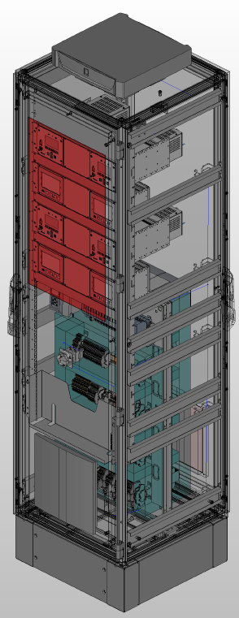
Status IND control systems
- INSULATION VACUUM
Status
  Cabinet: Elec. design phase finished, FAT prototype finished, delivery of all cabinets in Q4/2025
  PLC software: Driver and standards finalized
  SCADA software: Visualization standards finalized
  / Detailed panels in progress
17x
Notes:
SCADA: Supervisory Control and Data Acquisition

Slide 8
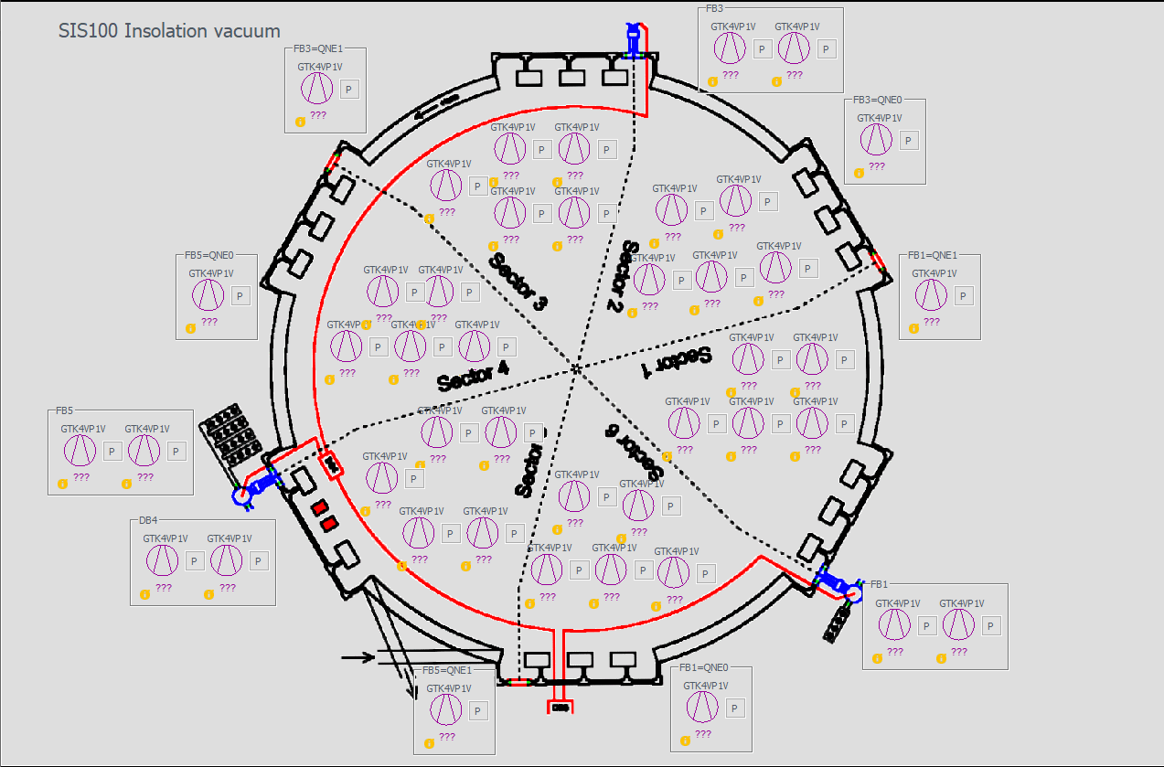
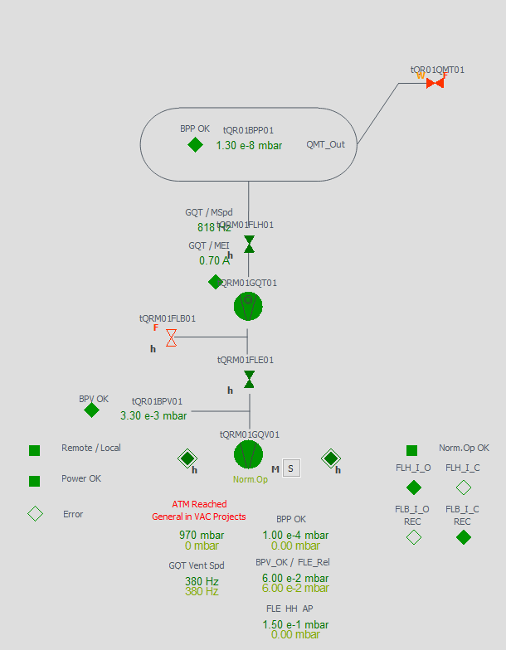
Status IND control systems
- INSULATION VACUUM
SCADA – SIS100 INV example
Notes:
Overview of the insulation vacuum.
All stationary pumps are shown in the overview image.
A click on one pump symbol shows a detailed view of a stationary pump with all ist related peripherals.

Slide 9
Status IND control system preparations - INSULATION VACUUM
Overview
after approval, offer request will be published based on frame contract 27 within the next days
Equipment | Material | Bezeichnung technisches Objekt | Subprojekt | Arbeitspaket | Institute | PSP Element | Referenzkennzeichnung | CDB Comp. Name | Status | LT expected | LT PLC comp.
CID:55000021333 |  | SIS100 INV Control Rack AV201+UH501 | Commons | Vacuum Control System | GSI | 2.14.10.6.10.1 | ==AV201+UH501 | 1S10YF.RACK[INV].001 | In production | Q4/2025 | delivered
CID:55000021340 |  | SIS100 INV Control Rack AV201+UH502 | Commons | Vacuum Control System | GSI | 2.14.10.6.10.1 | ==AV201+UH502 | 1S10YM.RACK[INV].001 | In production | Q4/2025 | delivered
CID:55000021357 |  | SIS100 INV Control Rack AV201+UH503 | Commons | Vacuum Control System | GSI | 2.14.10.6.10.1 | ==AV201+UH503 | 1S20YE.RACK[INV].002 | In production | Q4/2025 | delivered
CID:55000021364 |  | SIS100 INV Control Rack AV201+UH504 | Commons | Vacuum Control System | GSI | 2.14.10.6.10.1 | ==AV201+UH504 | 1S20YM.RACK[INV].001 | In production | Q4/2025 | delivered
CID:55000021371 |  | SIS100 INV Control Rack AV201+UH505 | Commons | Vacuum Control System | GSI | 2.14.10.6.10.1 | ==AV201+UH505 | 1S20YM.RACK[INV].003 | In production | Q4/2025 | delivered
CID:55000021388 |  | SIS100 INV Control Rack AV201+UH506 | Commons | Vacuum Control System | GSI | 2.14.10.6.10.1 | ==AV201+UH506 | 1S30YF.RACK[INV].001 | In production | Q4/2025 | delivered
CID:55000021395 |  | SIS100 INV Control Rack AV201+UH507 | Commons | Vacuum Control System | GSI | 2.14.10.6.10.1 | ==AV201+UH507 | 1S30YM.RACK[INV].001 | In production | Q4/2025 | delivered
CID:55000021401 |  | SIS100 INV Control Rack AV201+UH508 | Commons | Vacuum Control System | GSI | 2.14.10.6.10.1 | ==AV201+UH508 | 1S40YE.RACK[INV].002 | In production | Q4/2025 | delivered
CID:55000021418 |  | SIS100 INV Control Rack AV201+UH509 | Commons | Vacuum Control System | GSI | 2.14.10.6.10.1 | ==AV201+UH509 | 1S40YM.RACK[INV].002 | In production | Q4/2025 | delivered
CID:55000021425 |  | SIS100 INV Control Rack AV201+UH510 | Commons | Vacuum Control System | GSI | 2.14.10.6.10.1 | ==AV201+UH510 | 1S40YM.RACK[INV].001 | In production | Q4/2025 | delivered
CID:55000021432 |  | SIS100 INV Control Rack AV201+UH511 | Commons | Vacuum Control System | GSI | 2.14.10.6.10.1 | ==AV201+UH511 | K0923A.U20.120.RACK[INV].001 | In production | Q4/2025 | delivered
CID:55000021449 |  | SIS100 INV Control Rack AV201+UH512 | Commons | Vacuum Control System | GSI | 2.14.10.6.10.1 | ==AV201+UH512 | 1S50YF.RACK[INV].001 | In production | Q4/2025 | delivered
CID:55000021456 |  | SIS100 INV Control Rack AV201+UH513 | Commons | Vacuum Control System | GSI | 2.14.10.6.10.1 | ==AV201+UH513 | 1S50YM.RACK[INV].001 | In production | Q4/2025 | delivered
CID:55000021463 |  | SIS100 INV Control Rack AV201+UH514 | Commons | Vacuum Control System | GSI | 2.14.10.6.10.1 | ==AV201+UH514 | 1S60YE.RACK[INV].001 | In production | Q4/2025 | delivered
CID:55000021470 |  | SIS100 INV Control Rack AV201+UH515 | Commons | Vacuum Control System | GSI | 2.14.10.6.10.1 | ==AV201+UH515 | 1S60YM.RACK[INV].001 | In production | Q4/2025 | delivered
CID:55000021487 |  | SIS100 INV Control Rack AV201+UH516 | Commons | Vacuum Control System | GSI | 2.14.10.6.10.1 | ==AV201+UH516 | 1S60YM.RACK[INV].002 | In production | Q4/2025 | delivered
CID:55000021494 |  | SIS100 INV Control Rack AV201+UH517 | Commons | Vacuum Control System | GSI | 2.14.10.6.10.1 | ==AV201+UH517 | K0720A.E10.201.[RACK].001 | In production | Q4/2025 | delivered

Slide 10
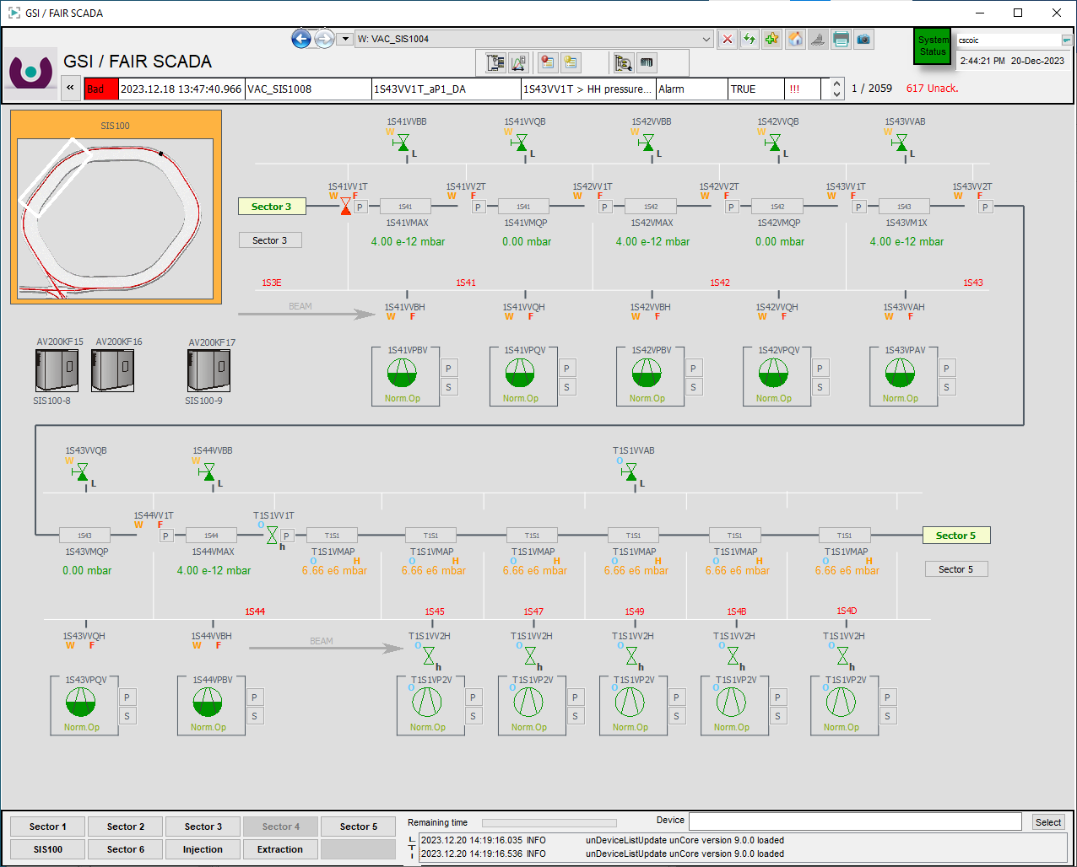
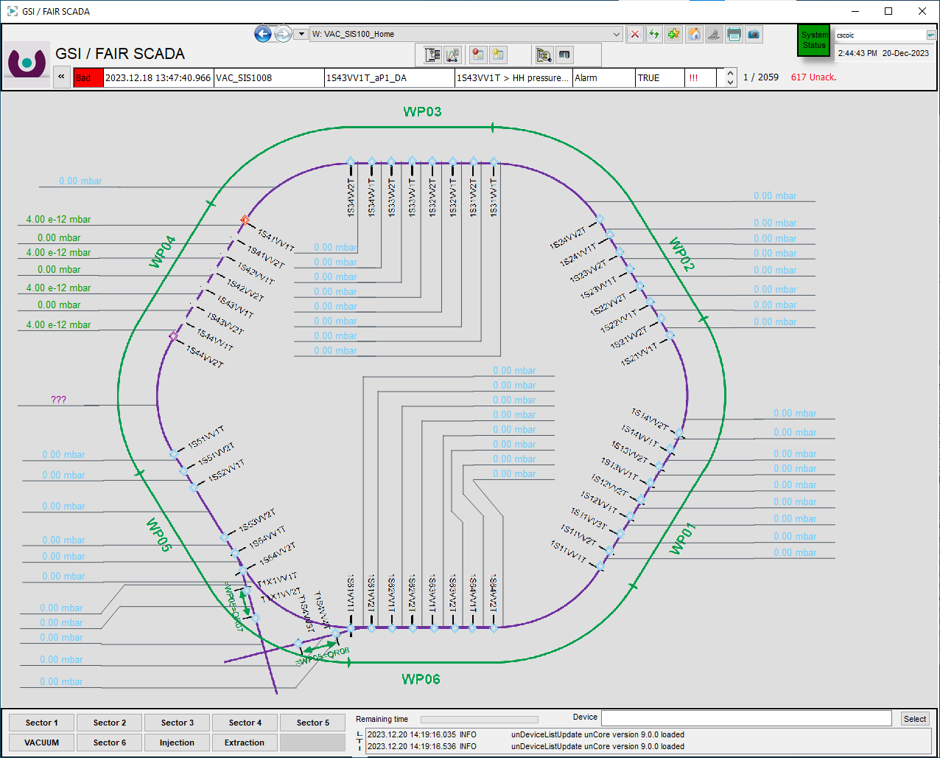
Status IND control systems
– BEAMLINE VACUUM
Status Slovenian inkind project
  Cabinet: 22 delivered
  PLC software: Completed
  SCADA software : Visualized / Based on UNILAC and HEBT
Notes:
The beamline vacuum was a Slovenian inkind project.
All 22 cabinets are delivered.
PLC software development completed.
SCADA completed. and based on the already running system for HEBT and UNILAC.

Slide 11
Status IND control system preparations – BEAMLINE VACUUM
Overview 1/2
Equipment | Material | Bezeichnung technisches Objekt | Subprojekt | Arbeitspaket | Institute | PSP Element | Referenzkennzeichnung | CDB Comp. Name | Bemerkung | Status | LT expected | LT PLC comp.
CID:55000020084 | AID:0003757 | SIS100 VAC Control Rack AV200+UH901 | Commons | Vacuum Control System | Cosylab | 2.14.10.6 | ==AV200+UH901 | 1S11.238.1.RACK[UHV].08 | ==AV200=KF01.KF00 +UH901 | delivered | Q2/2024 | x
CID:55000020107 | AID:0003759 | SIS100 VAC Control Rack AV200+UH903 | Commons | Vacuum Control System | Cosylab | 2.14.10.6 | ==AV200+UH903 | 1S11.238.1.RACK[UHV].05 | ==AV200=KF03.KF00 +UH903 | delivered | Q2/2024 | x
CID:55000020114 | AID:0003760 | SIS100 VAC Control Rack AV200+UH904 | Commons | Vacuum Control System | Cosylab | 2.14.10.6 | ==AV200+UH904 | 1S11.238.1.RACK[UHV].02 | ==AV200=KF04.KF00 +UH904 | delivered | Q2/2024 | x
CID:55000020121 | AID:0003761 | SIS100 VAC Control Rack AV200+UH905 | Commons | Vacuum Control System | Cosylab | 2.14.10.6 | ==AV200+UH905 | 1S12.248.1.RACK[UHV].01 | ==AV200=KF05.KF00 +UH905 | delivered | Q2/2024 | x
CID:55000020145 | AID:0003763 | SIS100 VAC Control Rack AV200+UH907 | Commons | Vacuum Control System | Cosylab | 2.14.10.6 | ==AV200+UH907 | 1S21.264.3.RACK[UHV].06 | ==AV200=KF07.KF00 +UH907 | delivered | Q2/2024 | x
CID:55000020152 | AID:0003764 | SIS100 VAC Control Rack AV200+UH908 | Commons | Vacuum Control System | Cosylab | 2.14.10.6 | ==AV200+UH908 | 1S21.264.3.RACK[INV].03 | ==AV200=KF08.KF00 +UH908 | delivered | Q2/2024 | x
CID:55000020169 | AID:0003765 | SIS100 VAC Control Rack AV200+UH909 | Commons | Vacuum Control System | Cosylab | 2.14.10.6 | ==AV200+UH909 | 1S21.264.4.RACK[UHV].04 | ==AV200=KF09.KF00 +UH909 | delivered | Q2/2024 | x
CID:55000020183 | AID:0003767 | SIS100 VAC Control Rack AV200+UH911 | Commons | Vacuum Control System | Cosylab | 2.14.10.6 | ==AV200+UH911 | 1S31.340.1.RACK[UHV].06 | ==AV200=KF11.KF00 +UH911 | delivered | Q2/2024 | x
CID:55000020190 | AID:0003768 | SIS100 VAC Control Rack AV200+UH912 | Commons | Vacuum Control System | Cosylab | 2.14.10.6 | ==AV200+UH912 | 1S31.340.1.RACK[INV].03 | ==AV200=KF12.KF00 +UH912 | delivered | Q2/2024 | x
CID:55000020206 | AID:0003769 | SIS100 VAC Control Rack AV200+UH913 | Commons | Vacuum Control System | Cosylab | 2.14.10.6 | ==AV200+UH913 | 1S32.346.6.RACK[UHV].04 | ==AV200=KF13.KF00 +UH913 | delivered | Q2/2024 | x
CID:55000020220 | AID:0003771 | SIS100 VAC Control Rack AV200+UH915 | Commons | Vacuum Control System | Cosylab | 2.14.10.6 | ==AV200+UH915 | 1S41.360.3.RACK[UHV].06 | ==AV200=KF15.KF00 +UH915 | delivered | Q2/2024 | x
CID:55000020237 | AID:0003772 | SIS100 VAC Control Rack AV200+UH916 | Commons | Vacuum Control System | Cosylab | 2.14.10.6 | ==AV200+UH916 | 1S41.360.3.RACK[INV].03 | ==AV200=KF16.KF00 +UH916 | delivered | Q2/2024 | x
CID:55000020244 | AID:0003773 | SIS100 VAC Control Rack AV200+UH917 | Commons | Vacuum Control System | Cosylab | 2.14.10.6 | ==AV200+UH917 | 1S41.360.4.RACK[UHV].04 | ==AV200=KF17.KF00 +UH917 | delivered | Q4/2024 | x
CID:55000020268 | AID:0003775 | SIS100 VAC Control Rack AV200+UH919 | Commons | Vacuum Control System | Cosylab | 2.14.10.6 | ==AV200+UH919 | 1S51.134.3.RACK[UHV].05 | ==AV200=KF19.KF00 +UH919 | delivered | Q4/2024 | x
CID:55000020275 | AID:0003776 | SIS100 VAC Control Rack AV200+UH920 | Commons | Vacuum Control System | Cosylab | 2.14.10.6 | ==AV200+UH920 | 1S51.134.3.RACK[UHV].02 | ==AV200=KF20.KF00 +UH920 | delivered | Q4/2024 | x
CID:55000020282 | AID:0003777 | SIS100 VAC Control Rack AV200+UH921 | Commons | Vacuum Control System | Cosylab | 2.14.10.6 | ==AV200+UH921 | 1S51.134.4.RACK[UHV].05 | ==AV200=KF21.KF00 +UH921 | delivered | Q4/2024 | x
CID:55000020299 | AID:0003778 | SIS100 VAC Control Rack AV200+UH922 | Commons | Vacuum Control System | Cosylab | 2.14.10.6 | ==AV200+UH922 | 1S51.134.4.RACK[UHV].08 | ==AV200=KF22.KF00 +UH922 | delivered | Q4/2024 | x
CID:55000020305 | AID:0003779 | SIS100 VAC Control Rack AV200+UH923 | Commons | Vacuum Control System | Cosylab | 2.14.10.6 | ==AV200+UH923 | 1S52.138.6.RACK[UHV].05 | ==AV200=KF23.KF00 +UH923 | delivered | Q4/2024 | x
CID:55000020312 | AID:0003780 | SIS100 VAC Control Rack AV200+UH924 | Commons | Vacuum Control System | Cosylab | 2.14.10.6 | ==AV200+UH924 | 1S52.138.6.RACK[UHV].02 | ==AV200=KF24.KF00 +UH924 | delivered | Q4/2024 | x
CID:55000020329 | AID:0003781 | SIS100 VAC Control Rack AV200+UH925 | Commons | Vacuum Control System | Cosylab | 2.14.10.6 | ==AV200+UH925 | 1S61.158.1.RACK[INV].04 | ==AV200=KF25.KF00 +UH925 | delivered | Q4/2024 | x
CID:55000020336 | AID:0003782 | SIS100 VAC Control Rack AV200+UH926 | Commons | Vacuum Control System | Cosylab | 2.14.10.6 | ==AV200+UH926 | 1S61.158.1.RACK[UHV].01 | ==AV200=KF26.KF00 +UH926 | delivered | Q4/2024 | x
CID:55000020343 | AID:0003783 | SIS100 VAC Control Rack AV200+UH927 | Commons | Vacuum Control System | Cosylab | 2.14.10.6 | ==AV200+UH927 | 1S62.164.9.RACK[UHV].04 | ==AV200=KF27.KF00 +UH927 | delivered | Q4/2024 | x

Slide 12
Status IND control system preparations – BEAMLINE VACUUM
Overview 2/2
Equipment | Material | Bezeichnung technisches Objekt | Subprojekt | Arbeitspaket | Institute | PSP Element | Referenzkennzeichnung | CDB Comp. Name | Bemerkung | RV 27 related | SLO Inkind | Status | LT expected | LT PLC comp.
out of CID:07000370010 - CID:07000370447 | AID:0003110 | VAC Control Rack 19´´ V2 | Commons | Vacuum Control System | GSI | 2.8.7.4.1 | ==AV200=KF01.KF01+UH011 ==AV200=KF01.KF02+UH012 ==AV200=KF03.KF01+UH031 ==AV200=KF03.KF02+UH032 ==AV200=KF04.KF01+UH041 ==AV200=KF04.KF02+UH042 ==AV200=KF05.KF01+UH051 ==AV200=KF05.KF02+UH052 ==AV200=KF07.KF01+UH071 ==AV200=KF07.KF02+UH072 ==AV200=KF08.KF01+UH081 ==AV200=KF08.KF01+UH082 ==AV200=KF09.KF01+UH091 ==AV200=KF09.KF02+UH092 ==AV200=KF11.KF01+UH111 ==AV200=KF11.KF02+UH112 ==AV200=KF12.KF01+UH121 ==AV200=KF12.KF01+UH122 ==AV200=KF13.KF01+UH131 ==AV200=KF13.KF02+UH132 ==AV200=KF15.KF01+UH151 ==AV200=KF15.KF02+UH152 ==AV200=KF16.KF01+UH161 ==AV200=KF16.KF01+UH162 ==AV200=KF17.KF01+UH171 ==AV200=KF17.KF02+UH172 ==AV200=KF19.KF01+UH191 ==AV200=KF19.KF02+UH192 ==AV200=KF20.KF01+UH201 ==AV200=KF20.KF02+UH202 ==AV200=KF21.KF01+UH211 ==AV200=KF21.KF02+UH212 ==AV200=KF22.KF01+UH221 ==AV200=KF22.KF02+UH222 ==AV200=KF23.KF01+UH231 ==AV200=KF23.KF02+UH232 ==AV200=KF24.KF01+UH241 ==AV200=KF24.KF02+UH242 ==AV200=KF25.KF01+UH251 ==AV200=KF25.KF02+UH252 ==AV200=KF26.KF01+UH261 ==AV200=KF26.KF02+UH262 ==AV200=KF27.KF01+UH271 ==AV200=KF27.KF02+UH272 | 1S11.238.1.RACK[INV].04 1S11.238.1.RACK[UHV].03 1S11.238.1.RACK[UHV].06 1S11.238.1.RACK[UHV].07 1S11.238.1.RACK[UHV].09 1S11.238.1.RACK[UHV].10 1S12.248.1.RACK[INV].03 1S12.248.1.RACK[UHV].02 1S21.264.3.RACK[UHV].04 1S21.264.3.RACK[UHV].05 1S21.264.3.RACK[UHV].07 1S21.264.3.RACK[UHV].08 1S21.264.4.RACK[INV].03 1S21.264.4.RACK[UHV].02 1S31.340.1.RACK[UHV].04 1S31.340.1.RACK[UHV].05 1S31.340.1.RACK[UHV].07 1S31.340.1.RACK[UHV].08 1S32.346.6.RACK[INV].03 1S32.346.6.RACK[UHV].02 1S41.360.3.RACK[UHV].04 1S41.360.3.RACK[UHV].05 1S41.360.3.RACK[UHV].07 1S41.360.3.RACK[UHV].08 1S41.360.4.RACK[INV].03 1S41.360.4.RACK[UHV].02 1S51.134.3.RACK[INV].06 1S51.134.3.RACK[UHV].03 1S51.134.3.RACK[UHV].04 1S51.134.3.RACK[UHV].07 1S51.134.4.RACK[UHV].03 1S51.134.4.RACK[UHV].04 1S51.134.4.RACK[UHV].06 1S51.134.4.RACK[UHV].07 1S52.138.6.RACK[INV].03 1S52.138.6.RACK[UHV].04 1S52.138.6.RACK[UHV].06 1S52.138.6.RACK[UHV].07 1S61.158.1.RACK[UHV].02 1S61.158.1.RACK[UHV].03 1S61.158.1.RACK[UHV].05 1S61.158.1.RACK[UHV].06 1S62.164.9.RACK[INV].03 1S62.164.9.RACK[UHV].02 |  | x |  | delivered |  | -
 | AID:0003110 | VAC Control Rack 19´´ V2 | Commons | Vacuum Control System | GSI | 2.8.7.4.1 |  |  |  | x |  | delivered |  | -
 | AID:0003110 | VAC Control Rack 19´´ V2 | Commons | Vacuum Control System | GSI | 2.8.7.4.1 |  |  |  | x |  | delivered |  | -
 | AID:0003110 | VAC Control Rack 19´´ V2 | Commons | Vacuum Control System | GSI | 2.8.7.4.1 |  |  |  | x |  | delivered |  | -
 | AID:0003110 | VAC Control Rack 19´´ V2 | Commons | Vacuum Control System | GSI | 2.8.7.4.1 |  |  |  | x |  | delivered |  | -
 | AID:0003110 | VAC Control Rack 19´´ V2 | Commons | Vacuum Control System | GSI | 2.8.7.4.1 |  |  |  | x |  | delivered |  | -
 | AID:0003110 | VAC Control Rack 19´´ V2 | Commons | Vacuum Control System | GSI | 2.8.7.4.1 |  |  |  | x |  | delivered |  | -
 | AID:0003110 | VAC Control Rack 19´´ V2 | Commons | Vacuum Control System | GSI | 2.8.7.4.1 |  |  |  | x |  | delivered |  | -
 | AID:0003110 | VAC Control Rack 19´´ V2 | Commons | Vacuum Control System | GSI | 2.8.7.4.1 |  |  |  | x |  | delivered |  | -
 | AID:0003110 | VAC Control Rack 19´´ V2 | Commons | Vacuum Control System | GSI | 2.8.7.4.1 |  |  |  | x |  | delivered |  | -
 | AID:0003110 | VAC Control Rack 19´´ V2 | Commons | Vacuum Control System | GSI | 2.8.7.4.1 |  |  |  | x |  | delivered |  | -
 | AID:0003110 | VAC Control Rack 19´´ V2 | Commons | Vacuum Control System | GSI | 2.8.7.4.1 |  |  |  | x |  | delivered |  | -
 | AID:0003110 | VAC Control Rack 19´´ V2 | Commons | Vacuum Control System | GSI | 2.8.7.4.1 |  |  |  | x |  | delivered |  | -
 | AID:0003110 | VAC Control Rack 19´´ V2 | Commons | Vacuum Control System | GSI | 2.8.7.4.1 |  |  |  | x |  | delivered |  | -
 | AID:0003110 | VAC Control Rack 19´´ V2 | Commons | Vacuum Control System | GSI | 2.8.7.4.1 |  |  |  | x |  | delivered |  | -
 | AID:0003110 | VAC Control Rack 19´´ V2 | Commons | Vacuum Control System | GSI | 2.8.7.4.1 |  |  |  | x |  | delivered |  | -
 | AID:0003110 | VAC Control Rack 19´´ V2 | Commons | Vacuum Control System | GSI | 2.8.7.4.1 |  |  |  | x |  | delivered |  | -
 | AID:0003110 | VAC Control Rack 19´´ V2 | Commons | Vacuum Control System | GSI | 2.8.7.4.1 |  |  |  | x |  | delivered |  | -
 | AID:0003110 | VAC Control Rack 19´´ V2 | Commons | Vacuum Control System | GSI | 2.8.7.4.1 |  |  |  | x |  | delivered |  | -
 | AID:0003110 | VAC Control Rack 19´´ V2 | Commons | Vacuum Control System | GSI | 2.8.7.4.1 |  |  |  | x |  | delivered |  | -
 | AID:0003110 | VAC Control Rack 19´´ V2 | Commons | Vacuum Control System | GSI | 2.8.7.4.1 |  |  |  | x |  | delivered |  | -
 | AID:0003110 | VAC Control Rack 19´´ V2 | Commons | Vacuum Control System | GSI | 2.8.7.4.1 |  |  |  | x |  | delivered |  | -
 | AID:0003110 | VAC Control Rack 19´´ V2 | Commons | Vacuum Control System | GSI | 2.8.7.4.1 |  |  |  | x |  | delivered |  | -
 | AID:0003110 | VAC Control Rack 19´´ V2 | Commons | Vacuum Control System | GSI | 2.8.7.4.1 |  |  |  | x |  | delivered |  | -
 | AID:0003110 | VAC Control Rack 19´´ V2 | Commons | Vacuum Control System | GSI | 2.8.7.4.1 |  |  |  | x |  | delivered |  | -
 | AID:0003110 | VAC Control Rack 19´´ V2 | Commons | Vacuum Control System | GSI | 2.8.7.4.1 |  |  |  | x |  | delivered |  | -
 | AID:0003110 | VAC Control Rack 19´´ V2 | Commons | Vacuum Control System | GSI | 2.8.7.4.1 |  |  |  | x |  | delivered |  | -
 | AID:0003110 | VAC Control Rack 19´´ V2 | Commons | Vacuum Control System | GSI | 2.8.7.4.1 |  |  |  | x |  | delivered |  | -
 | AID:0003110 | VAC Control Rack 19´´ V2 | Commons | Vacuum Control System | GSI | 2.8.7.4.1 |  |  |  | x |  | delivered |  | -
 | AID:0003110 | VAC Control Rack 19´´ V2 | Commons | Vacuum Control System | GSI | 2.8.7.4.1 |  |  |  | x |  | delivered |  | -
 | AID:0003110 | VAC Control Rack 19´´ V2 | Commons | Vacuum Control System | GSI | 2.8.7.4.1 |  |  |  | x |  | delivered |  | -
 | AID:0003110 | VAC Control Rack 19´´ V2 | Commons | Vacuum Control System | GSI | 2.8.7.4.1 |  |  |  | x |  | delivered |  | -
 | AID:0003110 | VAC Control Rack 19´´ V2 | Commons | Vacuum Control System | GSI | 2.8.7.4.1 |  |  |  | x |  | delivered |  | -
 | AID:0003110 | VAC Control Rack 19´´ V2 | Commons | Vacuum Control System | GSI | 2.8.7.4.1 |  |  |  | x |  | delivered |  | -
 | AID:0003110 | VAC Control Rack 19´´ V2 | Commons | Vacuum Control System | GSI | 2.8.7.4.1 |  |  |  | x |  | delivered |  | -
 | AID:0003110 | VAC Control Rack 19´´ V2 | Commons | Vacuum Control System | GSI | 2.8.7.4.1 |  |  |  | x |  | delivered |  | -
 | AID:0003110 | VAC Control Rack 19´´ V2 | Commons | Vacuum Control System | GSI | 2.8.7.4.1 |  |  |  | x |  | delivered |  | -
 | AID:0003110 | VAC Control Rack 19´´ V2 | Commons | Vacuum Control System | GSI | 2.8.7.4.1 |  |  |  | x |  | delivered |  | -
 | AID:0003110 | VAC Control Rack 19´´ V2 | Commons | Vacuum Control System | GSI | 2.8.7.4.1 |  |  |  | x |  | delivered |  | -
 | AID:0003110 | VAC Control Rack 19´´ V2 | Commons | Vacuum Control System | GSI | 2.8.7.4.1 |  |  |  | x |  | delivered |  | -
 | AID:0003110 | VAC Control Rack 19´´ V2 | Commons | Vacuum Control System | GSI | 2.8.7.4.1 |  |  |  | x |  | delivered |  | -
 | AID:0003110 | VAC Control Rack 19´´ V2 | Commons | Vacuum Control System | GSI | 2.8.7.4.1 |  |  |  | x |  | delivered |  | -
 | AID:0003110 | VAC Control Rack 19´´ V2 | Commons | Vacuum Control System | GSI | 2.8.7.4.1 |  |  |  | x |  | delivered |  | -
 |  |  |  |  |  |  |  |  |  | x |  | delivered |  | -
 | AID:0003110 | VAC Control Rack 19´´ V2 | Commons | Vacuum Control System | GSI | 2.8.7.4.1

Slide 13
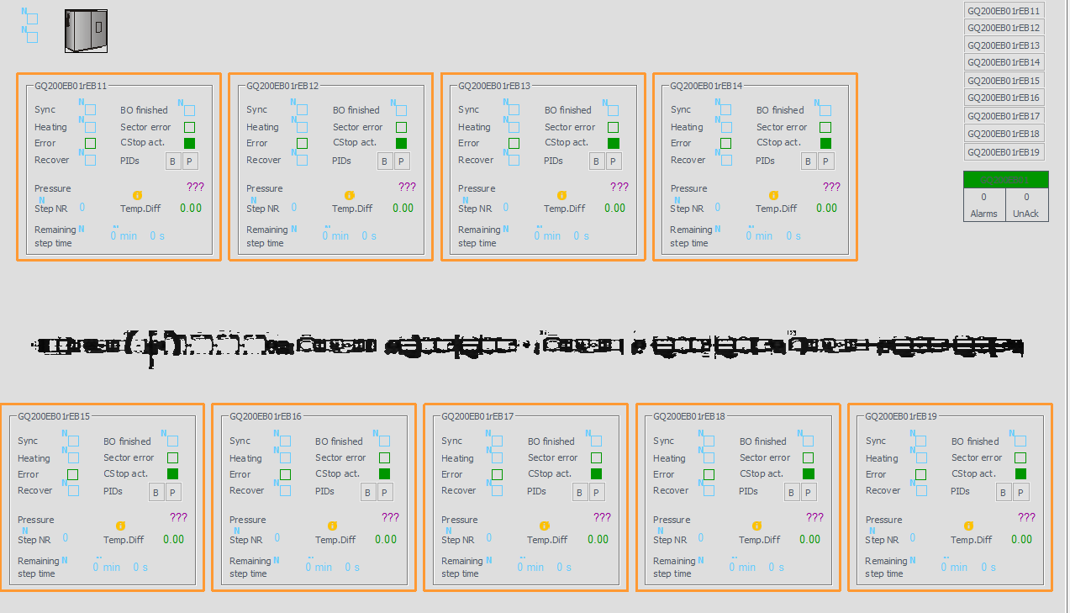
Status IND control systems
– BAKEOUT
Status
  Cabinet: Manufactured / Delivered
  PLC software: Completed / Based on CryRing BO
  SCADA software: Visualized / Based on CryRing BO
Notes:
All cabinets are delivered.
Most of the power and PLC cabinets for the bakeout are already installed in the tunnel.
PLC software is completed. It is based on the software already running in the CryRing BO system
The SCADA is also based on the system developed for CryRing

Slide 14
Status IND control system preparations – BAKEOUT
Overview
production / FAT completed & delivered
Equipment | Material | Bezeichnung technisches Objekt | Subprojekt | Arbeitspaket | Institute | PSP Element | EDMS Container | Referenzkennzeichnung | CDB Comp. Name | RV 27 related | SLO Inkind | Status | LT expected | LT PLC comp.
out of CID:07000380088 - CID:07000380910 | AID:0001262 | Bakeout - SSR Rack | Commons | BO Control System | GSI | 2.08.07.01.04.02.01 | FAIR-000009763 | '==GQ200=KF11.KF01+UH201 | 1S11VH1S 1S11VH2S 1S11VH3S ... 1S64VH2S 1S64VH3S 1S69VH1S | x |  | delivered | Q4/2024 | -
 | AID:0001262 | Bakeout - SSR Rack | Commons | BO Control System | GSI | 2.08.07.01.04.02.01 | FAIR-000009763 | '==GQ200=KF11.KF02+UH202
 | AID:0001262 | Bakeout - SSR Rack | Commons | BO Control System | GSI | 2.08.07.01.04.02.01 | FAIR-000009763 | '==GQ200=KF11.KF03+UH203
 | … | … | … | … | … | … | … | …
 | AID:0001262 | Bakeout - SSR Rack | Commons | BO Control System | GSI | 2.08.07.01.04.02.01 | FAIR-000009763 | '==GQ200=KF27.KF06+UH285
 | AID:0001262 | Bakeout - SSR Rack | Commons | BO Control System | GSI | 2.08.07.01.04.02.01 | FAIR-000009763 | '==GQ200=KF28.KF01+UH286
 | AID:0001262 | Bakeout - SSR Rack | Commons | BO Control System | GSI | 2.08.07.01.04.02.01 | FAIR-000009763 | '==GQ200=KF28.KF02+UH287
out of CID:07000180220 - CID:07000182736 | AID:0001261 | Heizbox (SSR) | Commons | BO Control System | GSI | 2.08.07.01.04.02.01 | FAIR-000009763 | '==GQ200=EB01.EB01+UC011 |  | x |  | delivered | Q4/2024 | -
 | AID:0001261 | Heizbox (SSR) | Commons | BO Control System | GSI | 2.08.07.01.04.02.01 | FAIR-000009763 | '==GQ200=EB01.EB02+UC012
 | AID:0001261 | … | … | … | … | … | … | …
 | AID:0001261 | Heizbox (SSR) | Commons | BO Control System | GSI | 2.08.07.01.04.02.01 | FAIR-000009763 | '==GQ200=EB87.EB01+UC871
 | AID:0001261 | Heizbox (SSR) | Commons | BO Control System | GSI | 2.08.07.01.04.02.01 | FAIR-000009763 | '==GQ200=EB87.EB02+UC872
 | AID:0001261 | Heizbox (SSR) | Commons | BO Control System | GSI | 2.08.07.01.04.02.01 | FAIR-000009763 | '==GQ200=EB87.EB03+UC873
out of CID:07000343014 - CID:07000343205 | AID:0001263 | Bakeout - PLC Rack | Commns | BO Control System | GSI | 2.14.10.06.07 | FAIR-000009763 | '==GQ200=KF11.KF00+UH111 | 1S11.238.2.RACK[UHV].01 1S11.238.2.RACK[UHV].02 1S12.248.1.RACK[UHV].04 ... 1S61.158.1.RACK[UHV].08 1S61.158.1.RACK[UHV].07 1S62.164.9.RACK[UHV].01 | x |  | delivered | Q4/2024 | x
 | AID:0001263 | Bakeout - PLC Rack | Commons | BO Control System | GSI | 2.14.10.06.07 | FAIR-000009763 | '==GQ200=KF12.KF00+UH112
 | AID:0001263 | Bakeout - PLC Rack | Commons | BO Control System | GSI | 2.14.10.06.07 | FAIR-000009763 | '==GQ200=KF13.KF00+UH113
 | AID:0001263 | Bakeout - PLC Rack | Commons | BO Control System | GSI | 2.14.10.06.07 | FAIR-000009763 | '==GQ200=KF14.KF00+UH114
 | AID:0001263 | Bakeout - PLC Rack | Commons | BO Control System | GSI | 2.14.10.06.07 | FAIR-000009763 | '==GQ200=KF15.KF00+UH115
 | AID:0001263 | Bakeout - PLC Rack | Commons | BO Control System | GSI | 2.14.10.06.07 | FAIR-000009763 | '==GQ200=KF16.KF00+UH116
 | AID:0001263 | Bakeout - PLC Rack | Commons | BO Control System | GSI | 2.14.10.06.07 | FAIR-000009763 | '==GQ200=KF17.KF00+UH117
 | AID:0001263 | Bakeout - PLC Rack | Commons | BO Control System | GSI | 2.14.10.06.07 | FAIR-000009763 | '==GQ200=KF18.KF00+UH118
 | AID:0001263 | Bakeout - PLC Rack | Commons | BO Control System | GSI | 2.14.10.06.07 | FAIR-000009763 | '==GQ200=KF19.KF00+UH119
 | AID:0001263 | Bakeout - PLC Rack | Commons | BO Control System | GSI | 2.14.10.06.07 | FAIR-000009763 | '==GQ200=KF20.KF00+UH120
 | AID:0001263 | Bakeout - PLC Rack | Commons | BO Control System | GSI | 2.14.10.06.07 | FAIR-000009763 | '==GQ200=KF21.KF00+UH121
 | AID:0001263 | Bakeout - PLC Rack | Commons | BO Control System | GSI | 2.14.10.06.07 | FAIR-000009763 | '==GQ200=KF22.KF00+UH122
 | AID:0001263 | Bakeout - PLC Rack | Commons | BO Control System | GSI | 2.14.10.06.07 | FAIR-000009763 | '==GQ200=KF23.KF00+UH123
 | AID:0001263 | Bakeout - PLC Rack | Commons | BO Control System | GSI | 2.14.10.06.07 | FAIR-000009763 | '==GQ200=KF24.KF00+UH124
 | AID:0001263 | Bakeout - PLC Rack | Commons | BO Control System | GSI | 2.14.10.06.07 | FAIR-000009763 | '==GQ200=KF25.KF00+UH125
 | AID:0001263 | Bakeout - PLC Rack | Commons | BO Control System | GSI | 2.14.10.06.07 | FAIR-000009763 | '==GQ200=KF26.KF00+UH126
 | AID:0001263 | Bakeout - PLC Rack | Commons | BO Control System | GSI | 2.14.10.06.07 | FAIR-000009763 | '==GQ200=KF27.KF00+UH127
 | AID:0001263 | Bakeout - PLC Rack | Commons | BO Control System | GSI | 2.14.10.06.07 | FAIR-000009763 | '==GQ200=KF28.KF00+UH128

Slide 15
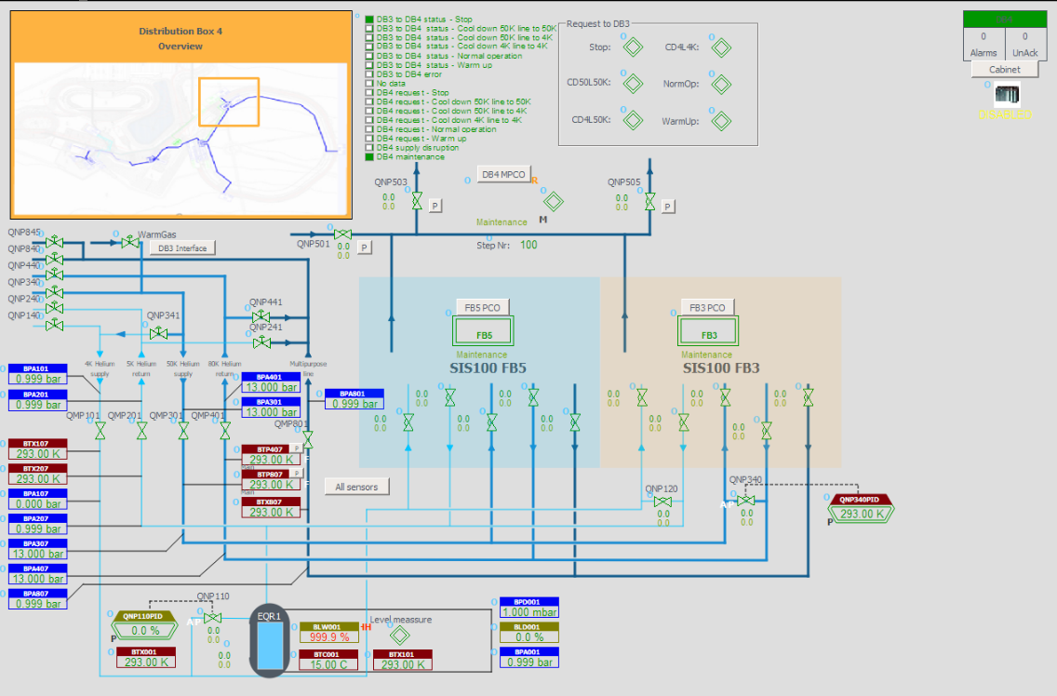
Status IND control systems
- CRYO
Distribution Box (==AY200=XLD4)
  Cabinet: Delivered
  Functional analysis: Completed
  PLC software: Completed / Automatic operation
  SCADA software: Visualized
Notes:
The cabinet is delivered.
The functional analysis is completed
The PLC software is ready for commissioning.
Even the automatic operation is already implemented based on the findings obtained during the functional analysis.
The SCADA software is also completed

Slide 16
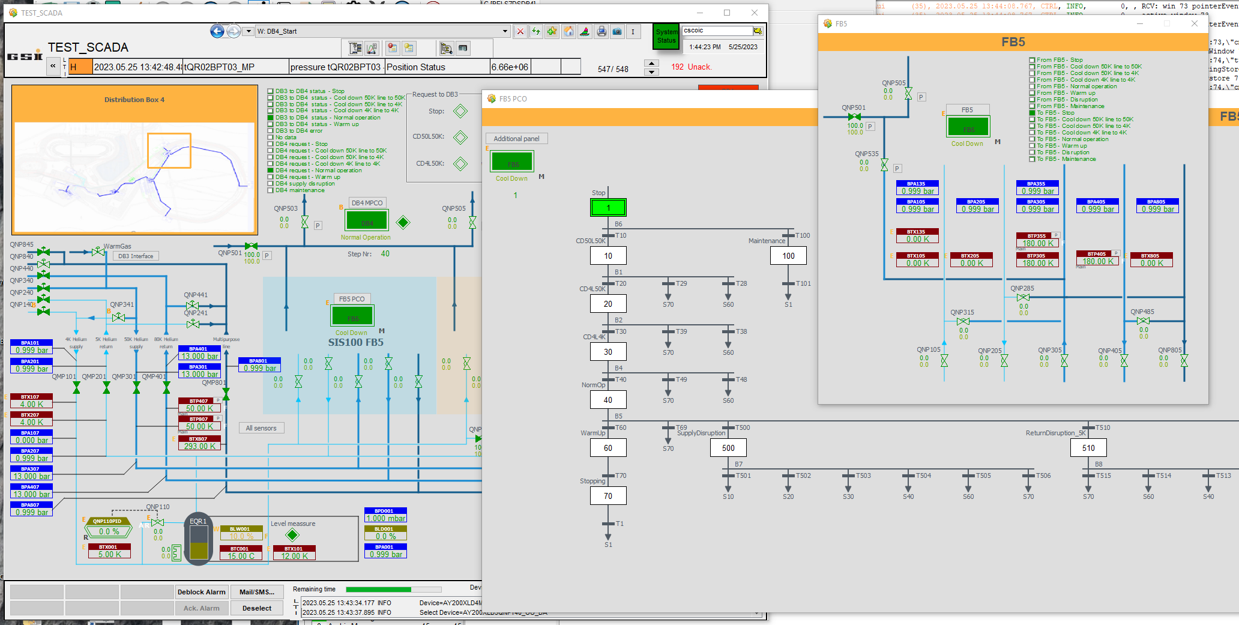
Status IND control systems
– CRYO – HMI DB
DB4 visualization:

Slide 17
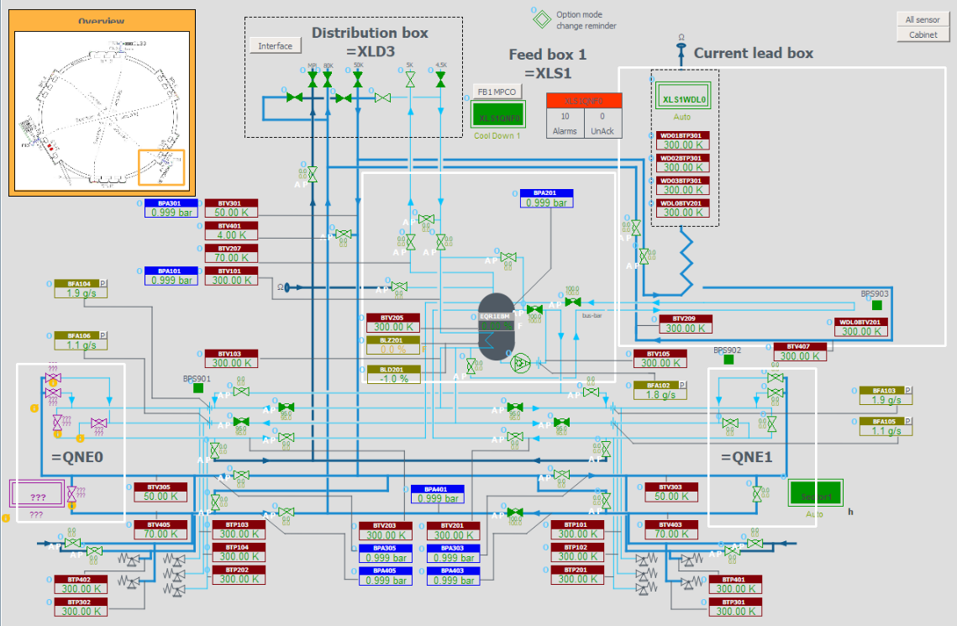
Status IND control systems
- CRYO
Feed Box (==AY200=XLS1 / =XLS3 / =XLS5)
  Cabinet: Delivered
  Functional analysis In progress
  PLC software: Completed / Semi-Automatic process ongoing
  /CLB tests succesfully
  SCADA software: Visualized
Notes:
All cabinets are delivered
The functional analysis is in progress.
The PLC software is ready for commissioning.
Manual operation of all valves and data acquisition of sensor signals is working
The implementation of the automatic process control is ongoing together with the functional analysis
The SCADA visualization is done

Slide 18
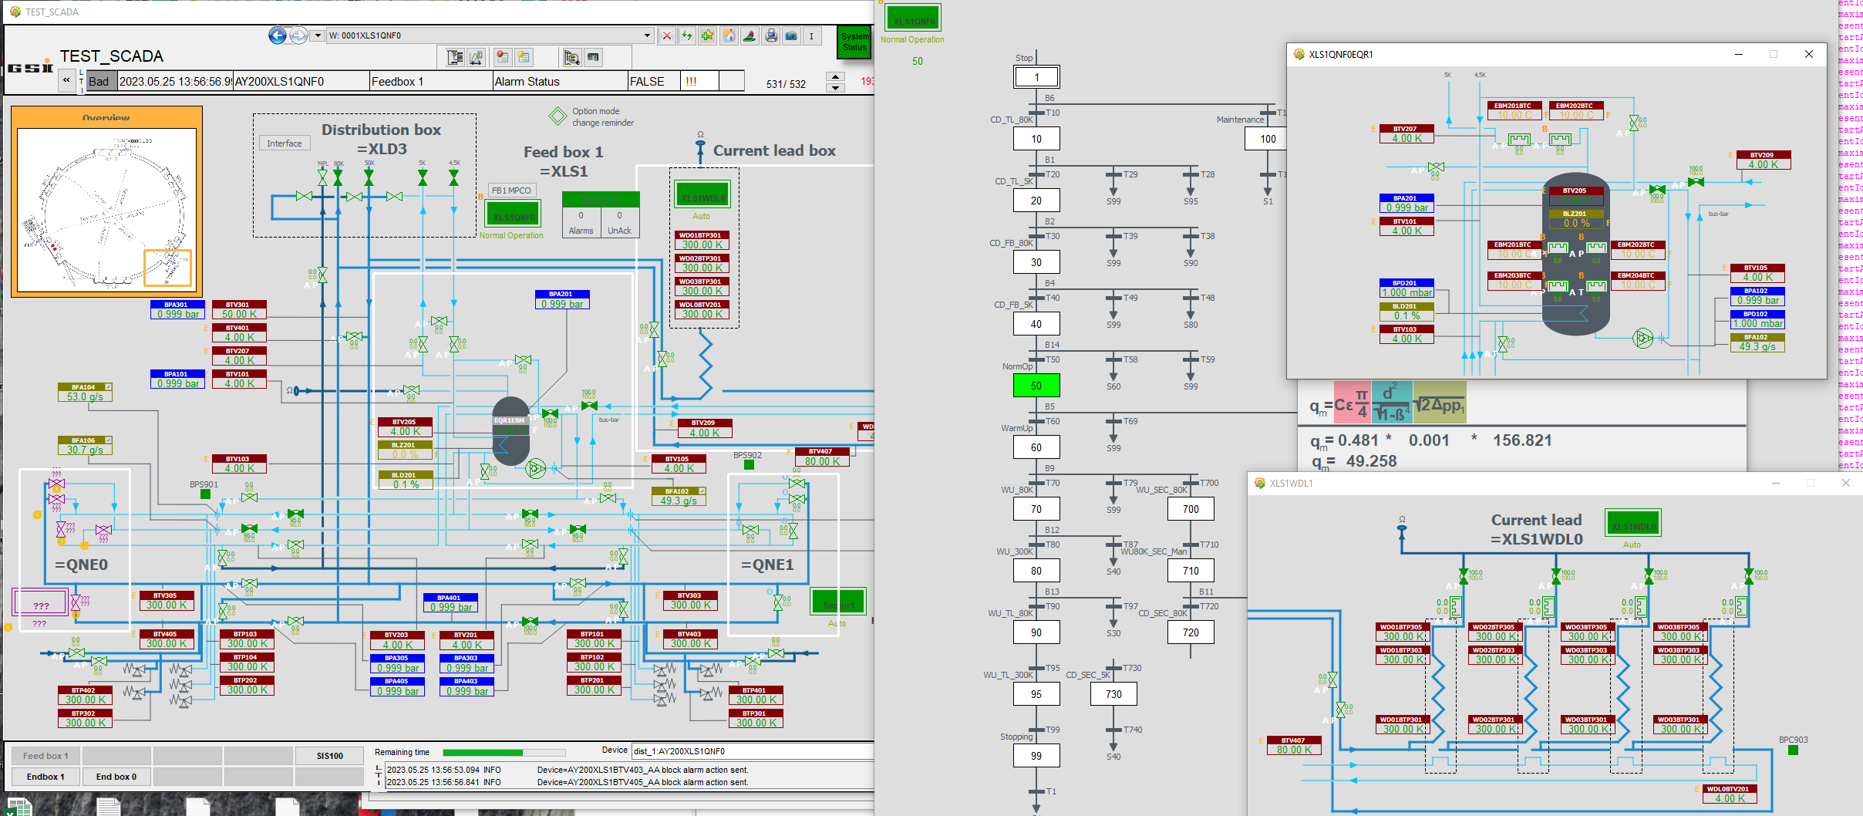
Status IND control systems
– CRYO – HMI FB
FB1 visualization:
Phase Separator

Slide 19
Status IND control systems
– CRYO controls results
CurrentLead-Box Tests – Achievements
tested and calibrated all valves
read out the temperature sensors
Successfully regulated
    temperatures of MCL ambient heater
    flow through MCL HTSC
    thermal shield temperature
    MCL temperature of cold terminal
Notes:
The current lead box control is part of the feedbox control cabinet.
During the tests in the SCM we could test a lot of things
We could operaste a lot of different regulation loops

Slide 20
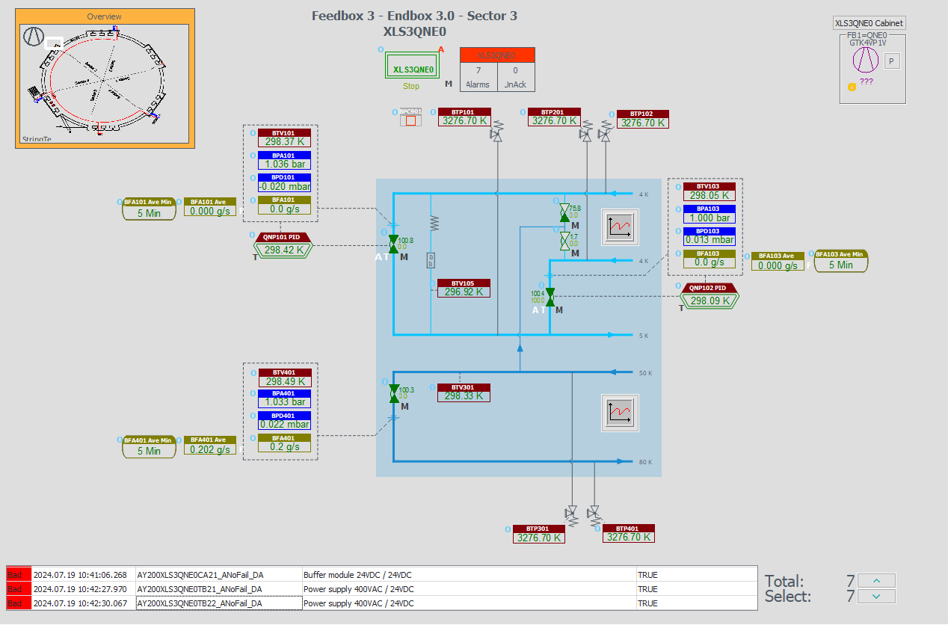
Status IND control systems
- CRYO
Endbox (==AY200=XLS1.QNE0 / .QNE1 / =XLS3.QNE0 / .QNE1 / =XLS5.QNE0 / .QNE1)
  Cabinets: Delivered
  Functional analysis: In progress
  PLC software: Completed / Semi-Automatic process ongoing
  SCADA software: Visualized
Notes:
All cabinets are delivered
The functional analysis is in progress. We have a scheduled meeting to make progress
The PLC software is ready for commissioning.
The implementation of the automatic process control is ongoing together with the functional analysis
The SCADA visualization is done

Slide 21
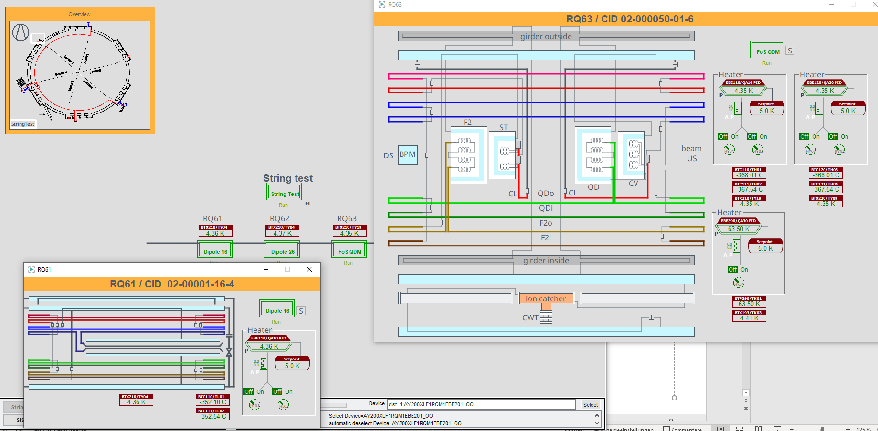
Status IND control systems
- CRYO
Sector (==AY200=XLS1.RQS1 / .RQS2 / .RQS3 / .RQS4 / .RQS5 / .RQS6) IN WORK
  Cabinet: In production (including last minute changes)
  Functional analysis: In progress / Heating logic missing
  PLC software: not yet started
  SCADA software: In progress
Notes:
Cabinets are in production.
The requested changes from SCM we got lately regarding additional heaters are ongoing. This is challenging because we have to introduce the changes in the ongoing production of the cabinets.

Slide 22
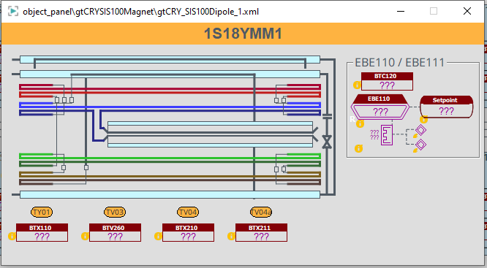
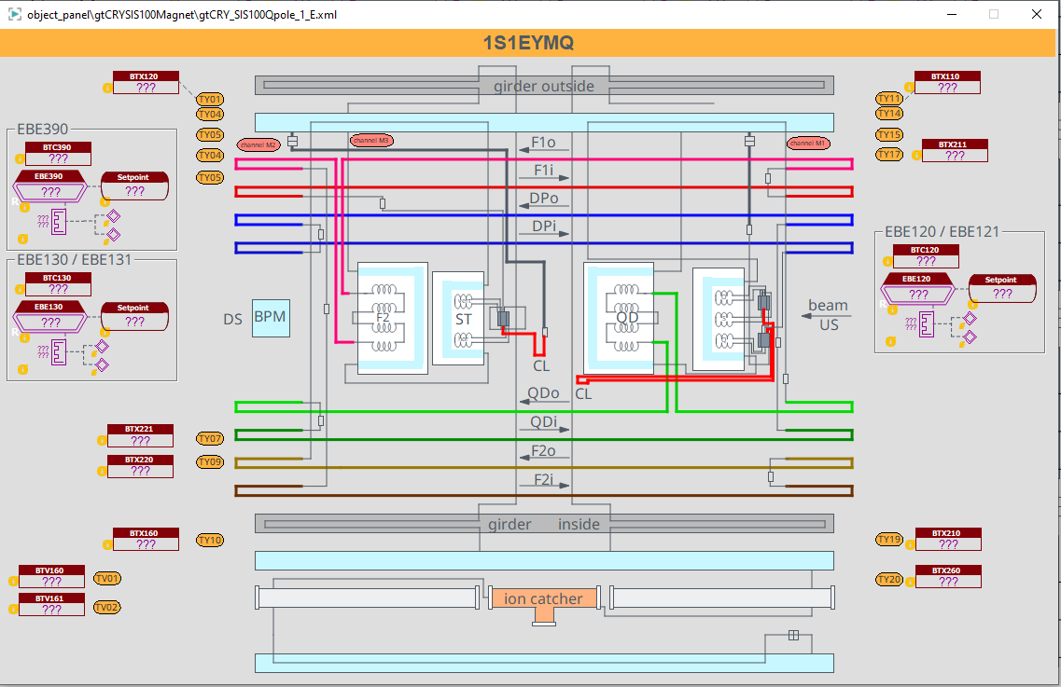
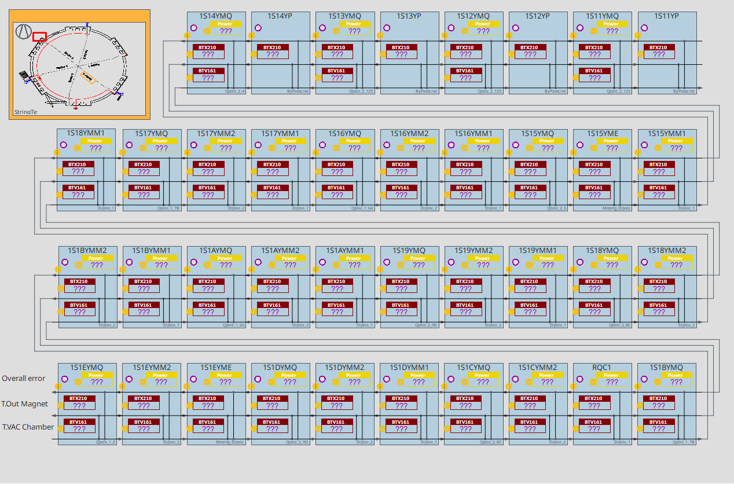
Status IND control systems
– CRYO - Sector
Sector visualization:
Notes:
New panels .
Overview shows outlet temperatures of magnet circuits and vacuum chambers, hesting power and alarm status.
Click on overviews opens detailed panel.

Slide 23
Status IND control system preparations - CRYO
Overview
10/16 cabinets delivered
SW ready for commissioning except for the sector cabinets
=>
~ 50% cabinets ready (in relation to their sizes)
~ 90% SW ready
Equipment | Material | Bezeichnung technisches Objekt | Arbeitspaket | PSP Element | Referenzkennzeichnung | CDB Comp. Name | Bemerkung | RV 27 related | SLO Inkind | Status | LT expected | LT PLC comp.
CID:55000001076 | AID:0003246 | SIS100 CRY XLD4 Control Rack | Cryogenic Control System | 2.14.10.7 | ==AY200=XLD4+UH001 | K0923A.U20.120.RACK[CRY].001 |  | x |  | delivered | Q4/2023 | Q4/2024
CID:55000001083 | AID:0003247 | SIS100 CRY QNF0 V1 Control Rack | Cryogenic Control System | 2.14.10.7 | ==AY200=XLS1.QNF0+UH001 ==AY200=XLS3.QNF0+UH001 | 1S10YF.RACK[CRY].001 1S30YF.RACK[CRY].001 | finale Zuordnung CID erfolgt beim Aufbau | x |  | delivered | Q4/2023 | Q4/2024
CID:55000001090
CID:55000001106 | AID:0003248 | SIS100 CRY QNF0 V2 Control Rack | Cryogenic Control System | 2.14.10.7 | ==AY200=XLS5.QNF0+UH001 | 1S50YF.RACK[CRY].001 |  | x |  | delivered | Q4/2023 | Q4/2024
CID:55000001014 | AID:0003249 | SIS100 CRY QNE Control Rack | Cryogenic Control System | 2.14.10.7 | ==AY200=XLS1.QNE0+UH061 ==AY200=XLS3.QNE1+UH021 ==AY200=XLS3.QNE0+UH061 ==AY200=XLS5.QNE1+UH021 ==AY200=XLS5.QNE0+UH061 ==AY200=XLS1.QNE1+UH021 | 1S20YE.RACK[CRY].001 1S20YE.RACK[CRY].002 1S40YE.RACK[CRY].001 1S40YE.RACK[CRY].002 1S60YE.RACK[CRY].001 1S60YE.RACK[CRY].002 | finale Zuordnung CID erfolgt beim Aufbau | x |  | delivered | Q3/2023 | Q4/2024
CID:55000001021
CID:55000001038
CID:55000001045
CID:55000001052
CID:55000001069
CID:55000001113 | AID:0003250 | SIS100 CRY RQS1 Control Rack | Cryogenic Control System | 2.14.10.7 | ==AY200=XLS1.RQS1+UH051 | 1S10YM.RACK[CRY].001 |  |  |  | In production | Q2/2026 | Part of new frame contract
CID:55000001120 | AID:0003251 | SIS100 CRY RQS2 Control Rack | Cryogenic Control System | 2.14.10.7 | ==AY200=XLS3.RQS2+UH011 | 1S20YM.RACK[CRY].001 |  |  |  | In production | Q2/2026 | Part of new frame contract
CID:55000001137 | AID:0003252 | SIS100 CRY RQS3 Control Rack | Cryogenic Control System | 2.14.10.7 | ==AY200=XLS3.RQS3+UH051 | 1S30YM.RACK[CRY].001 |  |  |  | In production | Q2/2026 | Part of new frame contract
CID:55000001144 | AID:0003253 | SIS100 CRY RQS4 Control Rack | Cryogenic Control System | 2.14.10.7 | ==AY200=XLS5.RQS4+UH011 | 1S40YM.RACK[CRY].001 |  |  |  | In production | Q2/2026 | Part of new frame contract
CID:55000001151 | AID:0003254 | SIS100 CRY RQS5 Control Rack | Cryogenic Control System | 2.14.10.7 | ==AY200=XLS5.RQS5+UH051 | 1S50YM.RACK[CRY].001 |  |  |  | In production | Q2/2026 | Part of new frame contract
CID:55000001168 | AID:0003255 | SIS100 CRY RQS6 Control Rack | Cryogenic Control System | 2.14.10.7 | ==AY200=XLS1.RQS6+UH011 | 1S60YM.RACK[CRY].001 |  |  |  | In production | Q2/2026 | Part of new frame contract

Slide 24
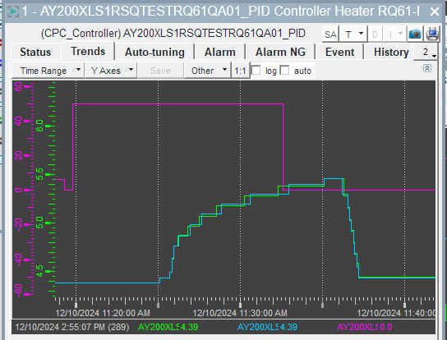
Status IND control systems
– CRYO controls results
String Test – Heater Regulation
goal: regulate temperature of cooling circuit to adapt to different heat loads
violet: Heater [% * 20W]
green: Temp [K]
very long dead time
(~5 minutes between the first heating pulse
and the observable effect through
the magnet)
Reasons for delay time
heater at inlet of cooling circuit
temp. sensor at outlet
temperature increases only if
helium is gaseous
Step response without any regulation
Notes:
The next topic is our attempt to regulate the heaters in the cooling circuits of dipoles and multiplets.
The goal is to regulate the temperature of the cooling circuits automatically to adapt to different heat loads.
To get an impression of the behaviour of the system a step to the input (in out case the heating power) was applied. The output then shows the step response (in our case the helium temperature)
The response of the output to the input change is significantly delayed.
The reason for this behaviour is …

Slide 25
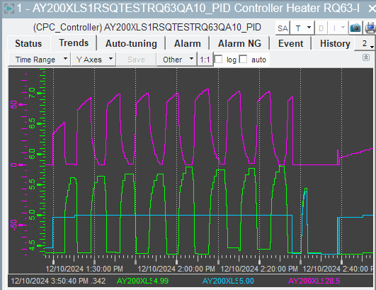
Status IND control systems
– CRYO controls results
String Test – Heater Regulation
violet: Heater [% * 20W]
green: Temp [K]
blue set point [K]
a “fast” regulator immediately
starts oscillating
Regulator oscillating
Notes:
A quickly responding regulation is not possible because of the long delay time.
As soon as the temperature is below the setpoint the heater starts to heat. When the tempererature crosses the setpoint the heater shuts off immediately.
The result is an oscillation.

Slide 26
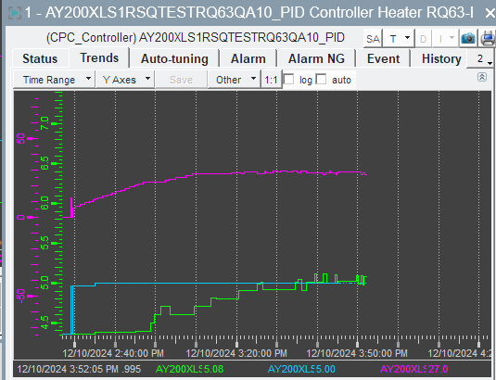
Status IND control systems
– CRYO controls results
String Test – Heater Regulation
violet: Heater [% * 20W]
green: Temp [K]
blue set point [K]
only a very slow regulator is
able to regulate the
temperature
Settling Time QP ~70 min.
Regulator more or less stable but slow
Notes:
With a very slow reacting regulator it was possible to regulate the temperature with a more or less stable behaviour.
BUT the resulting settling time was more than an hour.

Slide 27
Status IND control systems
– CRYO controls results
String Test – Heater regulation
Dipoles
delay time >300s
reaction time after set point change: 20 min.
Quadrupole
delay time >240s
reaction time after set point change: 70 min.
By pre-controlling the heater power with a value suitable for the expected heat load, the settling time could be reduced to 10 min.
(heat load/magnet cycle of the magnets need to be communicated in advance! by operator? by communication to other systems?)
Notes:
We have varying delay times for the different cooling circuits of the magnets.
Each control loop must be adjusted separately.
A possible solution could be a pre control of the heater power. Then the regulator only has to correct small remaining errors.
In this scenario the settling time could be reduced to around 10 minutes.
This means that the expected heating power has to be communicated to the system in advance.

Slide 28
Status IND control systems
– CRYO controls results
String Test – Challenges & Next Steps
Automatic heater regulation in dependency to the heat load is currently not possible due to the long dead time
As a result, regulation is far too slow
A new concept for heater control for the magnets is required
Who is responsible for this topic? (IND does not have the process engineering expertise)
Strong cooperation with SCM and CRYO departments will be essential

Slide 29
Status IND control systems
– RISKS
Small team size combined with wide variety of duties: Any absence could critically impact progress (one person - one topic)
Unclear responsibilities: It is still not defined who does the connecting of cables to the cabinet, to the instruments and the signal testing
(No resources from IND / CRY available)
Missing heating logic: The control and regulation concept for sector heating is not yet specified
Notes:
AThe team size of IND is very small and we have a lot of duties in a wide variety of different areas. CRYO Vacuum, Bakeout, PAS, SCADA, Cabinet design, …
For many topics we have only one single knowledgeable person.

Slide 30
Status IND control systems
– SUMMARY
  CRYO
    DB4, FB1,3,5 = Ready for installation and commissioning
    Sector 1-6 = in production, Delivery expected in Q2/2026
    SW to 90% finished and ready for commissioning
  PAS
    electrical design finished, frame contract awarded, FoS succesfully
    SW development and testing is ongoing
  INSULATION VACUUM
    electrical design finished,FAT prototype succesfully, PLC SW done
    Production ongoing
  BEAMLINE VACUUM, BAKEOUT
    done

Slide 31
Thank you for your attention
Are there any questions?

