Slide 1
Draft Concept for Beam Commissioning
D. Ondreka, GSI (SYS)
4th SIS100 Workshop, 24 September 2025

Slide 2
Contents
Goals
Conditions
Strategy
Preparations
Cycle

Slide 3
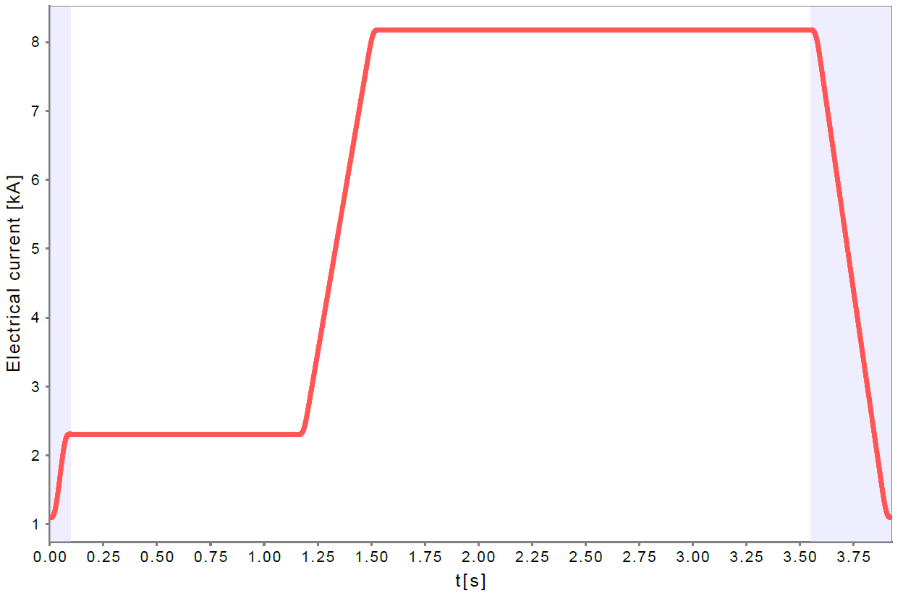
Goals
Testing each individual component with beam
Establishing proper functioning of SIS100
Validating machine protection systems
Preparation of first NUSTAR experiment in FS
Cycle for U²⁸⁺,1.5GeV/u, 4 injections, 2s extraction

Slide 4
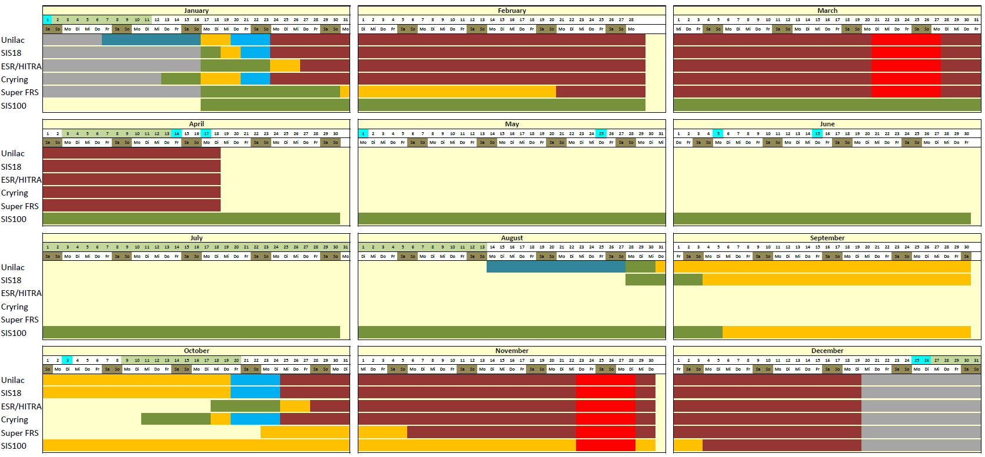
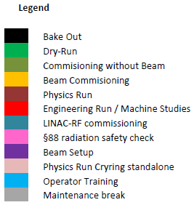
Annual Schedule 2028
user beam time
129 days (3096 h)
machine time
13 days
FAIR HEBT & SIS100
beam
commissioning
Early Science
physics
(Source: S. Reimann, Beam Time Retreat 2025)

Slide 5
Conditions
Pre-conditions
Machine cooled down
Hardware commissioning finished
Cryo system tuned for commissioning cycle in dry run
Operational and commissioning tools tested in dry run
Expected boundary conditions
Six weeks of exclusive operation for SIS100 BC
Six weeks of shared operation with physics run at SIS18
Commissioning only during day shifts (F, S)
Limited personnel (machine experts)
Frequent interventions by technical groups expected
Semi-automated test-procedures maybe run over night

Slide 6
Organization: Commissioning Team
BC manager (+ deputy)
Organizes and coordinates commissioning program
Authorizes major program changes in response to issues
BC leader (machine experts, weekly turn, overlap with SIS18 on-call)
Responsibility for execution of commissioning
Coordination of commissioning activities
Reporting in daily commissioning meeting
BC shift crew (machine experts, operators)
Execution of commissioning
Experts for difficult tasks, operators for systematic checks

Slide 7
Strategy: Commissioning Tracks
Fast track (‘pioneers’)
Try to get beam through machine as fast as possible
Ignore non-functional devices if not critical (but document the fact)
Main track
Systematically check all devices, follow-up on non-functional ones
Document achieved intermediate results
Establish commissioning, set-up, and tuning procedures for operation

Slide 8
Commissioning Sequence (I)
Beamline from SIS18 to SIS100
Main goal: beam spot on injection screen/grid with correct parameters
Steering, optics verification
First turn in SIS100
Main goal: loss-free transport around circumference up to injection point
Beam steering using BPMs and first-turn grids
Circulating beam at injection level
Main goal: prepare systematic measurements
Options for injection
Bunch-to-coasting and bunching in SIS100
Bunch-to-bucket
Beam deposition at injection energy on collimator using orbit bump
Systematic measurements
Main goal: validate and establish proper functioning of correctors and BI
Correction of closed orbit and tune
Main goal: establish correct optic and good orbit for further steps

Slide 9
Commissioning Sequence (II)
Commissioning of fast/emergency extraction
Main goal: establish simple way to dispose of beam
Useful for systematic tests of everything except SX
Commissioning of acceleration
Main goal: establish accelerated beam
Test of synchronicity of acceleration RF (among cavities and with magnets)
Commissioning of slow extraction
Main goal: establish slow extraction with high efficiency
Expected to be most challenging step due to strong non-linearities
Quick shot based on design settings shall be tried
Systematic approach with simpler schemes will be prepared

Slide 10
Preparations
Development of commissioning procedures
Description of steps to be executed in the commissioning sequence
Include input and exit conditions and define criteria for fulfillment
Development of software tools for commissioning
Necessary due to large size of SIS100 for efficient commissioning
Tool | Purpose
First-Turn Steering | Steering based on single-pass BPM data
Closed Orbit Correction | Correction of closed orbit based on multi-pass BPM data
Tune Measurement | Measurement and correction of machine tune Measurement and correction of chromaticity Validation of sextupoles Validation of octupoles?
ORM Measurement | Validation of steerers and BPMs Validation of optics Validation of octupoles?

Slide 11
Commissioning Cycle
Boundary conditions
Heat load must correspond to experiment cycle
Flat-top rigidity in experimental range
Reasonably short cycle time for commissioning
Expectations for first NUSTAR experiment
U²⁸⁺, 1 – 1.5 GeV/u, <10¹¹/spill
ES intensity limit: 2∙10¹¹, 2s extraction, 4s cycle
Proposed cycle
Flat-top rigidity: 50 Tm
Duration: 4 – 5 s
Flexibility in defining flat-bottom/flat-top length
Low charge state ions to lower energy (Ar¹⁰⁺: 3 GeV/u, Kr¹⁶⁺: 2 GeV/u, U²⁸⁺: 1 GeV/u)
Minimization of activation (interventions!)
Better control of SX losses (collimation system!)
Cycle for U²⁸⁺,1.5GeV/u, 4 injections, 2s extraction
Cycles with identical heat load

Slide 12
Summary
Goals, preconditions, organization, and strategy sketched
Coarse commissioning sequence presented
Procedures and tools need to be developed
Thanks for your attention!

