Slide 1
SIS100 Main Power Converters Status of the installation with outlook on the commissioning
V. Plyusnin
4th SIS100 Workshop: Procurement and Installation

Slide 2
Content
SIS100 Main Power Converters
Overview and production status
Installation status
Outlook on the comissioning

Slide 3
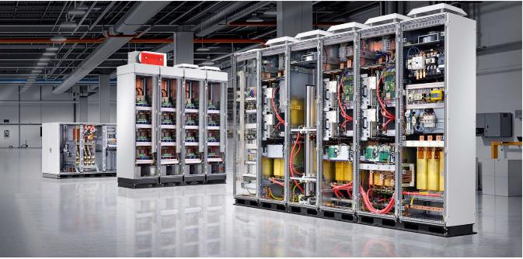
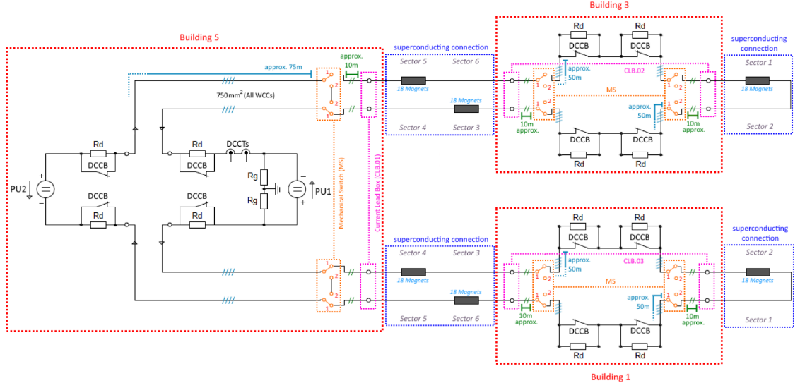
SIS100 Main Power Converters
Overview and production status
Main Dipole PC: 2 power units (PU) in series + quench protection (12 DCCBs + Rds) Iout = 13200 A di/dt = 19 kA/s Vout = ±1400 V Pmax = ±18,5MW Sn = 12 MVA | (2x) Main Quadrupole PCs: 1 power unit + quench protection (4 DCCBs + Rds) Iout = 8500 A di/dt = 15 kA/s Vout = ±700 V Pmax = ±6MW Sn = 4 MVA

Slide 4
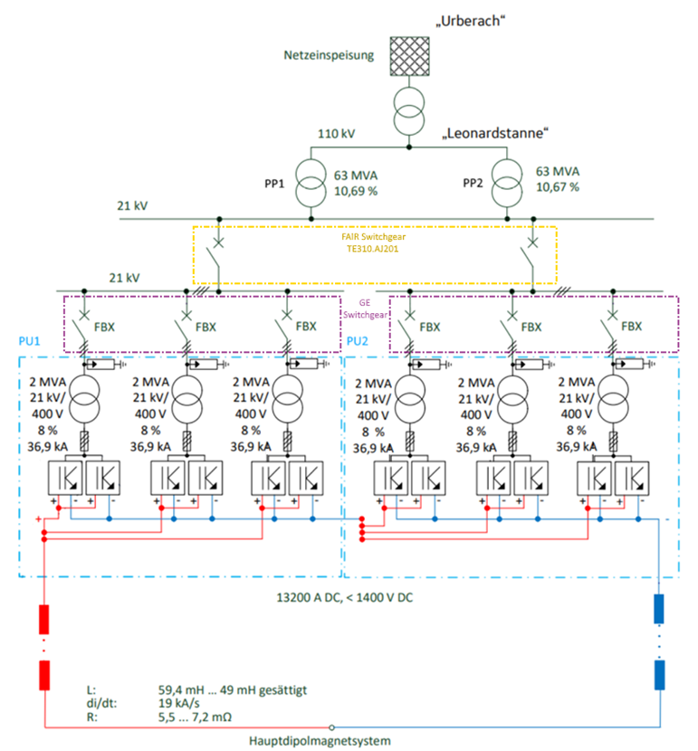
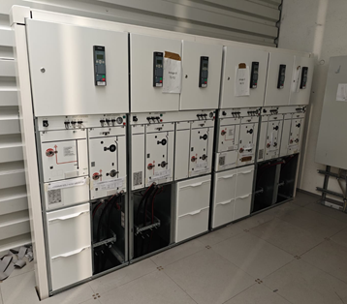
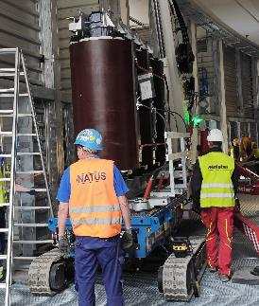
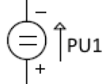

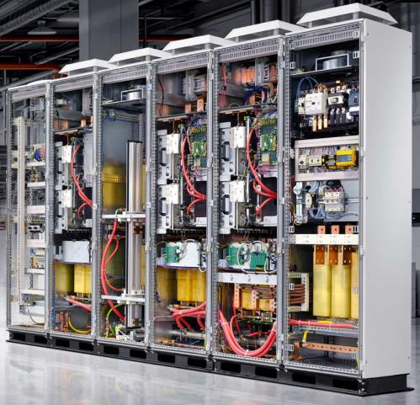
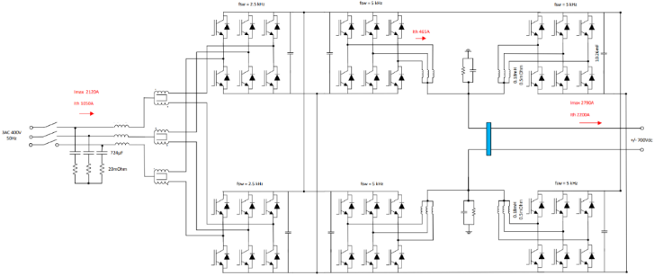
SIS100 Main Power Converters
Overview and production status
AC-DC
DC-DC
Notes:
Elektroinstallationen fehlen noch

Slide 5
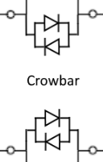
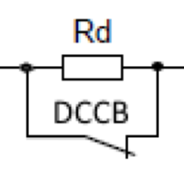
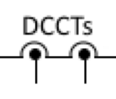
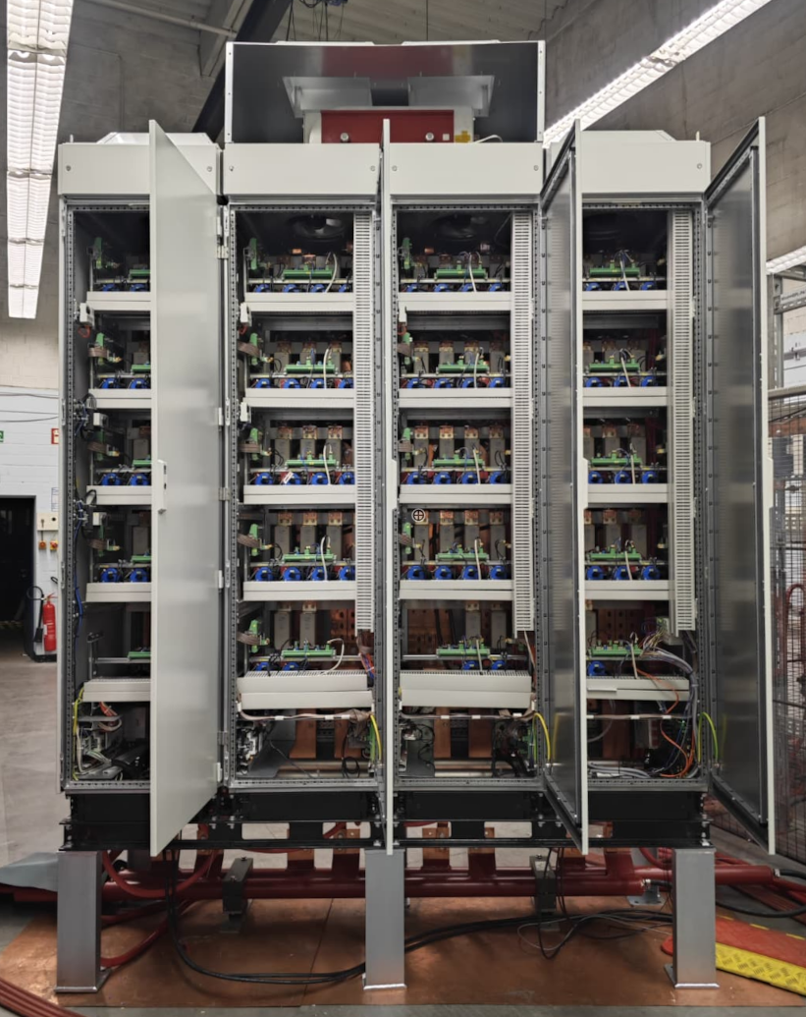
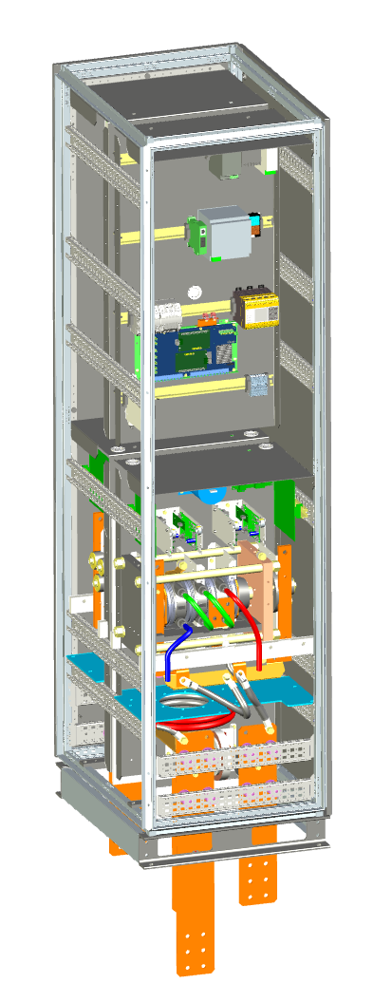
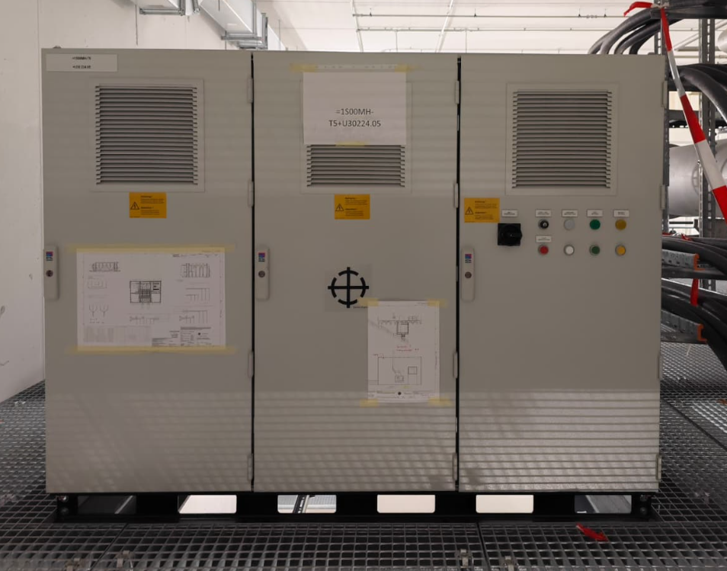
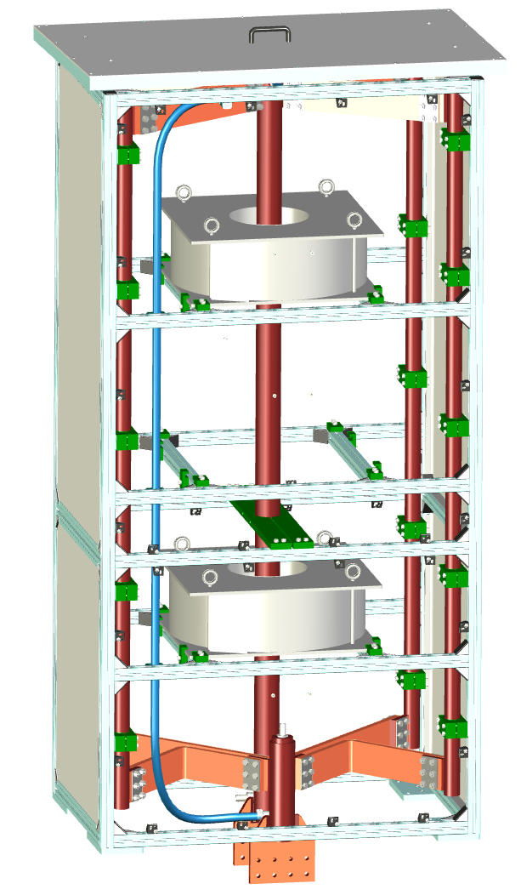
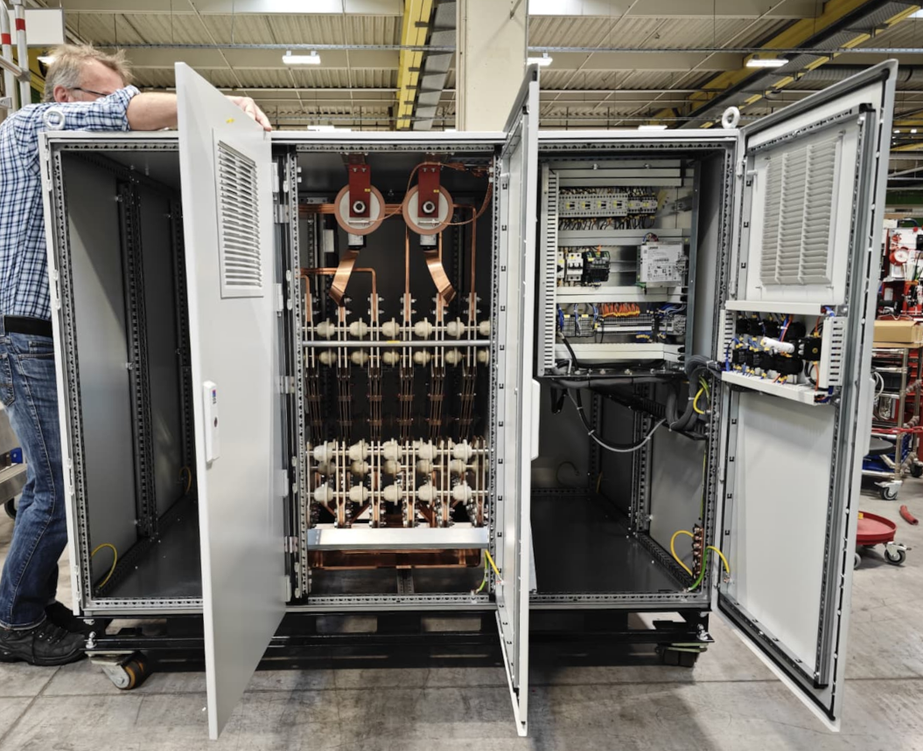
SIS100 Main Power Converters
Overview and production status
4 T/s operation – 14.5/11.5 kA
Water-cooled
DCCT heads ready

Slide 6
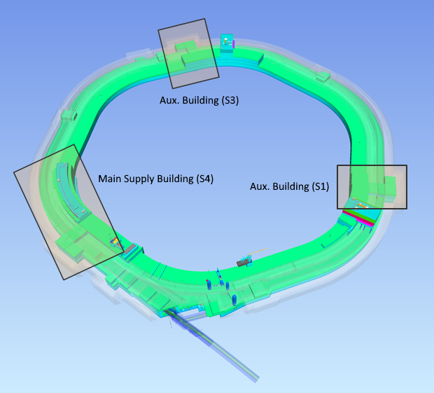
SIS100 Main Power Converters
In total components to be installed:
U10:
8 x 20kV Switchgear Cabinets
10 x 20kV/400V Transformers
U20:
Main Supply Building (S4):
20 x AC/DC Converters
12 x DCCBs
3 x Crowbar Cabinets
3 x DCCT Cabinets
WC-Bus-bars
8 x Mechanical Switches (Nische 5)
WC-Bus-bars (Nische 5)
Auxiliary Building (S3):
4 x DCCBs
WC-Bus-bars
2 x Mechanical Switches (Nische 3)
WC-Bus-bars (Nische 3)
Auxiliary Building (S1):
4 x DCCBs
WC-Bus-bars (Nische 1)
2 x Mechanical Switches
WC-Bus-bars (Nische 1)
Installed
Notes:
alle geräte auser für den teststand sind bereits unten, DCCBs mit aufzug einbgebracht in B3 und B1, futterbläche, kein gabelstpler im bereich erlaubt

Slide 7
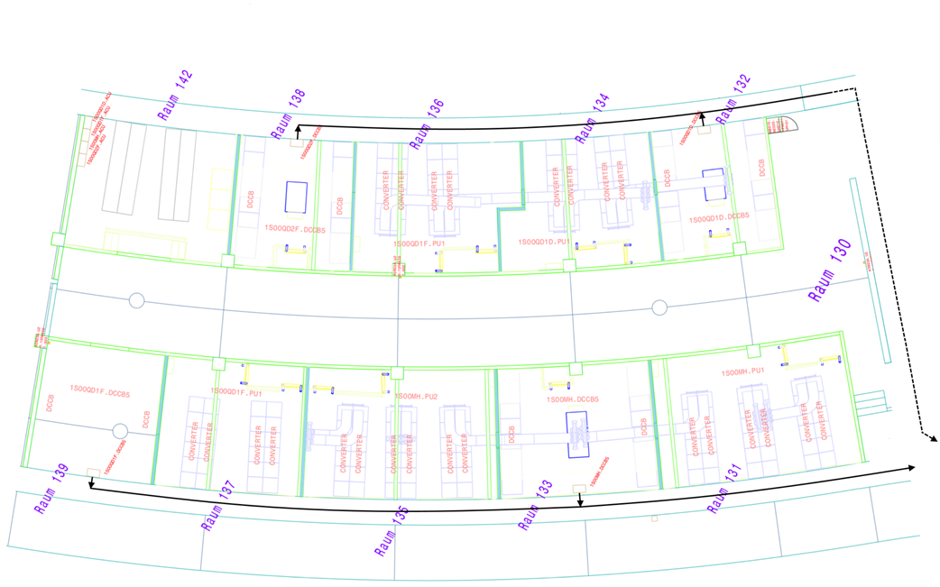
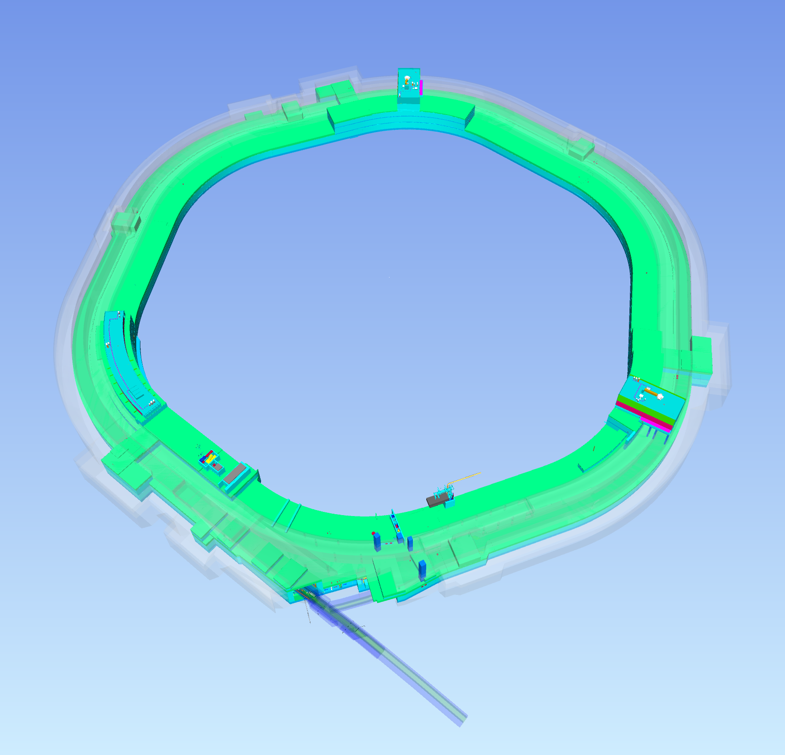
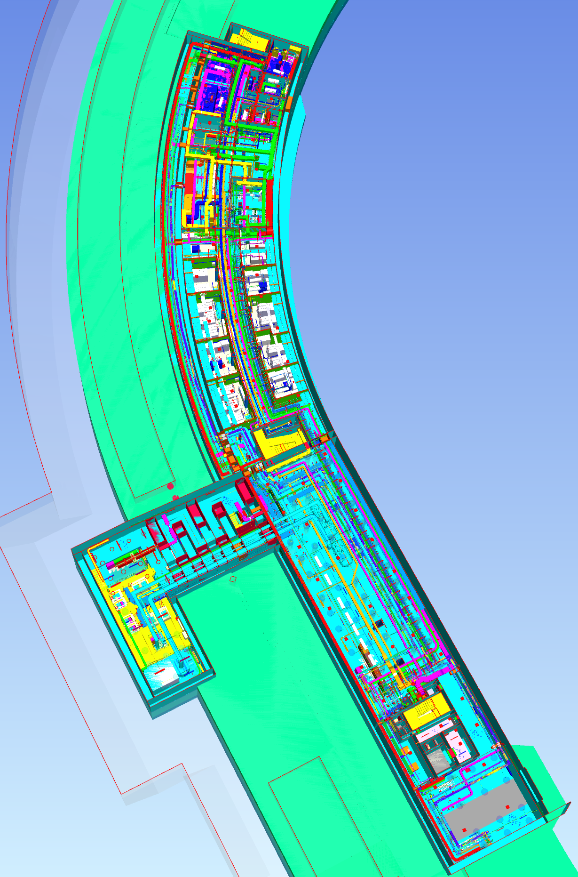
SIS100 Main Power Converters
U20: Main Supply Building (S4)
QF(1+2)
QD
1
1
Dipole
1
Most of the main components are already stored in U20 using main crane and cabinet transport trolley
Installation is ongoing using portal crane and forklifters
Some components still at Testbench in Berlin
Electrical installation works are under preparation (U10+U20) as well as water cooling infrastructure
Notes:
How to interconnect?

Slide 8
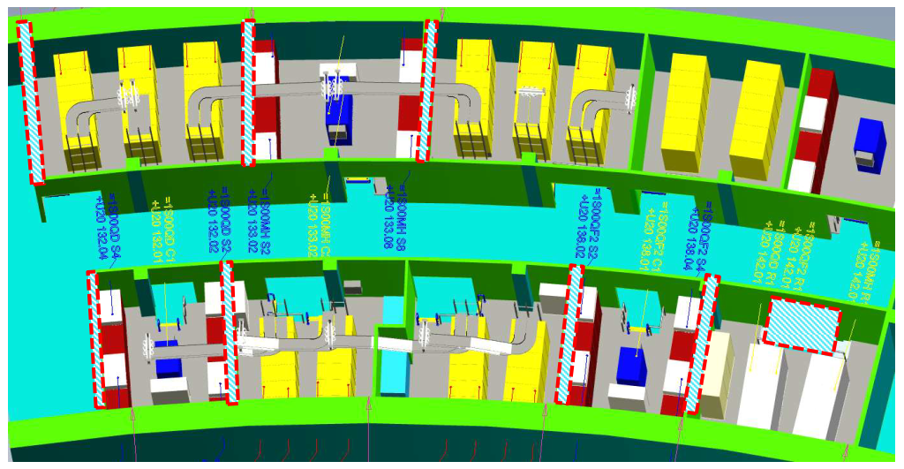
SIS100 Main Power Converters
U20: Installation Concept
4
2
Build
Build
6
5
Installed
3
1
3
1
Installed
3
5
2
4
4
2
Build
Build
Build
Build

Slide 9
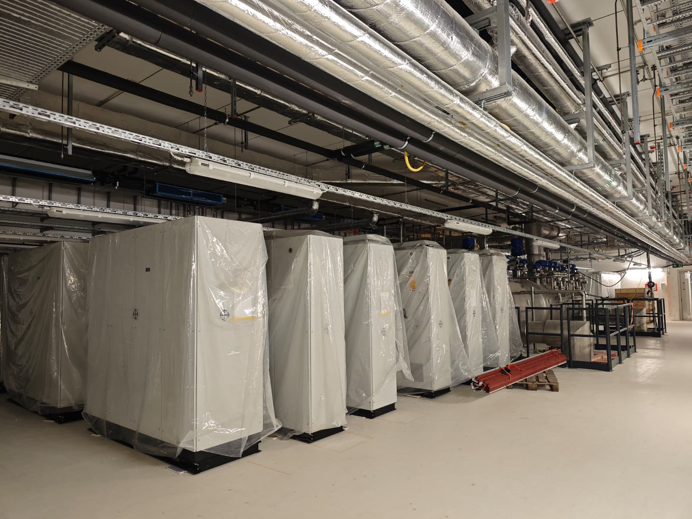
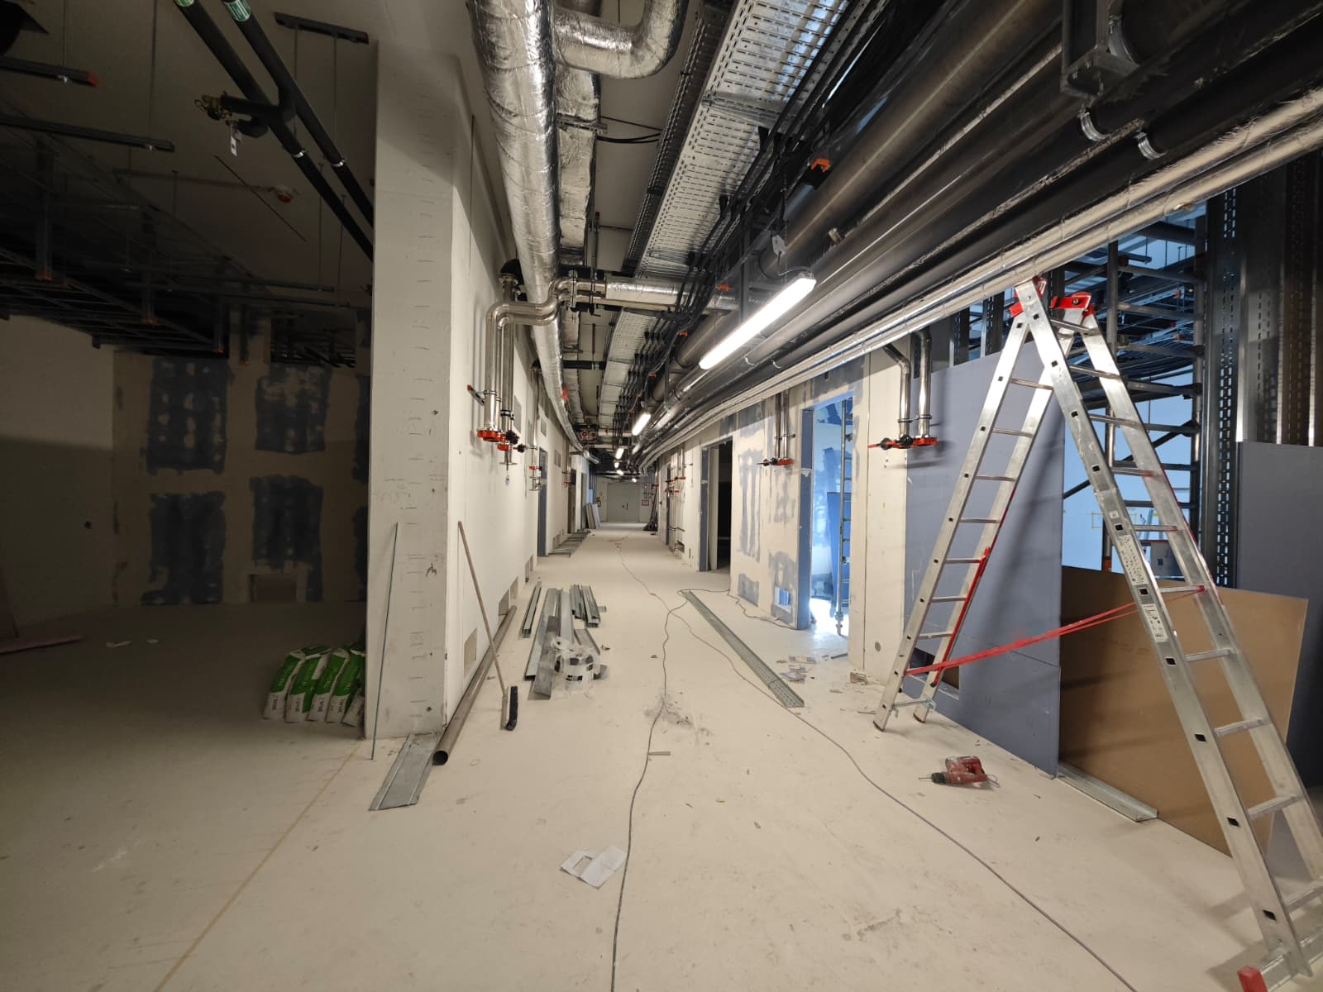
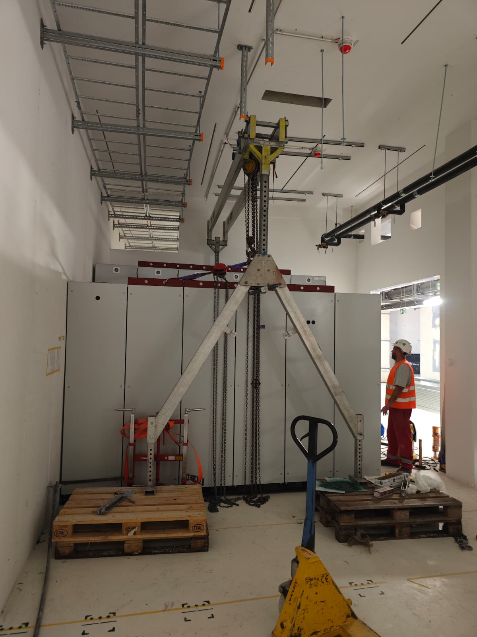
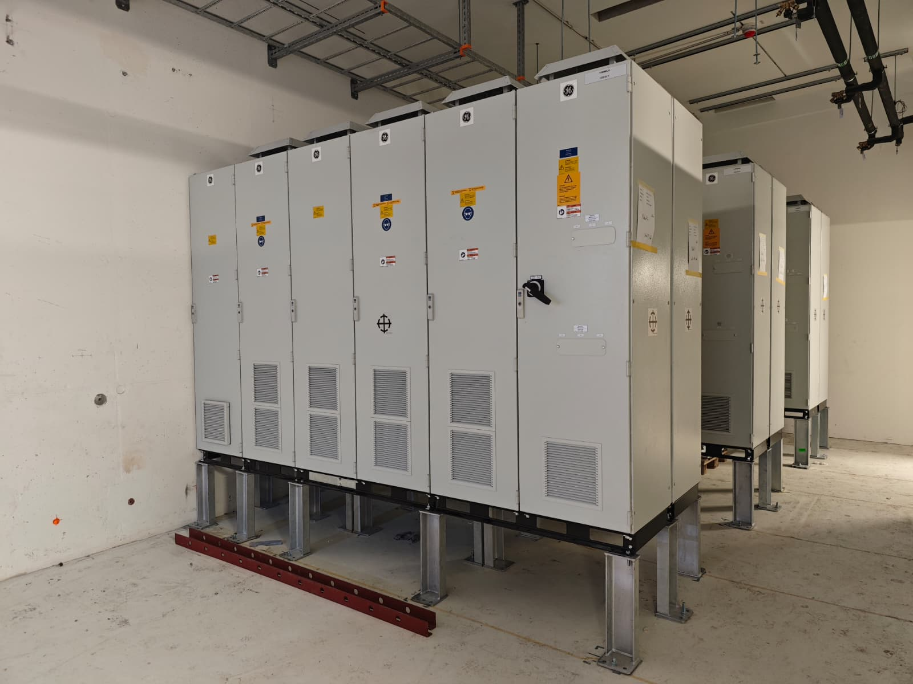
SIS100 Main Power Converters

Slide 10
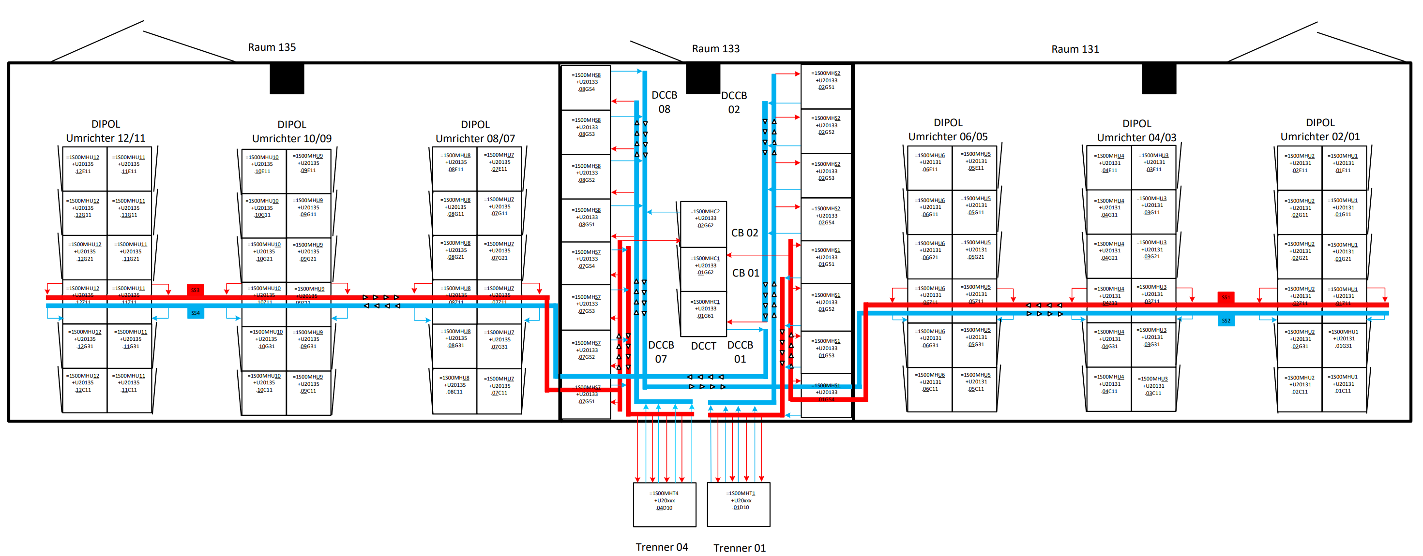
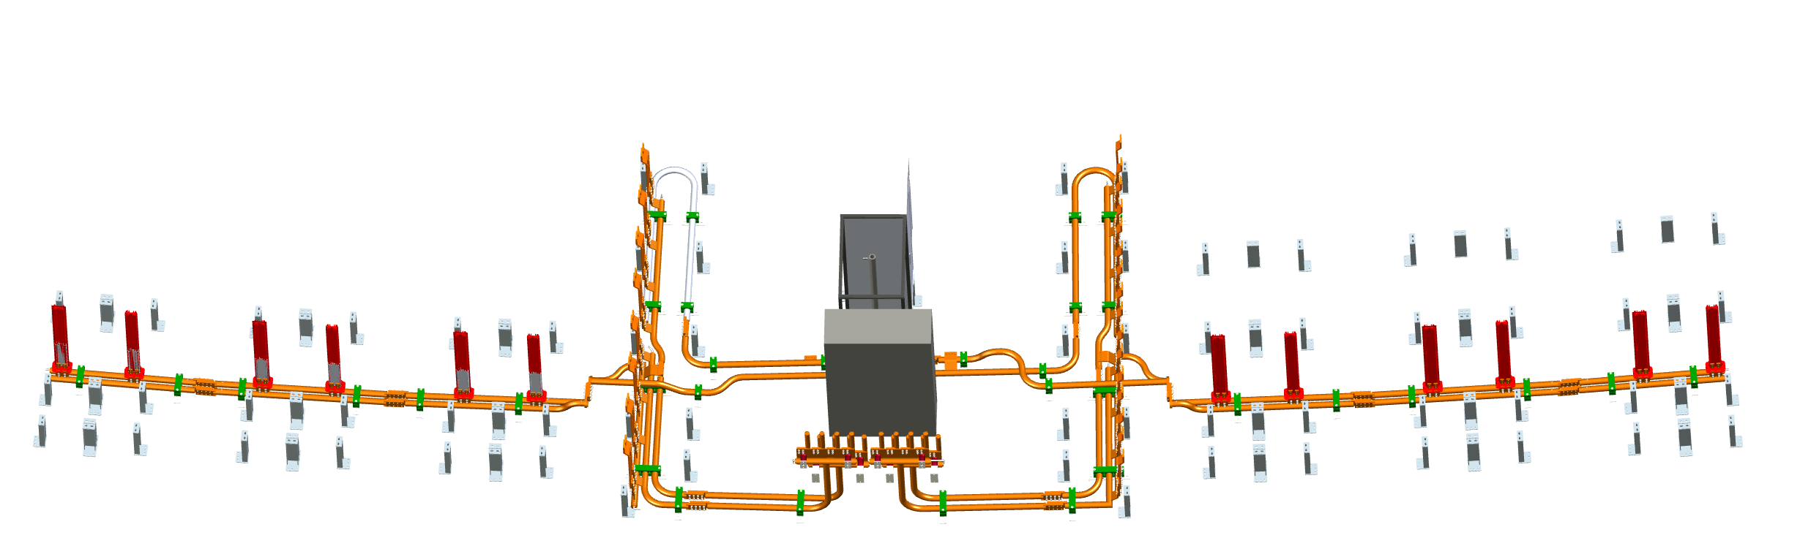
SIS100 Main Power Converters
Dipole:
Production - WC-Busbars:
Q1/2026
Notes:
3-4 month after order.

Slide 11
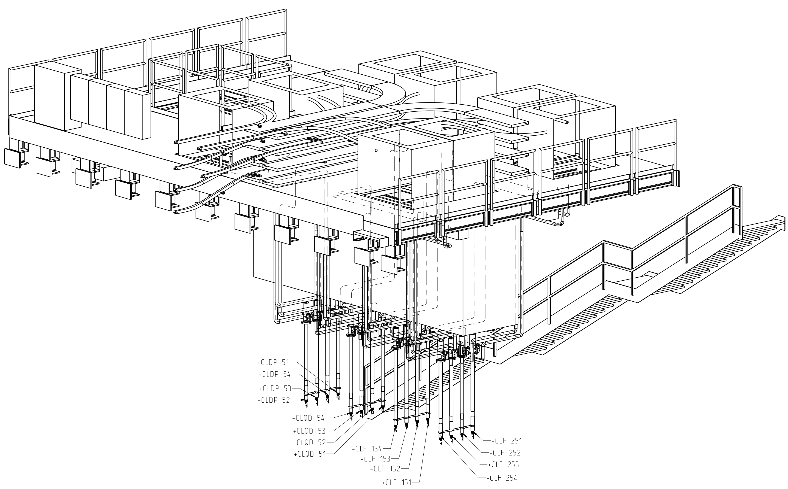
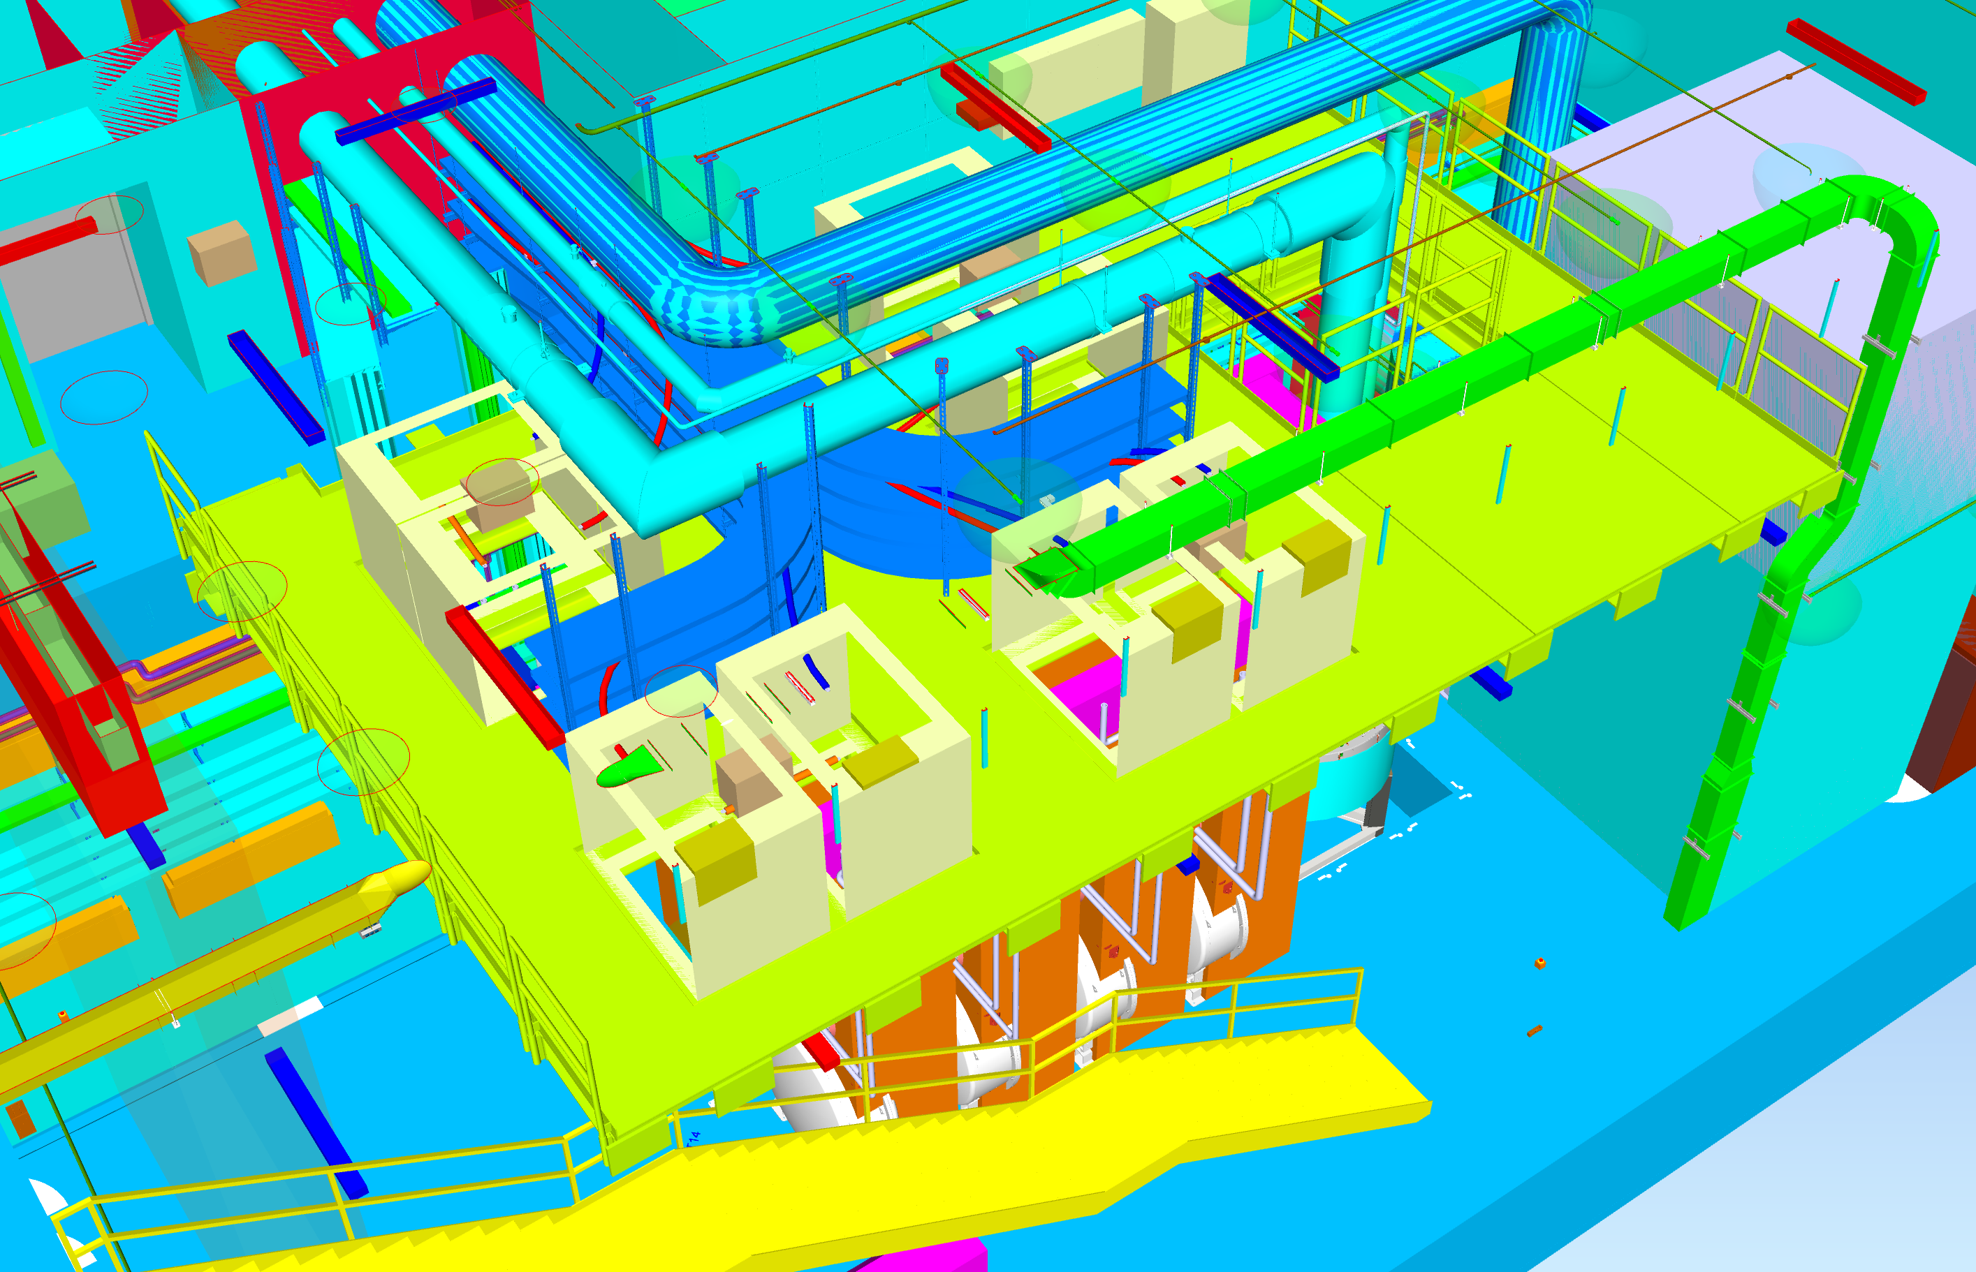
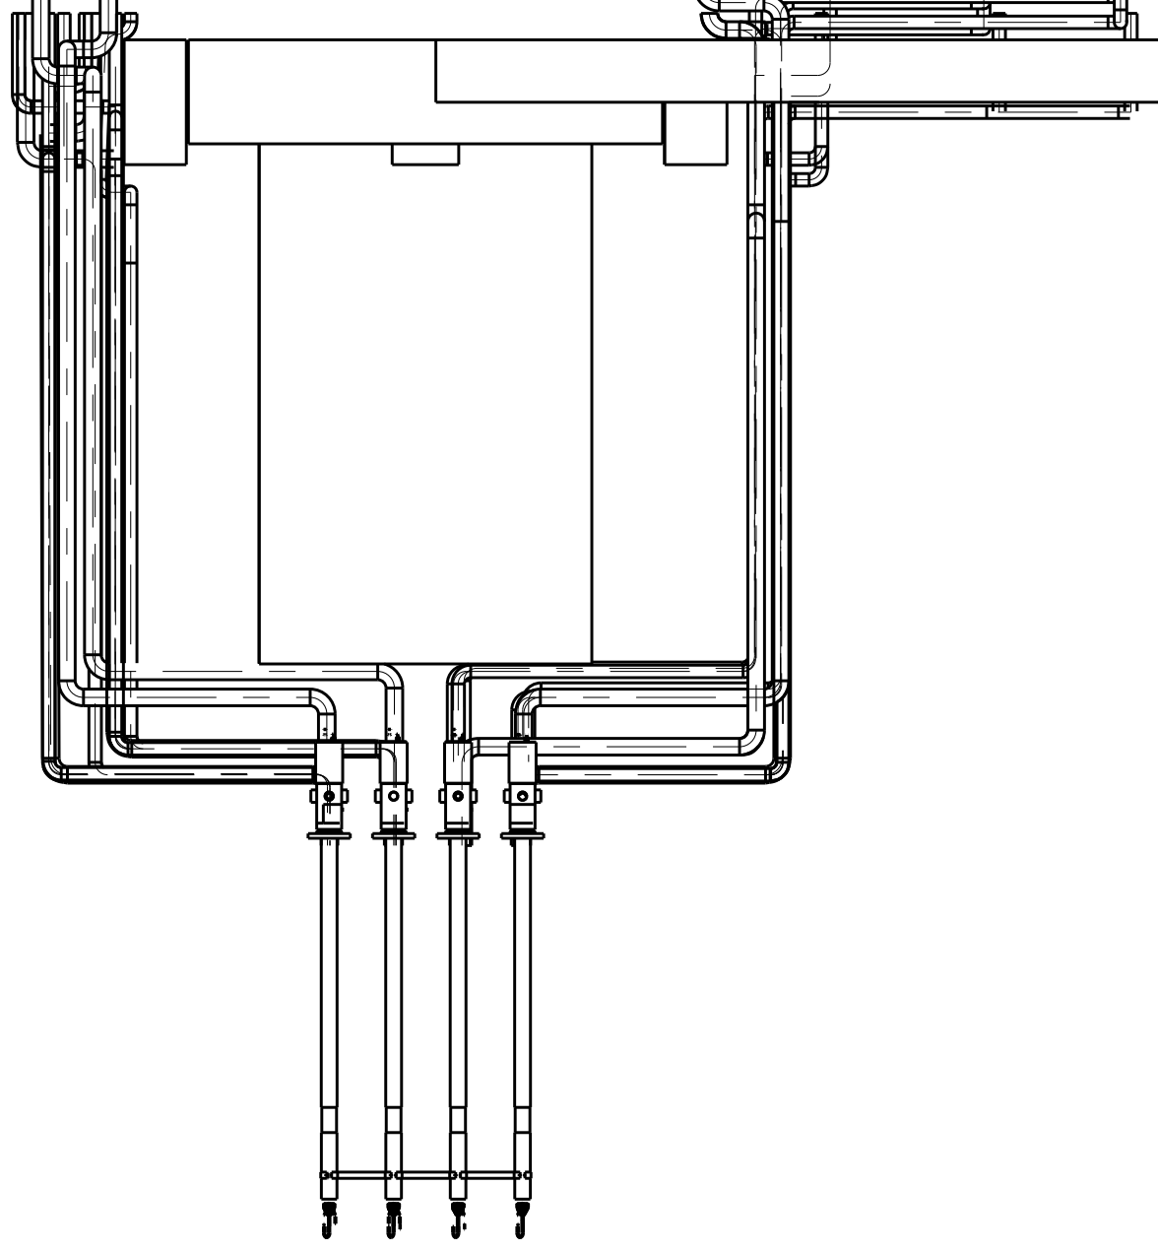
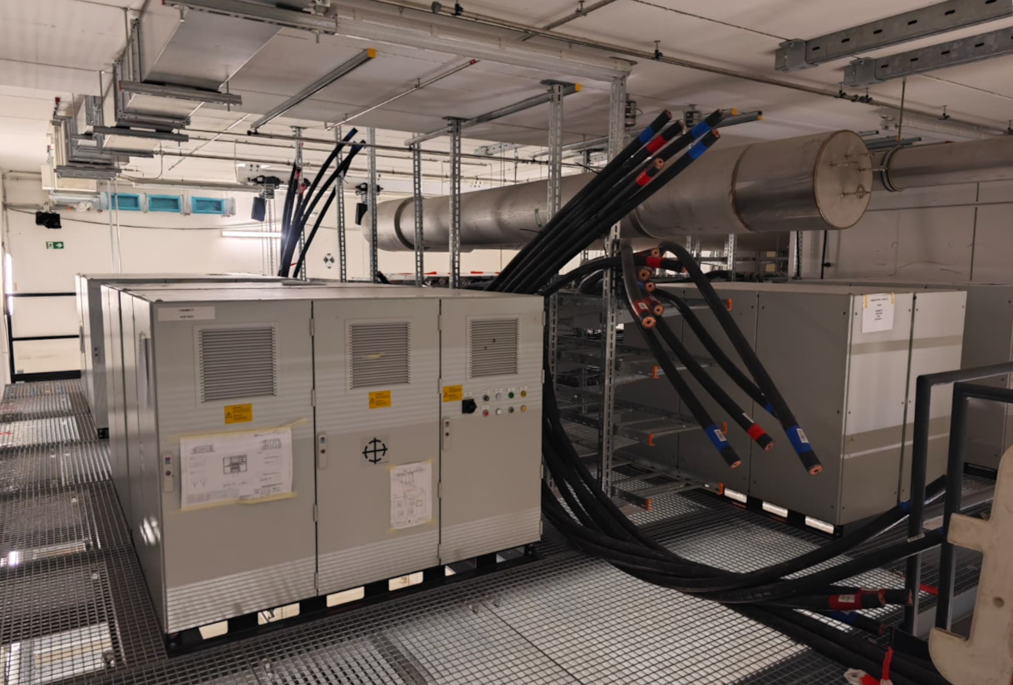
SIS100 Main Power Converters
Niches 5, 3, 1:
WC-busbars 2
8 x MS
All Mechanical Switches were successfully installed using mini-crane and hand fork-lifters
Next steps:
Bus-bars to connect the CLBs (still missing info. from GSI!)
Electrical installations and grounding of the components
Installation of the control and pulling of the control cabling
Installation and connection of the water distributions
Connections of F1 and F2 magnet systems ins series for the FQuads.
Notes:
Discussions how to bring the Switches to the platform.

Slide 12
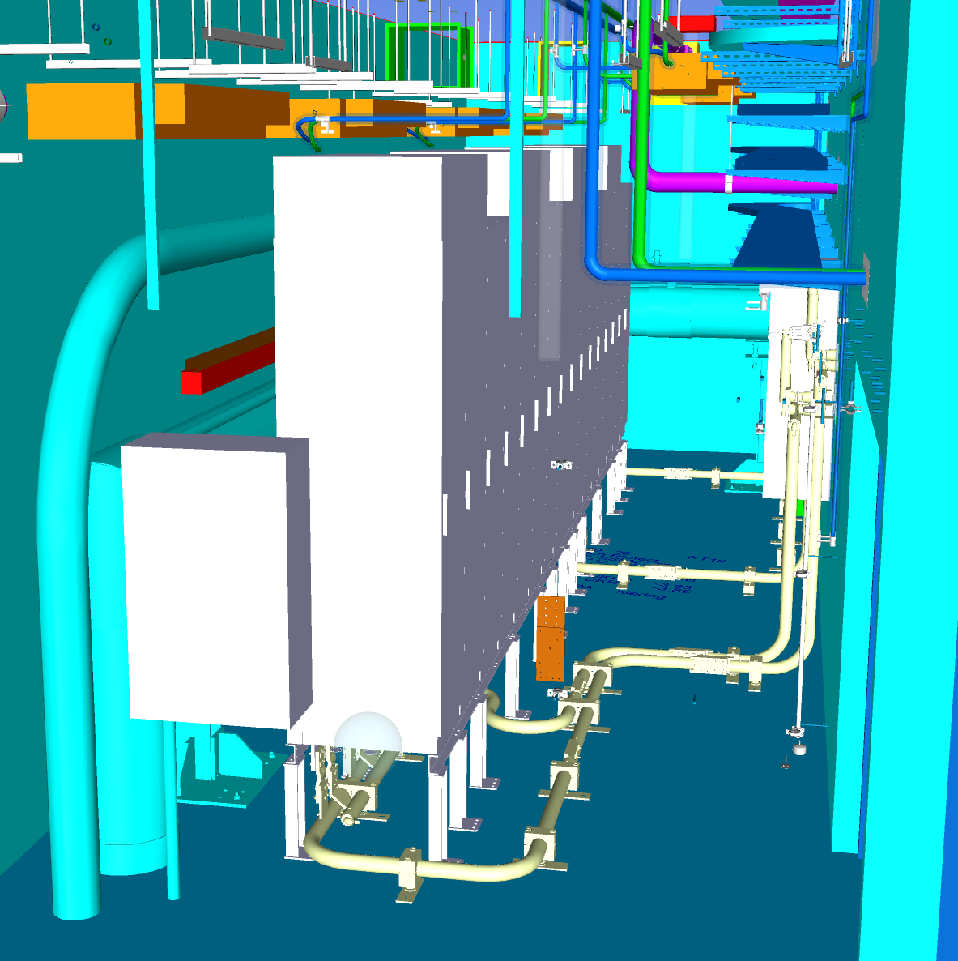
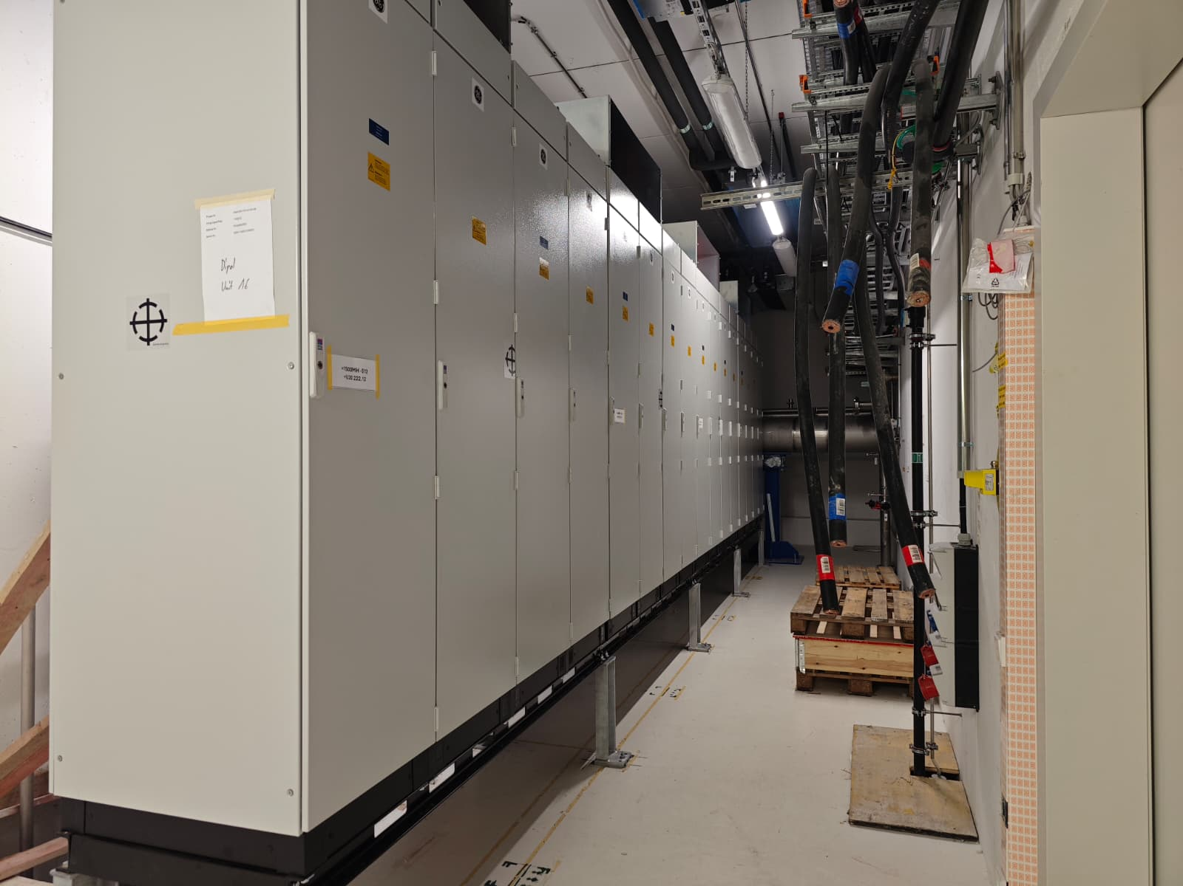
SIS100 Main Power Converters
DCCB Rooms U20 – 322/222
All DCCBs were inserted using elevators and cabinet transport trolley
All DCCBs installed using forklifters and appropriate supporting wood constructions
Dump resistors were installed on the top of the cabinets with chain hoists
Next steps:
Output Bus-bars transport and installation
Electrical installations and grounding of the components
Installation and pulling of the control cabling
Installation and connection of the water distributions

Slide 13
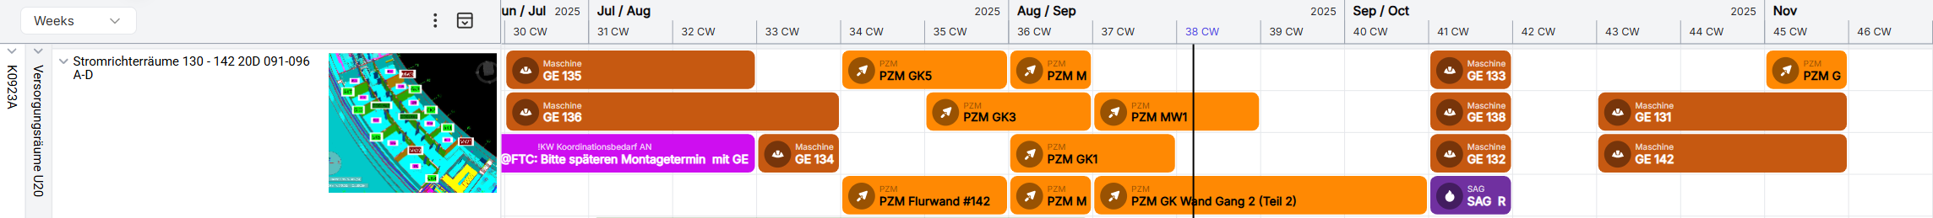
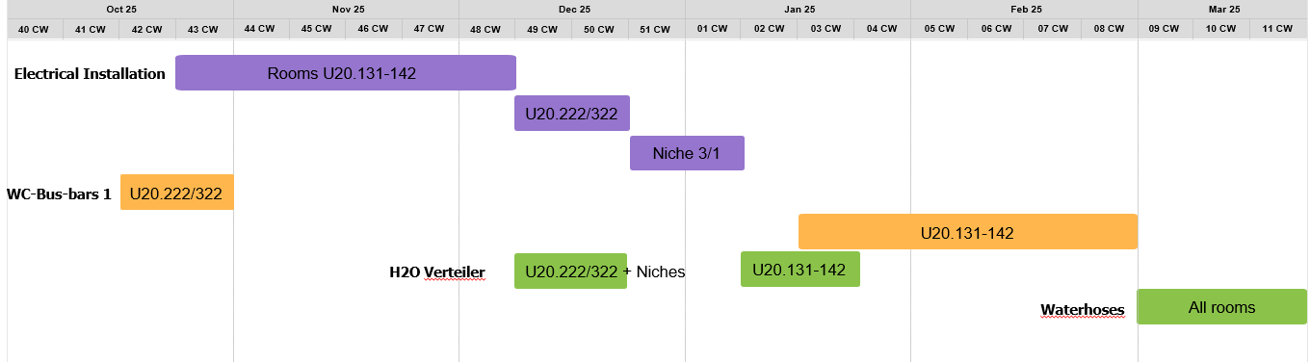
SIS100 Main Power Converters
Upcoming installation of the rest of main components:
Further installation activities:
Notes:
Detailed Installation Concept U20 – 500 entries

Slide 14
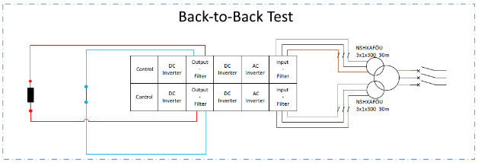
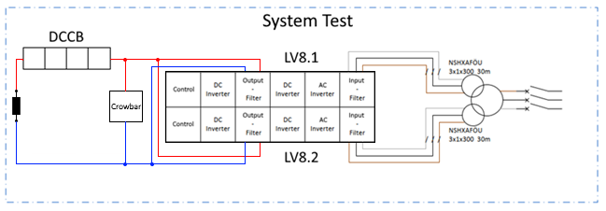
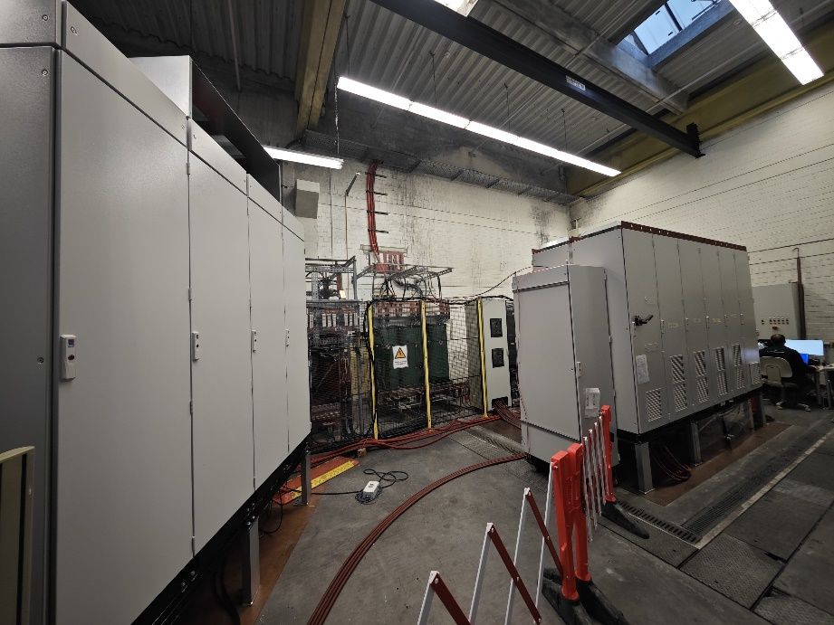
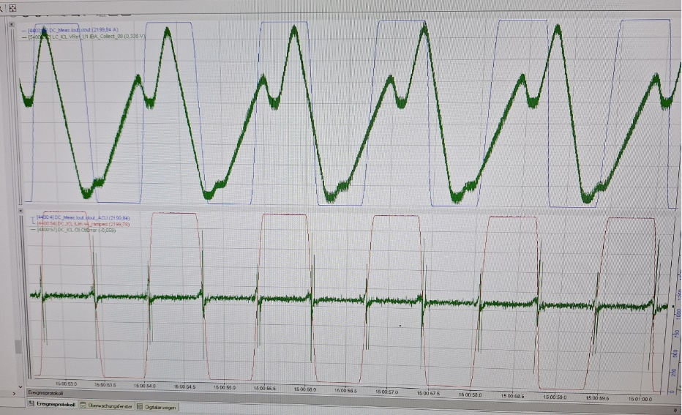
SIS100 Main Power Converters
FAT of 2xFoS Inverters – Done Q4/2023
System Safety Test – Done Q4/2024
Routine tests
Isolation tests
Pressure tests
Thermal test with full current of the inverters
Operation of two converters in series (DC & ramped modes) completed
Current flow in both directions
Accuracy tests on a test load
Operation mode of two converters in parallel (DC & ramped modes)
Operation and accuracy tests
With reactive power compensation of SIS18 current shape tested
Safety concept being finalized based on test results
MPS Trigger
Performance of the system safety mechanisms
Notes:
Installation

Slide 15
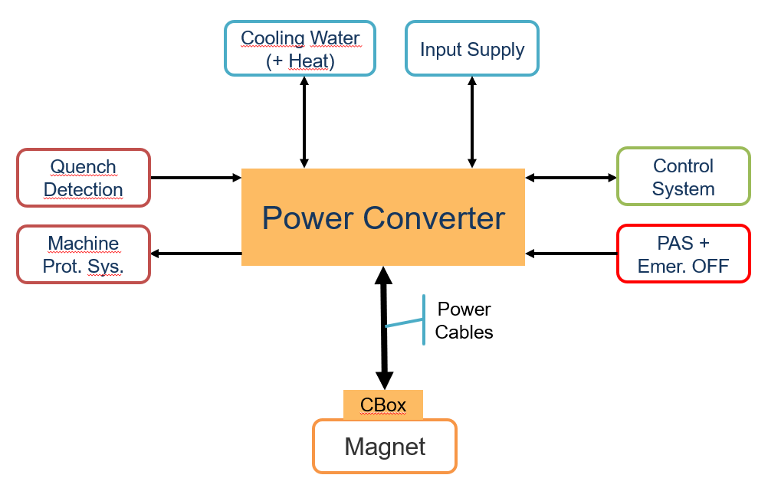
SIS100 Main Power Converters
Commissioning of the main power converters:
SAT Aa - End of installation including VDE tests, pressure tests, etc.
Pre-conditions: 400V supply
SAT Ab:
Dry commissioning without 20 kV [i.e. signal checks, functionality tests without power, etc.]
Pre-conditions: Cooling water available, output power cables connected and tested
Short circuit test with 20kV [i.e. operation of the complete power converters]
Pre-conditions: 20kV supply, doors with locks and working emergency-off system.
SAT B – Supply of the final load
Pre-conditions:

Slide 16
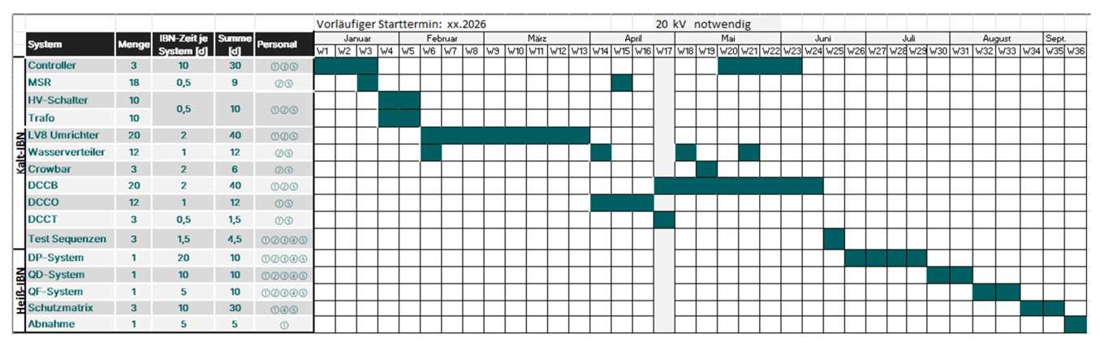
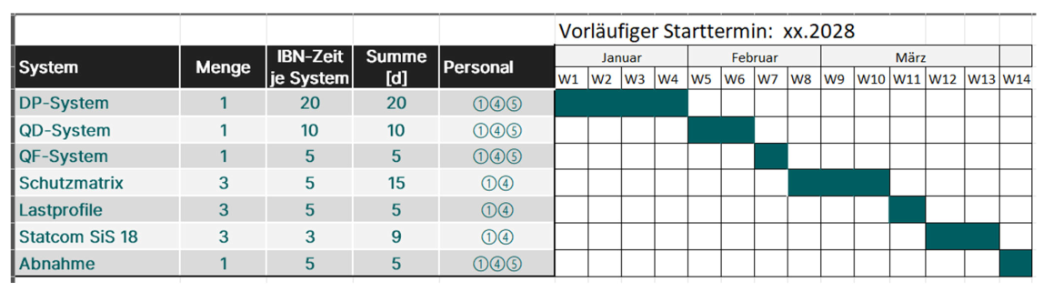
SIS100 Main Power Converters
SAT Ab:
SAT B:

Slide 17
Thank you for your attention

