Slide 1
General consideations for FAIR commissioning
Seva Kamerdzhiev, Stephan Reimann
4th SIS100 Workshop

Slide 2
Content
Top-Level commissioning schedule
Organization of the Subproject FAIR Commissioning
Transition from installation to commissioning, planning, organization
Gate Reviews
Current focus
CRYO2
FCC
First Beam Event
Lessons learned so far

Slide 3

GSI & FAIR – Integrated Campus Schedule
2024 2025 2026 2027 2028
First beam in T1S1
Beam Time
Beam Time
Beam Time
Beam Time
FCC Construction & Procurement of Interior equipment
Equipment
Installation
Commissioning
ACC operation
from new FCC
Injector Controls Upgrade: 1st version of new production system
Injector Controls Upgrade: finalization
Controls & BI Digitization UNILAC, SIS18, ESR, Cryring, HEBT
Civil Construction
Start SIS100 PC commissioning HW Commissioning
FAIR Tech. Buildings Infrastructure
FAIR Buildings Testing & Commissioning
HBO
Regular Operation of Tech. Buildings Infrastructure
FAIR Accelerator / Experiments Procurement & Manufacturing
SFRS-ES
SIS100-FS
FAIR Accelerator / Experiments Installation
HEBT/SFRS-ES
SIS100-FS
Cryo 2 Commissioning
HEBT-ES Hardware-Commissioning
Dry-Runs
Start of ES
science program
SFRS Hardware-Commissioning
ES Beam Commissioning
start of first
science program
& first science+ program
Dry-Runs
SFRS Cooldown
HEBT & SIS100 -FS Hardware-Commissioning
FS Beam Commissioning
Dry-Runs
today
SIS100 Cooldown

Slide 4
Organisation of Commissioning
Commissioning is organized as a subproject within FAIR project
fully integrated in FAIR management lead team with other sub project leaders and in GSI accelerator organisation (ACC)
fully integrated into FAIR reporting structures (planning, risk management, controlling) and committees
Subproject Commissioning is divided in 12 work packages with dedicated work package leaders (commissioning responsible)
Full integration of experiment groups and facility management (technical building infrastructure) in the commissioning process
Sub structure is developed as project progresses
line management
project organisation (matrix)
Technical Director
J. Blaurock
Note: handover to operation organisation after delivering beam with project completion parameters (PCP) on target:
Early Science: 238U73+, 1 GeV/u, 2E9 ions/second
First Science: 238U28+, 1.4 GeV/u (60Tm), 2.5E10 ions/cycle
First Science+: 197Au79+, 11 GeV/u, 1E7 ions/second
Head Accelerator Operation & Development
R. Assmann
FAIR Project Lead
J. Blaurock
associated GSI-group (FAIR Commissioning and Operation) in ACC-OPE Lead: V. Kamerdzhiev
FAIR Commissioning Subproject Leader & GSI Operation Manager
S. Reimann
HEBT
commissioning responsible
Cryogenic
commissioning responsible
FAIR Control Center
commissioning responsible
Safety
commissioning responsible
technical building infrastructure responsible
NUSTAR
commissioning responsible
Radiation Safety
commissioning responsible
SFRS
Stephane Pietri
Controls commissioning responsible
Line management S. Reimann to operations department OPE
first science
and beyond
SIS100
Peter Spiller
Notes:
SFRS Commissioning Leader S. Pietri

Slide 5
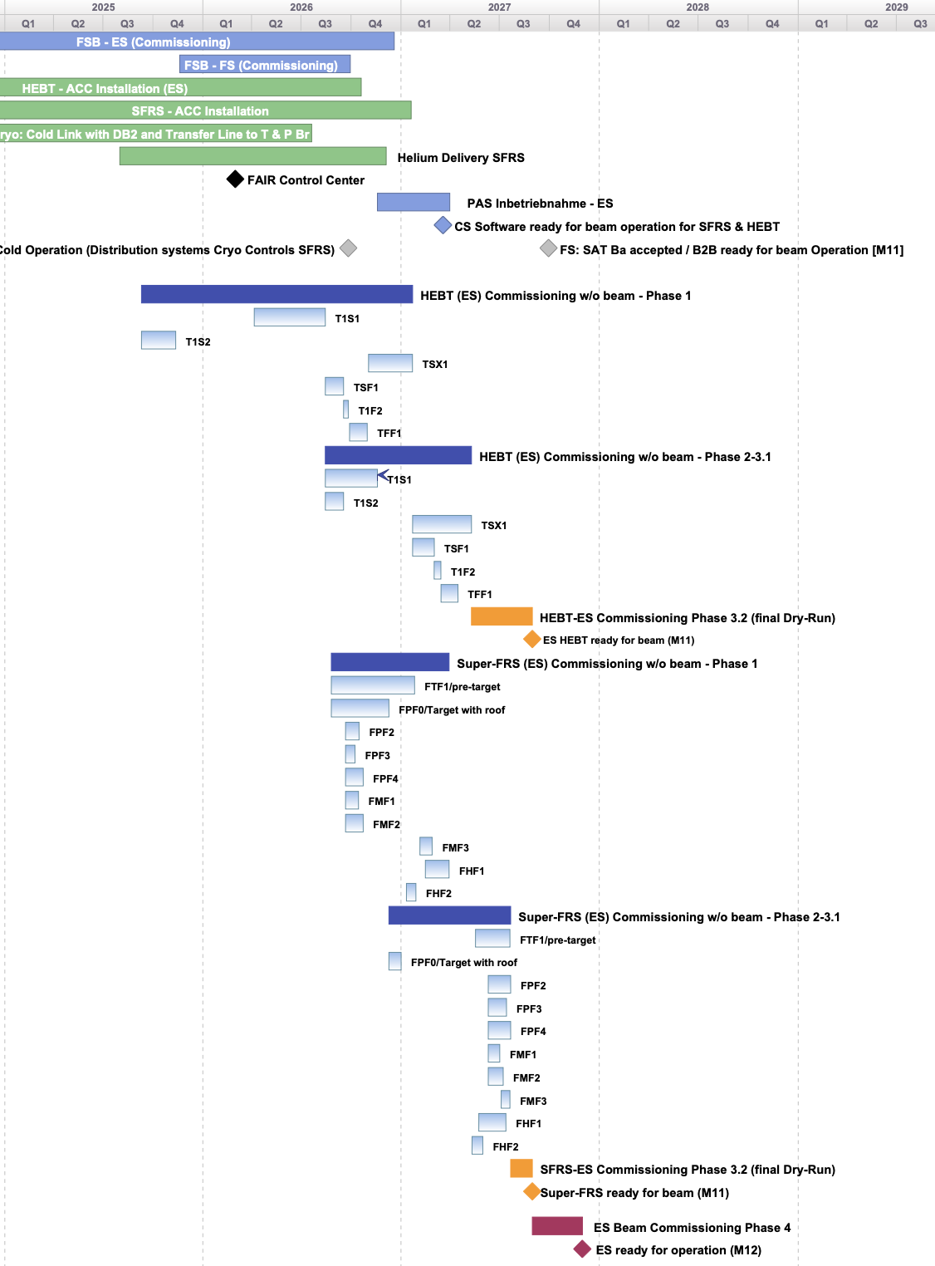
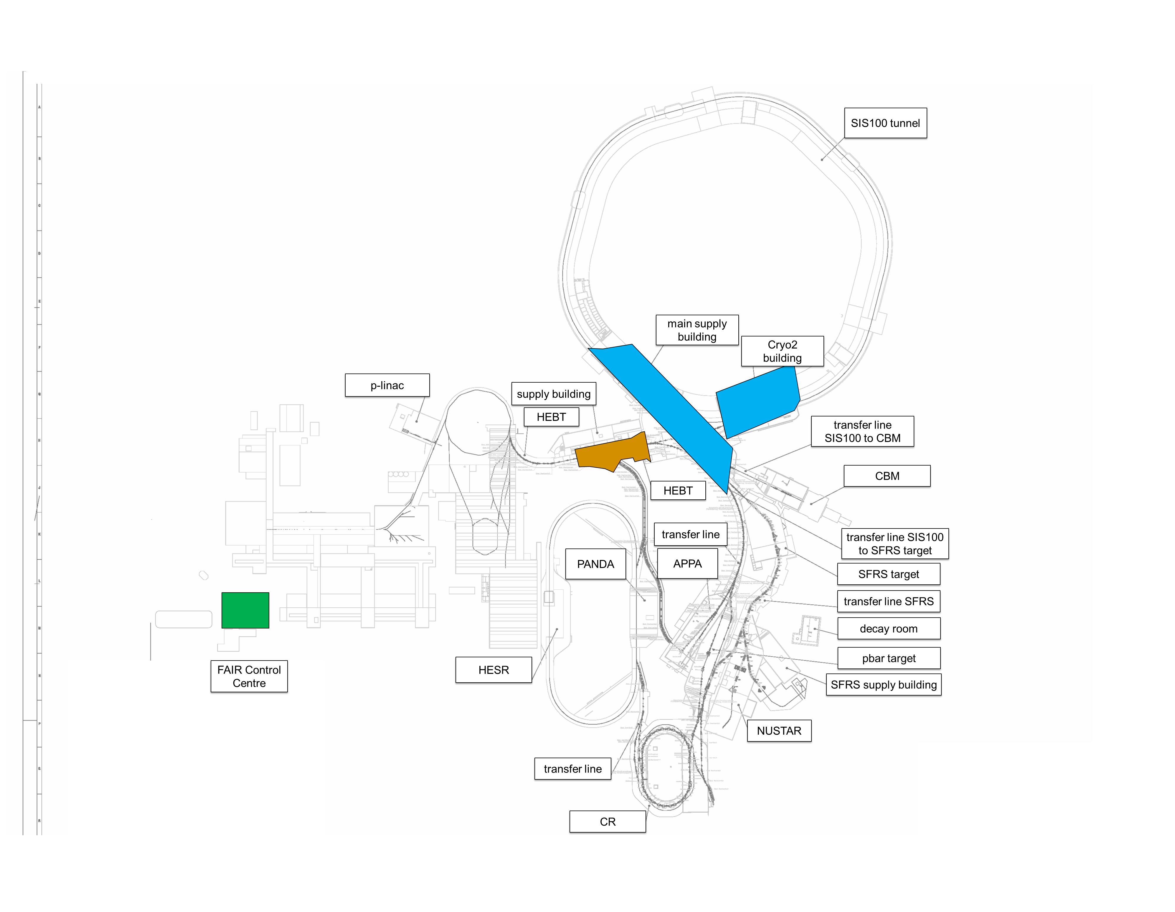
First 3 major Commissioning Milestones
FSB – ES Commissioning
← Early Science commissioning schedule on section level
Cryo2 Commissioning
Q2/2025 → Q4/2025: cryogenic plant “Cryo2” (building K0720A & parts of main supply building H0719A)
Q4/2025: start of first commissioning activities in Transfer Lines T1S1/2
(T1S1 ready for beam in Q4/2026)
Q1/2026 start commissioning of FAIR Control Centre and new Main Control Room

Slide 6
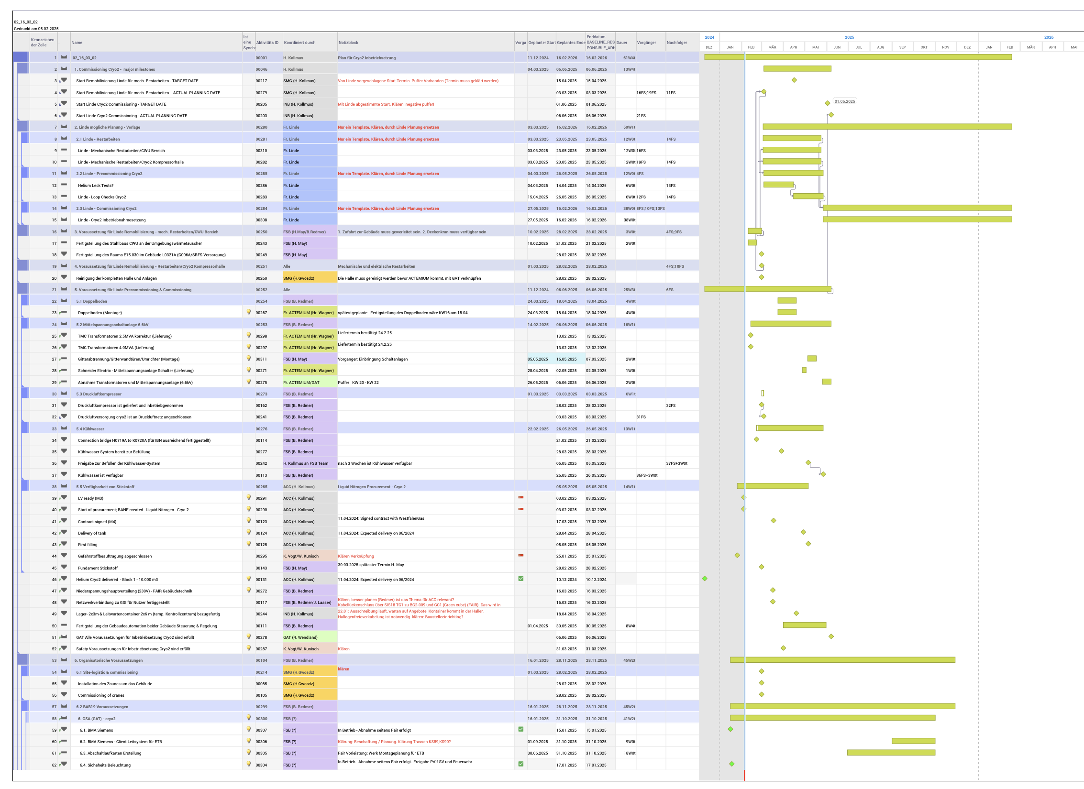
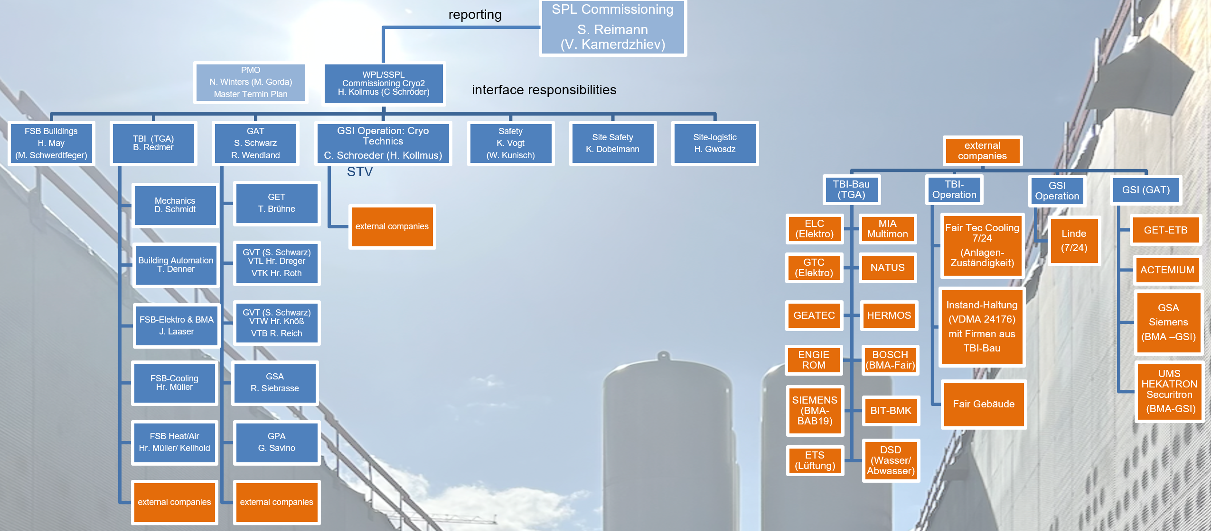
Substructure Example: Cryogenic Systems
Cryo2 Commissioning - work package organization with external companies
Cryo2 work package organization has been developed (as pilot for all further commissioning activities e.g. HEBT & SFRS commissioning)
Strong support by Commissioning Subproject Lead
Organisation, processes and responsibilities including safety are clarified and documented
Detailed commissioning schedule of cryo system

Slide 7
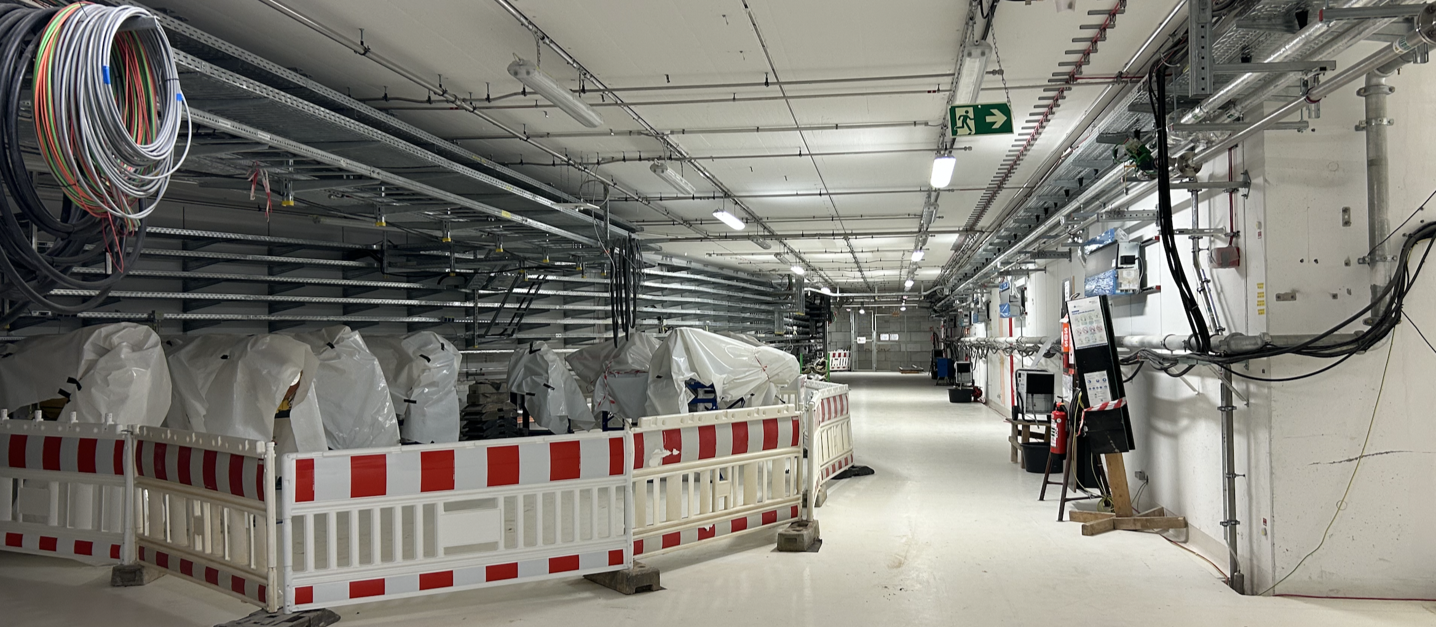
HEBT Commissioning Organisation
reporting
SPL Commissioning
S. Reimann (V. Kamerdzhiev)
FSB
H. May?
(M. Schwerdtfeger)
HEBT-Arbeitspakete (Inbetriebnahme-ansprechpartner)
conventional & rad. Safety
WPL/SSPL Commissioning HEBT F. Hagenbuck (...)
Site Safety
K. Dobelmann (D. Benz, W. Klor)
TBI J. Uhrich
(B. Redmer)
FSB-Elektro & BMA
J. Laaser
Mechanik D. Schmidt
Gebäudeautomation T. Denner
PMO
N. Winters (M. Gorda)
Master Termin Plan
GAT
S. Schwarz
(R. Wendland)
GET
T. Brühne
GVT (S. Schwarz) VTW Hr. Knöß
VTB R. Reich
GSA
R. Siebrasse
EPS
N.N.
FSB-Kühlung/ Kälte Hr. Müller
GPA
G. Savino
FSB Heizung/Lüftung
Hr. Müller/ Keilhold
GVT (S. Schwarz) VTL Hr. Dreger
VTK Hr. Roth
Fremdfirmen
Fremdfirmen
Site-logistic
H. Gwosdz ? (F. Veenstra)
NCM
N.N.
BEA
N.N.
VAC
A. Krämer
ACO
R. Pfeil
Radiation Safety T. Radon
Safety
K. Vogt
(W. Kunisch)
SYS
N.N.
SI N.N.
interface responsibilities
Fremdfirmen (Montage & Berieb)
GSI Betrieb
TBI-Bau (TGA)
ELC/ELC (Elektro)
GEATEC
NATUS
GSI (FAM/GAT)
UMS HEKATRON Securitron
(BMA-GSI)
Jäger ECIL (E-Technik)
ROM (FTC)
BOSCH (BMA-Fair)
BOSCH (BMA)
TBI-Betrieb
Fair
(Anlagen-Zuständigkeiten: Liste aus PB)
GET-ETB
BIT-BMK
DSD (Druckluft)
ETS (Lüftung)
Wartung
(VDMA 24176)
mit Firmen aus
TBI-Bau
GSA
Siemens
(BMA –GSI)
HERMOS
PZM
SESKA
Fair Gebäude (bis BAB20)
EAB
Sigma3D Vermessung
TPI Vermessung
Zutrittsberechtigungen G0702A/ G0704A über GSI Betrieb (I. Tsiokanos/ J. Stadlmann, C. Kleffner)
Betreiber- / Anlagenverantwortung FAIR/GAT
Instandhaltung & Wartungen

Slide 8
Commissioning Gate Reviews
Determination of: mechanical completion, safety readiness for commissioning activities and commissioning readiness
Goals: handover to commissioning & release of commissioning permit
Test-case: Cryo2
1. Pre-comm. & Local HW
3. Integration
M103-s
M103
M104-s
2. remote & single system
M104
3.1 Integration (multi system)
first and only gate review
for cryo plant
M11
M12
M12-s
3.2 Integration (Dry Runs)
M105
4. Pilot beam comm.
M12-A

Slide 9
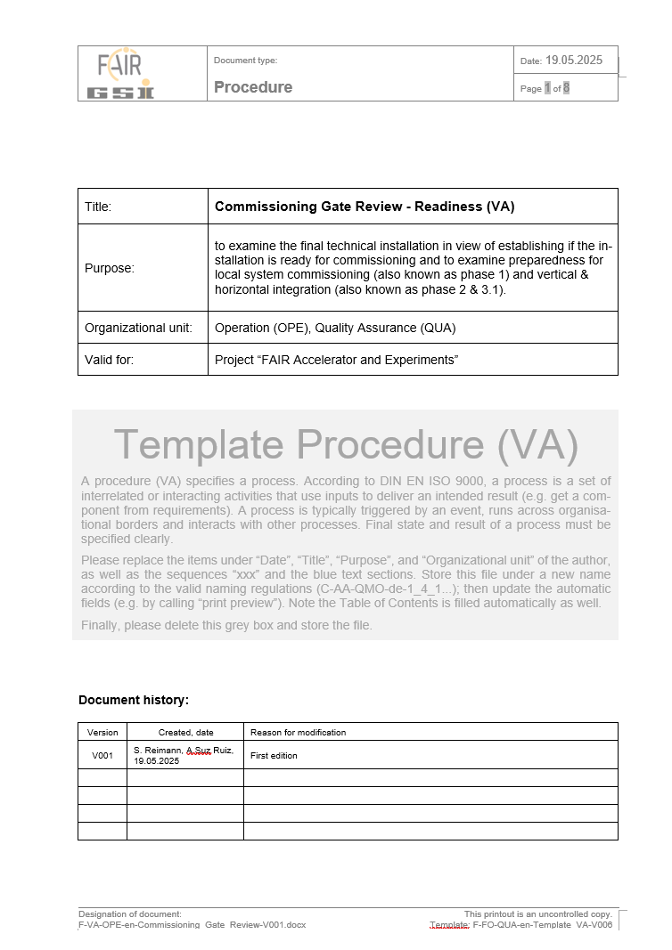
Preparation of Gate Reviews for phase transitions concept under development
goal is to ensure a safe and orderly transition from installation to commissioning while minimizing the additional effort for the WPLs
key Points:
declaration of Mechanical Completion (incl. NCRs)
confirmation of proper commissioning of TBI / media
commissioning procedures
all GBU(s) for commissioning
checklist of test steps (well chosen level of detail)
appointment of all necessary responsible persons
...
procedure & checklist
first tests:
Cryo and HEBT (T1S1)

Slide 10
Abbreviations - for your convenience ☺
ACC Accelerator
Cryo2 Cryo plant, cryo compressors and He-storage
STV Safety responsible person (room based, working permits, access control)
PLM Product lifecycle management (used for accelerator components)
PDB Plan database (used for technical building infrastructure FAIR)
SiGeKo Safety and health coordinator (on FAIR site)
HSE Health, safety, environment – management (on FAIR site)
SMG Subproject: site management
HBO Site manager according to Hessian building regulations
FCM Subproject: FAIR commissioning management
GAT Department: Buildings and systems engineering (in GSI organization)
TBI Technical building infrastructure
K0720A Building number for cryo-hall, compressor-hall and He-storage
H0719A Building number for Main supply building
BAB20 Final HBO release

Slide 11
Main requests for Commissioning Gate Review
CGR1 Order letter (STVs, system owners, ...)
CGR2 Availability of safety instructions for all areas
CGR3 Confirmation of an adequate access control
CGR4 Declaration of operational readiness of media supply
CGR5 Documentation of installations and systems (in PLM or PDB)
CGR6 Handover document for safety responsibility per area
CGR7 Release by fire department (if needed)
CGR8 Protocol of the site inspection
requested from Commissioning Manager
requested from HSE, HBO, SiGeKo for recommendation for commissioning permit
requested from SMG for transition of area responsibility

Slide 12
Main requests from SMG & HSE (HBO, SiGeKo)
P1A List of responsible persons and organizational chart
P1B Lists of affected areas and items
P1C Plan of the area with room identifiers
P1D Commissioning procedures
P1E Hazard assessments (GBUs)
P1F Flow diagrams with system boundaries
P1G Circuit diagram with system boundaries
P1H Material safety data sheets for all media
P1I Reporting chain
P1K MCC Installation confirmations for the electrical area
P1L MCC Assembly confirmations for the machinery and equipment sector
P1M MCC Assembly confirmations for pipes and containers
requested from Commissioning Manager
requested from HSE, HBO, SiGeKo for recommendation for commissioning permit
requested from SMG for transition of area responsibility

Slide 13
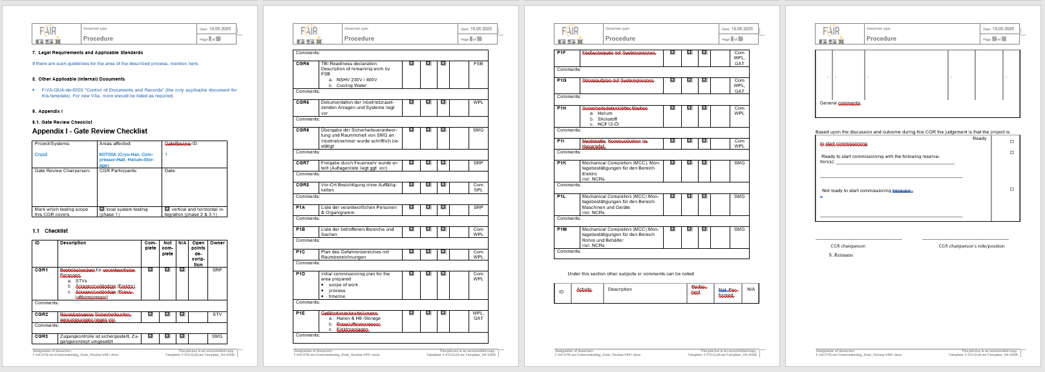
Commissioning Gate Review Approval & Checklist

Slide 14
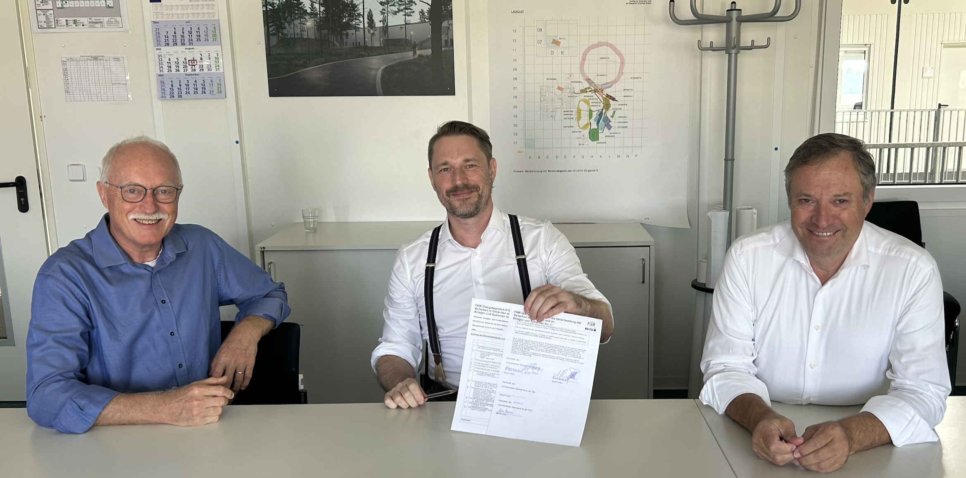
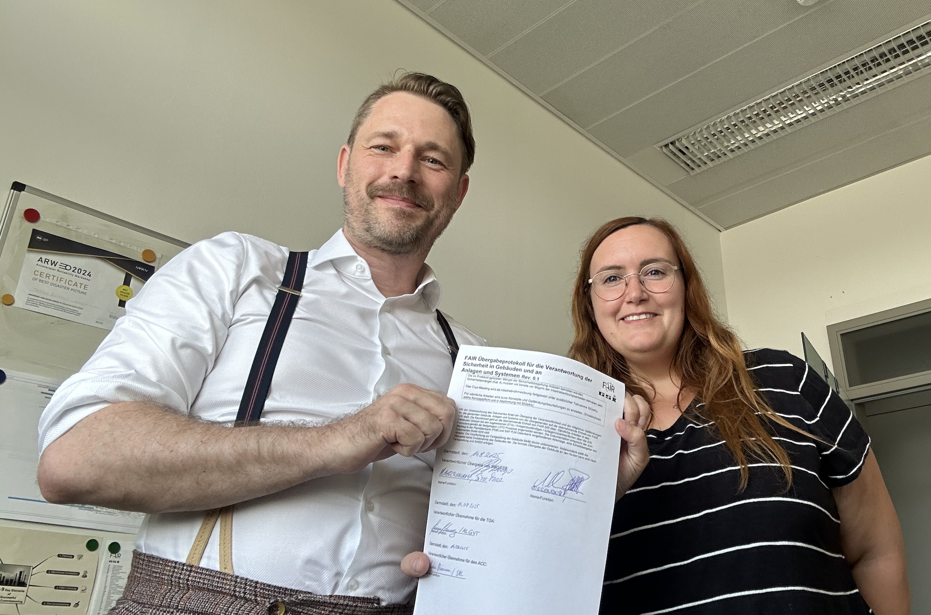
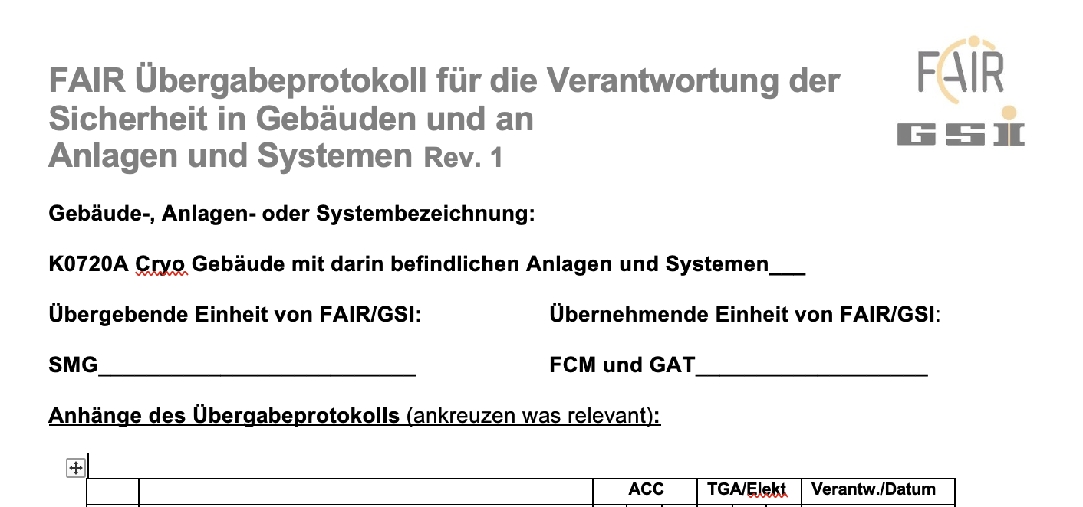
Handover of K0720A to the Commissioning Team
The handover from the installation team/SMG to the commissioning teams - for Accelerator- and Building Infrastructure - has been formally completed.
As of now, the safety organization (STV, AVs, SiFa) for K0720A is in effect for the commissioning phase.

Slide 15
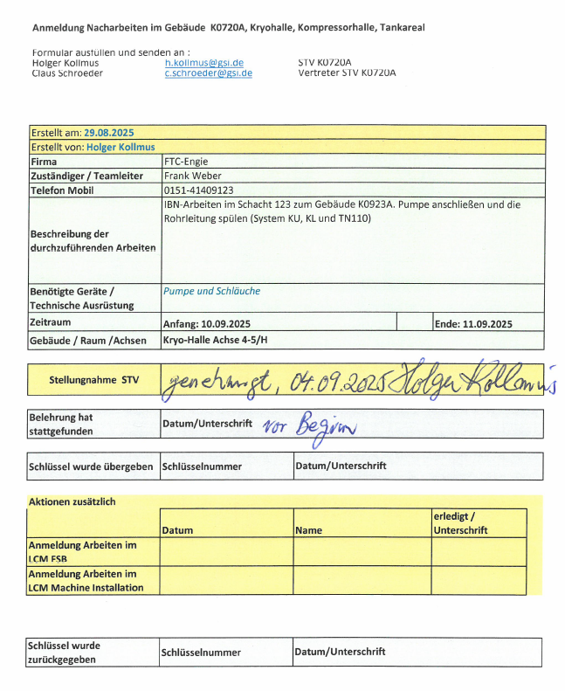
Work Permits for Areas under Commissioning Responsibility
Work requests are to be submitted to the STV
Only persons who have received safety instruction are permitted to carry out work
Access control is the responsibility of the STV
Keys can be temporarily handed out to instructed personnel upon signature

Slide 16
Summary
Requirements for SIS100 commissioning
Commissioning organization for SIS100
joint work of SIS100 & FCMS, a few iterations probably needed
Commissioning plan (with similar level of detail as the current HEBT plan)
Gate Review 1 month prior to commissioning start
Lessons learned
During first commissioning phase the area may still be a construction site
Requirements from DEKRA, HSE, HBO Bauleiter are to be fulfilled
Time consuming processes
Appoint persons responsible for systems (Anlagenzuständige)
Appoint STV, a lot of details
Risk assessment documents (GBU), not only for single systems but also for commissioning of many systems together (Commissioning GBU)
Access concept (Schlißkonzept) for areas under commissioning
Need a kickoff meeting for SIS100 commissioning soon

Slide 17
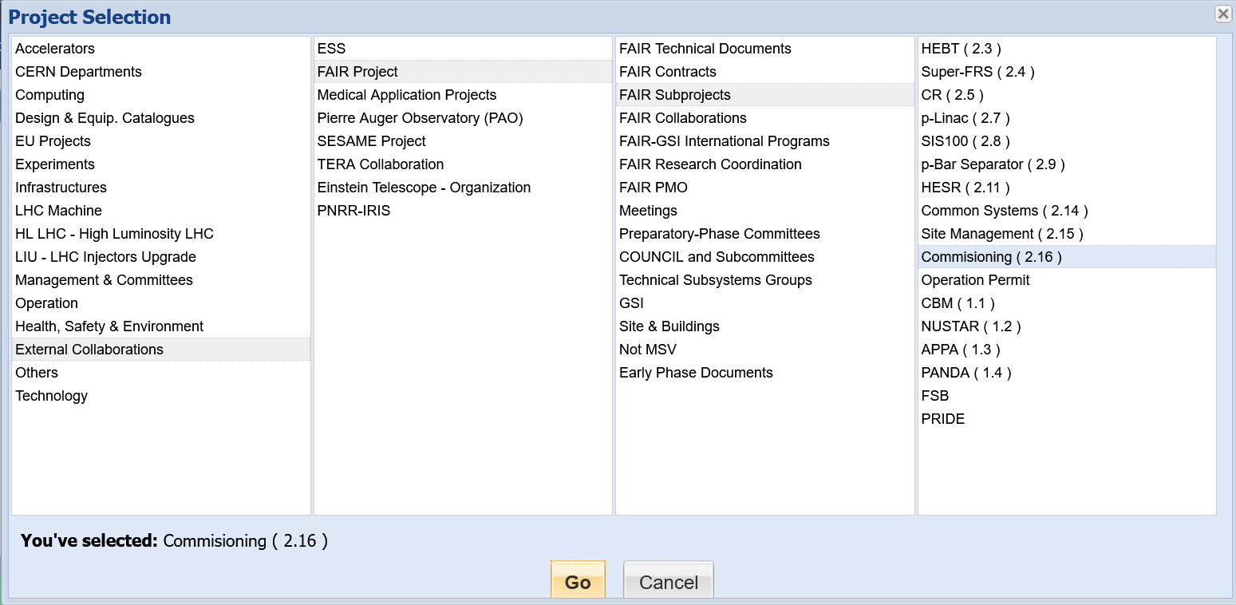
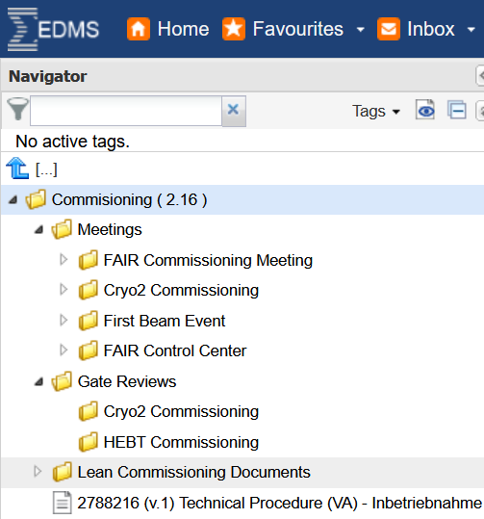
EDMS

