Slide 1
SIS100 Klausurtagung Status of SIS100 RF Systems
22.-24.09.2025
RRF Department
U. Laier

Slide 2
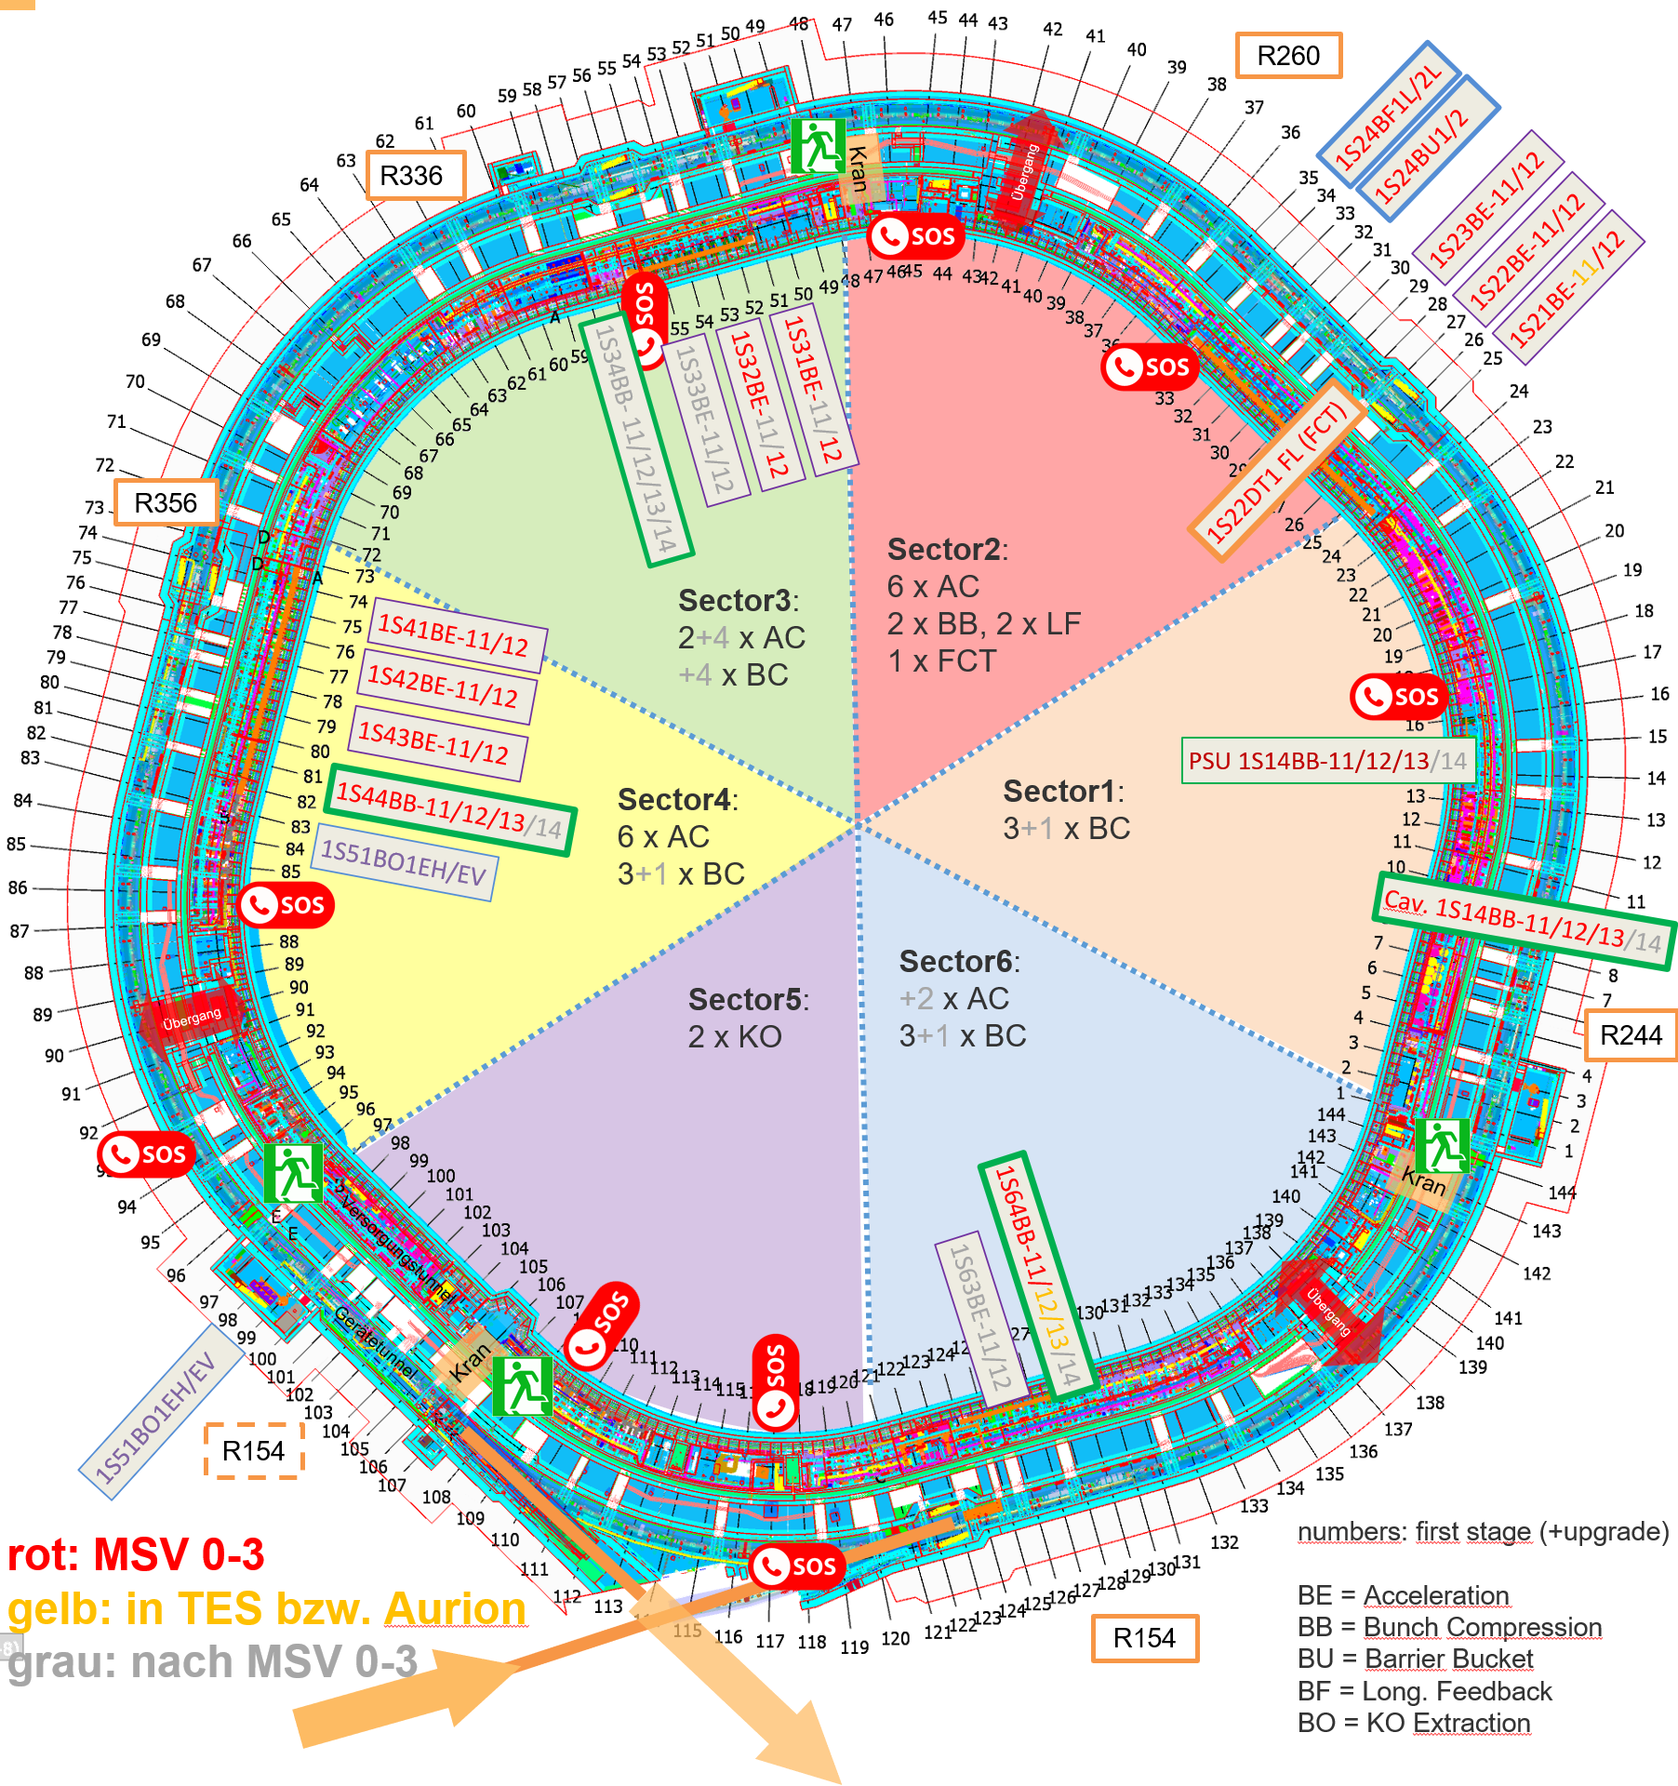
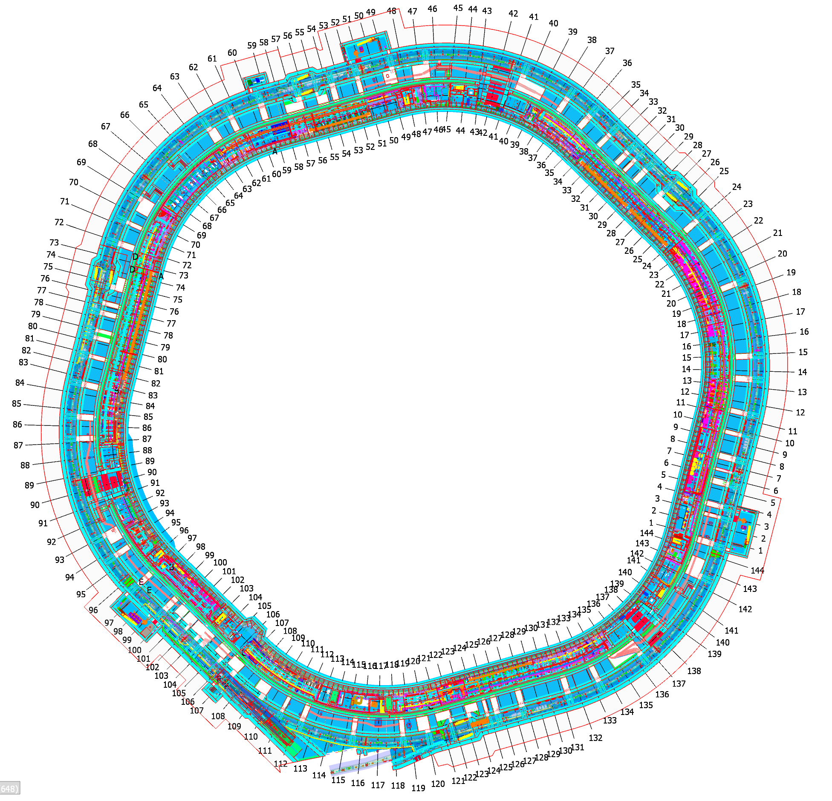


Overview of the RF Systems in SIS100
SIS100 Acceleration System: 14 stations in S2, S3, S4
SIS100 Bunch Compression System: 9 stations in S1, S4, S6
SIS100 Barrier Bucket System: 2 stations in S2
SIS100 Longitudinal Feedback System: 2 stations in S2
SIS100 KO System: 2 exciters in S5
R260
1S24BF1L/2L
R336
Kran
Übergang
1S24BU1/2
1S23BE-11/12
1S22BE-11/12
1S21BE-11/12
1S31BE-11/12
1S32BE-11/12
1S33BE-11/12
R356
1S34BB- 11/12/13/14
1S22DT1 FL (FCT)
Sector3:
2+4 x AC
+4 x BC
Sector2:
6 x AC
2 x BB, 2 x LF
1 x FCT
1S41BE-11/12
1S42BE-11/12
1S43BE-11/12
Sector4:
6 x AC
3+1 x BC
Sector1:
3+1 x BC
PSU 1S14BB-11/12/13/14
1S44BB-11/12/13/14
1S51BO1EH/EV
Cav. 1S14BB-11/12/13/14
Übergang
Sector5:
2 x KO
Sector6:
+2 x AC
3+1 x BC
R244
Kran
Versorgungstunnel
1S64BB-11/12/13/14
Übergang
Gerätetunnel
1S63BE-11/12
1S51BO1EH/EV
Kran
R154
R154
numbers: first stage (+ upgrade)
BE = Acceleration
BB = Bunch Compression
BU = Barrier Bucket
BF = Long. Feedback
BO = KO Extraction
rot: MSV 0-3 gelb: in TES oder bei Aurion
grau: nach MSV 0-3

Slide 3
Main Components
Each RF station consists of several subcomponents:
Cavity
Power amplifier
Electronics in the niches (talk by D. Lens)
Power supply unit
Sequence and interlock control incl. interfacing to main control
Driver amplifier
Local LLRF electronics incl. interfacing to main control (talk by D. Lens)
Synchronization LLRF electronics incl. interfacing to main control (talk by D. Lens)
Cabling within one and between different locations
Media supply required: electrical power, deionized cooling water, closed air cooling
blue: located in accel. tunnel, green: located in supply tunnel

Slide 4
SIS100 Acceleration System Status (Power Equipment)
14/14 main components (cavities, power amplifiers, power supply units) manufactured
14/14 main components have passed SAT Ab and are ready for installation
7/13 cavities transported to SIS100 (S3 and S4)
7/13 power amplifiers transported to SIS100 (S3 and S4)
13/13 power supply units transported to SIS100 (S2, S3 and S4)
Installation work concerning cavities, power amplifiers and power supply units is ongoing
One SIS100 ACC system (1S21BE11) will remain in test environment until end of commissioning with beam to support commissioning of the stations in SIS100

Slide 5
SIS100 Bunch Compression System Status (Power Equipment) I
9/9 cavities manufactured
9/9 power amplifiers manufactured
9/9 power supply units manufactured
6/9 cavities have passed SAT Ab and are ready for installation
6/9 power amplifiers have passed SAT Ab and are ready for installation
9/9 power supply units are manufactured and have passed SAT Ab and are ready for installation (one required for acceptance testing of cavities/amplifiers)

Slide 6
SIS100 Bunch Compression System Status (Power Equipment) II
3/8 cavities have been transported to SIS100 (S4)
3/8 power amplifiers have been transported to SIS100 (S4)
7/8 power supply units have been transported to SIS100 (S1, S4 and S6)
Installation work concerning cavities, power amplifiers and power supply units has started
One SIS100 BC system (1S64BE12) will remain in test environment until end of commissioning with beam to support commissioning of the stations in SIS100

Slide 7
SIS100 Barrier Bucket and Longitudinal Feedback System Status (Power Equipment)
The power parts of both systems will be identical
Conceptional design available
System is in the technical design phase
Substantial research has been done by GSI and TUD especially to improve the overall bandwidth of the system
Technical Concept document in preparation
MA cores for FoS available
Procurement of broadband semiconductor amplifiers for FoS will start in 2025
Creation of manufacturing drawings (ext. company) cavity and power amplifier will start beginning of 2026
FoS is planned to be ready for testing beginning of 2028

Slide 8
SIS100 KO System Status (Power Equipment)
Conceptual design available
The system is in the technical concept phase
Main components are currently evaluated within a test bench
Technical concept document in preparation
Procurement of first components (semiconductor amplifiers and transformer ring cores) will start in 2026
Creation of manufacturing drawings including manufacturing of parts of the kicker tanks will start beginning 2026 (ext. company).
Manufacturing of tanks will start end of 2026
FoS will be ready for testing end of 2028

Slide 9
Installation of RF Systems in SIS100 I
Specified prerequisites (F-AA-RRF-0004) by RRF department
All works that may create dust, dirt or other contamination is finalized (no drilling, no grinding)
Requirements to both tunnels (e.g. floor, walls, temperature and humidity stabilization, …) have to be met
Tunnel has been cleared from debris, building tools and cleaned
Building is accessible by truck and by foot (roads are paved)
Lights and sockets are installed and working
Personnel safety is ensured (fire protection system working, evacuation routes are cleared, etc…)
Access to tunnel is restricted (in order to prevent damage and theft)
Grounding connections („Erdungsfestpunkte“) are installed and connected
Cable trays are installed and all infrastructure cables have to be installed and terminated (according to cable data base)
some cables must have specified delay (constant length)
Transport routes have to be ensured and transport equipment have to be available (accelerator and supply tunnel)
Media supply (air, water) is installed

Slide 10
Installation of RF Systems in SIS100 II
Installation of RF stations, main topics:
Transport of subcomponents
Positioning of subcomponents
Installation of missing parts inside subcomponents
Establishing of connections within subcomponents
Connecting all subcomponents together
Establishing external connections (vacuum, power, cooling water, air)
Installation is followed by commissioning of subcomponents and then commissioning without beam
All required installation documents for SIS100 ACC and BC (cavity, power amplifier, power supply units and LLRF components) are available.
Some modifications of cavities, power amplifiers and power supply units are required in the SIS100. Will be done by RRF department or external company (Aurion).
Installation of SIS100 BC power supply units will be done by external company (OCEM). Ongoing tendering. Work is planned to start beginning of 2026.

Slide 11
Installation of RF Systems in SIS100 III
RF installation work will be done by three groups of people
RRF department
Other GSI/FAIR departments
External companies hired by RRF department
Complete list of installation work available and coordinated with other departments
Required budget (installation equipment, ext. companies) and RRF resources (people) for installation are in Planisware (2.15.01.01.08)

Slide 12
Installation of RF Systems in SIS100 IV
Current issues / proposals
Dust creating work in SIS100 will create particles on HV carrying surfaces inside RF stations -> possible sparkovers (potential damage)
Sinking of SIS100 floor has partially exceeded the vertical adjustment range of the cavities/power amplifiers. Adjustment range extenders for SIS100 ACC have been developed and tested. Leads to harder installation and future maintenance work.
Extensive delay regarding start of commissioning has already put some RF components significantly above the recommended storage times. Conditioning required (equipment included in ‘Keep Alive List’).
Easier access to elevator required

Slide 13
Installation of RF Systems in SIS100 V
Current issues / proposals
All topics regarding cabling see talk by D. Lens
One fully functional SIS100 ACC and one SIS100 BC station in the SIS100 tunnel within near future would be very beneficial (test of commissioning procedures, conditioning of equipment, …) Therefore, it is required to have the mains power, air and water cooling and all cables for these two stations available

Slide 14
Summary
SIS100 ACC cavities and power amplifiers: 100% ready for installation, 54% on location
SIS100 BC cavities and power amplifiers: 67% are ready for installation, 38% on location
SIS100 ACC power supplies: 100% ready for installation, 100% on location
SIS100 BC power supplies: 100% ready for installation, 88% on location
Documentation for installation (SIS100 AC and SIS100 BC) available
Installation work ongoing
Status of RRF cabling and Integrated RRF time schedule (installation + commissioning) given in talk by D. Lens

