Slide 1
SIS100 Workshop
Installation Plan Dipole and quadrupole
22.09.2025 – Hans Jürgen Löcker

Slide 2
AGENDA
01
Content
02
Status Quo Installation (Status 2024)
03
Status Quo delivery dates Quadru-Poles
04
Installation Plan Quadru-Poles (Status 09.2025)
05
Open Issues / to clarify
06
Next Steps

Slide 3
SIS100 Workshop – Installation Plan Dipole and quadrupole
Content
Installation Plan of Dipoles and Quadrupoles in SIS100
Delivery Dates of Quadru-Poles M10-P (Status 09.2025)
Start of Installation of Quadru-Poles
Installation of Quadru-Poles
Further installation dates (beyond the Qadru-Poles) are not content of the today´s presentation. (will be presented on 23rd September 2025)

Slide 4
AGENDA
01
Content
02
Status Quo Installation (Status 2024)
03
Status Quo delivery dates Quadru-Poles
04
Installation Plan Quadru-Poles (Status 09.2025)
05
Open Issues / to clarify
06
Next Steps

Slide 5
SIS100 Workshop – Installation Plan Dipole and quadrupole
Takt gem. Abstimmungen
LCM erstellt
Installationsbeginn Bogen 2 in KW39
Nach Kabelzugarbeiten
Tests und Mechanical 2 nach Quadru-Pole
Takt gem. Abtimmung
Status Quo Installation (Stand 2024)
DiPole
Tests und
Mechanical 2
Mechanical Completion
Bogen
Quadru-Pole
Mechanical Completion
nach Fertigstellung aller Leistungen
In diesem Fall abhängig von Quadru-Polen in den Geraden
Beginn nach Vermessung und Nachjustierung
Typenweise Installation
Takt gem. Abstimmungen
Gerade
ByPass
Cryo Nischen
straight section (warm connections)
Fortsetzung Quadru-Pole Geraden
Typenweise Installation
Takt abhängig von Lieferterminen
Quadru-Pole
Quadru- Pole
Beginn nach Quadru-Pole Bogen Typenweise Installation
Takt gem. Abstimmungen

Slide 6
AGENDA
01
Content
02
Status Quo Installation (Status 2024)
03
Status Quo delivery dates Quadru-Poles
04
Installation Plan Quadru-Poles (Status 09.2025)
05
Open Issues / to clarify
06
Next Steps

Slide 7
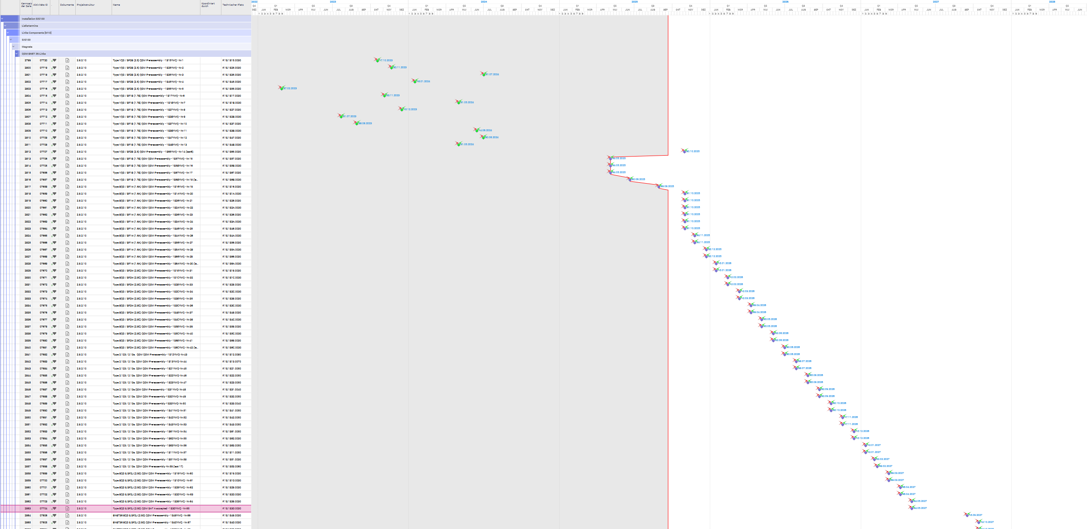
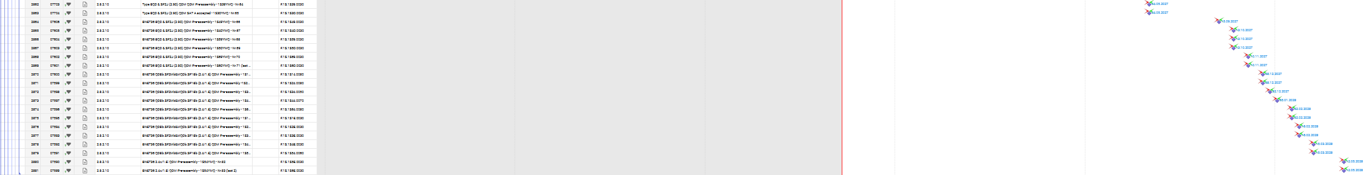
SIS100 Workshop – Installation Plan Dipole and quadrupole
Status Quo delivery dates Quadru-Poles (delivery milestones M10-P in Planisware)
Basics / Boundary Conditions
BNET36 is basis for definition of delivery milestones M10-P
Technische Plätze (technical places) - information is assigned to each module in the installation plan
3 weeks of non-working time at the turn of the year seam not to be included in the pre-assembly plan (to be claryfied)

Slide 8
SIS100 Workshop – Installation Plan Dipole and quadrupole
Status Quo delivery dates Quadru-Poles (sequence according to delivery milestones M10-P)
2025
2026
2027
2028
Q4
Q1
Q2
Q3
Q4
Q1
Q2
Q3
Q4
Q1
Q2
Q3
Q4
Activity
Month
10
11
12
1
2
3
4
5
6
7
8
9
10
11
12
1
2
3
4
5
6
7
8
9
10
11
12
1
2
3
4
5
6
7
8
9
10
11
12
Responsible
Type 2.5 B1-B6
Curve
Type 1.7B B1-B6
Curve
Type 1.6A B1-B6
Curve
Type 2.8C B1-B6
Curve
Type 2.123 S2
Straight
Type 2.123 S3
Straight
Type 2.123 S4
Straight
Type 2.123 S6
Straight
Type 2.123 S1
Straight
Type 2.123 S5
Straight
Type 2.9 B1-B6
Straight / Curve
Type 1.E / 2.4 S1-S6
Straight / Curve

Slide 9
AGENDA
01
Content
02
Status Quo Installation (Status 2024)
03
Status Quo delivery dates Quadru-Poles
04
Installation Plan Quadru-Poles (Status 09.2025)
05
Open Issues / to clarify
06
Next Steps

Slide 10
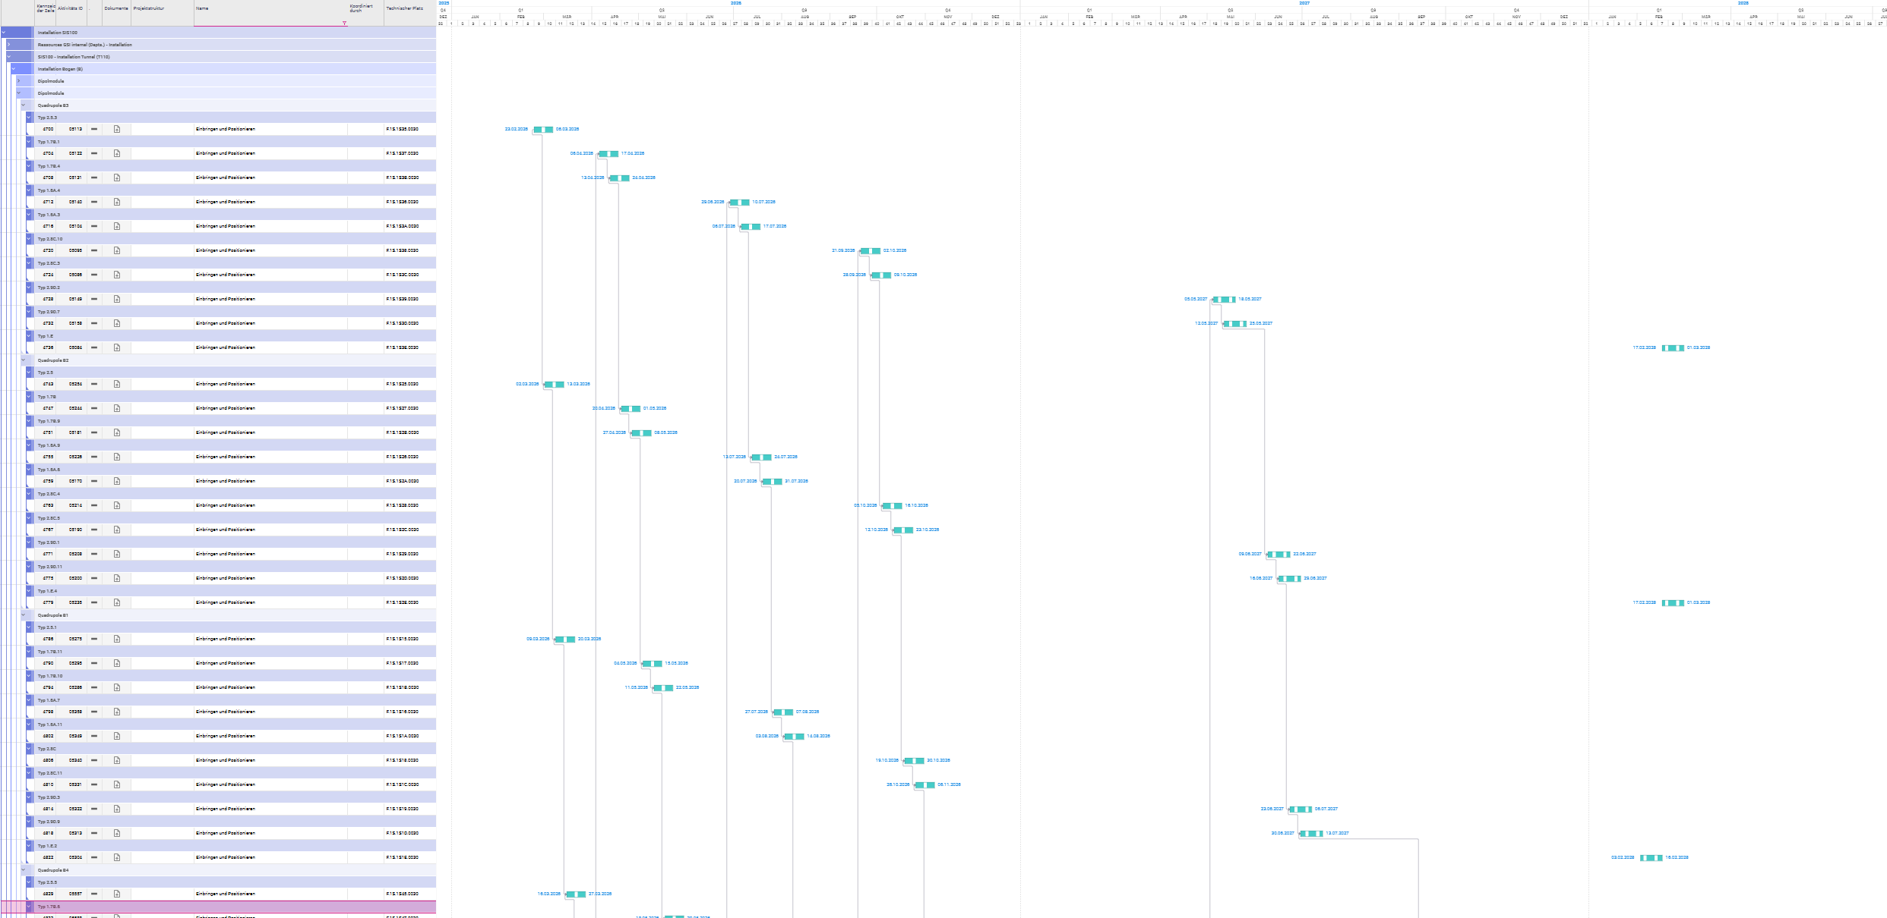
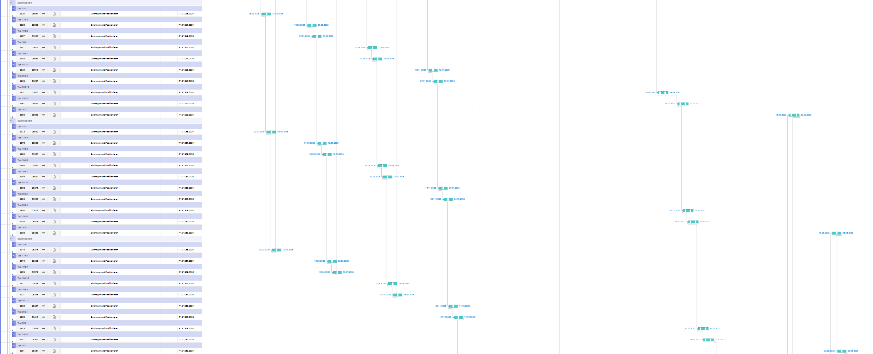
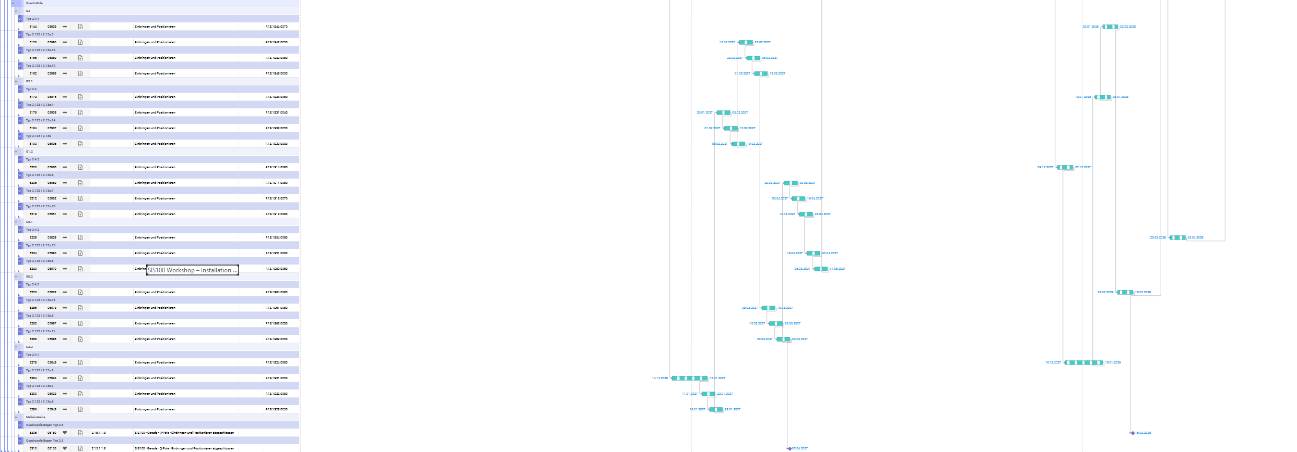
SIS100 Workshop – Installation Plan Dipole and quadrupole
Installation Plan Quadru-Poles (Status 09.2025)
Start of Quadru-Pole installation
02.2026 Start of installation Quadru-Poles
according to installation plan Status 2024
Basics / Boundary Conditions
3 weeks of non-working time at the turn of the year is included in the installation plan (manually due to missing calender with 3 weeks off)
Technische Plätze (technical places) - information is assigned to each module in the installation plan
New Apporach of installation:
Order of delivery (M10-P) defines order of installation (Status 09.2025)

Slide 11
SIS100 Workshop – Installation Plan Dipole and quadrupole
Installation Plan Quadru-Poles (installation of quadru-pole modules)
2025
2026
2027
2028
Q3
Q4
Q1
Q2
Q3
Q4
Q1
Q2
Q3
Q4
Q1
Q2
Q3
Q4
Activity
Month
7
8
9
10
11
12
1
2
3
4
5
6
7
8
9
10
11
12
1
2
3
4
5
6
7
8
9
10
11
12
1
2
3
4
5
6
7
8
9
10
11
12
Responsible
Type 2.5 B1-B6
Curve
Type 1.7B B1-B6
Curve
Type 1.6A B1-B6
Curve
Type 2.8C B1-B6
Curve
Type 2.123 S2
Straight
Type 2.123 S3
Straight
Type 2.123 S4
Straight
Type 2.123 S6
Straight
Type 2.123 S1
Straight
Type 2.123 S5
Straight
Type 2.9 B1-B6
Straight / Curve
Type 1.E / 2.4 S1-S6
Straight / Curve
9/22/2025

Slide 12
SIS100 Workshop – Installation Plan Dipole and quadrupole
Installation Plan Quadru-Poles (Free buffer time: delivery milestones and installation dates)
2025
2026
2027
2028
Q3
Q4
Q1
Q2
Q3
Q4
Q1
Q2
Q3
Q4
Q1
Q2
Q3
Q4
Activity
Month
7
8
9
10
11
12
1
2
3
4
5
6
7
8
9
10
11
12
1
2
3
4
5
6
7
8
9
10
11
12
1
2
3
4
5
6
7
8
9
10
11
12
Responsible
Type 2.5 B1-B6
Curve
Type 1.7B B1-B6
Curve
Type 1.6A B1-B6
Curve
Type 2.8C B1-B6
Curve
Type 2.123 S2
Straight
Type 2.123 S3
Straight
Type 2.123 S4
Straight
Type 2.123 S6
Straight
Type 2.123 S1
Straight
Type 2.123 S5
Straight
Type 2.9 B1-B6
Straight / Curve
Type 1.E / 2.4 S1-S6
Straight / Curve
9/22/2025

Slide 13
AGENDA
01
Content
02
Status Quo Installation (Status 2024)
03
Status Quo delivery dates Quadru-Poles
04
Installation Plan Quadru-Poles (Status 09.2025)
05
Open Issues / to clarify
06
Next Steps

Slide 14
SIS100 Workshop – Installation Plan Dipole and quadrupole
Open issues / to clarify (Status delivery until today)
2025
2026
2027
2028
Q1
Q2
Q3
Q4
Q1
Q2
Q3
Q4
Q1
Q2
Q3
Q4
Q1
Q2
Q3
Q4
Activity
Month
1
2
3
4
5
6
7
8
9
10
11
12
1
2
3
4
5
6
7
8
9
10
11
12
1
2
3
4
5
6
7
8
9
10
11
12
1
2
3
4
5
6
7
8
9
10
11
12
Responsible
Type 2.5 B1-B6
Curve
Type 1.7B B1-B6
Some milestones for the delivery of the modules have been achieved but are not yet completed (according do the status in Planisware).
Recommendation:
Confirmation of the status of past delivery milestones.
Curve
Type 1.6A B1-B6
Curve
Type 2.8C B1-B6
Curve
Type 2.123 S2
Straight
Type 2.123 S3
Straight
Type 2.123 S4
Straight
Type 2.123 S6
Straight
Type 2.123 S1
Straight
Type 2.123 S5
Straight
Type 2.9 B1-B6
Straight / Curve
Type 1.E / 2.4 S1-S6
Straight / Curve
9/22/2025

Slide 15
SIS100 Workshop – Installation Plan Dipole and quadrupole
Open issues / to clarify (non-working time at the turn of the year)
2025
2026
2027
2028
Q3
Q4
Q1
Q2
Q3
Q4
Q1
Q2
Q3
Q4
Q1
Q2
Q3
Q4
Activity
Month
7
8
9
10
11
12
1
2
3
4
5
6
7
8
9
10
11
12
1
2
3
4
5
6
7
8
9
10
11
12
1
2
3
4
5
6
7
8
9
10
11
12
Responsible
Type 2.5 B1-B6
Curve
Type 1.7B B1-B6
Recommendation:
Add 3 weeks of non-working time at the turn of the year in pre-assembly (A10-P) and the M10-P Milestones for the quadru-poles.
All following M10-P Milestones are affected by that.
Curve
Type 1.6A B1-B6
Curve
Type 2.8C B1-B6
Curve
Type 2.123 S2
Straight
Type 2.123 S3
Straight
Type 2.123 S4
Straight
Type 2.123 S6
Straight
Type 2.123 S1
Straight
Type 2.123 S5
Straight
Type 2.9 B1-B6
Straight / Curve
Type 1.E / 2.4 S1-S6
Straight / Curve
9/22/2025

Slide 16
SIS100 Workshop – Installation Plan Dipole and quadrupole
Open issues / to clarify (Section 1 – Type 2.123)
2025
2026
2027
2028
Q3
Q4
Q1
Q2
Q3
Q4
Q1
Q2
Q3
Q4
Q1
Q2
Q3
Q4
Activity
Month
7
8
9
10
11
12
1
2
3
4
5
6
7
8
9
10
11
12
1
2
3
4
5
6
7
8
9
10
11
12
1
2
3
4
5
6
7
8
9
10
11
12
Responsible
Type 2.5 B1-B6
Curve
Type 1.7B B1-B6
Delivery milestones vary considerably for Type 2.123 in Sector 1 (approx. 5 months).
Recommendation:
Clarification and confirmation of delivery dates for modules in all sectors.
Curve
Type 1.6A B1-B6
Curve
Type 2.8C B1-B6
Curve
Type 2.123 S2
Straight
Type 2.123 S3
Straight
Type 2.123 S4
Straight
Type 2.123 S6
Straight
Type 2.123 S1
Straight
Type 2.123 S5
Straight
Type 2.9 B1-B6
Straight / Curve
Type 1.E / 2.4 S1-S6
Straight / Curve
9/22/2025

Slide 17
SIS100 Workshop – Installation Plan Dipole and quadrupole
Open issues / to clarify (Section 5 – Type 2.123)
2025
2026
2027
2028
Q3
Q4
Q1
Q2
Q3
Q4
Q1
Q2
Q3
Q4
Q1
Q2
Q3
Q4
Activity
Month
7
8
9
10
11
12
1
2
3
4
5
6
7
8
9
10
11
12
1
2
3
4
5
6
7
8
9
10
11
12
1
2
3
4
5
6
7
8
9
10
11
12
Responsible
Type 2.5 B1-B6
Curve
Type 1.7B B1-B6
Just 2 M10-P Milestones are defined for Sector 5.
Recommendation:
Clarify whether in fact only two quadru-pole modules (Type 2.123) will actually be installed in sector 5.
Curve
Type 1.6A B1-B6
Curve
Type 2.8C B1-B6
Curve
Type 2.123 S2
Straight
Type 2.123 S3
Straight
Type 2.123 S4
Straight
Type 2.123 S6
Straight
Type 2.123 S1
Straight
Type 2.123 S5
Straight
Type 2.9 B1-B6
Straight / Curve
Type 1.E / 2.4 S1-S6
Straight / Curve
9/22/2025

Slide 18
SIS100 Workshop – Installation Plan Dipole and quadrupole
Open issues / to clarify (Interruption delivery milestones)
2025
2026
2027
2028
Q3
Q4
Q1
Q2
Q3
Q4
Q1
Q2
Q3
Q4
Q1
Q2
Q3
Q4
Activity
Month
7
8
9
10
11
12
1
2
3
4
5
6
7
8
9
10
11
12
1
2
3
4
5
6
7
8
9
10
11
12
1
2
3
4
5
6
7
8
9
10
11
12
Responsible
Type 2.5 B1-B6
Curve
Type 1.7B B1-B6
There are conspicuous, incomprehensible time slots between individual delivery dates for the modules
Recommendation:
Clarification of delivery dates and interruptions for the modules.
Curve
Type 1.6A B1-B6
Curve
Type 2.8C B1-B6
Curve
Type 2.123 S2
Straight
Type 2.123 S3
Straight
Type 2.123 S4
Straight
Type 2.123 S6
Straight
Type 2.123 S1
Straight
Type 2.123 S5
Straight
Type 2.9 B1-B6
Straight / Curve
Type 1.E / 2.4 S1-S6
Straight / Curve
9/22/2025

Slide 19
SIS100 Workshop – Installation Plan Dipole and quadrupole
Open issues / to clarify (postponed delivery milestones of last modules)
2025
2026
2027
2028
Q3
Q4
Q1
Q2
Q3
Q4
Q1
Q2
Q3
Q4
Q1
Q2
Q3
Q4
Activity
Month
7
8
9
10
11
12
1
2
3
4
5
6
7
8
9
10
11
12
1
2
3
4
5
6
7
8
9
10
11
12
1
2
3
4
5
6
7
8
9
10
11
12
Responsible
Type 2.5 B1-B6
Curve
Type 1.7B B1-B6
The delivery dates for the final modules have been postponed compared to the installation plan (Status 2024). The installation dates will also be postponed accordingly.
The critical path for installation is defined by the delivery, installation and commissioning by the last modules.
Recommendation:
The delivery dates of the final modules must be checked and coordinated in detail with the suppliers.
Curve
Type 1.6A B1-B6
Curve
Type 2.8C B1-B6
Curve
Type 2.123 S2
Straight
Type 2.123 S3
Straight
Type 2.123 S4
Straight
Type 2.123 S6
Straight
Type 2.123 S1
Straight
Type 2.123 S5
Straight
Type 2.9 B1-B6
Straight / Curve
Type 1.E / 2.4 S1-S6
Straight / Curve
9/22/2025

Slide 20
AGENDA
01
Content
02
Status Quo Installation (Status 2024)
03
Status Quo delivery dates Quadru-Poles
04
Installation Plan Quadru-Poles (Status 09.2025)
05
Open Issues / to clarify
06
Next Steps

Slide 21
SIS100 Workshop – Installation Plan Dipole and quadrupole
Next Steps
Start / continuation of work preparation for the start of installation of the Quadru-Pole in February 2026.
Clarification of the topics highlighted in the previous slides.

