Slide 1
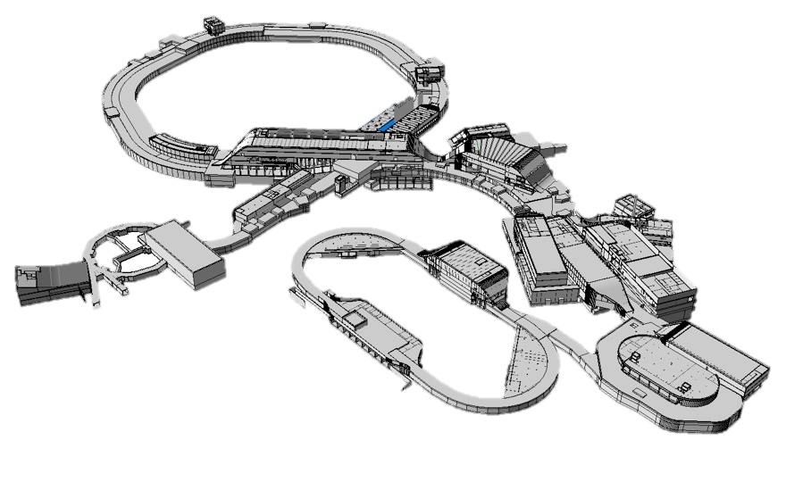
4rd SIS100 Workshop
Status of Rack Installation
Wednesday, September 24th, 2025
Mike Draisbach

Slide 2
Status of Rack Installation
Included in numbers presented:
Electronic Racks (VAC, CRY, SCM, BEA, PAS, RRF)
Power converter (EPS)
Power Supply Units (RRF)
Excluded:
Network racks (FSB)
CPS Sources (FSB)
Mini racks (BEA)
Detector racks (BEA)

Slide 3
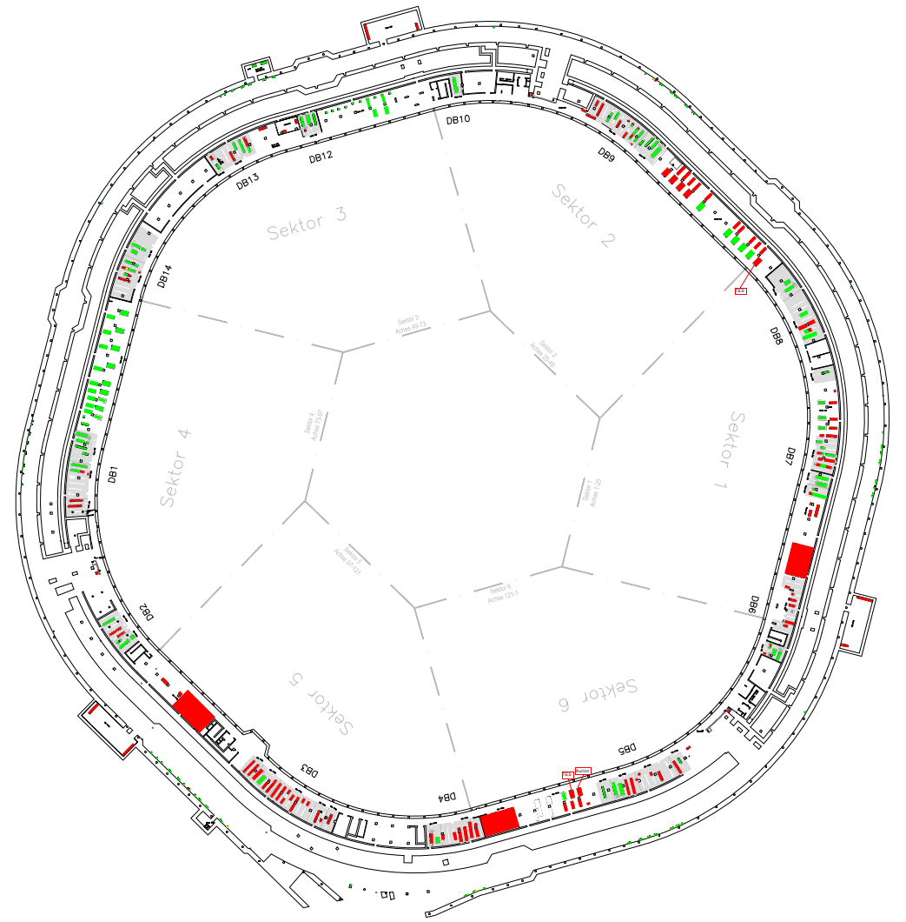
Status of Rack Installation
General Overview
73%
43%
 | Total | Installed | In progress
Sektor 1 | 123 | 65 | 4
Sektor 2 | 137 | 59 | 0
Sektor 3 | 116 | 84 | 0
Sektor 4 | 137 | 109 | 5
Sektor 5 | 140 | 21 | 16
Sektor 6 | 84 | 39 | 0
80%
51%
on position
53%
15%
44%

Slide 4
Status of Rack Installation
By Rack Type
Status Rackinstallation SIS100 | Electronic Racks | Power Converter | PSUs | Total
Total of racks to install: | 567 | 150 | 23 | 737
Already installed (racks on position): | 274 | 83 | 20 | 377
Installation scheduled: | 11 | 14 | 0 | 25
Remaining racks to install: | 282 | 53 | 3 | 335
Available for installation (warehouse): | 171 | 27 | 2 | 198
Not available (not delivered yet): | 111 | 26 | 1 | 137
51%
KW40
19%

Slide 5
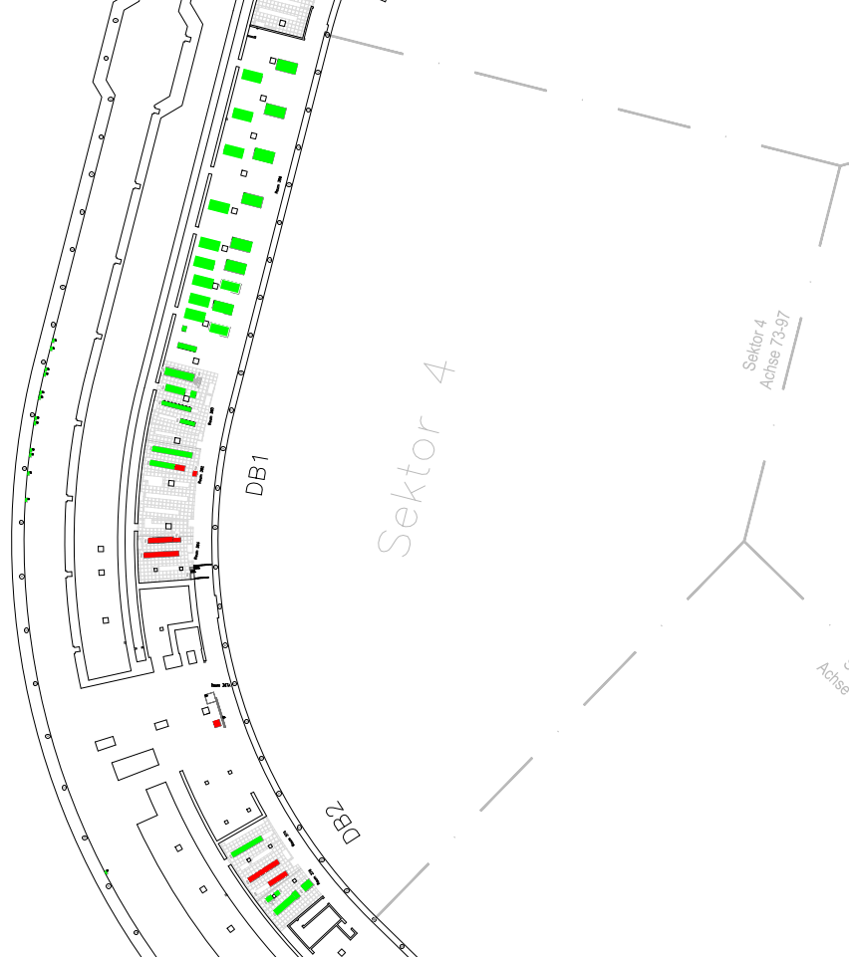
Status of Rack Installation
Sector 4
Total | Installed | In progress | Remaining | Unavailable
137 | 109 | 5 | 23 | 19
80%
Room | CRY | EPS | PAS | SCM | VAC | ∑
307A |  |  | 1 |  |  | 1
362 |  | 1 |  |  |  | 1
364 | 1 |  | 2 | 3 | 2 | 8
374 |  | 2 |  | 7 |  | 9

Slide 6
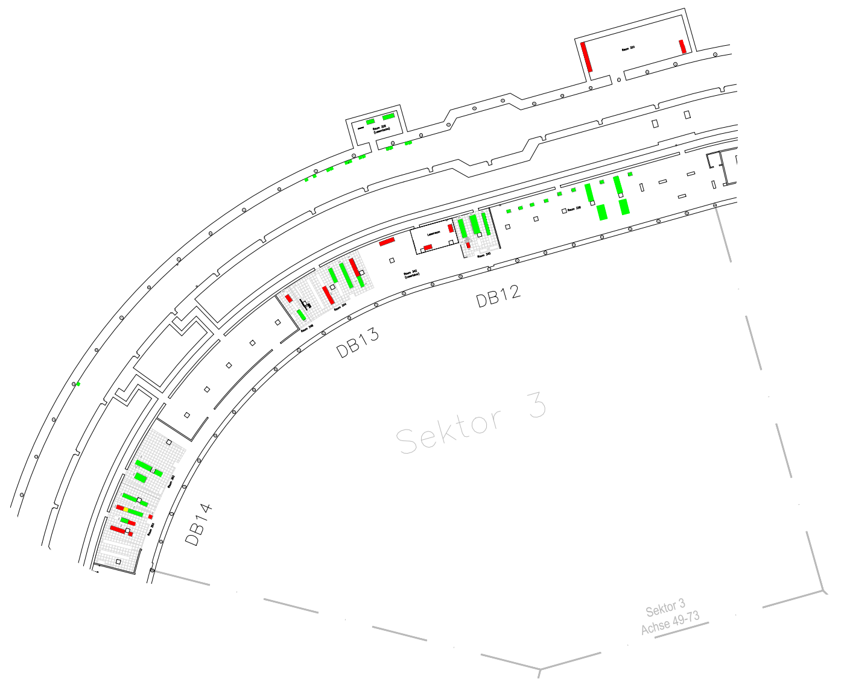
Status of Rack Installation
Sector 3
Total | Installed | In progress | Remaining | Unavailable
116 | 84 | 0 | 32 | 14
73%
Room | CRY | EPS | PAS | SCM | VAC | ∑
320 |  |  | 1 |  |  | 1
324 |  |  |  | 1 | 1 | 2
340 |  |  |  |  | 1 | 1
344 | 1 |  | 1 | 1 |  | 3
346 |  |  |  | 2 |  | 2
354 |  | 1 |  | 3 | 1 | 5

Slide 7
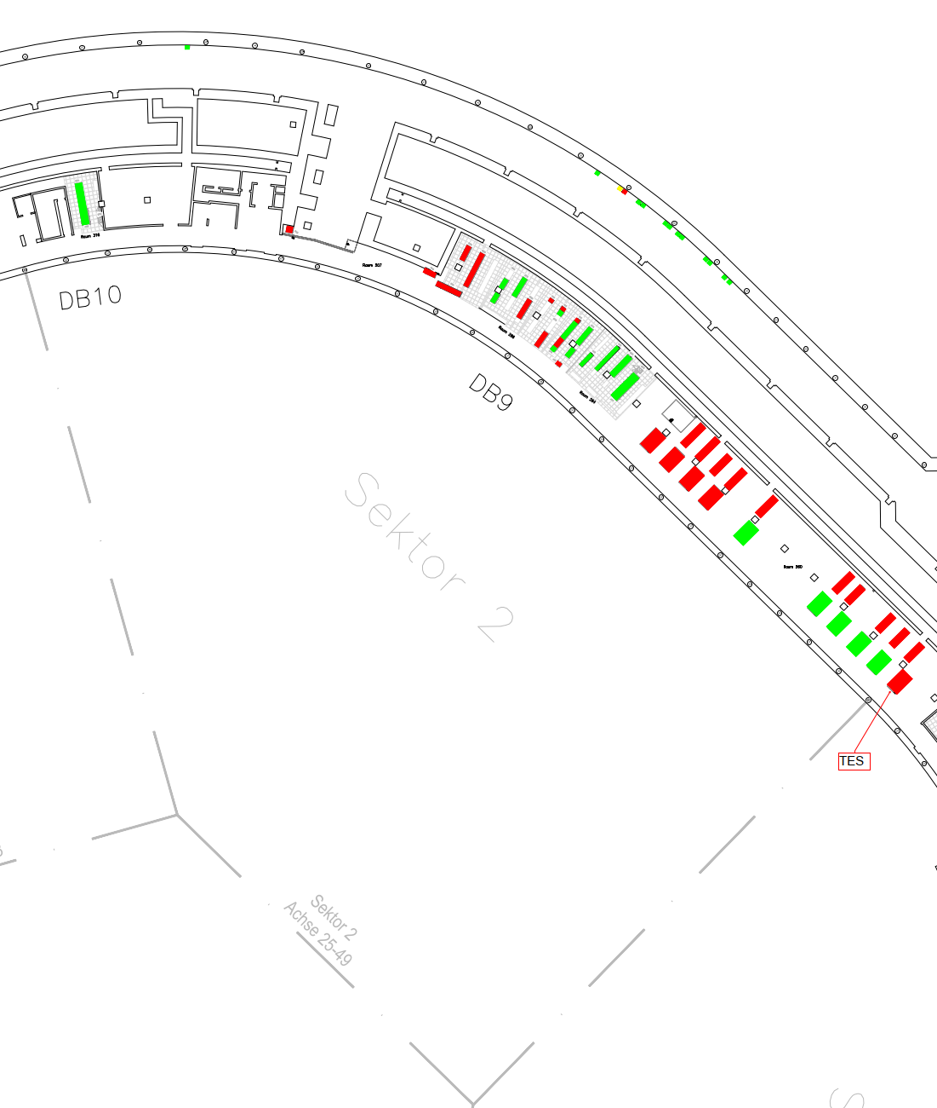
Status of Rack Installation
Sector 2
Total | Installed | In progress | Remaining | Unavailable
137 | 59 | 0 | 78 | 19
43%
Room | CRY | EPS | PAS | RRF | SCM | VAC | ∑
207 |  |  | 2 |  |  |  | 2
260 |  |  |  | 5 |  |  | 5
266 | 1 | 3 |  |  | 6 | 2 | 12

Slide 8
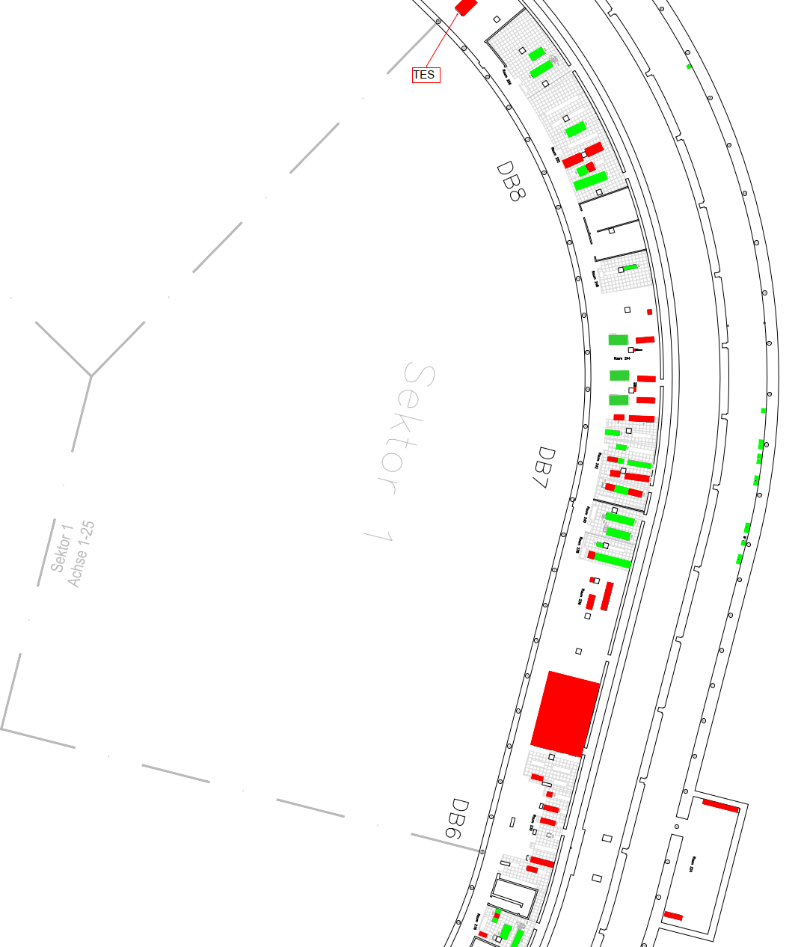
Status of Rack Installation
Sector 1
Total | Installed | In progress | Remaining | Unavailable
123 | 65 | 4 | 54 | 21
53%
Room | CRY | EPS | PAS | SCM | VAC | ∑
224 |  |  |  | 1 | 1 | 2
220 |  |  | 1 |  |  | 1
230 |  | 1 |  | 3 |  | 4
242 | 1 | 3 |  | 3 | 1 | 8
244 |  |  | 1 |  |  | 1
252 |  | 1 |  | 3 | 1 | 5

Slide 9
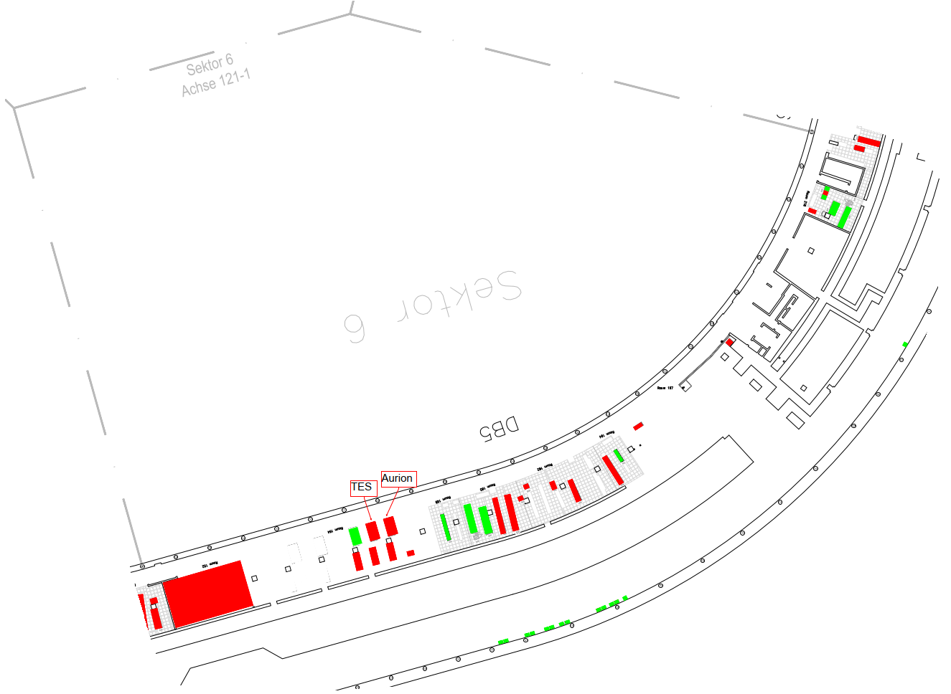
Status of Rack Installation
Sector 6
Total | Installed | In progress | Remaining | Unavailable
84 | 39 | 0 | 45 | 11
44%
Room | CRY | EPS | PAS | RRF | SCM | VAC | ∑
107 |  |  | 2 |  |  |  | 2
154 |  |  |  | 1 |  |  | 1
160 |  | 1 |  |  |  |  | 1
162 | 1 |  |  |  |  | 2 | 3
164 |  |  |  |  | 4 |  | 4

Slide 10
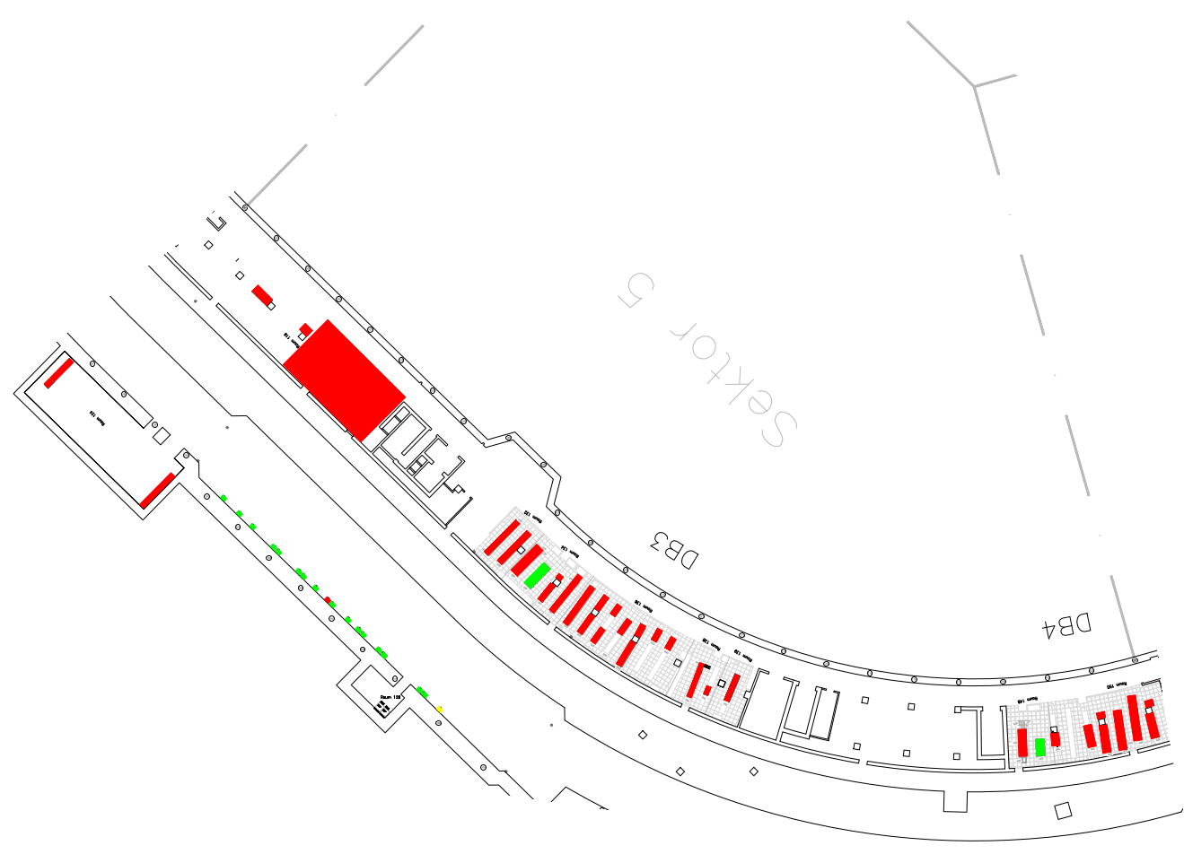
Status of Rack Installation
Sector 5
Total | Installed | In progress | Remaining | Unavailable
140 | 21 | 16 | 103 | 53
15%
Room | CRY | EPS | NCM | PAS | RHV | SCM | VAC | ∑
130 |  |  |  | 1 |  |  |  | 1
152 |  |  |  |  | 1 |  |  | 1
220 |  |  |  | 1 |  |  |  | 1
320 |  |  |  | 1 |  |  |  | 1
116 |  |  |  |  | 12 |  |  | 12
120 |  |  | 2 | 3 |  | 2 | 1 | 8
124 |  |  |  |  |  | 5 | 1 | 6
132 |  | 3 |  |  |  |  |  | 3
136 |  | 7 |  |  |  | 3 |  | 10
138 |  |  |  | 1 |  |  | 1 | 2
139 | 1 |  |  |  |  |  |  | 1
150 |  | 3 |  |  |  | 3 | 1 | 7

Slide 11
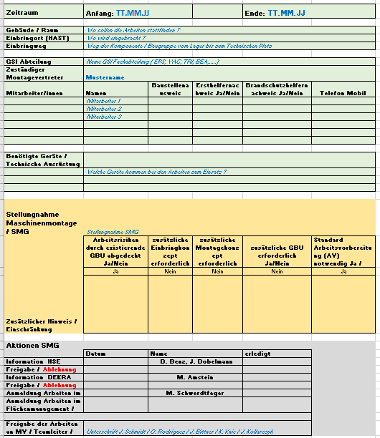
Status of Rack Installation
Next steps for rack owners towards hardware completion:
Prepare work instructions , test protocols, check lists, etc.
Support: Jan Erik Albrecht
Upload documents to EDMS for AV preparation
Support: Carrie Wessel & Justus Ühlein
File “Anmeldung Arbeiten Maschinenmontage” min. 1 week in advance
Support: Mike Draisbach (Supply Areas only) Template@ https://edms.cern.ch/document/3328283/2
If possible, don’t wait for the last cable and/or ideal room conditions.
Just get started ☺

Slide 12
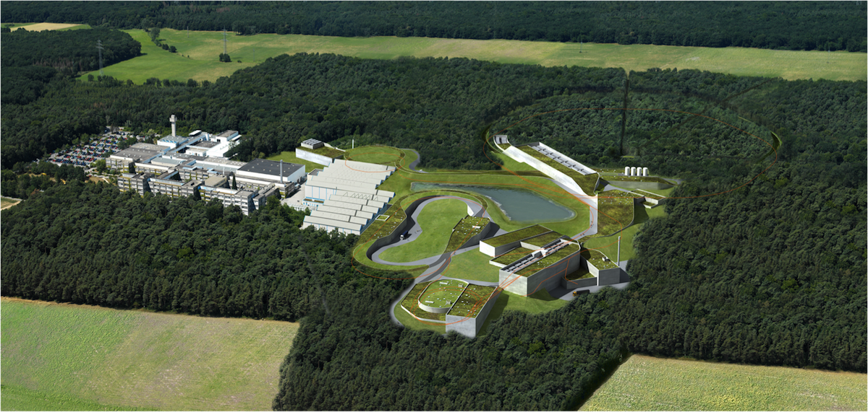


The FAIR Project
Thank you very much !

