Slide 1
SIS100 Special Installations Status of procurement and findings
Lars Bozyk (Synchrtotron Special Installations)

Slide 2
SIS100 Special Installations
2.8.11.1: Cryocatcher
60 cryogenic ion catcher, integration into QDMs
2.8.11.2: Halo Collimation System
Proton halo collimation system – two stage collimation system
Ion halo collimation system – stripping and collimation
Collimation system for systematic extraction losses
81 collimators / foils
SIS18: Development of Cryoinserts and further upgrade measures incl. laboratory administration
Simulation and machine experiments wrt Dynamic Vacuum in SIS18 and SIS100
Care & maintainance of 23 collimators in SIS18

Slide 3
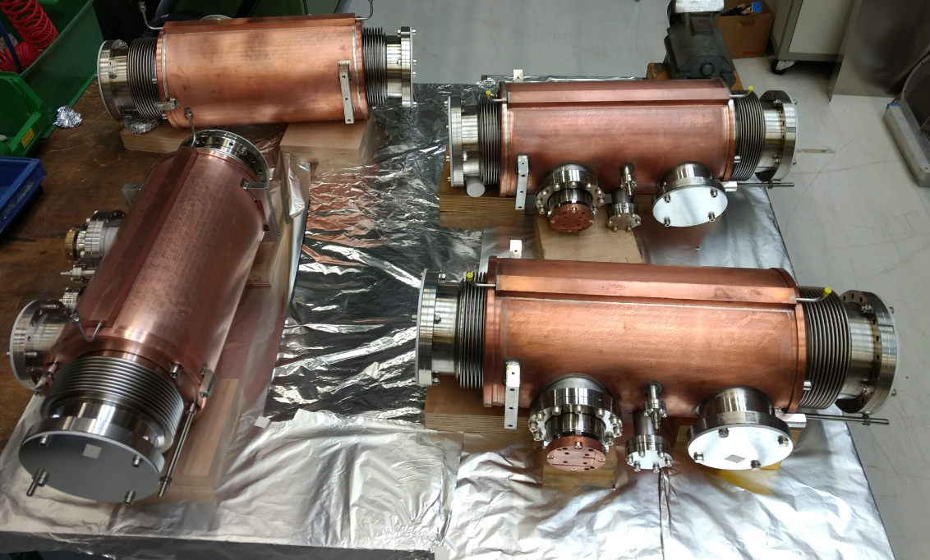
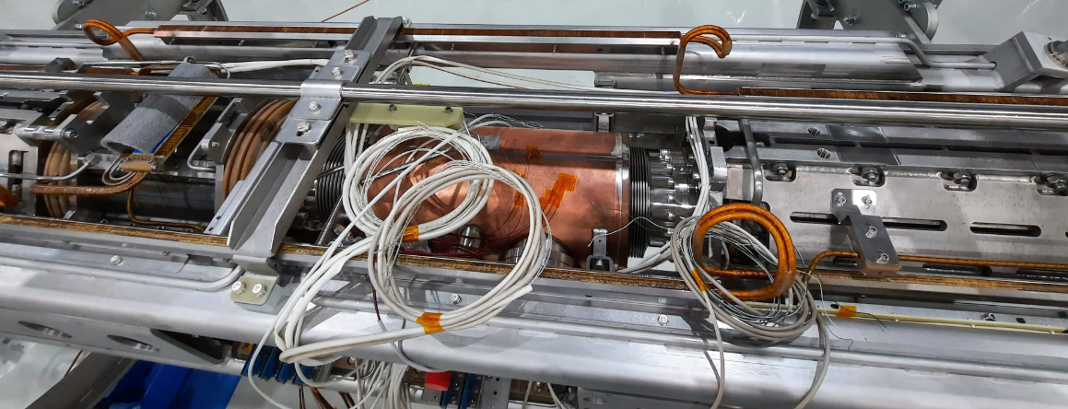
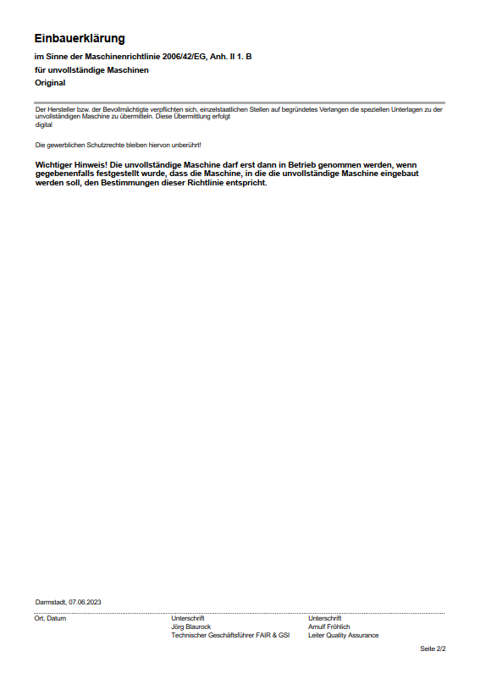
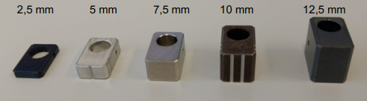
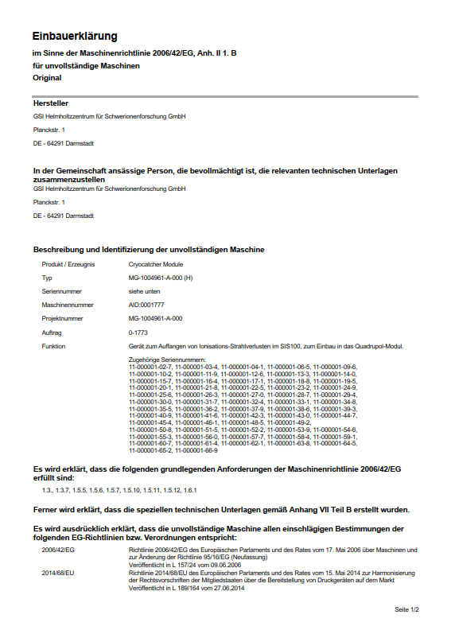
SIS100 Cryocatcher
60 cryocatcher in SIS100 will suppress dynamic vacuum effects
Located between quadrupoles in QDM
Production is finished
All components in store
ready to delivery to integration
or already integrated in Würzburg
Integration ongoing
Monitoring of distances
Still waiting for Einbauerklärung…

Slide 4
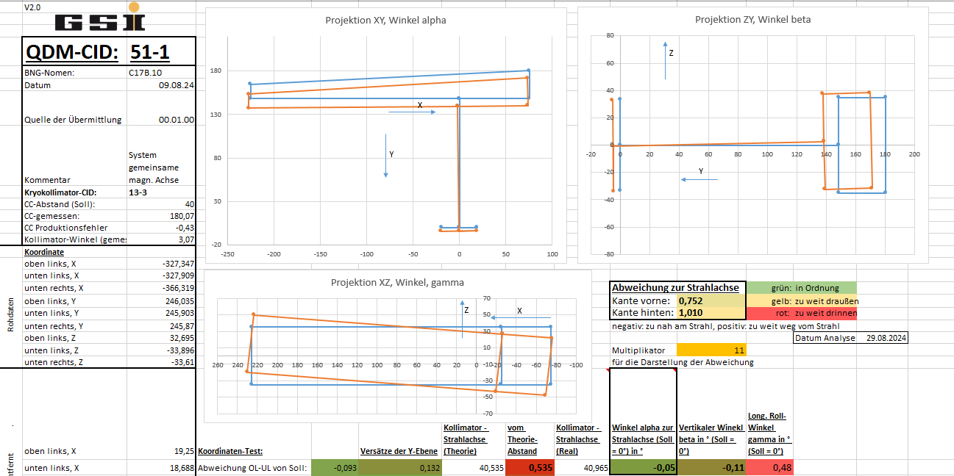
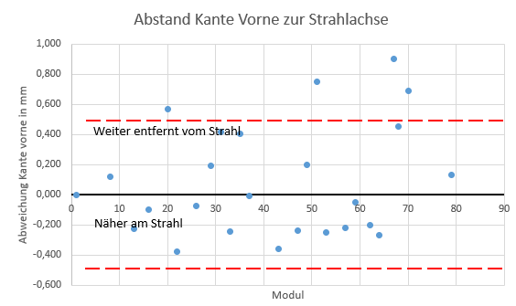
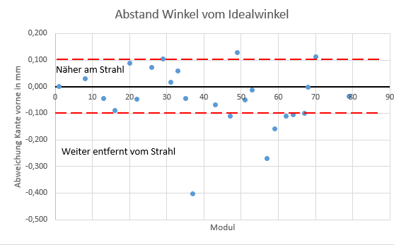
Cryocatcher QDM-FAT
Verification of position measurement data
Verification of electrical integrity for current measurement
So far: 24 integrated

Slide 5
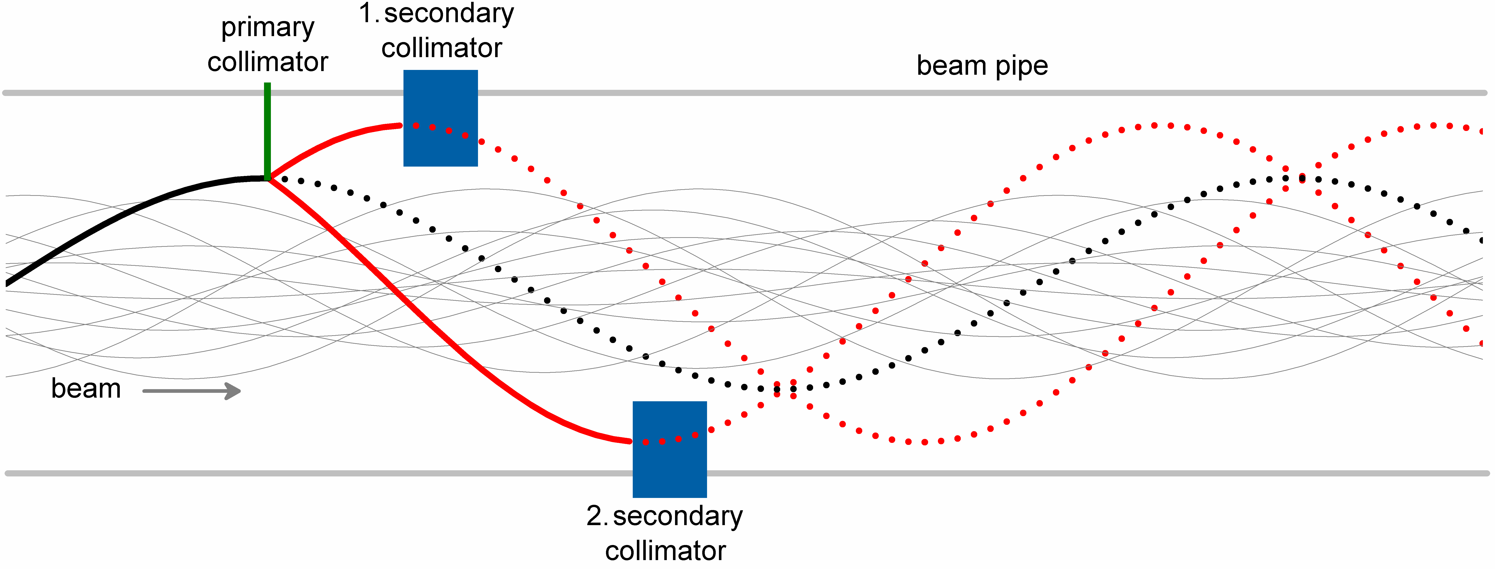
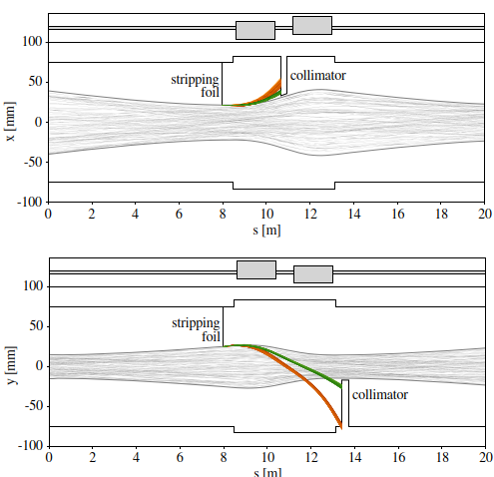
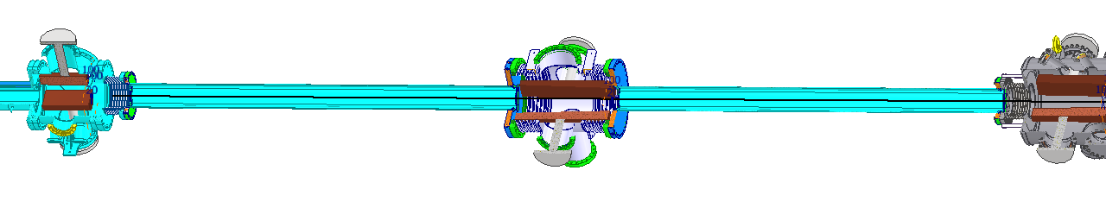
Halo-Collimation in SIS100
Three different, non-independent collimation systems:
Proton halo collimation system
Two stage collimation system
Highly charged or fully stripped ions
Ion halo collimation system
Stripping and collimation
Medium charge states
Collimation system for systematic extraction losses
I.Strasik

Slide 6
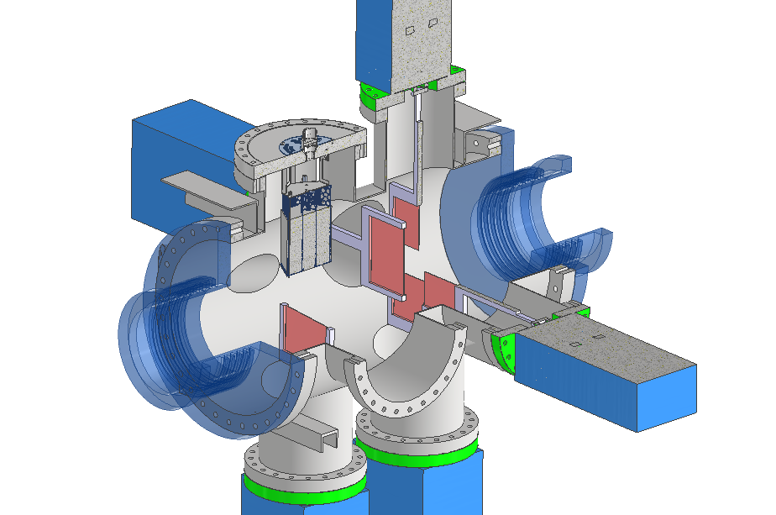
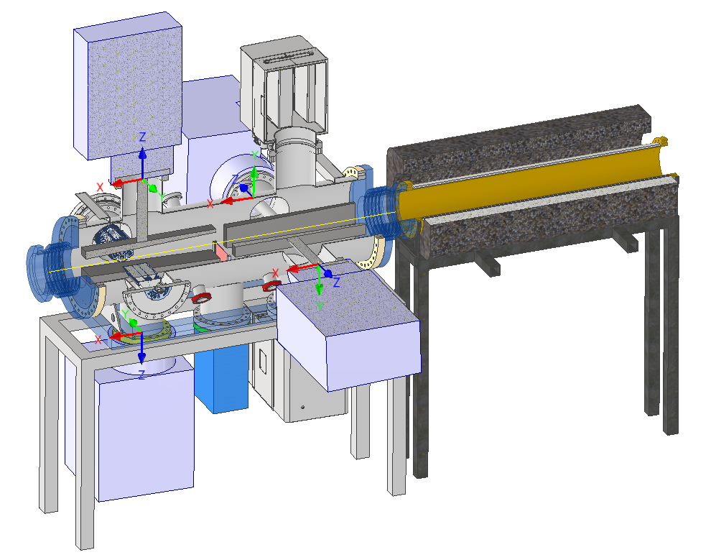
Proton Halo Collimation
Proton halo collimation system
Collimation efficiency (multi-turn) close to 100%
High collimation efficiency for light ions
4x scattering foil (2x horizontal, 2x vertical)
2x: 4x absorber block “protons”, 1x concrete shielded vacuum pipe

Slide 7
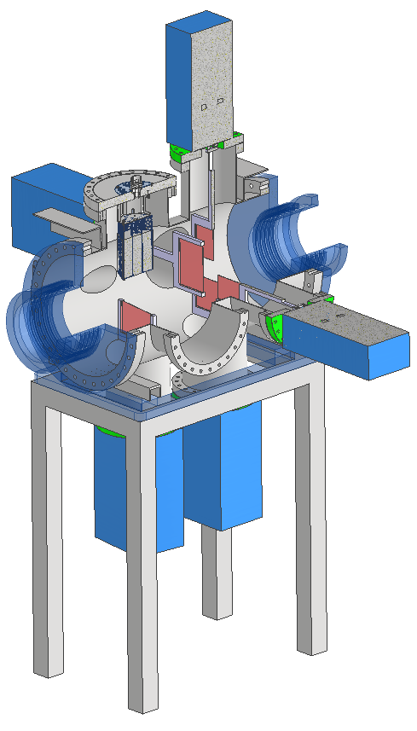
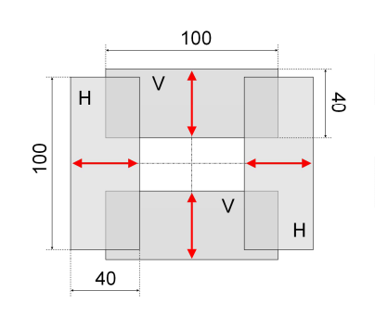
Proton Scattering
Scattering foils:
Tungsten sheet metal, 1mm width
Four foils, 2 horizontal, 2 vertical
Precision: +-0.5 mm
fast movement (20 mm in 200 ms) required due to parallel operation

Slide 8
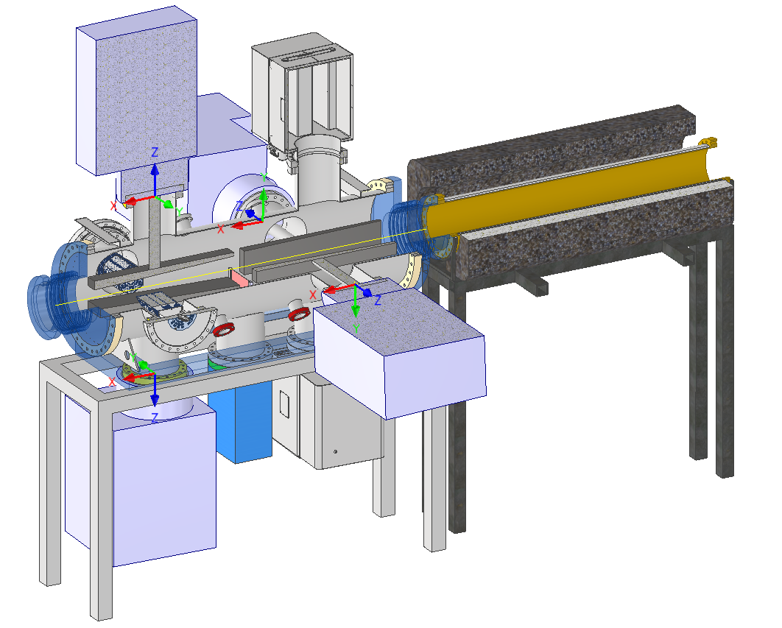
2x Proton Absorber Station
Absorber blocks, 2 horizontal, 2 vertical
Material: Tungsten or Densimet, ca. 50 cm x 8 cm x 3 cm, ~25kg
Movement: ~20 mm, speed: 5 mm in 200 ms desirable
Precision: +- 0.2 mm
Shielding pipe:
1m bakeable pipe
surrouonded by concrete shielding
Option for vertical ionstripping foil

Slide 9
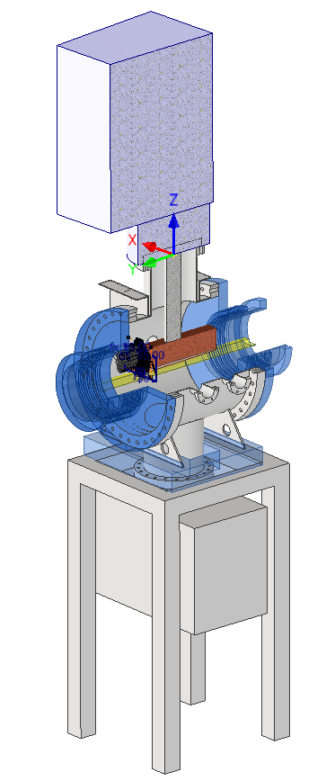
Ion Halo Collimation in SIS100
Halo collimation of partially stripped ions:
Stripping foil close to beam removes electrons
Stripped ions are separated from circulating beam in magnets
Collimator / absorber block removes these particles
Two positions:
Sector 1 for vertical collimation (1 foil in foil chamber, 1 collimator)
Sector 5 for horizontal collimation (1 foil at EE-kicker, 1 collimator between warm quads)
Stripping foil: Graphite, 0.5 mm – 1 mm
Collimator block: Copper with Ni/Au plating

Slide 10
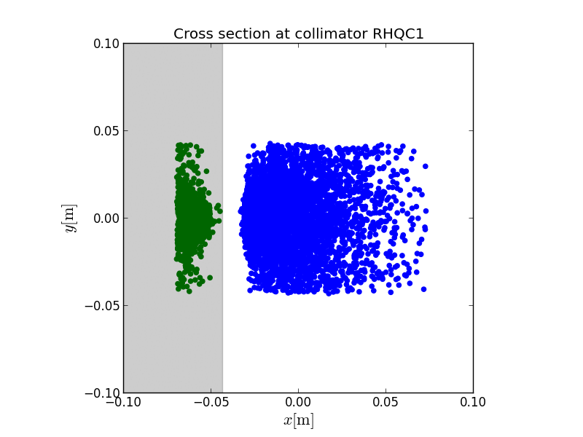
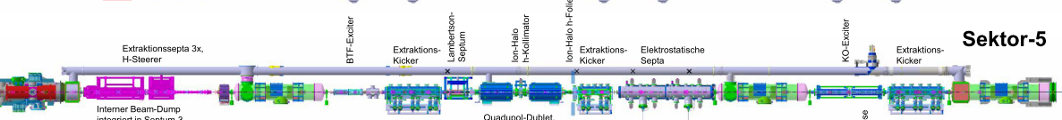
Extraction Collimation
During slow extraction some particles interact with the septum wires and get stripped
These particles will get lost
→ collimators required, to catch these particles!
Two horizontal and one vertical pair in extraction straight
400 MeV, D.Onreka
2 between
warm Quads
2 behind EE-Kicker
2 in front of L-Septum

Slide 11
Flowchart Halo-Collimation (2025)
drive incl. inside stuff
SSI Assemblies
Vacuum chamber
other assemblies
Procurement:
SIS100 Warm Quad Collimation Chamber
2.8.11.2.3
AID: 0000784
production running
FAT in October 2025
Doble-Kicker-Assembly
AID: 0000568
1
2
Procurement:
15x slow drives, incl. 7x Cu-collimator
2.8.11.2.3
AID: 0002861
Collimator and Pump Module
AID: 0000783
Warm Quadrupole Doublet Assembly
AID: 0000762
(almost) contracted
delivery 09/2026
2
2
Lambertson-Septum Assembly
AID: 0000764
Procurements:
6x fast drives
2.8.11.2.1
AID: 0002860
procurement start:
end of 2025
1
5
8
1
4
1
vertical
I-Collimation Absorber Assembly
AID: 0002869
Procurement:
1x vIon-Chamber
2.8.11.2.2
AID:
1
common procurement possible
Q2/2026
Procurement:
SIS100 Foil Chamber
2.8.11.2.3
AID: 0002866
Foil Chamber Assembly
AID: 0002865
1
Procurement:
8x W-collimator
2.8.11.2 (<100 k€)
8
Procurement:
2x P-Absorber Chamber
2.8.11.2.2
AID:
2 x P-Collimation Absorber-Assembly
AID: 0002863
2
Procurement:
SIS100 P-Collimation Shielding Pipe
2
+ Auxiliary Systems…

Slide 12
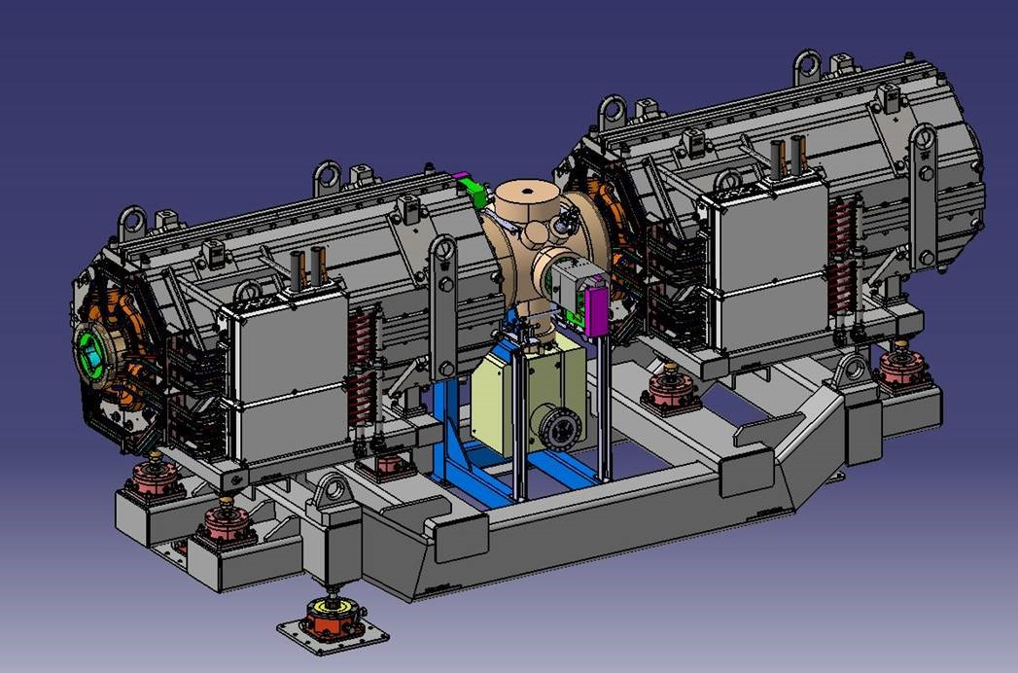

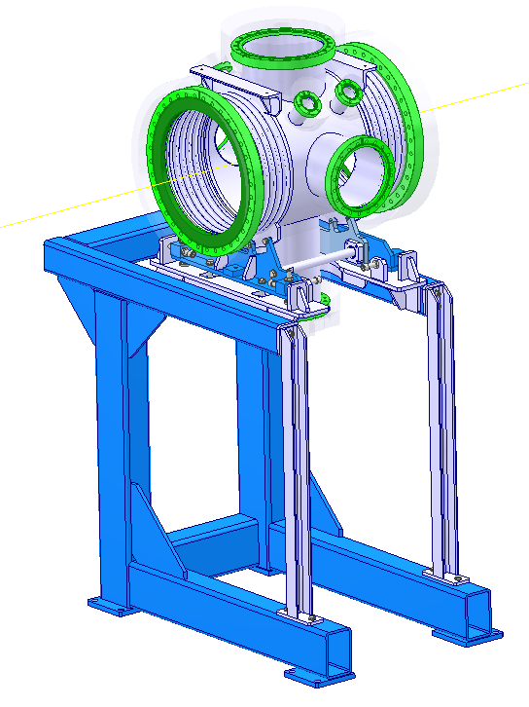
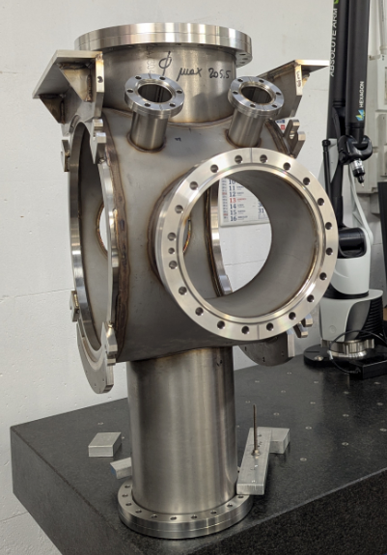
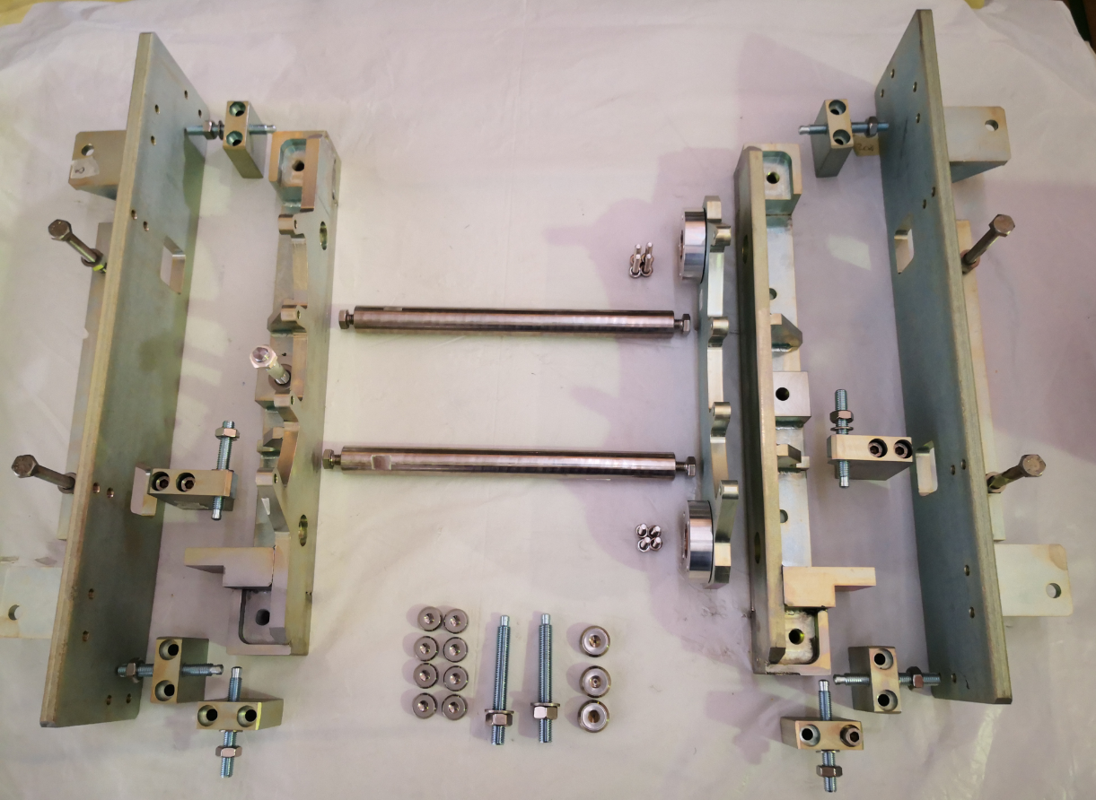
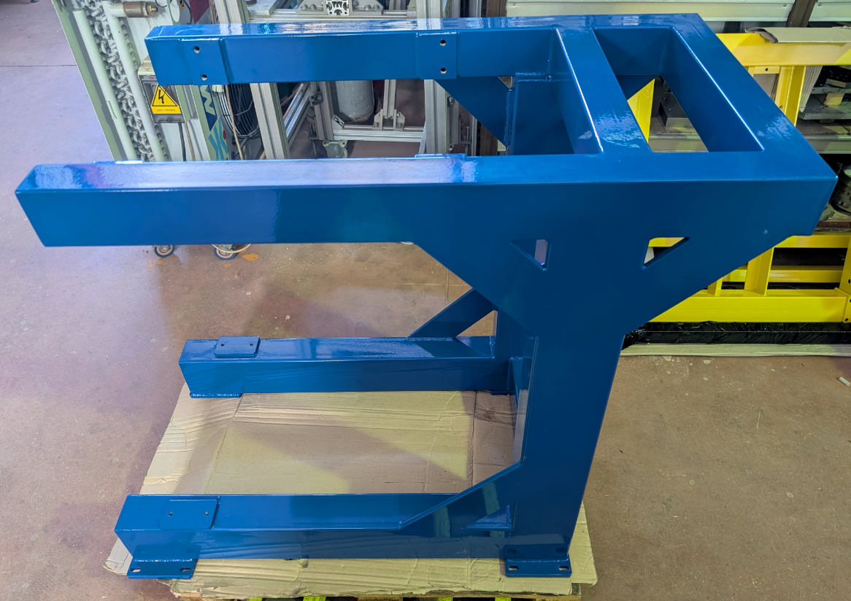
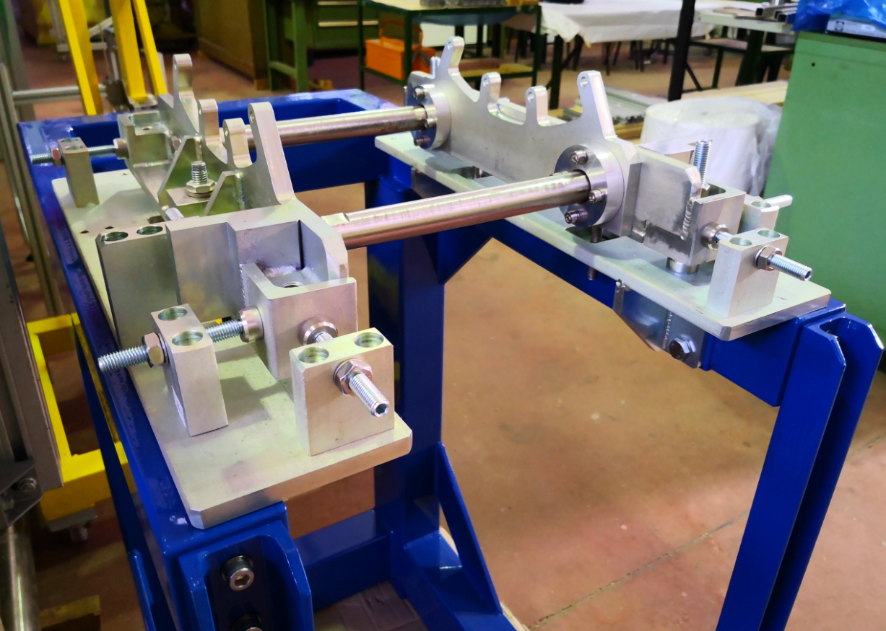
Proc: Warm Quad Collimator Chamber
Manufacturer: TEES srl. in Italy
Production ongoing
Delivery expected in October 2025

Slide 13

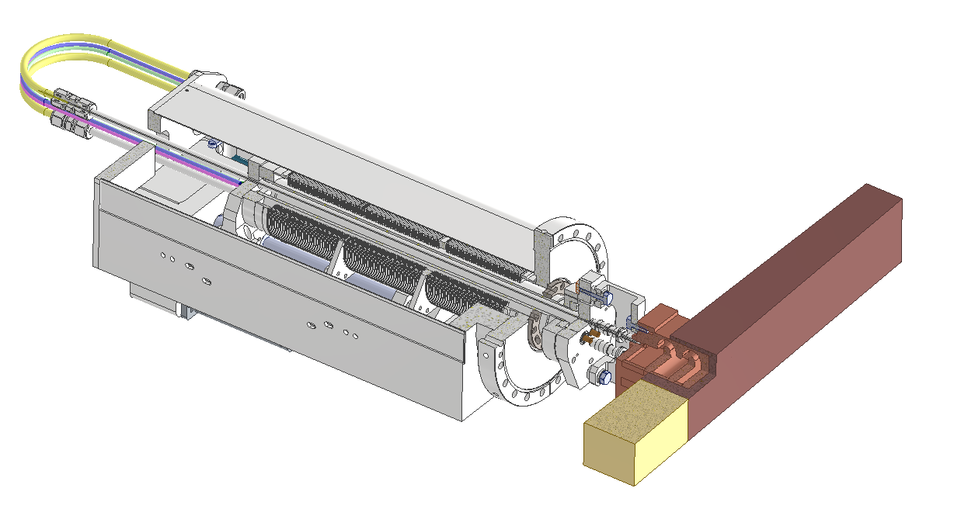


Proc: Slow drives
7 slow drives incl. copper collimators
Slow extraction collimation
Vertical ion collimation
8 slow drives for proton collimation
Only drives, no support or collimator block
3 offers received, negotiation finished
Contract will be awarded soon to Omega Physics, France
Manufacturing at Andesun, Nanjing, China
Delivery expected in stages
First delivery in June 2026
Last delivery in September 2026

Slide 14
Proc: Fast Drives
6 components
5 in foil chamber
1 in kicker tank
Two different foils, simple mounting of foils
Electrical current measurement on foil
HV sparkover from kicker has to be considered
Fast movement (20 mm in 200 ms) required due to parallel operation
Later installation possible (no large internal fixtures)
Own driver system required
tbd: interface to accelerator control system
DS in work, 80%, coordination with ACO required
Start of procurement expected for end of 2025

Slide 15
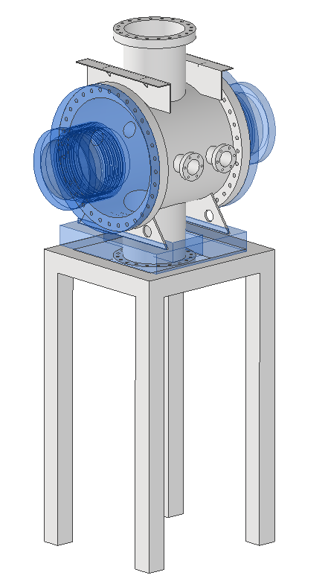
Proc: Vertical Ion Chamber
One single vacuum chamber
1 flange for drive with standard distance 300 mm
1 flanges for pump
Alignment & support

Slide 16
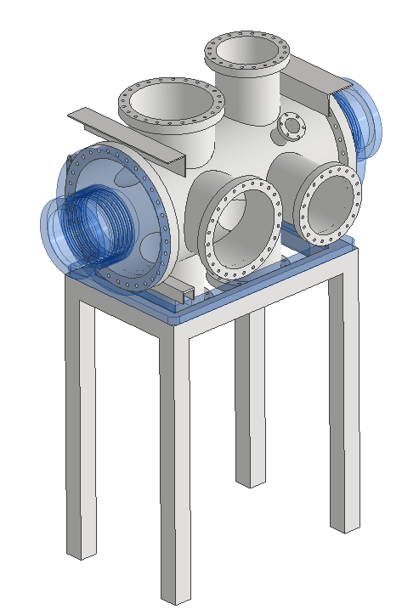
Proc: Foil Chamber
One single vacuum chamber
5 flanges for drives with standard distance 300 mm
Several flanges for pumps (roughing chamber)
Viewport to observe foil damage
Detailing of chamber requirements and design required
Alignment & support
DS in work, 70%

Slide 17
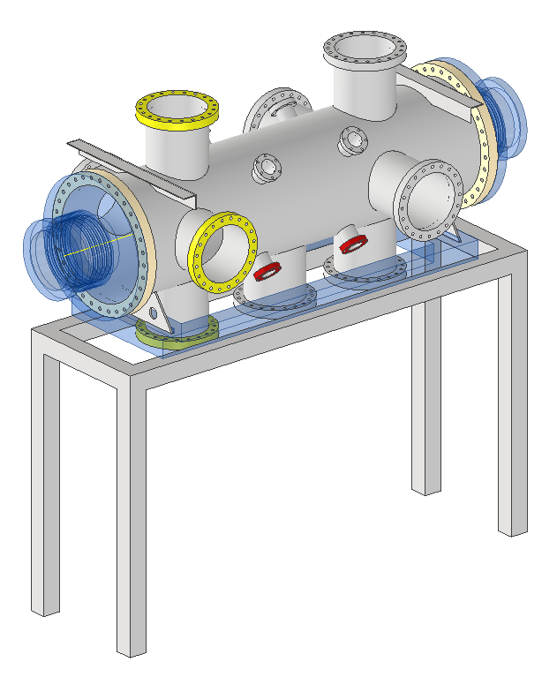
Proc: P-absorber Chamber
Two vacuum chambers
5 flanges for drives with standard distance 300 mm
Several flanges for pumps
Viewport to observe foil damage
Alignment & support
Detailing of chamber requirements and design required
Could be used to temporarily house collimators instead of EE-kicker

Slide 18
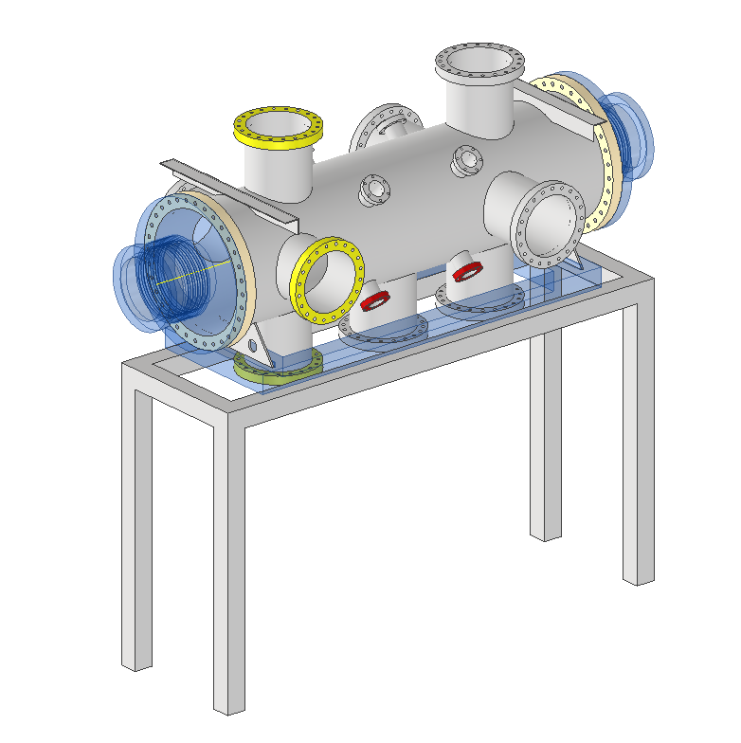
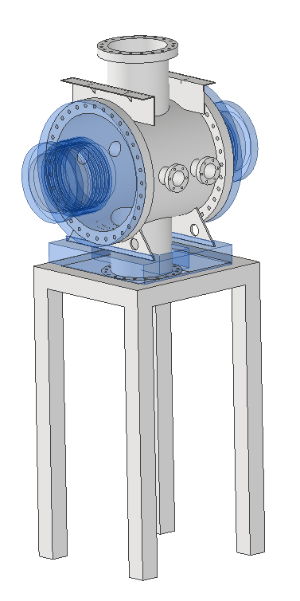
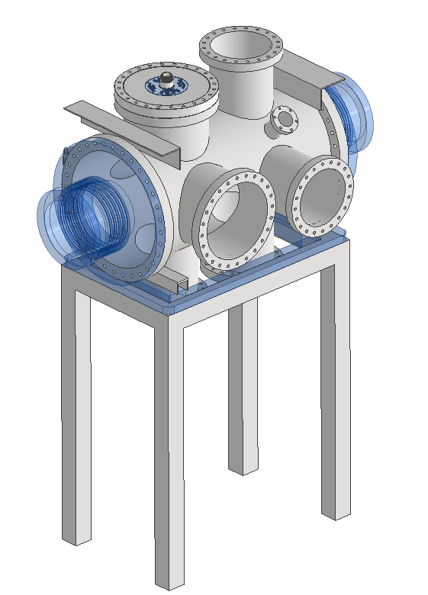
Vacuum Chambers: common procurement?
1x
1x
2x
vertical Ion-Chamber
Foil-Chamber
Protonabsorber-Chamber
200-250 k€

Slide 19
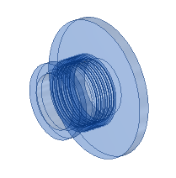
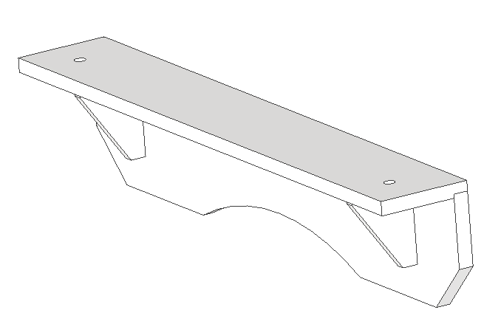
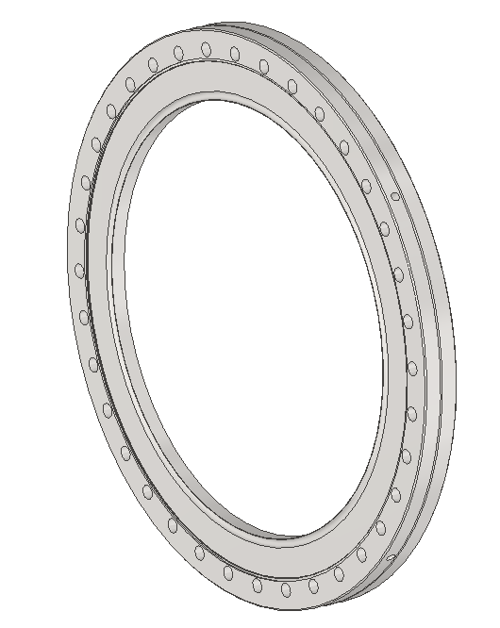
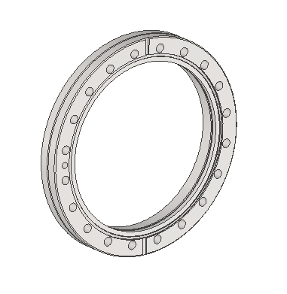
Many common parts
8x cover with bellow and bellow support
8x Fiducial bridge
8x Big flanges with reference surfaces and ref. holes
N x Drive flanges with tolerances and dowel pin holes
Same pipe-diameter for all chambers (300 mm)
Same support structure concept (only different lengths)
Same alignment bridge concept possible
Many common bakeout jackets
→ common procurement?!

Slide 20
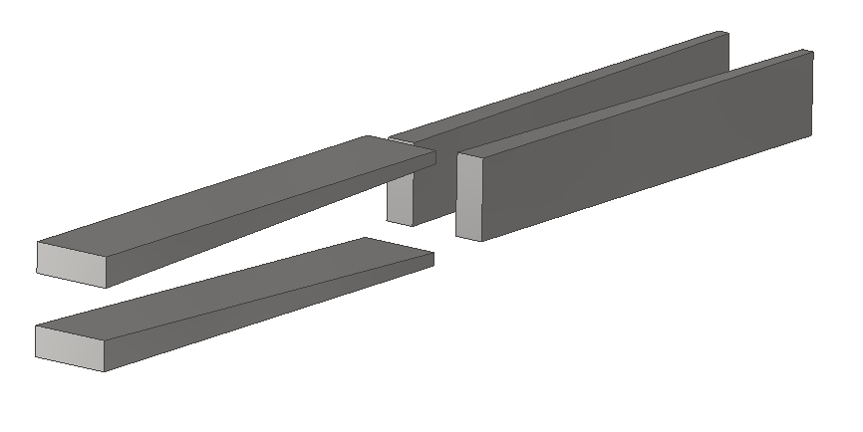
Proc: 8x W-Collimator incl. support
Small procurement
< 100 k€
can be shifted until simulations are done
Blocks shall be adaptable to slow drives, same weight
Absorber blocks
Material: Tungsten or Densimet
ca. 50 cm x 8 cm x 3 cm, ~25kg
2x four blocks, each 2 horizontal, 2 vertical
Movement: ~20 mm, speed: 5 mm in 200 ms desirable
Precision: +- 0.2 mm
Fluka Simulation required for
angle
material

Slide 21
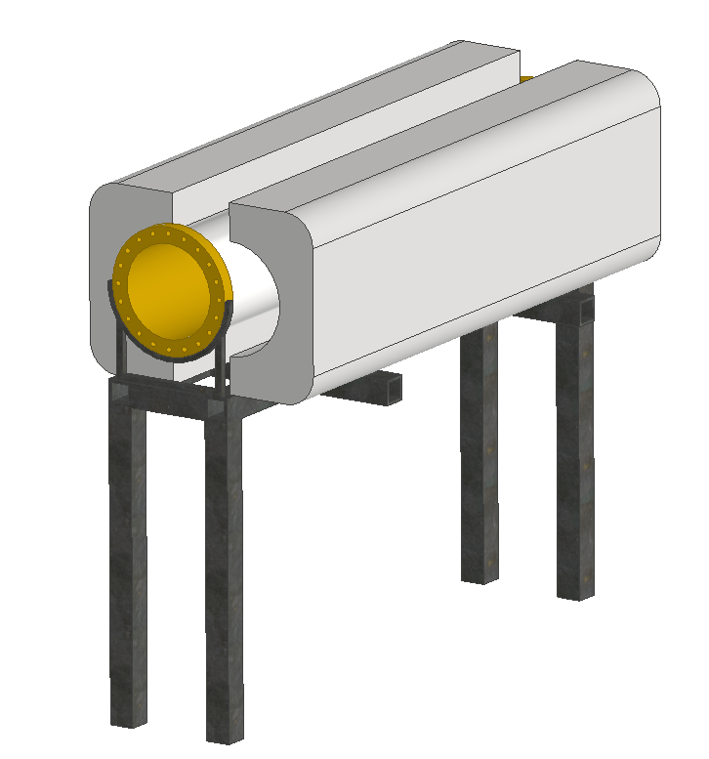
Proc: P-Absorber Shielding Pipe
~1 m bakeable vacuum pipe
Surrounded by (moveable) concrete shielding
Alignment & support
Open questions:
Thickness of concrete?
specifications for concrete?
Can the heating jacket remain inside the concrete?
More concrete required?
(no progress since last SIS100 workshop)

Slide 22
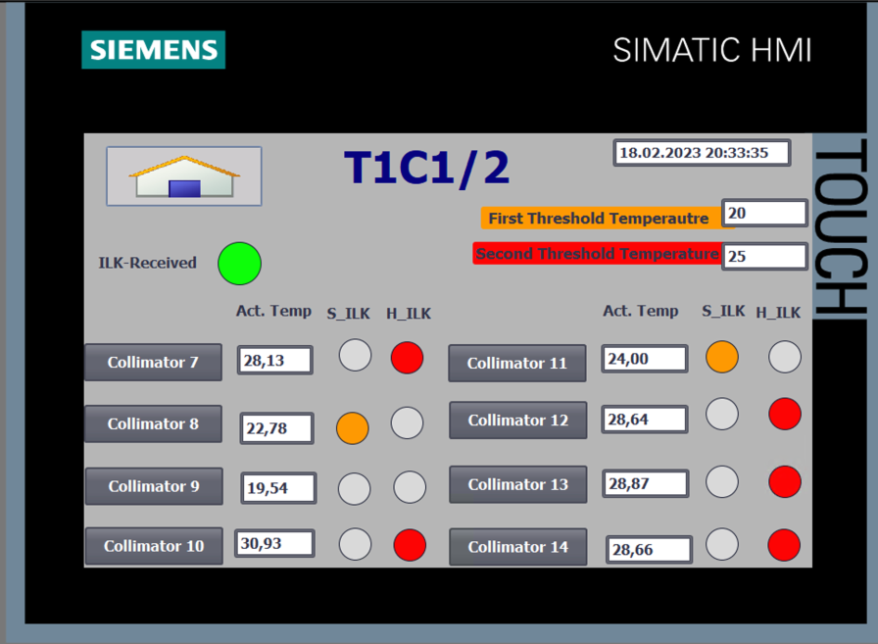
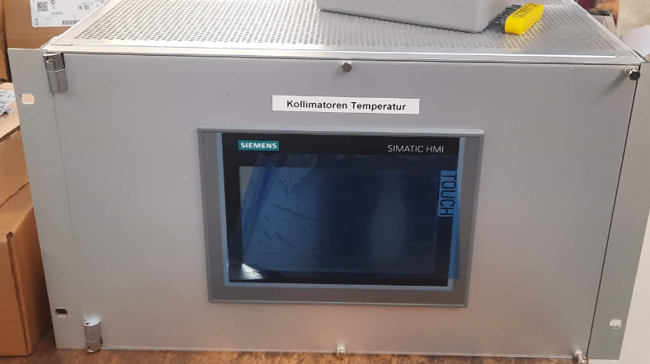
Auxiliary Systems
Current measurement system
IFCs are missing, procurement starting soon (BEA)
All other components are delivered
Temperature measurement system for collimators (together with HEBT)
SPS-based system
Prototype has been developed (bachelor thesis, BEA)
All components have been ordered and delivered
Housing and support development
Assembly pending, cabling needs to be done
Cameras for foil observation (BEA)

Slide 23
Summary
Cryocatcher: running
Collimator chamber:
Manufacturing running, FAT: middle/end of October 2025
SAT and integration @ gsi: end of 2025
Slow drives:
Contract (almost) awarded
Deliveries starting from June 2026
Fast drives:
Specification to be finished, coordination with ACO required
Procurement start: End of 2025
Vacuum chambers:
Specifications required, procurement start estimated for Q2/2026
Concrete pipe + W-collimators:
Specifications to be developed, simulations required
Auxiliary systems:
Proc. mainly by BEA
Temperature monitor to be built

