Slide 1
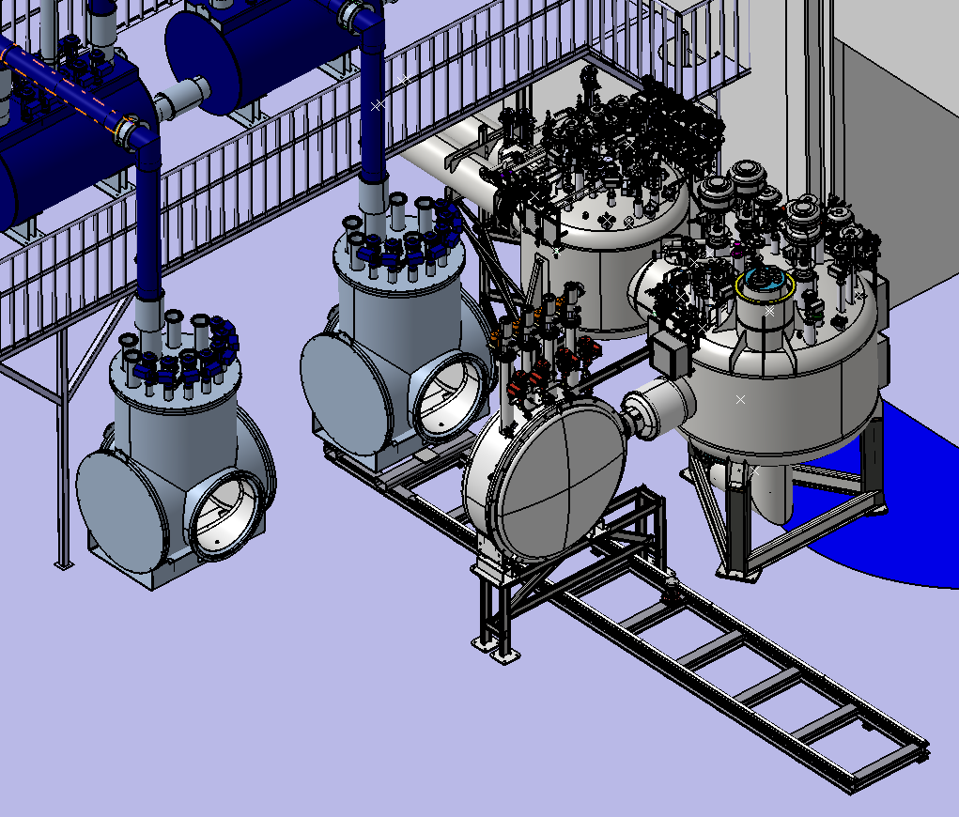
Feedbox testing and procurement of the parts
Artur ILUK
Eberbach, 23.09.2025

Slide 2
SIS100 Local cryogenics installation
Content:
Feedbox and Feed in Line Box
Current Lead box
Test stand
Procurement

Slide 3
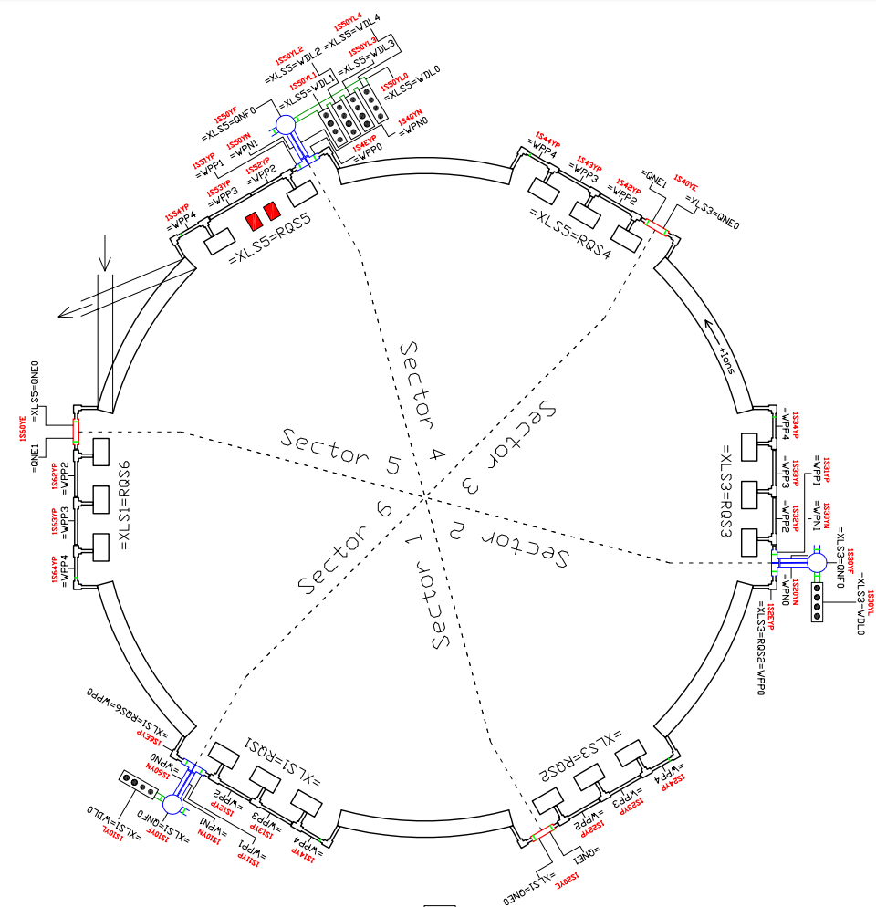
SIS100 Local cryogenics
Local cryo
SIS100 local cryogenics is not typical one, because it is providing not only cooling helium to SIS100 superconducting magnets, but as well the electrical power to the SIS100 fast ramping magnets.
Components of the local cryo prowided by Wrocław University of Science and Technology as a polish in-kind to the FAIR project:
Bypass Line
Current Lead Box
Current Lead Box Link
Feedbox system

Slide 4
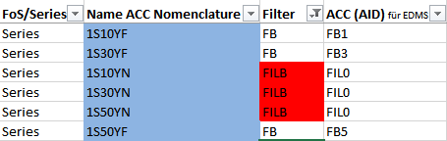
SIS100 Feedbox/Feed in Line Box
Three Feedbox systems located in sectors 1, 3 and 5 are main points of cooling He and power distribution for SIS100. Each Feedbox system serves two adjacent sectors.
Feedbox for sector 5 is more complicated, because it distrubute power by 16 busbars, while Feedboxes in sectors 1 and 3 distribute power by 4 busbars only.

Slide 5
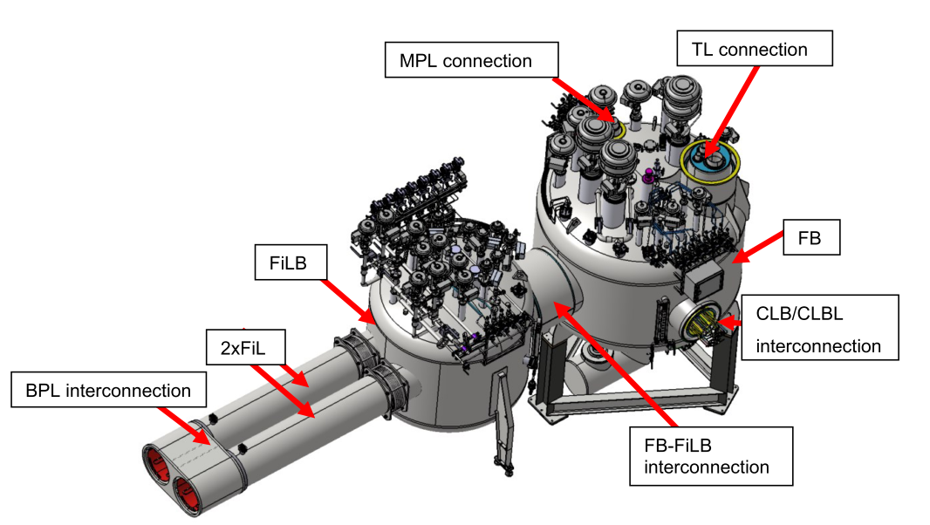
SIS100 Feedbox/Feed in Line Box
Each Feedbox system contains two parts transported separately:
Feedbox (FB) – part with components common for both adjacent sectors. FB is connected to external cooling helium transfer lines and to Current Link Boxes (CLB/CLBL) providing electrical power.
Feed in Line Box (FiLB) part with two sets of valves controlling helium flow for two adjacent sectors

Slide 6
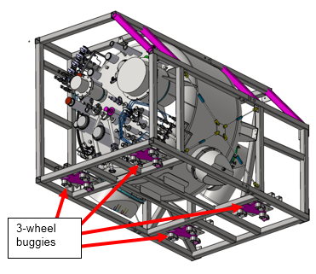
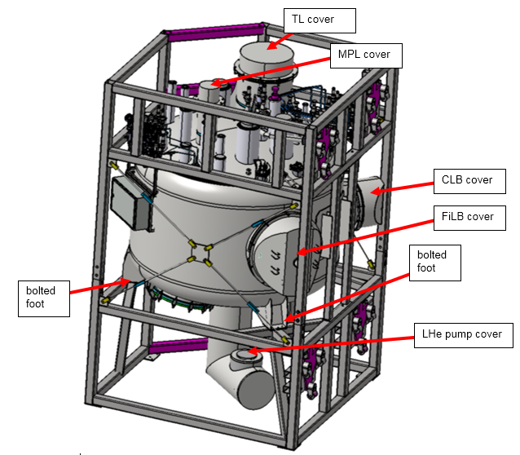
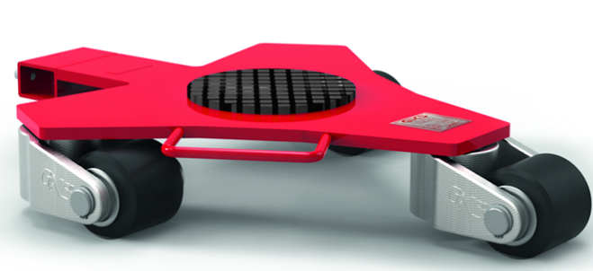
SIS100 Feedbox
SIS100 Feedbox transport
To transport Feedbox, special frame was designed to fit into tunel space during in-tunel transport. The frame allows transport in horizontal position and erecting to vertical position.

Slide 7
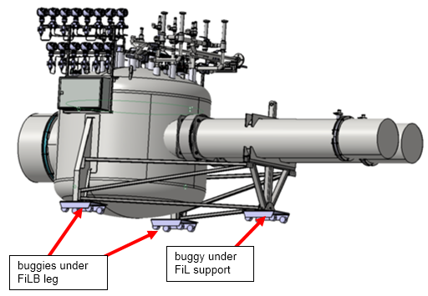
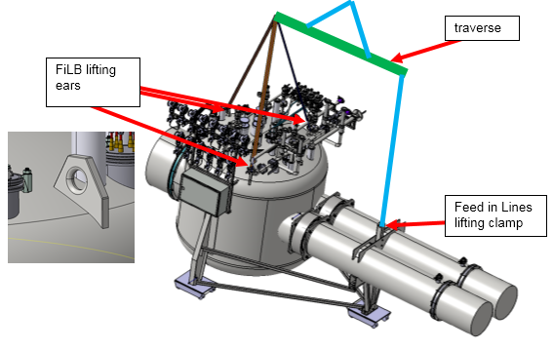
SIS100 Feed in Line Box
SIS100 Feed in Line Box transport
To transport Feed in Line Box, transport was also designed. Transport of FiLB is easier, can be done with crane and in horizontal position on buggies in the tunnel

Slide 8
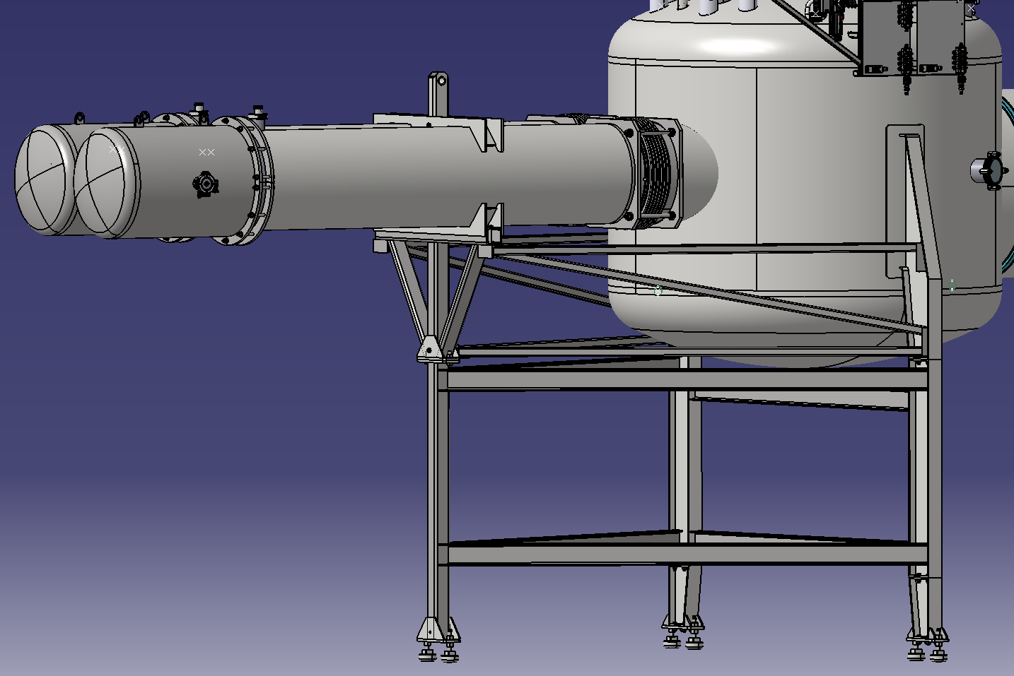
SIS100 Feed in Line Box
SIS100 Feed in Line Box transport
The FiLB test support frame is installed as an elongating part into FiLB leg parts. It is required to cover the 1m depression depth in the niche
Inserted part of test frame is shown in red box.

Slide 9
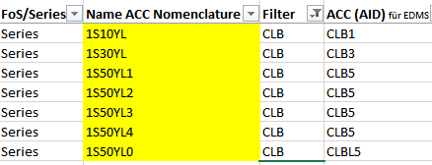
SIS100 Current Lead Box
The Current Lead Boxes (CLB) are located at Feedboxes and provide electrical power for SIS100. The input comes from warm Cu cables.
CLBs are actively cooled by Feedboxes.
In sectors 1 and 3 there is only single CLB (4 busbars). In sector 5 there are 4 CLB connected to FB by Current Lead Box Link.
In FB cold tests the CLB from sector 3 is used.

Slide 10
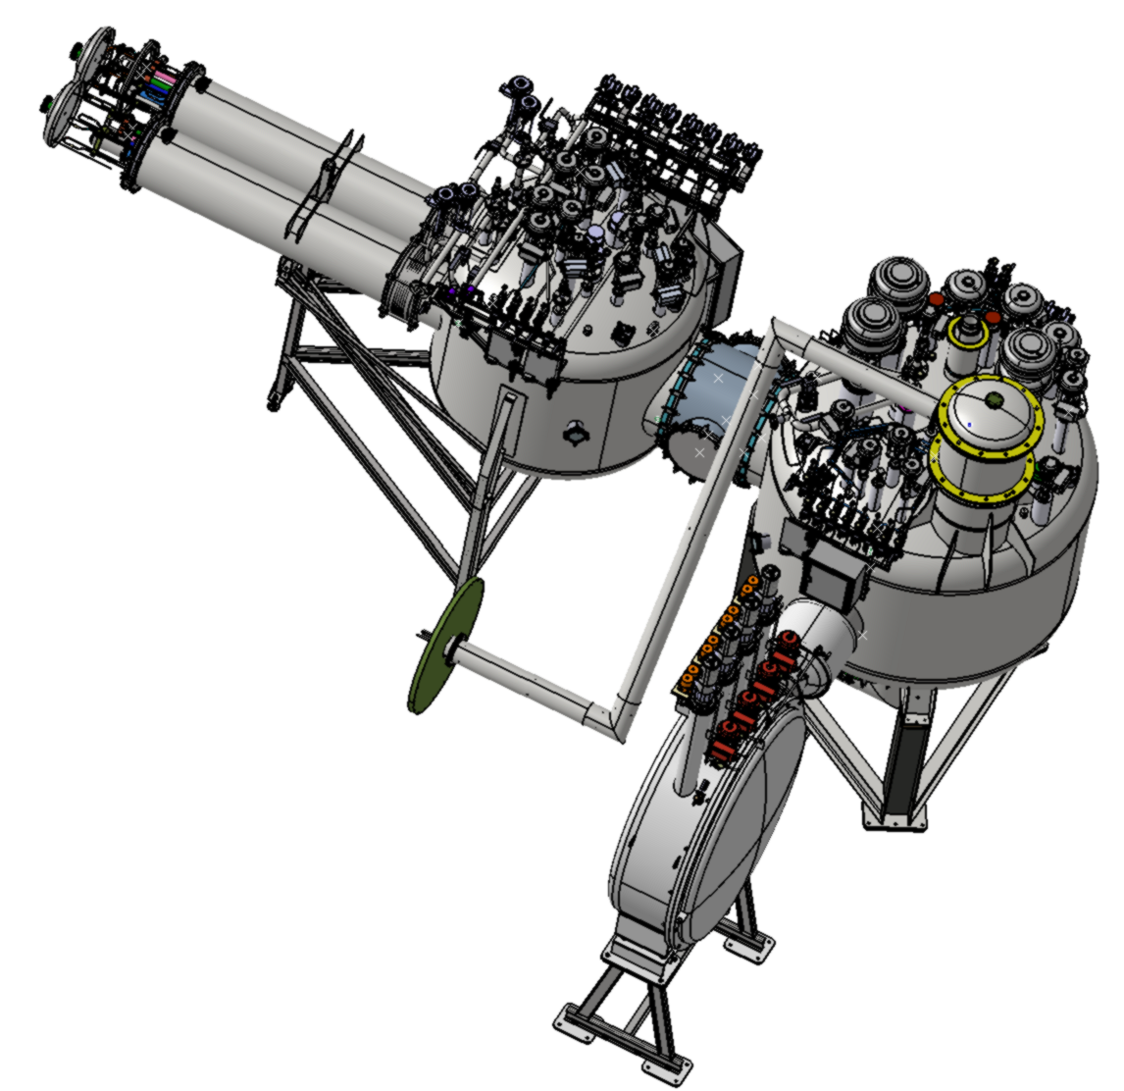
SIS100 FB test stand
SIS100 Feed Box system cold tests
The first of series Feedbox for sector 3 will be tested at GSI STF hall with Feed in Line Box and Current Lead Box.
Subjects of test:
operation of valves and filters
busbars stability
heat In-leaks
helium pump operation
Components to be tested:
FB sector 3
FiLB sector 3
CLB sector 3
connection to STF FB
connections to power cables

Slide 11
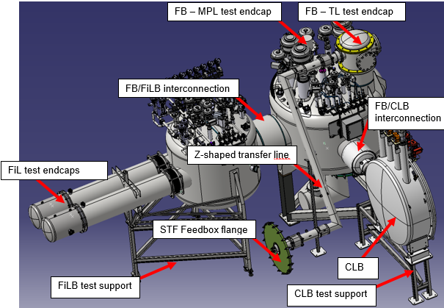
FB test stand
Tested components:
SIS 100 FB for sector 3
SIS100 FiLB for sector 3
Current Lead Box (CLB)
for sector 3
Components of test stand:
Test external supports
of FiLB and CLB
Endcap on MPL connection to SIS100 FB
Test Endcap on SIS100 FB transfer line connection, with interface to Z-shaped connection line
Test endcap on FB MPL connection
Z-shaped transfer line between FB and STF hall Feedbox
Flange of STF FB with interface to Z-shaped line (used in FoS test of CLB)
Two test Endcaps of FiLs with sensor connections

Slide 12
Test stand – scope of work
The scope of work for SIS100 FB test stand is including:
Positioning of FB, FiLB, CLB and test stand components at GSI STF Hall. The positioning by GSI include the removal of FB/FiLB and CLB from transport frame and moving it to the final position for integration. All the local transport including crane operation required and the operation of the FB erection from horizontal position to vertical position will be done by GSI transport team. Markers/line on the floor for positioning should be prepared by GSI.
Installation of valves, if were not installed during the transport, adjustment of the valves and its connection to the electrical cabinets of FB/FiLB.
Integration of FB, FiLB, CLB and test stand components at STF Hall. Integration include hydraulic and electrical connection of all components for testing, closing the vacuum space and all necessary test required to confirm that integration is done correct.
Connection of instrumentation required for tests from FB/FiLB electrical cabinets to GSI racks (GSI)
Cold tests of Feedbox system - operation of busbars at high current, helium pump operation etc.
Disassembling after SAT tests of Feebox all of components (FB/FiLB/CLB) to the state when all are in transport frames ready to transport to the tunnel. All the local transport including crane operation required and the operation of the FB rotation from vertical position to horizontal position will be done by GSI transport team.

Slide 13
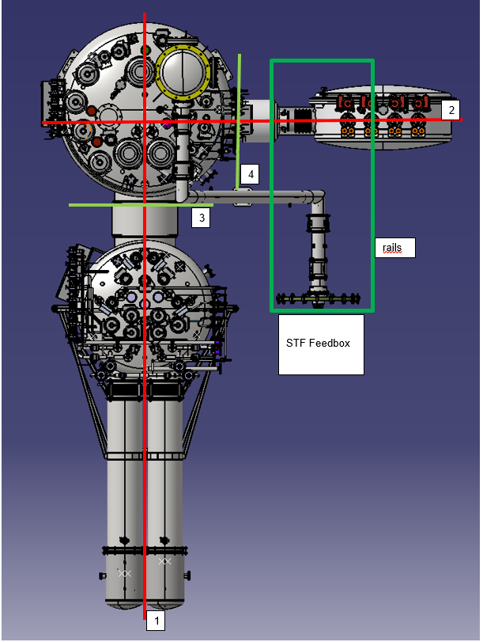
Test stand – prerequisites
Available space for FB, FiLB and CLB
Available electrical connection to CLB Main Current Leads
Available STB Feedbox without flange.
Floor markers/lines for FiLB, FB and CLB
FB, FiLB and CLB close the STF hall in transport
frames
Available compressed air supply
Available all racks for instrumentation
connections to FB/FiLB/CLB
Available power cables for connection to the MCL
Marked baselines of the floor.
1 – axis of FiLB, parallel to the rails
2 – axis of CLB
3 - vertical plane of FB flange on FiLB side
4 - vertical plane of FB flange on CLB side

Slide 14
Test stand – installation sequence
Phase I - installation
Installation of FB/FiLB/CLB supports
Erect FB in transport frame from hirizontal to vertical position
Remove transport endcaps from FB/FiLB
Move FB/FiLB/CLB onto supports and fix it
Install test endcaps FB/FiLB
Install flange to STF FB
Install Z-shaped transfer line

Slide 15
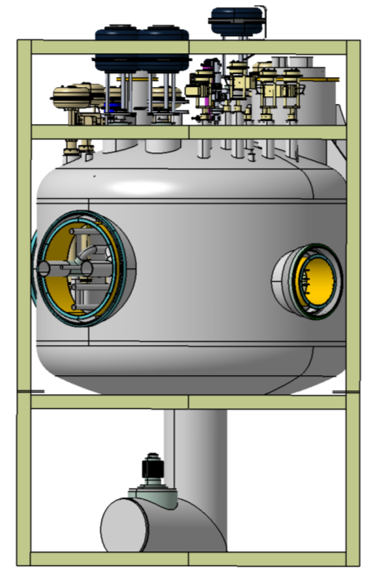
Test stand – installation sequence
Removal of upper part of FB transport frame, FB fixed to bottom frame on its legs.

Slide 16
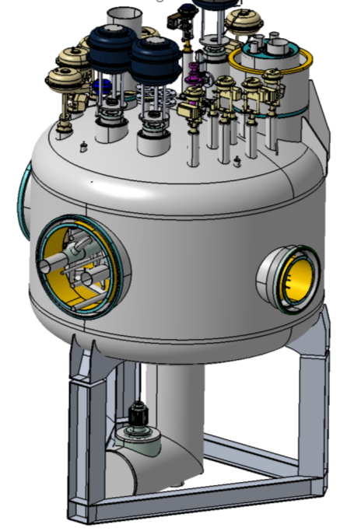
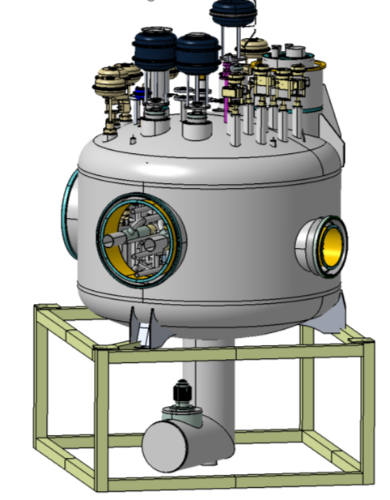
Test stand – installation sequence
Transfer (by crane) of the FB from bottom part of transport frame directly
onto FB support.
FB support

Slide 17
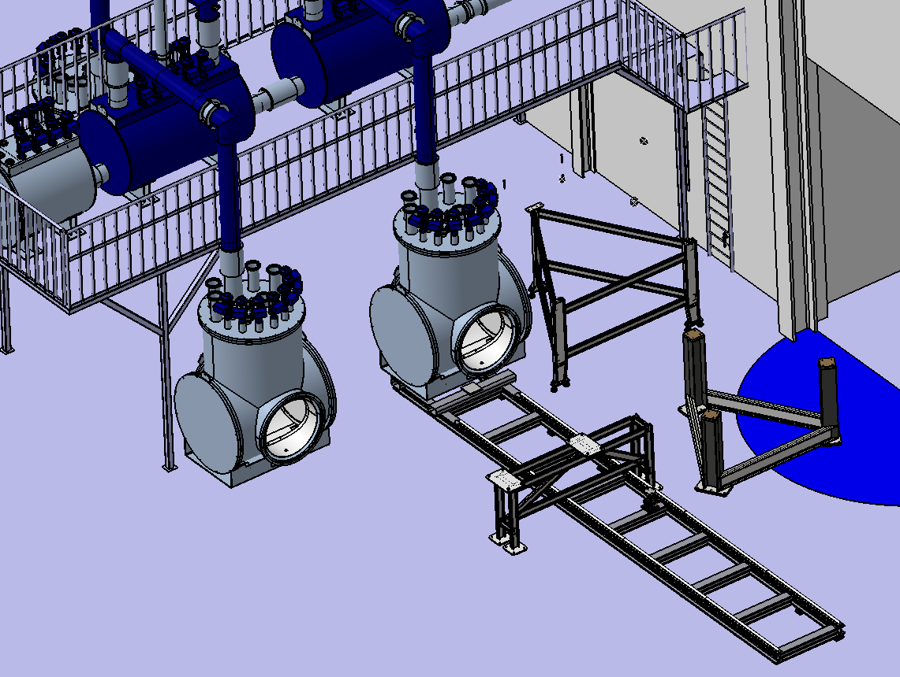
Test stand – installation sequence
FILB support
FB support
CLB support

Slide 18
Test stand – installation sequence

Slide 19
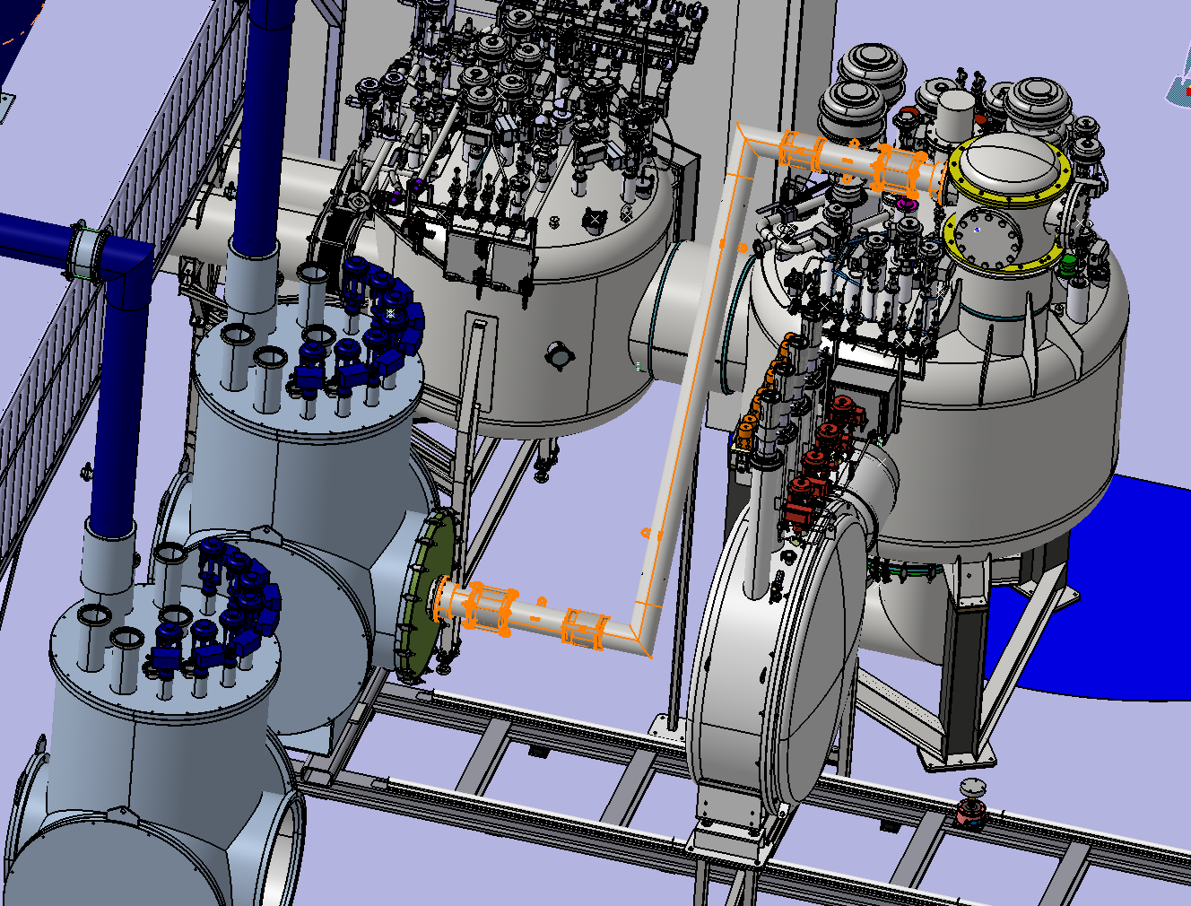
Test stand – installation sequence

Slide 20
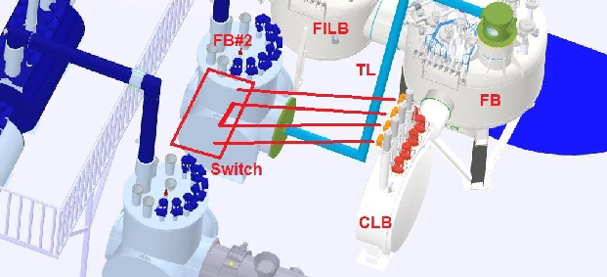
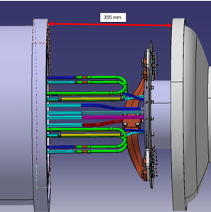
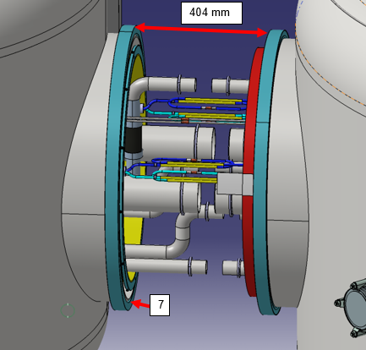
Test stand – installation sequence
Phase II integration
Assembly FB/FiLB/CLB interconnections (process pipes, BB) close the interconnection
Install MCLs in CLB and helium pump in FB (GSI)
Connect warm cables to CLB MCLs (GSI)
Install all valve drives if not installed
Connect compressed air to valve drives
Connect all required instrumentation from electrical cabinets of FB/FiLB/CLB
to control racks (GSI)

Slide 21
Test stand – installation sequence
Phase III disassembling
Disconnect all instrumentation from electrical cabinets of FB/FiLB and CLB valves to control racks (GSI)
Disassembly all valve drives if required for transport
Disconnect warm cables from CLB MCLs (GSI)
Deinstall MCLs from CLB and helium pump from FB (GSI)
Disassembly FB/FiLB/CLB interconnections (process pipes, BB)
Move FB/FiLB/CBL into tranport frames (GSI), install transport endcap and assembly in frames
Rotate FB in transport frame from vertical to horizontal position (GSI)

Slide 22
SIS100 FB tests - procurement
Delivery of test stand must be completed before delivering of FB3/FiLB3 and CLB3 – test stand itself is not a time critical component.
Status of procurement of tested components:
FB sector 3 – manufacturing start in September 2025
        expected FAT finished in Jun 2026
        at GSI in October 2026
FiLB sector 3 – manufacturing start in September 2025
        expected FAT finished in May 2026
        at GSI in June 2026
CLB sector 3 – manufacturing is planed to start in January 2026
expected end in April 2026
at GSI in June 2026
Feedbox Test Stand – tendering start in September 2025
        manufacturing is planned to start in January 2026
        expected end in Aprill 2026
        at GSI in May 2026

Slide 23
SIS100 FB test - timeline
Predicted duration of FB tests activities at GSI:
0 months – FB3/FiLB3/CLB3 SAT Aa tests accepted
+4 months – end of integration of FB test stand with FB/FiLB/CLB (optimistic)
+7 months – end of tests, SAT Ab accepted
+8 months – test stand disassembled – components ready to transport to the tunel
Under assumption that the last component (FB3) will be available at October 2026, the FB/FiLB and CLB will be ready to transport into the tunel in May 2027.
In the meantime the Feedboxes FB1/FiLB1 and FB5/FiLB5 should be ordered and manufactured.

