Slide 1
Status of cable laying and cable installation in SIS100
Horst Welker, COM/EPS
23.09.2025

Slide 2
Agenda
Status of cable routing and laying
Outlook on cable installation

Slide 3
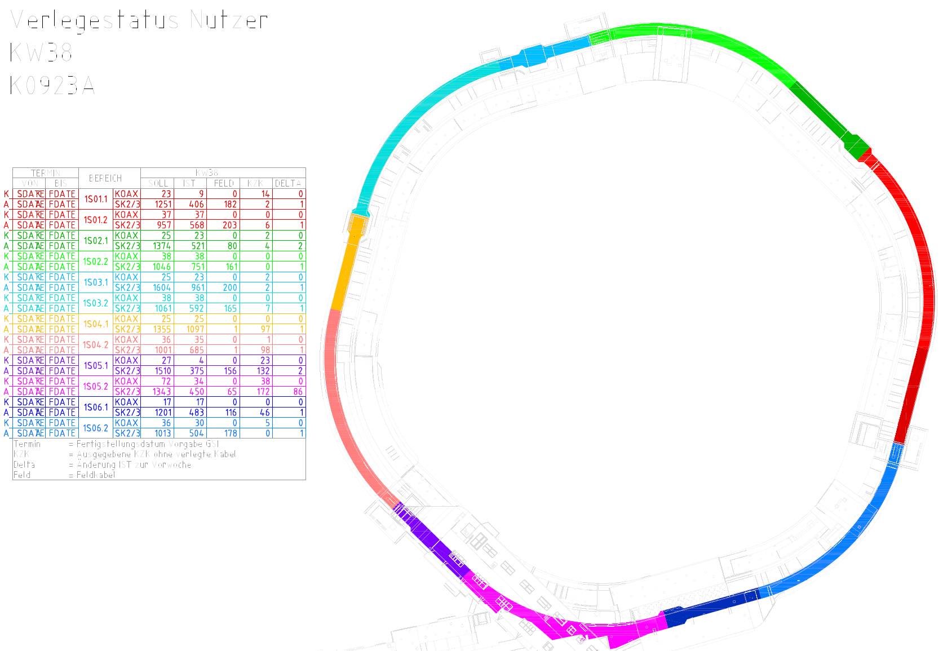
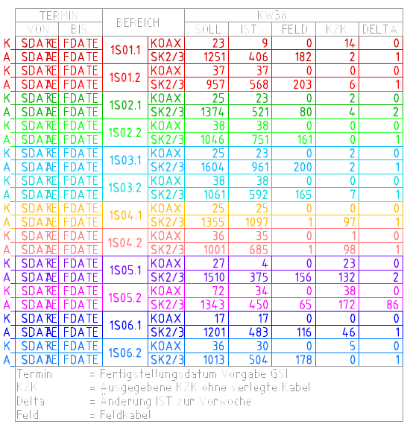
Status of cable routing and laying
Laid cables in K0923A
54%
59%
68%
76%
13%
52%
Total number of cables ~16.500
Total number of cables ~14.600 (excluding ~1900 Feldkabel)
Total number of laid cables ~7.600 (52%)

Slide 4
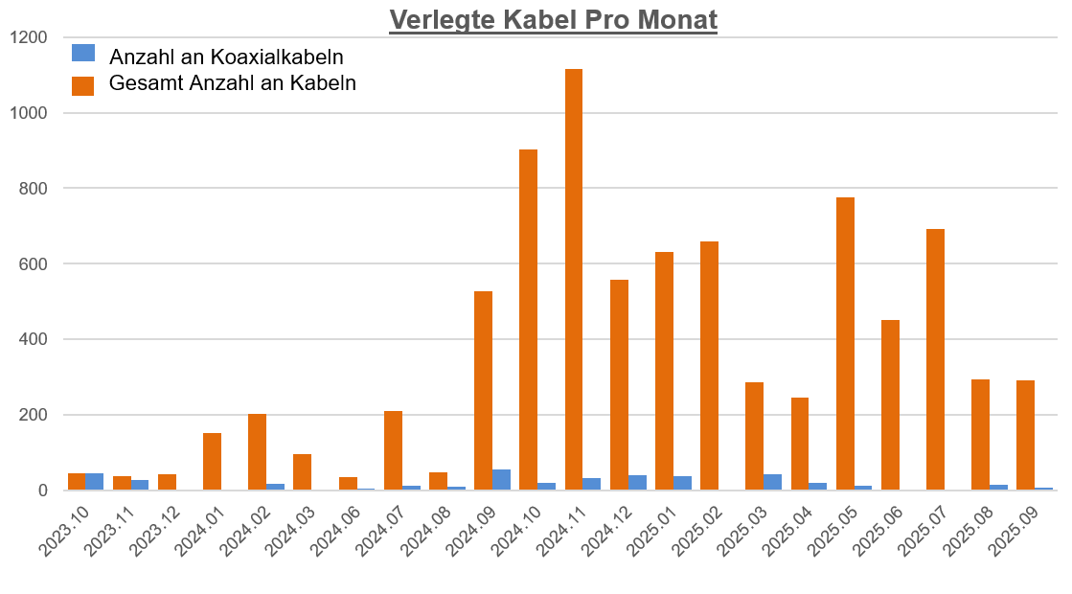
Status of cable routing and laying
 | No. of cables
Total laid cables | 7600
KzK available | 700
Cables approved | 1000
Cables to be checked (Dep.) | 1200
Routed cables to be checked by SEAR | 3800
Cables to be routed | 300
Feldkabel (no routing) | 1900
Sequence of routing and laying S4, S2s, S1s, tbd
Routing company SEAR is working with 2-3 routers on 2 sectors in parallel -> Routing expected to be finished end of Q4/25
Laying until Q2/26 (ELC with 2 teams)

Slide 5
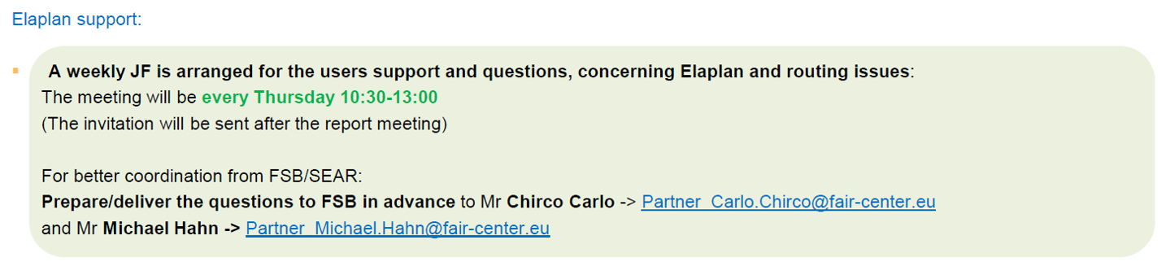
Status of cable routing and laying
Routing to be checked by departments until Q4/25 will be approx. 400 per week.
Weekly updated list of cables to be checked will be sent every Friday to the users (incl. priorities)
FSB is offering ELAPLAN support:

Slide 6
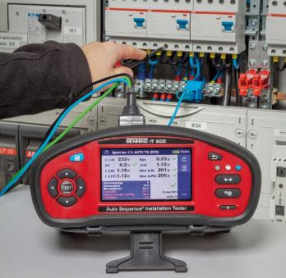
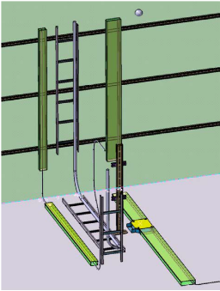
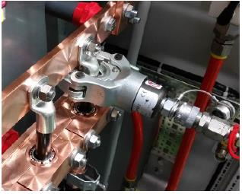
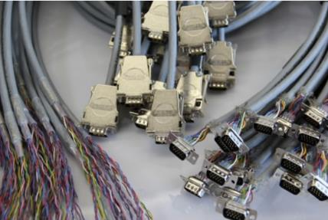
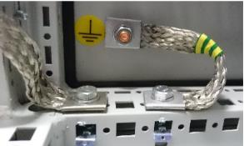
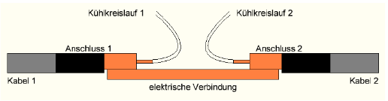
RV Cable installation
Scope of RV
  Planning, material und installation of machine trays
  Final laying of cables
  Material for connectors
  Installation of connectors and cable connection
  Material and installation of component grounding
  Special electrical installations (i.e. separation of water cooled cables and connection boxes)
  Electrical testing (incl. initial testing of electrical equipment according to VDE)

Slide 7
RV Cable installation
General information
Detailed information concerning cable installation collected and submitted via cable data base (per cable ID, Cable Connection Point Report)
Handover of information to ELC (material list, installation and test instructions, etc.) by technical place
All documentation uploaded to PKM
RV tasks are divided into 3 steps
    Machine tray installation and grounding
    Connectors assembly connection to the machine / racks and testing
    Connectors assembly and connection of electrical supply cables and VDE testing
Definition of 4 milestones for RV process
    Electrical Completion (EC) 0: Accelerator components are grounded
    Electrical Completion (EC) 1: Cables between accelerator components are installed and tested
    Electrical Completion (EC) 2: Electrical supply cables are connected (to power distribution)
    Switch-on Readiness (SoR): system is tested according to VDE and ready for commissioning

Slide 8
RV Cable installation
RV process overview
Step 1: Grid power off
Machine tray installation and
grounding
→ Results in Electrical Completion (EC) 0
Step 2: Grid power off
Connectors assembly connection
to the machine / racks and testing
→ Results in Electrical Completion (EC) 1
Step 3: Grid power off / Grid power on
Connectors assembly and connection of electrical supply cables and VDE testing
→ Results in Switch-on Readiness (SoR)
Installation
a
Install machine trays
b
Install tray and machine/rack grounding
c
Measure grounding
d
Upload protocols to PKM
e
Review by GSI
a
Lay final meters of cable
b
c
Connect cables to machines
e
f
Upload protocols to PKM
Test connected cables
Assemble connectors to cables
g
Review by GSI
Test of connectors assembly
d
c
Switch on power and VDE testing
d
Upload protocols to PKM
e
Review by GSI
f
Release the use of the system with power
a
b
Test connected cables →
Connect components to power distribution
EC2
Pre-Commissioning
Electrical Completion 0
Electrical Completion 1
Switch-on Readiness
Preconditions for step 1:
Machine components are installed in area of significant size
All cables are laid
CAD and material list ready
Preconditions for step 2:
Electrical Completion 0
Material list and installation/testing instructions ready
Preconditions for step 3:
Electrical Completion 1
Installation and testing instructions ready
Release for use of power distribution (FSB + STV)
Authorization from STV → Safety organization established (STV, AV nominated)

Slide 9
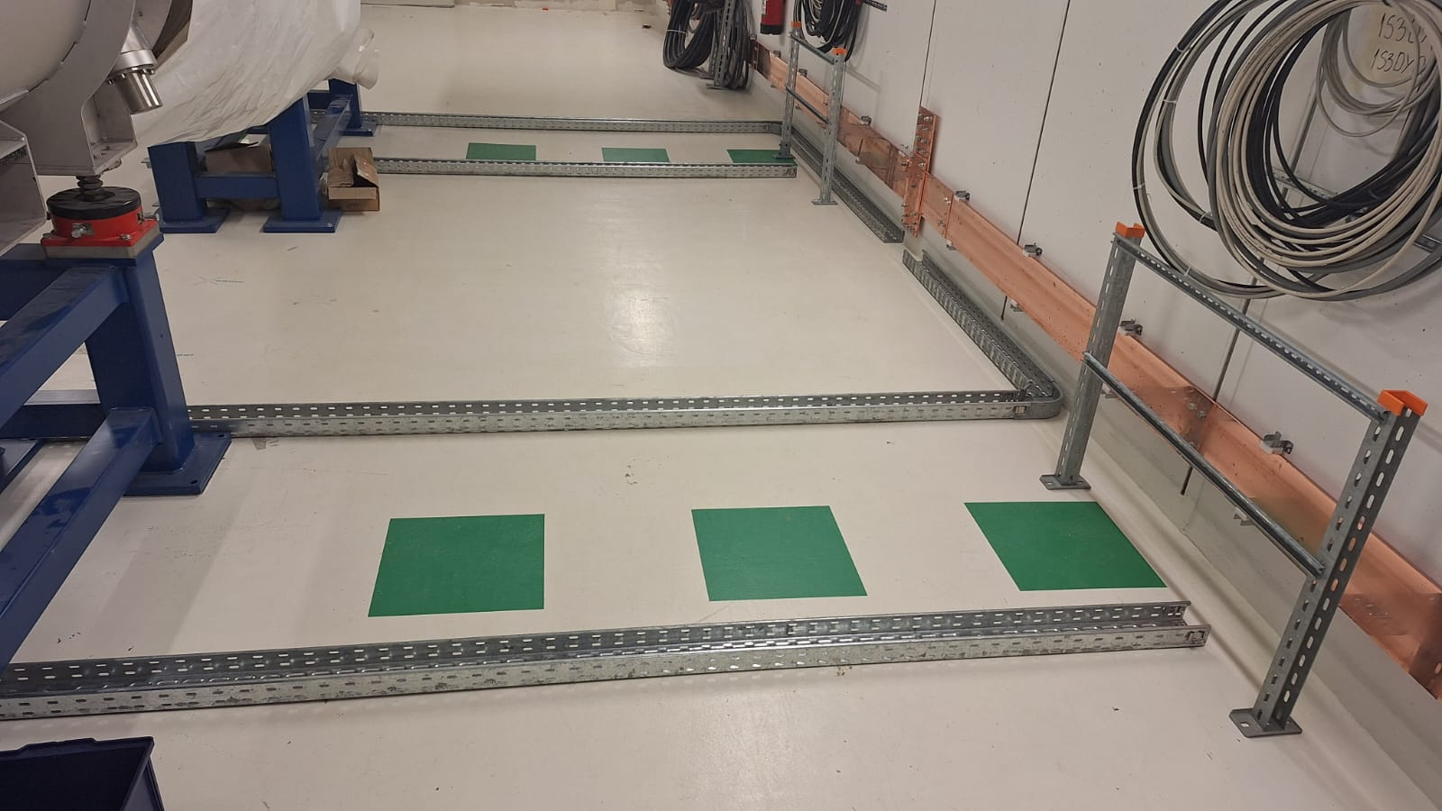
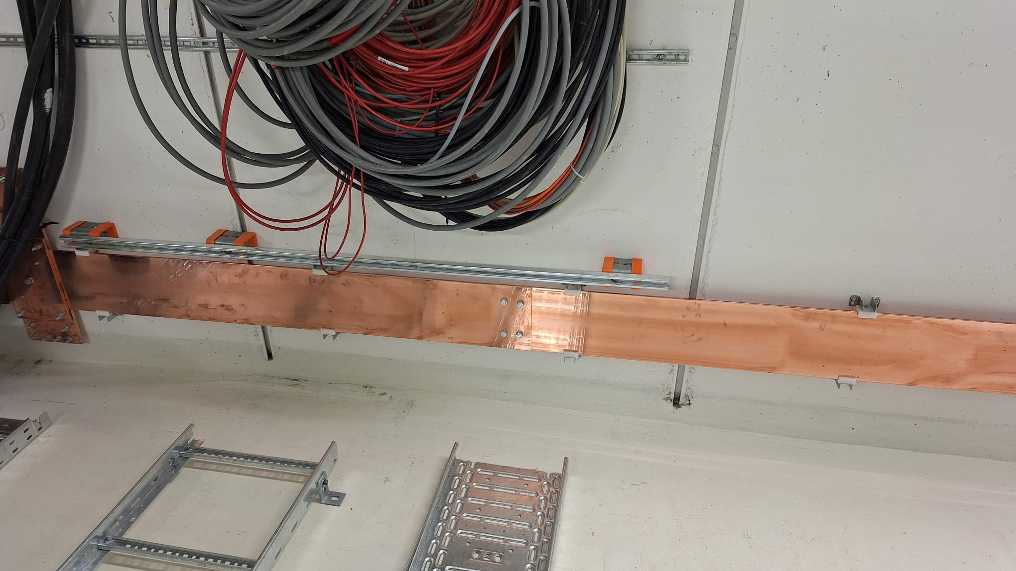
RV Cable installation
Machine trays
  Preconditions for cable tray installation in a given area:
    Machine components are installed in area of significant size
    All cables in the area must be laid
  Sequence of tray installation: S4s (starting KW44), S2s, S1s, tbd
  Lessons learned from test installation in S3a:
    Additional trays for grounding cables are required
    Cable supports for the Cu busbar

Slide 10
RV Cable installation
Data upload via CDB
Detailed information concerning cable installation collected and submitted via cable data base (per cable ID, Cable Connection Point Report)
Available information from CDB Main Report:
  Start and target information (e.g. nomenclature, rack name, TP, etc.)
  Approved connector type according to RV position
  Installation description (partially available)
  Special user remarks regarding installation
Required information for the Cable Connection Point Report:
  Installation description (if not yet provided)
  Connector nomenclature/designation (for both start and target)
  Schematic (if applicable)
  Pin assignment
  Number of connectors per cable (eg. optical fiber, multicore cables)
  Special test procedure (if applicable)

Slide 11
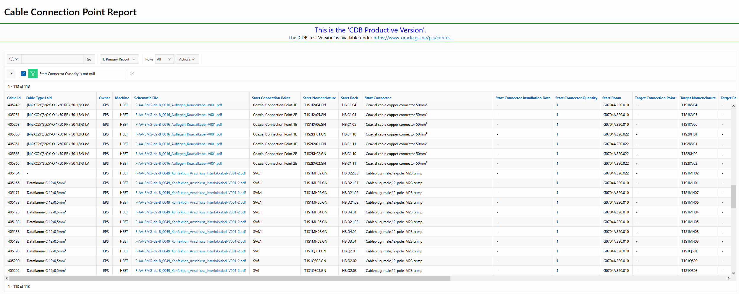
RV Cable installation
Data upload via CDB
Relevant cable IDs can be filtered by various criteria (e.g. department, machine, etc.)
The filtered selection can be downloaded as CSV file
The CSV file can be edited an re-uploaded
Additional documents (e.g. schematics, work descriptions, etc.) must be uploaded separately via CDB interface
The detailed process of the above will be described in a manual (under preparation)

Slide 12
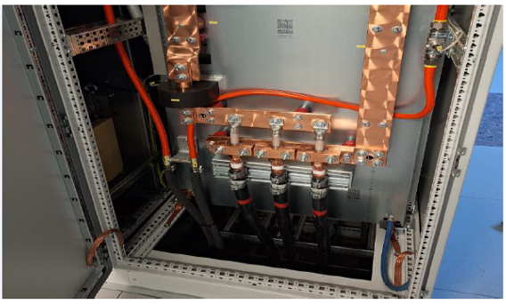
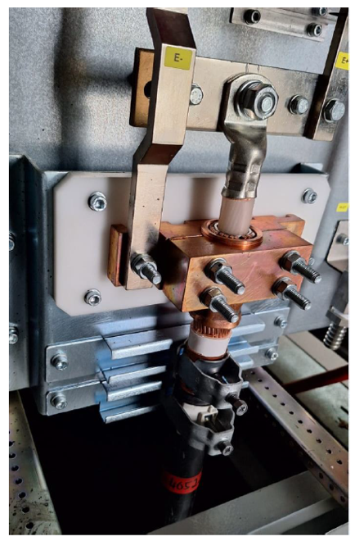
RV Cable installation
Installation of power cables has started in G0704A (HEBT, T1S1)
Installation of power cables in SIS100 is possible starting from week 43

Slide 13
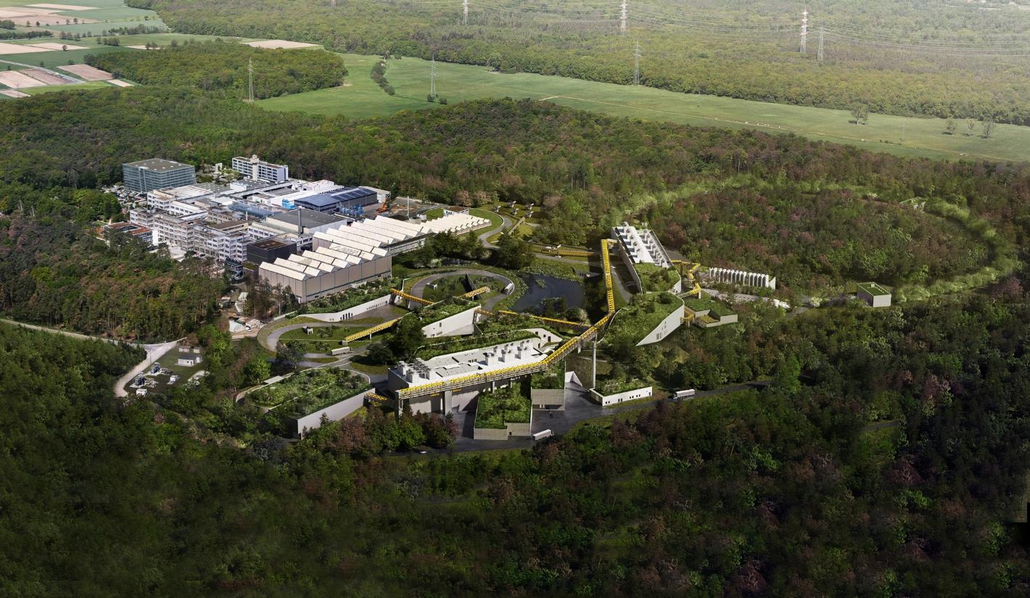
Thank You!

