Slide 1
4. SIS100 Klausur
Procurement and Installation and start of Commissioning
Peter Spiller, Niels Pyka
September, 2025

Slide 2
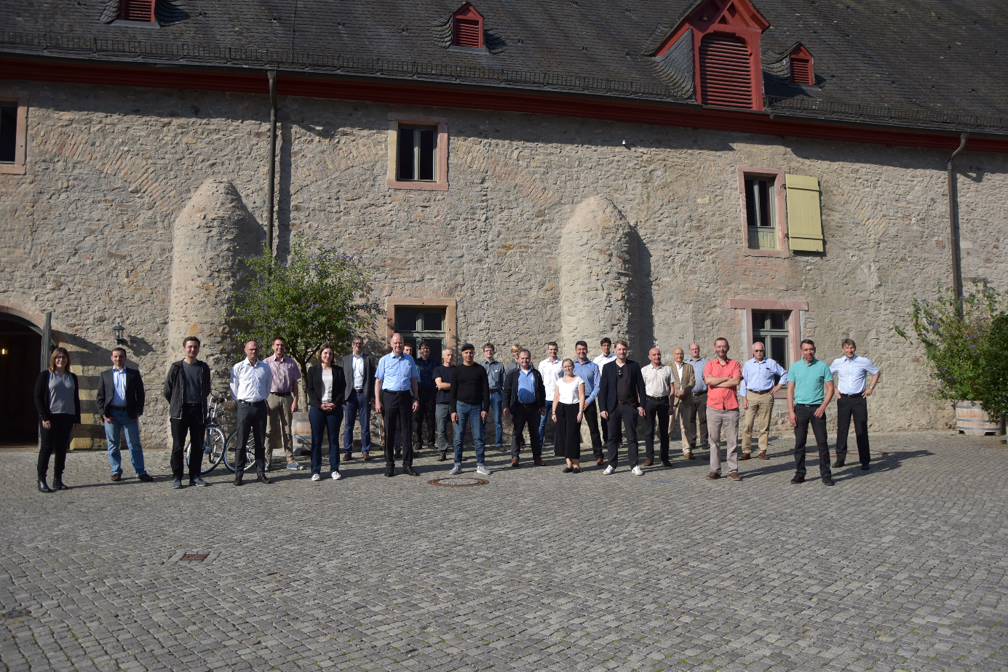
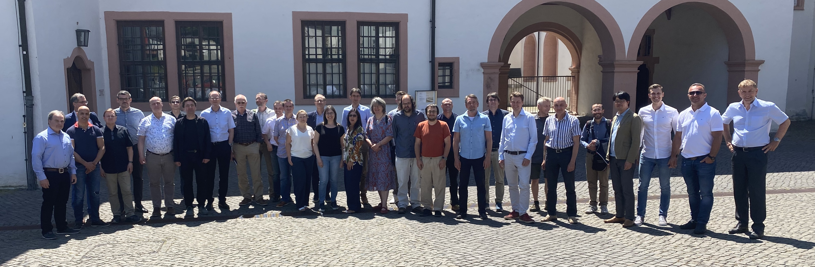
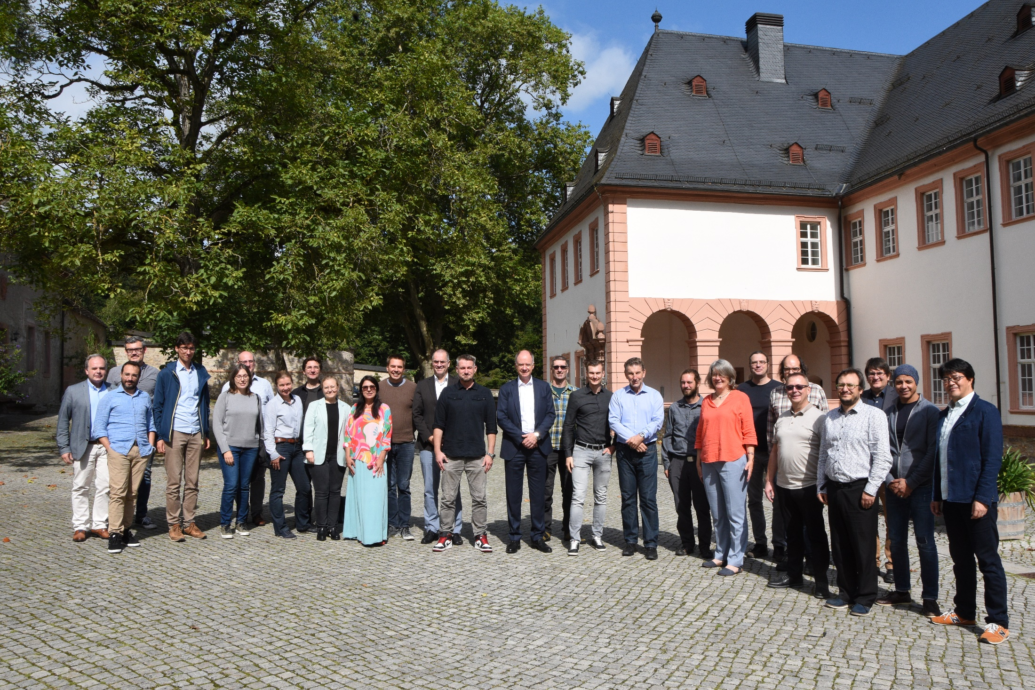
SIS100 Klausur #1,#2,#3…
Workshop 2023 Machine and Installation
Workshop 2020 with limited participation due to Corona measures
Workshop 2024 Procurement and Installation
Welcome colleagues from GSI/FAIR and from our international partners.
Integrating activities of Subproject SIS100/SIS18, SMG and Commissioning
(2024: Next year SIS100 Klausur will cover the first steps towards commissioning. > we start doing it)

Slide 3
Your stay at Kloster Eberbach
Coffee break and lunch is free.
Soft drinks are included.
Dinner and accomodation has to be covered by each participant.
In room „Vestibül“, free soft drinks are always available.
Lunch will be served in room „Gesellschaftsraum“ (Hotel).
Parking needs to be payed via the automat or you should inform Mrs. Aguilera to receive a batch from the hotel for the car.
We will take a group photo. Eventually we will publish the group photo (e.g. GSI home page). If you don‘t want to be „published“, you should not join the photo session.
We consider printing all talks as booklets for each session and distribute them.
Thanks a lot to Mrs. Aguilera for the organisation of this event.
Thanks a lot to Mr. Echouaf our media expert for his permanent loyality.

Slide 4
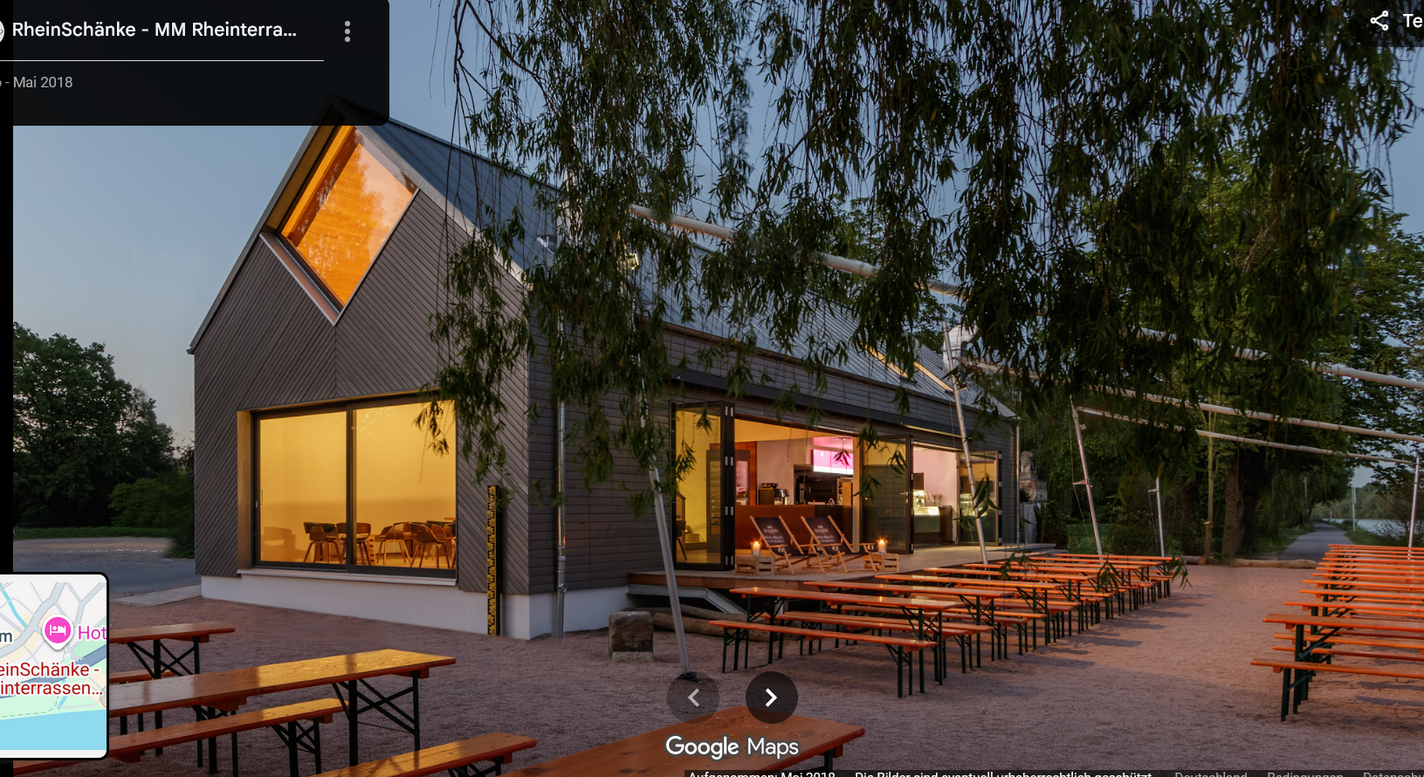
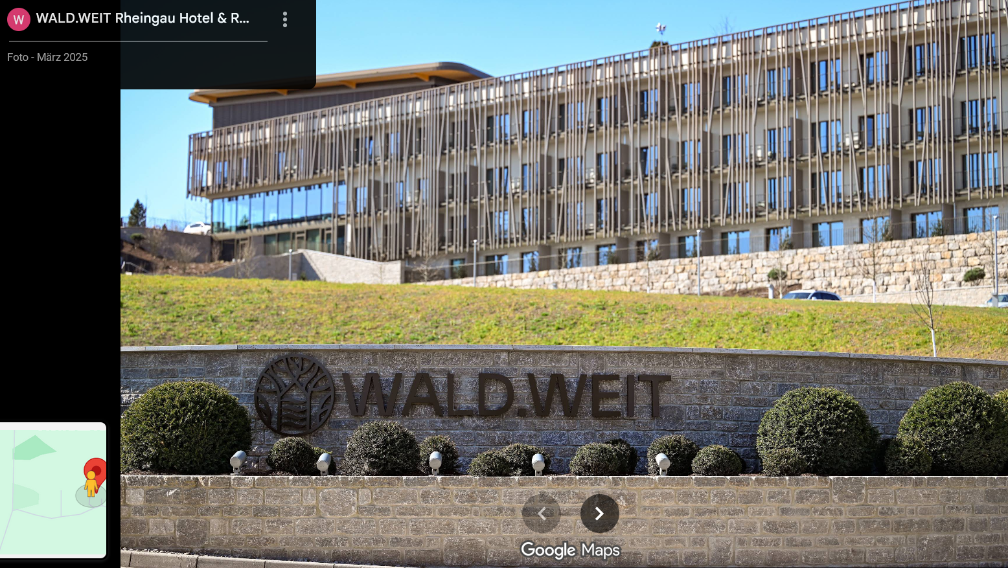
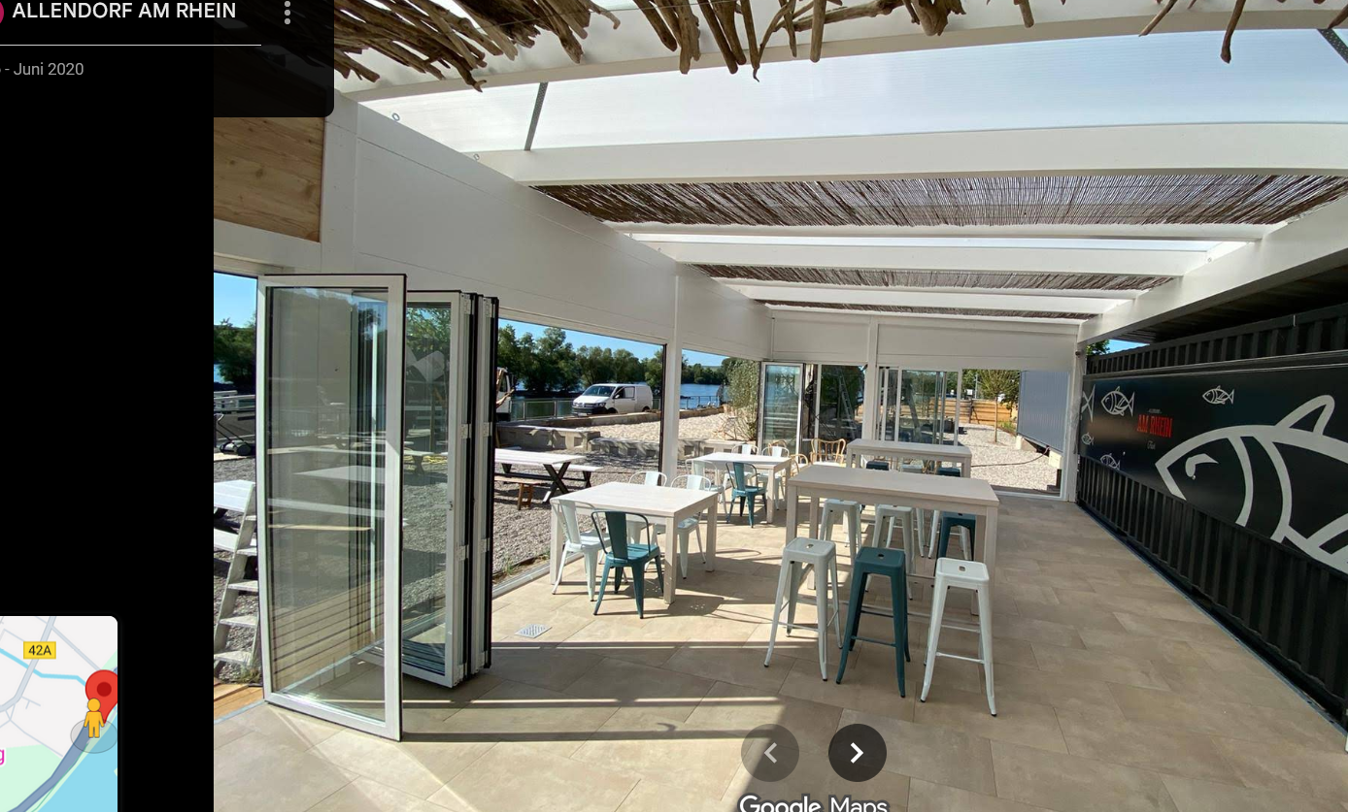
Recommendation for the evening
If you are not mobile you may have dinner in the restaurant of the „Kloster“.
If you are mobile you may visit:
Rheinschänke in Hattenheim
Allendorf beach club in Östrich Winkel)
Rooftop Bar Hotel Wald.Weit (Kiedrich)
and many other nice locations nearby.

Slide 5
Presentations
The former duration of 1 ½ days was to short to cover more and more installation topics > 2 ½ days
The time slot for each presentation is rather short and the agenda is tight.
The time for discussions is short.
The chairmen have to take care that the schedule is kept !
The presenters receive notice 5 minutes before the end of the presentation.
If necessary the discussions need to be stopped by the chairmen.
The chairmen received templates for summarizing the action items of each session.
Summary of each session will be the list of action items.
As a result of the presentations and discussions, communication and coordination shall improved, missing coordination shall be identified and actions shall be defined.

Slide 6
Session Chair and Minutes
Session Chair Template for Documentation of Action Items
Workpackage | Required Action/Activity | Activity Owner | Due Date

