Slide 2
Status Report About Activities In Juelich
Peter Wintz (IKP - FZ Jülich)
XLV – PANDA Collaboration Meeting, June-25, 2013

Slide 3
Outline Juelich Activities
STT layout
Geometry update / gas distribution
Online tracking (→ Marius)
STT construction (WPs)
Straw mass production
Hexagon sector setup
Readout electronics (→ Jacek/Greg)
COSY-beam tests
New to the group: Artur Cebulla, a.cebulla@fz-juelich.de

Slide 4
STT Geometry Update
Reminder: straws are close-packed with ~20µm gaps
Pressurized straw diameter defines layout dimensions
Depends on strip winding / glue layer, slight differences each delivery (LAMINA)
Precise diameter measurement neccess. for final new tubes, results this Sep.
Method approved, ~1-2µm precision (by Artur Cebulla)
Measure diam. vs overpressure & long-term (setting time)
Change (prelim.): 10.10 → 10.14(5) mm (incl. 20µm gap)
Small change in radial STT dimension (~1.3mm)
Few mm safety margin in layout still left
Re-calculation of all straw positions (in Sep./Oct.)
CAD & text file for MC input (Artur/Peter)
Mechanical frame adaption
STT x-y view, change of radial dimensions by larger straw diameter
ΔR ∼ 1.3 mm

Slide 5
STT Gas Distribution Lines
Per semi-barrel: 12× gas supply lines, 2×12 gas pipes (in-/outlet)
Optimisation of gas distribution scheme, parallel lines access. from outside
Arrangement of 4 parallel gas lines per hexagon sector, if one failures
still 3d tracking possible with momentum reso. in each sector
still 3d-online track recognition possible
similar number of straws per gas line,
#205, 196, 190, 142
different gas flows possible
No hints for serious gas failures
(leakage) from COSY-STT (4yrs in vacuum)
Proposal! open for discussions
Hexagon sector with 4 parallel gas lines: 1, 2, 3(a+b), 4(a+b)
1
3a
2
4a
3b
4b

Slide 6
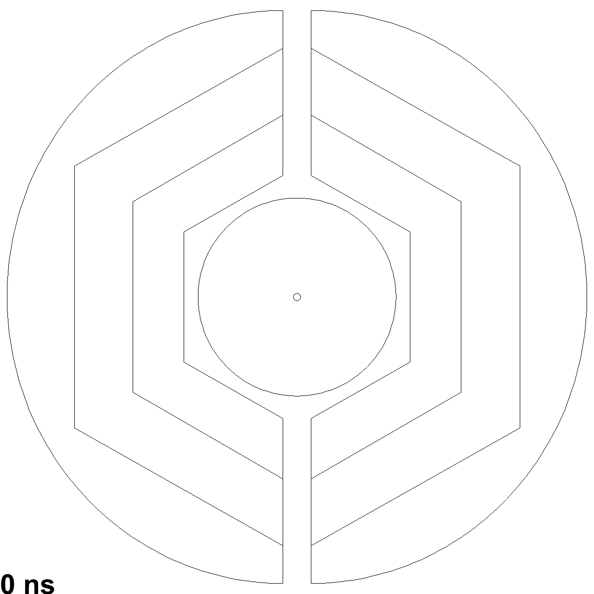
STT Online Reconstruction
STT layout must fullfill PANDA specific reco requirements
offline: full simulation & analysis of benchmark channels done
online: track & event reconstruction in continuous data stream
Online: proof by time-distributed event simulation (DPM)
STT stand-alone tracking, based on axial zones
STT hits w/o external timing (t₀)
hit triplets method seems to work
hit triplet: ~1mm precision (cms-x,y)
single straw: ~3mm
isochrone: ~ 150µm, only with t₀
Time-distributed event simulation (DPM) and track reco based on hit triplets
→ Marius‘ talk

Slide 7
STT Construction WPs
Straw mass production and layer modules
Electronic readout system
Mechanical frame system: STT (+ central support frame)
Hexagon sector setup (pre-comissioning)
Gas system
HV system
Slow control system (DCS)
STT final setup and comissioning
Partners in Germany, Italy, Poland, Romania, ..

Slide 8
Straw Production Status
Straw productions in Juelich (100% WP)
Pilot mass production run done at end 2012/13
Unexpected leakage → tests, new specific. of film tubes (winding/glue)
Replacement order (LAMINA), first 5000 straws delivered this June
Re-definition of production quality criteria, assurance tests, ..
Final straw mass production starts this Sep.
Preps done: all materials, mounting tools & techniques
Needs 3-4 years, including >> 50% spare straws
First task: precise measure of pressurized (p=2 bar) straw diameter
No change of inner tube diameter, same end plugs
New CAD drawings for straw modules (skew angle, side bands, ..)
Pending: new reference (groove) plate for straw layer gluing

Slide 9
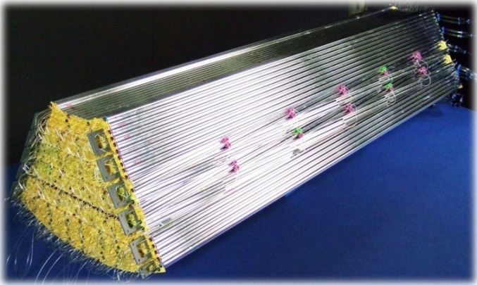
STT Hexagon Sector Setup
Ideal pre-commissioning of full STT design (mechanics & electronics)
Mechanical setup issues
Precision measurement of straw positions (3d-gauge)
Alignment structures (connecting tubes, frame-straw module connect.)
Mechanical frame adaption, final mounting scheme
Electronic readout system
800 straw channels
Final mounting scheme, cooling
Ready in 2014/ 2015, beam tests in 2015
In addition: existing straw prototype detector
setups for ongoing beam tests
STT hexagon sector, 1.5m length

Slide 10
STT Readout
2 Concepts to measure drift time + signal amplitude (for dE/dx)
TDR fully approved, ECE evaluation & recommendation: “.. following both electronics options is a wise approach ..“
Amplitude sampling: LE-Time + Q
Frontend amplifier + FADC (240MHz)
Status: σ_{rϕ} ~ 150 µm, σ(dE/dx) < 10% measured, ~7% feasible at PANDA
Pending: High-rate FPGA pulse analysis and readout, final amplifiers
Amplitude by time-over-threshold*: LE-Time + ToT(Q)
Frontend ASIC chip + Time-Readout-Boards
Status: first in-beam tests sucessfull, analysis ongoing
Pending: full ToT ↔ dE/dx calibration, analysis, >4 beam momenta, larger straw setups equipped with RO (few 100 straws, inclined to beam)
*ToT used for PID at ATLAS- TRT & HADES-MDC

Slide 11
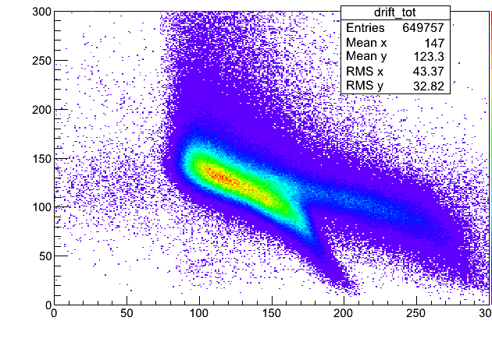
Time-Over-Threshold Method
ASIC testversion with analog out, first in-beam test 2012 (→ Jacek)
Next ASIC version in production: 100 chips× 8 ch, few param. optimisations
Calibration of ToT ↔ dE/dx with ⁵⁵Fe-source and beam protons
need >4 different beam momenta to get ToT ↔ dE/dx relation and resolution
⁵⁵Fe-signals
220(110)e⁻/200µm, pulse
integral + ToT measuremt
dQ/Q resolution ~ 10%
Beam on straws, TRB readout
50mV threshold
ToT
(25mV)
ToT
(50mV)
Pulse
integral
backgrd
Time over Threshold (ns) →
15mV thresh.
diff z-positions
25mV threshold
Charge (pC) vs ToT (ns)
Time (ns)→

Slide 12
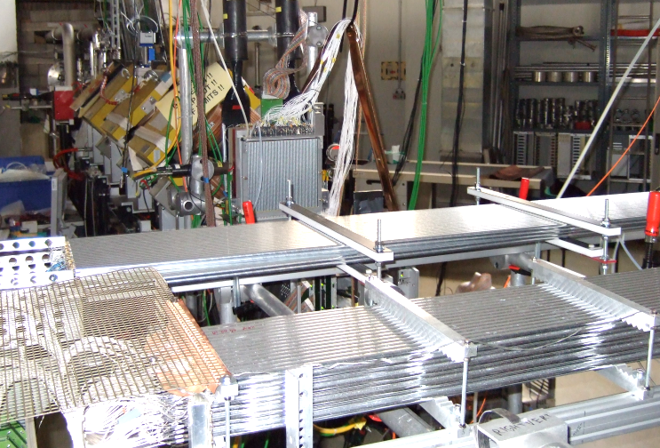
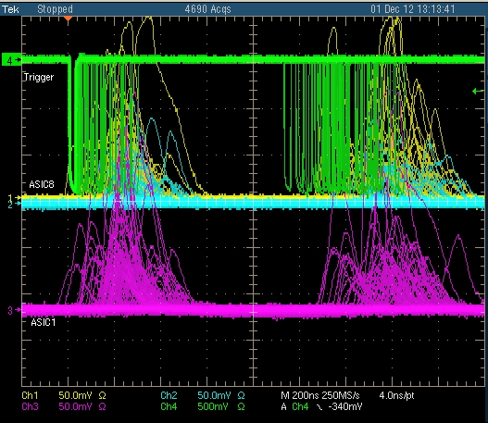
COSY Beam Tests
Accessible dE/dx-range: ~10×mips with proton/deuteron beams ~ 0.6-3 GeV/c
Straw prototype setups for readout tests in COSY beam area (Big Karl)
Pileups (trigger + straws) during last beam test (Dec-12)
multiple beam/triggers within 300ns, delayed straw hit times possible
next time: cleaner setup (multiplicity veto, lower intensities for checks, ..)
300ns
∼1000 ns
Scint. trigger
Straw signals
(ASIC analog out, yellow, blue, purple)
2 Straw setups, beam coming from the back (Big Karl area)

Slide 13
Summary
Well prepared to start straw production in Sep. this year
Beam straw tests at COSY ongoing for high-rate measurements
Hexagon sector setup ideal for pre-commissioning (mechanics/electr.)
Followed by dedicated beam tests at COSY in 2015

