Slide 1
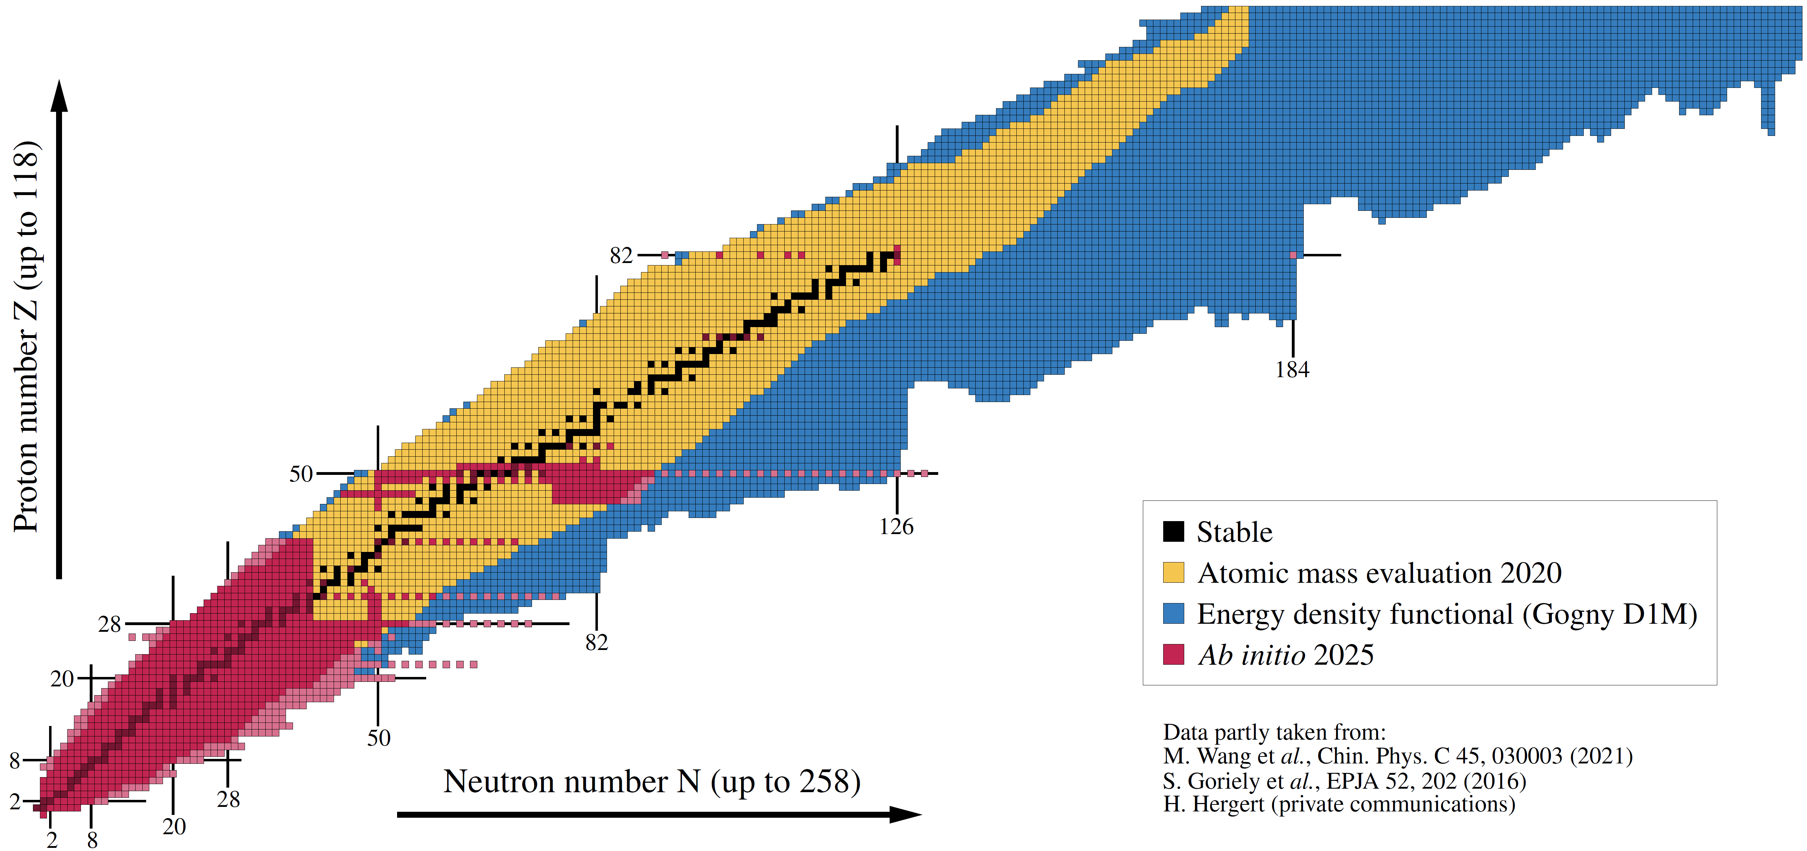

Charge radii in exotic tin isotopes from ab initio Bogoliubov coupled cluster theory
R_{ch}
^{A}Sn
Figure: B. Bally
P. Demol, U. Vernik, T. Duguet, A. Tichai, in preparation
Hirschegg 2026 - Challenges in effective field theory descriptions of nuclei
Thomas DUGUET
DPhN, CEA-Saclay, France

Slide 2
Contents
⦿ Introduction
⦿ Charge radii in exotic tin isotopes
⦿ Conclusions

Slide 3
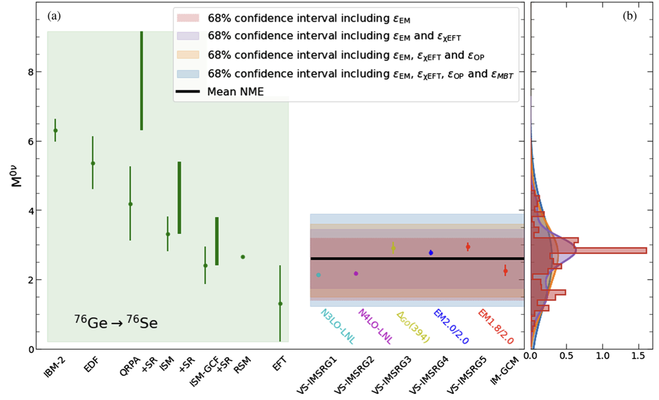
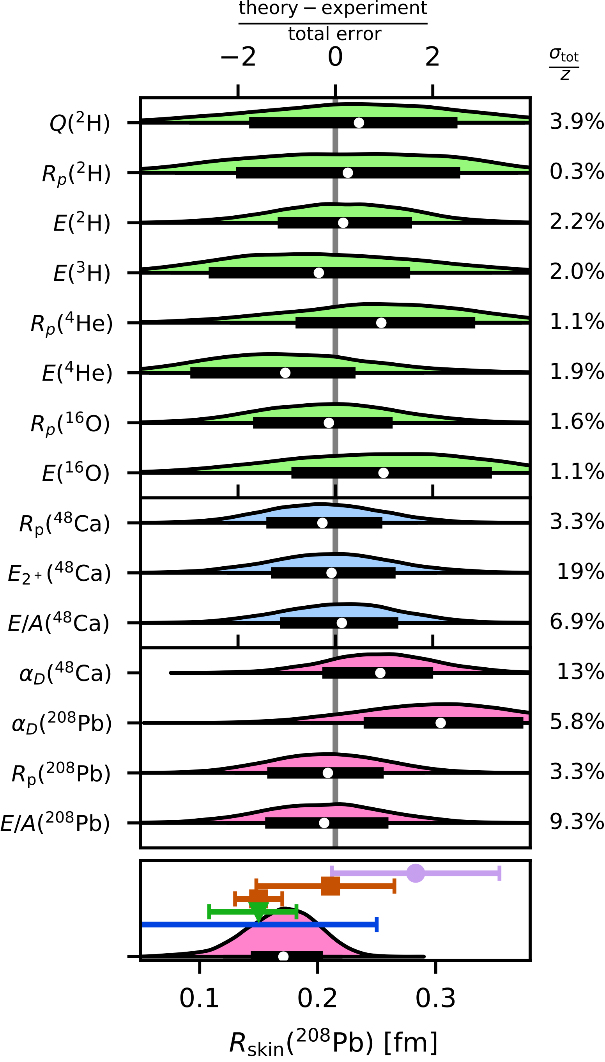
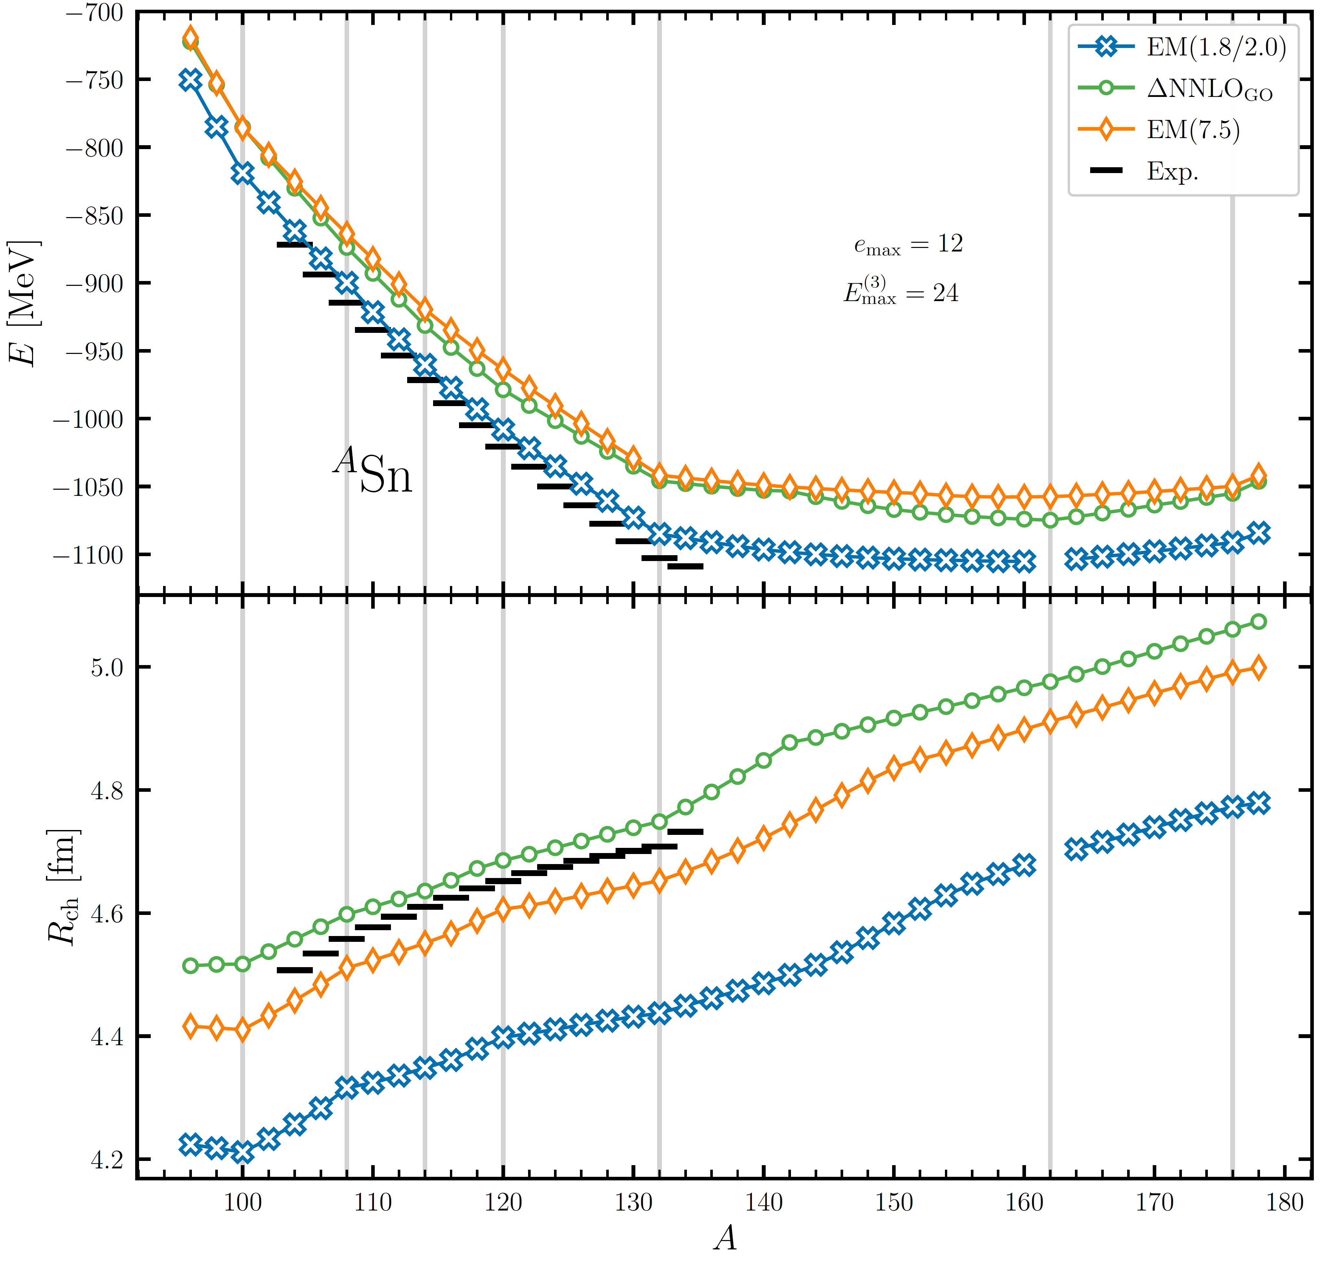
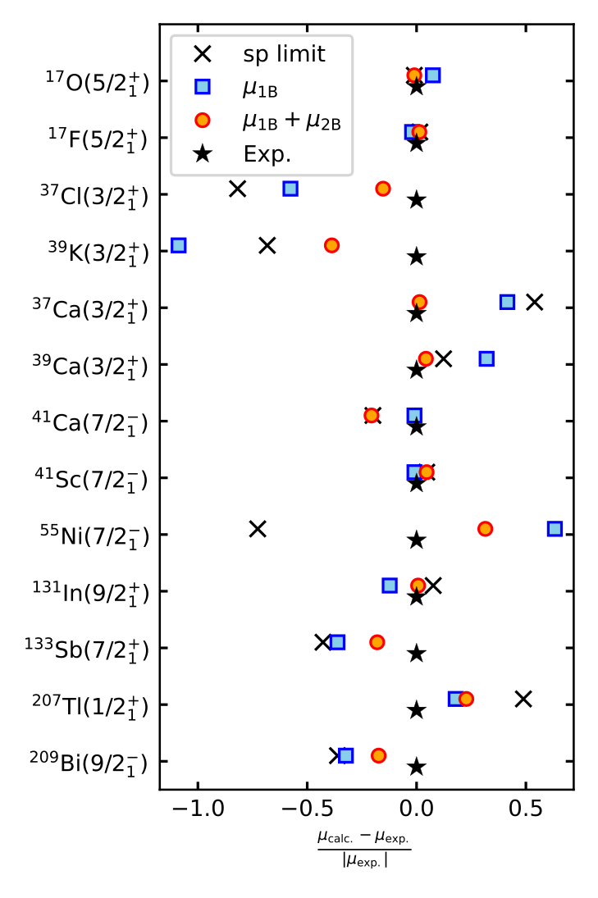
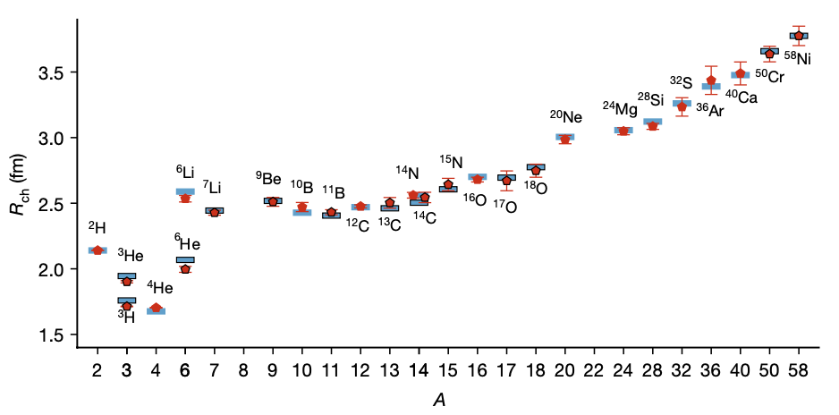
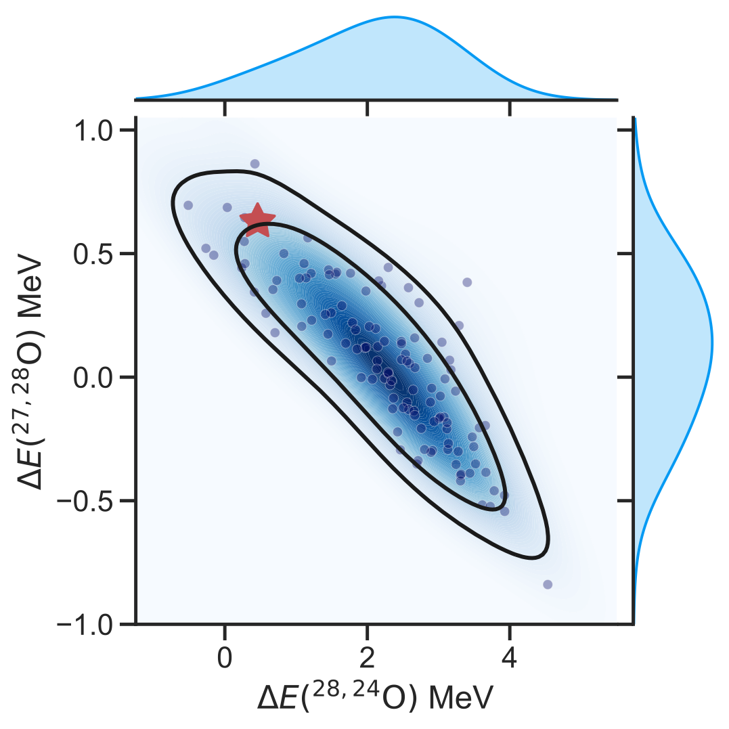
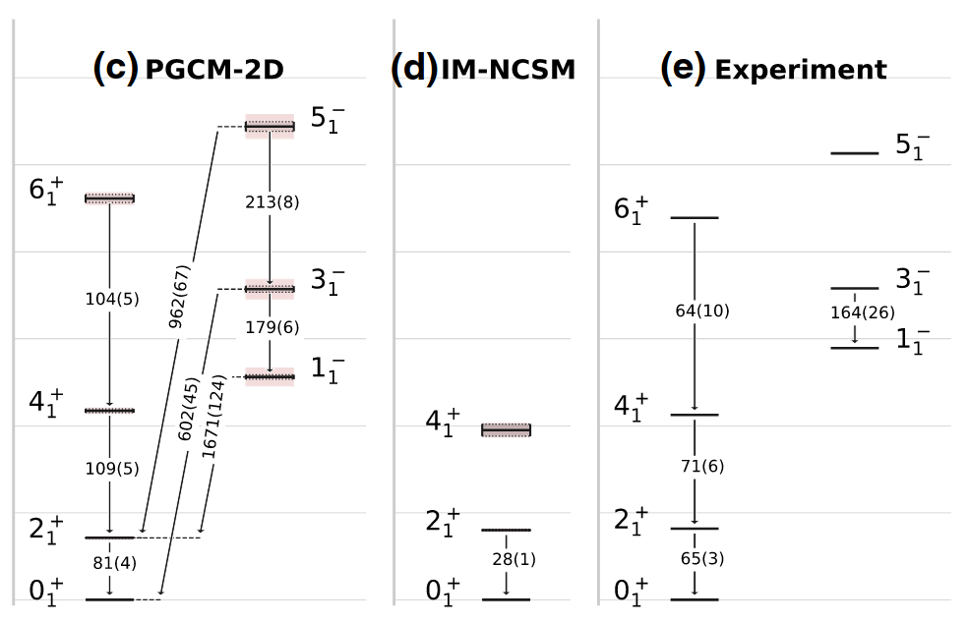
Ab initio theoretical scheme : current reach
UQ for 0νββ in ⁷⁶Ge
Skin thickness in ²⁰⁸Pb
Infinite matter EOS
Electroweak
Hadronic
Electromagnetic
Gravitational waves
Heavy ion collisions
Shape coexistence in ⁸⁰Zr
Hu et al. (2022)
Magicity of ²⁶⁶Pb
Belley et al. (2024)
E and R_{ch} in ¹⁰⁰⁻¹⁸⁰Sn
r-process with N=82 masses
Hu et al. (2025)
Optical potential
Hu et al. (2024)
³⁴Si bubble nucleus
Bonaiti et al. (2025)
2-body current for μ
Tichai et al. (2024,2025)
Vorabbi et al. (2024)
Kuske et al. (2025)
2⁺₁ through ¹³²Sn
Duguet et al. (2017)
Systematic ~700 nuclei
²H → ⁵⁸Ni R_{ch}
Clustering ¹⁶O&²⁰Ne
Miyagi et al. (2022)
Miyagi et al. (2024)
Stroberg et al. (2021)
Elhatisari et al. (2024)
Giacalone et al. (2025)
Stability of ²⁸O
Giant resonances
Rotational bands in ²⁰Ne
Courtesy of B. Bally
2025
²⁰Ne
Kondo et al. (2023)
Porro et al. (2024)
Frosini et al. (2022)

Slide 4
Heaviest nuclei studied ab initio
Singly open-shell nuclei
Doubly closed-shell nuclei
Magicity of ²⁶⁶Pb
Spherical Bogoliubov CC
Spherical CC
Valence-space IMSRG
r_{ch} and B(E2) in ¹⁰⁰⁻¹³²Sn
BE in ¹⁰⁰⁻¹⁸⁰Sn
Bonaiti et al., arXiv:2508.14217
Gustafsson et al., PRL (2025)
Tichai, Demol, Duguet, PLB (2024)
2025
Courtesy of B. Bally
Present study: evolution of absolute charge radii and isotopic shifts along complete Sn isotopic chain
→Absolute charge radii constitute a challenge for χEFT interactions
→Evolution of isotopic shifts uncovers refined challenges for χEFT interactions
→Heavy open-shell nuclei extend those tests into a new regime

Slide 5
Present study on r_{ch} in even-even Sn isotopes
^{100,102}Sn
¹⁰⁰⁻¹³²Sn
⁹⁸⁻¹⁵⁰Sn
Nuclear Lattice EFT (a=1.32fm; L=12; N³LO)
VS-IMSRG(2) (¹⁰⁰Sn core)
Spherical Bogoliubov CCSD[T]
BE
BE and r_{ch}
BE and r_{ch}
Hildenbrand et al., arXiv:2509.08579
Gustafsson et al., PRL (2025)
Demol et al., in preparation
Rise of δ<r_{ch}²>⁴⁸⁻⁵²
R_{ch} in doubly magic nuclei
3N c_{i} variation
Isotopic shift through ⁴⁸Ca
HF
IMSRG(2)
Exp = 0.53
IMSRG(2)
Companys-Franzke et al., arXiv:2510.08362
What about charge radii in heavier Sn isotopes?
0.32
Arthuis et al., priv. Comm.
Arthuis et al., arXiv:2401.06675
⦿ χEFT based Hamiltonian EM (1.8/2.0)
⦿ χEFT based Hamiltonian EM (7.5)
⦿ Δ-full χEFT ΔN²LO_{GO}(394) Hamiltonian
Hebeler et al., PRC (2011)
→Good BE (ΔE_{exp}<2%) + spectro. but radii too small (ΔR_{exp}=6%)
Arthuis et al., arXiv:2401.06675
→Same with improved charge radii (via c_{D} through r_{ch}(¹⁶O))
Jiang et al., PRC (2020)
→Good E_{sat} and ρ_{sat} and E_{sym} of SNM

Slide 6








Bogoliubov coupled cluster many-body method
Hamiltonian partitioning
Unperturbed state
Fully correlated state
Wave operator
« Easy »
to solve
Expansion series
Static correlations
Dynamical correlations
Mean-field-like =
Beyond-mean-field-like =
Break U(1) (SU(2)) symmetry to address singly (doubly) open-shell nuclei
U(1)
SU(2)
Coupled cluster theories
with cluster excitation operator
GSCGF dSCGF
BMBPT dMBPT
BCC dCC
singles
doubles
triples
Closed-shell (unpaired) nuclei: standard CC
Open-shell (paired) nuclei: Bogoliubov CC
Hagen et al., RPP (2014)
Signoracci et al., PRC (2015)
U(1) breaking
Slater determinant
Bogoliubov vacuum
np-nh excitations operator
2n quasi-particle excitations operator
Unknowns found via coupled algebraic non-linear equations
Unknowns found via coupled algebraic non-linear equations
$${\sim ndim}^{5}$$
Unbearable
$${\sim ndim}^{4}$$
$${\sim ndim}^{6}$$
$${\sim ndim}^{7}$$
$${\sim ndim}^{8}$$
$$\sim ndim!$$
BMBPT(2)
BMBPT(3)
BMBPT(4)
HFB
…
Diag.
Sub %
CI
Few %
BCCSD
BCCSDT

Slide 7






Bogoliubov coupled cluster many-body method
Hamiltonian partitioning
Unperturbed state
Fully correlated state
Wave operator
« Easy »
to solve
Expansion series
Static correlations
Dynamical correlations
Mean-field-like =
Beyond-mean-field-like =
Break U(1) (SU(2)) symmetry to address singly (doubly) open-shell nuclei
U(1)
SU(2)
Coupled cluster theories
with cluster excitation operator
GSCGF dSCGF
BMBPT dMBPT
BCC dCC
singles
doubles
triples
Closed-shell (unpaired) nuclei: standard CC
Open-shell (paired) nuclei: Bogoliubov CC
Hagen et al., RPP (2014)
Signoracci et al., PRC (2015)
U(1) breaking
Slater determinant
Bogoliubov vacuum
np-nh excitations operator
2n quasi-particle excitations operator
Unknowns found via coupled algebraic non-linear equations
Unknowns found via coupled algebraic non-linear equations
$${\sim ndim}^{4}$$
$${\sim ndim}^{5}$$
$${\sim ndim}^{6}$$
$${\sim ndim}^{7}$$
$${\sim ndim}^{8}$$
$$\sim ndim!$$
BMBPT(2)
BMBPT(3)
BMBPT(4)
Perturbative triple approximation
→BMBPT(4) complete
HFB
. . .
CI
Diag.
BCCSD
BCCSD[T ]
BCCSD(T)
BCCSD{T }
BCCSDT
BCCSD[T ]
More complete
Vernik, Demol, Duguet, Tichai, in preparation

Slide 8
Contents
⦿ Introduction
⦿ Charge radii in exotic tin isotopes
⦿ Conclusions

Slide 9
Calculation set up
Hamiltonian
EM (1.8/2.0)
EM (7.5)
ΔN²LO_{GO}
Characterizing properties of fine-tuned interactions
Gauge sensitivity to interactions = poor man’s way of estimating uncertainty
→No proper investigation of chiral order (and regulator dependence)
HO basis frequency
Arthuis et al., arXiv:2401.06675
Arthuis et al., priv. comm.
hw=12
Optimal for r_{ch} for the three Hamiltonians in ^{A}Sn
HO basis size
e_{1max} = 12
e_{3max} = 24 < 36
e_{1max} = 12 → 14 (at hw=12) to estimate basis size uncertainty
Many-body truncation
Vernik et al., in preparation
Perturbative triples correction for BE
Within [T] approximation
From ΛBCC evaluation
For BE only for now (need {T} approximation to correct r_{ch}²)
BCCSD[T] calculation at e_{1max} = 10
sHFB
sBCCSD
sBCCSD[T]
Zurek et al., to be submitted
Charge radius operator

Slide 10
Binding energy and two-neutron separation energy
@BCCSD
→“Hardness” still not resolved
~10% of ~[20,40]MeV
@BCCSD[T]
→“Hardness” resolved
Sub-percent many-body truncation uncertainty
Consistent with NLEFT @N=102
?
NO2B approximation
→Dominating source of many-body uncertainty?
→Problematic for heavy (A>130) doubly open-shell nuclei
→Time for the community to revisit it
Exaggerated N=82 S_{2n} step (~9MeV vs 6.5 exp)
→[T] lowers by 2MeV for EM(1.8/2.0) and ΔN²LO_{GO}
→Leftover outside many-body uncertainty estimate
→Test χEFT interactions in new regime
Predicted drip-line [¹⁴⁰Sn,¹⁶²Sn] fine tuned
→Subject to all sources of uncertainties

Slide 11
Absolute charge radii of even-even Sn isotopes
Absolute values
→EM(1.8/2.0) strongly underpredicts data
→ΔN²LO_{GO} largely improves but still underestimates data
→EM(7.5) further improves via slight overestimation
BCCSD
Consistent with expectations
Arthuis et al., arXiv:2401.06675
BCCSD correlations
→Small (~1%) but non-negligible
→Increase with N for EM(1.8/2.0)&ΔN²LO_{GO}
→Always in the right direction! Effect of (C_{D},C_{E})?
→BCCSD - VS-IMSRG(2)~0.1% for EM(1.8/2.0)
→Uncertainty estimate for EM(1.8/2.0)
Δr_{ch}^{CCSDT-1}(⁴⁸Ca)~0.7%
Δr_{ch}^{IMSRG(3)}(⁴⁸ca)~1.1%
Competition particle-like shell
1) Increased occupation
2) Shrinked orbital
by many-body correlations
Bonaiti, priv. Comm.
Heinz, priv. Comm.
Natural occupations and orbitals

Slide 12
Even-even Sn isotopic shifts with respect to ¹³²Sn
BCCSD
Overall performance against experimental data
→EM(1.8/2.0) and EM(7.5) similar (~20% error)
→ ΔN²LO_{GO} superior: rms error twice as small
Difference to VS-IMSRG(2)
→Below 10% ; best for ΔN²LO_{GO} (2%)
Measurement of ¹⁰⁴⁻¹⁰⁷Sn at CRIS@ISOLDE
Gustafsson et al., PRL (2025)
Measurement of ¹³⁴Sn at COLLAPS@ISOLDE
Sensitivity to employed Hamiltonian
→Significant but “constrained” over ¹⁰⁰⁻¹³²Sn
→Diverges over ¹³⁴⁻¹⁵⁴Sn
→Interaction spread magnified beyond ¹³²Sn
→Jumpstarted through kink at N=82
Gorges et al., PRL (2019)

Slide 13
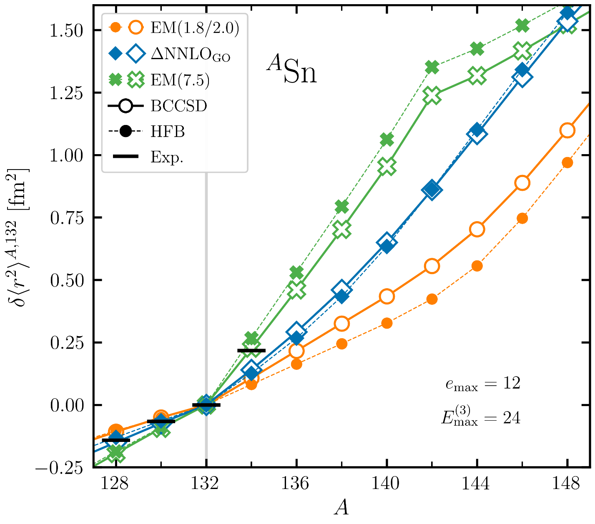
Isotopic shift kink through ¹³²Sn
Steep increase δ<r_{ch}²>¹³⁴⁻¹³² - Exp = 0.22 fm² (~⁵⁰⁻⁴⁸Ca)
→EM(1.8/2.0): 0.11 fm²
→ΔN²LO_{GO}: 0.14 fm²
→EM(7.5): 0.23 fm² ↔ Much improved
→More difference than through ⁴⁸Ca
→Δδ<r_{ch}²>^{IMSRG(3)}(⁵²⁻⁴⁸Ca)~6%
Significantly smaller than present interaction sensitivity
Arthuis et al., Priv. Comm.
Heinz, Priv. Comm.
EM(7.5) seems to be also superior regarding the kink at ¹³²Sn
Inverted kink predicted at ¹⁴²Sn for EM(7.5) only
→Is there a correlation with the kink at ¹³²Sn?
→Interesting prediction or else?
Measurement of ¹³⁴Sn at COLLAPS@ISOLDE
Gorges et al., PRL (2019)

Slide 14
Zoom on the kinks through ^{100,132,142}Sn
¹⁰⁰Sn
¹³²Sn
¹⁴²Sn
<r_{ch}²> kink predicted
→Consistent for three H (~0.2 fm²)
→Slope change sign (not EM(7.5))
S_{2n}
→Consistent large drop for three H
→BCCSD[T]≈data/NLEFT at ¹⁰²Sn
<r_{ch}²> kink
→Exp. known (0.22fm² ~ ⁵⁰⁻⁴⁸Ca)
→Best/well reproduced by EM(7.5)
S_{2n}
→Drop consistent for three H
Origin of difference in δ<r_{ch}²>¹³⁴⁻¹³²?
<r_{ch}²> kink
→Inverted kink for EM(7.5)
→No kink for the other two H
S_{2n}
→Dubious large jump up for EM(7.5)
Is it correlated to good kink in ¹³²Sn!?

Slide 15
Neutron shell ordering at the mean-field level
Good when fits exp data!
J from VS-IMSRG(2)
→Keep strong memory of sp shells
→But rarely the case in fact
→Couple of counter examples
Impact of shell ordering on r_{ch} kinks
→Very consistent in ¹⁰⁰Sn due to robust shell sequence
→1h_{9/2} for EM(7.5) vs 2f_{7/2} after N=82 → Larger kink in ¹³²Sn
→Jump back to 2f_{7/2} at ¹⁴⁴Sn → Inverted kink and dubious S_{2n}
☀️
🌦
Sensitivity of shell ordering to χEFT Hamiltonian employed
→Highly robust for N ϵ [50,82]
→One exception: inversion of 3s_{1/2} and 2d_{3/2} for EM(7.5)
→Much more versatile for N > 82: stringent test of χEFT Hamiltonians
Both features are correlated via shell ordering!
→Put in doubt merit of EM(7.5) for kink at ¹³²Sn

Slide 16
Detailed behavior in between major shell closures
Parabolic part of δ<r_{ch}²>
→Subtract linear part
Linear trend
→Slope quite off for EM(1.8/2.0)
→CCSD and VS-IMSRG(2) consistent
Parabolic trend
→EM(1.8/2.0)&ΔN²LO_{GO} in good overall agreement with data whereas EM(7.5) significantly underestimates
→Fingerprints of underlying subshells
Much too pronounced in CSSD
Smoothed out in VS-IMSRG(2) but still correlations are missing

Slide 17
Contents
⦿ Introduction
⦿ Charge radii in exotic tin isotopes
⦿ Conclusions

Slide 18
Conclusions
Demol, Vernik, Duguet, Tichai, in preparation
Charge radius along Sn isotopic chain offers stringent tests for χEFT interactions
→Parabolic behavior in between N=50 and N=82 magic numbers
→Kinks at N=50 (predicted) and N=82 (recently measured)
→Beyond N=82 where interaction uncertainty/sensitivity is strongly enhanced
Further work is needed
→Extend measurement towards ¹⁰⁰Sn and beyond ¹³⁴Sn
→Sensitivity analysis beyond ¹³²Sn, see e.g.
→Eventually go to high-accuracy calculations of <r_{ch}²>
⸙ Add triples correction: need BCCSD{T} (no counterpart in standard CC)
⸙ Add two-body charge density correction (~0.04fm in p-shell nuclei)
Companys-Franzke et al., arXiv:2510.08362
Sun et al., arXiv:2601.09614

