Slide 1
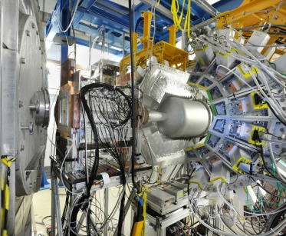
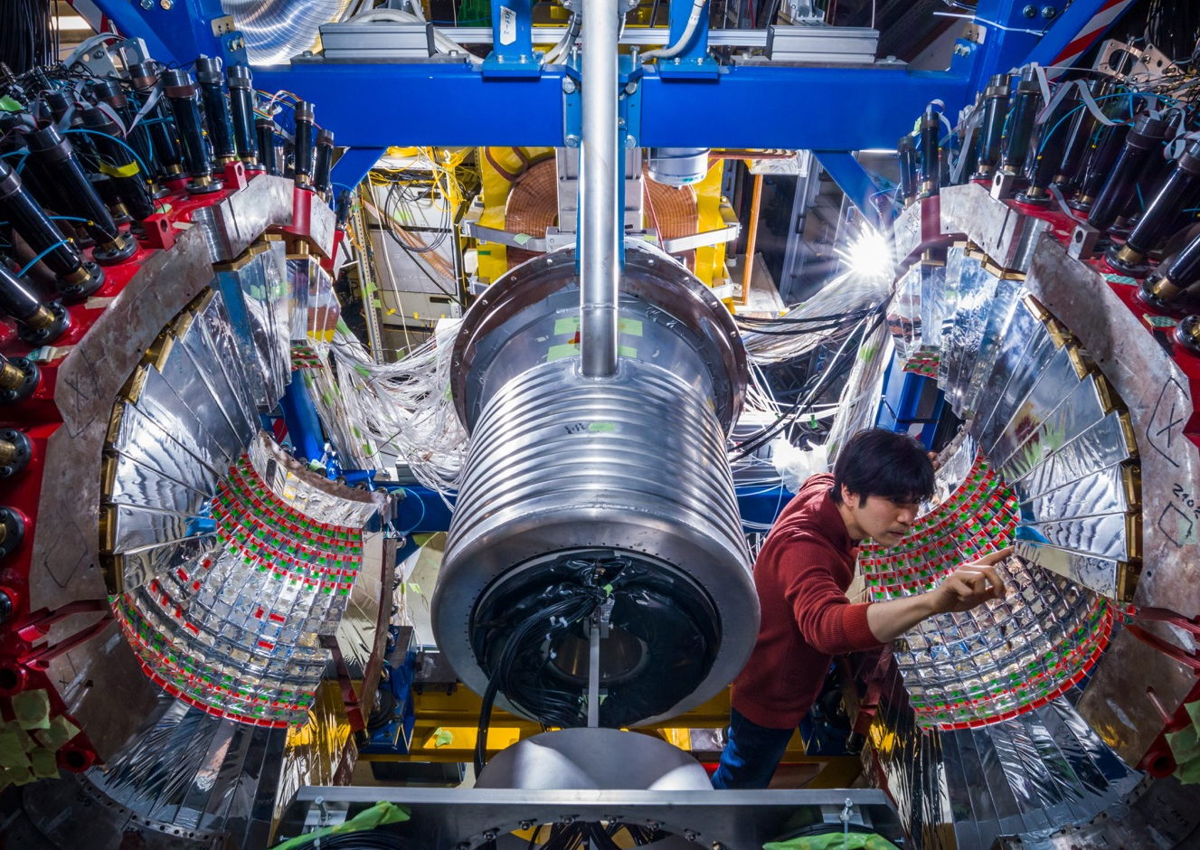
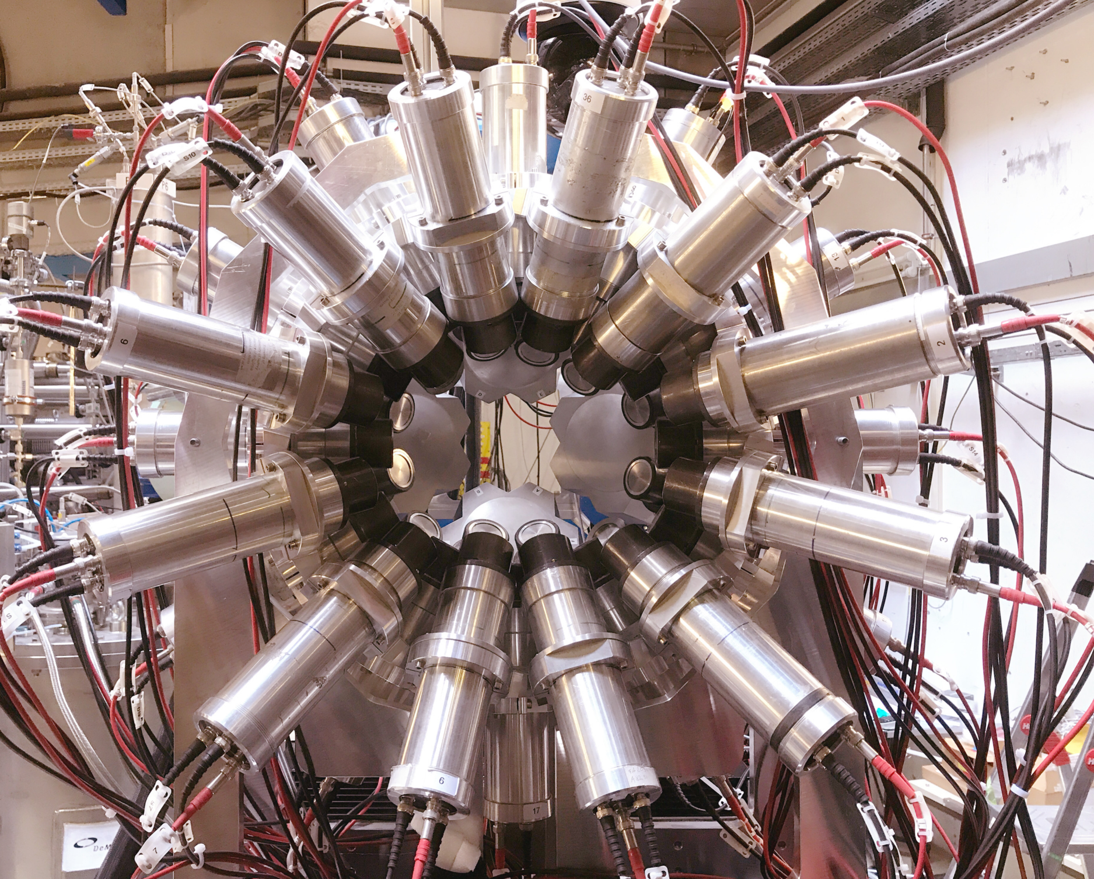

Update on NUSTAR Technical Status
Super-FRS EC Meeting, Mörfelden-Walldorf
17th September 2025
H.M. Albers

Slide 2
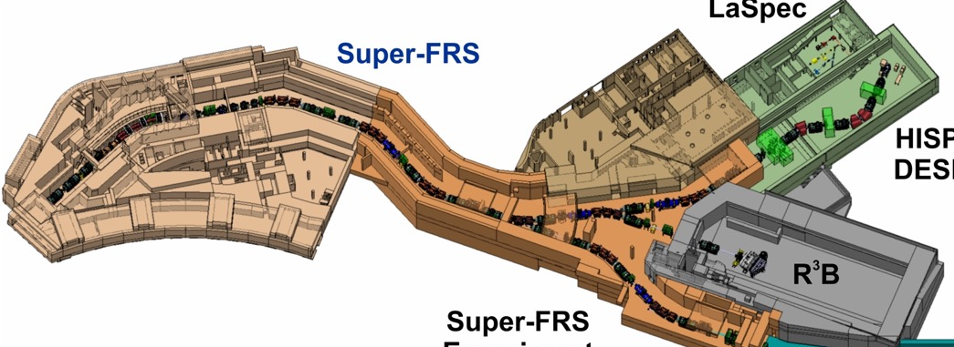
Overview of ES/FS at the S-FRS
Key focal planes of the S-FRS:
FMF2 mid-point of main separator
FHF1 (tunnel)
and FHF2 (HEC) along high-energy branch
Some basic infrastructure planned for LEC but no full TBI/beamline
LEC currently used for Super-FRS magnet preassembly
EXPERT neutron detectors NEURAD possible at FRF1
Two branching dipoles to be installed after ES start
FHF1
FHF1 area inside
S-FRS tunnel
FHF2
FMF2
HEC

Slide 3

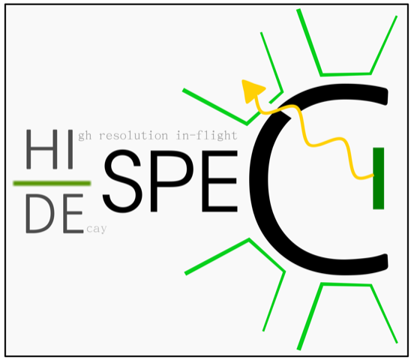
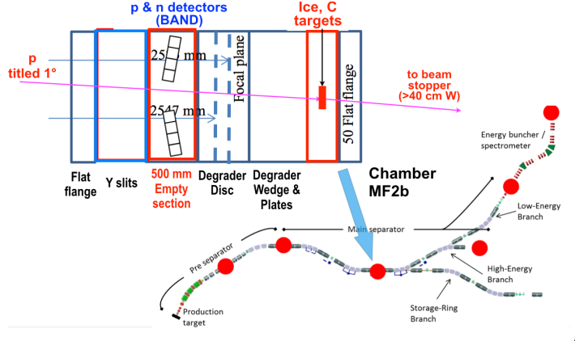
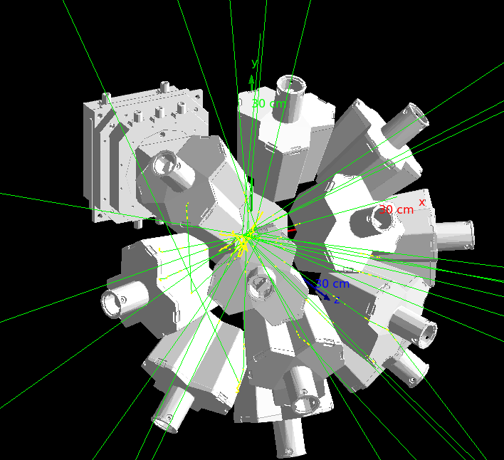
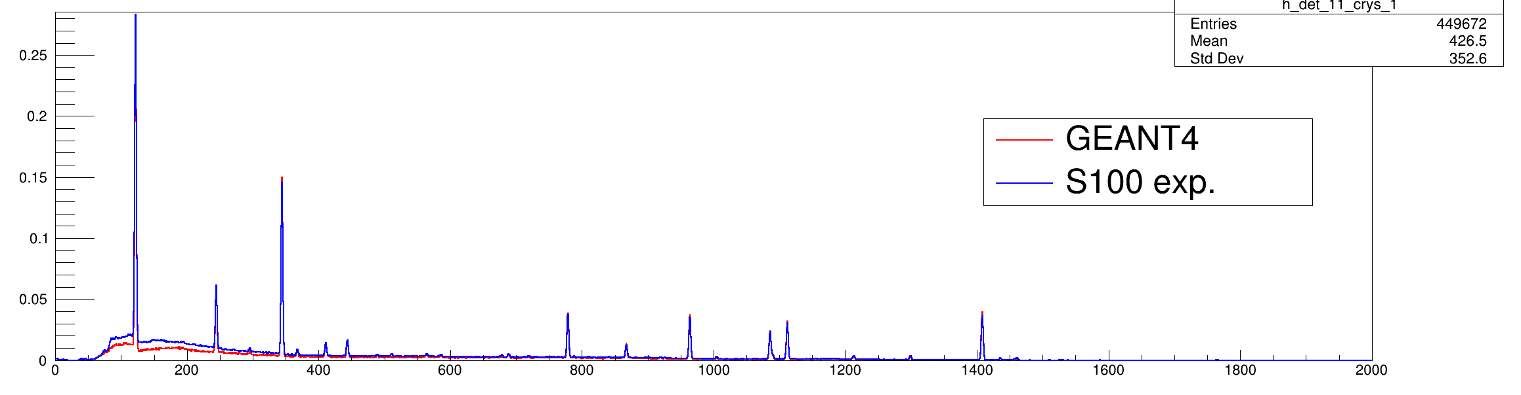
NUSTAR Technical Highlights
The Technical Design Report (TDR) for the Target & Detector Systems for Tensor-Force Experiments was submitted to the ECE/ECSG for review in June 2025
The TDR submission means that all NUSTAR ES TDRs are either accepted or submitted. Major milestone!
DEGAS+AIDA: Geant4 simulation for β–γ studies
A CAD-faithful Geant4 with realistic spill/decay timing to quantify detector response and guide analysis/upgrade choices has been developed
Precise geometry (CAD/GDML, dead layers, passive materials) + electronics effects (thresholds, timing gates, segmentation)
Proper time structure: beam spill → implant → decay chain
Unified response functions for DEGAS (HPGe), AIDA (DSSSD), BPLAST, BB7
Allows quantification of β-tagging efficiency and losses, efficiency maps vs implantation position, multiplicity, thresholds, and time gates
Comparison of simulated and real data
Figure from TDR 2_41 Ice target and tensor force draft

Slide 4

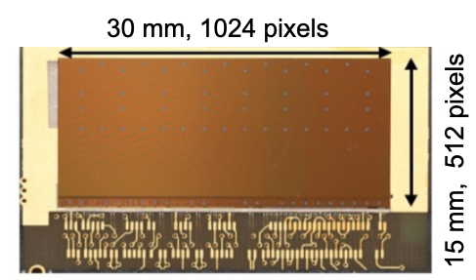
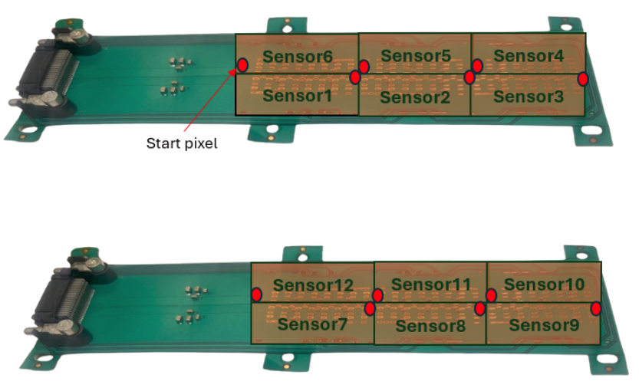
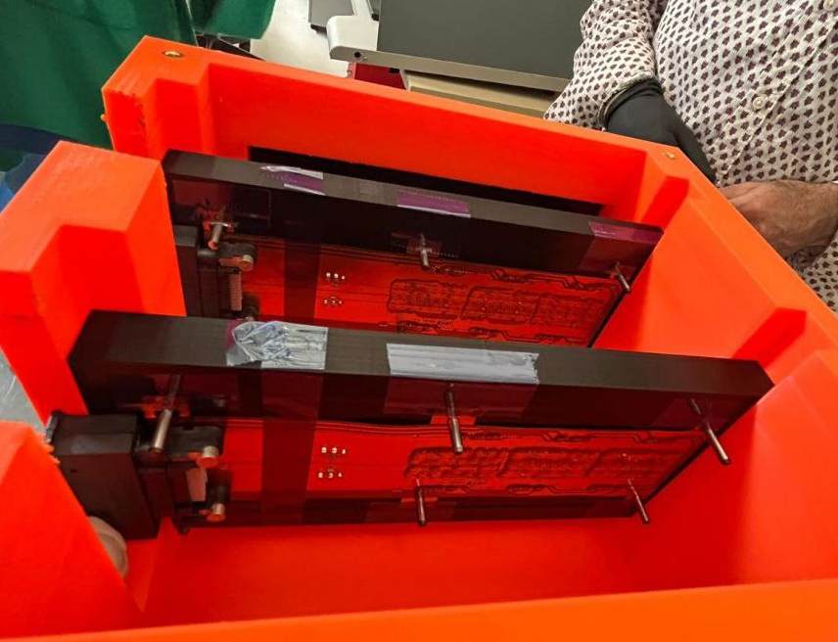
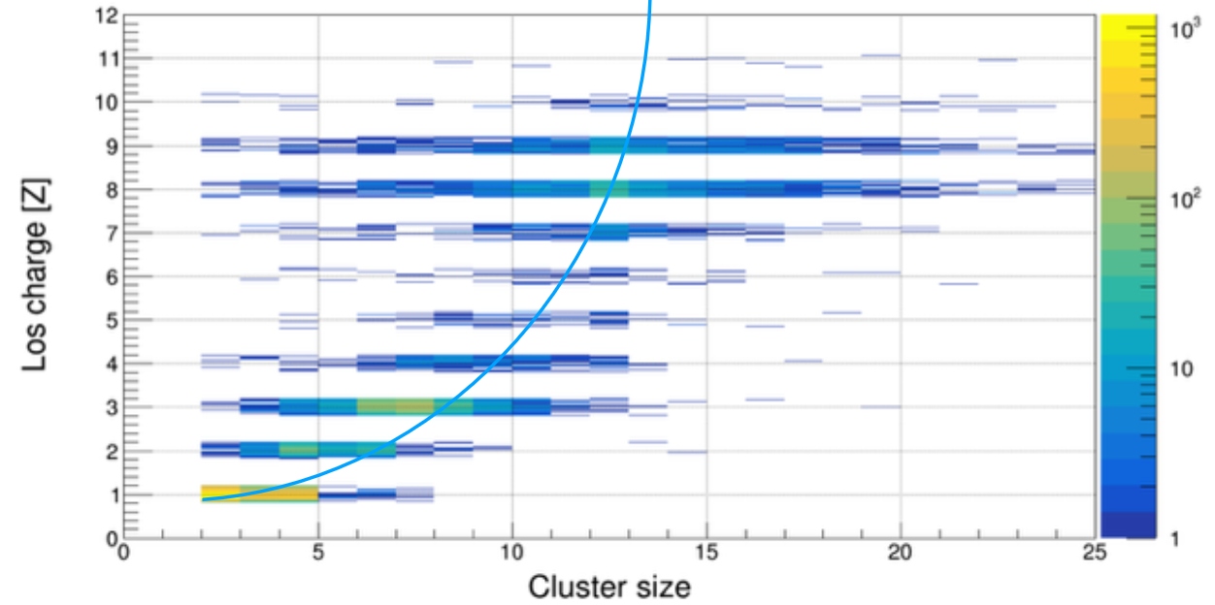
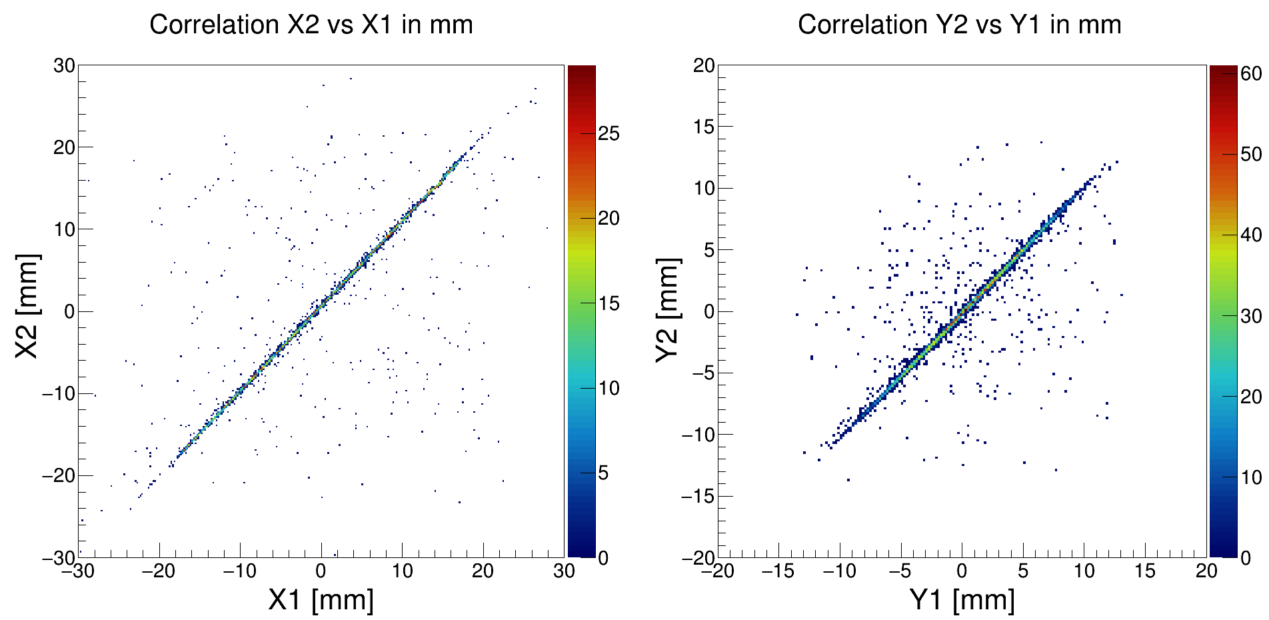
NUSTAR Technical Highlights
Target Recoil Tracker for R³B based on ALPIDE silicon pixel sensors
Excellent position resolution:
Pixel size: ~27 x 29 μm² x 50μm
Stage 1 modules assembled in Daresbury, UK
6 ALPIDE sensors on a single flex board x 2
In-beam tracking with the two stage 1 modules
G-24-00249 experiment (June 2025)
Single ALPIDE MAPS sensor
developed by ALICE@CERN
Incident beam from FRS
X and Y position correlation of the two ALPIDE modules with a ²⁵F cocktail beam @ ~630 MeV/u, providing a tracking resolution of sx < 10 mm
Correlation of the pixel-cluster size in ALPIDE vs. ion charge Z
particle identification capability for light ions
Slide courtesy V. Panin and R. Gernhaueser

Slide 5
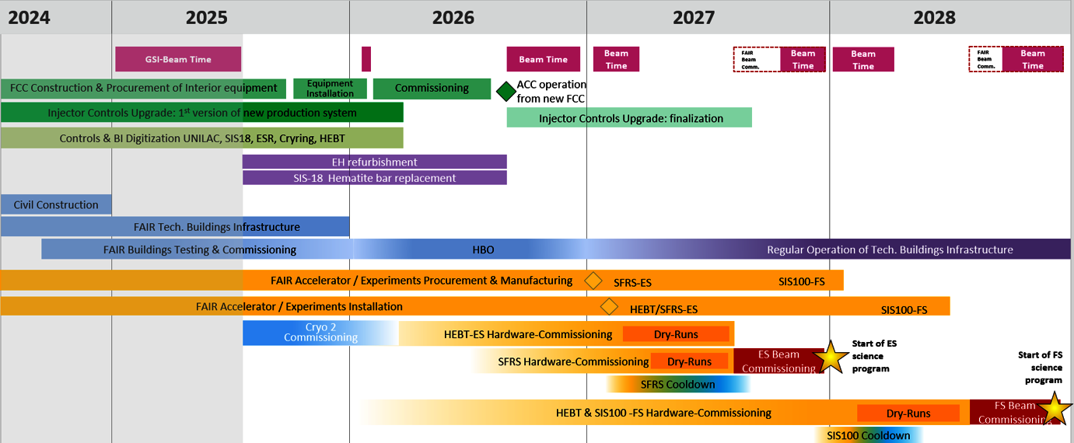
Installation and commissioning timeline
HE Cave installation work
GLAD Relocation
NUSTAR ES Commissioning and experiments
https://www.gsi.de/work/gesamtprojektleitung_fair/project_management_office/integrated_campus_scheduling

Slide 6
Possible (draft!) scenario: beamtime planning 2028
JAN
FEB
MAR
APR
MAY
JUN
JUL
AUG
SEP
OCT
NOV
DEC
SHUTDOWN
NUSTAR Startup / First operation
R³B comm. in HEC
R³B ES experiment
R³B setup change
R³B ES experiment
Comm. @ FHF1
end of Super-FRS commissioning, first physics results from ES
Order of FHF1 and FHF2 operation can be interchanged depending on science priorities

Slide 7
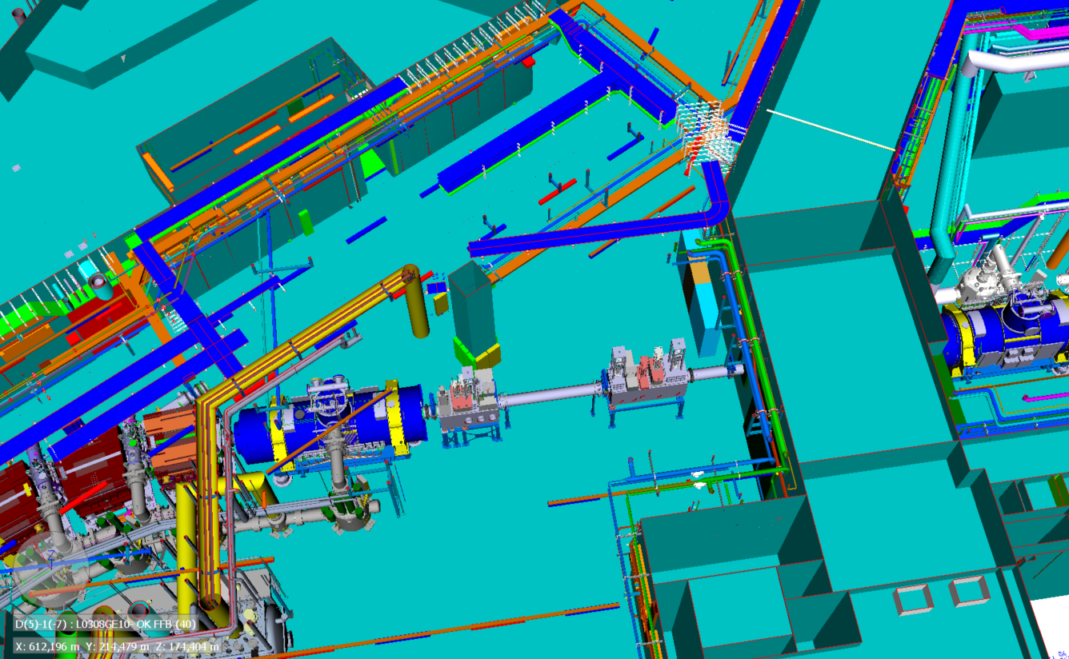
K0410A - FHF1 area – regular Super-FRS operation
Super-FRS operation with 2 diagnostic chambers in place
One of them contains a beam stopper, which has to remain in place all the time

Slide 8
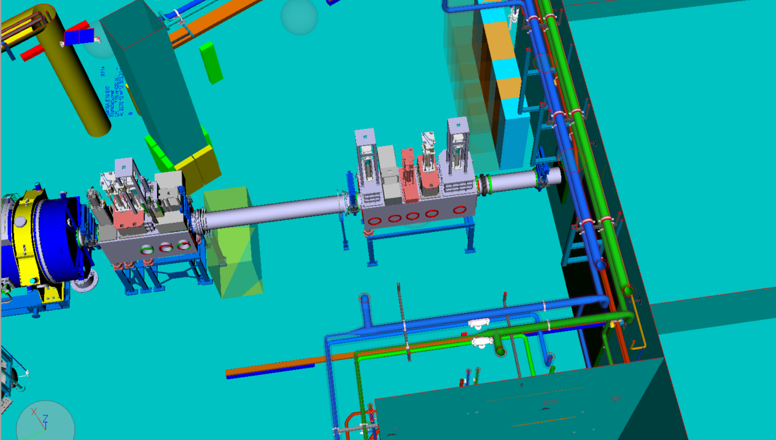
K0410A - FHF1 area – preparation for NUSTAR exps
move upstream
BC chamber
remains
move out
P. Hofmann

Slide 9
CATIA model with „green box“ for experimental units
In beam direction (from left to right):
beam stopper chamber
„long“ diagnostic chamber – shared use by Super-FRS and NUSTAR
„green box“ for
user table
experiment platform
beamline crossing
Green box:
length of 6.3m
off axis (slightly to the right in beam direction)
0.55m distance to the shielding wall
P. Hofmann

Slide 10
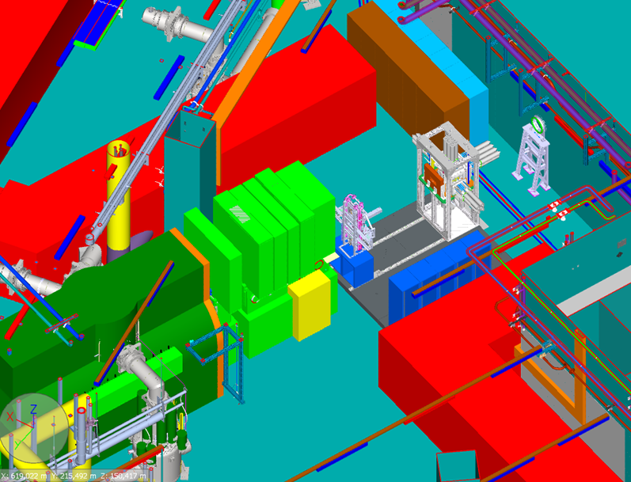
FHF1 view in Navisworks model
Following parts must fit into the 6.3m long area:
user table (length unclear, but can be adapted as necessary)
experimental equipment
beamline crossing (~1m)
6,3m
Detailed planning of the user table urgently needed (Super-FRS EC and DESPEC)
P. Hofmann

Slide 11
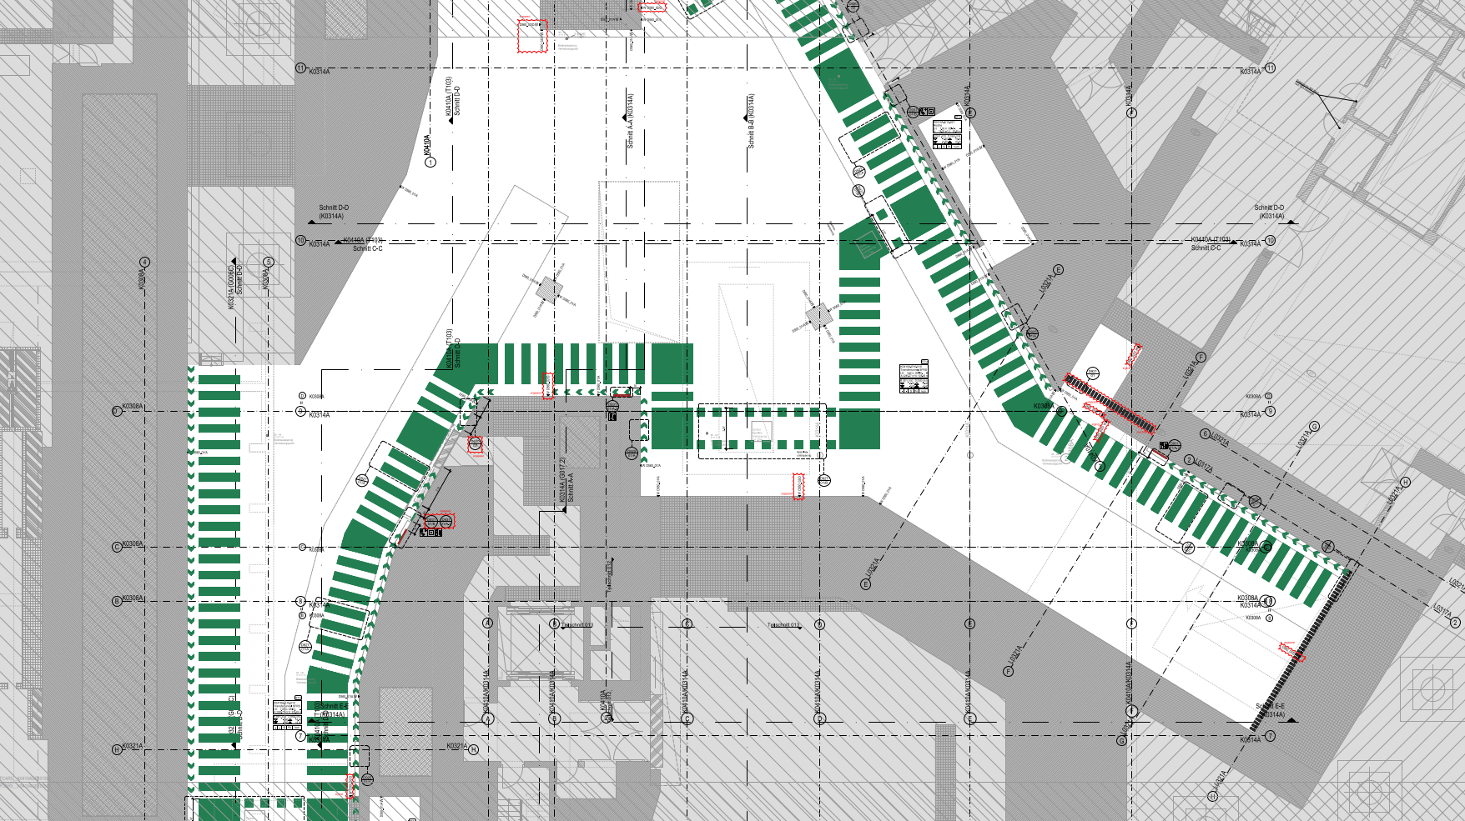
Escape routes K0410A
P. Hofmann

Slide 12
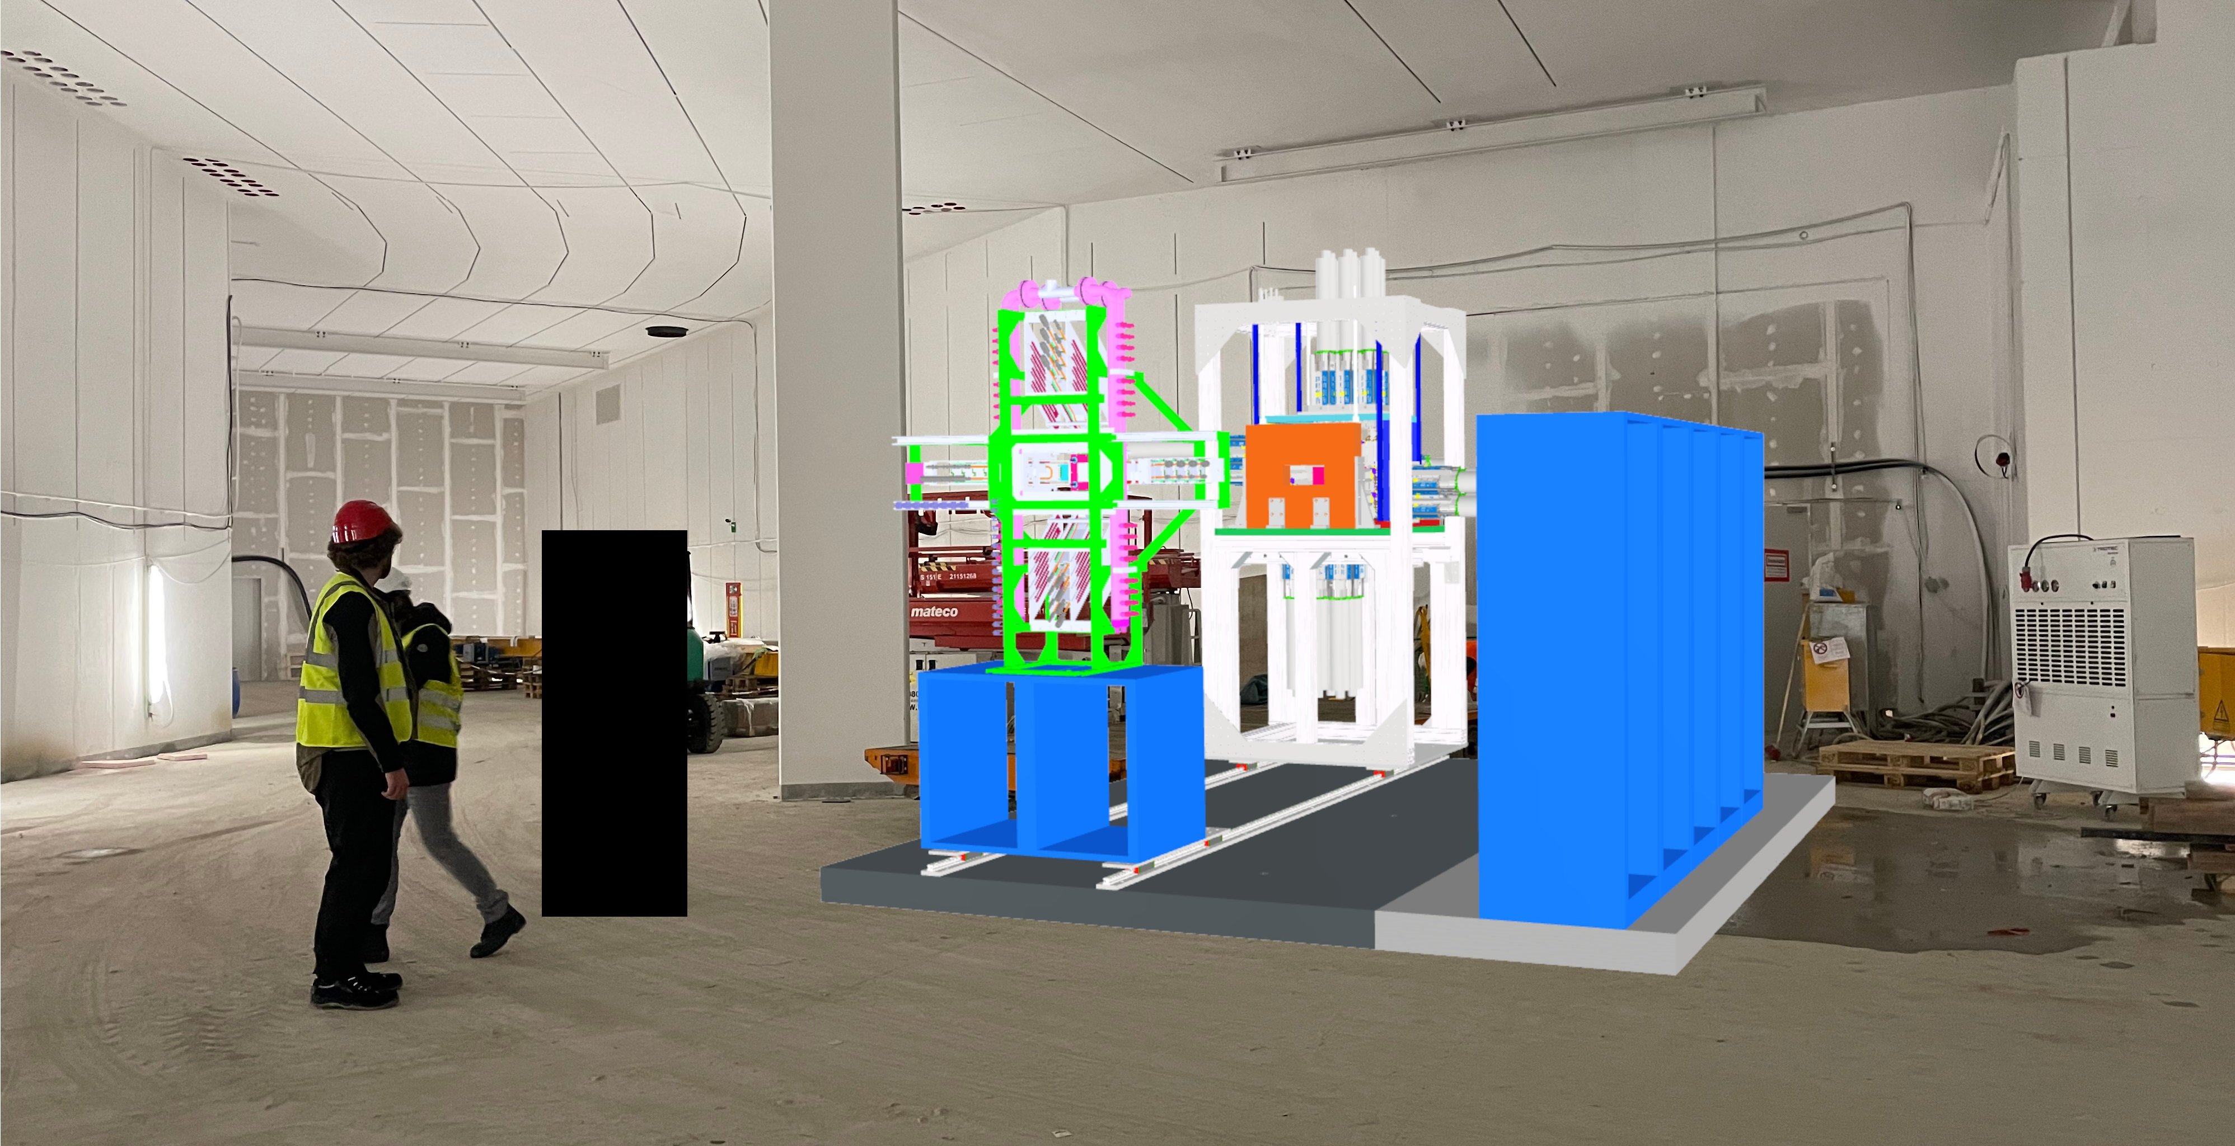
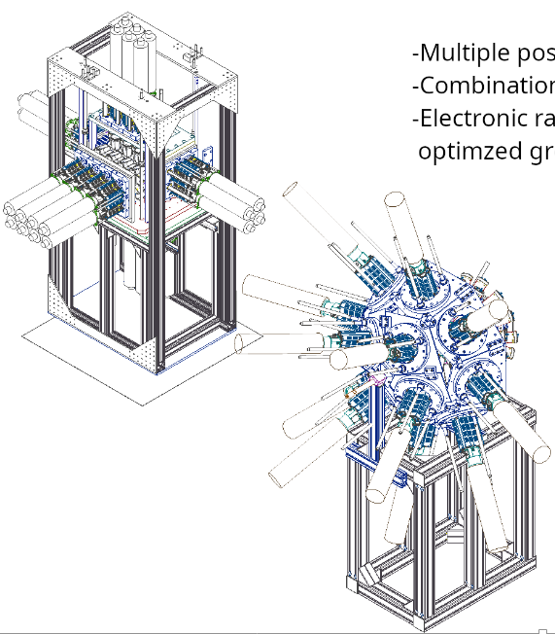
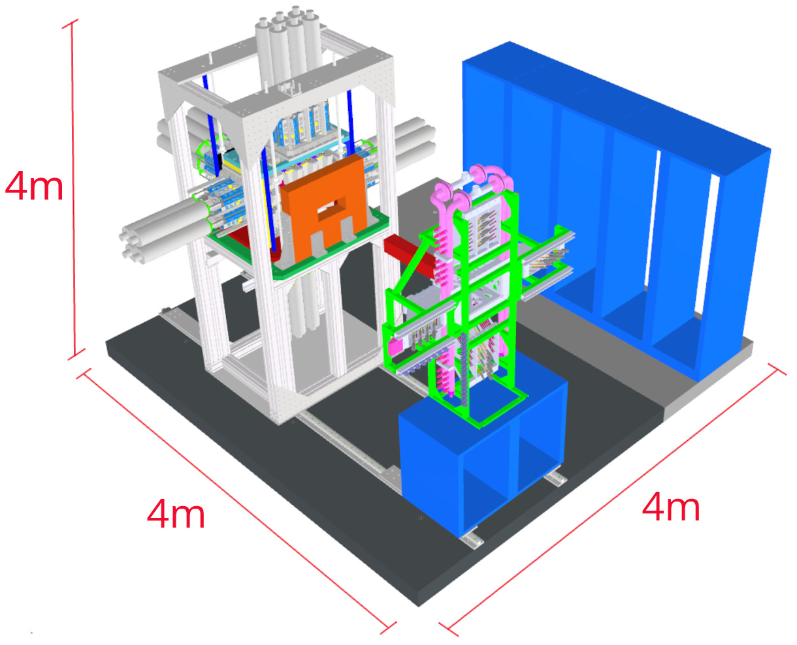
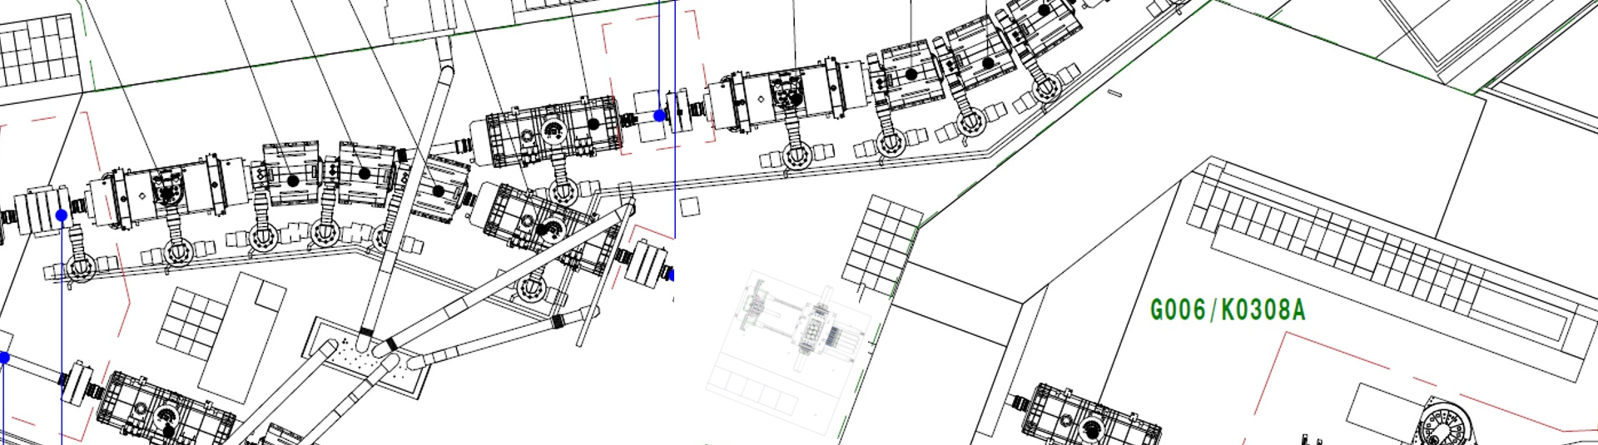
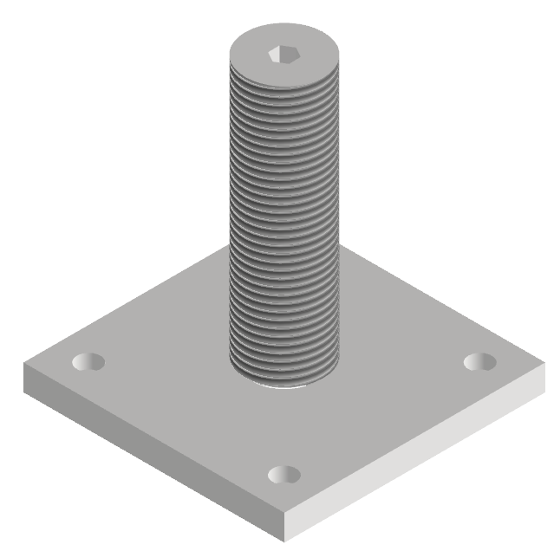
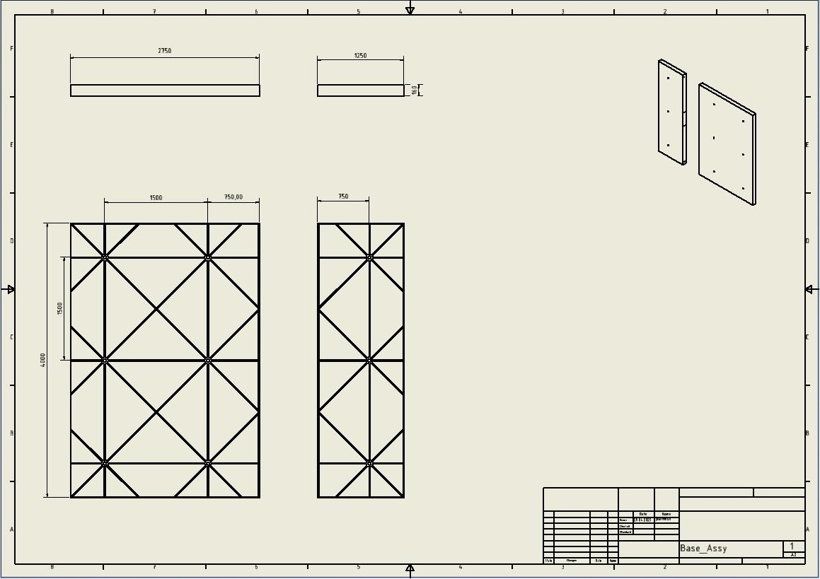
DESPEC Platform @ FHF1
- A new DESPEC platform for FAIR under development
- Improved functionality and flexibility compared to the existing platform in use in FAIR Phase-0 at GSI, production planned for 2026
- Multiple configurations possible, mounted on rails for accessibility
- Electronic racks for DAQ and signal processing with optimised ground
- Concept using fixed plates and alignment pins planned for stable and repeatable positioning with ~1-mm accuracy
Visualisation of DESPEC platform at FHF1

Slide 13
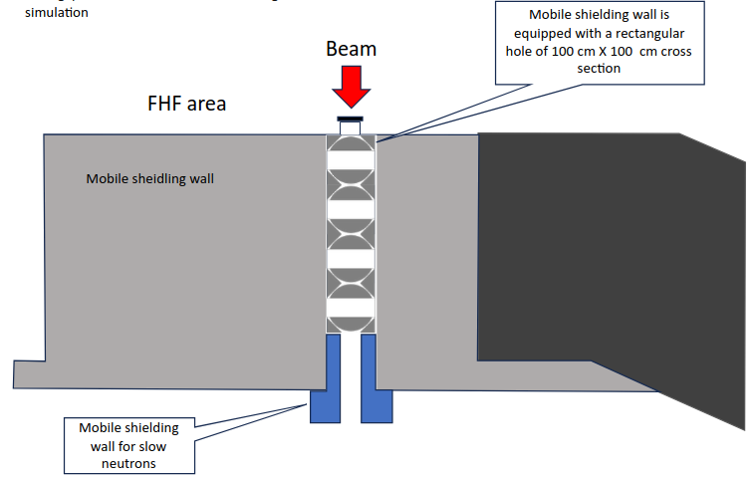
Update on Switchable Radiation Protection Mechanism
- When beam is incident on experiments at FHF1, access to the HEC is not permitted due to radiation levels
- This situation drastically increases experiment downtime and reduces the scientific output of Early and First Science
- An elegant concept for a switchable mechanism inside of the wall has been developed
(S. Purushothaman)
- Access possible to HEC within short timeframe
- No reduction of available experimental space
- The design is fully compatible with the mobile shielding wall
- Integration into the Personal Access System is possible
- Detailed specifications are available
- Production on a short timescale is possible (<1 year)
- Calculations were carried out with ES intensity. Beam dump
will not allow access for SIS-100 beams
Under discussion with SiSt and Super-FRS
S-FRS Tunnel
High-Energy Cave
S. Purushothaman

Slide 14
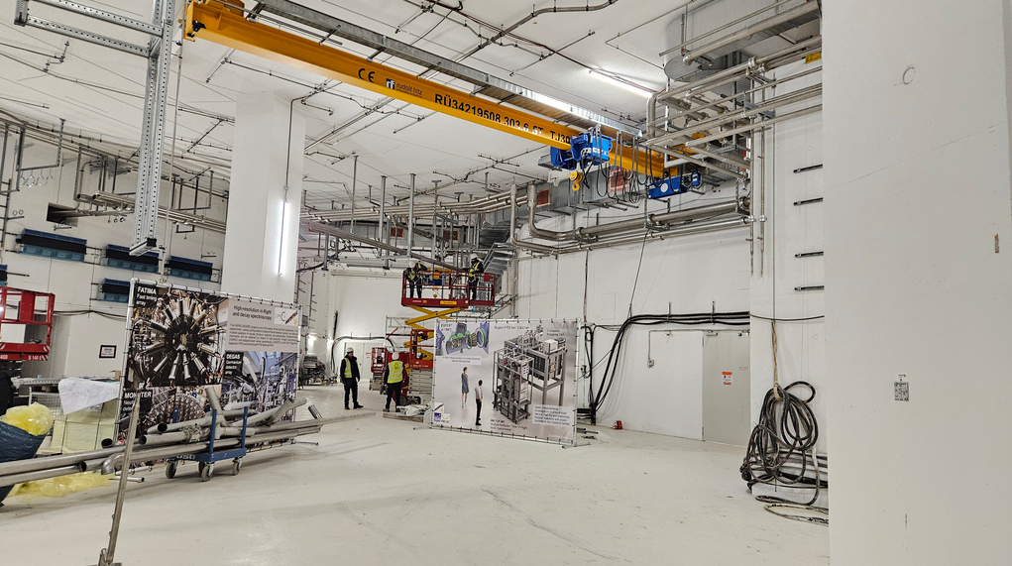
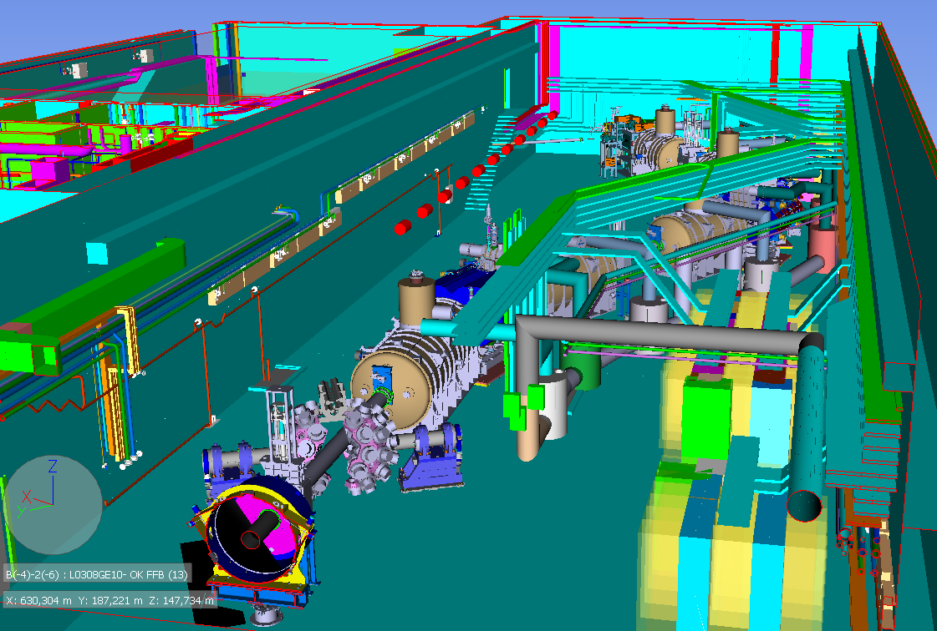
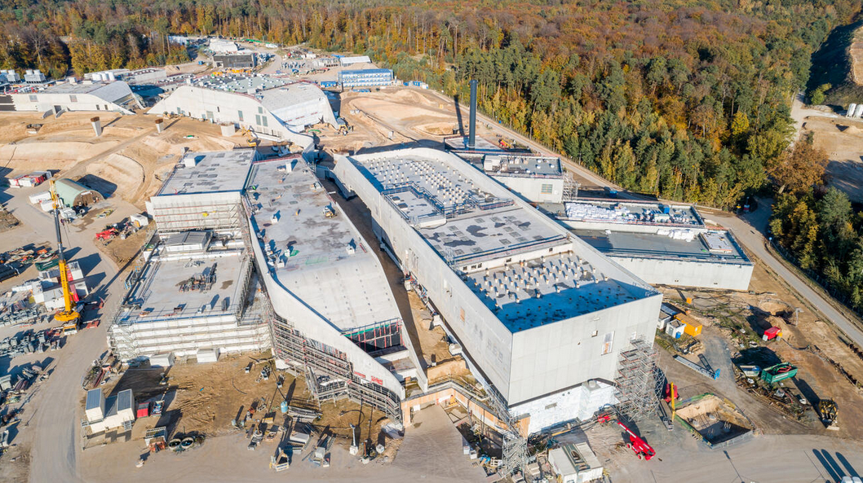
Super-FRS tunnel, FHF1 area
NUSTAR HEC
NUSTAR LEC
FHF1
Southern caves
© M. Konradt, GSI/FAIR Hofmann
HEC

Slide 15
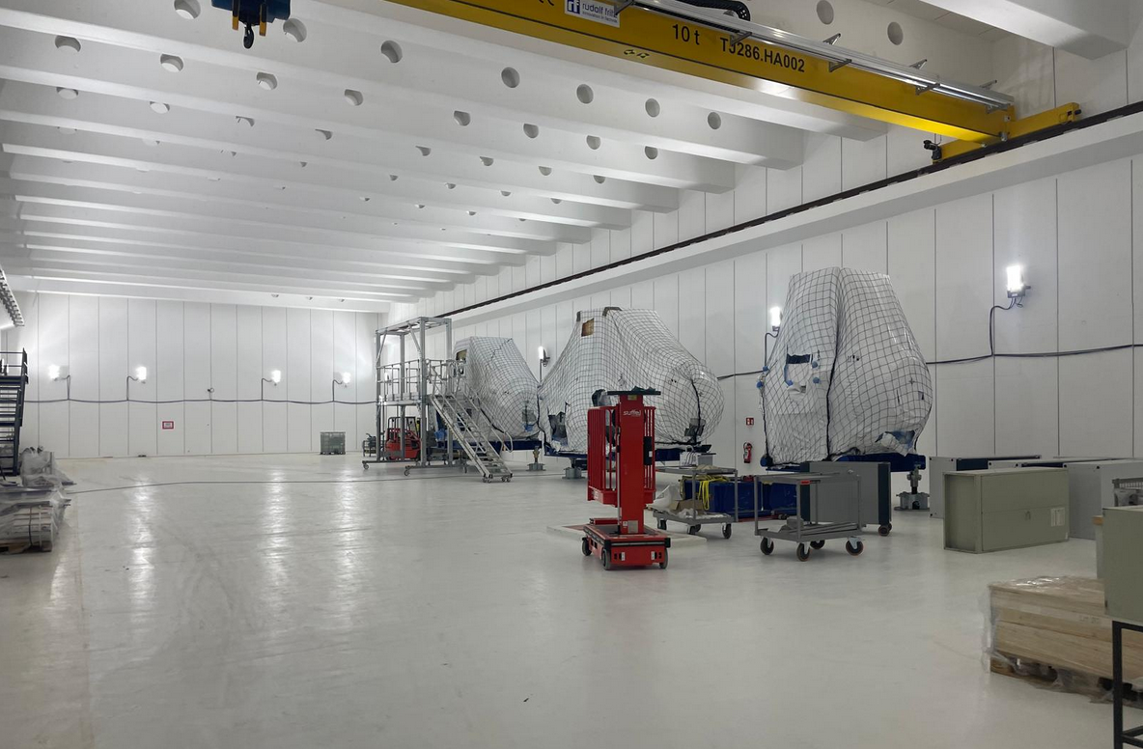
NUSTAR Low-Energy Cave
Temporary space for S-FRS magnet pre-assembly until completion of Low-Energy Branch

Slide 16
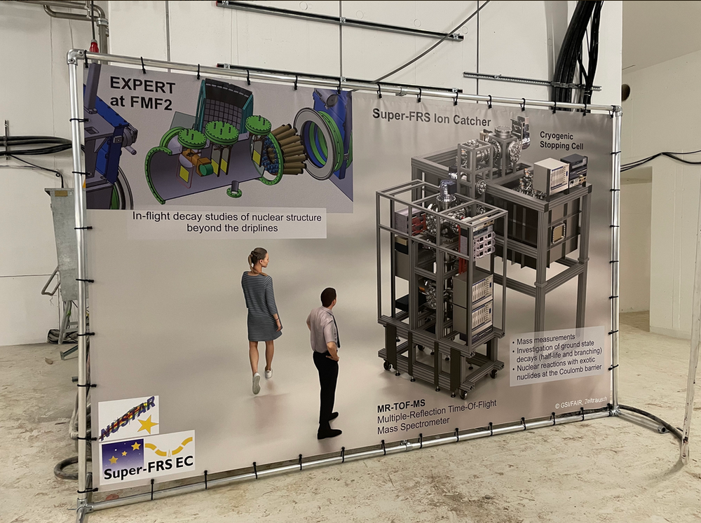
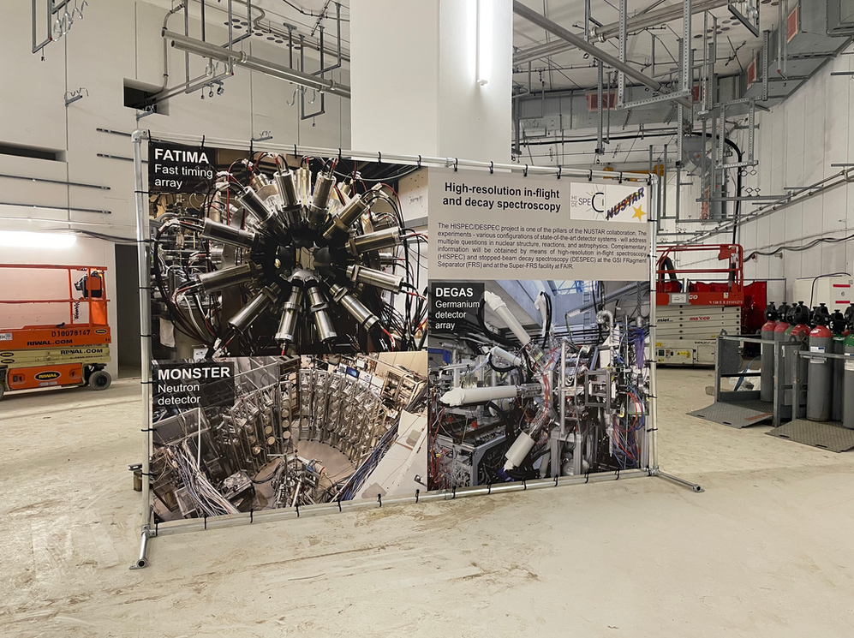
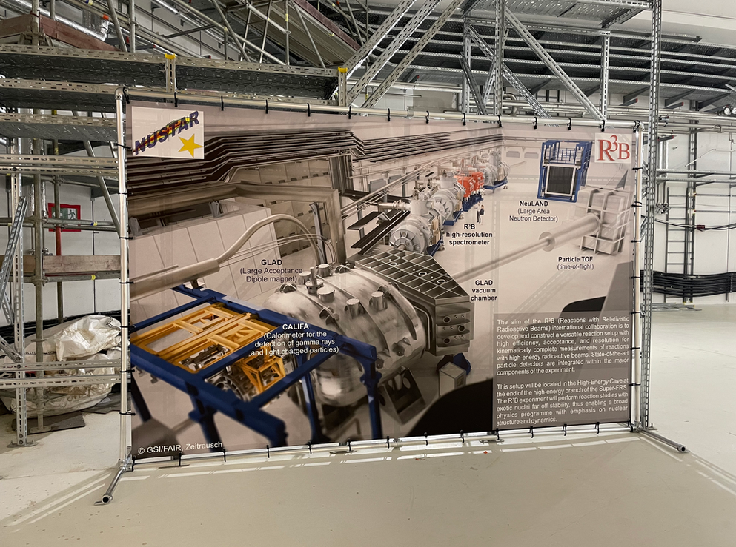
First NUSTAR installation work was completed in Q4 2024!

Slide 17
Update on NUSTAR Early Science Planning
Kick-off meeting within NUSTAR to discuss possible setup for NUSTAR Start-up/Commissioning at FHF2 planned
Ongoing discussions with FSB (FAIR Site and Buildings) on Fire Safety Measures in the experimental areas
List of Super-FRS targets for first Early Science block has been collected
Work on the NUSTAR M&O MoU has begun; current discussions with all pillars on cost categories (A. Herlert)
Detailed breakdown of relocation/installation steps for R3B components worked out in regular LCM (Lean Construction Management) Workshops
Safety and QUA Engineer hired - starting Q4 2025; interviews for NUSTAR DAQ position are ongoing
Discussions on a concept for the appointment of STVs has begun between NUSTAR and Super-FRS
LISE++ simulation file for ES provided by Super-FRS colleagues (S. Pietri et al)
2nd FAIR Commissioning retreat planned for 11/25 - NUSTAR asked to provide updated plans
Constructive discussions with SMG (FAIR Installation) on required process and documentation for installation
FAIR commissioning budget will ramp up until end of 2028, when it becomes FAIR operating budget. NUSTAR departments were asked to provide personnel requirements for coming years
New NIT Team (lead by Petra Hofmann) focussed on ES Installation Readiness and Machine Interfaces kicked off

Slide 18
Thank you!

