Slide 1
Centrality estimation with FSD
Radim Dvořák

Slide 2
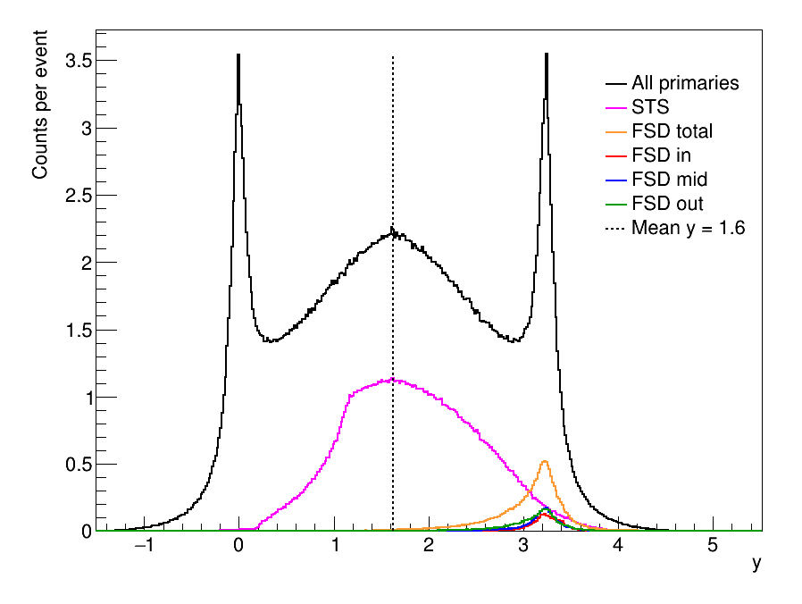
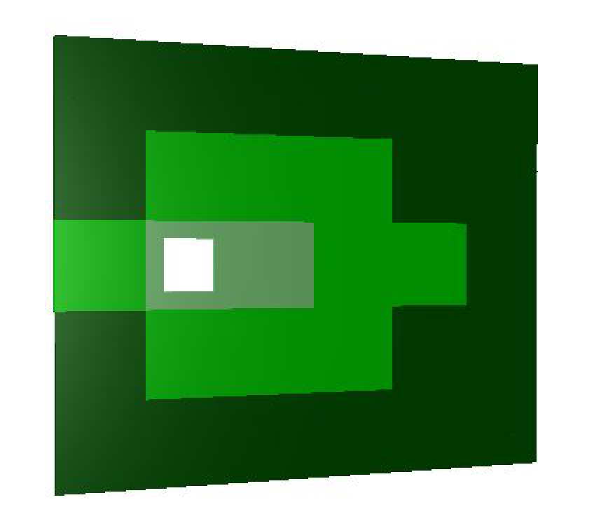
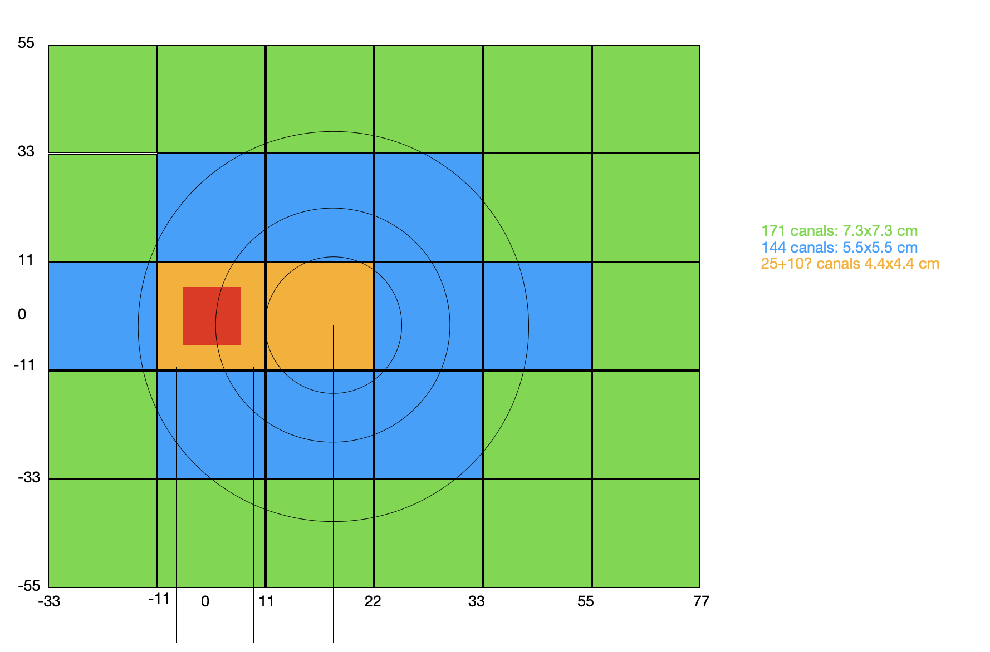
Simulation setup
DCM-QGSM-SMM
11AGeV Au+Au collisions
Area of interest
x=40 cm, r=40 cm (large circle)
Hole in FSD diameter 14 cm
Focus of this presentation: reproduce plots from PSD TDR

Slide 3
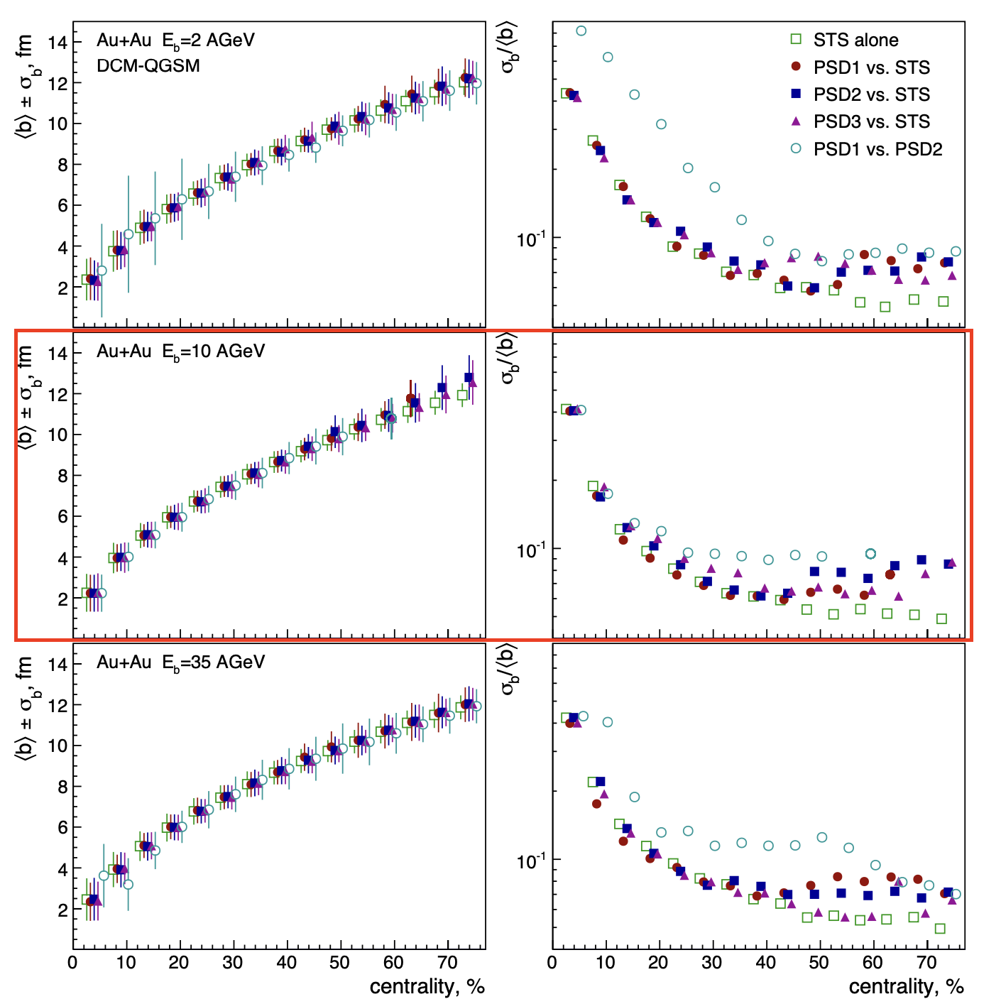
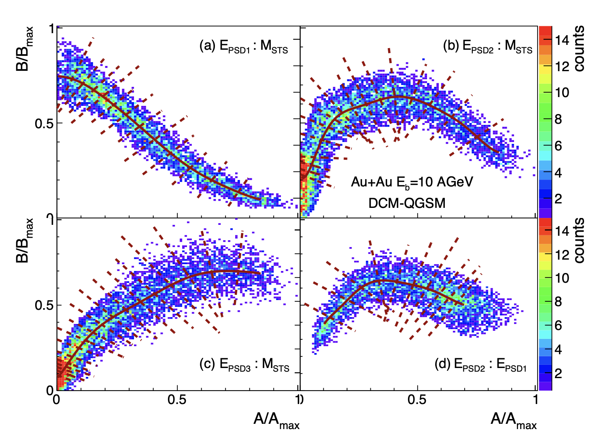
PSD performance
Small hole: diameter 6 cm - unrealistic

Slide 4
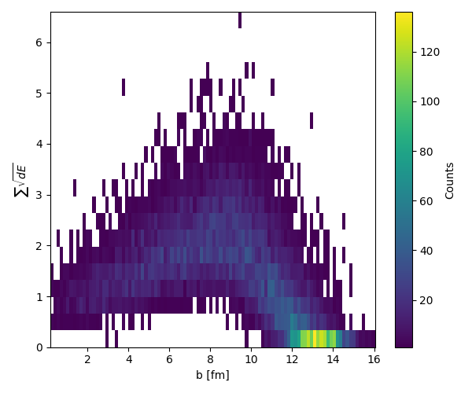
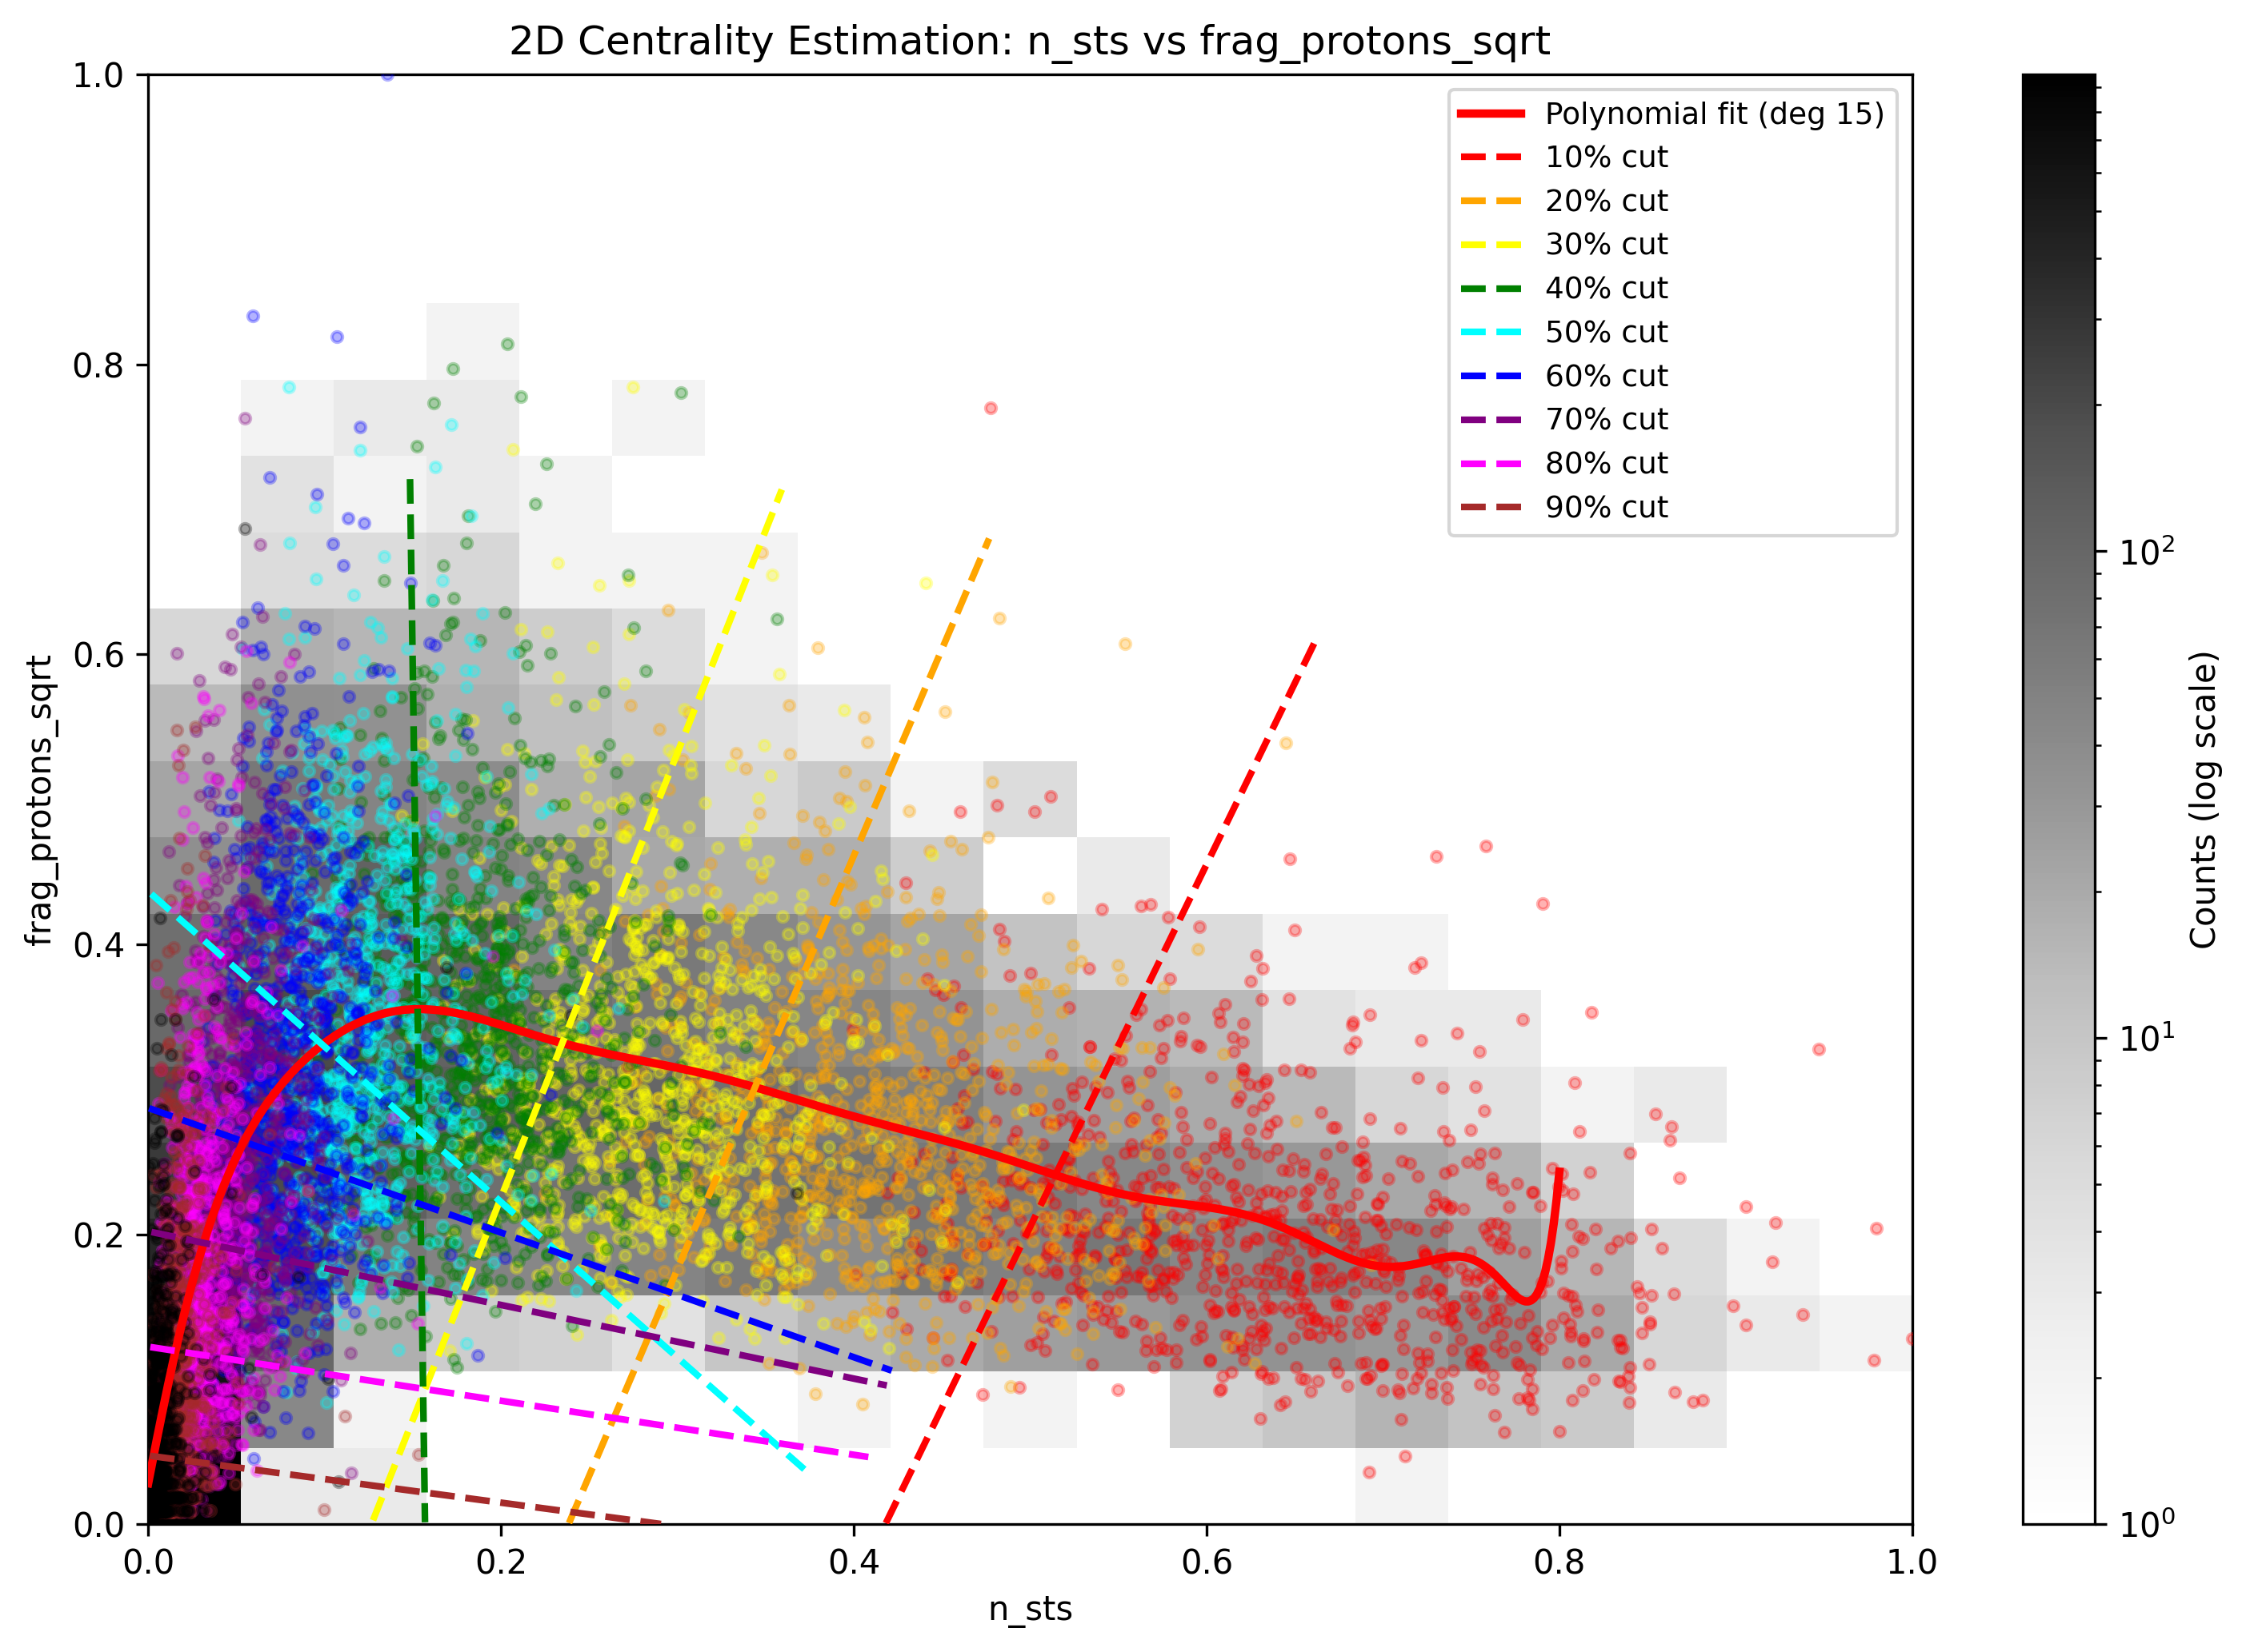
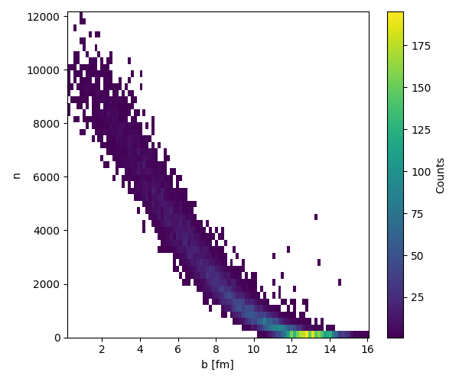
FSD performance
FSD
+
=
STS

Slide 5
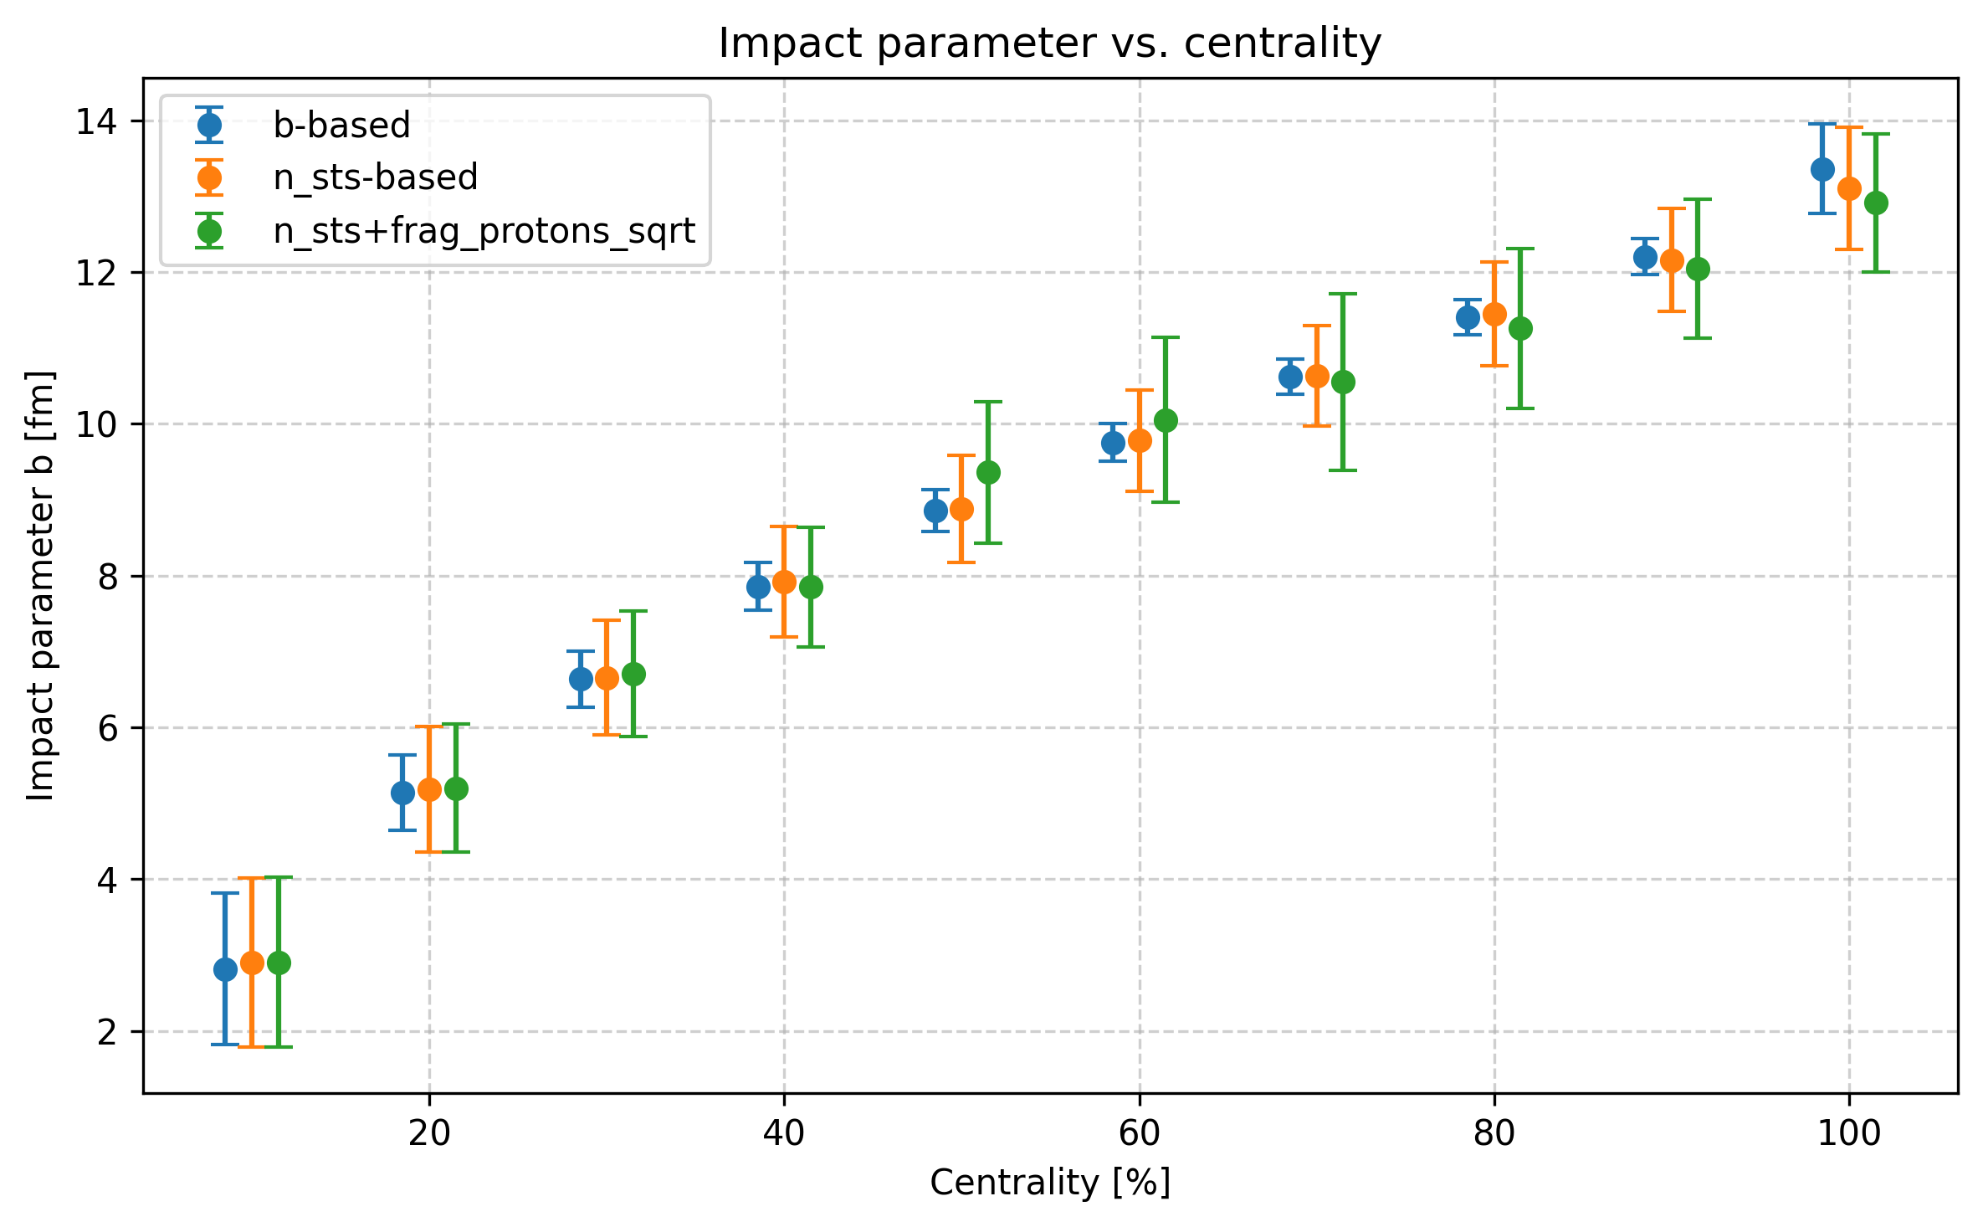
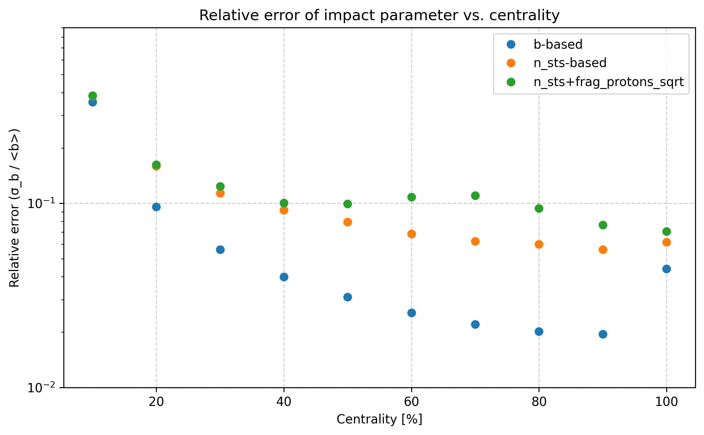
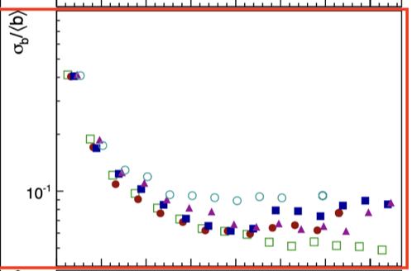
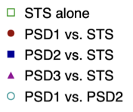
FSD performance
Similar results to PSD
70

Slide 6
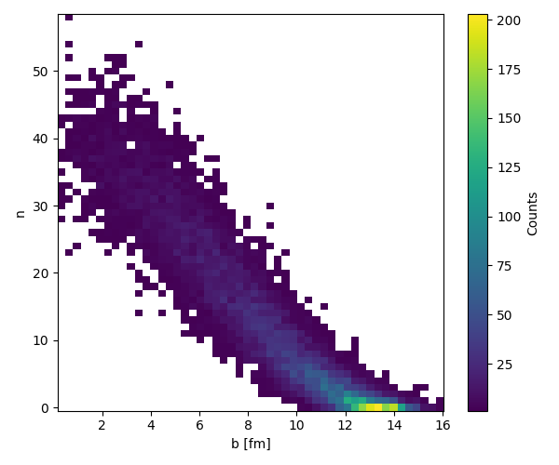
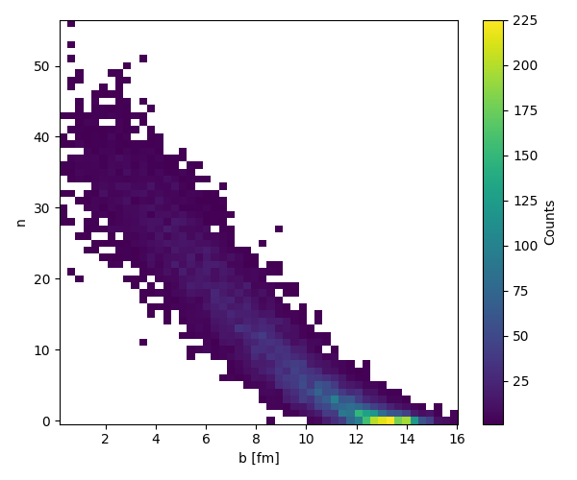
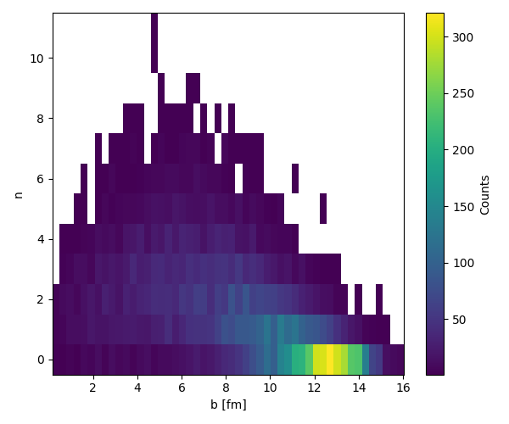
Forward STS region
STS has some coverage for spectators y>2.8
MC primary tracks with hit in STS, y>2.8
MC primary tracks with hit in STS, y>2.8, pions
MC primary tracks with hit in STS, y>2.8, protons

Slide 7
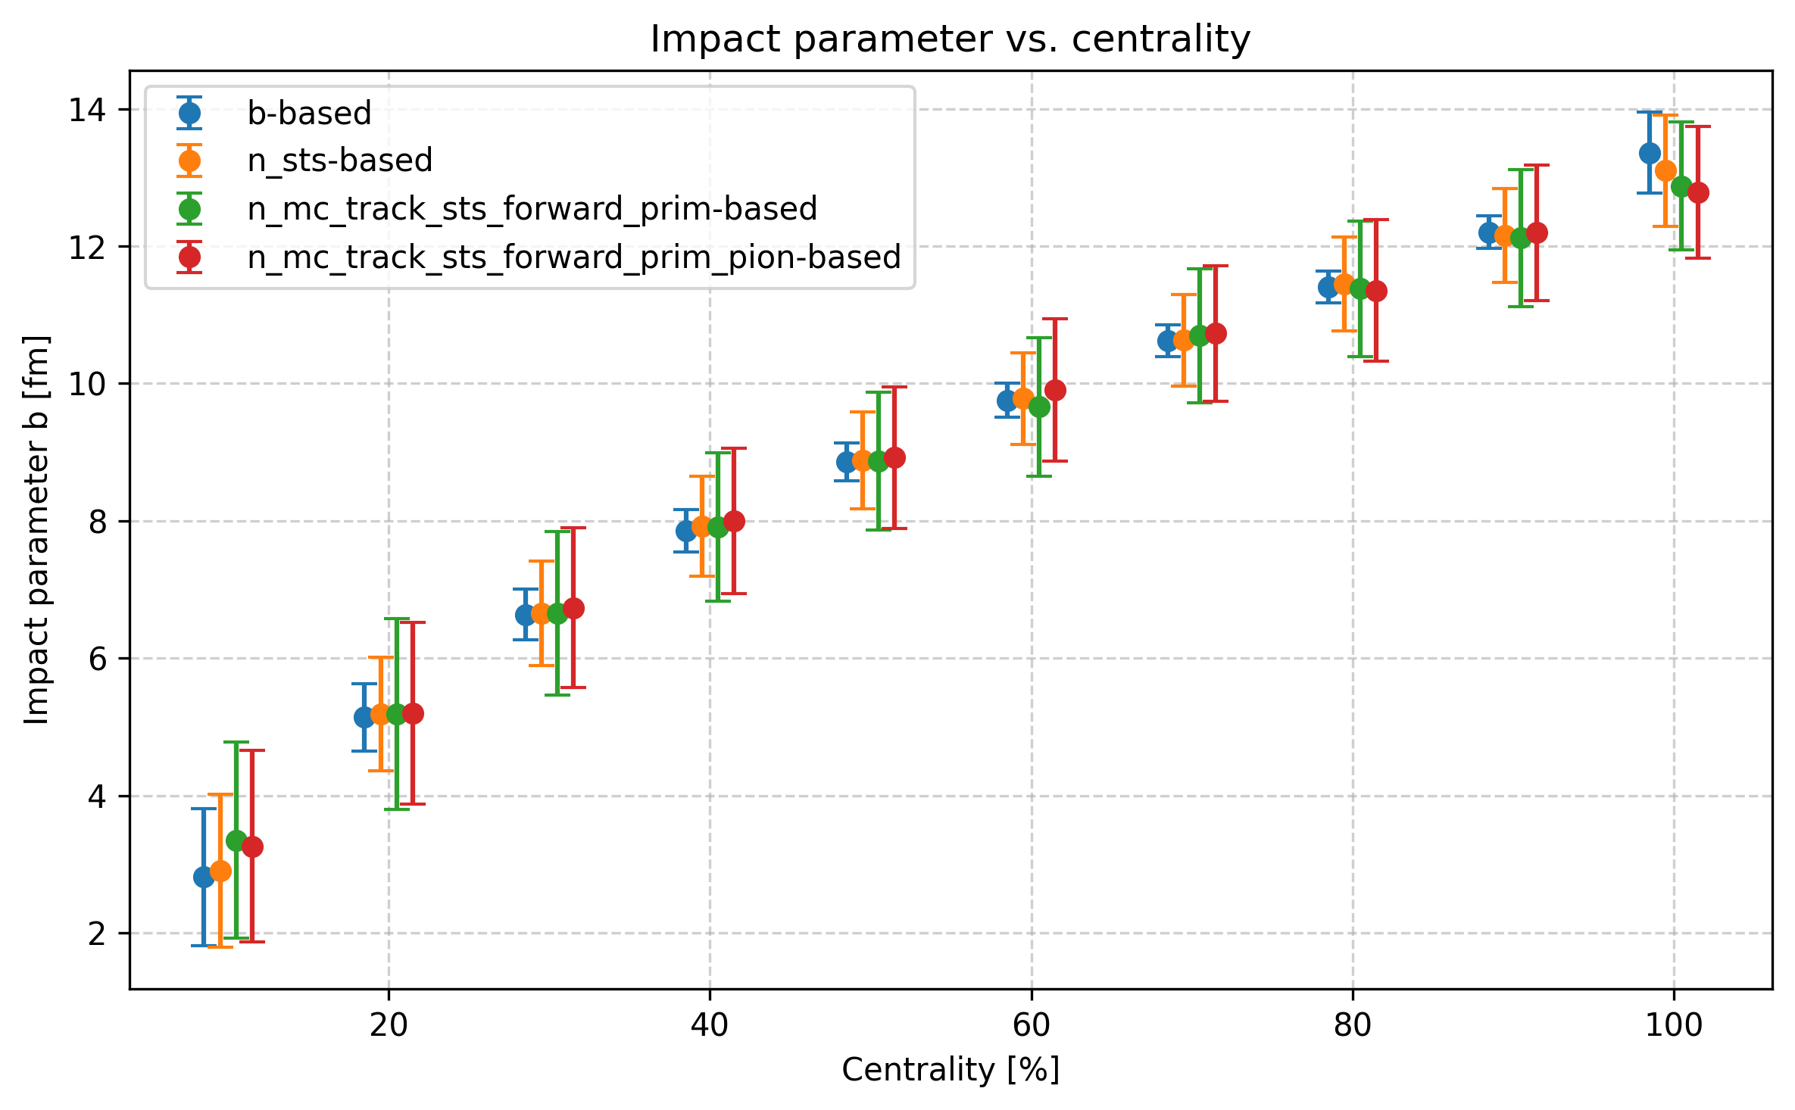
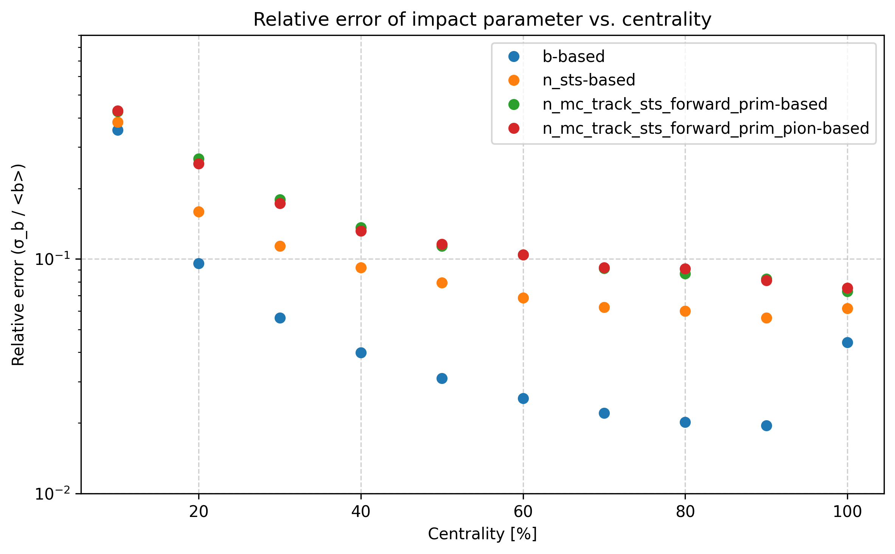
Forward STS region
Forward STS region has only slightly worse results than full STS
Forward pions as a good centrality estimator???

Slide 8
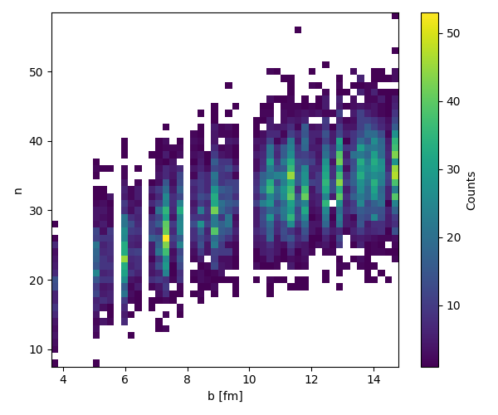
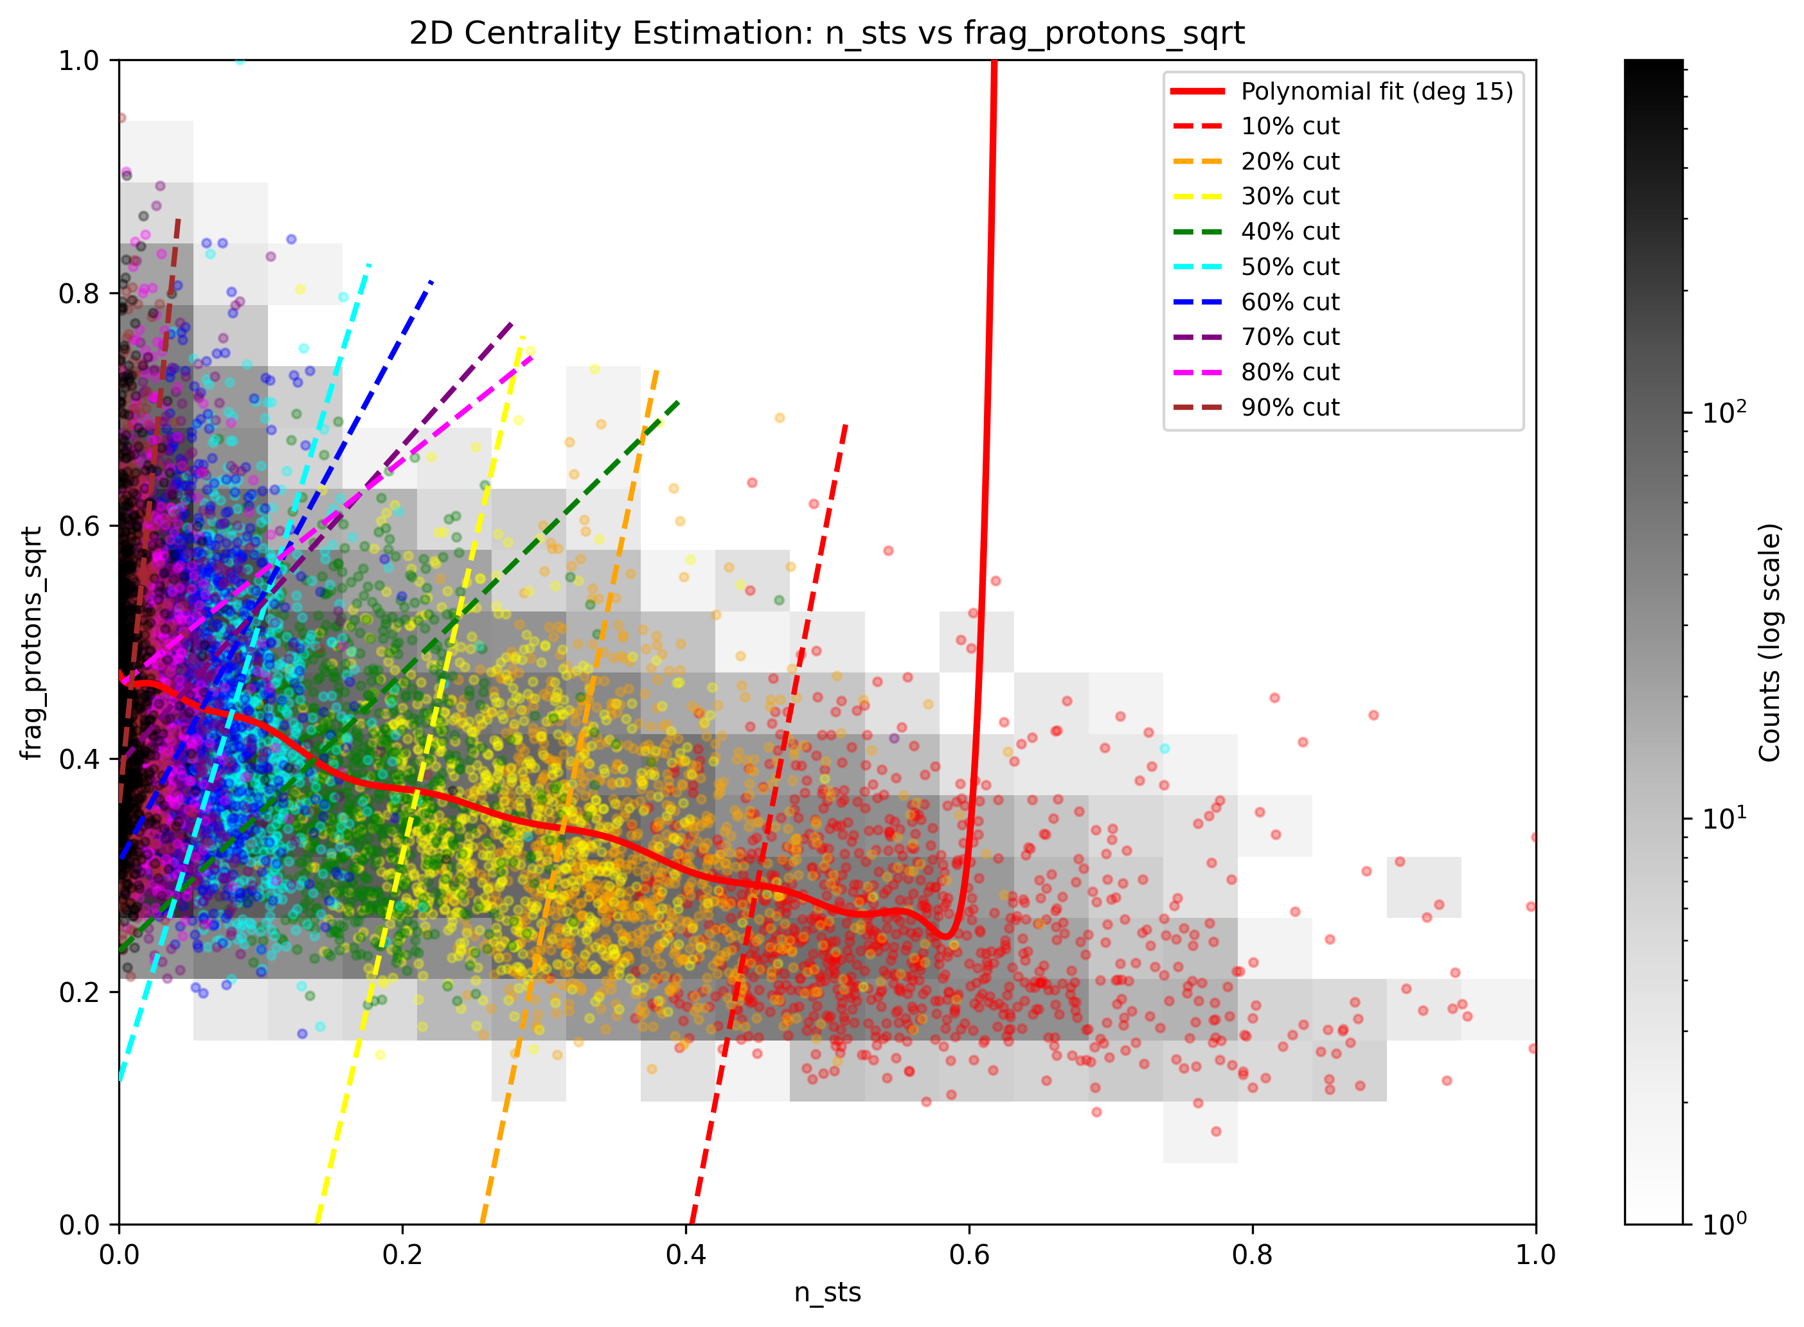
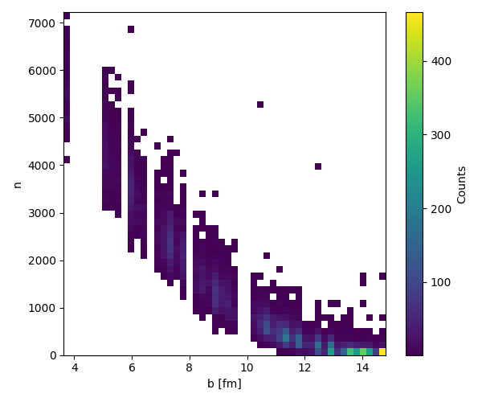
Model comparison - PHQMD small clusters
FSD
=
+
STS
Different behavior to DCM!

Slide 9
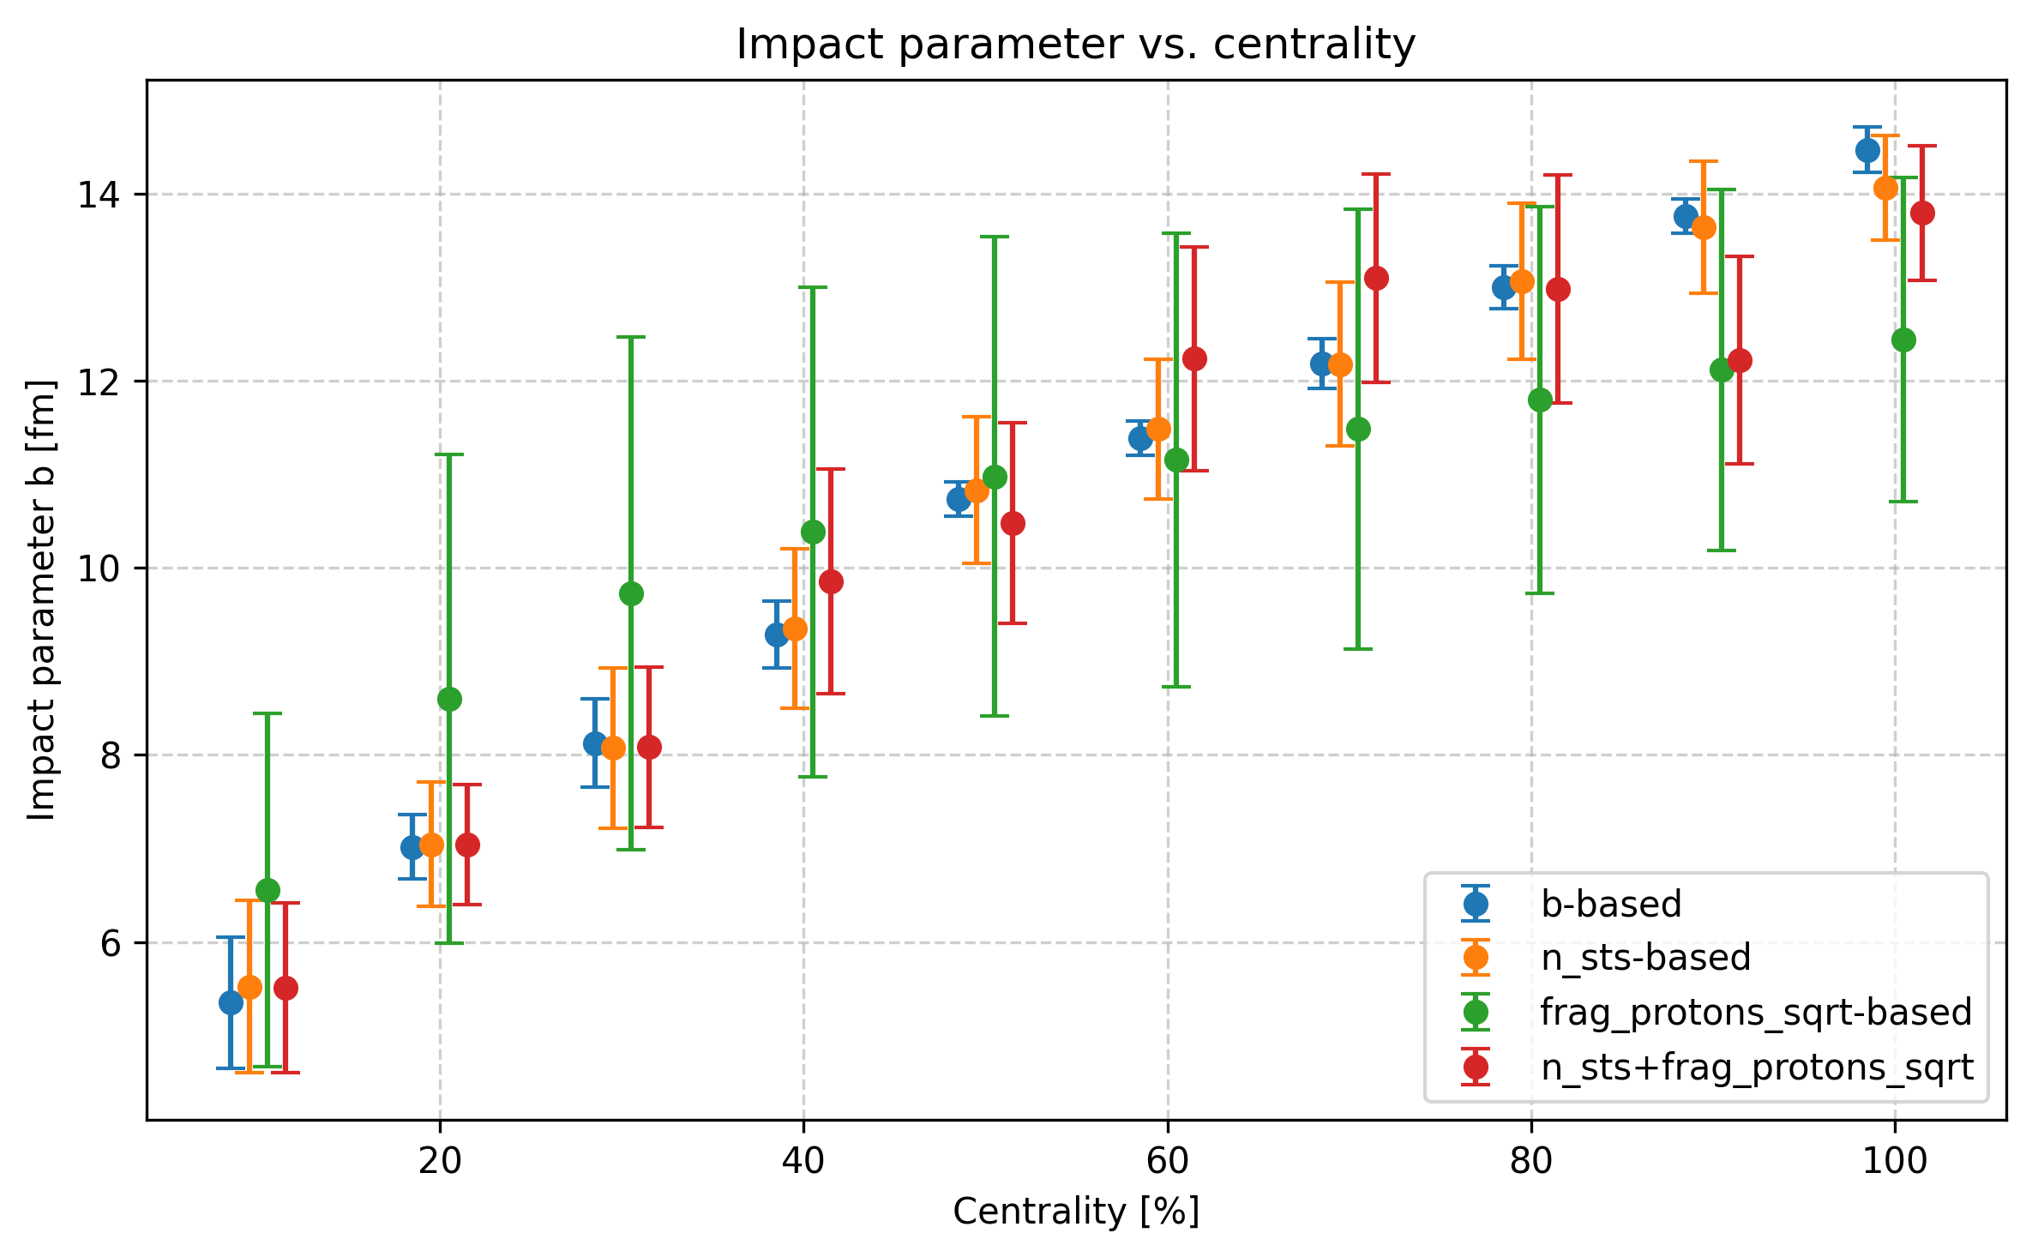
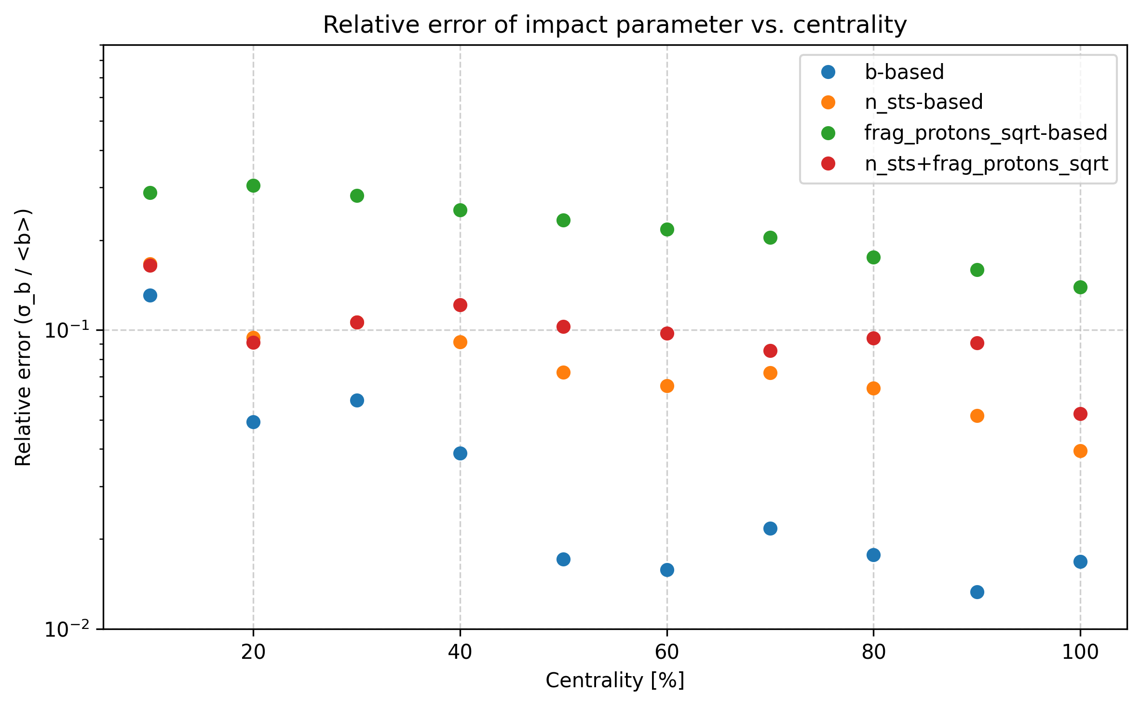
Model comparison - PHQMD small clusters
With PHQMD we can estimate centrality only using FSD
Combination STS+FSD same as STS alone

Slide 10
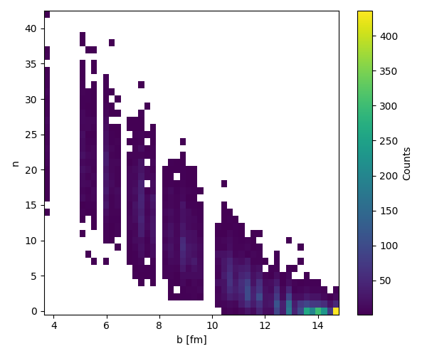
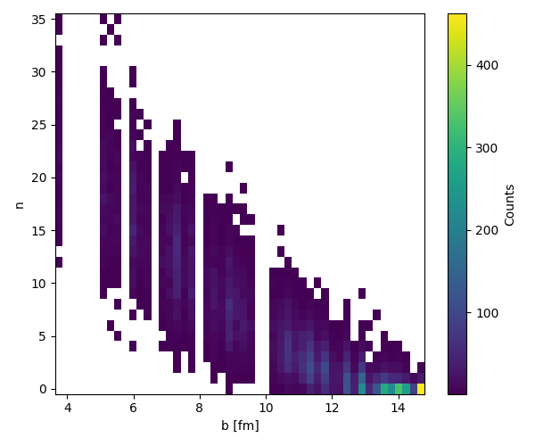
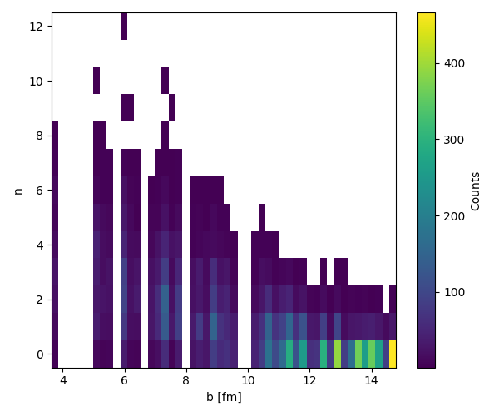
Model comparison - PHQMD small clusters
MC primary tracks with hit in STS, y>2.8
MC primary tracks with hit in STS, y>2.8, pions
MC primary tracks with hit in STS, y>2.8, protons

Slide 11
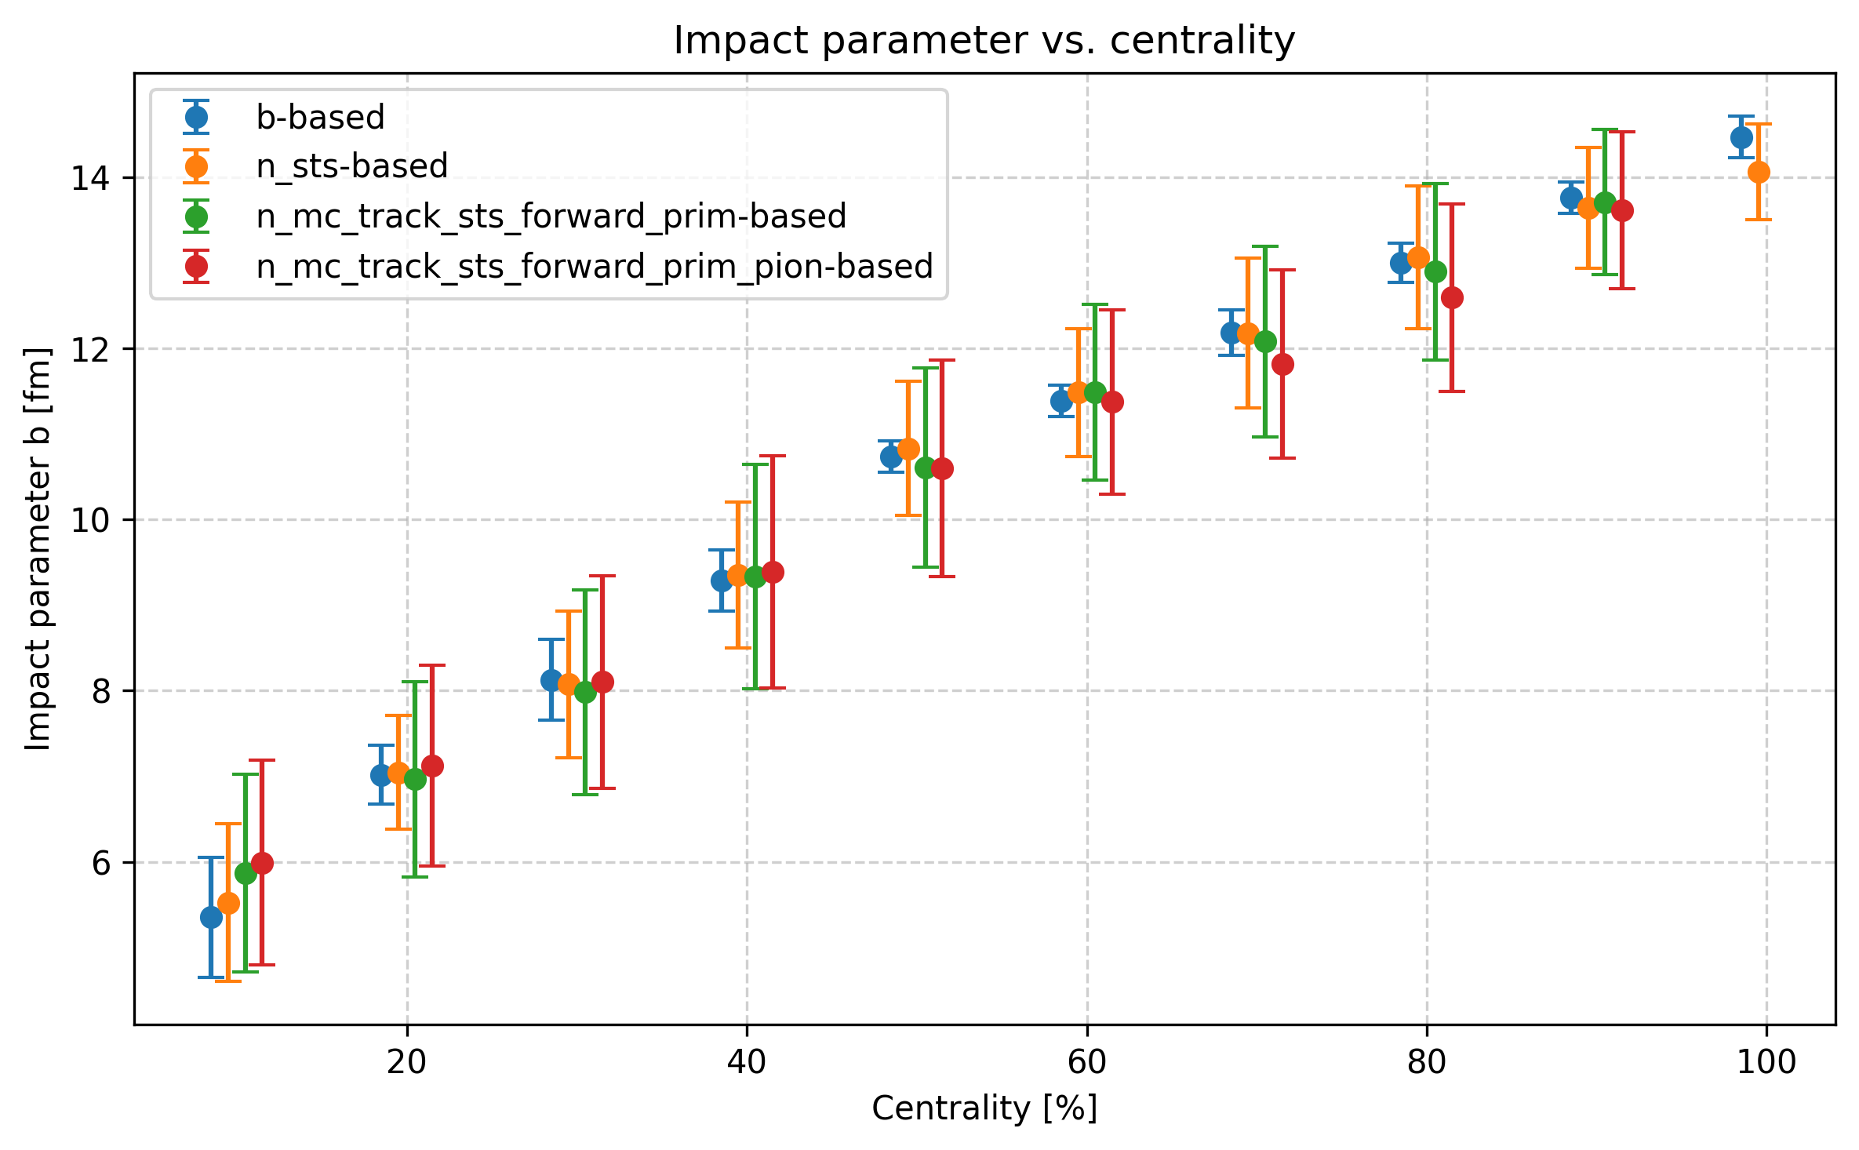
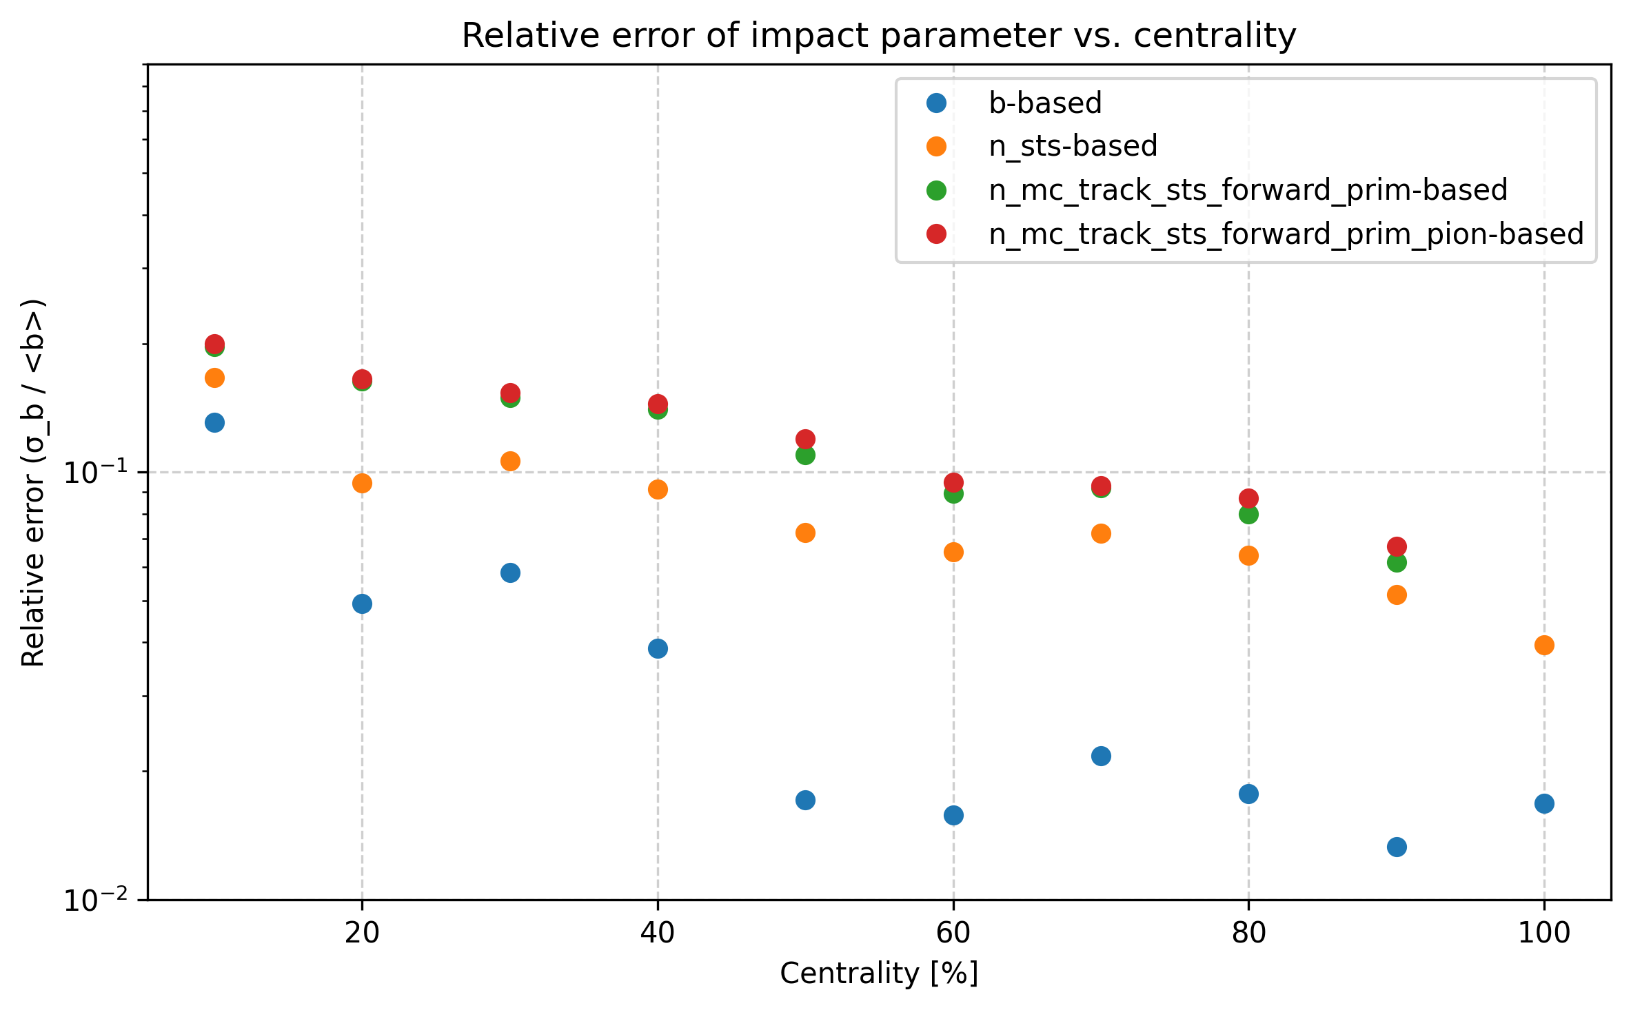
Model comparison - PHQMD small clusters
Forward pions are the good estimator for centrality for this model

Slide 12
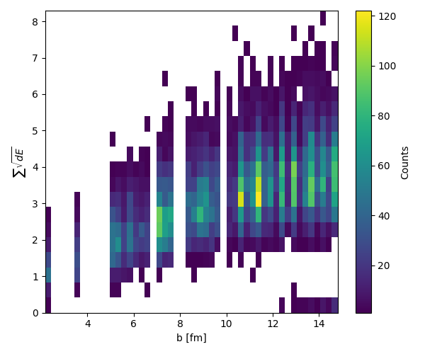
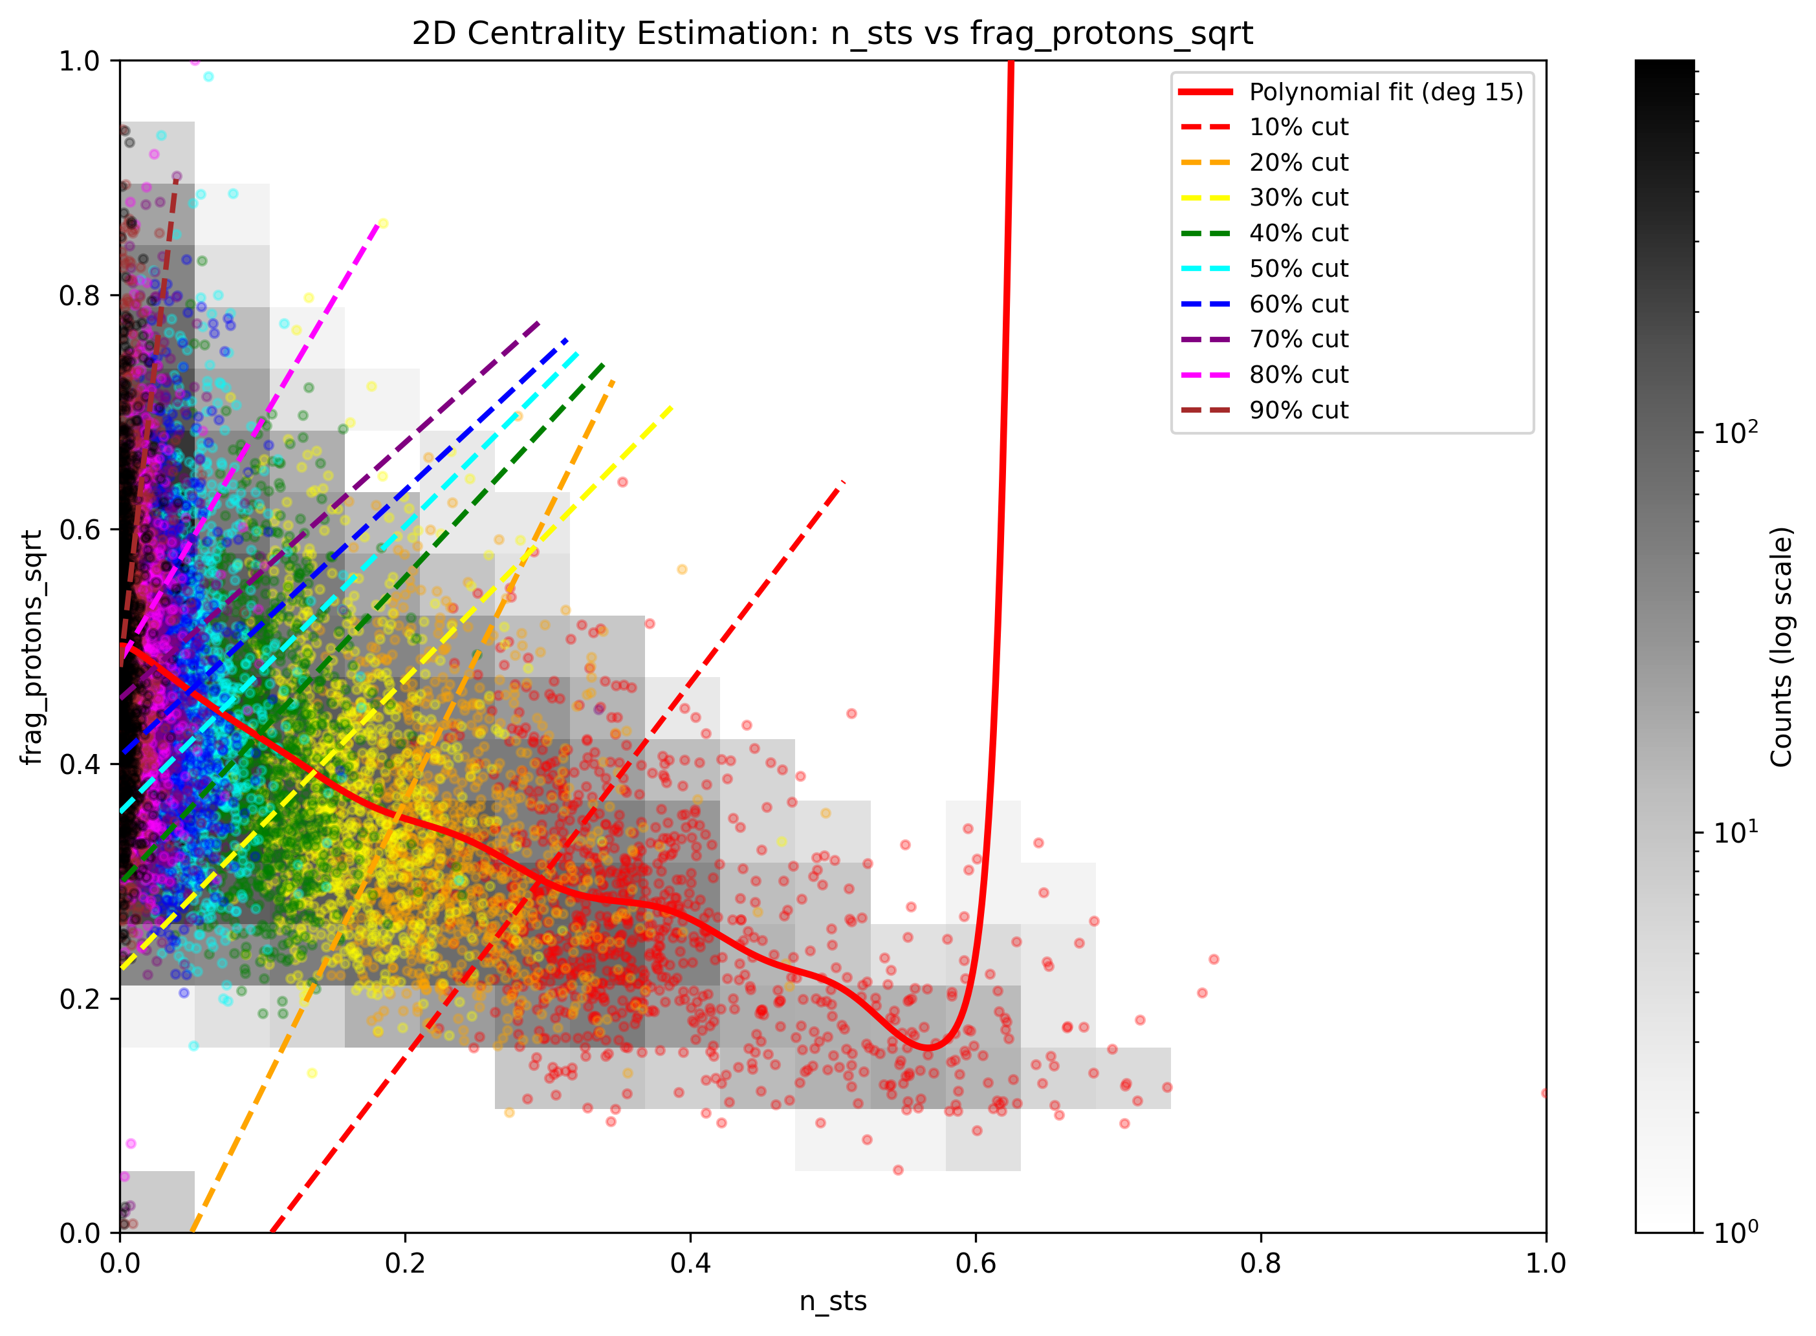
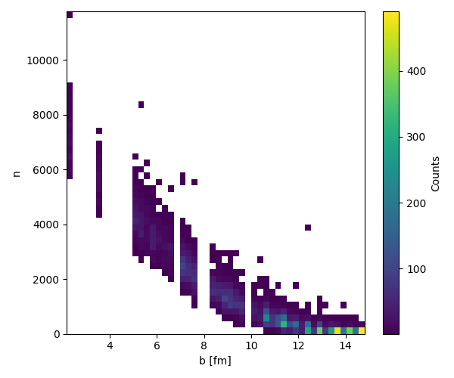
Model comparison - PHQMD all clusters
FSD
+
=
STS

Slide 13
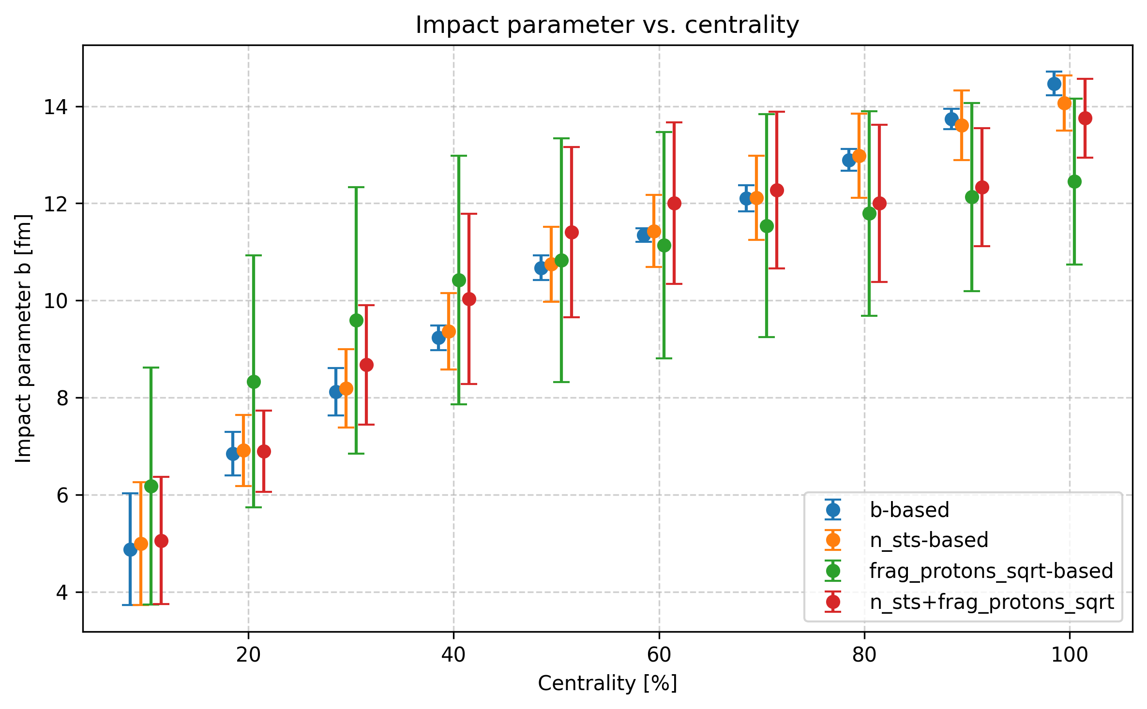
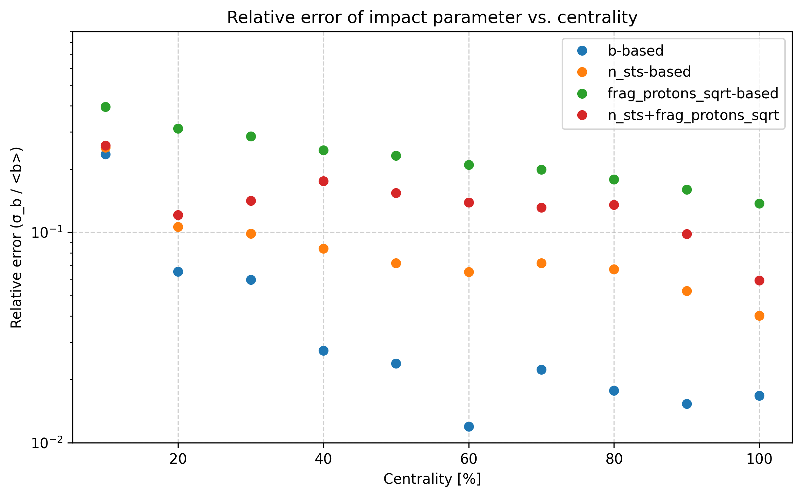
Model comparison - PHQMD all clusters
Identical results to small clusters

Slide 14
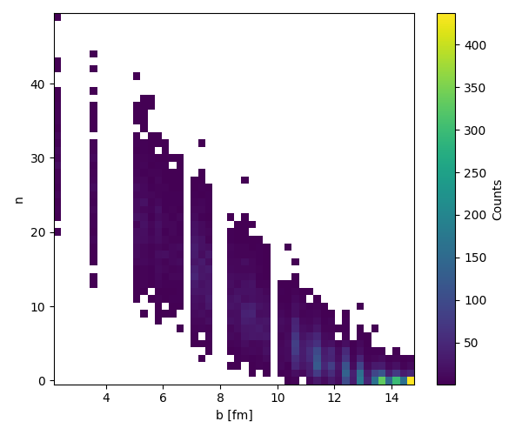
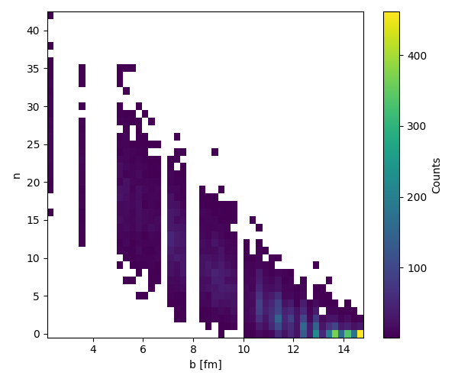
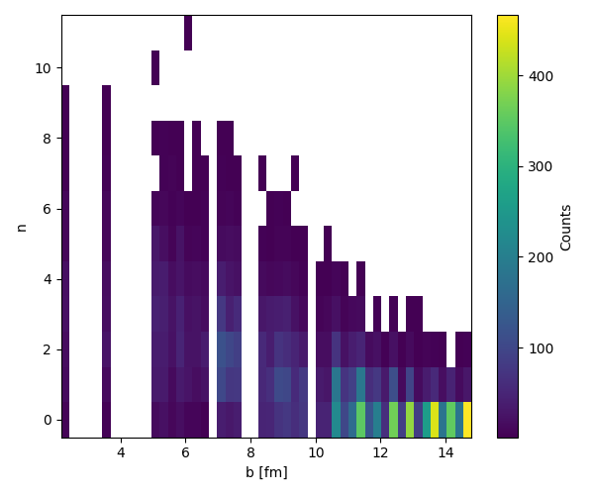
Model comparison - PHQMD all clusters
MC primary tracks with hit in STS, y>2.8
MC primary tracks with hit in STS, y>2.8, pions
MC primary tracks with hit in STS, y>2.8, protons

Slide 15
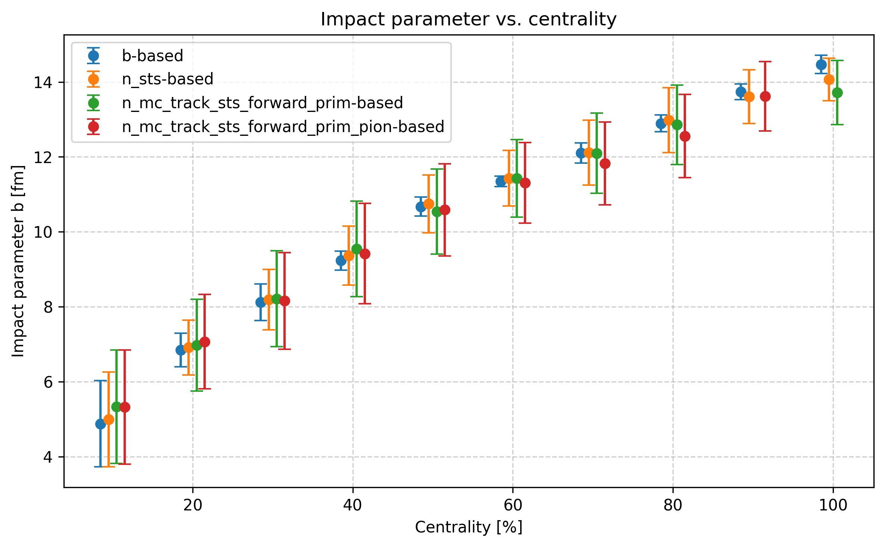
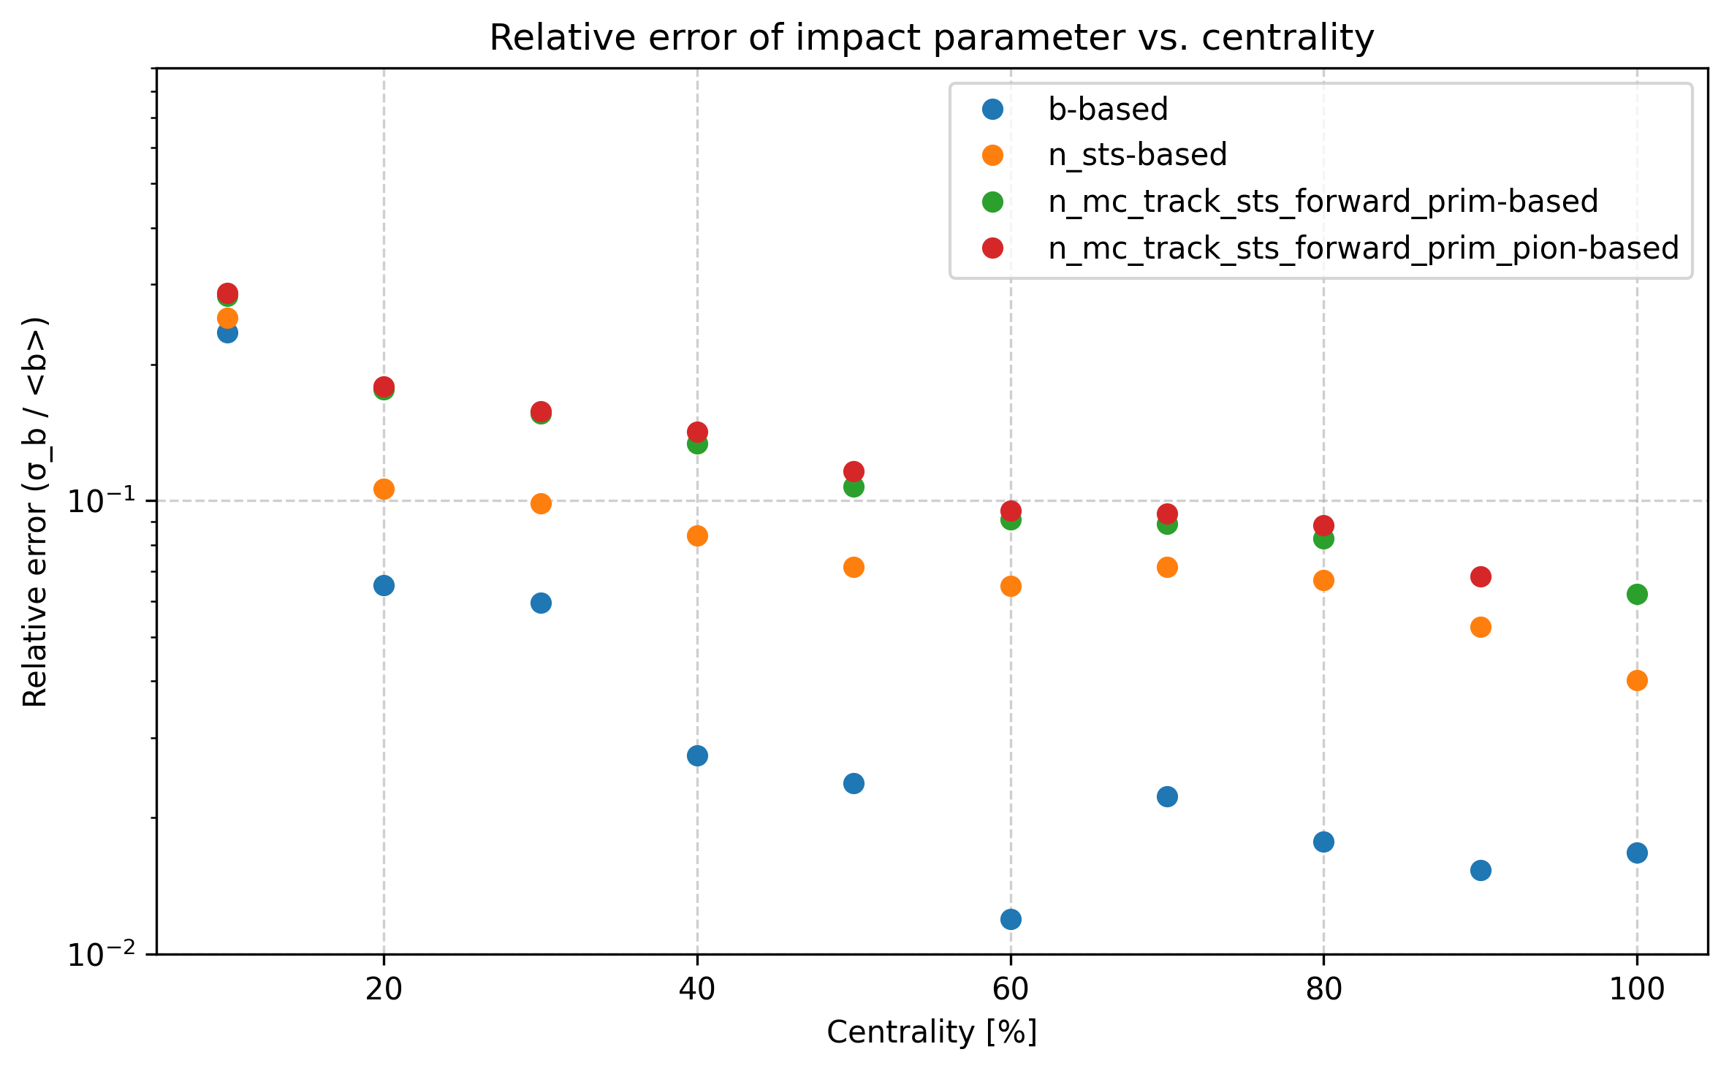
Model comparison - PHQMD all clusters
Forward pions are almost as good as full STS

Slide 16
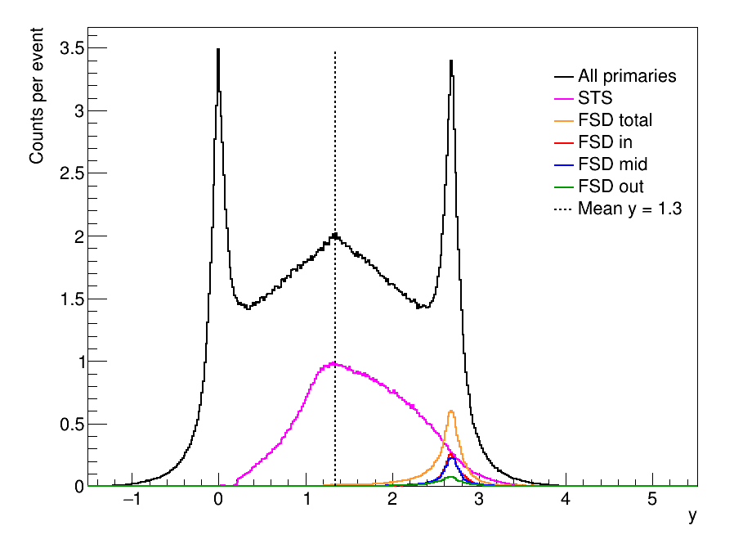
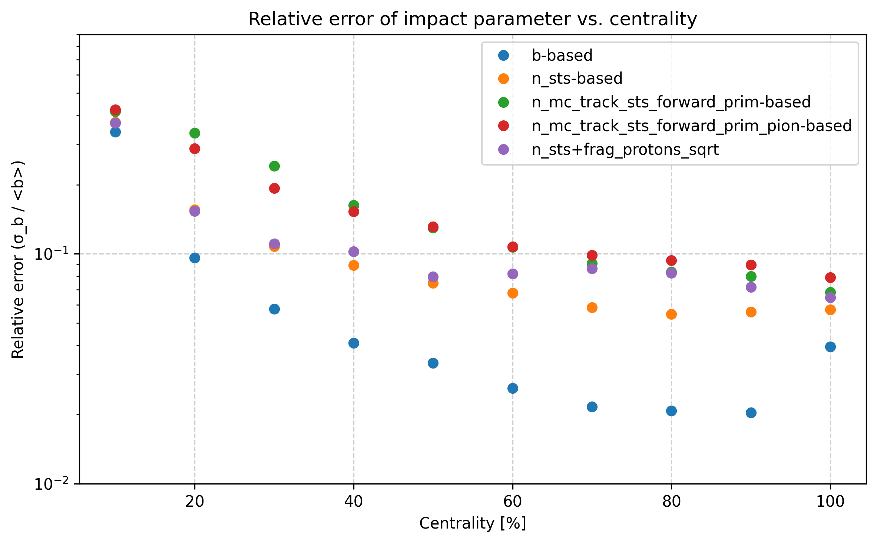
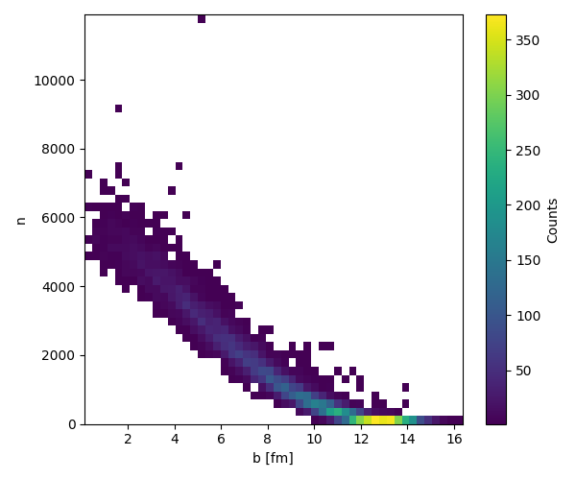
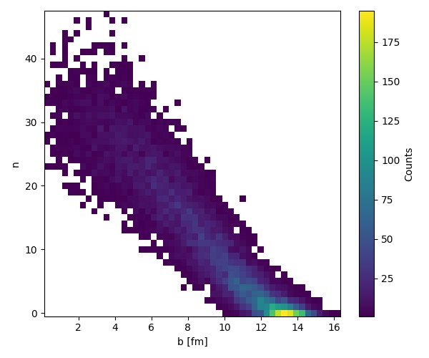
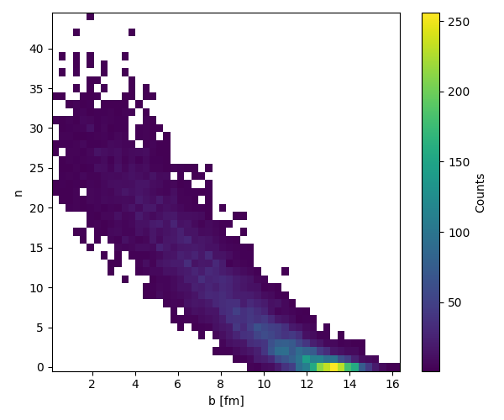
6AGeV
DCM-QGSM-SMM
MC primary tracks with hit in STS, y>2.4, pions
MC primary tracks with hit in STS, y>2.4
STS

Slide 17
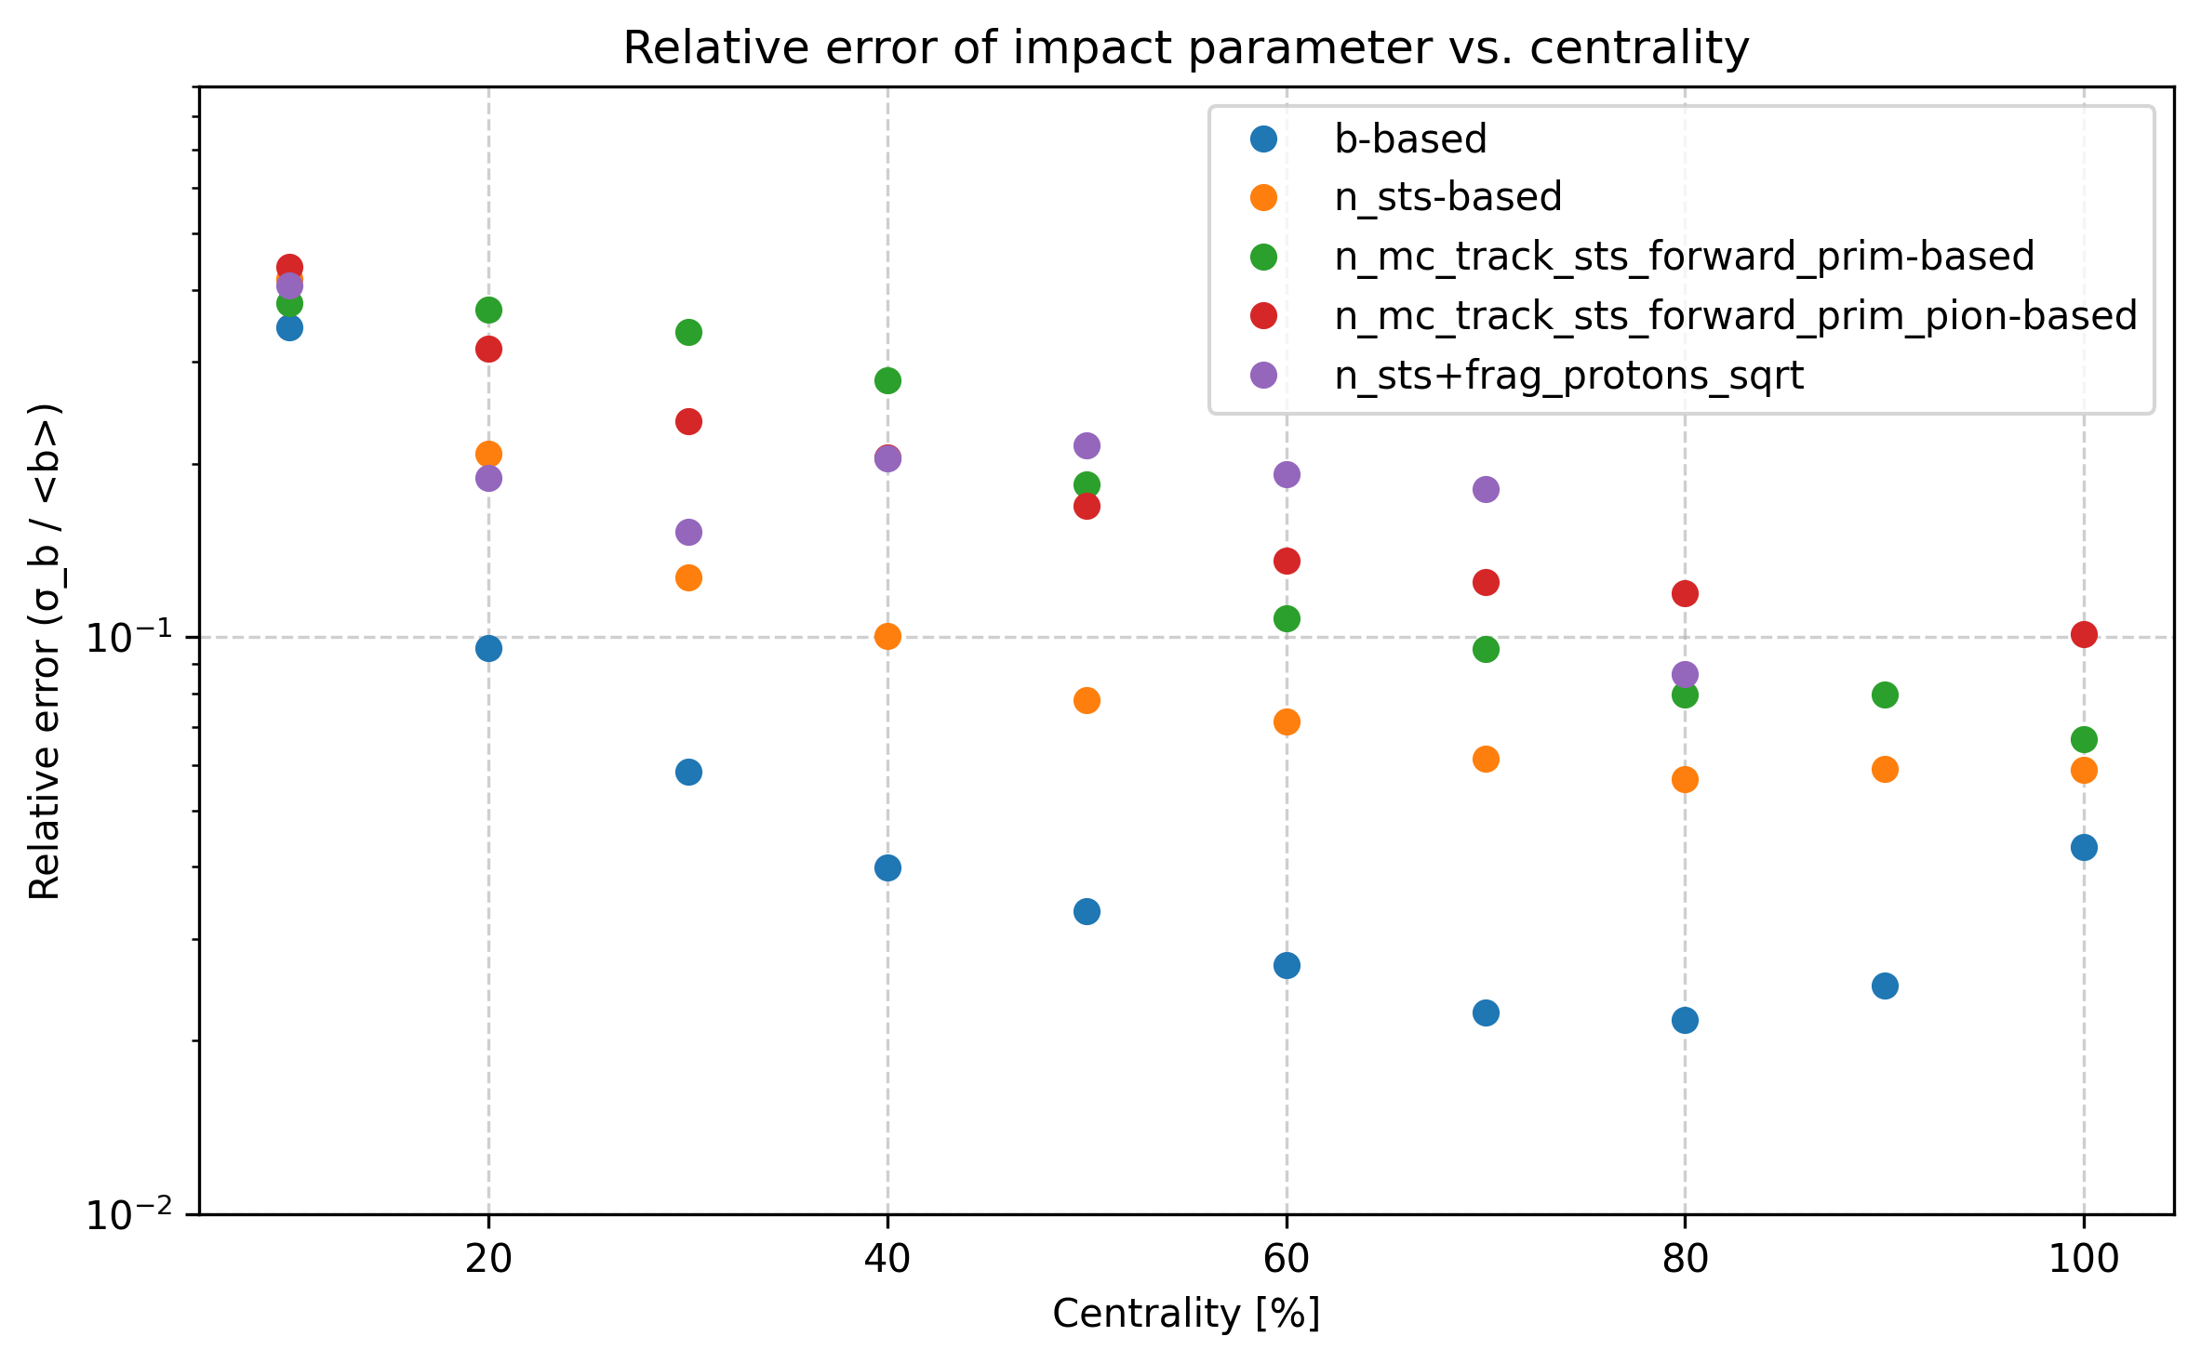
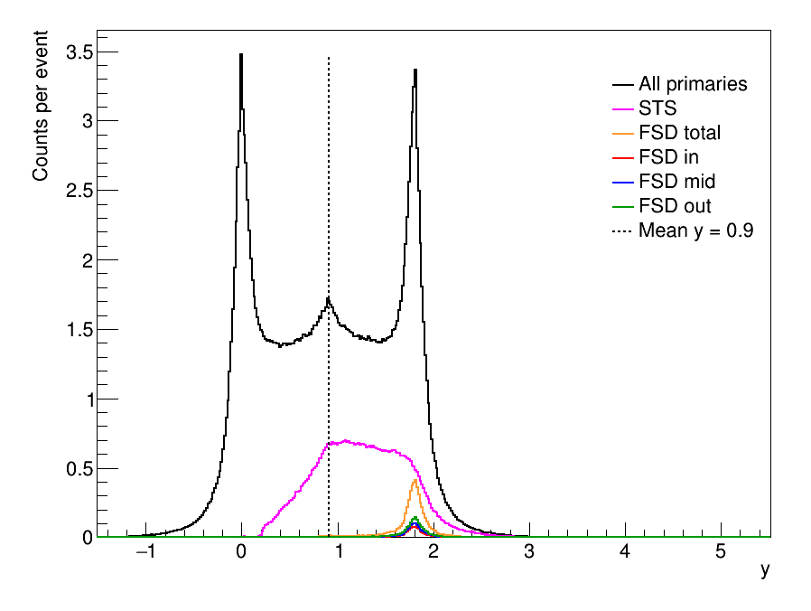
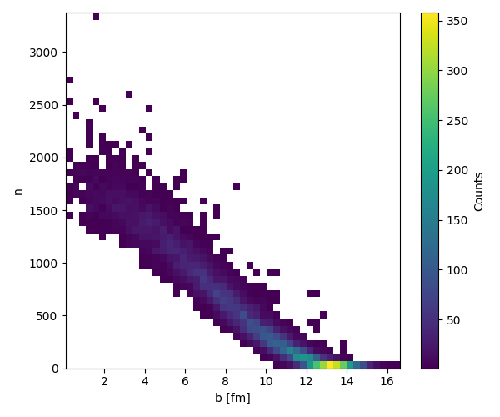
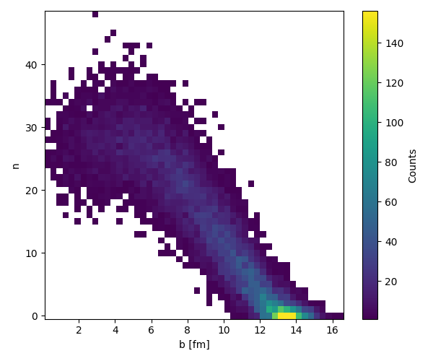
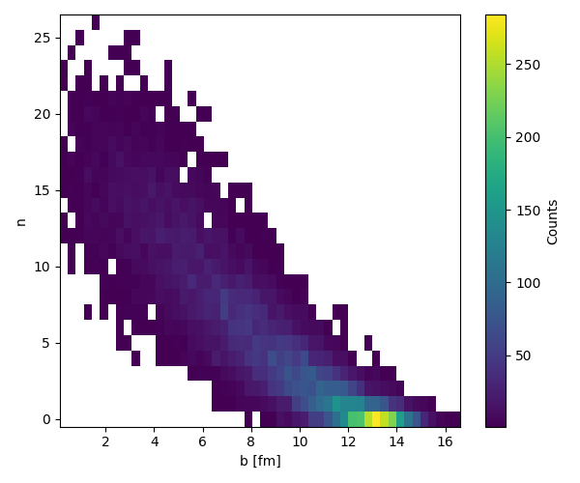
2AGeV
DCM-QGSM-SMM
MC primary tracks with hit in STS, y>1.6, pions
MC primary tracks with hit in STS, y>1.6
STS

Slide 18
Conclusion
FSD has similar performance as PSD - no improvement of centrality measurement of STS using 2D method
Forward pions are good estimator of centrality - model and energy independent - todo: the estimator are primary MC tracks with STS hit and y>2.8 not reconstructed STS tracks
In PHQMD FSD can reconstruct centrality alone
FSD can reconstruct centrality using ML - see my previous presentation

Slide 19
Backup

Slide 20
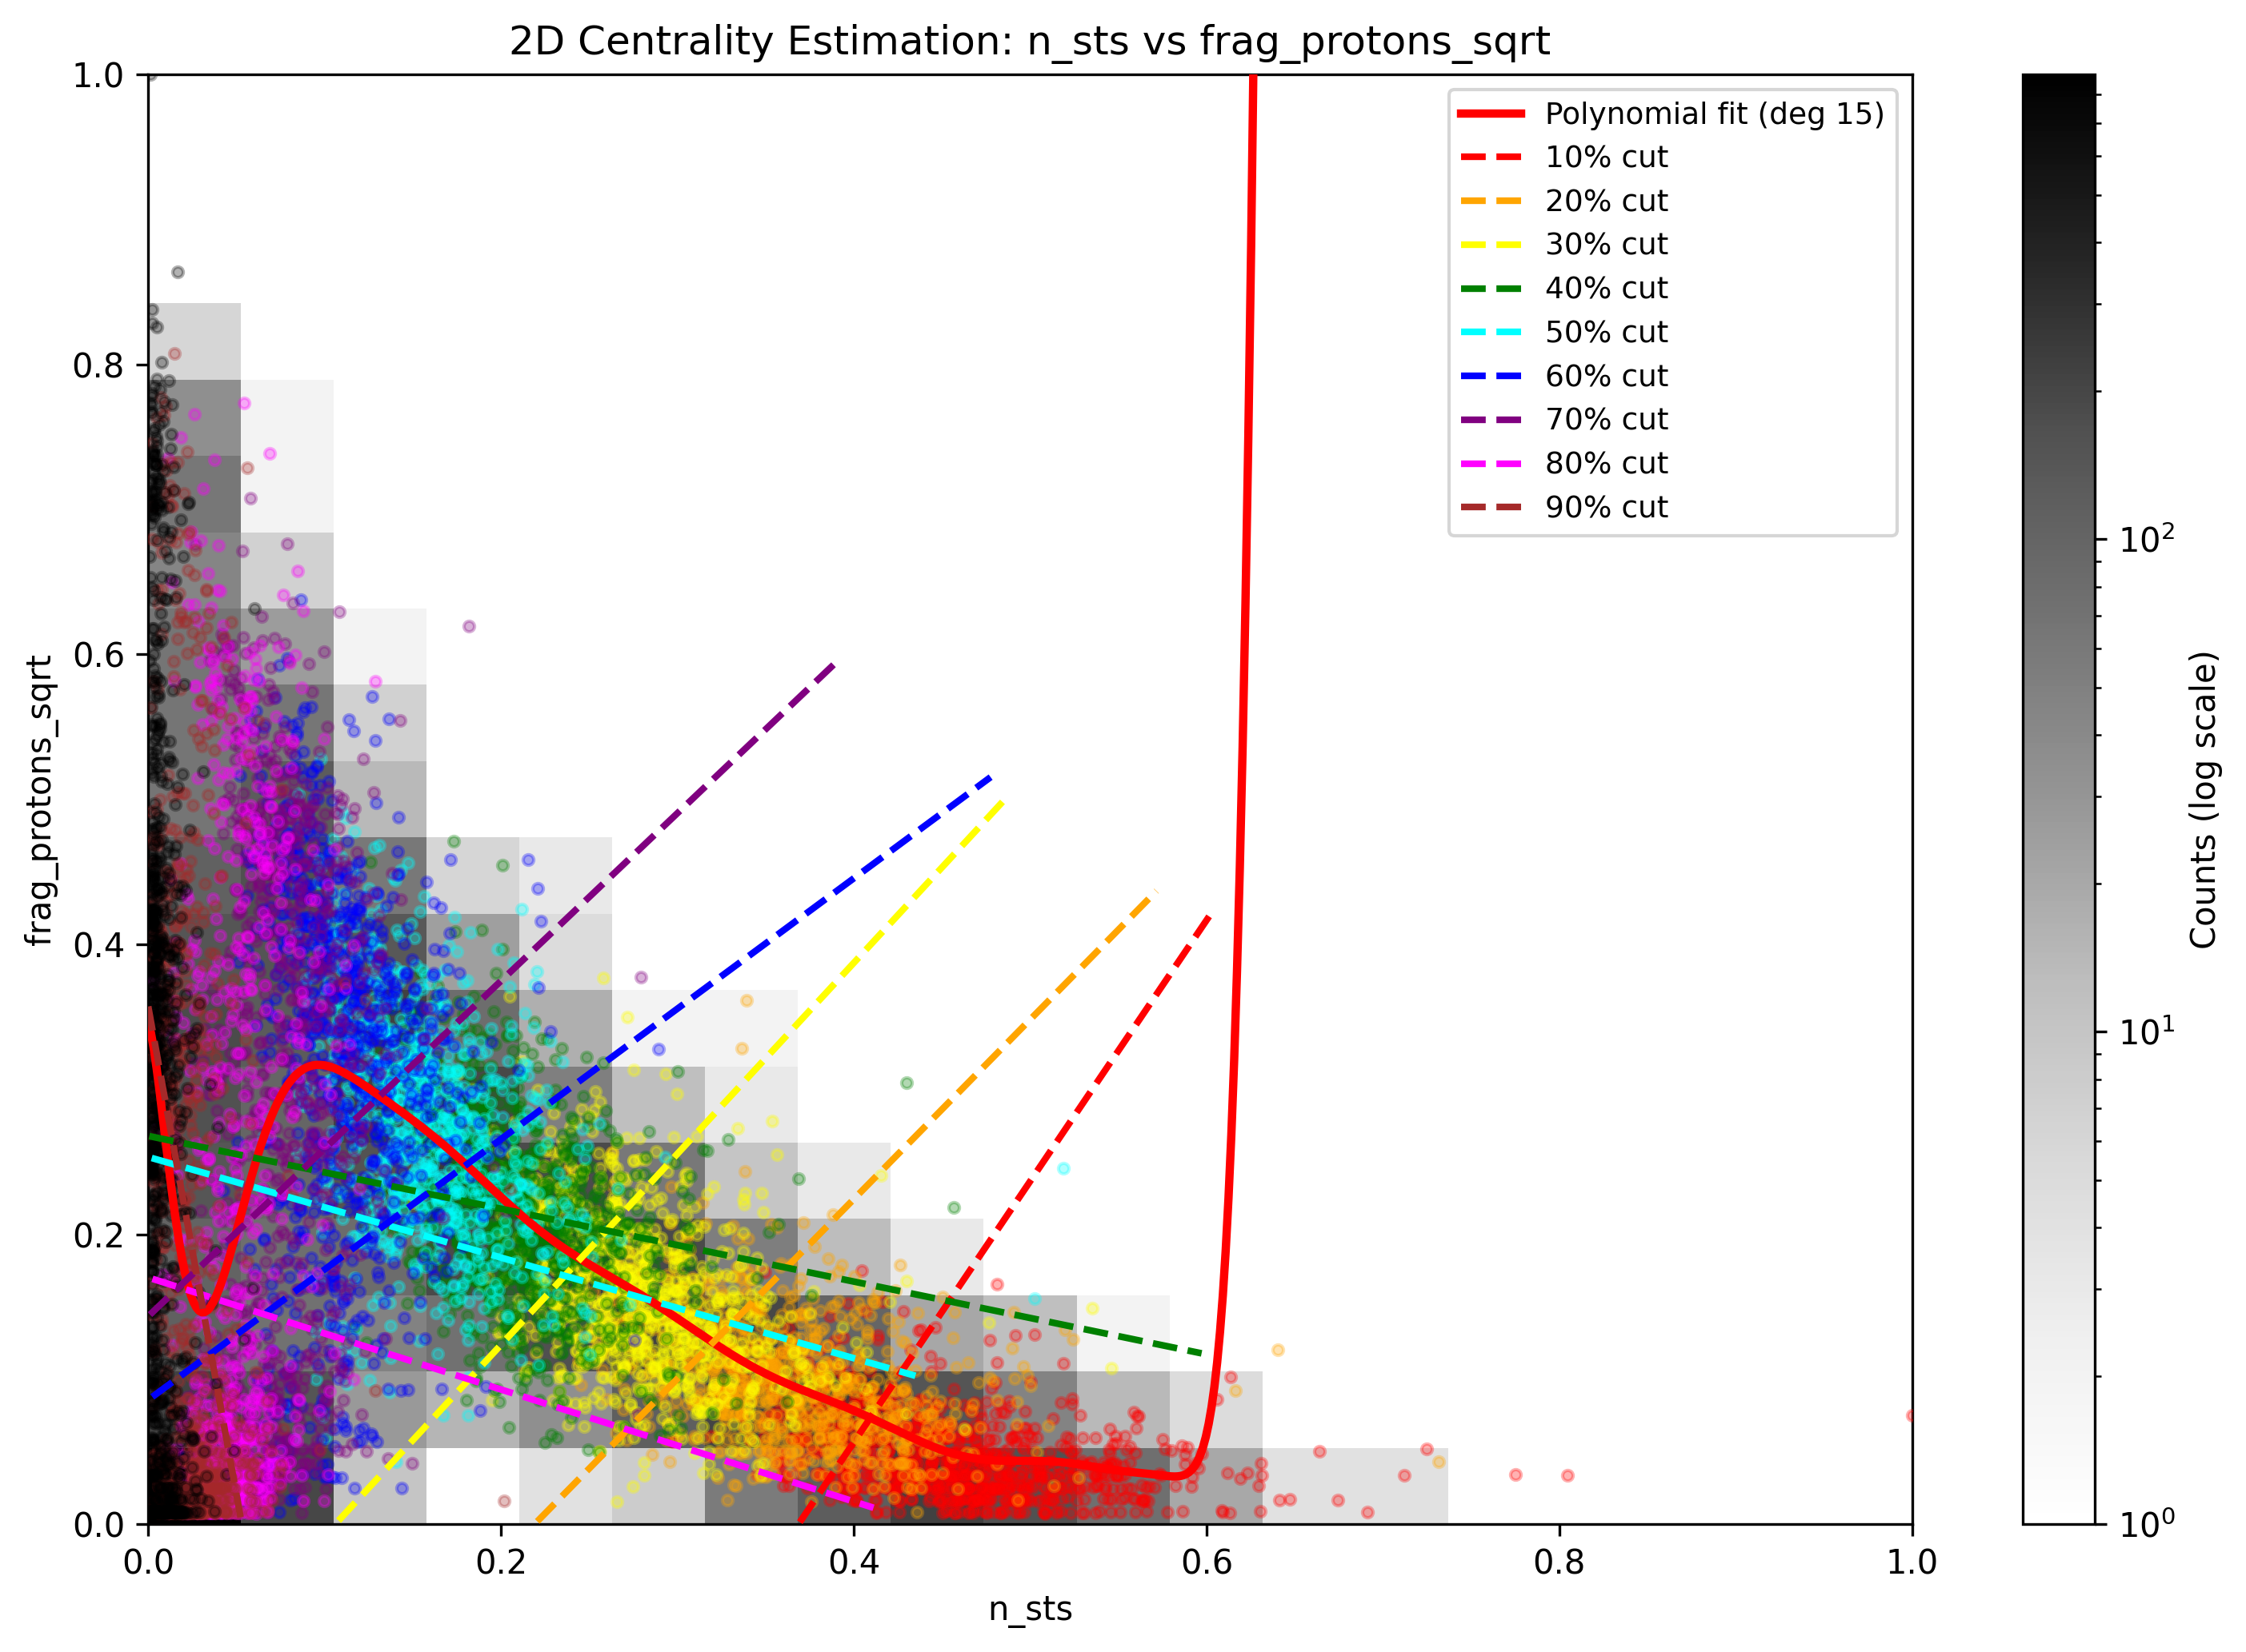
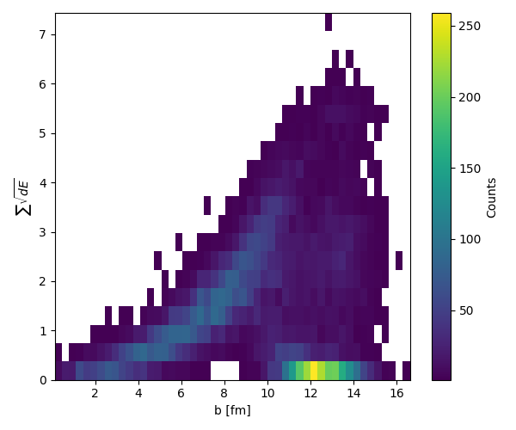
2AGeV

Slide 21
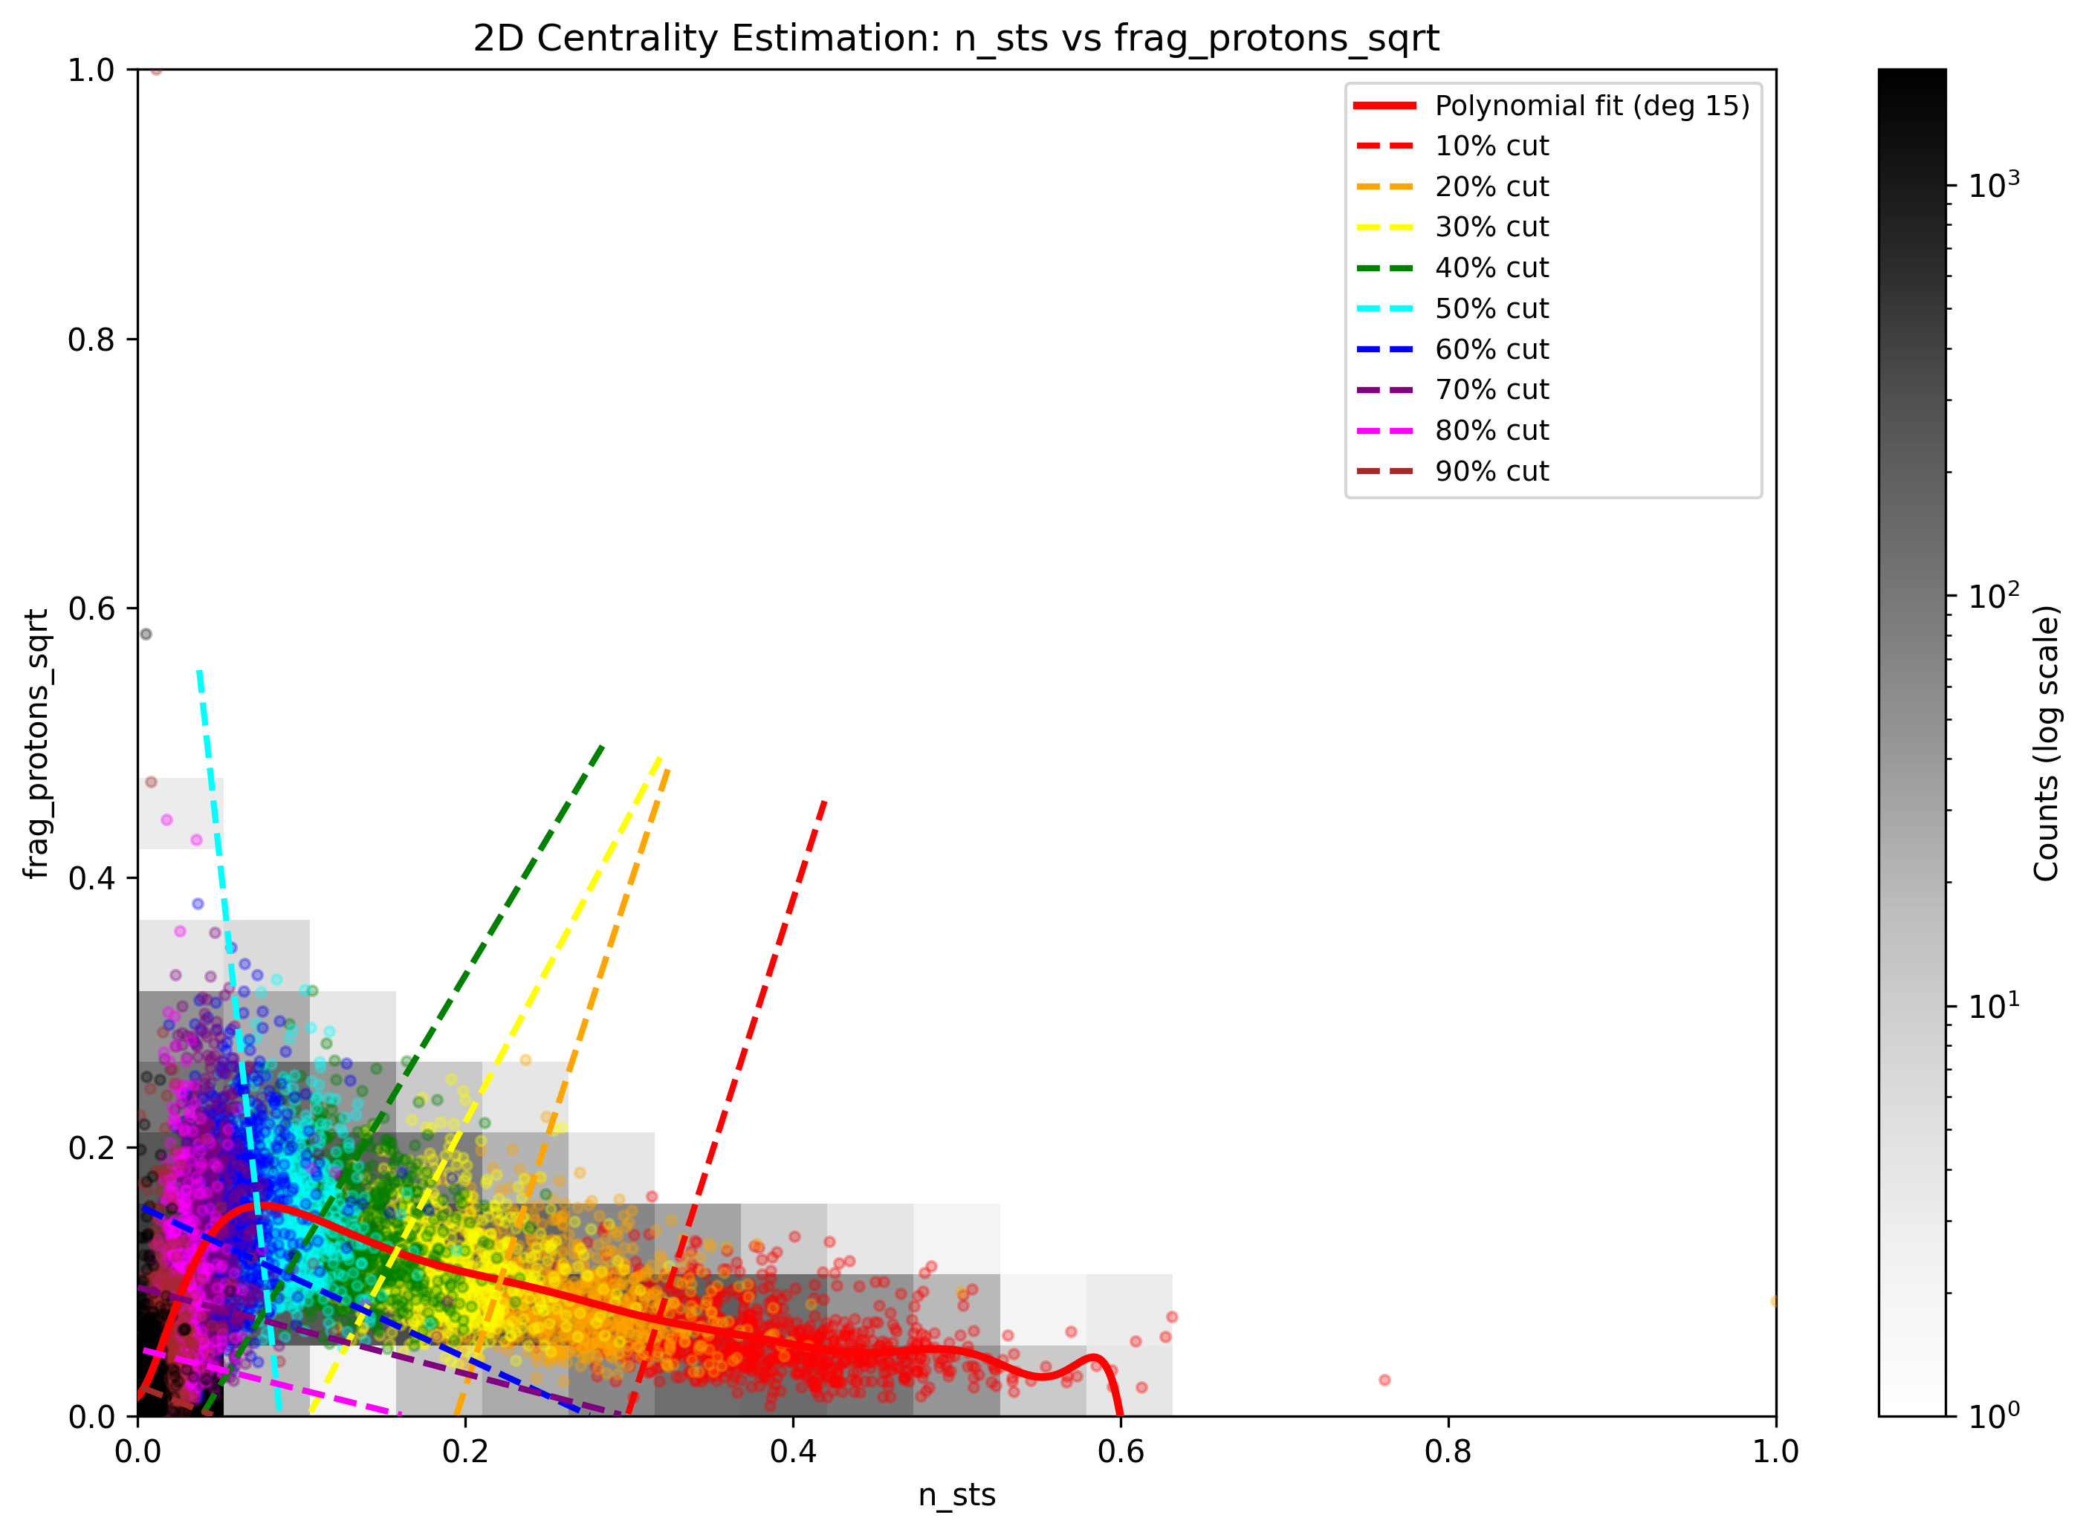

6AGeV

