Slide 1
Simulations for Forward Spectator Detector in CBM
Ruijia Yang
30.06.2025

Slide 2
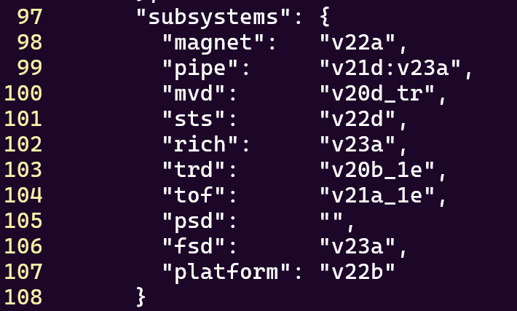
Simulation
Beam: proton 12 GeV/c
Events: 100,000

Slide 3
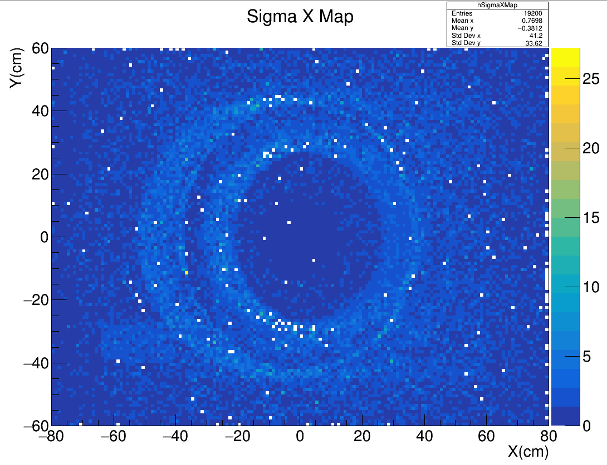
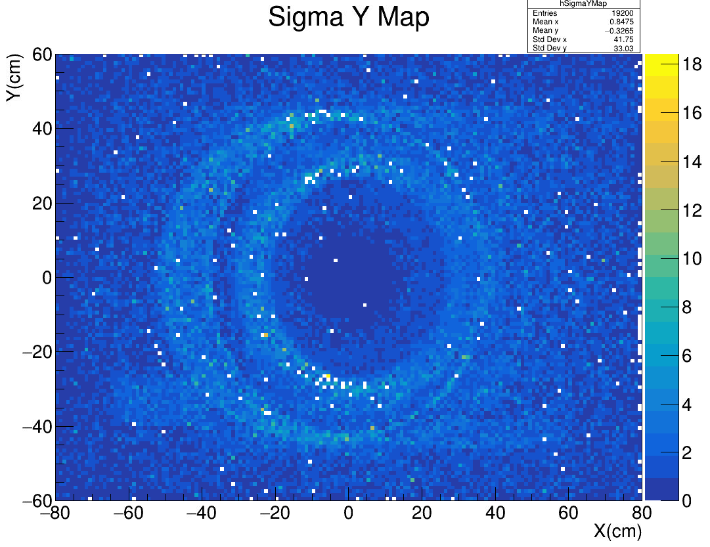
Simulation – 1cm x 1cm
Beam: proton 12 GeV/c
Events: 100,000*10

Slide 4
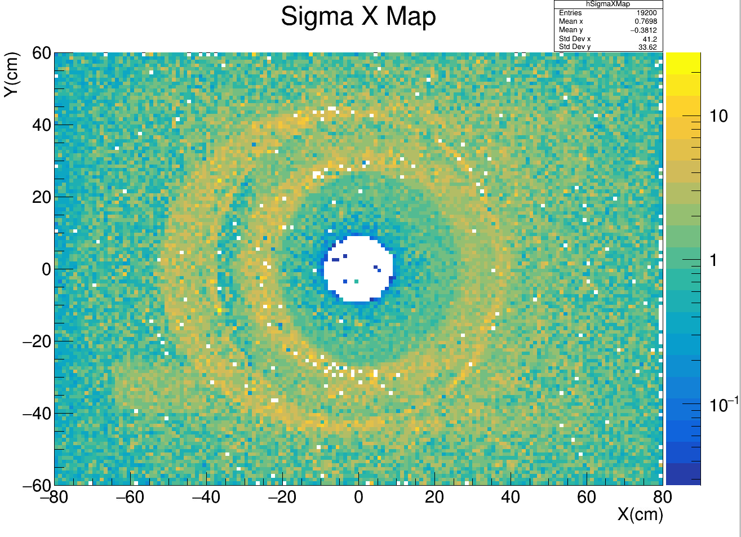
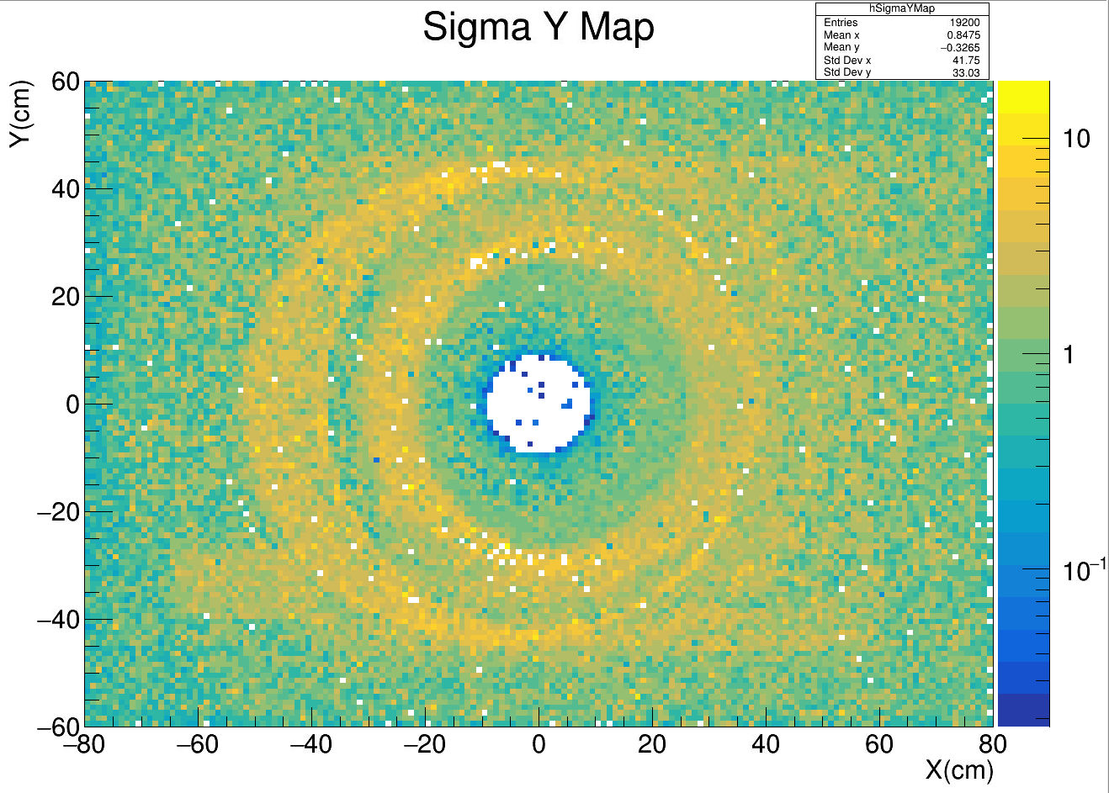
Simulation – 1cm x 1cm
Beam: proton 12 GeV/c
Events: 100,000*10

Slide 5
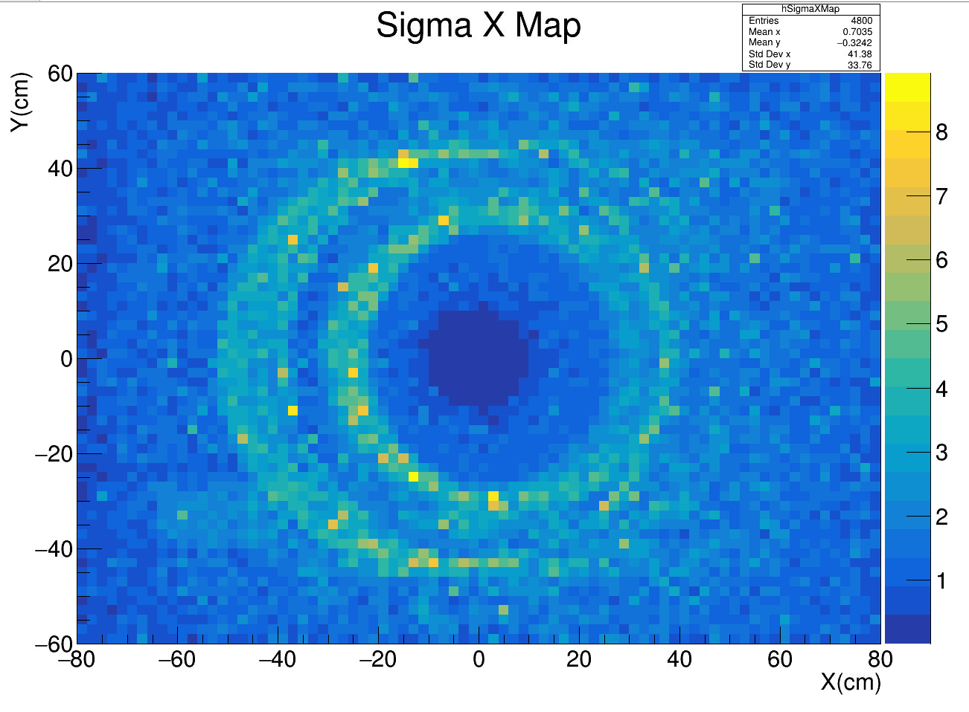
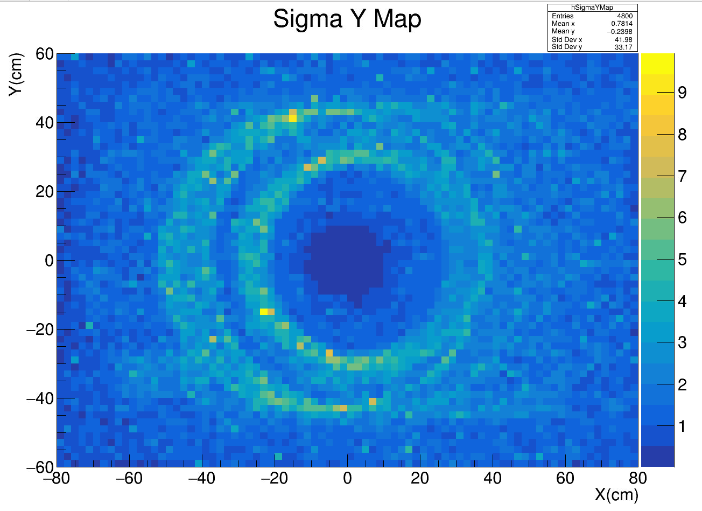
Simulation – 2cm x 2cm
Beam: proton 12 GeV/c
Events: 100,000

Slide 6
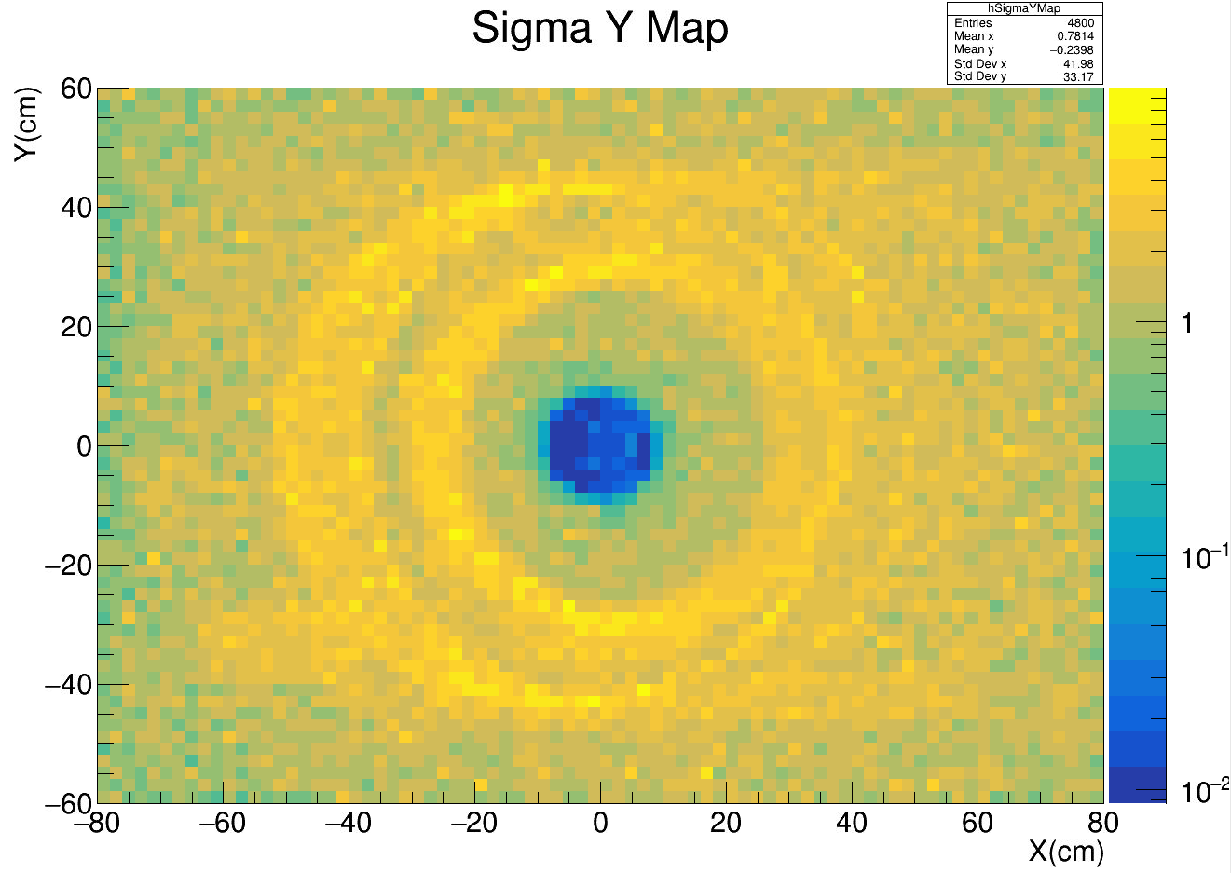
Simulation – 2cm x 2cm
Beam: proton 12 GeV/c
Events: 100,000

Slide 7
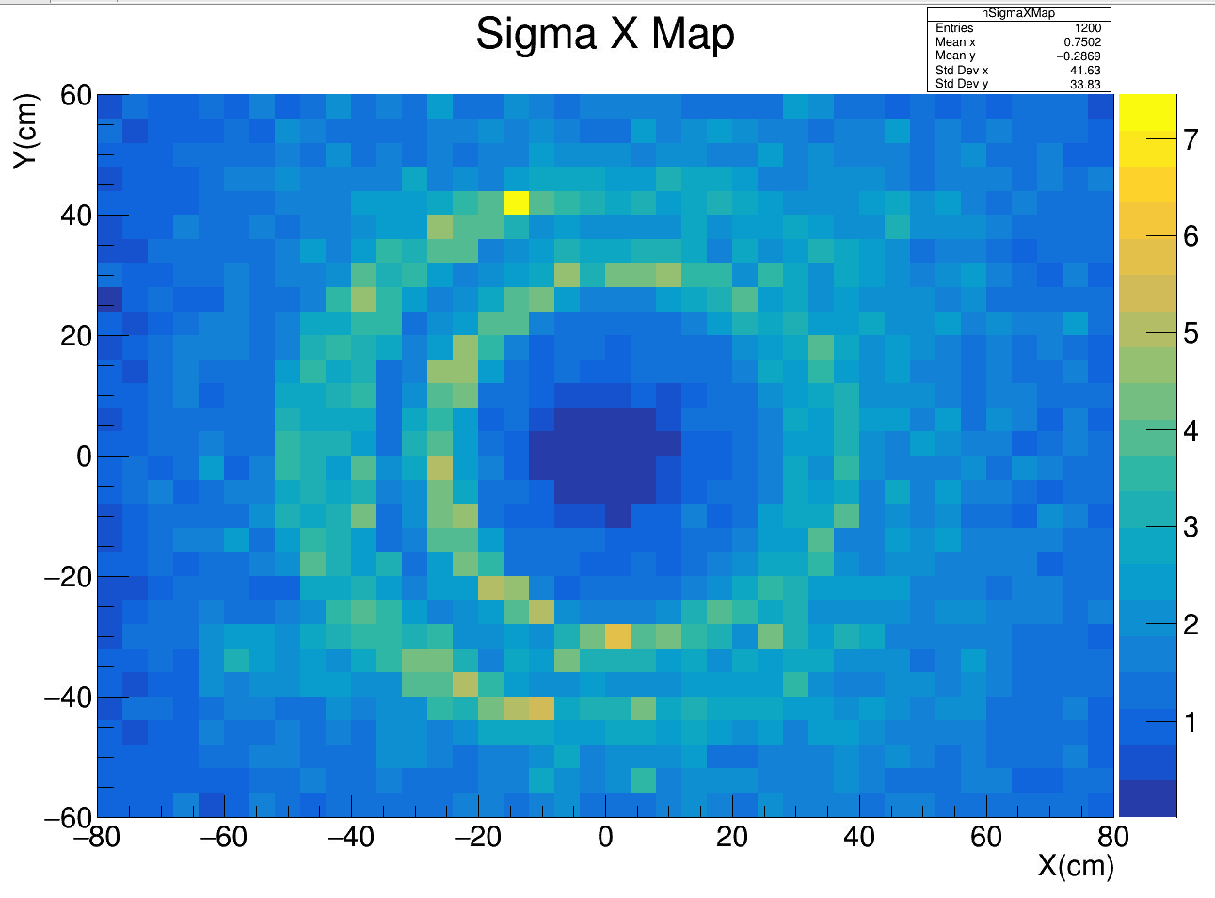
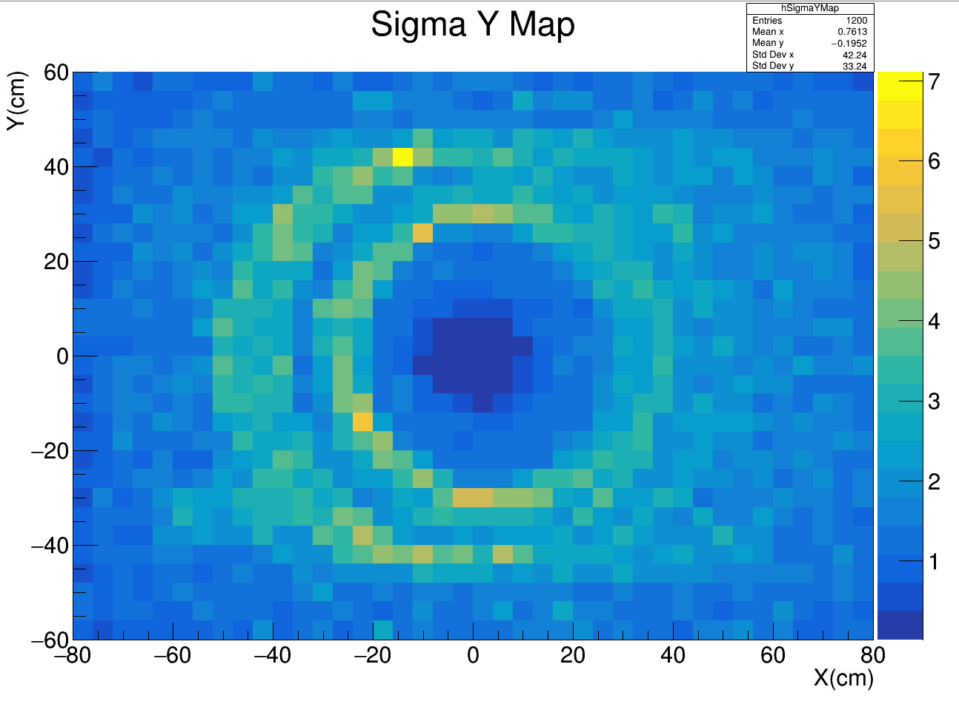
Simulation – 4cm x 4cm
Beam: proton 12 GeV/c
Events: 100,000

Slide 8
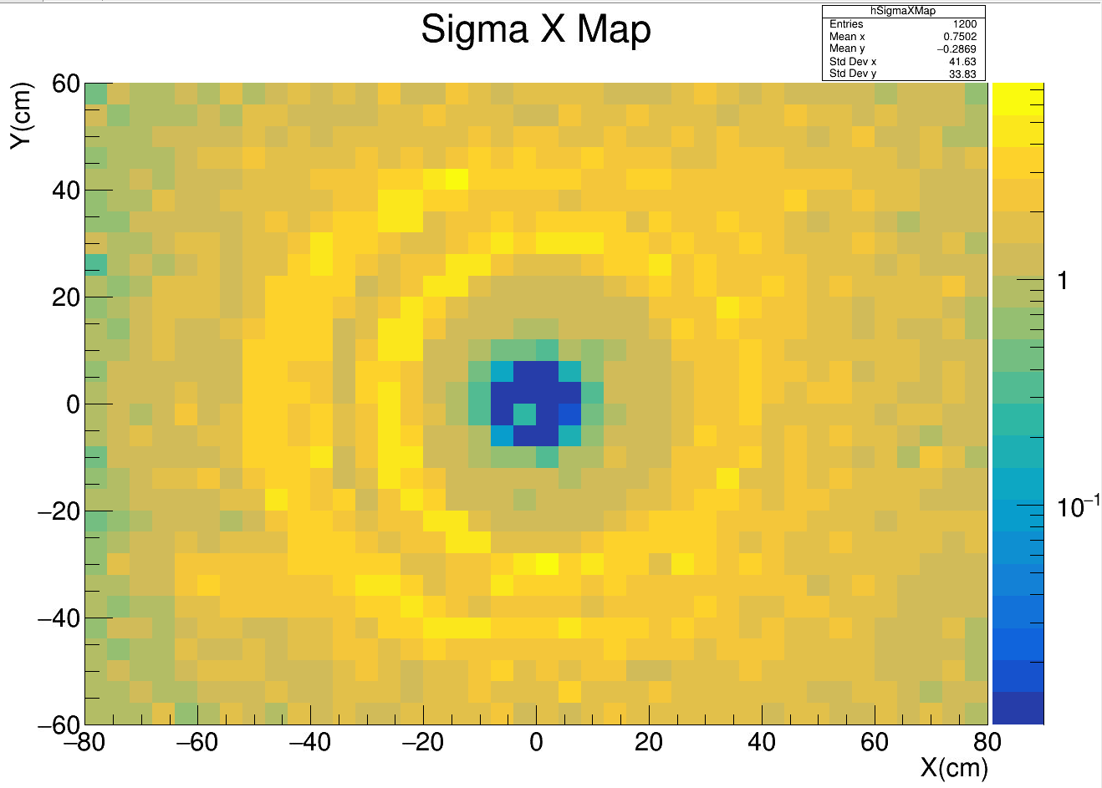
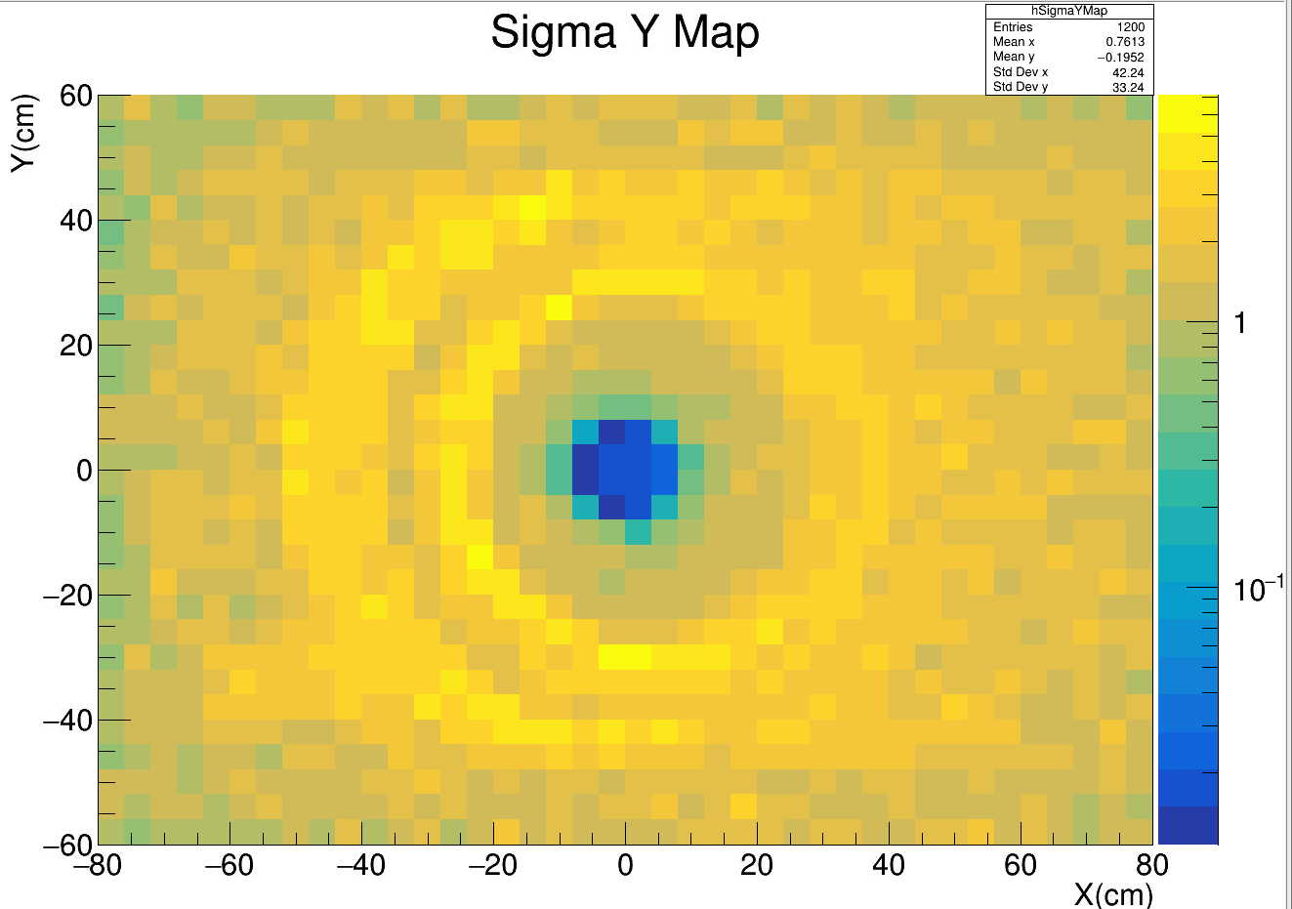
Simulation – 4cm x 4cm
Beam: proton 12 GeV/c
Events: 100,000

Slide 9
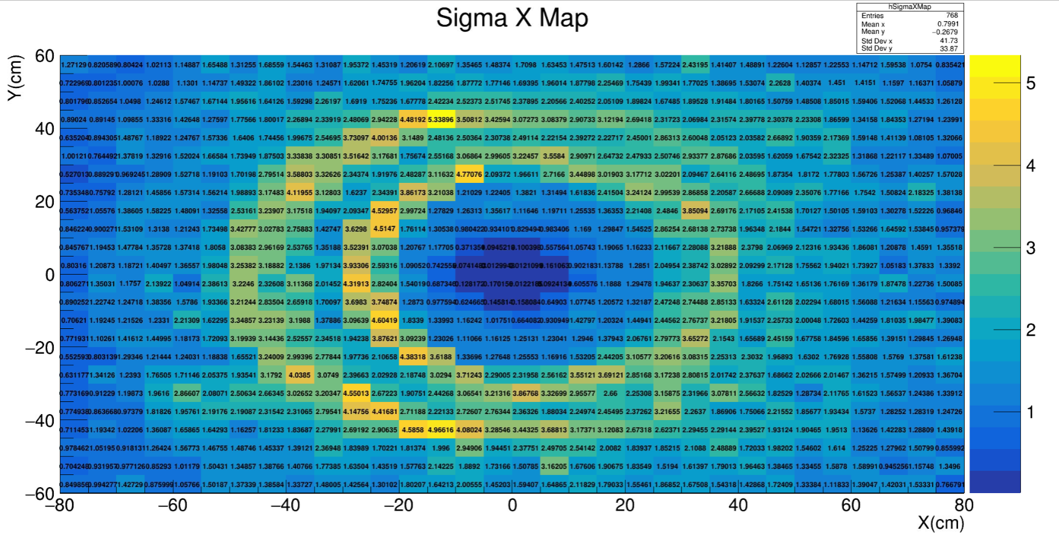
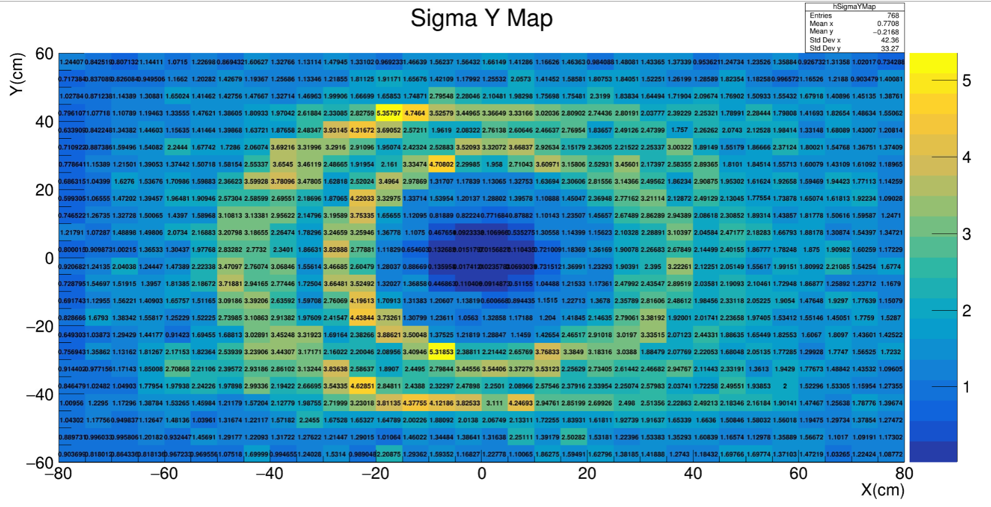
Simulation – 5cm x 5cm
Beam: proton 12 GeV/c
Events: 100,000

Slide 10
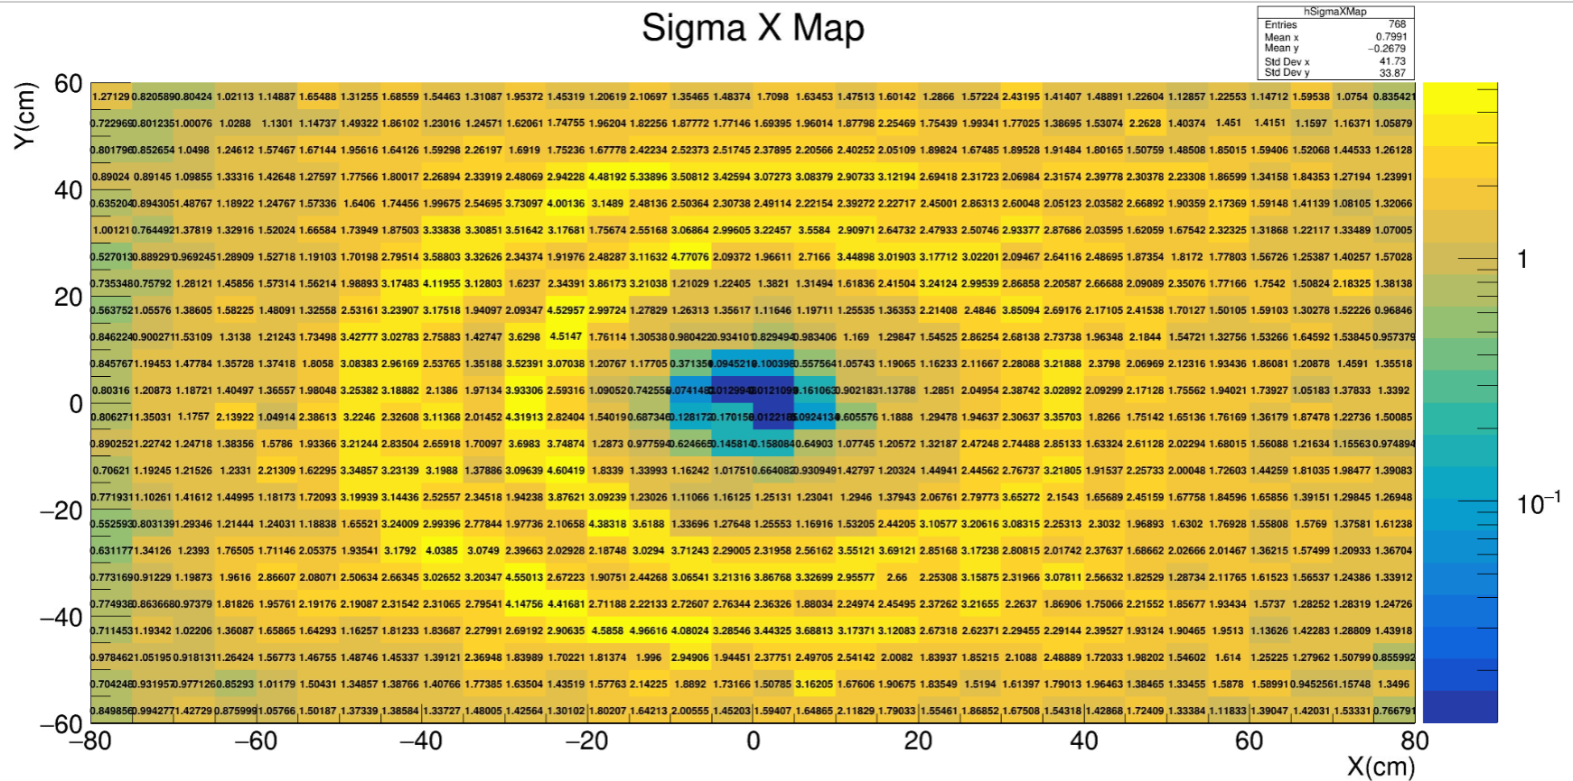
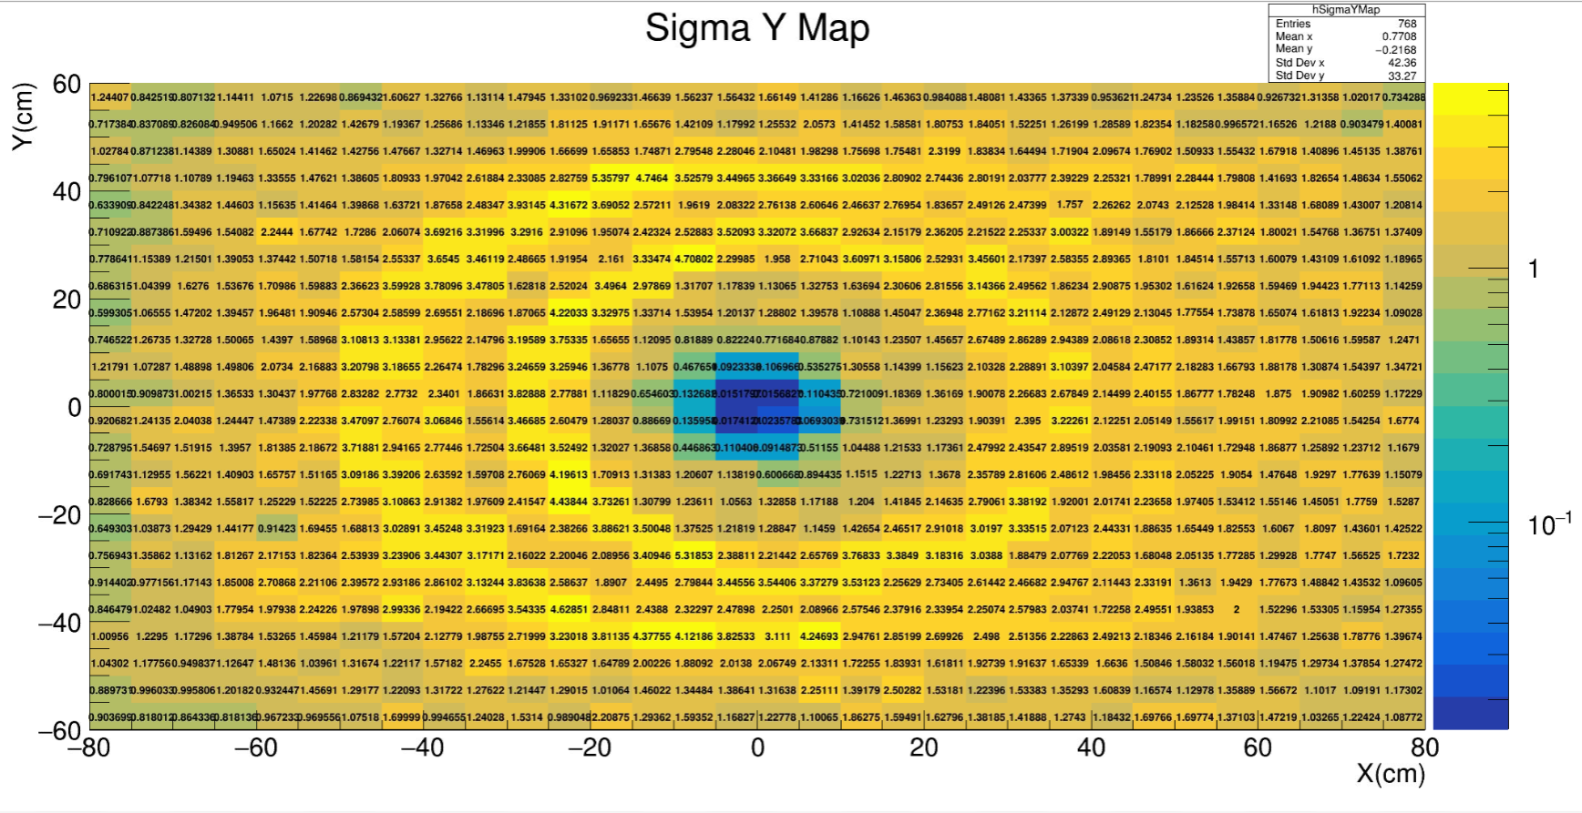
Simulation – 5cm x 5cm
Beam: proton 12 GeV/c
Events: 100,000

Slide 11
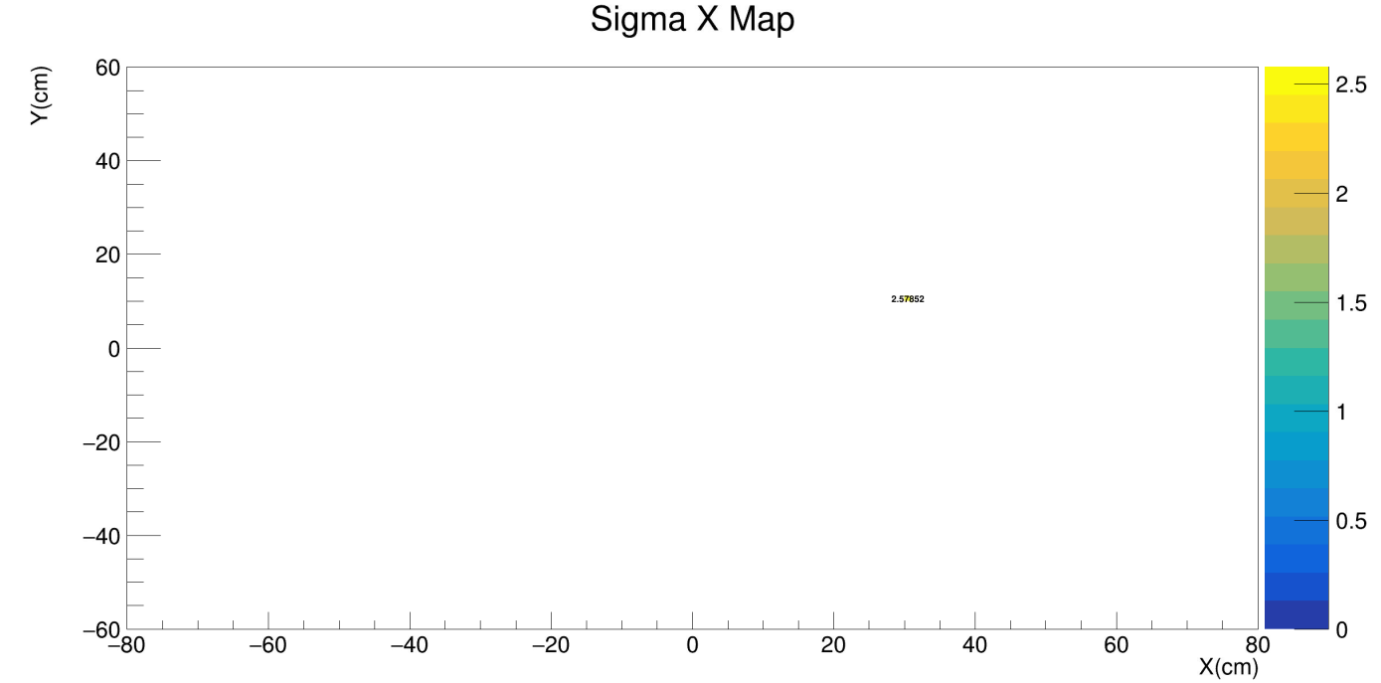
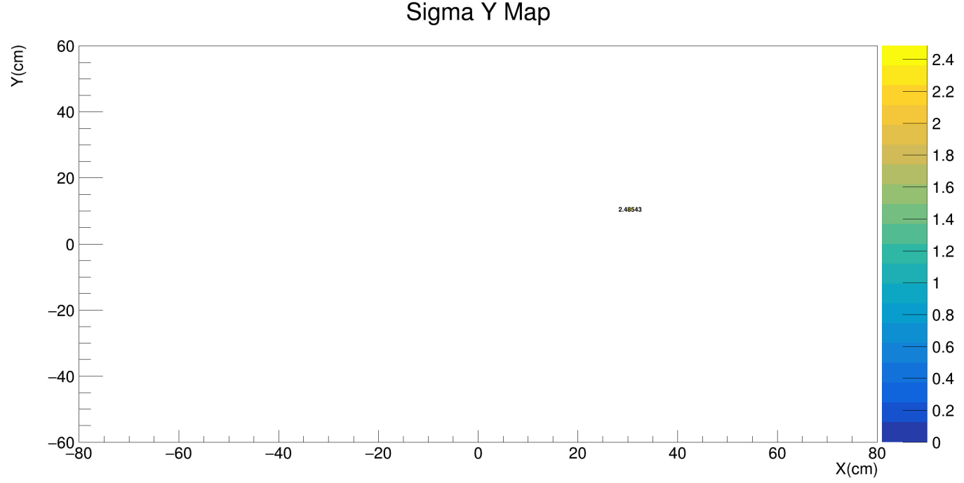

Simulation – fixed beam angle check
Beam: proton 12 GeV/c
Beam profile: fixed angle $θ_{x}=0.01, θ_{y}=0.01$
Events: 1000*10
2.57852
2.48543

