Slide 1
Flexible data transport for the online reconstruction in FairRoot
Mohammad Al-Turany
Dennis Klein
Anar Manafov
Alexey Rybalchenko

Slide 2
Contents
Motivation
Current status
Results
Summary

Slide 3
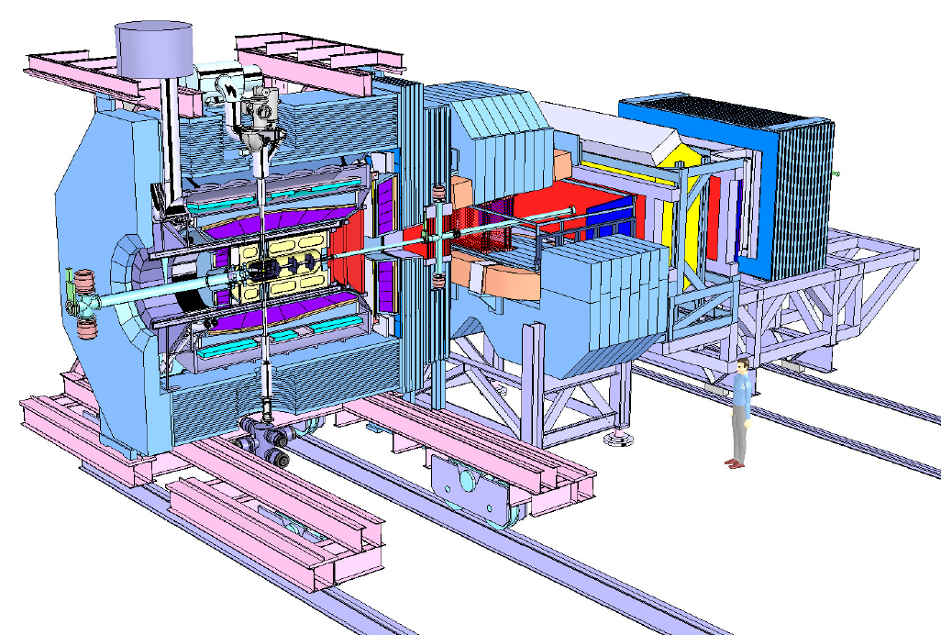
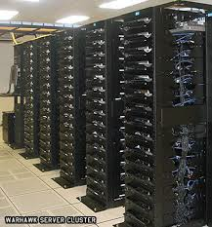
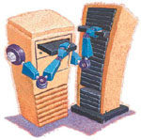
The Online Reconstruction and analysis
300 GB/s
20M Evt/s
> 60 000
CPU-core
or Equivalent
GPU, FPGA, …
< 1 GB/s
25K Evt/s
How to distribute the processes?
How to manage the data flow?
How to recover processes when they crash?
How to monitor the whole system?
……
1 GB/s
1 TB/s
> 60 000
CPU-core
or Equivalent
GPU, FPGA, …

Slide 4
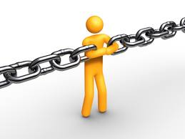
Design constrains
Highly flexible:
different data paths should be modeled.
Adaptive:
Sub-systems are continuously under development and improvement
Should works for simulated and real data:
developing and debugging the algorithms
It should support all possible hardware where the algorithms could run (CPU, GPU, FPGA)
It has to scale to any size! With minimum or ideally no effort.

Slide 5
Data transport
How to handle dynamic components, i.e. pieces that go away temporarily?
How to handle messages that we can't deliver immediately? Particularly, if we're waiting for a component to come back on-line
What if we need to use a different network transport. Say, multicast instead of TCP unicast? Or IPv6? Do we need to rewrite the applications, or is the transport abstracted in some layer?

Slide 6
Example for PANDA online reconstruction hierarchy
STT data
Mvd Pixel data
Mvd Srip data
GEM data
SciTel data
Clusterer
Clusterer
Clusterer
Clustrer
Pre-Procceing
Tracker
Tracker
Tracker
Global Event Reconstruction
Trigger event selection

Slide 7
Example for PANDA online reconstruction hierarchy Simulation
STT Sampler
Mvd Pixel Sampler
Mvd Strip Sampler
GEMSampler
SciTel Sampler
Clusterer
Clusterer
Clusterer
Clustrer
Pre-Procceing
Tracker
Tracker
Tracker
Global Event Reconstruction
Trigger event selection

Slide 8
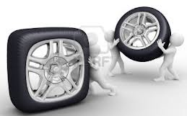
Before Re-inventing the Wheel
What is available on the market and in the community?
A very promising package: ZeroMQ is available since 2 years
Do we intend to separate online and offline? NO
Multi-Threaded concept or Multi-Processes based on message queues?
Message based systems allow us to decouple producers from consumers.
We can spread the work to be done over several processes and machines.
We can manage/upgrade/move around programs (processes) independently of each other.

Slide 9
ØMQ (zeromq)
A socket library that acts as a concurrency framework.
Carries messages across inproc, IPC, TCP, and multicast.
Connect N-to-N via fanout, pubsub, pipeline, request-reply.
Asynch I/O for scalable multicore message-passing apps.
30+ languages including C, C++, Java, .NET, Python.
Most OS’s including Linux, Windows, OS X, PPC405/PPC440.
Large and active open source community.
LGPL free software with full commercial support from iMatix.

Slide 10
What does it deliver?
It handles I/O asynchronously, in background threads.
These communicate with application threads using lock-free data structures,
Concurrent ØMQ applications need no locks, semaphores, or other wait states.
Components can come and go dynamically and ØMQ will automatically reconnect.
You can start components in any order.
You can create "service-oriented architectures" (SOAs) where services can join and leave the network at any time.
When a queue is full, ØMQ
Automatically blocks senders, or
Throws away messages, depending on the kind of messaging you are doing (the so-called "pattern").

Slide 11
What does it deliver?
It does not impose any format on messages.
They are blobs of zero to gigabytes large.
You can use any other product (Protocol) on top to represent your data (Google's protocol buffers, etc).
Applications talk to each other over arbitrary transports: TCP, multicast, in-process, inter-process.
You don't need to change your code to use a different transport.

Slide 12
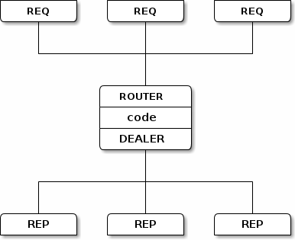
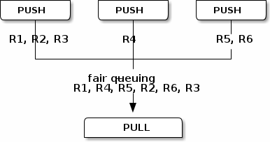
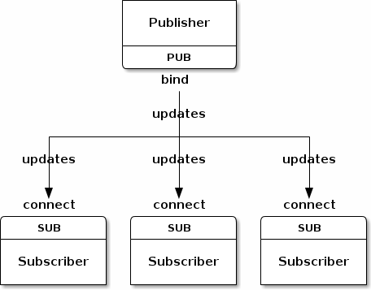
The built-in core ØMQ patterns are:
Request-reply, which connects a set of clients to a set of services. (remote procedure call and task distribution pattern)
Publish-subscribe, which connects a set of publishers to a set of subscribers. (data distribution pattern)
Pipeline, which connects nodes in a fan-out / fan-in pattern that can have multiple steps, and loops. (Parallel task distribution and collection pattern)
Exclusive pair, which connect two sockets exclusively

Slide 13
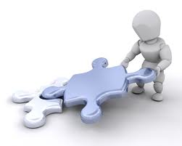
Current Status
The Framework deliver some components which can be connected to each other in order to construct a processing pipeline(s).
All component share a common base called Device (ZeroMQ Class).
Devices are grouped by three categories:
Source: Sampler
Message-based Processor:
Sink, BalancedStandaloneSplitter, StandaloneMerger, Buffer
Content-based Processor: Processor

Slide 14
Panda Example
FairMQ package
Experiment/detector specific code
Framework classes that can be used directly

Slide 15
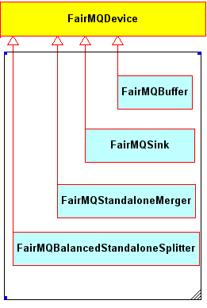
Message-based Processor
All message-based processors inherit from Device and operate on messages without interpreting their content.
Four message-based processors have been implemented so far

Slide 16
Example for Fan-out/Fan-in
the data path for load balancing
MVD data
MVD data
FairMQBalancedStandaloneSplitter
Clusterer
Clustrer
Clustrer
Clustrer
Tracker
Tracker
Tracker
MVD Tracker
FairMQStandaloneMerger

Slide 17
Example for Fan-out/Fan-in
the data path for load balancing
MVD data
MVD data
FairMQBalancedStandaloneSplitter
Clusterer
Clustrer
Clustrer
Clustrer
FairMQStandaloneMerger
MVD Tracker
MVD Tracker

Slide 18
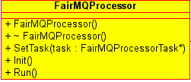
Content-based Processor
The Processor device has at least one input and one output socket.
A task is meant for accessing and potentially changing the message content.

Slide 19
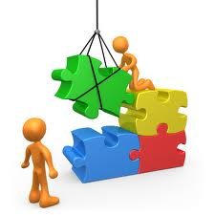
Example for Panda online reconstruction hierarchy (scenario)
Detector
Simulation
MVD Pixel data
Mvd Strip data
REP
REP
SUB
Parameter database
SUB
REQ
SUB
SUB
REQ
SUB
PUB
Clusterer
Clusterer
REP
REP
SUB
REQ
Tracker
PUB
REP
PUB

Slide 20
Results
Throughput of 940 Mbit/s was measured which is very close to the theoretical limit of the TCP/IPv4/GigabitEthernet
The throughput for the named pipe transport between two devices on one node has been measured around 1.7 GB/s
Each message consists of digits in one panda event for one detector, with size of few kBytes

Slide 21
Payload in Mbyte/s as function of message size
ZeroMQ works on InfiniBand but using IP over IB

Slide 22
Integrating the existing software:
ROOT Files, Lmd Files, Remote event server, …
Root (Event loop)
ZeroMQ
FairRootManager
FairRunAna
FairTasks
Init()
Re-Init()
Exec()
Finish()
FairMQProcessorTask
Init()
Re-Init()
Exec()
Finish()

Slide 23
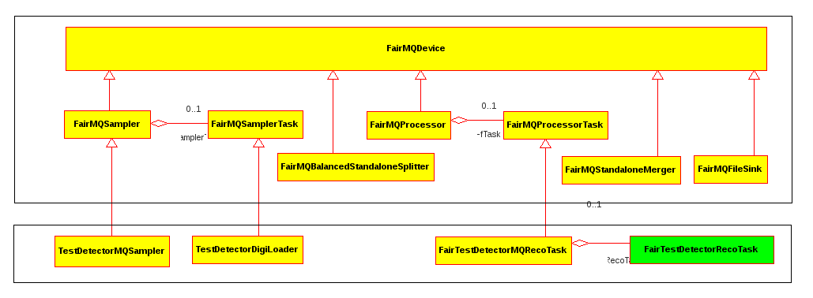
FairBase/examples/Tutorial3
Fairbase/example/Tutorial3

Slide 24
Next to implement
Local and central Log processors
Command channels and objects (messages)
Automatic monitoring and configuration
(hopefully till the end of this year!)

Slide 25
Summary
ZeroMQ communication layer is integrated into our offline framework (FairRoot)
On the short term we will keep both options ROOT based event loop and concurrent processes communicating with each other via ZeroMQ.
On long Term we are moving away from single event loop to distributed processes.
Thanks you !

Slide 26
Native InfiniBand/RDMA is faster than IP over IB
Implementing ZeroMQ over IB verbs will improve the performance.

Slide 27
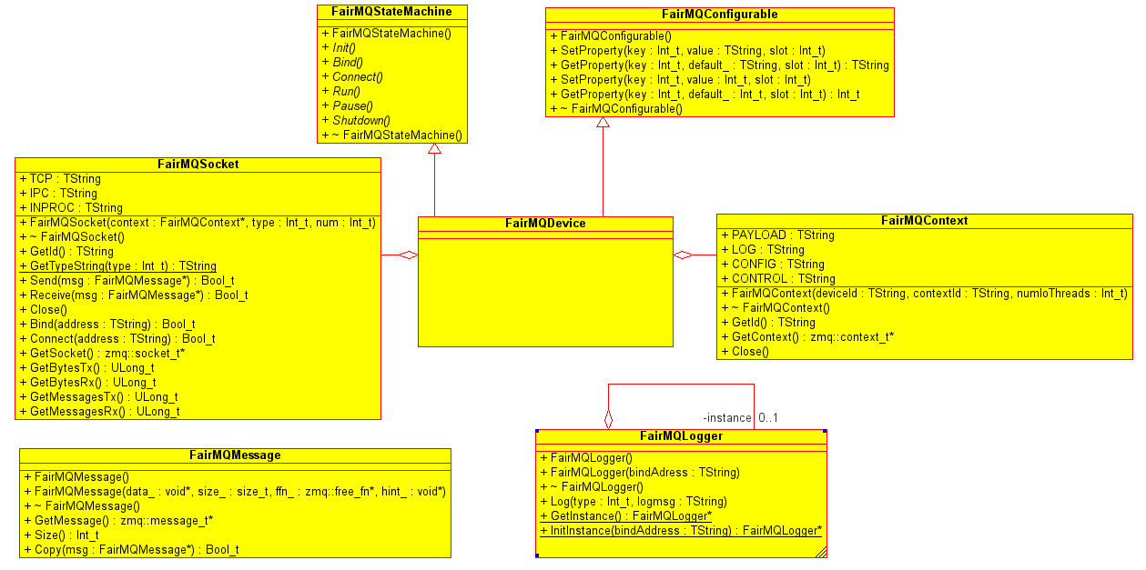
Device
Each processing stage of a pipeline is occupied by a process which executes an instance of the Device class

Slide 28
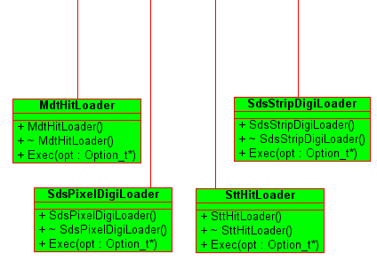
Sampler
Devices with no inputs are categorized as sources
A sampler loops (optionally: infinitely) over the loaded events and send them through the output socket.
A variable event rate limiter has been implemented to control the sending speed

Slide 29
Message format (Protocol)
Potentially any content-based processor or any source can change the application protocol. Therefore, the framework provides a generic Message class that works with any arbitrary and continuous junk of memory (FairMQMessage).
One has to pass a pointer to the memory buffer, the size in bytes, and can optionally pass a function pointer to a destructor, which will be called once the message object is discarded.

Slide 30
New simple classes without ROOT are used in the Sampler (This enable us to use non-ROOT clients) and reduce the messages size.

