Slide 1
Accelerator KPIs at GSI: first steps
Oksana Geithner, Wolfgang Geithner

Slide 2
Content
Motivation and Definition
First offline Analysis
Challenges for online and offline Analysis
Discussion & Decision

Slide 3
Why KPI and how we define it
Motivation
  Multiple accelerators, many beam chains → need a clear measurable metric for machine performance.
Performance Components (PC)
  Accelerator Availability (A) – fraction of scheduled Beam-on-Target delivered.
  Beam Intensity (I) – actual vs. promised particles per cycle.
  Beam Quality (Q) – brilliance, energy spread, emittance etc as required by each experiment.
KPI= A × I × Q (0 ≤ KPI ≤ 1)

Slide 4
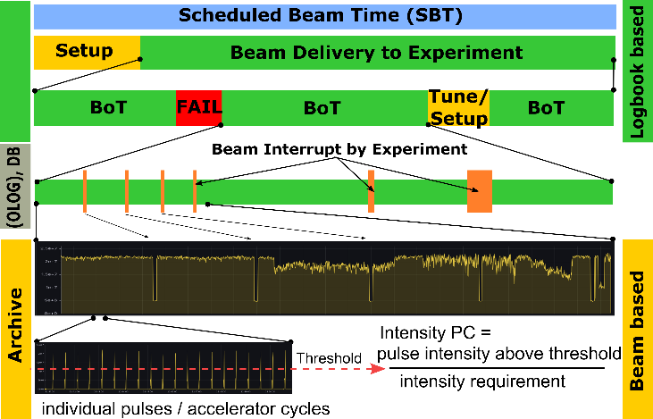

Slide 5
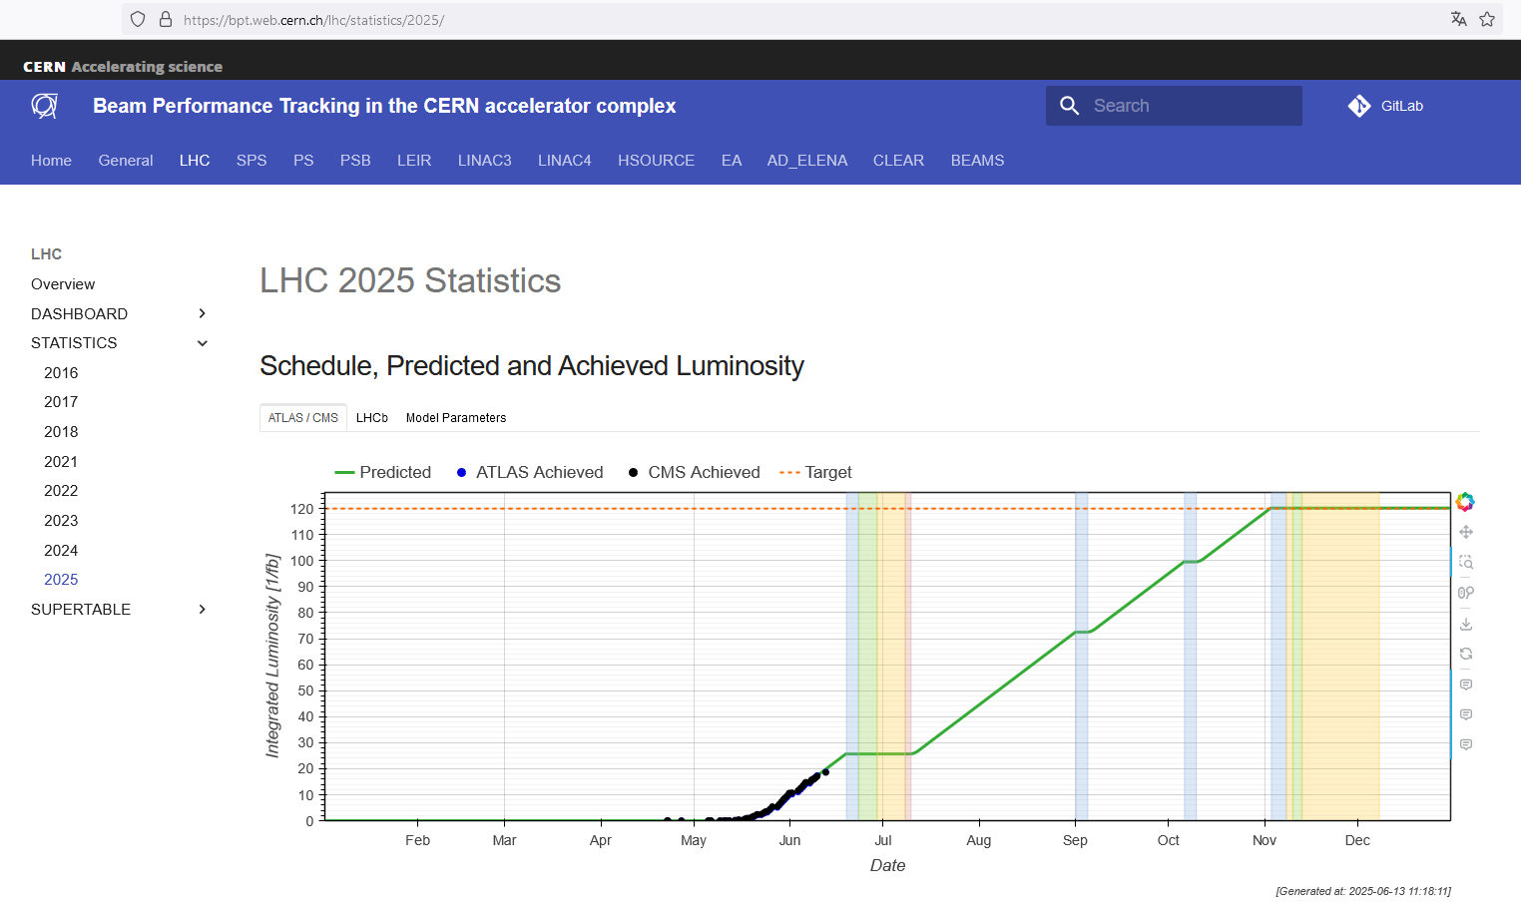
Example

Slide 6
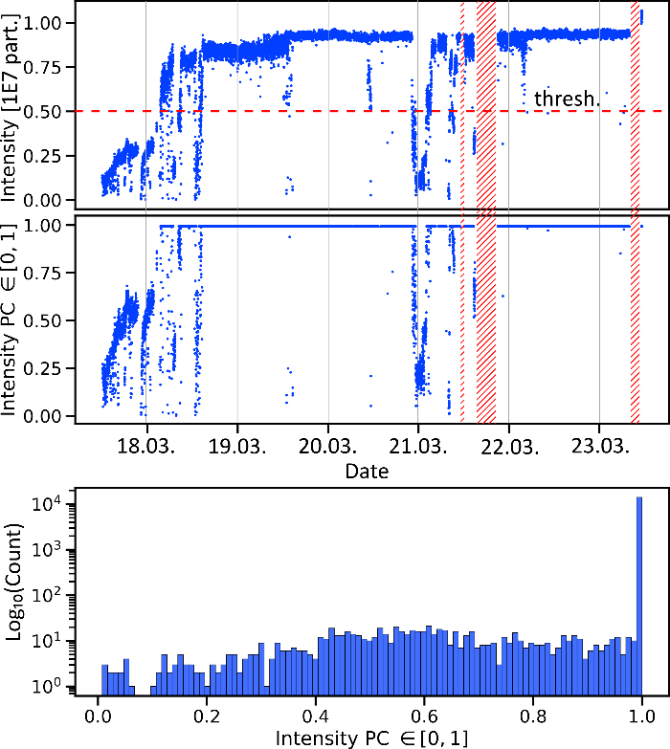
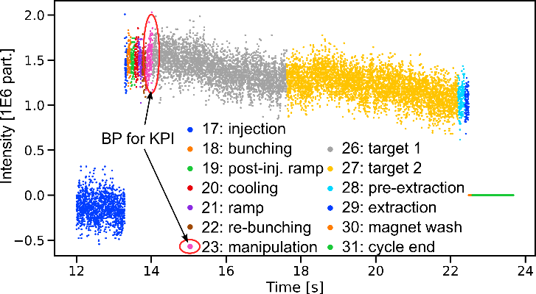
First offline analysis for CRYRING@ESR
Signal from DC Trafo:
YR08DT1ML/Acquisition

Slide 7
Challenges for online and offline analysis
Information from MASP and OLOG about beam interruptions (failures, cave opening) is difficult to access online
Information about beam process purposes is lost for offline, only beam process indexes are kept
Difficult handling of arrays in FESA Data structure (time series in time series)
Missing unique bunch ID for cross-machine correlation

Slide 8
Decisions, needed for the next steps
What is the best environment for running online analysis services? Proposals:
  SQL routines in (new) Archiving database
  JAVA routines in archiving framework or in middleware
  Dedicated API for external services
Where do we store and visualize the resulting data?
  Archiving
  Dedicated database and/or web-frontend

