Slide 1

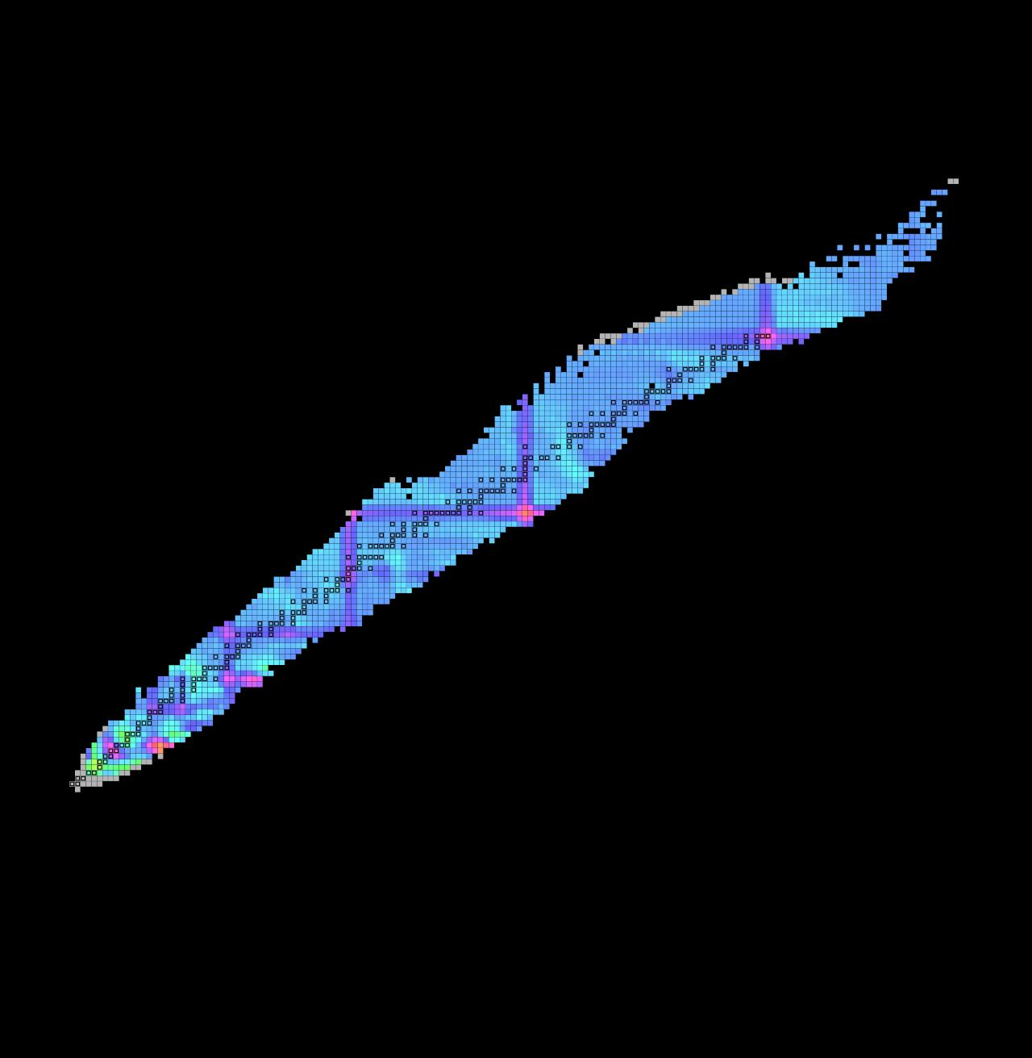
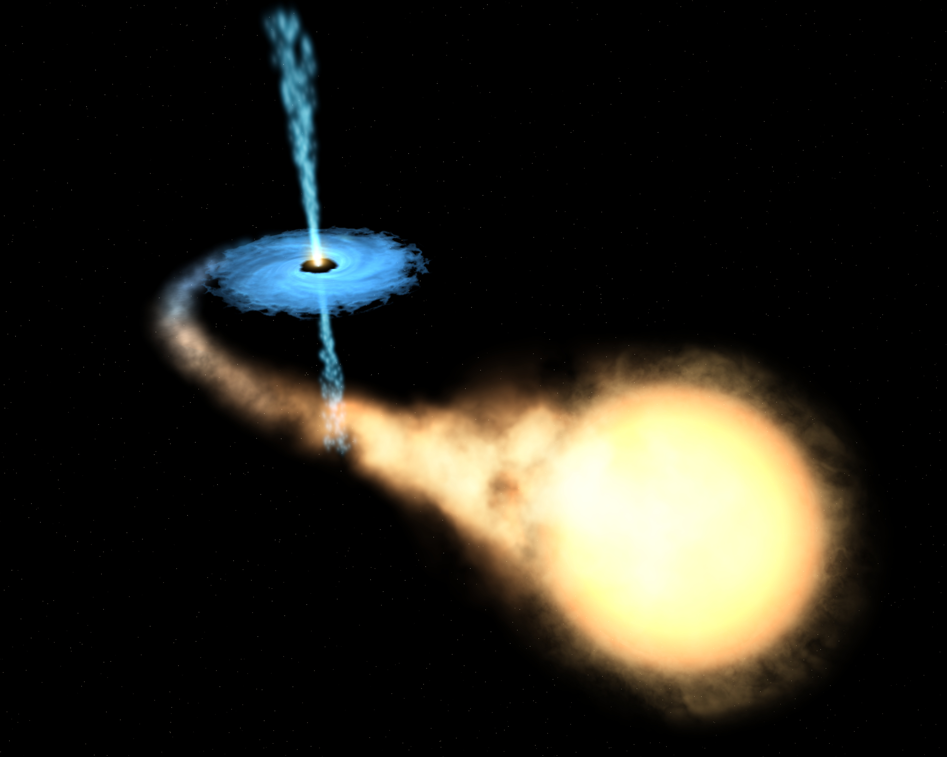
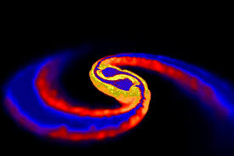

Unlocking Rare Isotope Masses: The Reach Of TOF-Bρ Measurements
Irin Sultana
Central Michigan University

Slide 2

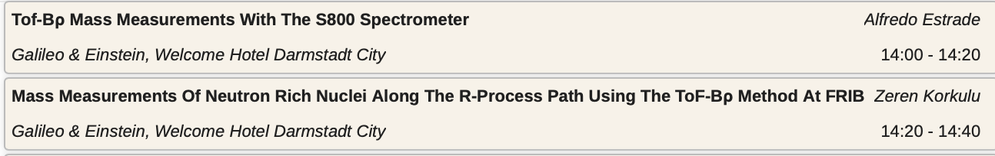
Main highlights of the week

Slide 3
Outline
Masses for neutron star crust processes
TOF-Bρ Technique
Experimental set up at NSCL
Results and Status of previous experiments
Future plans for TOF-Bρ at FRIB

Slide 4
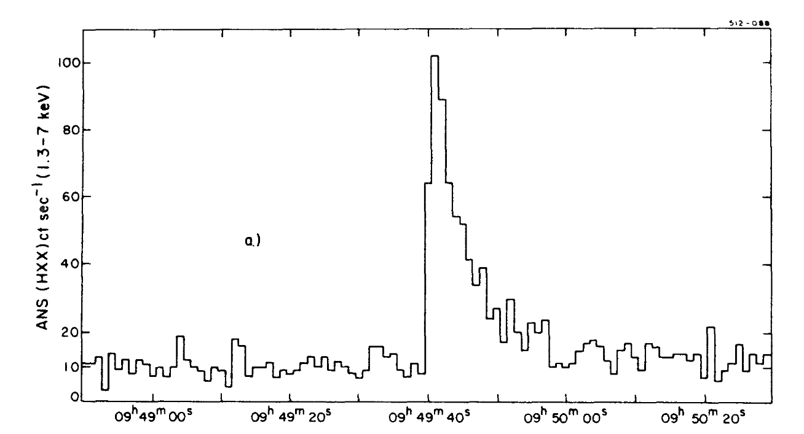
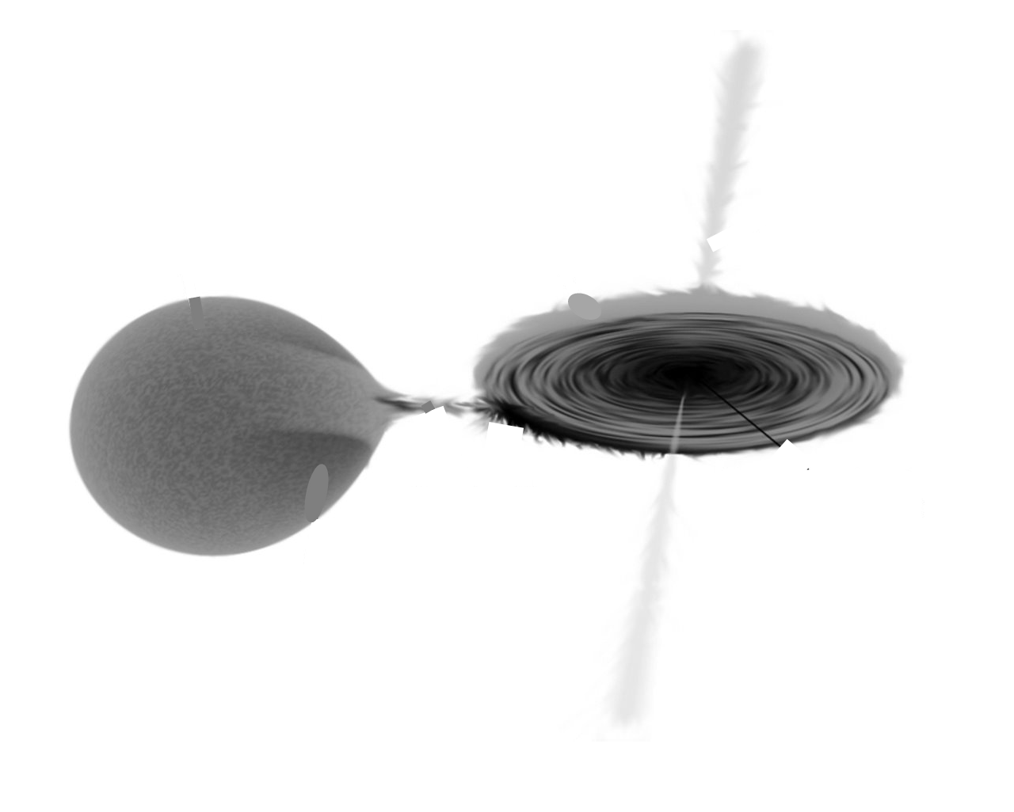
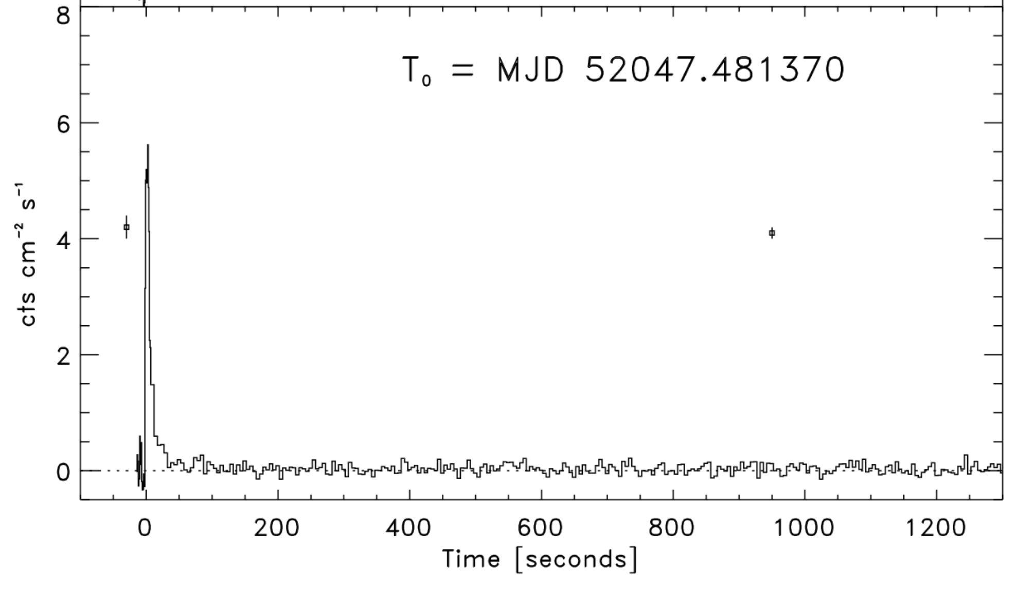
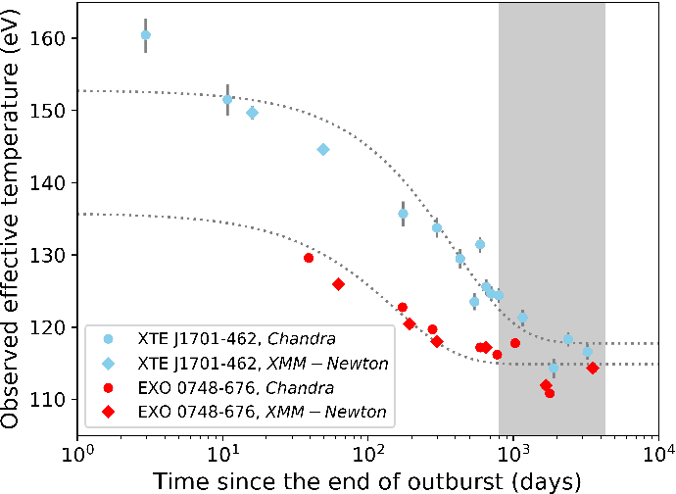

Accreting neutron stars are astrophysical laboratories
X-ray bursts
Grindlay et al. 1976
ANS (HXX) ct/s
Accretion disk
Time (s)
X-ray superbursts
atmosphere
p,α-capture
Accretion disk
¹²C-fusion
e-capture
Ocean
e-capture
crust
n-emission/capture
ρ-driven fusion
in ’t Zand et al. 2005b
Neutron star
Depth
core
Main sequence star
Cooling transients
Parikh et al. 2020
Unlocking Rare Isotope Masses (Irin Sultana)

Slide 5
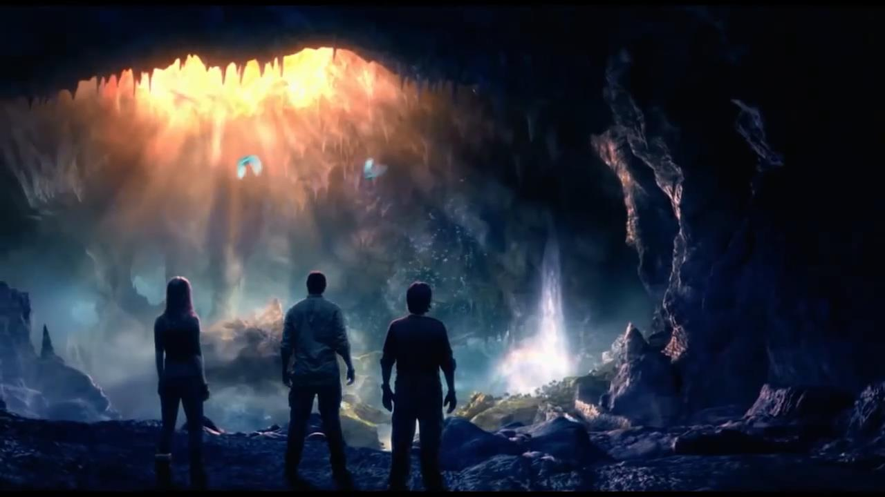
The Journey of a Nucleus in an
Accreting Neutron Star

Slide 6
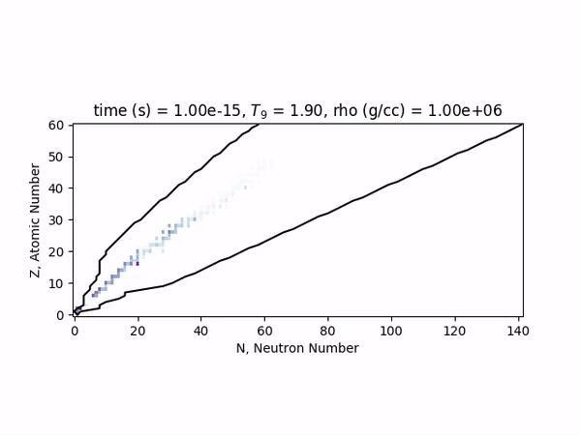
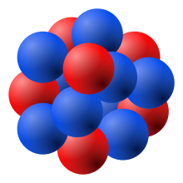
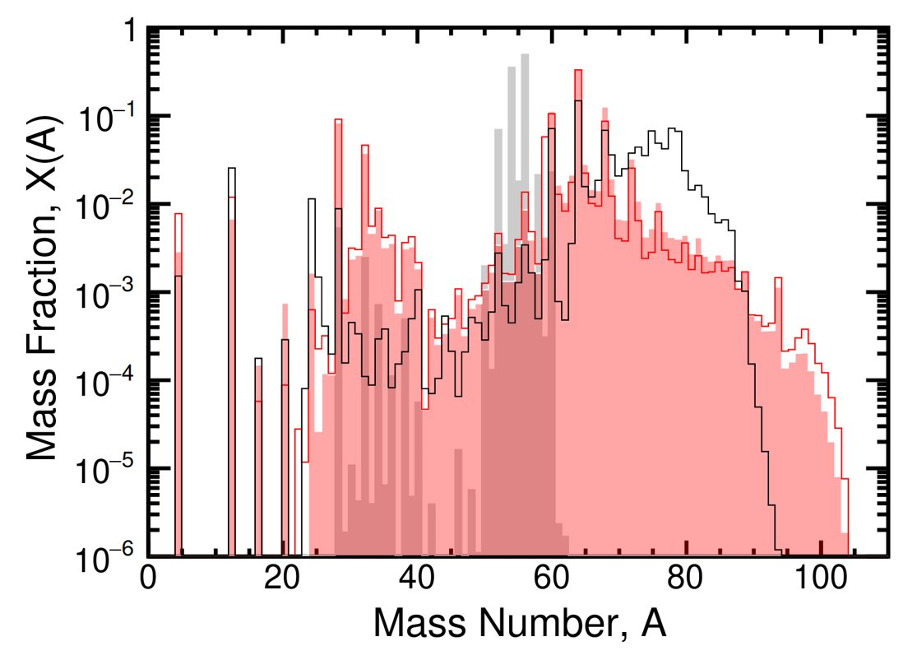
H, He and C burning and the surface ashes
Accretion disk
atmosphere
p,α-capture
Ocean
¹²C-fusion
e-capture
e-capture
crust
n-emission/capture
ρ-driven fusion
Depth
Z. Meisel et al 2018 J. Phys. G: Nucl. Part. Phys. 45 093001
core
https://sourceforge.net/projects/libnucnet/
Unlocking Rare Isotope Masses (Irin Sultana)

Slide 7
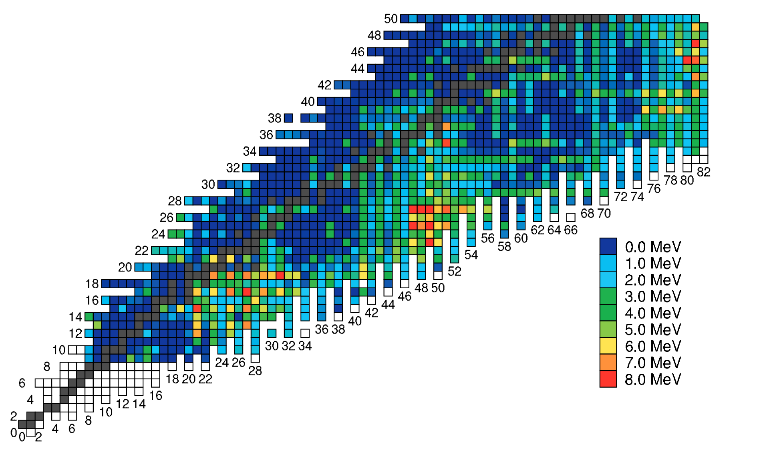
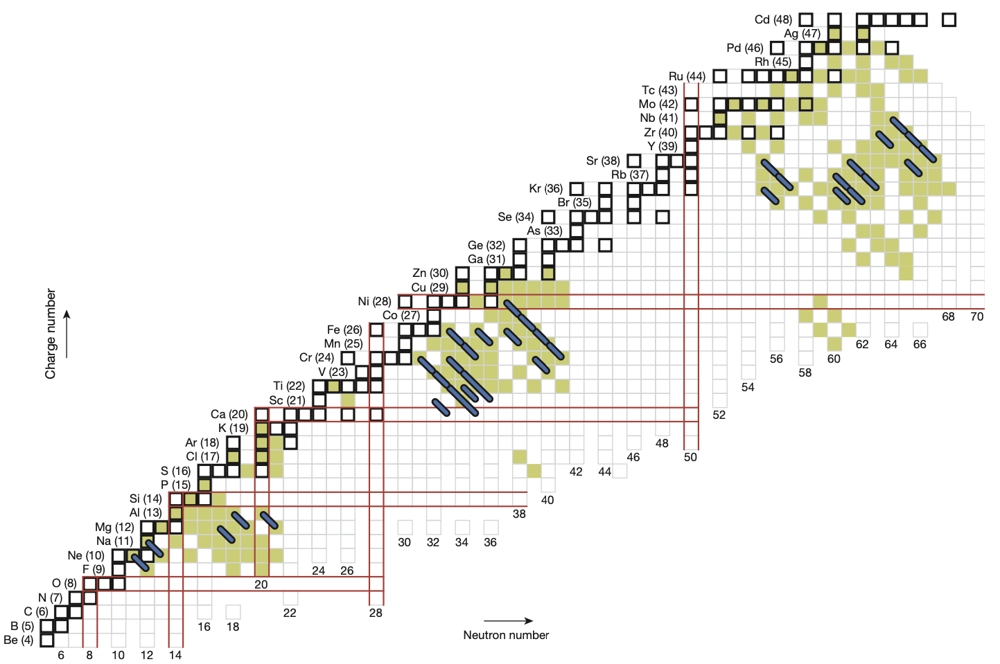
Electron capture reactions: heating and cooling
Accretion disk
Z
atmosphere
p,α-capture
S.S. Gupta et al. ApJ 2007
Ocean
¹²C-fusion
e-capture
N
e-capture
crust
n-emission/capture
ρ-driven fusion
Depth
core
Schatz et al. Nature 2014
Unlocking Rare Isotope Masses (Irin Sultana)
7

Slide 8
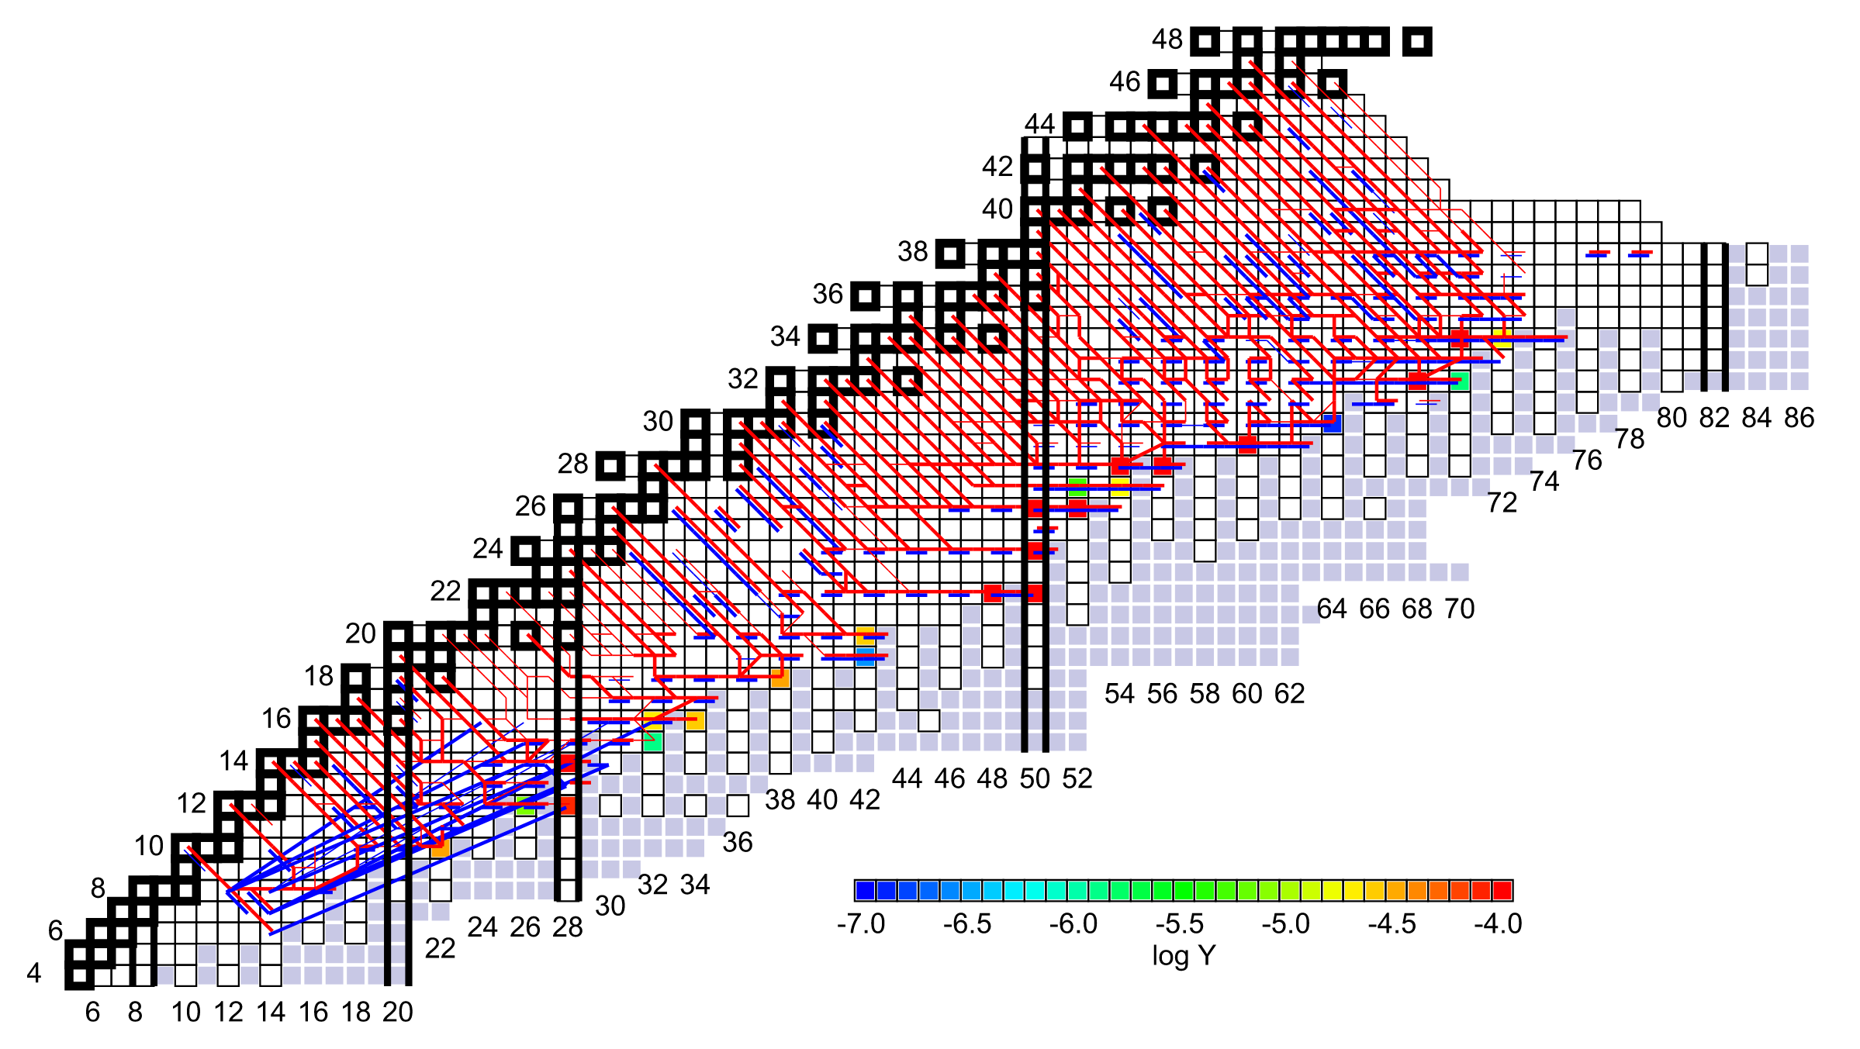

Fusion and disintegration
Accretion disk
$$ρ=3.77 ×{10}^{11} g/cm^{3}$$
atmosphere
p,α-capture
Ocean
¹²C-fusion
e-capture
e-capture
crust
n-emission/capture
ρ-driven fusion
Depth
Z
core
N
R. Lau et al, ApJ 859, 62 (2018)
Unlocking Rare Isotope Masses (Irin Sultana)

Slide 9
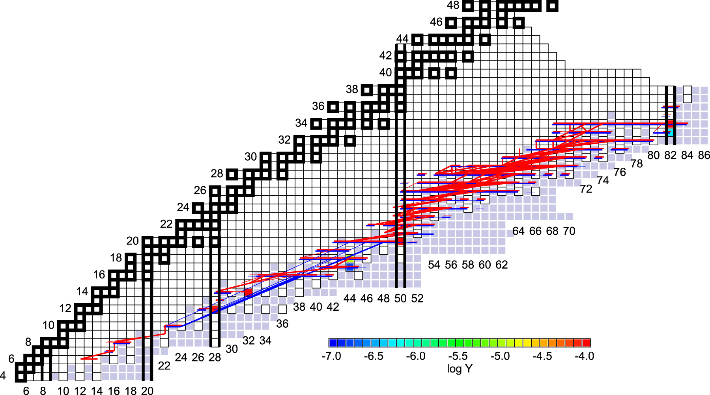

Fusion and disintegration
Accretion disk
$$ρ=1.28 ×{10}^{12} g/cm^{3}$$
atmosphere
p,α-capture
Ocean
¹²C-fusion
e-capture
e-capture
crust
n-emission/capture
ρ-driven fusion
Z
Depth
Z
core
Onset of ⁴⁰Mg +⁴⁰Mg
N
R. Lau et al, ApJ 859, 62 (2018)
Unlocking Rare Isotope Masses (Irin Sultana)

Slide 10
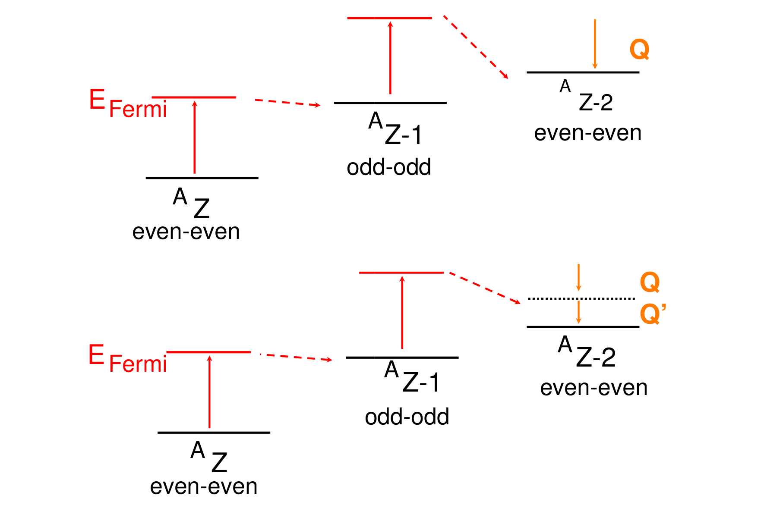
Masses are important to define where electron capture reactions happen
Accretion disk
Surface
E_{Fermi}
Depth
Unlocking Rare Isotope Masses (Irin Sultana)

Slide 11
Masses are important to define where electron capture reactions happen
Accretion disk
E_{Fermi}
Surface
Depth
Unlocking Rare Isotope Masses (Irin Sultana)

Slide 12
Masses are important to define where electron capture reactions happen
Accretion disk
Surface
Depth
^{A}Z + e⁻ ^{A}Z-1 + ν_{e}
Unlocking Rare Isotope Masses (Irin Sultana)

Slide 13
Masses are important to define where electron capture reactions happen
Accretion disk
Surface
Depth
^{A}Z + e⁻ ^{A}Z-1 + ν_{e}
^{A}Z-1 + e⁻ ^{A}Z-2 + ν_{e}
Unlocking Rare Isotope Masses (Irin Sultana)

Slide 14
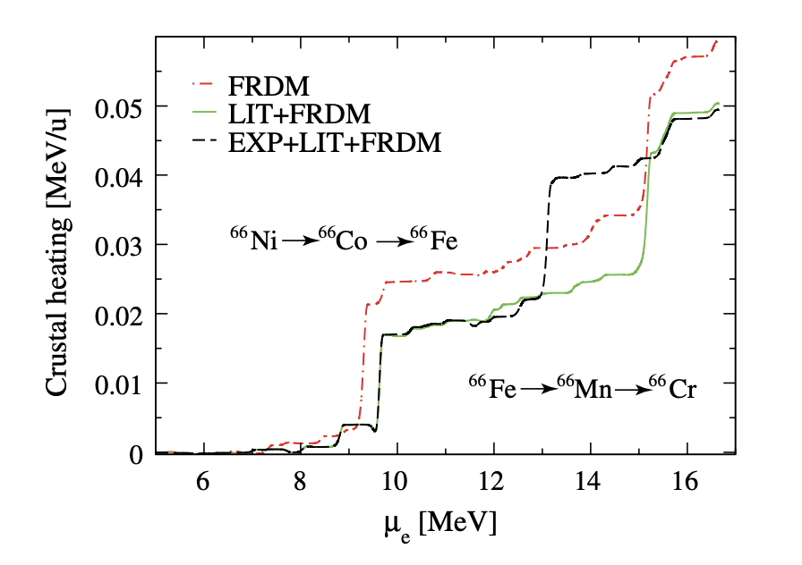
Masses are important to define where electron capture reactions happen
A. Estradé et al., PRL 107, 172503 (2011)
A. Estradè PhD thesis
Q_{EC} = M(A,Z) - M(A, Z-1)
Unlocking Rare Isotope Masses (Irin Sultana)

Slide 15
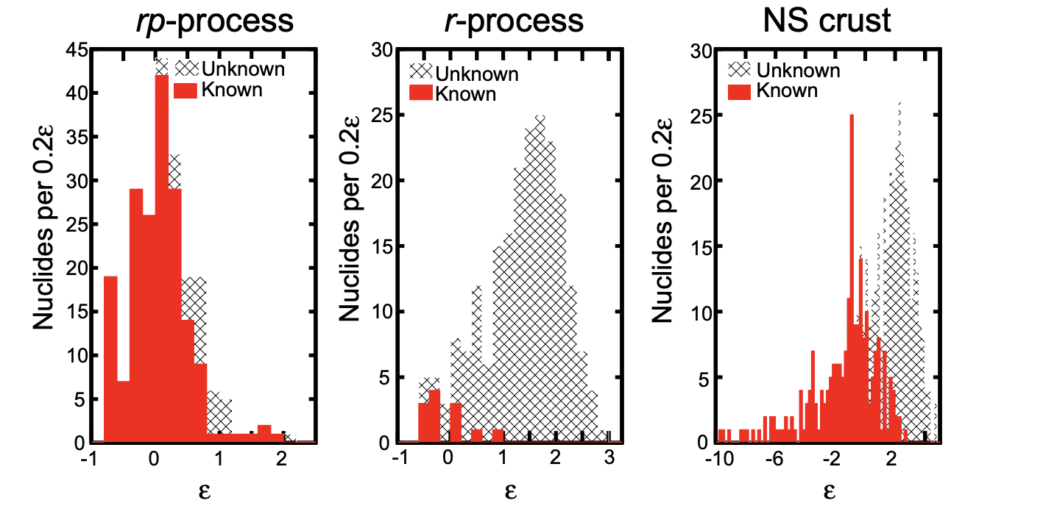
More exotic nuclear masses still need to be measured
Z. Meisel J. Phys.: Conf. Ser. 1668 012026
Unlocking Rare Isotope Masses (Irin Sultana)

Slide 16
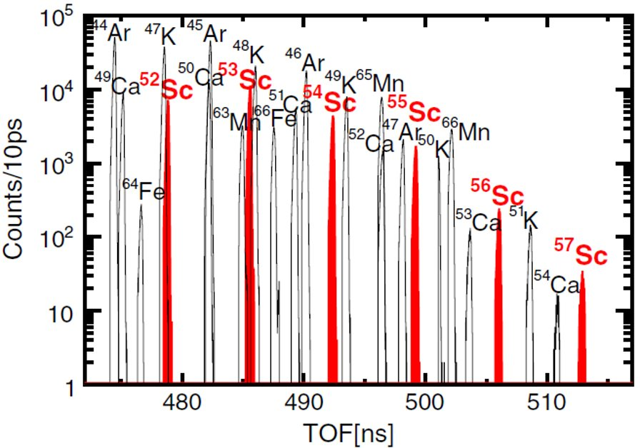
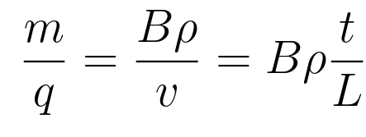
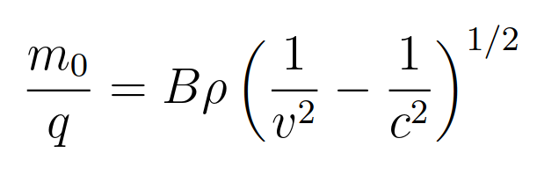
Time-of-flight (TOF) magnetic rigidity principle
Direct measurement:
Z. Meisel et al., PRL 115, 162501 (2015)
M. Matos et al. 2007
Instead m₀/q is determined empirically by measuring the TOF of well-known masses
Unlocking Rare Isotope Masses (Irin Sultana)

Slide 17
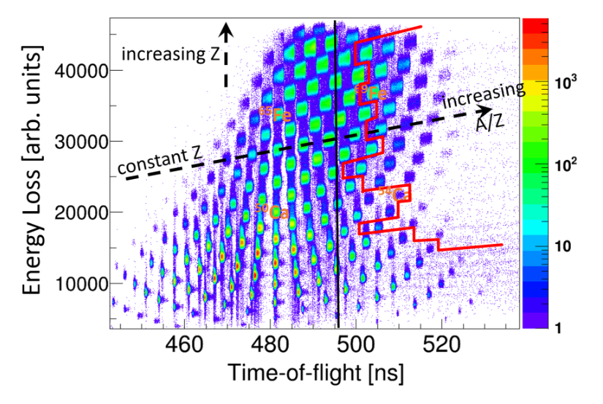
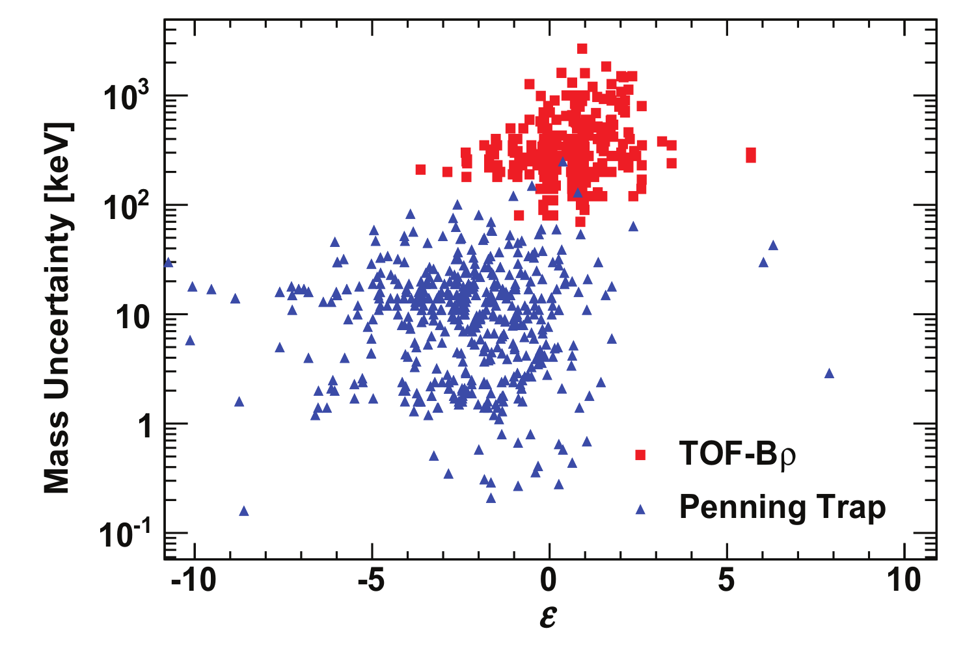
The reach of the TOF-Bρ technique
Z. Meisel PRC 93, 035805 (2016)
Z. Meisel PhD Thesis (2015)
Exoticity
Unlocking Rare Isotope Masses (Irin Sultana)

Slide 18
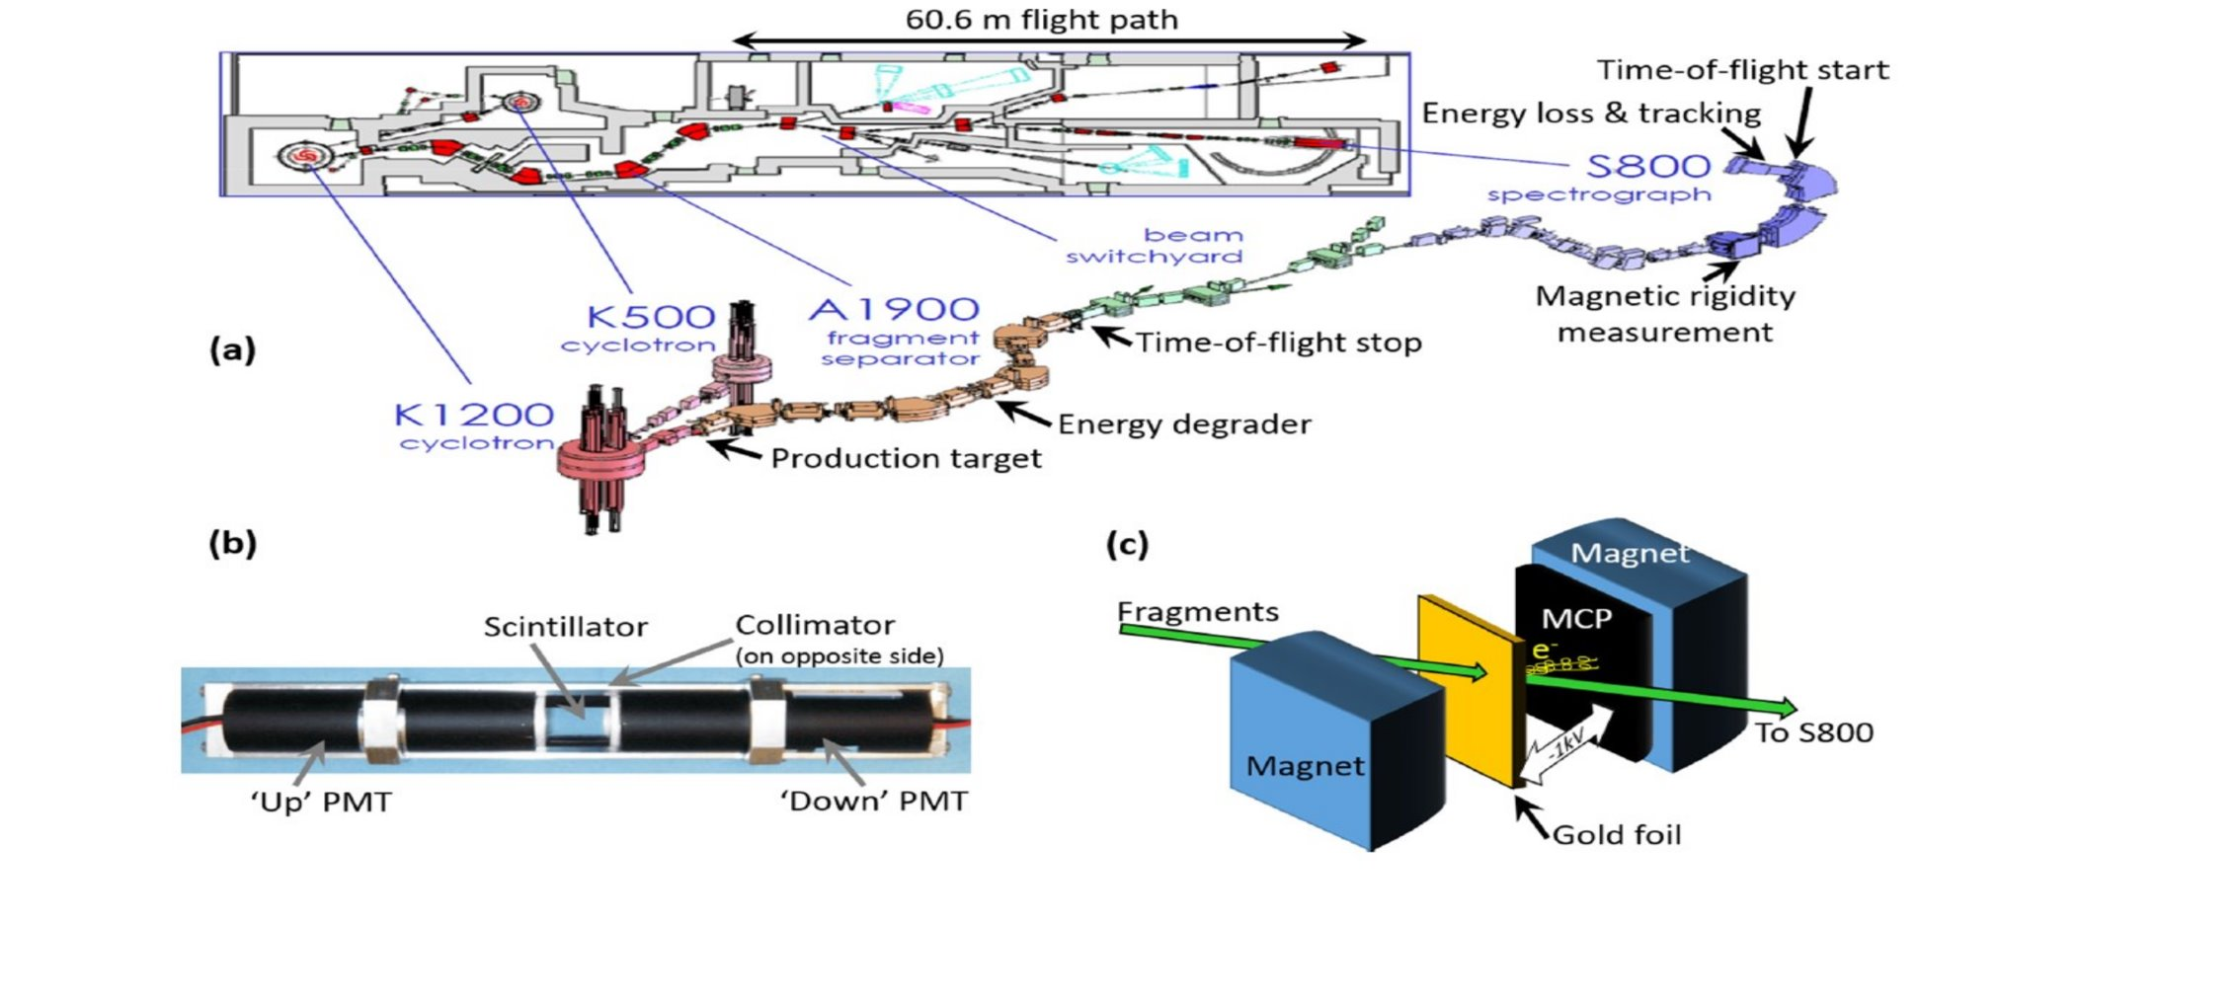
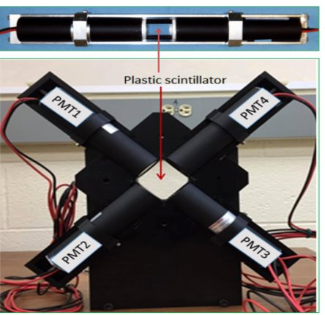
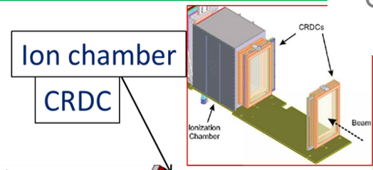
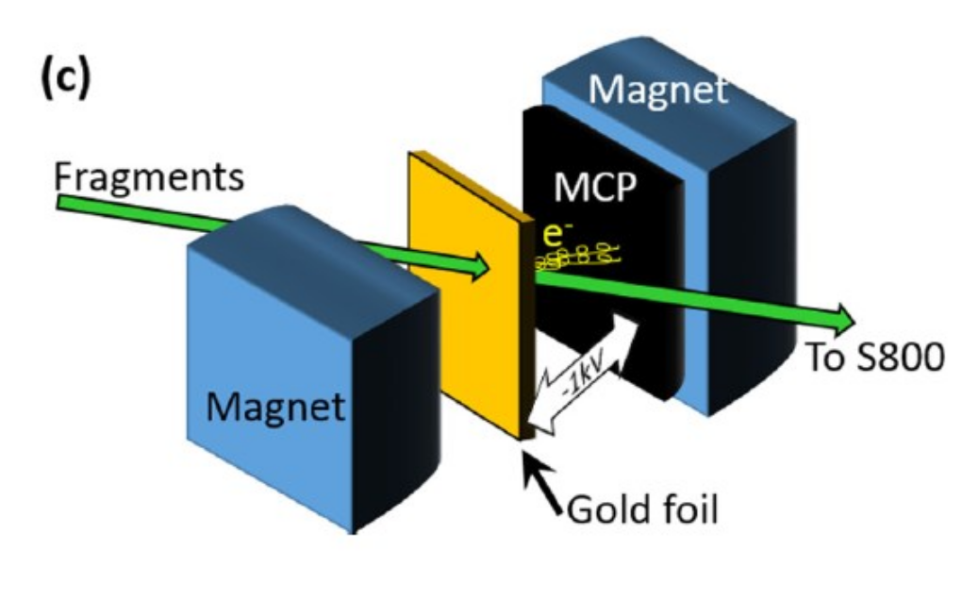
TOF-Bρ Mass Measurement at NSCL
Timing measurement
Momentum measurement
Energy loss & tracking
Ionization chamber
Beam
A. Estrade et al. PRL 2011
Z. Meisel, S. George et al. PRL 115 2015
A.M Rogers et al. Nucl. Instrum. Methods Phys. Res. 2015
Z. Meisel, S. George et al. PRC 2016
Unlocking Rare Isotope Masses (Irin Sultana)

Slide 19
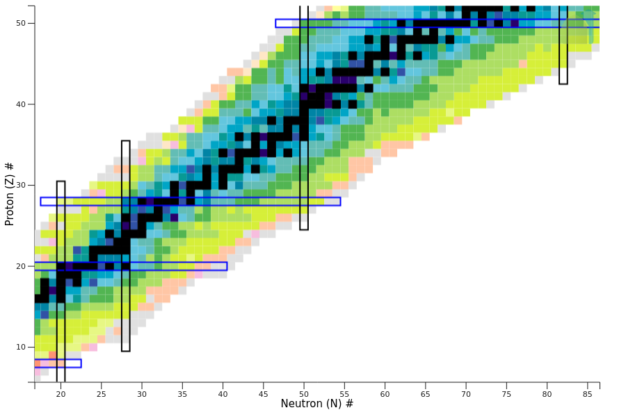
Past of TOF-Bρ Mass Measurement
Weak r-process nucleosynthesis
Neutron star crust processes
A. Estrade et al. PRL 2011
M. Matos, A. Estrade et al. NIMA 2012
Z. Meisel & S. George IJMS 2013
Z. Meisel, S. George, et al. PRL 114 2015
Z. Meisel, S. George et al. PRL 115 2015
Z. Meisel, S. George et al. PRC 2016
Z. Meisel, S. George et al. PRC 2020
K. Wang et al. PRC 109, 035806 (2024)
A. Estrade, I. Sultana et al. (Ongoing Analysis)
Shell evolution at N= 28
Neutron star crust processes
Unlocking Rare Isotope Masses (Irin Sultana)

Slide 20
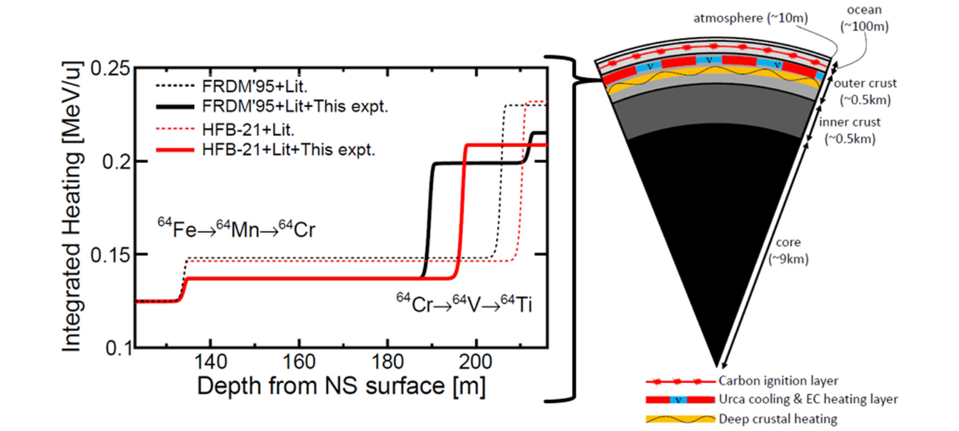
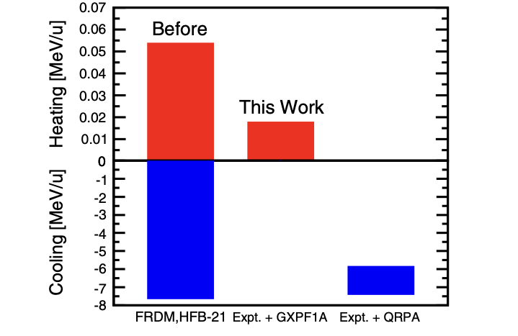
E09039: weak heating due to A= 56 and 64 mass chain
Energy per accreted nucleon released from or deposited into the neutron star crust at the ⁵⁶Ti → ⁵⁶Sc → ⁵⁶Ca
Unlocking Rare Isotope Masses (Irin Sultana)

Slide 21
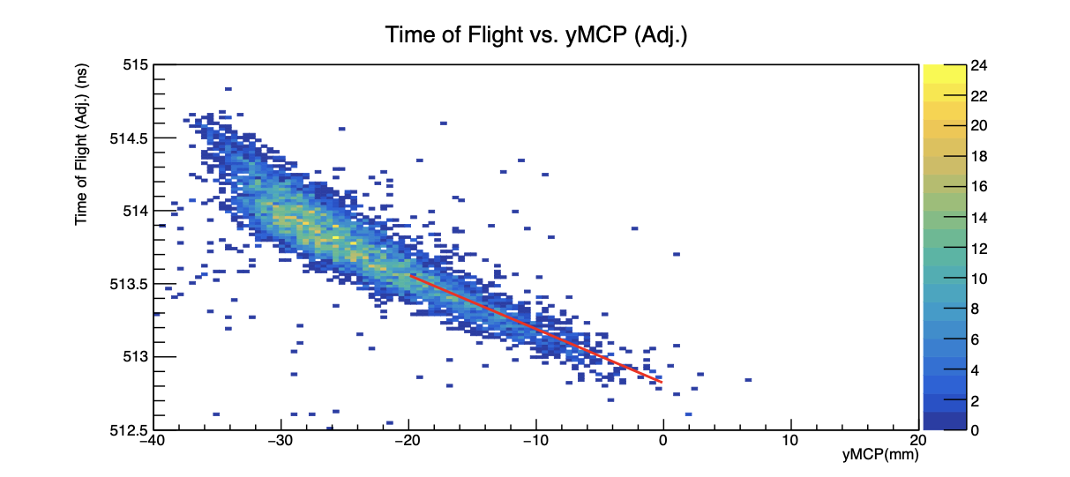
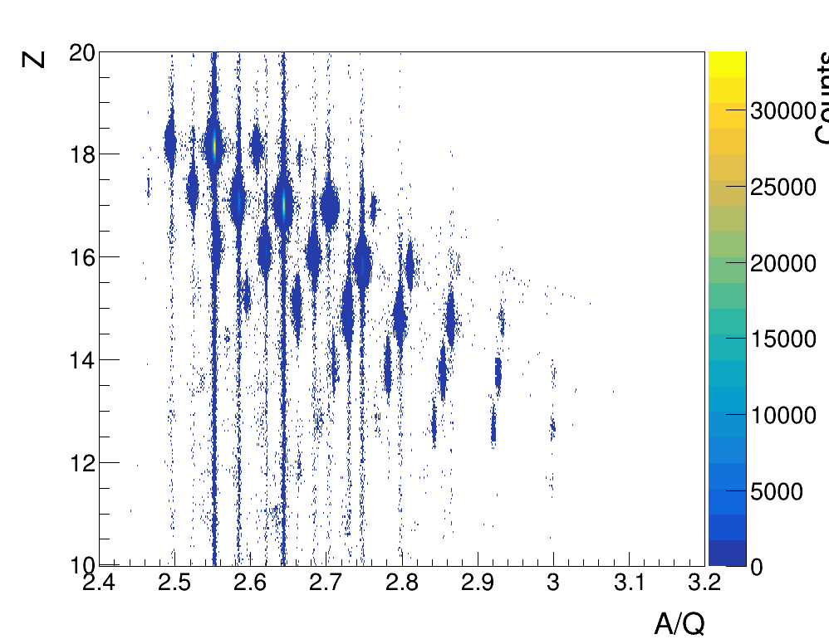
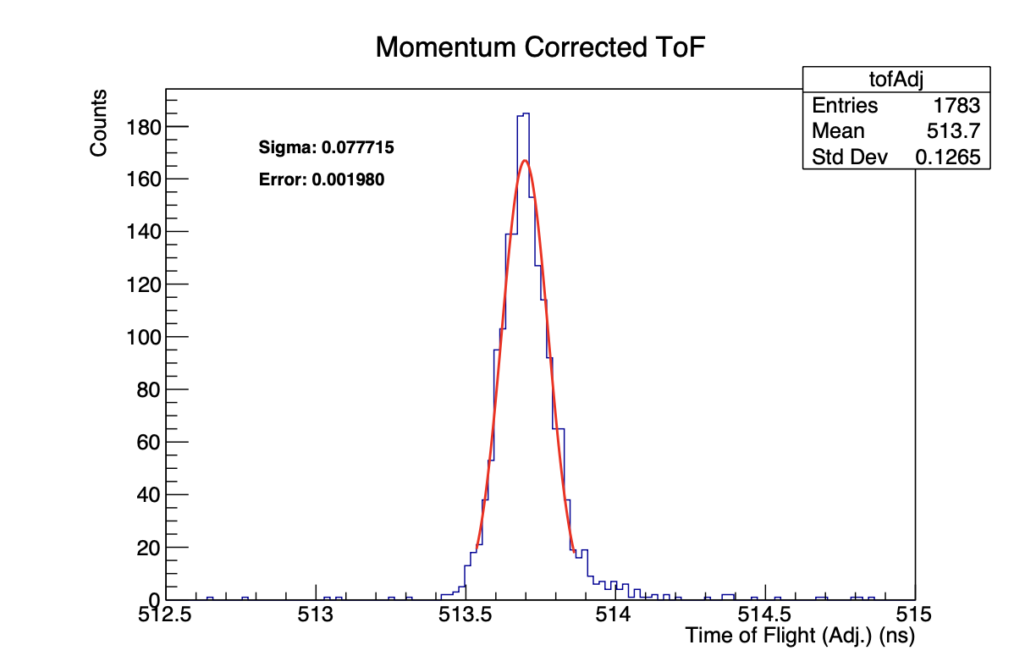
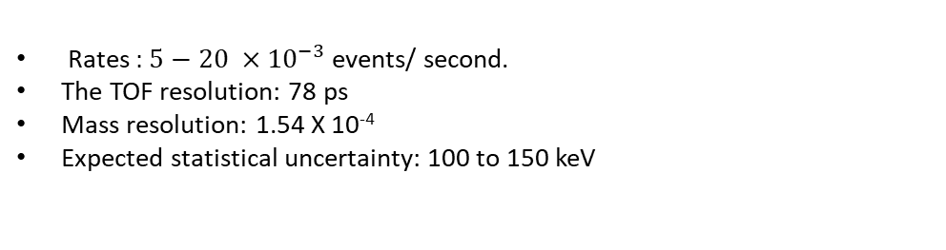
Status of E18009: Masses near N=28
Foster Kusz Master’s Thesis
Counts
⁴⁶S
⁴⁴P
⁴²Si
³⁹Al
Rates $\text{:} 5−20 ×{10}^{−3}$ events/ second.
The TOF resolution: 78 ps
Mass resolution: 1.54 X 10⁻⁴
Expected statistical uncertainty: 100 to 150 keV
Unlocking Rare Isotope Masses (Irin Sultana)

Slide 22
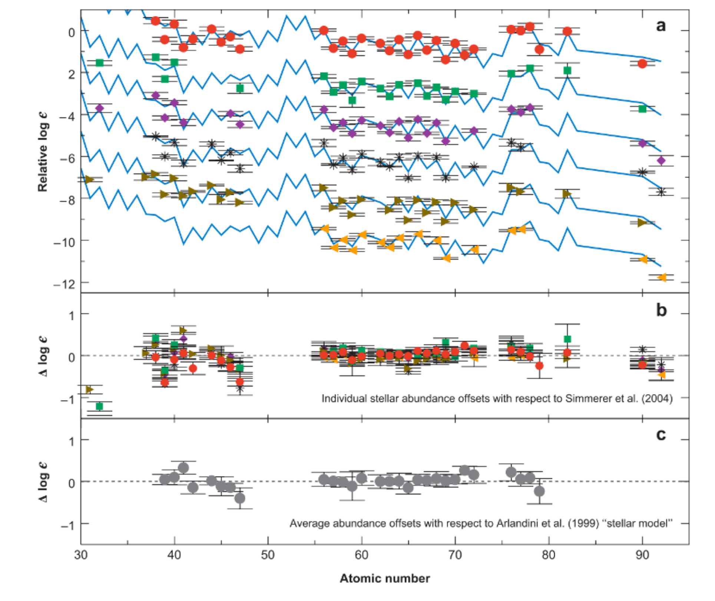
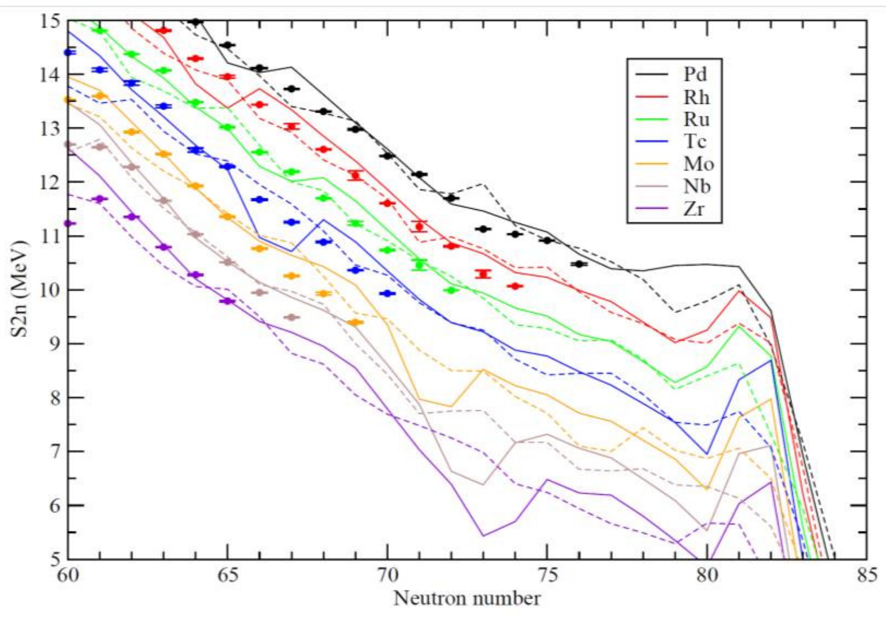
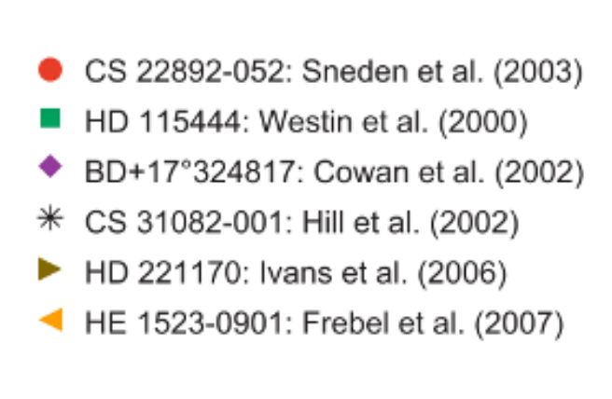

Lighter mass regions are of particular interest for r-process nucleosynthesis
Solid line: FRDM model
Dashed line: HFB-21 model
C. Sneden et al. 2008
Is there a different nucleosynthesis process producing medium mass elements?
Unlocking Rare Isotope Masses (Irin Sultana)

Slide 23
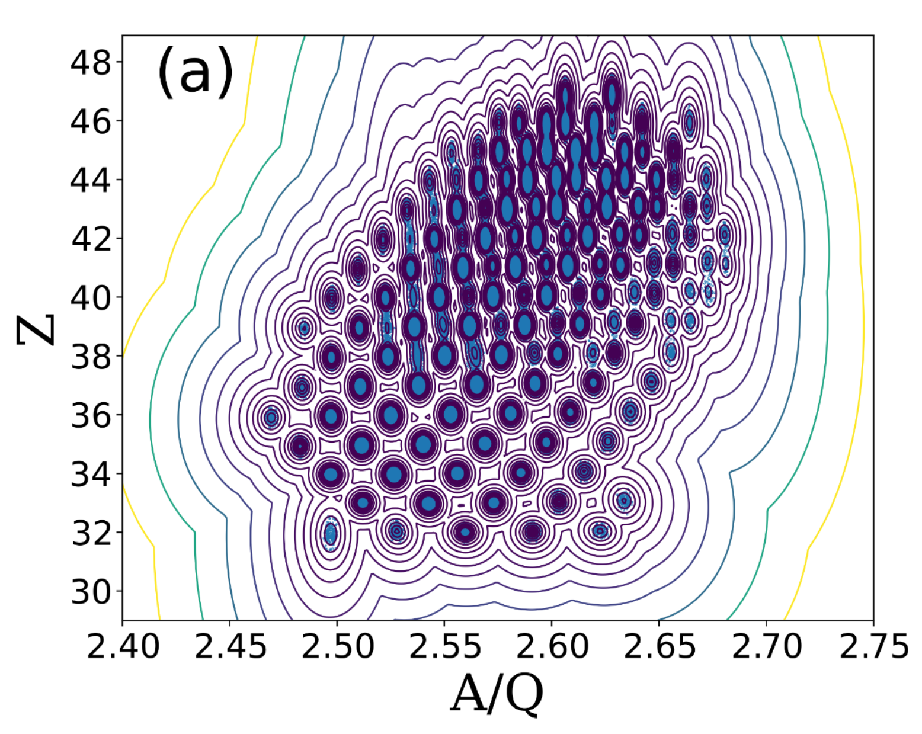
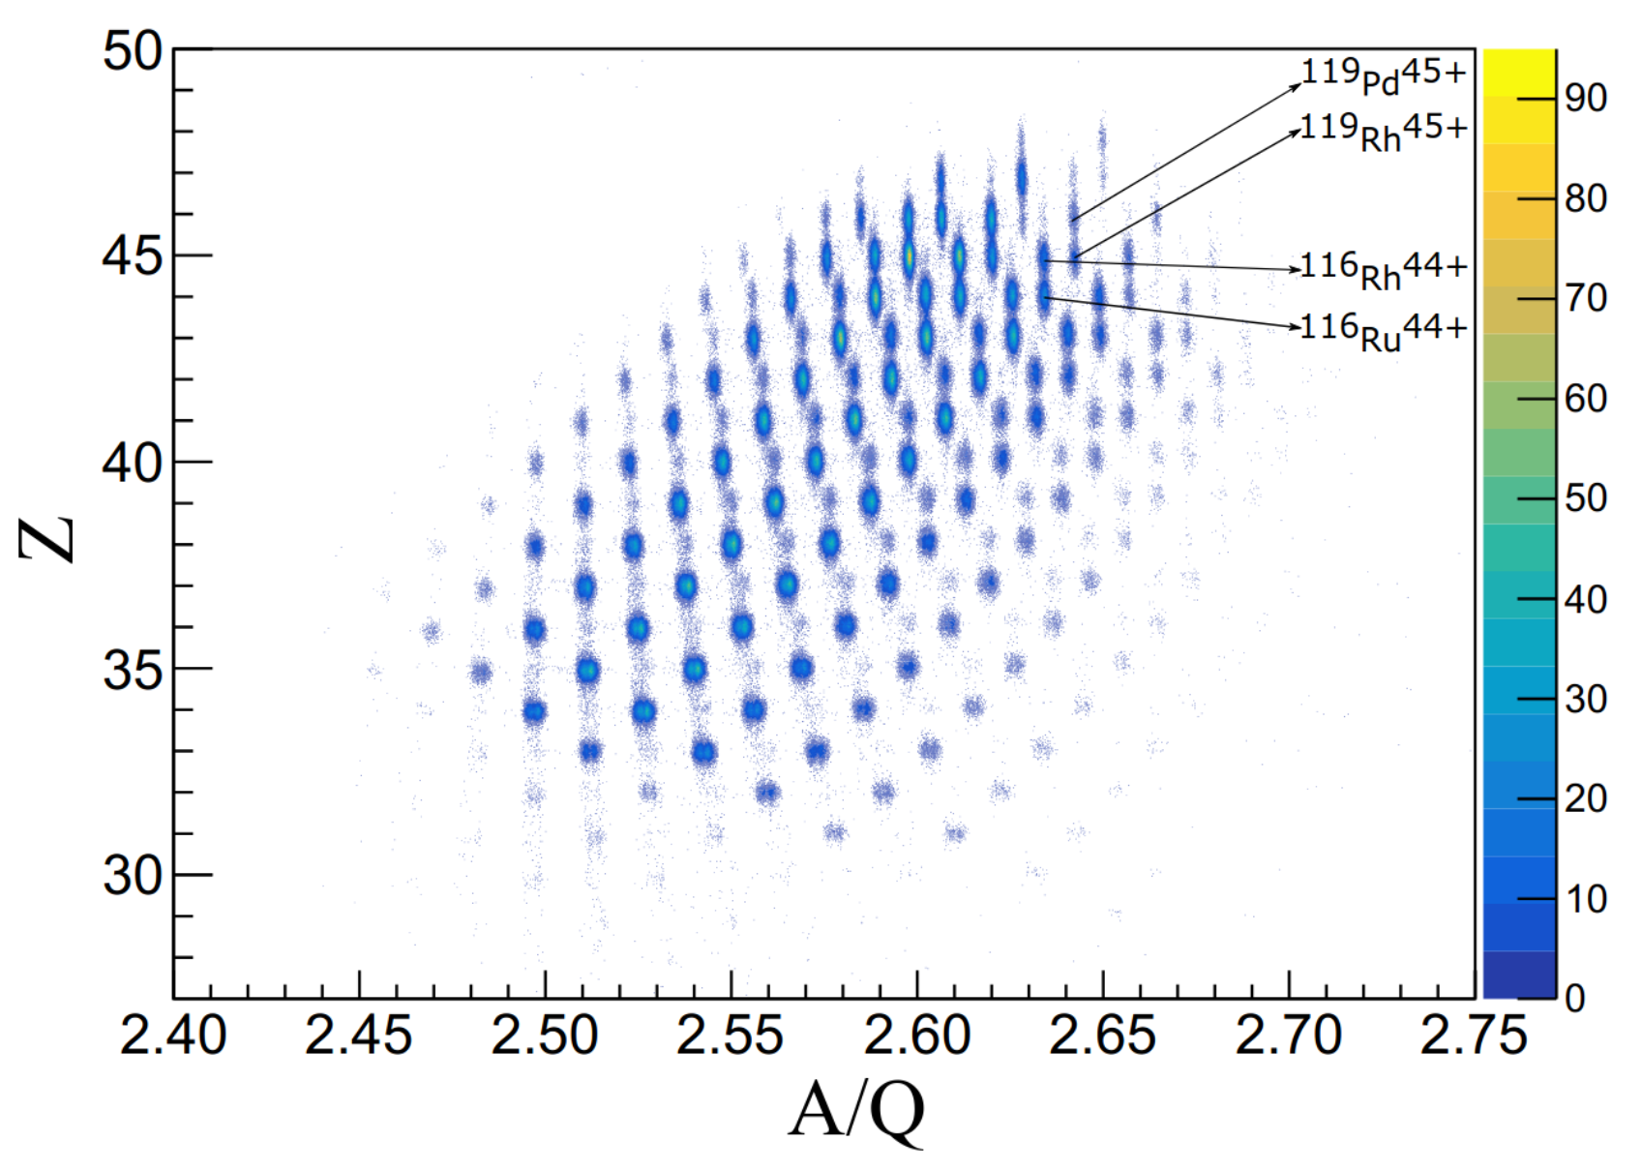
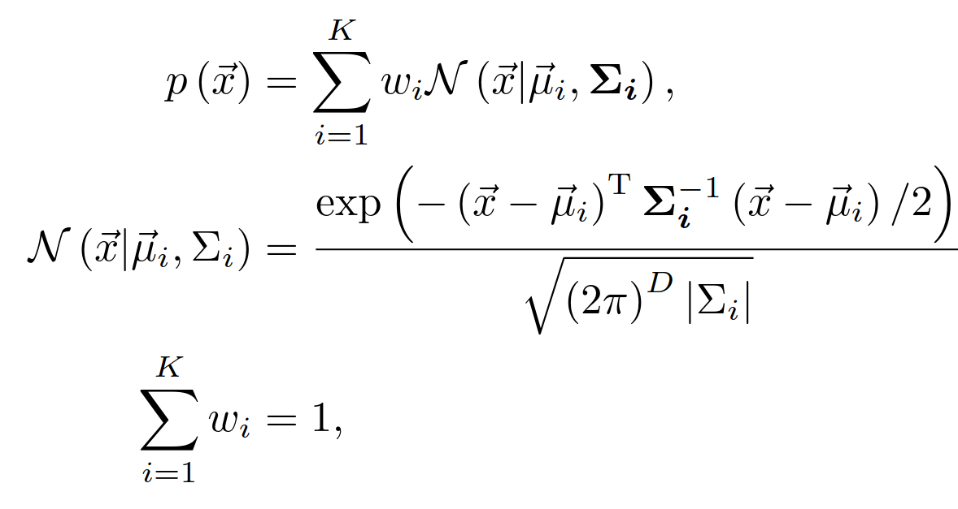

E12022: Clustering ions by Gaussian mixture model
Kailong Wang
K. Wang et al., PRC 109, 035806 (2024)
Unlocking Rare Isotope Masses (Irin Sultana)

Slide 24
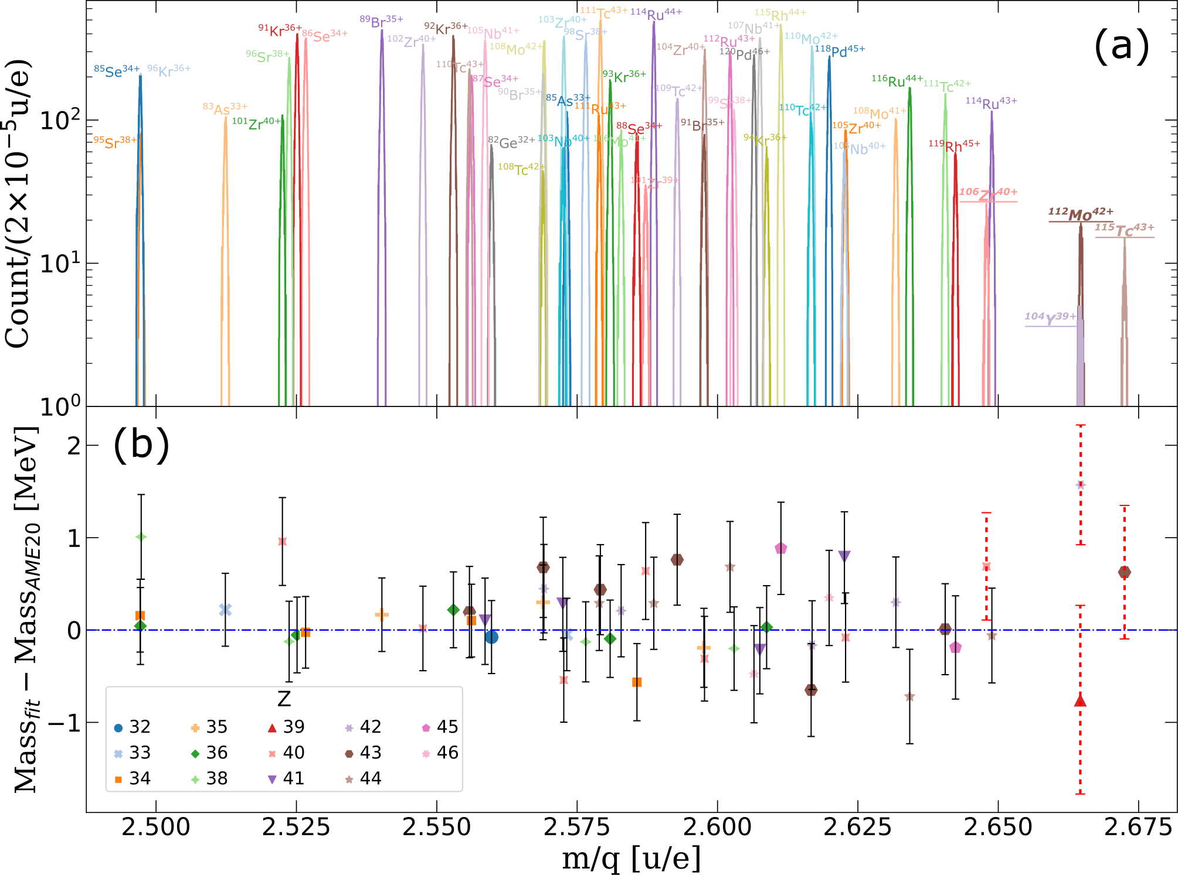
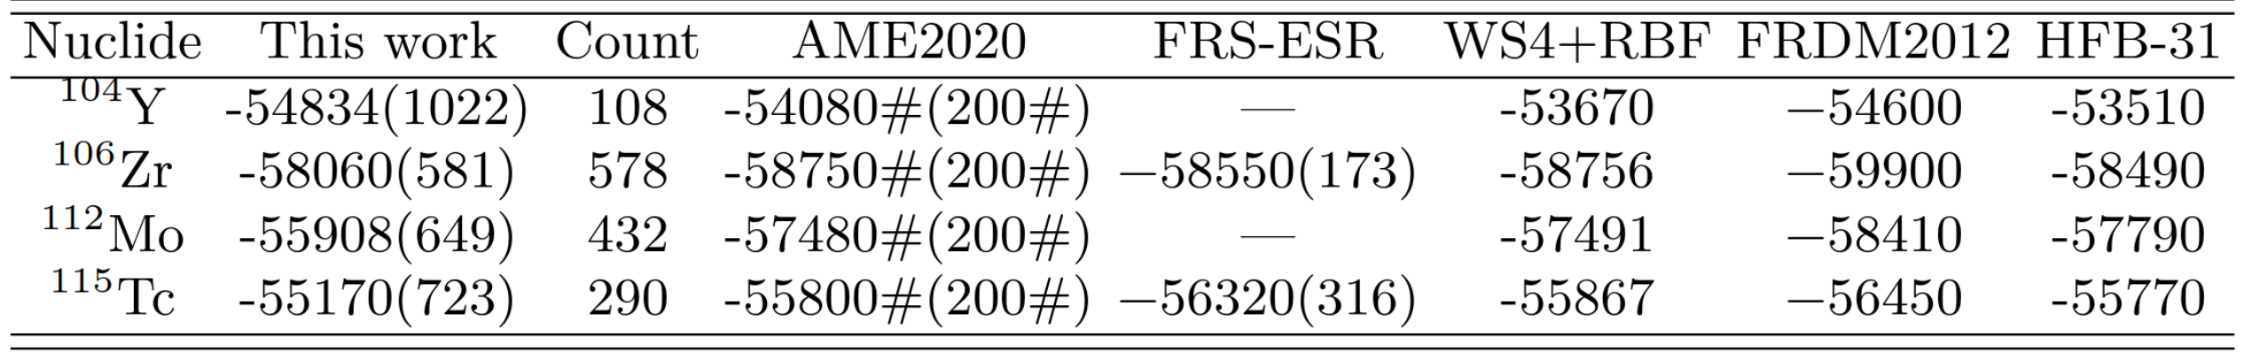
Results of E12022
FRIB will allow us to reach far into the r-process path
Unlocking Rare Isotope Masses (Irin Sultana)

Slide 25
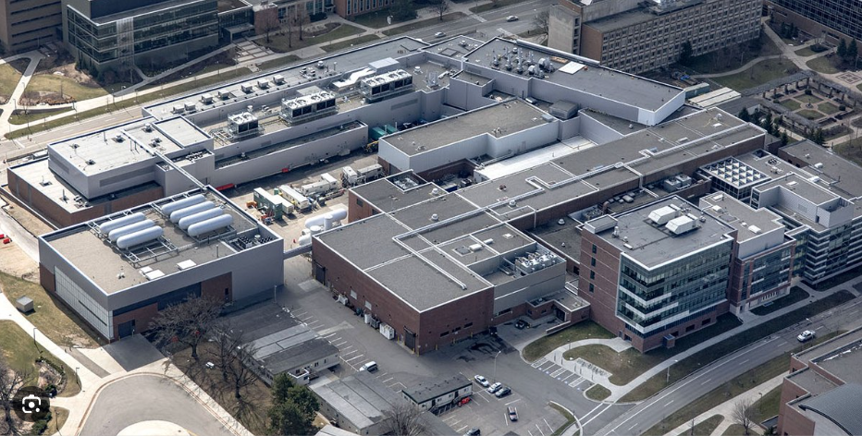
FRIB Radioactive Beam Facility at MSU
FRIB Status:
First experiment May 2022 at 1 kW 200 MeV/u beam energy
Since then two PACs, routine operation
Power ramp up to 20 kW now
400 kW over next years
400 MeV/u upgrade planned
Slide credit: H. Schatz

Slide 26
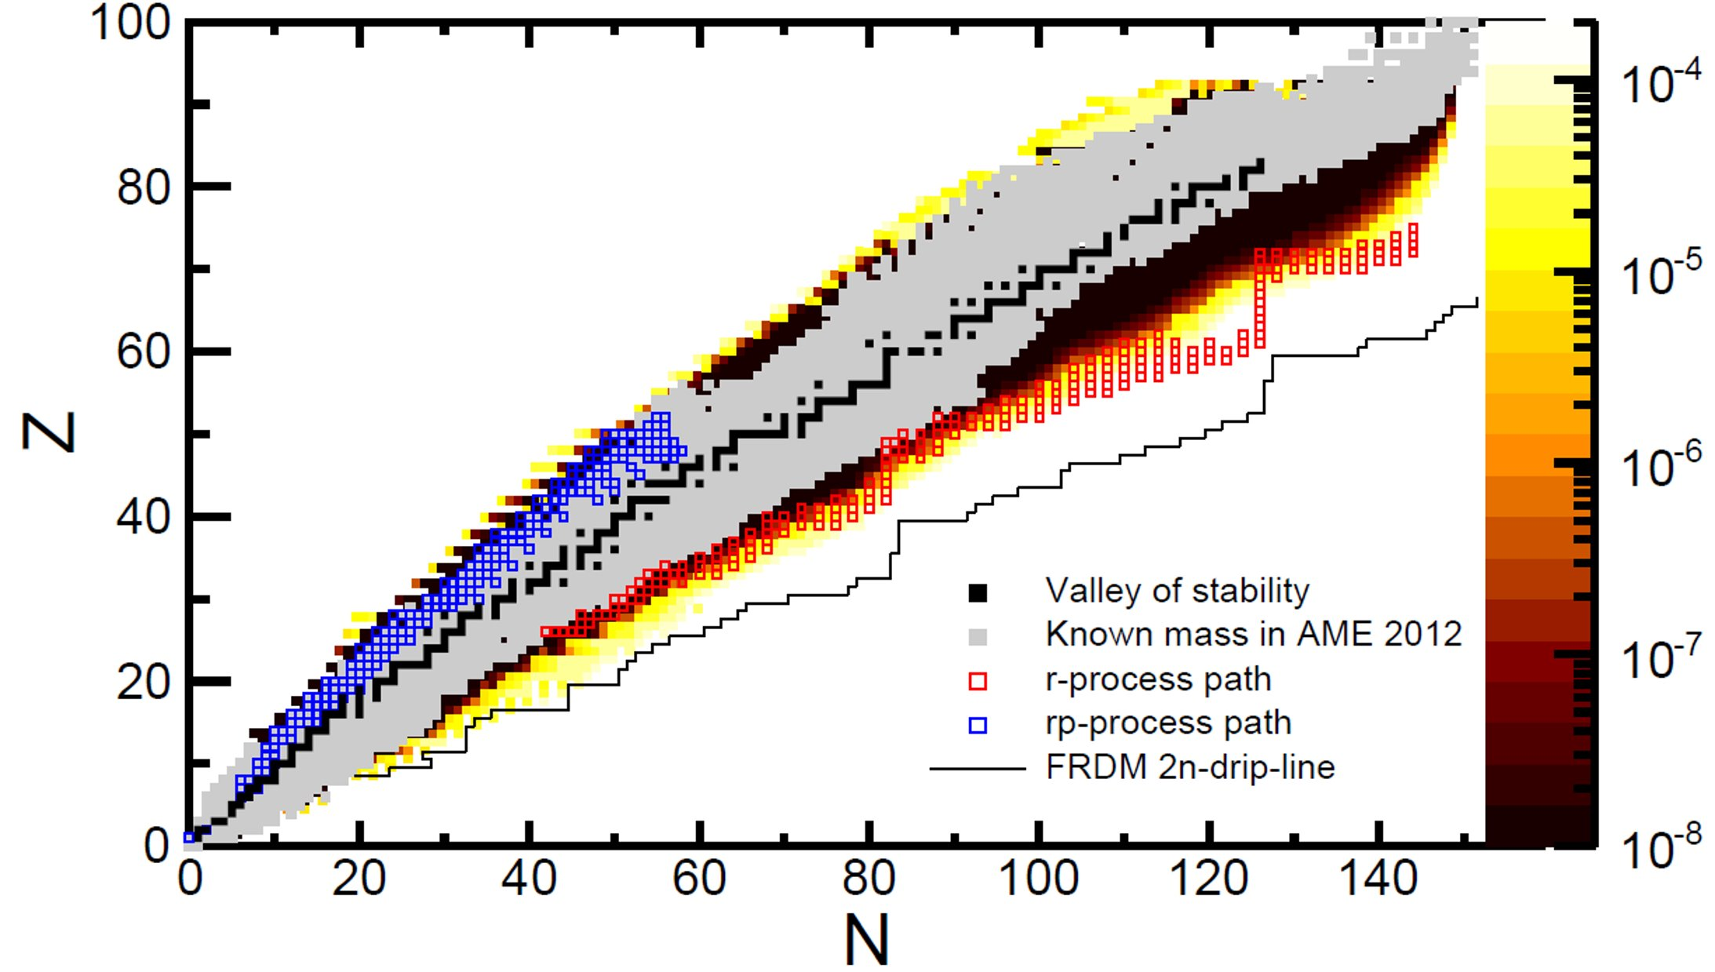
Mapping nuclear mass surface towards the dripline
δm/m
J. Pereira, et al.
Disentangling the R-process Rare-Earth Peak Abundances
Z. Korkulu et al.
Mass measurements on the r-process path relevant for the first r-process peak
A. Estradè et al.
Mass measurement along the neutron dripline
Z. Meisel J. Phys.: Conf. Ser. 1668 012026
FRIB will drastically expand our experimental reach
Unlocking Rare Isotope Masses (Irin Sultana)

Slide 27


TOF-Bρ collaboration
Central Michigan University:
A. Estradé, H. Arora, N. Dimitrakopoulos, N. Nepal, G. Perdikakis, M. Redshaw, S. Samaranayake, P. Tsintari, G. Zimba
Air Force Institute of Technology
Z. Meisel
Bucknell University:
A. M. Amthor
Oak Ridge National Laboratory
S. Pain
Center for Exotic Nuclear Studies, Institute for Basic Science:
T. Ahn, Z. Korkulu, S. Choi, K. Kim, K. Hahn, D. S. Ahn, S. Cha, L. stuhl, J. Park
St. Mary’s University and TRIUMF:
R. Kanungo
Facility for Rare Isotope Beams, Michigan State University:
H. Schatz, T. Baumann, D. Bazin, A. Gade, T. Ginter, R. Jain, E. Kwan, W. Mittig, F. Montes, S. Noji, J. Pereira, M. Portillo, N. Rijal, S. Liddick, E. Rubino(LLNL), B. Sherrill, O. Tarasov
University of Jyväskylä:
A. Kankainen, O. Beliuskina, M. Mougeot
University of Massachusetts Lowell:
A. Rogers, J. Dopfer, M. Giles
GSI Helmholtzzentrum für Schwerionenforschung:
Y. Litvinov
Wako Nuclear Science Center, IPNS, KEK:
P. Schury
Institute for Modern Physics, Lanzhou:
K. Wang
Western Michigan University:
M. Famiano, K. Bhatt (ANL), J. Jenkins, L. Kankowski
Los Alamos National Laboratory:
A. Lovell, M. Mumpower, T. Sprouse
Max-Planck-Institut Für Kernphysik:
S. George
Nuclear Science Division, Lawrence Berkeley National Laboratory:
P. Fallon , H. L. Crawford, C. M. Campbell, R. M. Clark, M. Cromaz, C. Porzio, E. Rice
"Dripline team"
estra1a@cmich.edu

