Slide 1
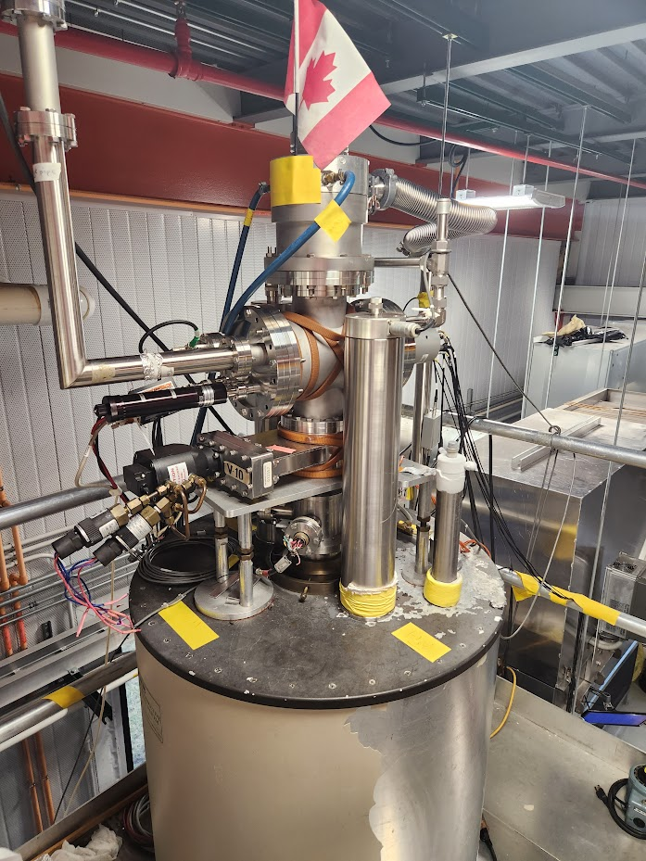
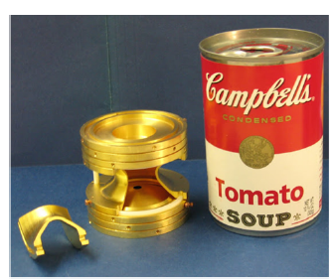
Mass Measurements for Nuclear Structure with the Canadian Penning Trap
Maxime Brodeur
University of Notre Dame

Slide 2

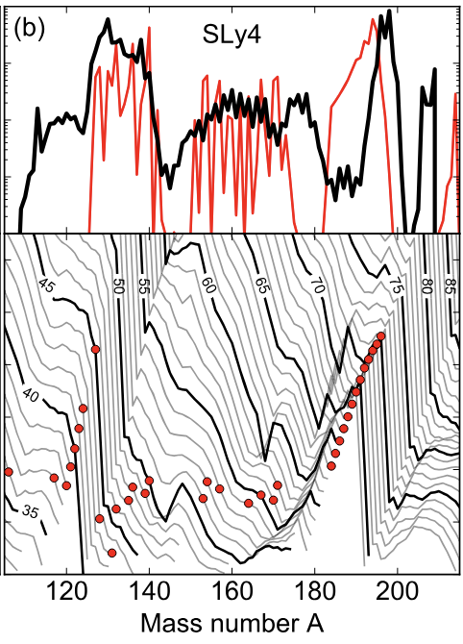
Nuclear structure and astrophysics
Atomic masses play key role in r-process nucleosynthesis.
Set forward and reverse reaction rates
(n,γ) – (γ,n) equilibrium abundances
Freeze-out abundance set around a fix S_{n}-value.
Rapid drop in S_{2n} near N = 82, 126 shell.
Result in accumulation of matter at those regions.
D. Martin et al., PRL 116, 121101 (2016)

Slide 3
Nuclear structure and astrophysics
Atomic masses play key role in r-process nucleosynthesis.
Set forward and reverse reaction rates
(n,γ) – (γ,n) equilibrium abundances
Freeze-out abundance set around a fix S_{n}-value.
Rapid drop in S_{2n} near N = 82, 126 shell.
Result in accumulation of matter at those regions.
Directional change in S_{2n} near A = 150 and 180.
Absence of matter there at freeze-out results in lower final abundances.
D. Martin et al., PRL 116, 121101 (2016)

Slide 4
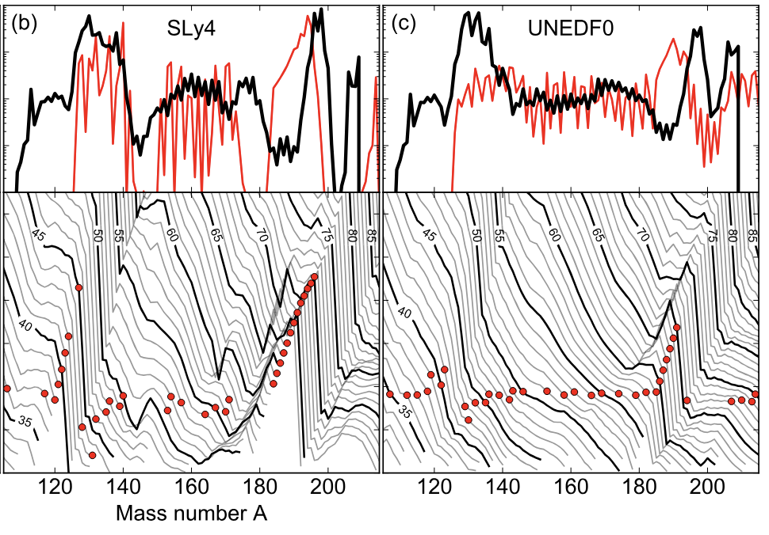
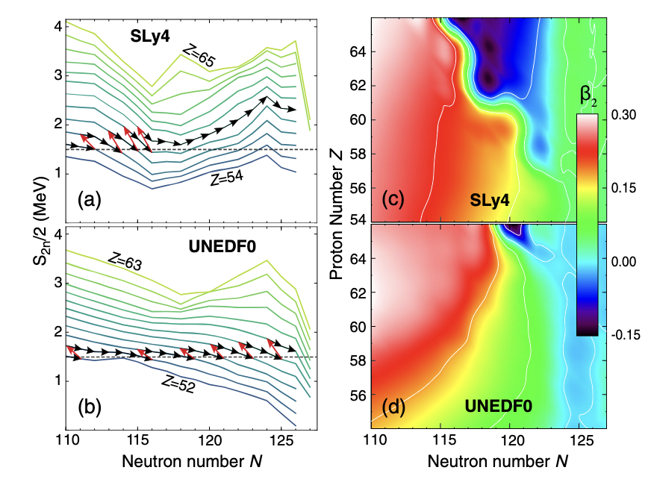
Nuclear structure and astrophysics
D. Martin et al., PRL 116, 121101 (2016)
Directional change in S_{2n} near A = 150 and 180.
Absence of matter there at freeze-out results in lower final abundances.
S_{2n} affected by change in nuclear deformation.
How strong are the N = 82, 126 shell far from stability?
Are there new shell closures?
What are the regions of shape transition?
Need to rely on mass models that provide conflicting predictions.

Slide 5
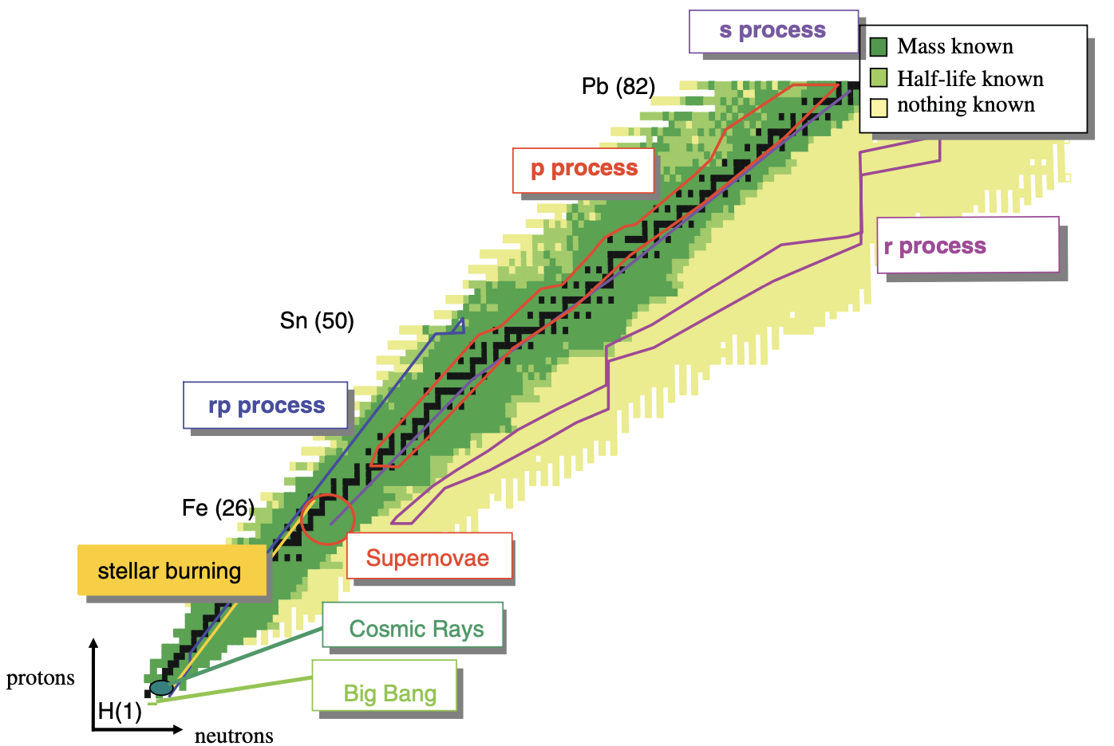
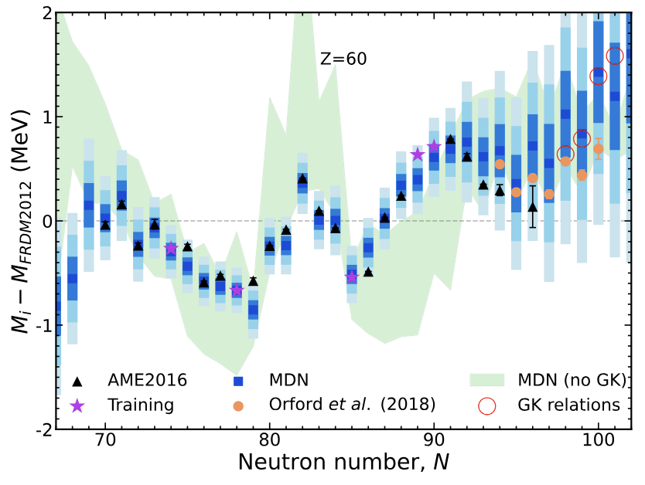
Nuclear structure and astrophysics
R-process happens far from stability where nothing is known nor can be measured in the near future.
Rely on conflicting mass model prediction. Machine learning mass modeling starting to surface.
K. Blaum, Phys. Rep. 425, 1 (2006)
M.R. Mumpower et al., PRC 106, L021301 (2022)
M. Mumpower talk

Slide 6
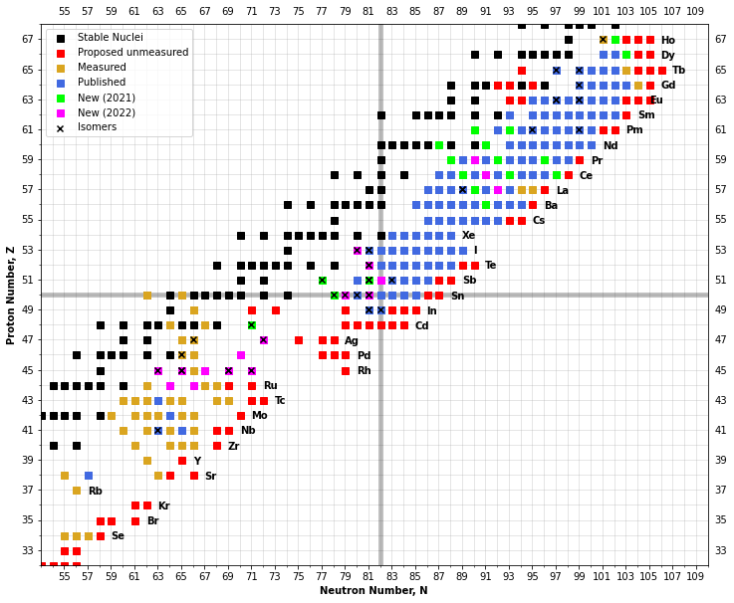
Masses measured with CPT @ CARIBU
Cases I will discuss:
133Te
A.A. Valverde et al., PLB 858, 139037 (2024)
N-rich Rh and Ru isotopes
B. Liu et al., PRC 111, 034308 (2025)
W.S. Porter et al., PRC 110, 034321 (2024)
Rest was discussed by Adrian Valverde on Monday.

Slide 7
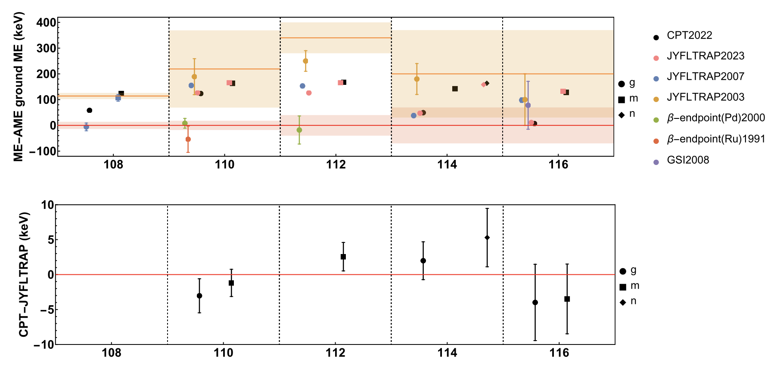
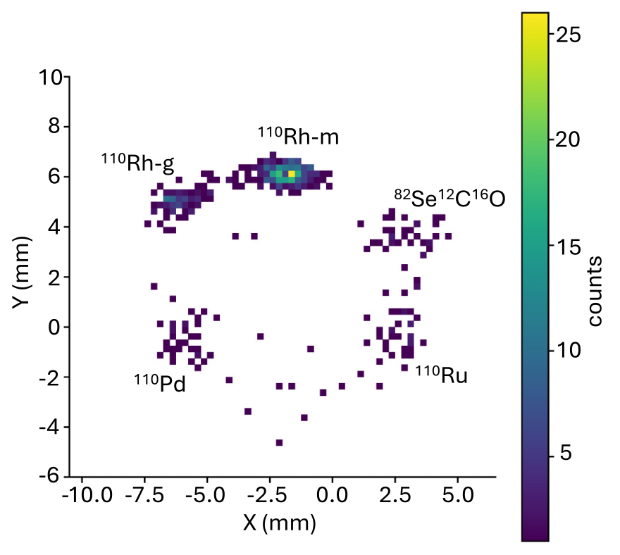
N-rich Rh isotopes
Measured the mass of ^{108,110,112,114,116}Ru using PI-ICR.
Ground and isomeric state values agrees with recent JYFLTRAP measurements.
Confirm ^{112m}Rh, low-spin ^{112g}Rh seen in post-analysis
Observed a new possible isomer in ¹¹⁴Rh that has also been independently seen at JYFLTRAP (A. Jaries talk on Monday).
B. Liu et al., PRC 111, 034308 (2025)

Slide 8
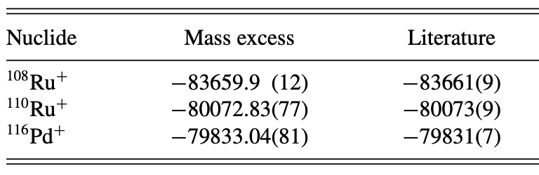
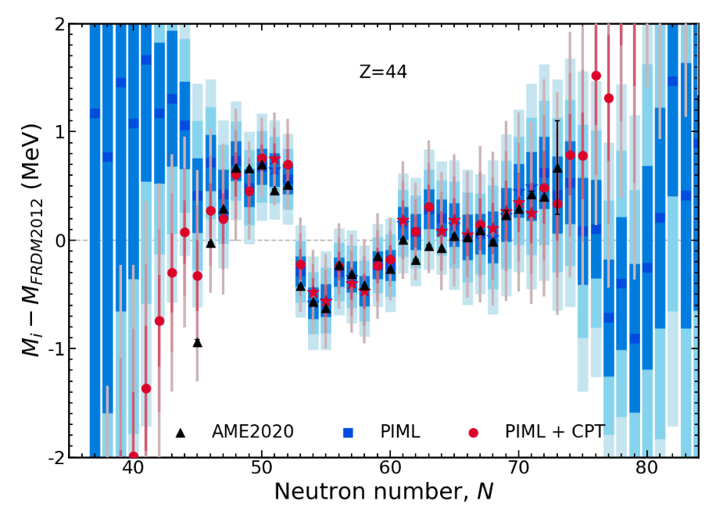
Training of ML modeling
Measured the mass of ¹⁰⁸Ru, ¹¹⁰Ru, and ¹¹⁶Pd using PI-ICR.
Improved precision by an order of magnitude.
Trained a Physically Interpretable Machine Learning (PIML) mass model w/ and w/o the CPT masses as well as with a subset of the AME2020.
Changing only three masses in the training set has a significant effect on the predicted masses from the model.
W.S. Porter et al., PRC 110, 034321 (2024)

Slide 9
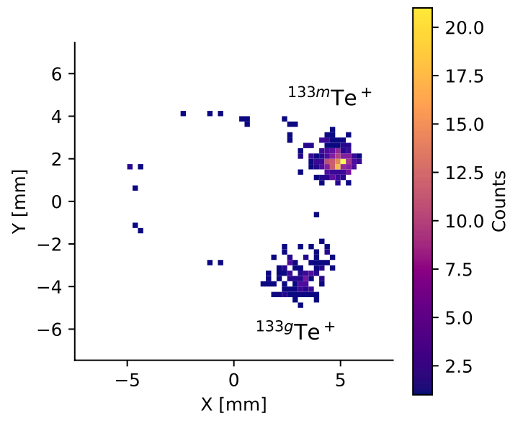
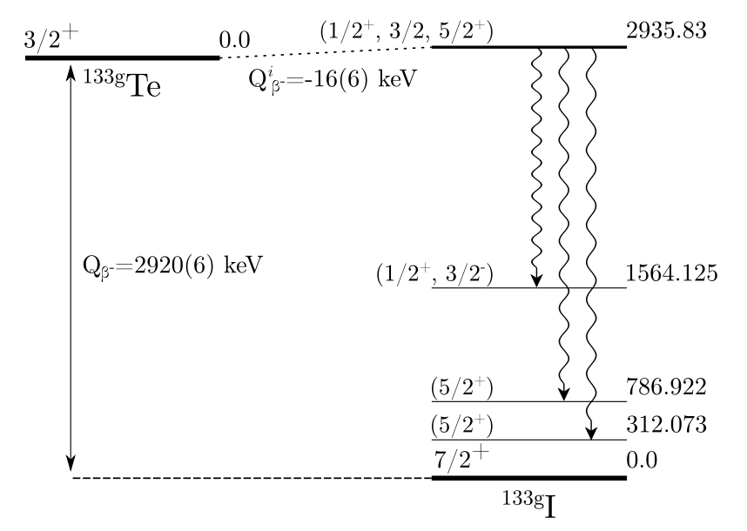
Q_{β}-value anomaly of astromer ¹³³Te
¹³³Te is an astromer candidate. However, several structural issues…
Based on AME2020 masses and excitation energy, Q_{β} = -16(6) keV.
The CPT clearly separated the ground and isomeric states of ¹³³Te and ¹³³I using the PI-ICR technique.
With the new ME, Q_{β} = -1.0(12) keV, resolving the anomaly while making it an ultra-low Q-value candidate (with possible interest in ν-physics).
Revealed anomalously-small ft-value of 3x10⁻⁶. Need to further investigate structure of this nucleus before concluding on its astromeric nature.
A.A. Valverde et al., PLB 858, 139037 (2024)

Slide 10
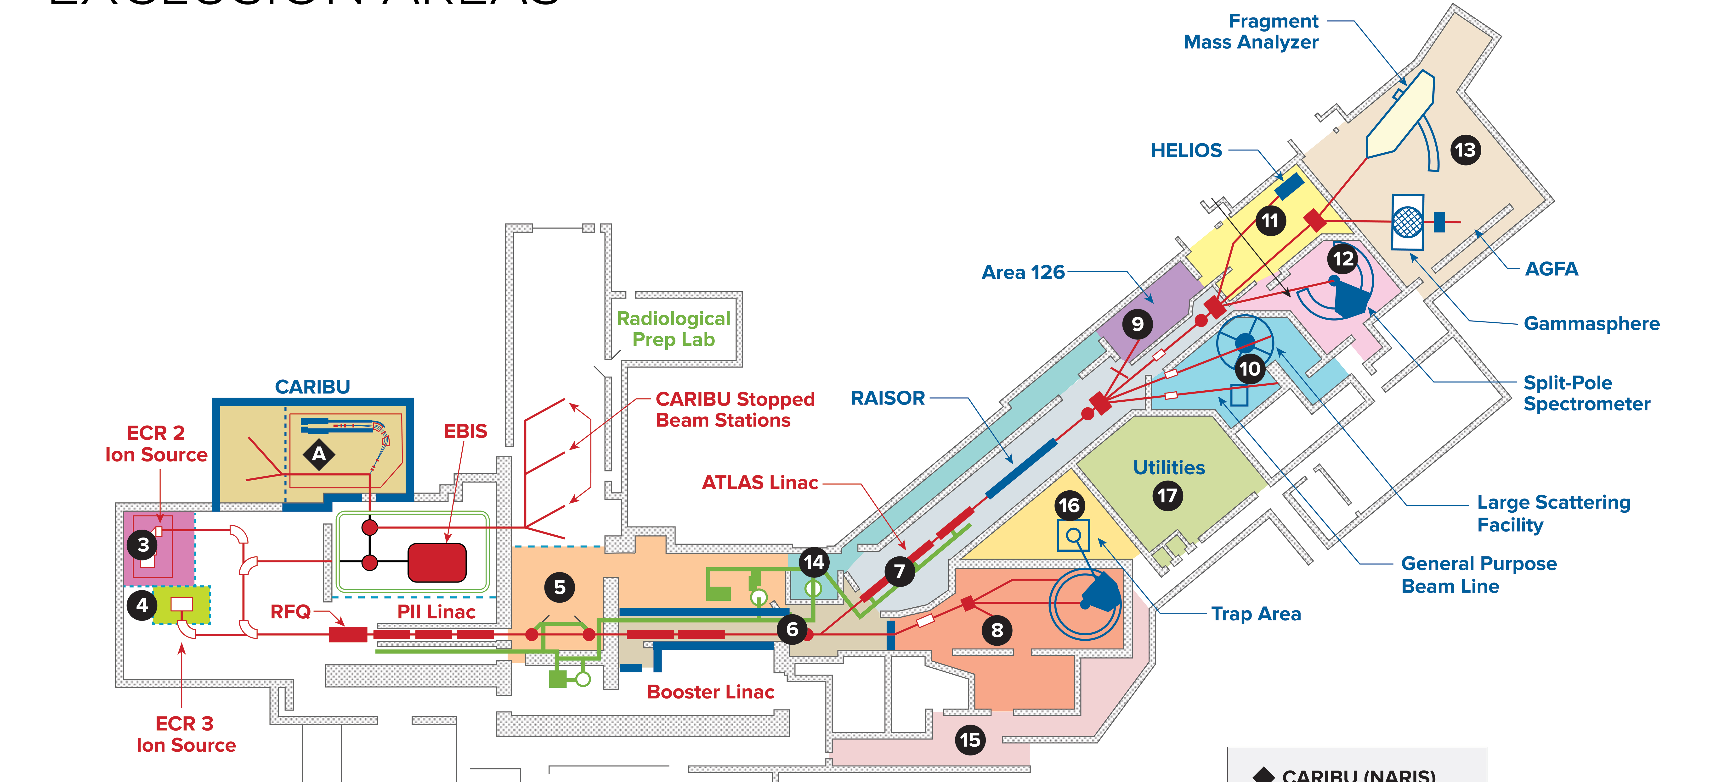
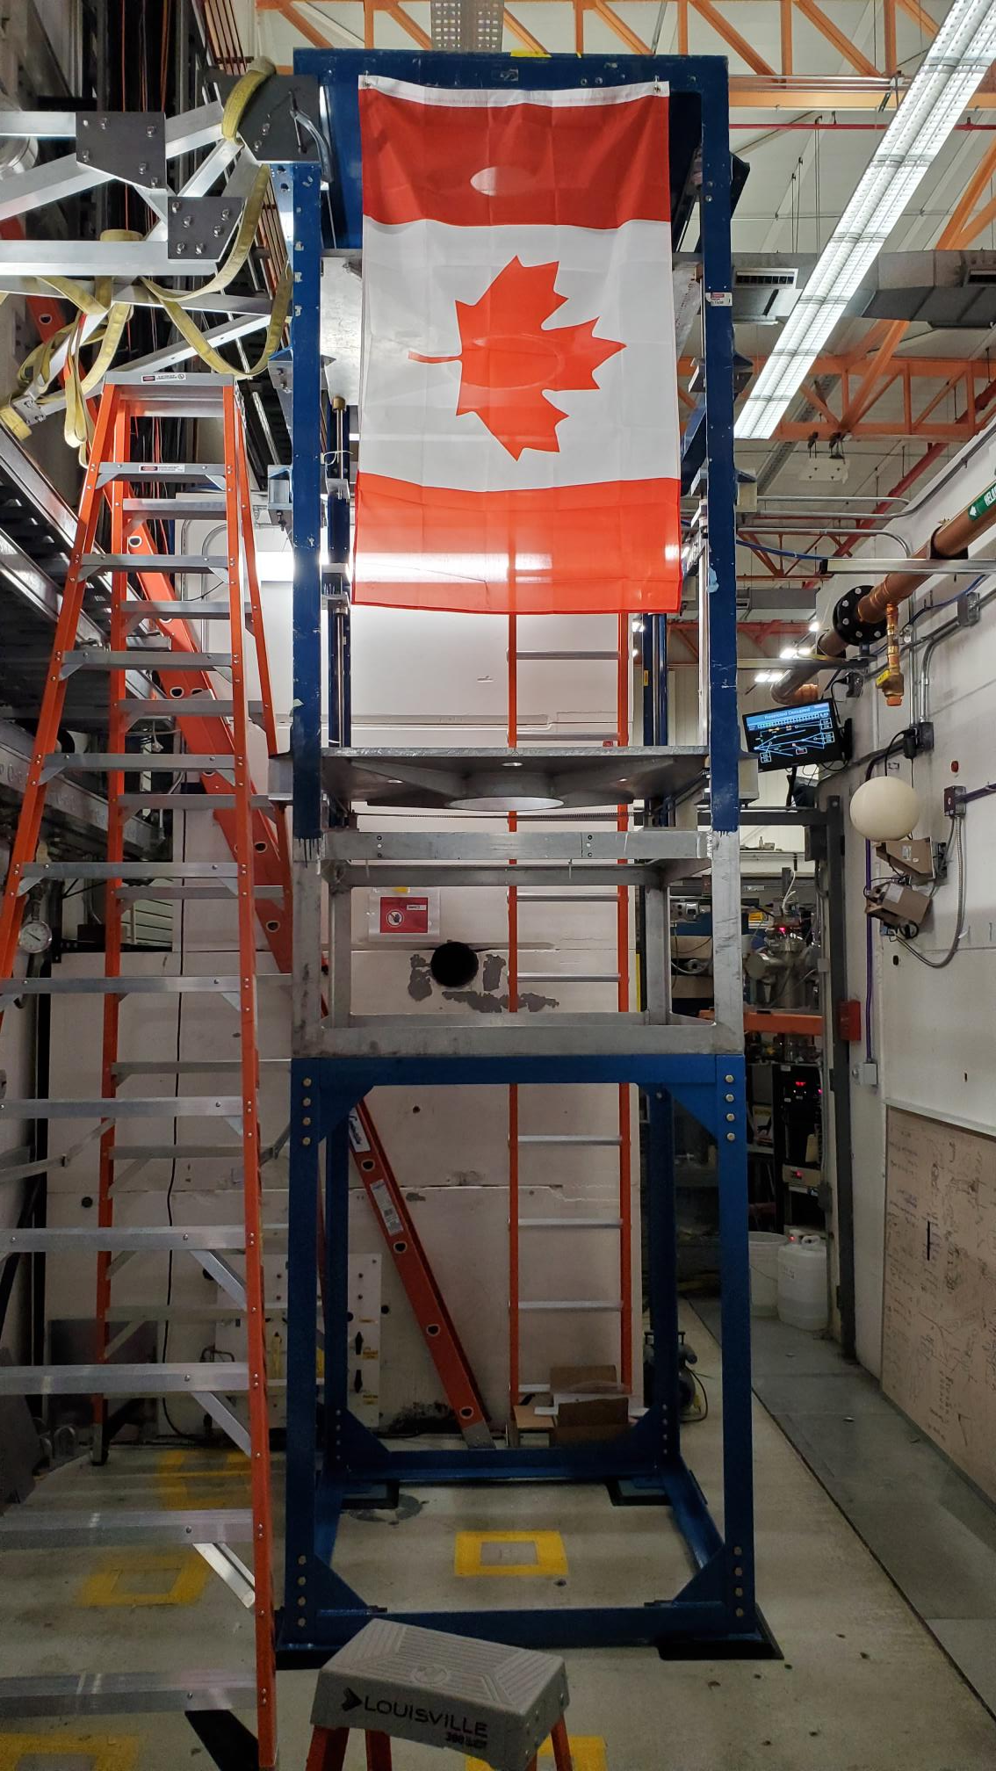
CPT on the move
CPT moved to the N = 126 where a broader range of nuclei can be produced.
At the same time, makes room for the nuCaribu upgrade (Guy Savard talk)

Slide 11
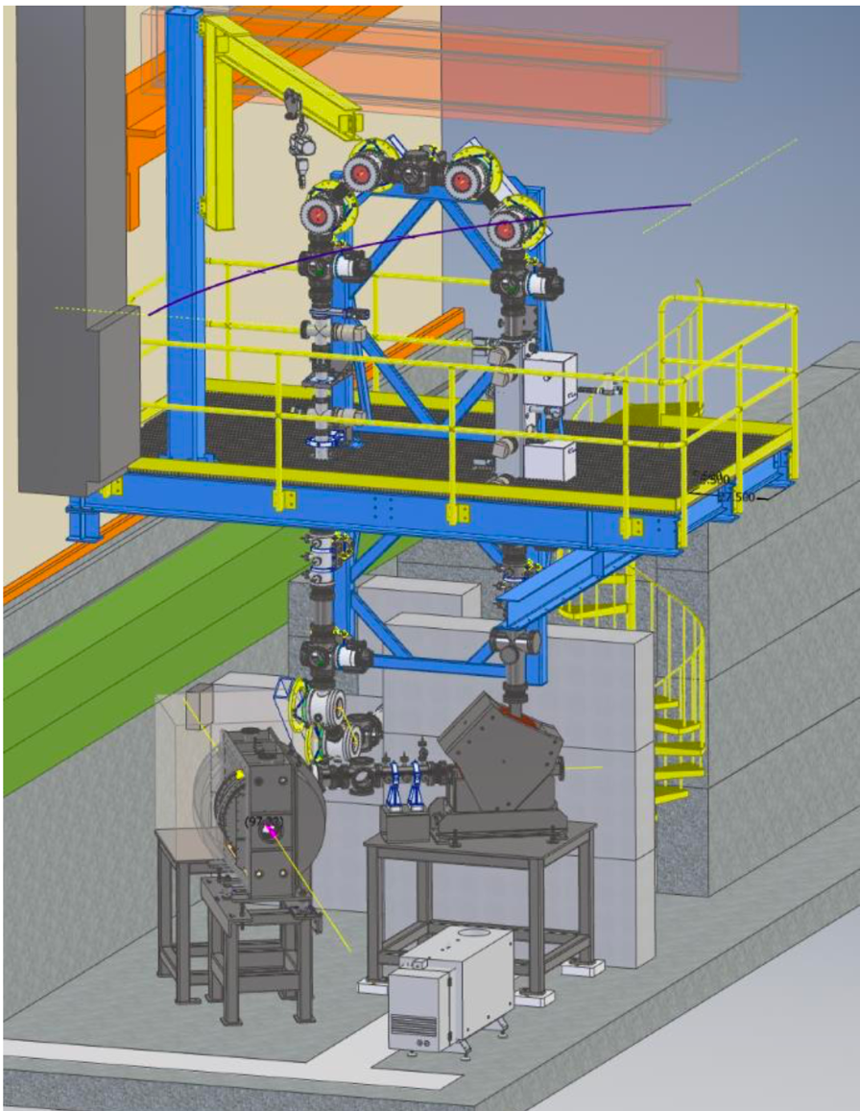
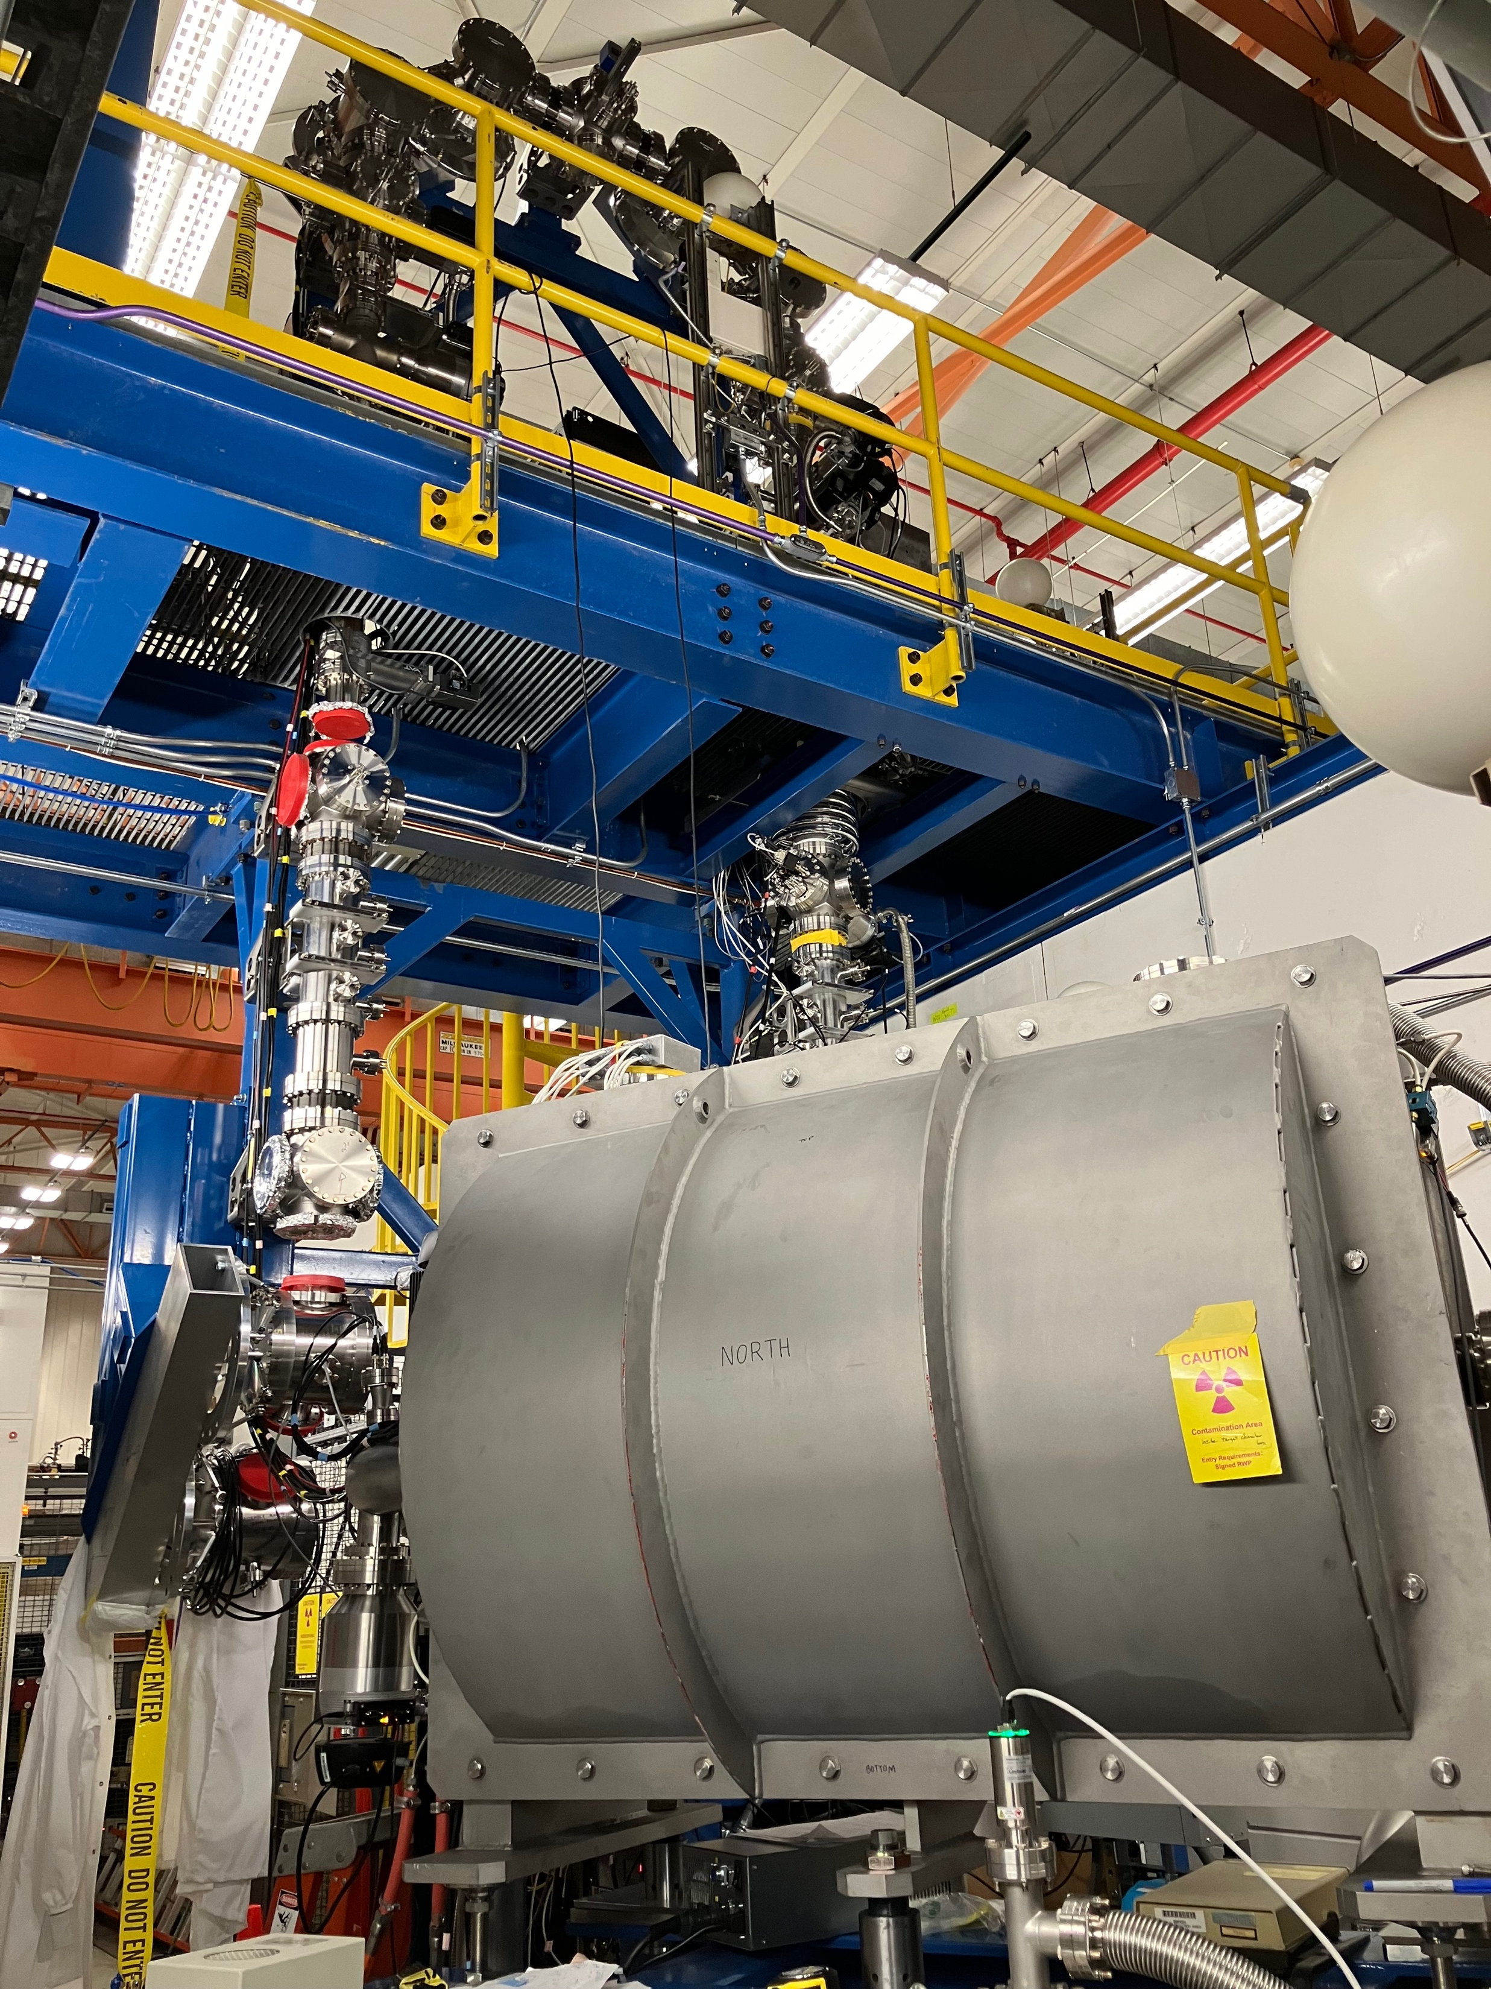
The N=126 Factory in Area 126
G. Savard et al., NIM B 463, 330 (2020)
See Jason Clark talk on Friday
RFQ cooler-buncher
Gas cell
Gas cell

Slide 12
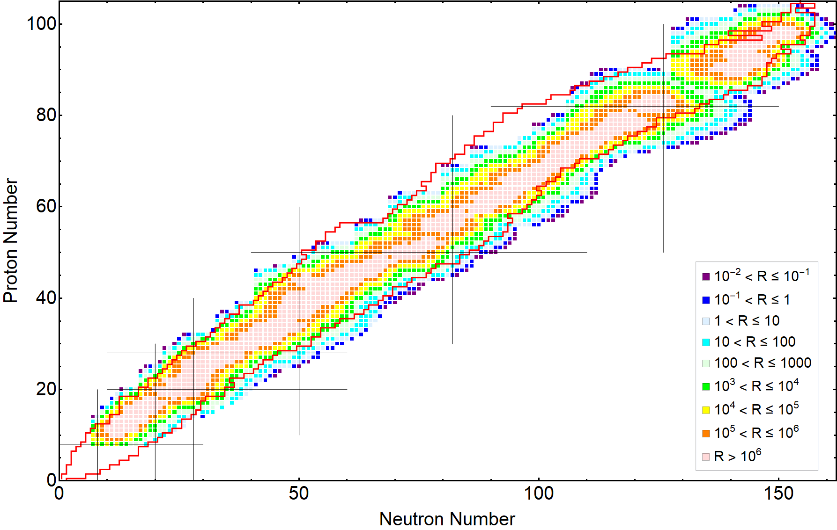
Not just around N = 126
5 pμA ¹³⁶Xe at 9 MeV/u on different targets (²⁶Mg to ²⁵²Cf)
Target thickness 10 mg/cm² or 50 mCi/cm² limit.
Red lines: AME20 known masses
Calculations by Biying Liu done using:
http://nrv.jinr.ru/nrv/webnrv/grazing/

Slide 13
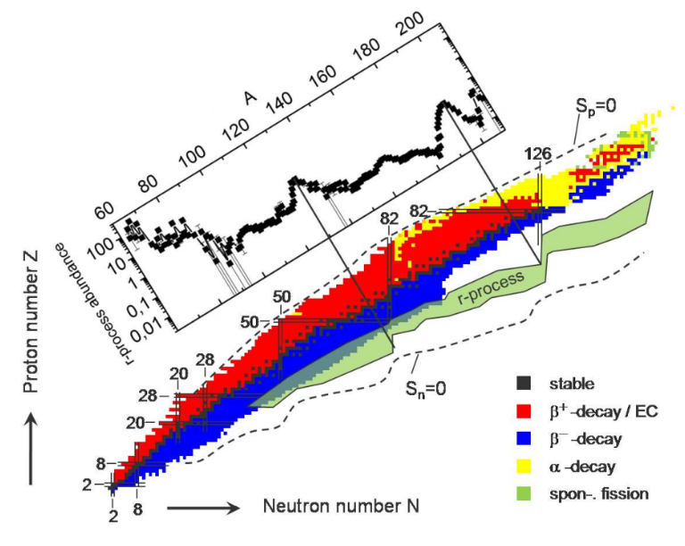
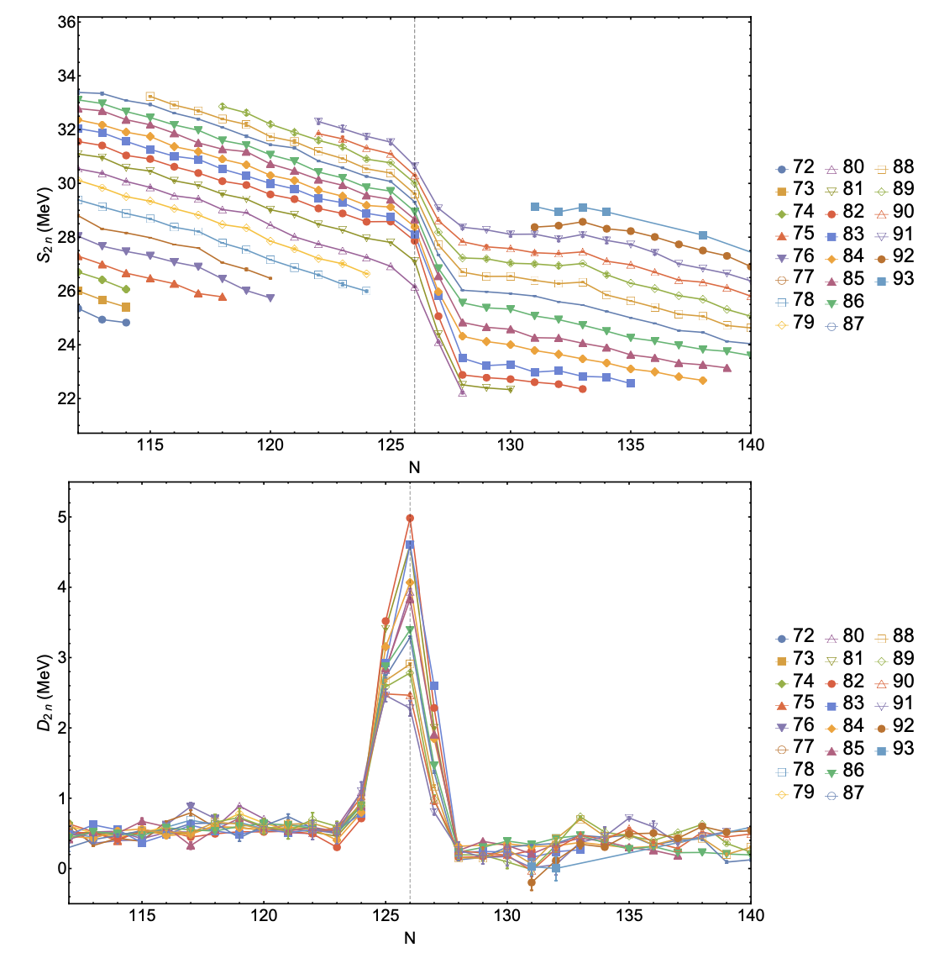
Does the N = 126 shell weaken?
?
N=126 shell closure play central role on the formation of 3rd peak
What is the strength of that shell far from stability?
Assess from S_{2N}, D_{2N}-values.
?

Slide 14
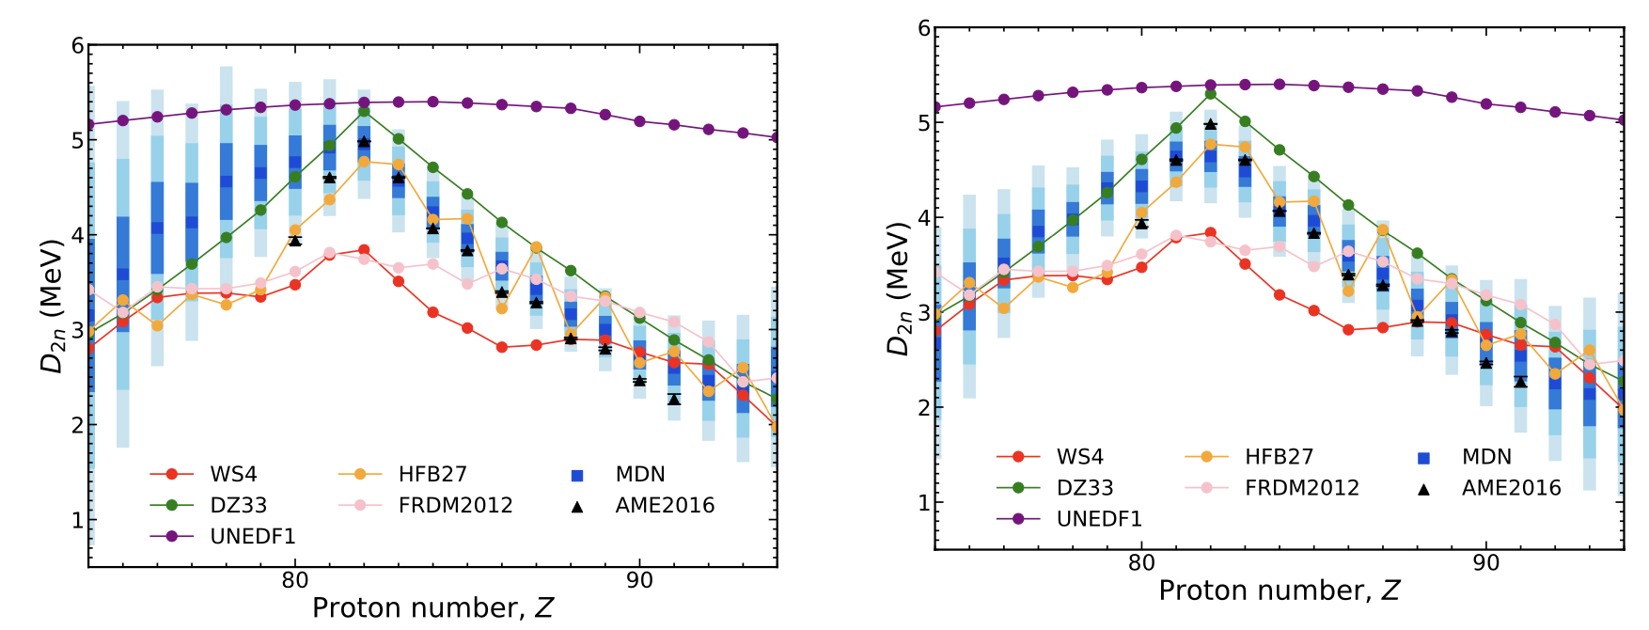
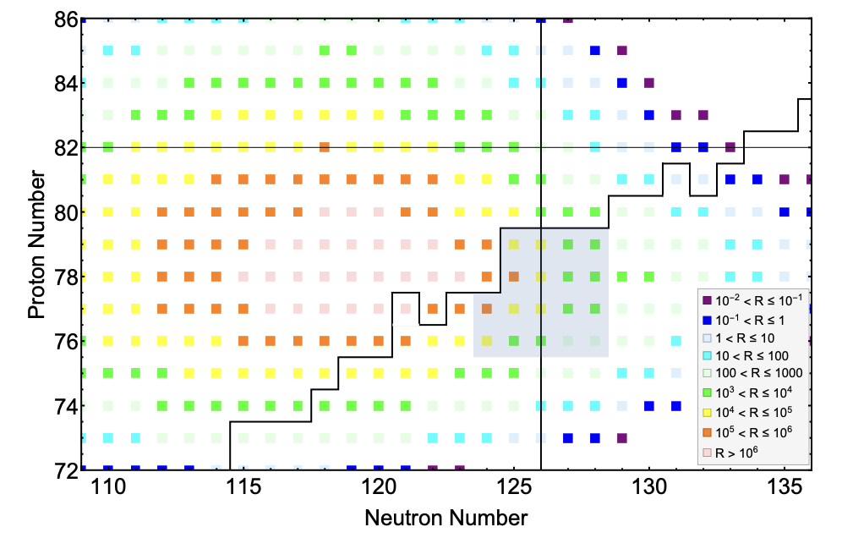
Does the N = 126 shell weaken?
Conflicting predictions for the strength of D_{2N}.
PIML used to predict masses in this region.
Follow more closely known masses.
Adding new precise masses to training set improve quality of predictions.
B. Liu et al., ATLAS proposal #1993

Slide 15
Conclusion
Understanding the changes in the structure of the nucleus far from stability is critical for reliable r-process abundance calculations.
The Canadian Penning Trap measured around >100 masses when located at the CARIBU facility.
These included several isotopes of interest for nuclear structure.
The masses of neutron-rich Ru were measured and used to benchmark machine-learning based mass models.
Mass measurement of neutron-rich odd-odd Rh isotopes confirmed the excitation energy several isomeric states while indicating the possible existence of a second isomer in ¹¹⁴Rh.
Anomalous negative Q-value for b-decay of ¹³³Te has been resolved.
Plan on investigating N = 126 shell closure and test PIML mass model using the CPT at the N = 126 Factory.

Slide 16


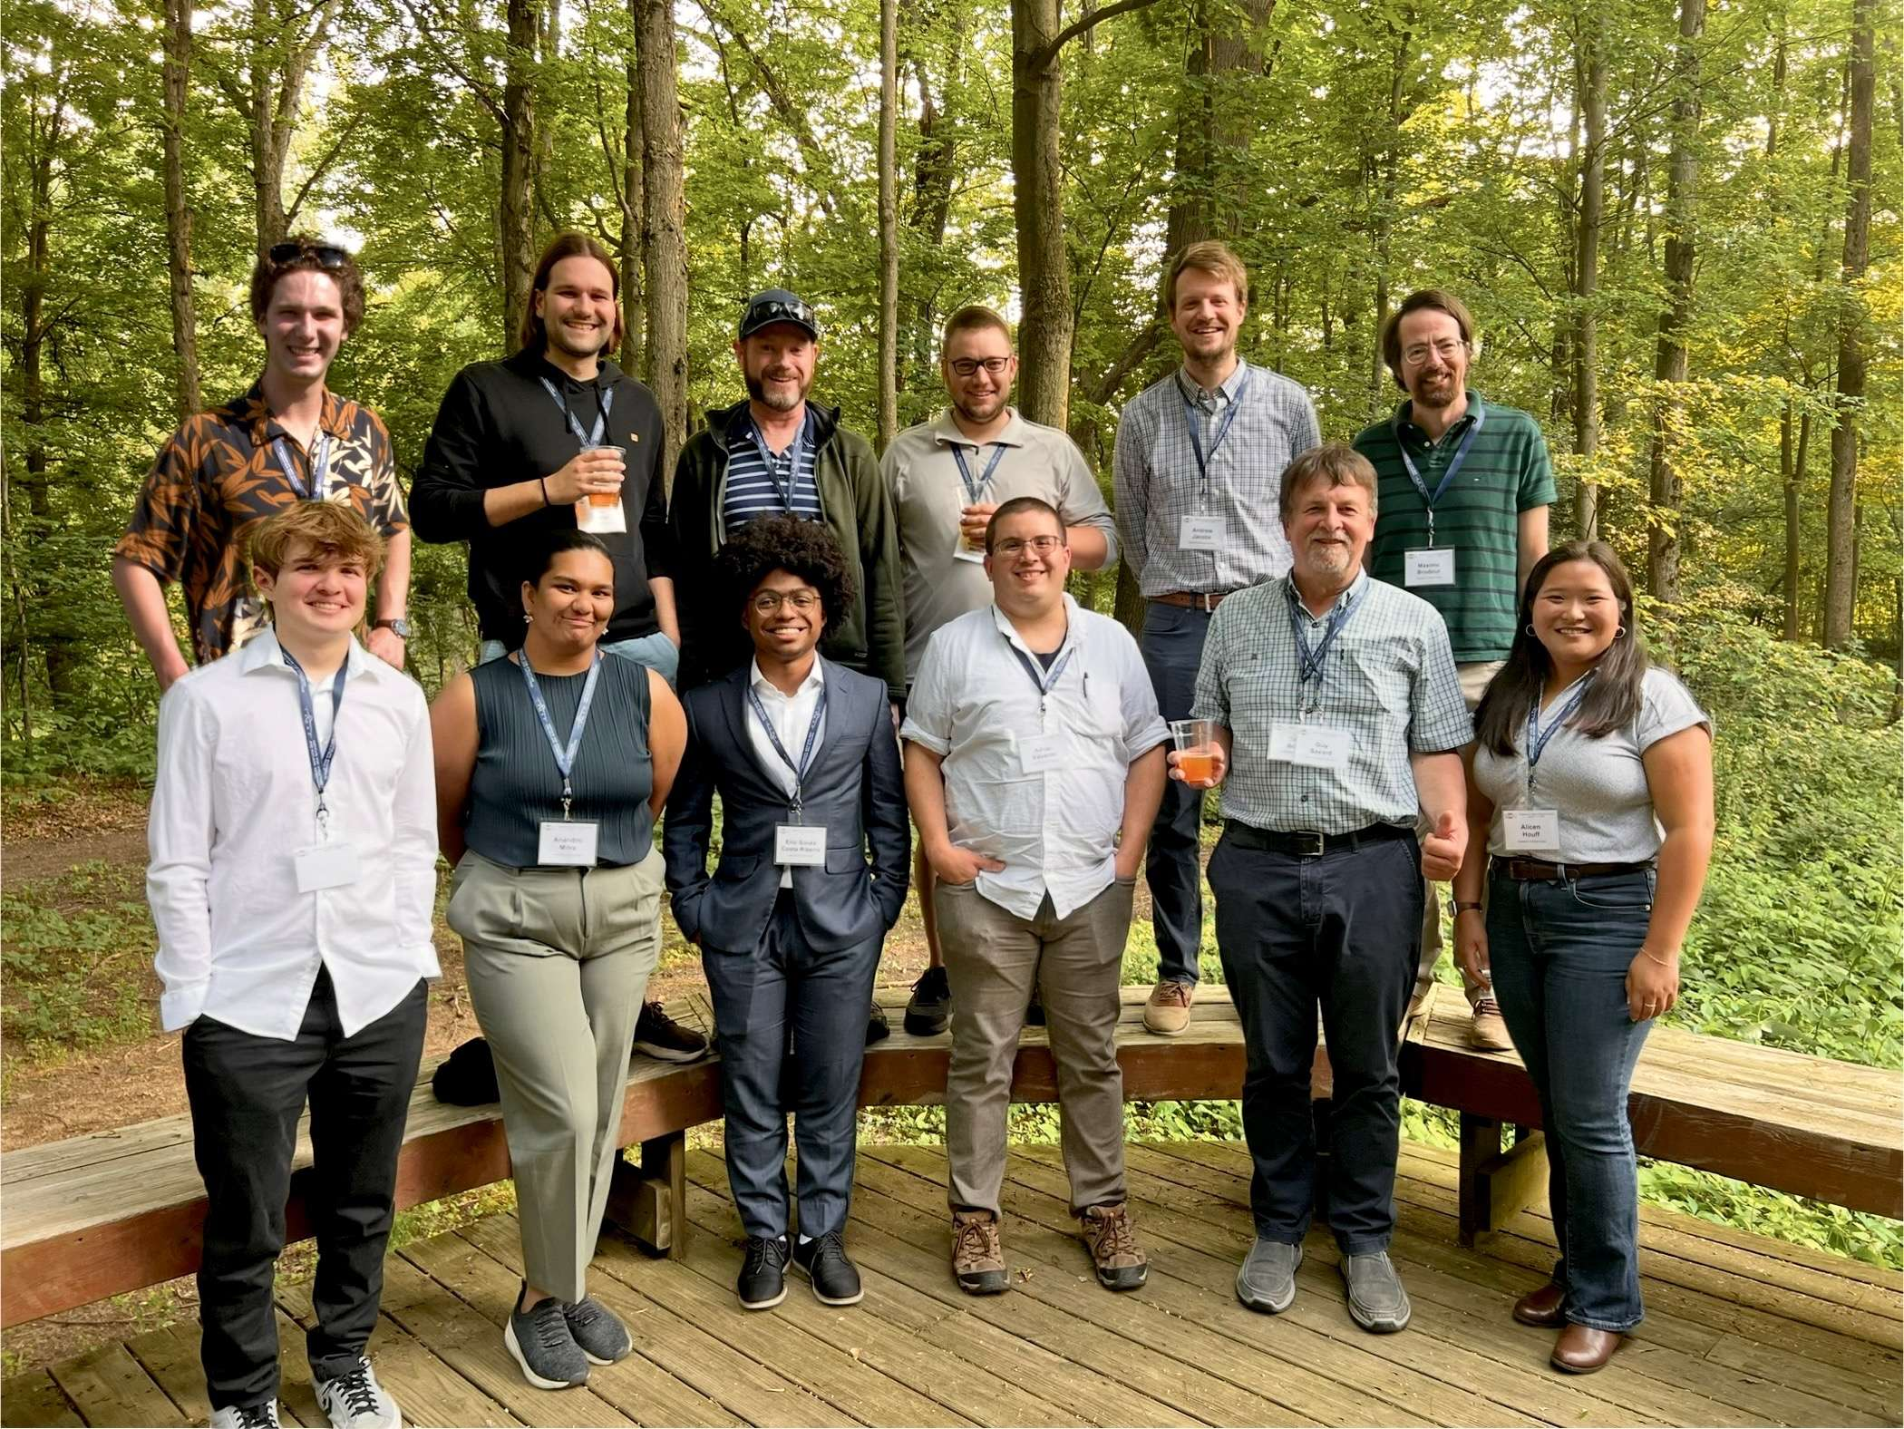



Acknowledgements
J.A. Clark,
A. Jacobs,
R. Knaack,
M. Martin,
J. Rohrer,
G. Savard,
A.A. Valverde
German Guy
M. Brodeur,
A. Houff,
B. Liu,
W.S. Porter,
F. Rivero
K.S. Sharma

