Slide 1


Mass Measurements of Actinides at the High-Precision Penning-Trap Mass Spectrometer TRIGA-Trap
Nuclear Masses in Astrophysics for the Next 25 Years, Darmstadt
TRIGA-TRAP
Tanvir Sayed, Szilard Nagy, Klaus Blaum, Michael Block, Burcu Cakirli, Stanislav Chenmarev, Christoph Düllmann, Dennis Renisch

Slide 2
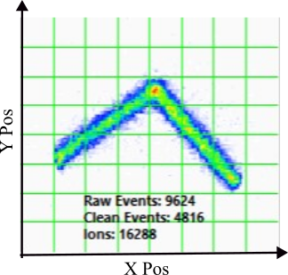
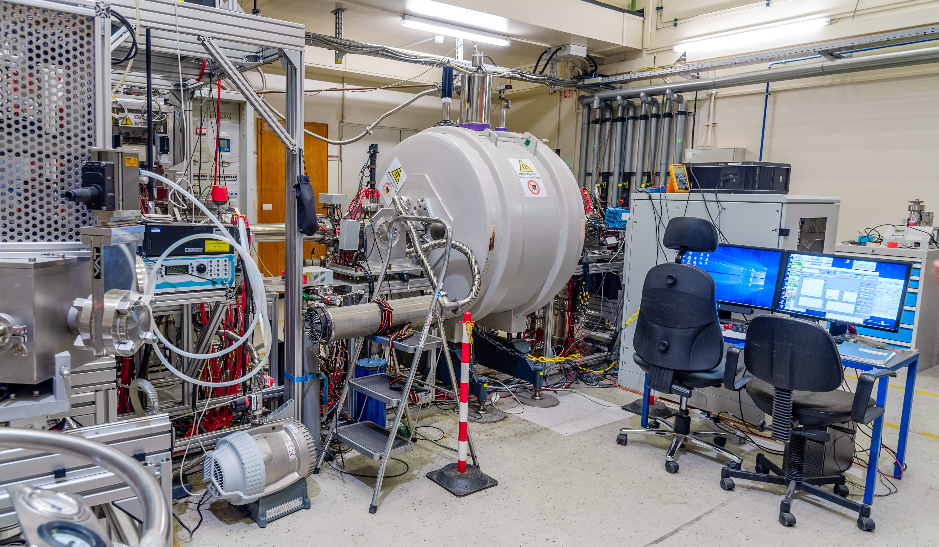
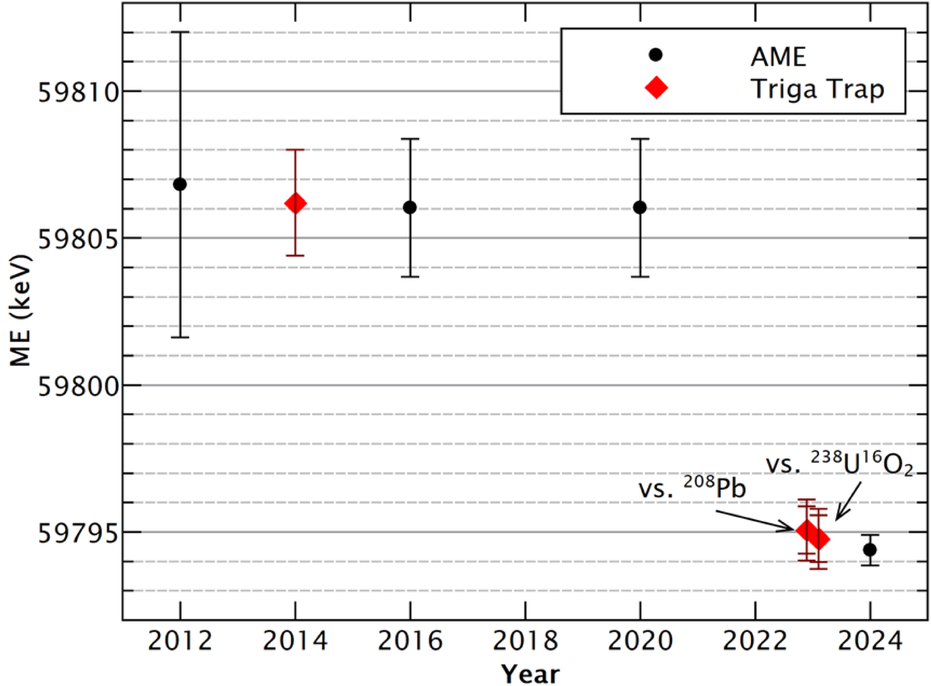
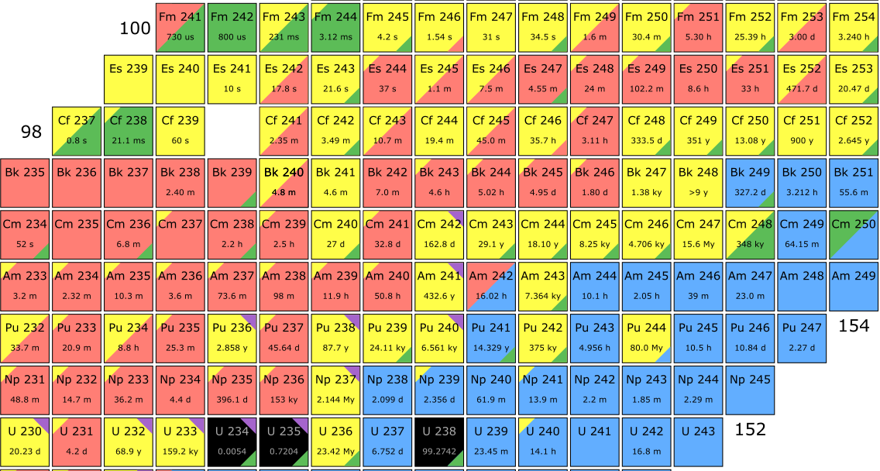
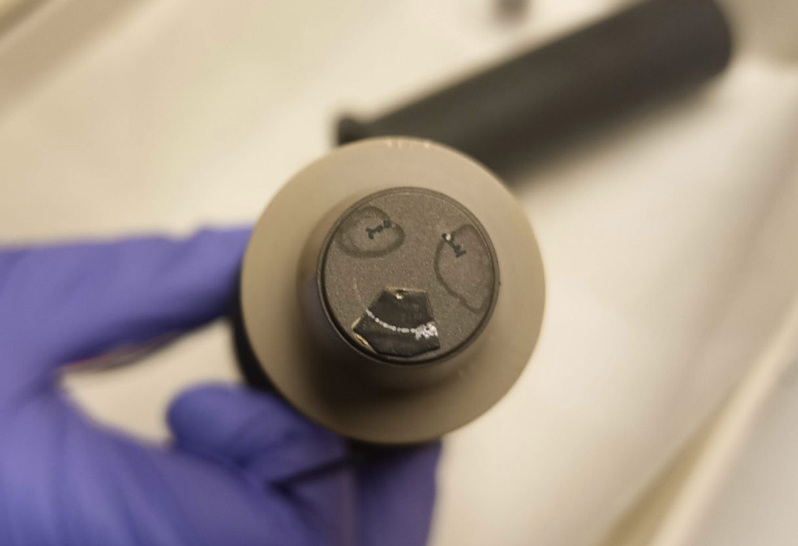
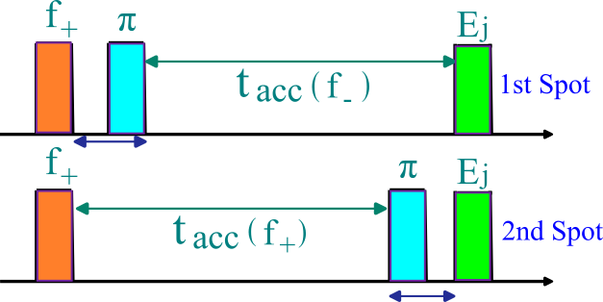
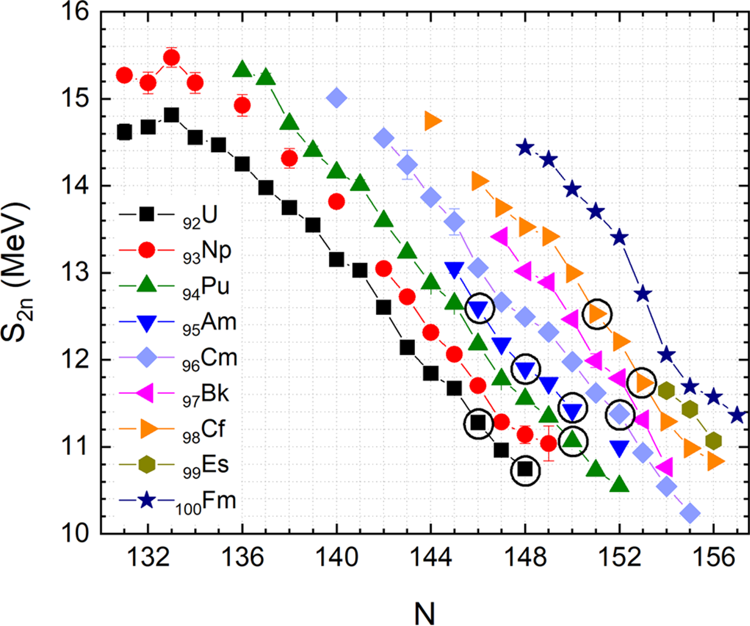
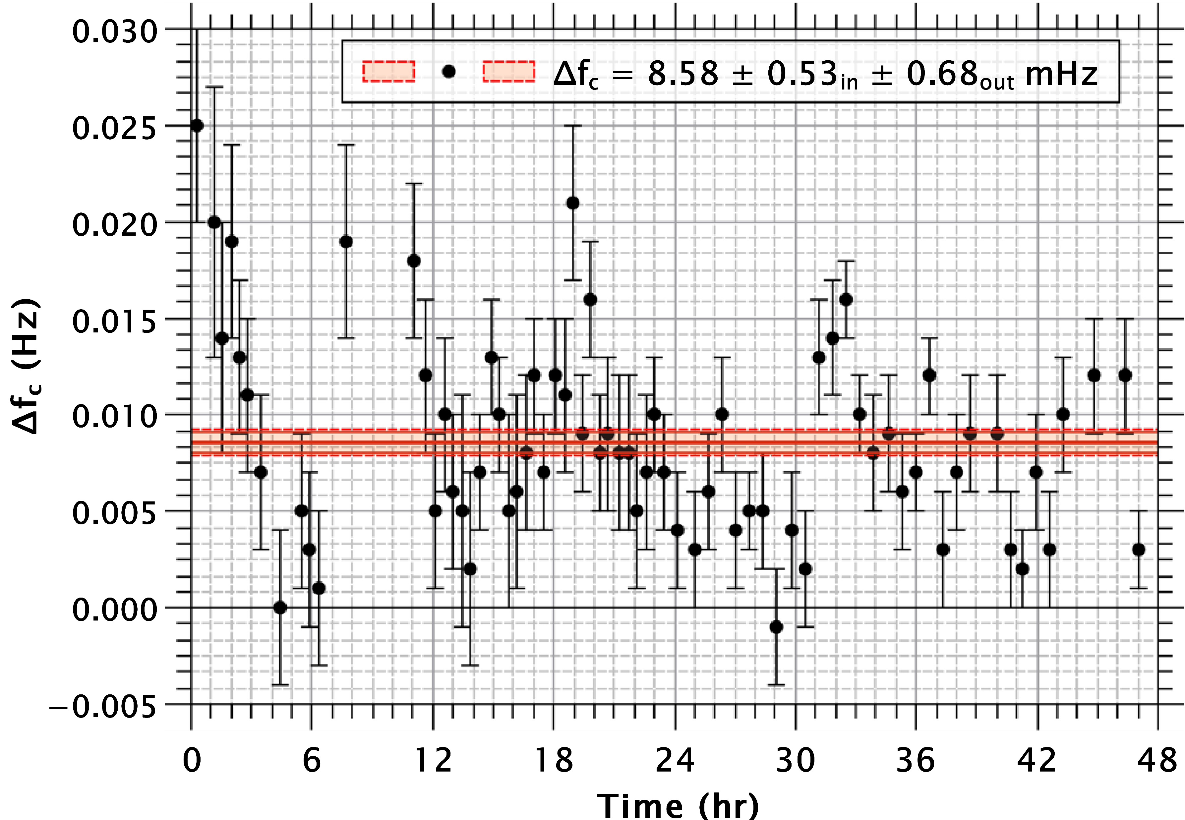
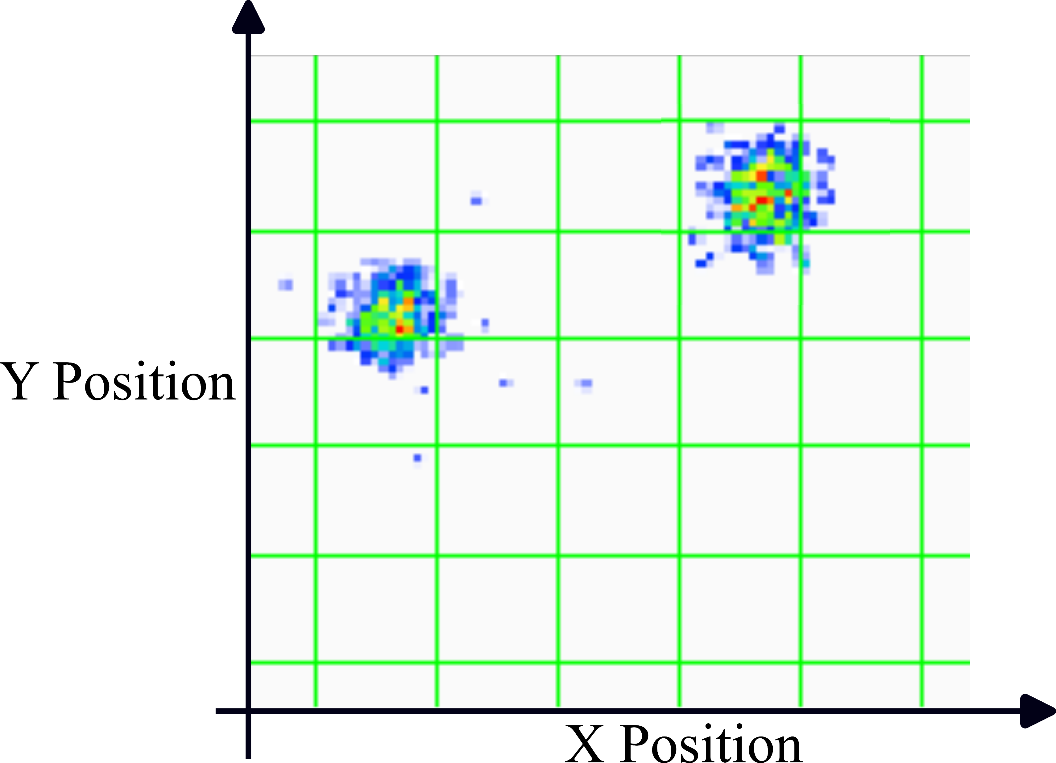
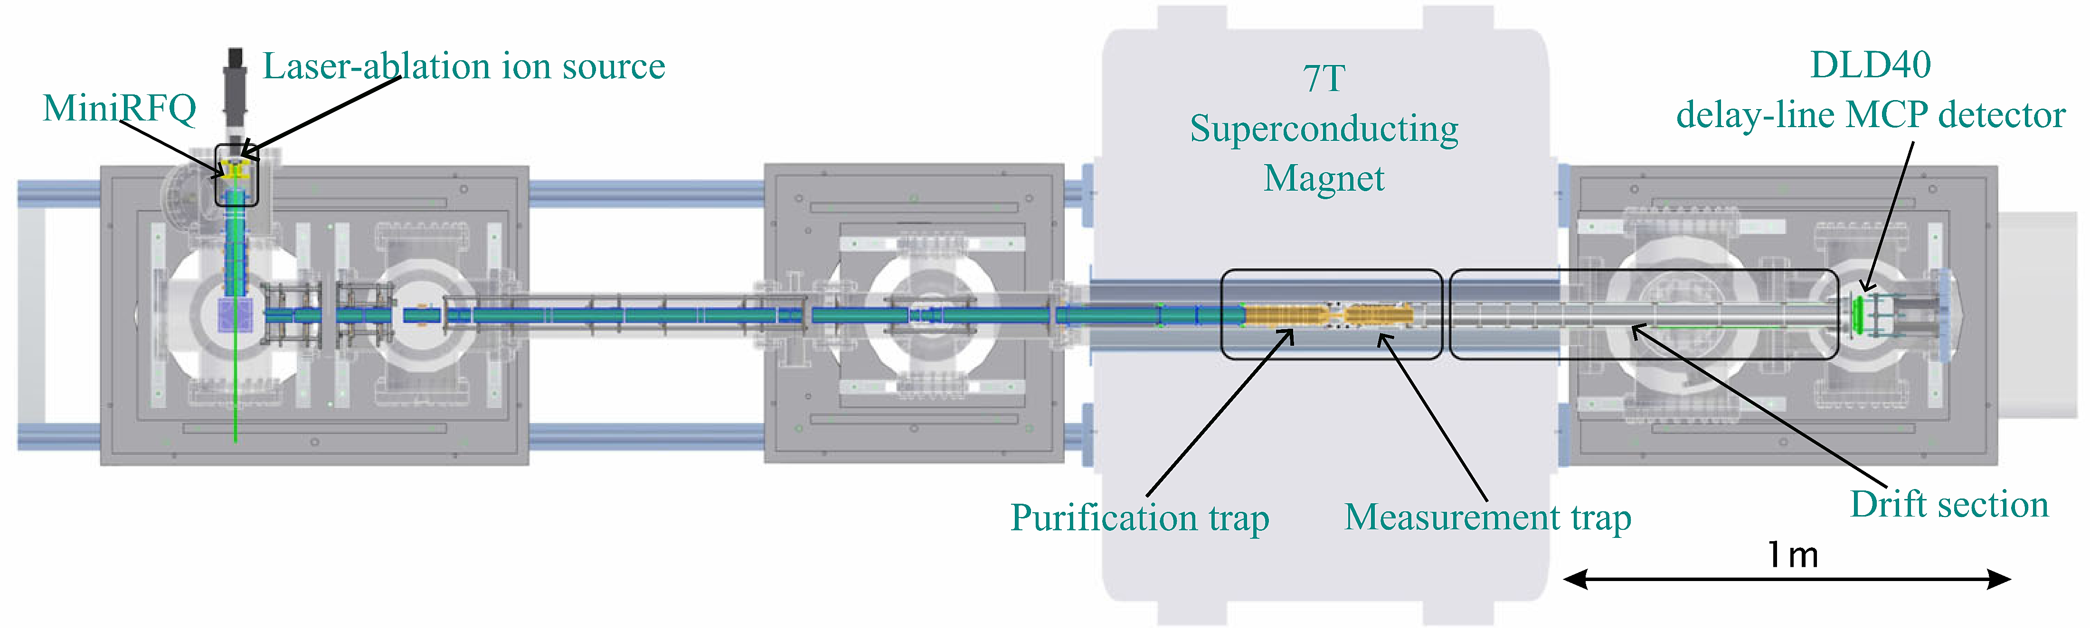



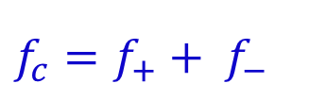

Topics for today
‘Harmonic’
$$f_{c}=f_{+}+ f_{−}$$
Background & Motivation
Systematic Checks
Mass Measurement
Recent Results & Evaluation
Ongoing & Future Projects
$$_{ 94}^{244}Pu$$
TRIGA-Trap
$f_{+}$ spot
$f_{−}$ spot
$$Δφ$$
center
Notes:
Figure highlighting each section (guess can be done at the end)
Blur ones with no image
TRIGA-Trap ()
Systematic Checks (with PI-ICR) Premeasurement
Mass Measurement
Recent results & Evaluation
Future Campaign

Slide 3
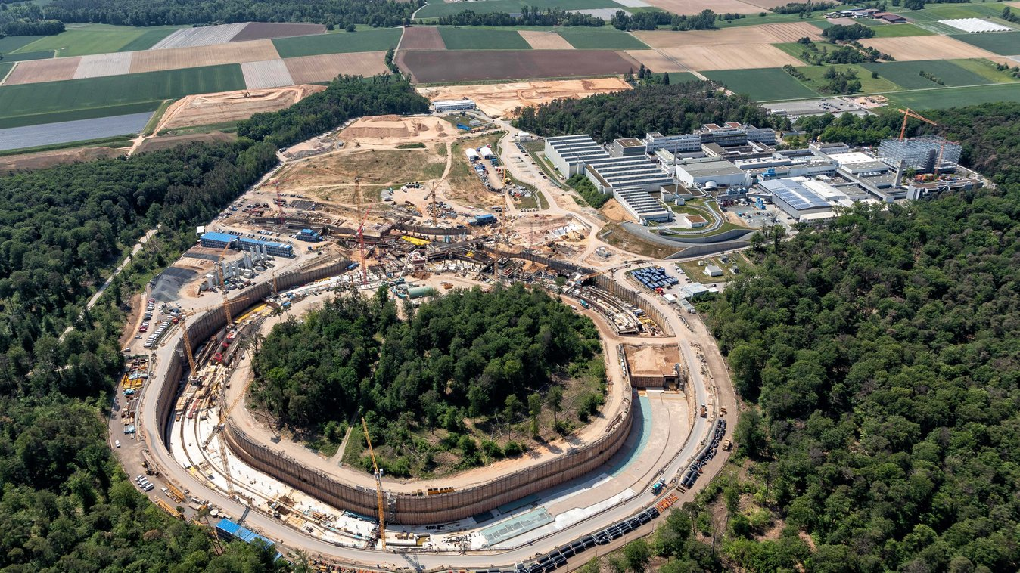
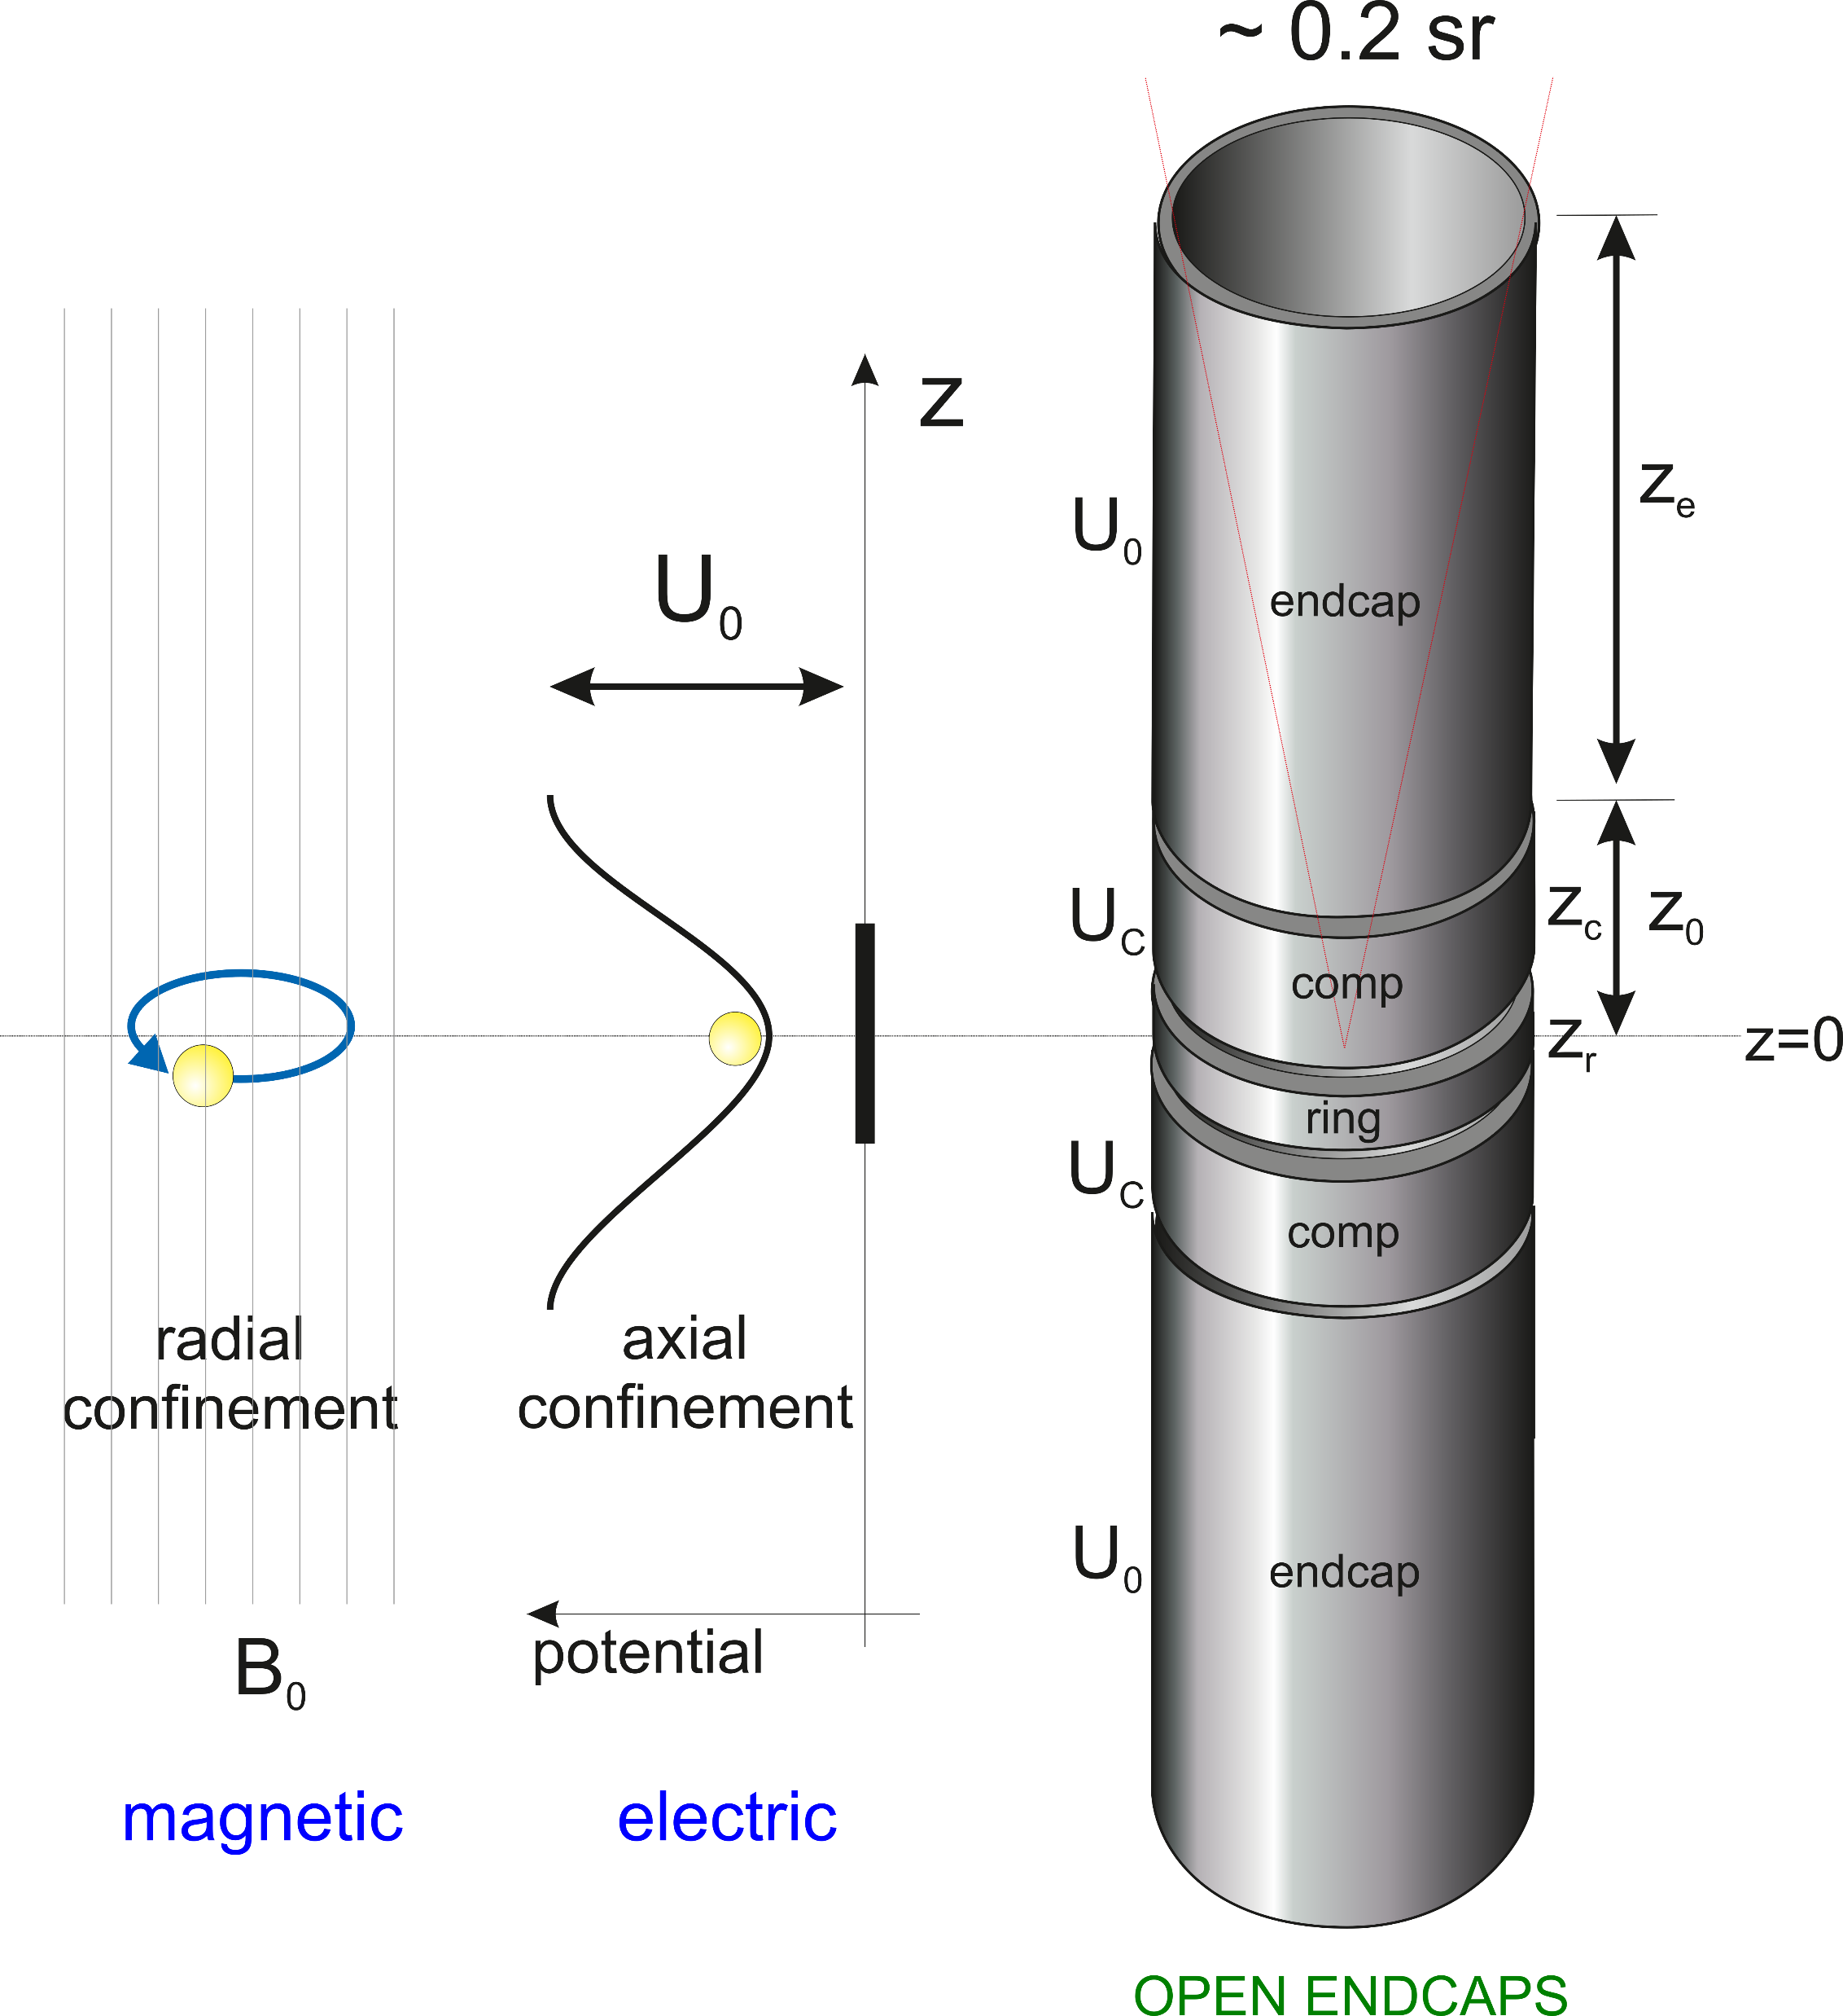

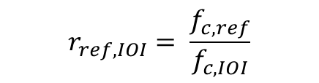

TRIGA-Trap
GSI-FAIR
Construction
Site
Image Source:https://fair-center.eu/
TRIGA-Trap
High-precision double penning-trap mass spectrometer
$$f_{c}= \frac{q}{2π∙m}B$$
$$r_{ref,IOI}= \frac{f_{c,ref}}{f_{c,IOI}}$$
$$M_{IOI}= r_{ref,IOI}\left(M_{ref}−m_{e}\right)+m_{e}$$
Fig ref: D.Lindenfels. Hyperfine Interact (2014) 227:197–207
Notes:
FAIR site image. Future at MATS but right now at MAINZ TRIGA Reactor Hall
Double Penning Trap

Slide 4
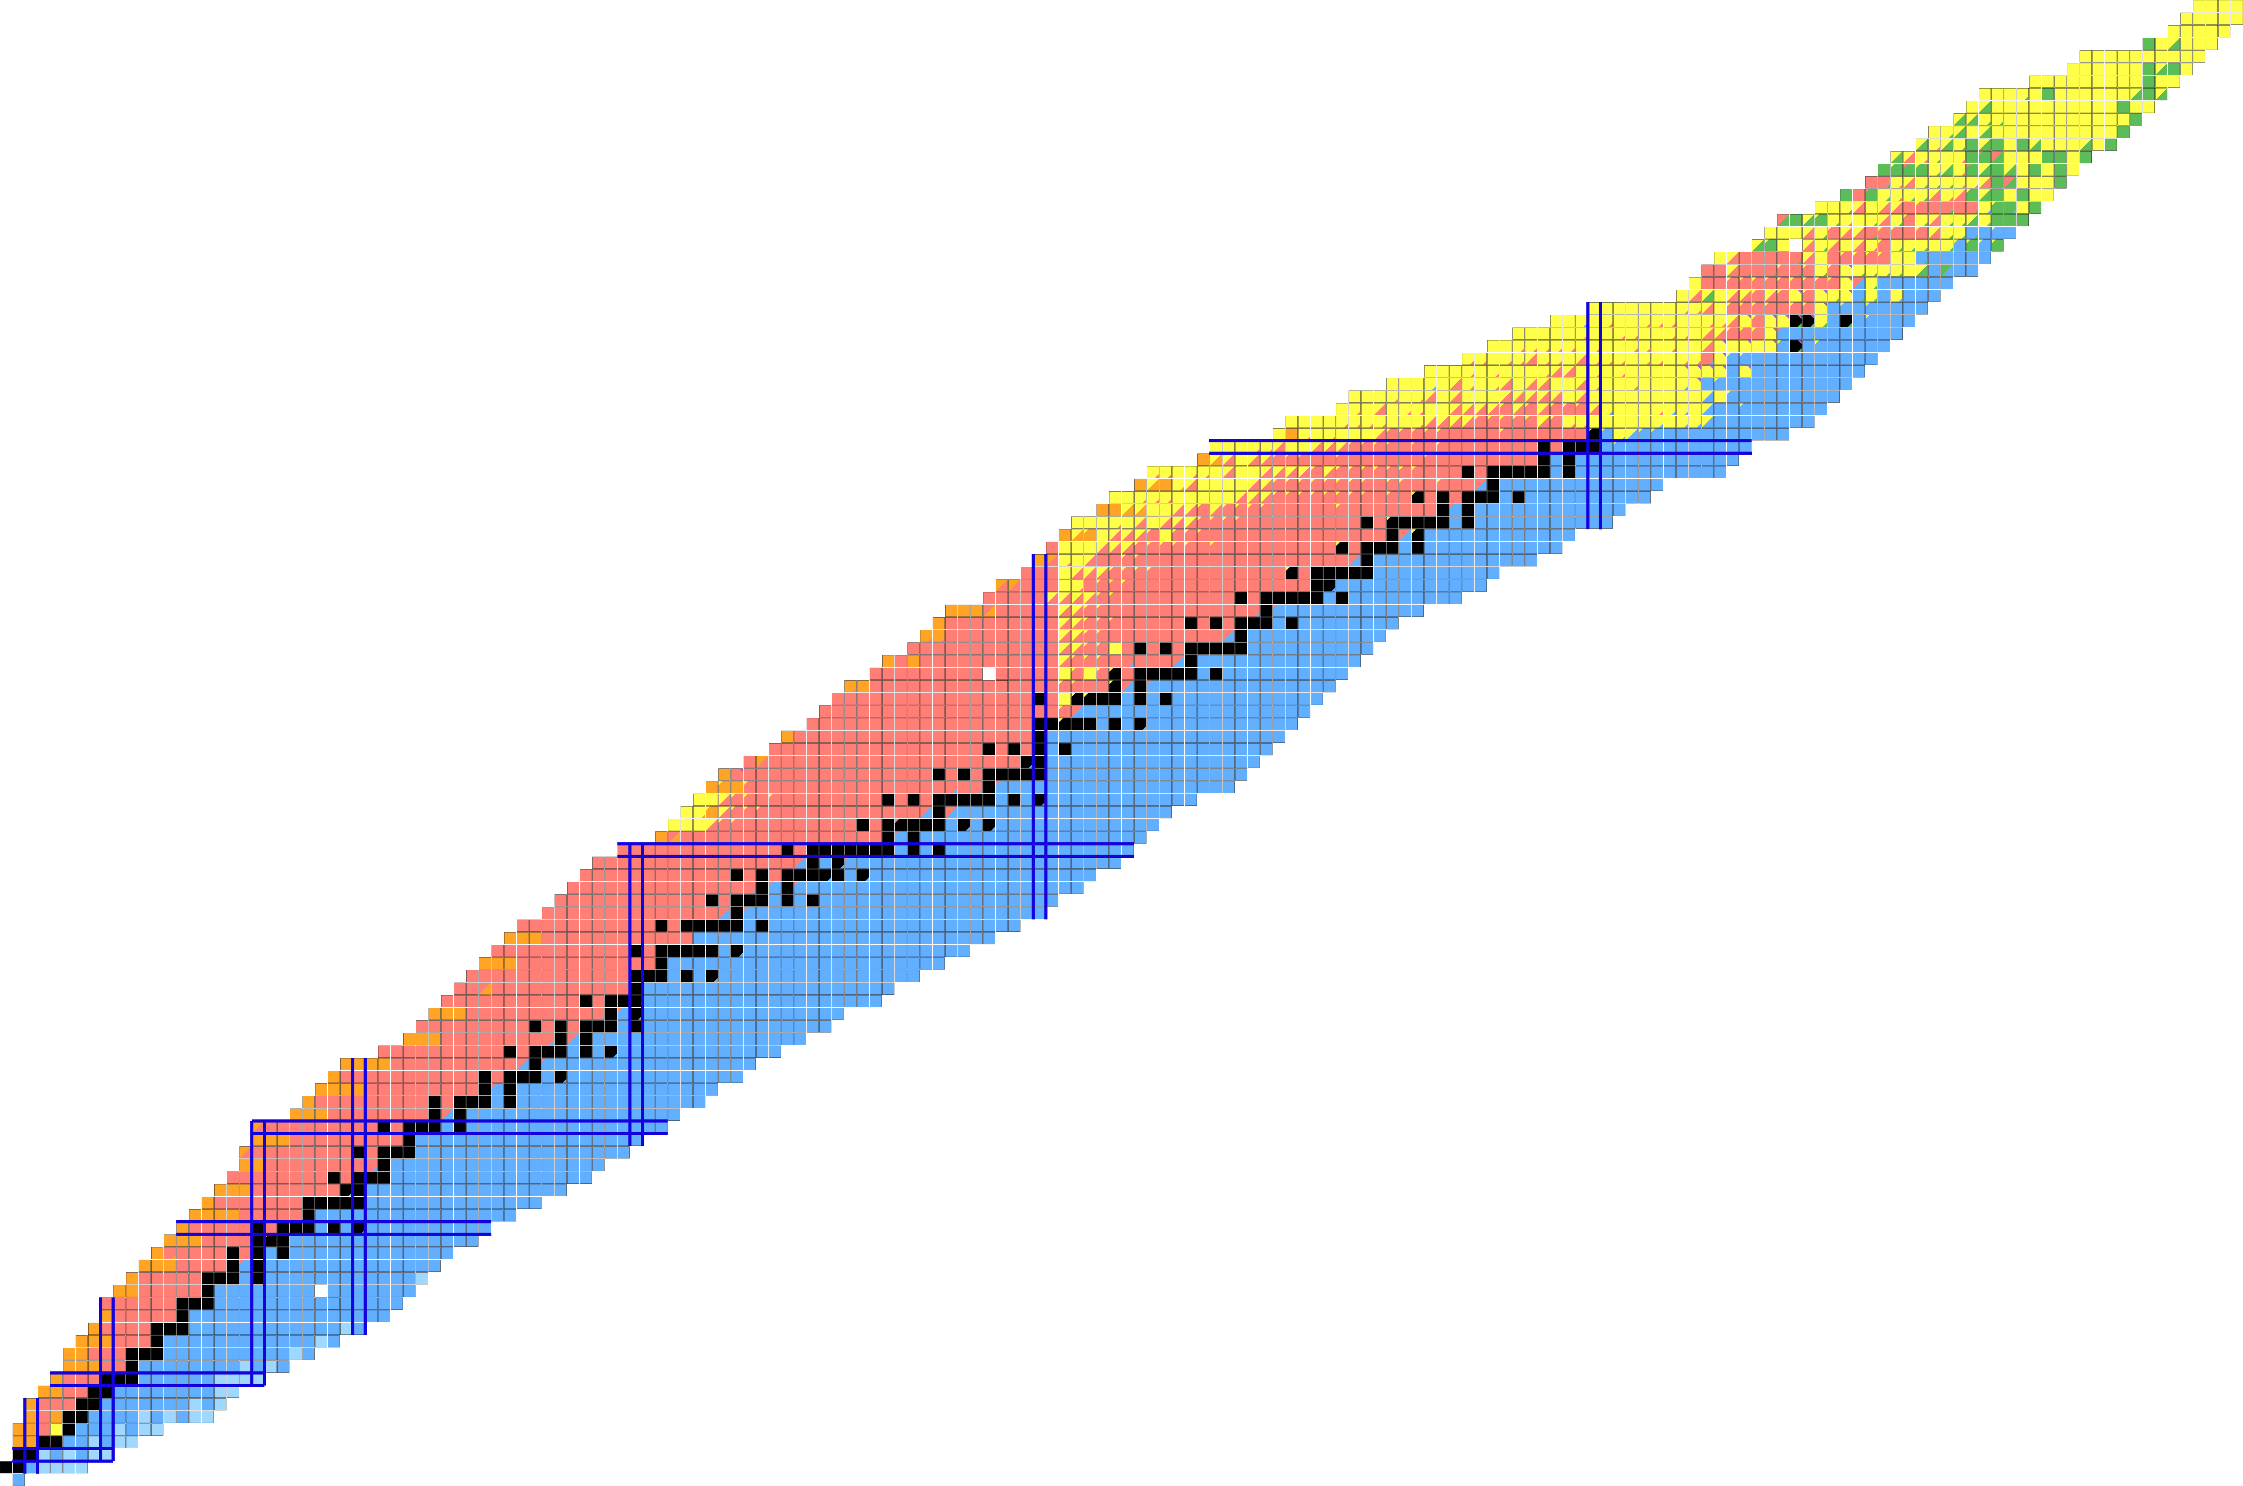
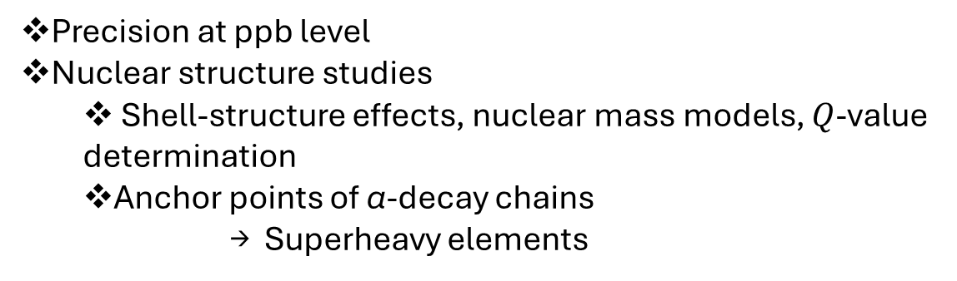
Studies at TRIGA-Trap
Precision at ppb level
Nuclear structure studies
  Shell-structure effects, nuclear mass models, $Q$-value determination
  Anchor points of α-decay chains
      → Superheavy elements
Fig ref: .S. Chenmarev, Eur. Phys. J. A (2024) 60:204
AME mass evaluations
Astrophysical Nucleosynthesis Calculations
Neutrino studies
Notes:
High Precision Mass Measurements (ppb level precision), probe heavy actinide/transuranium elements
Important for nuclear structure studies, benchmarking nuclear mass models, or for astrophysical nucleosynthesis calculations.
Possibility to study shell structure effects in the heavy mass region.
Mass measurements in the transuranium region provide anchor points of α-decay chains, which are used to identify superheavy elements (SHE).
Mass defect : Delta m = total mass of constituent nucleons – actual mass of nucleus = N*m_n + Z* m_p - M
Mass excess: ME = Mass of nucleus – Mass number = M - A
Q- value puzzle for neutrino studies

Slide 5
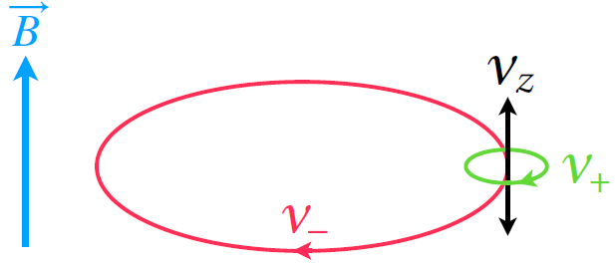

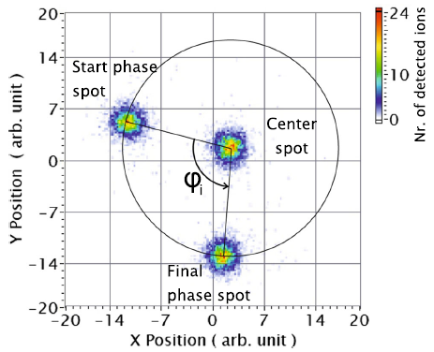
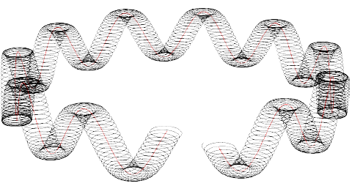

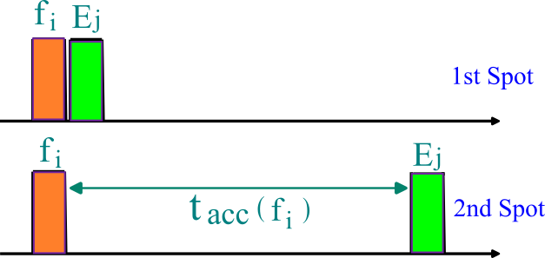



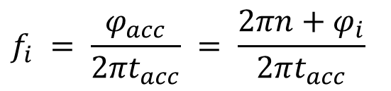


Trapped Ion Manipulation & PI-ICR
Phase-Imaging Ion-Cyclotron Resonance
$$f_{z}$$
$$f_{+}$$
Dipole
$$f_{−}$$
Excite Eigenmode
Quad’
$${ f_{c}}^{2} ={ f_{+}}^{2} +{{ f}_{−}}^{2}+{f_{z}}^{2}$$
Couple Eigenmodes
$$f_{c}=f_{+}+ f_{−}$$
$$f_{i} = \frac{φ_{acc}}{{2πt}_{acc}} = \frac{2πn+φ_{i}}{2πt_{acc}}$$
Notes:
180 out-of-phase rf
Image Simplified to show concept, ejection doesn’t necessarily have to be right after excitation
Repeating excitation and ejection scheme *** If necessary Quad Exc to convert eigenmode when ion spread too large on detector (for PI-ICR); For TOF it’s the opposite, since we want fastest TOF
Eject ions with no excitations → center spot ***
${0≤φ}_{i}≤2π$ ***

Slide 6
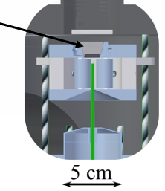
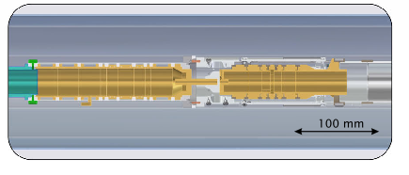
The TRIGA-Trap Setup
Purification Trap
Mass-selective
buffer gas cooling
Measurement Trap
Excitation scheme
to collect ion phases
Phase-Imaging of the trapped ions
Fig Ref: .S. Chenmarev, Eur. Phys. J. A (2023) 59:29
Notes:
Freq Doubled Nd(Neodymium)-Yag Laser (5ns pulsed, 0.05-0.5 mJ)
Ions stored and cooled in MiniRFQ in He Buffer gas for 5ms, then extracted by ion optics and transported
PT and MT in homogenous region of 7T supermag (cylindrical traps, fully open on capture and ejection sides)
Ions first in PT , He buffer gas filled for mass selective … connect to MT (50mm long, 1.5 mm diameter)
MT – initial amplitudes further reduced bef measurement through excitation scheme
Ions ejected through drift section along a mag gradient onto a pos sensitive delay line MCP detector (projecting magnified ion motion in the MT)

Slide 7
Systematic Errors
Nature | Δf_{C} | Δf_{C}/f_{C}
Radial electric field imperfection | < 0,5 mHz | < 1∙10⁻⁹
Radial magnetic field imperfection | < 0,5 mHz | < 1∙10⁻⁹
Axial magnetic field imperfection | < 0,1 mHz | < 2∙10⁻¹⁰
Count-rate dependance | < 0,1 mHz | < 2∙10⁻¹⁰
Image distortion | < 0,25 mHz | < 5∙10⁻¹⁰
Bore temperature | < 1 mHz | < 2∙10⁻⁹
Magnet pressure | < 0,3 mHz | < 6∙10⁻¹⁰
Total systematic: |  | ~2.5∙10⁻⁹
S. Chenmarev et al., Eur. Phys. J. A 59, 29 (2023)
Notes:
Magnetic and electric field misalignment results in constant frequency shift
Actually I am not aware of how the final values were achieved/calculated!!!

Slide 8

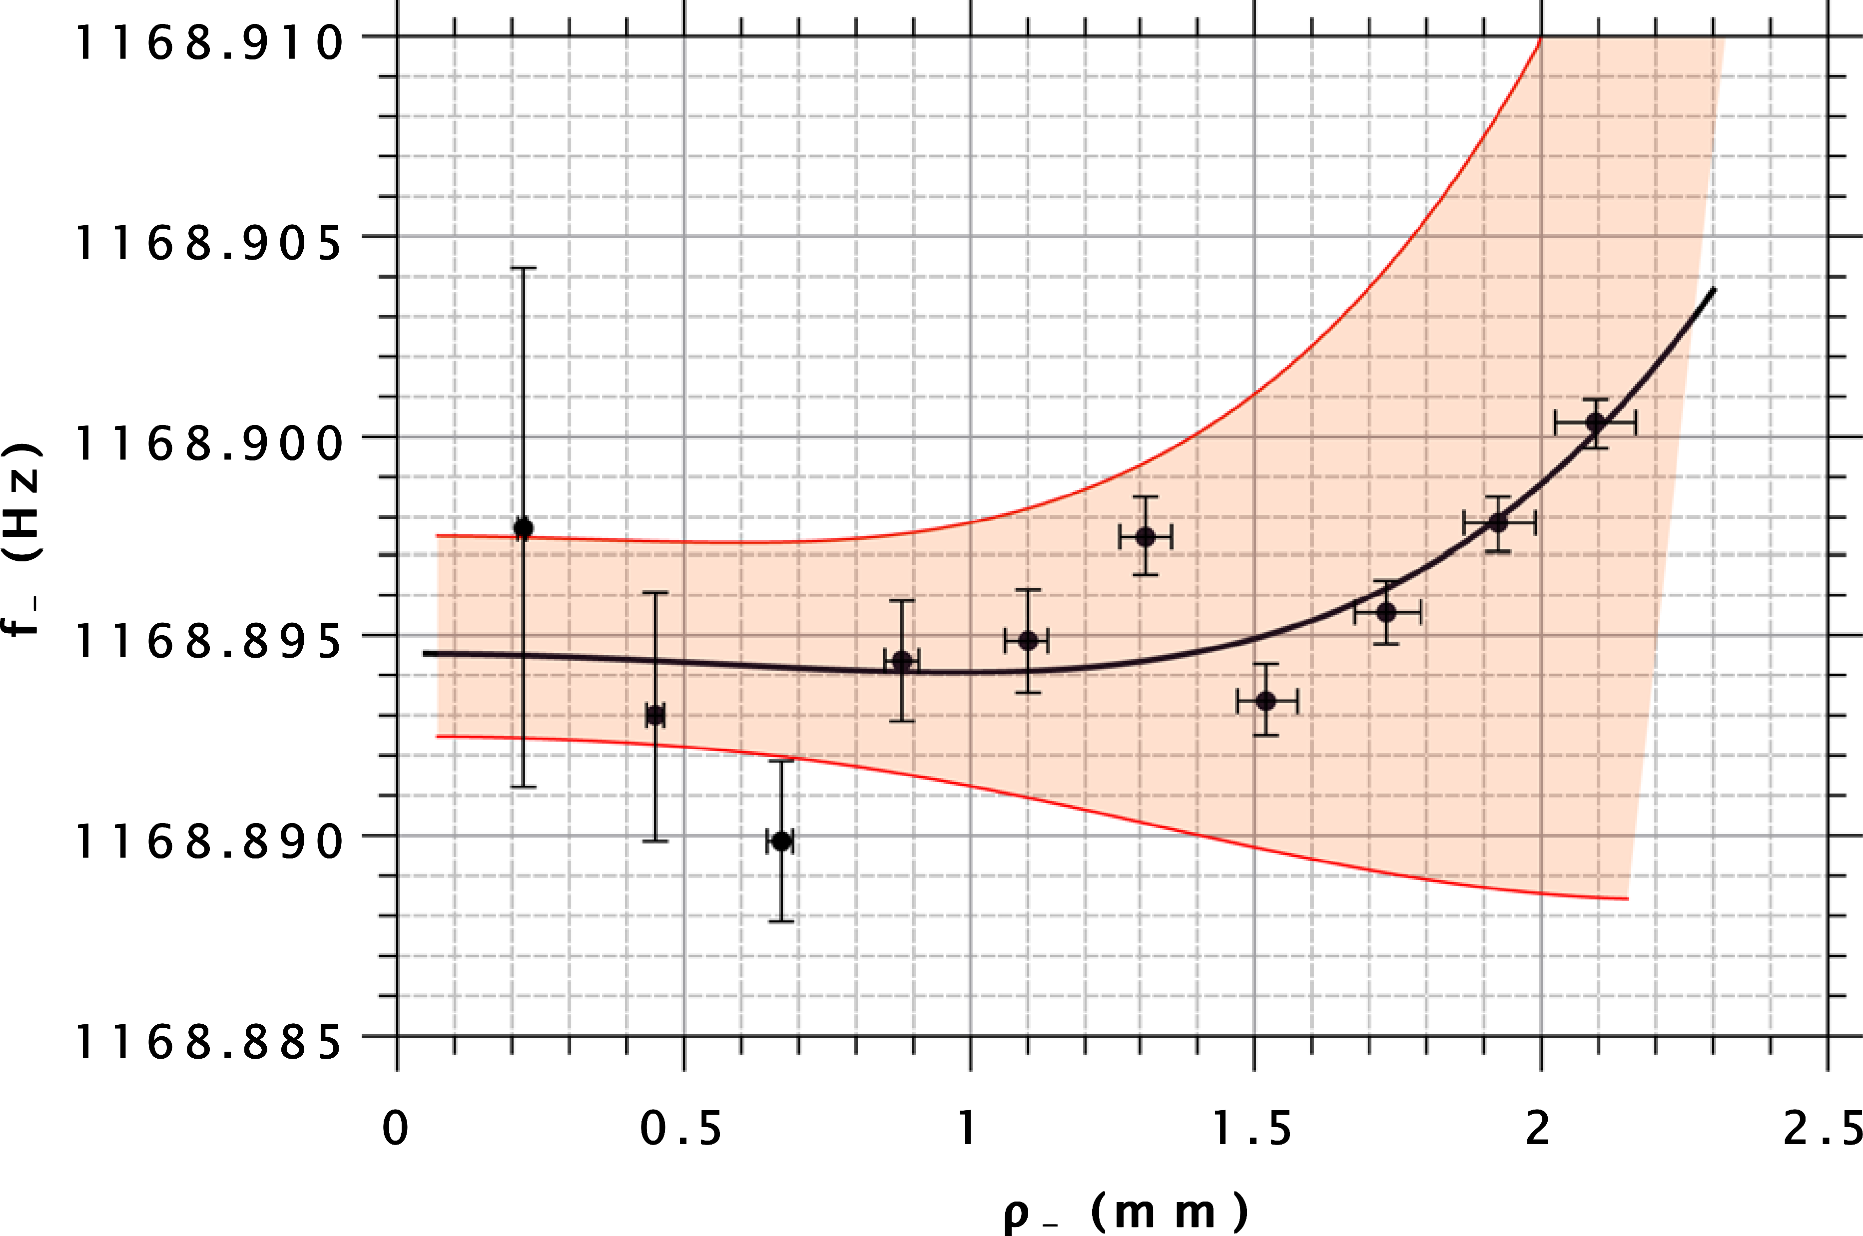
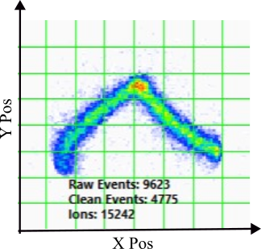
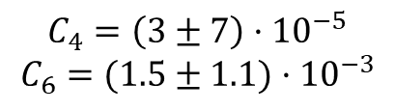
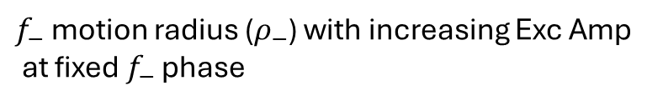
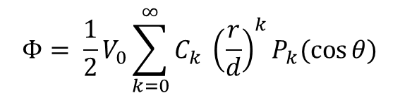
Harmonicity of Electric Potential
$$Φ= \frac{1}{2}V_{0}\sum_{k=0}^{∞}{C_{k} {\left(\frac{r}{d}\right)}^{k}P_{k}(\cos{θ})}$$
$f_{−}$ motion radius ($ρ_{−}$) with increasing Exc Amp
at fixed $f_{−}$ phase
‘Harmonic’
‘Anharmonic’
$$C_{4}=\left(3±7\right)·{10}^{−5}$$
$$C_{6}=(1.5±1.1)·{10}^{−3}$$
Fine tune Correction Electrode Voltages
Notes:
I guess the legendre equation is ok for the motivation
Magnetron Line: increase exc amplitude at const mag phase. (Straight line for no Harmonicity)
(Curve for Anharmonicities)
Tune Trap Correction Voltages
(Get E field approx. constants, these should be as small as possible)
Fig Mag line Proper
Fig Mag Line Curved
Why the zero amplitude had a high uncertainty?

Slide 9
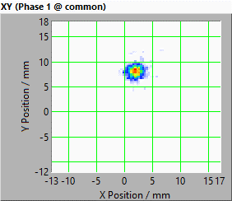
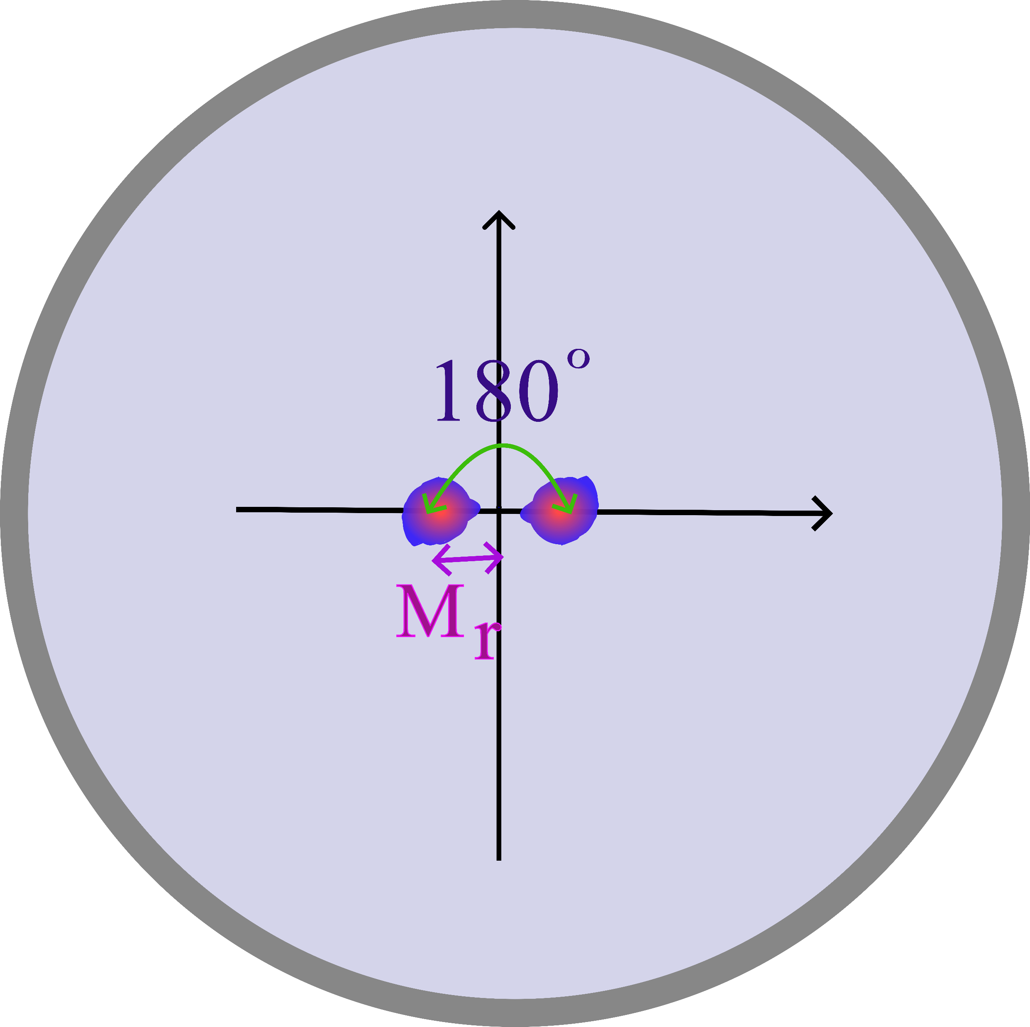
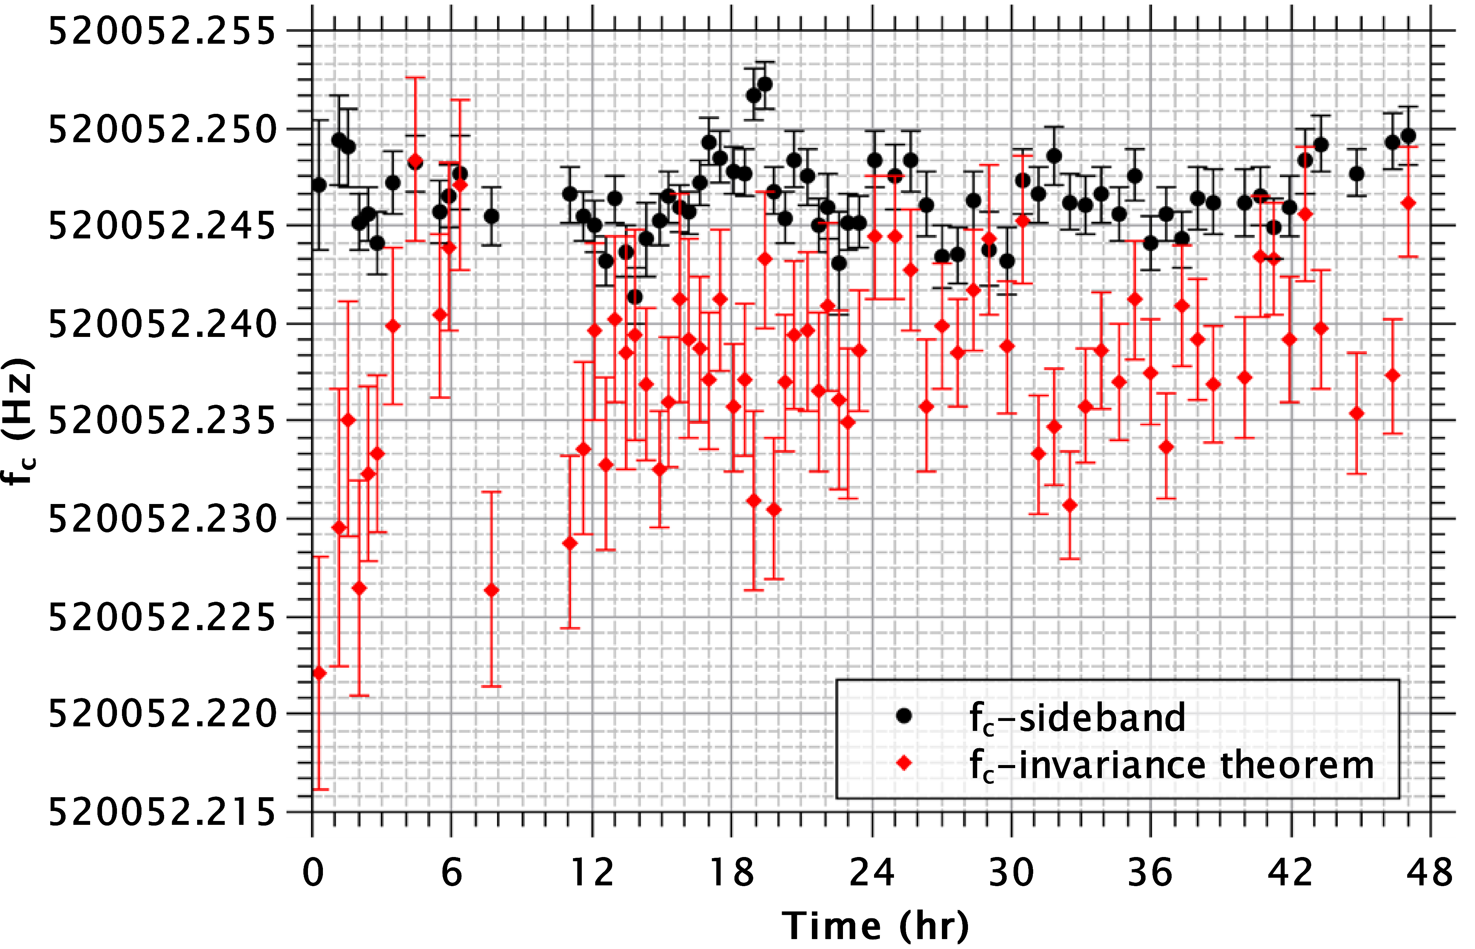

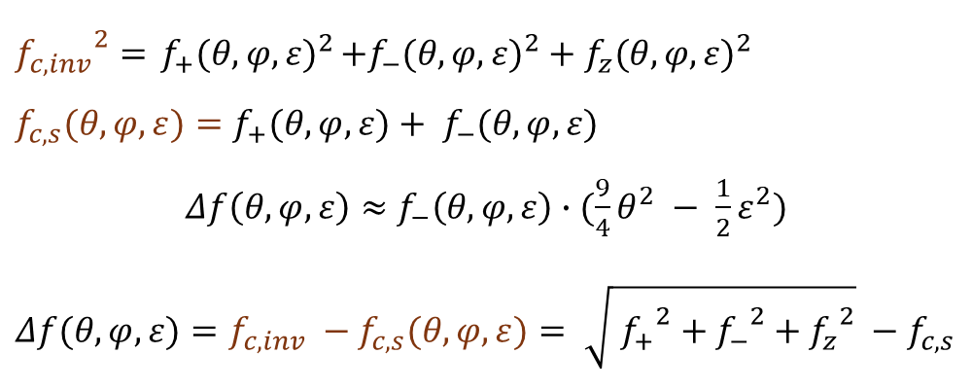
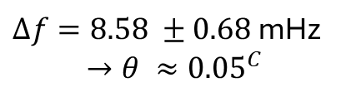
B-Field Alignment with E-Field
$${f_{c,inv}}^{2}={ f_{+}(θ, φ, ε)}^{2}+{f_{−}(θ, φ, ε)}^{2}+{f_{z}(θ, φ, ε)}^{2}$$
$$f_{c,s}(θ, φ, ε)=f_{+}(θ, φ, ε)+ f_{−}(θ, φ, ε)$$
$Δf\left(θ, φ, ε\right)≈$ $f_{−}\left(θ, φ, ε\right)∙(\frac{9}{4}θ^{2} − \frac{1}{2}ε^{2})$
$$Δf(θ, φ, ε)={f_{c,inv} −f}_{c,s}(θ, φ, ε)= \sqrt{{ f_{+}}^{2} +{{ f}_{−}}^{2}+{f_{z}}^{2}} −f_{c,s}$$
$ρ_{−}(0)$ ≤ 0.1 mm
Fine-Tune Trap-axis alignment in B-field
$Δf=8.58 ±0.68$mHz
$$→θ ≈{0.05}^{C}$$
Notes:
B-Field Alignment with E-Field/z-axis/axial direction
Fine Alignment with Initial Mag tuning. Imaging with PI-ICR. Spot more elliptical with higher Initial Mag. Adjust Support Table for Traps to align Trap Tower(the traps have the E-field) in B-field
Further Quality Check with a Delta F Measurement

Slide 10
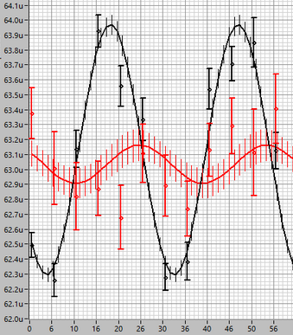
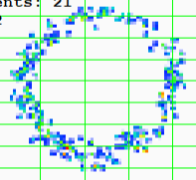
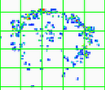
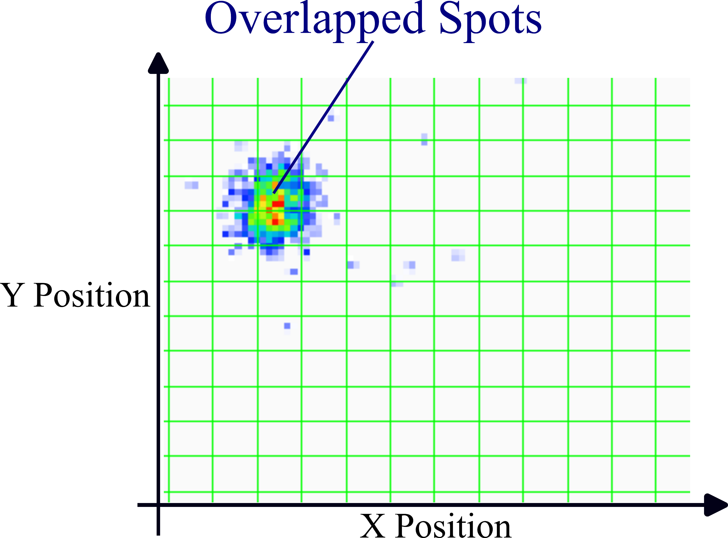



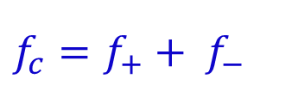


Measurement Procedure
Contaminants
$$_{ }^{238}U$$
IOI ($_{ }^{239}Pu$ )
Time of Flight [s]
Pb
Long f+ excitation
$$f_{c}=f_{+}+ f_{−}$$
$f_{+}$ spot
Eject Time [μs]
$f_{−}$ spot
Axial damping → Lowest Peak-Peak
$$Δφ$$
center
Alternate Ref-1, Ref-2, IOI measurements iteratively
→ series of frequency measurements
Measure Center every 5-7 iterations
Notes:
Prepare Target
Check for contaminants (Figure) dependent on Target preparation & Buffer gas cooling
Axial Damping?
Set-up Measurement
References ($_{ }^{208}Pb^{+}$ & $_{ }^{238}U{O_{2}^{+}}_{}$) & Ion of Interest (IOI)
Set up overlap of spots for all nuclides

Slide 11
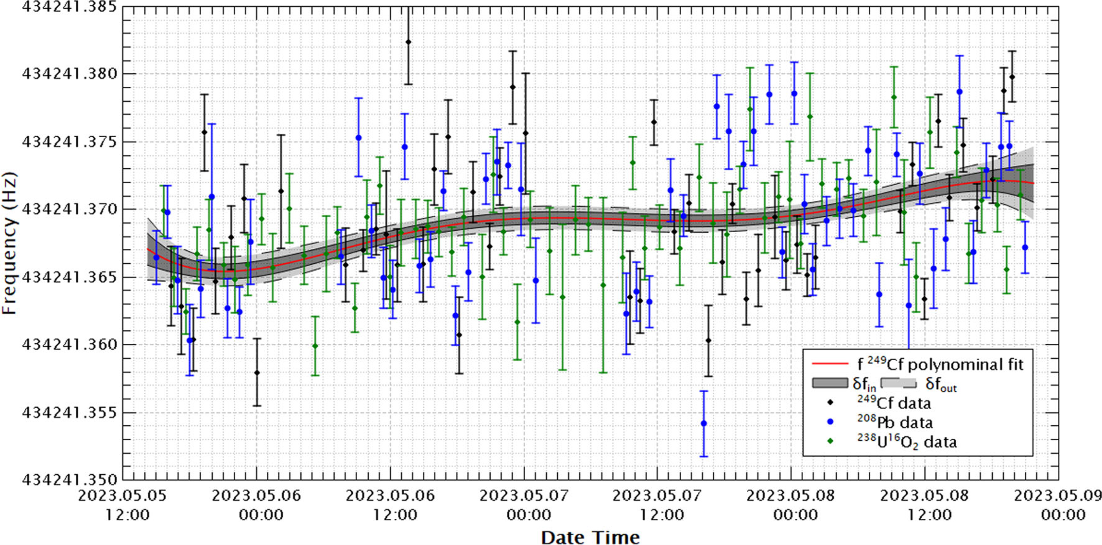

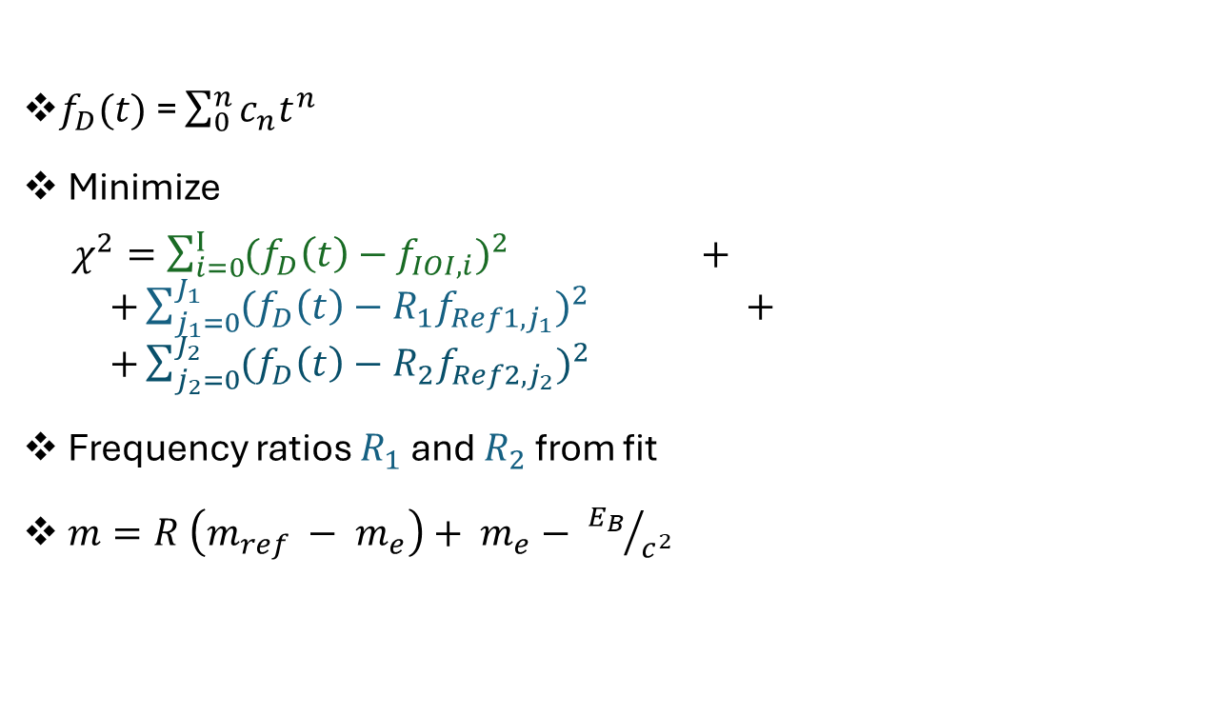

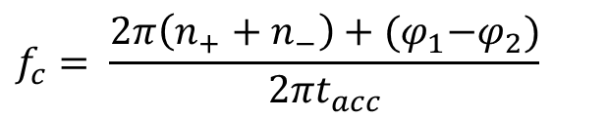

Data Analysis
$f_{+}$ spot
$f_{−}$ spot
$$Δφ$$
Compute Frequencies
$$f_{c}= \frac{2π\left(n_{+}+n_{−}\right)+{(φ}_{1}−φ_{2})}{{2πt}_{acc}}$$
center
$f_{D}(t)$ = $\sum_{0}^{n}{c_{n}t^{n}}$
Minimize
$χ^{2}=\sum_{i=0}^{I}{{{(f}_{D}\left(t\right)−f_{IOI, i})}^{2}} + +\sum_{j_{1}=0}^{J_{1}}{{{(f}_{D}\left(t\right)−{R_{1}f}_{Ref1, j_{1}})}^{2}} + +\sum_{j_{2}=0}^{J_{2}}{{{(f}_{D}\left(t\right)−{R_{2}f}_{Ref2, j_{2}})}^{2}}$
Frequency ratios $R_{1}$ and $R_{2}$ from fit
$m=R \left(m_{ref} − m_{e}\right)+ m_{e}− {E_{B}}/{c^{2}}$
Fig ref: .S. Chenmarev, Eur. Phys. J. A (2024) 60:204
Notes:
No of complete turns for each cyclotron eigenmotion plus the phase shift

Slide 12
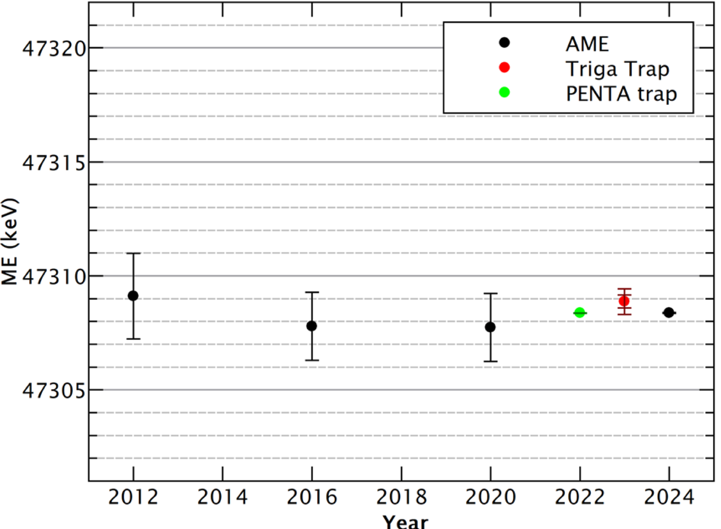
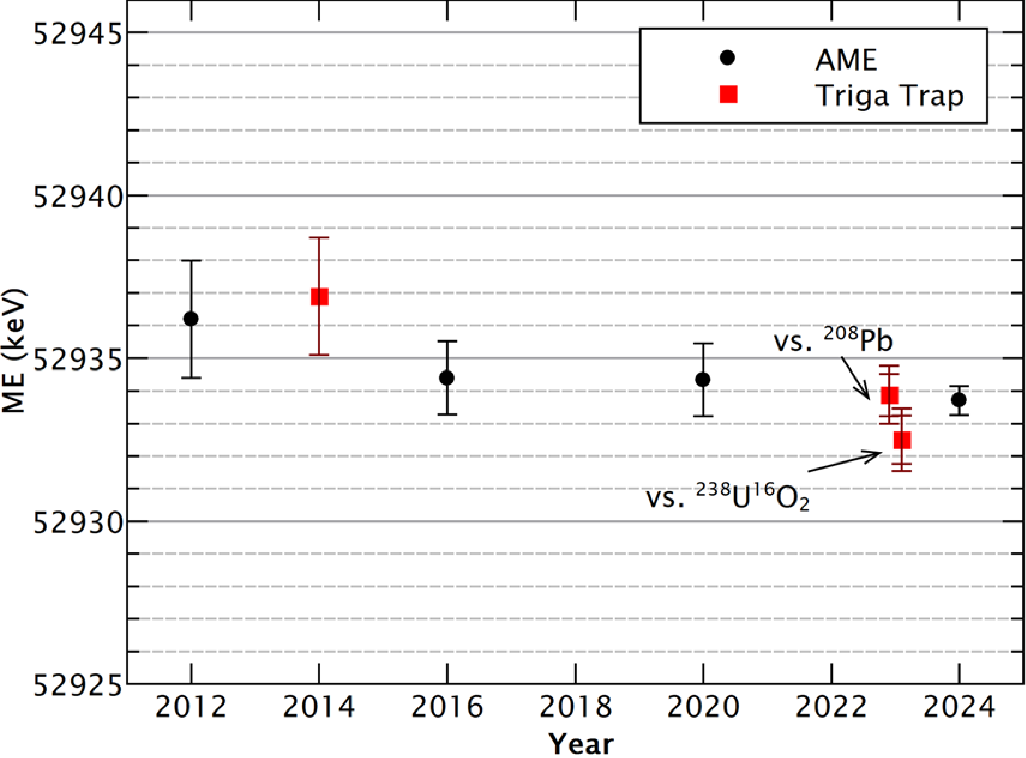
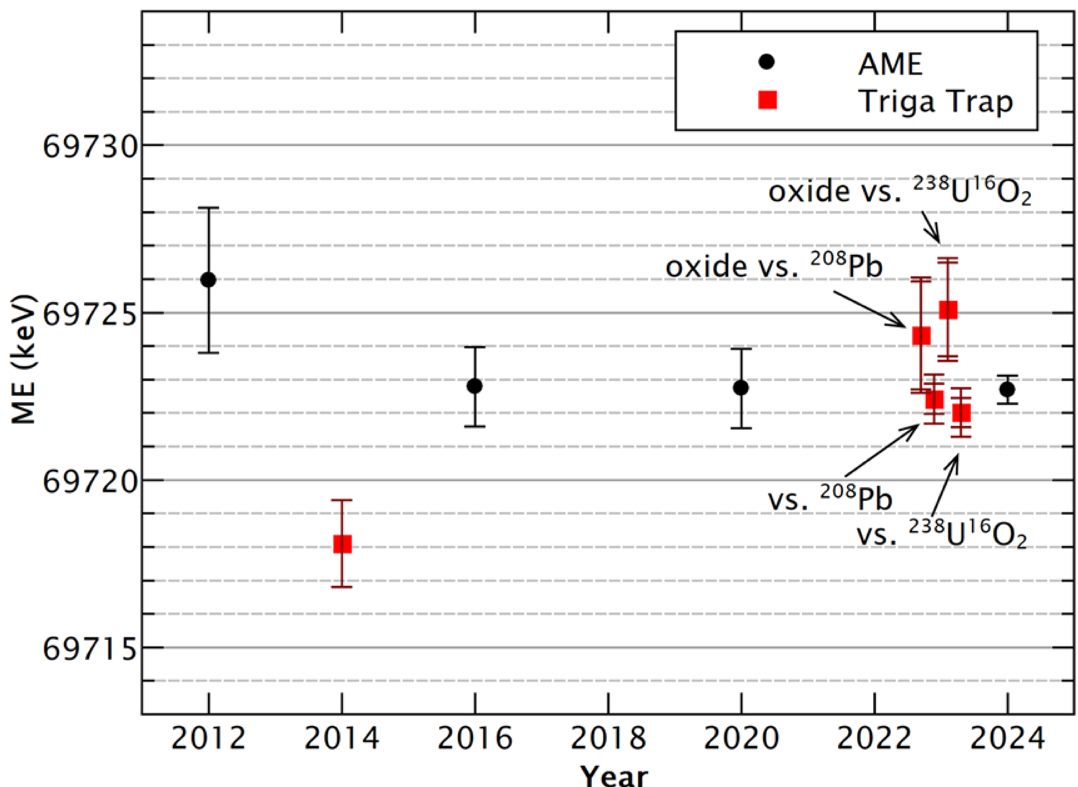
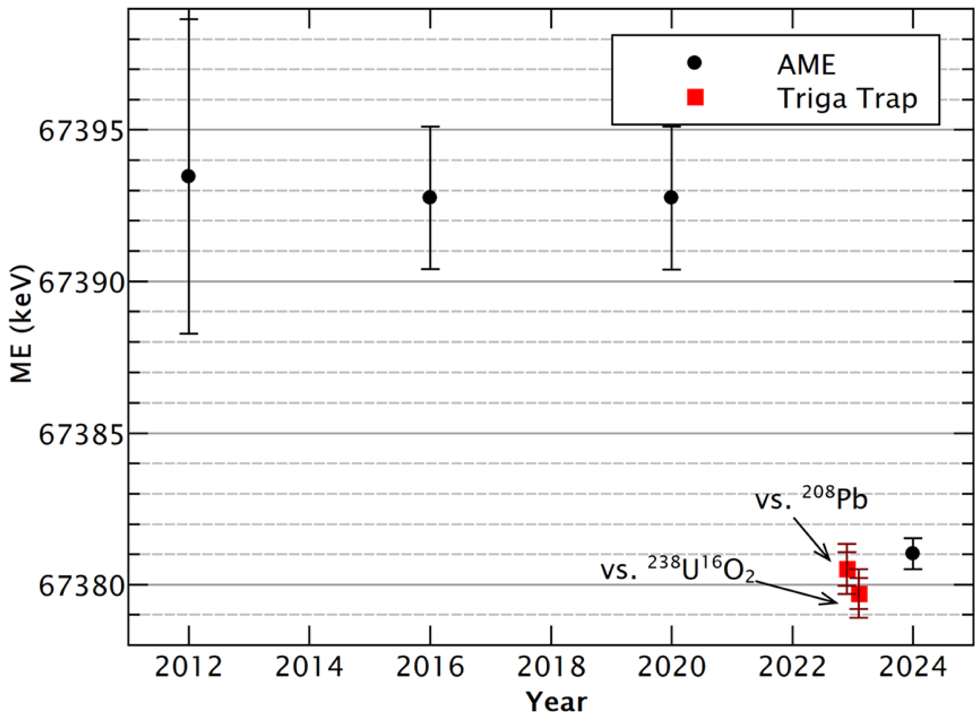
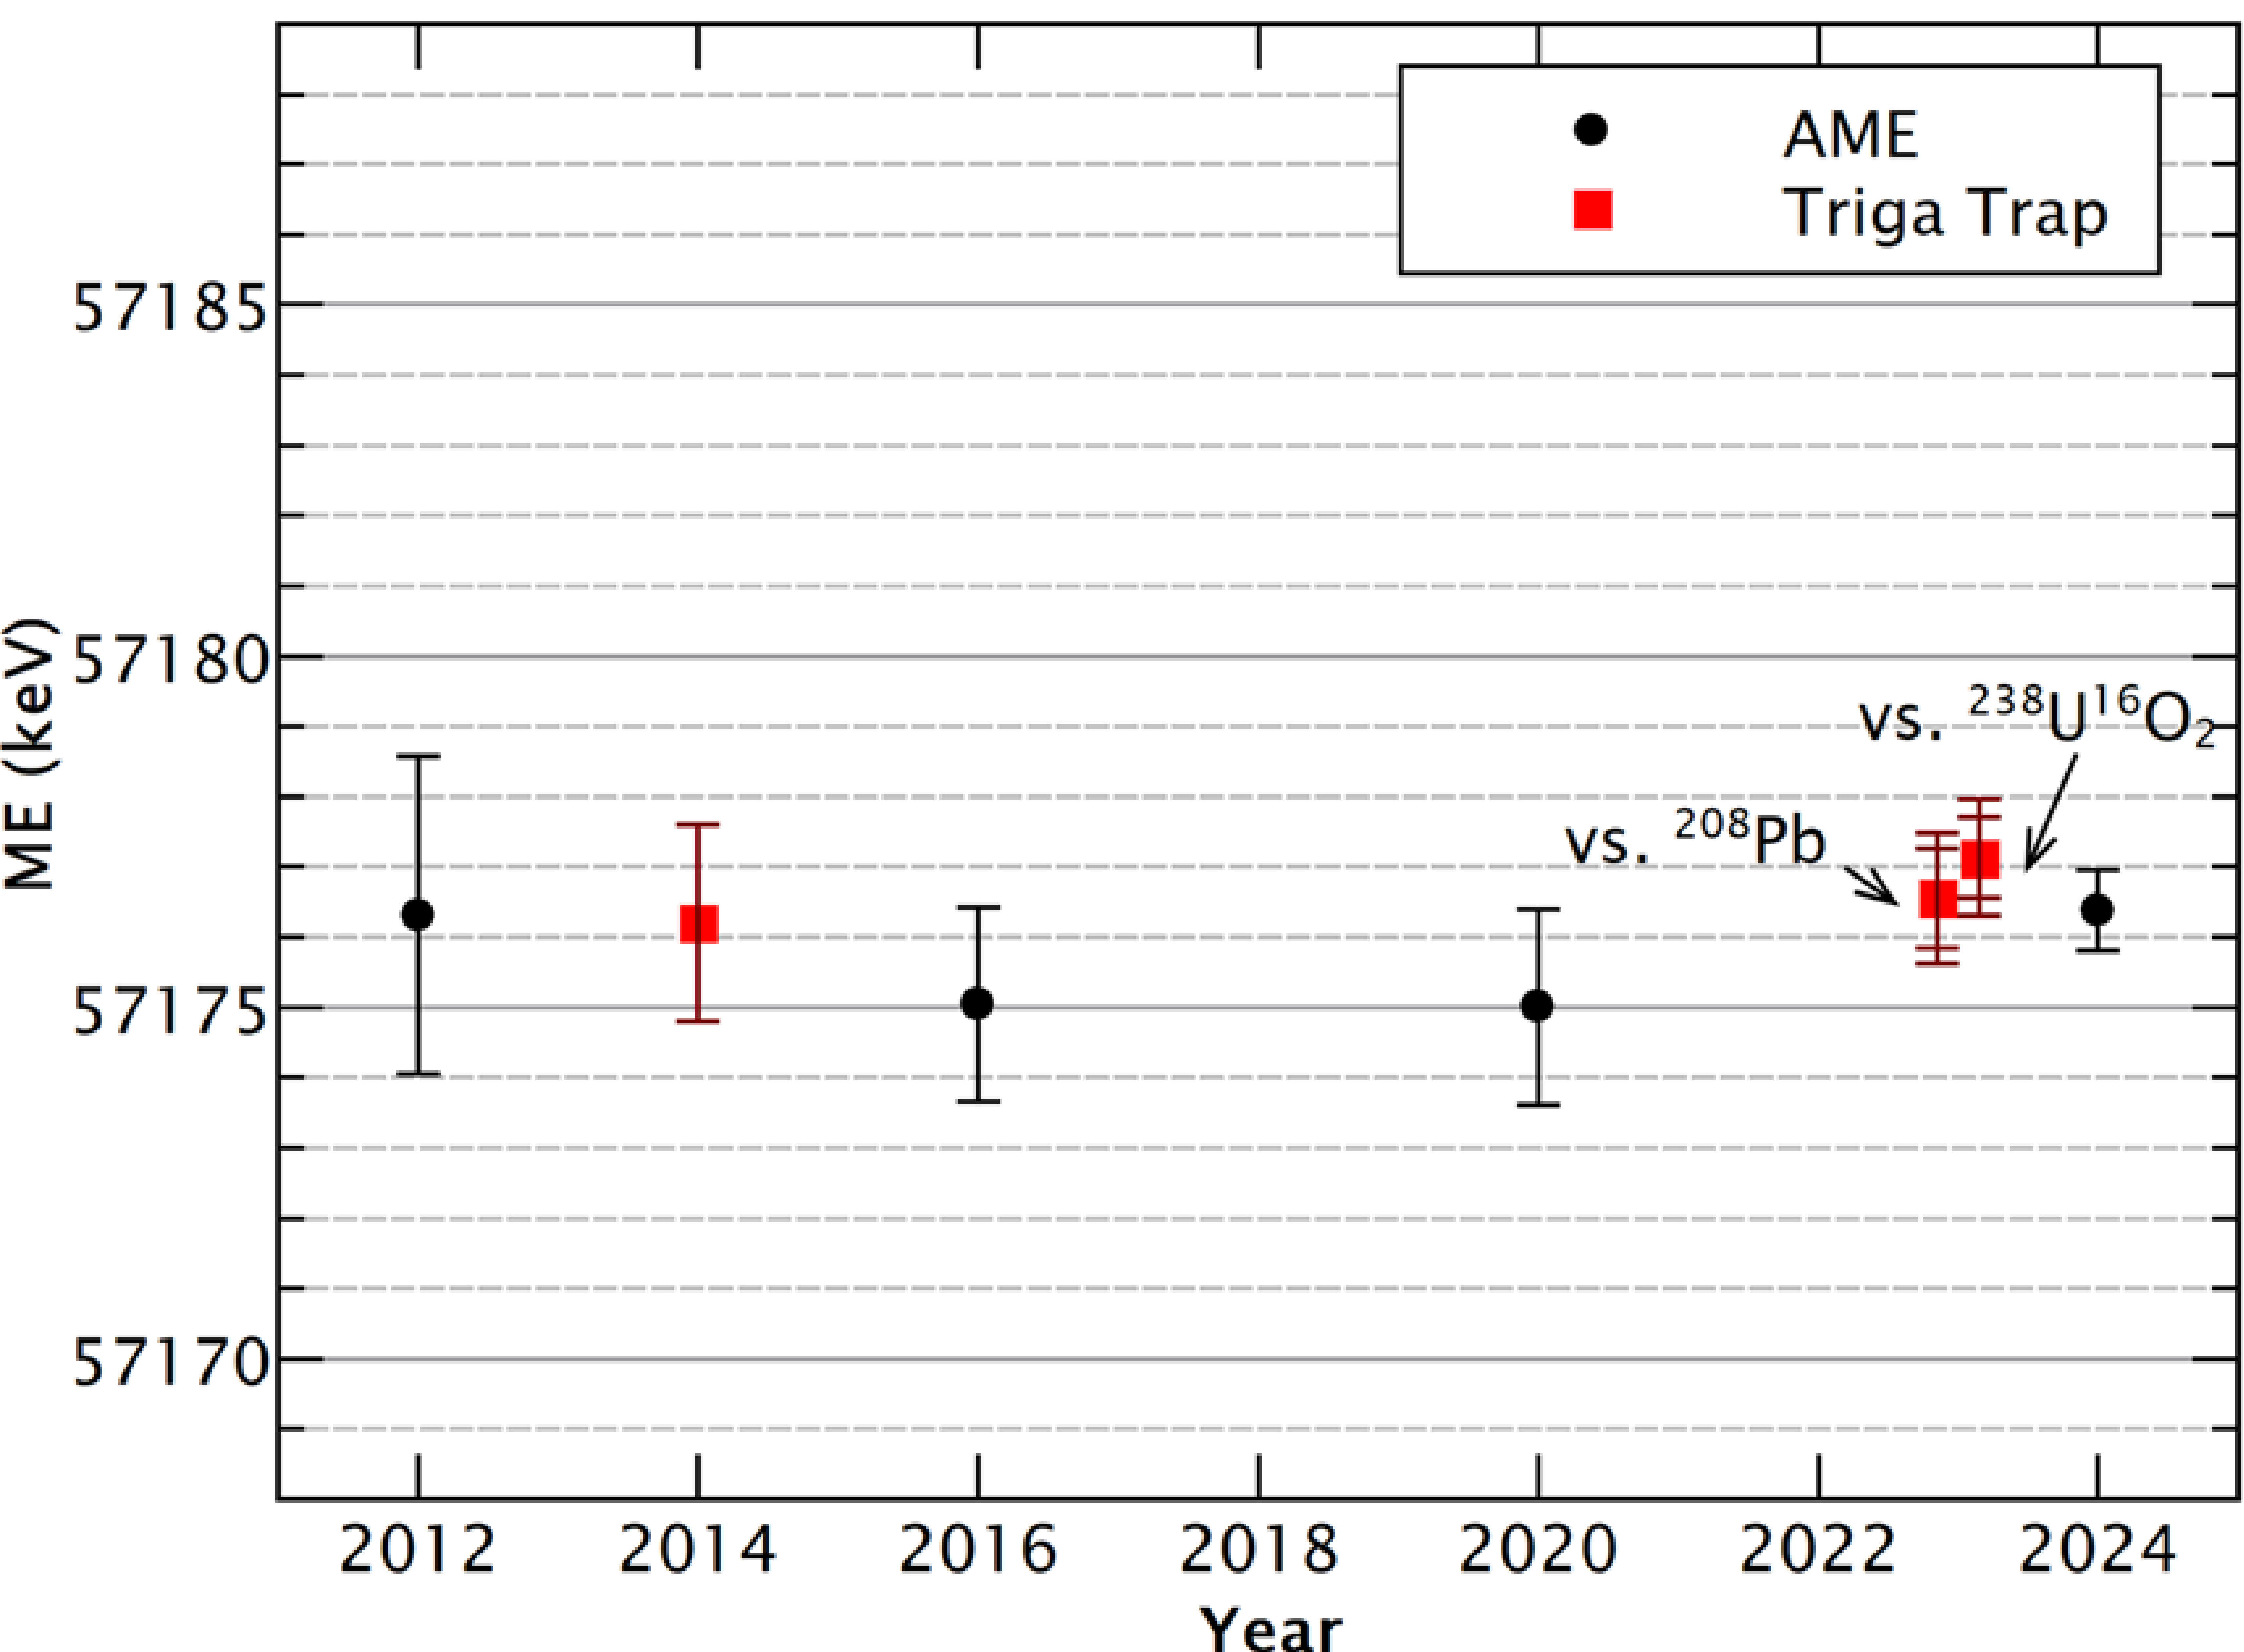






Recent Actinide Measurements
$$_{ 92}^{238}U$$
$$_{ 95}^{241}Am$$
$$_{ 94}^{244}Pu$$
Published
$$_{ 95}^{243}Am$$
$$_{ 96}^{248}Cm$$
$$_{ 98}^{249}Cf$$
Results published in .S. Chenmarev, Eur. Phys. J. A (2024) 60:204
Notes:
Cross Check
Increase in Precision
Increase in accuracy/offset observed
Other masses these affect (AME connections)
(Am243 -> Am241 -> S2n direct
Cm248 -> Pu244 -> a-decay Q-value
238U best agreement in mass)
All even-Z nuclei here! So proton-spin = 0 in extreme shell model -> can see neutron effects # btw Am is 95 ☺ so odd
Axial damping/centering perhaps wasn’t the best before => systematic shift

Slide 13
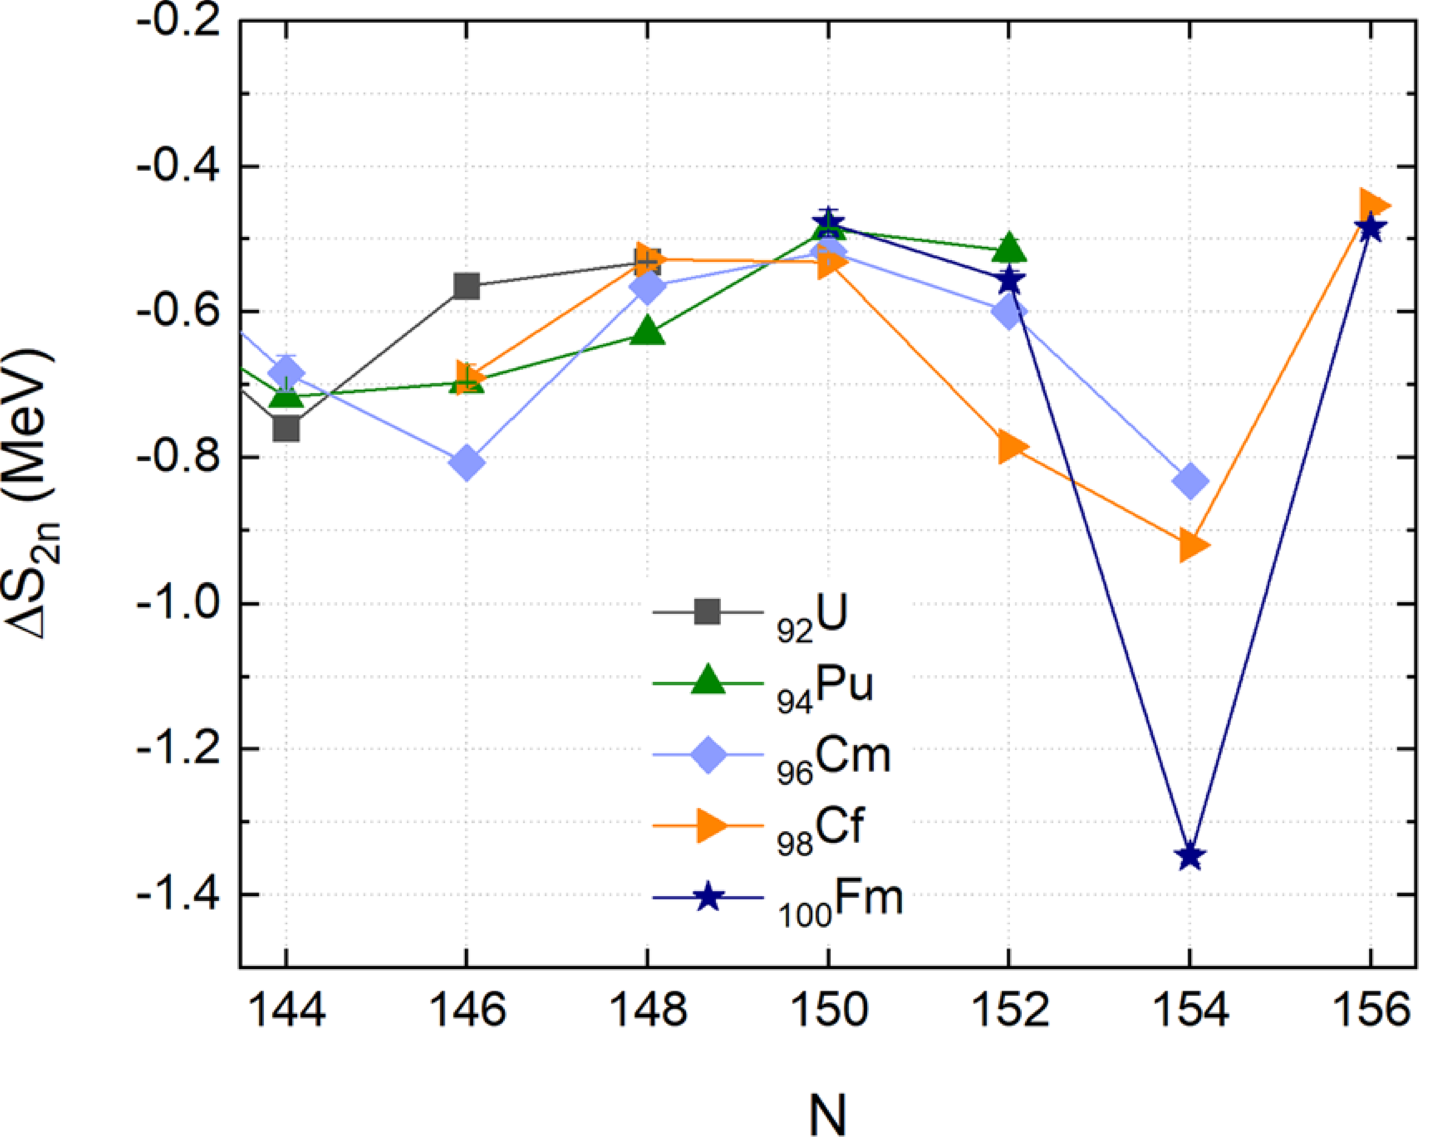
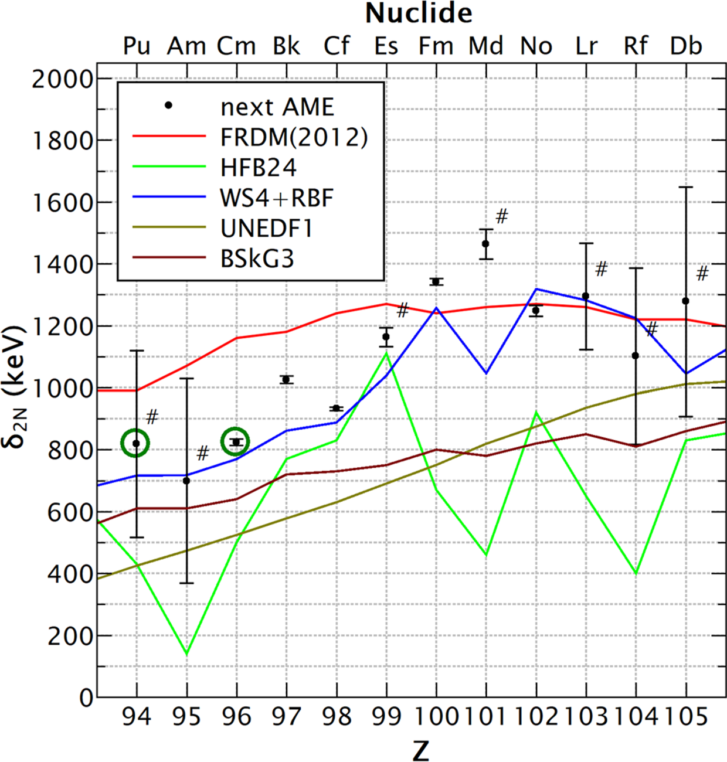
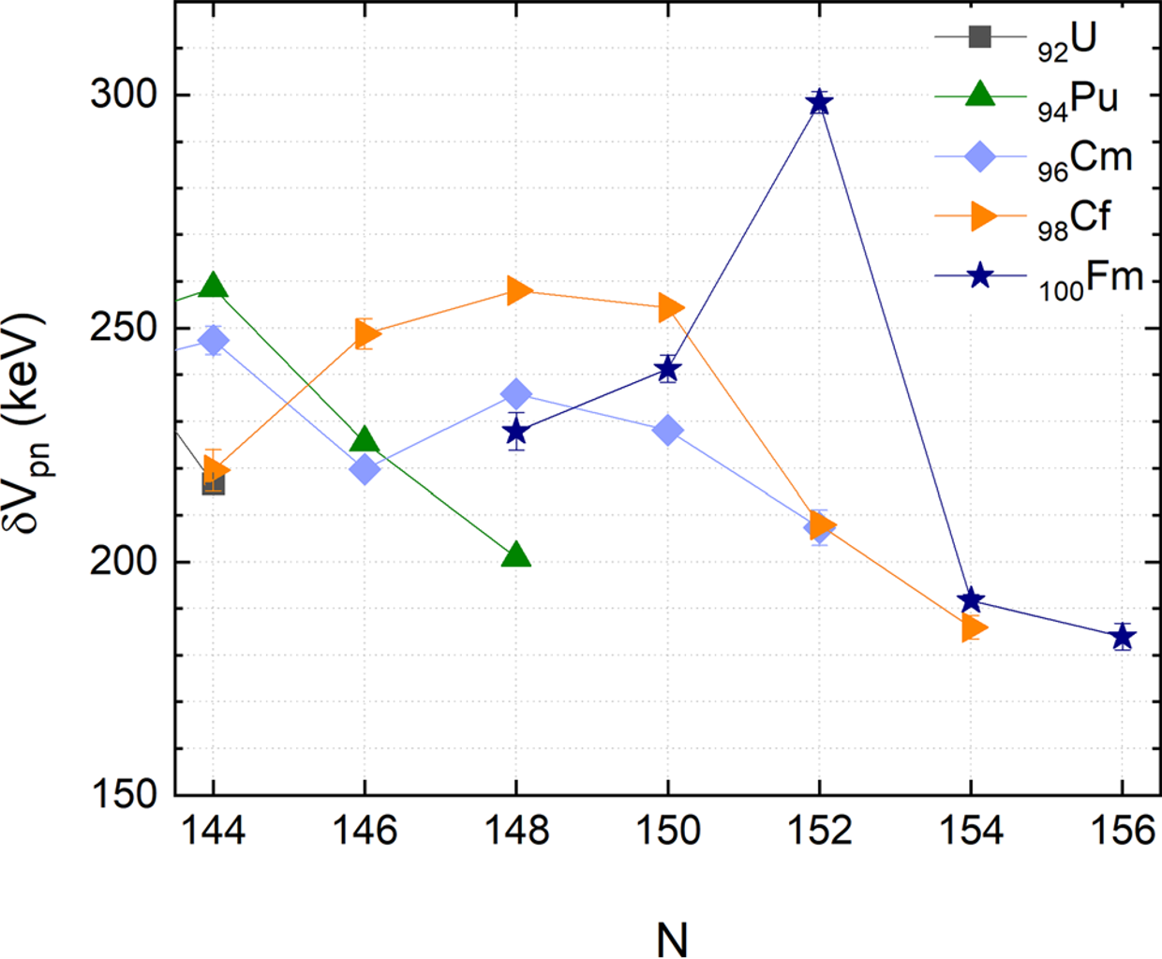



Nuclear Structure Evaluation
$$BE=Nm_{n}+Zm_{p}−m\left(N,Z\right)c^{2}$$
TRIGA-TRAP
$$δ_{2n}\left(N, Z\right)=S_{2n}\left(N,Z\right)−S_{2n}\left(N+2,Z\right)$$
$$=ME\left(N−2, Z\right)+ME\left(N+2,Z\right)−2ME\left(N,Z\right)$$
$$S_{2n}(N,Z)=BE\left(N,Z\right)−BE(N−2,Z)$$
$$ΔS_{2n}\left(N,Z\right)=S_{2n}\left(N,Z\right)−S_{2n}\left(N−2,Z\right)$$
$$δV_{p,n}\left(N,Z\right)=\frac{1}{4}\left(\left(BE\left(N,Z\right)−BE\left(N−2,Z\right)\right)−\left(BE\left(N,Z−2\right)−BE\left(N−2, Z−2\right)\right)\right)$$
Results published in .S. Chenmarev, Eur. Phys. J. A (2024) 60:204
Notes:
94+152 = 246 (Pu244 –> N-2 = 150); 96+152 =248 (Cm248 -> N)
Mass Filters
Shell-gap parameter & Mass Filters around N=152, think this is explained well in a cern phd paper

Slide 14




Campaign on Pu Isotopic Chain
Masses of Pu isotopic chain
  $_{ 94}^{238}Pu$, $_{ 94}^{239}Pu$, $_{ 94}^{240}Pu$, $_{ 94}^{242}Pu$, $_{ 94}^{244}Pu$
  Enhance current dataset
  Evolution of shell structure
    towards $N = 152$along $Z=94$
Preliminary
Preliminary
Preliminary
Notes:
Redo / Prepare to have mass measurement of Pu 242 ready
Berkeleium to come on September: if approved (made in France, we send sample for neutron irradiation,)

Slide 15

Outlook & Concluding Remark
Complete Mass measurement of Pu isotopic chain
  $_{ 94}^{238}Pu$, $_{ 94}^{239}Pu$, $_{ 94}^{240}Pu$, $_{ 94}^{242}Pu$, $_{ 94}^{244}Pu$
Mass measurement of ${}_{97}^{249}$Bk$_{152}$
Evaluate Relevant Mass Filters => Nuclear Structure Insights
Test mass models
for heavy, deformed nuclei
The high-precision double penning-trap TRIGA-Trap is used for mass measurements in the heavy actinide region allowing exciting nuclear structure studies, evaluation of theoretical models and predictions for inaccessible nuclides.
Notes:
Why Bk-249 is interesting?

Slide 16




The End
Thank You for Listening
Acknowledgements
Contributors: Klaus Blaum, Michael Block, Burcu Cakirli, Stanislav Chenmarev, Christoph Düllmann, Szilard Nagy, Dennis Renisch
Thanks to TRIGA-Trap Group, MPIK Stored & Cooled Ions Division,
and HIM SHE Chemistry Group
TRIGA-TRAP

Slide 18
Mass Measurements of Actinides at the High-Precision Penning-Trap Mass Spectrometer TRIGA-Trap
Triga-setup, Piicr, Pu + Old result, S2n

