Slide 1

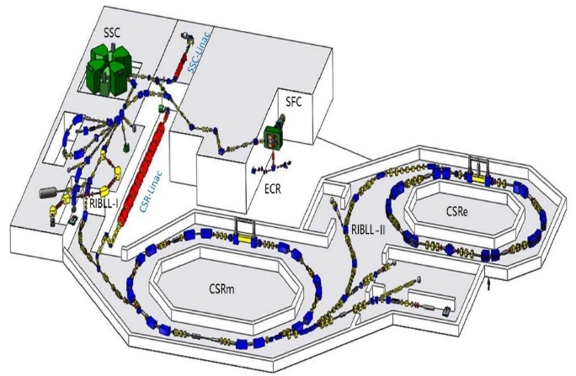
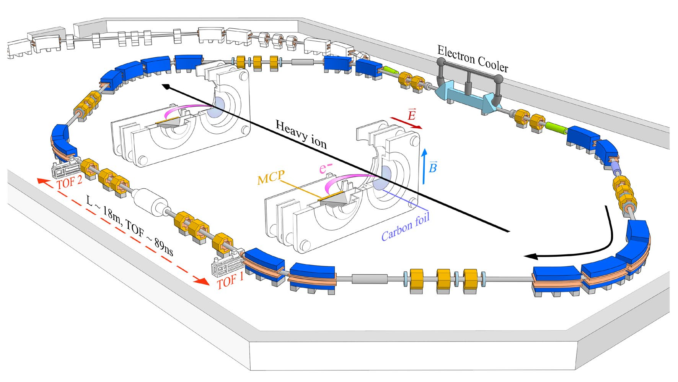


Nuclear Masses in Astrophysics for the Next 25 Years
Impact of experimental ⁷⁰Kr mass on the potential waiting point ⁶⁸Se in rp-process
Xu Xing （徐星）
Institute of Modern Physics, Lanzhou CHINA
2025.08.21 Darmstadt

Slide 2
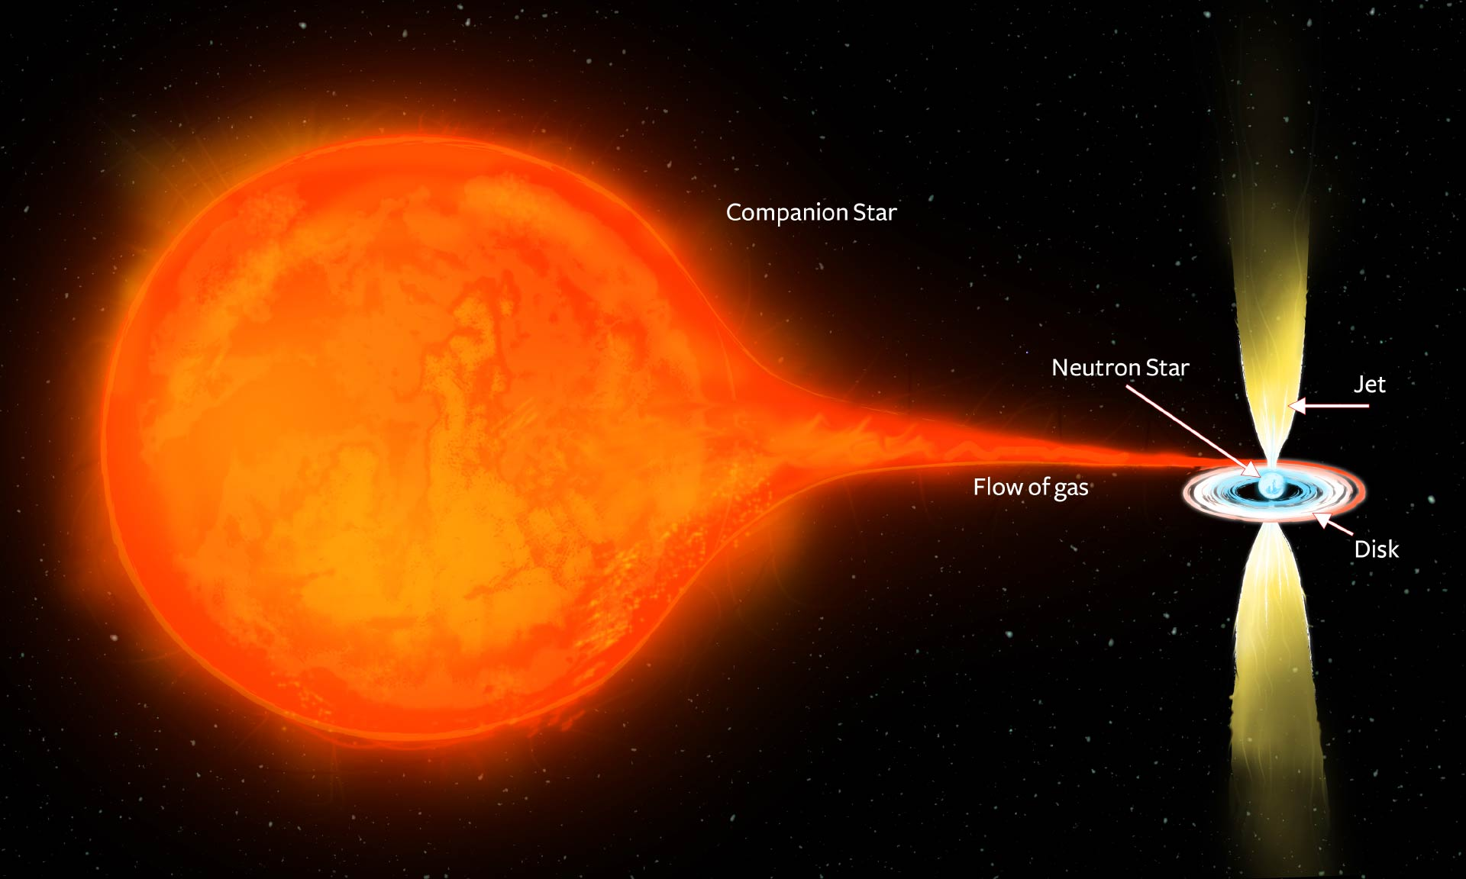
X-ray burst
CHANDRA
X-ray observatory
Credit: NASA
XMM-Newton
• First observed by Grindlay et al. (1976).
• Accreting Low-Mass X-ray Binary (LMXB) system.
• Initiated due to unstable thermonuclear burning in the surface layers.
• Burst timescale of ~10-200 s.
• Recurrence times are of hours or todays.

Slide 3
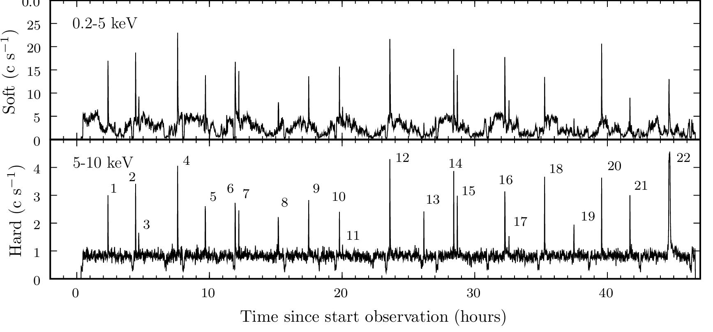
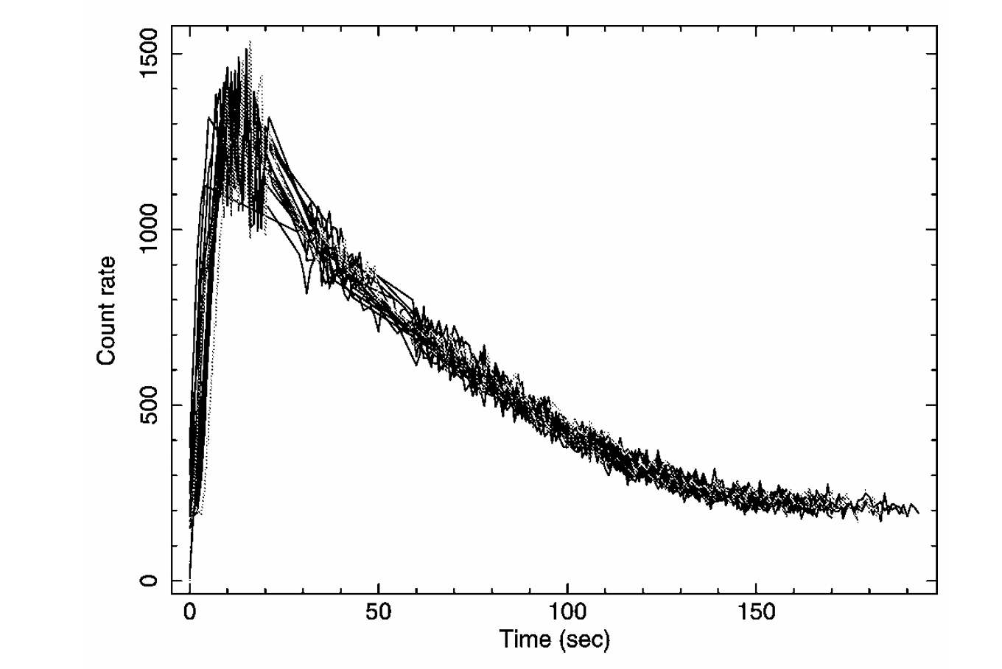
X-ray burst
Dynamic system that depends on accretion rate,
magnetic field strength
spin frequency, etc. . .
Repeatable measurement!!!
Driven by nuclear processes
L.Keek et al., ApJ. 718: 219, 2010
rp-process
XMM-Newton observation
16 type I x-ray bursts!
• X-ray burst temperatures reach temperature of T~1.5-2 billion degrees Kelvin.
• Energy release of ~10³⁶ - 10³⁸ erg/s
Kong et al.,ApJ. 670: L17, 2007

Slide 4
rp-process reaction path
•Breakout of CNO cycle for T>3x10⁸ K.
•Sequence of rapid proton-capture
reactions and β+ decays.
•Waiting point: Nucleus where proton
capture is inhibited and β decay is slow.
courtesy from H.Schatz

Slide 5
impact of 2p-capture on waiting point
Z+2,N
Z+1,N
Z,N
Z-1,N
⁵⁶Ni：⁵⁸Zn Thermonuclear reaction rate of ⁵⁷Cu(p,γ)⁵⁸Zn in rp-process
Phys. Rev. C 109, 045802 (2024)
⁶⁴Ge：⁶⁶Se Mass measurements show slowdown of rapid proton capture process at
waiting-point nucleus ⁶⁴Ge
Nat. Phys. 19, 1091–1097 (2023)
⁶⁸Se：⁷⁰Kr

Slide 6
⁶⁸Se waiting point?: mass of ⁶⁸Se
CPT : -54232(19)keV
J.A. Clark et al., PRL 92, 192501 (2004)
LEBIT: -54189.3(5) keV
J. Savory et al., PRL 102, 132501 (2009)
ME(⁶⁸Se)

Slide 7
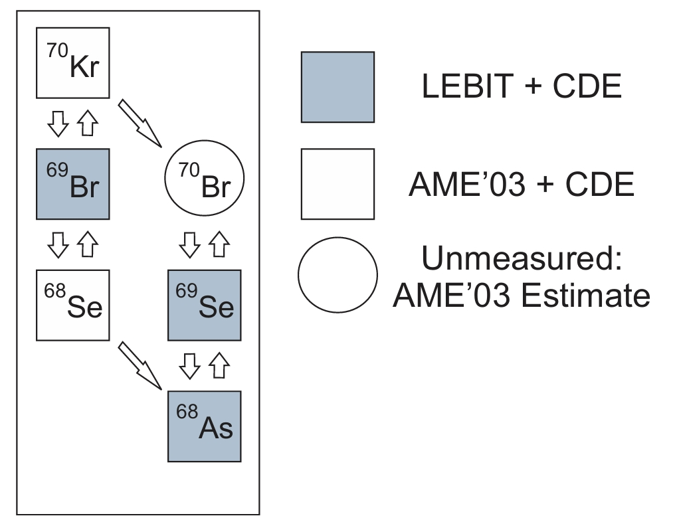
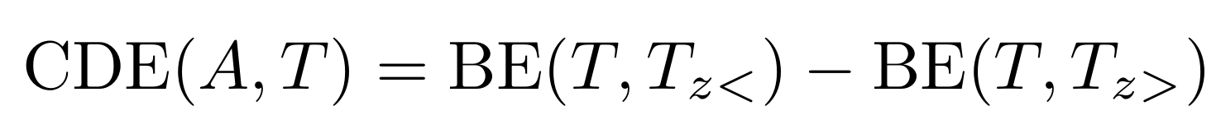
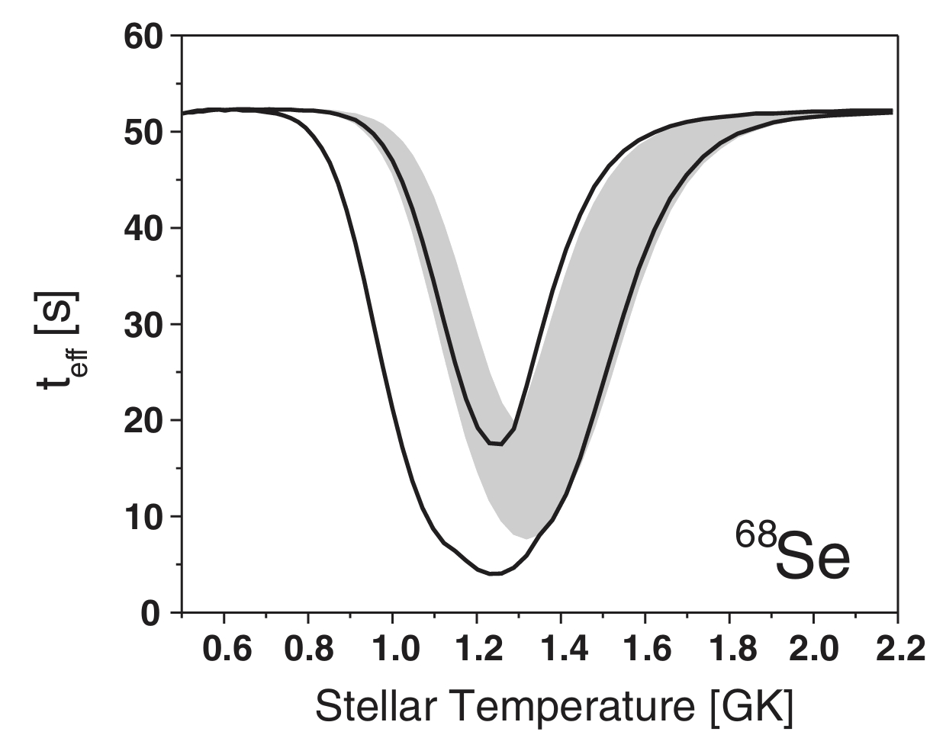
⁶⁸Se waiting point?: mass of ⁷⁰Kr,⁶⁹Br
⁶⁸Se a weak waiting-piont
P. Schury et al., PRC 75, 055801 (2007)
J. Savory et al., PRL 102, 132501 (2009)
Mass of Mirror Nulcei ⁶⁹Se，⁷⁰Se + CDE calculations

Slide 8
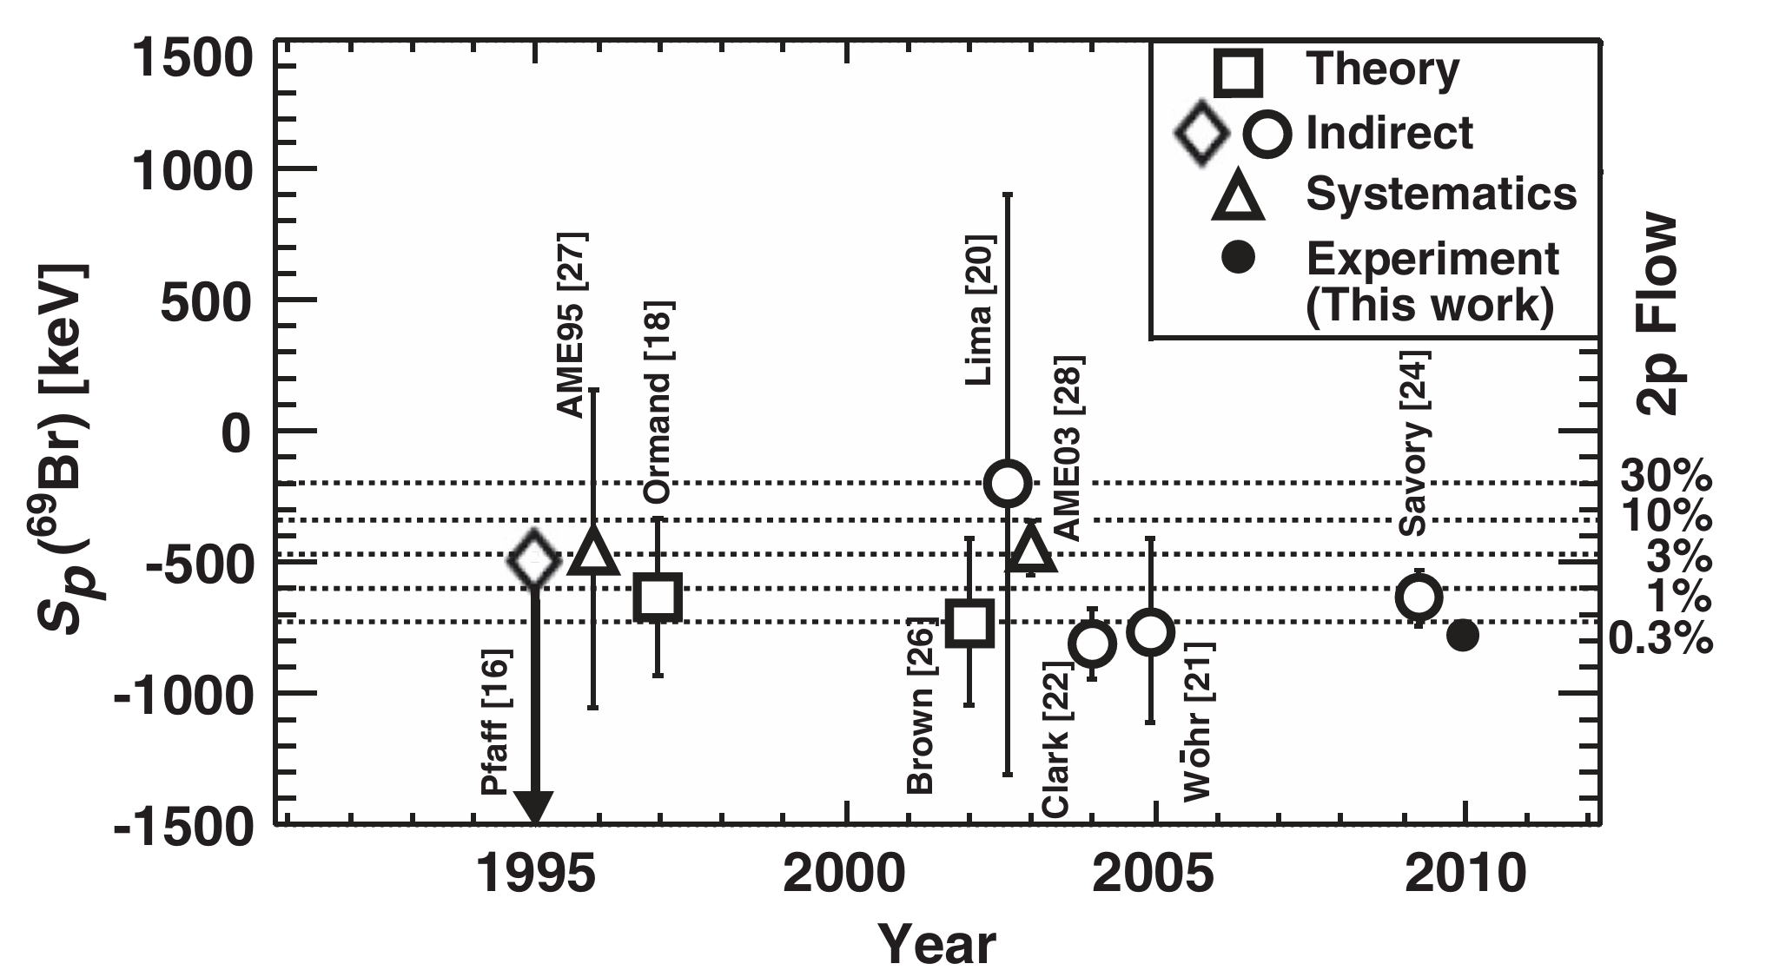
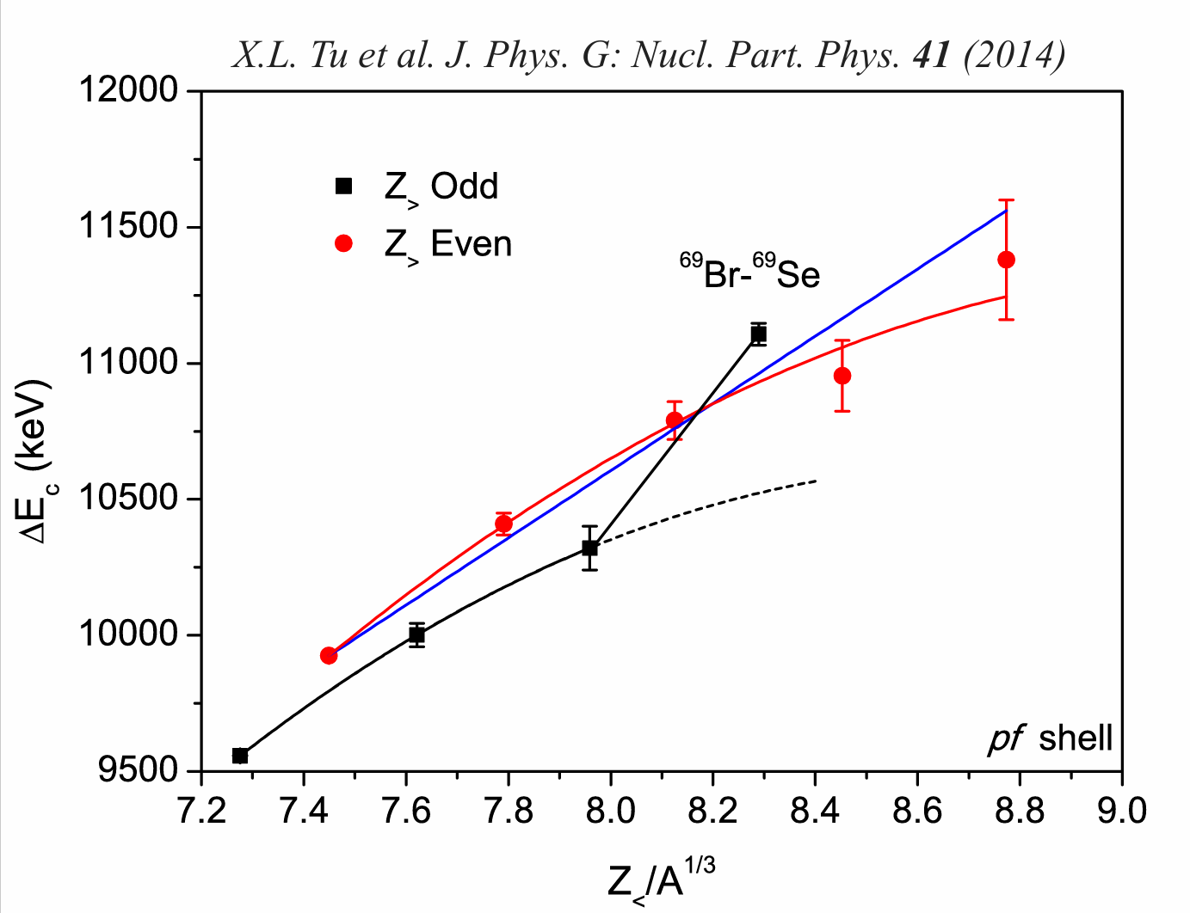
⁶⁸Se waiting point?: mass of ⁶⁹Br
⁶⁹Br g.s. proton decay experiment
Sp(⁶⁹Br) = -785 ±40 keV 2p Flow: 0.3%
A.M. Rogers et.al, PRL 106, 252503 (2011)
⁶⁹Kr β-delayed proton experiment
Sp(⁶⁹Br) = -641 ±42 keV 2p Flow: 20%
M.Del Santo et.al, PLB 738, 453 (2014)
Mass of ⁶⁹Br was questioned
Shell-model calculations using GXPF1A and JUN45 effective interactions predicted regular odd even patten
Odd–even staggering in CDE for the T = 1/2
mirror nuclei changes at A = 69.
“The anomaly could be removed if the experimentally measured ⁶⁹Br mass is for an isomer, and not for the ground state.”

Slide 9
⁶⁸Se waiting point?: mass of ⁷⁰Kr,⁶⁹Br
two task：
Measure ME(⁷⁰kr)
Verify ME(⁶⁹Br)

Slide 10
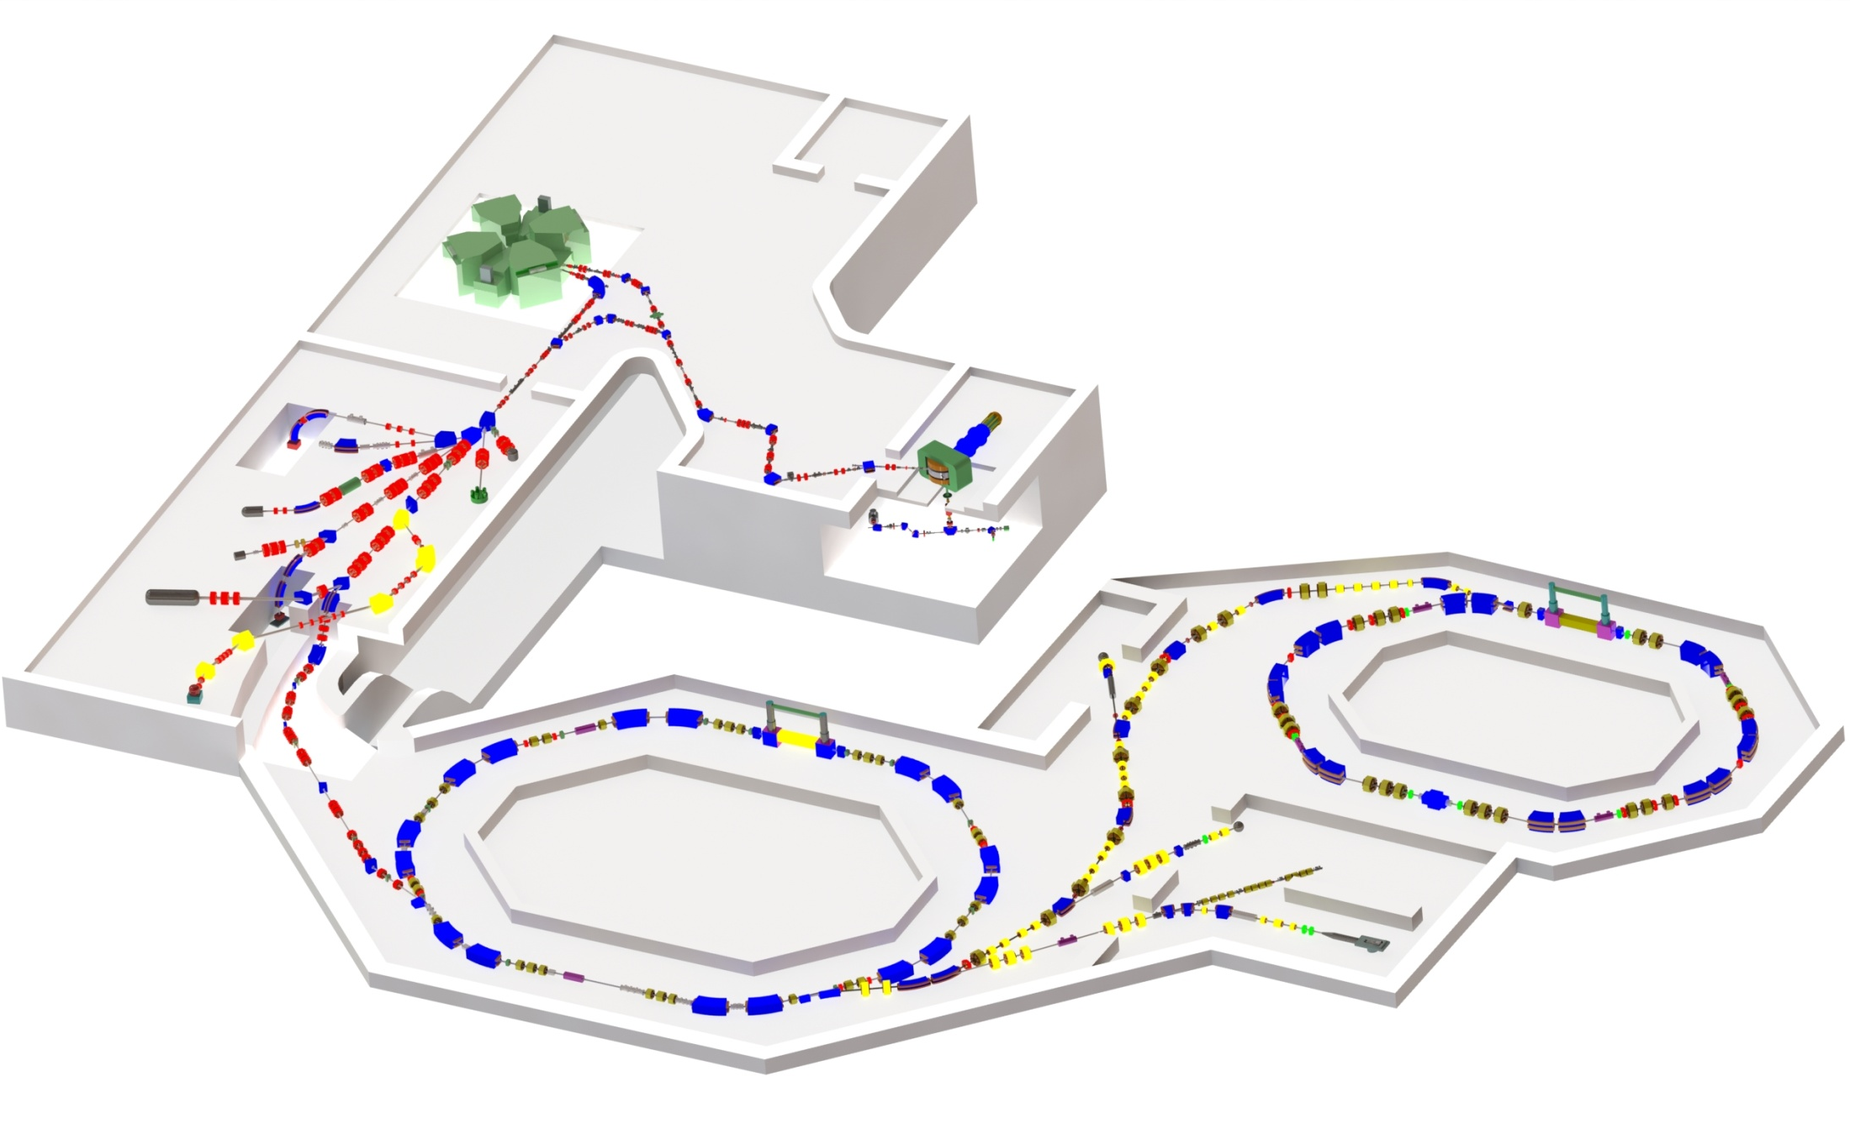
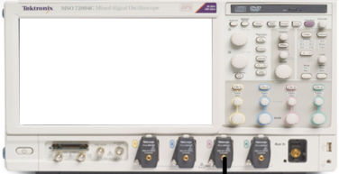
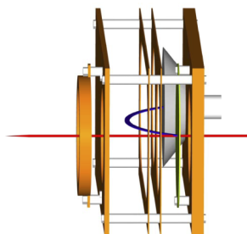


Mass measurements for ⁷⁸Kr fragments
e-
C foil
上游信号传输时间$t_{d1}$
下游信号传输时间$t_{d2}$
CSRe
TOF Detector2
MCP
e-
C foil
CSRe
MCP
TOF Detector1
RIBLL2
CSRe
CSRm
PF
⁹Be

Slide 11
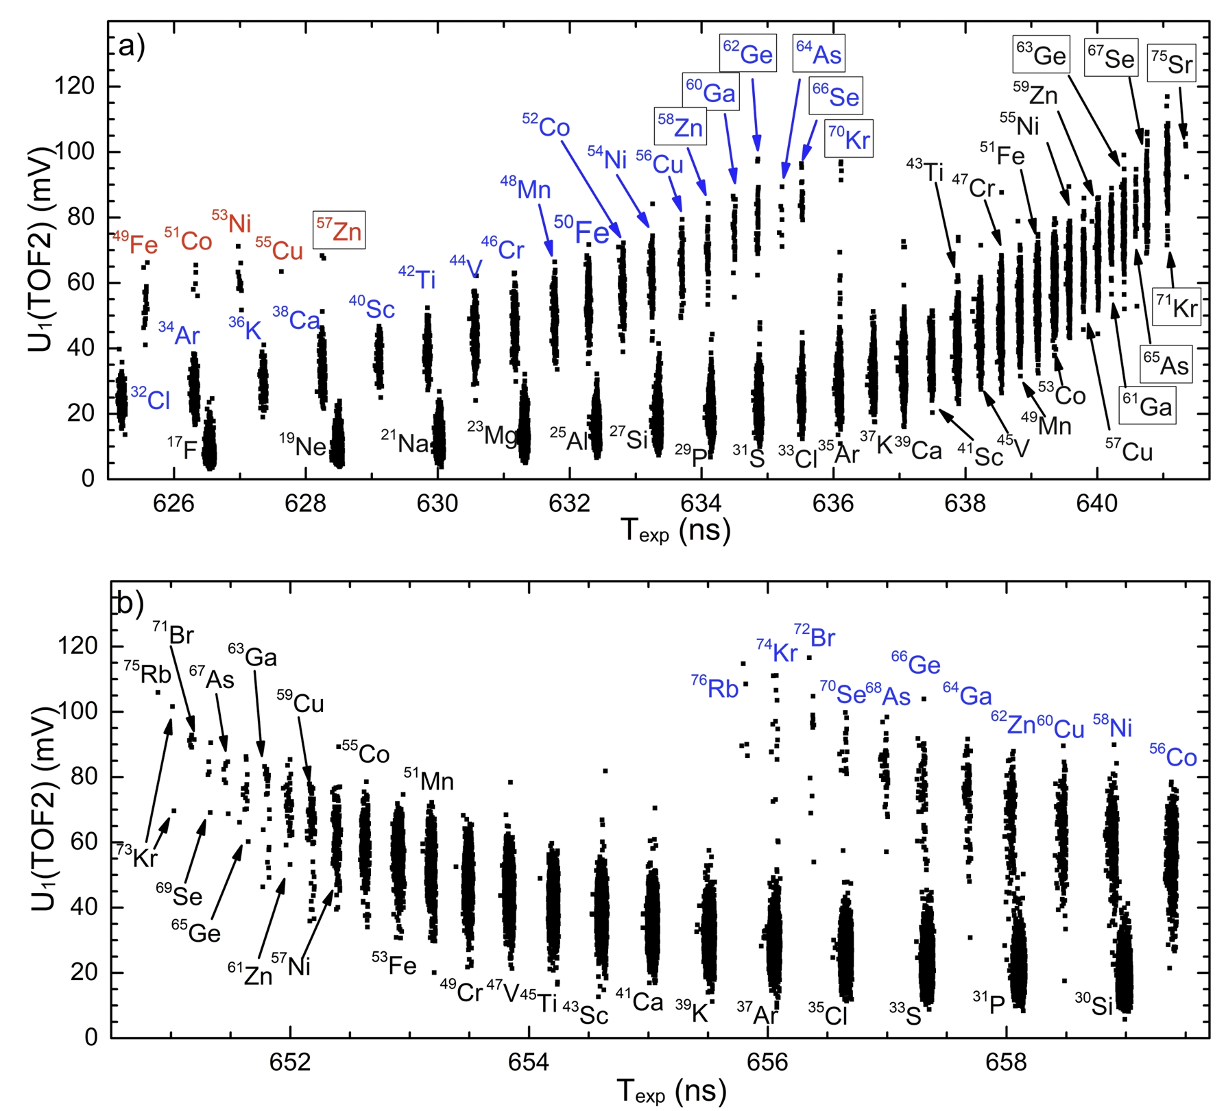
Experimental result
Notes:
This is the spectrum obtained in the experiment. We can see that, we measured the mass of krypton seventy. We also measure mass for proton rich nuclei with Tz minus one half. These masses can be used to check the indirect mass of bromine sixty nine.

Slide 12
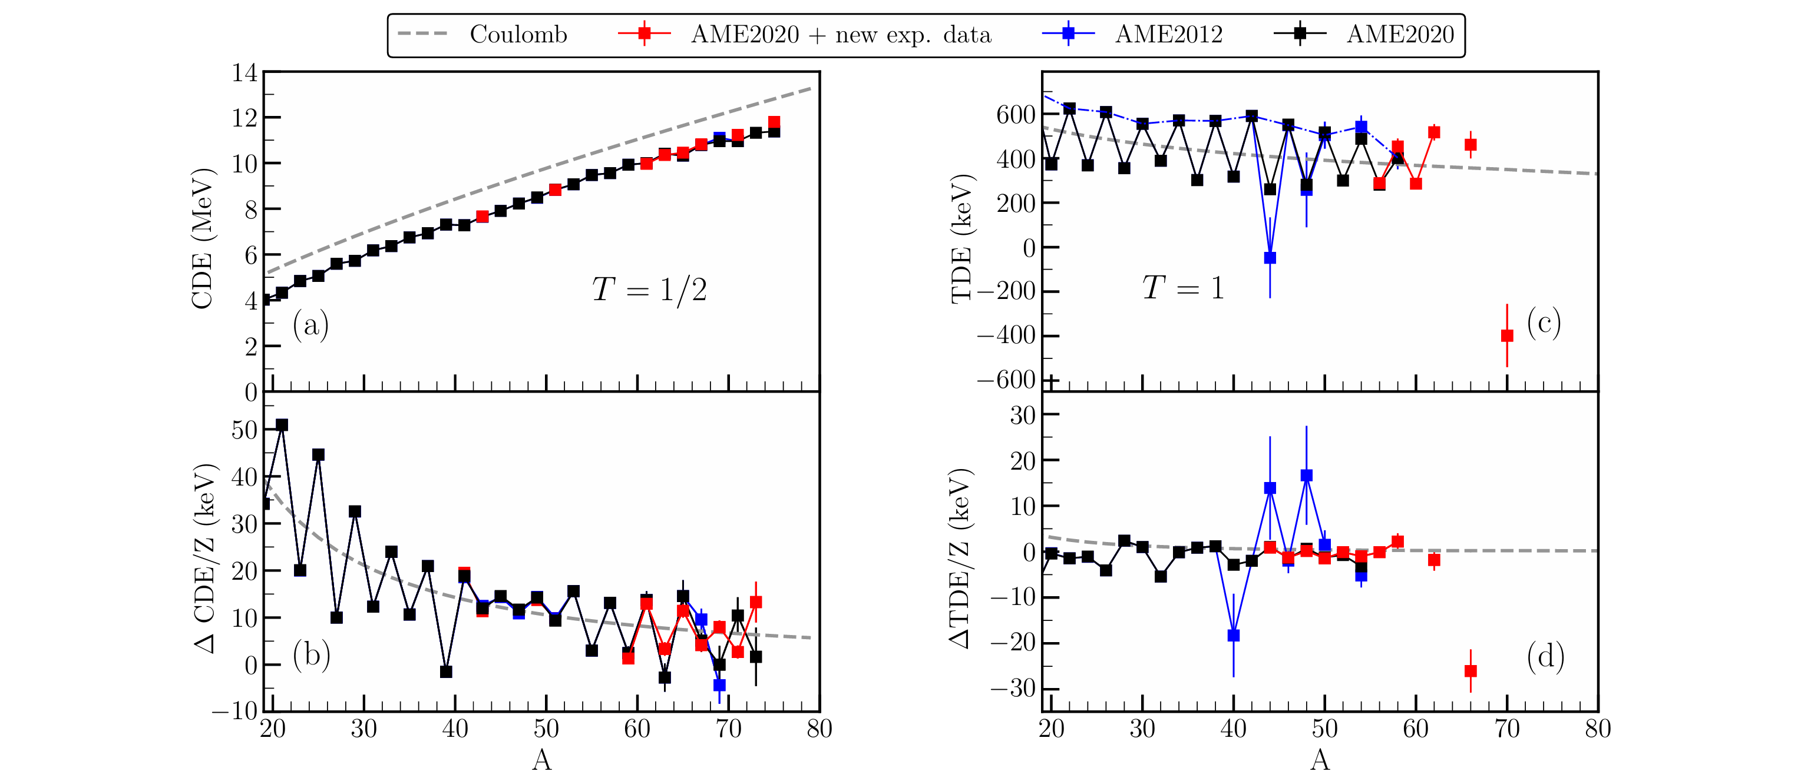
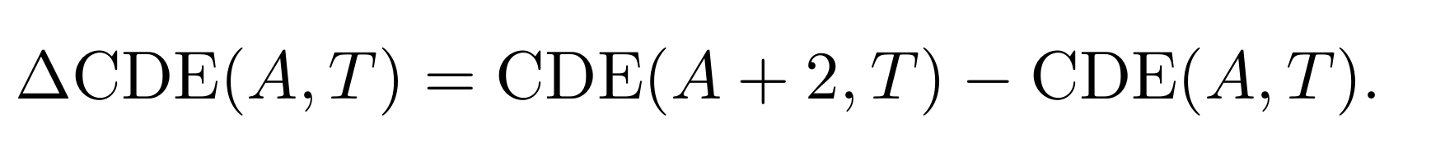
⁶⁸Se waiting point?: verify mass of ⁶⁹Br
H.F. Li, X. Xu*, Y. Sun* et al.,
Phys. Rev. C 110, 021301L (2024)
The anomaly is caused by the incorrect mass of ⁷¹Kr rather than ⁶⁹Br
How strongly can the ⁶⁸Se waiting point be bypassed via 2p capture?
depend on the mass of 70Kr

Slide 13
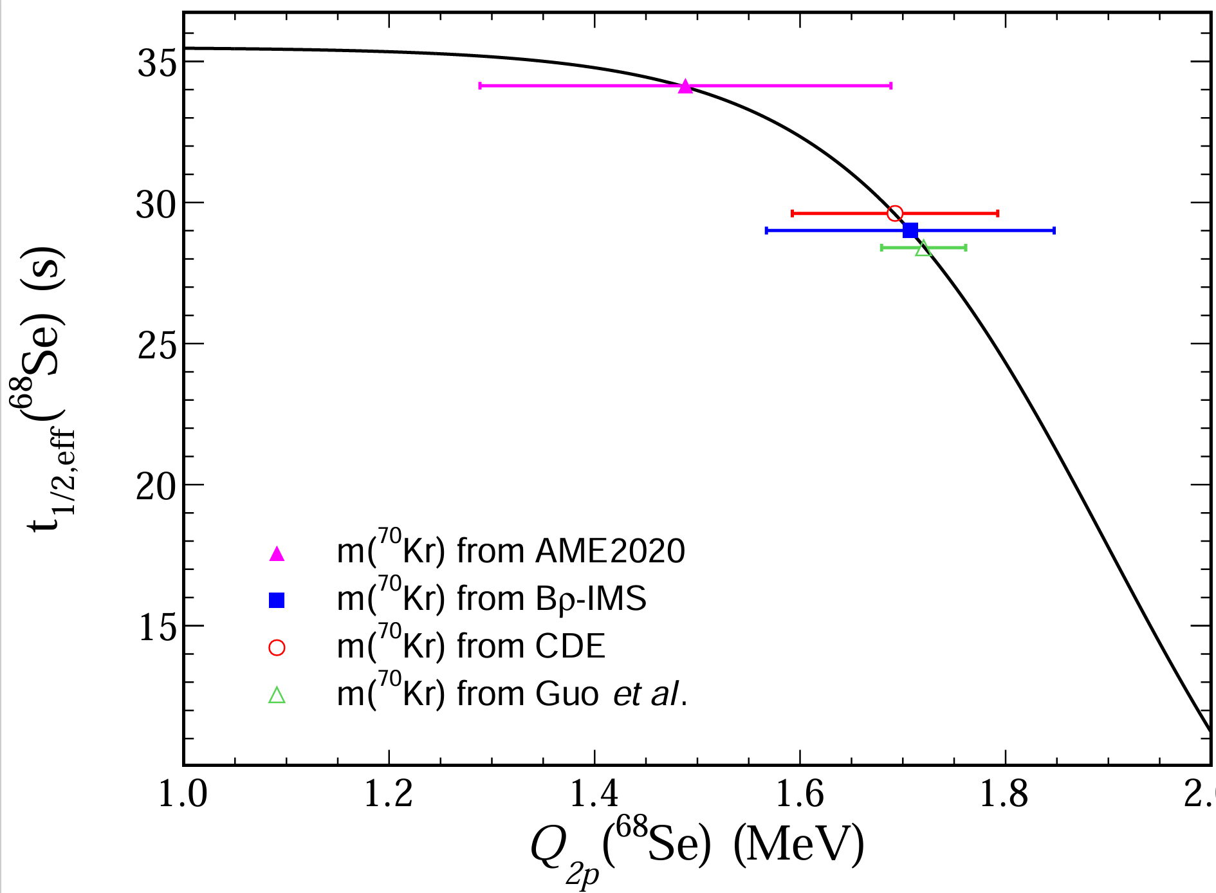
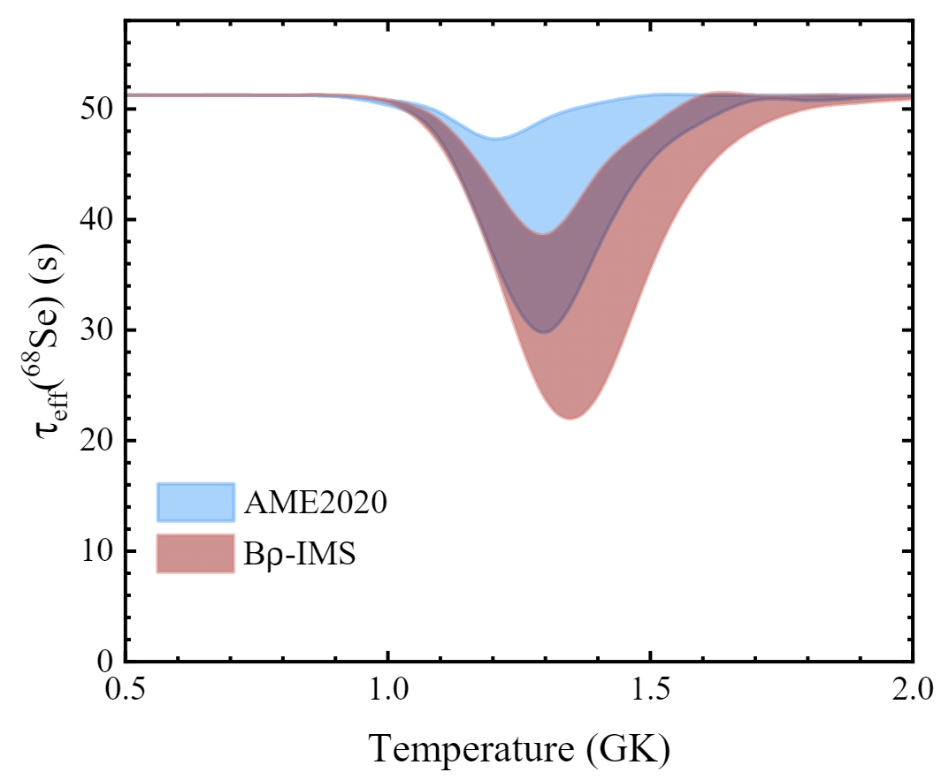
Effective half-life of ⁶⁸Se
ME(⁷⁰Kr) = -41320(140) keV was obtain from only 4 counts
220 keV more bound than AME20 predictions

Slide 14
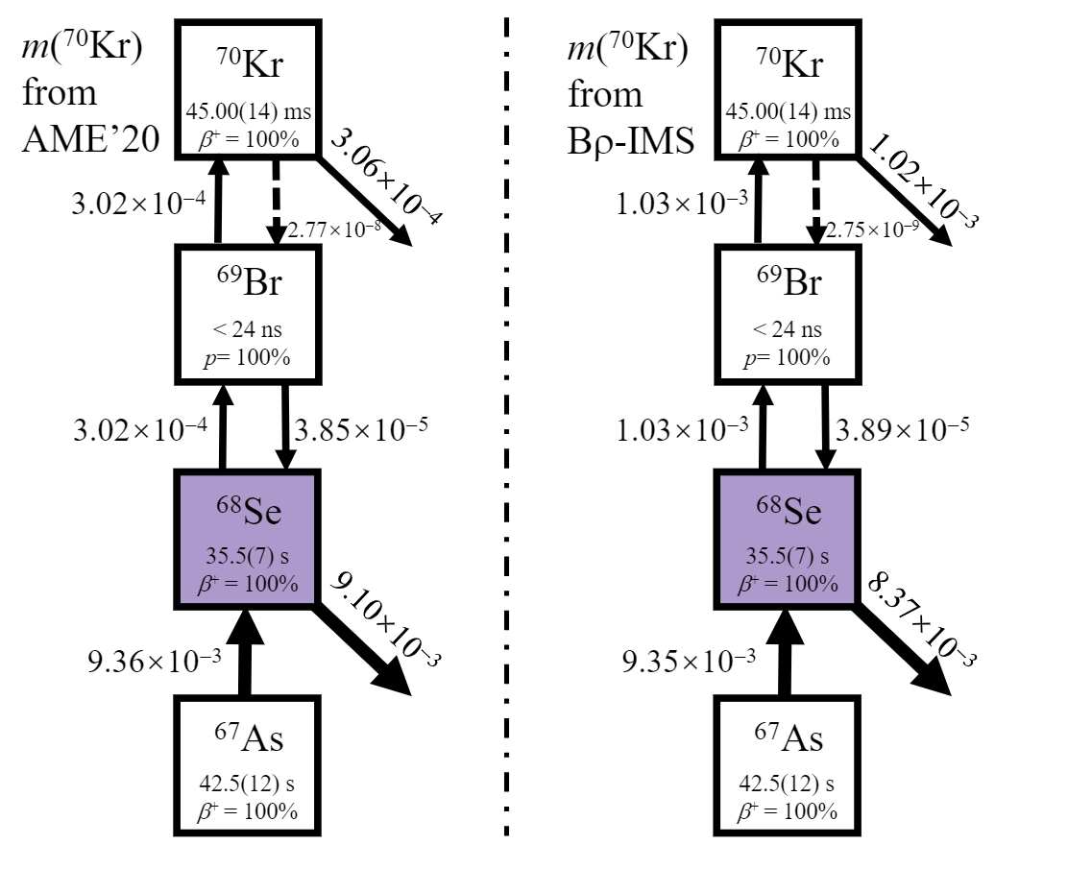
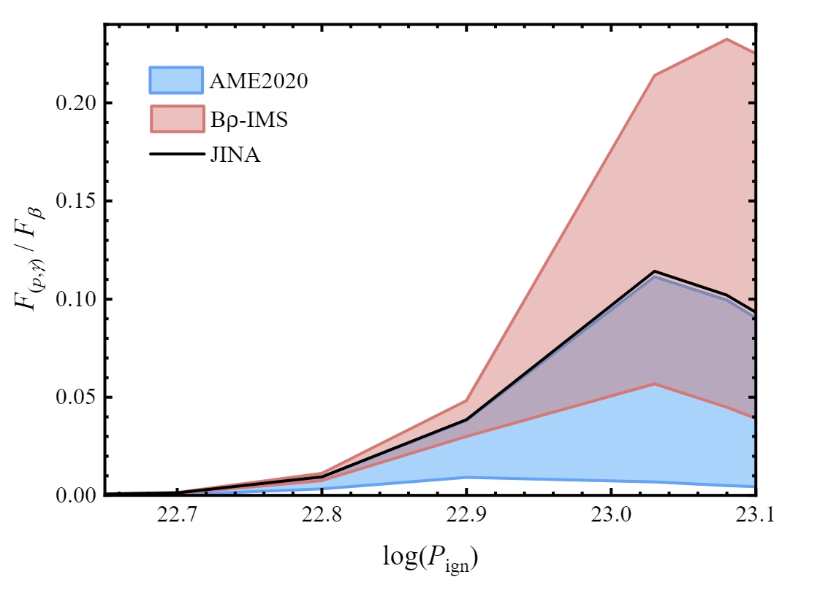
Impact of ⁷⁰Kr Mass on rp-process
More tightly bound nature of ⁷⁰Kr enhances 2p reaction flow up to a factor of four.
This enhancement reduces the effective half-life of ⁶⁸Se.

Slide 15
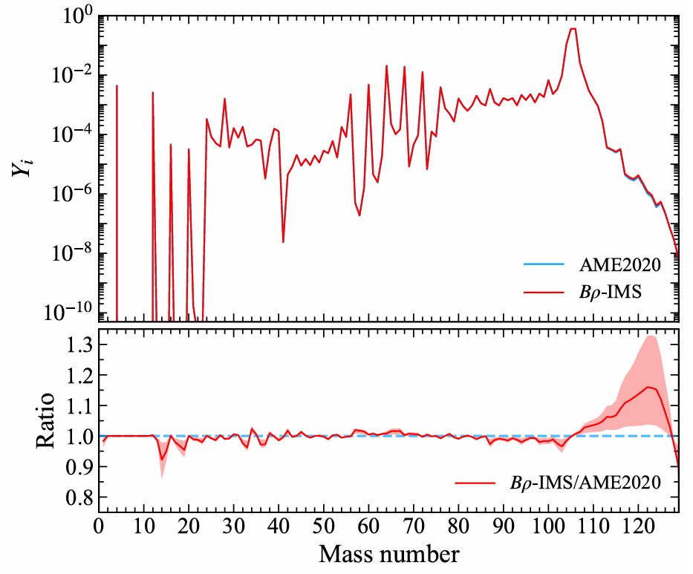
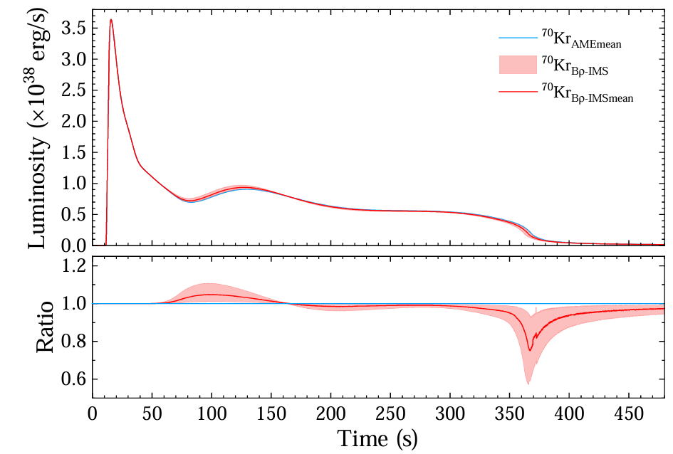
Impact of ⁷⁰Kr Mass on rp-process

Slide 16
Summary
The question on mass of ⁶⁹Br was fixed
The last piece of puzzle relevant to the ⁶⁸Se waiting point has been found, the mass of ⁷⁰Kr was directly measured
Mass of 70Kr is 220keV more bound than AME20 prediction
⁶⁸Se is a waiting point
leads to a 10% luminosity difference
result in a significant enhancement of SnSbTe cycle abundances in the final ashes

