Slide 1
Dennis Mücher (IKP Cologne)
M. Schiffer, T.F. Pabst, Derin Schmidt, Stefan Heinze, C. Schlaier, S. Schroeder et al. (IKP Cologne)
A. Spyrou, S. Liddick, K. Bosmpotinis, J. Berkman, R. Lubna, S. Uthayakumaar, et. al. (FRIB + MSU)
A.C. Larssen, M. Guttormsen et al (Oslo)
M. Wiedeking (LBNL)
B. Greaves (UoGuelph)
G. Savard, D. Santiago et. al. (Argonne National Lab.)
S. Goriely (Univ. Brussels)
D. Rochman (PSI, Villingen))
Nuclear Astrophysics with Long- and Short-lived Radionuclides
Institute for Nuclear Physics / University of Cologne | Dennis Mücher | 24.02.26

Slide 2
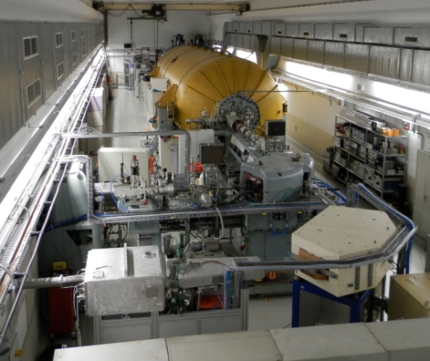
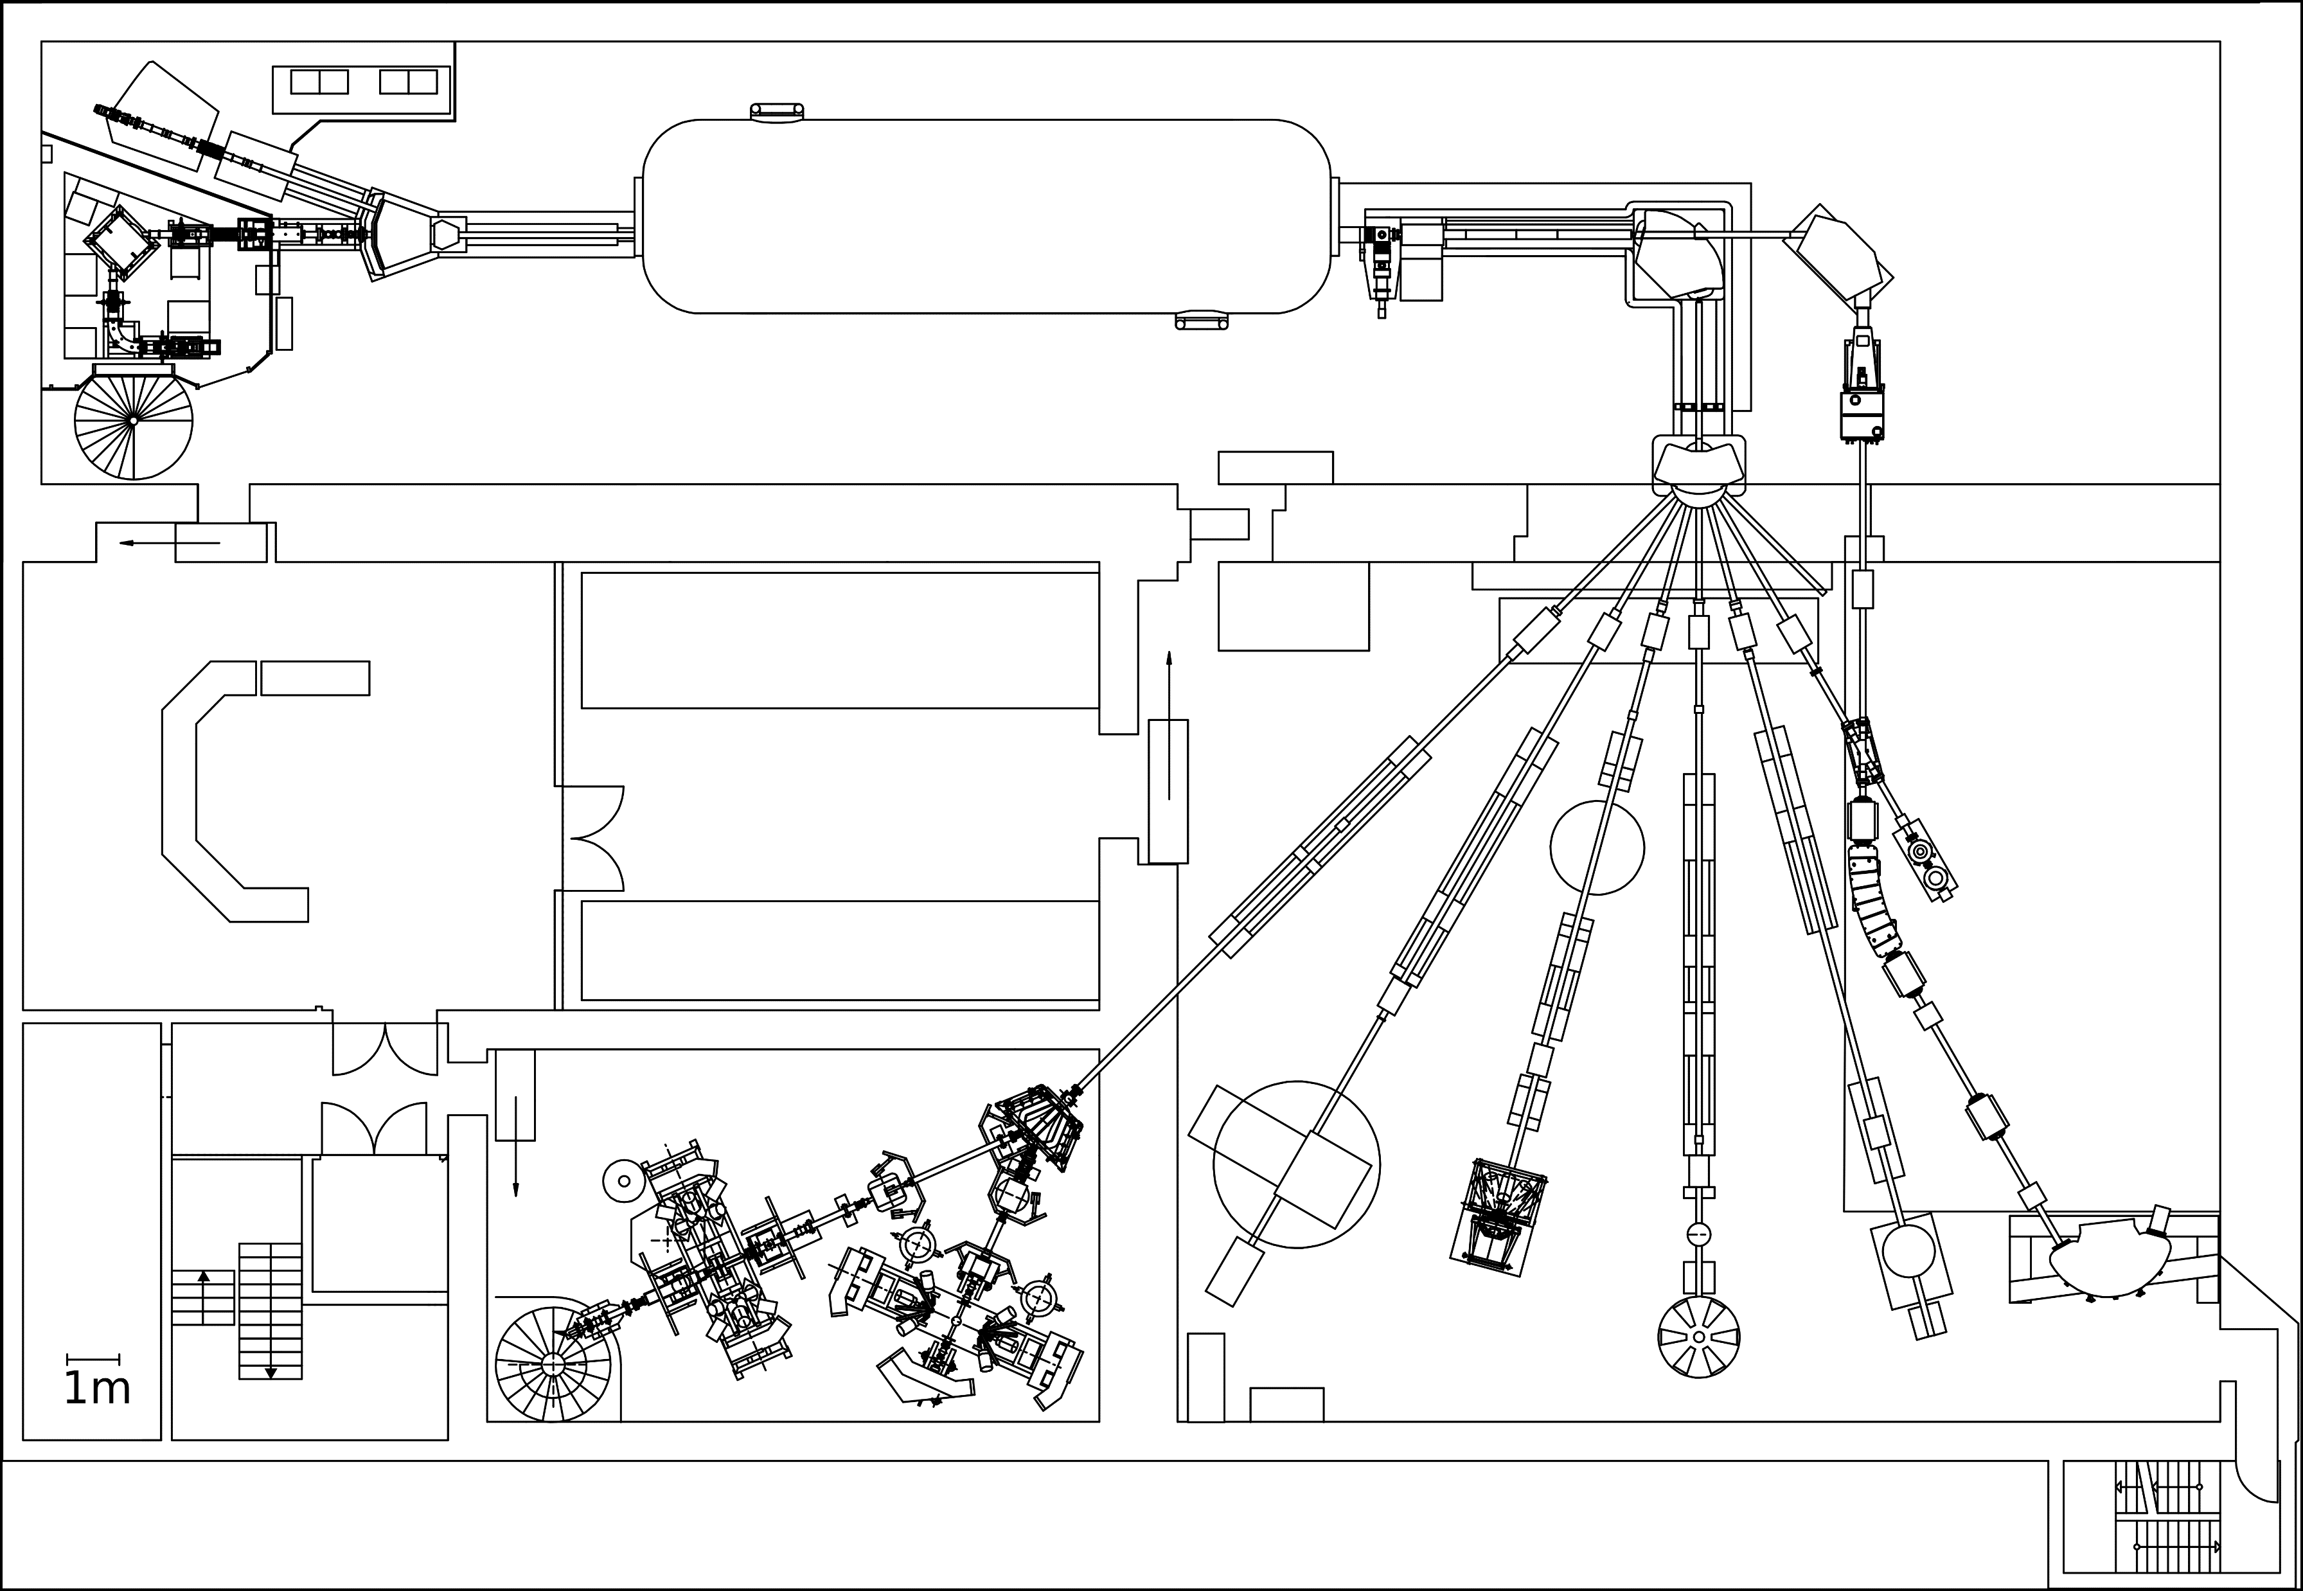
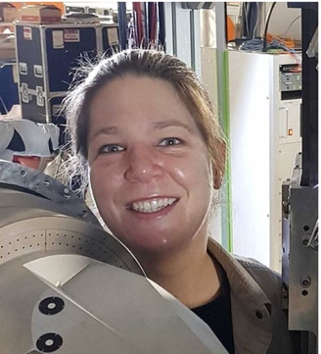
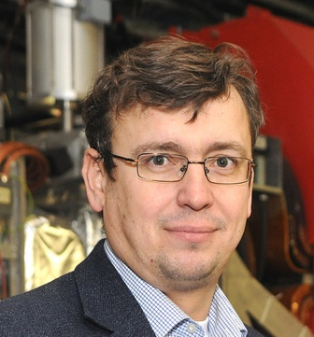
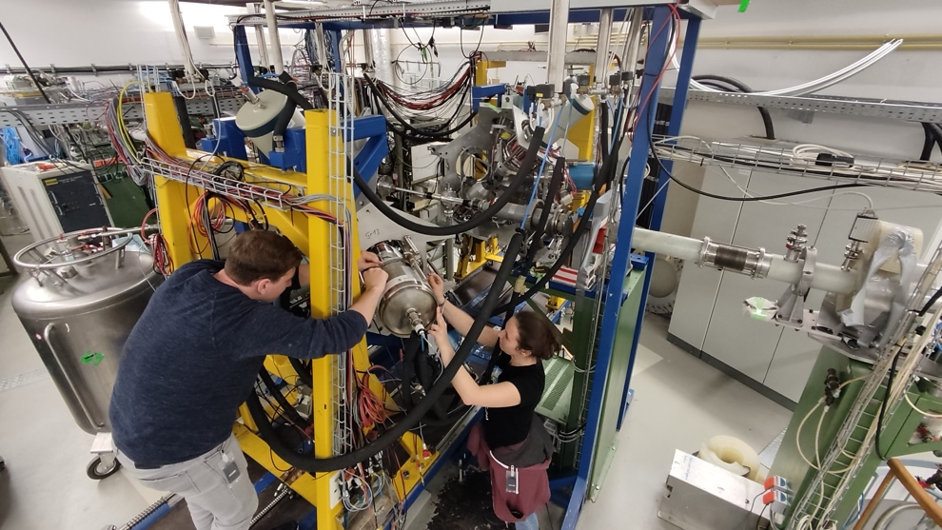
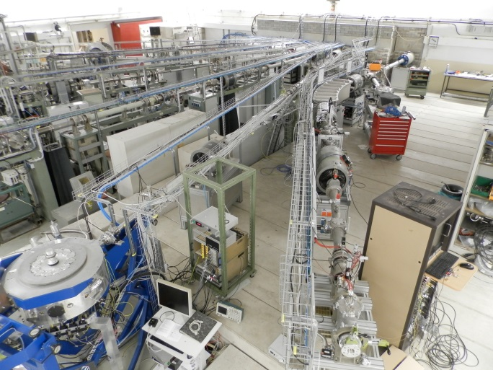
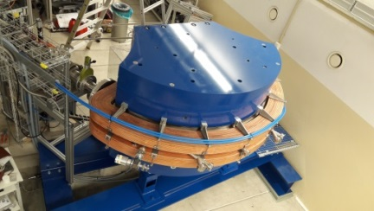
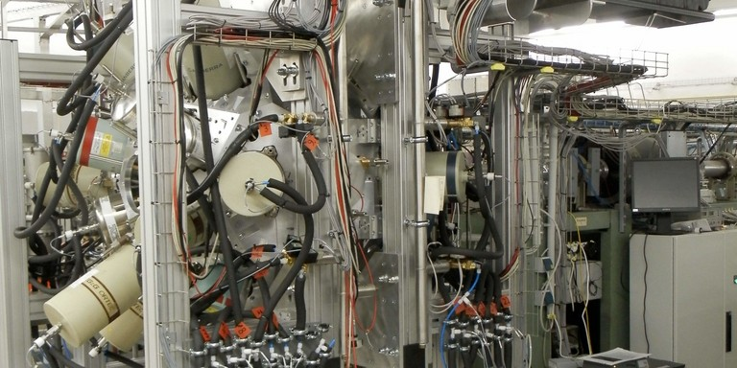
IKP, University of Cologne
Our newest faculty!
K. Wimmer Y. Litvinov
HORUS
AMS
CATHEDRAL
2

Slide 3


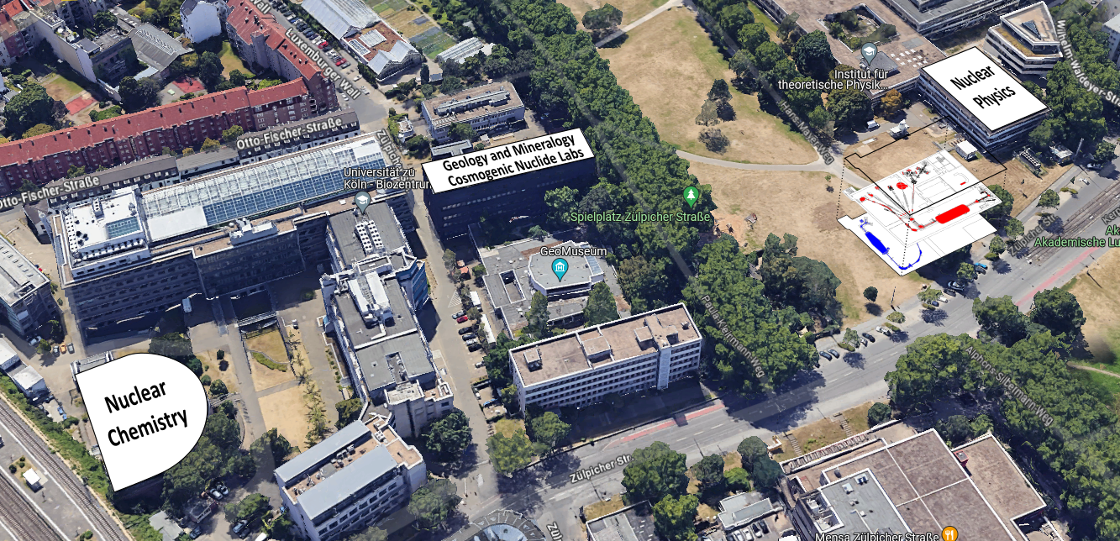
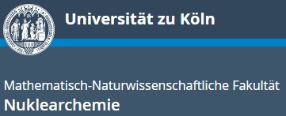



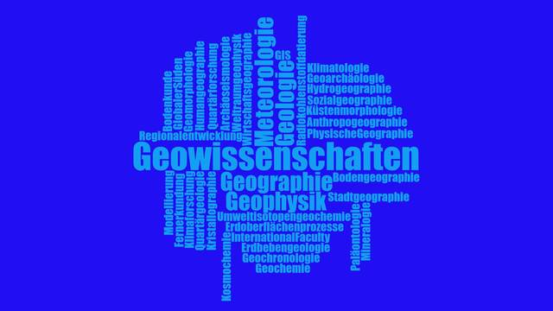

CologneAMS – Center for Accelerator Mass Spectrometry
UFG

Slide 4




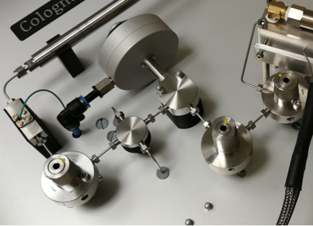
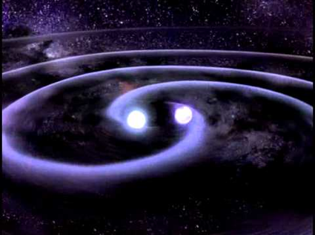
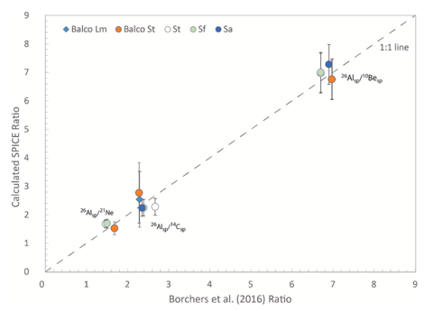
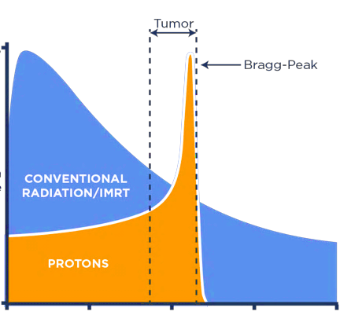
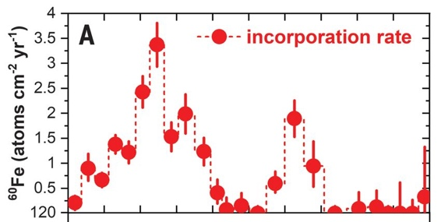
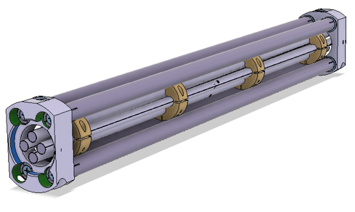
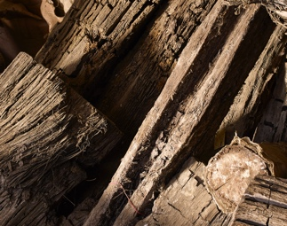
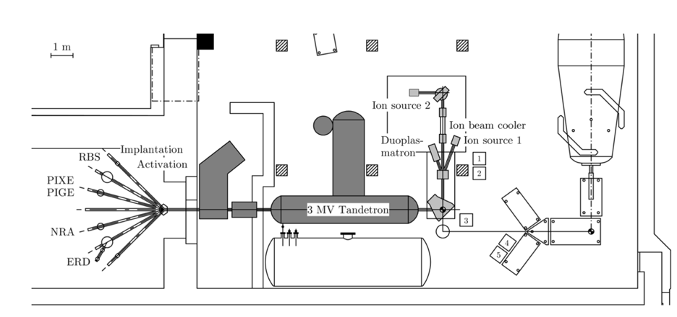
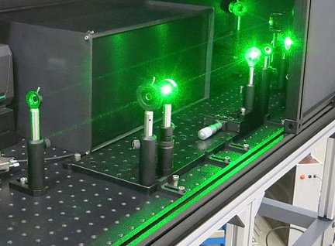
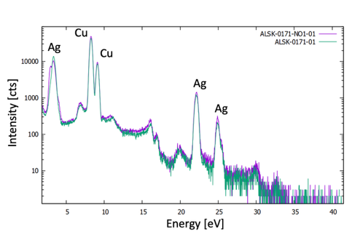
Geology
Medical Physics
Astrophysics
Carbon-14
measurement of gaseous CO₂ samples: e.g. permafrost
input for modelling climate change
Cancer metastases
early detection via AMS
supporting development of targeted therapies through study of drug metabolism
Formation of the elements
reaction rates in stars
new processes in nucleosynthesis
complementary experiments with radioactive beams:
Cosmogenic nuclides
dynamics in geological formations
new level of precision for dating of rocks and minerals using ⁵³Mn, ²⁶Al and ¹⁰Be
Proton and ¹²C Therapy
high-precision radiation therapy using tumour markers and IVI
toxicity studies
long-lived isotopes
direct detection of Supernovae remnants
meteorites
direct measurements of n-capture reactions
Environment
Technology
Archaeology
FORKA-C14
creating new standards in the clearance of reactor debris
new possibilities via 3MV Tandetron machine
ion cooler
suppression of isobars
access to many new AMS isotopes
new version developed @IKP Cologne
Isotope Archaeology
Cologne Lithoteca
PIXE measurements
laser detachment
18W Nd:YVO4 laser
new ion source
coupling to 6MV Tandetron machine
Dendroarchaeology & Archaeobotany
new ways for efficient extraction of ¹⁴C from botanic and wood samples

Slide 5
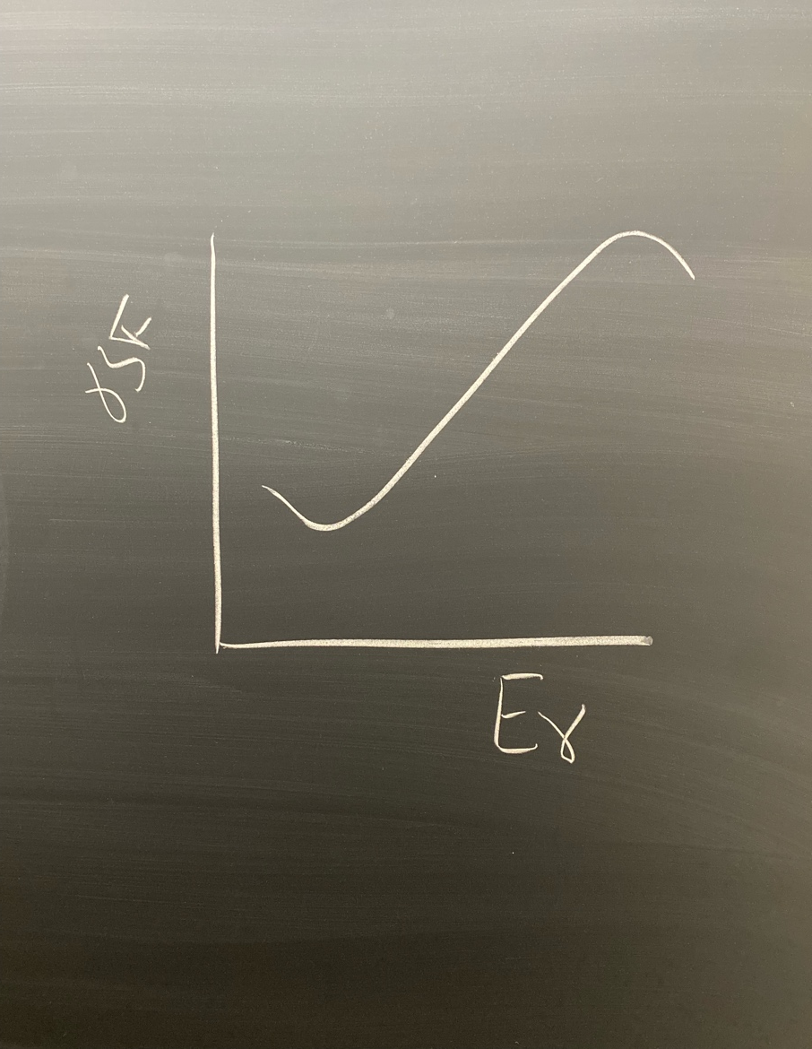
Outline of my talk
Supernovae in the milky-way: ⁵⁹Fe(n,γ)⁶⁰Fe and the role of the upbend
The intermediate neutron capture process: ¹³⁹Ba (n,γ)¹⁴⁰Ba
The rapid neutron capture process: region below ¹³²Sn
sketch at IAS, Princeton, 2026

Slide 6
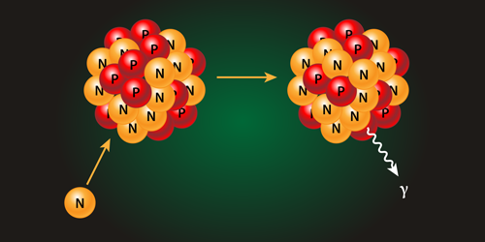
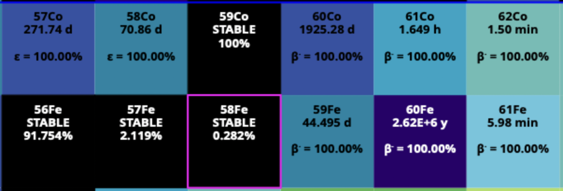
Overview: Stellar processes

Slide 7
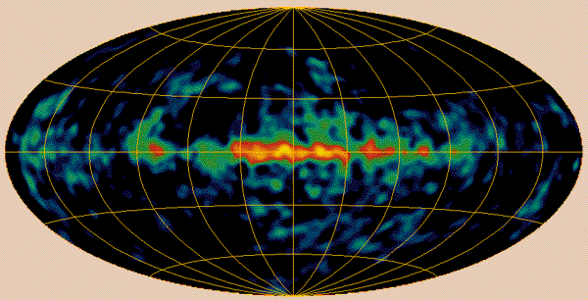
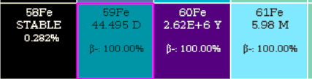
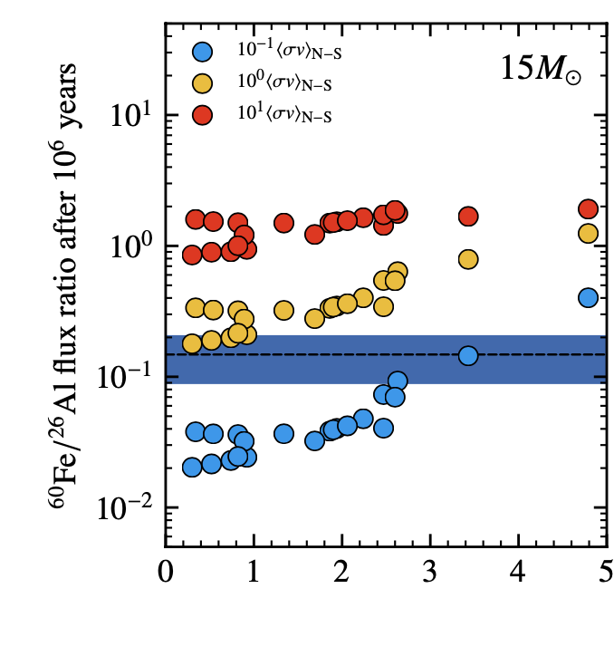
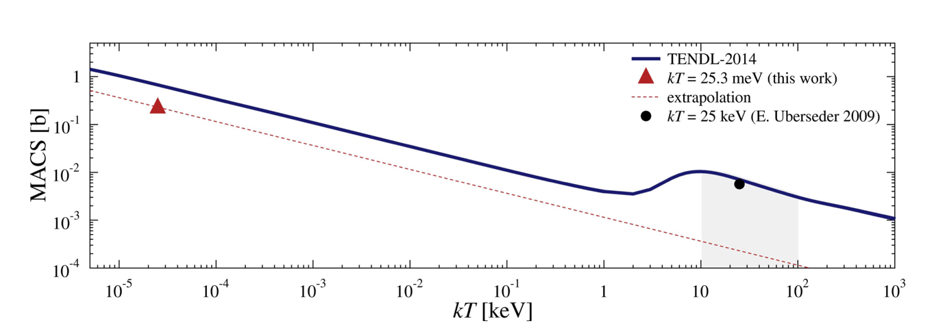
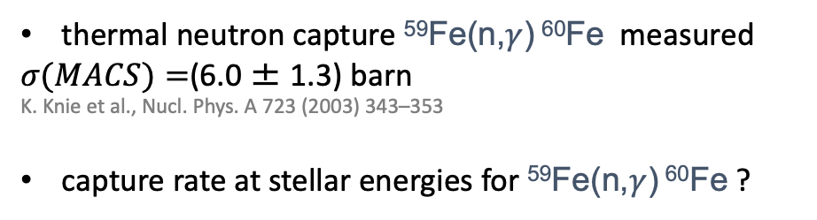

The starting point of heavy nucleosynthesis: ⁵⁹Fe(n,$γ$)⁶⁰Fe
thermal neutron capture ⁵⁹Fe(n,$γ$) ⁶⁰Fe measured
$σ(MACS)=$(6.0 ± 1.3) barn
K. Knie et al., Nucl. Phys. A 723 (2003) 343–353
capture rate at stellar energies for ⁵⁹Fe(n,$γ$) ⁶⁰Fe ?
⁶⁰Fe(n,$γ$)
T. Heftrich et al., Phys. Rev. C 92, 015806 (2015)
Notes:
The topic of my presentation is a new method to constrain n capture rates in unstable nuclei.

Slide 8
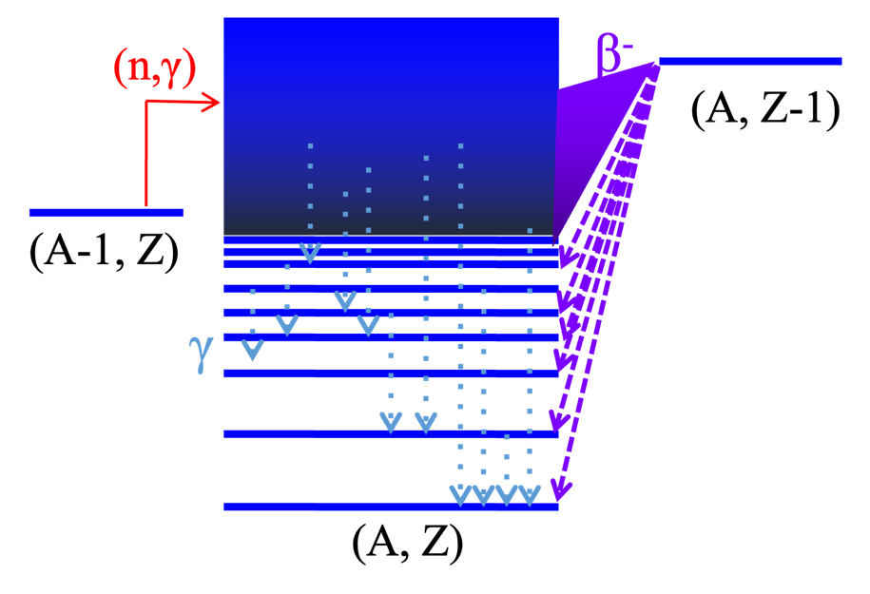
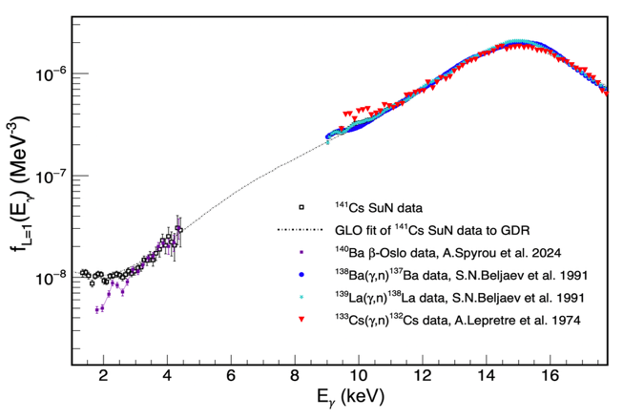
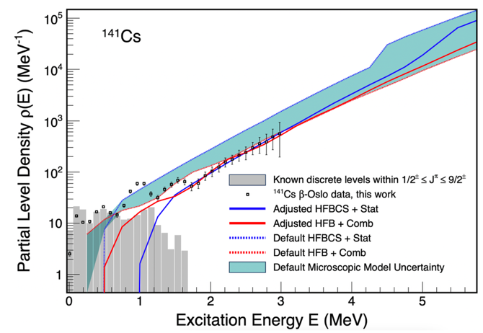
Hauser-Feshbach and the β-Oslo method
Required input:
Nuclear Level Density (NLD)
γ-ray strength function (γSF)
Optical model potential
+ Direct capture contributions can play a role
A. Spyrou et. al, Phys. Rev. Lett. 113, 232502
In general, β-Oslo is the (far) more sensitive method in terms of how exotic we can go
In certain cases, β-Oslo cannot be applied because of Q-value and/or spin restrictions
Notes:
The topic of my presentation is a new method to constrain n capture rates in unstable nuclei.

Slide 9
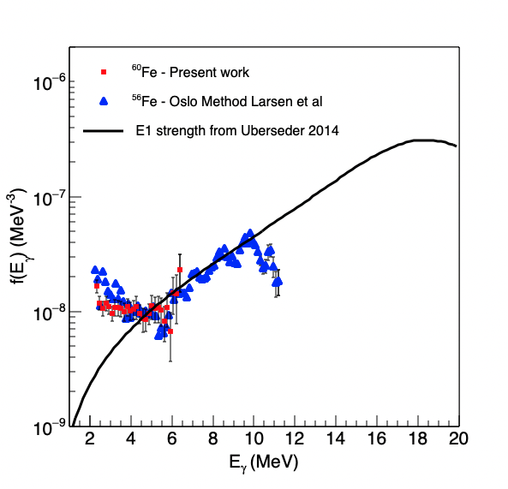
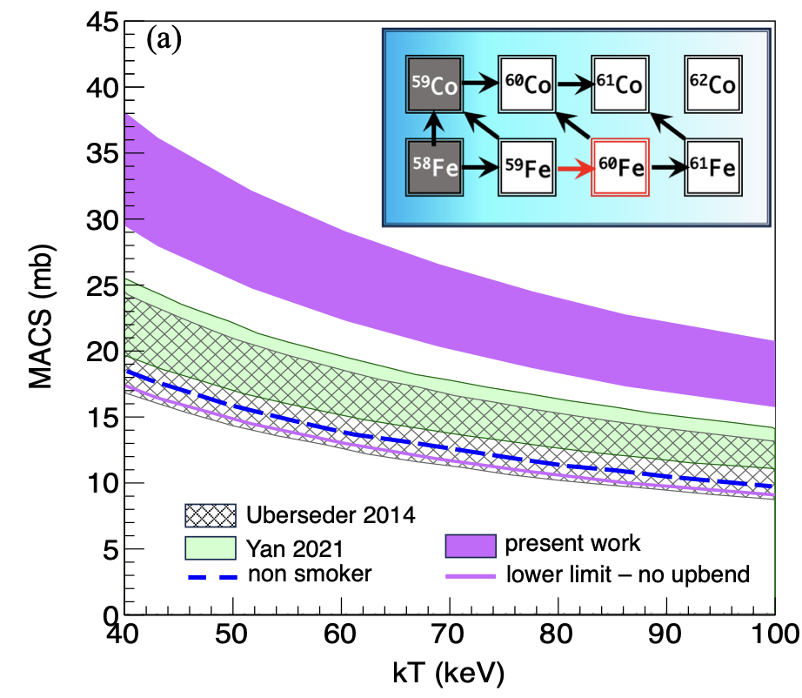
Slide: A. Spyrou
The importance of the upbend in ⁵⁹Fe(n,$γ$)⁶⁰Fe
model
γ-ray Strength Function
⁵⁹Fe(n,γ)⁶⁰Fe cross section
Spyrou et al. Nature Com. (2024)

Slide 10
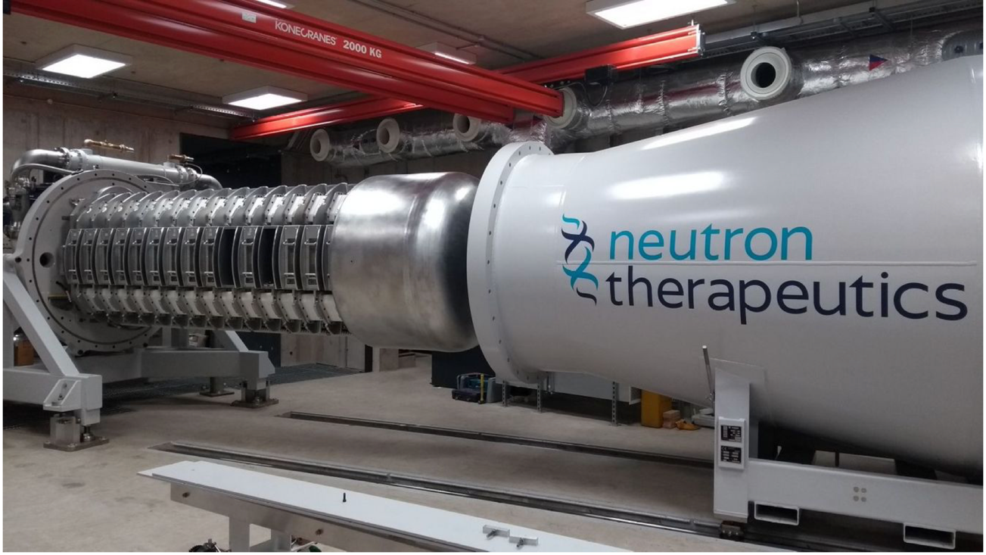
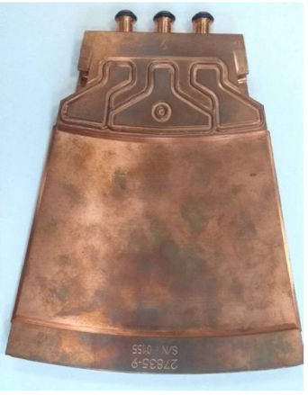
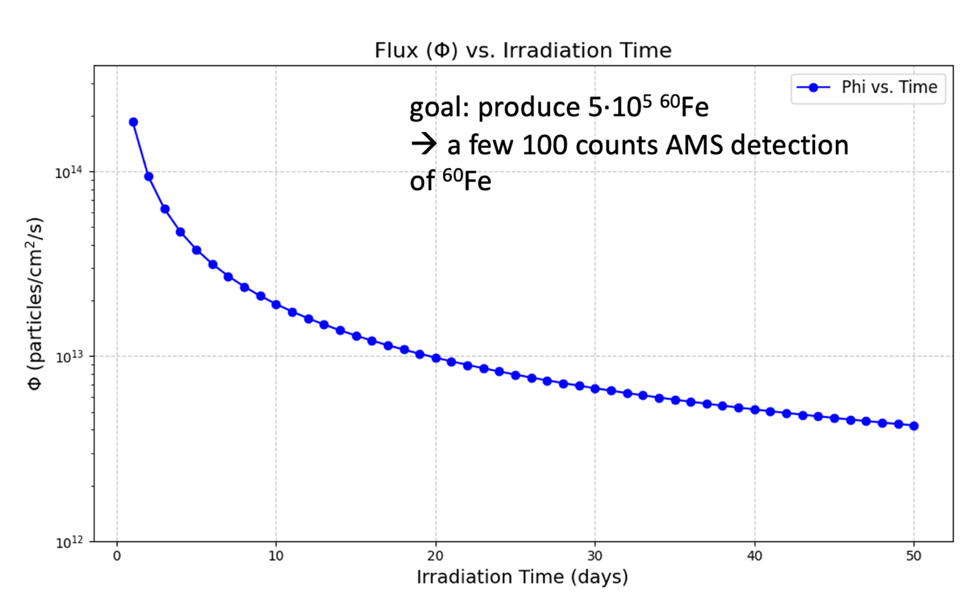
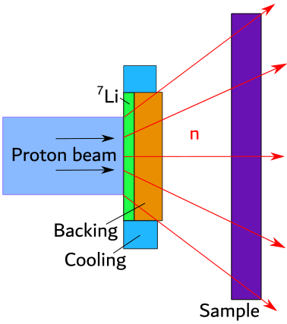
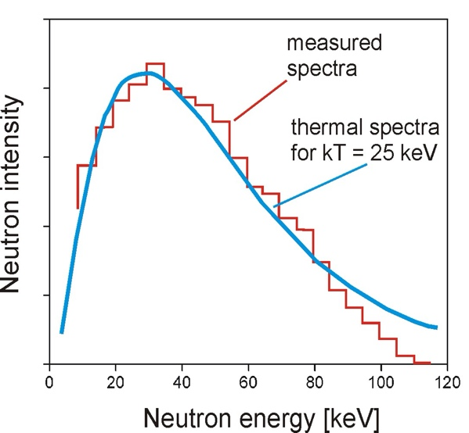
The “breeding” method: towards direct n-capture measurements
High Flux Accelerator-Driven Neutron Facility
(Birmingham)
50mA Proton driver
> 10¹² n/cm²/s
7Li(p,n) @ 1.9 MeV
W. Ratynski and F. Käppeler, PRC 37, 595 (1988)
Notes:
The topic of my presentation is a new method to constrain n capture rates in unstable nuclei.

Slide 11
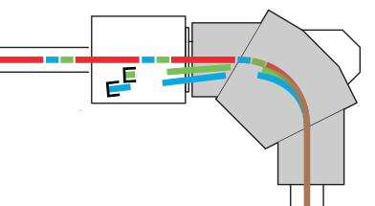
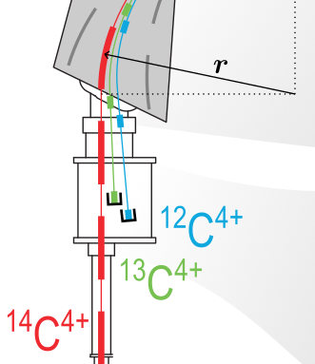
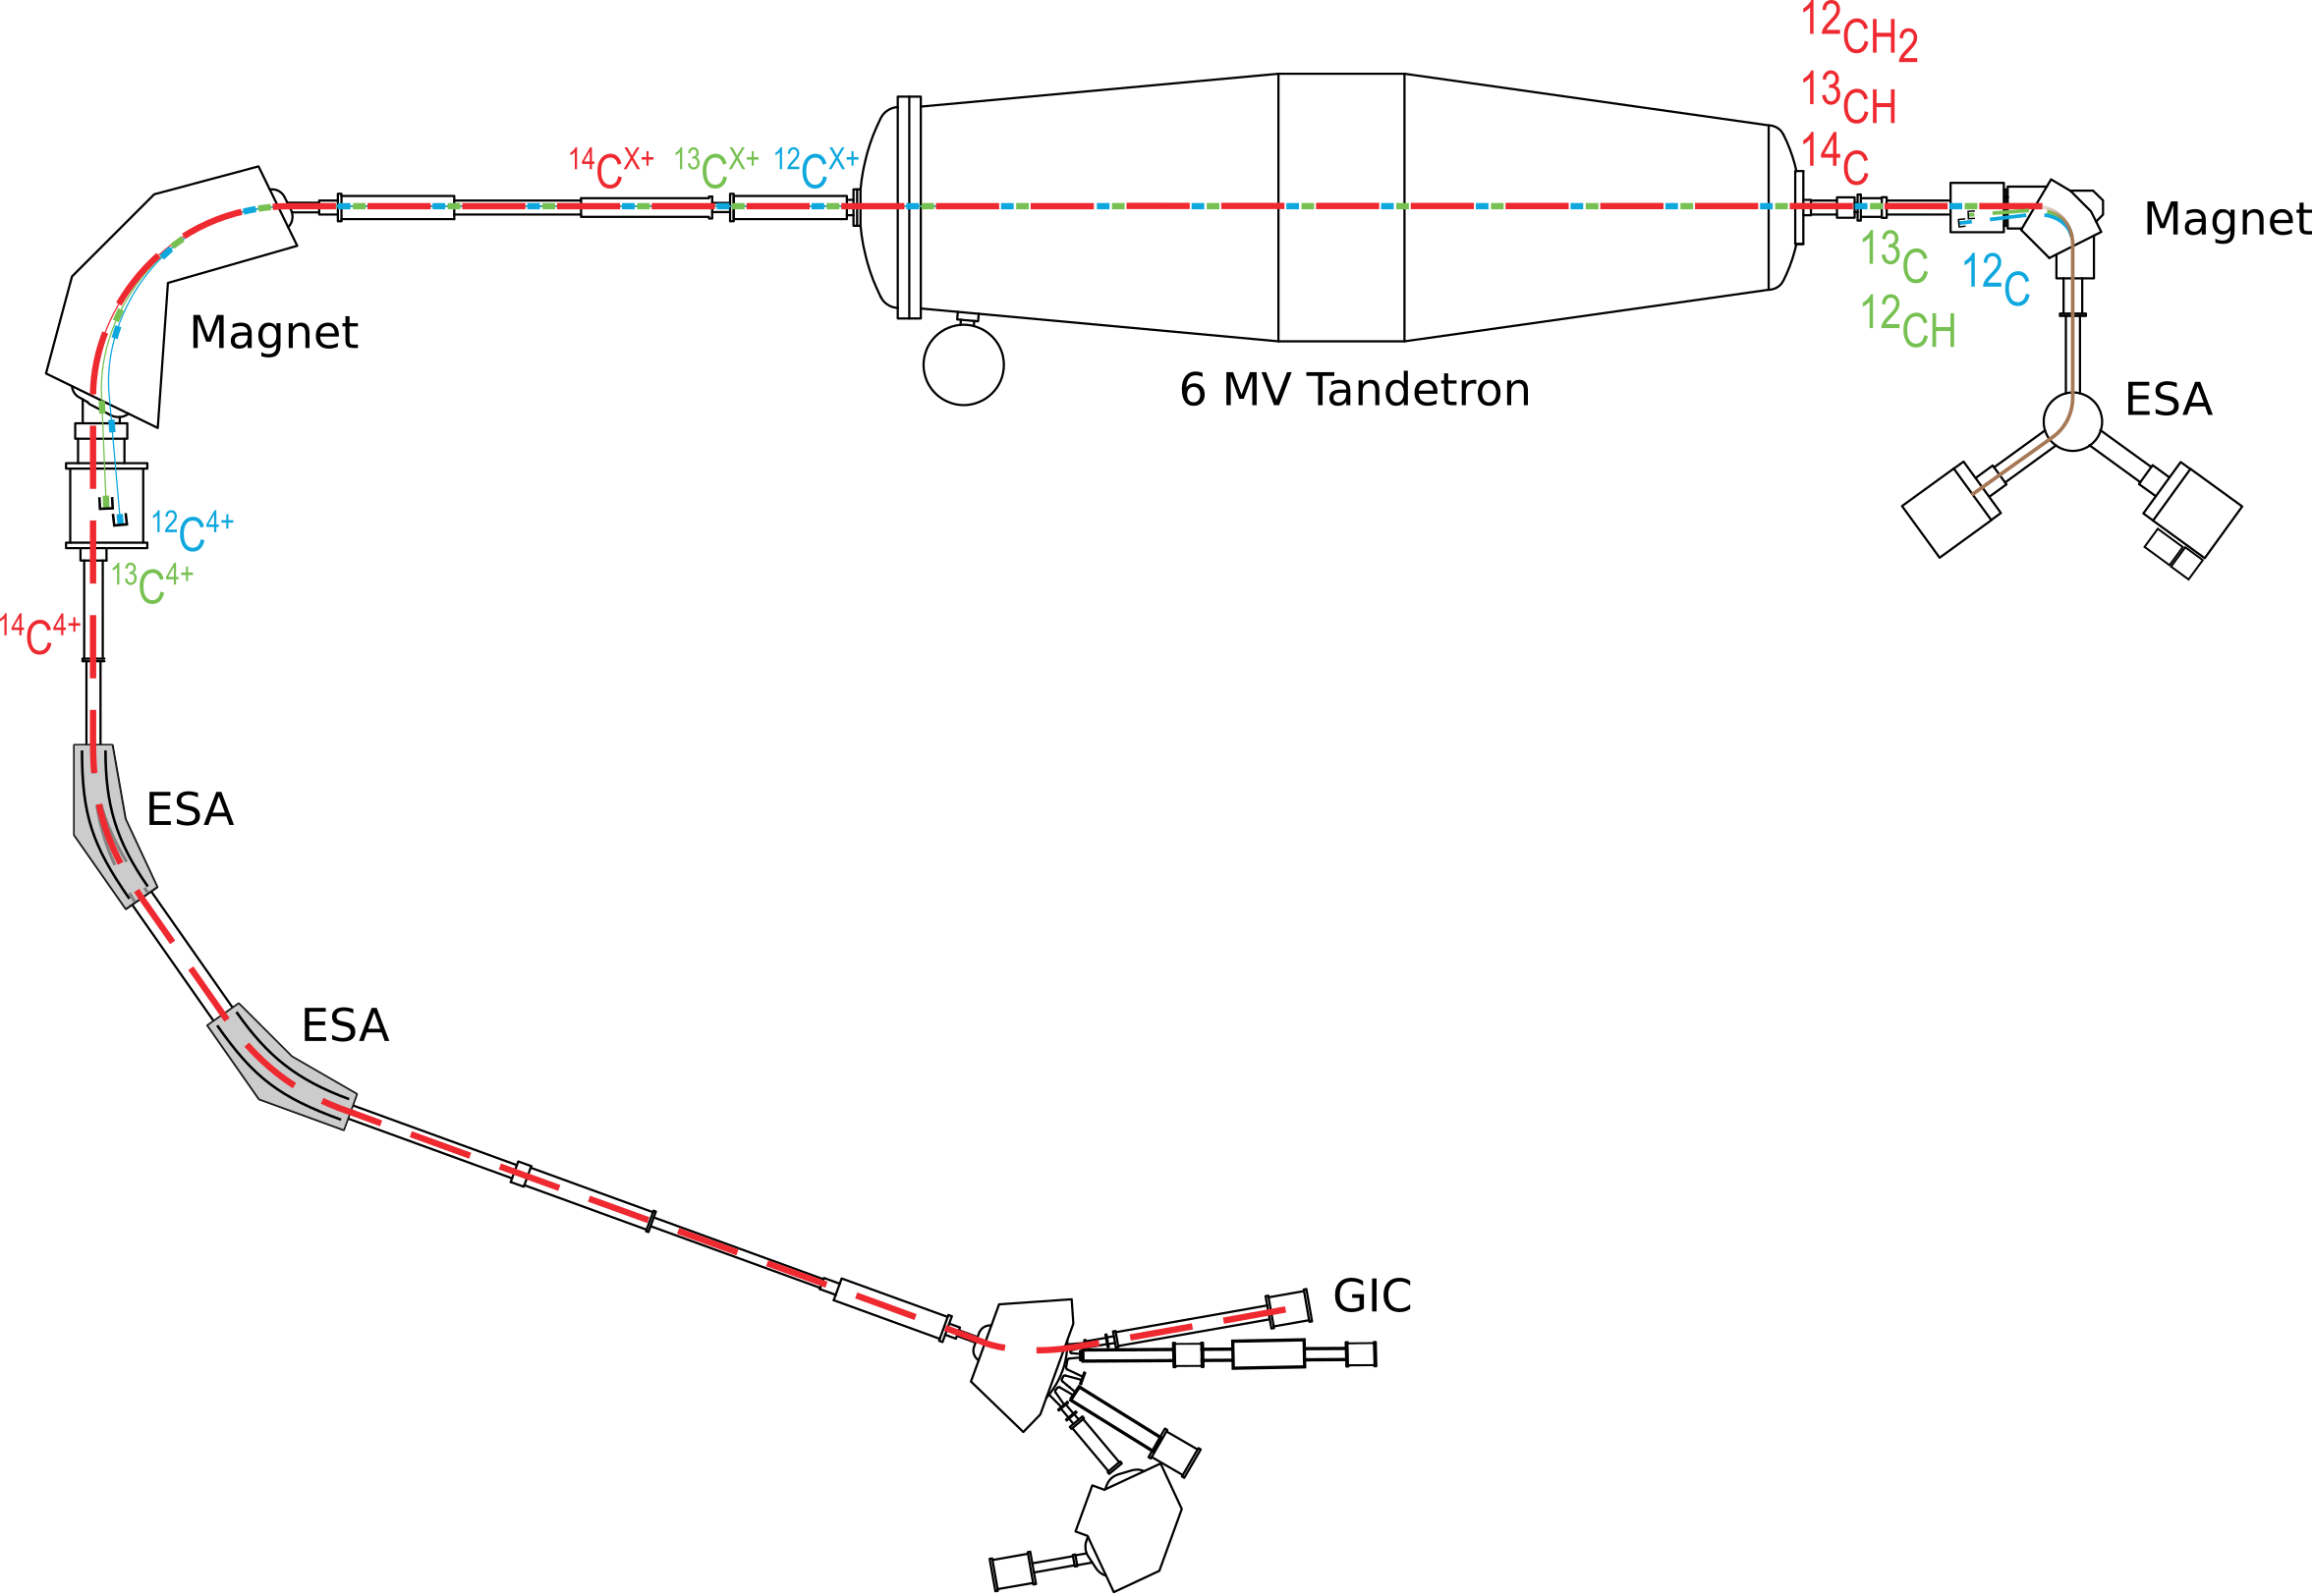
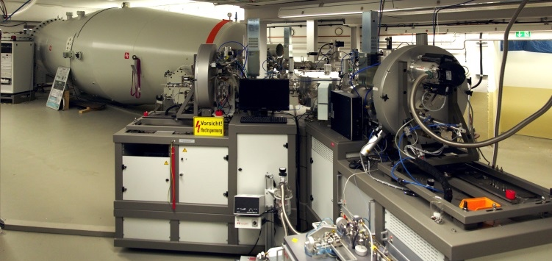
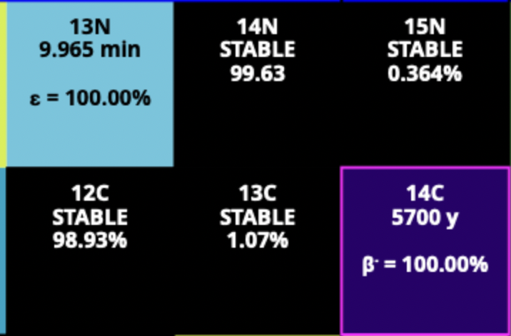
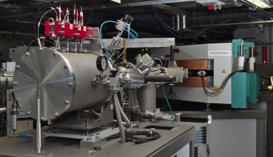

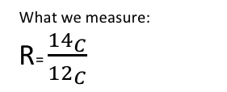
Accelerator Mass Spectrometry
CologneAMS 6 MV AMS-System: ¹⁰Be, ¹⁴C, ²⁶Al, ³⁶Cl, ⁴¹Ca, ^{2xx}Pu
isobar
What we measure:
R= $\frac{{14}_{C}}{{12}_{C}}$
⁶⁰Fe: very difficult to separate from ⁶⁰Ni (stable)
single atom counting
Institute for Nuclear Physics / University of Cologne | Dennis Mücher | 24.02.26

Slide 12
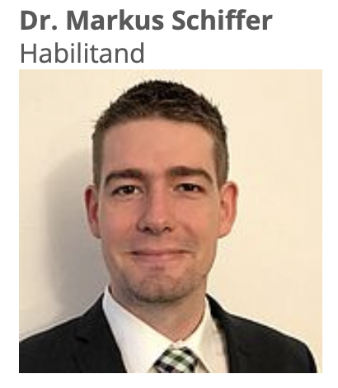
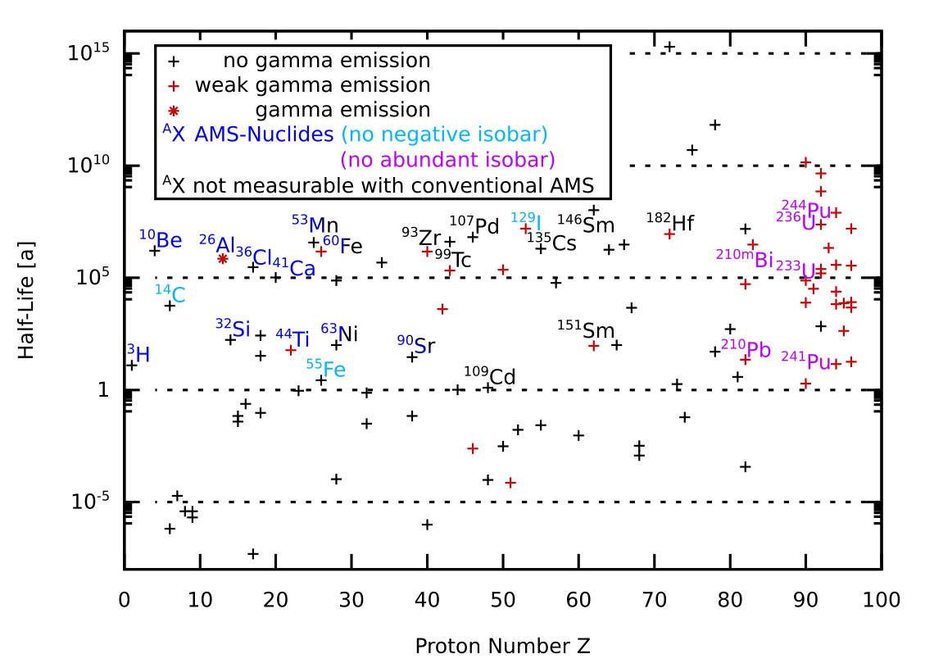
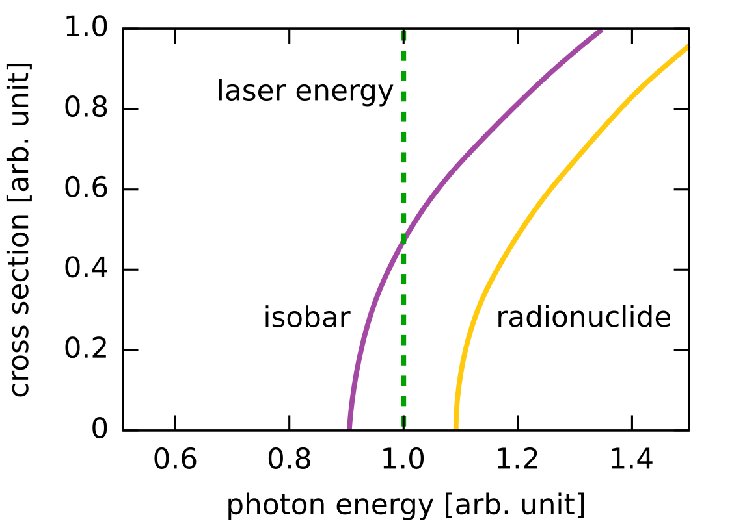
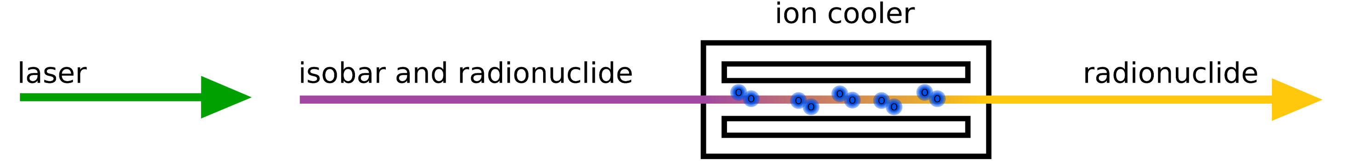
A new era in AMS: Isobar Suppression
O. Forstner et al., NIMB 361(2015) 217-221

Slide 13




Institute of Nuclear Physics - CologneAMS 6 MV
Nuclei: ¹⁰Be, ¹⁴C, ²⁶Al, ³⁶Cl, ⁴¹Ca, ^{2xx}Pu
ALIS
Anion Laser Isobar Separator
ALIS
single atom counting

Slide 14









Developments for ²⁶Al
Preliminary results:
blank, 1.5 Pa, 0 W
R = (3.00±0.07) × 10⁻¹¹
Laser off
Laser on
blank, 2.5Pa, 0 W
R = (2.00±0.05) × 10⁻¹²
1.5 Pa + 0 W
blank, 2.5 Pa, 18 W
R = (4.0±0.5) × 10⁻¹³
2.5 Pa + 0 W
2.5 Pa +18 W

Slide 15

Developments for ²⁶Al
Preliminary results:
blank, 1.5 Pa, 0 W
R = (3.00±0.07) × 10⁻¹¹
blank, 2.5Pa, 0 W
R = (2.00±0.05) × 10⁻¹²
Markus Schiffer, Timm Pabst, Derin Schmidt
Some ALIS Projects:
²⁶Al improvement for geochronology
³⁶Cl in hyper-arid landscapes
⁵³Mn for burial dating
⁶⁰Fe for nuclear astrophysics
⁹⁰Sr in soil for nuclear declaration
¹⁸²Hf for nuclear astrophysics
blank, 2.5 Pa, 18 W
R = (4.0±0.5) × 10⁻¹³

Slide 16
Overview: Stellar processes

Slide 17




Evidence for additional nucleosynthesis processes
Mo overabundances
10
s,r
s,r
1
s,r
r
X(^{i}Mo) / X(^{i}Mo)_{solar}
0.1
p
s
~10⁸ n/cm³
p
0.01
Stardust grains
0.001
92
94
96
98
100
Mass Number
Meyer et al, APJ 2000
La/Eu
Stellar observations and stardust measurements provide evidence for additional processes
Models attempt to disentangle the contributions from each process
Accurate nuclear physics input is necessary with guidance from observations
Intermediate
i –process?
~10²⁰ n/cm³
JINAbase
Ba/La
Herwig, Denissenkov

Slide 18

Impact of the neutron flux
~10⁸ n/cm³
Simple one zone model changing the neutron density
s and r process stars exhibit different abundance ratios
Group of stars not explained by s or r neutron densities
La/Eu
~10²⁰ n/cm³
Ba/La
Falk Herwig, NPA2019 Proceedings

Slide 19



The intermediate neutron capture process
Nature Reviews Physics volume 7, pages 696–712 (2025)
Iris Dillmann, TRIUMF

Slide 20



Impact of neutron capture rate uncertainties
s process
~10⁸ n/cm³
Problem: both the ¹³⁹Ba nucleus as well as the neutron (lifetime: 879.4(6)) are unstable particles!
La/Eu
10¹³ n/cm3
Herwig, Denissenkov
~10²⁰ n/cm³
JINAbase
Denissenkov, et al, MNRAS (2019)
Herwig et al, 2018
Ba/La

Slide 21





Normalizations and the Oslo Method
Oslo-Data
from D₀
In exotic nuclei: we don’t know D₀
We can’t determine the “slope” $α$
use level density model to calculate $ρ(Sn)?$
S. Goriely, S. Hilaire and A. J. Koning
PRC 78, 064307 (2008)
Notes:
Commnet: already a few lvels at low excitationb energies really helps!

Slide 22


The Shape Method
Integration bin with sufficient number of states
2⁺
⁸⁸Br->⁸⁸Kr
Data from SuN @ CARIBU
2⁺

Slide 23

absolute partial Nuclear Level Density in an unstable nucleus
⁸⁸Kr
⁸⁸Kr

Slide 24


Reaction rate for ¹³⁹Ba(n,γ)

Slide 25



Reaction rate for ¹³⁹Ba(n,γ)
A. Spyrou, D. Muecher et al.,
Phys. Rev. Lett. 132, 202701, 2024
conclusions on i process:
10¹³ n/cm³ is in agreement with Ba/La observations
individual selected n-capture rates help pinning down origin of the i process

Slide 26




Outlook: Direct measurement of the ¹³⁷Cs(n,g) stellar neutron capture rate
¹³³Cs(n,g)¹³⁴Cs
A. Karaka, UoC 2025
¹³⁷Cs
Sample activity ~ 3 MBq
Parent nuclides ~ 10¹⁶
Φ_{Birmingham} ~ 6 x 10¹² cm⁻²
Activation time ~ 1 h
Produced ¹³⁸Cs ~ 1.5 x10⁴
Activity ¹³⁸Cs ~ 52. 4 Bq

Slide 27


The rapid neutron capture process
Adapted from M. Mumpower et al.,
Prog. Part. Nucl. Phys. 86 (2016)
FRIB: 10⁻⁴ pps
ANL, 2022: ¹⁴⁰Cs →¹⁴¹Cs
FRIB, June 2025 (PI: A. Spyrou, DM)
Notes:
Artemis and I actually came late to this conference because we just finished our first experiment targeting neutron capture rates using the new FRIB facility.
Explain FRIB
Why are we excited? Well for years we would say: we have constrained a n-capture towards the r process. And that is what I will also do for the first part of my talk, focussing on new data from ANL constraining 140Cs(n,g). I will also discuss from a more theporetical prerspective what likely happens if we move towards Z=50 closed shell. But now at FRIB we have finally arrived. Looking at this sensitivity study for neutorn captures from Matt Mmpower et al we see that in case of n-star mergers the region south west of 132Sn is critical.And this is exactly what we were able to do at FRIB. The experiment concluded Sunday so I won‘t show much, but I can show some first snapshots to show the quality of the data.

Slide 28



Probing the Limit of the Statistical Regime: The High-Fidelity Resonance Model
Lower NLD has impact on validity of Hauser-Feshbach model
B. Greaves, DM, A. Spyrou et al, Phys. Lett. B 871 (2025) 139992
Our data suggest that NLDs in the A=140 region tend to be smaller than expected by some models

Slide 29


Hauser-Feshbach vs. Individual Resonances
Lower NLD has impact on validity of Hauser-Feshbach model
B. Greaves, DM, A. Spyrou et al, Phys. Lett. B 871 (2025) 139992
We have already experimentally reached the limit of the statistical regime
General trend: Hauser-Feshbach unterpredicts (n,γ) rates
D. Rochman, S. Goriely et al, Physics Letters B 764 (2017)

Slide 30


News from SuN@FRIB, MSU June 2025
1h of data
50
Sensitivity to r process
49
PRELIMINARY
Z
48
Cote et al, Science 2021
47
46
Sensitivity to ¹²⁹I
2.65 2.7 2.75
A/Q

Slide 31


News from SuN@FRIB, MSU June 2025
E_{x} (keV)
Sensitivity to r process
PRELIMINARY
Setup
SuN++ TAS (12 NaI, 8 CeBr₃)
seg. implantation DSSD detector (both PiD and β-trigger)
hosted inside MTAS frame
¹²⁹Cd →¹²⁹In
10h of data ≈ 80.000 counts
E_{γ} (keV)
PIs: A. Spyrou, DM
+ S. Lidick + many people

Slide 32



Outlook: Neutron captures towards the dripline
(n,γ): J^{π}=1/2⁺
β⁻, allowed: J^{π}=(1/2⁻, 3/2⁻)
→(E1): J^{π}=(1/2⁺, 3/2⁺, 5/2⁺)
Idea: use high-resolution γ-array or TAS to directly measure # levels
total # levels in ¹³³Sn up to S_{n}: about 50
total # populated levels: about 10
Example: using a CeBr TAS (3% energy resolution):
about 20% accuracy to count 100 levels / MeV

Slide 33


Summary + Thank you
β-Oslo: powerful technique for constraining n-capture rates in exotic nuclei
⁵⁹Fe(n,γ)⁶⁰Fe larger than previously thought due to up-bend
A neutron density of 10¹³ is a possible condition for the i process
First constraint of the ¹⁴⁰Cs(n,γ)¹⁴¹Cs reaction rate at the limit of statistical behaviour
Successful first experiment for n-capture rates at FRIB below ¹³²Sn
Cologne-AMS: new ALIS setup opens new window for AMS measurements, including for nuclear astrophysics experiments

