Slide 1
Artificial intelligence
for high energy density physics at large scale facilities
Michael Bussmann · Topic Lead Helmholtz Matter Data Management & Analysis · CASUS / HZDR

Slide 2
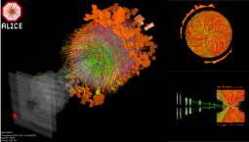
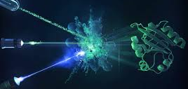
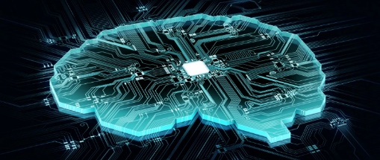
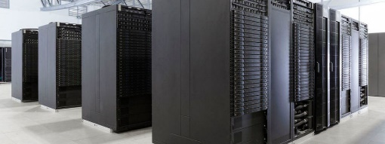
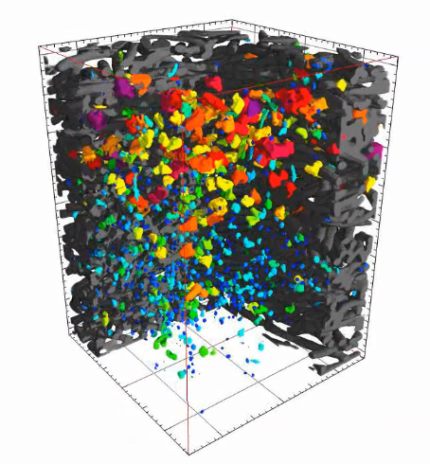
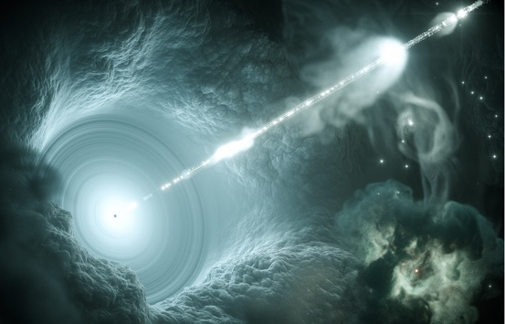


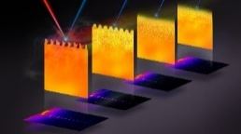
Matter & Technologies Topic Data Management and Analysis (DMA)
AI-augmented research facilities – closing the loop between modeling and experiment
Hypothesis
Modeling
Simulation
& Prediction
Experiment
& Machine
Processing
& Analysis
Data Acquisition
Exascale
Computing
A.I.
Quantum/
Neuromorphic
Computing
Edge to Cloud
Computing

Slide 3
Matter & Technologies Topic Data Management and Analysis (DMA)
Building blocks for AI-augmented facilities (Tycho Brahe, Manhattan project, CERN, …)
A well defined understanding of observables
  A clear ontology and semantic approach
  Models with predictive capability
  How to measure and quantify observables
A detailed knowledge of your system
  Digital twins of systems under investigation
  Variation over all possible outcomes
Digitalization of facility operation and experiments
  A quantifiable and steerable model of your facility
  Include all known sources of errors
  A complete error analysis
  Invertible synthetic diagnostics
A sustainable, F.A.I.R., long term data base
  F.A.I.R. data lifecycle management
  From MHZ to decades
  Self-descriptive, federated, licensed
Reproducible workflows
  for simulation and data analysis
  for operation and experiments
Clear criteria for data selection & observation
  Trigger / data reduction rules
  Small signal vs. background
  Anomaly detection

Slide 4
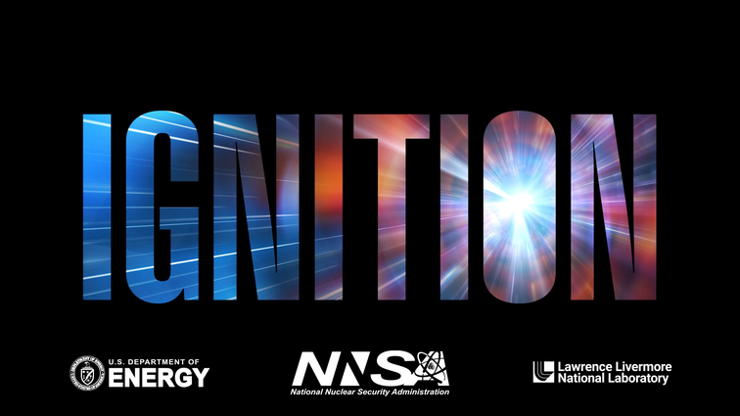





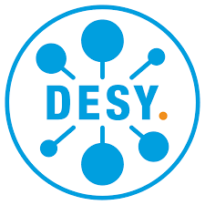


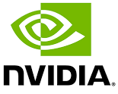






Helmholtz facilities provide unique data
AI-augmented research facilities – enabling and accelerating science by digitalization
Dagstuhl Seminar 23132 / Dagstuhl Reports 13
AI-Augmented Facilities:
Bridging Experiment and Simulation with ML

Slide 5
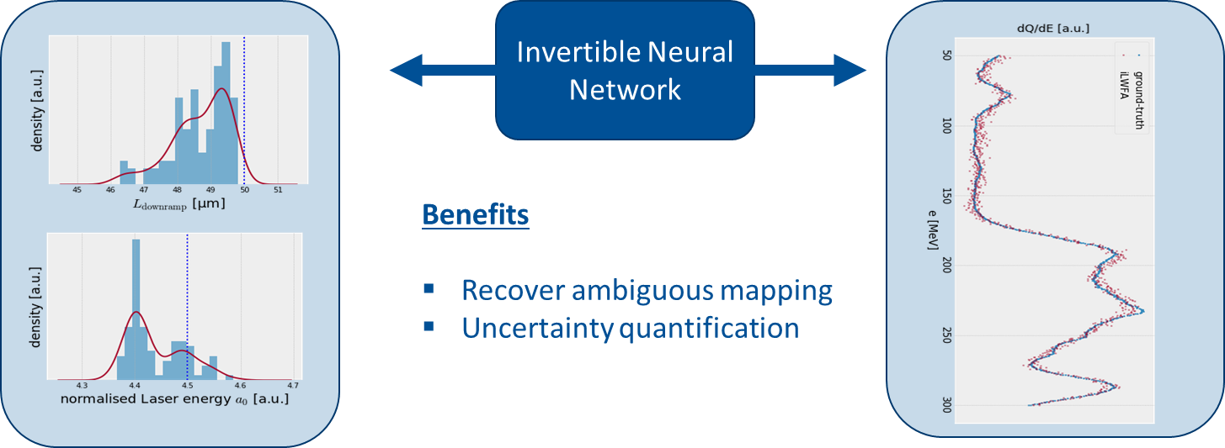
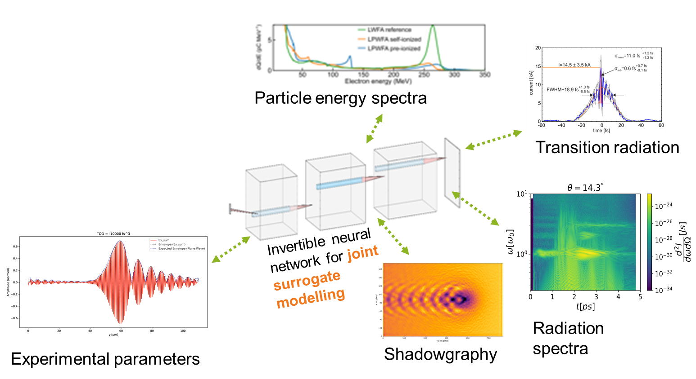
Simulate what is measured – zooming into parameter space
Multimodal diagnostic outputs and system state parameters define the observed system
Multi-physics, multi-modal surrogate modeling
Invertible physics-informed neural networks
Data-driven models including laser, beamline and
system diagnostics and covering a large
parameter space leverage the full capabilities
of Hz-level, reproducible experiments

Slide 6
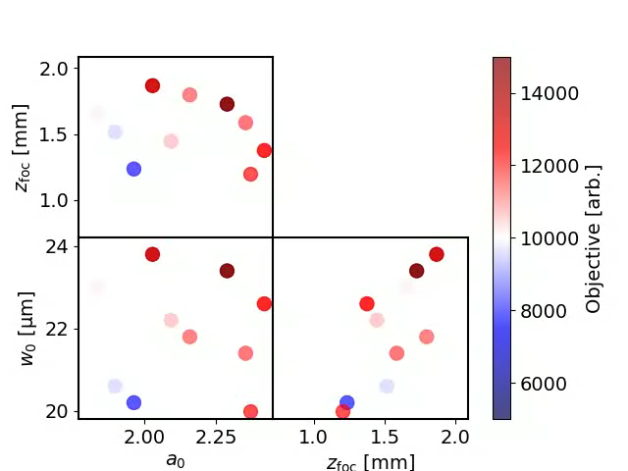
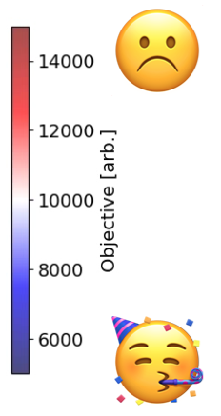
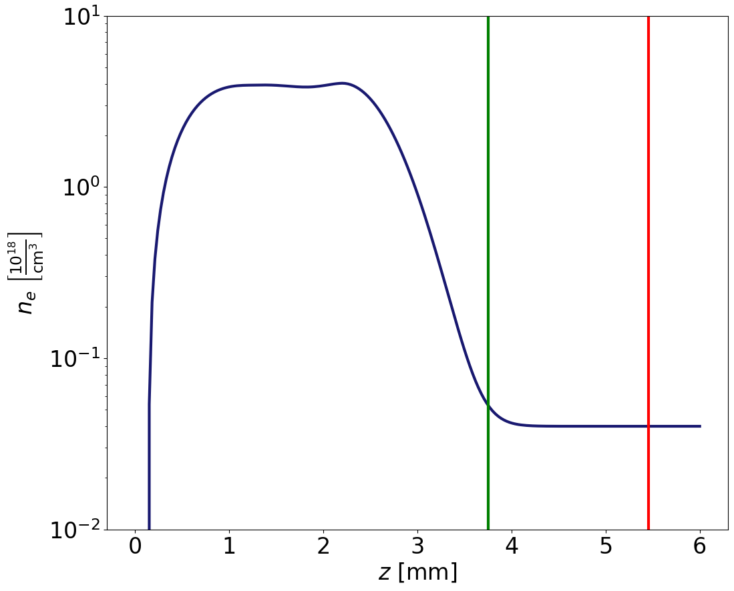
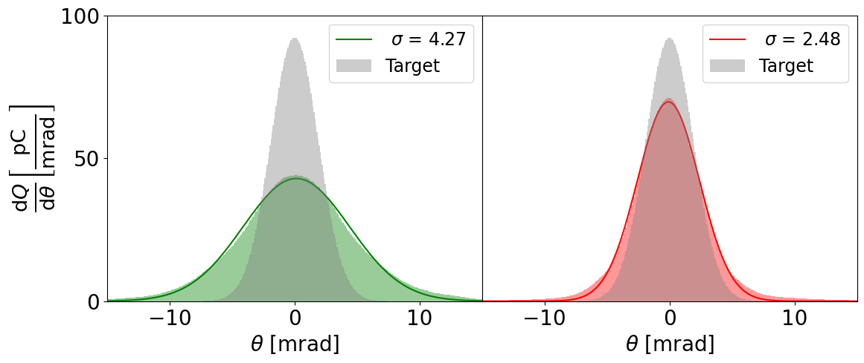
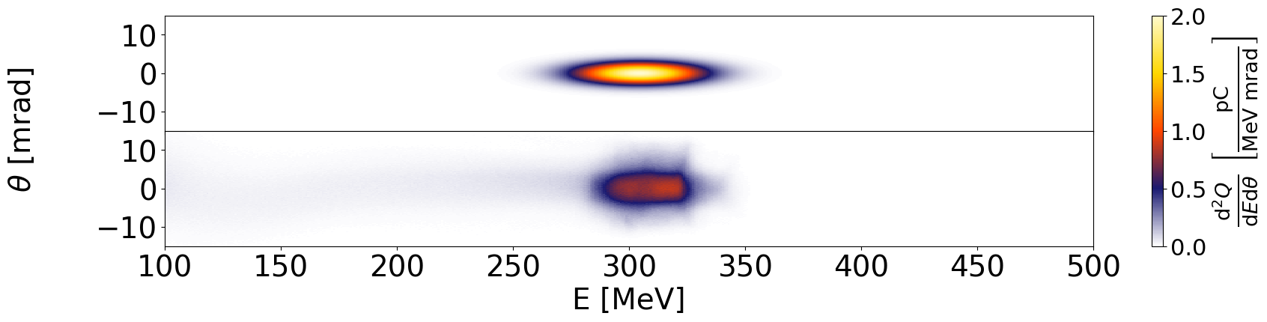
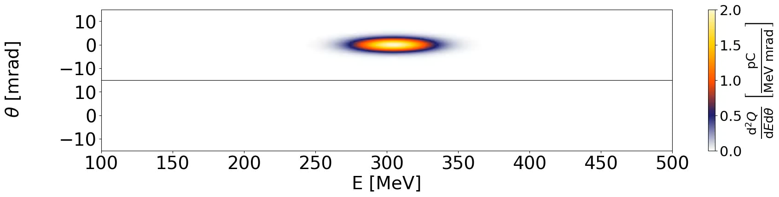
Linking observables and models
We can infer the internal plasma parameters by linking diagnostics with simulations
J. Tiebel, R. Pausch

Slide 7
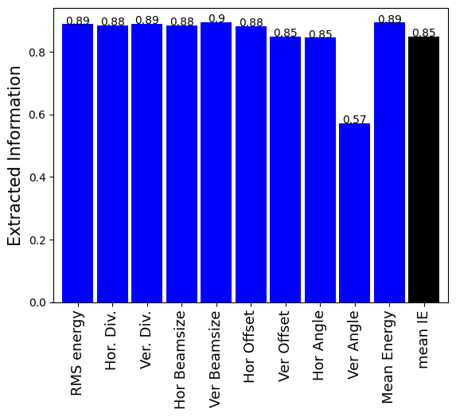

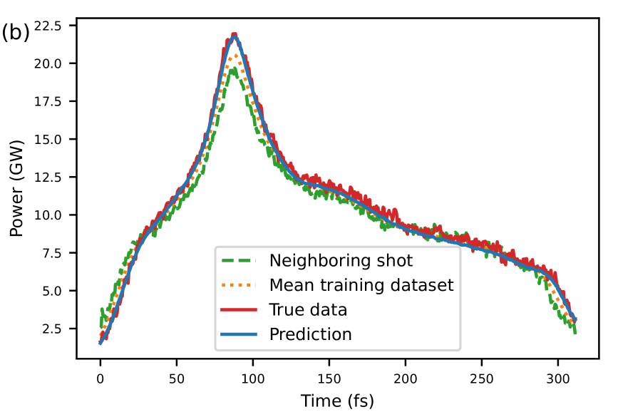
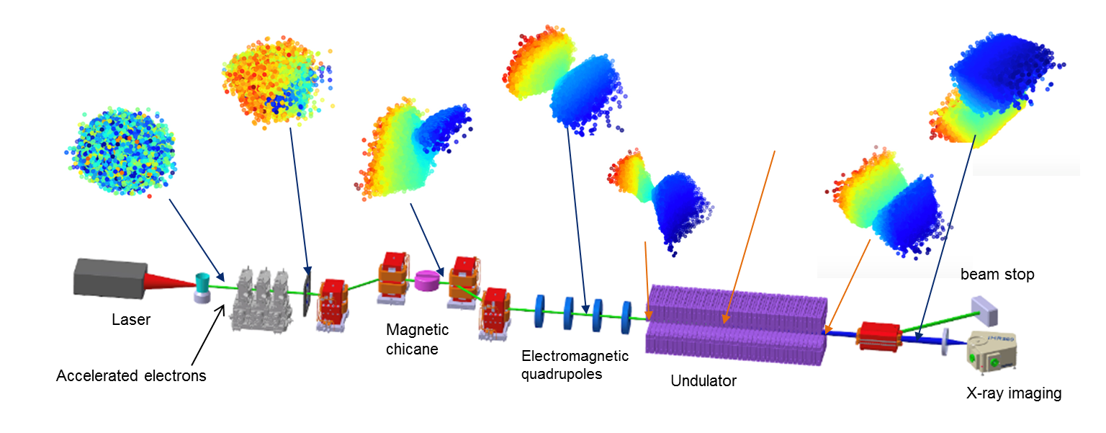

6D phase space reconstruction, single-shot FEL pulse prediction
We can infer all relevant beam and radiation parameters using only limited diagnostic information
Single-shot FEL pulse shape prediction
based on FLASH beamline parameters
Electron bunch reconstruction
at the COXINEL laser-diven FEL
Reproducibility
Award

Slide 8
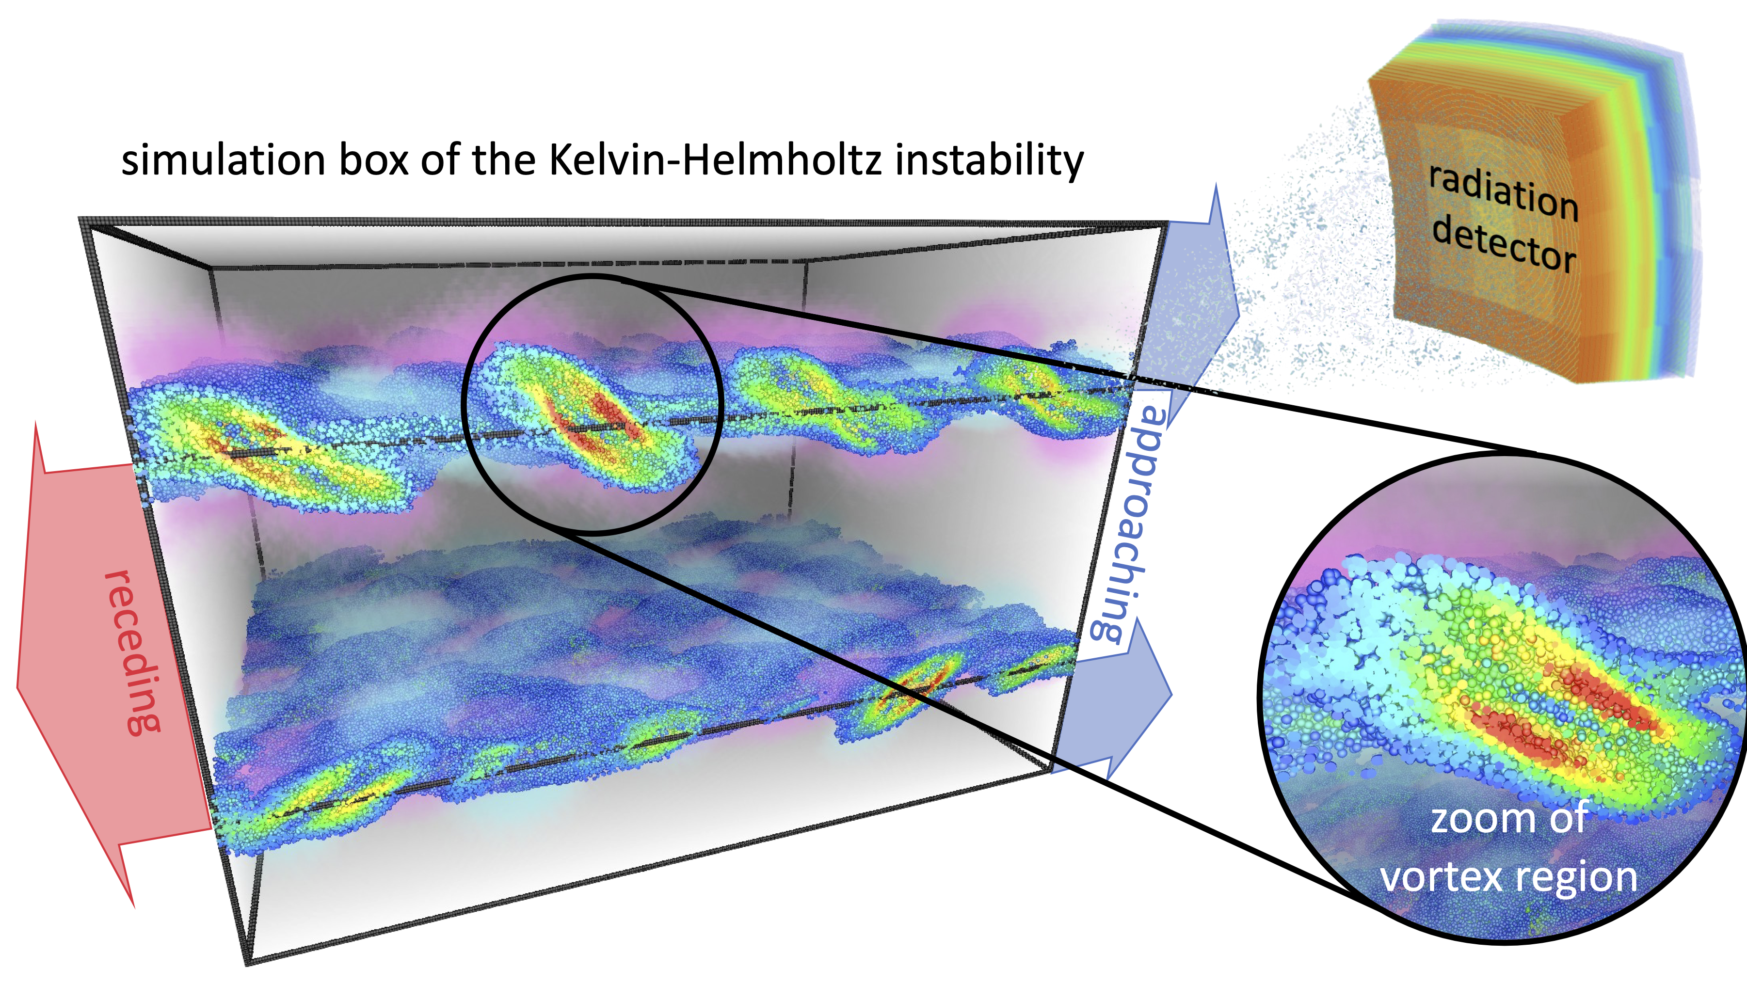
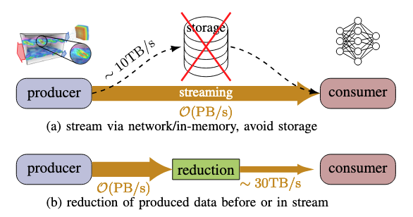


Reconstructing electron dynamics from radiation spectra @ PB/s
Radiation from plasmas tells us their composition, structure and dynamic evolution
Train neural networks for:
Forward problem:
particle to radiation
Compression:
particle to particle latent space
Inverse problem:
radiation to particle

Slide 9
What’s special about AI?
Not much, actually. It just allows us to represent (all) our knowledge in a very efficient way
Uncertainty quantification Error bars on steroids
Outlier detection Huh, what was that? An error? Something new?
Complex optimization Multi-parametric, Multi-objective, single-shot, etc.
Differentiable models How do systems evolve in parameter space?
Surrogate models Fast input/output models, multi-scale, multi-physics
Physics-informed models: Use both data and your knowledge to make predictions
Invertible models In what state is my system in? (single-shot, non-convex inverse problems)
Foundation models Represent all our knowledge and connect the dots
Reinforcement, evolution Include new knowledge, learn from mistakes, adapt
Symbolic AI, operators Construct PDEs from data alone
Agentic AI Solve complex tasks, act autonomously, explore and give feedback
Your daily tasks,
just MUCH better!
You can do that?
And fast?
WHAT???
HOW???

Slide 10
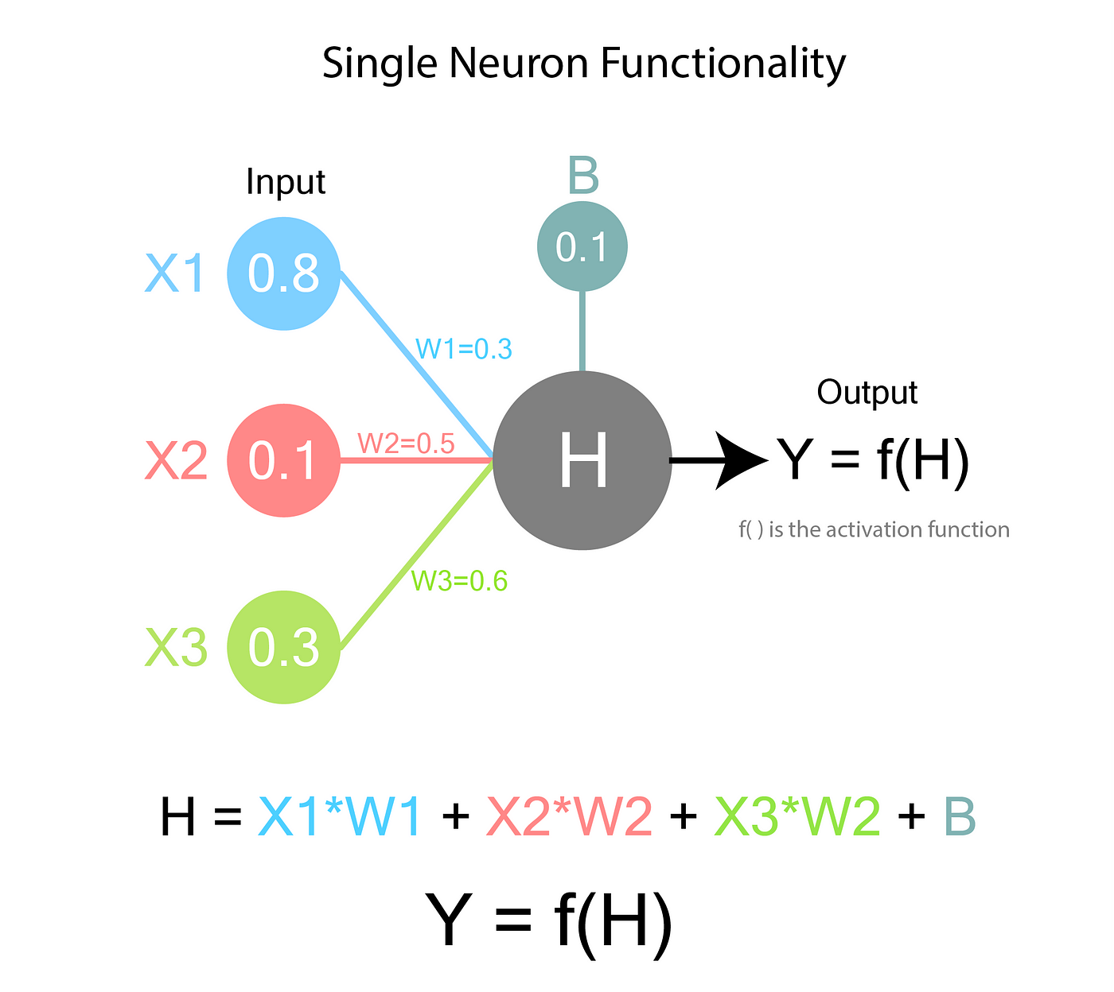
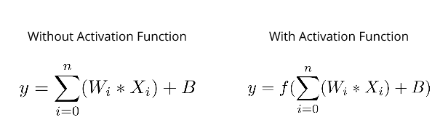
The AI atom: The perceptron
Universal approximators (or “fitting”)
Linear
Can be nonlinear

Slide 11
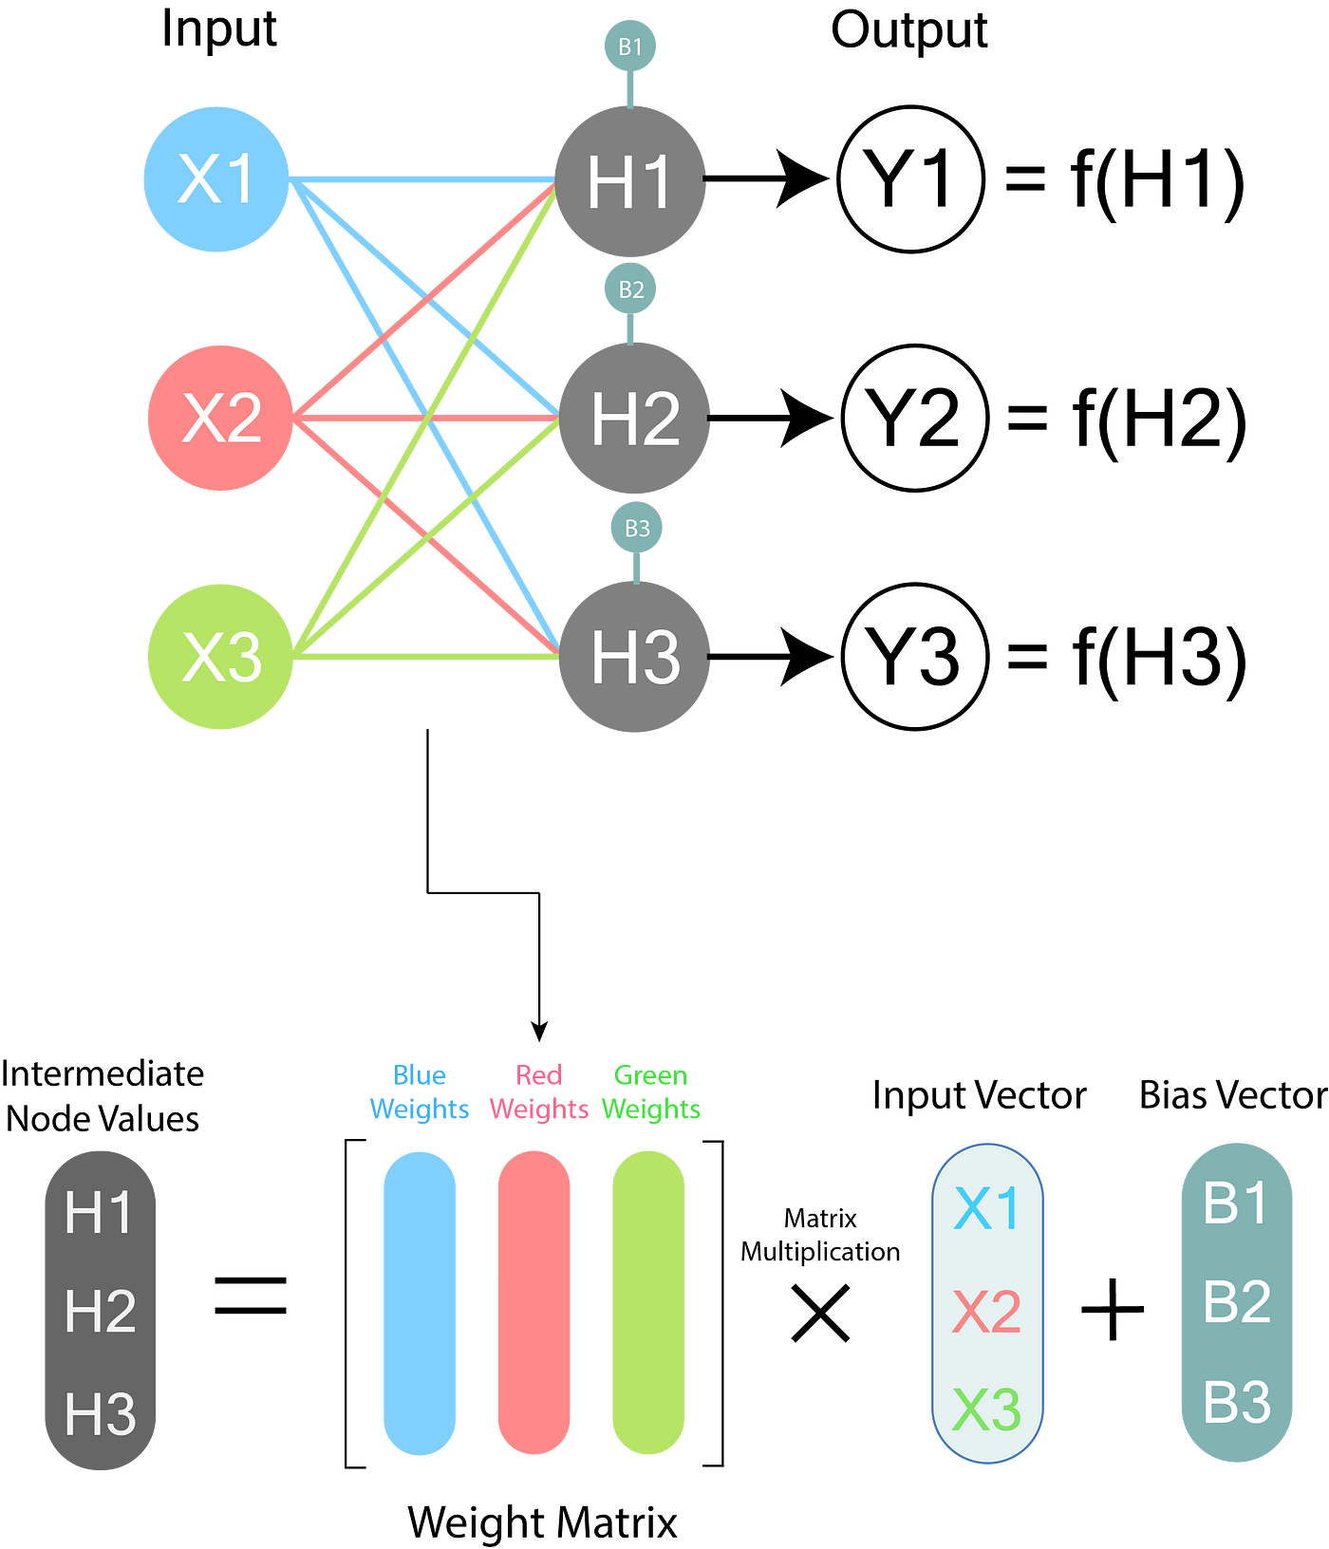
Neural networks are made of perceptrons
Universal approximators (or “fitting”)

Slide 12
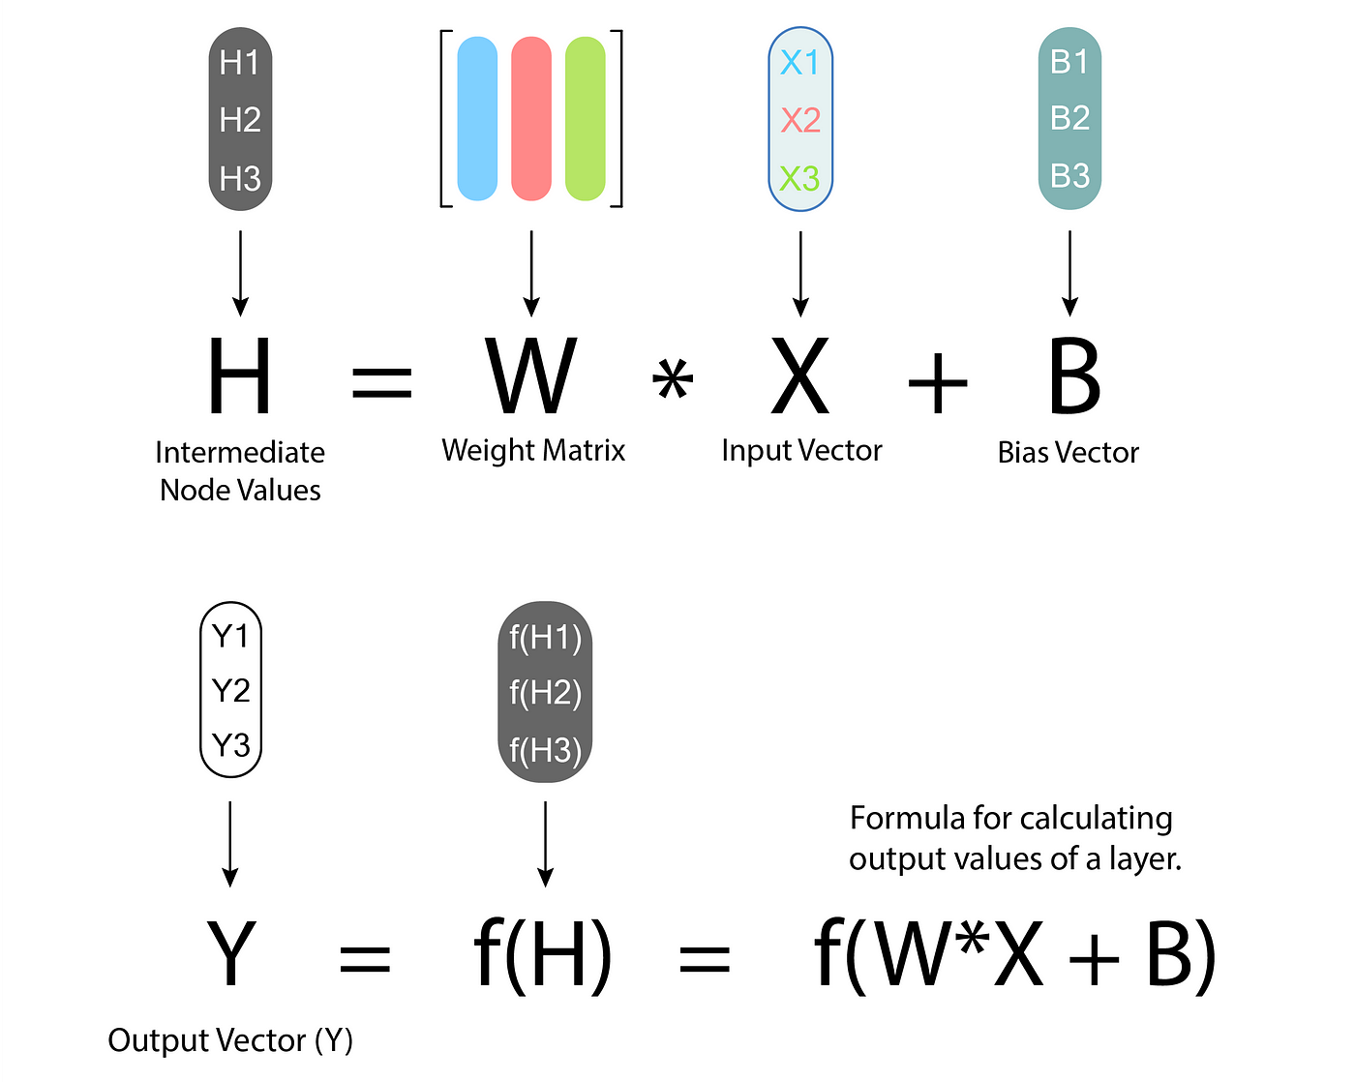
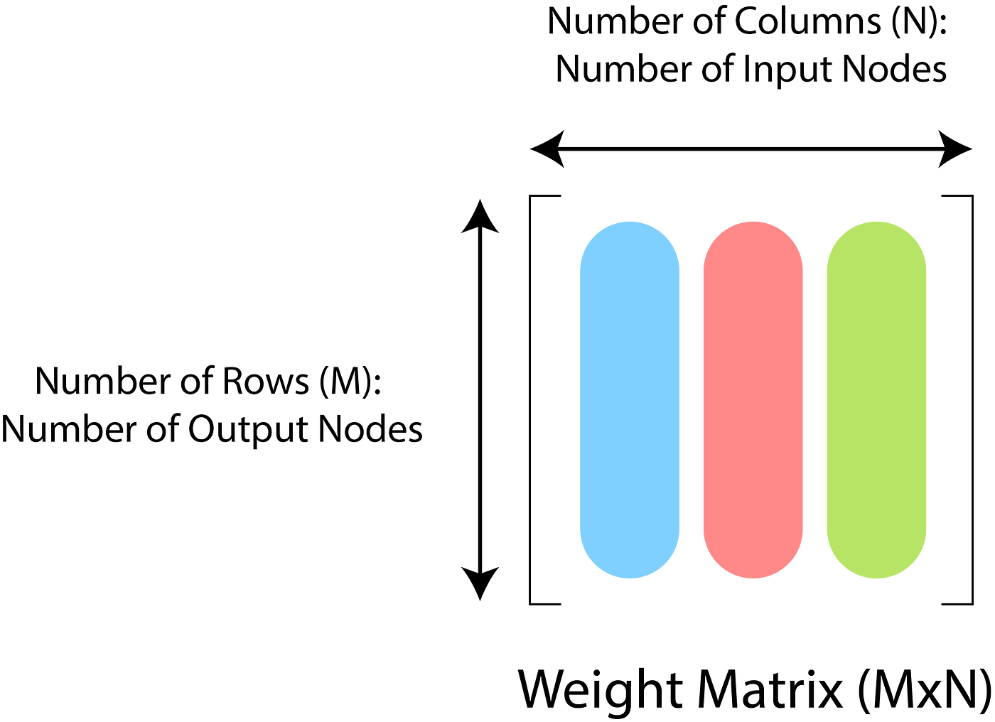
Input, output and “hidden” layers
Universal approximators (or “fitting”)

Slide 13
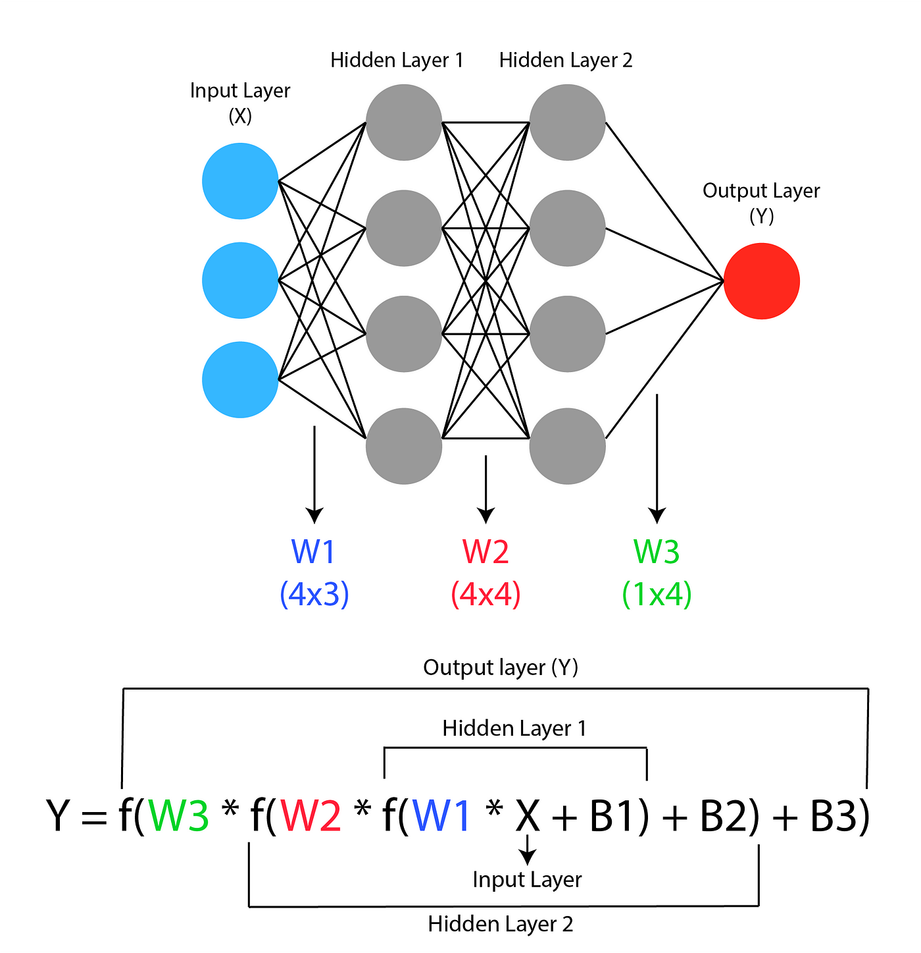
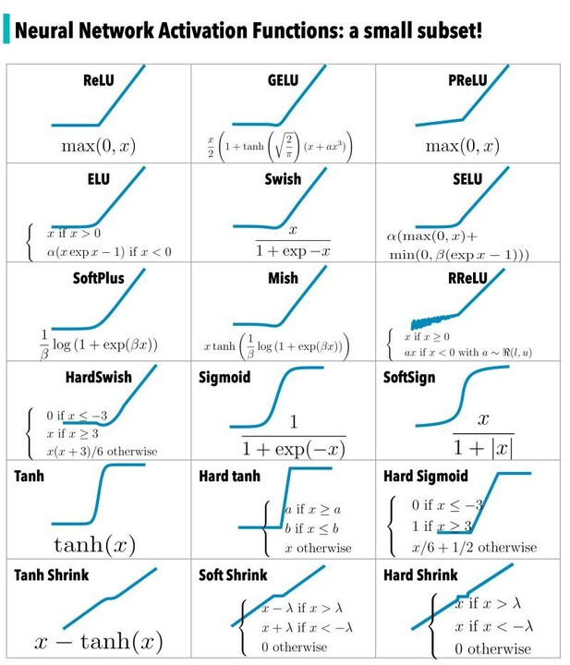
Activation functions “optimize” gradient calculations
Universal approximators (or “fitting”)
*activation functions have to be locally differentiable, but not monotonic!

Slide 14
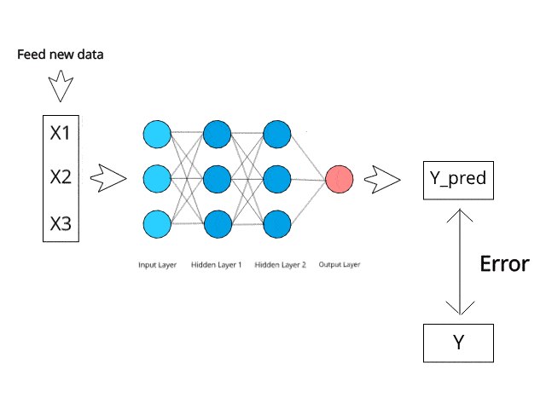
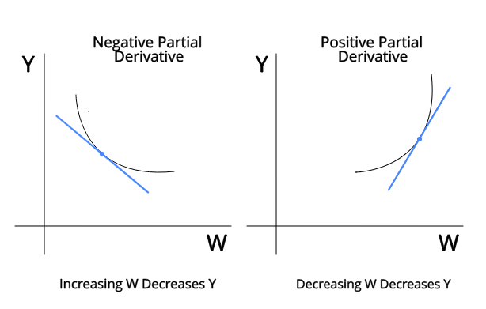
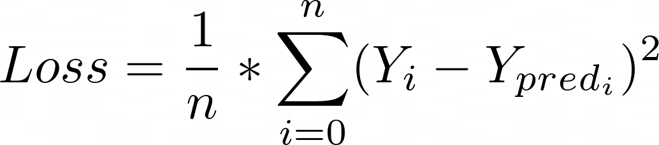
The loss function, backpropagation and fitting
Universal approximators (or “fitting”)
„Backpropagation“ means
updating node values to
minimize loss function
„Mean squared error“

Slide 15
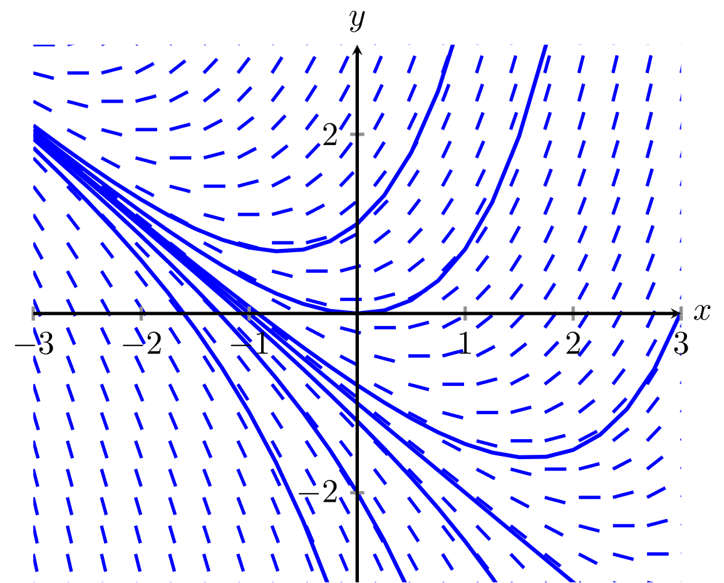
Solving PDEs is local gradient optimization
An example: Solving partial differential equations with physics-informed neural networks
Local tangent field

Slide 16
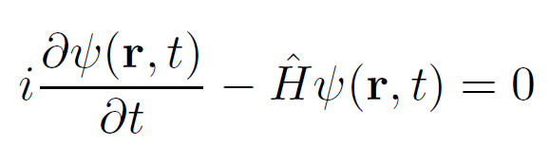
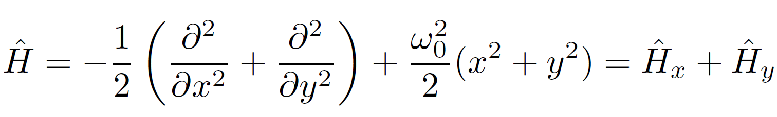
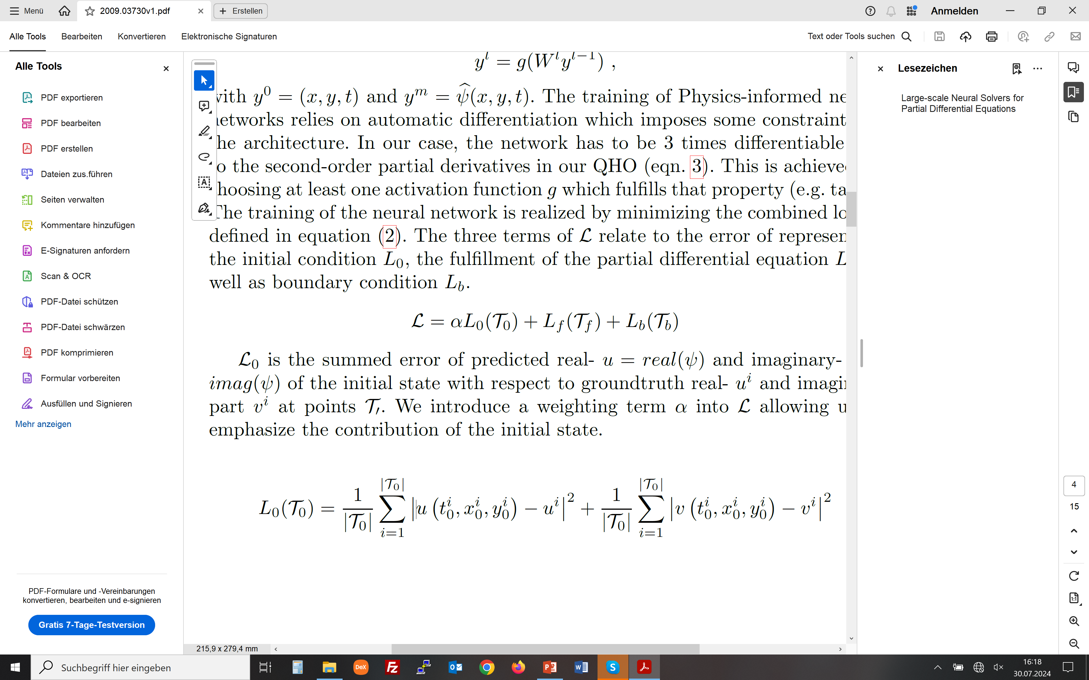
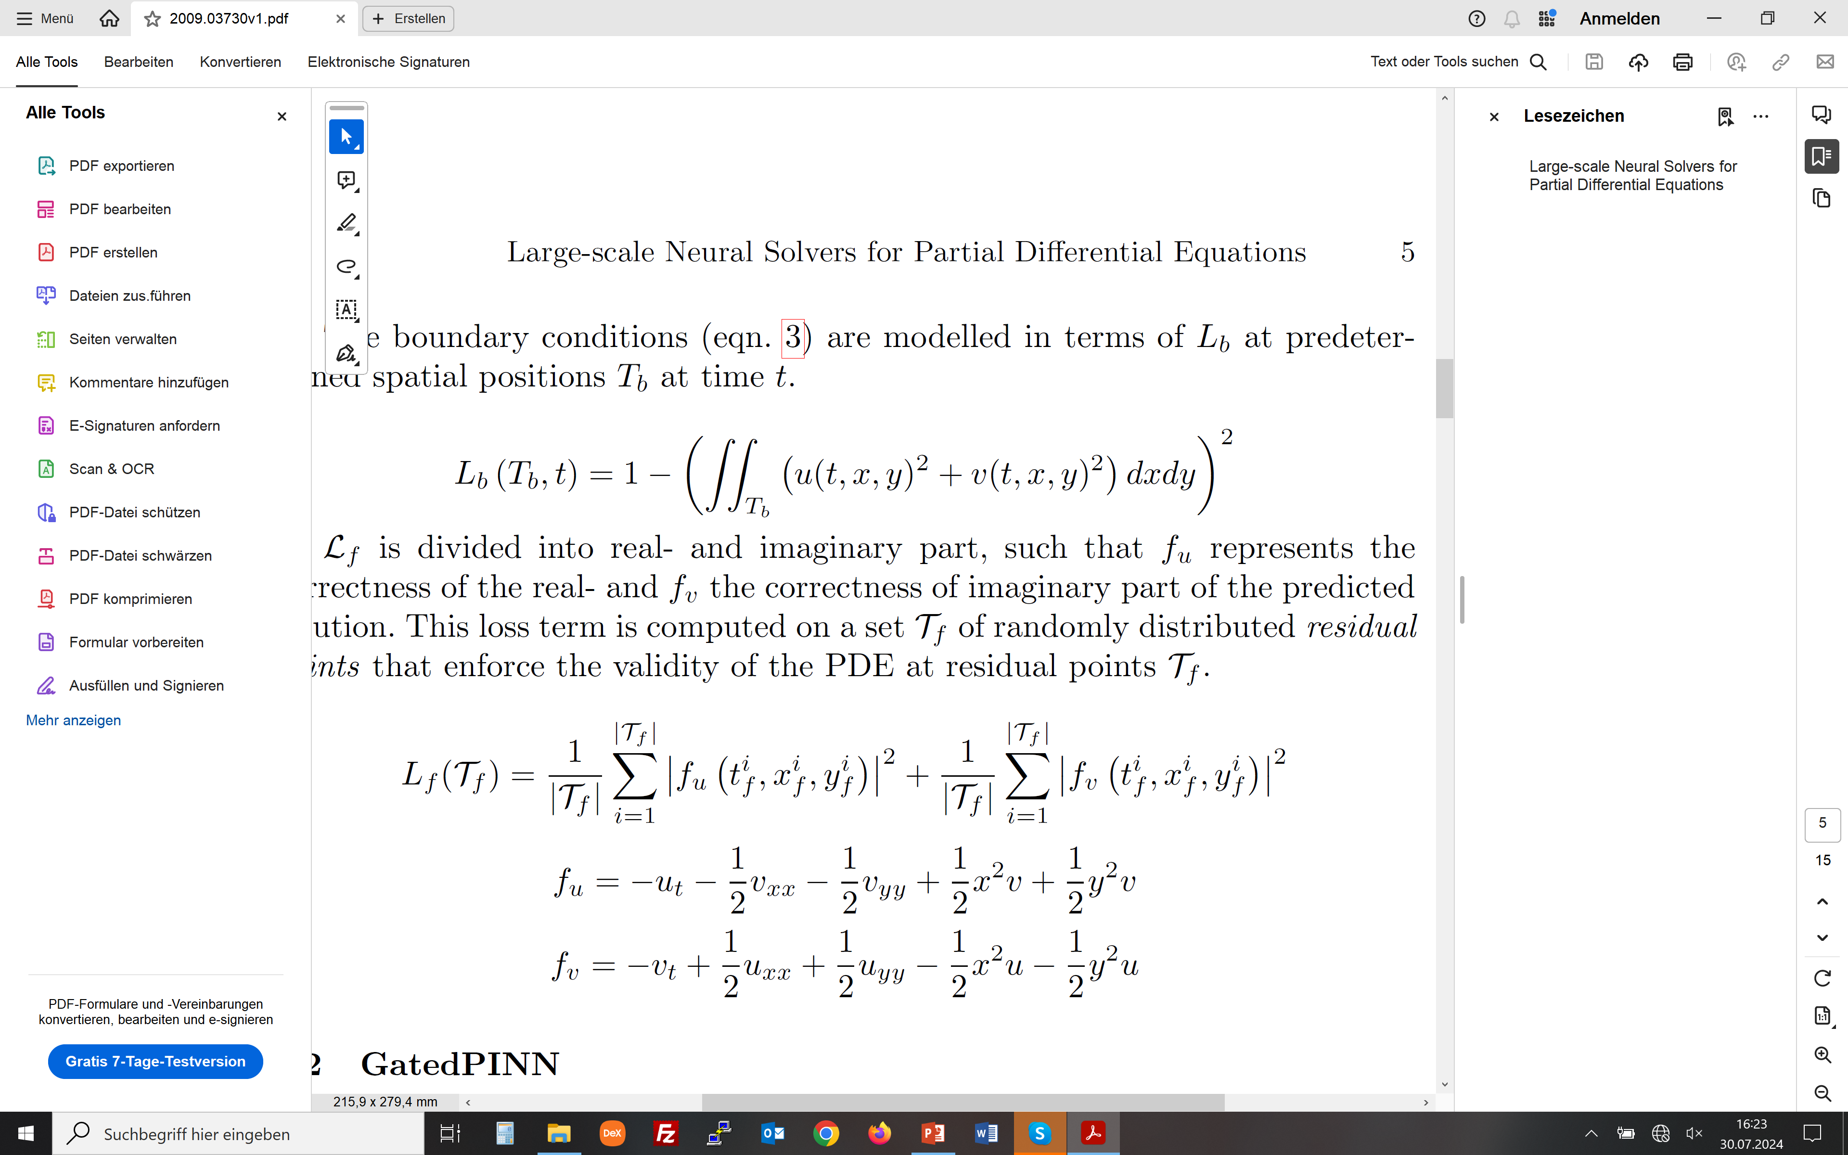
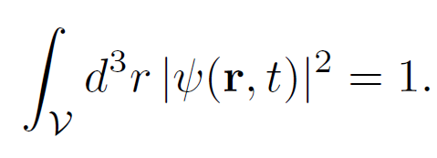
Using the loss function to include “physics knowledge”
An example: Physics-informed neural networks for the time-dependent quantum harmonic oscillator
Put all „physics knowledge“ in the „loss term“
Initial conditions (comparison to „ground truth“)
Boundary conditions
Solving the PDE as a minimization problem

Slide 17
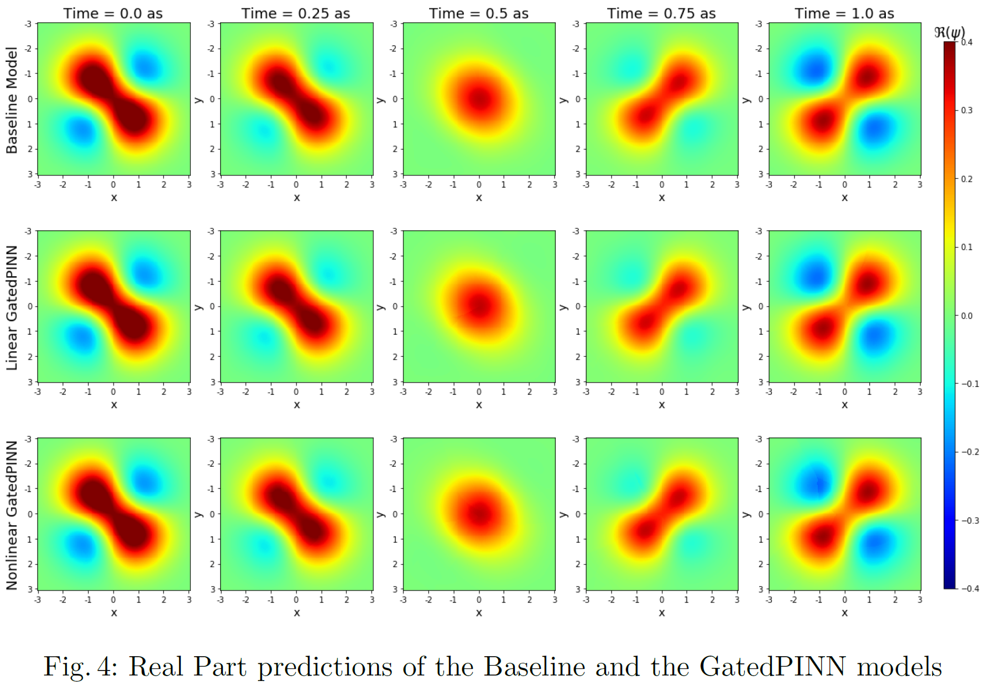
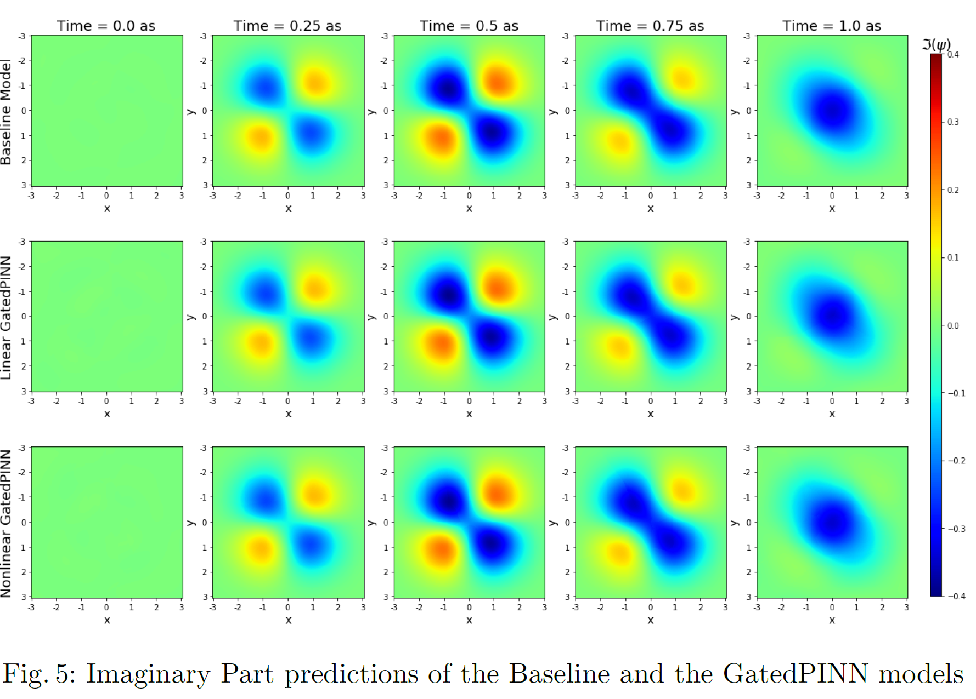
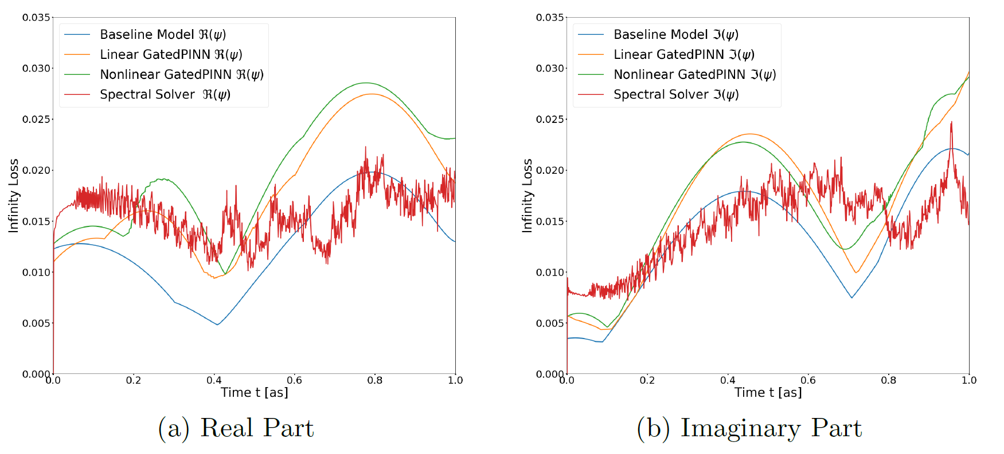
This is physics-informed data fitting
An example: Physics-informed neural networks for the time-dependent quantum harmonic oscillator

Slide 18
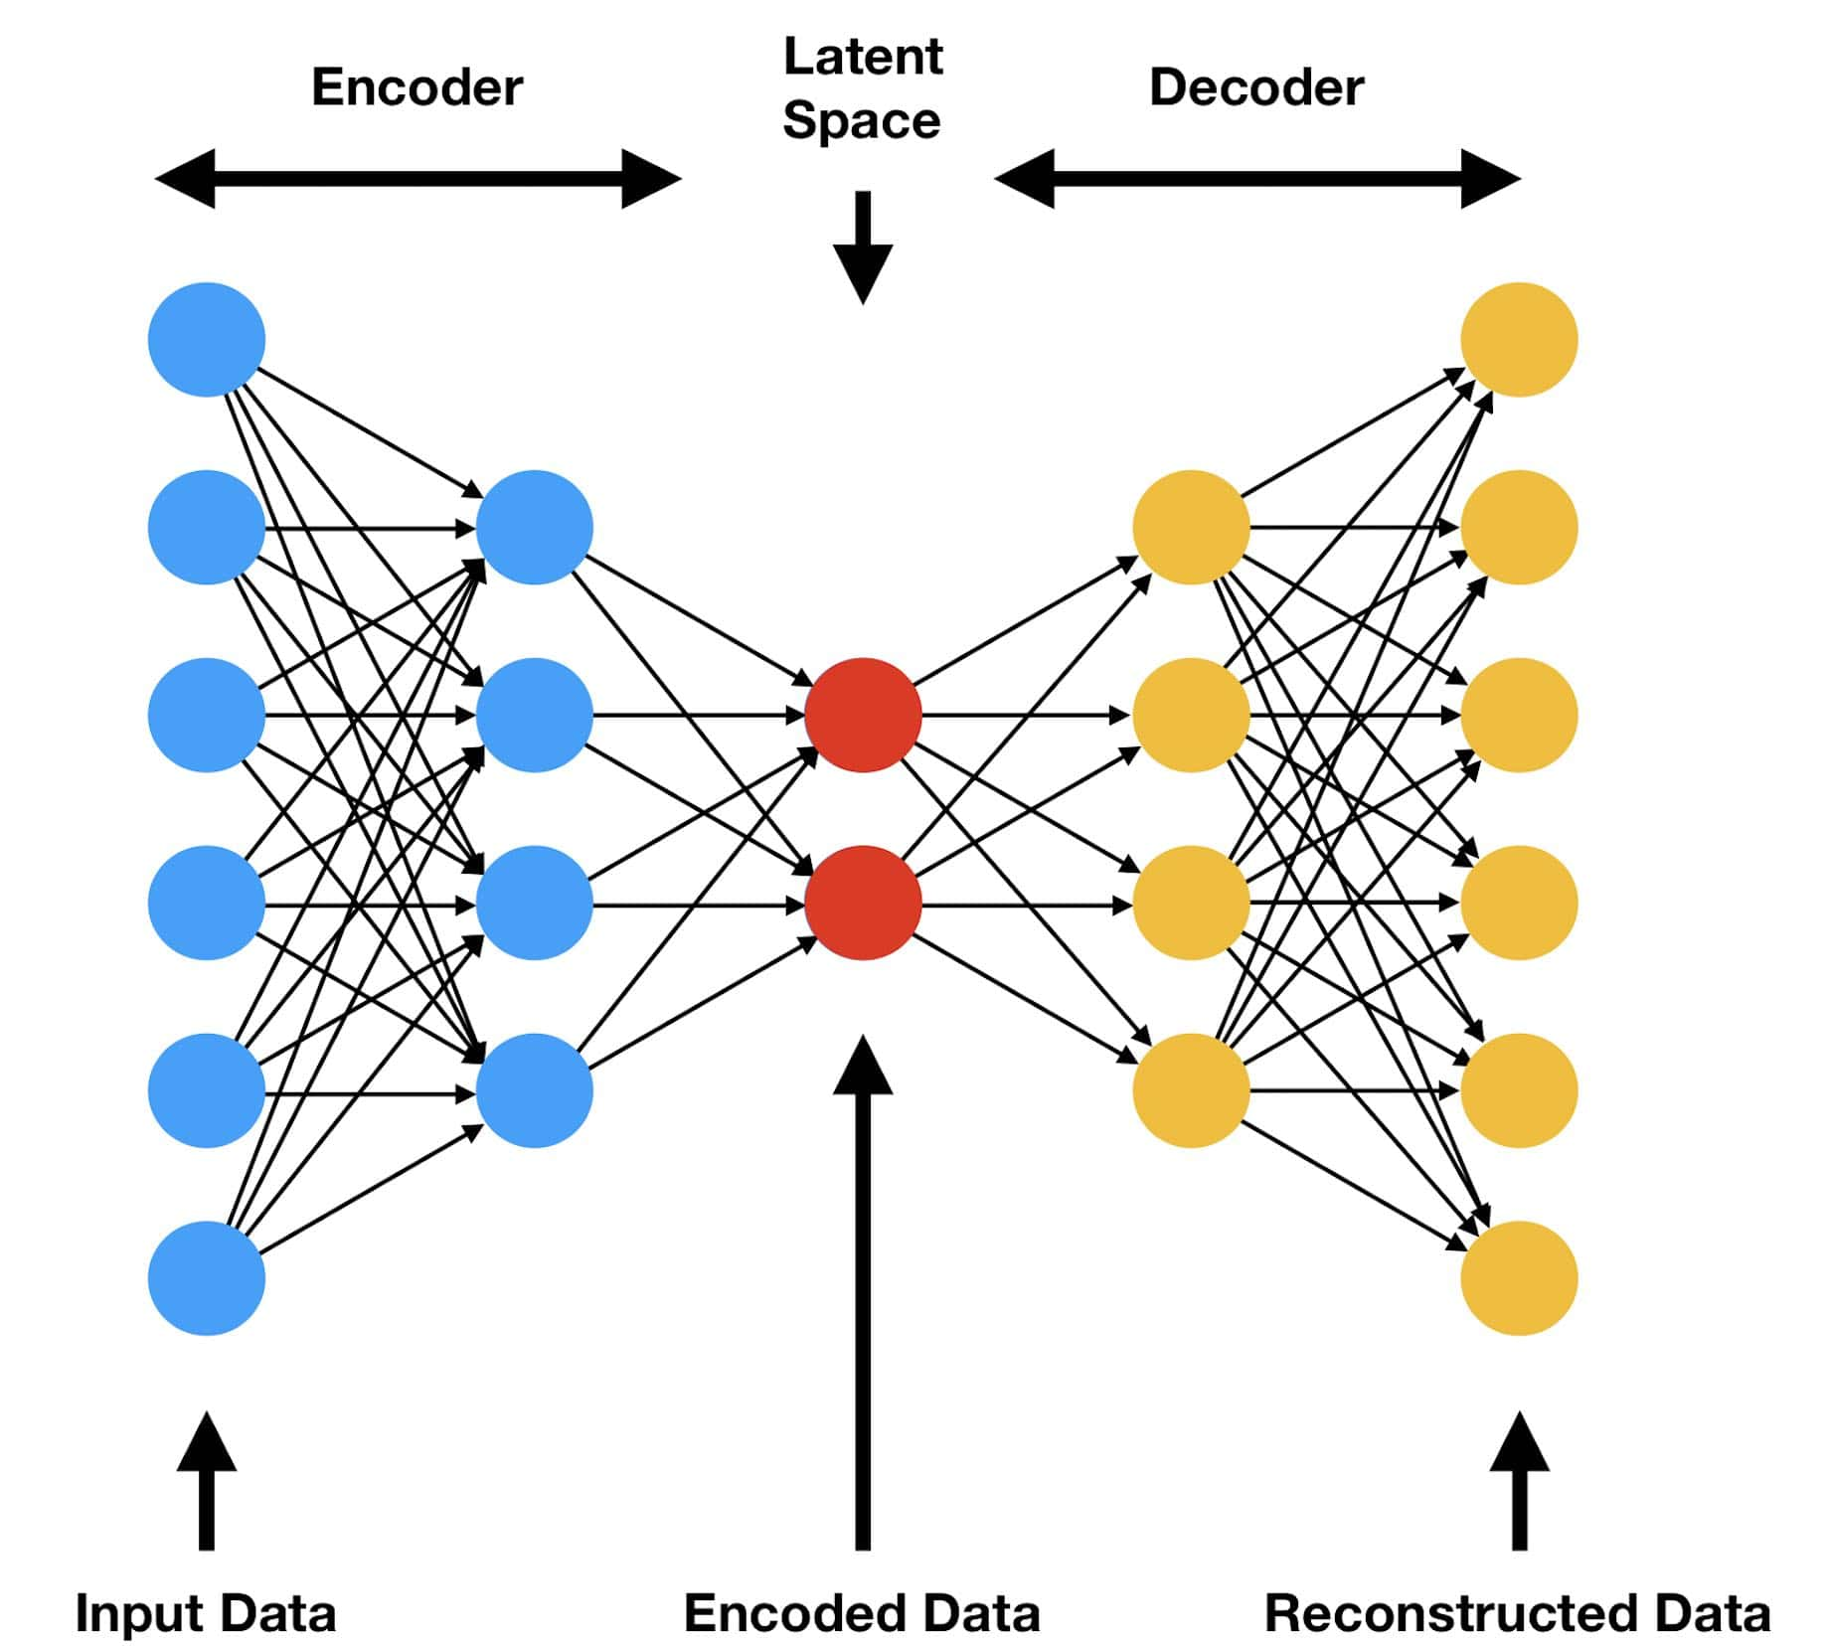
Generative AI: Find the latent space, generate random latent vector
A universal building block of generative AI: The encoder / decoder architecture

Slide 19
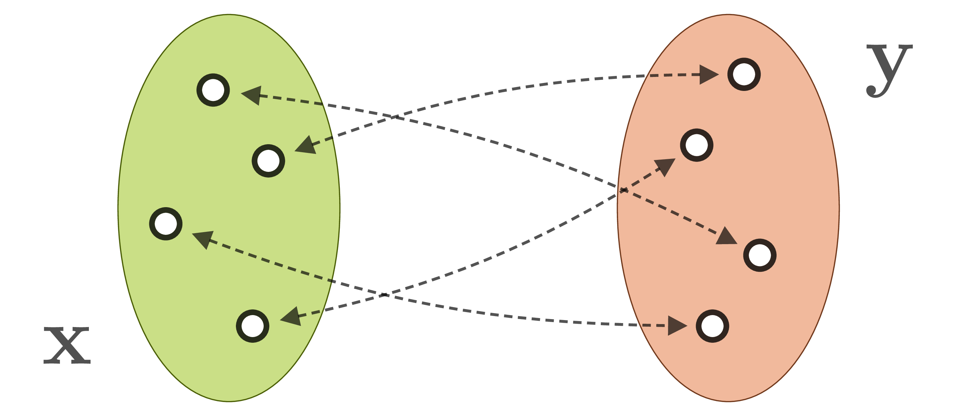
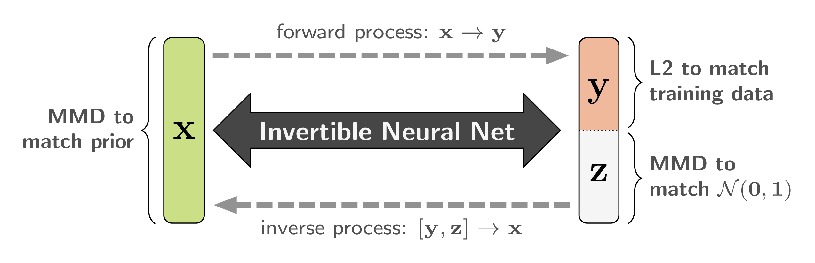
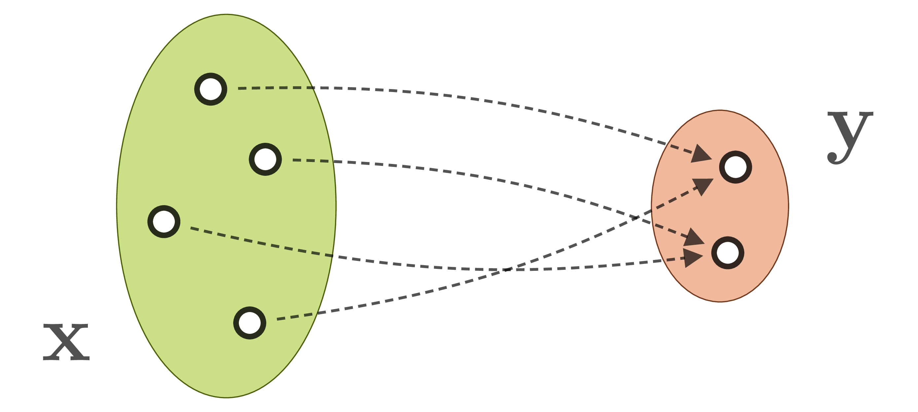
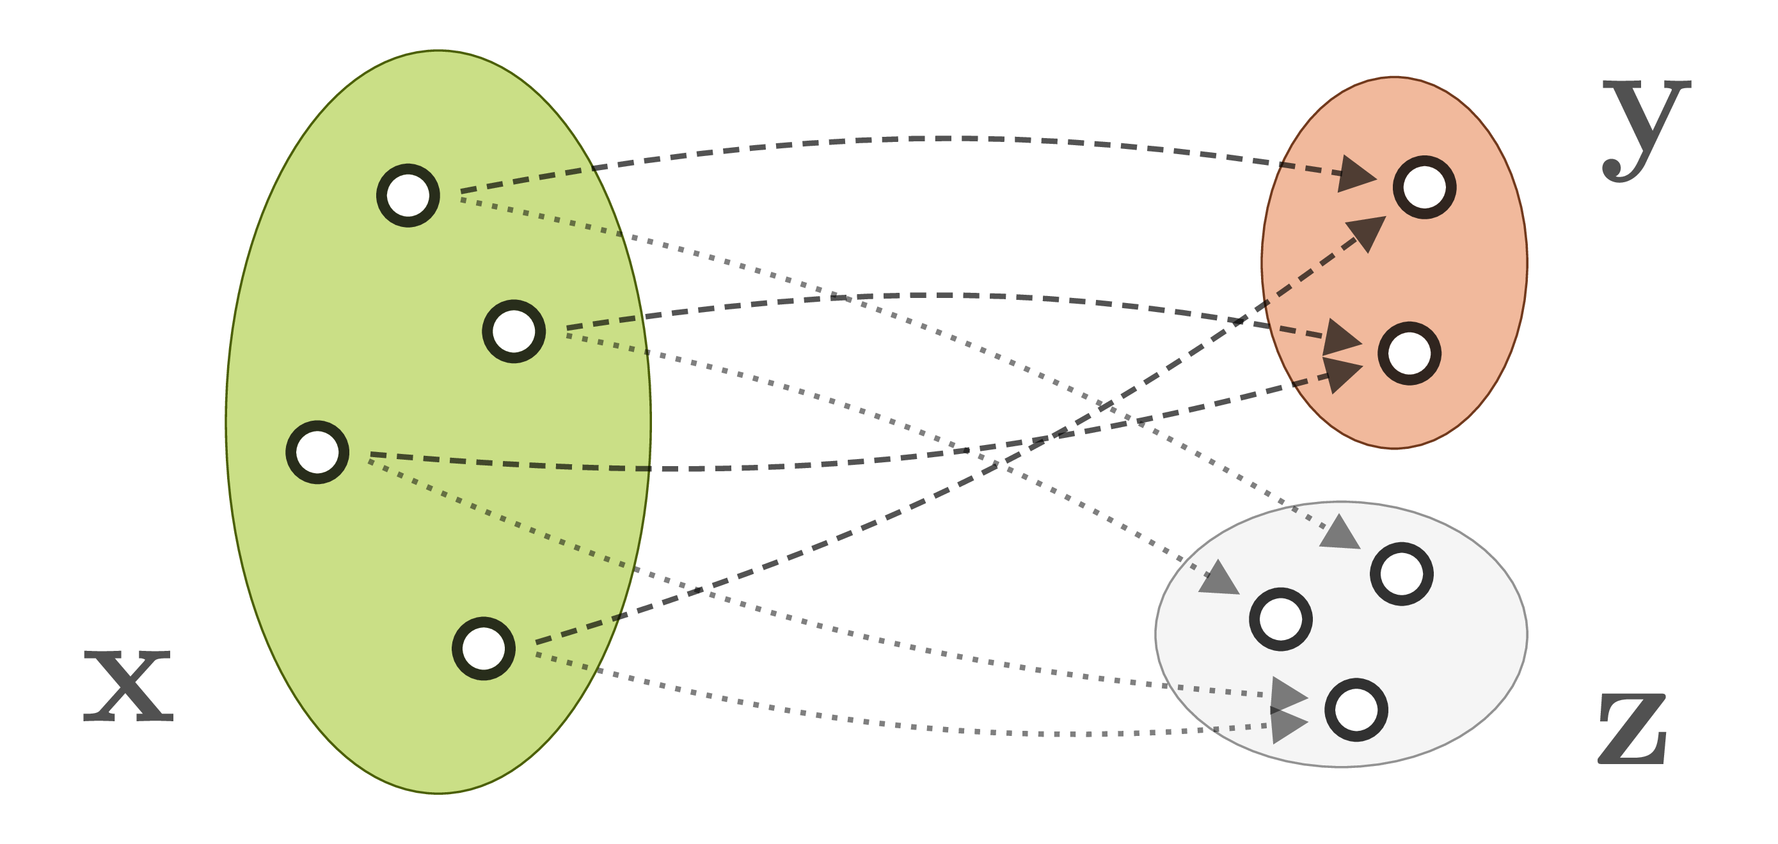
AI is very often piecewise linear, so inversion is possible
Matching outputs to inputs for inverse problems: Invertible neural networks

Slide 20
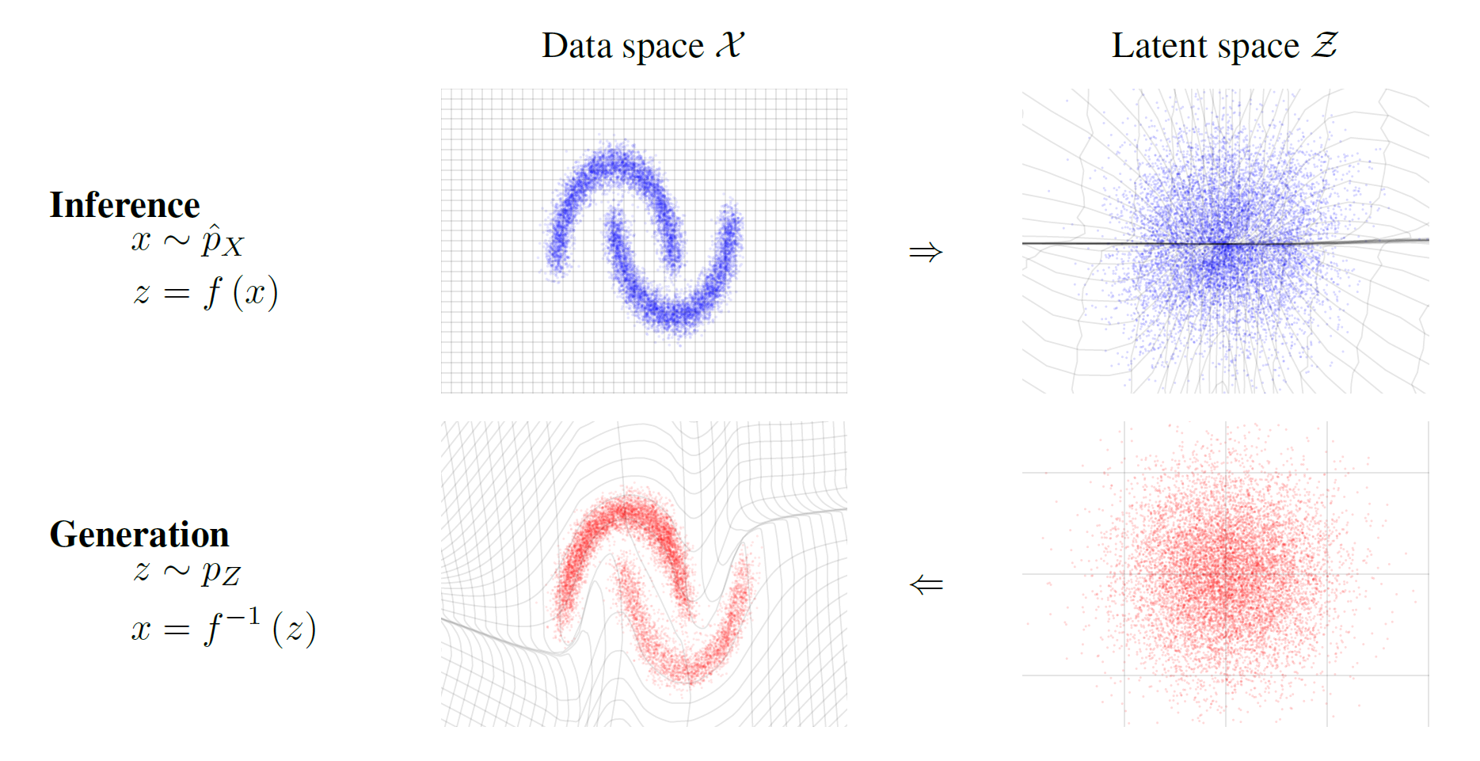
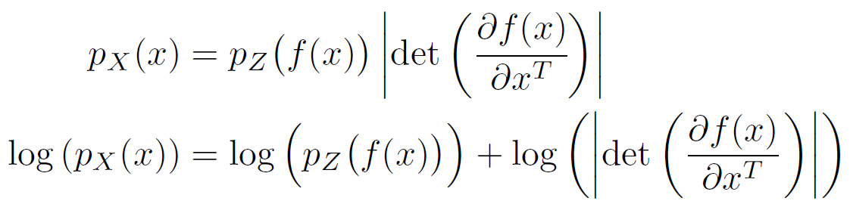
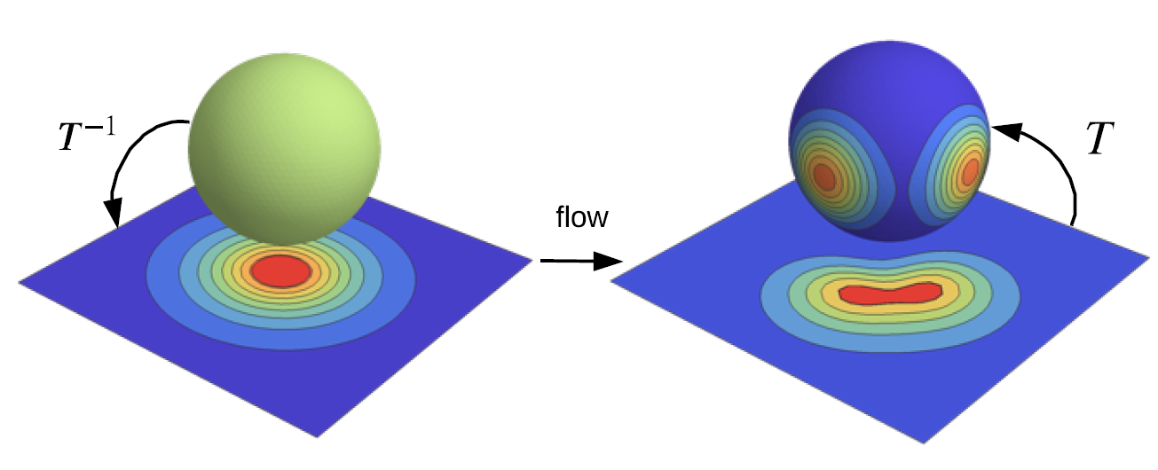
Instead of fitting, find the correct space your date lives in
Generative AI: Normalizing flows (find the space structure for which data is Gaussian distributed)
Change of variable formula
Perfect for maximum likelihood estimation
(given a distribution function, what parameters of this function best fit the data?)

Slide 21



Invertible normalizing flows for non-convex problems
Generative AI: Normalizing flows with piecewise invertible (usually linear) transformations
x
z

Slide 22




O.k., but shouldn’t we find PDEs rather than solve them?
Neural Operators: Fitting operators on function spaces
PDE
*
Green‘s function
$$Lu=b$$
$LG\left(x,ξ\right)=δ(x−ξ$)
Approximated inverse operator
„Fitting error“

Slide 23



Lifting, kernel integration, projection
*
Projection
Weights
Bias
Lifting
Activation
function
Integral Kernel
Operator

Slide 24

The many ways to proper kernel integration
Integral truncation, tensor product forms, Fourier domain parametrization

Slide 25



Transformers (just a special type of Neural Operators)
This still powers most large language models

Slide 26


“Attention is all you need”
Attention creates links to different parts of a sentence, ranking it by probability
More text means more „context“ („Call me Ishmael“)

Slide 27
Agentic AI
Large Language Models talking to the real World
Input
Finite State Machine
(repository, experiment station, simulation, AI model, electronic lab book)
Output
Query
Result

Slide 28
Agentic AI
Everything is a finite state machine (except some Hilbert spaces) that can be put into contexts
Everything is a state machine, connected via directed graphs
Responsive, reproducible, F.A.I.R. workflows
Query
Result

Slide 29
Agentic AI
Everything is a finite state machine (except some Hilbert spaces) that can be put into contexts
Agentic AI
Foundation Model
Optimization
Digital Twins
Foundation models
are like LLMs,
but for all kinds of data
Analysis
Finding
Input
Finite State Machine
(repository, experiment station, simulation, AI model, electronic lab book)
Output
Query
Result

Slide 30

AI-augmented research facilities
Agentic AI for research
https://doi.org/10.48550/arXiv.2512.24189

Slide 31



Sovereign LLM access for you to try
Safe, secure, open, free
https://kisski.gwdg.de/leistungen/2-02-llm-service/
https://helmholtz-blablador.fz-juelich.de/
https://opengpt-x.de/

