Slide 1
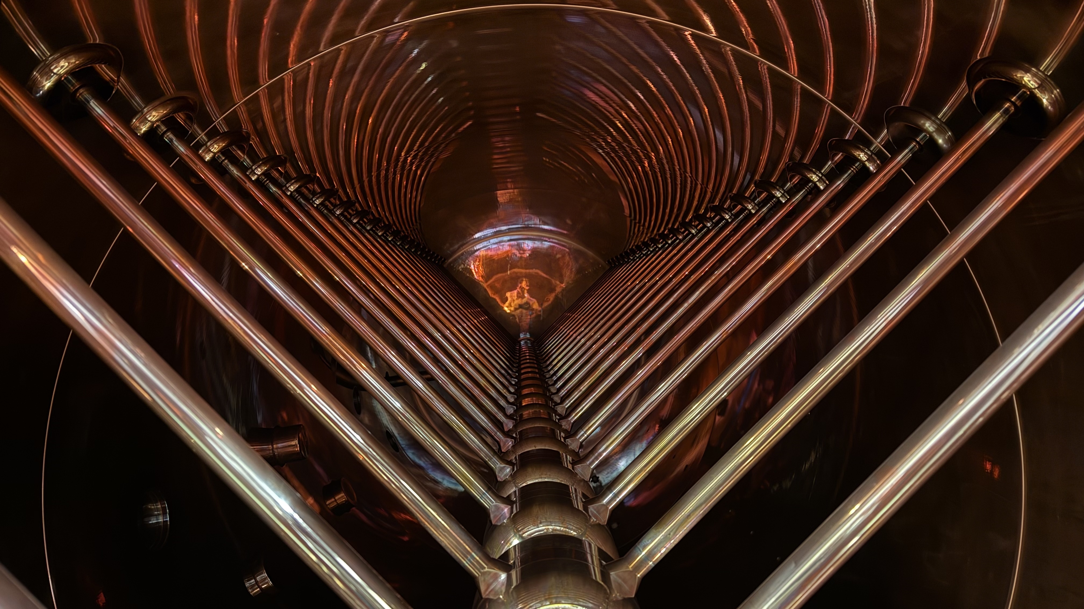


Report from beamtime coordinator Daniel Severin
NUSTAR Annual Meeting 2026

Slide 2




Outlook
2026
Next beamtime 2027
FAIR 2028 and
beyond

Slide 3
Research Perspectives
Short term (1-2 years):
Experiments with available beams, alternatives for science
Mid term (3-5 years) :
Resumption of the full physics program
FAIR2028 (possibly delayed)
Long term (>5 years):
Ensuring research dependent on long beam-pulse structure - superheavy elements, parts of materials research and fusion-related research and redundancy of the injector chain → pushing the HELIAC
Notes:
kurzfristig = 0 bis 2 Jahre
mittelfristig = 3 bis 5 Jahre
langfristig = 5 Jahre
lang-puls ist nach der Instandsetzung des UNILAC mit Fokus auf Kurzpulsbetrieb für die FAIR-Injektion nicht mehr möglich

Slide 4
The „hard“ questions
What will happen to the beamtime 26/27?
Which beams will be available, and when?
Intensities?
Energies?
How will ES look like?
When shall we move GLAD?
What about Super-FRS commissioning?
What about experiment commissioning?
Installation of the target-ladder?
What about FAIR28? How shall we proceed?
What about the SHE program?

Slide 5
Thanks for your attention!
And now, the “really hard” questions…

