Slide 1
Liquid Hydrogen targets
&
physics program at FAIR
NUSTAR week, GSI/FAIR, February 25, 2026
Alexandre Obertelli, TU Darmstadt
Thanks to Anna Corsi, Meytal Duer, Andrea Lagni, Valerii Panin, Christina Xanthopoulou and Manuel Xarepe for their inputs

Slide 2

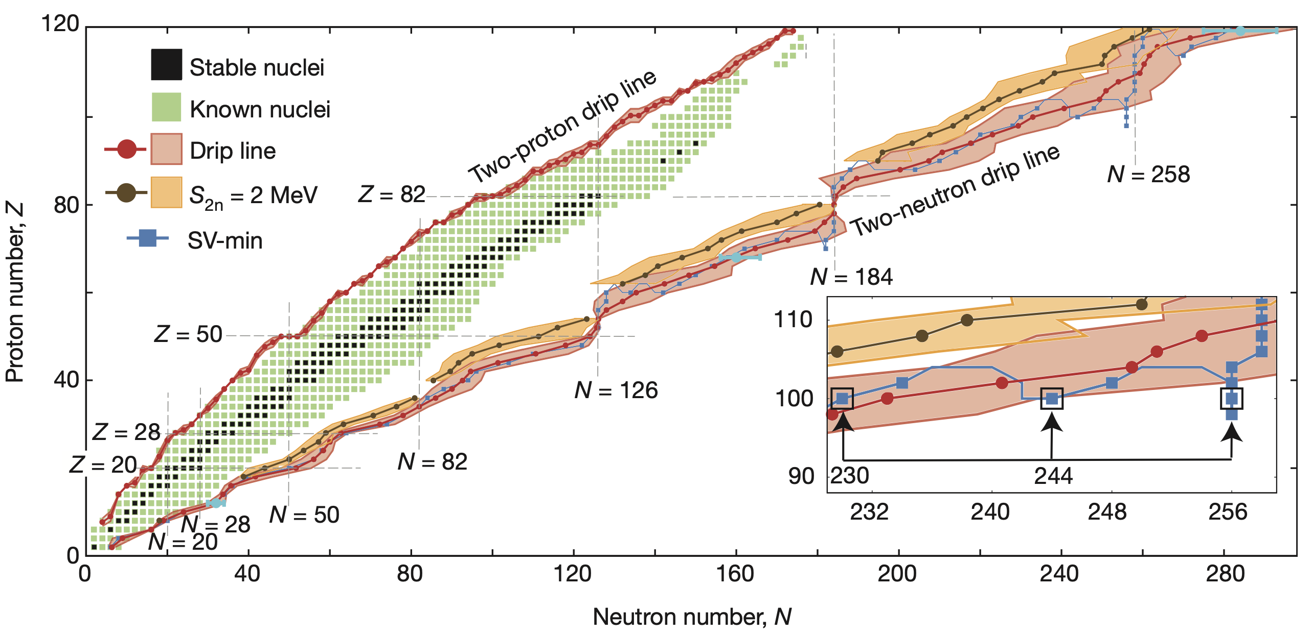
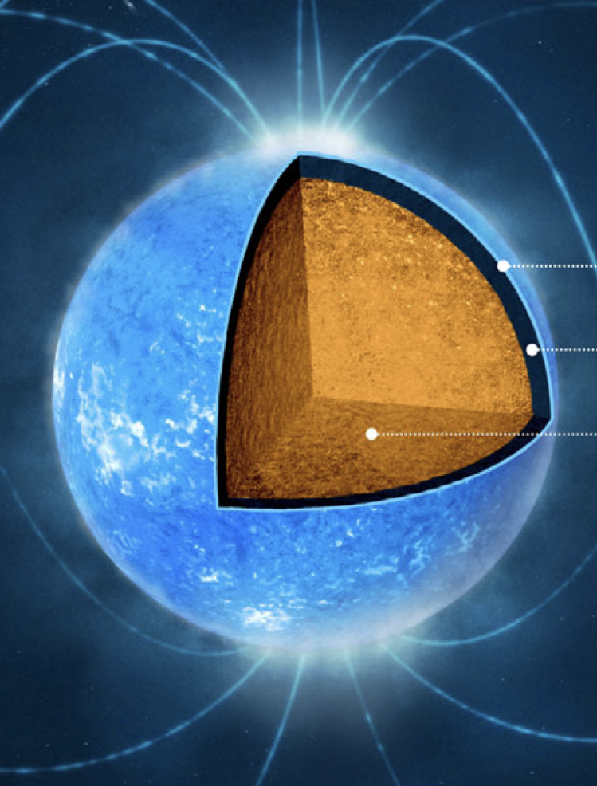
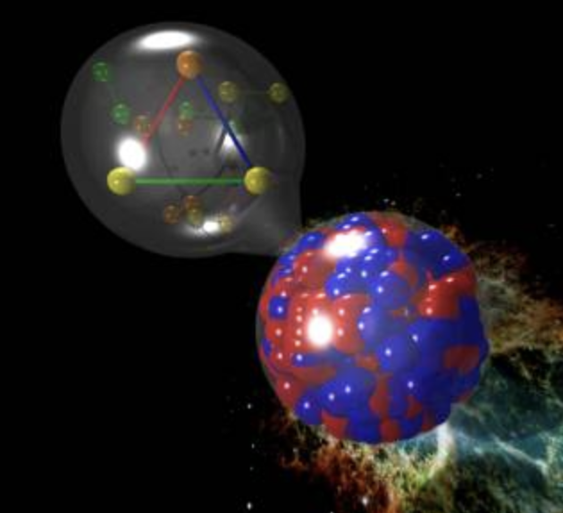
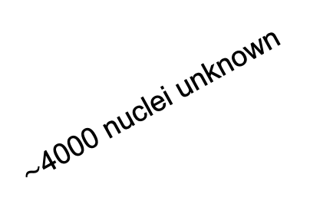

Nustar & nuclear matter
NUSTAR addresses it all: shells, correlations, halos, nucleosynthesis, clustering, fission, SRCs, EOS,…
in close connection with the other pillars of FAIR
$\sim$4000 nuclei unknown
A $\sim$ 10⁵⁷ baryons
Erler et al, Nature 486, 509 (2012)
From Watts et al, RMP 88, 021001 (2016)

Slide 3
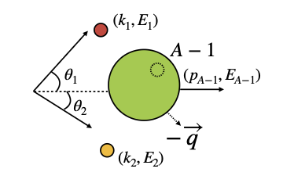
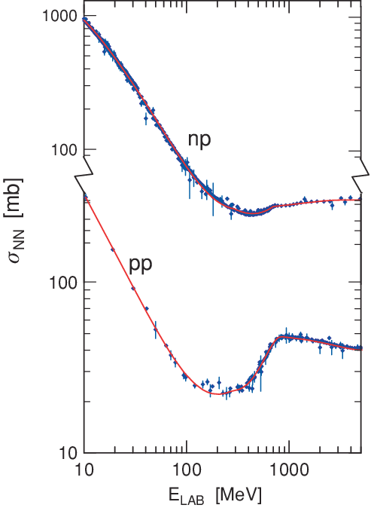
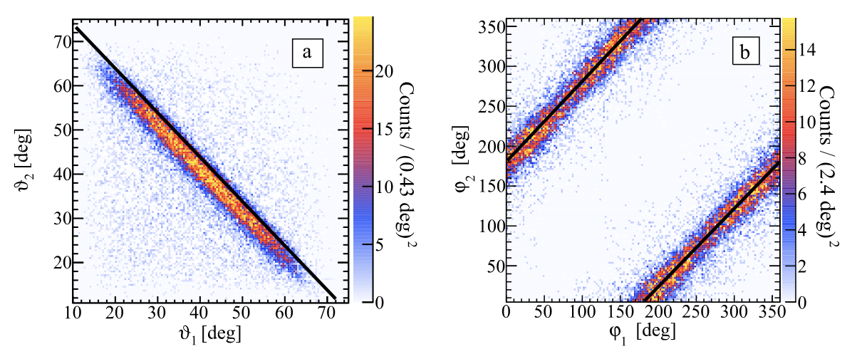
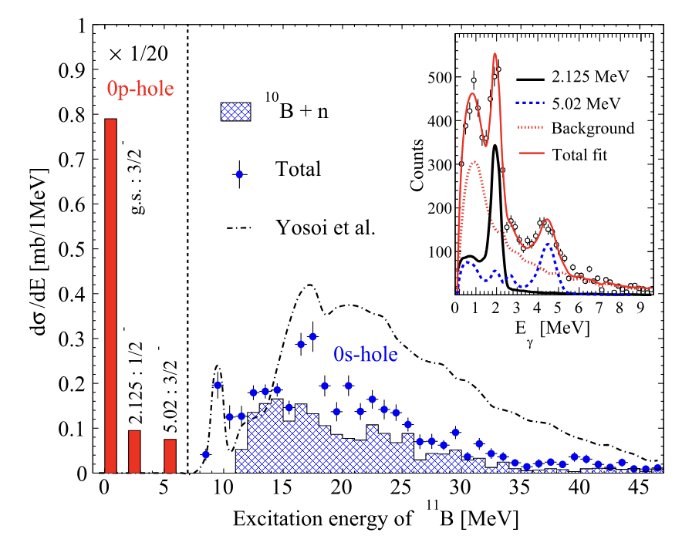
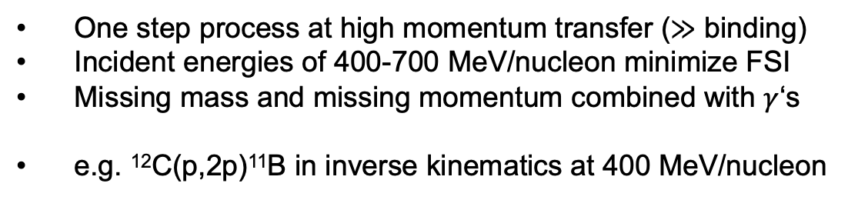
Quasifree scattering:
Queen of probes
One step process at high momentum transfer ($≫$ binding)
Incident energies of 400-700 MeV/nucleon minimize FSI
Missing mass and missing momentum combined with $γ$‘s
e.g. ¹²C(p,2p)¹¹B in inverse kinematics at 400 MeV/nucleon
Panin et al, PLB 753, 204 (2016)
R³B : 12 / 19 Letters of Intent for Early Science and First Science require the use of a liquid hydrogen target

Slide 4
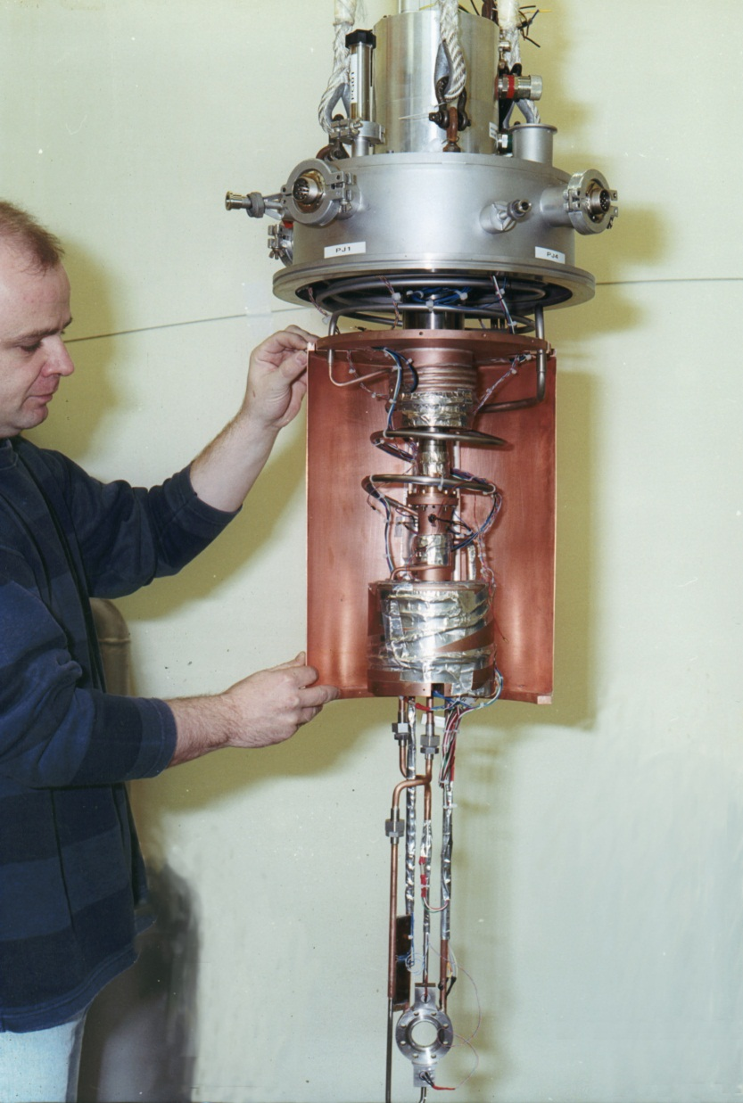
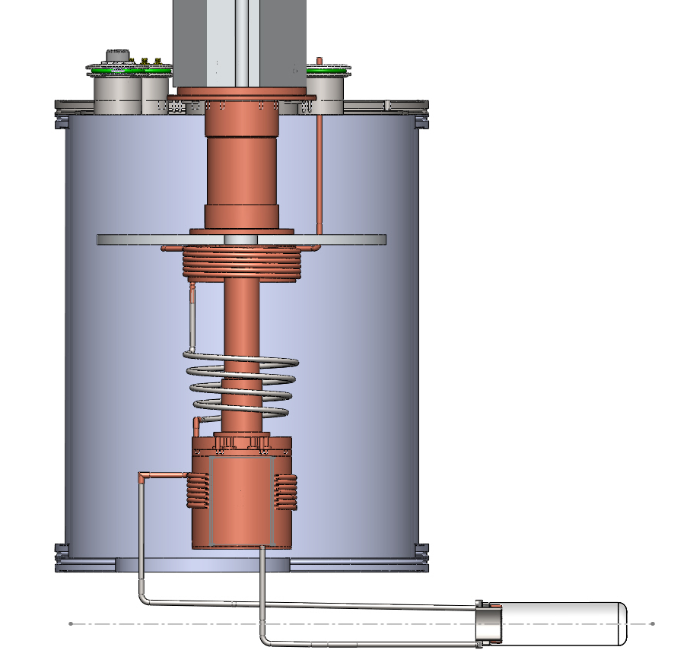

LH2 & thermosyphon
Requirements
Pure hydrogen
High density for luminosity (liquid: 70.8 mg/cm³ at 20 K)
Minimal material budget & deported
Challenges to overcome
Cryogenics
Safety (H₂ explosive when 4-96% O₂)
IRFU / CEA design
Mylar target cell
Thermosyphon (H2 is also the coolant)
Successful series of targets
FRS I&II, PRESPEC, R³B (COCOTIER)
MINOS, STRASSE (TUDa)
Complementary to other designs (e.g. active target ACTAF with gas H₂ at R³B)
FRS II target (GSI)
GasH₂
(ρ: 0,089 g/L)
from reservoir
© Thomas Ott
Precooled H₂
Liquid H₂
(ρ : 70,8 g/L)
flows out by gravity

Slide 5
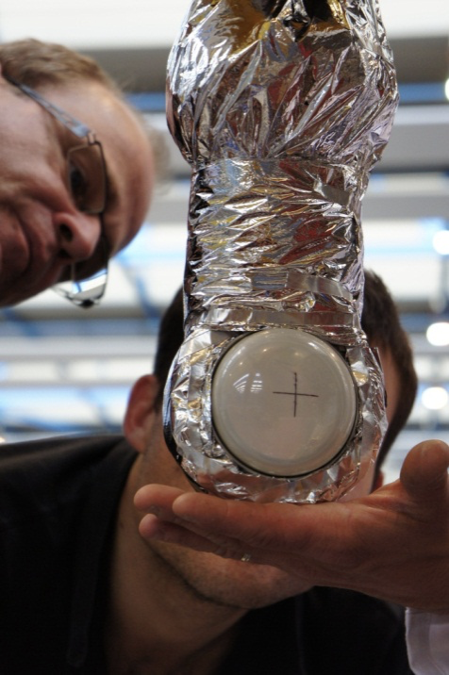
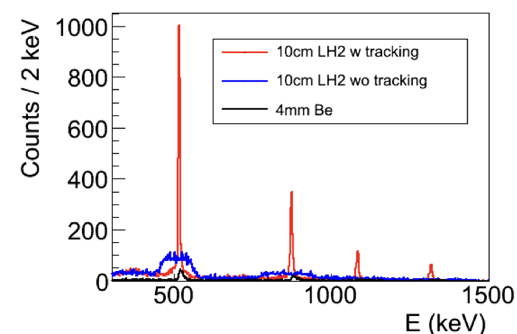
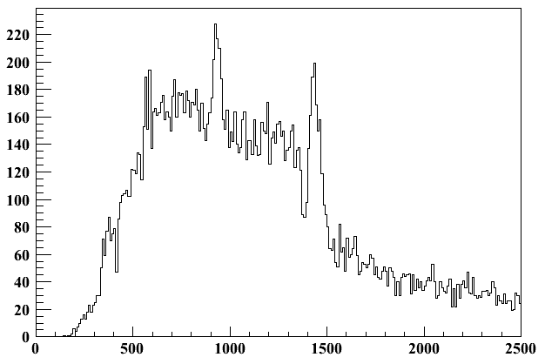
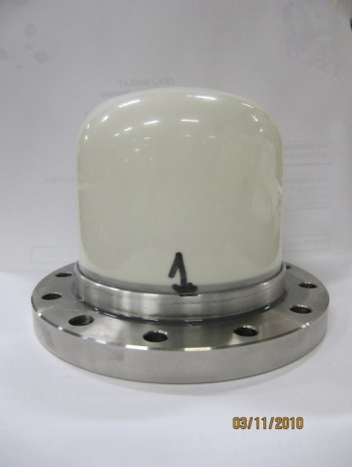
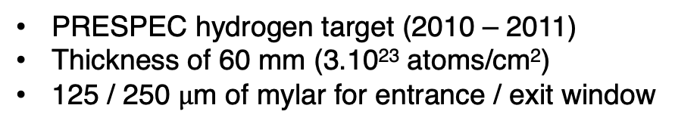
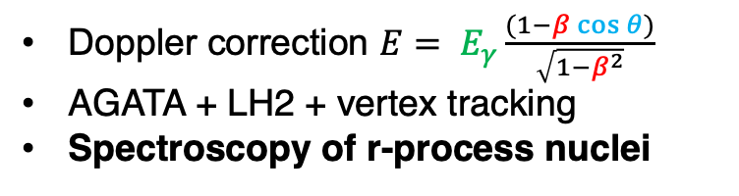
In-beam gamma spectroscopy
PRESPEC hydrogen target (2010 – 2011)
Thickness of 60 mm (3.10²³ atoms/cm²)
125 / 250 $\text{μ}$m of mylar for entrance / exit window
60 mm
Doppler correction $E= E_{γ}\frac{(1−β\cos{θ})}{\sqrt{1−β^{2}}}$
AGATA + LH2 + vertex tracking
Spectroscopy of r-process nuclei
⁵⁴Fe(p,X)⁵²Fe @ 400 MeV/nucleon
4⁺→ 2⁺
@ 932 keV
4⁺
935.5 keV
2⁺
1434.1 keV
0⁺
10 keV FWHM
Counts (10keV/bin)
2⁺→ 0⁺
@ 1436 keV
Energy (keV)
Louchart et al, NIM A 736, 81 (2014)

Slide 6
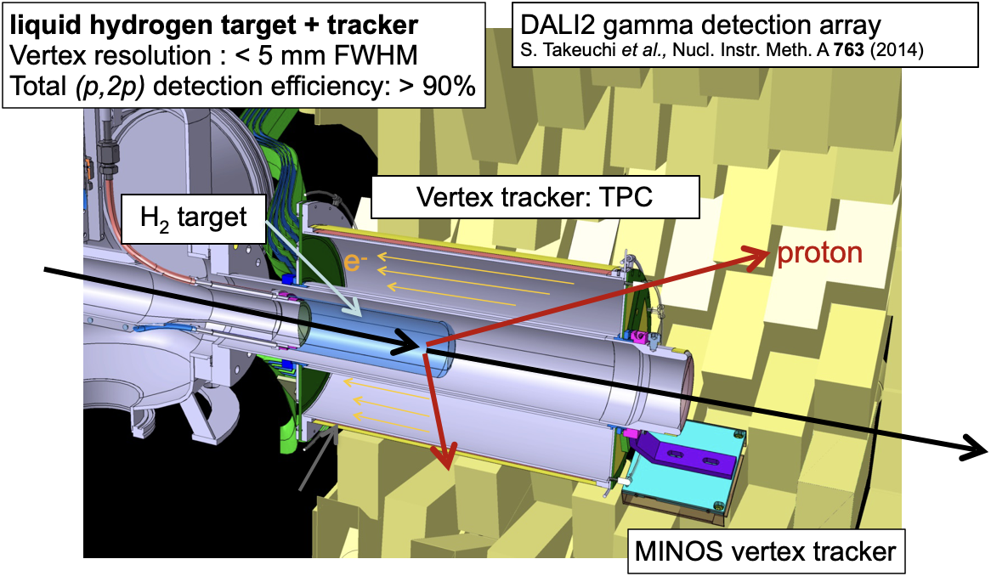
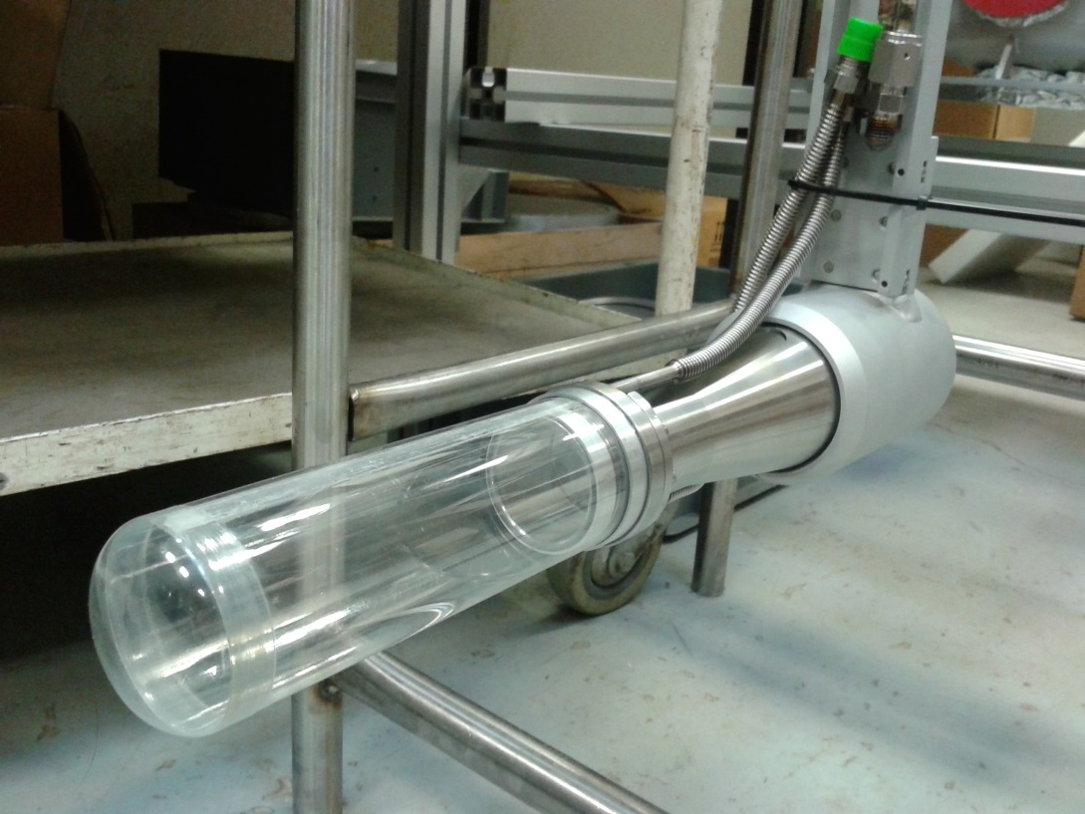
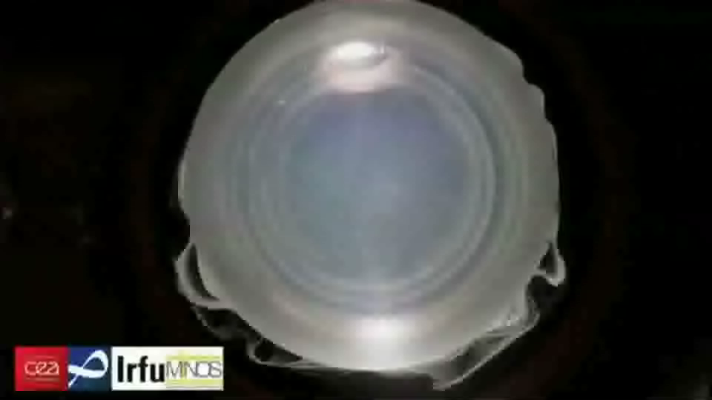
In-beam gamma spectroscopy
SEASTAR @ RIBF : In-beam gamma spectroscopy program for 2+ state energies
MINOS: thick liquid hydrogen target (up to 150 mm) combined with TPC, focusing on QFS
Liquid H₂ Target
150 mm long
Obertelli et al, EPJA 50, 8 (2014)
Real Time video

Slide 7
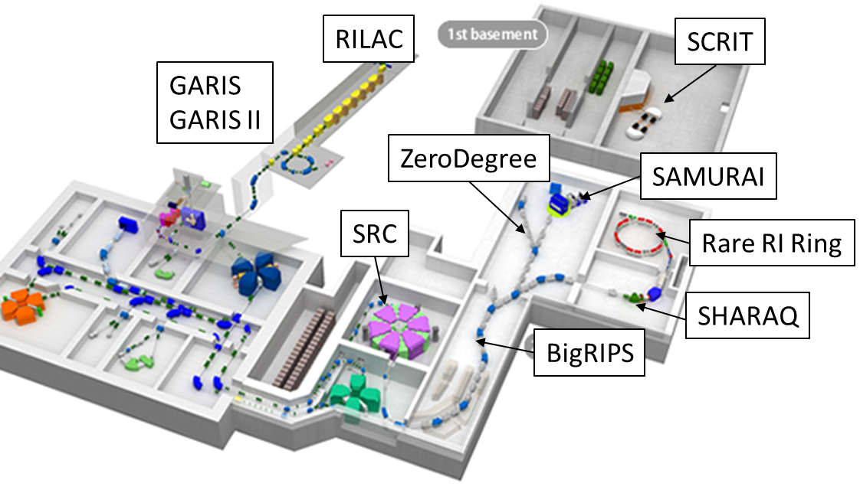
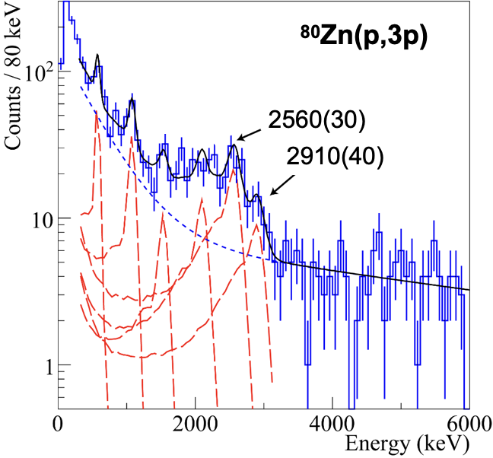
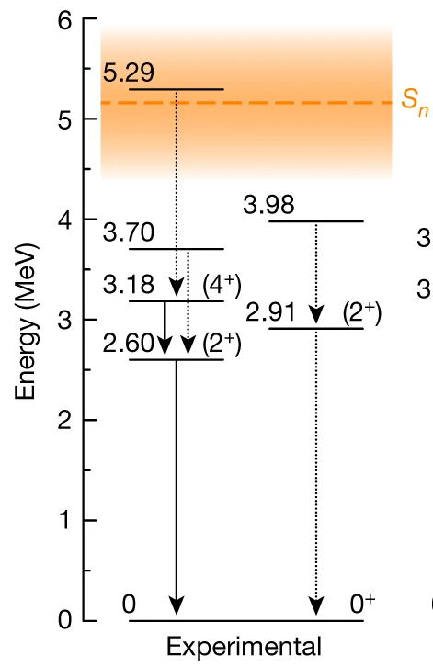
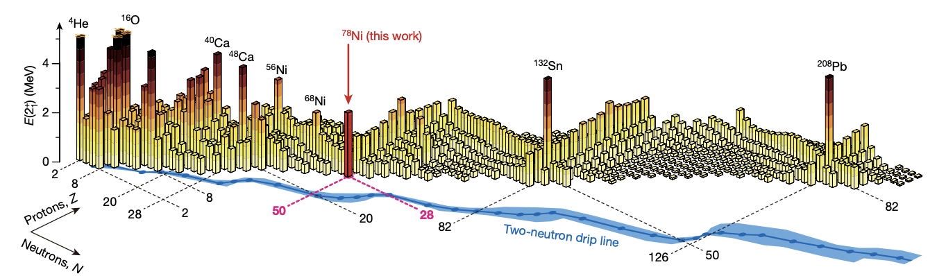
The doubly-magic nucleus ⁷⁸Ni
(p,3p)
RIBF, RIKEN (Sp.: P. Doornenbal, AO)
⁷⁹Cu(p,2p), ⁸⁰Zn(p,3p) at 220 MeV/u
5 pps (⁷⁹Cu) and 290 pps (⁸⁰Zn)
²³⁸U primary beam at 12 pnA
150-mm long H2 target
9 days of beam time
Taniuchi et al, Nature 569, 7754 (2019)

Slide 8
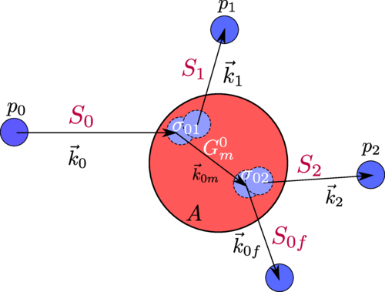
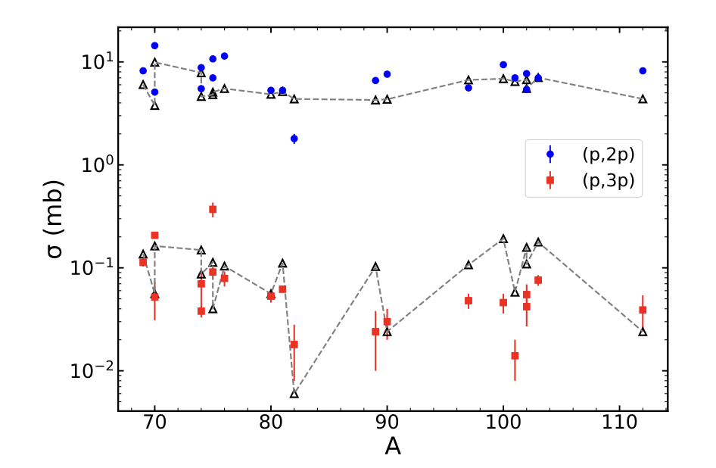
(p,3p) reactions
Sequential mechanism
Sensitivity to wave function (e.g. ⁷⁸Ni)
Proposed sensitivity to neutron skin
Ongoing theoretical developments
⁸¹Ga(p,3p)⁷⁹Cu
⁸¹Ga(p,2p)⁸⁰Zn
© Thomas Ott
Frotscher et al, PRL 125, 012501 (2020)
Gomes Ramos, PRC 109, 064622 (2024)
Bertulani and Lobato, arXiv:2601.01049v1 (2026)

Slide 9
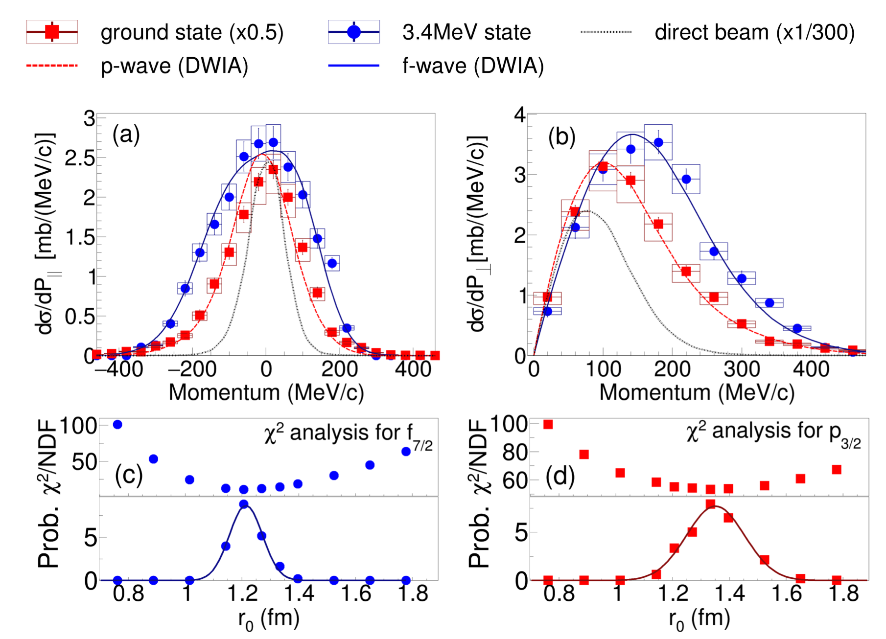
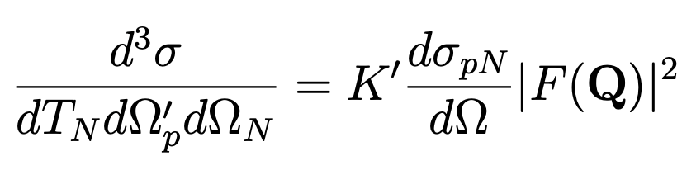
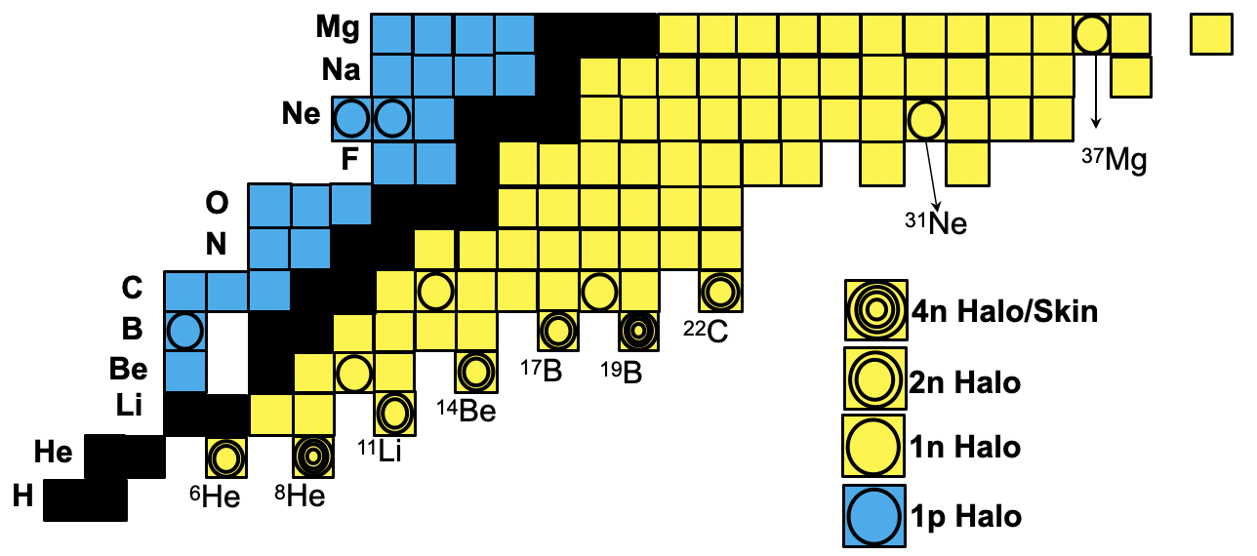
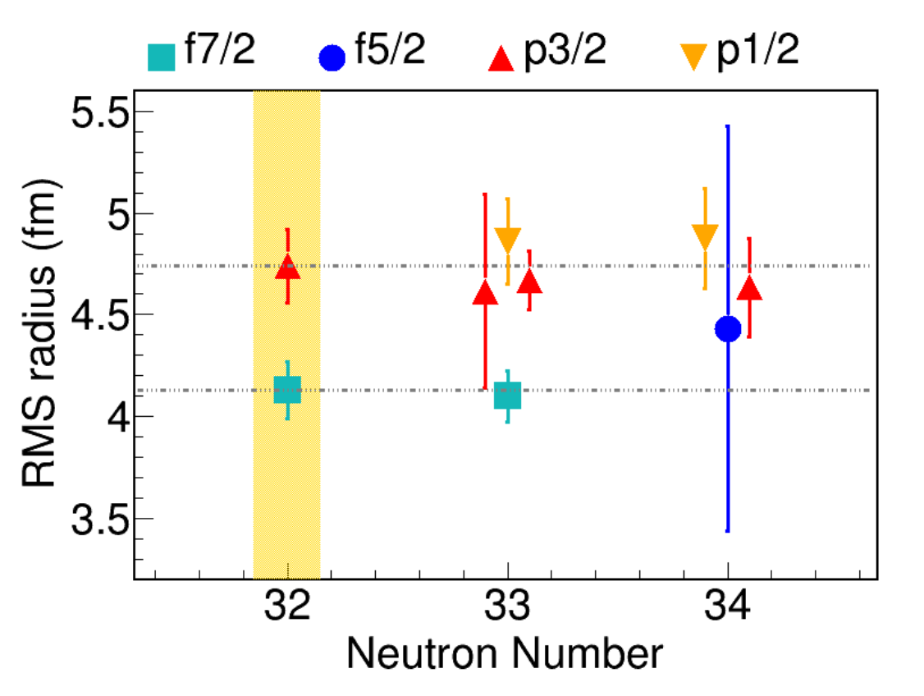
single-particle wave functions
And halos
Enciu et al, PRL 129, 262501 (2022)
Exclusive momentum distribution probes the single-particle wave function
Missing momentum resolution of 50 MeV/c achievable
Halos and neutron skins at R³B, S-FRS
R³B LoI: Obertelli et al
Enciu et al, unpublished (2025)

Slide 10
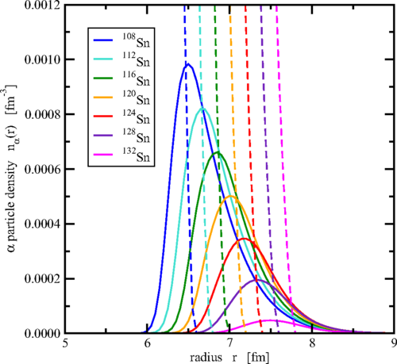
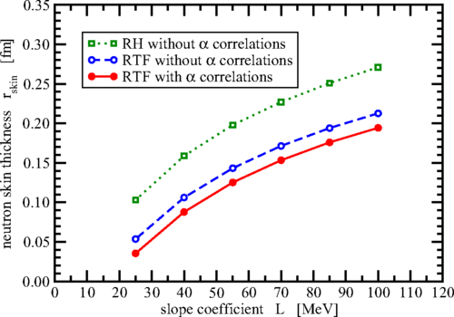
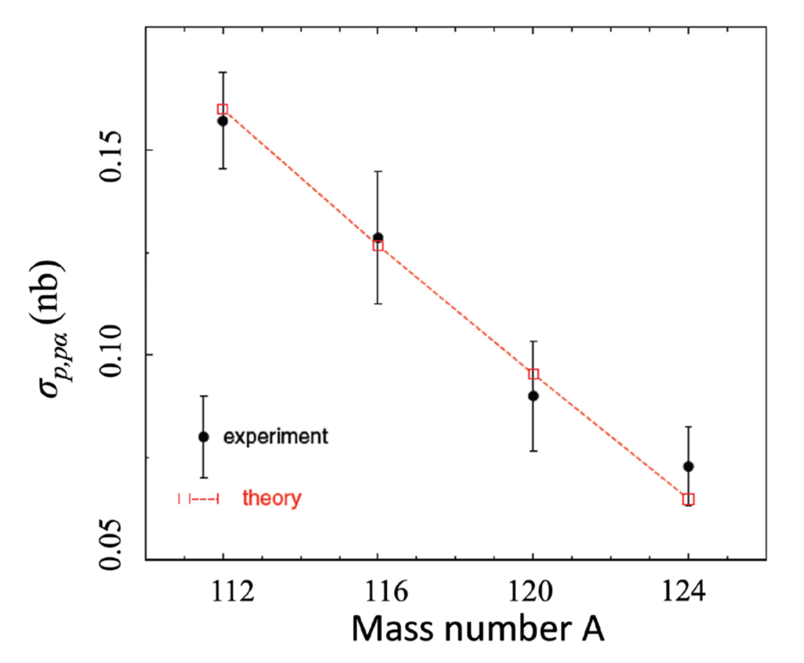
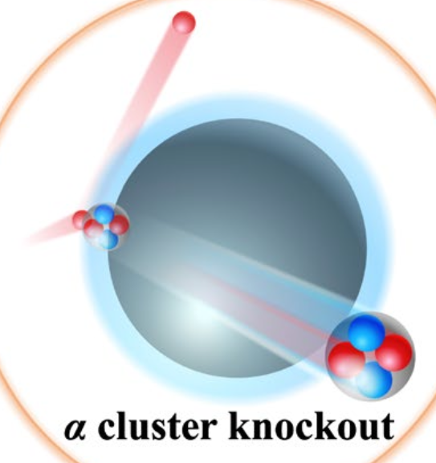
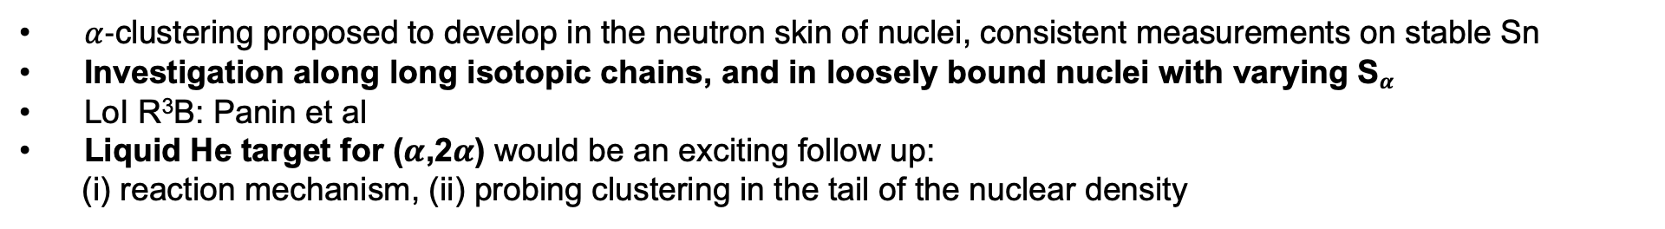
Clustering in nuclei
Typel, PRC 89, 064321 (2014)
Tanaka et al, Science 371, 260 (2021)
$α$-clustering proposed to develop in the neutron skin of nuclei, consistent measurements on stable Sn
Investigation along long isotopic chains, and in loosely bound nuclei with varying S$α$
LoI R³B: Panin et al
Liquid He target for ($α$,2$α$) would be an exciting follow up:
(i) reaction mechanism, (ii) probing clustering in the tail of the nuclear density

Slide 11
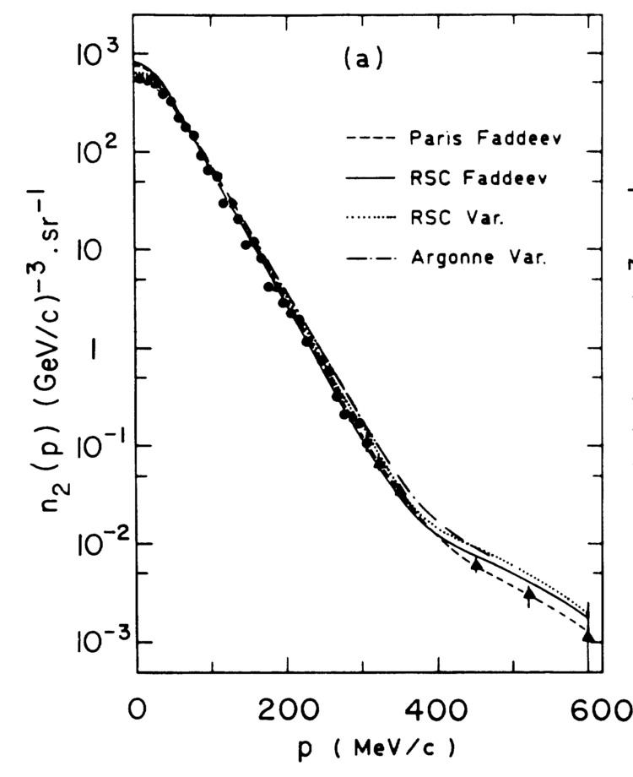
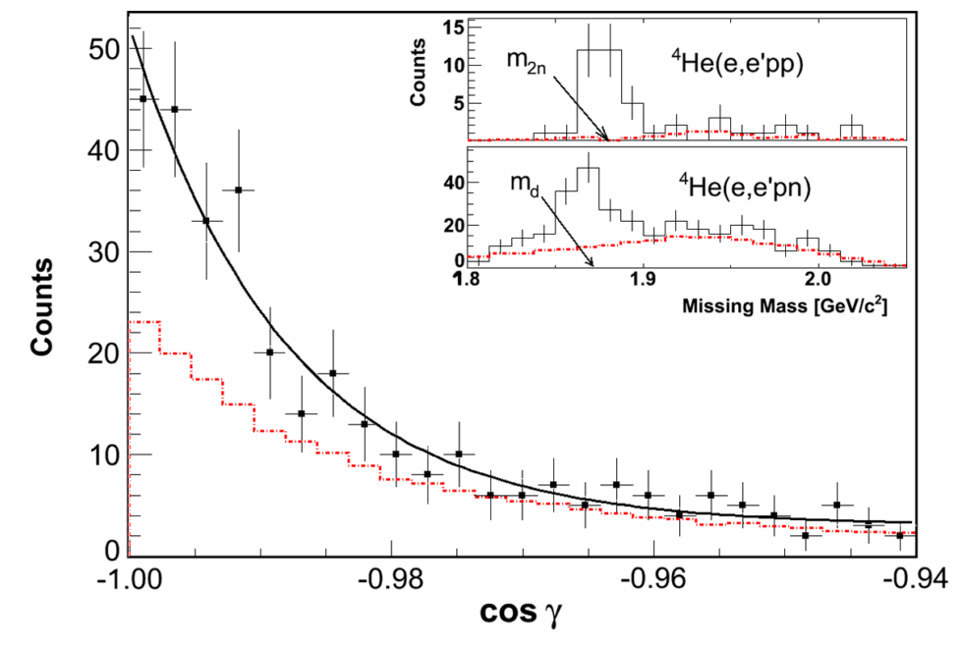
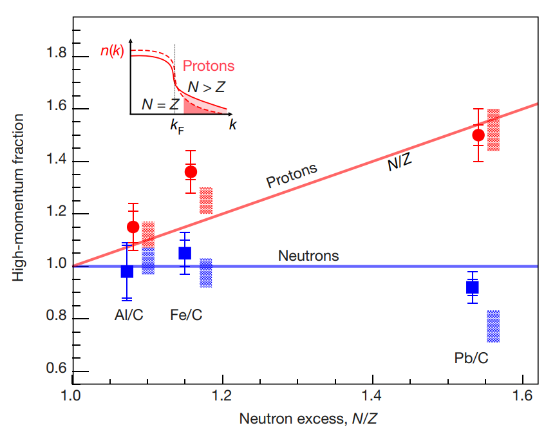
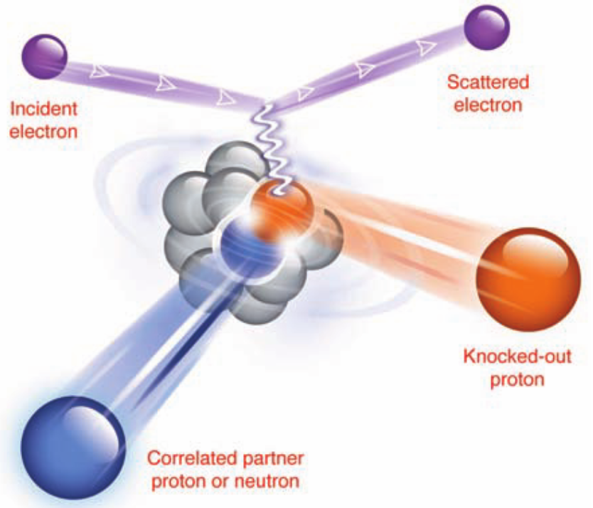
Short-range correlations (SRC)
Subedi et al, Science 320 (2008)
Korover et al, PRL 113 (2014)
Marchand et al, PRL 60 (1988)
Duer et al, Nature, 506, 617 (2018)
³He(e,e’p)d
High momentum component interpreted as repulsive-short range part of the NN potential
JLab (e,e’pX) data: 20% of nucleons experience SRCs, mostly neutron-proton pairs
Isospin dependence indicates neutron saturation and growth of involvement of protons in SRCs

Slide 12
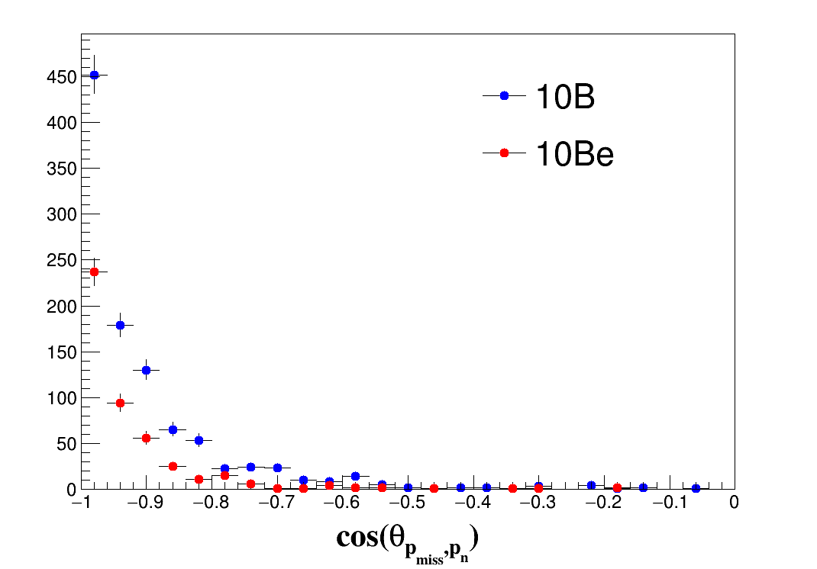
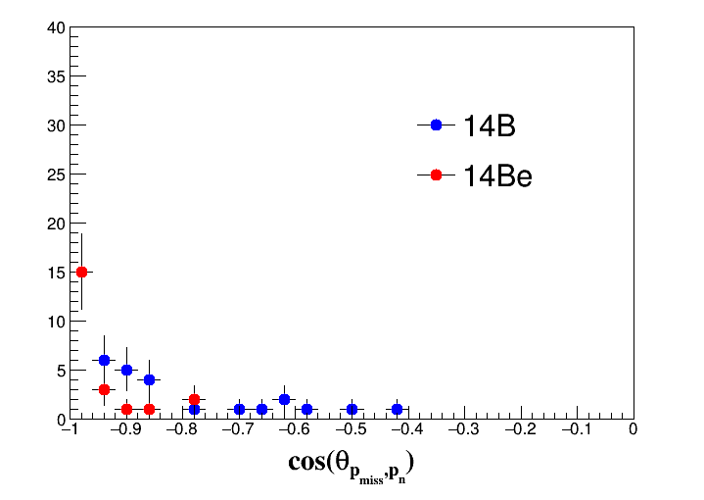
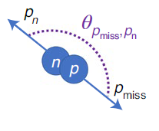
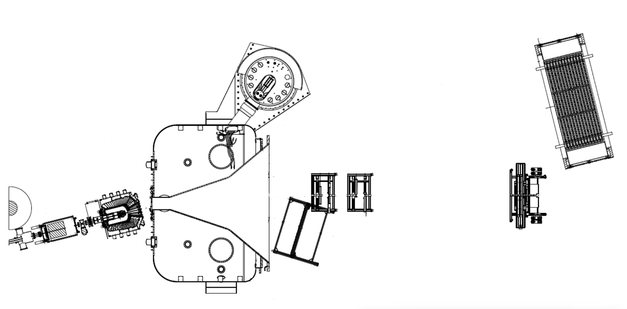
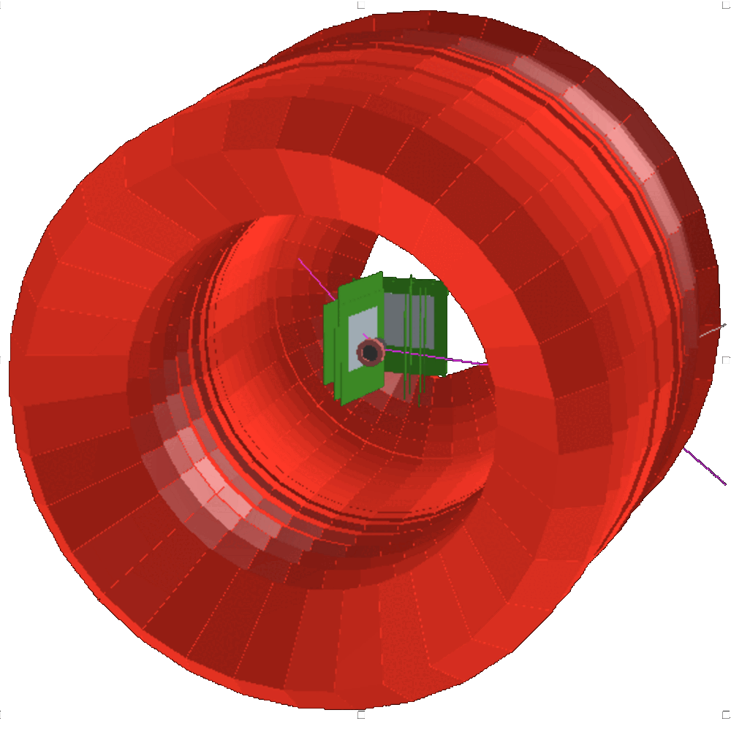
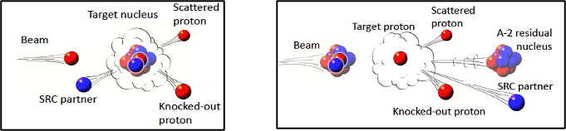

ISOSPIN dependence at R3B
Short-range correlations in neutron-rich matter: ^{12,16}C Beam @ 1.25 GeV/u (2022)
¹⁰⁻¹⁶C(p,pd) as a complementary probe (2024)
Systematic and precision SRC program at R³B
Quantum nature of SRCs
Interplay of nuclear structure and SRCs
Short-range 3N correlations
R³B LoIs: Julian Kalhbow, Valerii Panin et al, Marina Petri et al
(p,2p) reaction
?
Recoil neutron
Preliminary
Preliminary
LiH target
LH₂ target
Heavy Fragment
Recoil Proton

Slide 13
Hydrogen target developments
At GSI/FAIR
Quality assurance: systematic studies on influence of parameters (materials, height, cell design)
Development of a reliable and data-proven simulation
LH2 target and cryostat for S-FRS
Full remote control and automatized processes
Target cells (TU Darmstadt)
R&D for a liquid He target once the physics case is further confirmed
Hydrogen laboratory at GSI/FAIR is needed and foreseen. Ongoing plans.

Slide 14
summary
Liquid hydrogen targets are key for a diverse and successful NUSTAR program
Quasifree scattering: unique clean reaction probe
Broad physics program
Exciting theory developments coming along
Already core system of R³B, near-future plans for S-FRS, great prospects for HISPEC with AGATA

