Slide 1
Conclusions, open points from yesterday
Y. Grigoryev, J. Hetzel, V. Kamerdzhiev, S. Pietri

Slide 2
General time line (on the fly, first feeling from yesterday)
Installation 2025/2026,
vacuum test 2026 (up to phase 2 in most cases)
chambers installed in 2026
some phase 1 commissioning without load of some power convertors 2026
Main commissioning 2027:
branch T early 2027
main separator magnets after cool down spring 2027
in // beam diagnostic
in // target area

Slide 3
General Information
Never delay a test!
Never delay a test!
Never delay a test!
Never delay a test!
Never delay a test!
Never delay a test!
Never delay a test!
Never delay a test!
Never delay a test!
Never delay a test!

Slide 4
Mechanical completion
Mechanical completion:
cables are connected
assures company laid them right (proper length)
assures cables are properly labeled
Basically : everything that a subcontractor does is done
Mechanical completion is everything before you power the system

Slide 5
Open points – FSB information
TGA dates exercise: need push not pull action
do it through Stephan, or through Klaus solution
TGA commissioning, discussed in commissioning workshops
this concerns TGA, uplinks etc…
Not clear the N2 dry nitrogen
one line from Technical Gas
one line from FSB
bottles will be used

Slide 6
Open points - alignment
Alignment action confusion for me
alignment at blue line
alignment at MC
alignment check before beam
is there clear documentation, this is needed! Need of clear process definition!
action: COM contact Ina Pschorn to request process (SP, VK)

Slide 7
Comments on installation presentation
Roof target
Klaus Q3/Q4 2026 iron roof→ most commissioning target area in 2027
Test of branch T
Mai 2026 pre-target are power convertor.
Issue DB2 so nothing before Q1 2027,
we should aim early cool down, test as much as we can
we should do a specific detailed planning for branch T as example

Slide 8
Installation/commissioning not planned and need action
rack filling/test BD/DAQ/DEX/NEX racks
“NUSTAR” network (It is Super-FRS mostly, please)
MBOX and PDC
BEA electronic
EE electronic
NMR controlers
Phytron
rack filling VAC and INV
shall filling be planned in commissioning LCM planning or in installation planning?
com planning (preferred)
installation planning

Slide 9
Open points - vacuum
Vacuum: make sure we have enough blind flanges for
MC preparation (few)
replacing active inserts when first phase of vacuum commissioning
Not clear (sorry we did not remember the answer): how switch from pumping for MC and connection to standard vacuum pumps
Vacuum phase 2: how many people needed
Vacuum controls section for phase 2 needed for planning
What happen between MC and phase 1? N2 filling?

Slide 10
Open points – NCM magnets and target
NCM magnet: question pre assembly QS pumps
Water commissioning TGA done in meeting ala Cryo2
Before closing iron roof: test water lance
-> water chamber
-> water interlock
-> water magnet
plan a plug removal commissioning/training during commissioning phase

Slide 11
Power convertor questions
Question was : How soon shall deliveries from PC be, could they be relaxed to fit when PC are needed?
Answer: we should install and get mechanical completion as soon as possible, so as soon as double floor ready installation shall start, if delay happen better to have buffers.
How to test PC without cooled magnets
short circuit test enough, like Hugues presented
otherwise first test after cooling deep in 2027

Slide 12
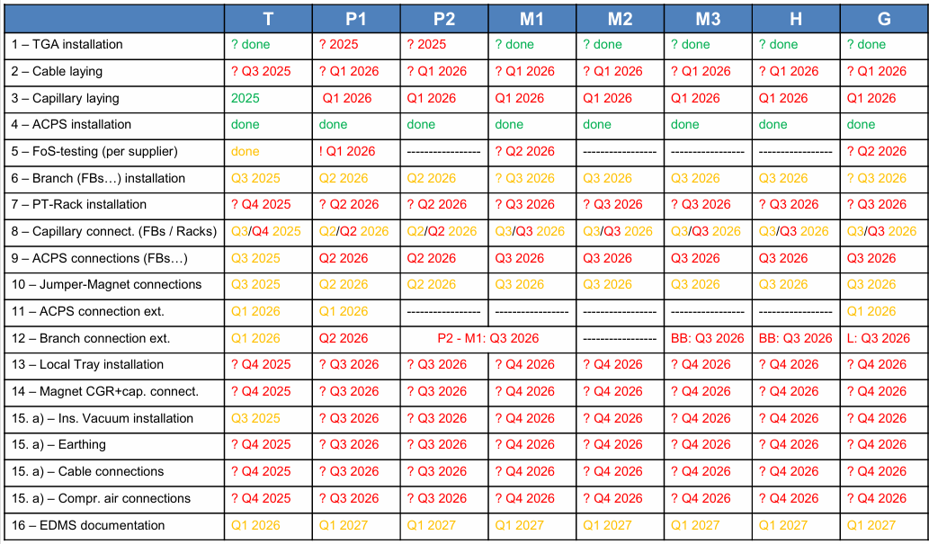
Local cryogenics
Where can we find those dates for planning? Plannisware?

Slide 13
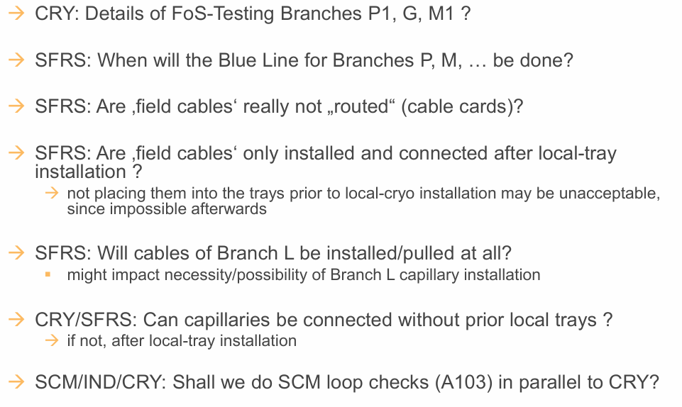
Local cryogenics
Internal CRY discussion
Shall be present in plannisw.
Answered: routed only length limited
cables
Answer:
request filed cables to be connected AFTER
cable tray installation
Not COM, internal SFR/CRY
Not COM, internal SFR/CRY
Next slide

Slide 14
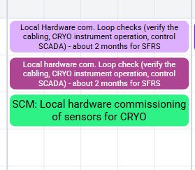
Local cryogenics
Is this the answer:

Slide 15
SCM
Talk from Vasileios, lesson learned from pre-assembly and installation “work instruction nice, human presence better”
Trigger a question from COM team to SFR:
how to transfer CERN experience (just to clarify for commissioning team)
formalise process
suggestion : we want to assure presence from personnel from CERN test facility at first key installation phase (few days)

Slide 16
SCM
Quench training done at CERN, shall we do it here ? (current sequence in LCM)
shall we test one quench in situ to check He recovery? one per branch?
Naïve question: if LEMO leaky connector why not change it? Other option were suggested?

Slide 17
Sequencer available for testing many thing in //
Reminder for all
Mostly for SCM magnets I presume
Could be used for NMR (to check)

Slide 18
To take in discussion with ACO
disk degrader control specific gui/interface
thermo sensors in control system and software interlock
post mortem

Slide 19
SCM

