Slide 1
LCM schemes and work estimates, SCM and local cryo
S. Pietri

Slide 2
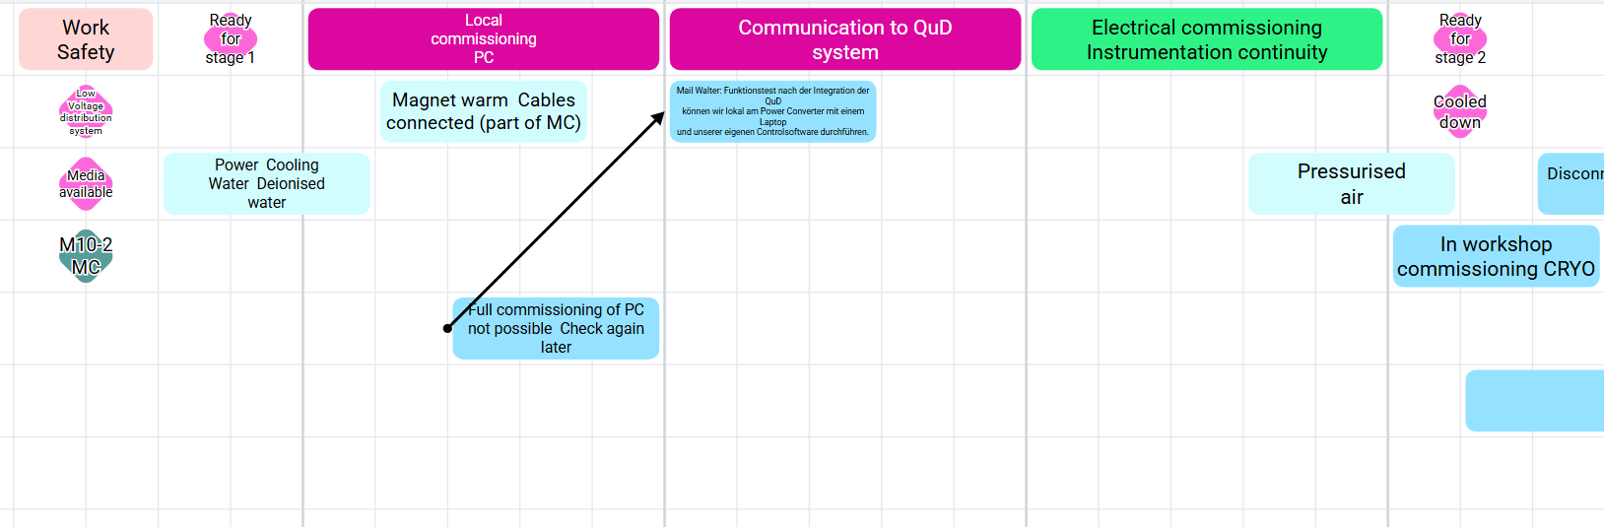
SCM phase 1 (as soon as possible)

Slide 3
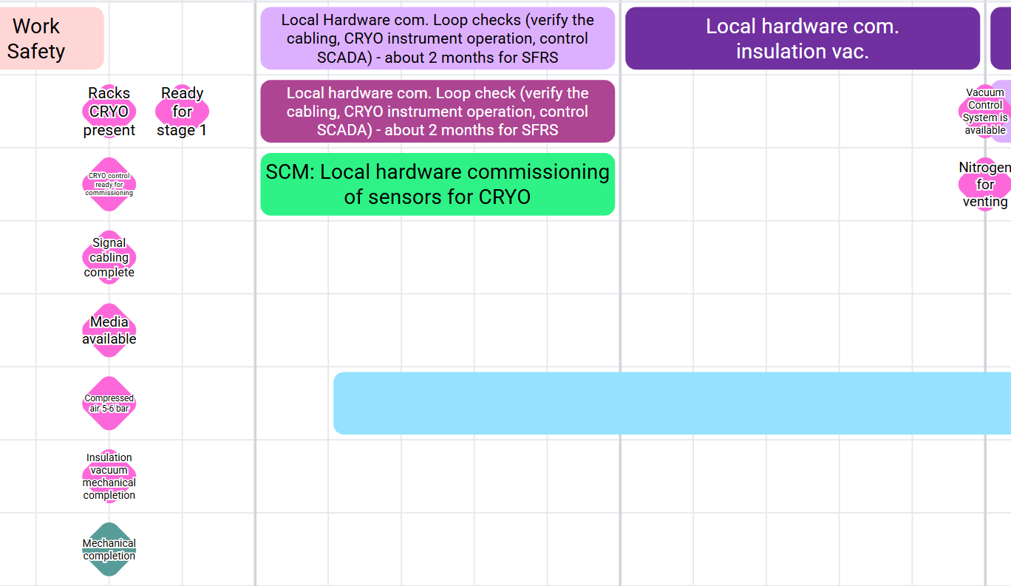
Local cryo phase 1

Slide 4
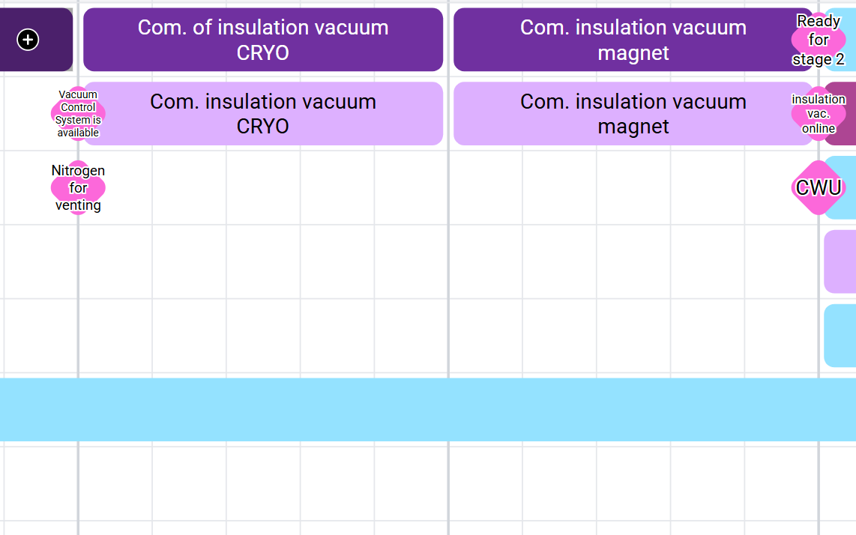

Slide 5
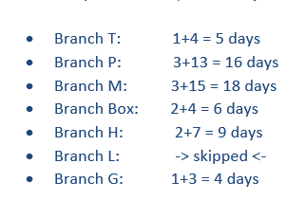
Time estimates phase 1 (F. Wamers)
Branch | Time for phase 1
T | 5 days
P | 16 days
M | 18 days
B | 6 days
H | 9 days
L | >skipped<
G | 4 days
58 days but can be //

Slide 6
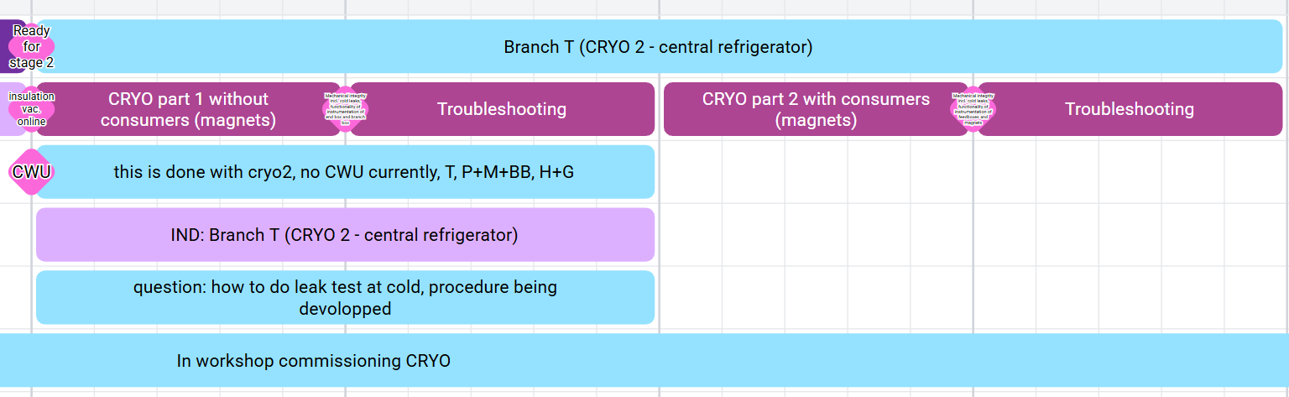
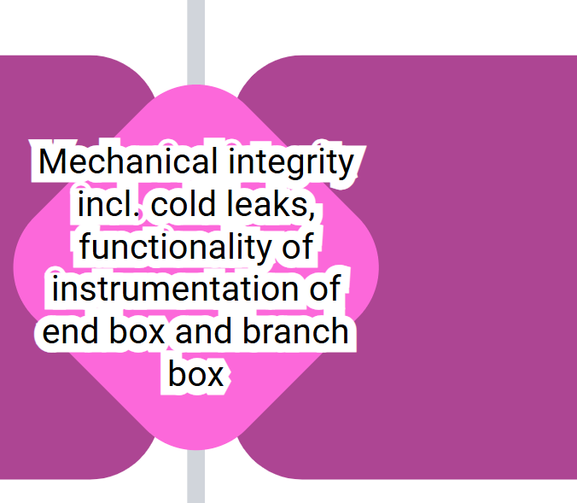
Branch T cryo phase 2 commissioning Cryo2

Slide 7
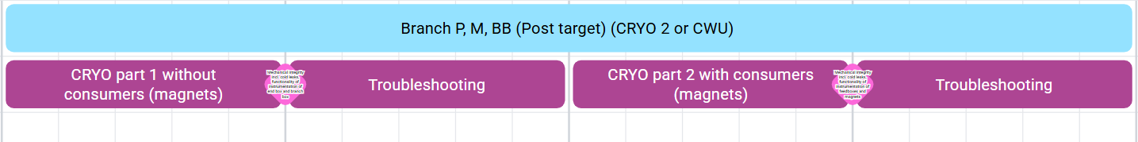
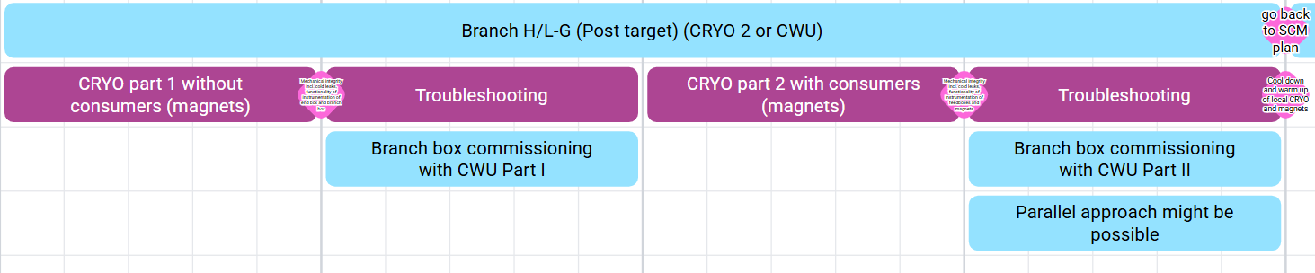
Other branches
CWU: to 70 K faster.
Time estimate: few days per branch for part 1, few week for part 2?

Slide 8
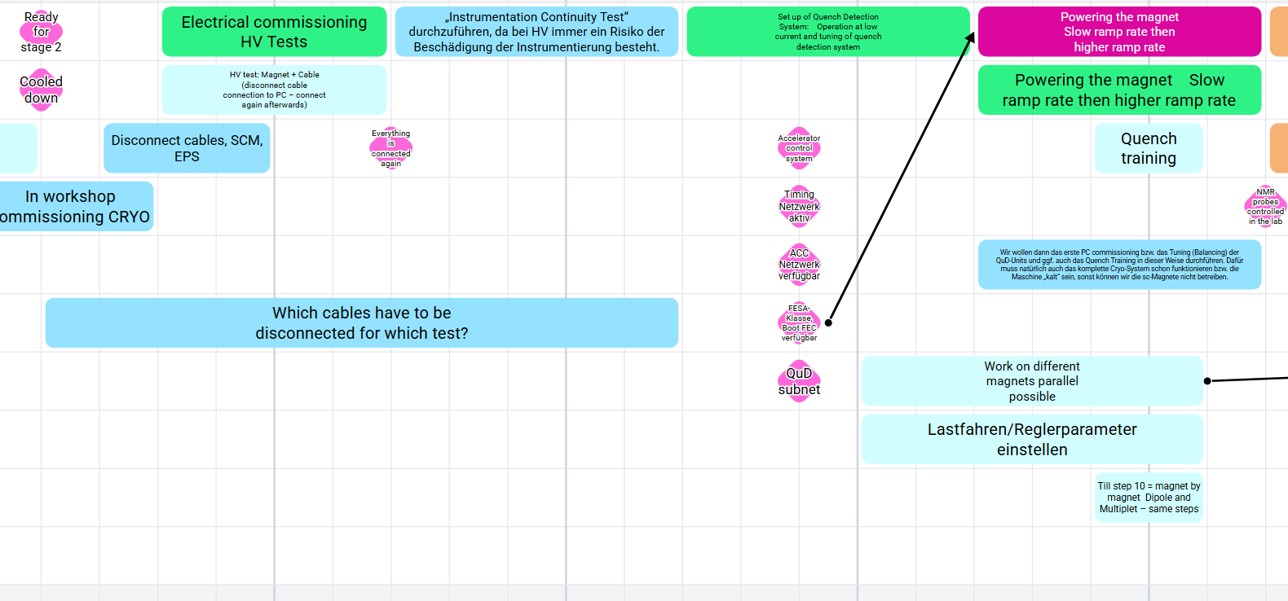
Phase 2 SCM

Slide 9
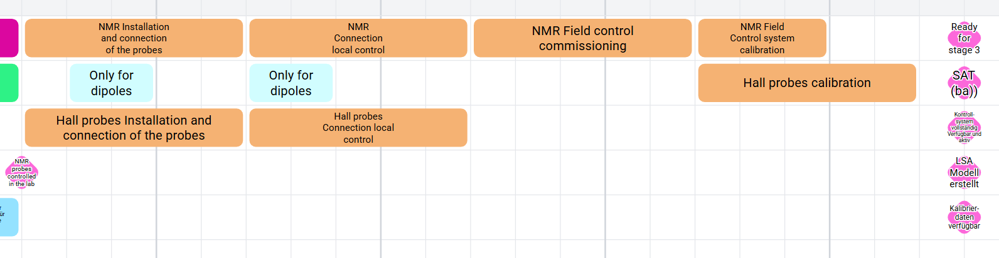
Phase 2 SCM (NMR and hall probes)
done per triplet of magnets
2 weeks, including calibration? more on IO commissioning

Slide 10
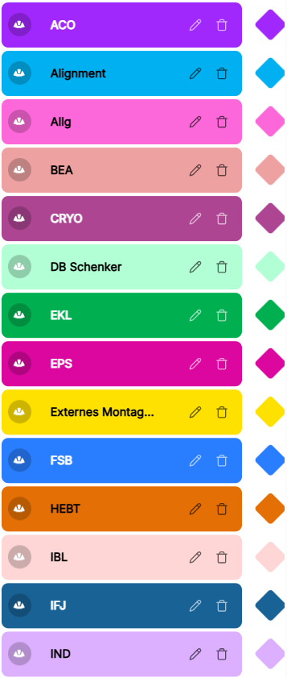
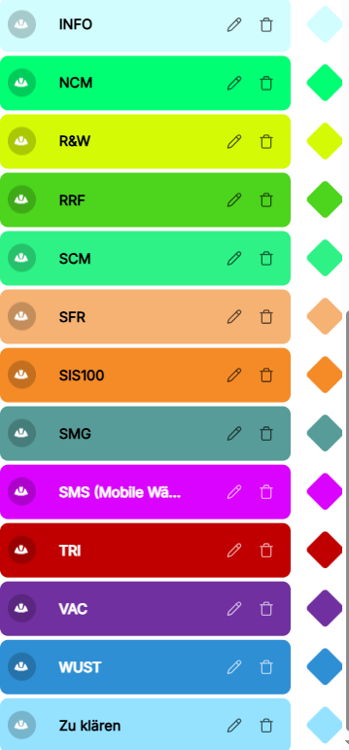

Slide 11
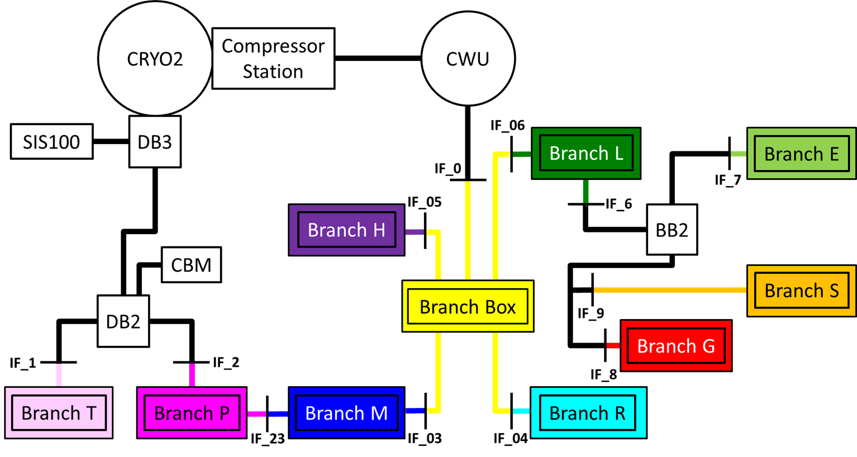
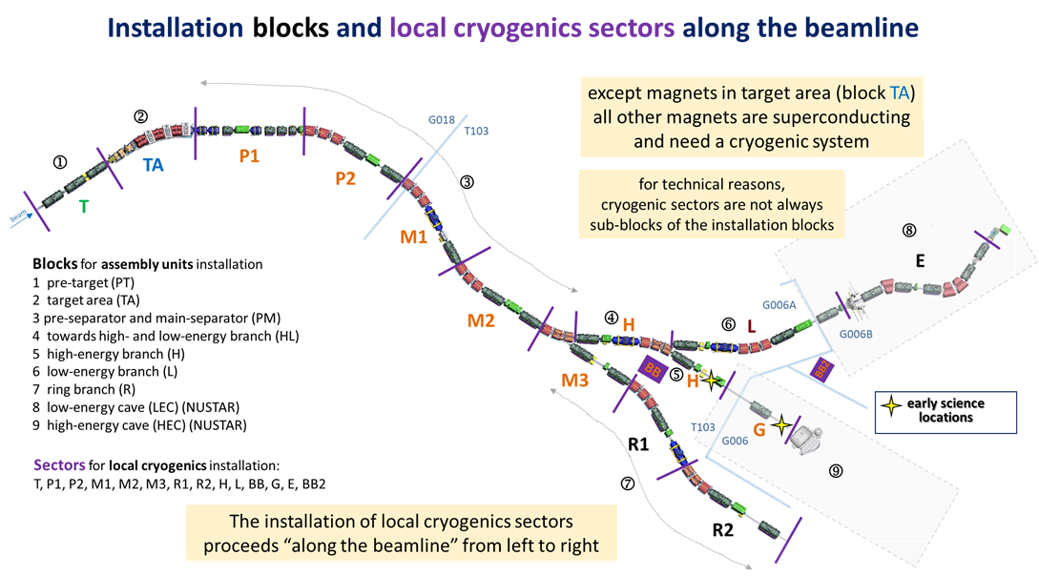
ES just bypass
Not ES
Not ES
Not ES
L

Slide 12
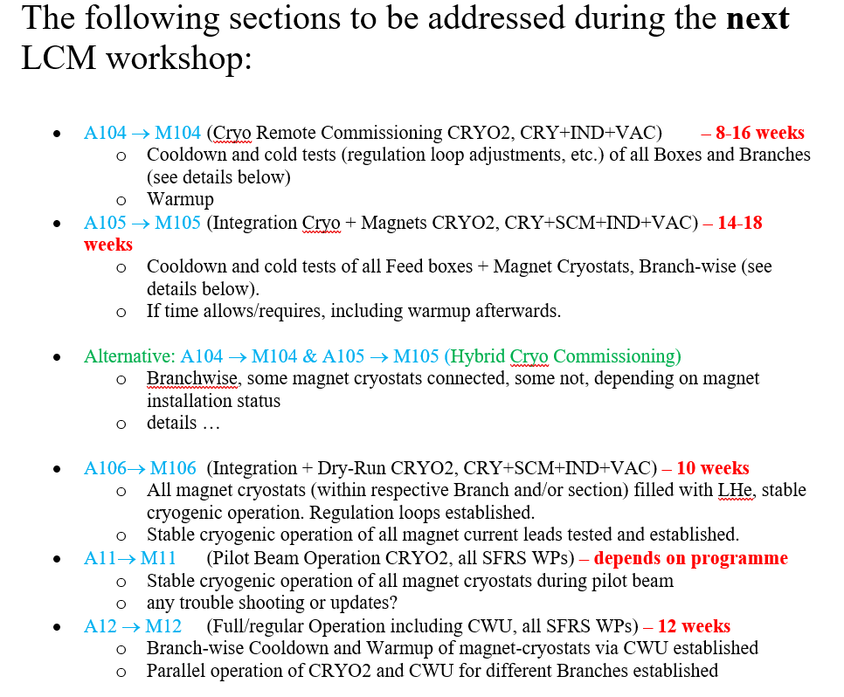
Resources estimates, Cryo phase 2

