Slide 1
The Status of
Superconducting Multiplets at Mechanical Completion
Melanie Cho
26.05.2025

Slide 2
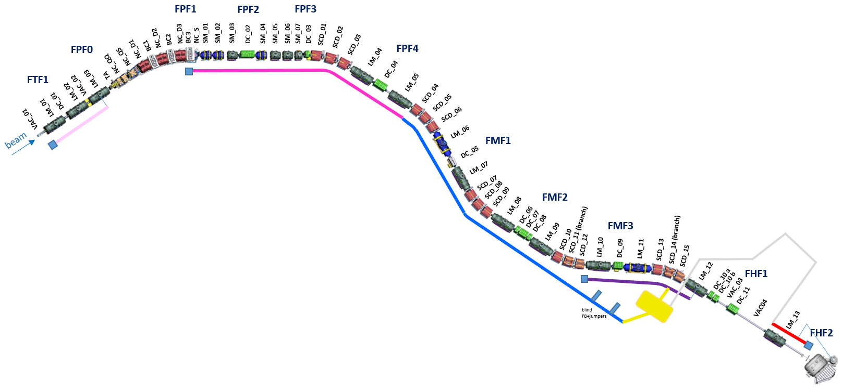
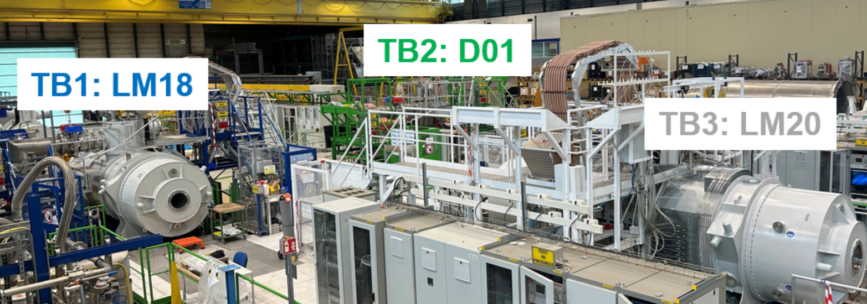
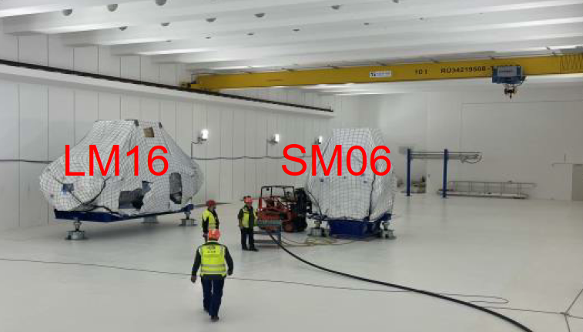
SC multiplets for Early Science 2027
branch T
pre-target area
Cold test completed at CERN or delivered to GSI
SM3
SM2
SM6
SM5
SM4
SM8
SM1
Cold test on-going at CERN
LM16
LM10
Waiting for cold test at CERN
LM18
LM09
target area
branch P
Final FAT test passed at ASG
LM11
Production/Repair on-going at ASG
branch T
LM20
LM21
@ CERN : LM20/18/25 and SM04
LM22
LM23
LM25
LM13
@ ASG FAT completed
SM05/LM22/LM23/LM21
@ ASG, under repair and production SM01/SM03/SM08/LM13/LM15/LM29
branch M
LM15
@ GSI : 6 multipets
LM09/10/11/16 and SM02/06
branch H
LM29
BB
Super-FRS SC Multiplet | M. Cho

Slide 3
Working process for the multiplets
Working Processes Pre-assembly
1.
2.
3.
4.
5.
6.
7.
8.
9.
10.
11.
12.
13.
14.
15.
16.
purging + filling with nitrogen
transport to LEB cave
unpacking
quench detection box (only FOS)
mounting terminal boxes
mounting flexible power cables
inspection report electr.
tests
cleaning vacuum chamber
mounting vacuum gauges
Isolation Vacuum leak test
Preparation transport
Documen-tation in PLM
Magnet arrival at GSI
assembly of support feet
incoming/ goods
tests
electr.
tests (sensors)
mounting valve panel
Beam pipe Vacuum leak test
mounting vacuum valves
inspection report of works VAC
documentation/ plans of DMU
air cushion transport
Working Processes Installation
1.
2.
3.
4.
5.
6.
7.
8.
9.
10.
11.
12.
13.
14.
15.
16.
Transport to final position
(air cushion)
positioning on blue line
Bodenbefestigung
removal of transport rods
Mounting safety valve in tunnel installation
mounting vacuum pumps
mounting gate valve
Beam pipe
welding
Jumper welding
Current Lead Warm Gas (swagelock)
Grounding
Connecting signal cables
Electrical tests
Insulation vauum tests
Documen-tation in PLM
MC
Multiplet bereit für IBN
Closing open non-conformities before MC

Slide 4
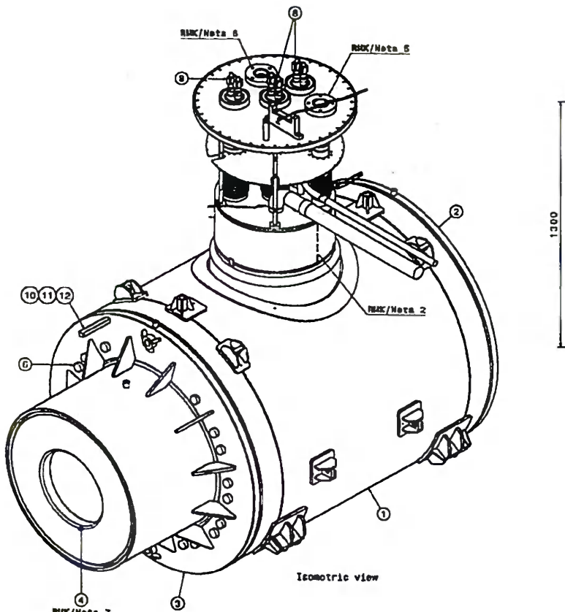
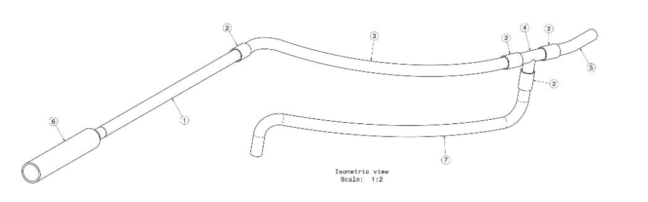
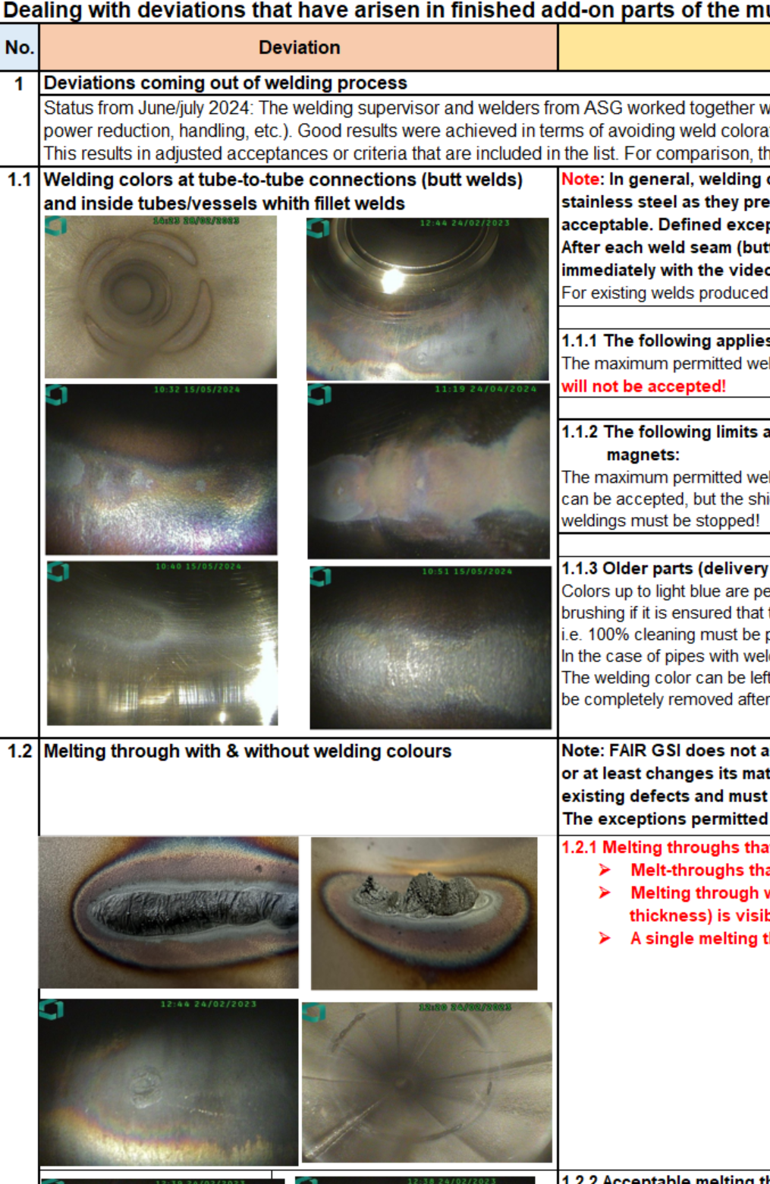
Storage conditions
Welding Jobs by ASG and
sub-contactors
  Lhe vessel
  TS shield
  Pipes
F-QB-SCM-en-MT-0009_Deviations_list_for_welding
_and_brazing_process
Visual/Endoscopic inspection
No exposure to humidity
and oxygen
No
No
Risk is
acceptable?
Conform ?
Repairable?
Yes
Yes
Yes
Issue NCR
Repair
Assembly
Issue NCR
Assembly
Used in production

Slide 5
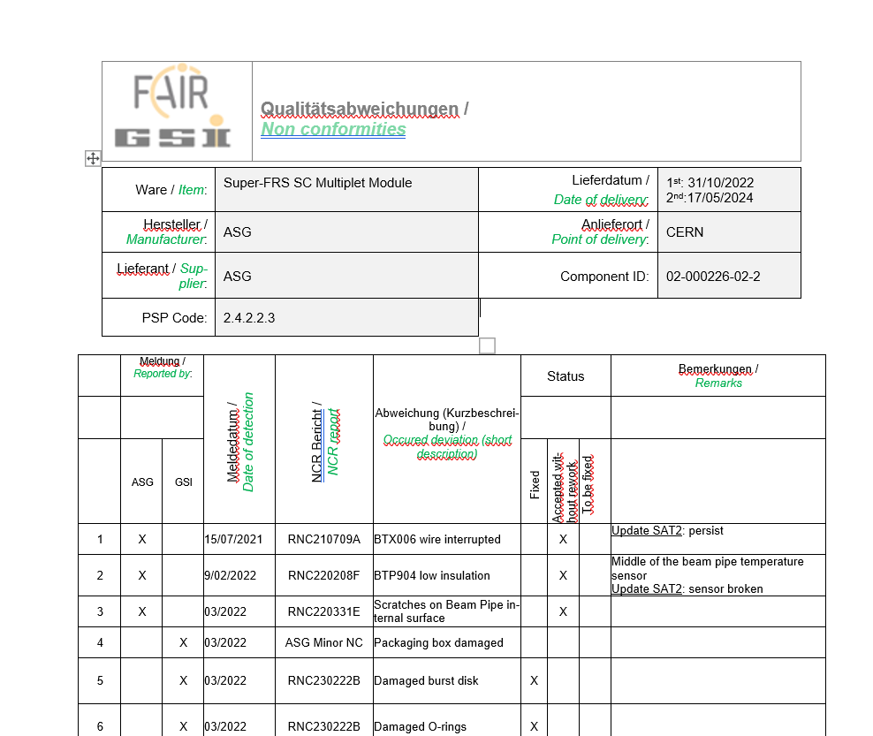
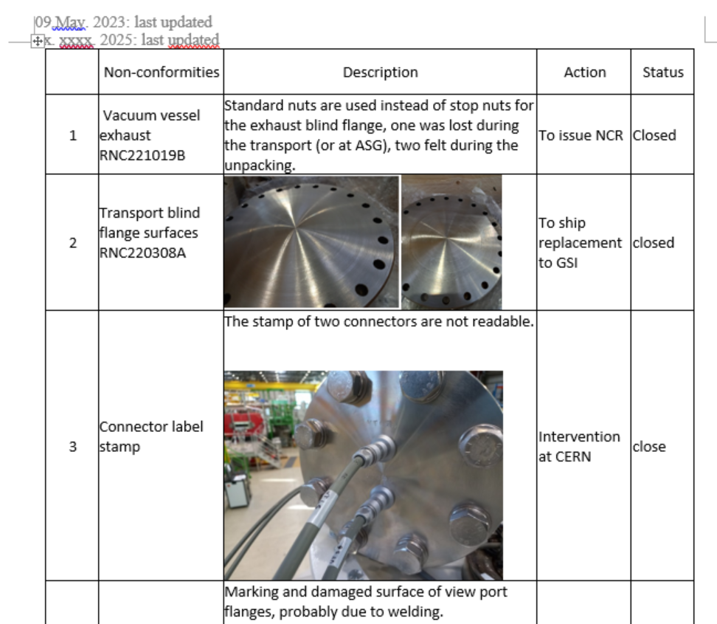
Management of Non-conformities
Report findings by testing team
Evaluate and officially inform ASG
by WPL
Non-conformity ?
Yes
No
Repairable at CERN?
Repair at GSI after SAT Ab
Yes
Repair
Issue NCR

Slide 6
Open non-conformities
Modules | Non-conformities | Where/when
LM09 | Repair Leaky LEMO feedthroughs Leak on a flange on the cryo jumper's bolted flange Isolation T90 sensor on LQB Repair one damaged voltage tap cable | Pre-target after October, 2025
LM10 | Short circuit of BTX13 and BTX14 Leaky LEMO feedthroughs
LM11 | Leaky LEMO feedthroughs
SM06 | Low insulation between BTP 407 and BTP408 T90 temperature sensor swap between WD15 and WD16 Leaky LEMO feedthroughs | LE cave, the timeline to be decided
LM16 | Low insulation between Sensors BTX007 and BTX008 Leaky LEMO feedthroughs
SM02 | Repair damaged VT cable (Quad cold)

Slide 7
Conclusion
There is no major issue with a delivery of Multiplet to CERN.
It is very important to keep the multiplets in non-oxidation environment.
Open non-conformities must be closed before the completion of the machine.
ASG’s intervention will be scheduled in coordination with the GSI installation
working groups.

