Slide 1
Scope of the SCM and Cryo
S. Pietri

Slide 2
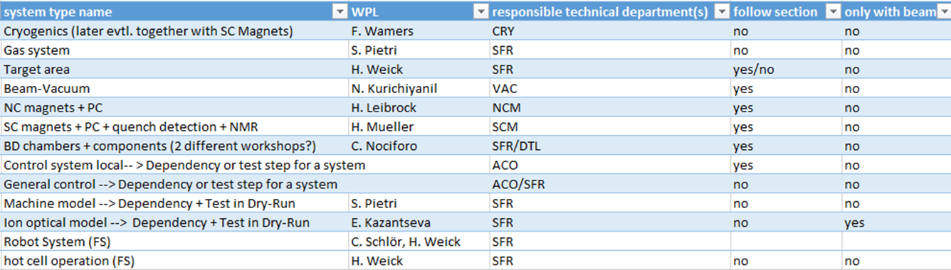
Scope

Slide 3
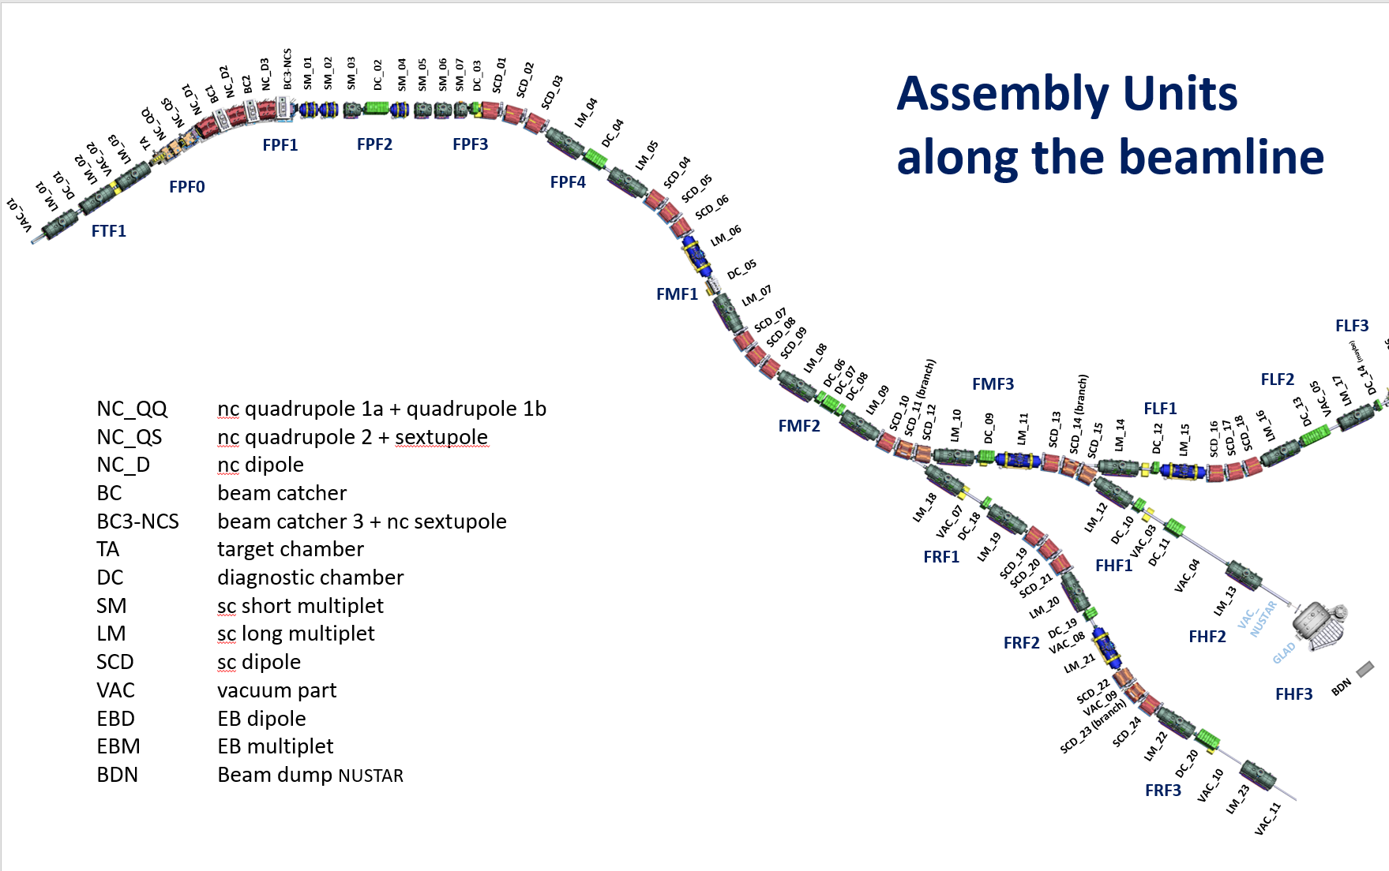
Super-FRS assembly units

Slide 4
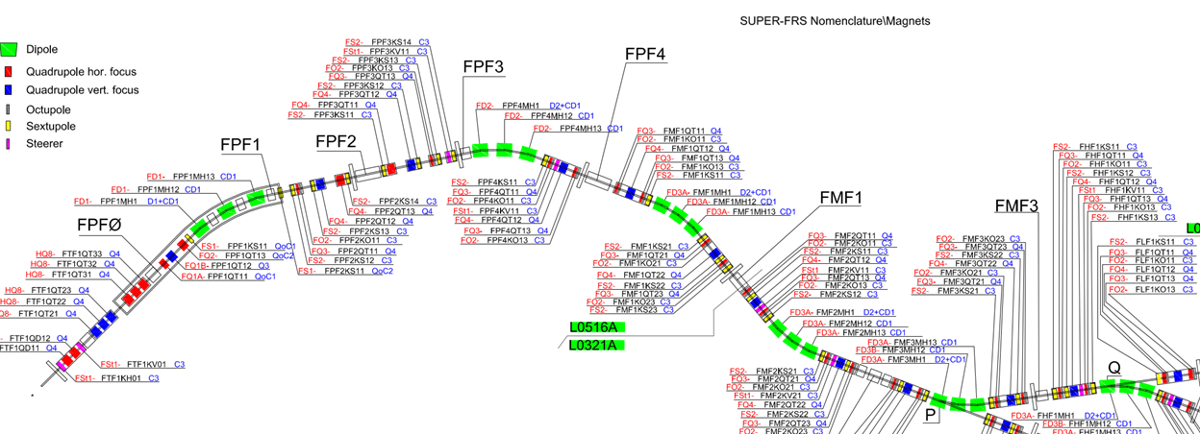

Slide 5
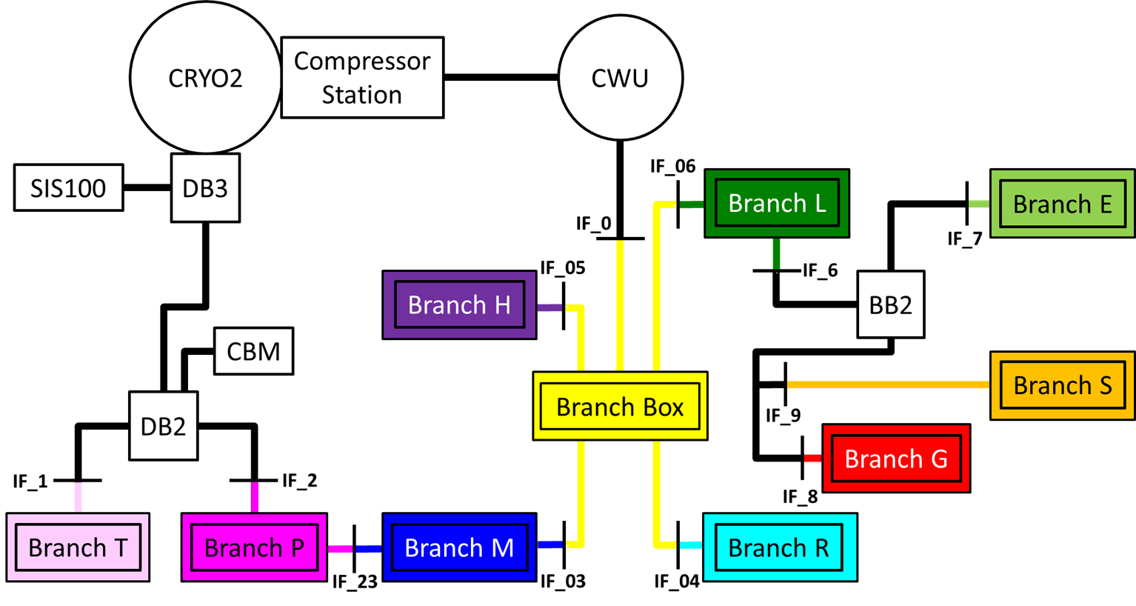
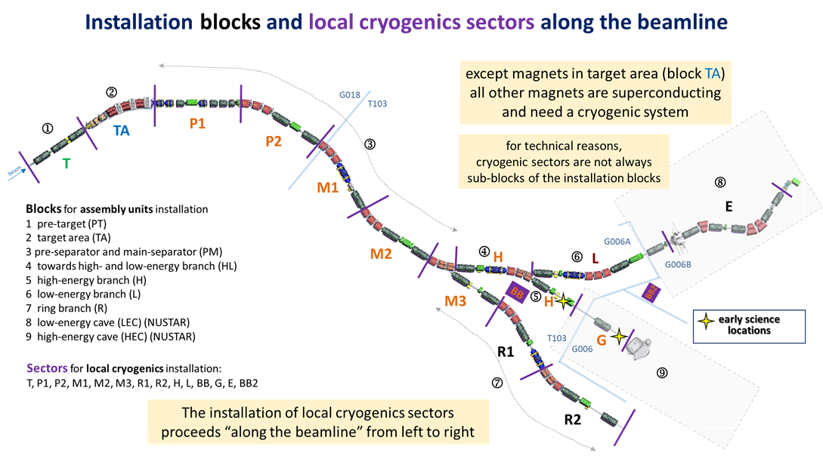
ES just bypass
Not ES
Not ES
Not ES
L

Slide 6
Input on mechanical completion
Magnets: Melanie and Hans
Power convertors: Tripti
Cryogenics: Felix
the “sections” definition is different for Cryo and Magnets.
need to cool down (finish phase 2/3 local cryogenics commission) to perform local magnet commissioning with load

Slide 7
