Slide 1

Super FRS commisioning
workshop May 25
Christos Karagiannis
25.May.2025
Pillow seals
Component
Layout
Installation
Commisioning

Slide 2
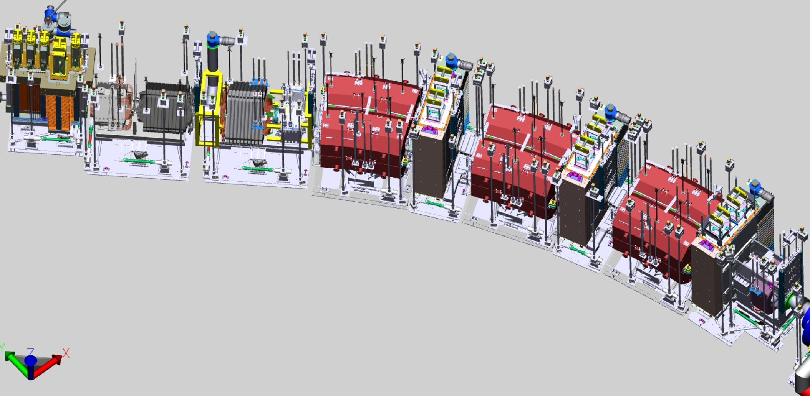
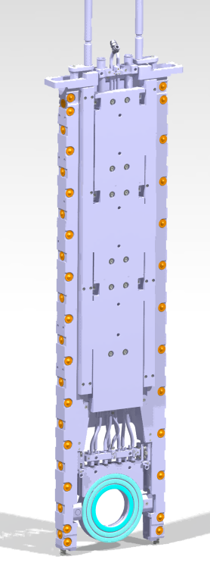
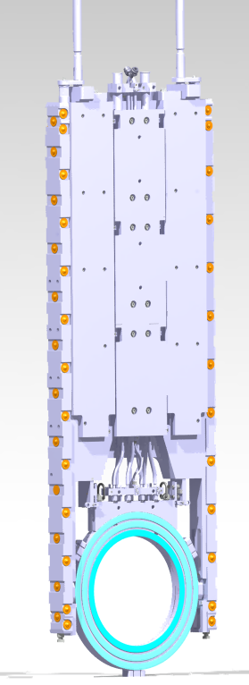
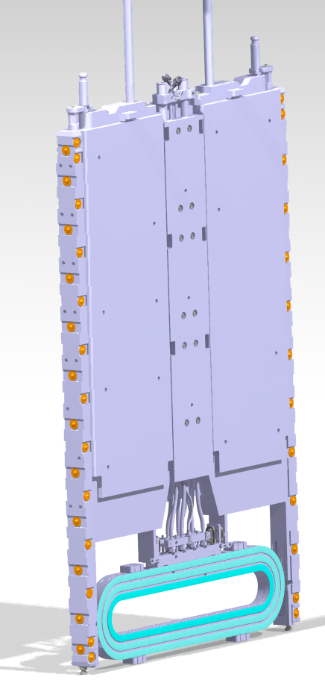
PS at the beam line
5x PS
DN 500
3x PS
RT
2x PS
DN 200

Slide 3
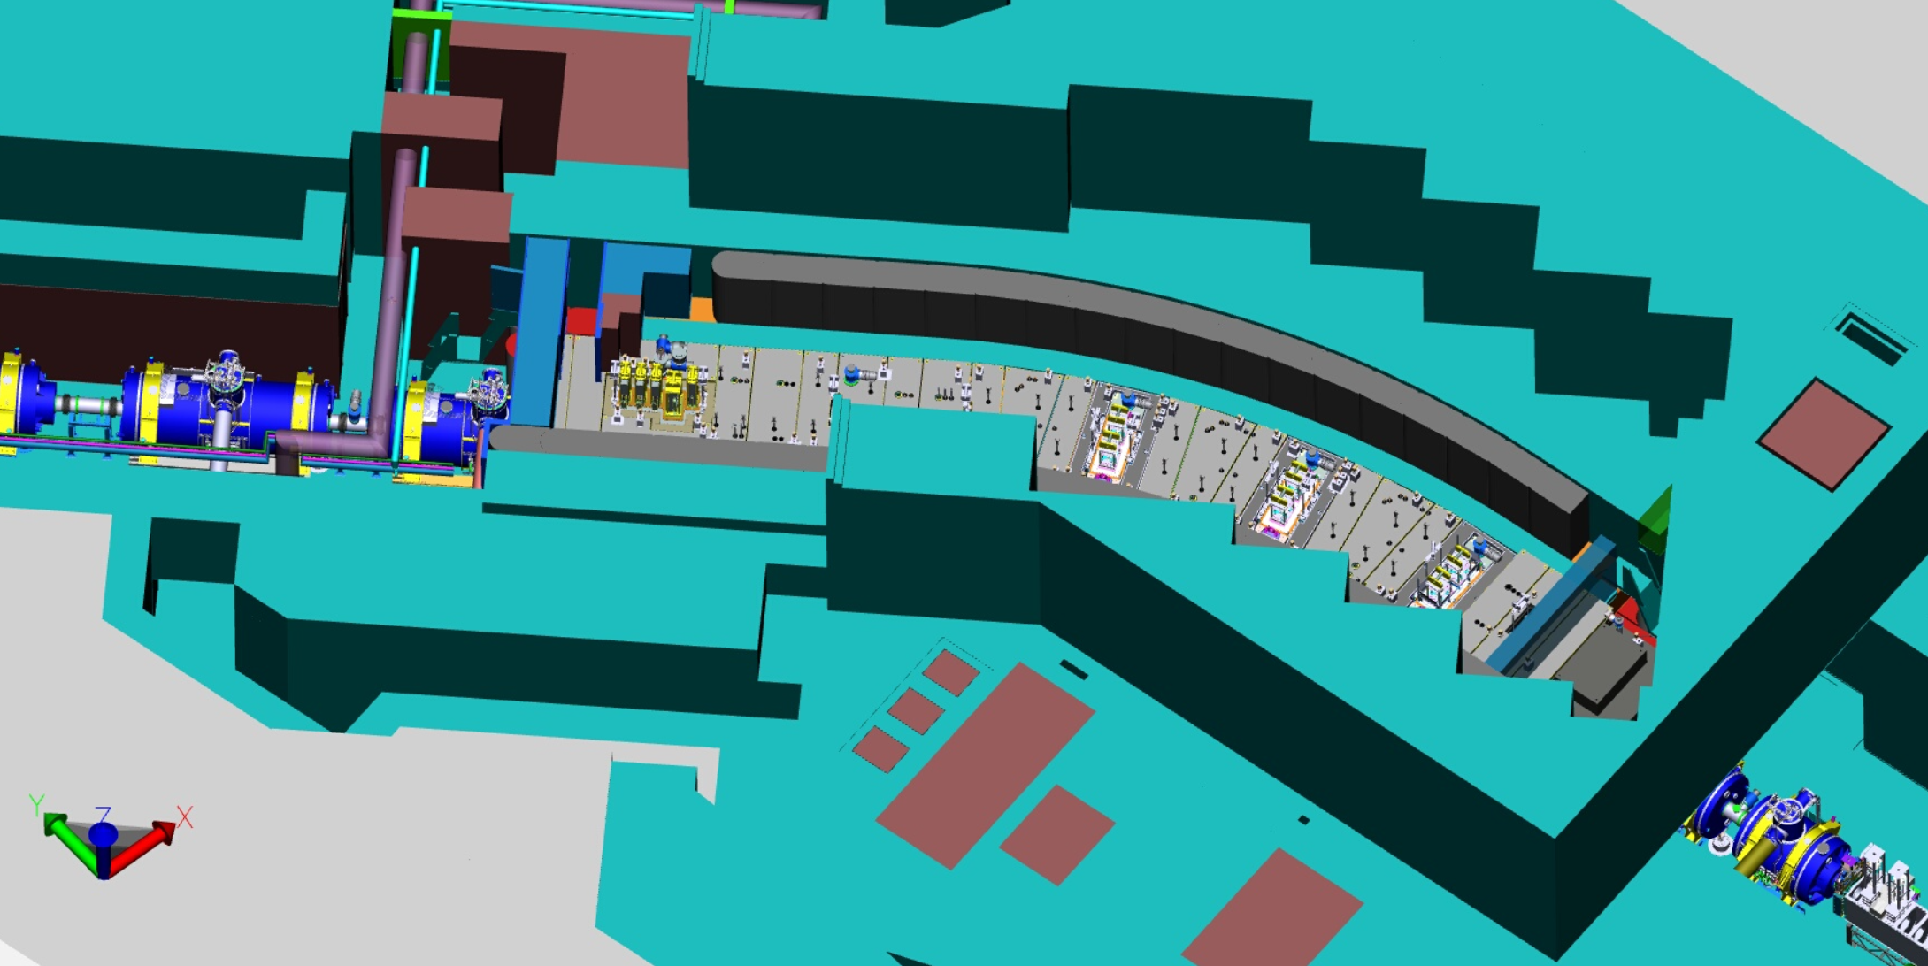
PS Peripherical parts
PS pump station
Two cabinets with
compressed air
hardware beside
compressed air
2x vacuum lines
Components:
Pillow seals
Vacuum / copmressed air peripherical parts
Control system

Slide 4
Installation-Tests- Commisioning
Necessary components
1. Pillow seals
2. Utilities
Vacuum / copmressed air peripherical parts
3. Control system
Installation and test procedure arranged with vacuum group
Under development
Cosylab
Blind PS for Tests needed
Thank you

