Slide 1

SFRS Special Installations
Commissioning
Helmut Weick, GSI Helmholtzzentrum
Darmstadt 26.05.2025
Target Chamber
Beam Catchers
Degrader Drives
Alignment Supports
Radiation Shielding
drives, sensors, …
-- just use for alignment
Shielding Flask
Hot Cell
-- no commissioning
-- commissioning with each plug
-- not today, much TBI
Pillow Seals --> dedicated talk by Christos

Slide 2
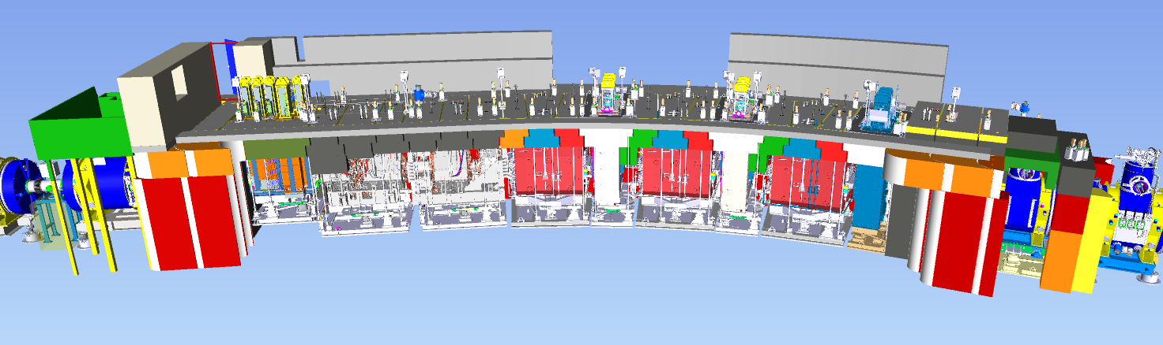
Target Area
iron shielding blocks
iron roof bars
target chamber
quadrupole + dipole magnets
beam catchers
25 m
All cabling, piping only after installation of iron roof,
Racks (motor controller, PLC) on roof and pressure controls.
Only vacuum commissioning step by step with pumps mounted.

Slide 3

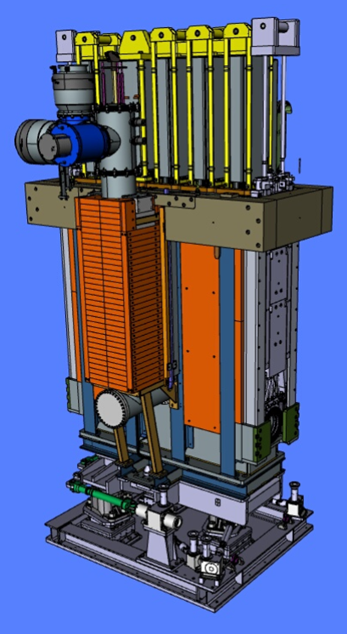
Target Chamber
Drives (local, remote)
6 stepper motor drives (PDC, MBox)
1 Phytron motor for target wheel, extra PLC local rack, readout via FESA in LSA
Thermo sensors for monitoring, read out locally, integration in LSA?
Adjust cooling water flow, flow matched to beam, local flow meter, remote?
Target camera system readjust mirrors, start with optical camera and laser spot on target, Heated wires for infrared camera, local, later remote behind wall
Practice plug removal and insertion also with shielding flask

Slide 4
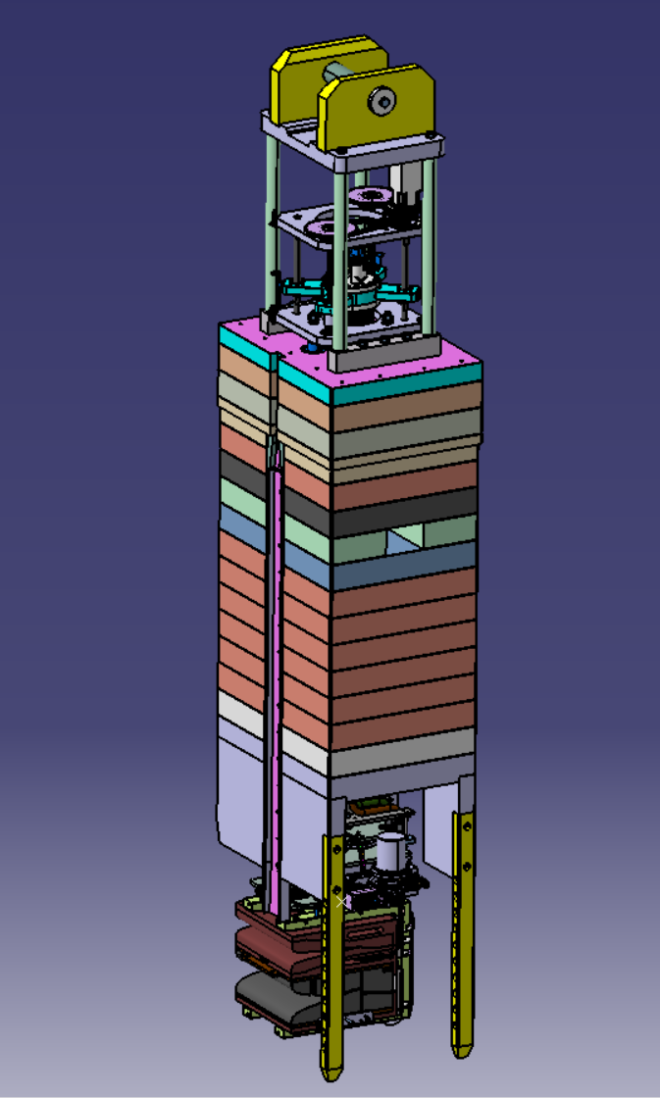
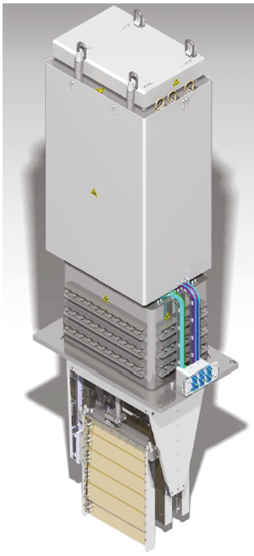
Beam Catcher, Degrader Drives
Beam-Catcher Drives (local, remote)
6 stepper motor drives (PDC, MBox)
2 Phytron motors for absorber, extra PLC local rack, readout via FESA in LSA
Thermo sensors for monitoring, read out locally, integration in LSA?
Adjust cooling water flow, 12 tubes, match flow to beam, local flow meter, remote not planned
Practice plug removal and insertion
also with shielding flask
Degrader Drives (8x Stepper motor, 2x pressure)
at FPF2 and FMF2, local test possible not in chamber end switches, rotation needs other display in Device_Control

