Slide 1
Hanno Leibrock
Status NC-Magnets at mechanical completion
Super-FRS Commissioning Workshop,
May 26th-27th, 2025

Slide 2
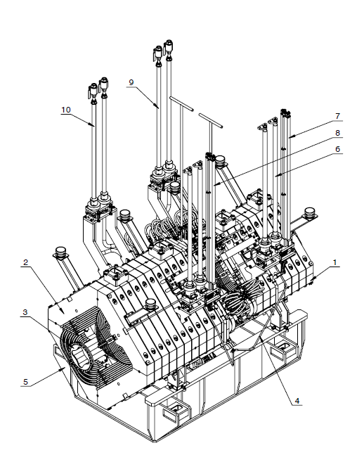
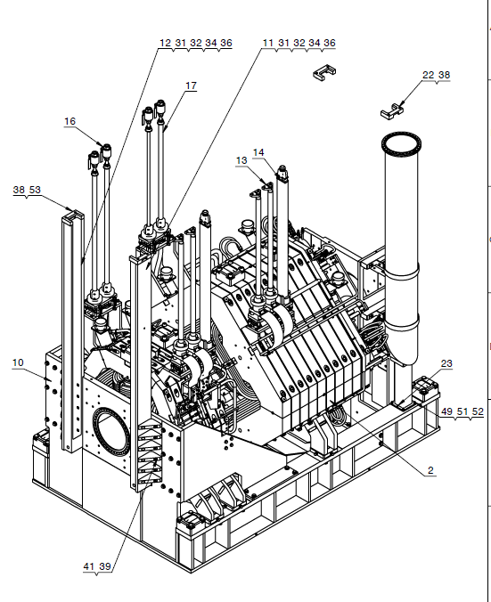
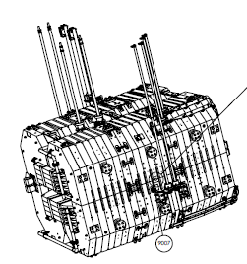
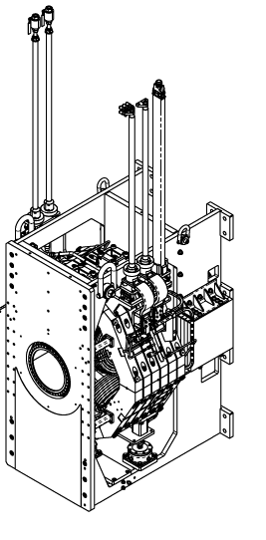
mechanical completion NC magnets
overview drawings from the from the manufacturers of the magnets

Slide 3
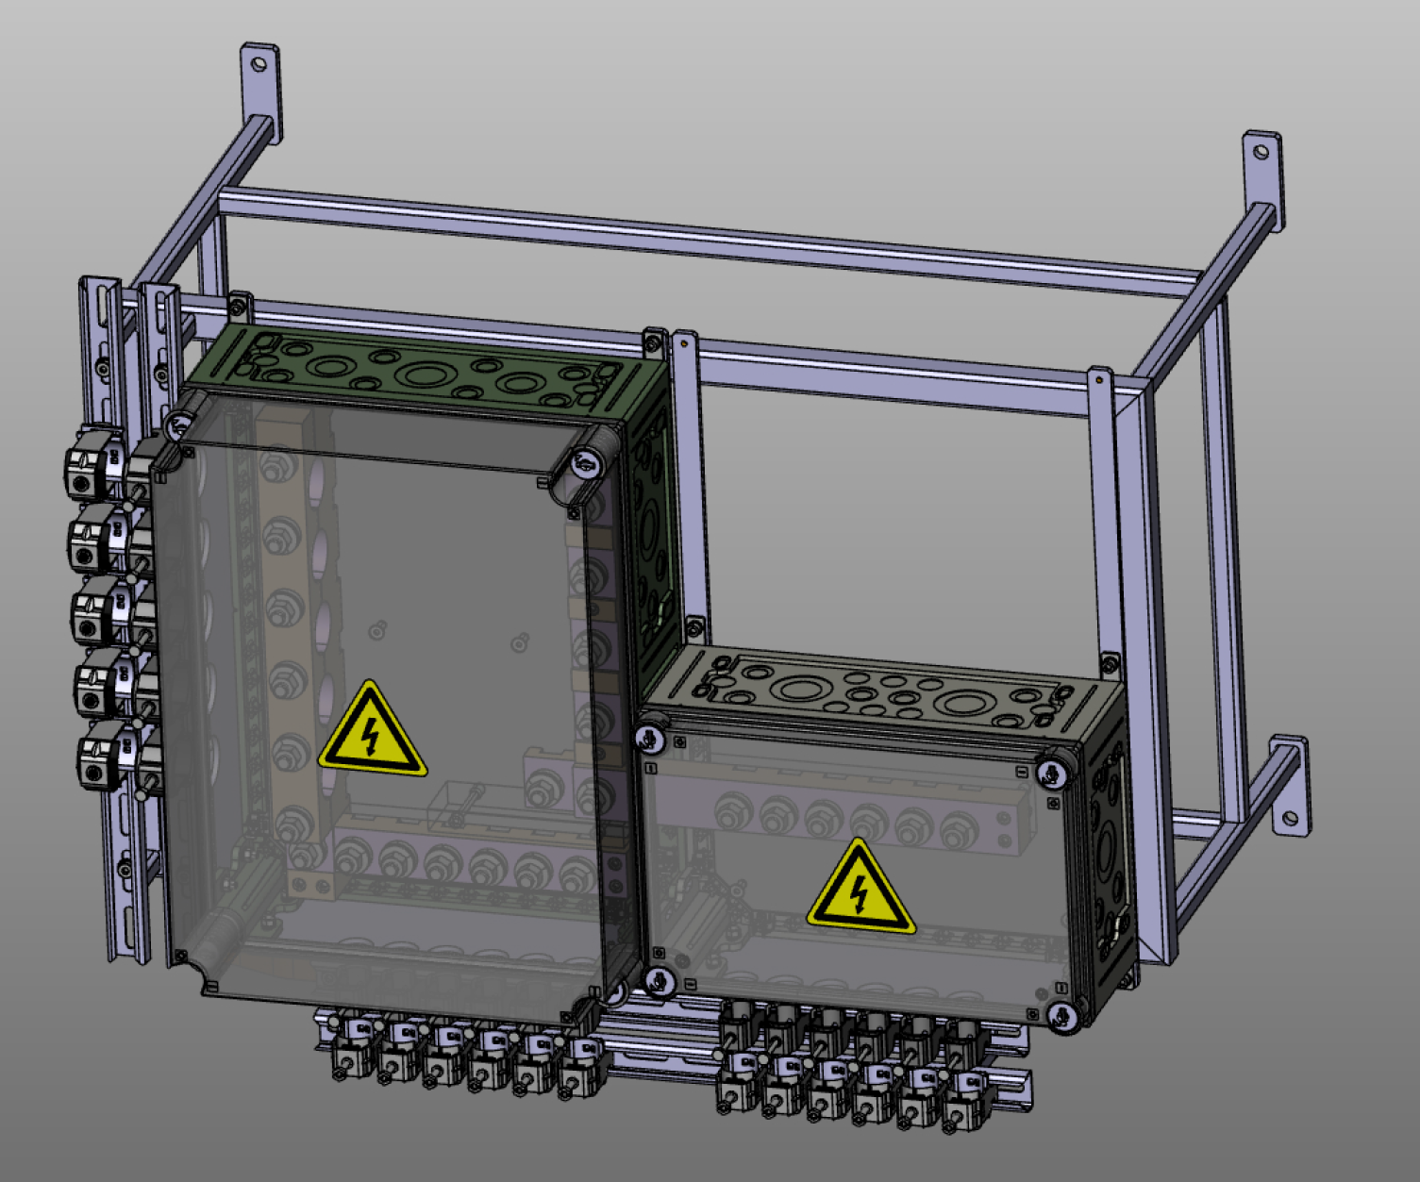
mechanical completion NC magnets
Situation after mechanical completion:
The copper lances for the magnet current are installed
Adapter boxes for the power cables are mounted onto the wall of the service tunnel. The coaxial cables have been connected into the adapter boxes.
The flexible cables between the copper lances and the adapter boxes are assembled. A savety cover at the top of the copper lances is installed.

Slide 4
mechanical completion NC magnets
Situation after mechanical completion:
The copper lances for the magnet current are installed
Adapter boxes for the power cables are mounted onto the wall of the service tunnel. The coaxial cables have been connected into the adapter boxes.
The flexible cables between the copper lances and the adapter boxes are assembled. A savety cover at the top of the copper lances is installed.
The water lances for the coil cooling are connected with the interfaces of the magnets.
The water lances for the cooling of the vacuum chambers inside the dipoles are connected with the interfaces at the dipoles.
Water hoses connect the water lances to the water distributor. The correct water flow has been set in each case. A water monitor is installed in the return line.

Slide 5
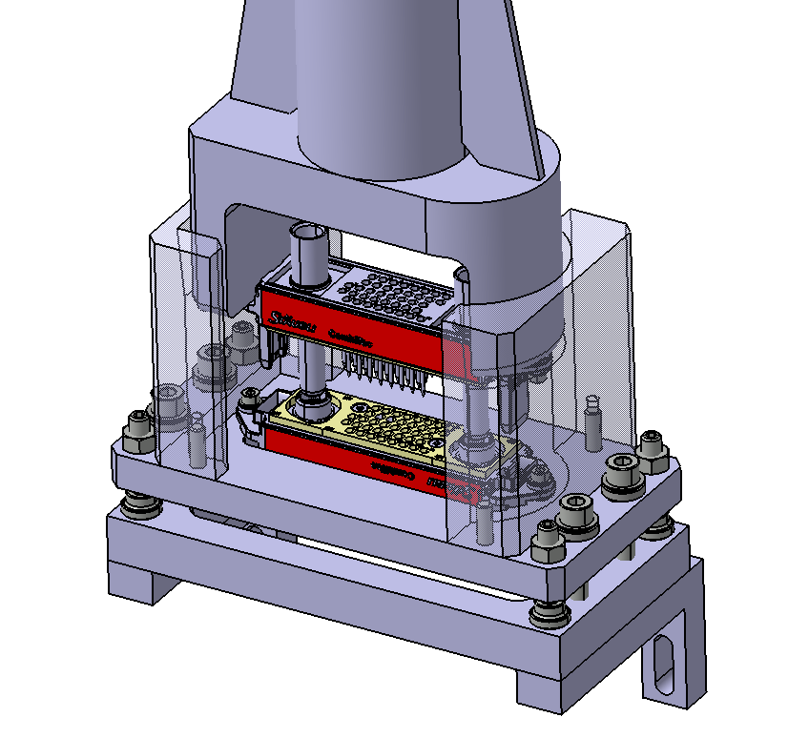
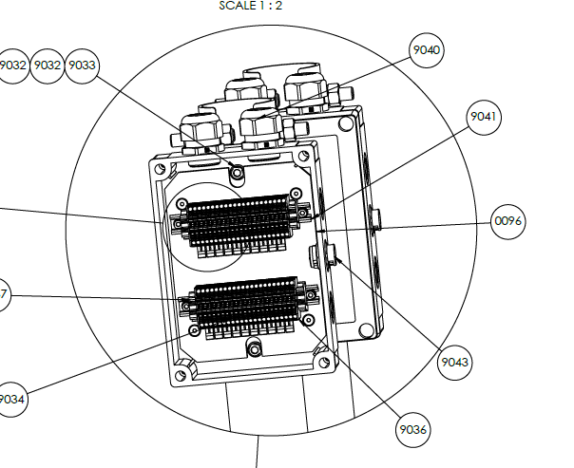
mechanical completion NC magnets
Situation after mechanical completion:
The connection lances with the wires from the thermo switches are installed on the interfaces of the magnets.
Small connection boxes collect the outputs of the thermos switches and the water monitors. They are connected to the emergency stop of the power converters.
The grounding cables are connected.
The rods to the gears of the adjustable support frames are installed with counters.
A first fine adjustment of the magnets took place with the Fiducial Bar System (FiBS, except the Sextupol – Beamcatcher combination). The FiBS-bars can be removed after the fine adjustment.

Slide 6
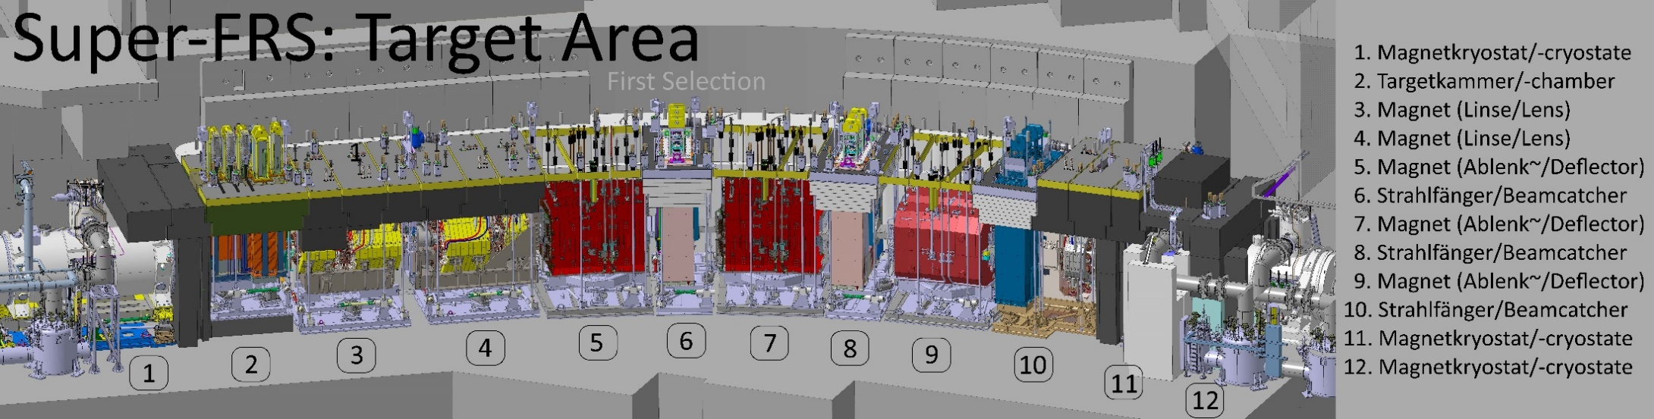
mechanical completion NC magnets
Service tunnel
Figure copied from the Super-FRS Status Report, M. Winkler NUSTAR Week 2024

Slide 7
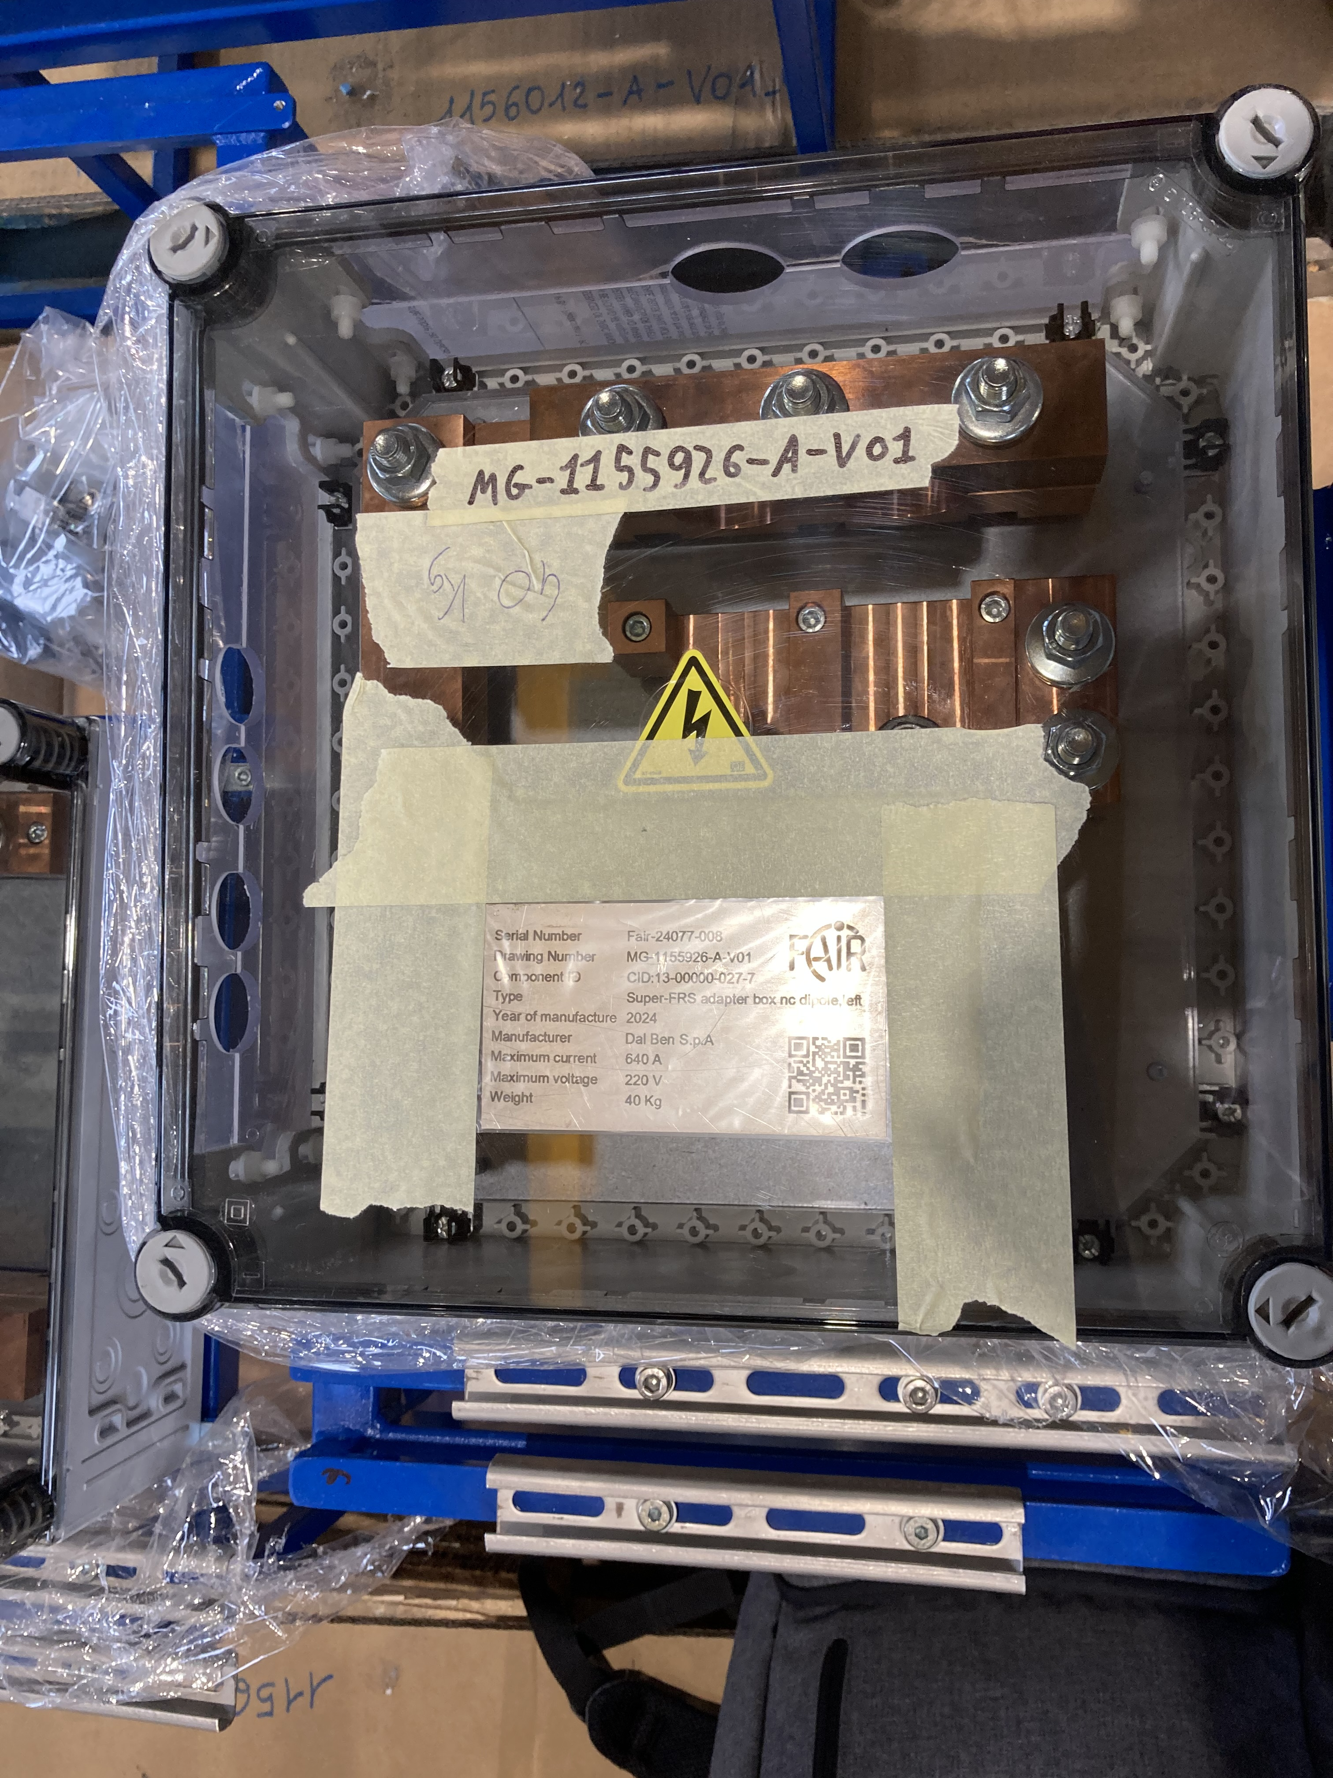
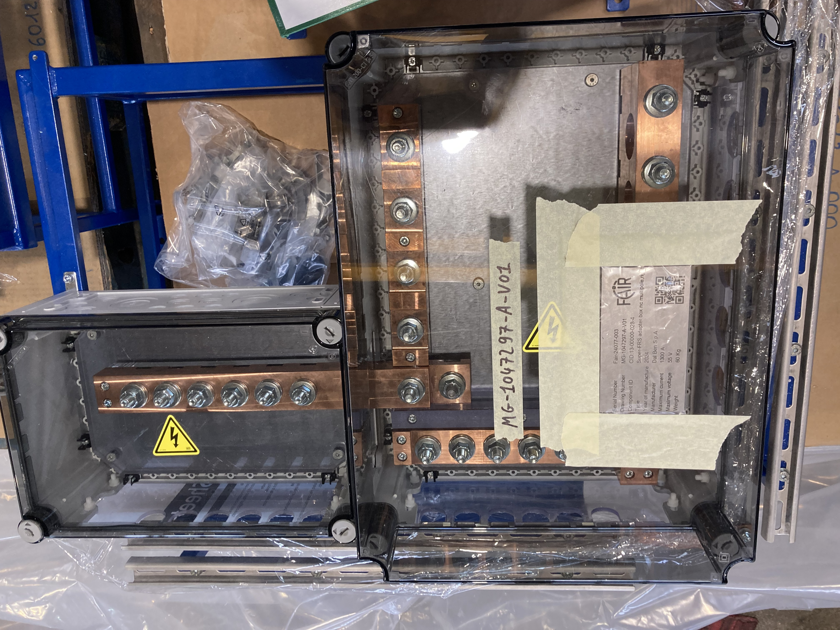
mechanical completion NC magnets

