Slide 1
LCM schemes and work estimates, Target area and NCM
S. Pietri

Slide 2
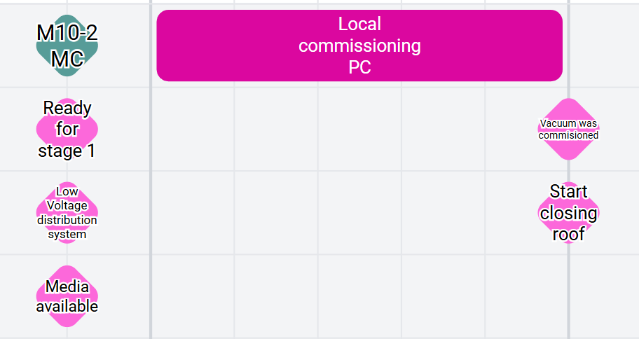
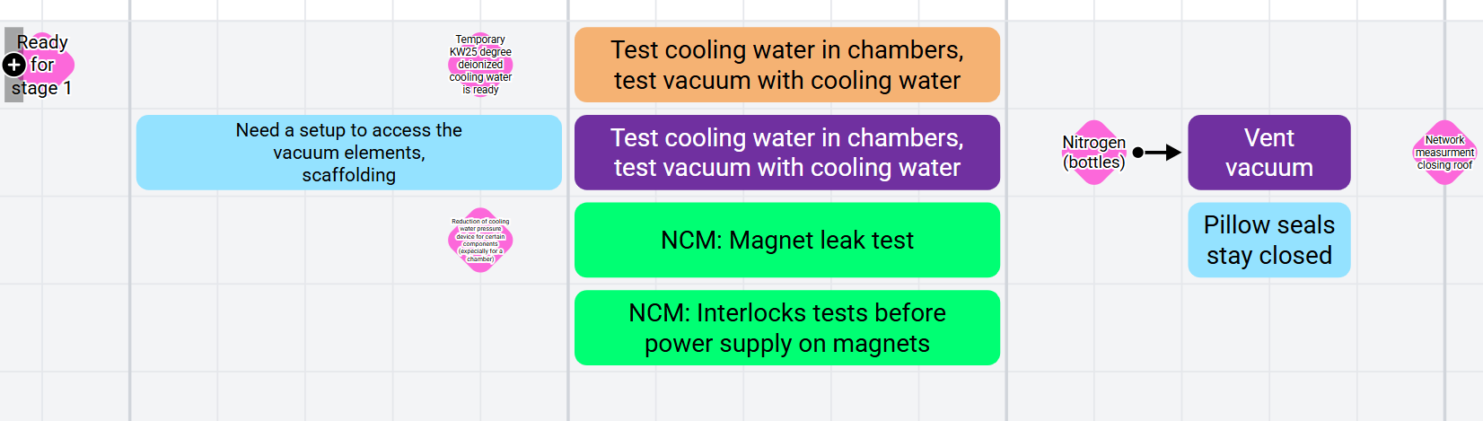
Before closing the roof
reduction water pressure

Slide 3
closing the roof
Installation task!
include connection of PowerLances

Slide 4
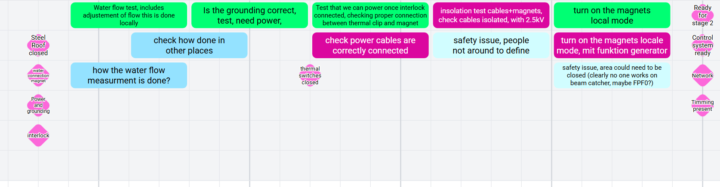
NCM phase 1 after closing the roof

Slide 5
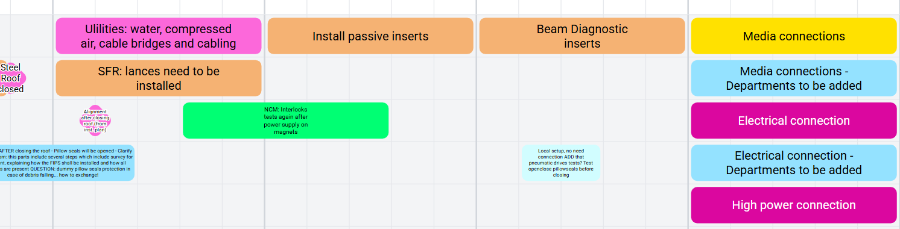
target chamber and special inserts after closing roof
Alignment after closing the roof

Slide 6
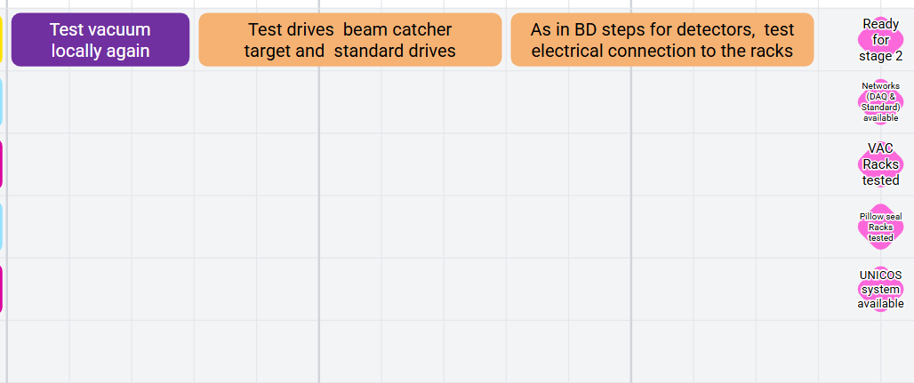
phase 1 target area (non NCM)

Slide 7
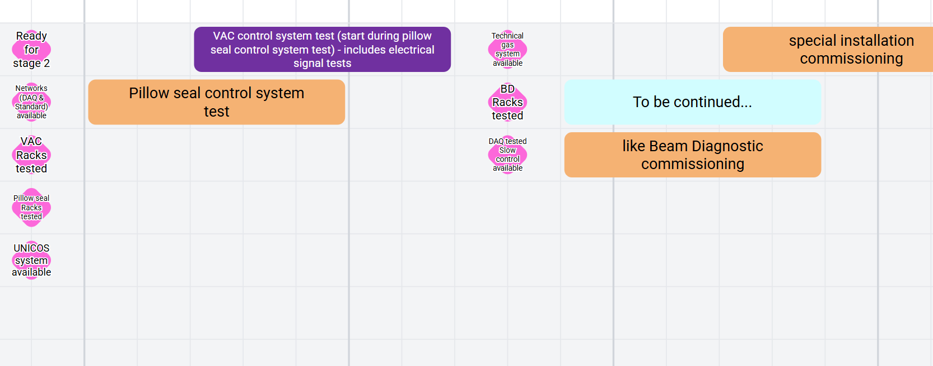
Phase 2 target area

Slide 8
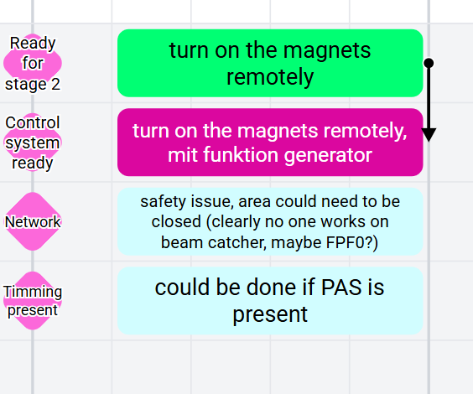
NCM phase 2

Slide 9
