Slide 1
Scope of Target area
S. Pietri

Slide 2
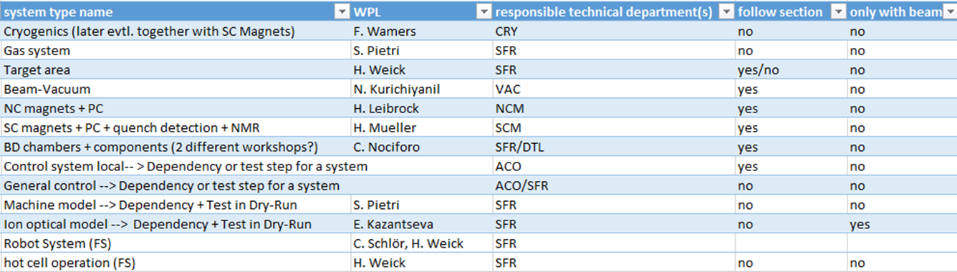
Scope
Goal is to come with an integrated plan for the commissioning of Beam Vacuum
and of the beam diagnostic chambers
BD chambers: 11 of them, between 8 inserts to 1 insert

Slide 3
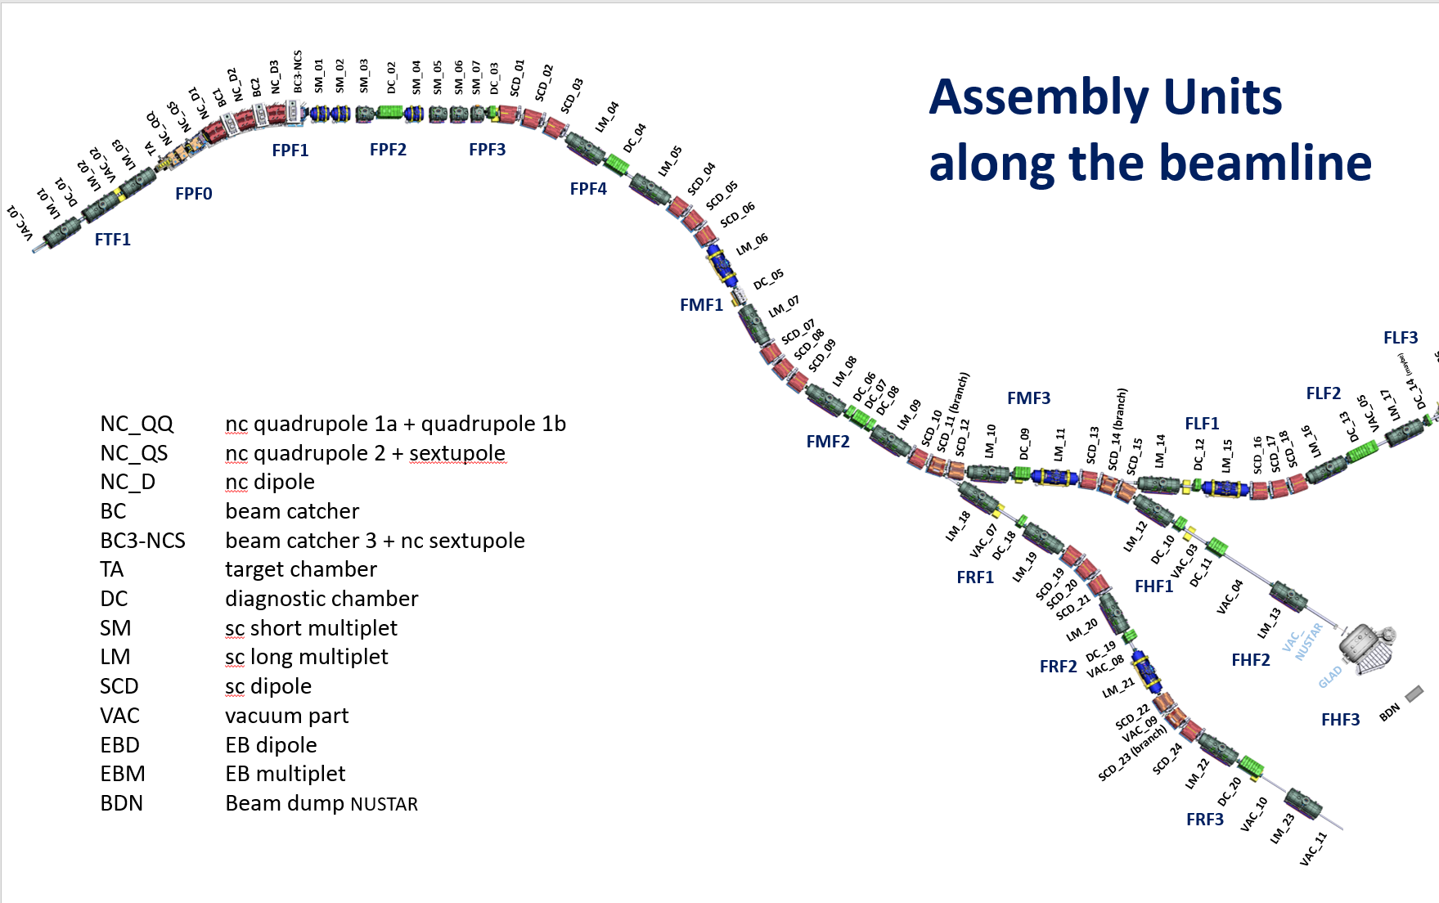
Super-FRS assembly units

Slide 4
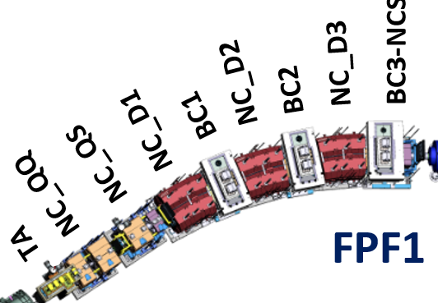
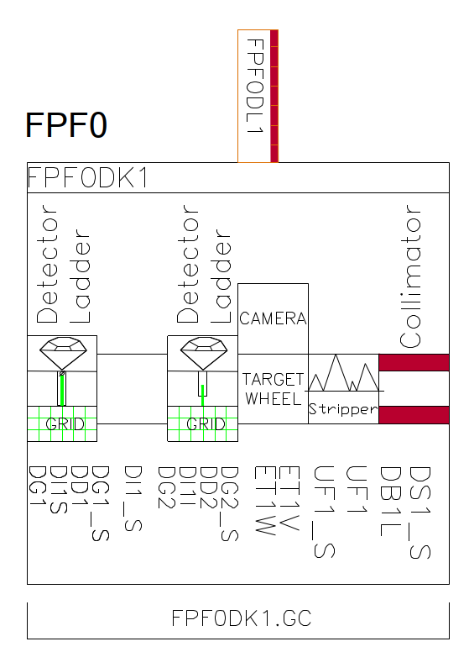
Target area
Specificities:
-one vacuum sections
-under a steel roof
-pillow seals to stop sections
-no cryogenics
-Normal conducting magnets

Slide 5
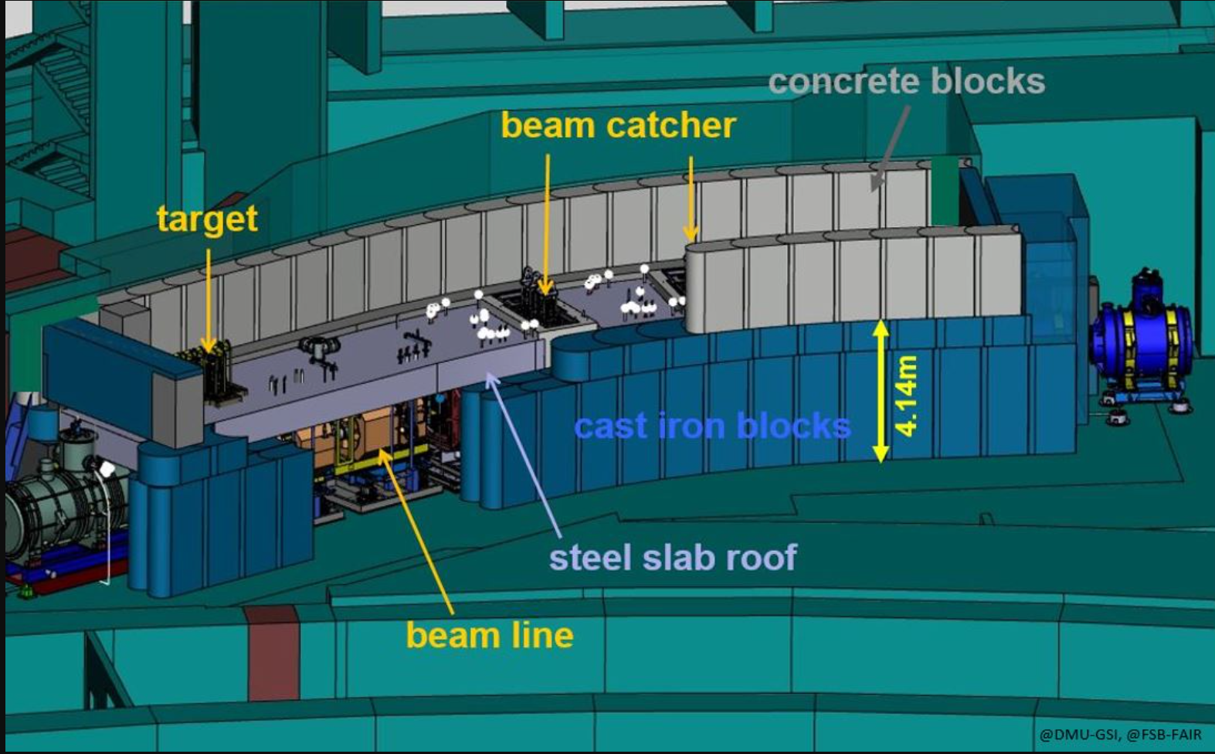
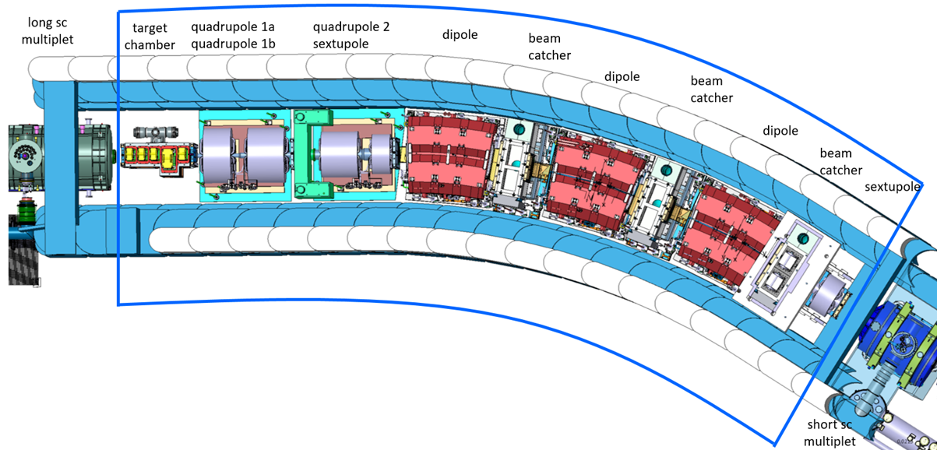
High radiation
high radiation, target complexity
all elements encased in a
steel “sarcophagi”
limit access, only one vacuum
section
this is special for
commissioning and installation

Slide 6
Input on mechanical completion
Vacuum: Neeraj and Christos
Chamber and special installations: Helmut
Power convertors: Tripti, Alex
Magnets: Hanno and Peter
Main questions: what is done/tested before closing the roof

