Slide 1
LCM schemes and work estimates: Beam Vacuum and Diagnostic chambers
S. Pietri

Slide 2
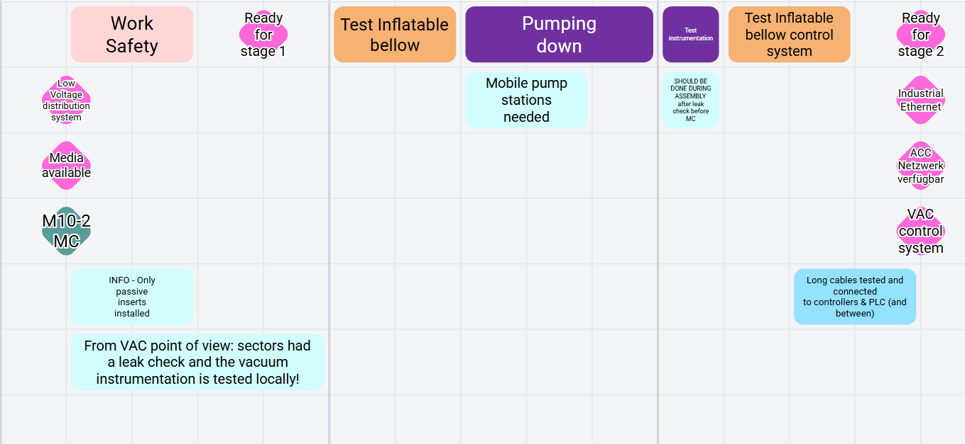
VAC
1 day
2 SFR
3 days
1.5 VAC
1 days
1 VAC
2 days
1 SFR
7 days, 4 days SFR, 5.5 days VAC
some sections are more complex

Slide 3
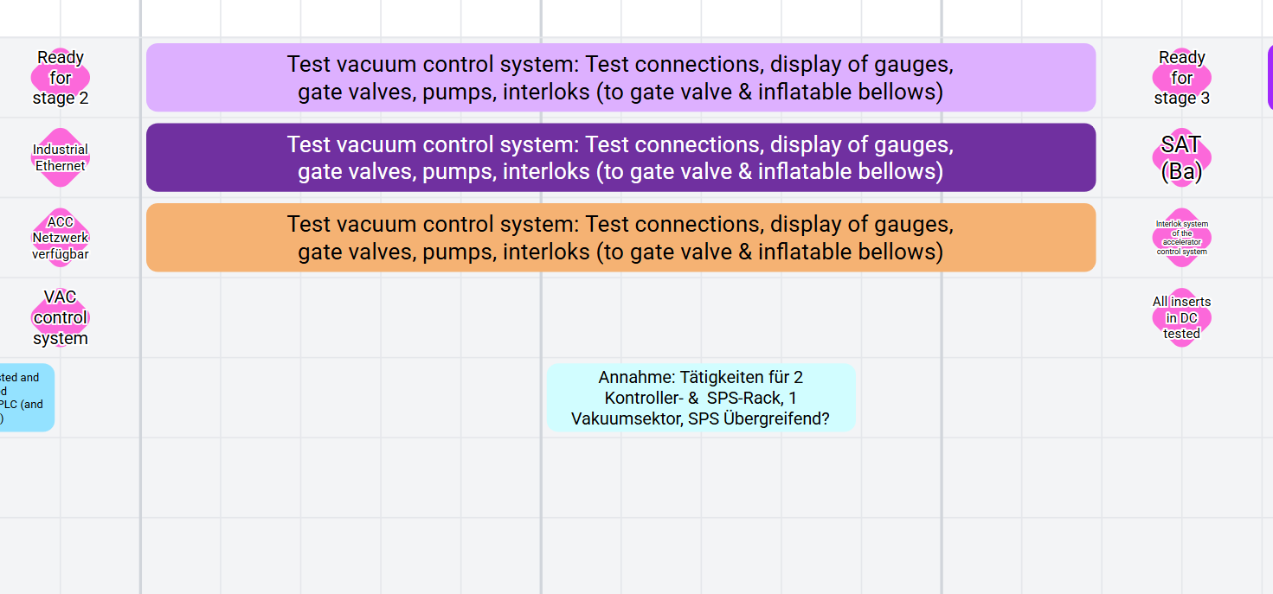
VAC phase 2
12 days per vacuum control sections (?)
10 people from IND and 11 people from VAC?
suppose 1 person from each department?
information needed: control sections of vacuum

Slide 4
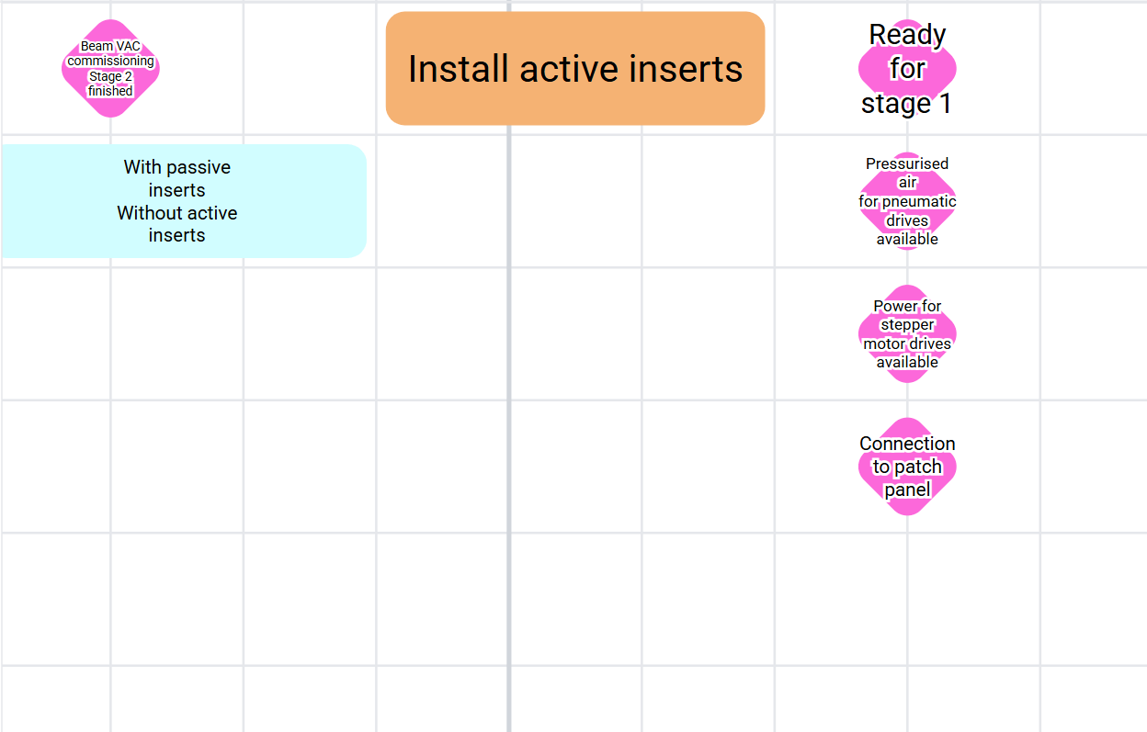
BD pre-phase 1

Slide 5
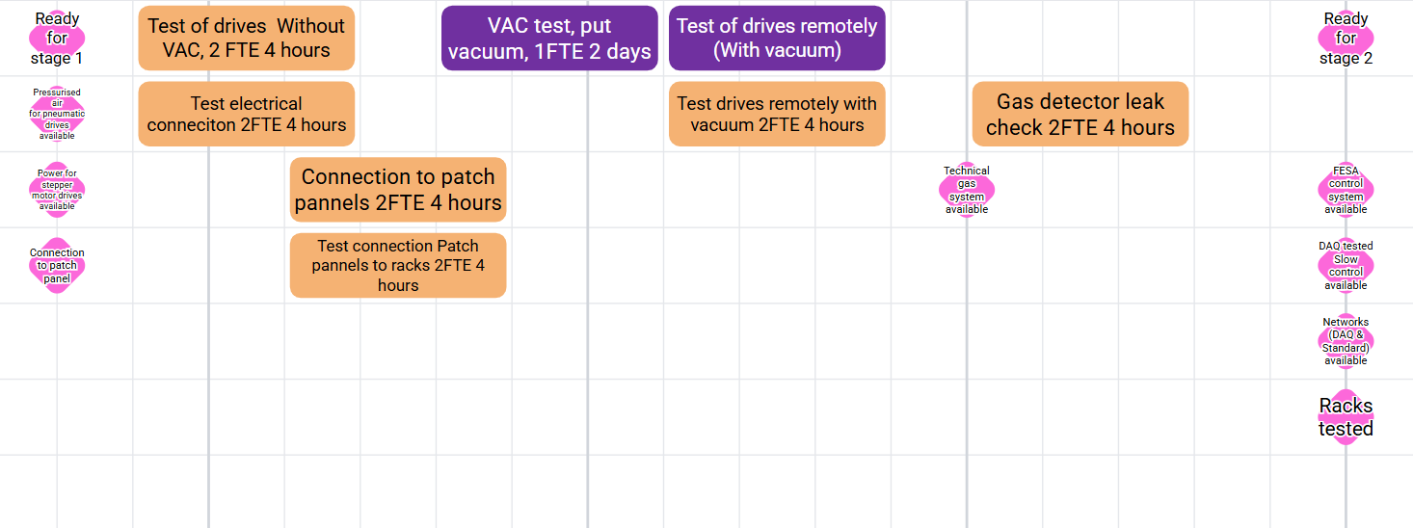
BD phase 1

Slide 6
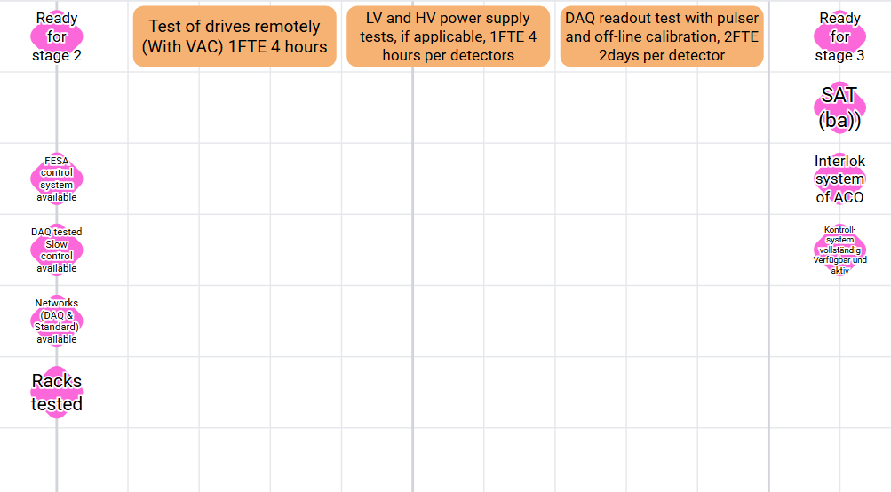
BD phase 2

Slide 7
Major issue
Rack tested? when installed, when filled, when tested?

