Slide 1
Current status of Super-FRS Commissioning planning, LCM and open points
S. Pietri

Slide 2
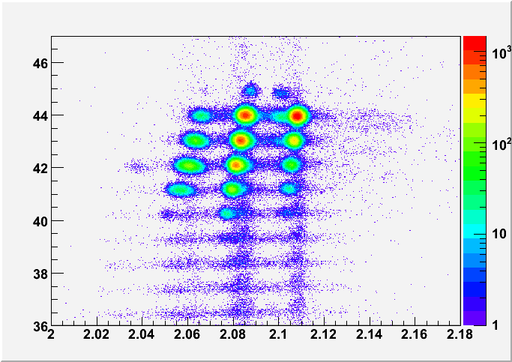
Objective of Super-FRS commissioning
Main goal of Super-FRS: select and identify ions produced in nuclear reactions at the target to deliver to NUSTAR experiments.
Final goal of the Super-FRS commissioning: assure Super-FRS can select and identify ions reliably.
Confirm something like
this ➔
Z of particle
Data from
FRS
AoQ of particle

Slide 3
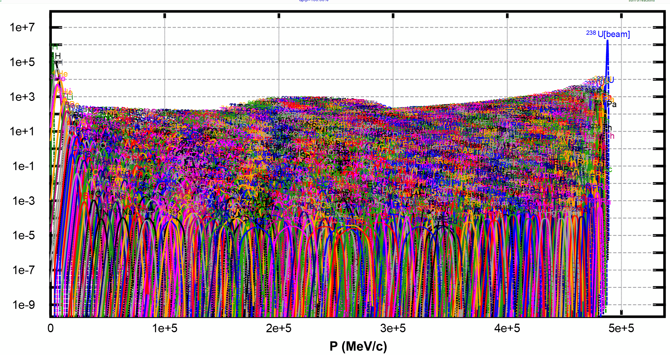
Super-FRS: Super FRagment Separator
²³⁸U from SIS18 on target to produce ²¹²Pb, ²³⁸U+¹²C@1 GeV.A ➔ ²¹²Pb
This is what is produced
at the target (yield)
3000+ isotopes
we need to select
the one we want

Slide 4
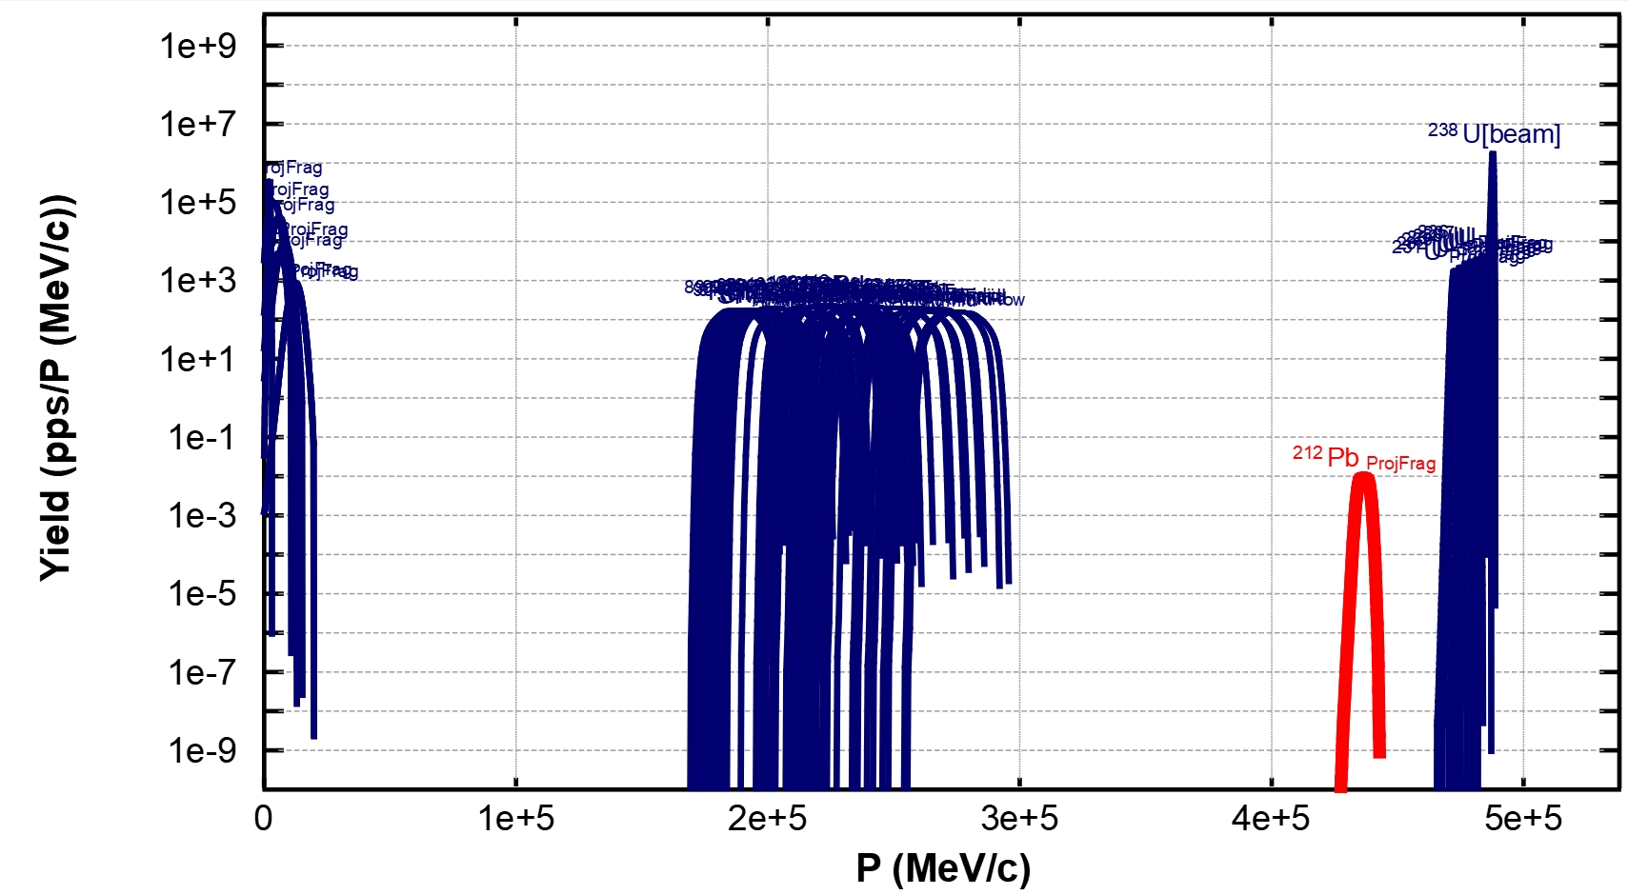
Super-FRS: Super FRagment Separator
²³⁸U from SIS18 on target to produce ²¹²Pb, ²³⁸U+¹²C@1 GeV.A ➔ ²¹²Pb
50 most produced ones
➔ red is ²¹²Pb

Slide 5
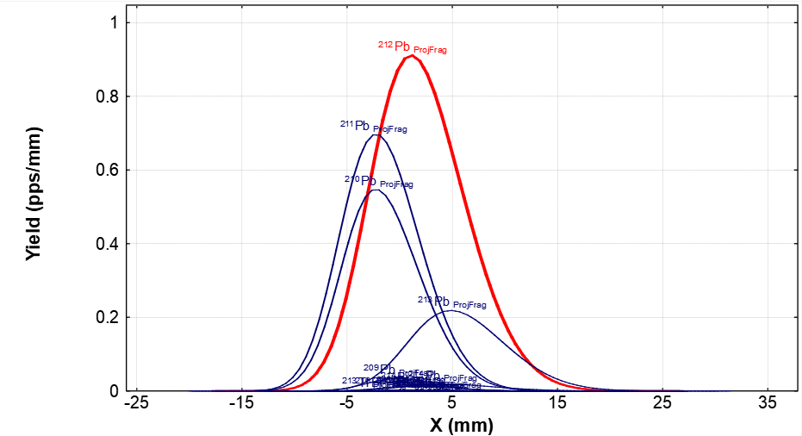
Super-FRS: Super FRagment Separator
²³⁸U from SIS18 on target to produce ²¹²Pb, ²³⁸U+¹²C@1 GeV.A ➔ ²¹²Pb
At FHF2 after selection

Slide 6
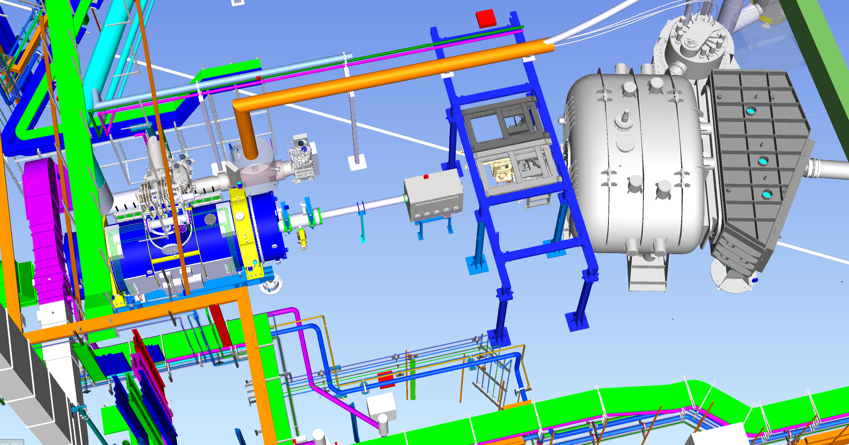
Commissioning include last multiplet at FHF2
FHF2 is in HEB, in front of the R3B experiments
SFRS multiplet
beam reach here during SFRS beam commissioning

Slide 7
For this to happen
We need vacuum and cryo
we need detectors working and characterized
we need all drives to work as expected
we need to have aligned the beam
we need settings to be reproductible (field control/ machine model tested)
we need to have measured ion optical parameters
we need analysis working quickly enough
we need to cross check our identification independently
we will need some tracking at FHF2 (one plan at least, two better for IO com.)

Slide 8
Detector beam characterization
Detector characterization:
  needs 3 different primary beam species (Sn, Ar, U/Pb)
  beam intensity from 1000 particle per spill to 10e8 particle per spill (for some detectors)
  Brho from 12 Tm to 18 Tm
  done along the beam line
  first time, done with testing field control and machine model
  done with measuring thickness of detectors and passive drives (calibrations)
Once beam trimmed through detector characterized we can start performing “physics calibration” of the spectrometer
Strategy still in discussion
to be done in parallel to Ion Optical Commissioning

Slide 9
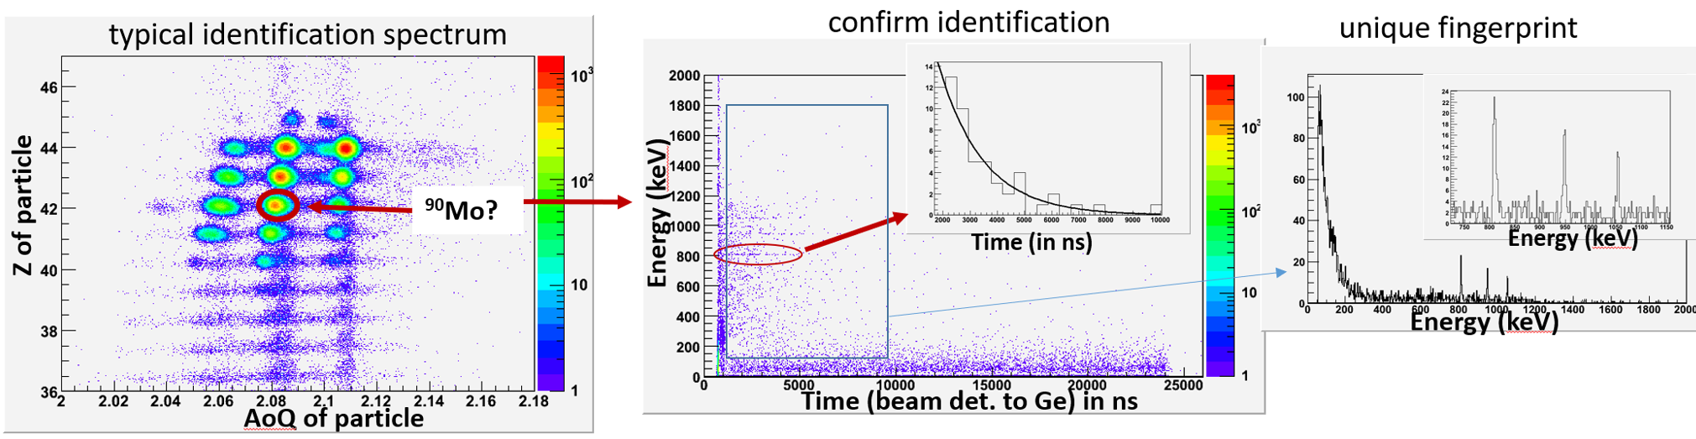
How to check we do the job right – isomer tagging
Example : Fabio Farinon PhD thesis (isomer tagger)
Need two Ge detectors and a piece of thick plastic/copper at FHF2
Create a nucleus in a metastable state, implant it and wait (us) for it to decay
➔ radiation energy (gamma) is a unique finger print of implanted nucleus
➔ SFRS detectors should tell us which nucleus it is, isomer can confirm we are right

Slide 10
Final Super-FRS beam commissioning
At the end we should “prepare” the first NUSTAR experiment (agreement in February, seems things changed)
We suggested our “last” setting of beam commissioning should be the first setting of “NUSTAR commissioning”
The last Isomer Identification shall be done with NUSTAR equipment
If possible, and clearly defined, some settings during commissioning could be to help NUSTAR experiments
Note: Super-FRS beam commissioning is done by SFR and COM teams.

