Slide 1
Ideas for phase 3.1 integration tests and phase 3.2 Dry Runs
S. Pietri

Slide 2
Phase of commisining
Phase 1: hardware commissioning (after mechanical completion)
Phase 2: remote commissioning
Phase 3.1: integration test
Phase 3.2: dry run (SAT Ba/M11 ready for beam)
Phase 4: beam commissioning (SAT Bb/M12)
(note, beam can be reasonably high intensity at the end)

Slide 3
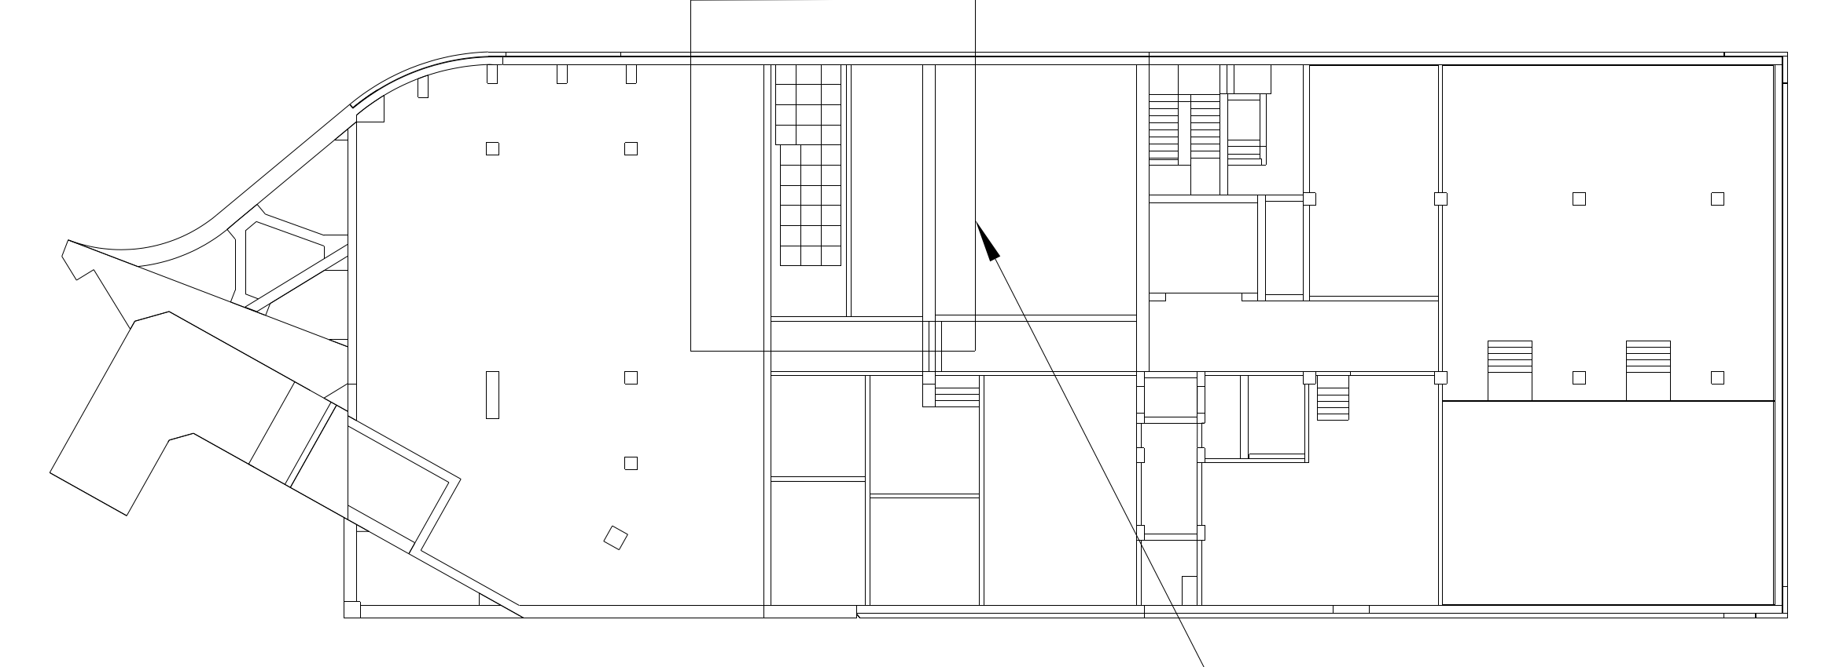
From phase 3.1 to 4
higher level expertise will be needed (harder to plan with general ressources):
SFRS EXP DAQ coupling of detectors to experiment, very few people can do it (6 people at GSI+ 2 outside)
integration to higher level control system ➔ need support from ACO
phases ran from NUSTAR control room (SFRS room):
closer access
close to our labs
modern solutions we can
easily interact with FAIR
control room
E20.008
NUSTAR
13 m
E20.009
SFRS control
L0321A ( G006a)

Slide 4
LCM up to phase 2, then standard “beam time” planning
Lean Construction Management works for “construction”, up to integration test
work instruction per task
repetitive tasks along the beam line (several pumps to test)
easy to organize daily
for Dry Run and beam commissioning, plan of “standard beam time planning” as usually run.
same people doing it (operators/experts)
dependencies clarified
feed back due to measurement more present
Switch from an environment
dominated by well defined constrain (complicated ➔ solution Lean management)
to an environment dominated by moving constrain (complex ➔ solution Agile/scrum)

Slide 5
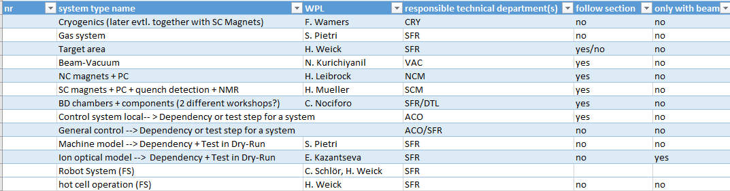
System list
SCM: Super Conducting Magnets
NCM: Normal Conducting Magnets (target area)

Slide 6
Objective of Phase 3.1:
during phase 3.1:
Perform SAT Ba on all components (check documentation)
Assure control system ready for beam operation to control local components
Test interlocks and machine protection
to be done as soon as possible per functional section (focal planes)
For SCM magnets, phase 3.1 needs everything cooled down.

Slide 7
Objective of Phase 3.2 – dry run
This is done FULL Super-FRS together
during Phase 3.2: mimic beam operation without beam (train operator, test control system)
test and run full integrated data acquisition for Super-FRS detectors
test fully integrated analysis framework
test specific Super-FRS control system applications
test machine model and field control of magnets

Slide 8
Objective of Phase 3:
during phase 3.1:
Perform SAT Ba on all components (check documentation)
Assure control system ready for beam operation to control local components
Test interlocks and machine protection
during Phase 3.2: mimic beam operation without beam (train operator, test control system)
test and run full integrated data acquisition for Super-FRS detectors
test fully integrated analysis framework
test specific Super-FRS control system applications
test machine model and field control of magnets

Slide 9
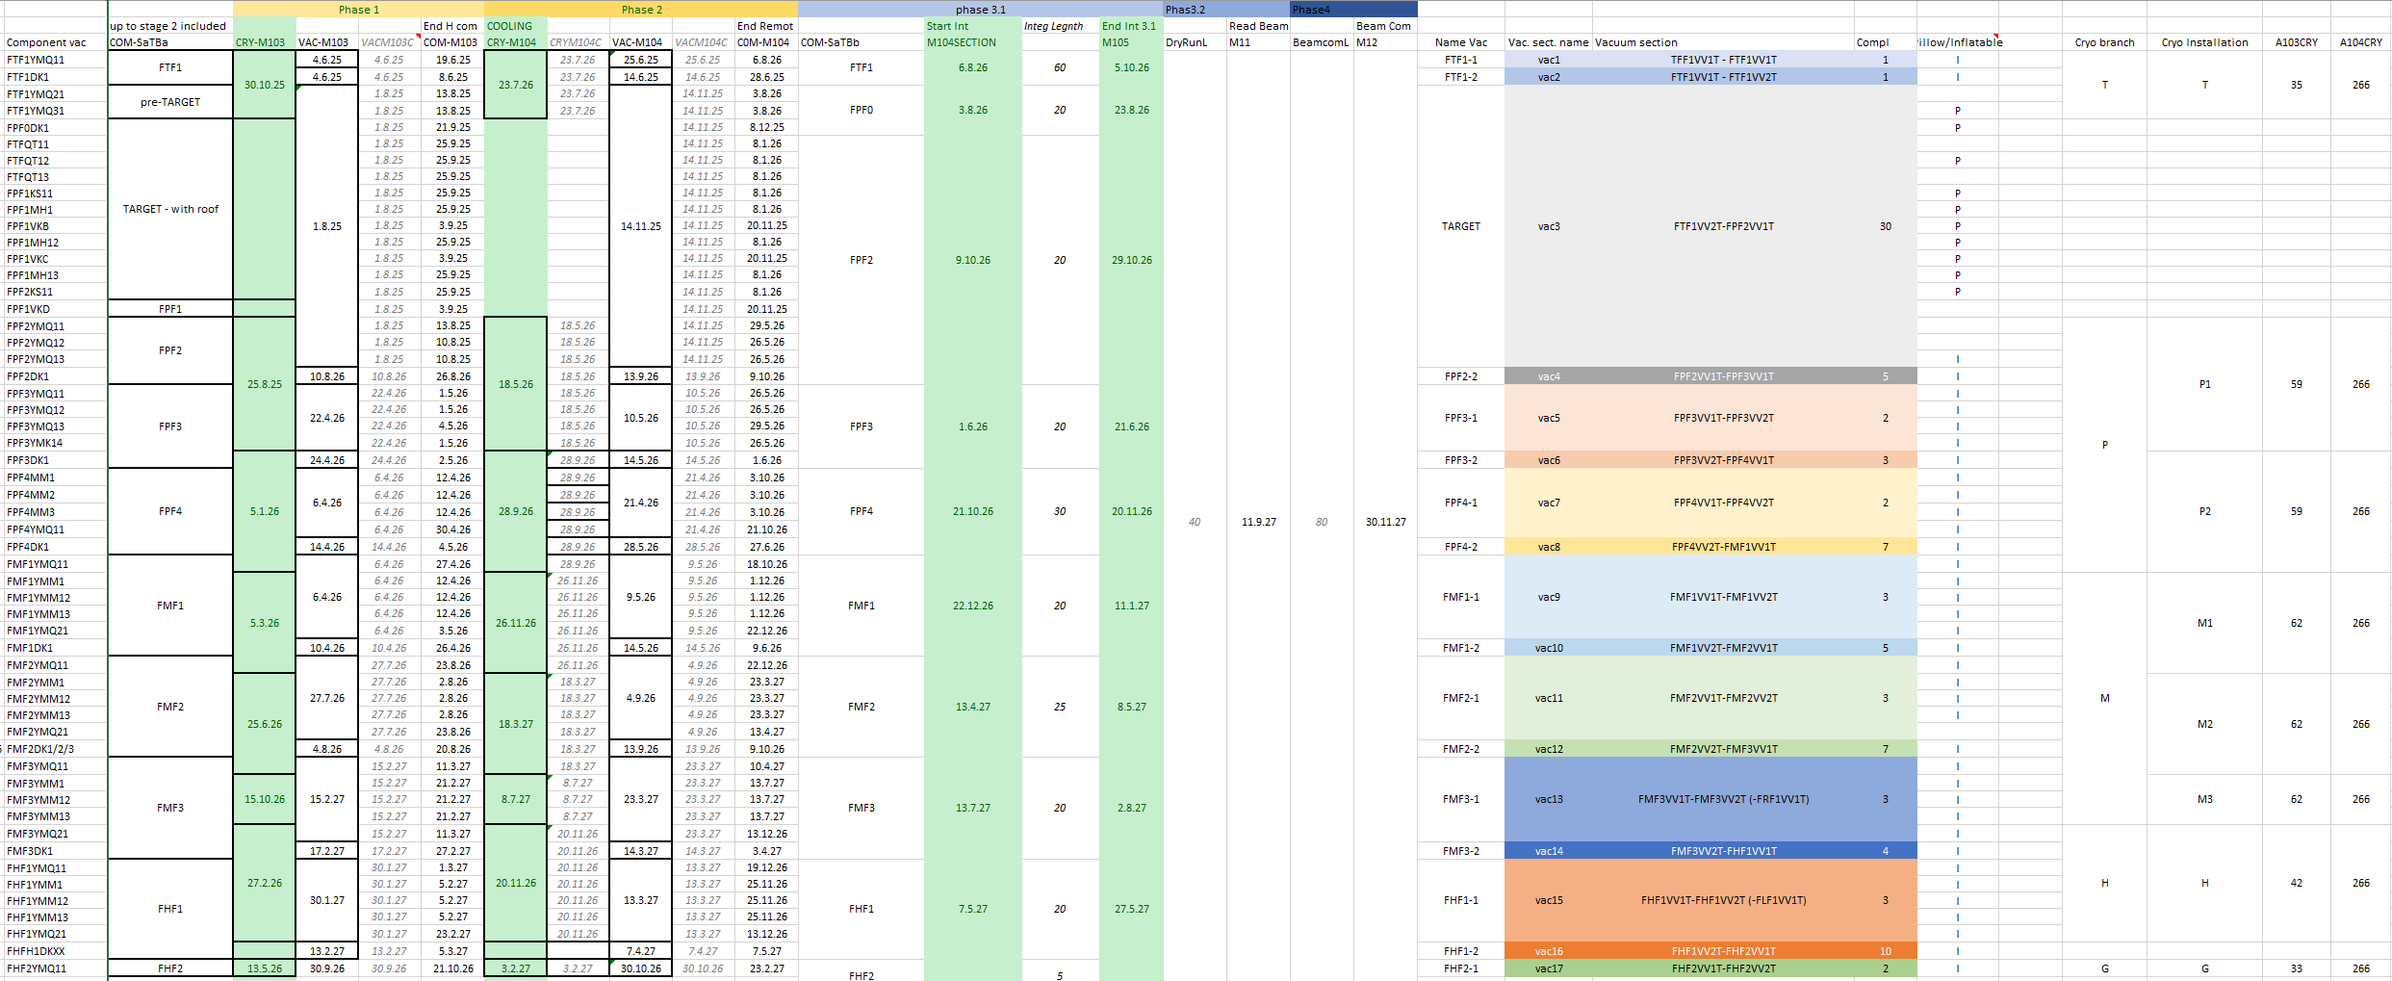
Full .xls document

Slide 10
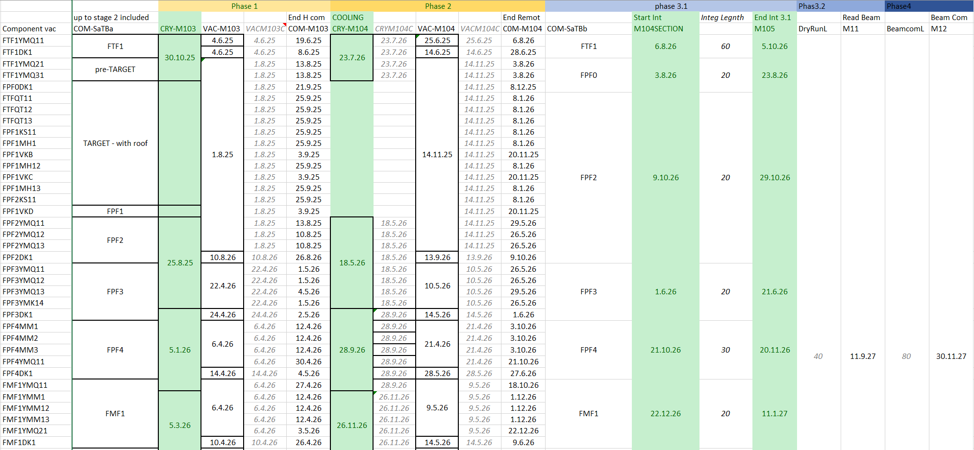
First simulations – toy model

